Slide 1
The PBL, Part 3:
KPP and TKE schemes
ATM 419/563
Fall 2024
Fovell
© Copyright 2024 Robert Fovell, Univ. at Albany, SUNY, rfovell@albany.edu

Slide 2
Outline
Some Richardson numbers
Recap of flux-gradient (1st-order) approach
Deficiencies of the flux-gradient approach
K-profile parameterization (KPP) schemes
TKE schemes
Notes:
First order = everyone learns about it, but no one uses it. Not even such a scheme in WRF (until I added it for this class)

Slide 3
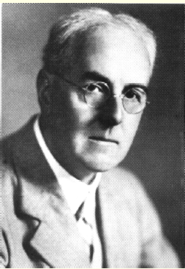
Some Richardson numbers
Wikipedia
Named for NWP pioneer Lewis Fry Richardson

Slide 4
Recall: Reynolds averaging
Divided variables into a mean (based on grid volume average over some time interval) and a deviation from it
The average was defined as:
And perturbations averaged out

Slide 5
Richardson number(s)
A Richardson number (Ri) is a nondimensional measure of stability divided by shear (squared)
Named for NWP pioneer Lewis Fry Richardson
Some forms: gradient Ri, bulk Ri, surface bulk Ri, flux Ri
gradient Richardson number
bulk Richardson number
Notes:
Bulk Ri approximates gradients discretized on a grid
Richardson forecast sfc p +145/6 h. Linear instability. Published 1922.

Slide 6
Surface bulk Ri
A surface bulk Richardson number is computed from the surface up to height z, presuming wind speed at surface (s) is zero.
Notes:
Need to define TKE before defining flux Ri

Slide 7
Turbulent kinetic energy
Turbulent kinetic energy (TKE) per unit mass can be defined as:
A prediction equation for averaged TKE* can be derived as
dissipation/
other terms
related to vertical heat flux
related to shear
Stensrud’s text, p. 169
*1D approximation already assumed
Notes:
Shear (mechanical) generation of turbulence and convective (buoyancy) generation

Slide 8
Flux Richardson number
related to vertical heat flux
related to shear
Negative when stable
flux Richardson number
Normally negative (as winds
increase with height)
Notes:
Ri positive when stable because denom usually neg and numerator is neg when stable.

Slide 9
Critical Richardson number (Ri_{c})
When Ri ≤ Ri_{c}, turbulence can be produced. (However, preexisting turbulence is not necessarily extinguished when Ri rises above Ri_{c}.)
Ri_{c} is typically given as 0.25, but values used range between 0.0 and 1.0 (cf. Vickers and Mahrt 2004; Galperin et al. 2007; Hong 2010), with larger values often used when vertical resolution is poorer.
  e.g., Troen and Mahrt (1986) argued for using a relatively larger value. More later…

Slide 10
Ri, Ri_{c} and turbulence

Slide 11
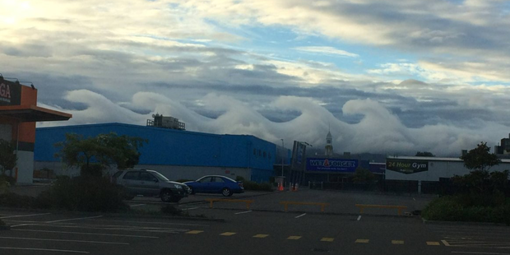
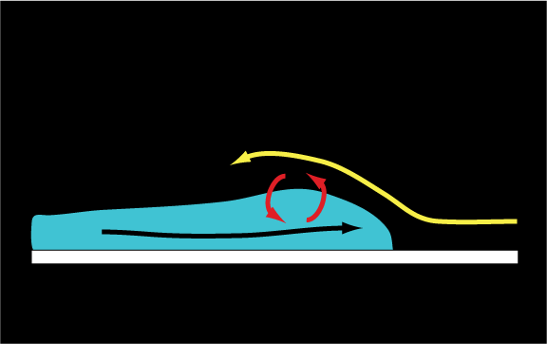
http://www.nzherald.co.nz/nz/news/article.cfm?c_id=1&objectid=11803687
K-H waves:
Shear-driven turbulence
Notes:
Why eddies are important…

Slide 12
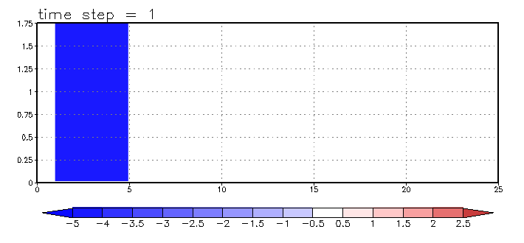
K-H instability
Animation
High-resolution simulation. At lower resolution, you need to parameterize this!
Notes:
Look at the MIXING the eddies accomplish. But you need HIGH RES to capture this effect. At lower res, you need to PARAMETERIZE it

Slide 13
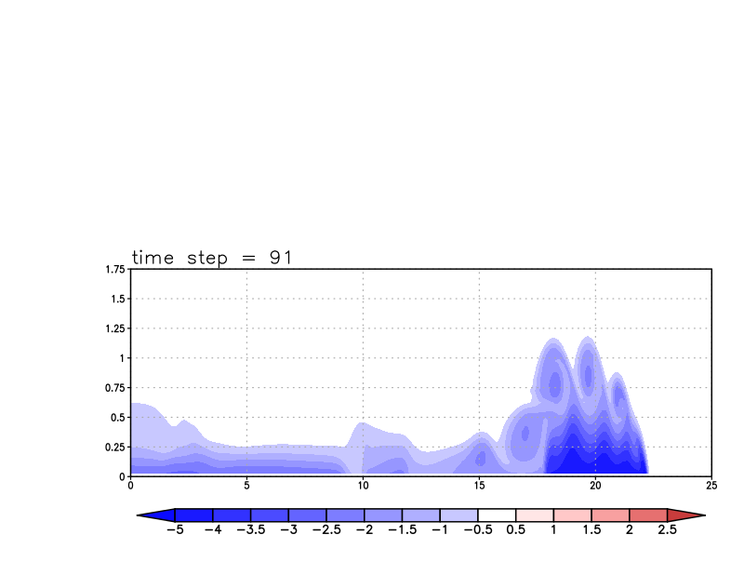
Explicitly resolved eddies, little extra parameterized mixing
∆x = 50 m

Slide 14
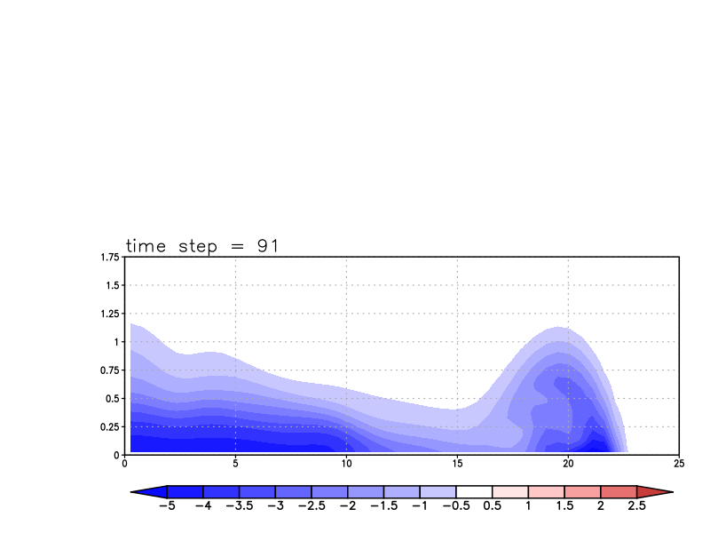
No resolved eddies, considerable parameterized mixing
∆x = 500 m

Slide 15
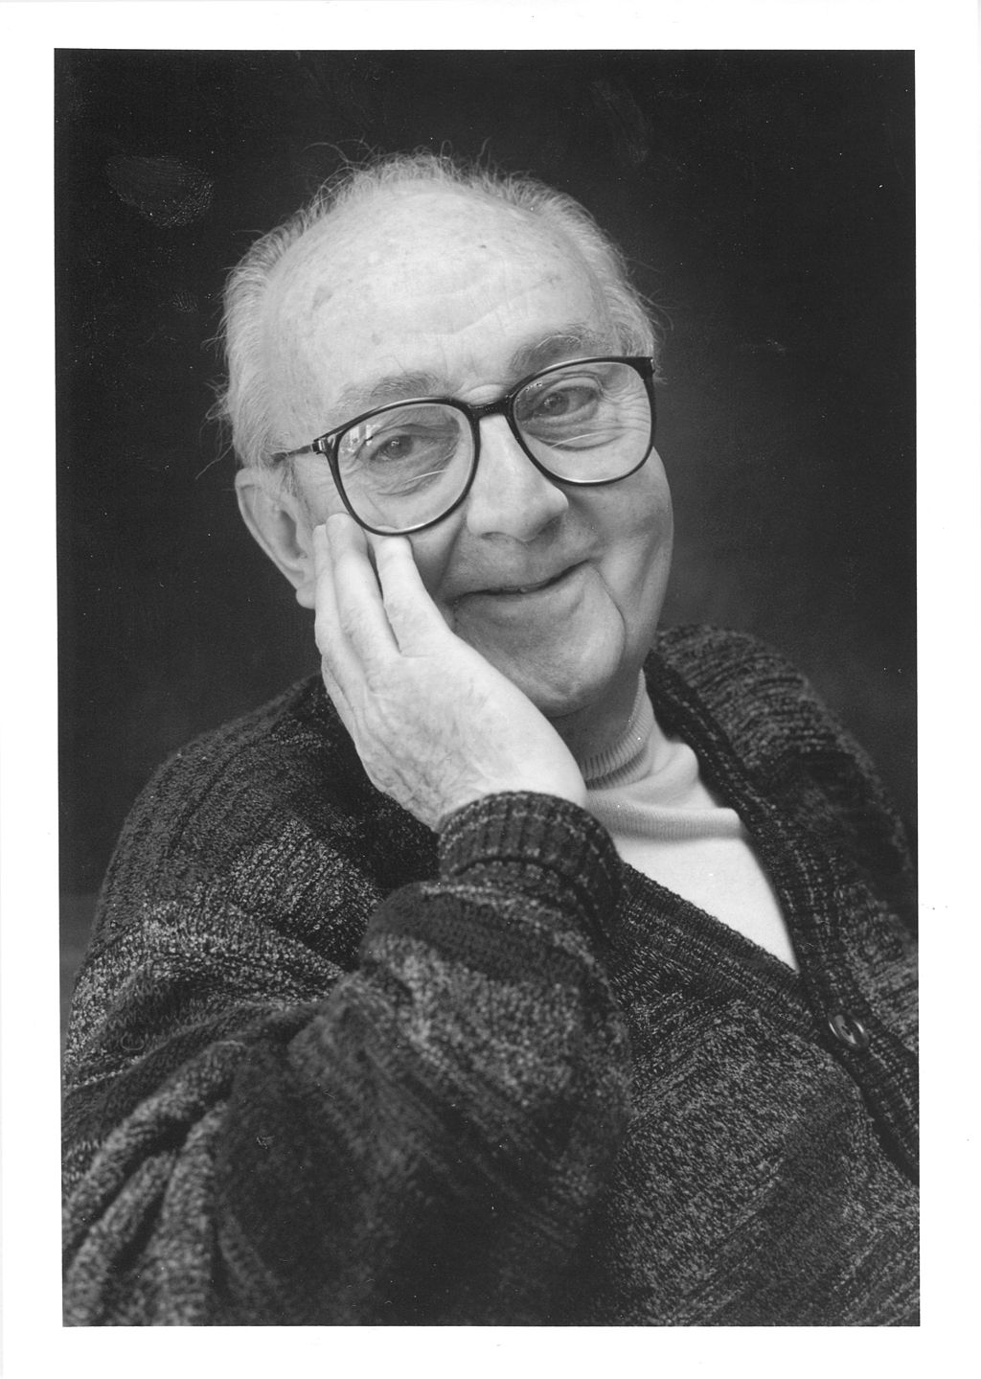
Implementing these ideas in the NWP model
“All models are wrong,
but some are useful.”
-- George E. P. Box
(1919-2013)
Wikipedia

Slide 16
Reminder (1)
Eddies are not resolvable but important to the evolution of the PBL
We used Reynolds averaging to identify important eddy covariances such as:
We invoked flux-gradient theory to relate these covariances to eddy mixing coefficients acting on resolved-scale fields

Slide 17

Reminder (2)
Then we used Prandtl’s mixing length theory to relate K_{m} to mixing length l_{v} and mean (absolute) shear S
Mixing length was presumed to be small near surface and grow (to some upper bound of 50-100 m or so) with height
We also discussed the log wind profile, how it must respond to stability, and saw mixing fields produced by the YSU PBL scheme in the in-class demonstration
But first: focus on a scheme that is just based on the equation above (a 1st-order scheme)

Slide 18
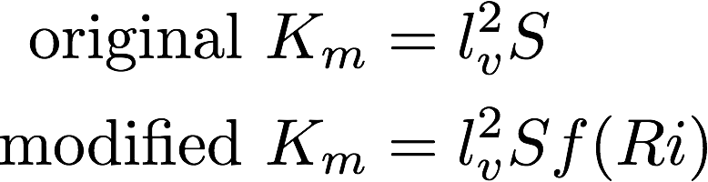
1st-order scheme
Computing K_{m} from a mixing length and the base state vertical shear is called a 1st-order local closure scheme.
  “local” because K_{m} only depends on local gradients
In original formulation, K_{m} did not also depend on stability. The modified form modulates mixing by some function of stability: amplifying it when unstable, suppressing it where stable.
Blackadar (1979)
Notes:
The f(Ri) is an improvement, but does not fix the scheme’s systemic problems

Slide 19
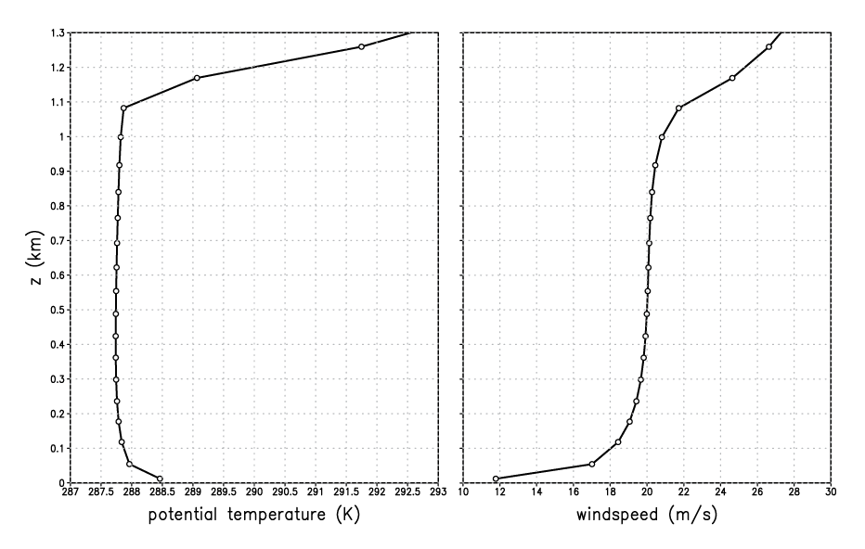
A strongly-heated PBL
(simulations with WRF SCM v.3.7.1)
Notes:
Simulated using WRF SCM
This is using a higher wind initial sounding, and lower soil moisture, and that helps exaggerate diff wrt MRF

Slide 20
A strongly-heated PBL
well-mixed
layer
superadiabatic
Notes:
Remember how this was formed. The PBL top inversion is a consequence of the PBL mixing itself

Slide 21
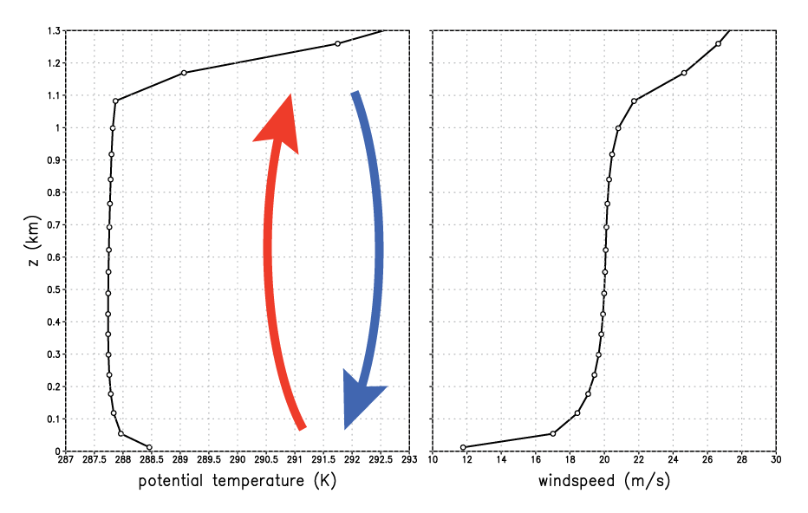
A strongly-heated PBL
well-mixed
layer
superadiabatic
Notes:
Superadiabatic near sfc because mixing restricted near solid boundary. Mixed layer results owing to mixing through a deep layer.

Slide 22
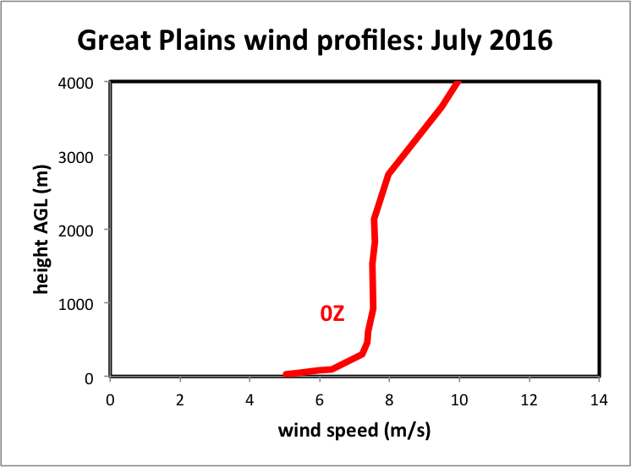
A strongly-heated PBL
11 radiosondes
31 days
well-mixed
layer
superadiabatic
Notes:
Magnitudes, depths different, but shape is similar

Slide 23
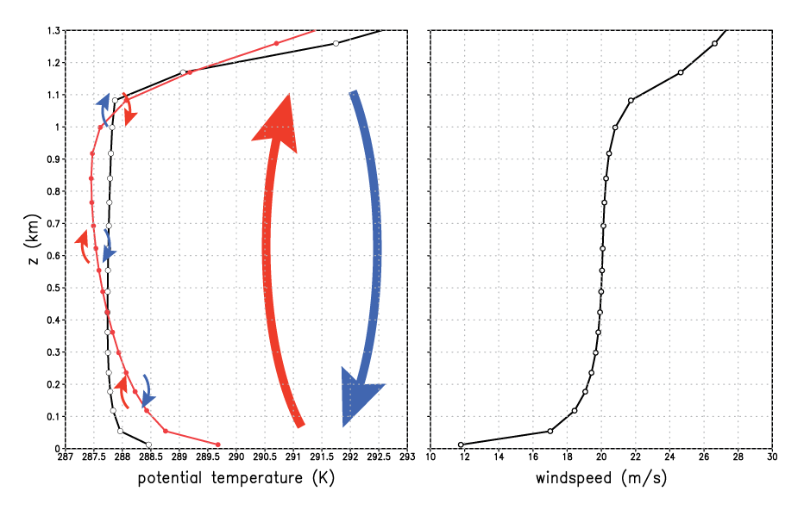
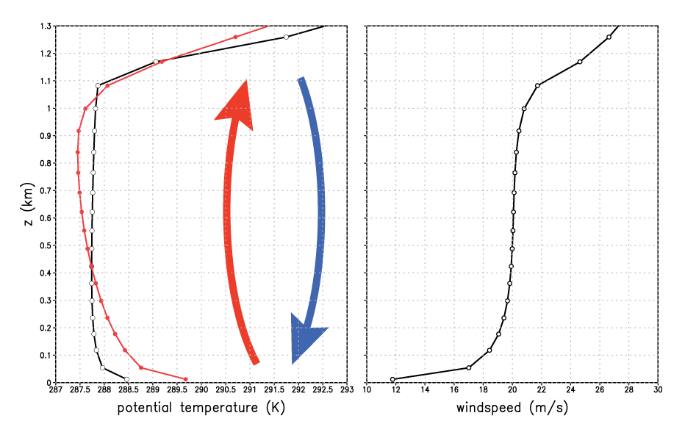
1st-order scheme
well-mixed
layer
First-order scheme’s
local mixing fails to
establish mixed layer
First-order
scheme
superadiabatic
Notes:
First order scheme fails to develop neutral mixed layer. Superadiabatic through a very deep layer.

Slide 24
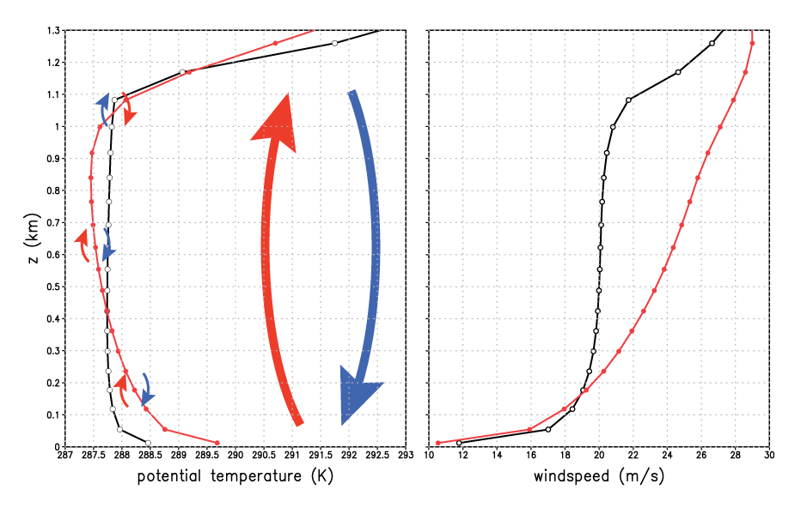
1st-order scheme
Notes:
“For statically unstable ABLs with vigorous convective thermals… wind speed becomes uniform with height a short distance above the ground.” – Stull’s Met for Sci and Eng, p. 81. If shear really disappeared, Km = 0 during time when it actually would be LARGEST. Indeed, shear is very small BECAUSE mixing is so large and effective.

Slide 25

A fundamental inconsistency…
Eddy mixing K_{m} helps remove vertical shear
Thus, as the shear S disappears, K_{m} → 0 in this equation
But, in reality, shear is smallest when mixing is most vigorous!
This model is too simple

Slide 26
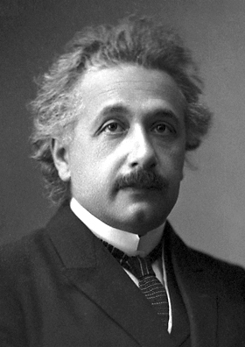
Einstein’s admonition
“Make things as simple as possible,
but no simpler.”
-- Albert Einstein
(1879-1955)
[attributed]
Wikipedia

Slide 27

Beyond 1st-order schemes
1.5-order scheme
[based on prognosed TKE e]
[S* is nondimensional
profile function]
KPP (K-profile parameterization)
[diagnosed mixing]
w_{s} = a velocity scale; h = PBL depth
Notes:
Here 2022

Slide 28
A strongly-heated PBL
Produced by
YSU (KPP) scheme
Notes:
Simulated using WRF SCM

Slide 29
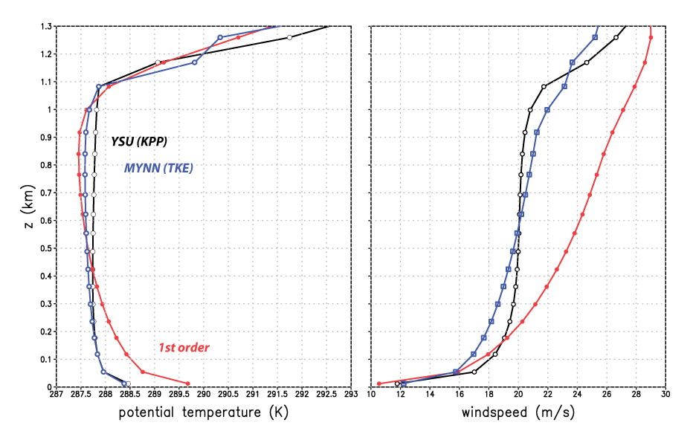
A strongly-heated PBL
(MYNN has changed and added new features since WRF V3.7.1)
YSU and MYNN closer match
(YSU still “better”)
Notes:
Those weren’t obs. They were the YSU solution, presumed to be closest to truth.
MYNN much closer to YSU in surface layer and lower half of mixed layer
(Should say MYNN2)

Slide 30
K-profile parameterizations
(KPP)
Including MRF, GFS, YSU, Shin-Hong

Slide 31
KPP scheme lineage
Attempts to specify local mixing (i.e., mixing between neighboring model levels) with a certain and expected vertical distribution
Origins include: Brost and Wyngaard (1978) and Troen and Mahrt (1986)
MRF scheme developed for Medium Range Forecasting (MRF) model: Hong and Pan (1996). Still available in WRF!
  MRF/AVN models became GFS in 2002
MRF scheme evolved into GFS and YSU schemes
  GFS PBL scheme developed as MRF/AVN models became the GFS and was adopted for Hurricane WRF (HWRF). Continues in current HWRF and HAFS models as the GFS-EDMF scheme and also in GFS-FV3.
  YSU scheme developed for WRF (Noh et al. 2003, Hong et al. 2006, Hong 2010)
  Shin-Hong (S-H) scheme evolved from YSU (Shin and Hong 2015)
  ACM2 (Pleim 2007) incorporates some aspects of KPP approach
Notes:
Best citation abbreviation ever

Slide 32
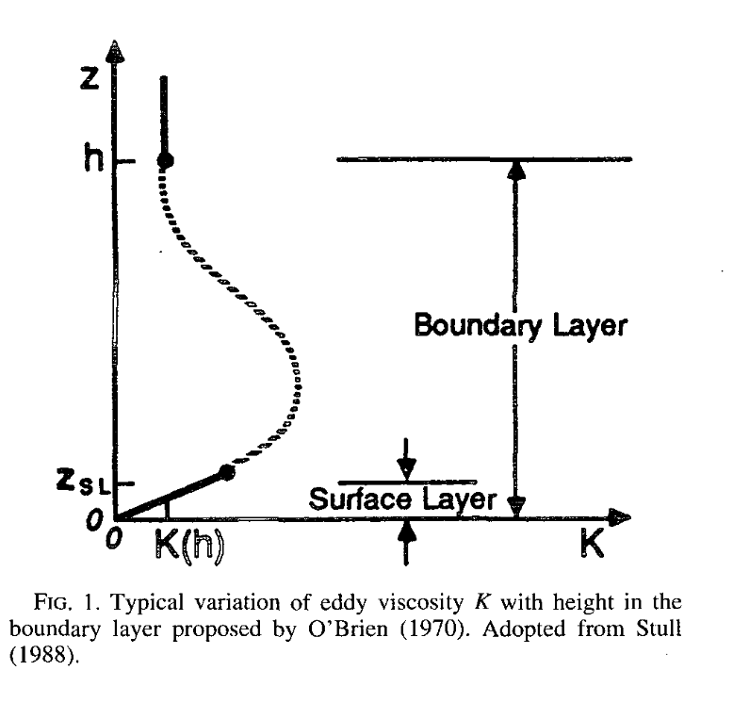
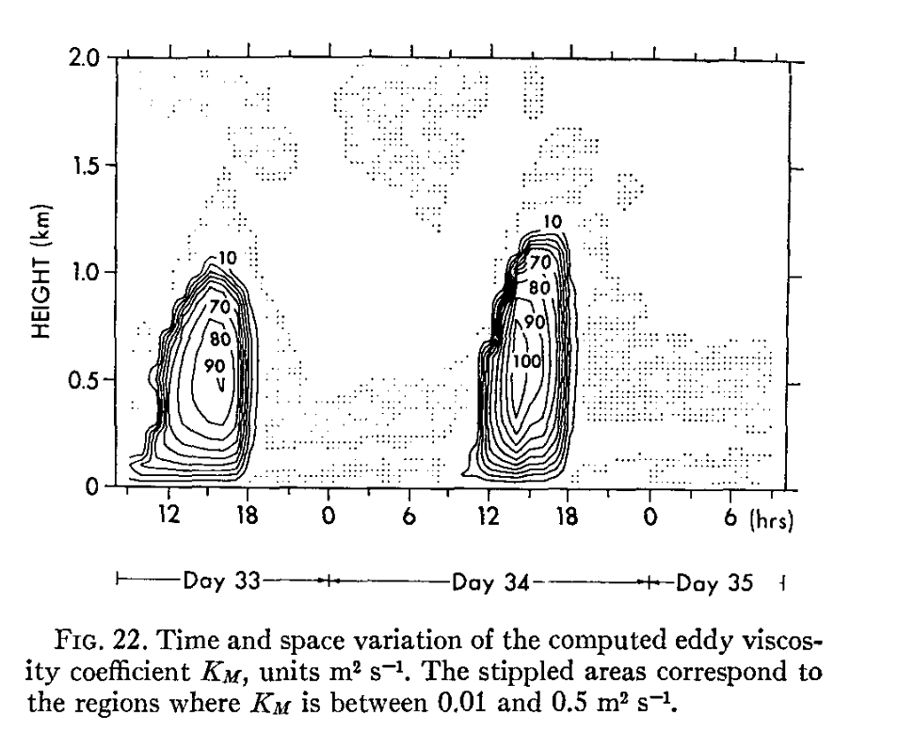
K_{m}, K_{h} profile with height
YSU (diagnostic scheme) imposes this profile
based on diagnosed PBL height h
MYJ (prognostic scheme) tries to develop it
organically by predicting TKE
Yamada and Mellor (1975)
Hong and Pan (1996)

Slide 33

A simple KPP scheme
p = 2 usually adopted
(but Brost and Wyngaard used p = 1.5)
• w_{s} (velocity scale) = u*/φ_{m}
computed in surface layer*
(φ_{m} stability corrector, see Part 1)
• κ = von Karman constant (~0.4)
Tasks:
• Determine PBL depth h
• Fit the profile to K_{m}
MORE
Hong and Pan (1996)
*MRF/GFS velocity scale is constant with height. YSU’s is made a function of height.
Notes:
MRF is simplest version of this approach – the basics
Unstable \phi_m < 1, amping up the velocity scale and thus the mixing

Slide 34
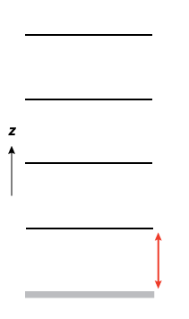
A simple KPP scheme
Finding PBL top h
~ depends on selected critical Ri (Ri_{c})
Compute surface bulk Ri (Rib_{s}) for lowest layer
If Rib_{s} > Ri_{c} then PBL top is reached
model surface

Slide 35
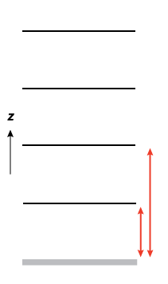
A simple KPP scheme
Finding PBL top h
~ depends on selected critical Ri (Ri_{c})
If not reached, compute Rib_{s}
between surface and next level up,
compare again to Ri_{c}
model surface
Notes:
NOT between layers 1 and 2. Between surface and layer 2.

Slide 36
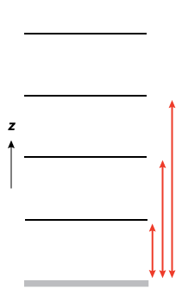
A simple KPP scheme
Keep going until
PBL top is found
Finding PBL top h
~ depends on selected critical Ri (Ri_{c})
h
This is MRF’s PBL height
YSU uses this height as a first guess, and then
factors in a “thermal excess” at surface,
achieving a relatively higher h when PBL unstable
model surface
Notes:
YSU uses this as first guess to PBL depth h. Then, it factors in a “thermal excess” and recomputes h, finding a higher value when PBL is unstable.

Slide 37
A simple KPP scheme
Keep going until
PBL top is found
Finding PBL top h
~ depends on selected critical Ri (Ri_{c})
h
model surface
Notes:
YSU uses this as first guess to PBL depth h. Then, it factors in a “thermal excess” and recomputes h, finding a higher value when PBL is unstable.

Slide 38
Importance of PBL depth h
In KPP schemes, PBL depth h plays a crucial role, as it directly influences
  Mixing depth (obviously),
  Mixing magnitude, and
  Height of maximum mixing
    (located at z = h/3)
Ri_{c} largely determines h

Slide 39
Selecting the critical Ri_{c}
We’re computing a bulk surface Ri, between some level z and the surface
Theoretical value: Ri_{c} = 0.25, but again this also depends on resolution and affected by averaging
Troen and Mahrt (1986) argued for Ri_{c} = 0.5 owing to low vertical resolution in PBL
MRF PBL scheme (Hong and Pan 1996), based on Troen and Mahrt (1986), also used Ri_{c} = 0.5
GFS PBL scheme (descended from MRF) adopted Ri_{c} = 0.25
YSU PBL (also descended from MRF) started with Ri_{c} = 0.5 (Hong et al. 2006). By 2010, it used Ri_{c} = 0.25 when stable, but Ri_{c} = 0 over land when surface layer is unstable (Hong 2010)
  The smaller Ri_{c} when unstable was adopted so that the PBL top would be diagnosed below the inversion, permitting explicit treatment of entrainment (see later)
Does this make a difference? (Yes, it can.)
Notes:
Might be OK if Ric didn’t affect the forecasts, but of course it does.

Slide 40
Standard YSU simulation at t = 49 (unstable surface layer)
In this situation, YSU uses Ri_{c} = 0.0 (not 0.25) for its first guess at h
Scheme determines PBL depth ~ 1 km
Notes:
YSUresults_at_time_49.pdf

Slide 41
risfc.gs
Notes:
When stable, may not matter all that much because mixing produced is so small.
Computed with risfc.gs

Slide 42
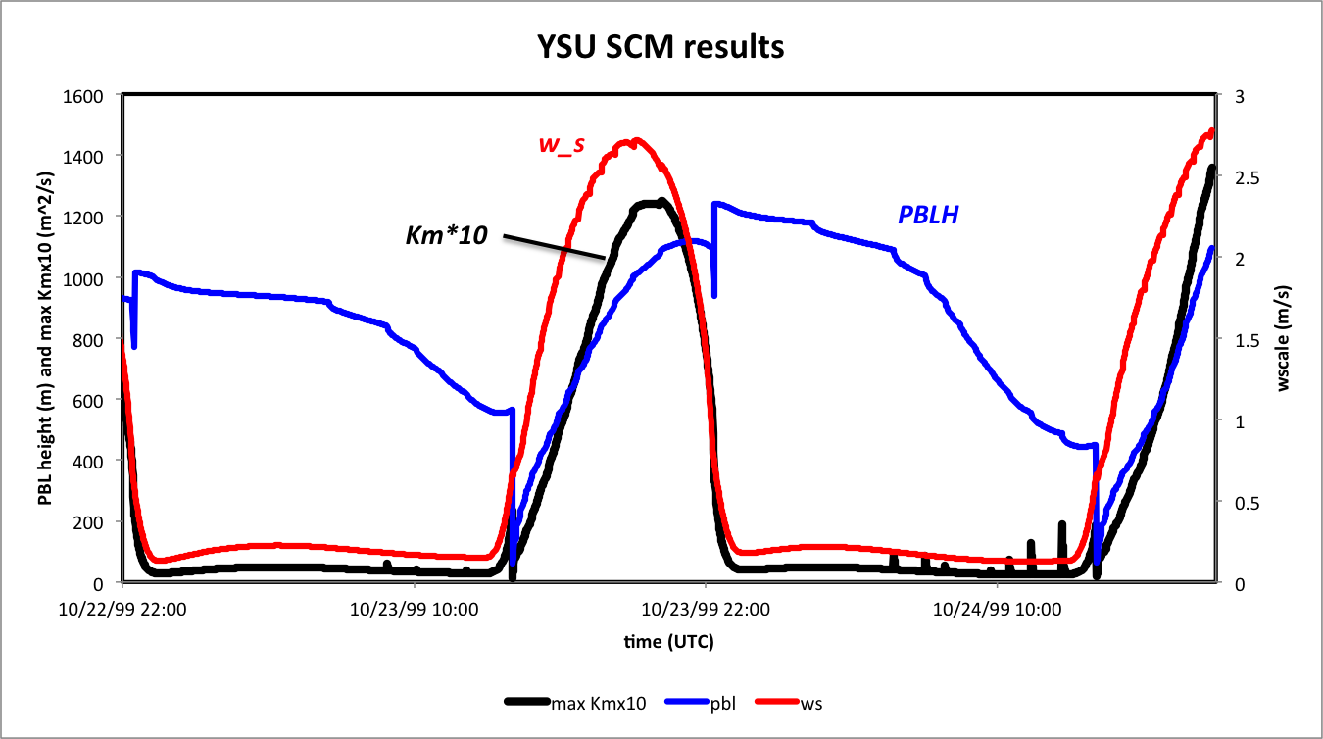
The velocity scale w_{s} also plays a key role, magnifying the mixing when surface
layer is unstable. (This term is more complex in YSU than in sister schemes.)
• Note diurnal variation of K_{m} and w_{s}. Shortly after sunrise, surface layer becomes
unstable, and w_{s} (red curve) increases. At first, PBL depth h (blue curve PBLH)
is shallow, limiting the mixing (black curve).
• Later in the afternoon, surface layer becomes stable, and w_{s} decreases quickly.
Mixing becomes small even though PBLH ostensibly remains deep.
• Note there are discontinuities in PBLH, caused by regime changes between
stable and unstable. (This is seen here because I used output every time step.)
Notes:
Early in afternoon, ws grows quickly but PBLH is shallow, limiting the mixing magnitude and depth
Later, PBLH is deep but ws becomes small as sfc layer goes stable, becoming limiting factor on the mixing

Slide 43
That’s just local mixing. There’s also nonlocal mixing and entrainment.
This model is still too simple
“Make things as simple as possible,
but no simpler.”
-- Albert Einstein
(1879-1955)
[attributed]

Slide 44

Nonlocal mixing
Local mixing is from one grid volume
to adjacent grid volumes → slow
Nonlocal mixing involves deep flows
of fluid involving many grid volumes
quickly – like rising thermals
https://tenor.com/view/lava-lamp-gif-14859421

Slide 45
Reynolds-averaged θ equation
• K_{m} applies to momentum, K_{h} to heat
• That’s local mixing, between model
levels
Notes:
Apply to theta eq instead. Will explain why – it’s for adding countergrad term, which MRF did not apply to momentum.
One of the neglected RHS terms is diabatic term

Slide 46
Nonlocal mixing term added…
Adds a new term: for nonlocal mixing
Also needs a parameterization!
Notes:
Apply to theta eq instead. Will explain why – it’s for adding countergrad term, which MRF did not apply to momentum.

Slide 47
Nonlocal mixing:
MRF/YSU “countergradient” term
This accomplishes deep layer
(i.e., nonlocal) mixing
This does local mixing
• “Countergradient term” is what makes this scheme nonlocal
• Term is generally parameterized based on surface fluxes
to capture effect of deep, penetrating thermals
• In MRF scheme, term applied only to temperature and water vapor
• In YSU, it is also applied to momentum
• This term is what effectively removes mixed layer vertical gradients
Notes:
Although TKE schemes try to do this too, many KPP schemes explicitly account for countergradient diffusion
\gamma_c > 0 for pot temp, increases tendency where dK/dz < 0 (PBL top) and decreases it where dK/dz > 0 (PBL bottom). Helps make less stable

Slide 48
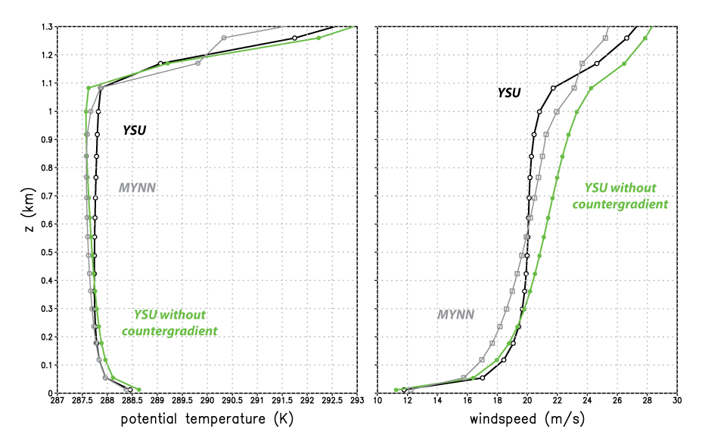
YSU with and without countergradient (nonlocal) term
More recent versions
of MYNN have nonlocal
mixing options
Notes:
I added a namelist option to turn off countergradient terms in YSU

Slide 49
Countergradient term history
The need to account for mixing associated with deep thermals to augment local mixing was recognized long ago (e.g., Priestley and Swinbank 1947; Deardorff 1966).
Troen and Mahrt (1986) included the countergradient term in the scheme that gave rise to the MRF, GFS, and YSU schemes.
The MRF and GFS (Hong and Pan 1996) apply the countergradient term to θ and water vapor only.
Starting with Noh et al. (2003), YSU also applied it momentum.
  Troen and Mahrt (1986) explicitly excluded momentum from countergradient treatment
  Frech and Mahrt (1995), however, showed examples of well-mixed momentum profiles that countergradient momentum mixing can reproduce
  Still, Pleim (2007) notes “application of the countergradient term to other quantities has been problematic”.
YSU countergradient term was originally specified in terms of surface fluxes only.
  Wilson and Fovell’s (2018) revision to include fluxes at top of boundary layer (ysu_topdown_pblmix = 1) to handle fog cases. (This was a minor factor.)
Clearly, however, this is the term that permits YSU to remove the vertical shear in the mixed layer (last slide).
Notes:
MYNN can do nonlocal momentum mixing but HRRR has not turned it on yet

Slide 50
Aside: mass flux alternative to nonlocal mixing
The Troen-Mahrt approach to nonlocal mixing was (slightly rewritten):
The “mass flux” approach (Siebesma et al. 2007)
  Thermal updrafts are presumed to occupy a small area of the grid volume, with fractional area a_{up} << 1.
  M is a mass flux = w_{up}a_{up}, where w_{up} is updraft velocity
  Can obtain θ_{up} via an entraining plume model (Soares et al. 2004)
  Combined with eddy diffusion (ED), approach is called “EDMF”
  GFS-EDMF scheme based on GFS recently adopted for HWRF, HAFS
Notes:
Just the bare bones

Slide 51
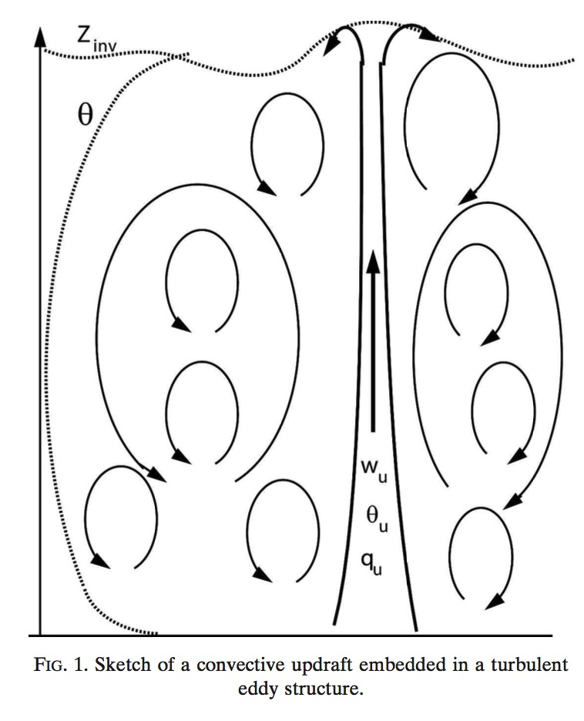
Entrainment into PBL
• In addition to nonlocal mixing, air is also
being entrained into the PBL from
the free atmosphere above
• That’s also subgrid, and ALSO needs a
parameterization!
Siebesma et al. (2007)
Notes:
Lava lamp

Slide 52
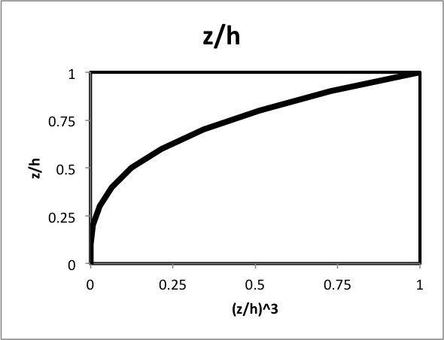
PBL entrainment
YSU parameterizes entrainment into the PBL from the free atmosphere in terms of surface fluxes
entrainment term
PBL top flux, but made
inversely proportional
to surface heat flux
ysu_topdown_pblmix = 1 makes
entrainment a function of PBL top
flux also. This was the key to improved
fog forecasts (Wilson and Fovell 2018).
(z/h)³ function weighted towards
PBL top
Notes:
Got here 2019
Epicycles?

Slide 53
Aside on California fog…

Slide 54
ysu_topdown_pblmix=0
ysu_topdown_pblmix=1
Parameterizes turbulence
but did not get sufficient
entrainment
After improved handling
of entrainment term
Resolves turbulence
LES = Large Eddy Simulation
Shaded field: horizontal domain averages of cloud water
Wilson and Fovell (2018)

Slide 55
A quick peek at TKE-based (Mellor-Yamada) schemes
Including MYJ, MYNN2, MYNN3, QNSE, GBM
[WRF’s MYNN: Olson et al. (2019)]

Slide 56
Recall from Part 1…
• Overbars were grid-averaged quantities (what the model is explicitly predicting)
• Primes indicate turbulent variations about those grid-averaged means
• We ignored molecular viscosity as insufficiently large
• We neglected the u’u’ term as small relative to u’w’ term (will reconsider that)
• We then developed a proxy for the u’w’ term based on eddy mixing K_{m}
… but we need to backtrack…

Slide 57
TKE and temperature variance
After defining TKE (velocity variance) as
  We saw…
We can also develop a prognostic equation for turbulent temperature variance and …
dissipation/
other terms
related to shear
related to vertical heat flux
Notes:
Not jumping just yet to develop proxies for these eddy covariances

Slide 58
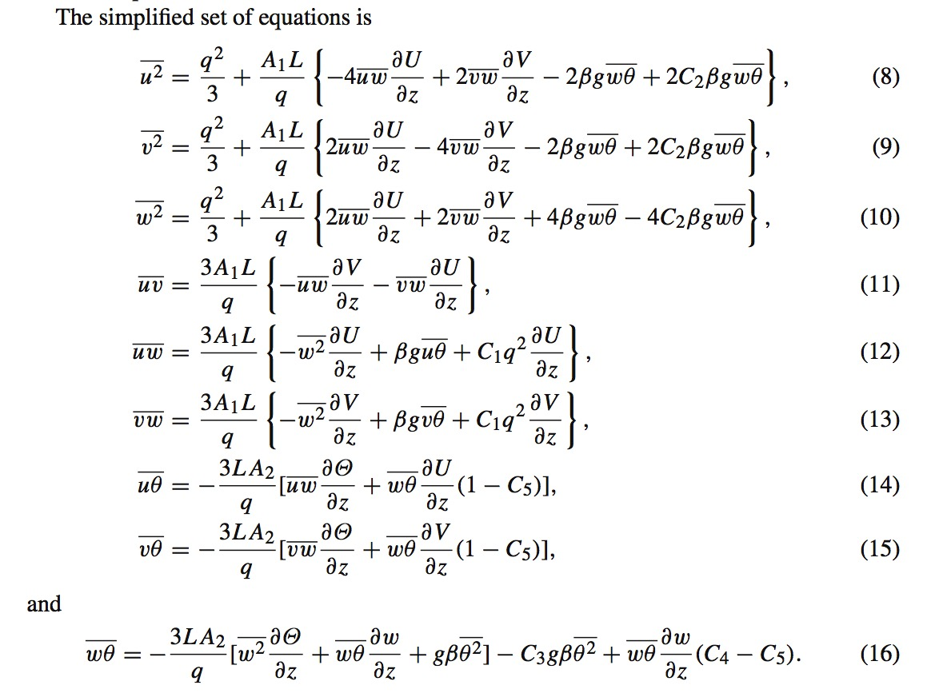
Jahn et al. (2017)
Previously neglected
Previously simplified and modeled as:
MYNN3 scheme
bl_pbl_physics=5
bl_mynn_closure=3.0
We wind up with equations for a large set of eddy covariances in the Mellor and
Yamada “Level 3” model, which contain a sizable set of parameters in need of values
[Notation shift… TKE e = q²/2, and u = u’, etc.]
What sets some TKE schemes apart is which terms retained and parameter values chosen.
MYNN2 [versions 2.5, 2.6] is a further simplified version of MYNN3.
Notes:
First eq is \bar{u’u’}. In eq (12), their numbering, term 3 in bracket looks a little like our original proxy, but this is much much more complicated
A real mess of algebraic manipulation
Actually Jahn et al’s second 2017 paper

Slide 59
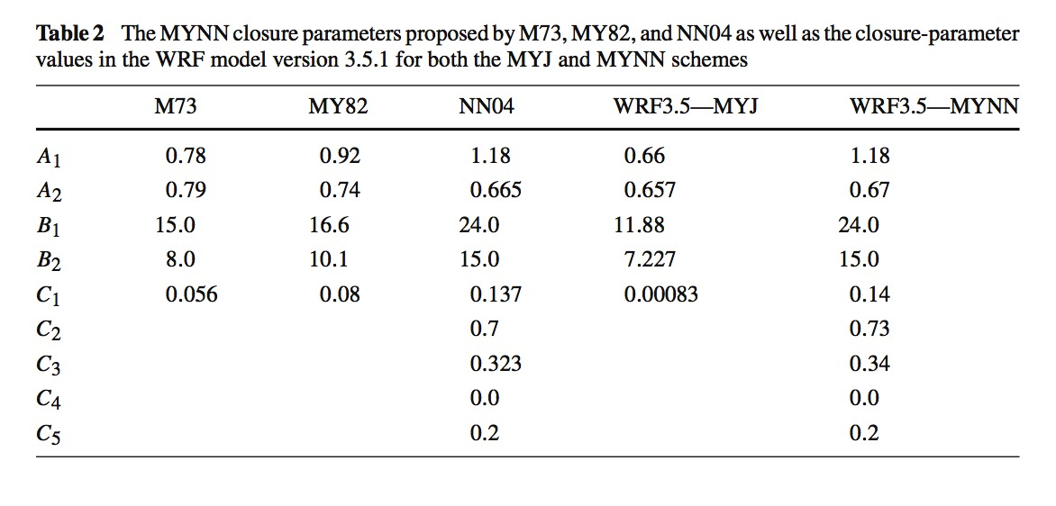
How parameters vary among related schemes
MYJ and MYNN3 in WRF
Jahn et al. (2017)
NOTE: MYNN has changed a lot since WRF V3.5.1
Notes:
Lots of terms means lots of tunable parameters

Slide 60
contaminated
observations
Evaluating HRRR wind speed profiles
near the ground
We also evaluated
temperature profiles
in the PBL
contaminated
observations
Observations from ~60 radiosonde locations
HRRR MYNN2 forecasts at analysis time (00 h forecast)
HRRR MYNN2 forecasts at hours 23 and 24
Fovell and Gallagher (2020)
Notes:
Remind why this stuff can matter

Slide 61
There are a lot of different PBL schemes, incorporating a lot of different assumptions
They’re all “wrong” but some are useful.
We can anticipate our forecasts to be sensitive to the assumptions made and parameterizations selected.

Slide 62
Some PBL and surface layer schemes
PBL and surface layer (not LSM) schemes are often paired. Some combinations are optimized, and others do not work.
Names of eddy mixing coefficients vary among schemes
bl_pbl_physics (incomplete list) | Scheme name | sf_sfclay_physics (bold = default) | K_{m} | K_{h}
1 [Hong 2010] | YSU (KPP) | 1, 91 | dku3d | dkt3d
2 [Janjic 1994] | MYJ (TKE) | 2 | -- | exch_h
4 [Sukoriansky et al. 2005] | QNSE (TKE) | 4 | exch_m | exch_h
5 [Olson et al. 2019] | MYNN2 (TKE) | 1, 2, 5, 91 | exch_m | exch_h
6 [Olson et al. 2019] | MYNN3 (TKE) | 1, 2, 5, 91 | exch_m | exch_h
7 [Pleim 2007] | ACM2 (KPP) | 1, 7, 91 | -- | exch_h
11 [Shin and Hong 2015] | Shin-Hong (KPP) | 1, 91 | -- | exch_h
99 [Hong and Pan 1996] | MRF (KPP) | 1, 91 | dku3d | dkt3d
Surface layer scheme 91 is the old version of scheme 1 (Jimenez et al. 2012). MYNN surface layer: Olson et al. (2021)
Notes:
Here 2022

Slide 63
Extra info
I showed previously how surface roughnesses were defined in LANDUSE.TBL. When the Noah LSM is used, however, those are overridden by values defined in VEGPARM.TBL.
  Roughness values are saved in wrfout files as both Z0 and ZNT.
In VEGPARM.TBL, landuse categories are assigned max and min roughness values, Z0MAX and Z0MIN. The Noah LSM (sf_surface_physics=2) imposes a seasonal cycle* with these values as bounds, and does this during the first time step (after 1st wrfout write).
  As a consequence, Z0 & ZNT values written to wrfout for the first time step (at model start) are likely to be incorrect
*See, for example, Fig. 8 of Cao and Fovell (2018)

Slide 64
[end]

