Slide 1
The SCM ensemble
ATM 419/563
Fall 2024
Fovell
10/16/2024
© Copyright 2024 Robert Fovell, Univ. at Albany, SUNY, rfovell@albany.edu

Slide 2
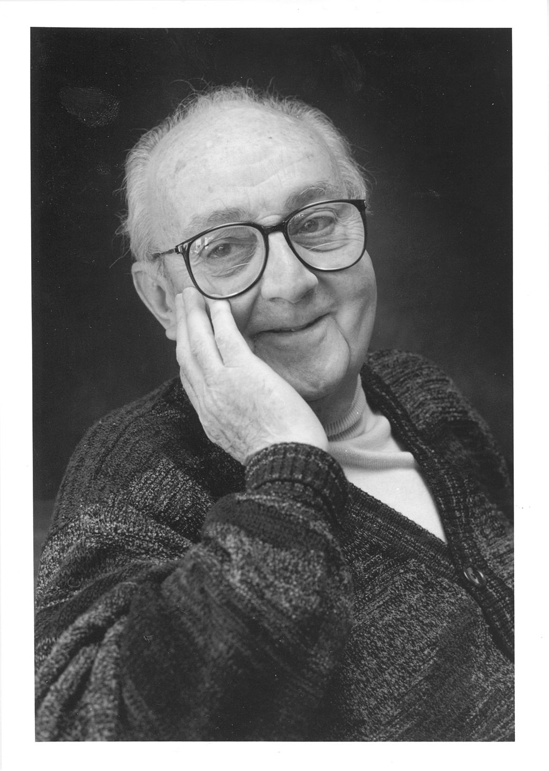
Keep in mind
“All models are wrong,
but some are useful.”
-- George E. P. Box
(1919-2013)
ALSO: “A difference is a difference,
only if it makes a difference.”
-- Darrell Huff
Wikipedia
Notes:
13 PBL schemes in WRF. They often help generate different forecasts. Not only cannot all be right, it is very likely all are wrong. Sometimes different schemes produce the same wrong forecast. In those cases, it may be that the schemes are all making the same poor assumptions.
FERMI PROBLEM, analogy to NWP – a chain of reasonable guesses.

Slide 3
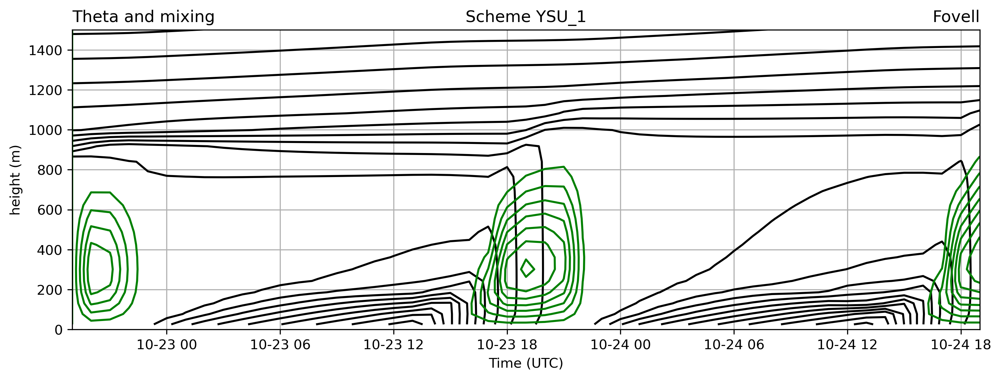
Potential temperature and mixing: height x time
YSU with surface layer 1 – our control run

Slide 4
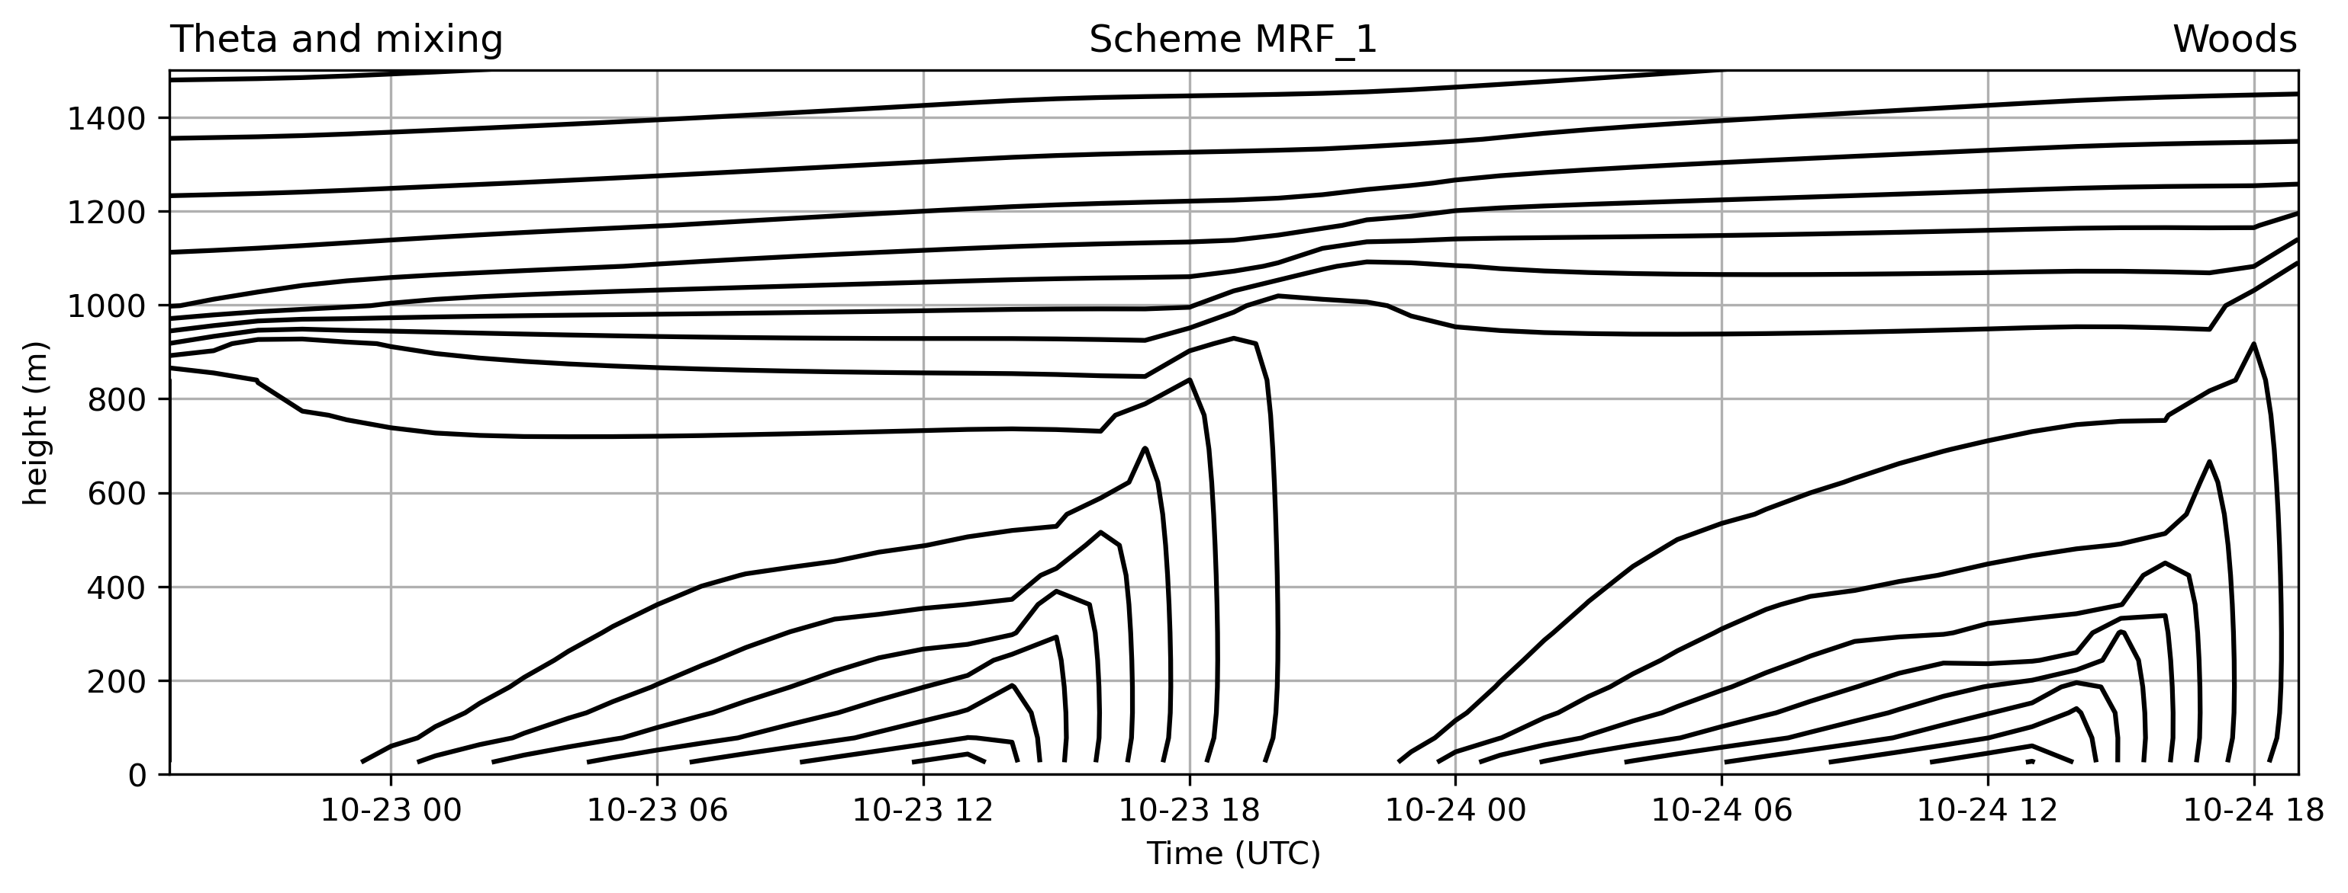
Potential temperature and mixing: height x time
MRF with surface layer 1 – the scheme YSU evolved from – nocturnal inversion weak and deep
• this scheme has mixing but does not output it

Slide 5
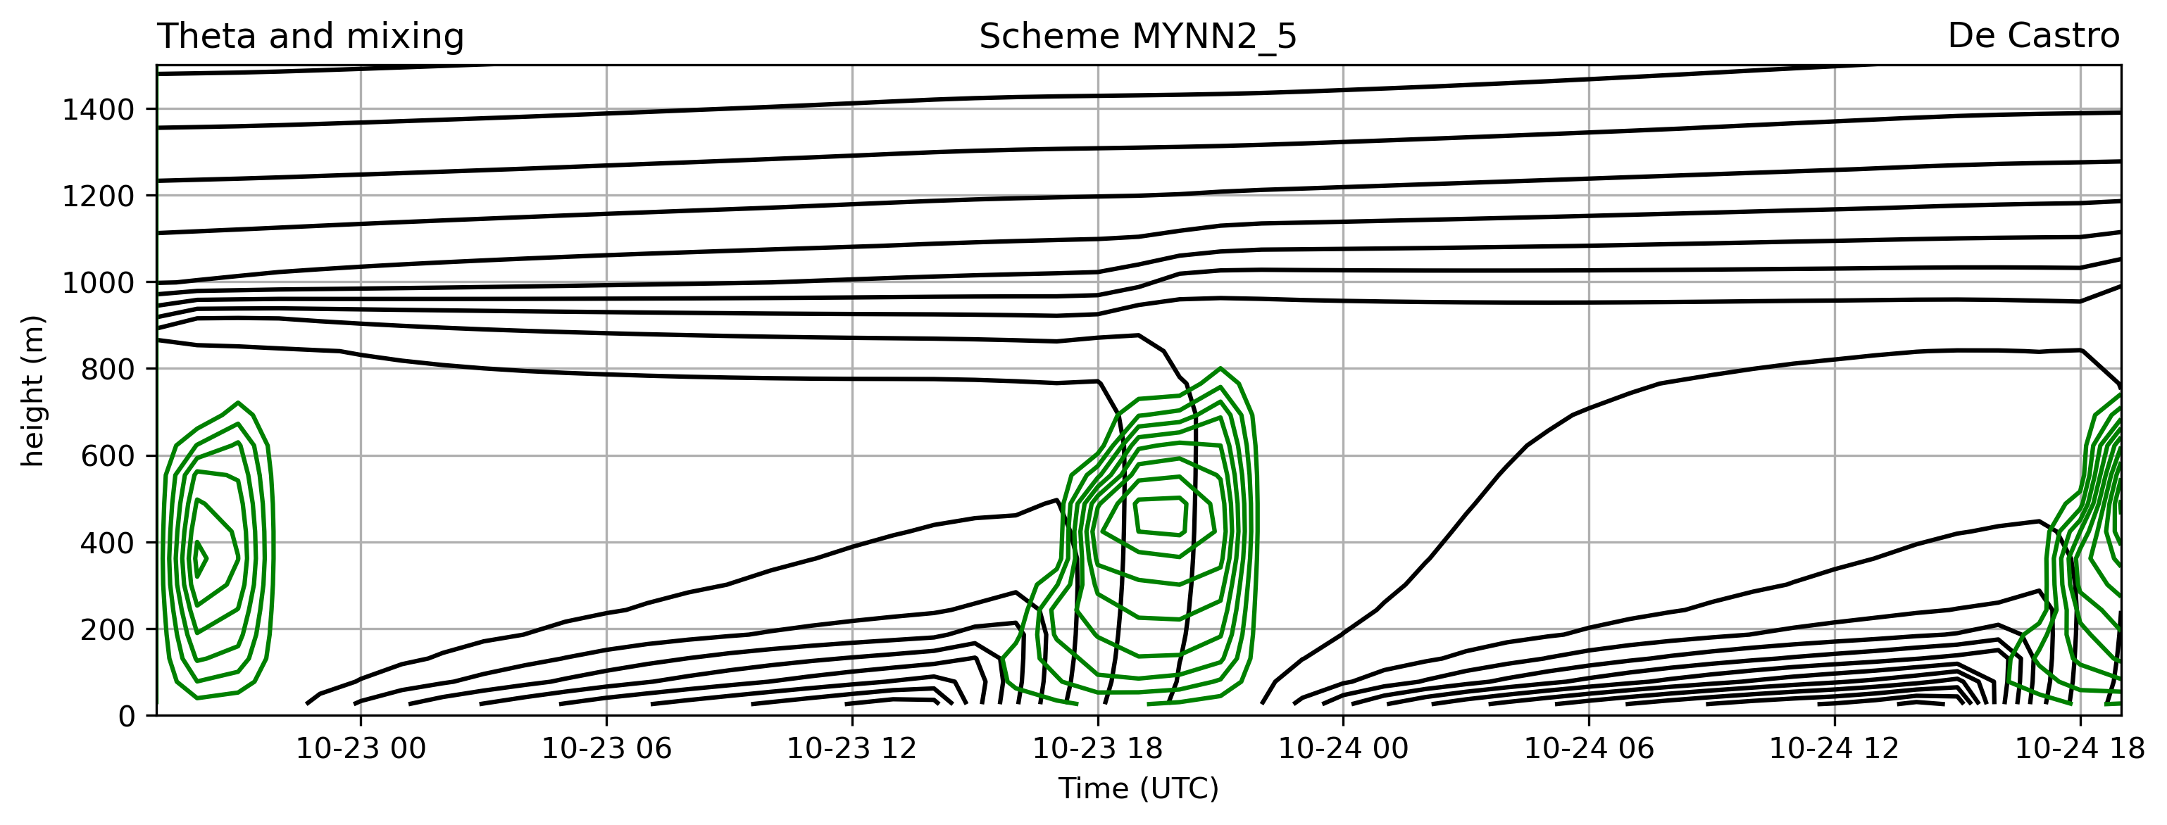
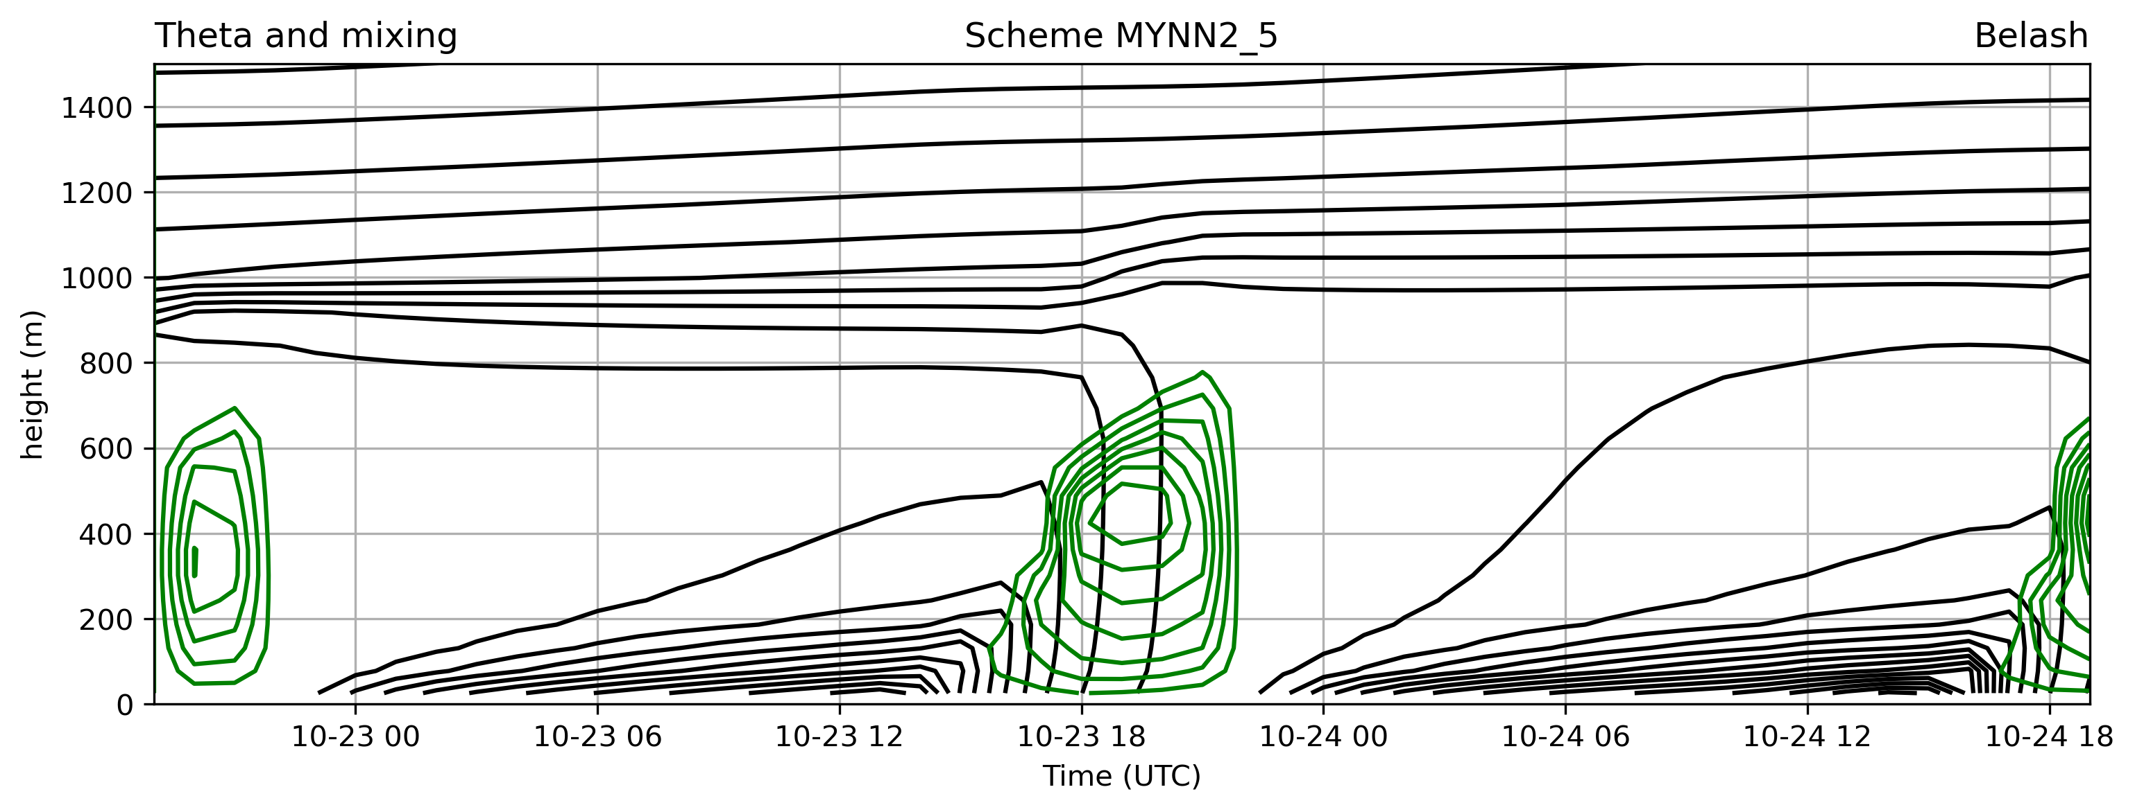
Potential temperature and mixing: height x time
MYNN2 with surface layer 5 – like the HRRR and RAP

Slide 6
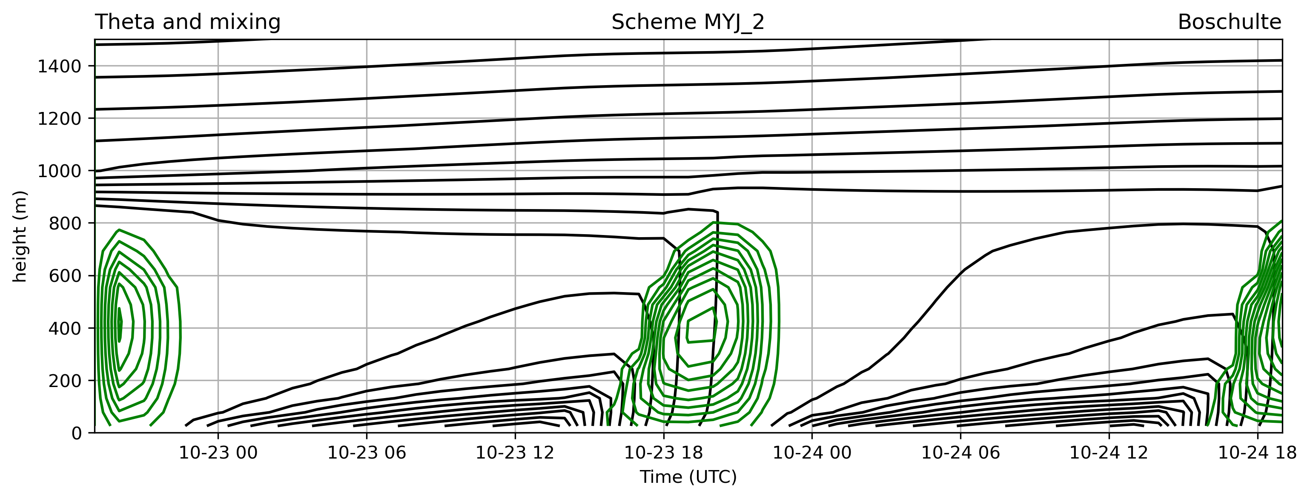
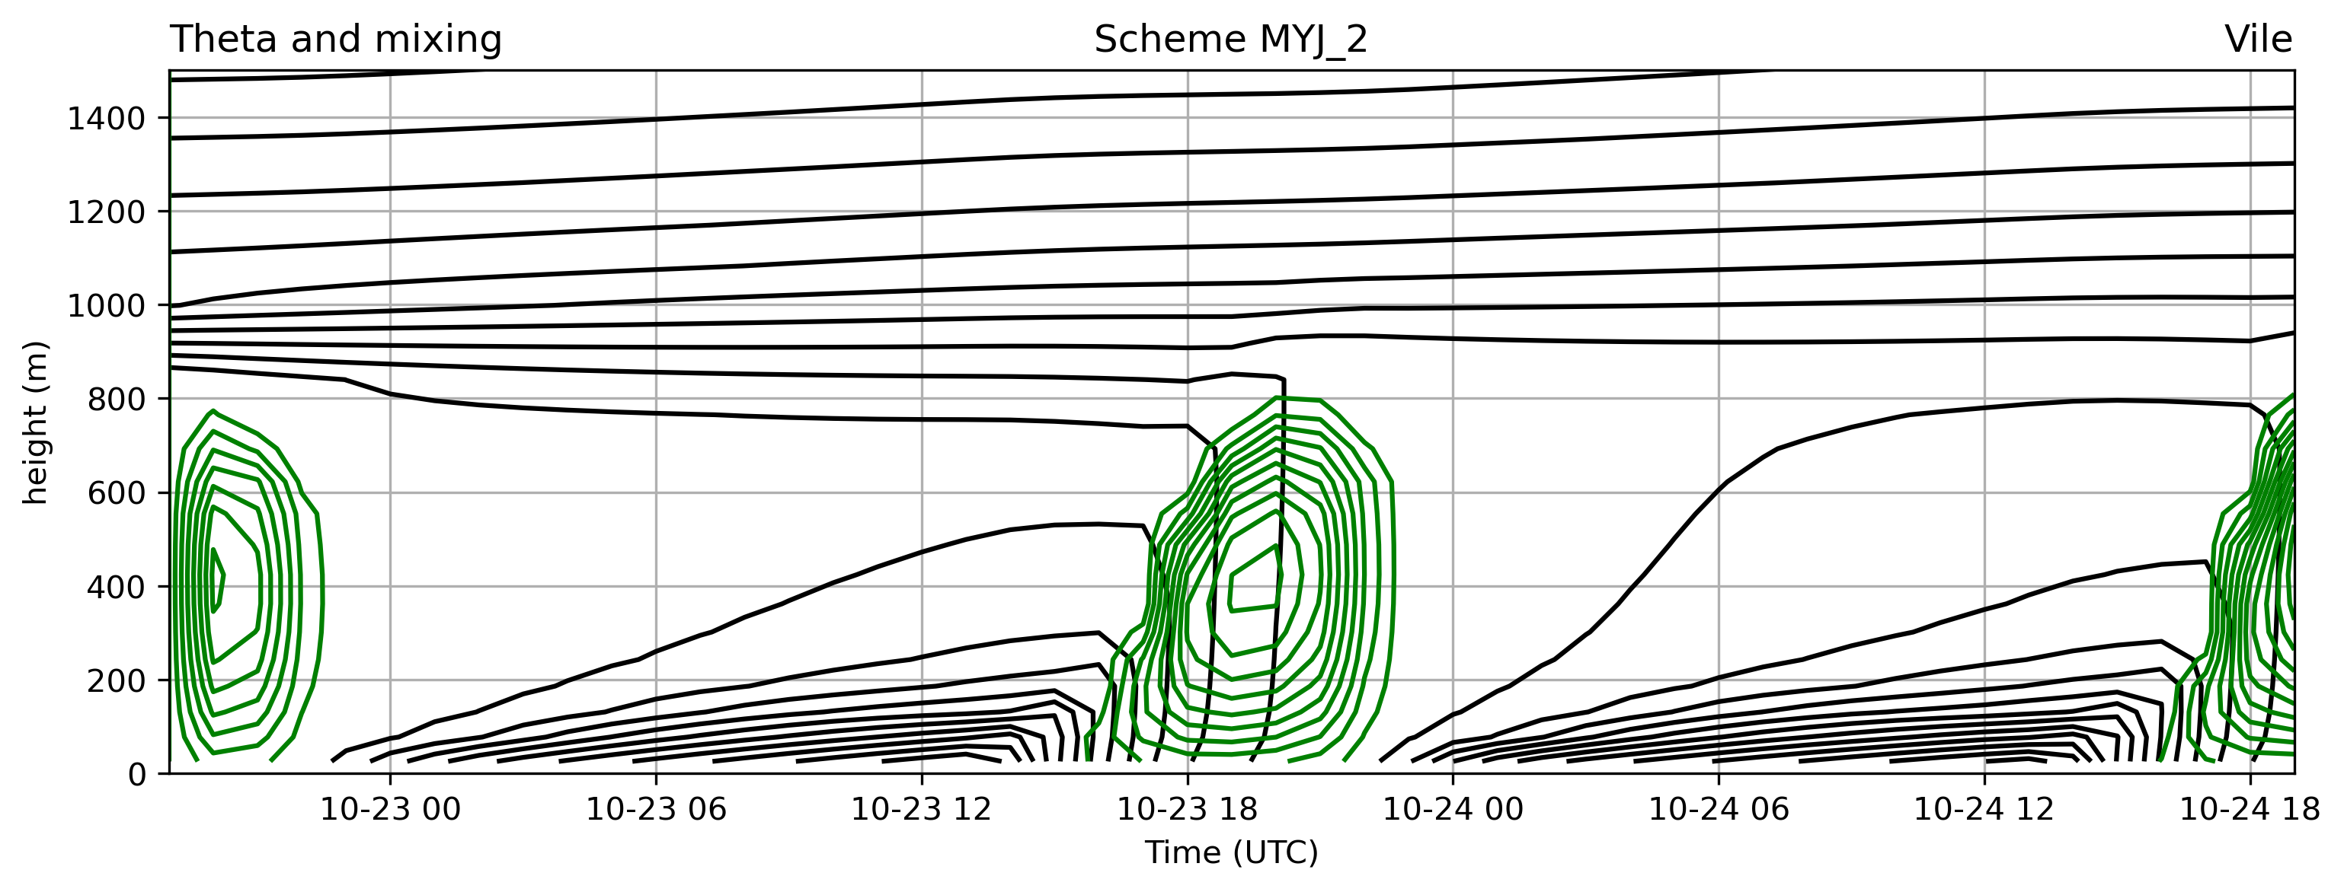
Potential temperature and mixing: height x time
MYJ with surface layer 2 – like the NAM

Slide 7
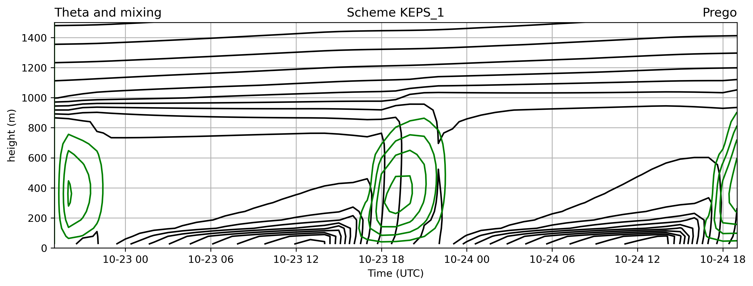

Potential temperature and mixing: height x time
KEPS with surface layer 1 – very sharp and stable inversion

Slide 8
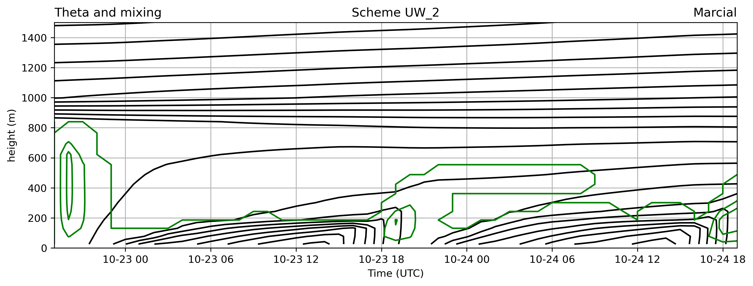
Potential temperature and mixing: height x time
UW with surface layer 2 – something seems wrong

Slide 9
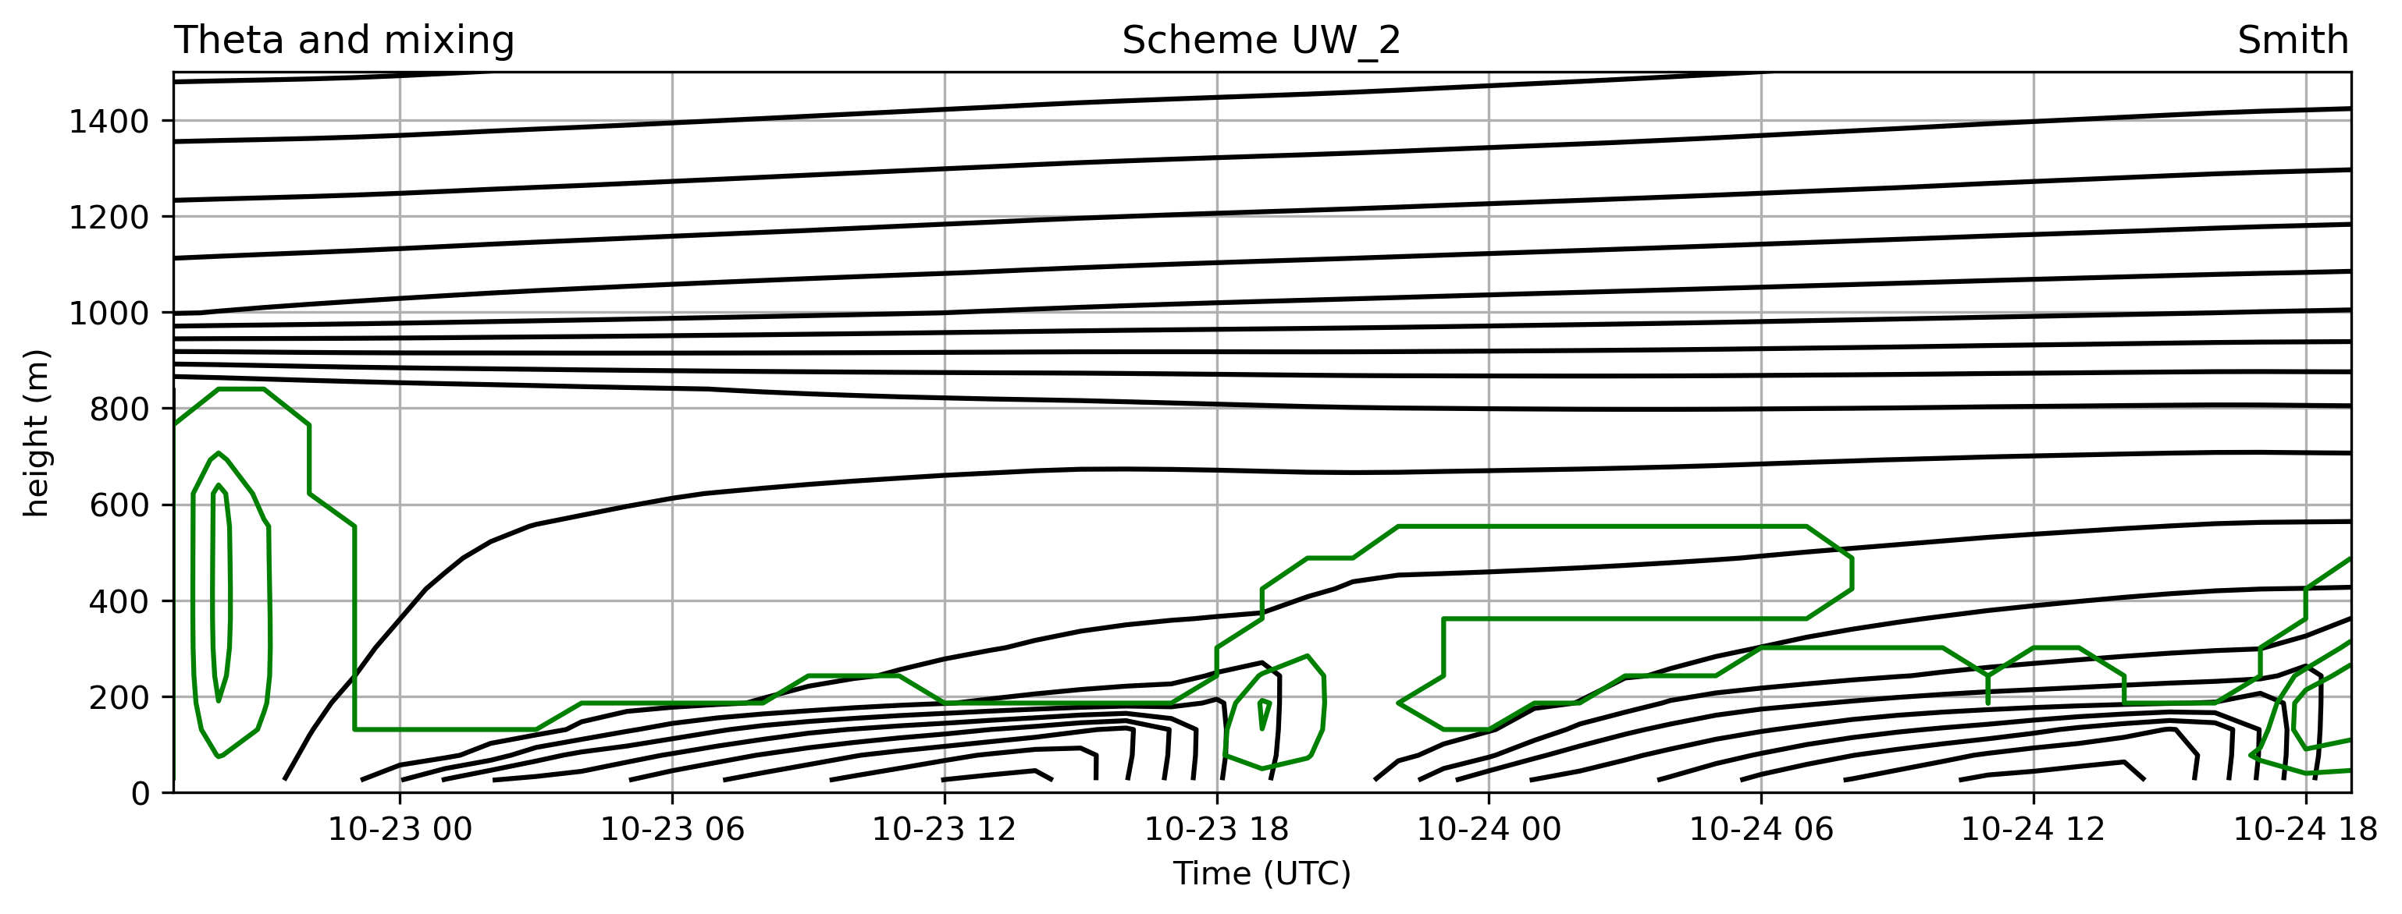
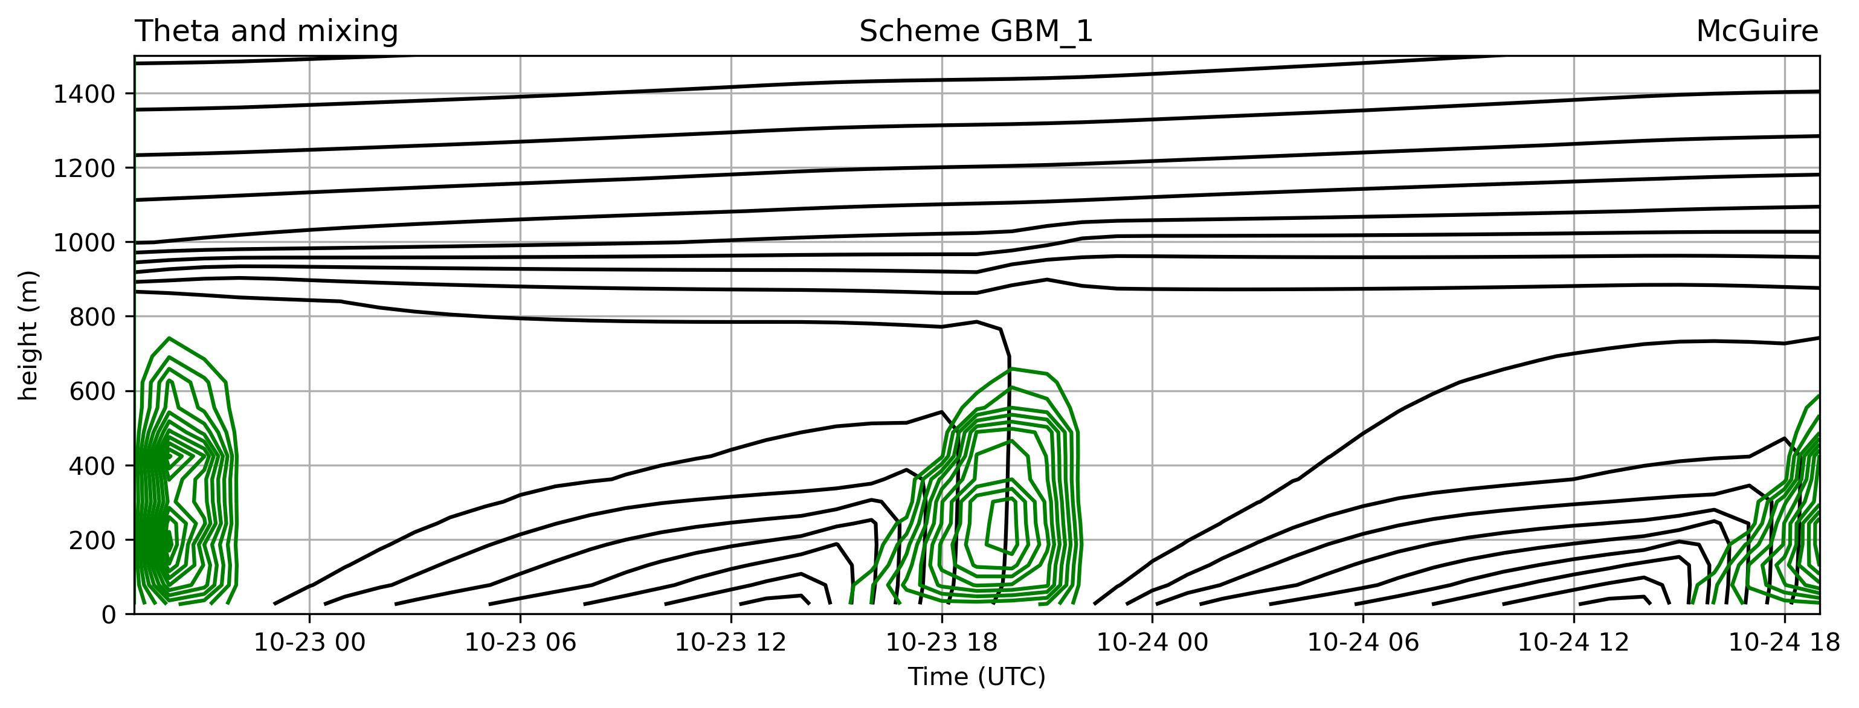

Potential temperature and mixing: height x time
GBM with surface layer 1 – a related scheme, also from U Washington
- not a very sharp or shallow nocturnal inversion

Slide 10
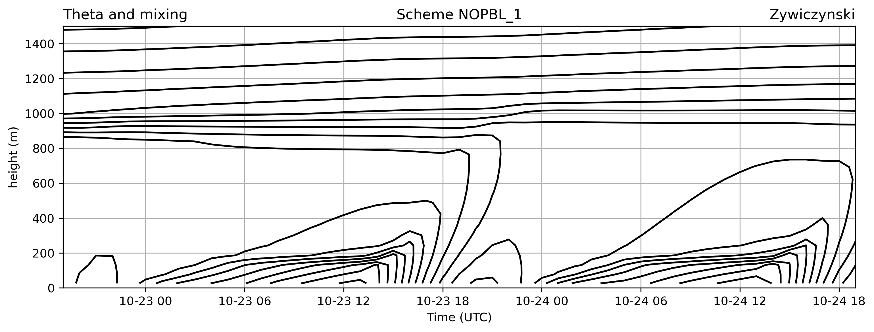

Potential temperature and mixing: height x time
NO PBL with surface layer 2 – note how unstable the convective PBL is

Slide 11

Potential temperature and mixing: height x time [animation]
• Variations in:
- depth of the PBL
- depth and strength of the nocturnal inversion – important for pollution and nocturnal convection
- stability of the convective PBL (around 18 UTC)
- amount, depth, temporal persistence of mixing
- temperature at and near the ground
“there is only one correct answer”

Slide 12
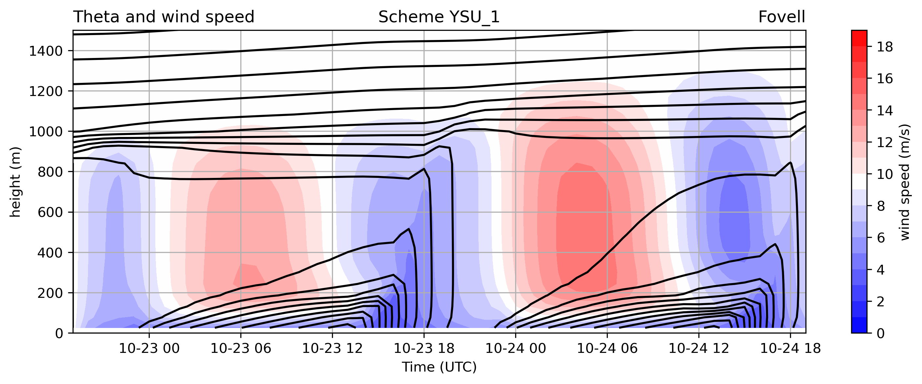
Potential temperature and wind speed: height x time
YSU with surface layer 1 – our control run
- substantial diurnal variation in wind speed [and shear] through the boundary layer

Slide 13
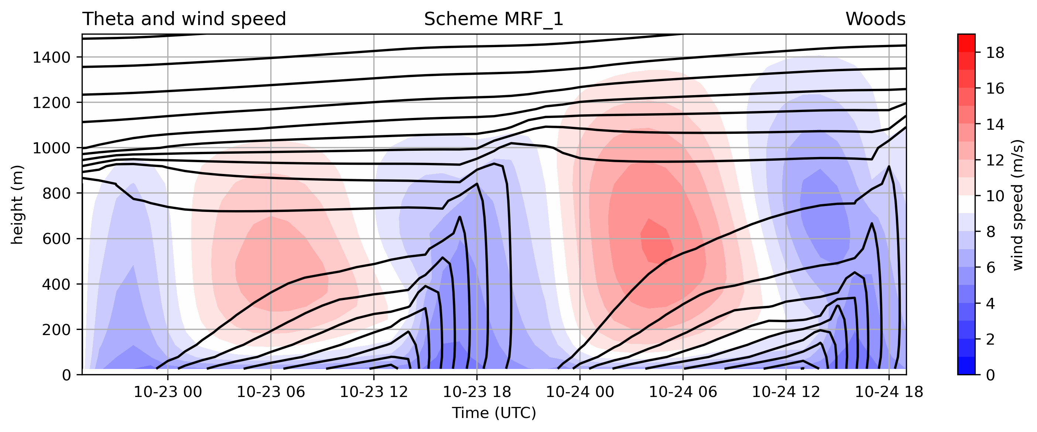
Potential temperature and wind speed: height x time
MRF with surface layer 1 – the scheme YSU evolved from
→ Differences in magnitude and altitude of nocturnal jet

Slide 14
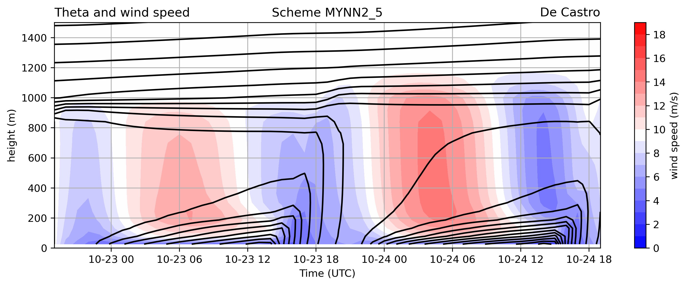
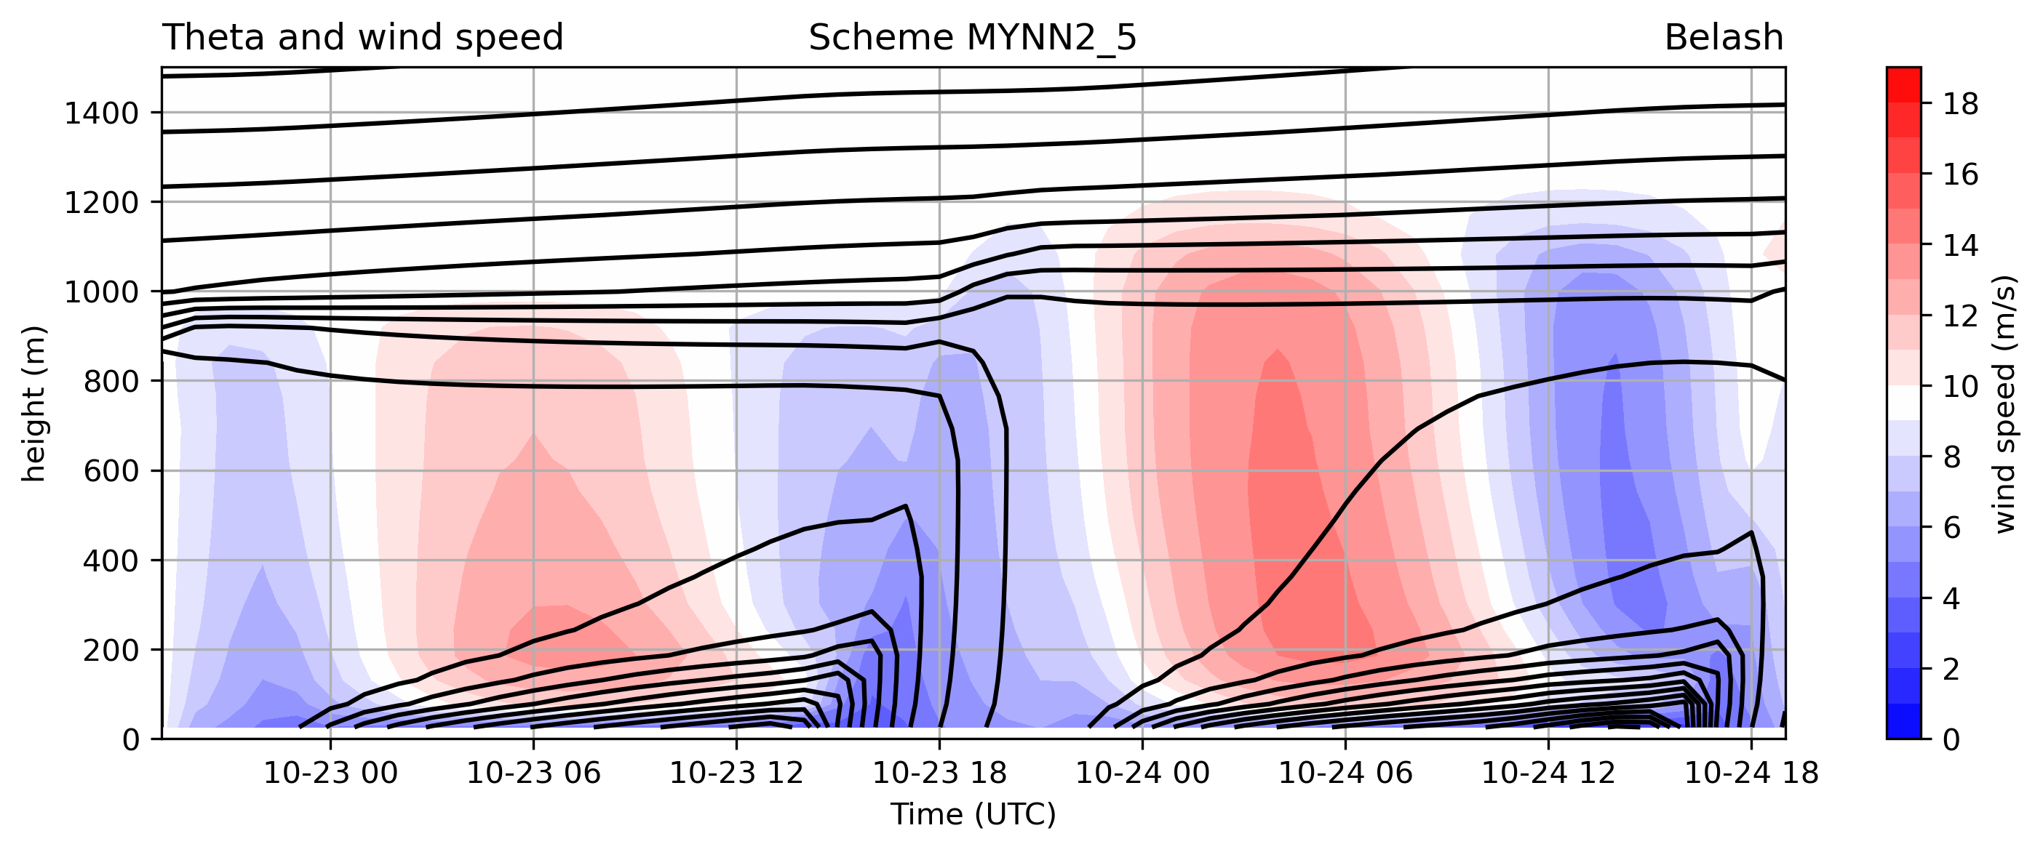
Potential temperature and wind speed: height x time
MYNN2 with surface layer 5 – like the HRRR and RAP

Slide 15
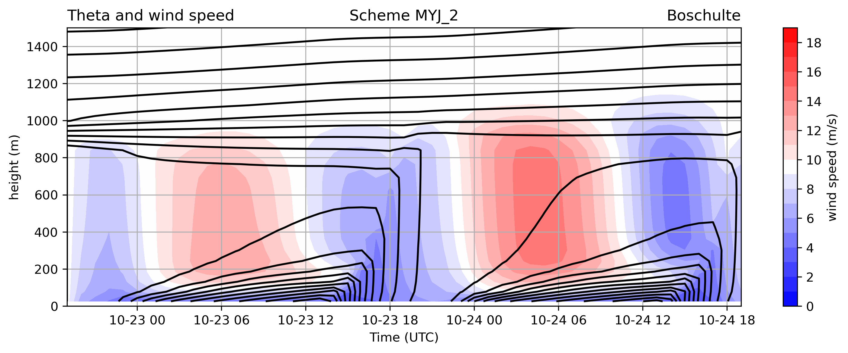
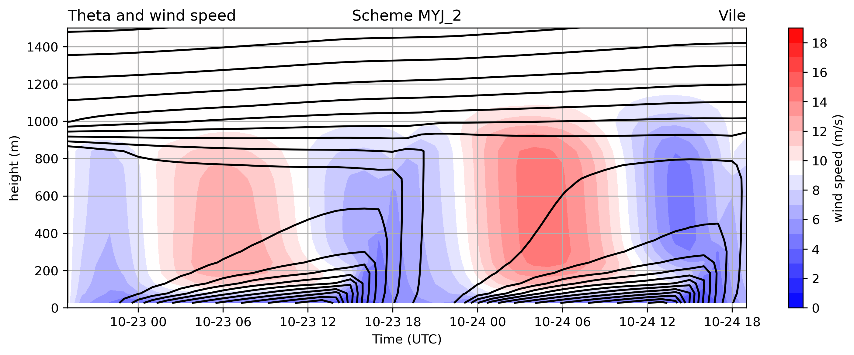
Potential temperature and wind speed: height x time
MYJ with surface layer 2 – like the NAM

Slide 16
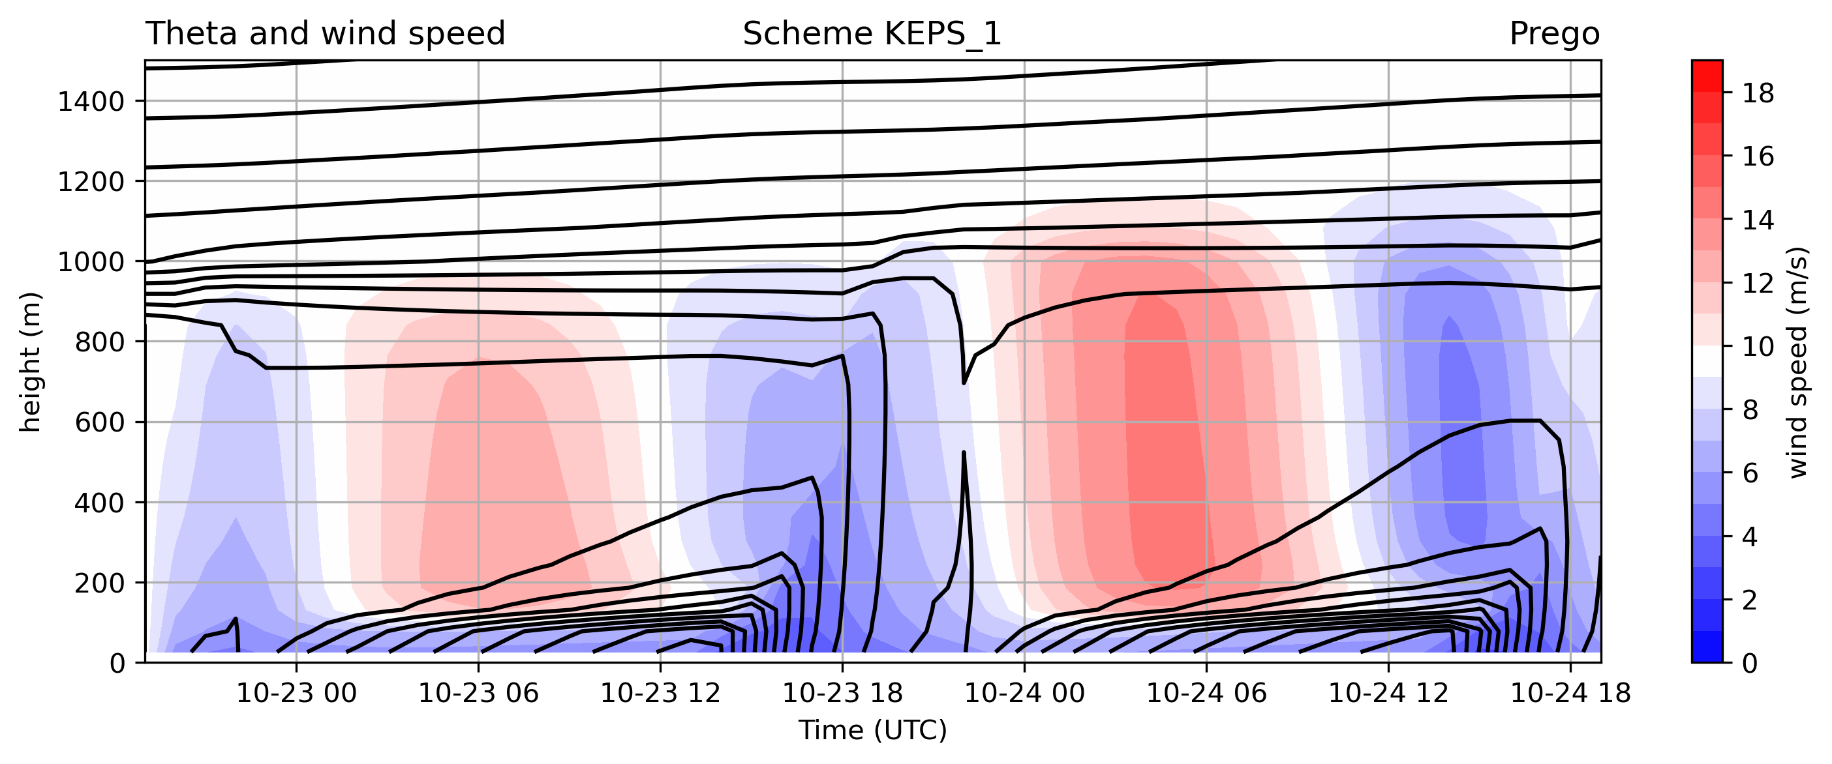

Potential temperature and wind speed: height x time
KEPS with surface layer 1 – very sharp and stable inversion

Slide 17
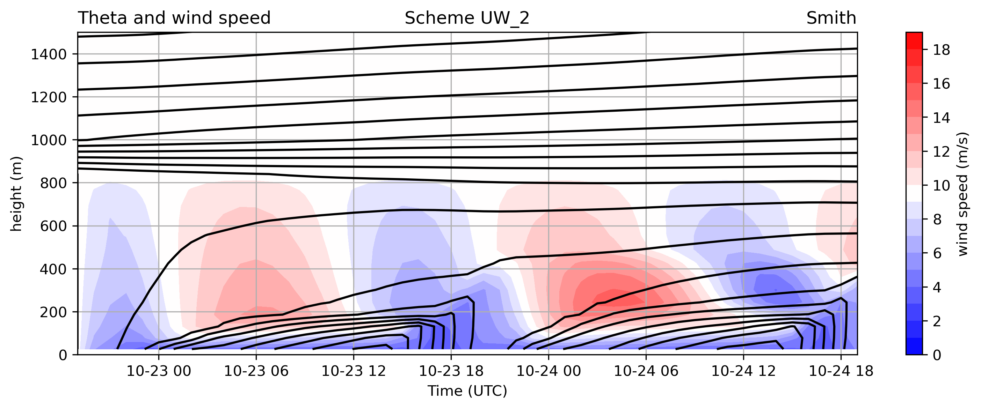
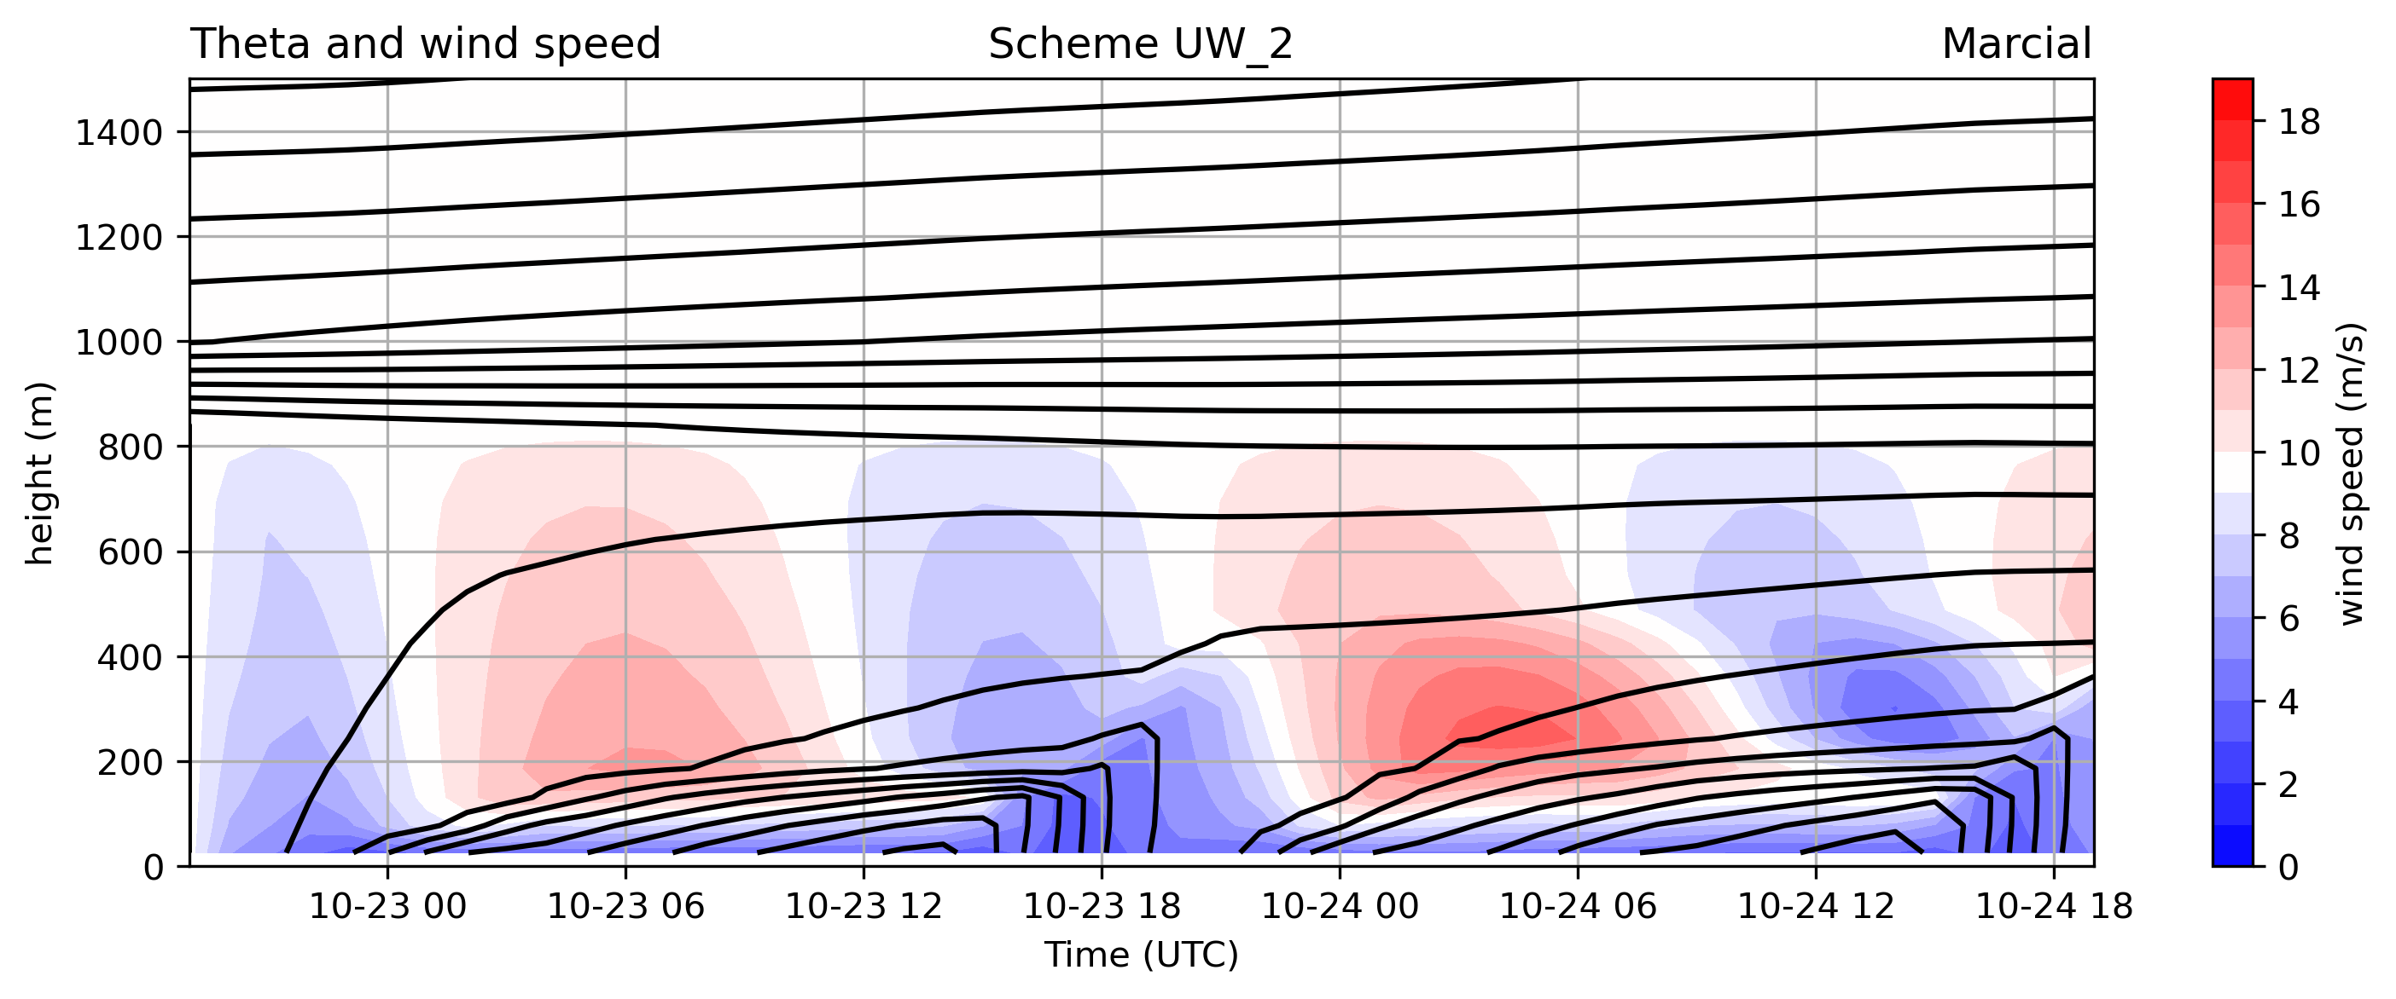
Potential temperature and wind speed: height x time
UW with surface layer 2 – something seems wrong

Slide 18
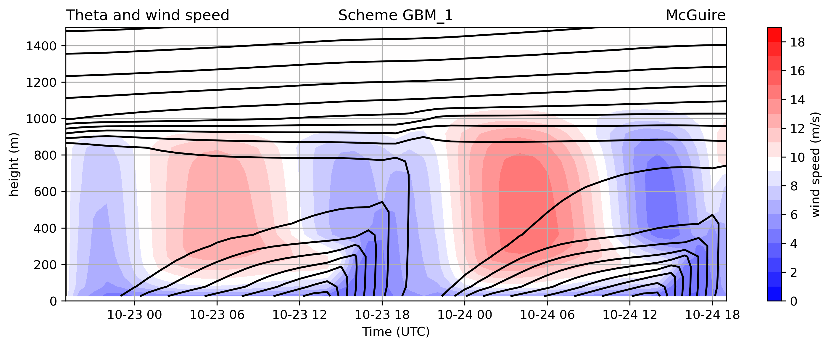

Potential temperature and wind speed: height x time
GBM with surface layer 1 – a related scheme, also from U Washington

Slide 19
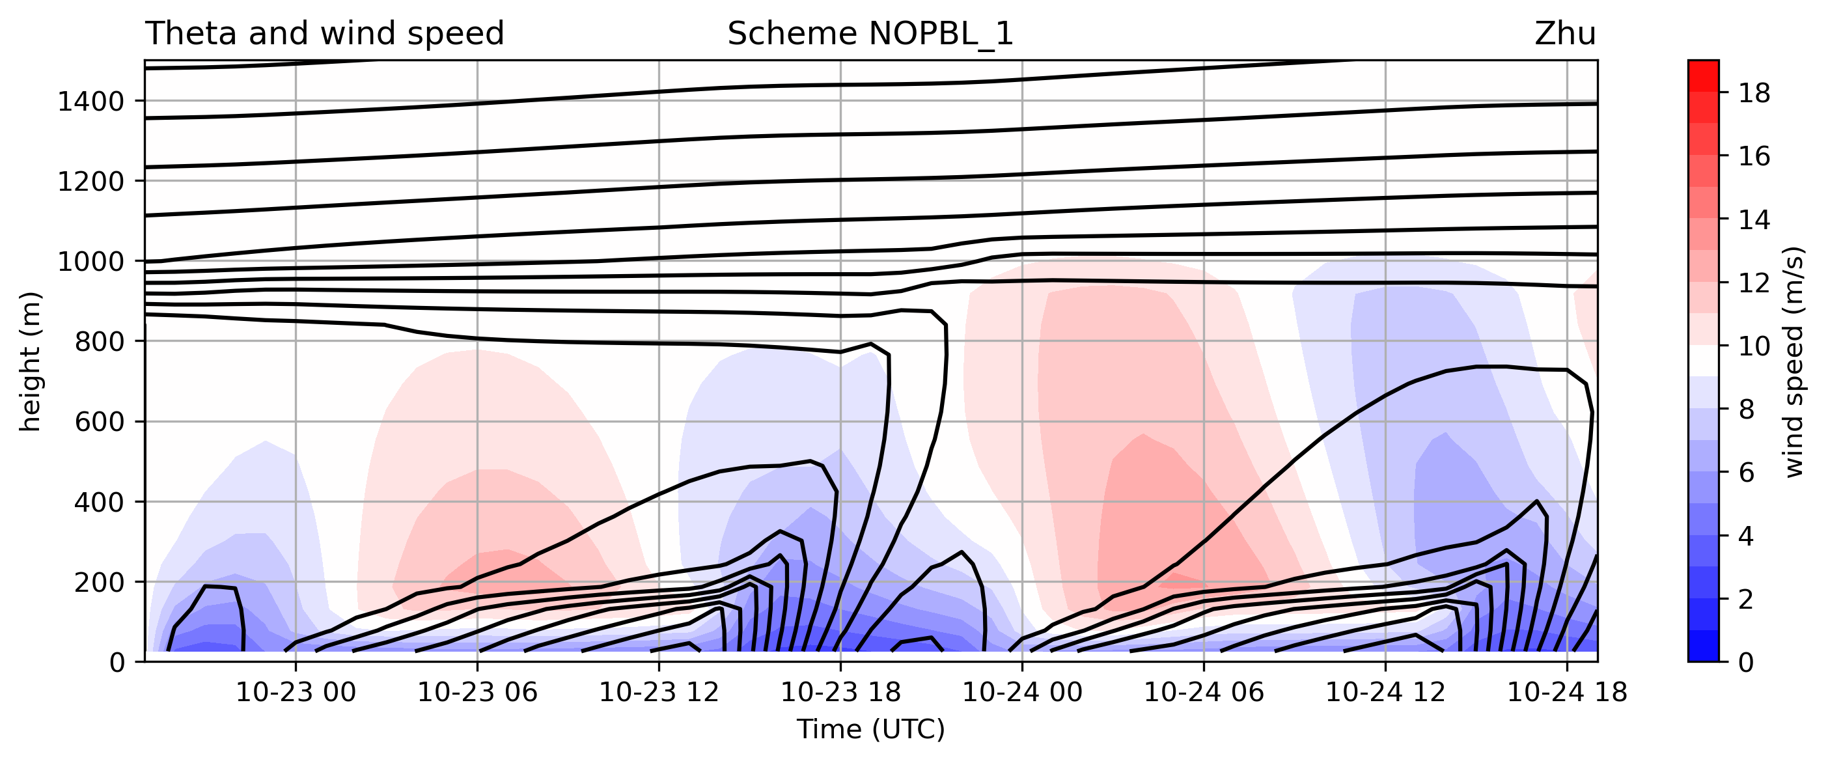
Potential temperature and wind speed: height x time
NO PBL with surface layer 2 – note how unstable the convective PBL is.
There’s no mixing to spread the slow near-surface winds aloft
very far but there’s still a diurnal cycle driven by surface fluxes

Slide 20

Potential temperature and wind speed: height x time [animation]
• Variations in:
- amplitude of diurnal cycle
- magnitude and altitude of the nocturnal jet [and vertical shear]
- speed of winds near the surface

Slide 21
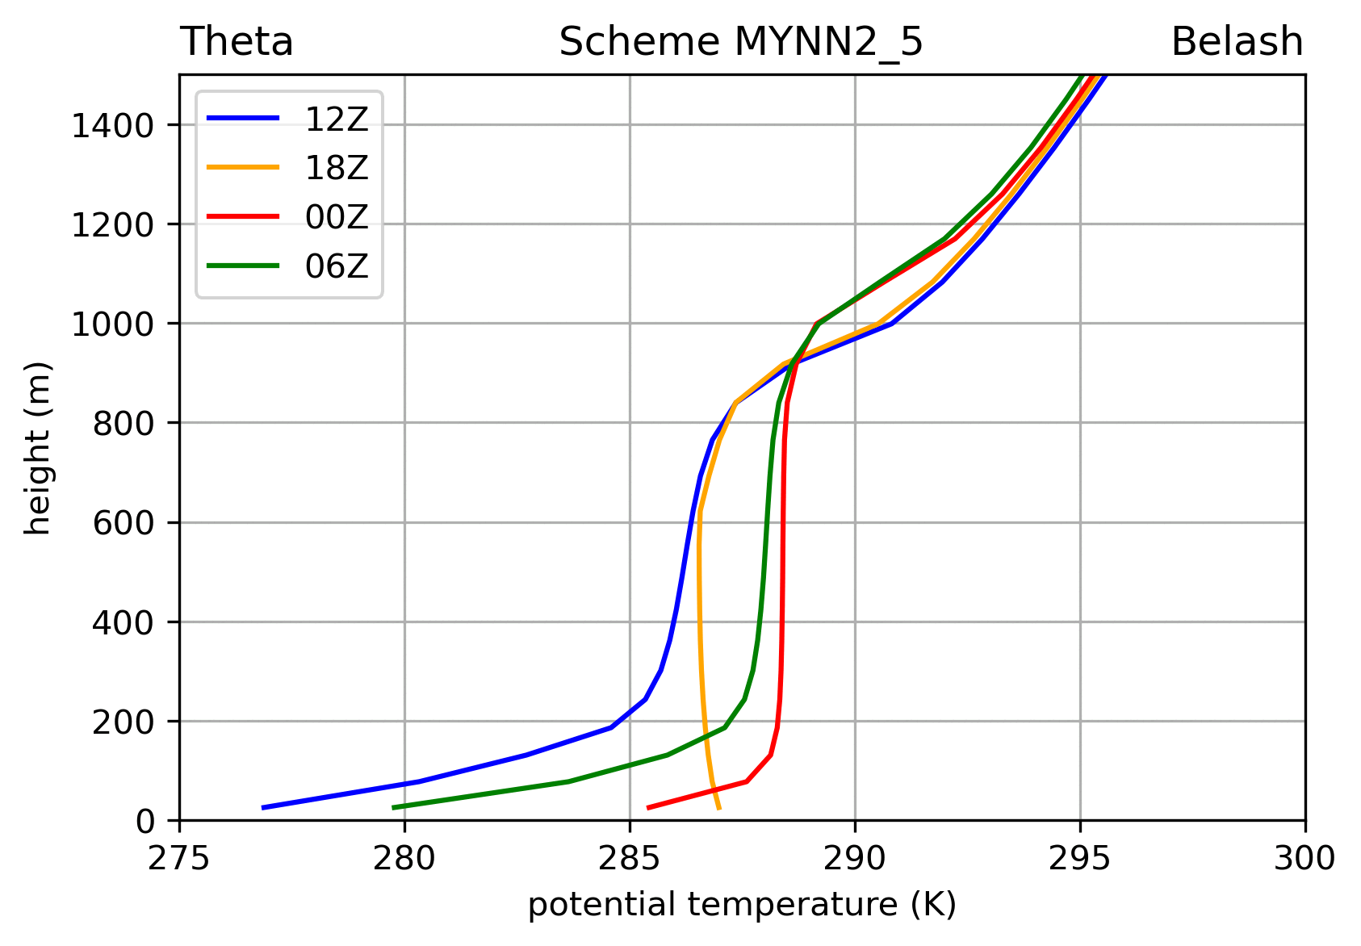
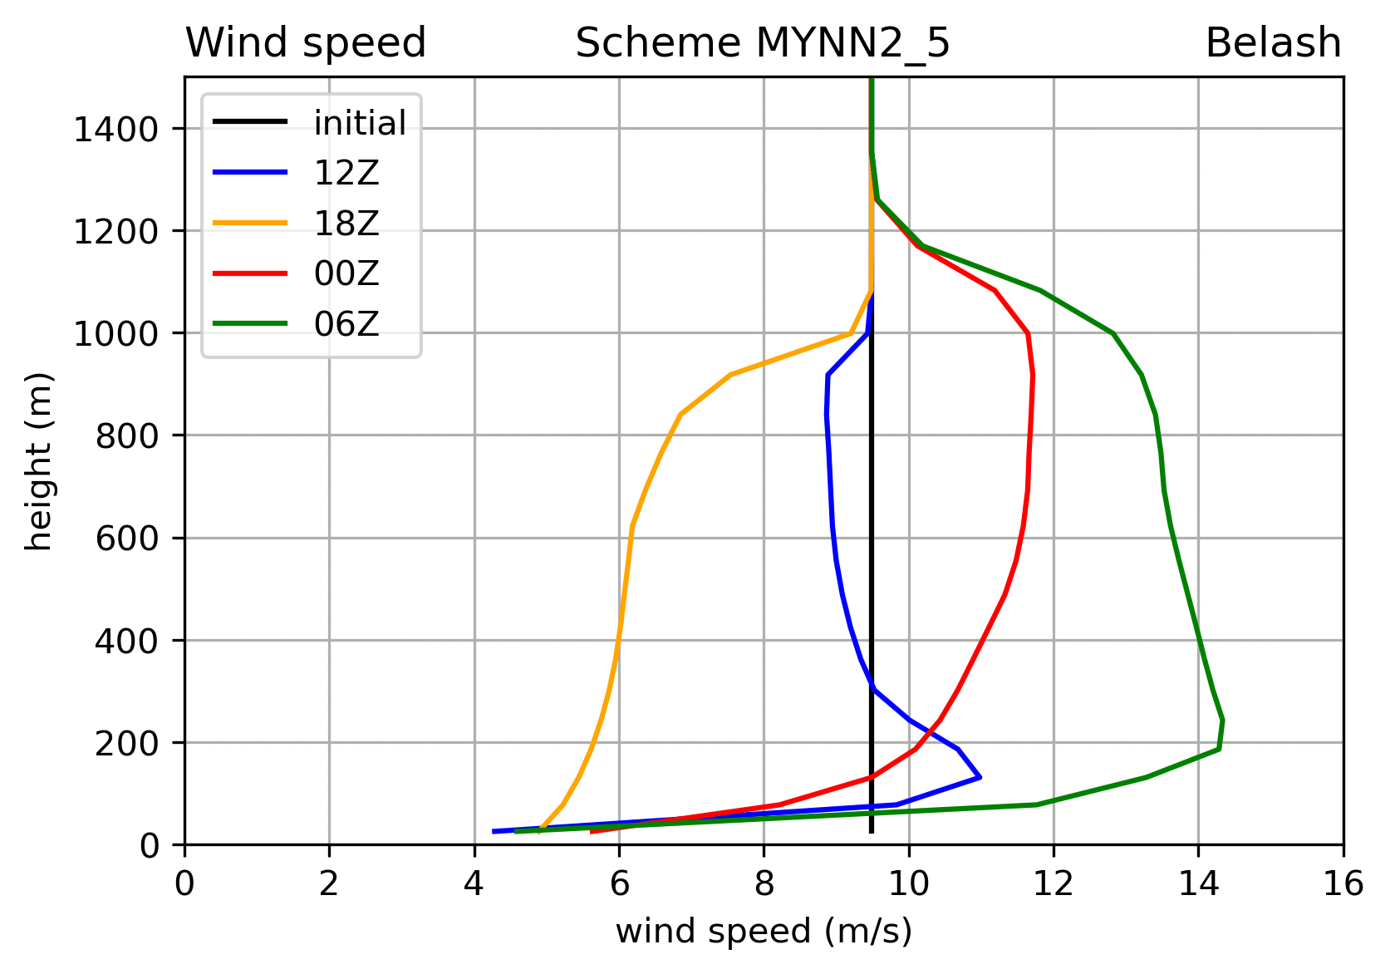
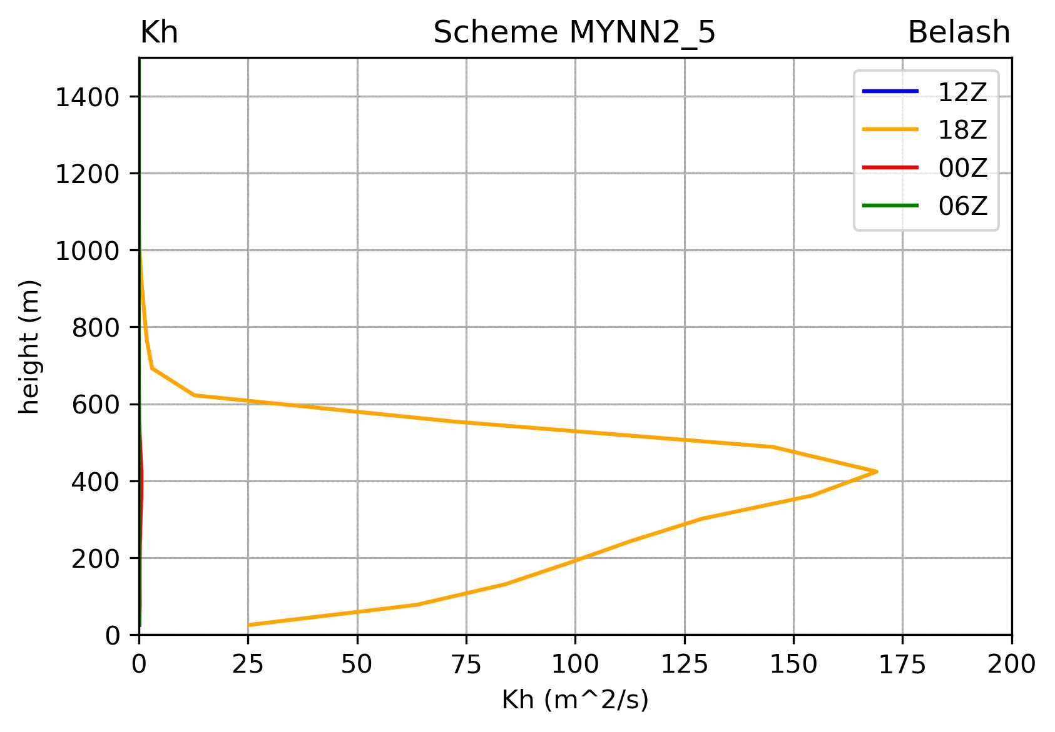
Vertical profiles at 00, 06, 12, 18 UTC
potential temperature wind speed mixing

Slide 22
[end]

