Slide 1
Planetary Boundary Layer (PBL): Highlights of implementations
ATM 419/563
Spring 2024
Fovell
© Copyright 2024 Robert Fovell, Univ. at Albany, SUNY, rfovell@albany.edu

Slide 2
Mellor and Yamada’s depiction of the PBL diurnal cycle

Slide 3
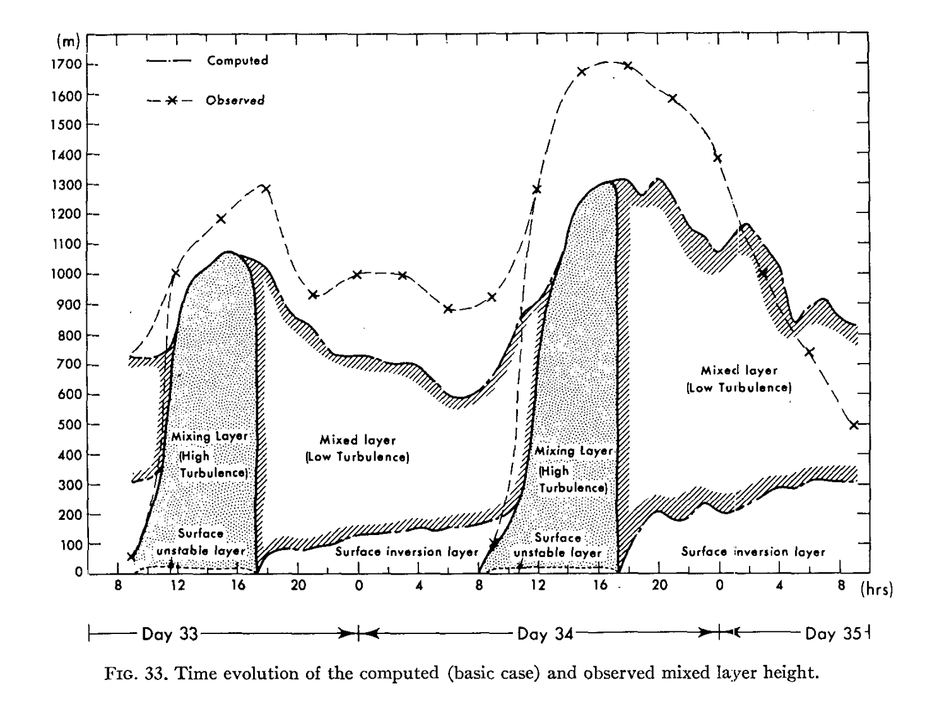
PBL height
Height (m)
[or Residual layer]
Local time
Yamada and Mellor (1975)
Notes:
PBL height computed vs observed

Slide 4
PBL height
Height (m)
Surface heating produces
unstable surface layer
[or Residual layer]
Local time
Yamada and Mellor (1975)
Notes:
PBL height computed vs observed

Slide 5
PBL height
Deep vigorous mixing
Height (m)
[or Residual layer]
Local time
Yamada and Mellor (1975)
Notes:
PBL height computed vs observed

Slide 6
PBL height
Height (m)
Late afternoon to evening:
surface layer stabilizes
[or Residual layer]
Local time
Yamada and Mellor (1975)
Notes:
PBL height computed vs observed

Slide 7
PBL height
Height (m)
Mixing rapidly vanishes,
leaving residual layer
Next day: do it again
[or Residual layer]
Local time
Yamada and Mellor (1975)
Notes:
PBL height computed vs observed

Slide 8
PBL height
PBL height varies with time
Height (m)
[or Residual layer]
Local time
Yamada and Mellor (1975)
Notes:
PBL height computed vs observed

Slide 9
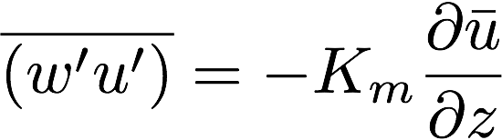
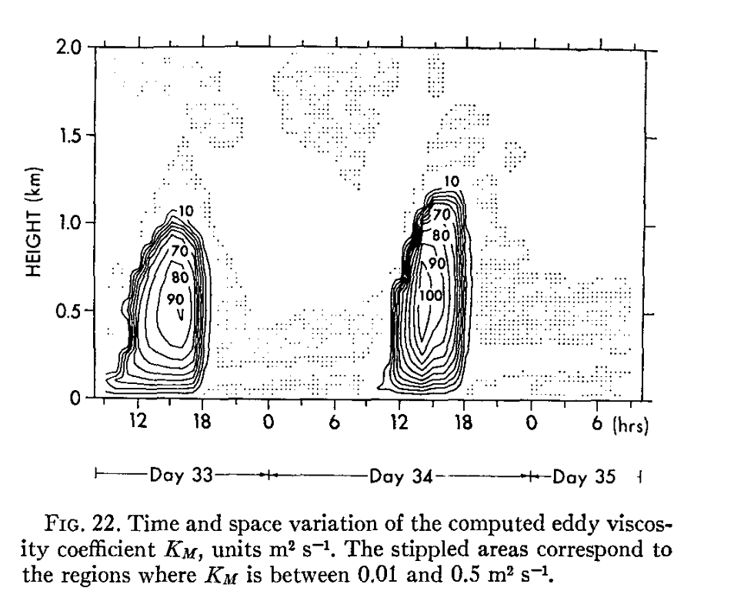
Estimates of eddy mixing (K_{m})
Max values ~ 100 m²/s
Max in afternoon
Abrupt disappearance
at night
Yamada and Mellor (1975)
Notes:
Emphasize very rapid collapse of mixing as sun goes down
What’s the big difference between afternoon and overnight? MIXING. PBL. SUBGRID MIXING. Need to param it right to get the forecast right.

Slide 10
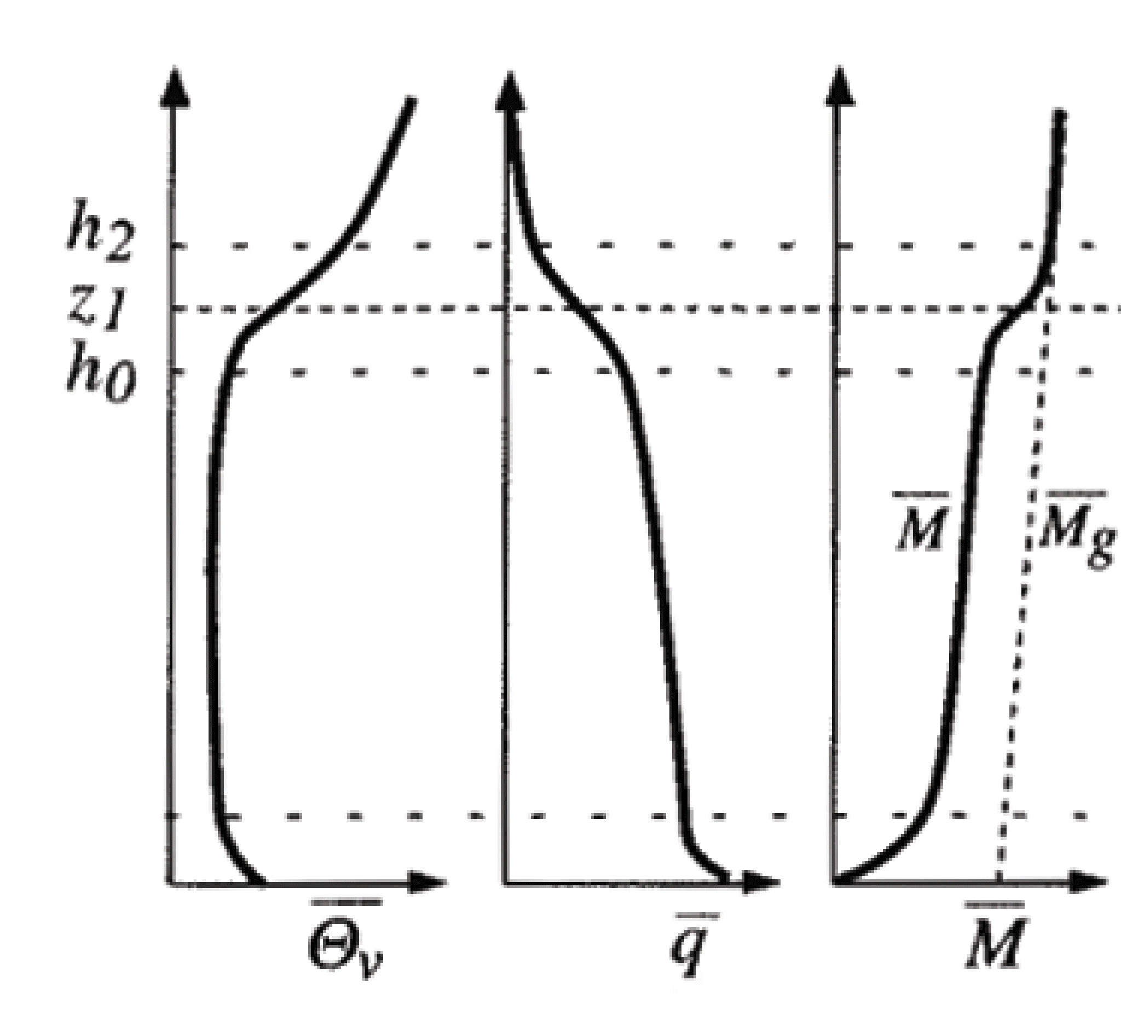
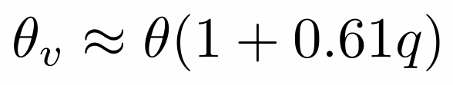
A strongly-heated afternoon PBL
Hartmann’s text Fig. 4.6
• Temporally averaged vertical profiles of virtual potential temperature (θ_{v}), vapor mixing ratio (q) and horizontal momentum (M)
• Strong surface heating, combined with surface friction that impedes vertical mixing, causes θ_{v} to decrease with height near the ground in the surface layer (superadiabatic)
• Farther above, convective turbulence (eddies) efficiently mixes the atmosphere and its conserved properties in the mixed layer
• For a dry adiabatic process, θ_{v} and q are conserved. If inviscid and unaccelerated, M is also conserved.
Virtual potential temperature contains a moisture influence:
q = water vapor mixing ratio (kg of water per kg of air)
Notes:
Virt PT because vapor content influences density via gas constant R
Surface layer is absolutely unstable but its shallowness and frictional drag makes it hard for eddies to form and “get a grip”

Slide 11
A strongly-heated afternoon PBL
• The entrainment zone (h₀ to h₂) separates the mixed layer from the free troposphere. Mixing between the PBL and free troposphere occurs intermittently there. Note that it is more stable there than the free troposphere above or the mixed layer below.
[entrain: French, to drag away]
• The q and M profiles are not as well mixed due to entrainment of drier and higher momentum air from aloft
Notes:
What does the T-z profile look like?
Why does q decrease w/ z in mixed layer? I think it’s due to entrainment from above, which is larger closer to the free atmosphere (i.e., near PBL top). In case of potential temp, entrain from above brings high theta down, which helps maintain the neutral profile, but with vapor, it’s dry, so entrain erodes moisture at PBL top.
Also consider the countergradient term and what even theta looks like without it.

Slide 12
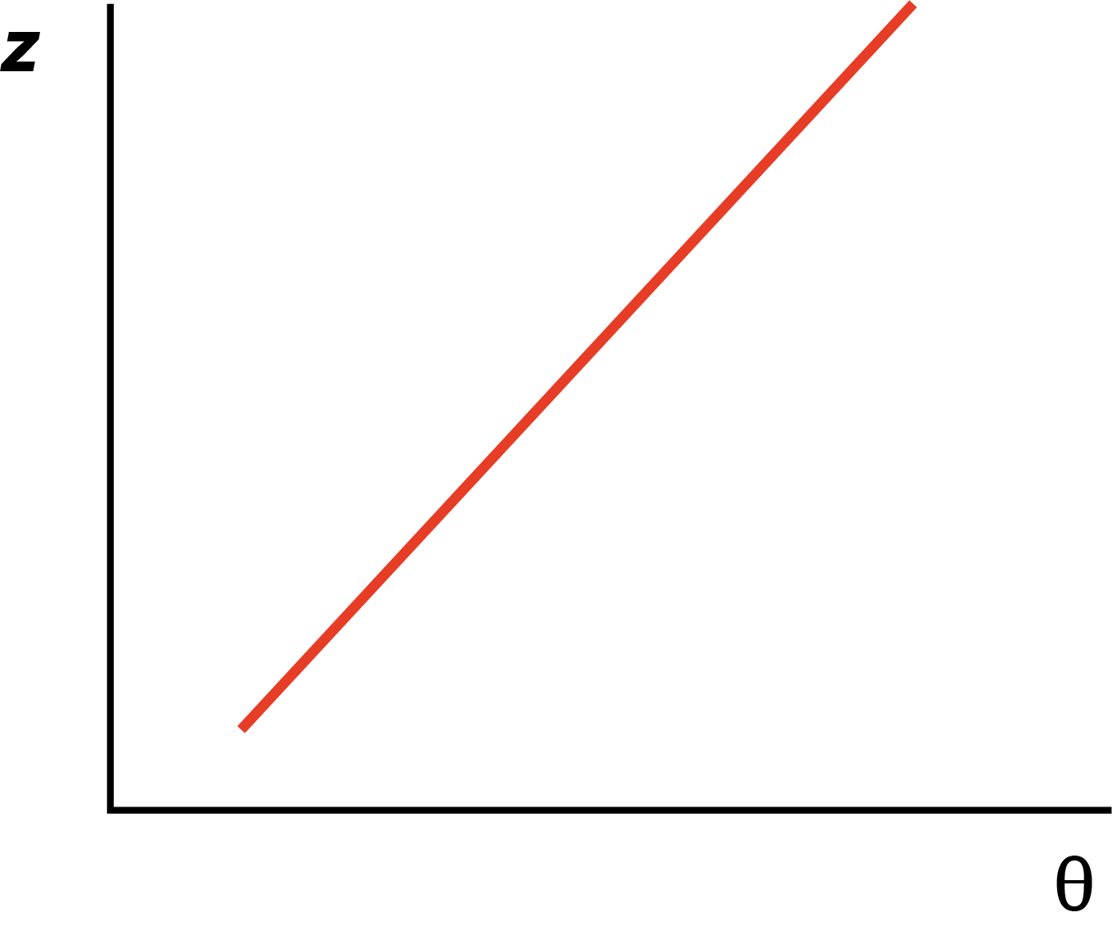
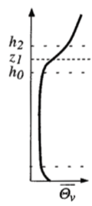
Evolution of well-mixed PBL #1
We start with a stable vertical profile
of potential temperature θ

Slide 13
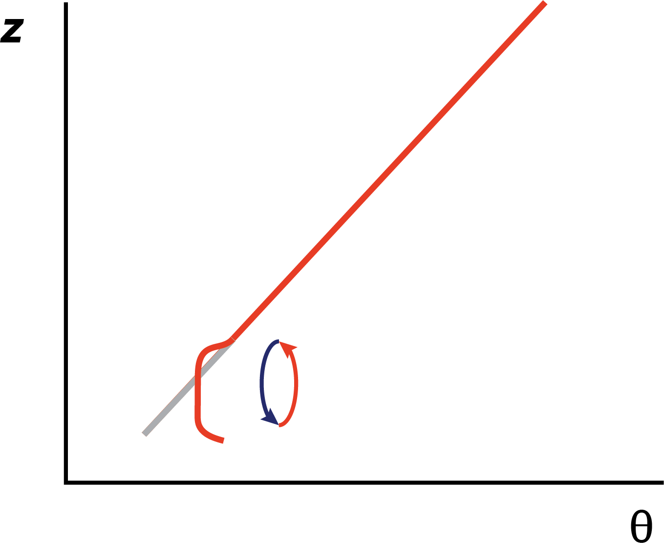
Evolution of well-mixed PBL #2
Daytime heating makes the surface layer unstable.
Mixing is restricted close to the ground, leaving
surface layer superadiabatic.

Slide 14
Evolution of well-mixed PBL #3
Above, mixing makes q profile neutral.
At top of PBL, air pushing from below establishes
the very stable PBL-top inversion.

Slide 15
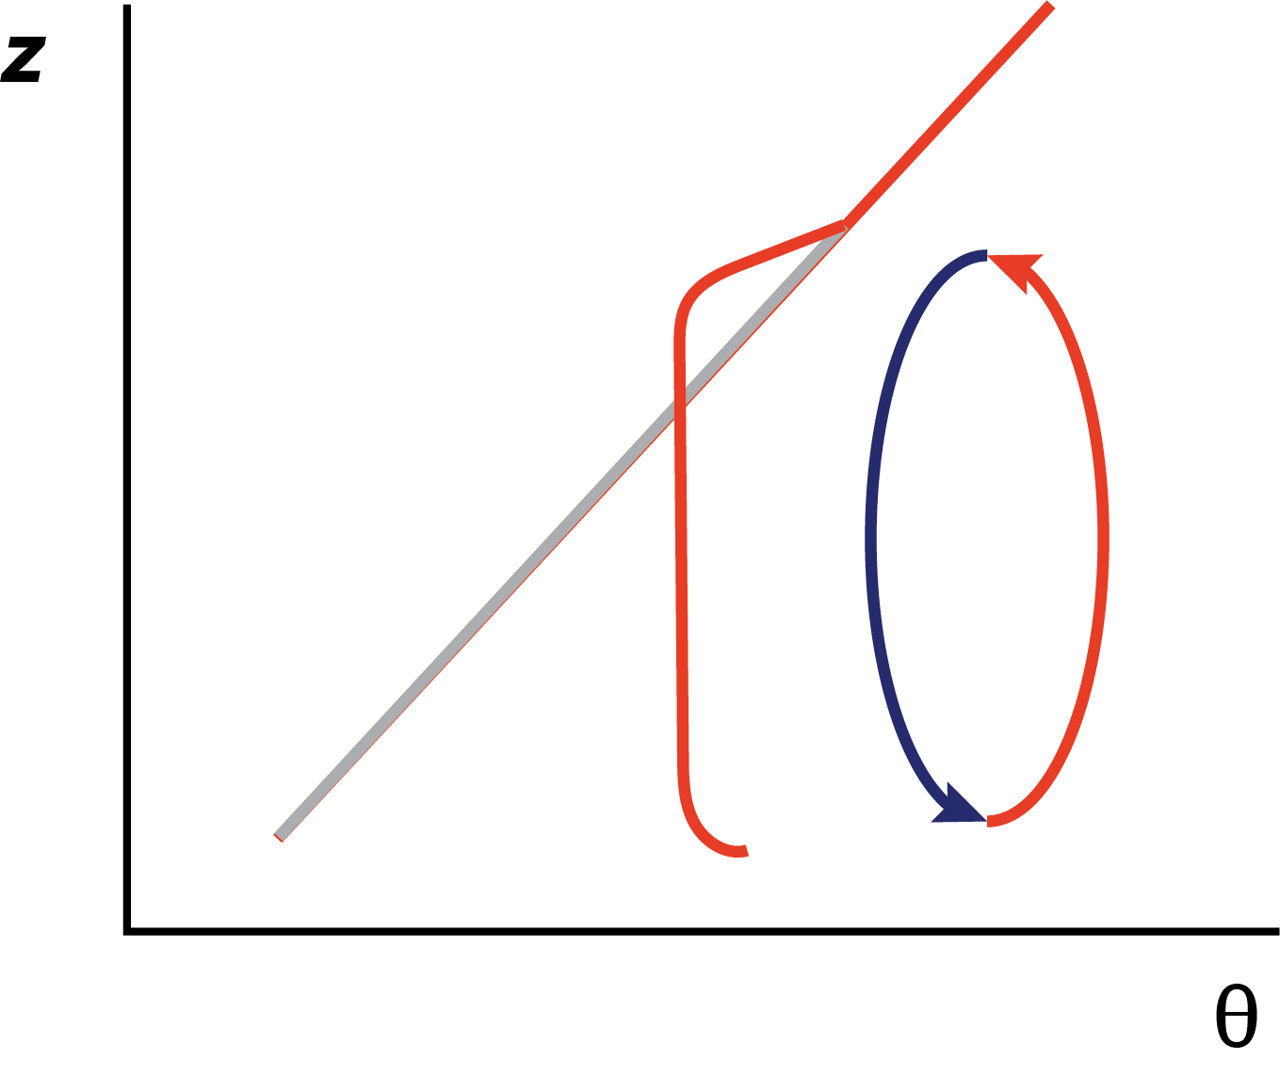
Evolution of well-mixed PBL #4
PBL top inversion
As heating continues, the surface temperature becomes warmer
and the PBL depth grows

Slide 16
A strongly-heated afternoon PBL
• Here, M is being compared to M_{g}, the geostrophic momentum
• The effect of surface drag can be seen in the M profile near the surface
• The straight-line large-scale wind comes into geostrophic balance
[geostrophic: Greek = Earth turns]
• However, the near-surface wind is slowed by friction. Upward mixing of slower air causes the wind to be subgeostrophic in mixed layer… during the day, anyway….
Notes:
Why does Mg increase with z? If for no other reason, mean density is decreasing with height, but that’s a pretty small effect over a 1km deep or so PBL. U itself will have less slope?

Slide 17
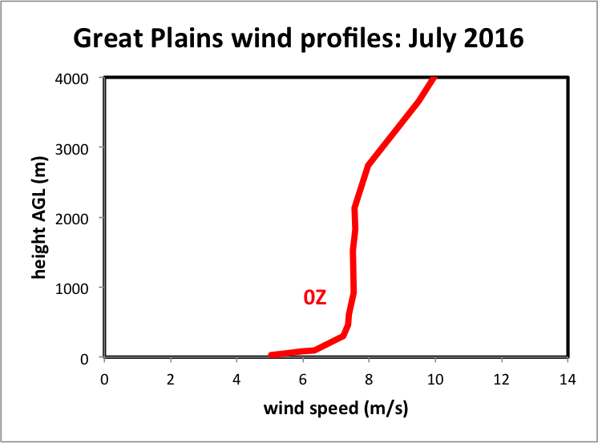
Great Plains wind profile: July 2016
next slide
Wind speed, not momentum
Averaged over 11 radiosonde stations and 31 days
Notes:
HIFREQ_July2016_analysis.xlsx
Is the mixed layer shearless? Basically, yes. Avg over large area, many days, many wx types, many PBL depths, so a lot of variability about this mean, but the mean stands out cleanly.
This is U, not rho*U,

Slide 18
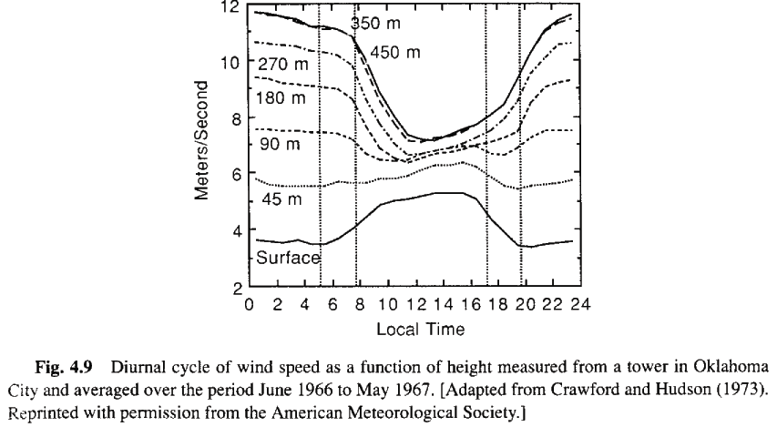
Diurnal variation of wind speed and shear with height
noon
midnight
Vertical wind shear varies through day owing to diurnally-driven mixing.
Do you see the vertical shear is larger at night, smaller in afternoon?
Hartmann’s text, p. 99
Notes:
So when is vertical shear largest? Plot can be deceptive. Largest at MIDNIGHT.
Actually, convective mixing during the DAY is mixing out the momentum, decreasing the wind at 350m and shear over the sfc-350m layer. But there’s another factor (next 2 slides)

Slide 19
The well-mixed boundary layer
PBL top inversion
As heating continues, the surface temperature becomes warmer
and the PBL depth grows

Slide 20
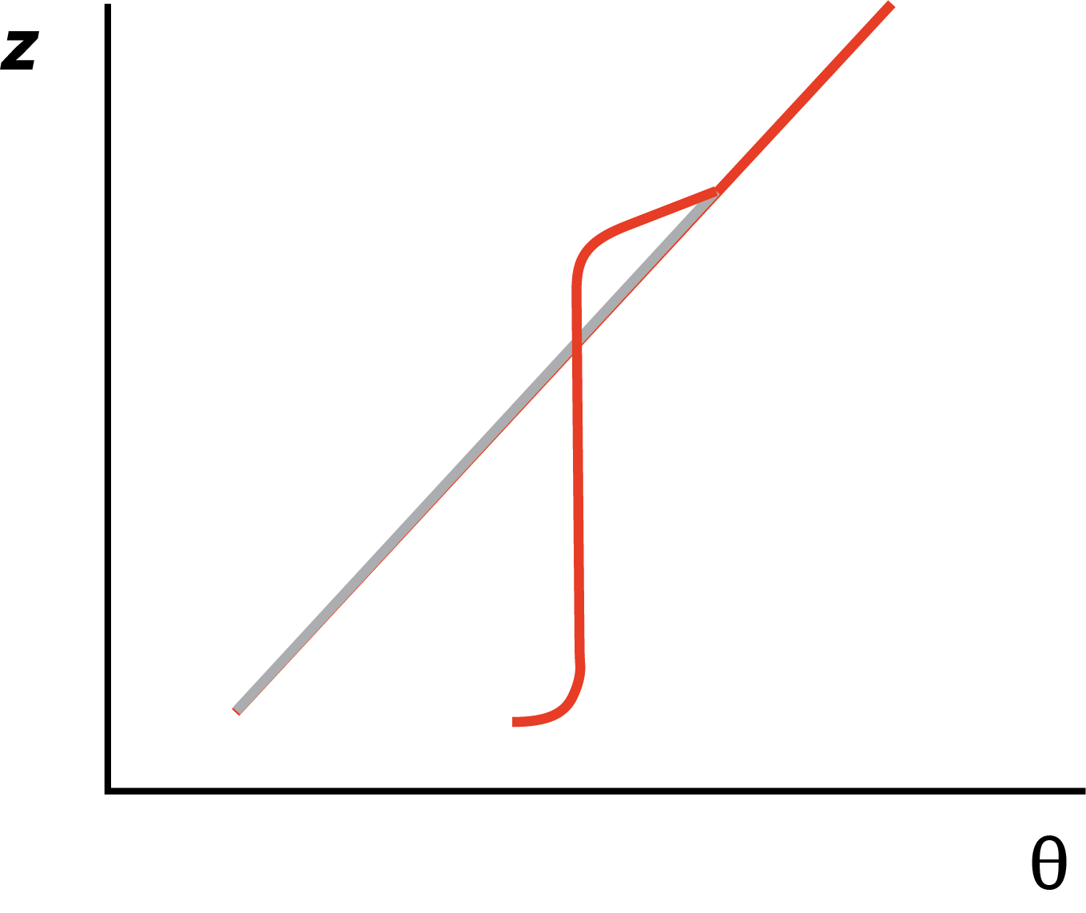
The overnight residual layer
PBL top inversion
Surface inversion
Approaching evening, the surface layer stabilizes and
the surface inversion forms. Mixing vanishes but
the neutral residual layer remains.

Slide 21
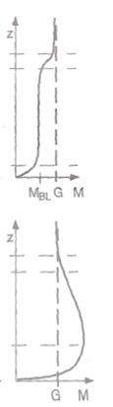
Momentum: day vs. night
Stull (2000)
• Momentum (M) during day is subgeostrophic
(M < G) owing to vertical mixing. Parcels are
brought down to the surface to get slowed by
friction
• Momentum at night is supergeostrophic (M > G).
The temporal variation of mixing influences a
pendulum-like effect on wind speed.

Slide 22
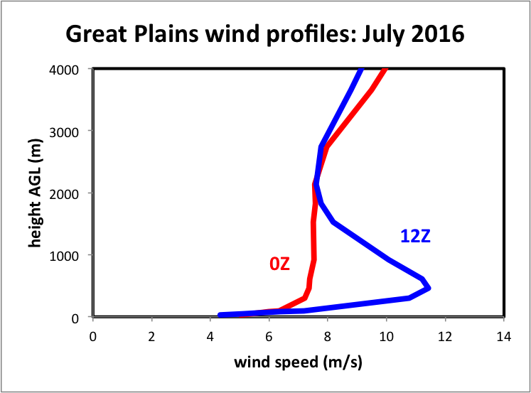
Great Plains wind profiles: July 2016
about 450 m AGL
Averaged over 11 radiosonde stations and 31 days
Notes:
HIFREQ_July2016_analysis.xlsx
Again, lots of variability but this really sticks out. These are features our PBL scheme better be able to develop
Wind speed closest to sfc actually lower but not far above, speeds higher at NIGHT

Slide 23
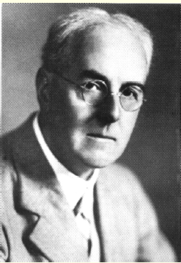
Some Richardson numbers
Wikipedia
Named for NWP pioneer Lewis Fry Richardson

Slide 24
Richardson number(s)
A Richardson number (Ri) is a nondimensional measure of stability divided by shear (squared)
Some forms: gradient Ri, bulk Ri, surface bulk Ri, flux Ri
gradient Richardson number
bulk Richardson number
Notes:
Bulk Ri approximates gradients discretized on a grid
Richardson forecast sfc p +145/6 h. Linear instability. Published 1922.

Slide 25
Surface bulk Ri
A surface bulk Richardson number is computed from the surface up to height z, presuming wind speed at surface is zero.
Notes:
Need to define TKE before defining flux Ri

Slide 26
Turbulent kinetic energy
Turbulent kinetic energy (TKE) per unit mass can be defined as:
A prediction equation for averaged TKE* can be derived as
dissipation/
other terms
related to vertical heat flux
related to shear
Stensrud’s text, p. 169
*1D approximation already assumed
Notes:
Shear (mechanical) generation of turbulence and convective (buoyancy) generation

Slide 27
Flux Richardson number
related to vertical heat flux
related to shear
Negative when stable
flux Richardson number
Normally negative (as winds
increase with height)
Notes:
Ri positive when stable because denom usually neg and numerator is neg when stable.

Slide 28
Critical Richardson number (Ri_{c})
When Ri ≤ Ri_{c}, turbulence can be produced. (However, preexisting turbulence is not necessarily extinguished when Ri rises above Ri_{c}.)
Ri_{c} is typically given as 0.25, but some schemes use different values

Slide 29
Ri, Ri_{c} and turbulence

Slide 30
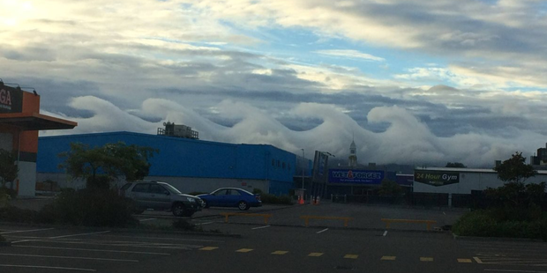
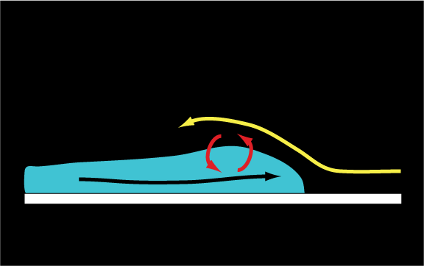
http://www.nzherald.co.nz/nz/news/article.cfm?c_id=1&objectid=11803687
K-H waves:
Shear-driven turbulence
Notes:
Why eddies are important…

Slide 31
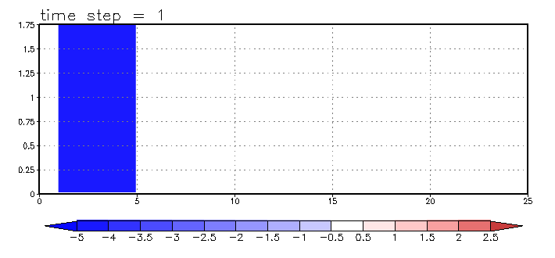
K-H instability
Animation
High-resolution simulation. At lower resolution, you need to parameterize this!
Notes:
Look at the MIXING the eddies accomplish. But you need HIGH RES to capture this effect. At lower res, you need to PARAMETERIZE it

Slide 32
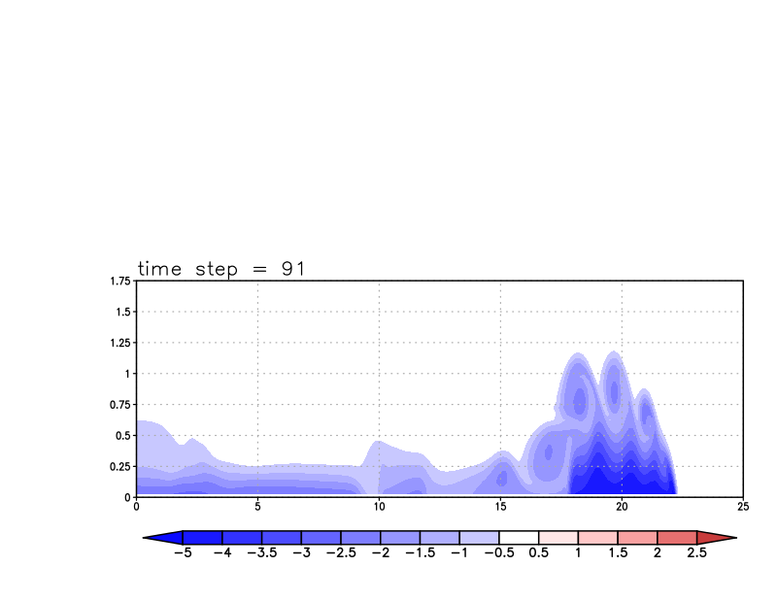
Explicitly resolved eddies
∆x = 50 m

Slide 33
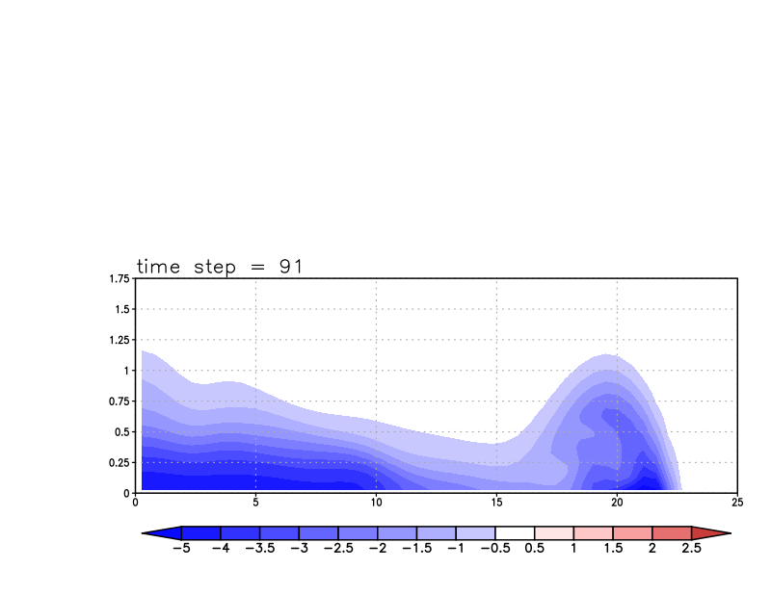
No resolved eddies, parameterized mixing
∆x = 500 m

Slide 34
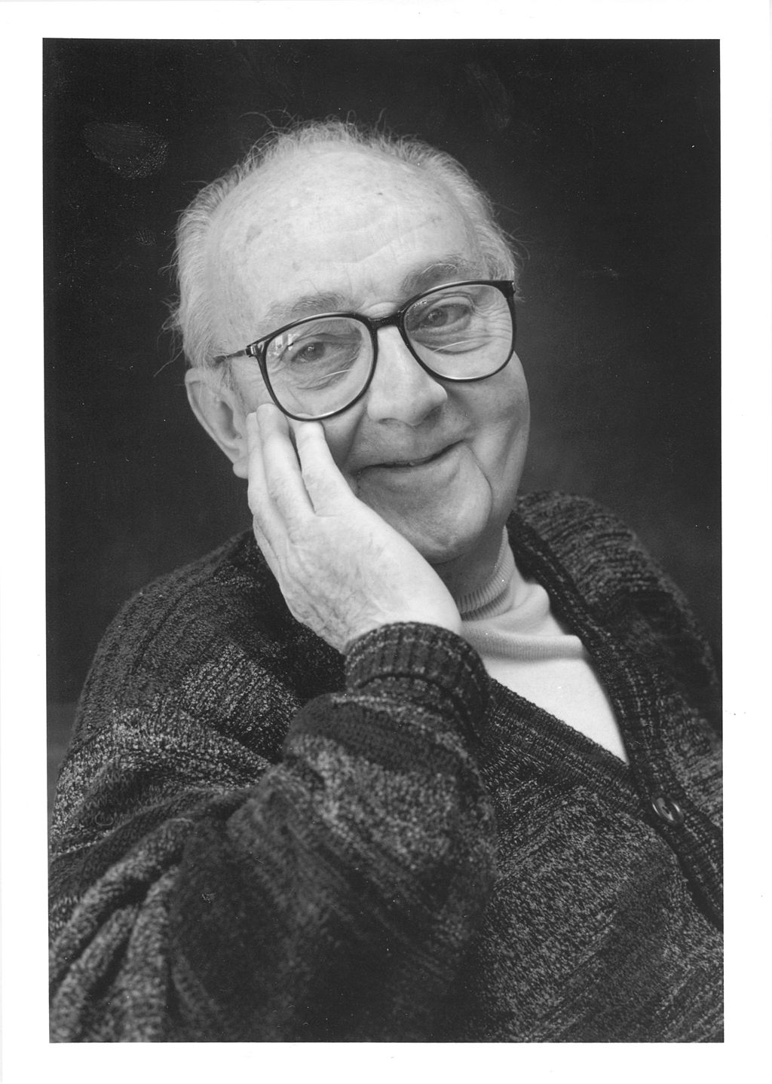
Implementing these ideas in the NWP model
“All models are wrong,
but some are useful.”
-- George E. P. Box
(1919-2013)
Wikipedia

Slide 35
Eddy mixing for momentum (K_{m})
Max values ~ 100 m²/s
Max in afternoon
Abrupt disappearance
at night
Yamada and Mellor (1975)
Notes:
Emphasize very rapid collapse of mixing as sun goes down
What’s the big difference between afternoon and overnight? MIXING. PBL. SUBGRID MIXING. Need to param it right to get the forecast right.

Slide 36
Eddy mixing for momentum (K_{m})
Vertical profile at time
of maximum mixing
Yamada and Mellor (1975)

Slide 37
Reminder (1)
Eddies are not resolvable but important to the evolution of the PBL
We used Reynolds averaging to identify important eddy covariances such as:
We invoked flux-gradient theory to relate these covariances to eddy mixing coefficients acting on resolved-scale fields

Slide 38

Reminder (2)
Then we used Prandtl’s mixing length theory to relate K_{m} to mixing length l_{v} and mean (absolute) shear S
Mixing length was presumed to be small near surface and grow (to some upper bound of 50-100 m or so) with height
We also discussed the log wind profile and how it must respond to stability
Now: focus on a scheme that is just based on the equation above (a 1st-order scheme)

Slide 39
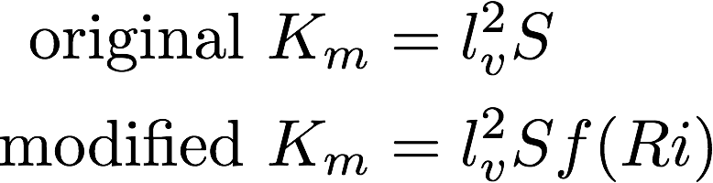
1st-order scheme
Computing K_{m} from a mixing length and the base state vertical shear is called a 1st-order local closure scheme.
  “local” because K_{m} only depends on local gradients
In original formulation, K_{m} did not also depend on stability. The modified form amplifies mixing when unstable and suppresses it where stable.
Blackadar (1979)
Notes:
The f(Ri) is an improvement, but does not fix the scheme’s systemic problems

Slide 40
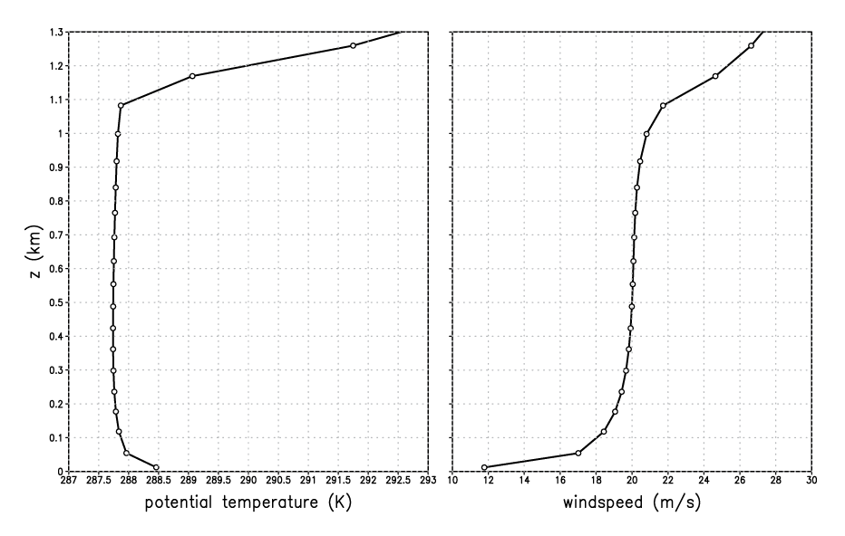
A strongly-heated PBL
Simulated with WRF SCM v3.7.1
Notes:
Simulated using WRF SCM
This is using a higher wind initial sounding, and lower soil moisture, and that helps exaggerate diff wrt MRF

Slide 41
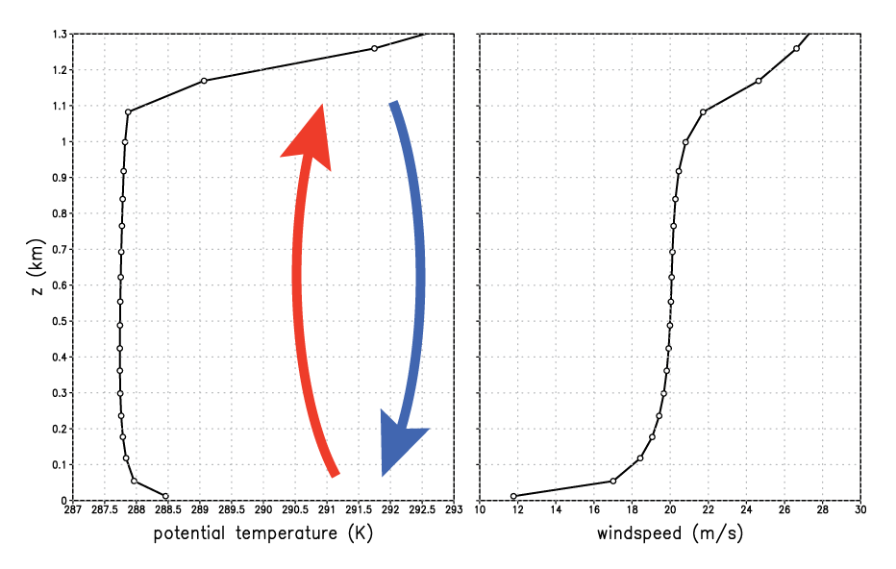
A strongly-heated PBL
well-mixed
layer
superadiabatic
Notes:
Superadiabatic near sfc because mixing restricted near solid boundary. Mixed layer results owing to mixing through a deep layer.

Slide 42
A strongly-heated PBL
11 radiosondes
31 days
well-mixed
layer
superadiabatic
Notes:
Magnitudes, depths different, but shape is similar

Slide 43
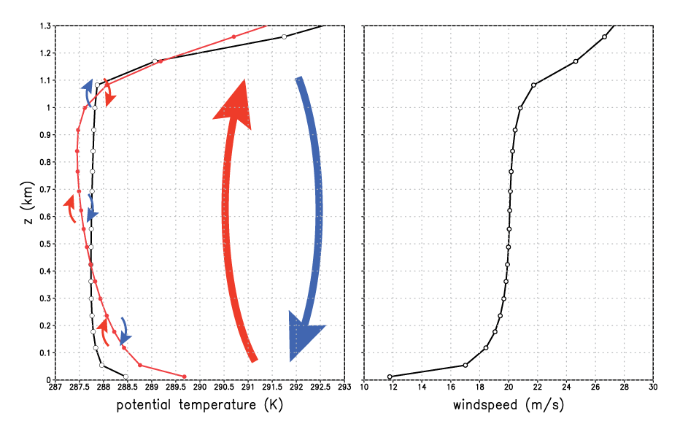
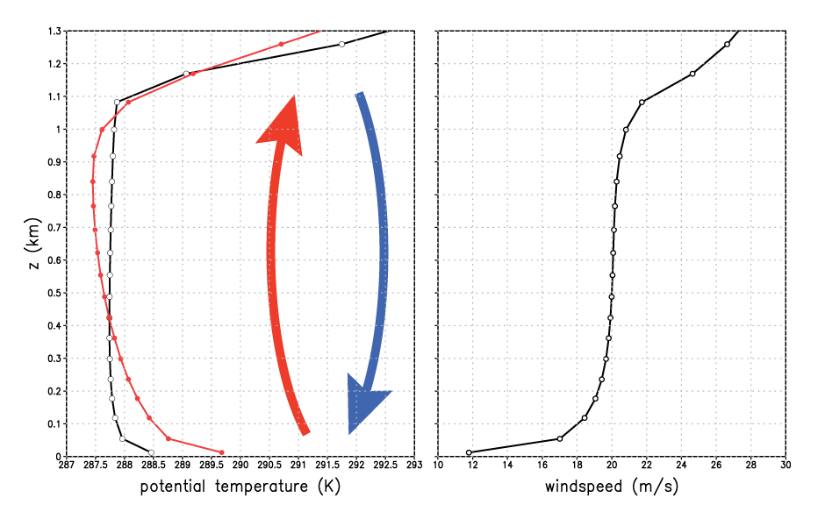
1st-order scheme
well-mixed
layer
First-order scheme’s
local mixing fails to
establish mixed layer
First-order
scheme
superadiabatic
Notes:
First order scheme fails to develop neutral mixed layer. Superadiabatic through a very deep layer.

Slide 44
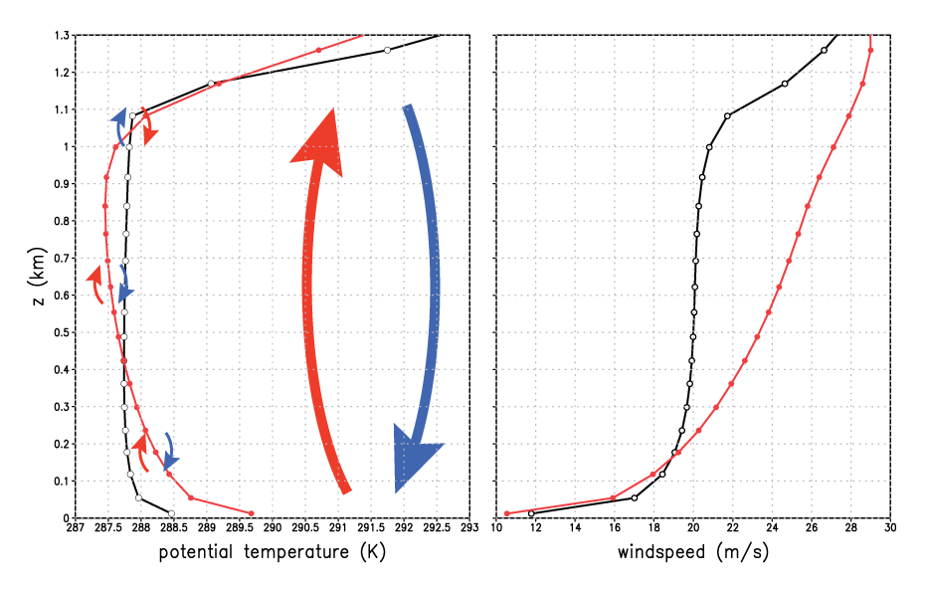
1st-order scheme
First-order
scheme
Notes:
“For statically unstable ABLs with vigorous convective thermals… wind speed becomes uniform with height a short distance above the ground.” – Stull’s Met for Sci and Eng, p. 81. If shear really disappeared, Km = 0 during time when it actually would be LARGEST. Indeed, shear is very small BECAUSE mixing is so large and effective.

Slide 45

Einstein’s admonition
“Make things as simple as possible,
but no simpler.”
-- Albert Einstein
(1879-1955)
[attributed]
Wikipedia

Slide 46


Beyond 1st-order schemes
1.5-order TKE scheme
[based on prognosed TKE e]
[S* is nondimensional
profile function]
Examples: MYJ, MYNN
KPP (K-profile parameterization)
[diagnosed mixing]
Example: YSU
w_{s} = a velocity scale; h = PBL depth
Notes:
Here 2022

Slide 47
Eddy mixing for momentum (K_{m})
Mixing produced by a
TKE PBL scheme
Vertical profile at time
of maximum mixing
MYJ, MYNN (prognostic schemes) try to develop
this profile organically by predicting TKE
YSU (diagnostic scheme) imposes this profile
based on diagnosed PBL height h
Yamada and Mellor (1975)

Slide 48
K-profile parameterizations
(KPP)
Including MRF, GFS, YSU, Shin-Hong

Slide 49
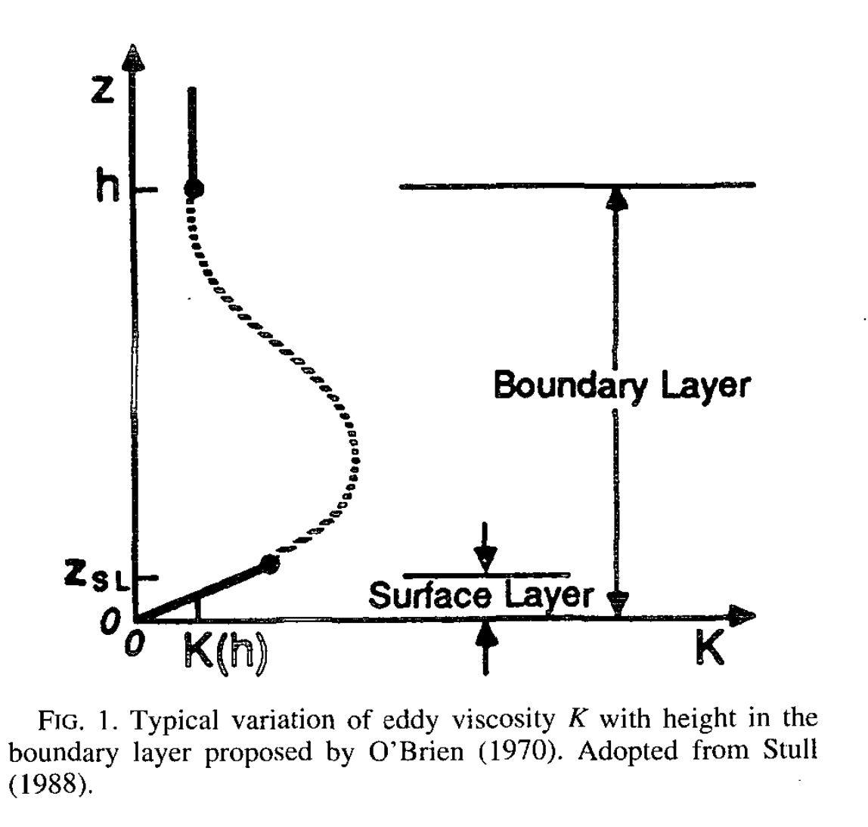
A simple KPP scheme
p = 2 usually adopted
• w_{s} (velocity scale) = u*/φ_{m}
computed in surface layer*
(φ_{m} = stability corrector)
• κ = von Karman constant (~0.4)
Tasks:
• Determine PBL depth h
• Fit the profile to K_{m}
MORE
Hong and Pan (1996)
*More details in PPTs on class web page. YSU is more complicated than this.
Notes:
MRF is simplest version of this approach – the basics
Unstable \phi_m < 1, amping up the velocity scale and thus the mixing

Slide 50
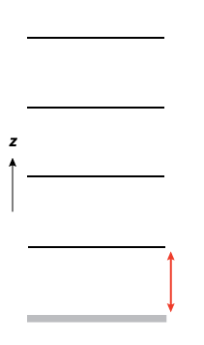
A simple KPP scheme
Finding PBL top h
~ depends on selected critical Ri (Ri_{c})
Compute surface bulk Ri (Rib_{s}) for lowest layer
If Rib_{s} > Ri_{c} then PBL top is reached
model surface

Slide 51
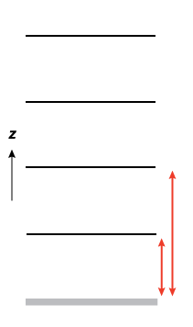
A simple KPP scheme
Finding PBL top h
~ depends on selected critical Ri (Ri_{c})
If not reached, compute Rib_{s}
between surface and next level up,
compare again to Ri_{c}
model surface
Notes:
NOT between layers 1 and 2. Between surface and layer 2.

Slide 52
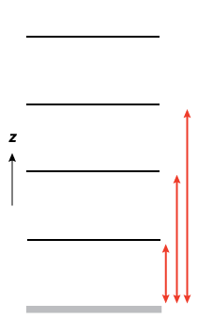
A simple KPP scheme
Keep going until
PBL top is found
Finding PBL top h
~ depends on selected critical Ri (Ri_{c})
h
YSU uses this height as a first guess, and then
adjusts based on surface layer instability
model surface
Notes:
YSU uses this as first guess to PBL depth h. Then, it factors in a “thermal excess” and recomputes h, finding a higher value when PBL is unstable.

Slide 53
A simple KPP scheme
Keep going until
PBL top is found
Finding PBL top h
~ depends on selected critical Ri (Ri_{c})
h
model surface
Notes:
YSU uses this as first guess to PBL depth h. Then, it factors in a “thermal excess” and recomputes h, finding a higher value when PBL is unstable.

Slide 54
Importance of PBL depth h
In KPP schemes, PBL depth h directly influences
  Mixing depth (obviously),
  Mixing magnitude, and
  Height of maximum mixing
    (located at z = h/3)
Ri_{c} largely determines h
Ri_{c} varies among schemes

Slide 55
That’s just local mixing. There’s also nonlocal mixing and entrainment.

Slide 56

Nonlocal mixing
Local mixing is from one grid volume
to adjacent grid volumes → slow
Nonlocal mixing involves deep flows
of fluid involving many grid volumes
quickly – like rising thermals
https://tenor.com/view/lava-lamp-gif-14859421

Slide 57
Reynolds-averaged θ equation
• K_{m} applies to momentum, K_{h} to heat
• That’s local mixing, between model
levels
Notes:
Apply to theta eq instead. Will explain why – it’s for adding countergrad term, which MRF did not apply to momentum.
One of the neglected RHS terms is diabatic term

Slide 58
Nonlocal mixing term added…
Adds a new term: for nonlocal mixing
Also needs a parameterization!
Notes:
Apply to theta eq instead. Will explain why – it’s for adding countergrad term, which MRF did not apply to momentum.

Slide 59
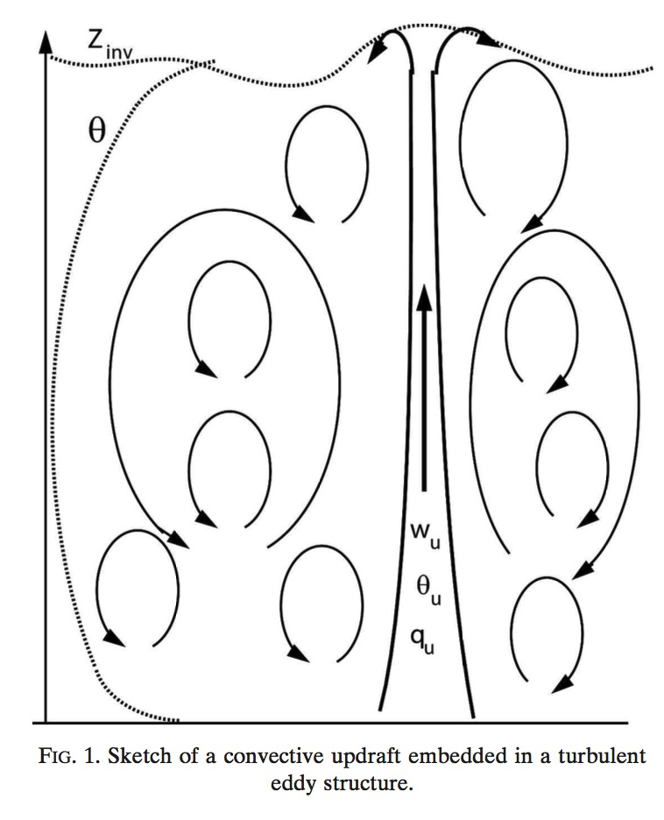
Entrainment into PBL
• In addition to nonlocal mixing, air is also
being entrained into the PBL from
the free atmosphere above
• That’s also subgrid, and ALSO needs a
parameterization!
Siebesma et al. (2007)
Notes:
Lava lamp

Slide 60
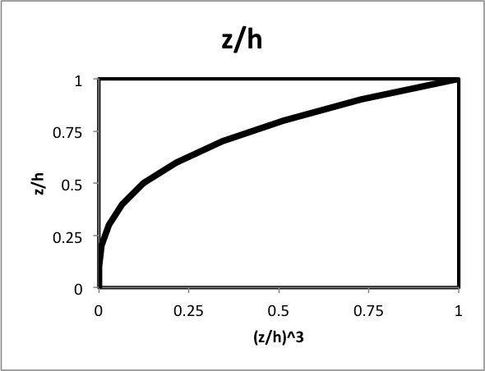
PBL entrainment
YSU parameterizes entrainment into the PBL from the free atmosphere in terms of surface fluxes
entrainment term
PBL top flux, but made
inversely proportional
to surface flux
ysu_topdown_pblmix = 1 makes
entrainment a function of PBL top
flux also. This was the key to improved
fog forecasts (Wilson and Fovell 2018).
(z/h)³ function weighted towards
PBL top
Notes:
Got here 2019
Epicycles?

Slide 61
Aside on California fog…

Slide 62
ysu_topdown_pblmix=0
ysu_topdown_pblmix=1
Parameterizes turbulence
but did not get sufficient
entrainment
After improved handling
of entrainment
Resolves turbulence
LES = Large Eddy Simulation
Wilson and Fovell (2018)

Slide 63
A quick peek at TKE-based (Mellor-Yamada) schemes
Including MYJ, MYNN2, MYNN3, QNSE, GBM
[WRF’s MYNN: Olson et al. (2019)]

Slide 64
Recall from earlier…
• Overbars were grid-averaged quantities (what the model is explicitly predicting)
• Primes indicate turbulent variations about those grid-averaged means
• We ignored molecular viscosity as insufficiently large
• We neglected the u’u’ term as small relative to u’w’ term (will reconsider that)
• We then developed a proxy for the u’w’ term based on eddy mixing K_{m}
… but we need to backtrack…

Slide 65
TKE and temperature variance
After defining TKE (velocity variance) as
  We saw…
We can also develop a prognostic equation for turbulent temperature variance and …
dissipation/
other terms
related to shear
related to vertical heat flux
Notes:
Not jumping just yet to develop proxies for these eddy covariances

Slide 66
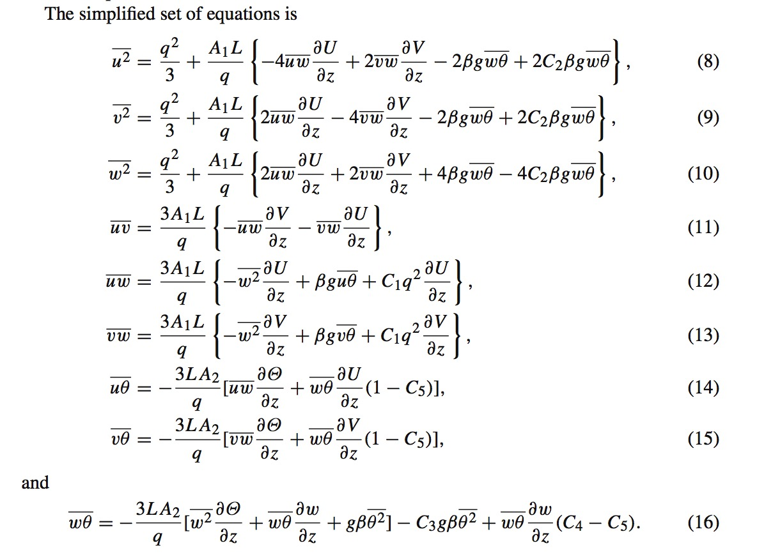
Jahn et al. (2017)
MYNN3 scheme
We wind up with equations for a large set of eddy covariances in the Mellor and
Yamada “Level 3” model, which contain a sizable set of parameters in need of values
[Notation shift… TKE e = q²/2, and u = u’, etc.]
What sets some TKE schemes apart is which terms retained and parameter values chosen.
MYNN2 is a further simplified version of MYNN3.
Notes:
First eq is \bar{u’u’}. In eq (12), their numbering, term 3 in bracket looks a little like our original proxy, but this is much much more complicated
A real mess of algebraic manipulation
Actually Jahn et al’s second 2017 paper

Slide 67
There are a lot of different PBL schemes, incorporating a lot of different assumptions
They’re all “wrong” but some are useful.
We can expect our forecasts to be sensitive to the assumptions made and parameterizations selected.

Slide 68
[end]

