Slide 1
Boulder windstorm case (Experiment #2, Parts 1, 2, and 3)
Parts 1 and 2 DUE Tuesday, March 7, by start of class.
ATM 419/563
Spring 2023
Fovell
© Copyright 2023 Robert Fovell, Univ. at Albany, SUNY, rfovell@albany.edu

Slide 2
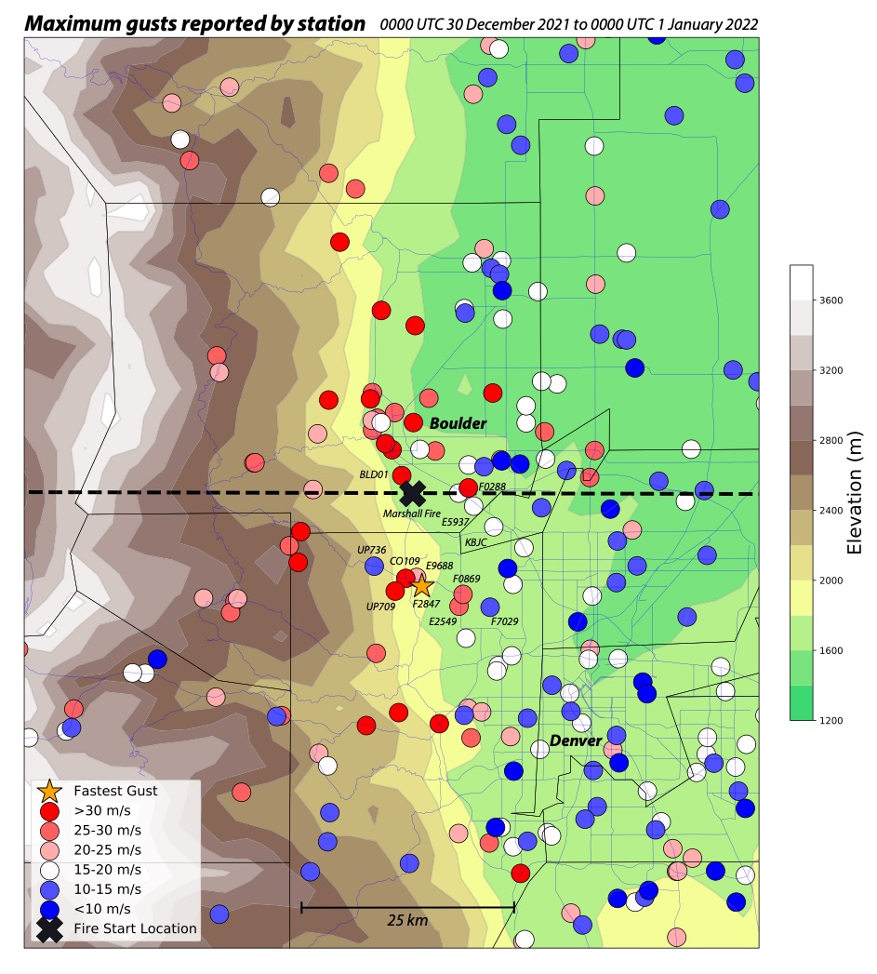
Marshall fire (X)
(2021) became
worst fire in
Colorado
history, driven
by drought and
high winds
HRRRv4
topography
with event
max gusts
(m/s)
during the
Marshall Fire
Event
Fastest gust
was 51.4 m/s
[115 mph] at
yellow star
Fovell et al. (2022)

Slide 3
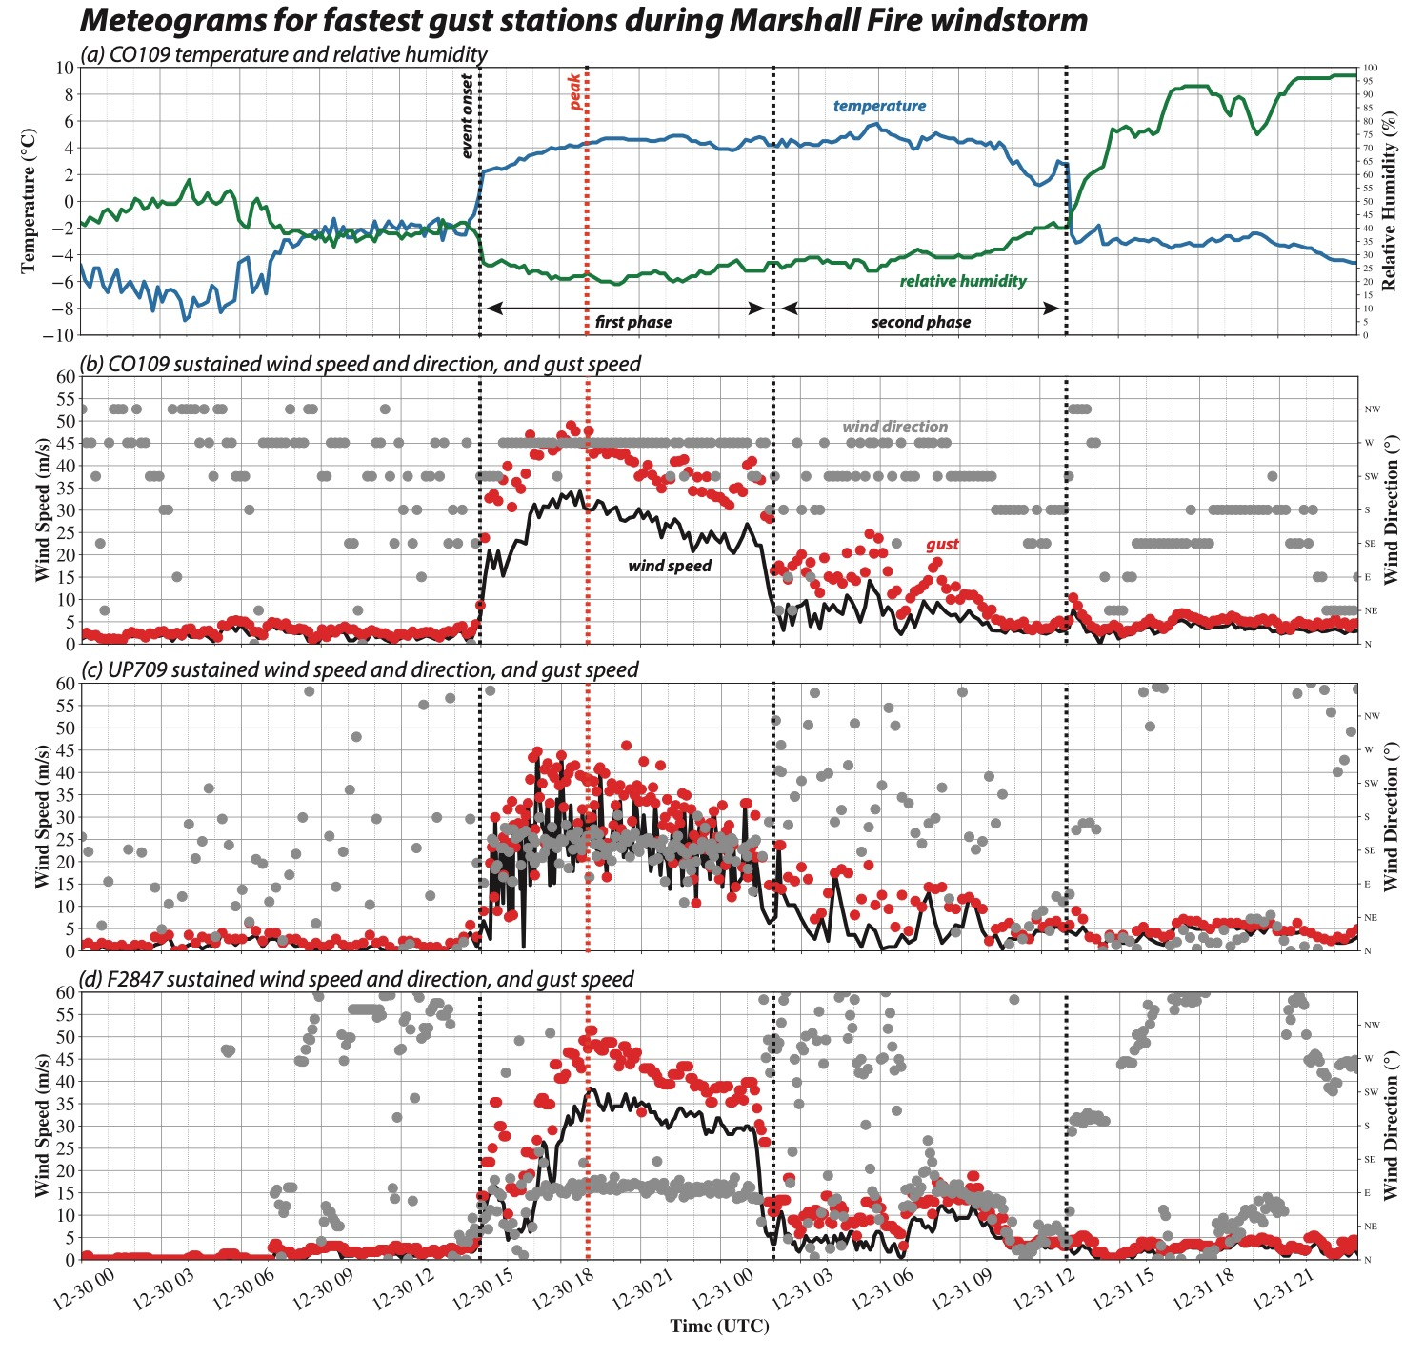
Windstorm
started about
15Z 12/30/21
[8 am MST],
peaked around
17-19Z, and
fell into a 2nd
weaker phase
after 2Z 12/31
[7 pm MST]
Fire started at
event peak (18Z,
11 am MST)
Fovell et al. (2022)

Slide 4
Instructions and Resources
YOU WILL NEED TO FINISH THIS OUTSIDE OF CLASS
In your lab space, create a directory called WINDSTORM and move into it
Copy the file $LAB/SCRIPTS/WRF_REAL_SETUP.TAR and unpack it (tar –xvf…)
Execute make_all_links.sh as per usual
Also follow the WINDSTORM script
Namelists will require extensive editing
Refer to the Real-data WRF Checklist on class website for detailed, step-by-step guidance

Slide 5
Experiment #2, Part 1

Slide 6
Study area
Boulder-centered 200 x 200 gridpoint, 6 km grid spacing domain
Lambert. Reference lat and lon: 40, -105. True latitudes: both 40. Standard lon: -105.
Make a simulation starting at 2021123012
Initialized from 3-km NAM, located in $LAB/DATA/NAM_2021123012, using Vtable.NAM
Run 12 h, ending 12/31 00Z
See script for more information.

Slide 7
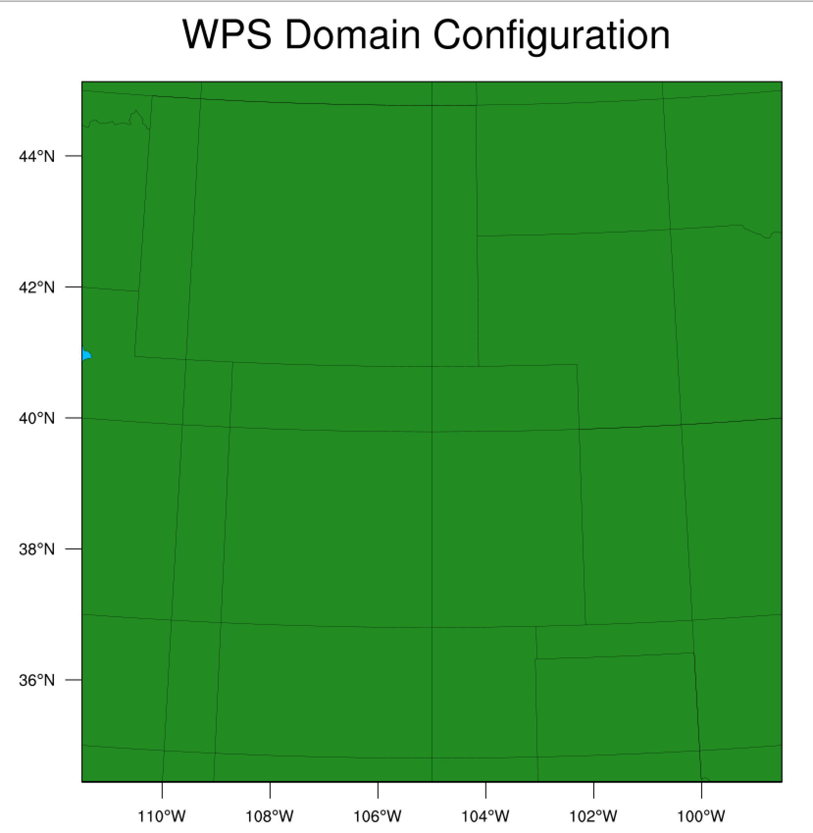

Slide 8
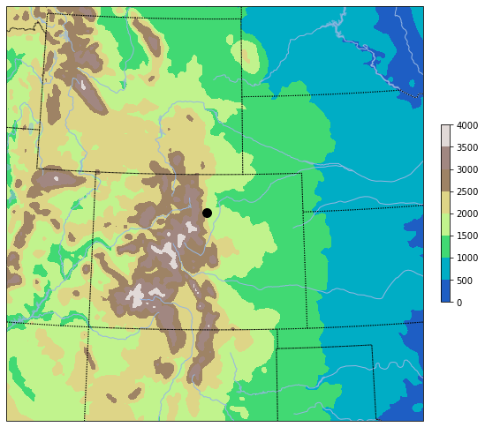
plot_terrain_wrfpython.ipynb (copy in $LAB/SCRIPTS, need to modify)
Our initial domain
extent and topography
For Part 1
Boulder

Slide 9
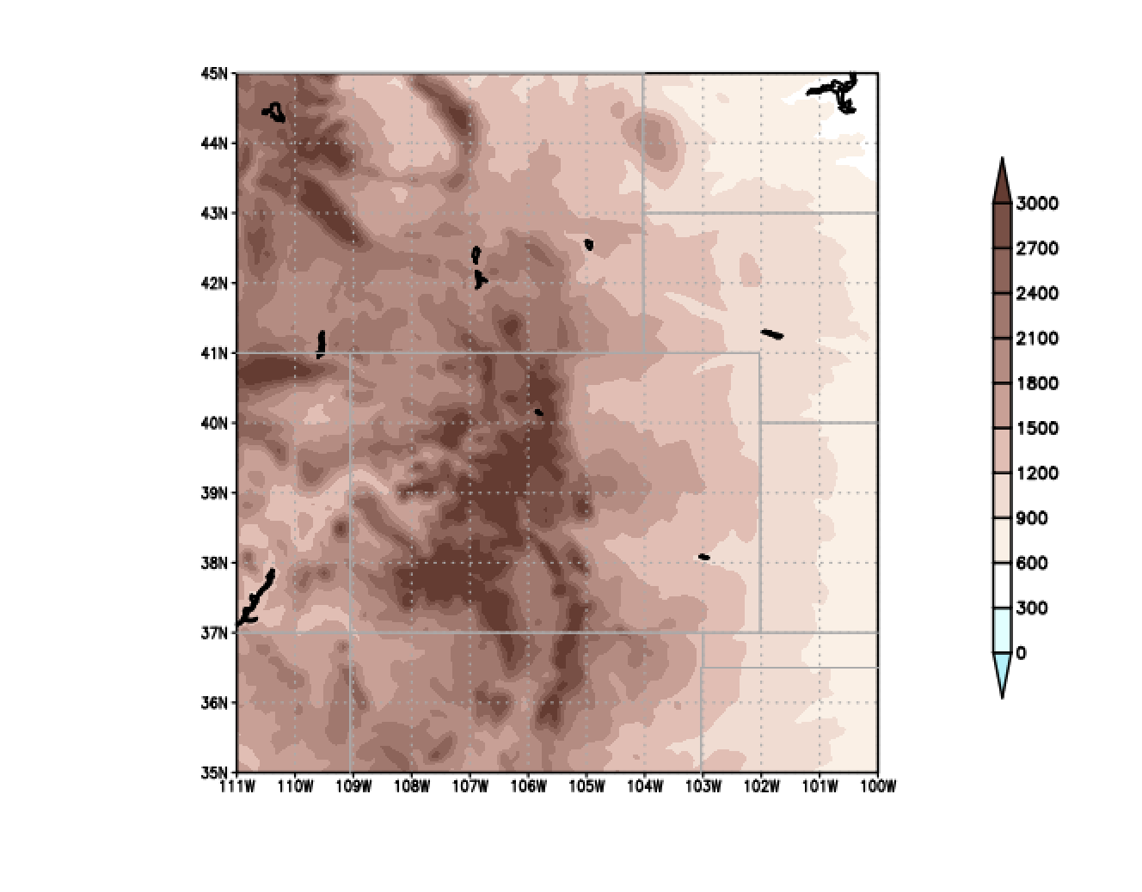
terrain.gs (copy from $LAB/SCRIPTS)
set lat 35 45
set lon -111 -100
/network/rit/lab/atm419lab/SCRIPTS/terrain.gs

Slide 10
Modifications necessary
You can modify and use these Python scripts (copy from $LAB/SCRIPTS/), or create/use your own
plot_terrain_wrfpython.ipynb
plot_vertical_cross_section_wrfpython.ipynb
Or, you can modify and use control_file* and scripts for GrADS-based analyses and plots, including $LAB/SCRIPTS/terrain.gs $LAB/SCRIPTS/vert_xz.gs
In a control_file* look for and modify this line:
! All list of files to read here
! Indent not to read
! Full path OK
wrfout_d01_2021-12-30_12:00:00
end_of_file_list

Slide 11
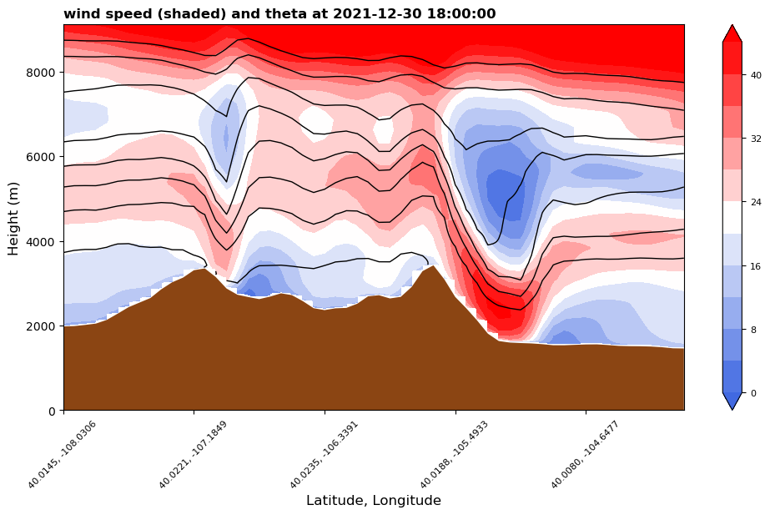
plot_vertical_cross_section_wrfpython.ipynb (suitably modified)
wind
Boulder
West-east vertical cross section across Boulder (40N), from -108 to -104 longitude
6 h forecast

Slide 12
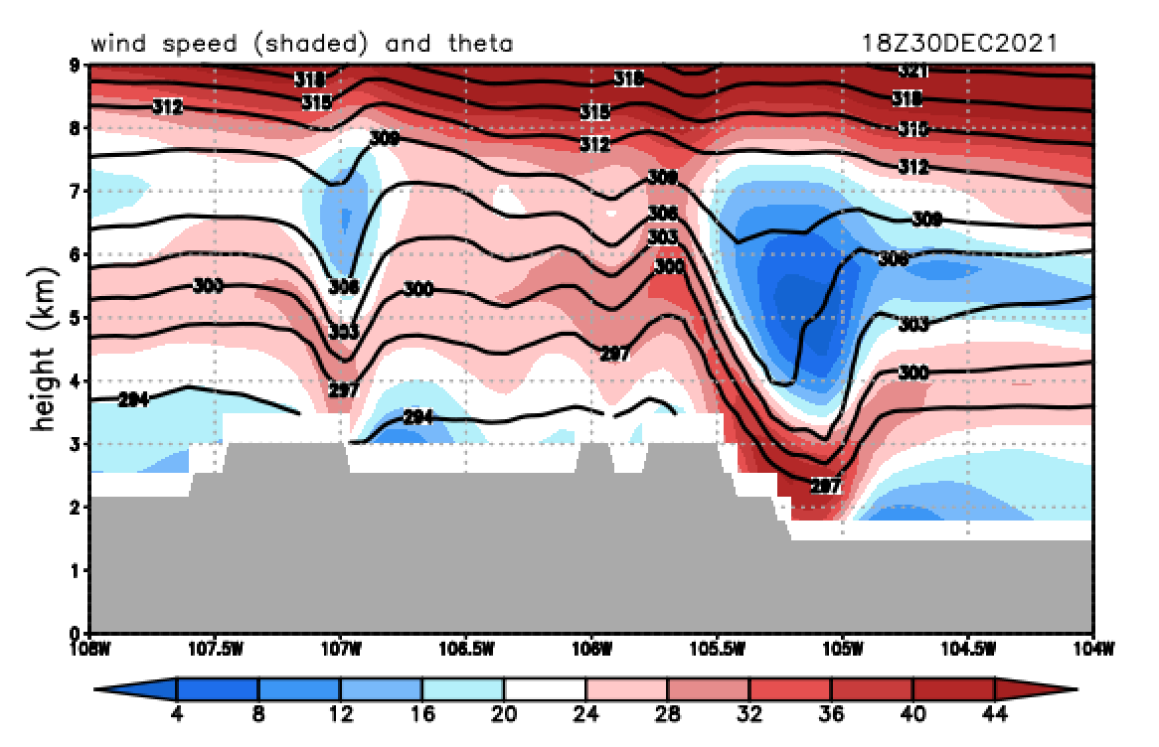
GrADS files made using control_file.3Dz and vert_xz.gs
set lat 40
set lon -108 -104
set lev 0 9
set t 7
vert_xz.gs
West-east vertical cross section across Boulder (40N), from -108 to -104 longitude
6 h forecast

Slide 13
Experiment #2 Part 1 task
Make a vertical cross section like that from the last 2 slides, using Python or GrADS, of forecast hour 12 (valid 2021-12-31-00Z).
Put your name in the plot title.
Email to Minghao and myself.
Archive your Part 1 work. I would create a folder inside WINDSTORM called WIND01 and into it copy: wrfout file, namelist.input, namelist.wps

Slide 14
Experiment #2, Part 2

Slide 15
Experiment #2 Part 2
For Part 1, we all created the same simulation
For Part 2, do something different. You can consider [see following slides]:
Initializing from a different parent model source
Initializing at an earlier time (and running longer, so still ending 12/31 at 00Z)
A combination of the foregoing
Changing the resolution (making topography coarser)
Changing the model physics
Have a different idea? Consult with me.
Create a brief report (PowerPoint, Word, other document) comparing your Part 1 control run with your Part 2 simulation. What’s different? What’s similar? Make it look nice.

Slide 16
Other parent model data available
In $LAB/DATA:
NAM (use Vtable.NAM):
NAM_2021123012 (We’re using these for Part 1)
NAM_2021123000
NAM_2021122912
GFS (use Vtable.GFS):
GFS_2021123012
GFS_2021123000
GFS_2021122912
HRRR (Use Vtable.HRRR.wrfprs, not Vtable.HRRR.wrfprs.SOIL_ONLY)
HRRR_2021123012
HRRR_2021123000
HRRR_2021122912

Slide 17
Changing model physics
Most likely candidates for physics sensitivity:
PBL scheme bl_pbl_physics
Surface layer sf_sfclay_physics
Land surface model sf_surface_physics
Less likely candidates include microphysics (mp_physics), cumulus scheme (cu_physics), radiation (ra_lw_physics, ra_sw_physics), urban physics (sf_urban_physics), topographic and slope shading (topo_shading, slope_rad)

Slide 18
PBL and surface layer schemes
PBL and surface layer (not LSM) schemes are often paired. Some combinations are optimized, and others do not work.
Names of eddy mixing coefficients vary among schemes
bl_pbl_physics (incomplete list) | Scheme name | sf_sfclay_physics (bold = default) | K_{m} | K_{h}
1 [Hong 2010] | YSU (KPP) | 1, 91 | dku3d | dkt3d
2 [Janjic 1994] | MYJ (TKE) | 2 | -- | exch_h
4 [Sukoriansky et al. 2005] | QNSE (TKE) | 4 | exch_m | exch_h
5 [Olson et al. 2019] | MYNN2 (TKE) | 1, 2, 5, 91 | exch_m | exch_h
6 [Olson et al. 2019] | MYNN3 (TKE) | 1, 2, 5, 91 | exch_m | exch_h
7 [Pleim 2007] | ACM2 (KPP) | 1, 7, 91 | -- | exch_h
11 [Shin and Hong 2015] | Shin-Hong (KPP) | 1, 91 | -- | exch_h
99 [Hong and Pan 1996] | MRF (KPP) | 1, 91 | dku3d | dkt3d
Surface layer scheme 91 is the old version of scheme 1 (Jimenez et al. 2012). MYNN surface layer: Olson et al. (2021)
Notes:
Here 2022

Slide 19
Land surface models (LSMs)
Most common: Noah (sf_surface_physics = 2)
Used on control run WIND01, and GFS and NAM
Set num_soil_layers = 4
Other reasonable options:
sf_surface_physics = 3 (RUC LSM, used in HRRR)
num_soil_layers = 6 or 9
sf_surface_physics = 4 (NoahMP, related to Noah)
num_soil_layers = 4
Many additional options available [optional]
sf_surface_physics = 7 (Pleim-Xiu)
num_soil_layers = 2
Less desirable options:
Thermal diffusion scheme (sf_surface_physics = 1): too old
NCAR CLM4 LSM (sf_surface_physics = 5): very, very slow
num_soil_layers is not the same as num_metgrid_soil_levels

Slide 20
Experiment #2, Part 3

Slide 21
Model verification
Part 3 will be an in-class demonstration of how to use Model Evaluation Tools (MET) to perform a simple comparison of observed and forecasted wind, temperature, RH, dewpoint for ASOS stations in Colorado.
We’ll use the control run for this.

Slide 22
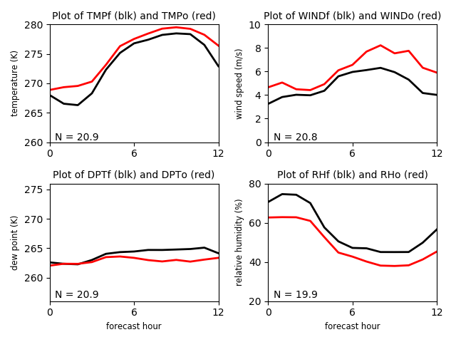
Output created using provided scripts, including read_output3.py
showing forecast and observed averages over ~ 21 Colorado ASOS stations

Slide 23
[end]

