Slide 1
Real-data WRF: Forecast verification
ATM 419/563
Spring 2023
Fovell
© Copyright 2023 Robert Fovell, Univ. at Albany, SUNY, rfovell@albany.edu

Slide 2
Overview
Surface station comparison: WRF forecasts v. observations
Data sources:
Your WRF simulation of the Boulder windstorm of December 2021
Surface observations from the NOAA MADIS archive
Focus on near-surface temperature and wind speed for this example
Tools:
UPP (Unified Post Processor): convert WRF output to GRIB for MET
MET (Model Evaluation Tools): perform comparisons, compute statistics
Python for charts and maps, with topo maps from Google
Goal:
Assess how good WRF forecast skill is, and whether we need to reevaluate model configuration
Consider the question: are all surface observations created equal?

Slide 3
Surface stations [keep in mind WRF forecasts “2 m T” and 10 m wind]
ASOS
Primarily at airports
Sonic anemometers, nominally mounted at 10 m AGL, usually flat and well-exposed (but not always)
AWOS
Older installations, at smaller and lesser used airports; many commingled with ASOS in MADIS
RAWS
US Forest Service and other agencies, primarily sited on mountain slopes
Propeller or cup/vane anemometers nominally mounted at 6.1 m AGL
MESOWEST
An eclectic mix of stations, including many public utilities, and railroad mesonets
Public utility mesonets often use propeller anemometers mounted at various heights, including 6.1 m AGL
APRSWXNET
A real polyglot mix of citizen- and corporate-owned weather stations
OTHER
Include agriculture stations, avalanche stations, roadway stations, hydromet stations, etc.
There are differences in instrument type (sonic vs. non-sonic anemometer), mounting height, instrument
characteristics (aspirated vs. non-aspirated), characteristic placement and exposure – and reason for placement

Slide 4
Boulder windstorm simulation
Verification using MET against observations collected in Colorado and extracted from the NOAA MADIS public database
Our domain extended beyond Colorado’s state borders
MET interpolates forecast variables to observation stations’ lat/lon coordinates
We’re not filtering for elevation differences between model and station
We have hourly output. MET will find observations valid for as close to top-of-hour that are available
At an extreme, observations may be up to 30 min before or after model valid time
We start by verifying against all available observations. Follow script.

Slide 5
Network- and station- averaged results

Slide 6
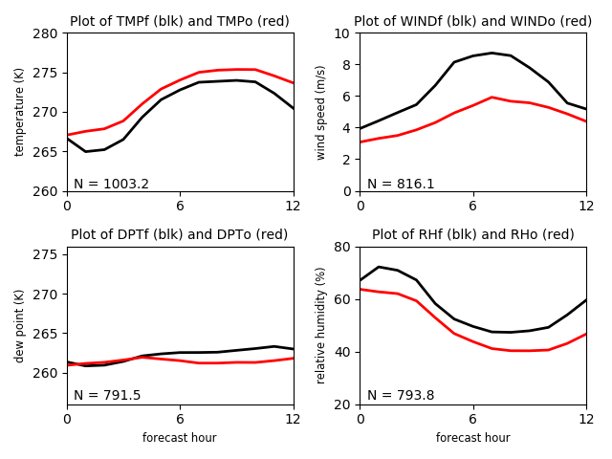
ALL STATIONS in COLORADO available in MADIS
Up to 1050 stations depending on variable and time
Network averages
T: cold bias
Td: wet bias
RH: high bias
Wind: very overpredicted,
especially at peak
MET6_ALL.sh
OBS_base=$MYLAB/DATA/MADIS/DEC2021_BOULDER_V2/
Notes:
How do you overpredict the wind during a windstorm?

Slide 7
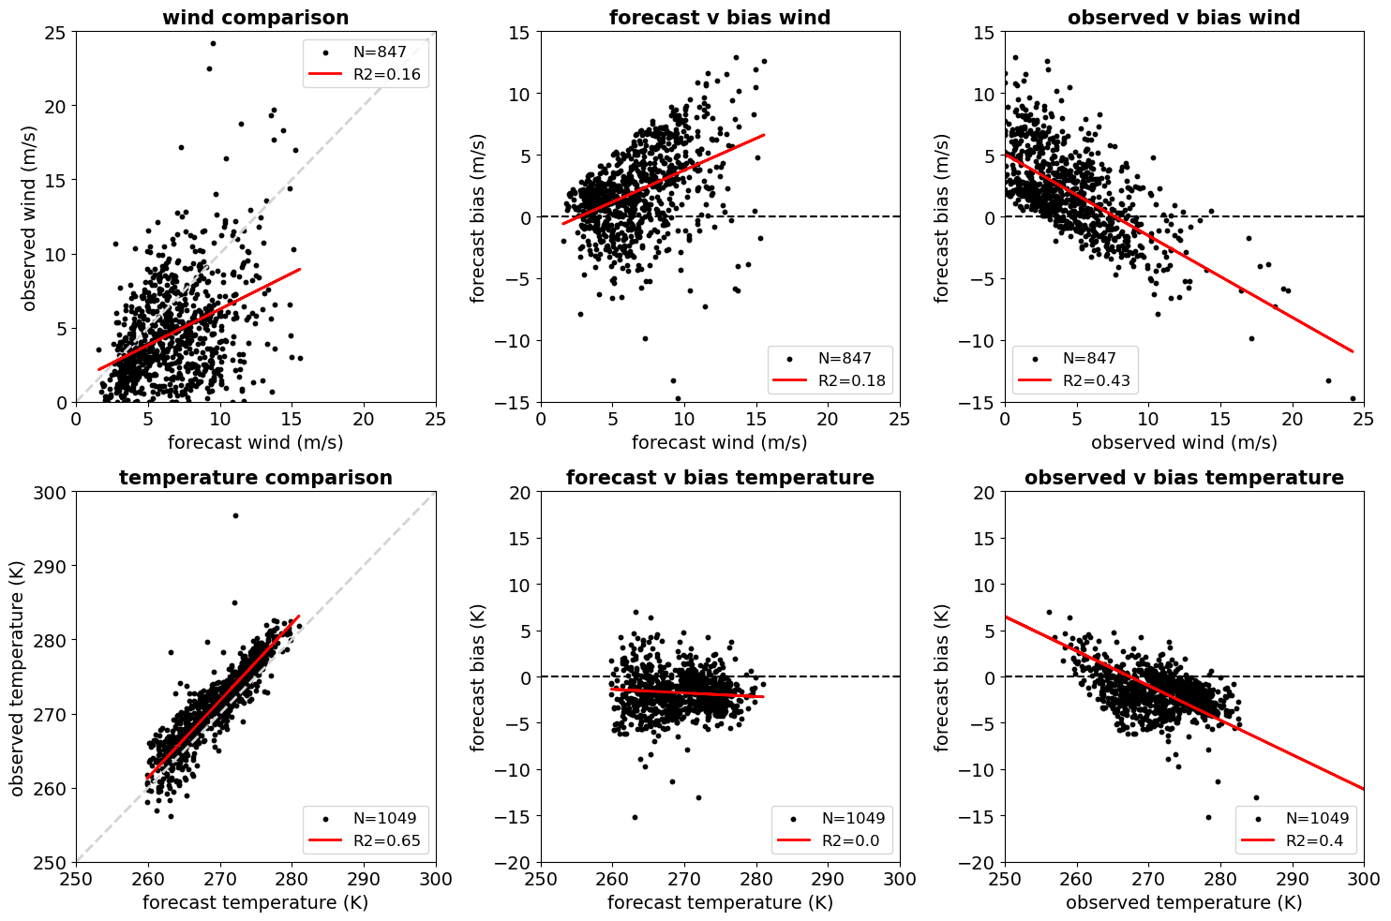
ALL
Each dot is a station
averaged over 13 h
Notes:
How can your wind bias be + for where forecasts are high and – for where obs are high?

Slide 8
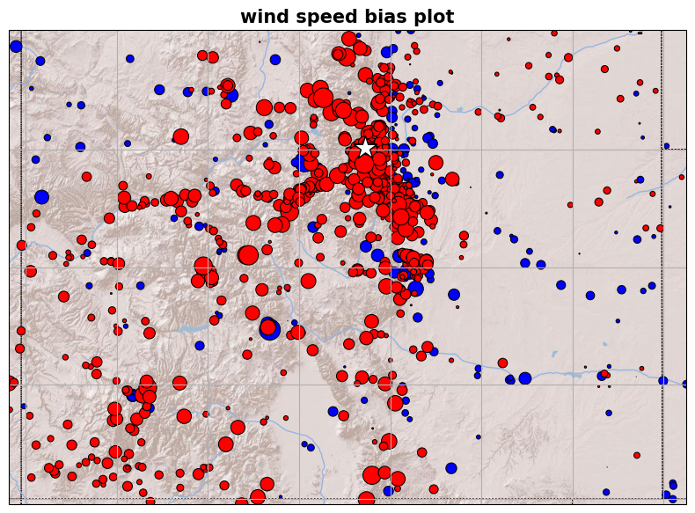
ALL
Star =
Boulder
Marker color:
red + bias
blue – bias
size ∝ bias size
MADIS state
filtering is
imperfect

Slide 9
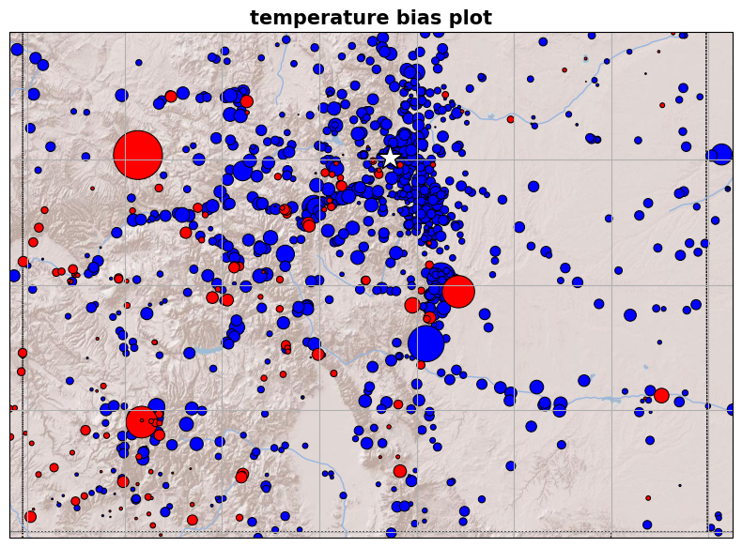
ALL

Slide 10
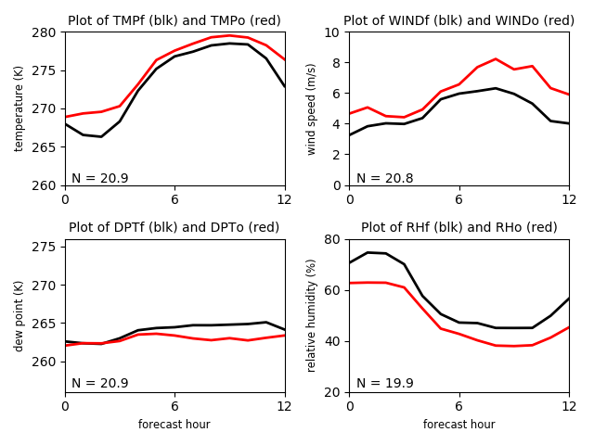
ASOS stations in COLORADO available in MADIS
21 stations
Network averages
T: cold bias
Td: wet bias
RH: high bias
Wind: underpredicted
MET6_ASOS.sh
OBS_base=$MYLAB/DATA/MADIS/DEC2021_BOULDER_ASOS/

Slide 11
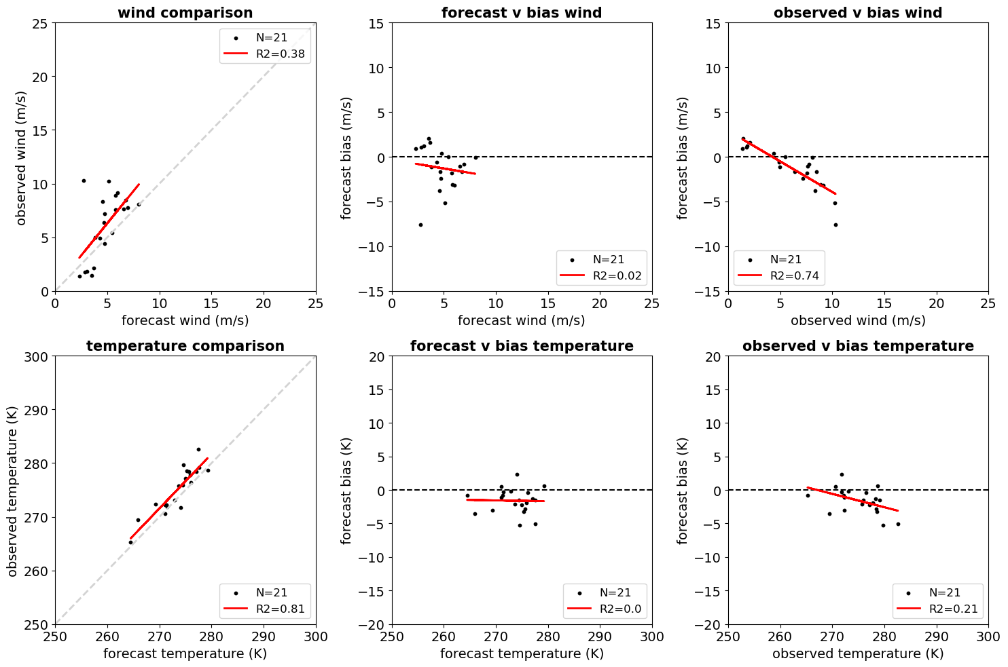
ASOS

Slide 12
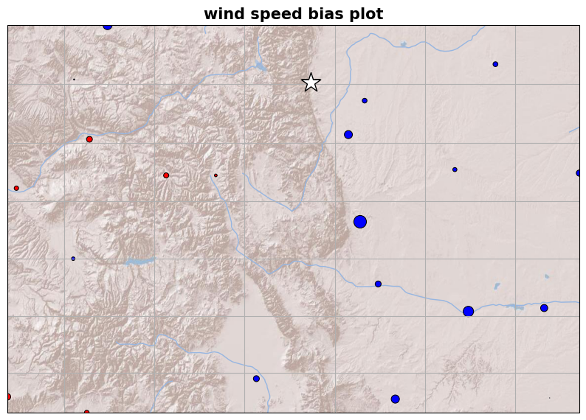
ASOS

Slide 13
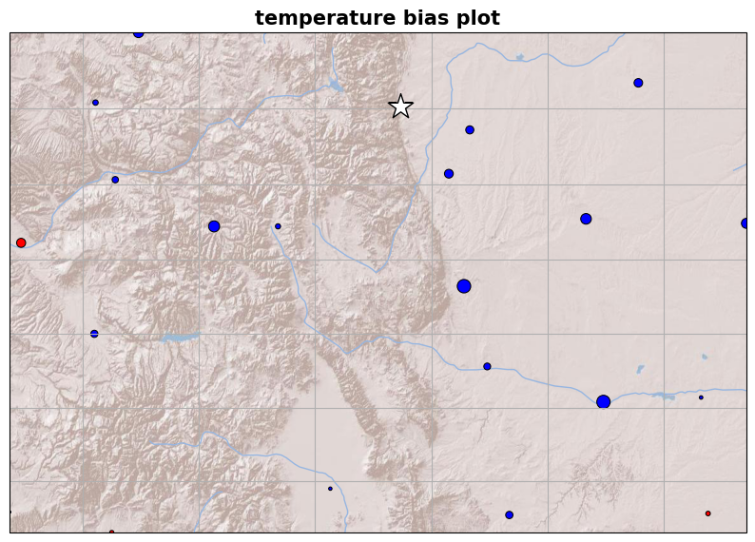
ASOS

Slide 14
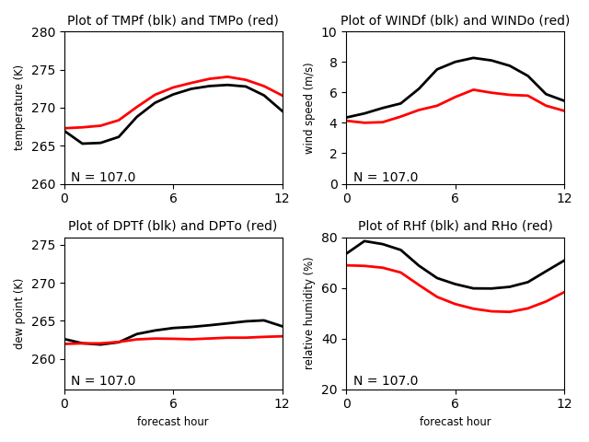
RAWS stations in COLORADO available in MADIS
107 stations
Network averages
T: cold bias
Td: wet bias
RH: high bias
Wind: overpredicted
[RAWS are 6.1m winds,
in complex terrain, and
are often obstructed]
MET6_RAWS.sh
OBS_base=$MYLAB/DATA/MADIS/DEC2021_BOULDER_V2_RAWS/

Slide 15
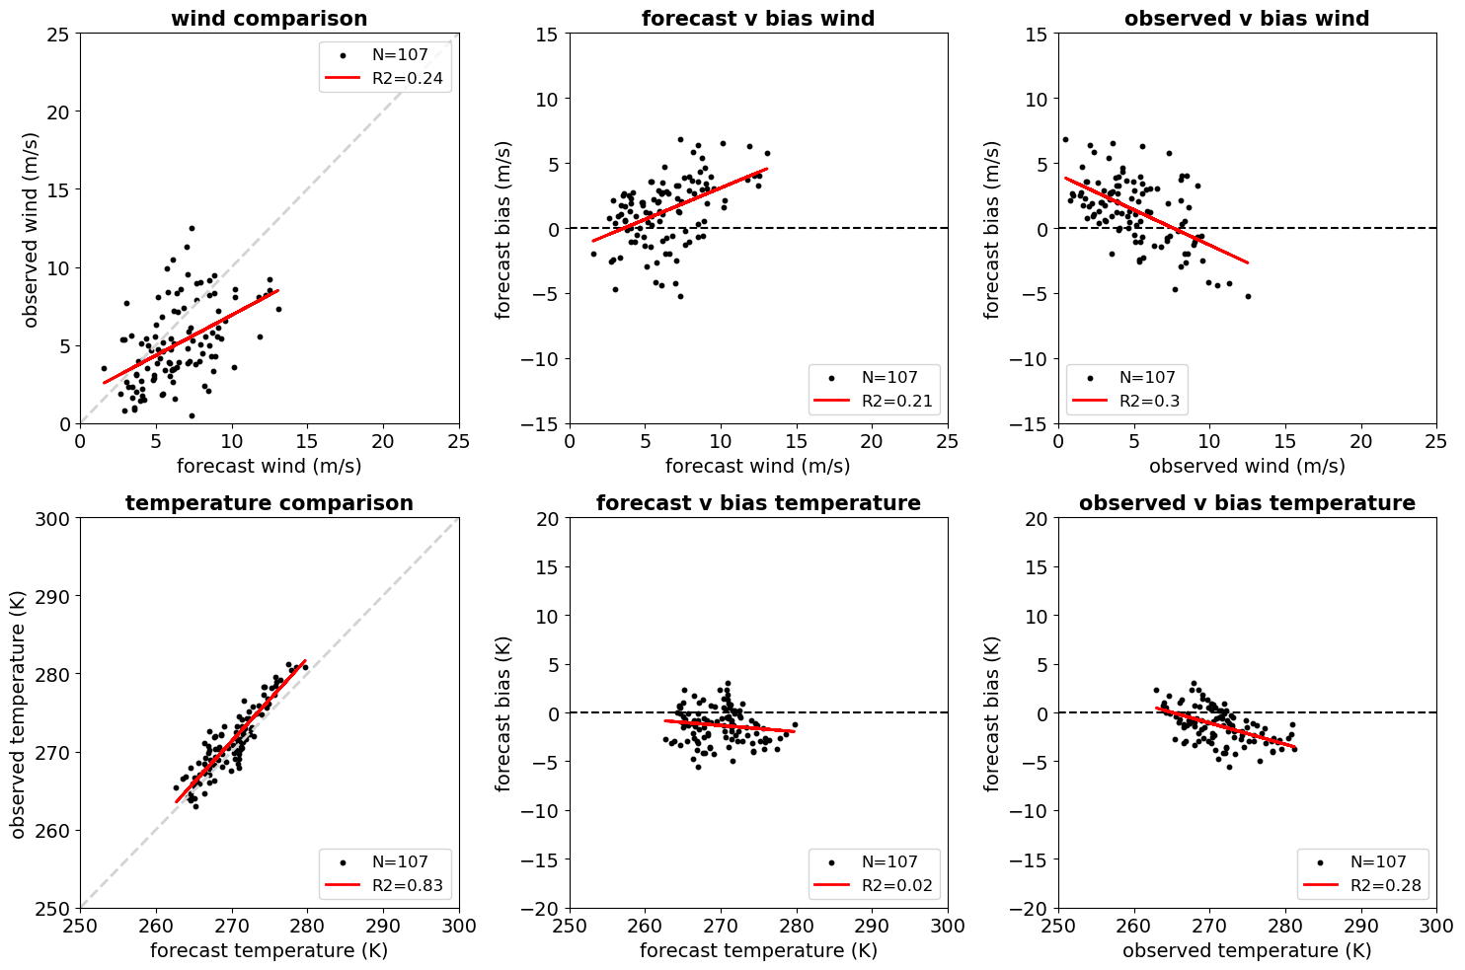
RAWS

Slide 16
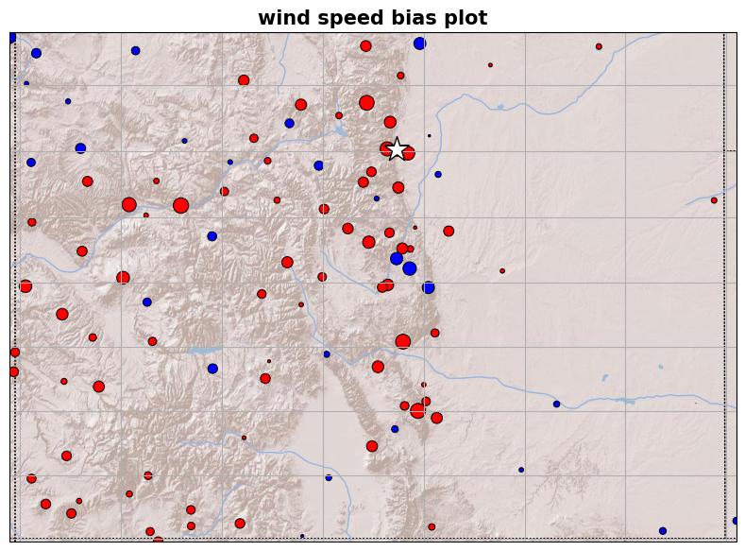
RAWS

Slide 17
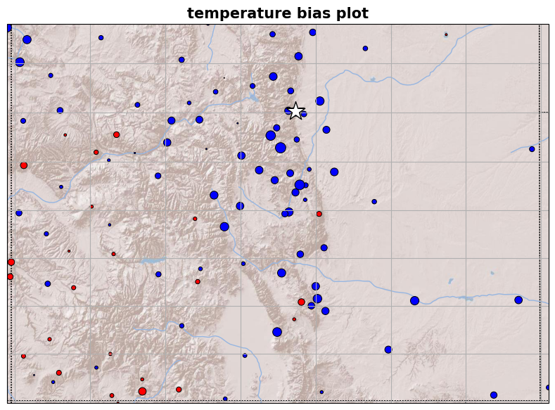
RAWS

Slide 18
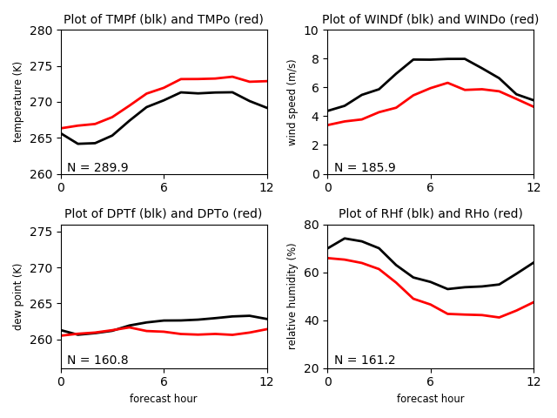
MESOWEST stations in COLORADO available in MADIS
Up to 329 stations depending on variable and time
Network averages
T: cold bias
Td: wet bias
RH: high bias
Wind: overpredicted
[bias similar to RAWS]
MET6_run_ASCII2_MESOWEST.sh
OBS_base=$MYLAB/DATA/MADIS/DEC2021_BOULDER_V2_MESOWEST/

Slide 19
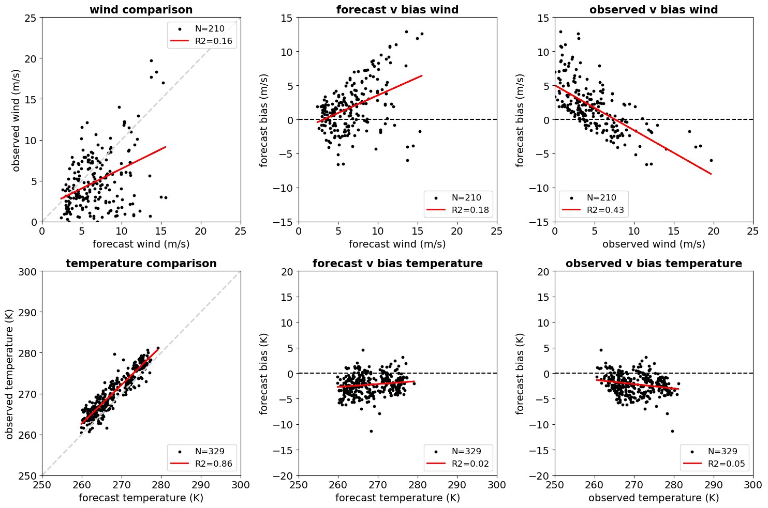
MESOWEST

Slide 20
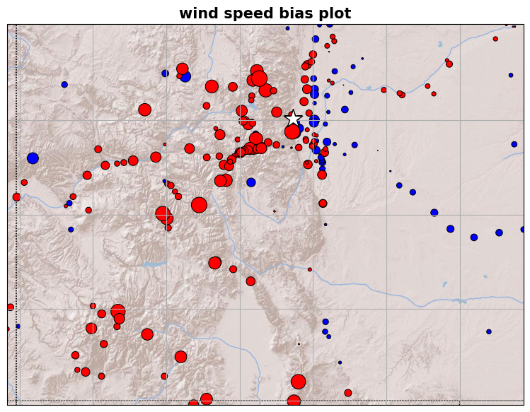
MESOWEST

Slide 21
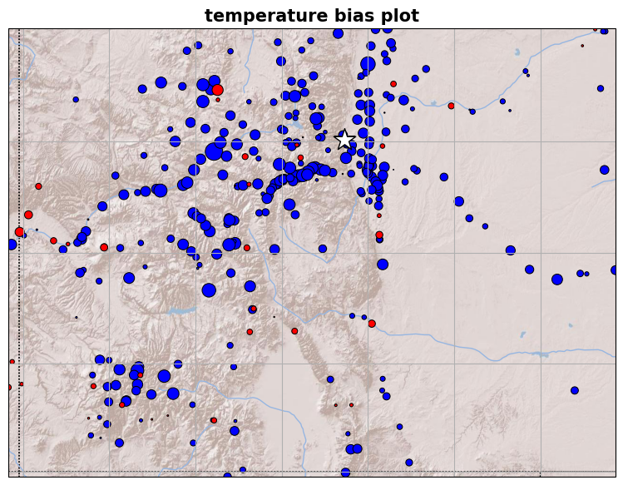
MESOWEST

Slide 22
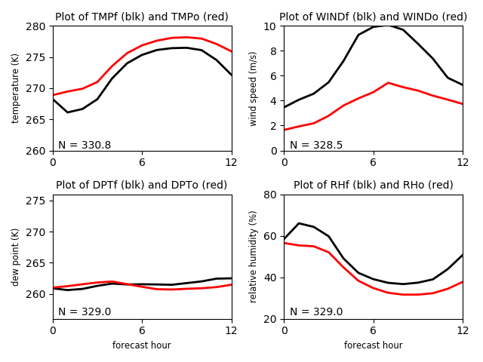
APRSWXNET stations in COLORADO available in MADIS
331 stations
Network averages
T: cold bias
Td: wet bias
RH: high bias
Wind: very overpredicted
[forecasts are fastest but
avg. obs wind is slowest!]
MET6_run_ASCII2_WXNET.sh
OBS_base=$MYLAB/DATA/MADIS/DEC2021_BOULDER_V2_WXNET/

Slide 23
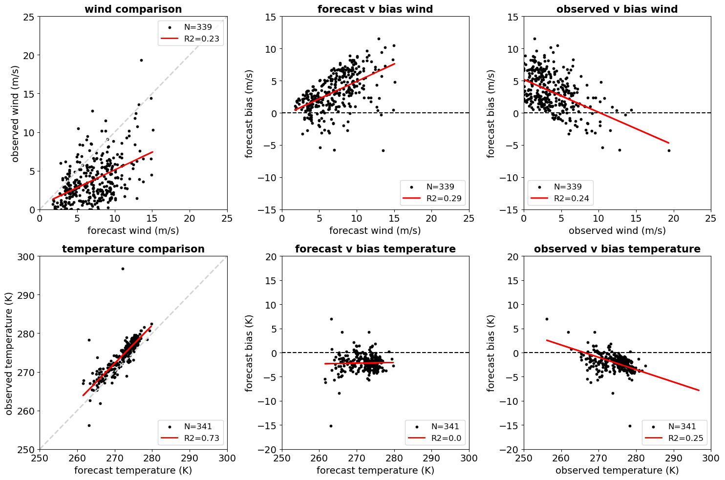
WXNET

Slide 24
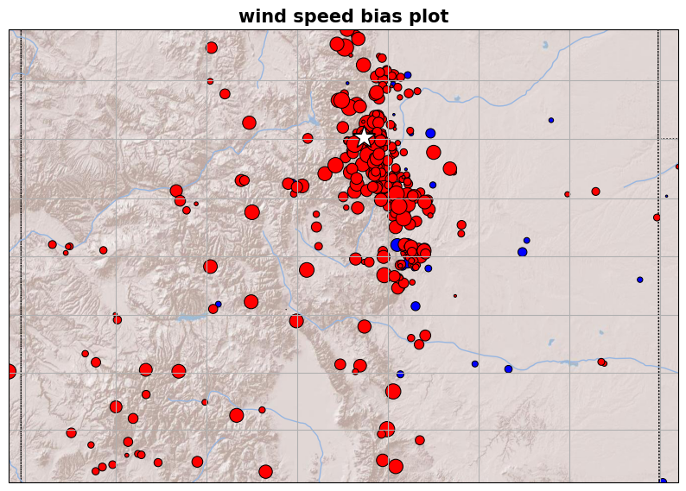
WXNET

Slide 25
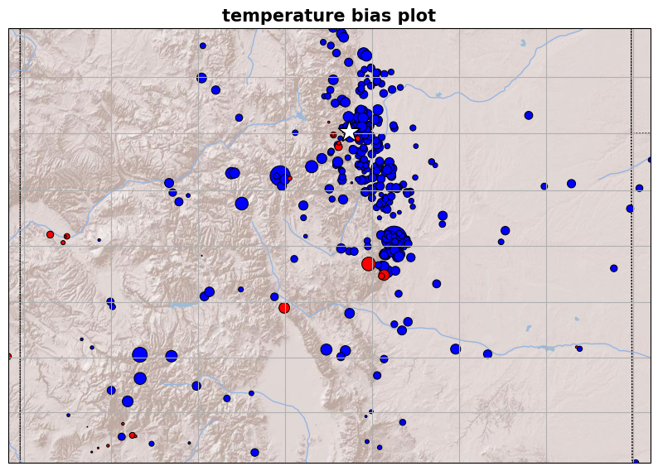
WXNET

Slide 26
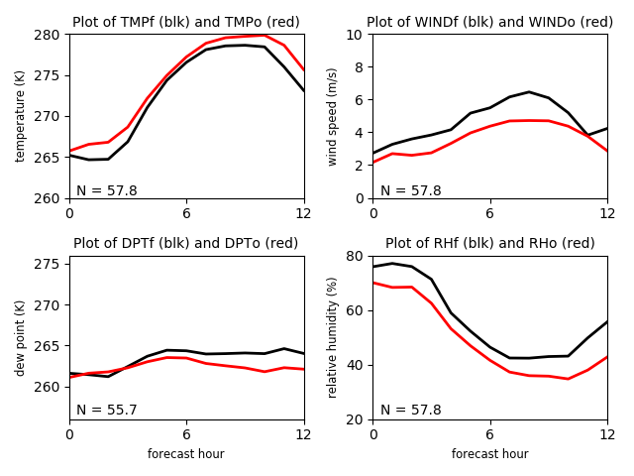
COAGMET stations in COLORADO available in MADIS
62 stations
Network averages
T: cold bias
Td: wet bias
RH: high bias
Wind: overpredicted but
not so bad
[These are 2m AGL winds,
but on farms and likely
well-exposed in winter]
MET6_COAGMET.sh
OBS_base=$MYLAB/DATA/MADIS/DEC2021_BOULDER_V2_COAGMET/
Notes:
2m winds but in ag land

Slide 27
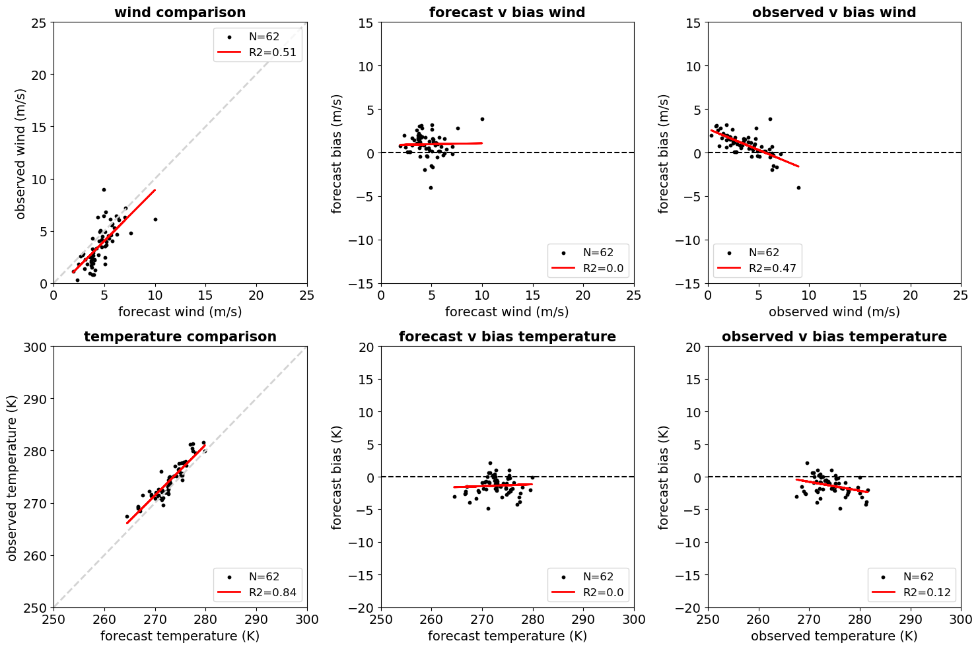

Slide 28
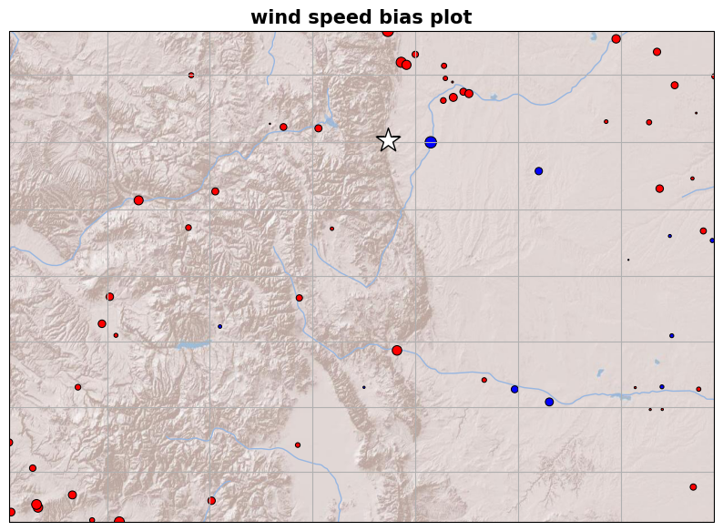

Slide 29
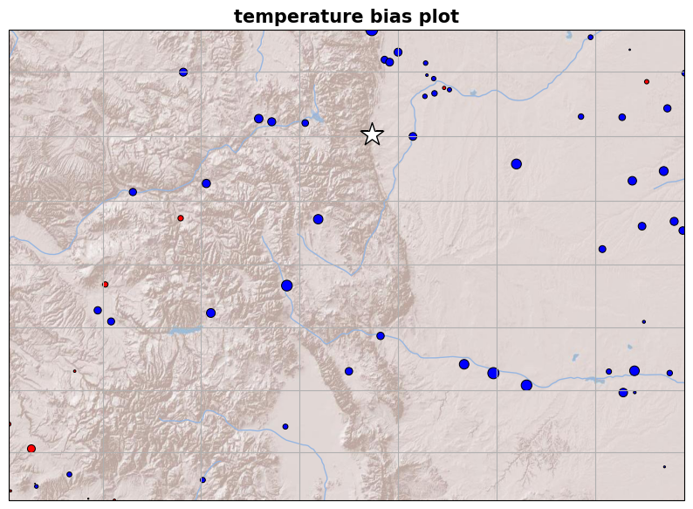

Slide 30
Summary
There are a lot of surface stations but
Siting characteristics vary enormously, including location and exposure
Hardware and mounting heights vary a lot
→ purposes for these stations vary
We’re underpredicting winds at the best stations and have a pervasive cold temperature bias
Work on the model physics and maybe the initialization
Don’t pay attention to bad obs!
There is very little information available above 6-10 m AGL!
WRF and HRRR (WRF-based) surface verifications: many papers, but also see Cao and Fovell (2016, 2018), Wilson and Fovell (2016), Fovell and Cao (2017), Wilson and Fovell (2018), Duine et al. (2019), Fovell and Gallagher (2020, 2022)

