Slide 1
WRF on Mac via Jupyter Notebook
Version of 12/9/2023
ATM 419/563
Spring 2024
Fovell
© Copyright 2024 Robert Fovell, Univ. at Albany, SUNY, rfovell@albany.edu

Slide 2
Objective
Compile and run the entire WRF workflow on a Mac, executed on multiple cores and controlled entirely from a Jupyter notebook
Requirements: Anaconda python and Homebrew
Additional files and data (in addition to WRF/WPS code and data) available at https://www.atmos.albany.edu/facstaff/rfovell/NWP/WRF_on_Mac/
run_real_WRF.ipynb
namelist.input.PRISTINE
namelist.wps.PRISTINE
NNRP_DATA.tar.gz

Slide 3
Caveats
Knowledge of the WRF system and Mac Terminal (command line) necessary and expected
These instructions have not been tested on multiple machines and edge cases may remain undetected
No warranty expressed or implied
Administrator privileges are required
In my tests, shared memory (OpenMP, smpar) simulations are not thread safe. Results vary (substantially) with number of threads requested.
In my tests, distributed memory (MPI, dmpar) simulations are (slightly) sensitive to the number of cores requested unless the optimization level is reduced from –O2 to –O1.
This has to be done manually, by editing the configure.wrf file created later.

Slide 4
Anaconda
Install Anaconda
https://www.anaconda.com/download
Install packages
$ conda install XXXX
matplotlib, xarray¹, pandas, cartopy, netCDF4
Then, install wrf-python
$ conda install -c conda-forge wrf-python
I had to “downgrade” Python to get wrf-python to work correctly. Then install wrf-python
$ conda install python=3.10
¹May already be installed in base package

Slide 5
Homebrew
Install Homebrew
https://brew.sh
Requires administrator privileges
Install packages [brew install XXXX]
gcc, netcdf-cxx, netcdf-fortran, gnu-sed, coreutils, mpich, ncview
You may also want to install NetCDF operators [nco]
Make gcc default C/C++ compiler
$ cd /opt/homebrew/bin [Apple Silicon] or
$ cd /usr/local/bin [Intel]
$ ln -s gcc-13 gcc
$ ln -s g++-13 g++

Slide 6
Identify compilers
In a Terminal window:
$ which gcc
/opt/homebrew/bin/gcc or /usr/local/bin/gcc
$ gcc --version
gcc (Homebrew GCC 13.2.0) 13.2.0
$ which gfortran
/opt/homebrew/bin/gfortran or /usr/local/bin/gfortran
$ gfortran --version
GNU Fortran (Homebrew GCC 13.2.0) 13.2.0
You may have to open and use a new terminal window to activate these changes

Slide 7
Get WRF
Make sure you are in your home directory
$ cd
Get WRF
$ git clone https://github.com/wrf-model/WRF.git
Installs into new folder called “WRF”
Current version is 4.5.1

Slide 8
Set up environment (Apple Silicon)
This presumes your shell is bash or zsh
Execute these in Terminal
cd ~/WRF
export CC=/opt/homebrew/bin/gcc-13
export CXX=/opt/homebrew/bin/g++-13
export FC=gfortran
export CFLAGS="-fPIC -fPIE -O3 -Wno-implicit-function-declaration"
export FCFLAGS=-m64
export F77=gfortran
export FFLAGS=-m64
export DIR=/opt/homebrew
export LDFLAGS=-L$DIR/lib
export CPPFLAGS=-I$DIR/include
export NETCDF=/opt/homebrew/
export NETCDFINC=$NETCDF/include
export LD_LIBRARY_PATH=${NETCDF}/lib:${LD_LIBRARY_PATH}
export NETCDF_classic=1

Slide 9
Set up environment (Intel)
This presumes your shell is bash or zsh
Execute these in Terminal
cd ~/WRF
export CC=/usr/local/bin/gcc-13
export CXX=/usr/local/bin/g++-13
export FC=gfortran
export CFLAGS="-fPIC -fPIE -O3 -Wno-implicit-function-declaration"
export FCFLAGS=-m64
export F77=gfortran
export FFLAGS=-m64
export DIR=/usr/local
export LDFLAGS=-L$DIR/lib
export CPPFLAGS=-I$DIR/include
export NETCDF=/usr/local/
export NETCDFINC=$NETCDF/include
export LD_LIBRARY_PATH=${NETCDF}/lib:${LD_LIBRARY_PATH}
export NETCDF_classic=1

Slide 10
Configure WRF
$ ./configure
Please select from among the following Darwin ARCH options:
1. (serial) 2. (smpar) 3. (dmpar) 4. (dm+sm) PGI (pgf90/pgcc)
5. (serial) 6. (smpar) 7. (dmpar) 8. (dm+sm) INTEL (ifort/icc)
9. (serial) 10. (smpar) 11. (dmpar) 12. (dm+sm) INTEL (ifort/clang)
13. (serial) 14. (dmpar) GNU (g95/gcc)
15. (serial) 16. (smpar) 17. (dmpar) 18. (dm+sm) GNU (gfortran/gcc)
19. (serial) 20. (smpar) 21. (dmpar) 22. (dm+sm) GNU (gfortran/clang)
23. (serial) 24. (dmpar) IBM (xlf90_r/cc)
25. (serial) 26. (smpar) 27. (dmpar) 28. (dm+sm) PGI (pgf90/pgcc): -f90=pgf90
29. (serial) 30. (smpar) 31. (dmpar) 32. (dm+sm) INTEL (ifort/icc): Open MPI
33. (serial) 34. (smpar) 35. (dmpar) 36. (dm+sm) GNU (gfortran/gcc): Open MPI
Enter selection [1-36] :
→ enter 17 (dmpar, GNU gfortran/gcc)

Slide 11
Modify configure.wrf [optional]
Configure creates a text file called “configure.wrf”
In my environment, to get results independent of number of cores requested, I had to edit the FCOPTIM line to read
FCOPTIM = -O1 #-ftree-vectorize -funroll-loops

Slide 12
Compile WRF
This will take some time:
$ ./compile em_real
This should result in the creation of these files in main/
real.exe, wrf.exe, ndown.exe, tc.exe
If you need to start over (to select different compile options or make Registry modifications, for example), do ./clean –a and then redo ./configure. The “clean” removes the configure.wrf file, if present

Slide 13
Get WPS
Go back to your home directory
$ cd
Get WPS
$ git clone https://github.com/wrf-model/WPS.git
Installs into a new folder called WPS
Current version is 4.5
Expects to find WRF installation at ~/WRF
If you renamed the WRF folder, you need to modify configure.wps

Slide 14
Set up environment (Apple Silicon)
This presumes your shell is bash or zsh
Execute these in Terminal
cd ~/WPS
export CC=/opt/homebrew/bin/gcc-13
export CXX=/opt/homebrew/bin/g++-13
export FC=gfortran
export CFLAGS="-fPIC -fPIE -O3 -Wno-implicit-function-declaration"
export FCFLAGS=-m64
export F77=gfortran
export FFLAGS=-m64
export DIR=/opt/homebrew
export LDFLAGS=-L$DIR/lib
export CPPFLAGS=-I$DIR/include
export NETCDF=/opt/homebrew/
export NETCDFINC=$NETCDF/include
export LD_LIBRARY_PATH=${NETCDF}/lib:${LD_LIBRARY_PATH}
export NETCDF_classic=1

Slide 15
Set up environment (Intel)
This presumes your shell is bash or zsh
Execute these in Terminal
cd ~/WPS
export CC=/usr/local/bin/gcc-13
export CXX=/usr/local/bin/g++-13
export FC=gfortran
export CFLAGS="-fPIC -fPIE -O3 -Wno-implicit-function-declaration"
export FCFLAGS=-m64
export F77=gfortran
export FFLAGS=-m64
export DIR=/usr/local
export LDFLAGS=-L$DIR/lib
export CPPFLAGS=-I$DIR/include
export NETCDF=/usr/local/
export NETCDFINC=$NETCDF/include
export LD_LIBRARY_PATH=${NETCDF}/lib:${LD_LIBRARY_PATH}
export NETCDF_classic=1

Slide 16
Configure and compile WPS
$ ./configure --build-grib2-libs
Select the option for gcc/gfortran dmpar (10)
This option will build needed Jasper libraries
This creates the file configure.wps
$ ./compile
This should result in the creation of these files in ~WPS/
geogrid.exe, metgrid.exe, ungrib.exe
Make sure none of them are missing
If you need to start over (to select different compile options), do ./clean –a and then redo ./configure --build-grib2-libs. The “clean” removes the configure.wps file, if present
Don’t forget the “--build-grib2-libs”

Slide 17
Get geography data
https://www2.mmm.ucar.edu/wrf/users/download/get_sources_wps_geog.html
Download one of the two datasets indicated on the next slide.
Create folder WPS_GEOGV4 in your home directory. Place the *tar.gz file there and expand it
Note “Highest resolution of each mandatory field” expands to 30+ GB
My scripts expect to find these data in folder ~/WPS_GEOGV4

Slide 18
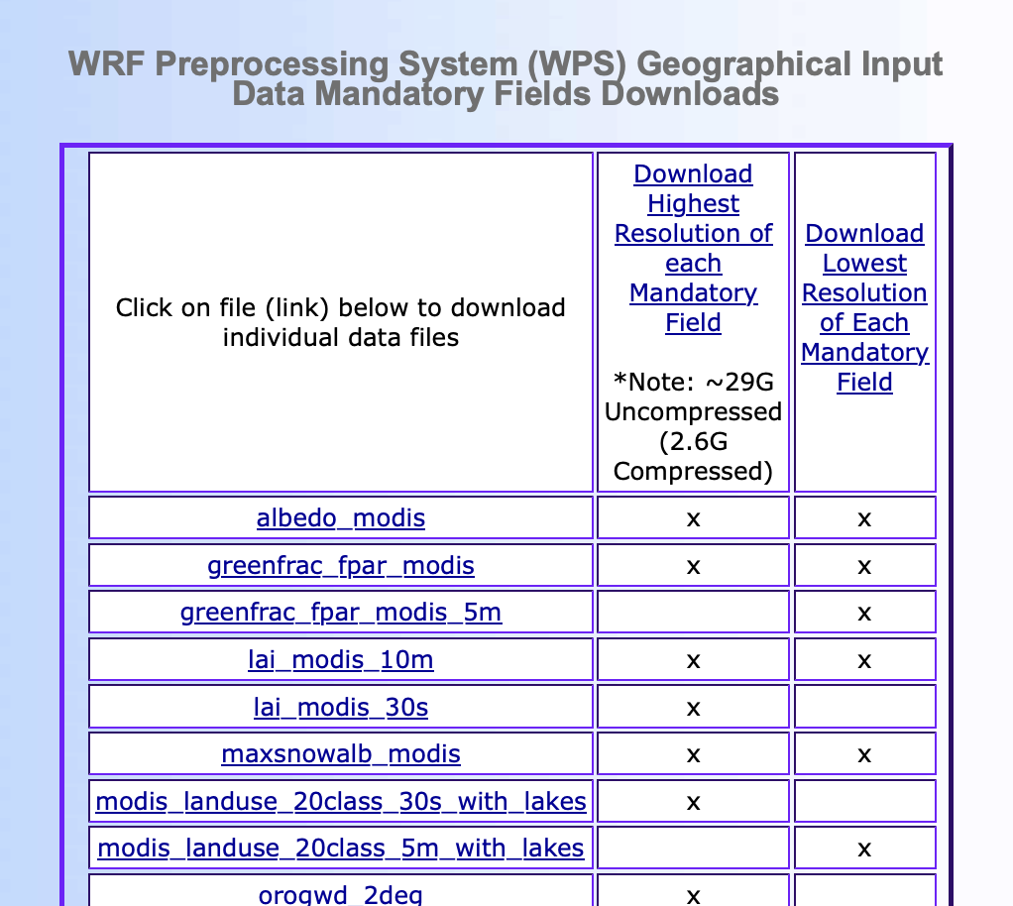
Click on one of
these two links

Slide 19
Contents of ~/WPS_GEOGV4 after expansion [highest resolution data]
albedo_modis/ orogwd_30m/
greenfrac_fpar_modis/ soiltemp_1deg/
lai_modis_10m/ soiltype_bot_30s/
lai_modis_30s/ soiltype_top_30s/
maxsnowalb_modis/ topo_gmted2010_30s/
modis_landuse_20class_30s_with_lakes/
varsso/
orogwd_10m/ varsso_10m/
orogwd_1deg/ varsso_2m/
orogwd_20m/ varsso_5m/
orogwd_2deg/

Slide 20
Obtain “pristine” namelists
namelist.input.PRISTINE and namelist.wps.PRISTINE [see slide 2]
Place these files in ~/WRF/test/em_real
Edit namelist.wps.PRISTINE to point to where you saved the WPS geography data
geog_data_path = '/Users/fovell/WPS_GEOGV4/'

Slide 21
Running WRF/WPS in notebook
Obtain run_real_wrf.ipynb and place it somewhere in your home directory (perhaps in ~/WRF)
Starting in the directory you put the run_real_wrf.ipynb file, launch jupyter notebook from command line
$ jupyter notebook
Launch run_real_wrf.ipynb. See next slide

Slide 22
Notes on notebook
The notebook executes geogrid.exe, metgrid.exe, real.exe, and wrf.exe requesting 4 cores via mpirun –np 4. This can be changed. Requesting additional cores may not be beneficial
The ungrib.exe program is NOT MPI
The notebook works on copies of namelist.wps.PRISTINE and namelist.input.PRISTINE via gnu-sed [gsed]
Editing of notebook is needed
Notebook is configured to run WRF in ~/WRF/test/em_real directory
Warning: notebook is configured to remove old files and outputs before running model again
In case of problems, I would restart and clear output

Slide 23
Test case
“Storm of the Century” 1993 March snowstorm, single 90 km domain, initialized from very coarse resolution NNRP
Get NNRP data [slide 2], unpack in ~/WRF/test/em_real
Creates folder called NNRP_199303/

Slide 24
Notebook tour: Cell #1
%matplotlib inline
from math import pi, cos, sin
import datetime
import numpy as np
import netCDF4
from netCDF4 import Dataset
from wrf import (getvar, to_np, get_cartopy, latlon_coords, vertcross, ll_to_xy,
cartopy_xlim, cartopy_ylim, interpline, CoordPair, destagger, interplevel, ALL_TIMES)
import matplotlib.pyplot as plt
from matplotlib.cm import get_cmap
from matplotlib.colors import LinearSegmentedColormap
# Cartopy stuff
import cartopy.crs as ccrs
import cartopy.feature as cf
import cartopy.geodesic
import shapely
Import needed modules

Slide 25
Notebook tour: Cell #2
# ------------------------------------------------------------------------------------------- #
# move to our WRF run directory in the next cell
#
# Expects to find WRF in ~/WRF and WPS in ~/WPS
# Run directory is set to ~/WRF/test/em_real
# Expects to find namelist.wps.PRISTINE and namelist.input.PRISTINE in ~/WRF/test/em_real
# Not currently configured for more than 3 domains total (one parent, 2 nests)
# Not currently configured for multiple wrfout files per domain
# Currently configured to analyze wrfout_d01... file
# ------------------------------------------------------------------------------------------- #
# do initial clean-up and file linking
#
# ANY EXISTING WRFOUT FILES WILL BE REMOVED
# This notebook presumes existence of unmodified files "namelist.input.PRISTINE"
# and "namelist.wps.PRISTINE" as starting points

Slide 26
Notebook tour: Cell #3
%cd ~/WRF/test/em_real
%ls
Move to the working directory and
list files

Slide 27
Notebook tour: Cell #4
echo " cleaning up and creating links"
\rm -rf Vtable
\rm -rf GRIBFILE*
\rm -f geo_em*
\rm -f setup_run.sh
\rm -f namelist.input
\rm -f namelist.wps
mkdir -p geogrid
\cp -f ~/WPS/geogrid/GEOGRID.TBL.ARW geogrid/GEOGRID.TBL
mkdir -p metgrid
\cp -f ~/WPS/metgrid/METGRID.TBL.ARW metgrid/METGRID.TBL
\cp -f namelist.input.PRISTINE namelist.input
\cp -f namelist.wps.PRISTINE namelist.wps
\rm -f wrfout* wrfinput* wrfbdy* rsl*
Clean up and linking to needed files
prior to running workflow

Slide 28
Notebook tour: Cell #5
%%bash
echo "setting up the domain..."
export max_dom=1 # number of domains to configure (hardcoded max 3 in this version)
export e_we="85,95,105" # west-east dimensions of domains 1,2,3 (even if only one used)
export e_sn="56,85,94" # south-north dimensions "
export i_parent_start="1,36,100" # first digit always 1
export j_parent_start="1,7,36" # first digit always 1
export dx=90000 # presumes dy=dx
export map_proj='lambert'
export ref_lat=39.5
export ref_lon=-100
export stand_lon=-100
export truelat1=30
export truelat2=60
Model domain setup

Slide 29
Notebook tour: Cell #6
%%bash
echo "Look for Successful completion of geogrid"
time mpirun -np 2 ~/WPS/geogrid/src/geogrid.exe
ls geo_em.d01.nc
Run geogrid.exe on 2 cores

Slide 30
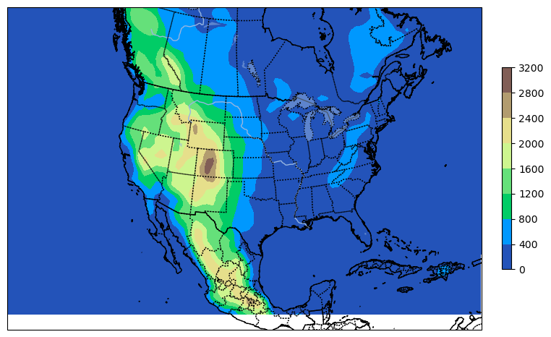
Cell #7 reads in fields using wrf-python and plots the domain terrain

Slide 31
Notebook tour: Cell #8
%%bash
echo "getting ready to run ungrib. NOTE max_dom IS SPECIFIED AGAIN"
echo "for numbers <10 LEADING ZEROES ARE REQUIRED (e.g., start_month=03)"
export max_dom=1
export run_hours=60
export start_year=1993
export start_month=03
export start_day=12
export start_hour=12
export end_year=1993
export end_month=03
export end_day=15
export end_hour=00
export interval_seconds=21600
Set start and end time information,
interval between parent model data,
and model run time

Slide 32
Notebook tour: Cell #9
%%bash
echo "run ungrib.exe after specifying appropriate Vtable and where parent model data are."
~/WPS/link_grib.csh NNRP_199303/* .
cp ~/WPS/ungrib/Variable_Tables/Vtable.NNRP Vtable
~/WPS/ungrib.exe
echo "check for successful completion, then run metgrid"
Link to parent model data, select Vtable,
and run ungrib.exe on one core only.
Ungrib is not an MPI program

Slide 33
Notebook tour: Cells #10-11
%%bash
echo "running metgrid. Check for successful completion"
time mpirun -np 4 ~/WPS/metgrid/src/metgrid.exe
# next: set up real and wrf runs, specifying run hours, history interval, time step,
# and model physics, etc.
# number of domains to run needs to be reset
# make sure num_metgrid_levels and num_metgrid_soil_levels are correctly specified below
Run metgrid.exe on 4 cores

Slide 34
Notebook tour: Cell #12
export max_dom=1 # how many domains will be active in this run
export history_interval=360 # how often (in minutes) to write to wrfout file
export time_step=240 # coarsest domain time step (seconda)
export e_vert=51 # number of vertical levels requested
# EDIT the next two lines. Needs to match info in met_em* files.
# Use ncdump -h on one of the met_em_d01* files
export num_metgrid_levels=18 # and look for "num_metgrid_levels" for this number
export num_metgrid_soil_levels=2 # and look for "num_st_layers","num_sm_layers"
export p_top_requested=1000 # pressure at model top (Pascals); cannot exceed that provided by parent data
# specify physics that are the same for each domain
export mp_physics=3 # microphysics
export ra_lw_physics=1 # LW radiation
export ra_sw_physics=1 # SW radiation
export radt=10 # radiation time step (minutes)
export sf_surface_physics=2 # land surface model
export sf_sfclay_physics=1 # surface layer
export bl_pbl_physics=11 # PBL scheme
# specify physics that can vary among domains
export cu_physics="3,3,0" # cumulus scheme
export cudt="0,0,0" # cumulus time step (usually 0)
Selections for common model options
and settings

Slide 35
Notebook tour: Cell #13
%%bash
echo "run real.exe, check output for SUCCESS COMPLETE REAL_EM INIT"
\rm rsl.*
time mpirun -np 4 ./real.exe
Runs real.exe on 4 cores

Slide 36
Notebook tour: Cell #14
%%bash
echo " LOOK for SUCCESS COMPLETE REAL_EM INIT"
tail rsl.out.0000
Displays end of rsl.out.0000 output file
to check for successful completion

Slide 37
Notebook tour: Cell #15
%%bash
echo " running WRF. WAIT for timing information to appear"
\rm rsl.*
time mpirun -np 4 ./wrf.exe
Runs WRF on 4 cores

Slide 38
Notebook tour: Cell #16
%%bash
echo " LOOK for SUCCESS COMPLETE WRF. The wrfout filename is changed to wrfout_done"
ls wrfout*
\rm -f wrfout_done
cp -f wrfout* wrfout_done
tail rsl.out.0000
Renames wrfout file to wrfout_done for ease
of processing. Displays end of rsl.out.0000
output file to check for successful completion

Slide 39
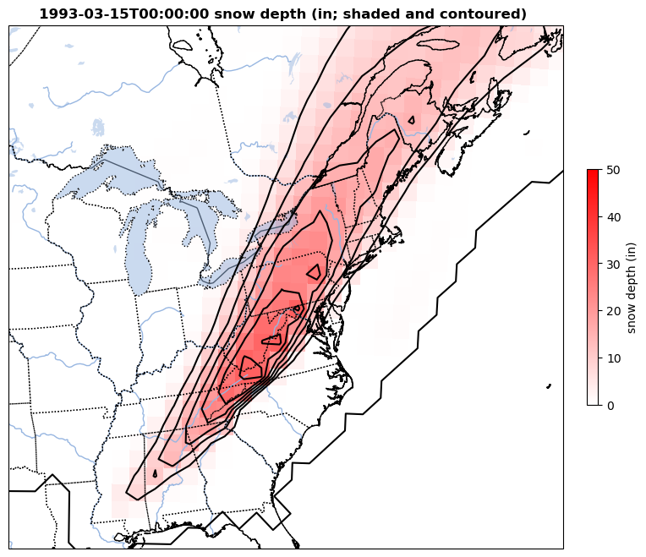
Cells #17-18 read in fields from wrfout
and computes/plots difference in snow
depth between final and initial times

Slide 40
Issues
It does not appear MYNN PBL is working with ice-free or simple ice microphysics. Segmentation fault and memory access error. This is not a WRF-on-Mac problem.

Slide 41
References
WRFV4 users guide
http://www2.mmm.ucar.edu/wrf/users/docs/user_guide_v4/contents.html
Technical description of WRFV4 (PDF)
https://www2.mmm.ucar.edu/wrf/users/docs/technote/v4_technote.pdf

Slide 42
[end]

