Slide 1
Cloud microphysics, Part 2
(Squall line structure and in-class demo)
Script is SQUALL_demonstration_Part1.pdf
PART 2 DUE DATE IS TUESDAY, MARCH 21ST, BEFORE START OF CLASS
ATM 419/563
Spring 2023
Fovell
© Copyright 2023 Robert Fovell, Univ. at Albany, SUNY, rfovell@albany.edu

Slide 2
Start 2D squall-line demonstration
Part 1
Read and do as instructed
in script lines 6-21
WARNING: You may see small differences between your plots and mine, depending on what
hardware your simulation runs on… due to differences in computer chips

Slide 3
Definition of “squall line”
Glossary of Meteorology (2000):
“[A] line of active thunderstorms, either continuous or with breaks, including contiguous precipitation areas resulting from the existence of thunderstorms.”

Slide 4
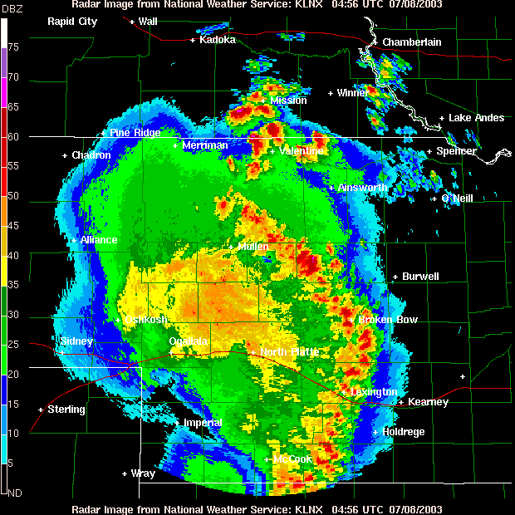
8 July 2003, Lincoln, NE
Notes:
08jul03-KLNX-multicell.GIF

Slide 5
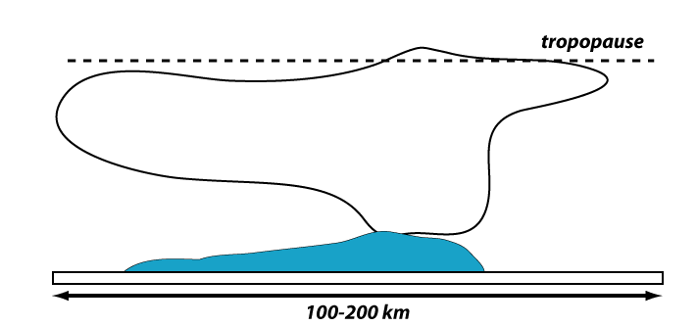
Squall line vertical x-section

Slide 6
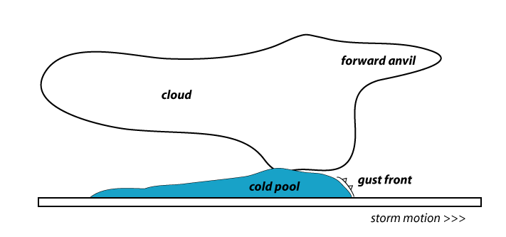
Squall line vertical x-section

Slide 7
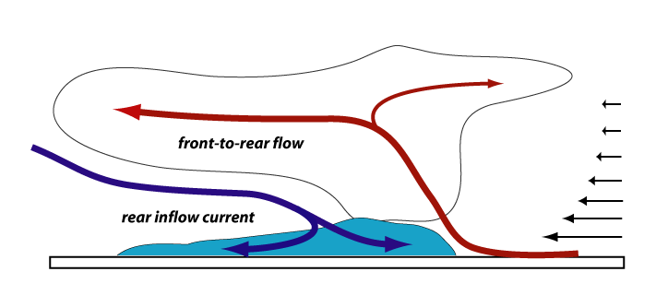
Squall line vertical x-section
Storm-relative flow in storm and far-field;
note vertical shear and upshear tilt

Slide 8
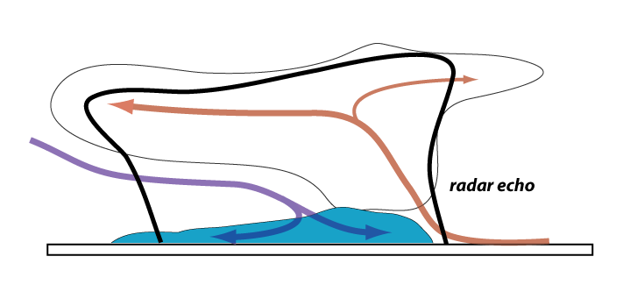
Squall line vertical x-section
Radar echo envelope

Slide 9
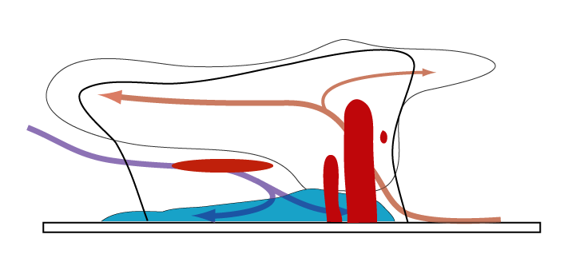
Squall line vertical x-section
Principal echo features; implied multicellularity

Slide 10
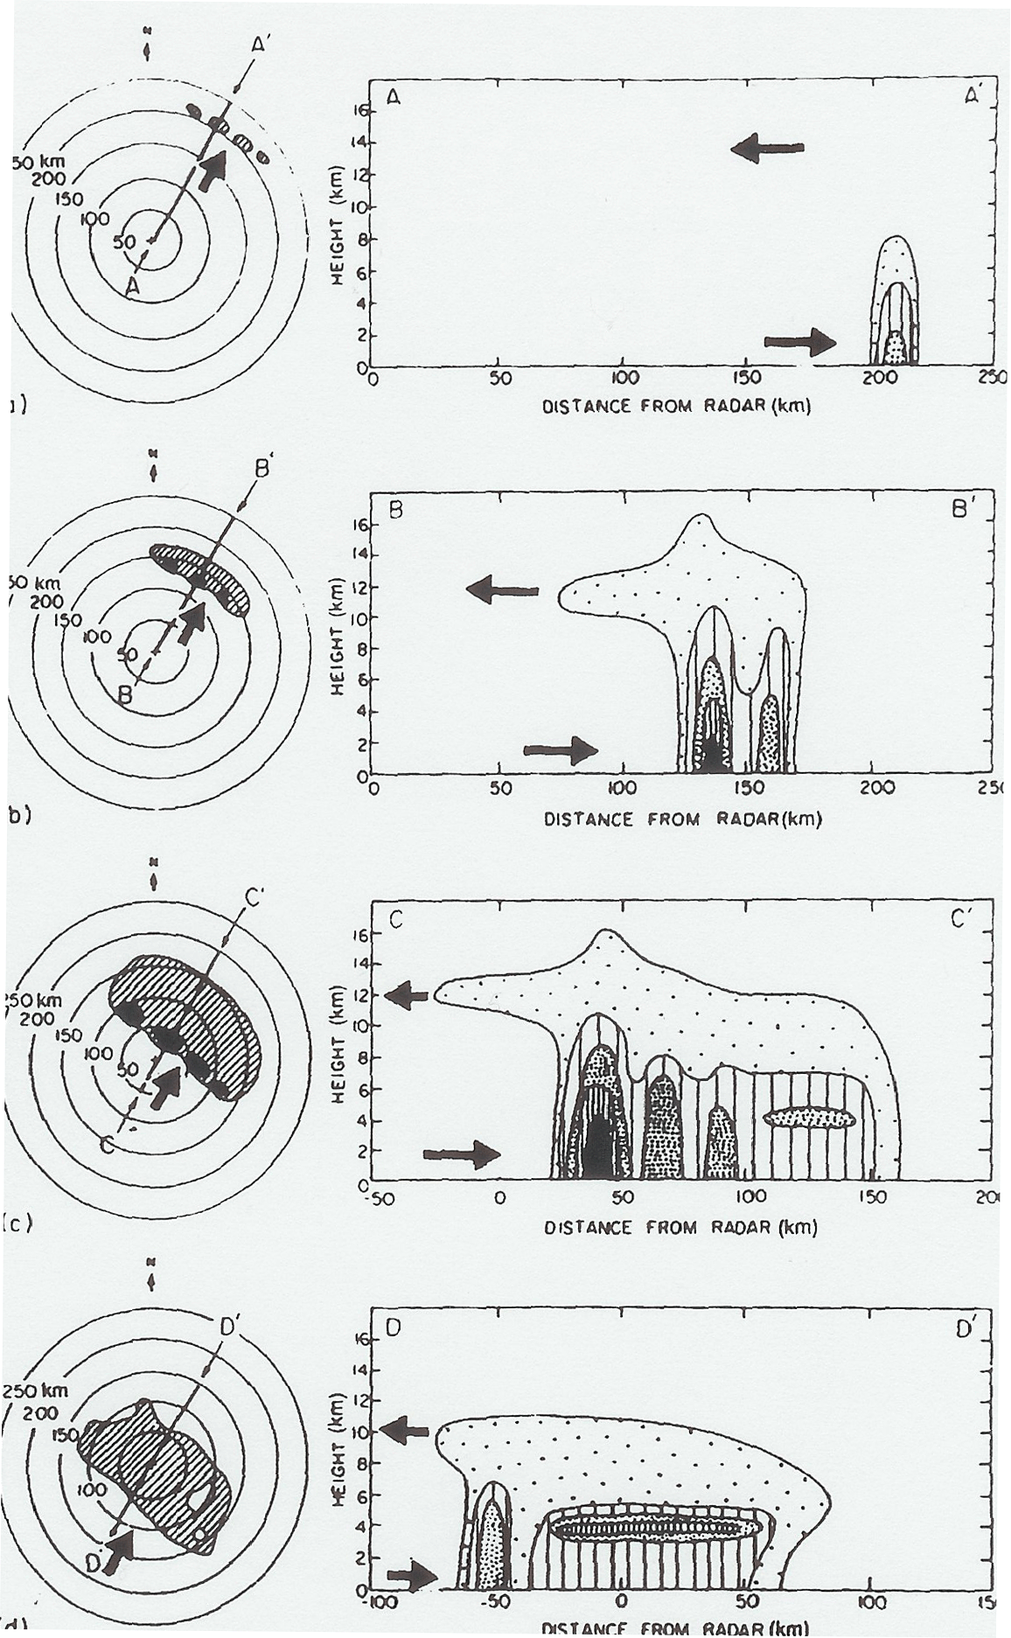
Life cycle of a tropical
squall line
(reversed for midlatitudes)
Leary and Houze (1979)
Notes:
Just looked at maturity up to now

Slide 11
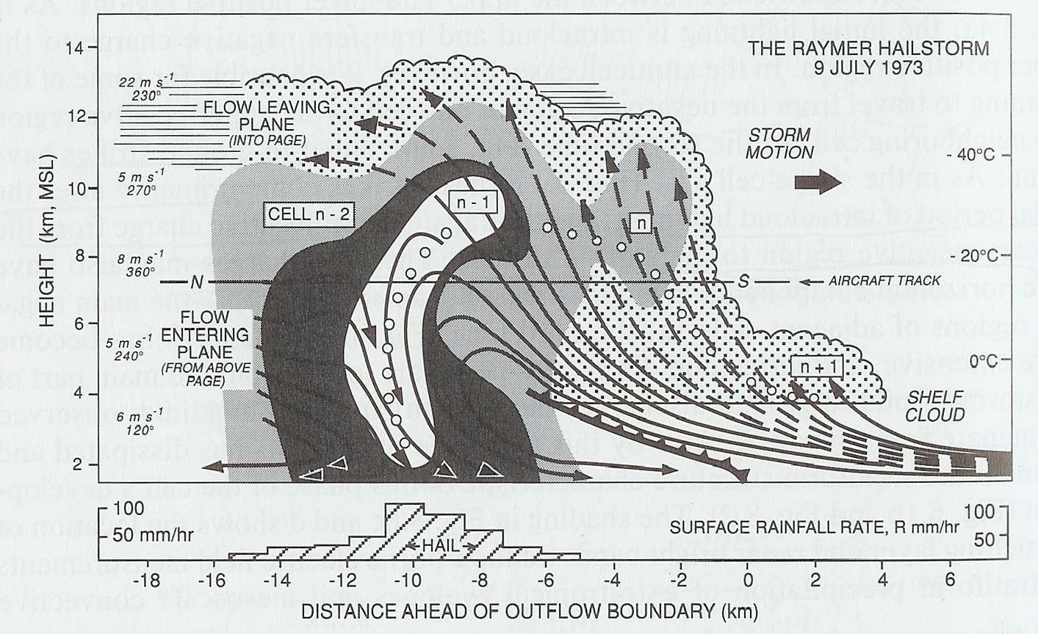
The multicell storm
Four cells at a single time
Or a single cell at four times
Browning et al. (1976)
Notes:
Also show multiple cells in conceptual model

Slide 12
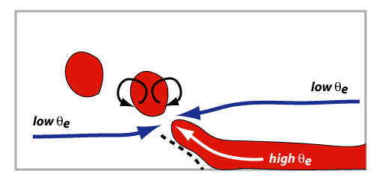
The multicell storm
Unsteadiness represents
episodic entrainment owing
to local buoyancy-induced
circulations.
Browning et al. (1976)
Fovell and Tan (1998)
Notes:
Also show multiple cells in conceptual model

Slide 13
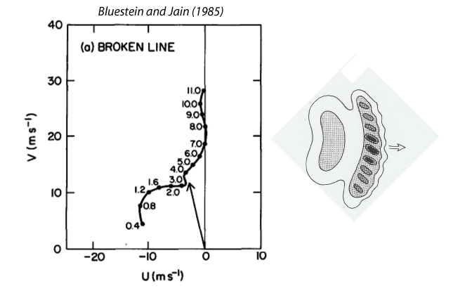
The severe squall line environment
Heights
km MSL
From 10 years of severe spring Oklahoma storms
Bluestein and Jain (1985)

Slide 14
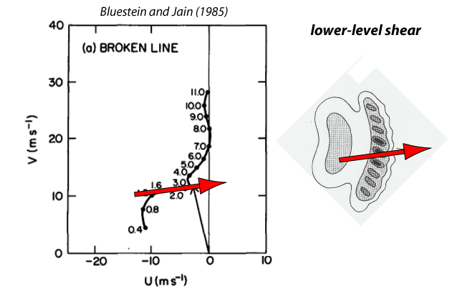
The severe squall line environment
(along-line)
(across-line)
Bluestein and Jain (1985)

Slide 15
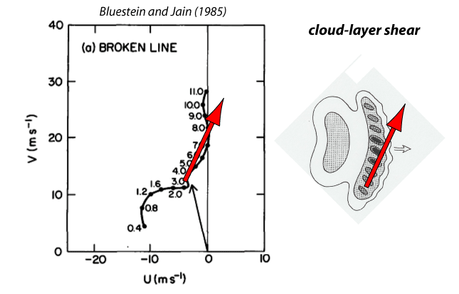
The severe squall line environment
Ground and storm
relative winds
Bluestein and Jain (1985)

Slide 16
Finish 2D squall-line demonstration
Part 1
Lines 23-end
WARNING: You may see small differences between your plots and mine, depending on what
hardware your simulation runs on… due to differences in computer chips

Slide 17
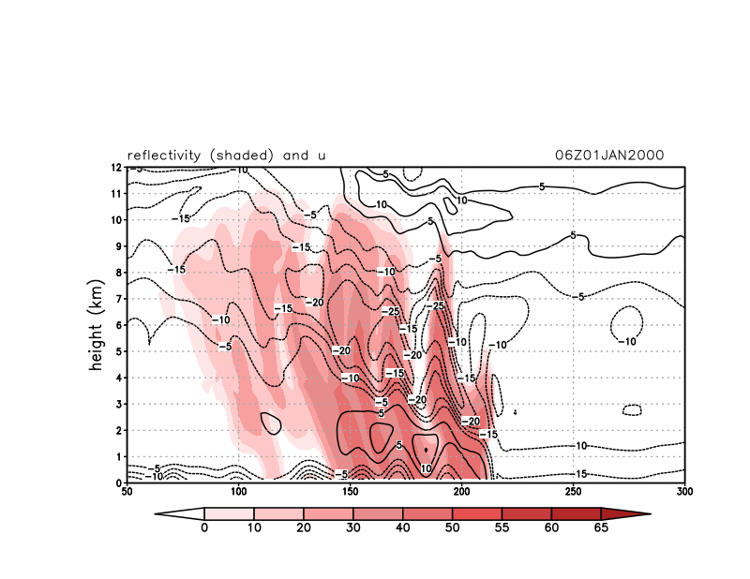
Reflectivity and horizontal wind
reflec.gs
Notes:
Not a great bright band…
2022 version

Slide 18
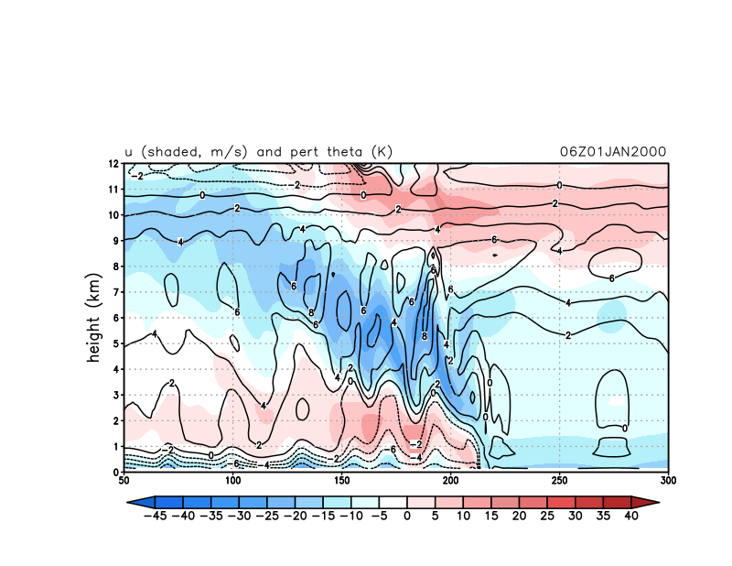
Horizontal wind and θ’
uthetap.gs
Surface gust front
Notes:
2022 version

Slide 19
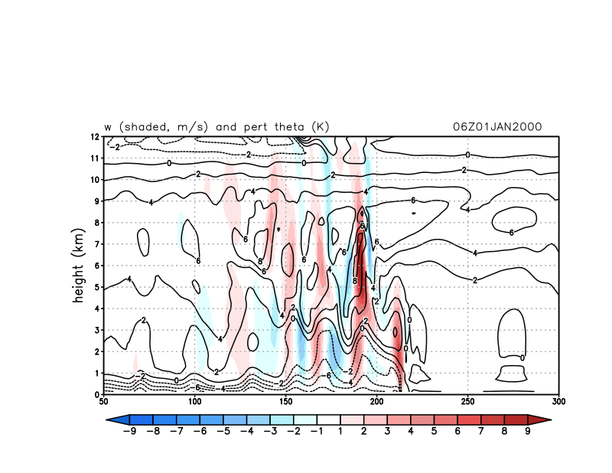
Vertical velocity and θ’
wthetap.gs
Notes:
2022 version

Slide 20
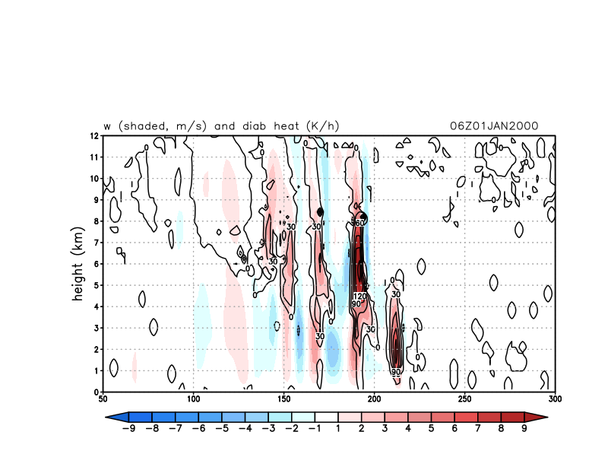
Vertical velocity and diabatic forcing from microphysics
wdiabatic.gs
Diabatic forcing tends to be small-scale in space and time – that’s close to the noise scale and don’t want to project those tendencies very far
Notes:
Diabatic forcing tends to be small-scale in space and time – that’s close to the noise scale and don’t want to project those tendencies very far. 2022 version

Slide 21
[continue following Part 1 script to end]

Slide 22
2D squall-line demonstration
Part 2
ADD YOUR ENSEMBLE MEMBER FILES TO $LAB/SQUALL BY START OF CLASS
ON TUESDAY, MARCH 21. WE WILL EXAMINE THE ENSEMBLE DURING THAT CLASS.
Contributing to a microphysics ensemble for the squall line case
WARNING: You may see small differences between your plots and mine, depending on what
hardware your simulation runs on… due to differences in computer chips

Slide 23
Simulation for squall ensemble
• Move into your SQUALL directory.
• Edit your namelist.input to set mp_physics to your assigned option (see next slide)
• You may also need to change the value for hail_opt
mp_physics = ## {don’t use a leading zero}
$ srun -p snow ideal.exe
$ srun -p snow wrf.exe
• Unpack your simulation, using w2g and control_file.ensemble [NOTE THIS!!!]
• Name your file mp## where ## is your microphysics option.
• If your option is < 10, use leading zero (e.g., mp02, or mp07)
• If you are using mp=6 or 16 with hail, call the runs mp66 and mp77, respectively
$ w2g control_file.ensemble mp##
• Copy your mp##.ctl and mp##.dat files to $LAB/SQUALL/
• Please add your .ctl and .dat file to $LAB/SQUALL before class Tuesday, March 21

Slide 24
Part 2: squall ensemble assignments
ensemble member | name | mp_physics | GrADS file name | scheme name | Note
1 | DEMO | 2 | mp02 | Purdue Lin
2 | Barletta | 1 | mp01 | Kessler | no reflectivity
3 | Colon | 3 | mp03 | WSM3
4 | Creighton | 6 | mp06 | WSM6
5 | Cubias | 7 | mp07 | Goddard
6 | Due | 8 | mp08 | Thompson
7 | England | 9 | mp09 | Millbrandt
8 | Liotta | 10 | mp10 | Morrison
9 | Loffredo | 13 | mp13 | SBU
10 | Lucy | 16 | mp16 | WDM6
11 | O'Keefe | 17 | mp17 | NSSL2
12 | Pagnotti | 18 | mp18 | NSSL2_CCN
13 | Ryan | 19 | mp19 | NSSL1
14 | Pena | 21 | mp21 | NSSL1_LFO
15 | Barreto Schuler | 24 | mp24 | WSM7
16 | Fovell | 26 | mp26 | WDM7
17 | Fovell | 28 | mp28 | Thompson_aerosol
18 | Fovell | 40 | mp40 | Morrison CESM
19 | Fovell | 6 | mp66 | WSM6_with_hail | (set hail_opt=1)
20 | Fovell | 16 | mp77 | WDM6_with_hail | (set hail_opt=1)
21 | Fovell | 30 | mp30 | HUJI_FAST | no reflectivity
22 | Fovell | 32 | mp32 | HUJI_FULL
Squall ensemble
will have 22 members.
Ensemble member
number
≠ scheme number

Slide 25
[end]

