Slide 1
Cloud microphysics, Part 3 (Class ensemble experiment)
ATM 419/563
Spring 2023
Fovell
© Copyright 2023 Robert Fovell, Univ. at Albany, SUNY, rfovell@albany.edu
Notes:
Cut out assignment relating to this in 2023 owing to showcase day

Slide 2
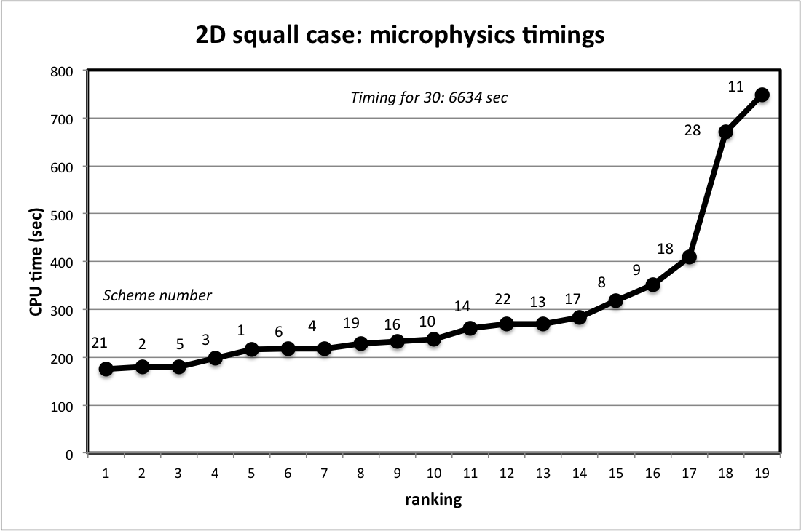
Timings for 2D squall case from 2017 (older version of WRF)
Timings for MP30 (6634 sec) and MP32 (19205 sec)
Scheme number = mp_physics, not ensemble member number
Notes:
35x as long; 100x as long

Slide 3
Squall ensemble assignments 2023
ensemble member | name | mp_physics | GrADS file name | scheme name | Note
1 | DEMO | 2 | mp02 | Purdue Lin
2 | Barletta | 1 | mp01 | Kessler | no reflectivity
3 | Colon | 3 | mp03 | WSM3
4 | Creighton | 6 | mp06 | WSM6
5 | Cubias | 7 | mp07 | Goddard
6 | Due | 8 | mp08 | Thompson
7 | England | 9 | mp09 | Millbrandt
8 | Liotta | 10 | mp10 | Morrison
9 | Loffredo | 13 | mp13 | SBU
10 | Lucy | 16 | mp16 | WDM6
11 | O'Keefe | 17 | mp17 | NSSL2
12 | Pagnotti | 18 | mp18 | NSSL2_CCN
13 | Ryan | 19 | mp19 | NSSL1
14 | Pena | 21 | mp21 | NSSL1_LFO
15 | Barreto Schuler | 24 | mp24 | WSM7
16 | Fovell | 26 | mp26 | WDM7
17 | Fovell | 28 | mp28 | Thompson_aerosol
18 | Fovell | 40 | mp40 | Morrison CESM
19 | Fovell | 6 | mp66 | WSM6_with_hail | (set hail_opt=1)
20 | Fovell | 16 | mp77 | WDM6_with_hail | (set hail_opt=1)
21 | Fovell | 30 | mp30 | HUJI_FAST | no reflectivity
22 | Fovell | 32 | mp32 | HUJI_FULL
Squall ensemble
will have 22 members.
Ensemble member
number
≠ scheme number

Slide 4
GrADS ensemble dimension

Slide 5
Ensembles
In addition to x, y, z, and t, GrADS has an ensemble dimension (e)
This permits you to access all of your ensemble members from a single control file
Every member has to be identical (time, resolution, physical dimensions, fields available)
For the microphysics runs, field availability is the limiting factor. Only QCLOUD and QRAIN are common to ALL microphysics schemes. Most (not all) of the ice-bearing schemes also have QICE, QSNOW, AND QGRAUP. Some also have QHAIL
Our 2023 class ensemble will encorporate virtually evey scheme available in WRF. As a consequence, only QCLOUD and QRAIN will be retained in control_file.ensemble. Other microphysical variables, if present, and/or extra fields associated with double-moment schemes, will be ignored

Slide 6
mp_ensemble.ctl
I created this file starting with the control file from one of the members
dset ^mp%e.dat
undef 1.e35
options template
edef 22 NAMES 02 01 03 06 07 08 09 10 13 16 17 18 19 21 24 26 28 40 [more]
xdef 201 linear 0 0.0001
ydef 1 linear 0 0.0001
zdef 80 levels
[etc.]
This uses the template option.
Filenames are declared with a wildcard: here “%e”
The edef line fills in the values for %e: 02, 10, 89, etc.
These values are filenames (hence NAMES is declared)
In this example, there are 22 ensemble members
Member 1 is mp02, member 12 is mp18…
What follows (tdef, xdef, ydef, fields) must be identical for, and
compatible with, each of the ensemble members
Notes:
One of the MP schemes, Kessler, has ONLY Qcloud and Qrain, and so that’s the limiting factor

Slide 7
Do 2D squall-line demonstration Part 2
Read and do as instructed in lines 6-14 of script

Slide 8
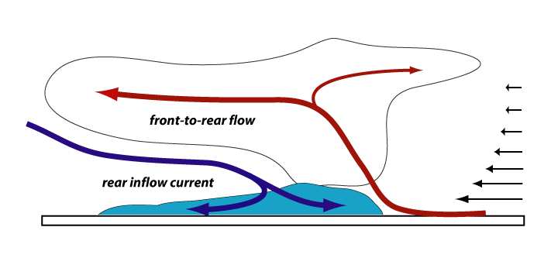
Squall line vertical x-section
Storm-relative flow in storm and far-field;
note vertical shear and upshear tilt
From Part #2

Slide 9
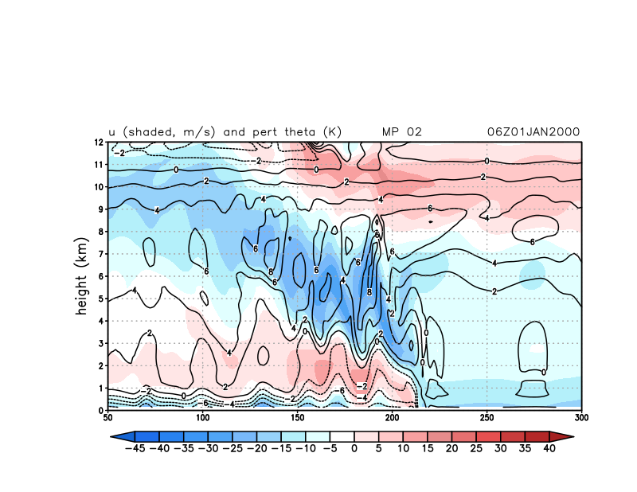
set e 1 (mp #2 Purdue Lin)

Slide 10
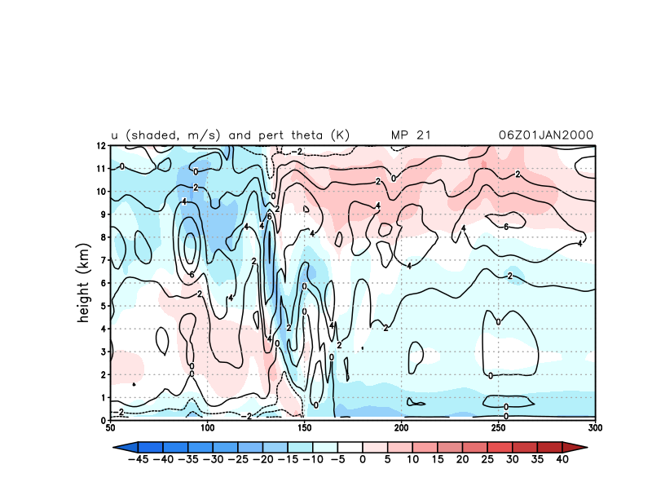
set e 14 (mp #21 NSSL’s version of Purdue Lin)

Slide 11
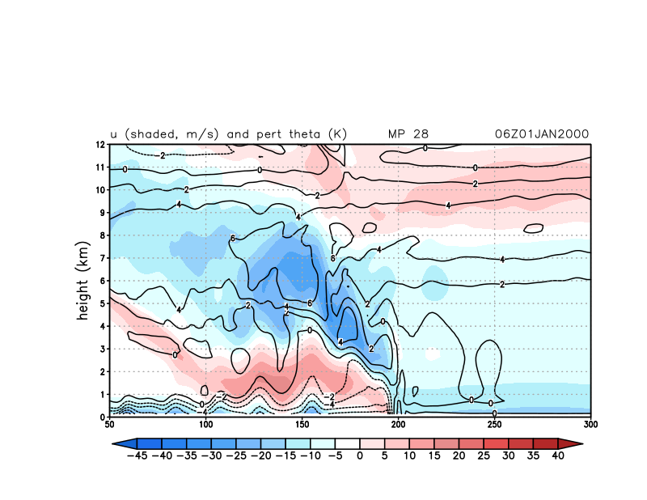
set e 17 (mp #28 Thompson aerosol scheme)

Slide 12
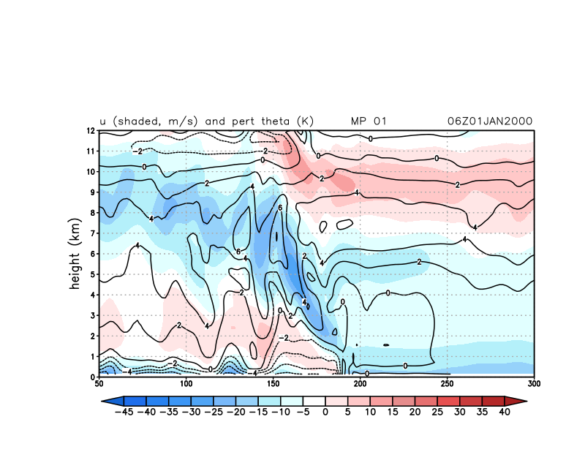
set e 2 (mp #1 Kessler warm rain scheme)

Slide 13
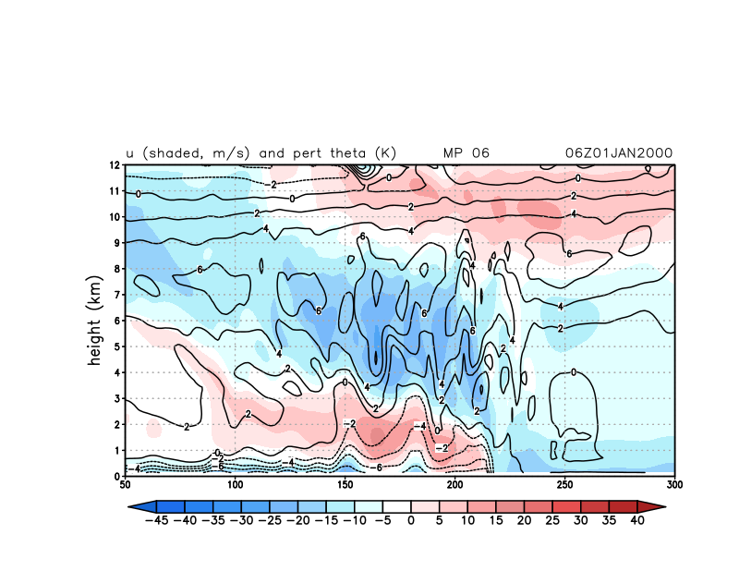
set e 4 (mp #6 WSM6)

Slide 14
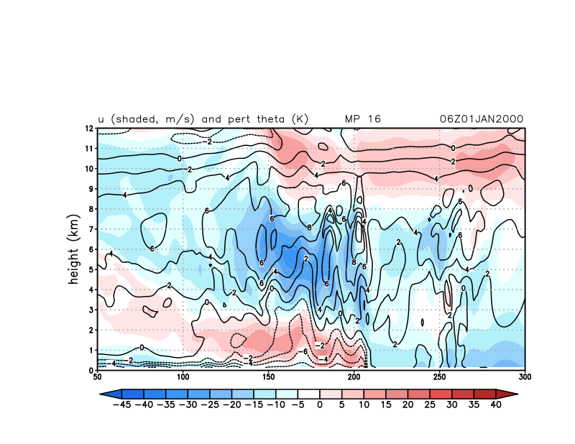
set e 10 (mp #6 WDM6)

Slide 15
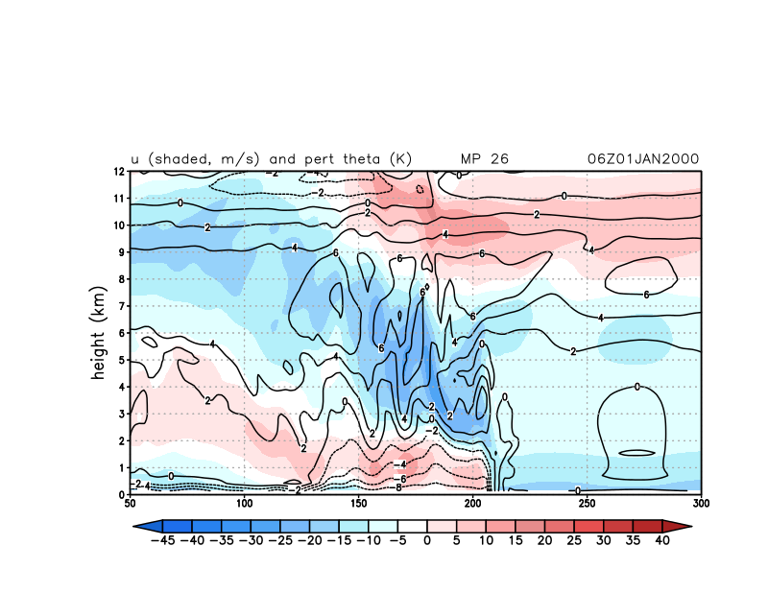
set e 16 (mp #26 WDM7)

Slide 16
set e 1 (mp #2 Purdue Lin, again)

Slide 17
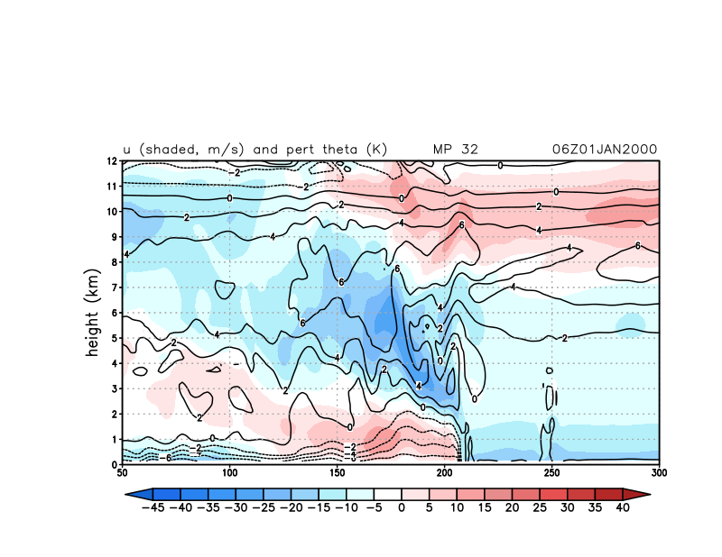
set e 22 (“full” bin microphysics scheme: 100x more time)

Slide 18
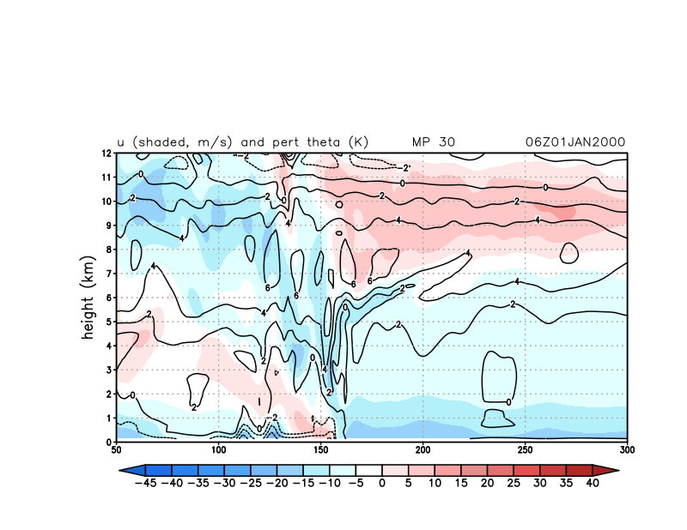
set e 21 (“fast” bin microphysics scheme: 35x more time)

Slide 19
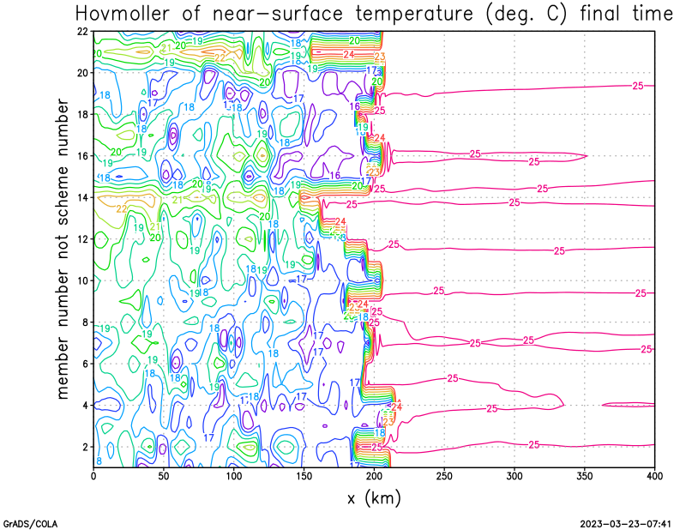
21 fast bin
14 NSSL LFO
13 SBU

Slide 20
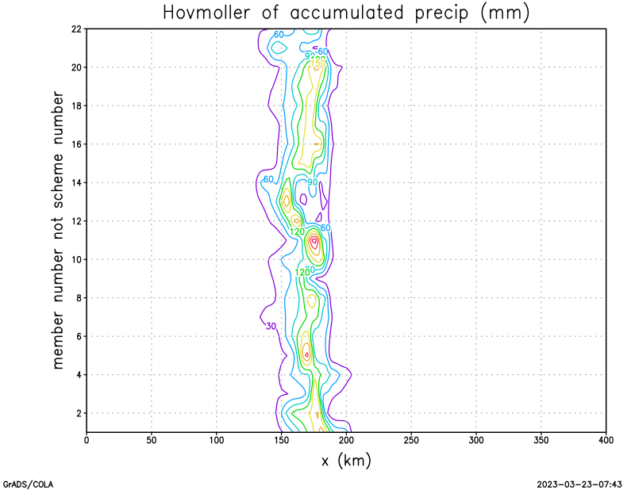
13 SBU
11 NSSL2

Slide 21
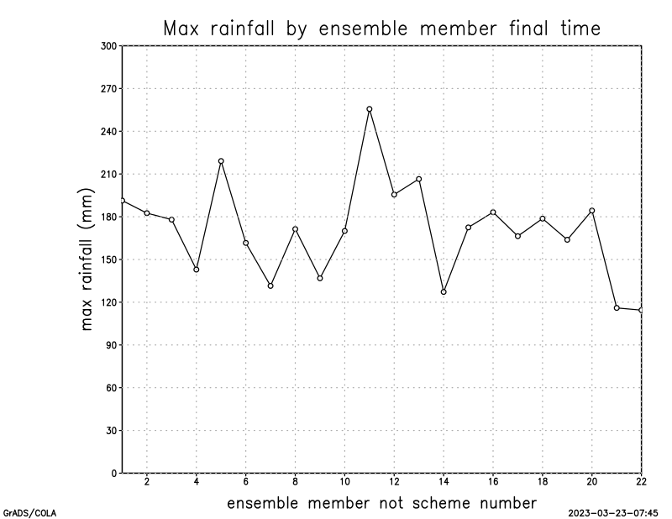
11 NSSL2
bin schemes

Slide 22
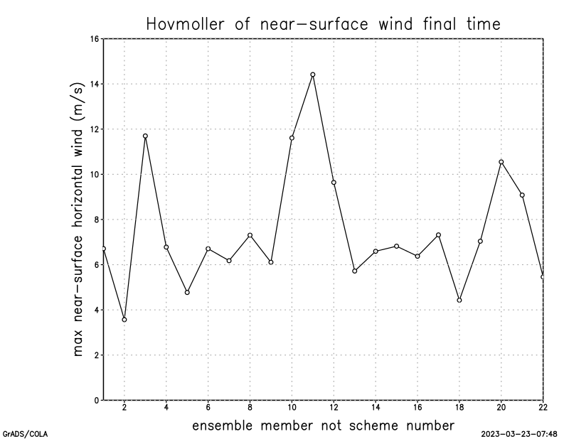
11 NSSL2

Slide 23
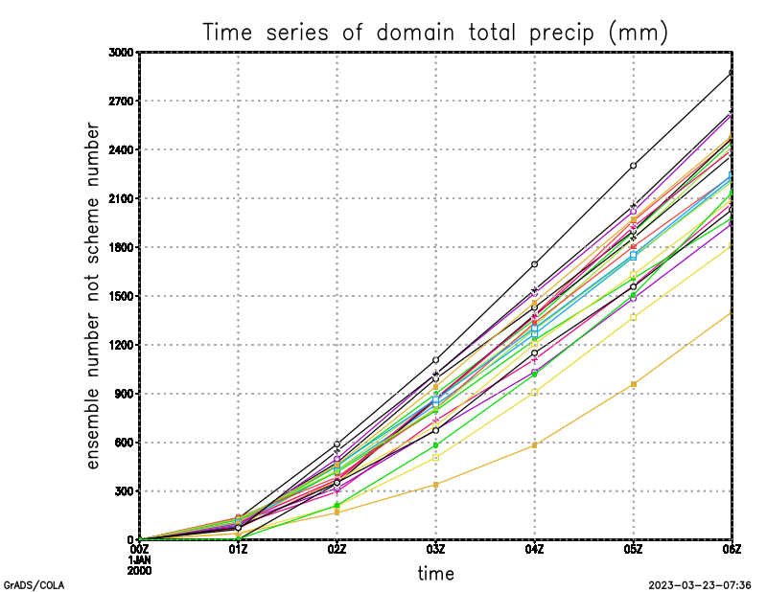
Lin
SBU

Slide 24
[end]

