Slide 1
Indicators of climate change, causes of climate change &
modeling of future climate change
Climate Change
Oliver Elison Timm ATM 306 Fall 2016
Lecture 7

Slide 2
Objectives
Introduce concepts of
  Climate forcing
  Climate sensitivity
  Fossil fuel consumption and greenhouse gas concentrations
  Emission scenarios and Representative Concentration Pathways (RPCs)
  Climate change projections with general circulation models (GCMs)
Notes:
The AMO is an ongoing series of long-duration changes in the sea surface temperature of the North Atlantic Ocean, with cool and warm phases that may last for 20-40 years at a time and a difference of about 1°F between extremes. These changes are natural and have been occurring for at least the last 1,000 years.
See:
http://www.aoml.noaa.gov/phod/amo_faq.php

Slide 3
Reminder: What is 'climate'?
The statistical description in terms of the average and variability of relevant quantities over a period of time
The classical period is 30 years, as defined by the World Meteorological Organization, WMO).
These relevant quantities are most often surface variables such as temperature, precipitation, and wind.
Climate in a wider sense is the state, including a statistical description, of the climate system.

Slide 4
What is the 'climate system‘?
The climate system is the complex system consisting of five major components:
the atmosphere, the hydrosphere, the cryosphere, the lithosphere and the biosphere, and the interactions between them.
The climate system evolves in time under the influence of its own internal dynamics and because of external forcings such as volcanic eruptions, solar variations, and human-induced forcings such as the changing composition of the atmosphere and land-use change.

Slide 5
What is 'climate change‘?
A statistically significant variation in either the mean state of the climate or in its variability, persisting for an extended period (typically decades or longer).
Climate change may be due to natural internal processes or external forcings, or to persistent anthropogenic changes in the composition of the atmosphere or in land use.

Slide 6
What is ‘global warming'
“Global warming” is an increase over time of the average temperature of Earth's atmosphere and oceans.
Use of the term “global warming" generally implies a human influence — the more neutral term “climate change” should be used for a change in climate with no presumption as to cause and no characterization of the kind of change involved.
Sometimes the term "anthropogenic climate change" is used to indicate the presumption of human influence.

Slide 7
Climate change signals in time series
(e.g. global temperature time series, ENSO index, etc)
Climate variability –
Stationary climate
Climate change –
Downward trend
(e.g. cooling)
Periodic change
Abrupt change
Burroughs, 2007

Slide 8
Climate change signals in time series
(e.g. global temperature time series, ENSO index, etc)
Stationary mean but
doubling of amplitude of
variability
Linear trend and change in
variability
Abrupt change and change
in variability
Burroughs, 2007

Slide 9
An update on US public perception
Inman, Nature Climate Change, 2012
Across all age groups, fewer US citizens accept global warming now than five years ago. Data taken from Pew Research (2011).
More information shown by state (county level) can be found at
Yale’s “Climate Opinion Maps (2014)”
Notes:
A further noteworthy article in this context: https://www.washingtonpost.com/news/energy-environment/wp/2015/03/10/floridas-ban-of-the-term-climate-change-is-straight-out-of-the-bush-playbook/

Slide 10
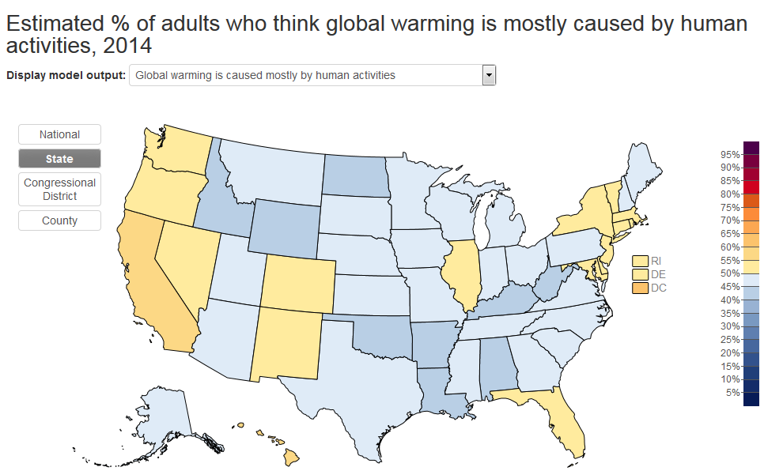
Across all age groups, fewer US citizens accept global warming now than five years ago. Data taken from Pew Research (2011).
More information shown by state (county level) can be found at
Yale’s “Climate Opinion Maps (2014)”
Notes:
A further noteworthy article in this context: https://www.washingtonpost.com/news/energy-environment/wp/2015/03/10/floridas-ban-of-the-term-climate-change-is-straight-out-of-the-bush-playbook/

Slide 11
Intergovernmental Panel on Climate Change (IPCC)
The IPCC was stablished by the United Nations Environment Programme (UNEP)
and the World Meteorological Organization (WMO) in 1988
  “[…] to provide the world with a clear scientific view on the current state of knowledge in climate change and its potential environmental and socio-economic impacts.”
  (quote from the official IPPC web page ww.ipcc.ch retrieved Nov. 2015)

Slide 12
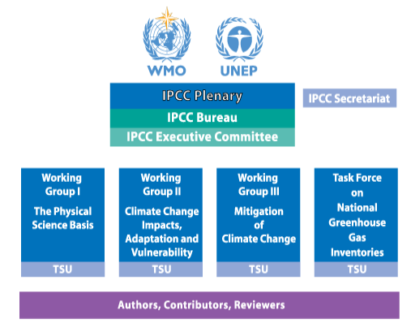
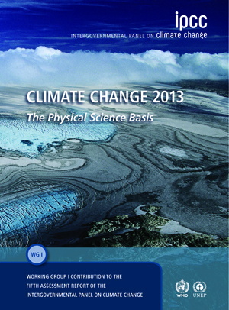
Intergovernmental Panel on Climate Change (IPCC)

Slide 13
Intergovernmental Panel on Climate Change (IPCC)
More than 830 Authors and Review Editors from over 80 countries were selected to form the Author teams that produced the Fifth Assessment Report (AR5).They in turn drew on the work of over 1,000 Contributing Authors and about 2,000 expert reviewers who provided over 140,000 review comments. For the Fourth Assessment Report (AR4) released in 2007, over 3,500 experts coming from more than 130 countries contributed to the report (+450 Lead Authors, +800 Contributing Authors, and +2,500 expert reviewers providing over 90,000 review comments).

Slide 14
Observational evidence for climate change
The fifth assessment report of working group 1 (AR5) was published 2013
Summary for Policymakers
(SPM)
SPM
Technical Summary
(TS)
TS
Full Report

Slide 15
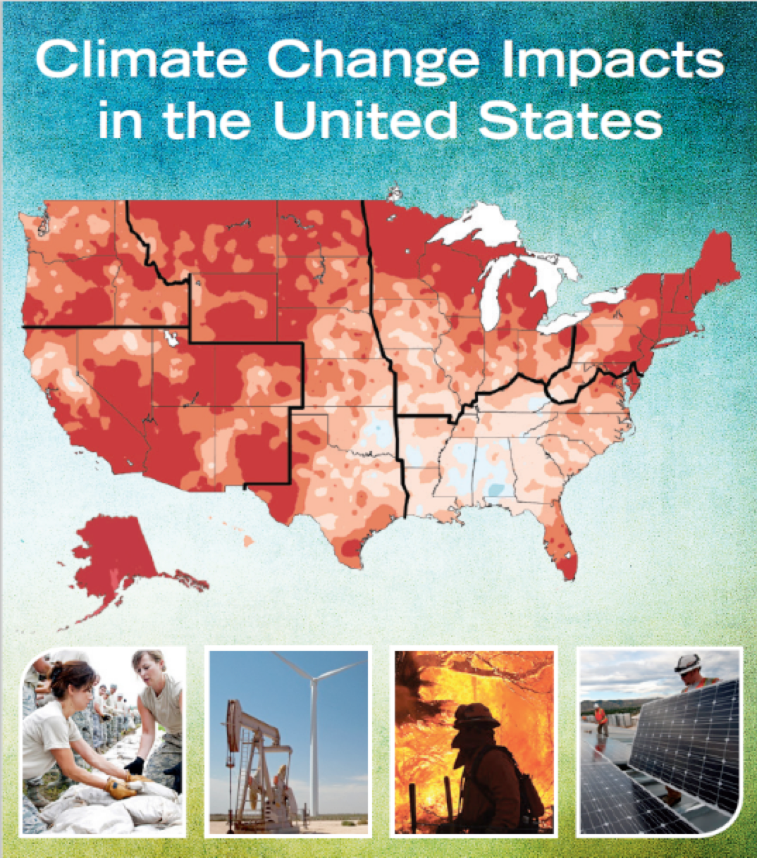
National climate change reports:
The National Climate Assessment provides a look at climate change impacts on the U.S
(published 2013/14)
Similar to IPCC it provides policymakers and other non-experts
with a compact summary of the
latest knowledge.
Focused more on the impacts than the
physics of climate change.
A web page provides access
to the report using interactive
web-design technologies

Slide 16
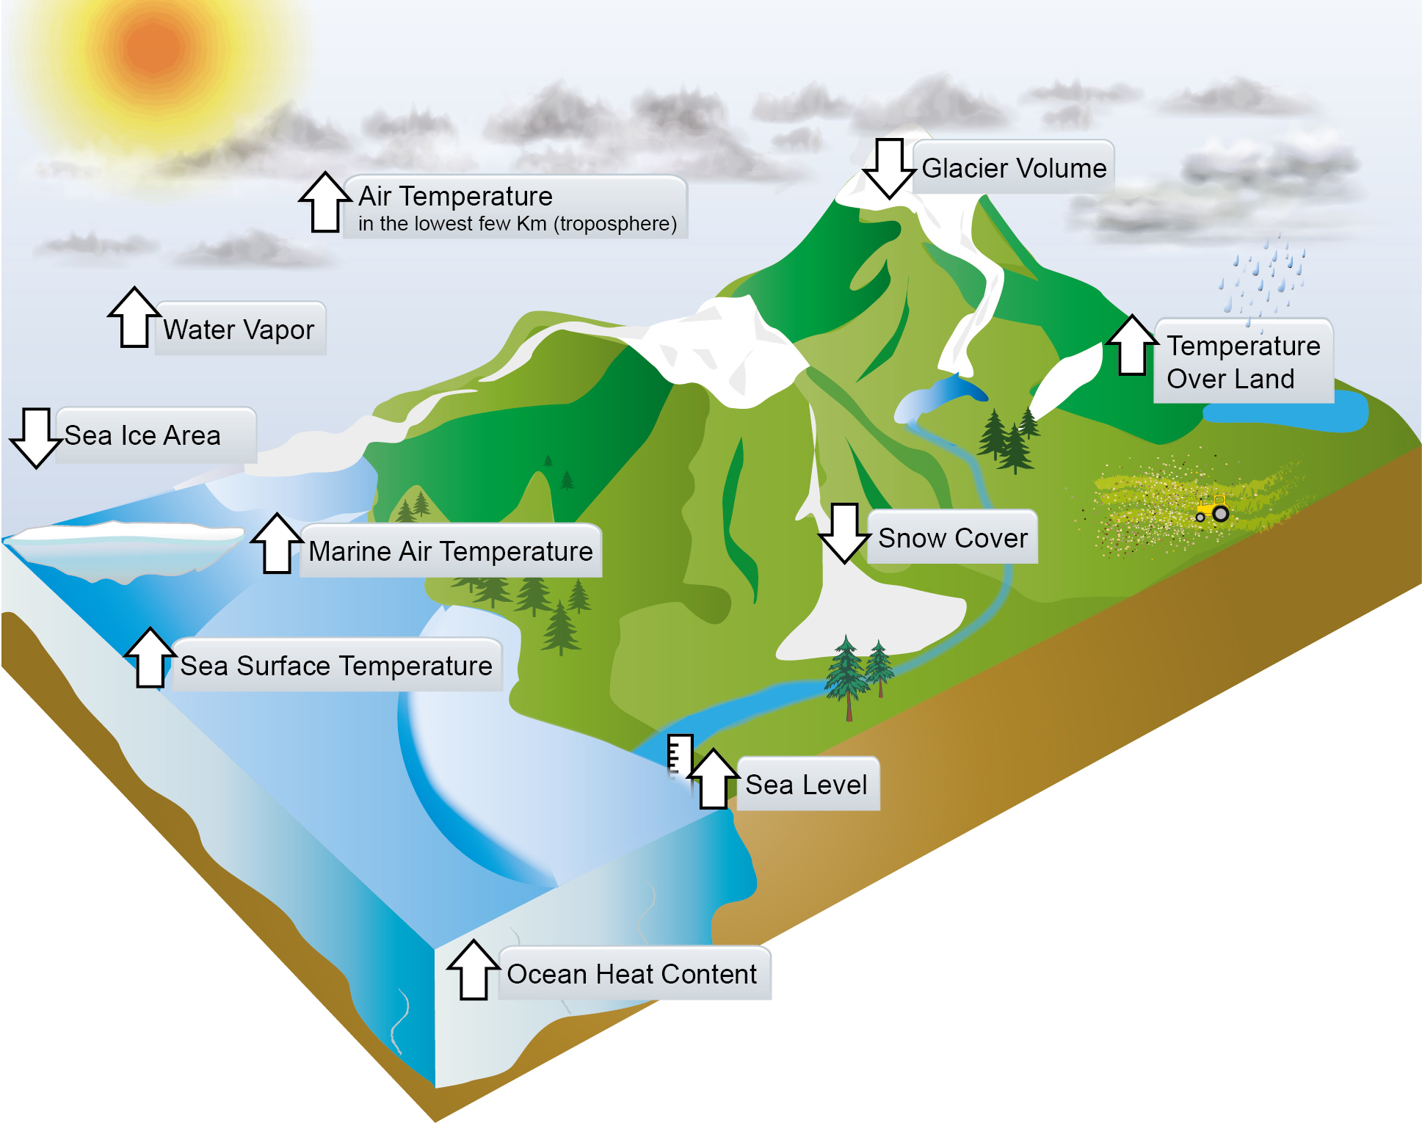
Observational evidence for climate change
IPCC WG1 AR, Report Ch. 2( FAQ 2.2, Fig 1)
Notes:
Note: But what about rainfall isn't rainfall a good indicator of climate change, too?
Yes and no: Global average rainfall less certain than temperatures, sea level, and mnay of the other observations.
That is because the precipitation change is not
Only positive but also negative in some regions.
Variables with only one possible sign in the change are clearer global average indicators.

Slide 17
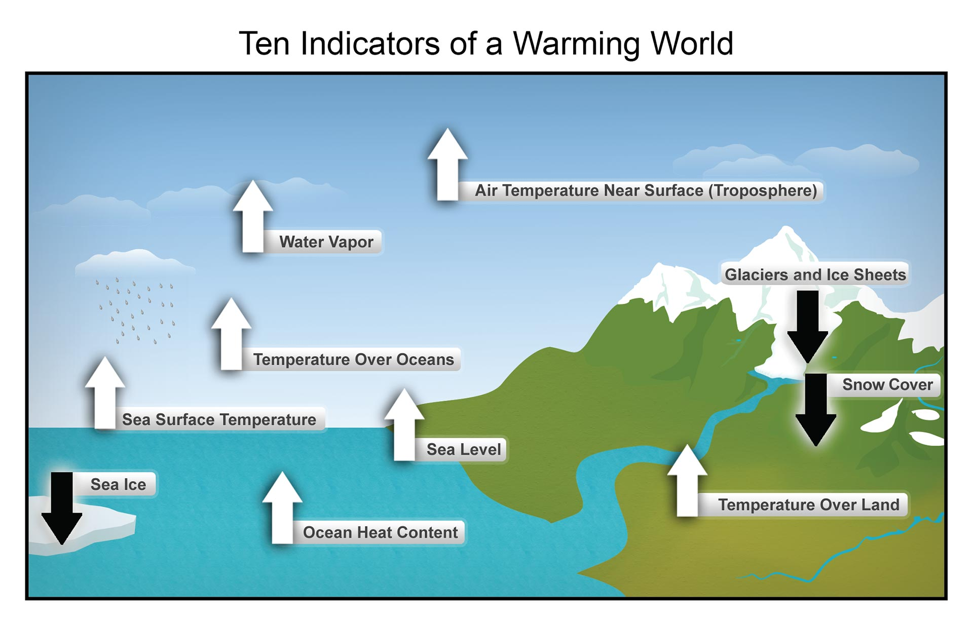
Observational evidence for climate change
http://nca2014.globalchange.gov/report
Notes:
Note: But what about rainfall isn't rainfall a good indicator of climate change, too?
Yes and no: Global average rainfall less certain than temperatures, sea level, and mnay of the other observations.
That is because the precipitation change is not
Only positive but also negative in some regions.
Variables with only one possible sign in the change are clearer global average indicators.

Slide 18
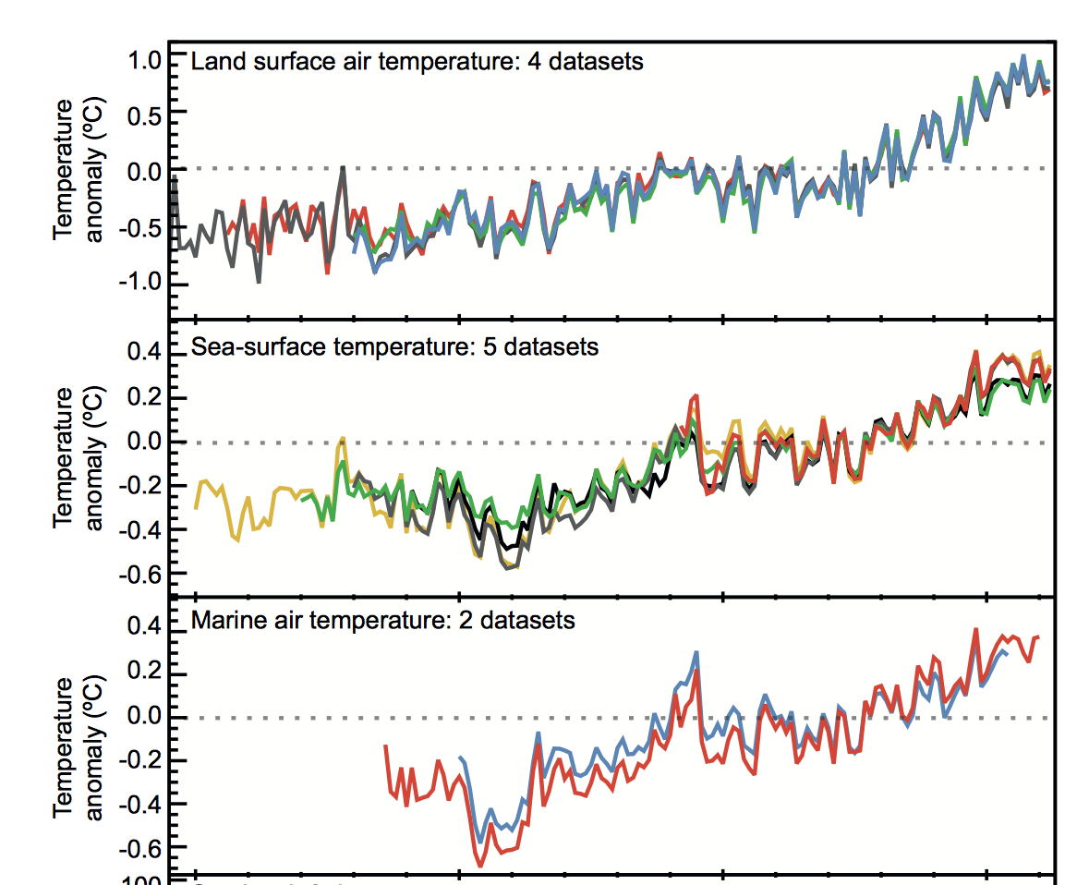
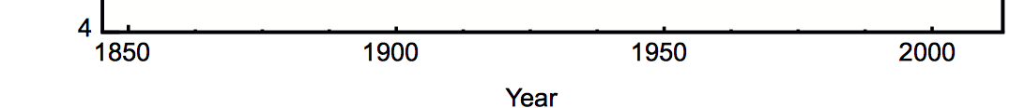
Changes in surface temperatures
over land and ocean
Land temperatures have increased more than ocean sea surface temperatures (or air temperature over ocean)

Slide 19
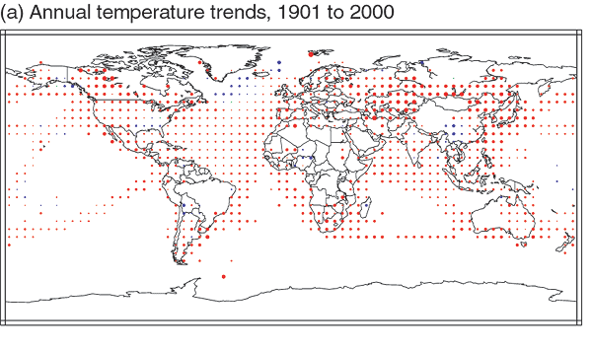

Spatial pattern of surface temperature changes
Notes:
19

Slide 20
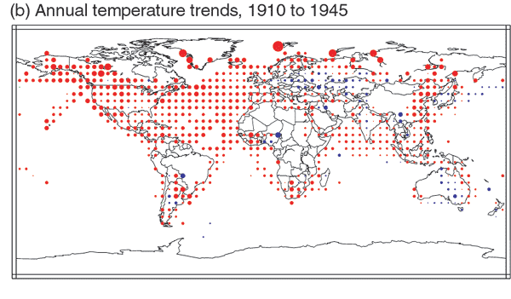
Spatial pattern of surface temperature changes
Notes:
20

Slide 21
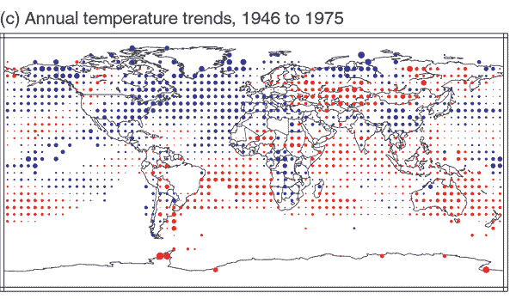
Spatial pattern of surface temperature changes
Notes:
21

Slide 22
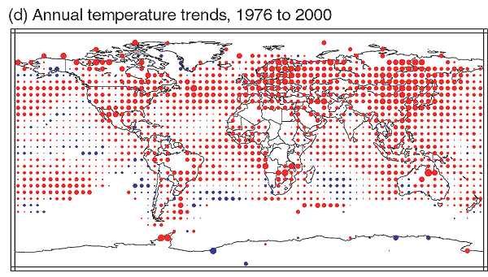
Spatial pattern of surface temperature changes
Notes:
22

Slide 23
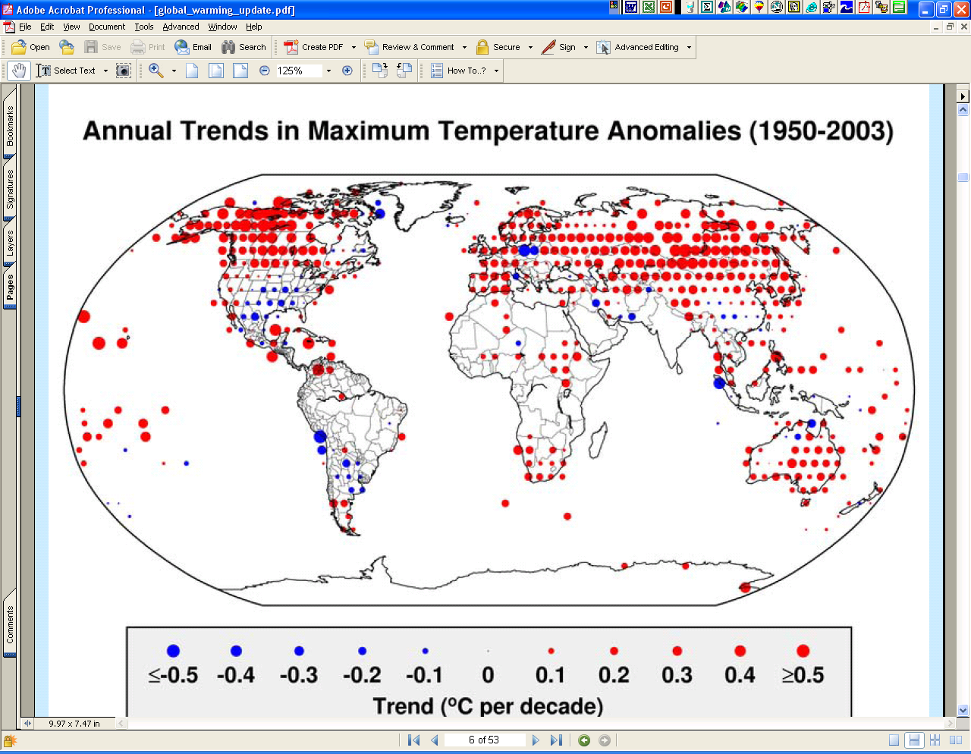
Notes:
23

Slide 24
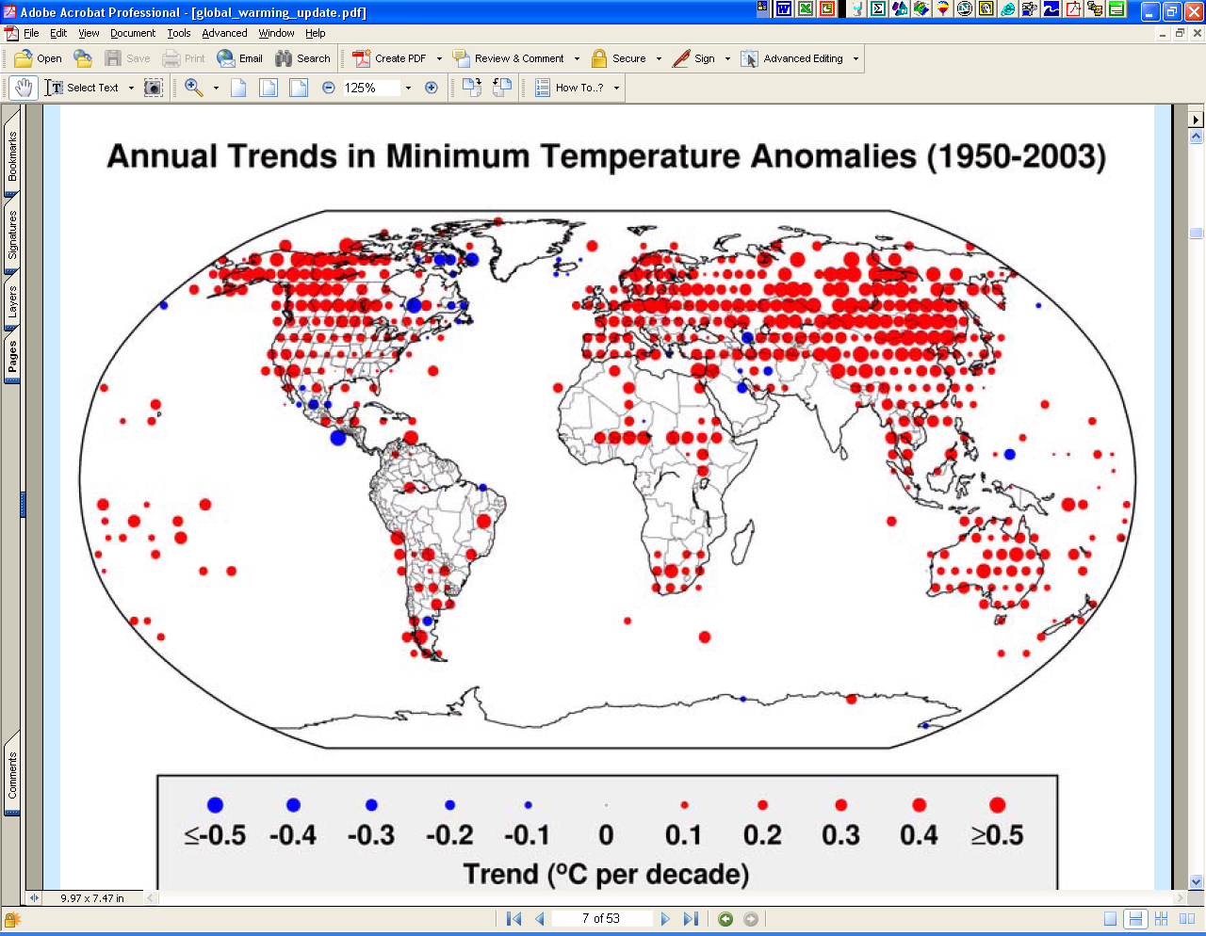
Notes:
24

Slide 25
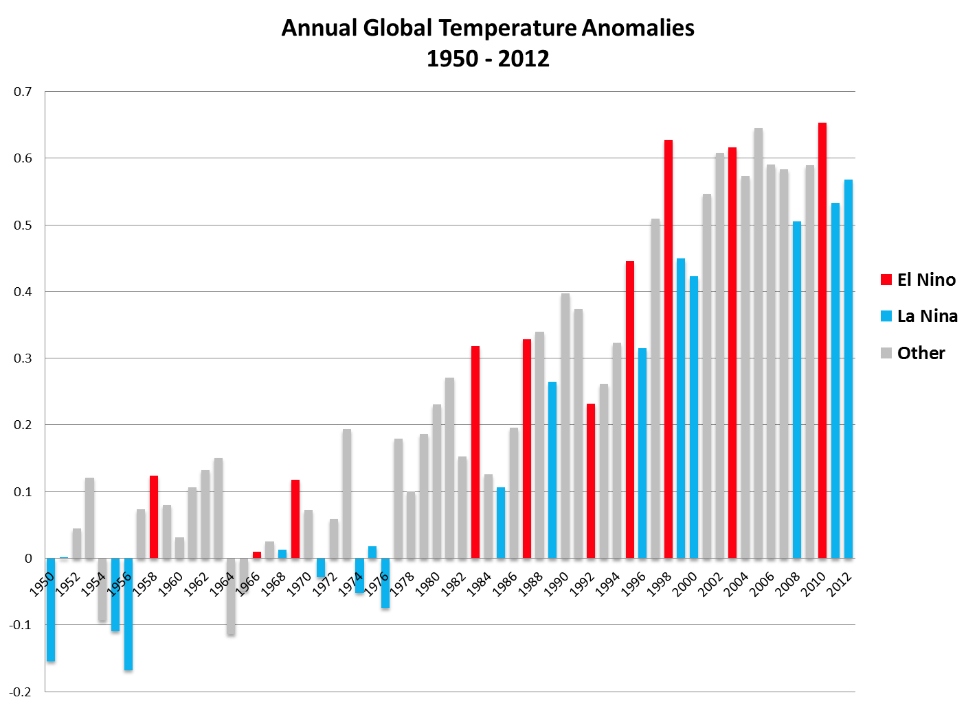
Natural variability:
El Niño globally warmer than La Niña years
Red marks:
El Niño
Blue: La Niña
El Nino years are
usually warmer than
normal*
(*compared with the years before and after)
Notes:
25

Slide 26
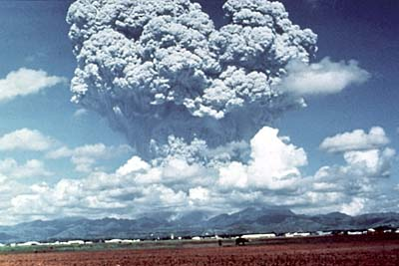
Strong volcanic eruptions
lead to surface temperature cooling
Cooling effect in an El Niño-year
Mt Pinatubo eruption
(date: 1991-06-15)
Notes:
Image from USGS (retrieved from http://pubs.usgs.gov/fs/1997/fs113-97/ on 2014-08-27 , copyrights may apply)
26

Slide 27
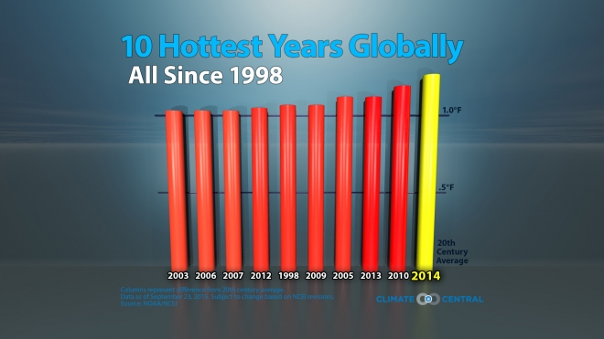
The 10 warmest years on record:
http://www.climatecentral.org/gallery/graphics/10-warmest-years-globally
Notes:
27

Slide 28
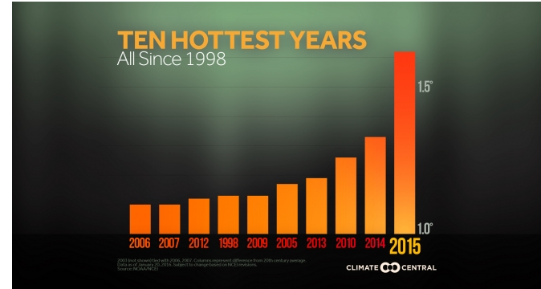
The 10 warmest years on record:
http://www.climatecentral.org/gallery/graphics/the-10-hottest-years-on-record
(retrieved Nov 2016)
Notes:
28

Slide 29
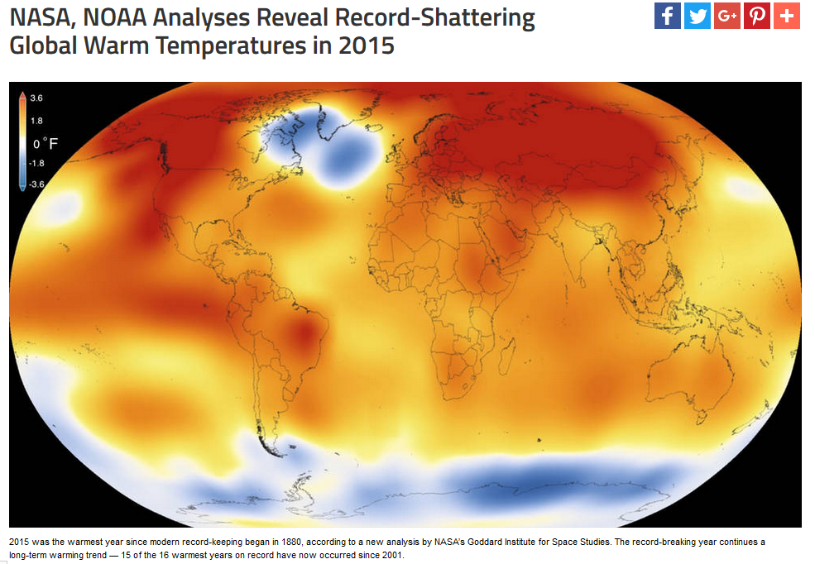
The 10 warmest years on record:
http://www.nasa.gov/press-release/nasa-noaa-analyses-reveal-record-shattering-global-warm-temperatures-in-2015
Notes:
29

Slide 30
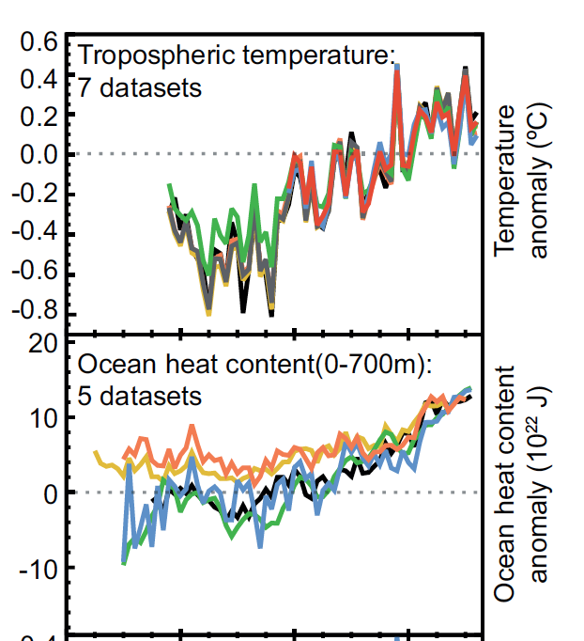
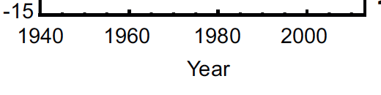
Changes in tropospheric temperature and
upper ocean heat content changes
Tropospheric temperature changes are obtained from
radiosondes (weather ballons, and from 1970s on satellites)
More than 90% of the excess in the TOA radiative energy imbalance has been estimated to be stored in the upper ocean 700m
Notes:
Note: remember our calculation of a heat content change for 1 yr of radiative imbalance:
2.38 W/m^2 over one year were good enough to give us 1 deg C warming for the upper 25m
And the energy amounted to 3.8*10^22 Joules.
Now from the scale of the units we can see here we are in the same order of magnitude, taking the longer years into account. We have yet to calculate the radiative forcing, and what causes the radiative imbalance.

Slide 31
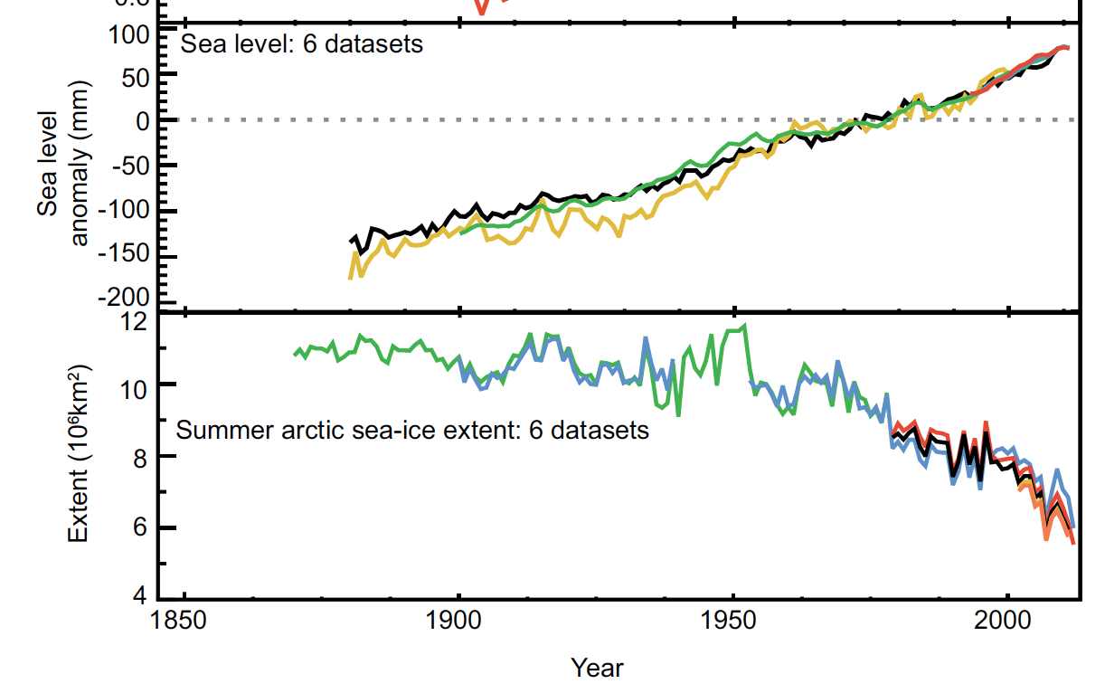
Changes in sea level
and Arctic sea ice (summer)
Sea level has been increasing globally
Summer Arctic sea ice
is decreasing (more rapidly in recent years)

Slide 32
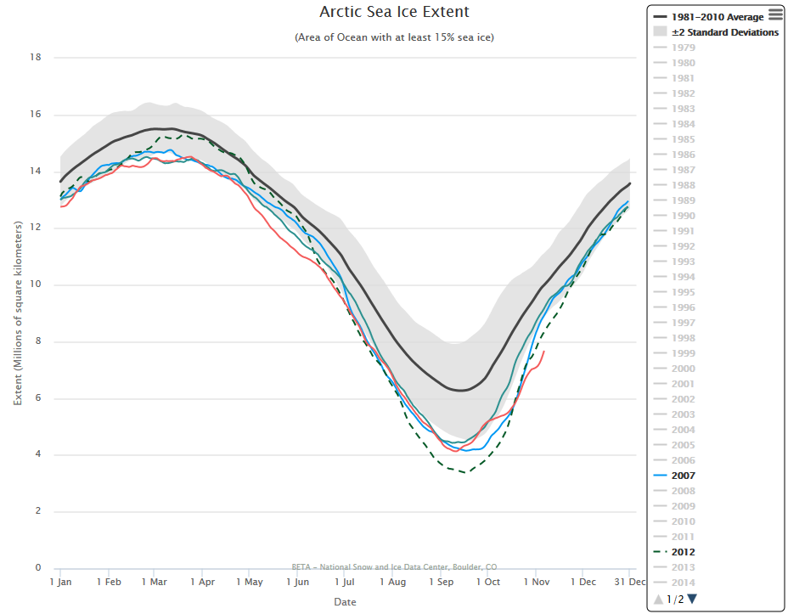
Changes in sea level
and Arctic sea ice (summer)
Summer Arctic sea ice
is decreasing (more rapidly in recent years)
2007, 2012 year with unusually low sea ice extents observed.
(black is the average
1981-2010;
gray shading the 2-sigma
standard deviation)
sea ice extent
(million square km)
National Snow Ice Data Center
http://nsidc.org/arcticseaicenews/charctic-interactive-sea-ice-graph/

Slide 33
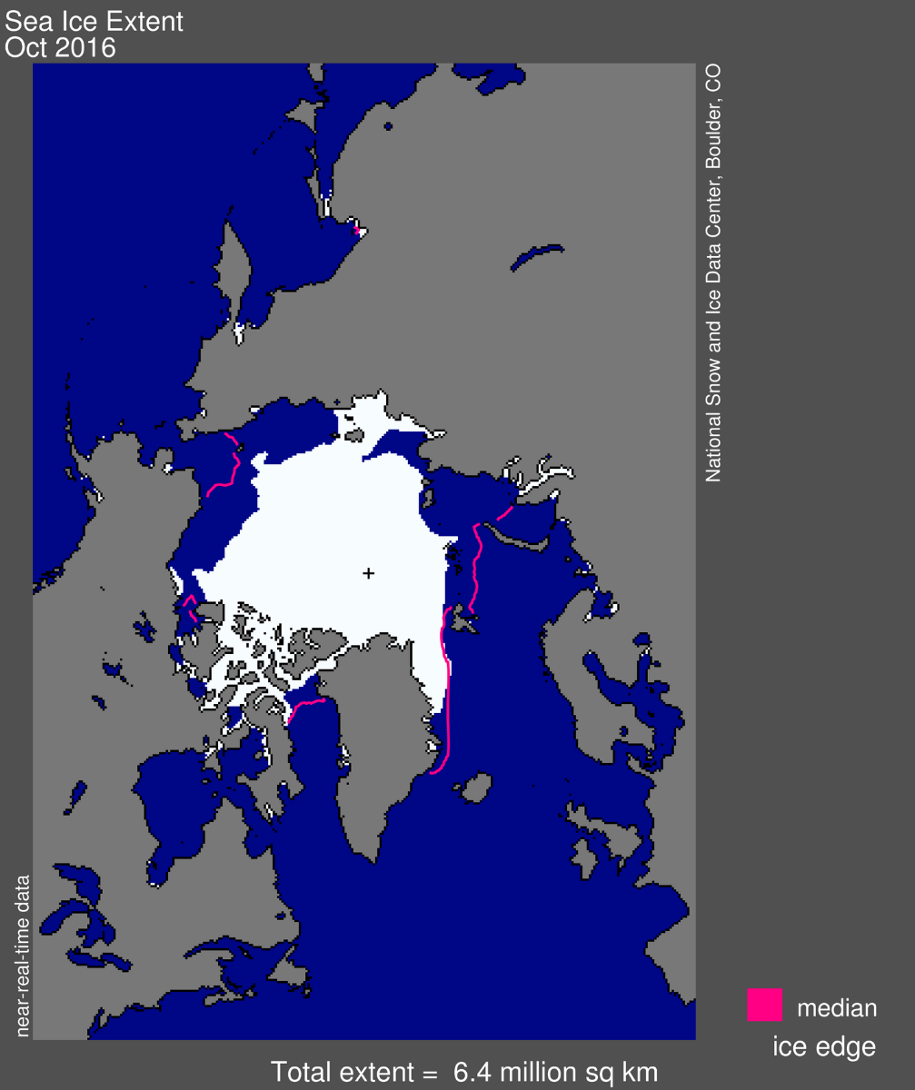
Changes in sea level
and Arctic sea ice (summer)
Summer Arctic sea ice
is decreasing (more rapidly in recent years)
2007, 2012 year with unusually low sea ice extents observed.
(black is the 1981-2010 average sea ice extent
(million square km)
National Snow Ice Data Center
(image retrieved Nov 2016)

Slide 34
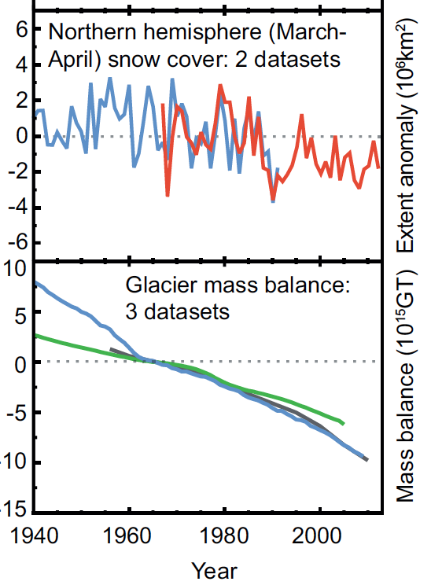
Other indicators of a globally warming climate
Land snow cover:
March/April snow cover
in northern hemisphere
glaciers mass balance:

Slide 35
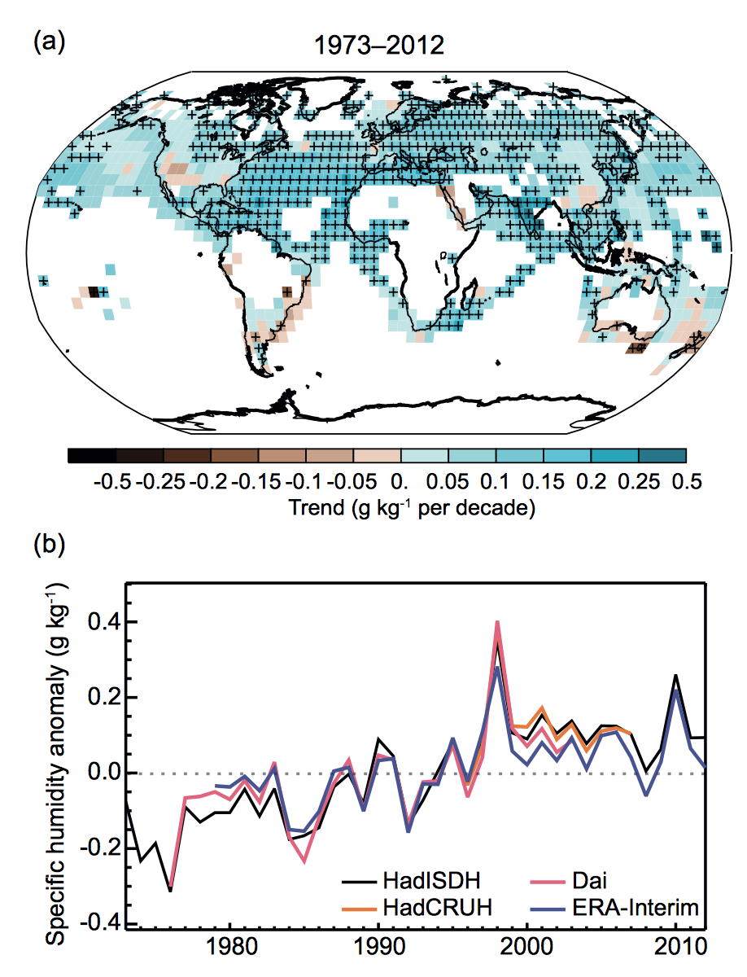
Other indicators of a globally warming climate
Specific humidity at surface
has increased
over land and ocean
Note: short records

Slide 36
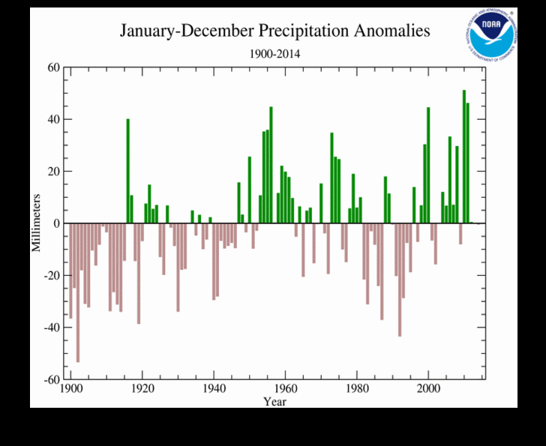
Indicators of a globally warming climate: Global precipitation?
Globally averaged precipitation
(land-based station data)
“For the third consecutive year, annual precipitation was near average on balance for land-based rain gauges around the globe. Precipitation for 2014 was 0.52 mm (0.02 inch) below the 1961–1990 average of 1,033 mm (40.7 inches)”
Source: NOAA
National Centers for
Environmental Prediction
retrieved on November 4, 2015 from http://www.ncdc.noaa.gov/sotc/global/201413.

Slide 37
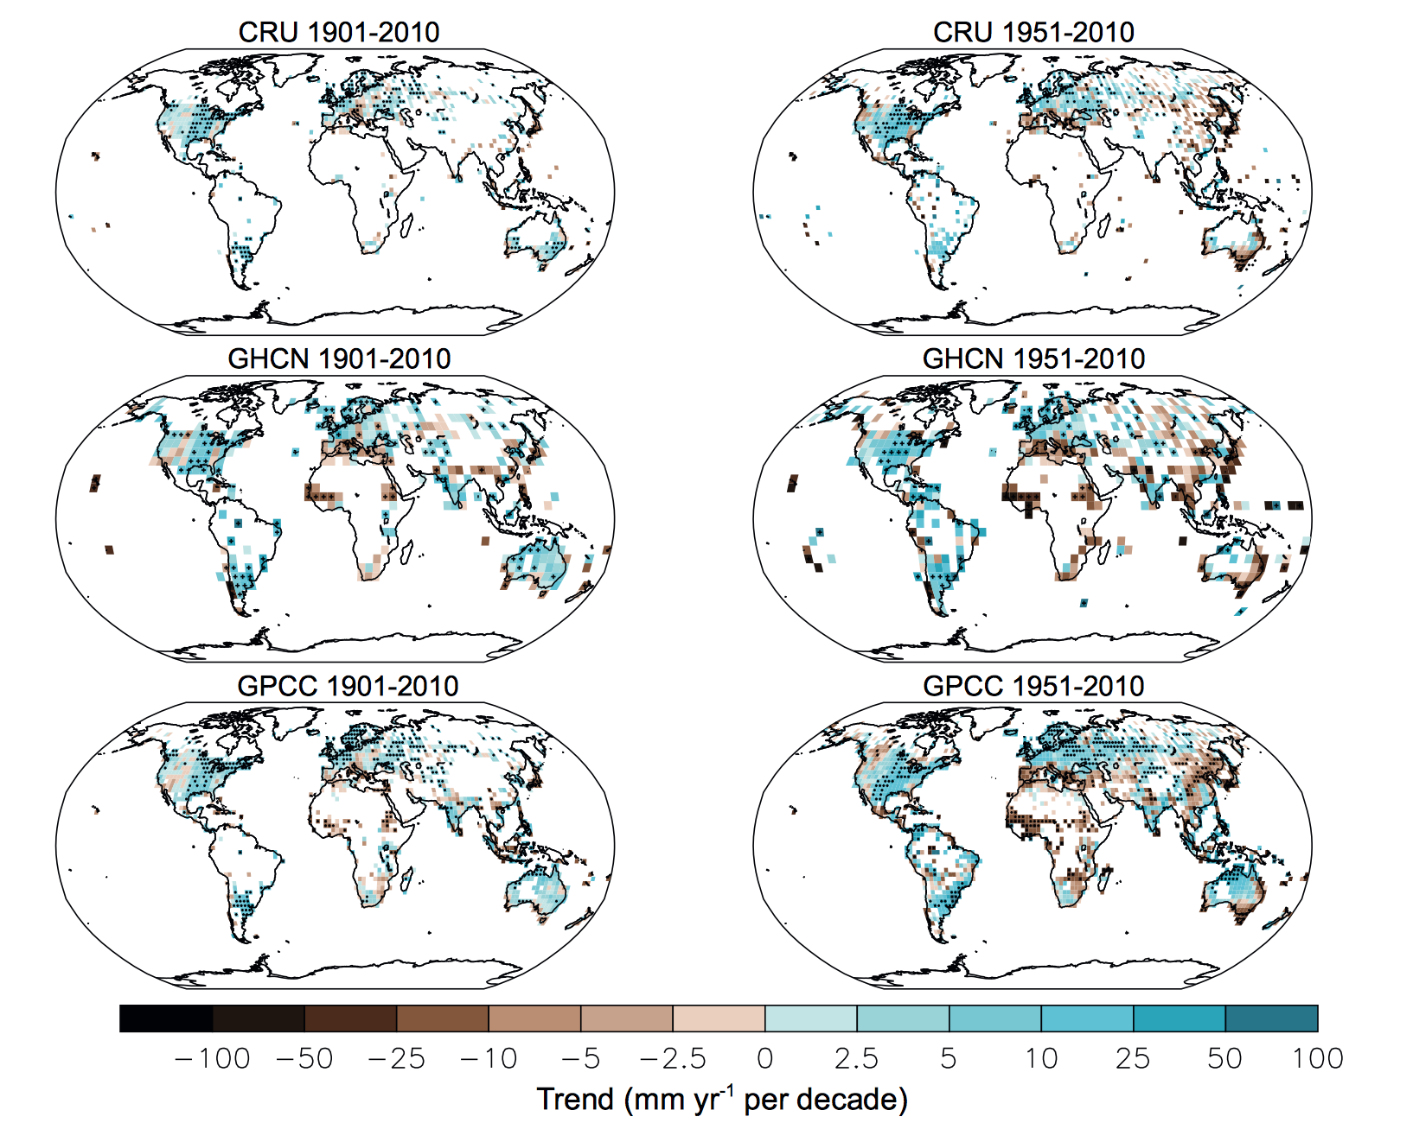
Pattern of Precipitation trends
Statistical tests
were conducted
on each regional
trend estimate
few regions show
significant
long-term trends
(they are marked
With a small ‘x’ in the map.
Note: NE US shows a strong
upward trend in average
(and extreme heavy rain events)

Slide 38
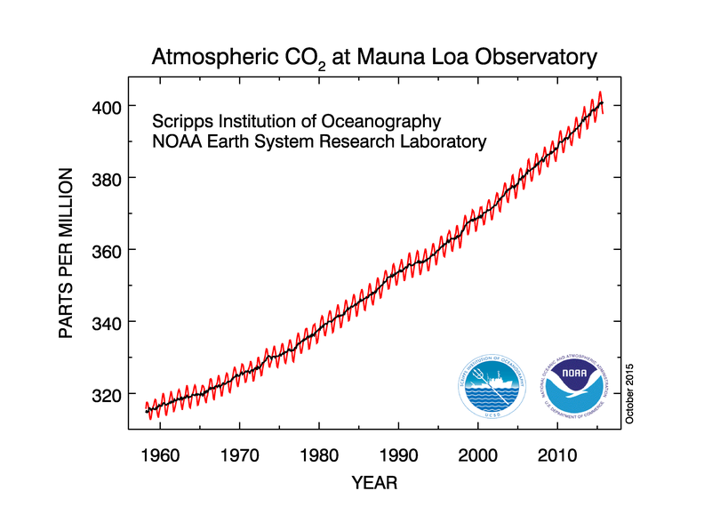
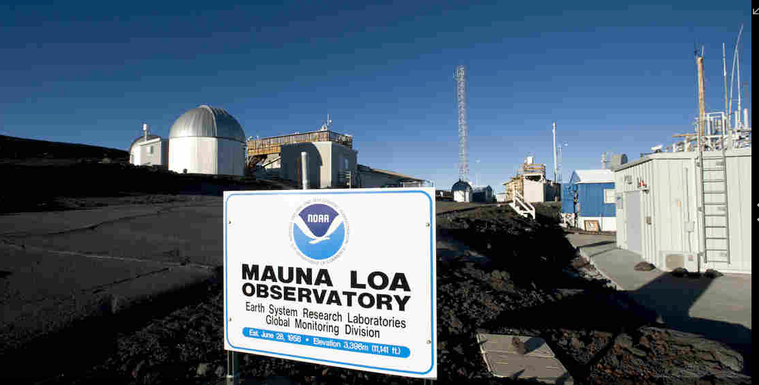
Atmospheric Carbon Dioxide
Background picture: source NPR

Slide 39
What causes the widespread warming trend and the associated environmental changes?
Researchers are confronted with two questions when it comes to
observation-based climate change investigations:
(a) Can we detect a change in the climate system or environment that is
consistent with a global warming trend?
This is the detection problem
(b) Once we have found a significant change in the system, the question is:
“What caused this change?”
This problem (or question) is known as the attribution problem
(we need to attribute the change to the right physical cause or causes)

Slide 40
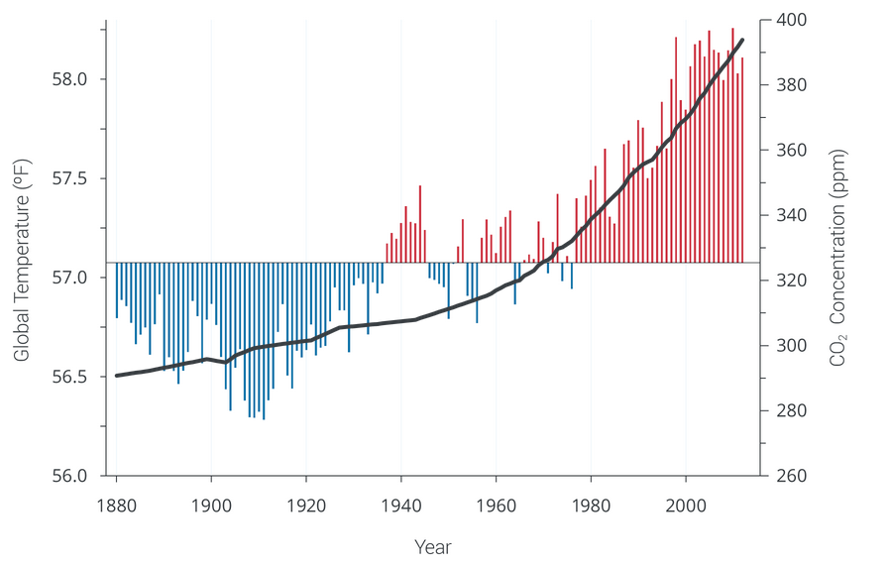
Global average temperature has increased by 0.85°C (1880-2012)
National Climate Assessment Report (2013)
Notes:
40

Slide 41
Atmospheric Carbon Dioxide
Background picture: source NPR

Slide 42
Global average temperature has increased by 0.85°C (1880-2012)
National Climate Assessment Report (2013)
Notes:
42

