Slide 1
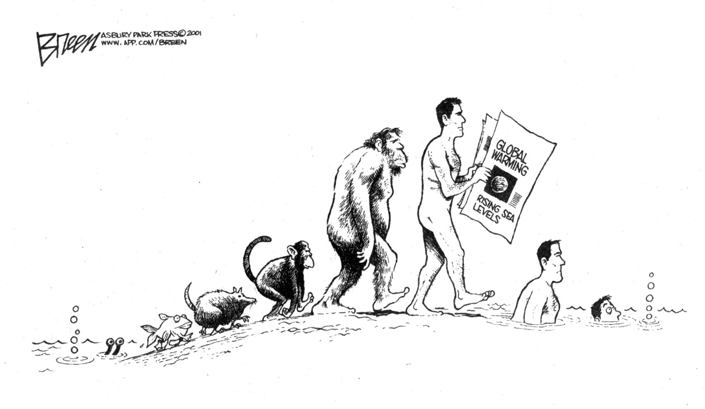
Sea level changes
Notes:
1

Slide 2
Sea level changes
Notes:
2

Slide 3
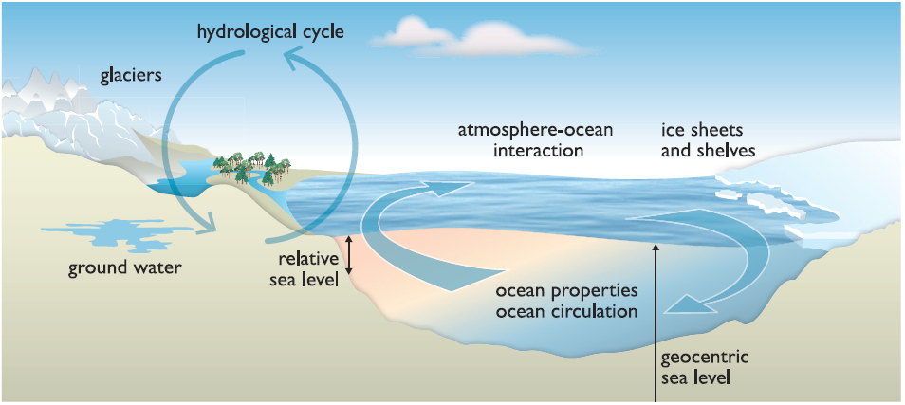
Some important terms used for global sea level (and changes)
IPCC WG1 AR5, Ch. 13 (Figure 13.1)

Slide 4
Some important terms used for global sea level (and changes)
Relative sea level (RSL): the height of the ocean surface at any given location, or sea level, is measured with respect to the surface of the solid Earth. (Measured at tide gauge stations)
Geocentric sea level (GSL): sea level is measured in a geocentric system: relative to a reference ellipsoid (from satellite observations)
Mean sea level (MSL):
time-average height at a location.
Global mean sea level (GMSL):
Averaged spatially we obtain
(and in time)
IPCC WG1 AR5, Ch. 13 (Figure 13.1)

Slide 5
A brief review of past sea level changes
During the last 3 million years:
  global mean sea level has exceeded 5 m above present sea level (very high confidence)
Last high-stand was during the last interglacial period (~129 to 116,000 years before present);
during the last interglacial the estimated global temperatures were 2 deg C warmer than the pre-industrial times (19th century).

Slide 6
Past sea level changes
Global mean sea level rose 2 to 3 m to near present-day levels between 7000-3000 years ago.
Last 2000 years before present, fluctuations in global mean sea level were less than 25 cm

Slide 7
20th century sea level changes
Global sea level increased at a rate of 1.5-1.9mm/yr between years 1901-2010 (estimated from observations)
Since 1993 the rate was about 3.2mm/yr (2.8-3.6)
  Primary contributors are thermal expansion of water
  Melting glaciers
  Contributions from Greenland ice sheet and Antarctic ice sheets have increased since 1990s.
IPCC WG1 AR5 report, Chapter 13, executive summary

Slide 8
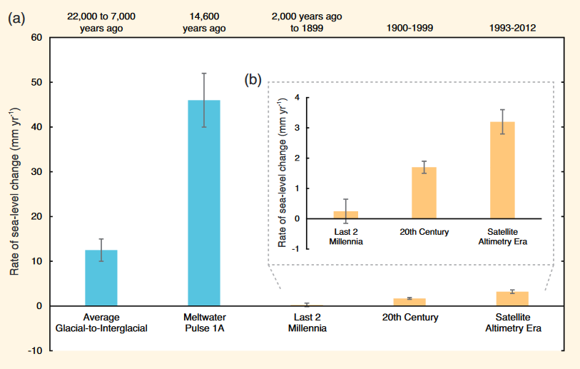
Rate of Global Sea Level Change
It is very likely that the 21st century sea level rise will be at a higher rate than in the 20th century
?
IPCC WG1 AR5 report, Chapter 5. FAQ 5.2 (Chapter 13, executive summary)
Notes:
Note: Meltwater Pulse 1A is associated with an extremely rapid disintegration of the Laurentide Ice Sheet. In addition contributions from Antarctic ice melt has further accelerated the seas level rise. The event was ‘short-lived’ probably 800-1200a long

Slide 9
Measurements of global sea-level rise
Tide-gauges:
  + long-term observations
  - local factors can bias the readings
Satellite data:
  + near-global coverage, high precision
  - short observational records

Slide 10
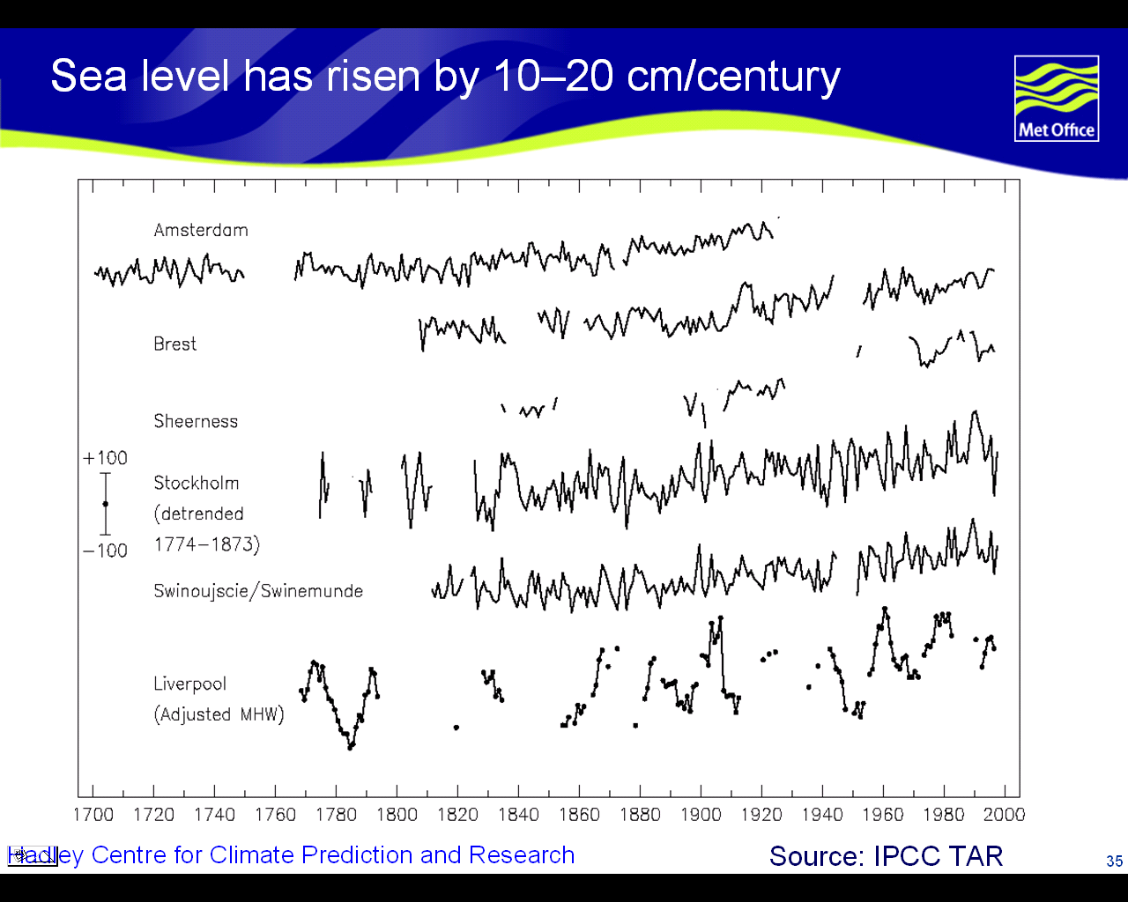
Notes:
10

Slide 11
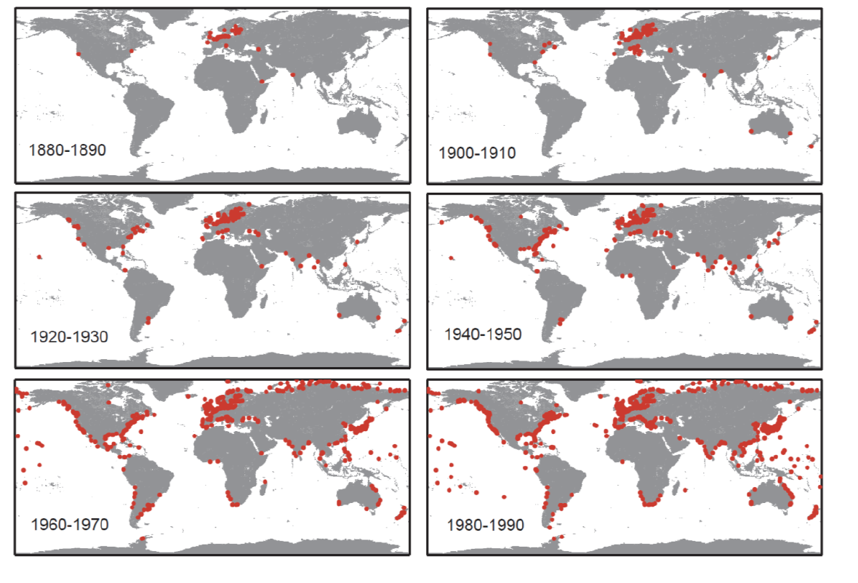
Location of tide gauges
IPCC, AR5, WG1, Chapter 3, [2013]

Slide 12
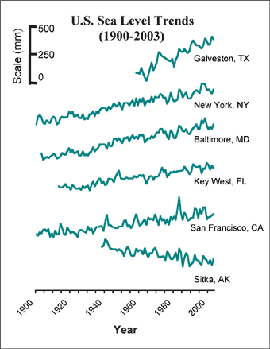
SLR influenced locally by subsidence (Texas) and isostatic rebound (Alaska)
This rebound of the Earth’s solid crust is a result of the last glaciation. The weight of the ice
pushed down the crust (due to viscous-elastic processes in the underlying asthenosphere) and this is slowly recovering.
This isostatic adjustment process is still going on in North America
and Scandinavia and parts of Europe (and other parts of the globe)
Source: Permanent Service for Mean Sea Level (PSMSL) data set
Notes:
12

Slide 13
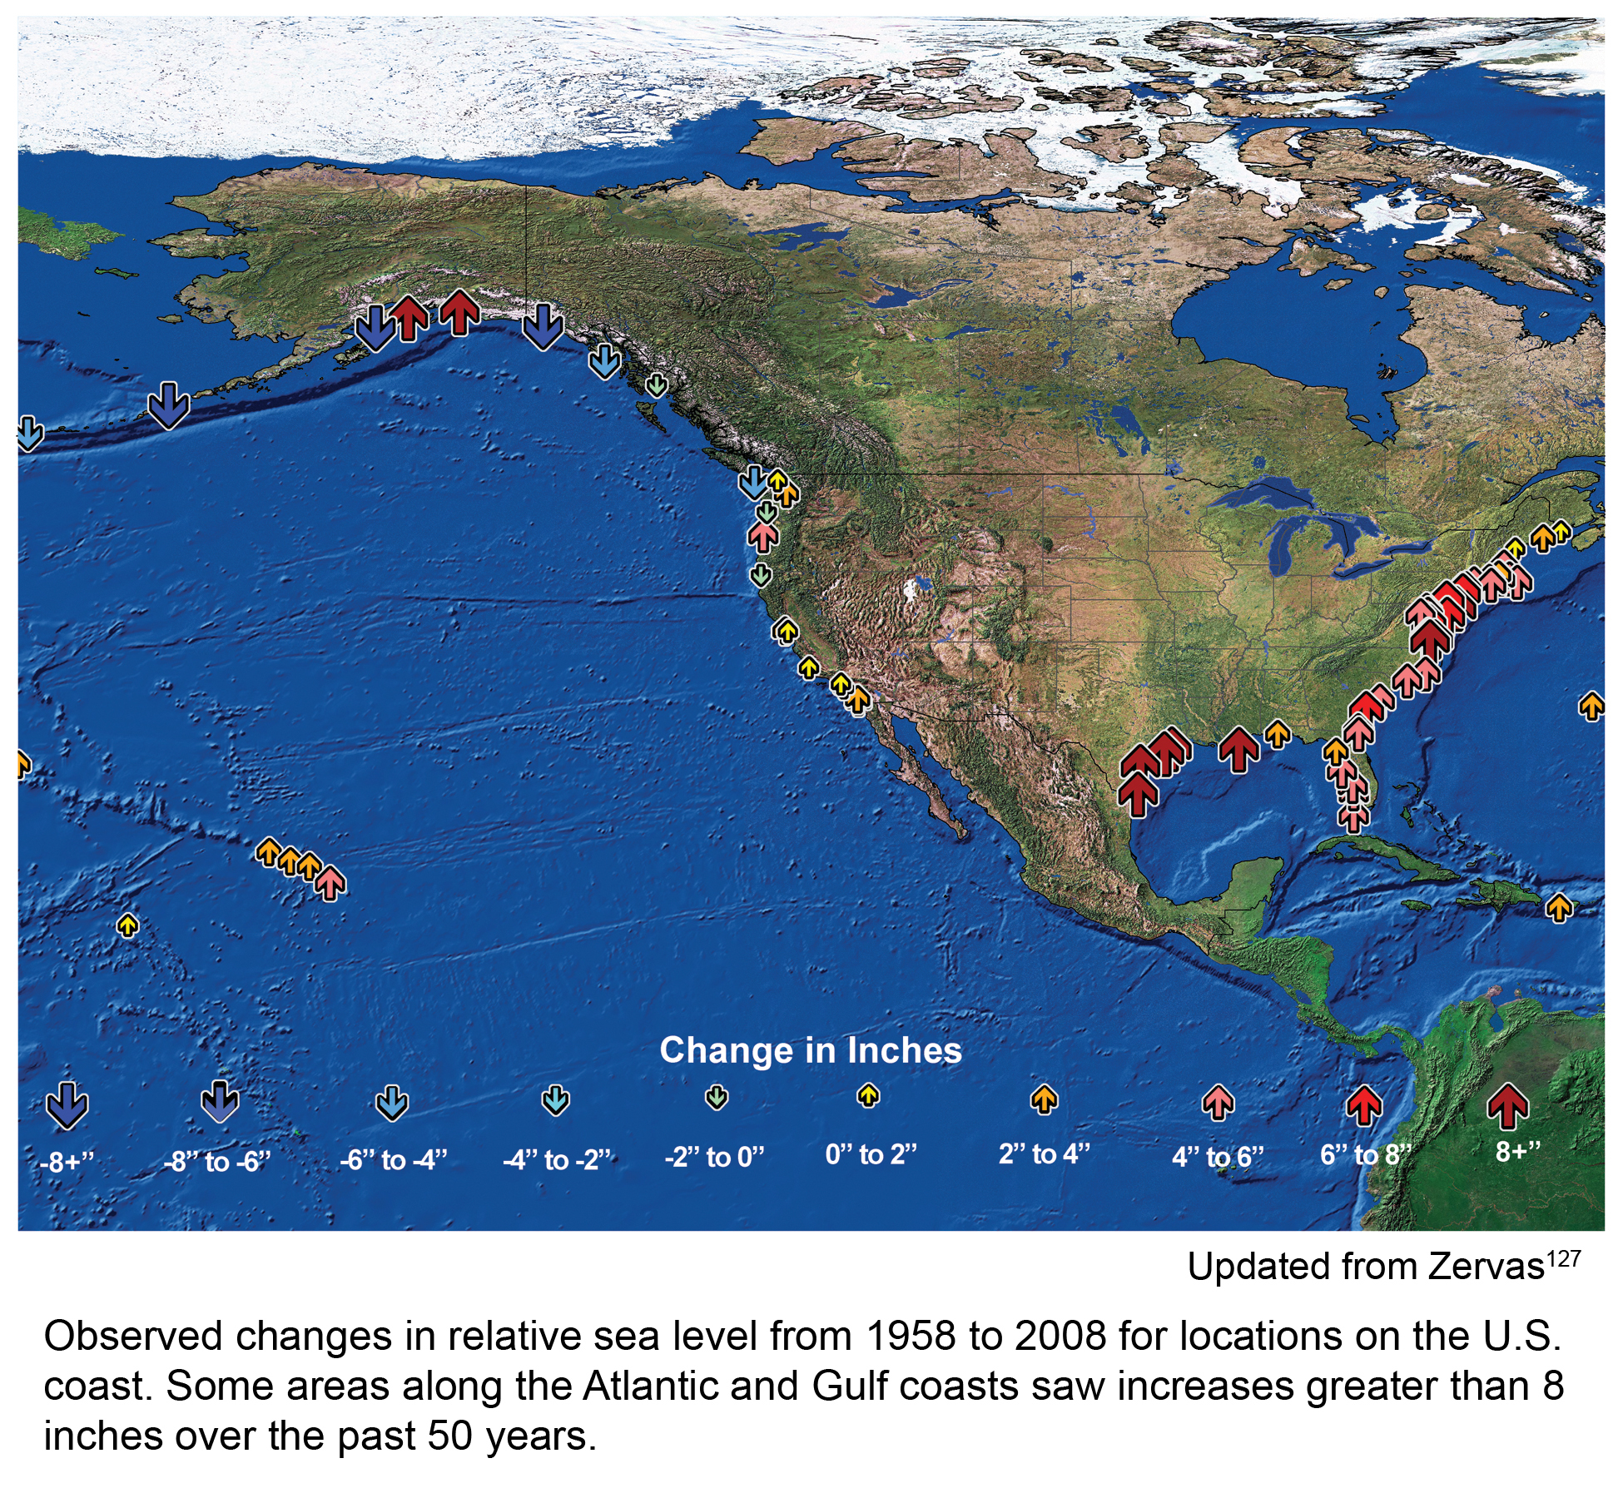
Observed sea level rise 1958-2008
US Global Change Research Program, 2009
Notes:
13

Slide 14
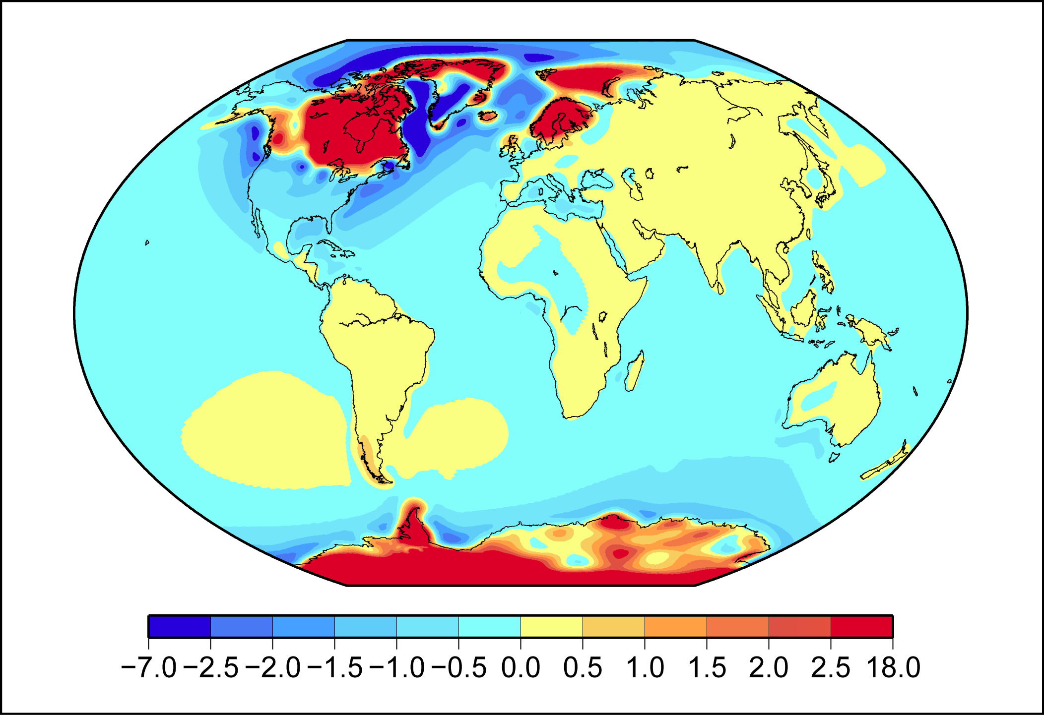
Glacial Isostatic Adjustment
mm/yr
http://www.antarcticglaciers.org/glaciers-and-climate/sea-level-rise-2/recovering-from-an-ice-age/
Notes:
http://www.antarcticglaciers.org/glaciers-and-climate/sea-level-rise-2/recovering-from-an-ice-age/
14

Slide 15
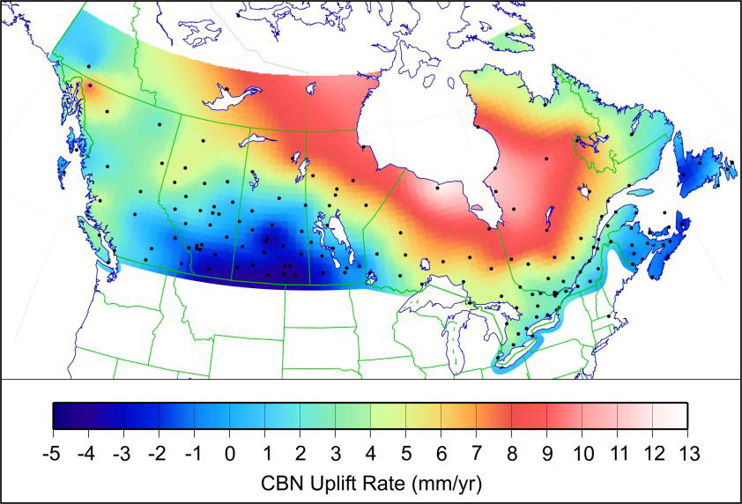
Glacial isostatic adjustment
Repeated GPS observations at Canadian base network stations have
permitted the detection of vertical uplift
Notes:
http://www.nrcan.gc.ca/earth-sciences/geomatics/geodetic-reference-systems/tools-applications/3d-networks/9082
15

Slide 16
20th century sea-level rise (departures from 1961-90 average)
Red: reconstructed
(+ 90% confidence intervals)
Blue: coastal tide
gauge measurements
Black: satellite altimetry
20th century sea-level rise:
~1.7 mm/yr
(based on ‘stable’ estimates)
IPCC, AR4, WG1, 2007
Notes:
16

Slide 17
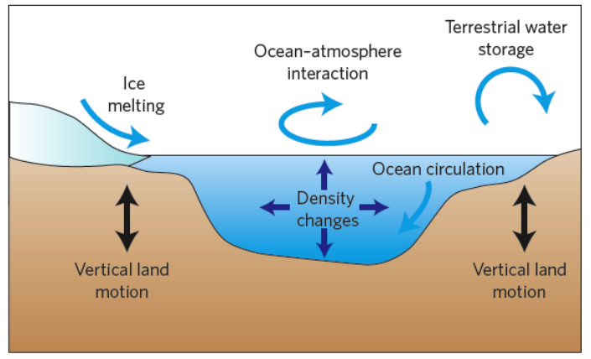
The causes for sea level rise:
Attribution to the sources
Milne et al., Nature Geoscience, 2009

Slide 18
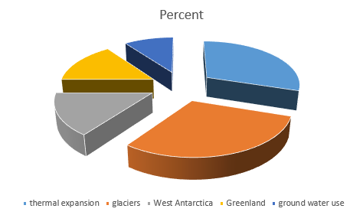
Contribution by source to total sea-level rise (1993-2009)
Source: Nicholls and Cazenave, Science (2010)
Notes:
Work at
18

Slide 19
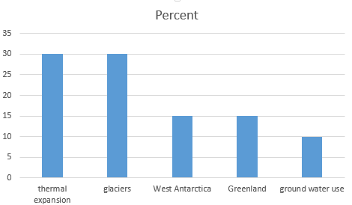
Contribution by source to total sea-level rise (1993-2009)
Years 1993-2009: on average 3.3 mm/yr
(compared with the trend since 1950s of ~ 1.7mm/yr, we see accelerated sea level increase)

Slide 20
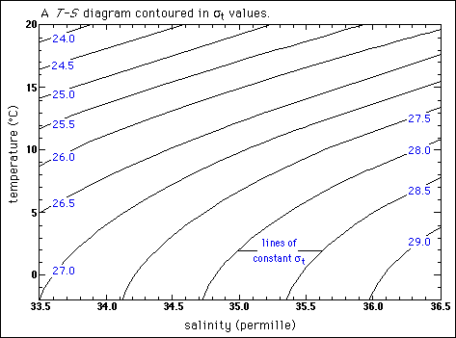
Thermal expansion (density of water)
Equation of state for sea water is a function of temperature, salinity, and pressure
density calculator
Non-linear relationship
A fixed degree warming
changes density more
in salty warm waters than in
cold less salty waters:
The detailed calculations
of sea-level rise must
consider the spatial pattern of
the ocean warming
Note: Sigma is density-1000kg/m^3
Notes:
Source: http://dusk.geo.orst.edu/oceans/lec14H.html
Note sigma is density-1000
20
You can go to a online calculation tool http://www.phys.ocean.dal.ca/~kelley/seawater/density.html
for the density calculation. Once you have the density, you can get for any fixed water mass the volume.
A change in density per degree warming can be approximated as a linear change. You pick your water mass with a current T,S (average value) and then mark get the difference in density when you go to T+deltaT, S.
Note the pressure increases with depth: The decibar is a c
onvenient unit because hy
drostatic pressure
increases by about one decibar per mete
r (or ~ 1 atmosphere every 10 meters).

Slide 21
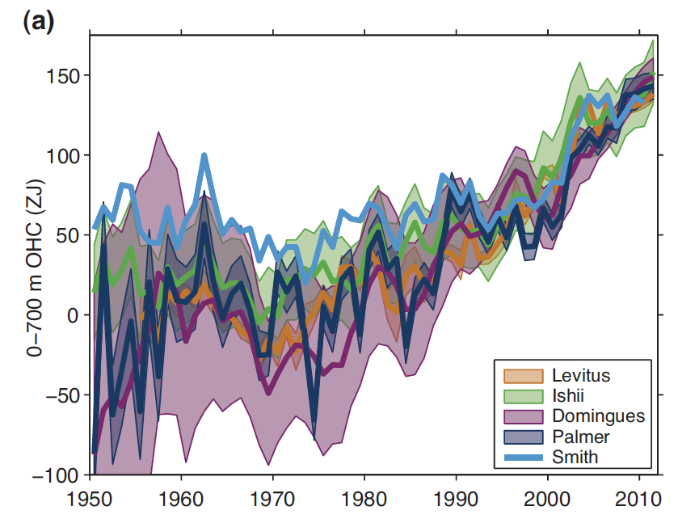
The ocean is expanding because its heat content is increasing
Observation-based estimates of annual global mean upper (0–700 m) ocean heat content in ZJ (Zetajoules, 1 ZJ = 10²¹ Joules)
IPCC, AR5, WG1, Chapter 3, [2013]
Notes:
21

Slide 22
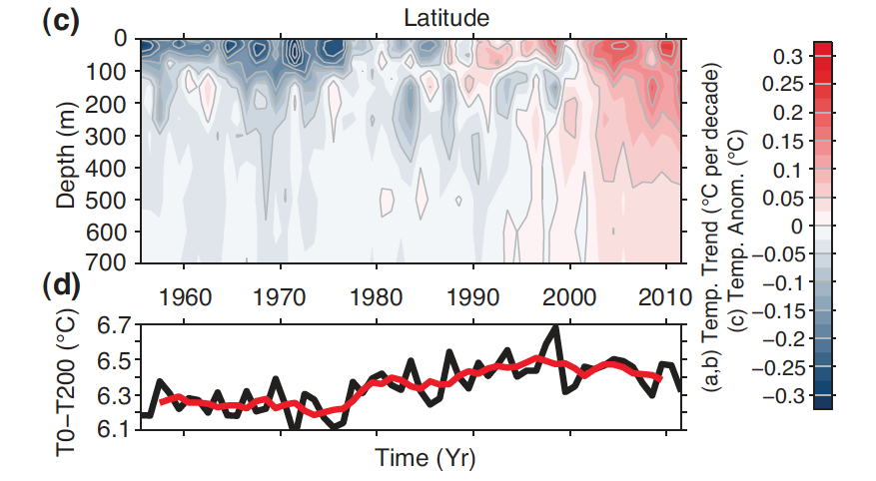
The ocean is expanding because its heat content is increasing
Globally-averaged temperature anomaly (time versus depth, colors and grey contours in  C) relative to the 1971–2010
mean.
Globally-averaged temperature anomaly (time versus depth, colors and grey contours in deg C) relative to the 1971–2010 mean.
IPCC, AR5, WG1, Chapter 3, [2013]
Notes:
22

Slide 23
3 estimates of changes in upper 700 m ocean heat content
Depends on 3-dimensional distribution of ocean temperature change
(expansion rate is temperature- and pressure- dependent)
IPCC, AR4, WG1, 2007
Notes:
23

Slide 24
SLR due to thermal expansion of upper ocean (0-700 m)
Contribution from thermal expansion:
~ 0.4 mm yr⁻¹
(1961-2003)
~ 1.6 mm yr⁻¹
(1993-2003; probably an overestimation))
(compared to ~ 2.8 mm yr⁻¹ total SLR)
IPCC, AR4, WG1, 2007
Notes:
24

Slide 25
Assessments of future sea-level rise
Global mean sea
level evolution over
the 20th and 21st
centuries.
red curve: tide
gauge measurements
black curve: altimetry
record (zoomed over
the 1993–2009 time
span)
shaded light blue:
IPCC AR4 (A1FI
scenario)
Bars: semi-empirical
projections
Nicholls and Cazenave,
Science, 2010

Slide 26
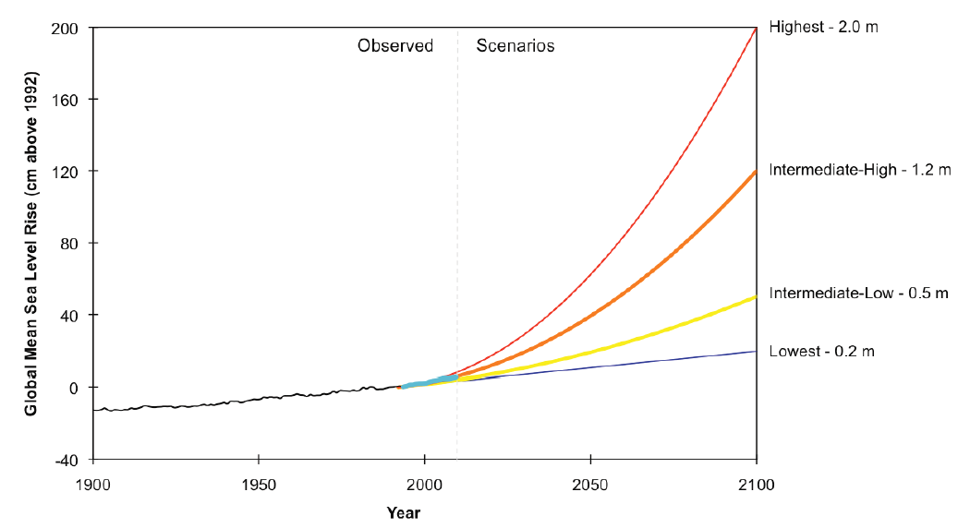
Global sea level is expected to rise, but
large uncertainty in projections by year 2100.
Expansion due to warming
Melting of glaciers, ice caps
4ft
2ft
8-12inch
Figure from NOAA Technical Report OAR CPO-1
Global Sea Level Rise Scenarios for the United States
National Climate Assessment (Parris et al, 2012)

Slide 27
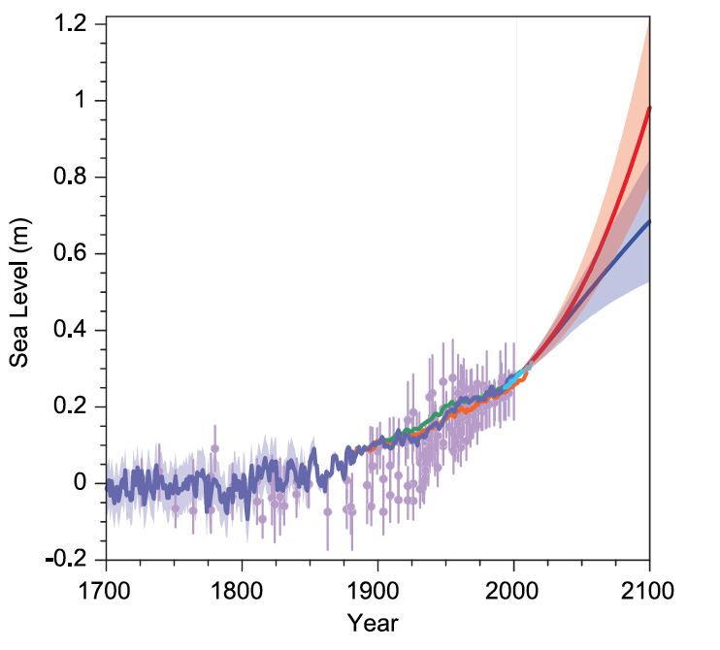
Future sea level rise: even at the lowest estimates
the projections exceed rates of change from the last centuries
Compilation of paleo sea level data, tide gauge data, altimeter data and central estimates and likely ranges for projections of global-mean sea level rise for RCP2.6 (blue) and RCP8.5 (red) scenarios
all relative to pre-industrial values.
IPCC, AR5, SPM [2013]
Notes:
27

Slide 28
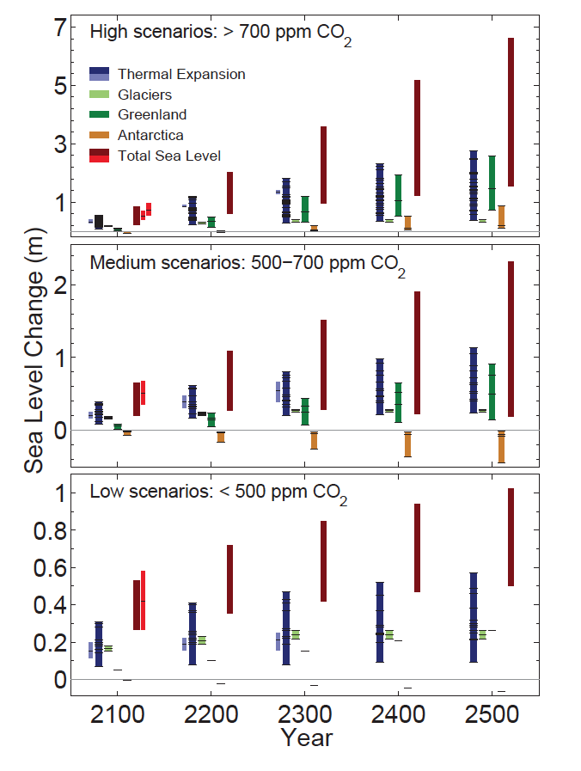
A long-term outlook on sea level rise
Sea level changes is a slow response process:
Long-term projections of
0.3-0.6 by year 2100 when CO₂ stays below 500ppmv
0.5-1m by year 2100 in high emissions scenario
By 2500 thermal expansion glaciers and ice sheets could lead to much
Higher sea level changes.
IPCC, AR5, WG1, Chapter 13, [2013]

Slide 29
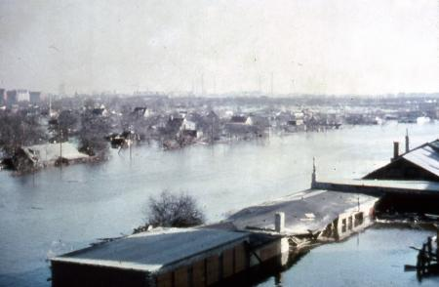
A long-term outlook on sea level rise
Hamburg, Germany, Feb 16th to 17th, 1962
(5.7m above mean sea level)
IPCC, AR5, WG1, Chapter 13, [2013]

Slide 30
Why does sea level rise matter?
World’s population in coastal zones
  21% live within 30 km from the coast
  37% live within 100 km from the coast
  Higher populations and GDP along coast lines
  compared to their nation’s average
  → high vulnerability
Notes:
30

Slide 31
Regions vulnerable to coastal flooding
→ Regions of highest risk: coastal zones with
dense population, low elevations, strong
subsidence & low adaptive capacity
Nicholls and Cazenave,
Science, 2010
Notes:
31

Slide 32
Vulnerability of coastal deltas to sea-level rise by 2050
(following current sea-level trends)
Extreme: > 1 million people displaced
High: 50,000 -1 million people displaced
Medium: 5,000 -50,000 people displaced
IPCC, AR4, WG2, 2007
Notes:
32

Slide 33
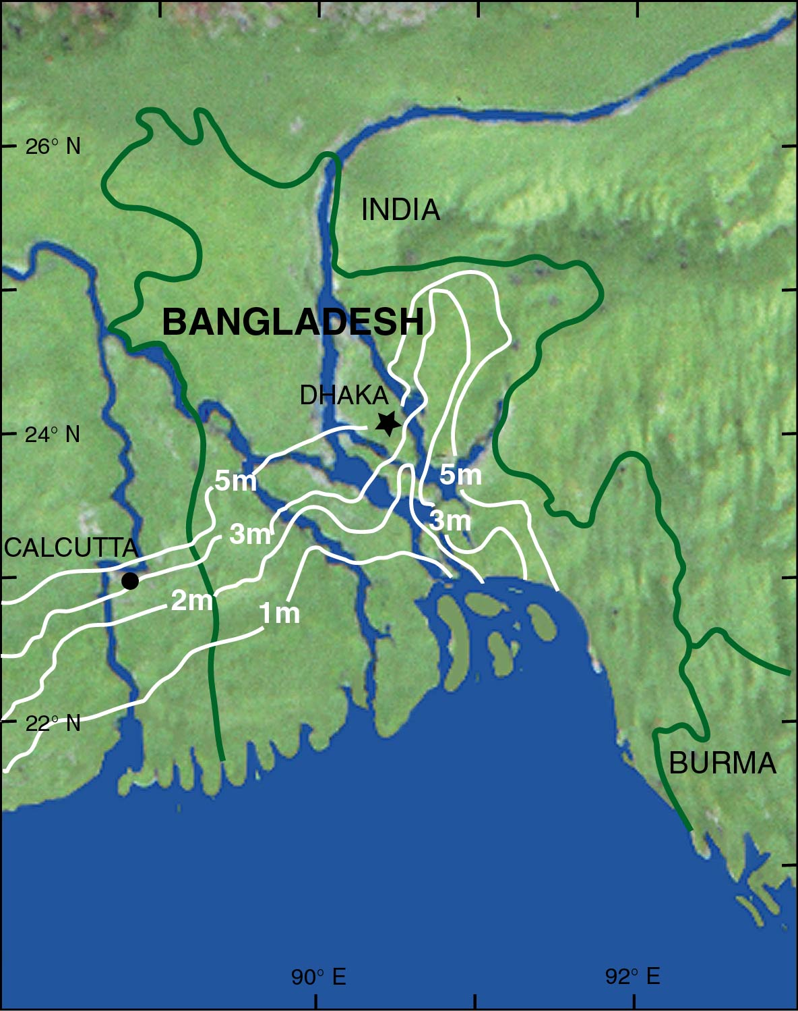
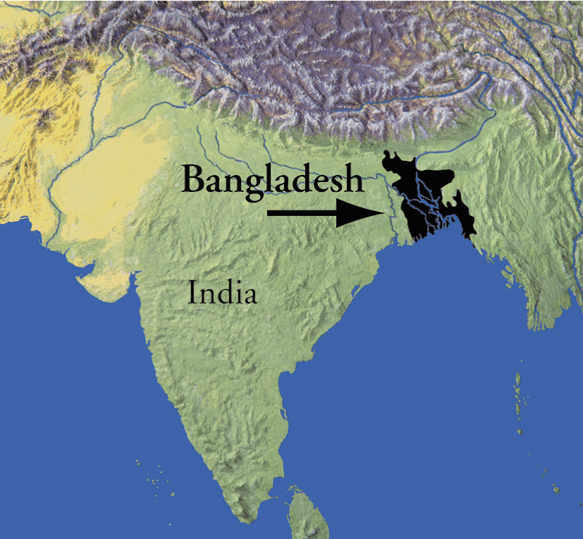
Sea-level transgression scenarios for Bangladesh
Bangladesh is projected to lose
~ 17% of its land area with
a sea level rise of 1 m
Adapted from Milliman et al. (1989).
Notes:
33

Slide 34
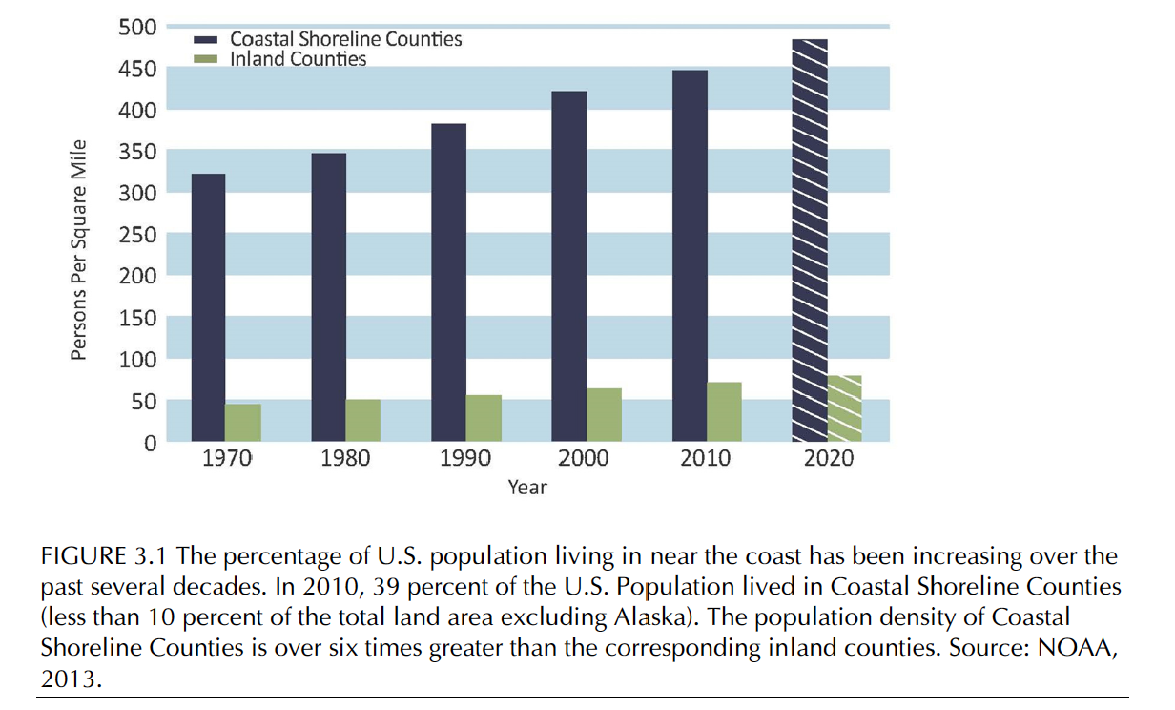
Percentage of US population living near the coast is increasing
NAS, Abrupt Climate Change, 2013

Slide 35
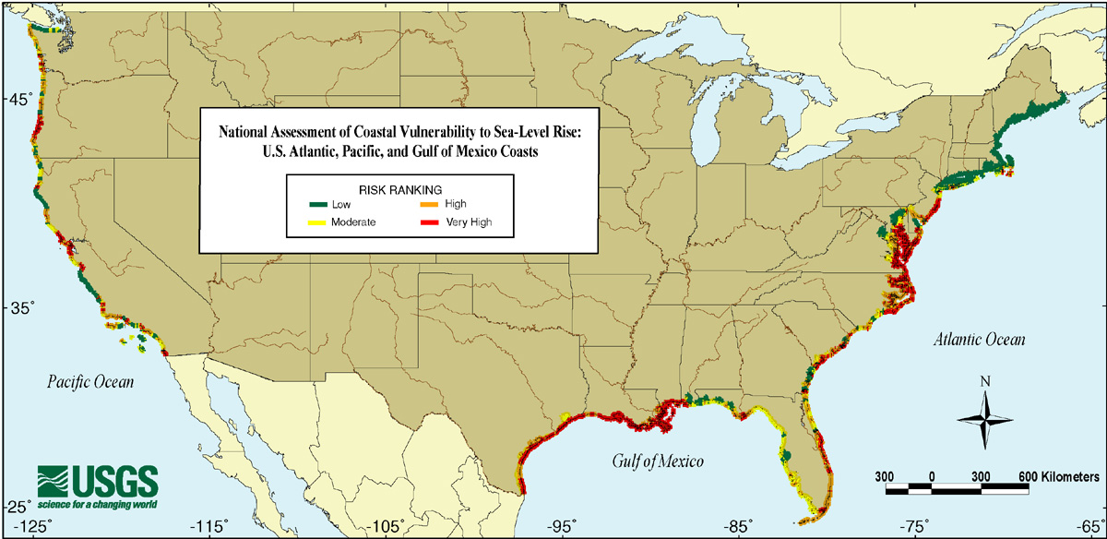
USGS assessment of US coastal risk
Notes:
35

Slide 36
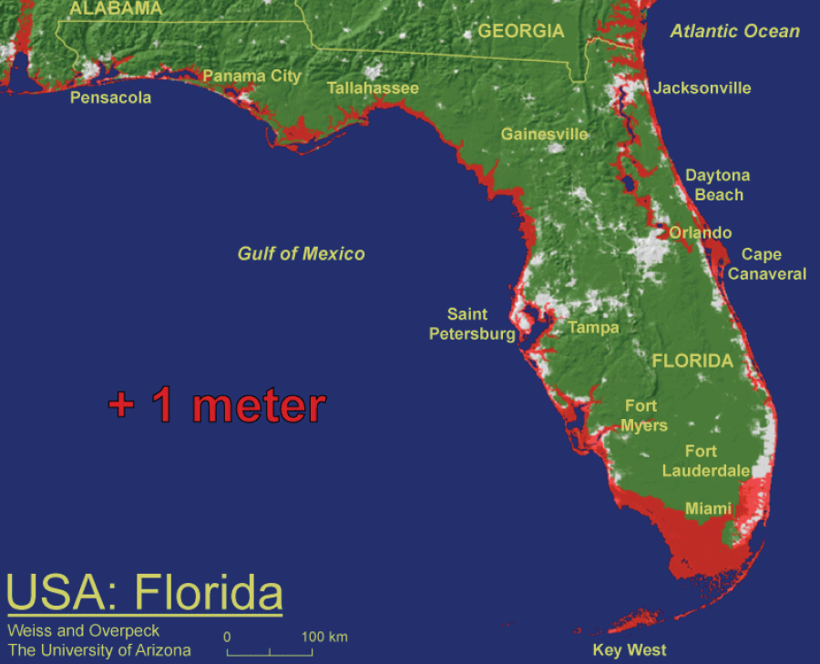
Assessment of US coastal risk
Overpeck & Weiss, PNAS, 2009

Slide 37
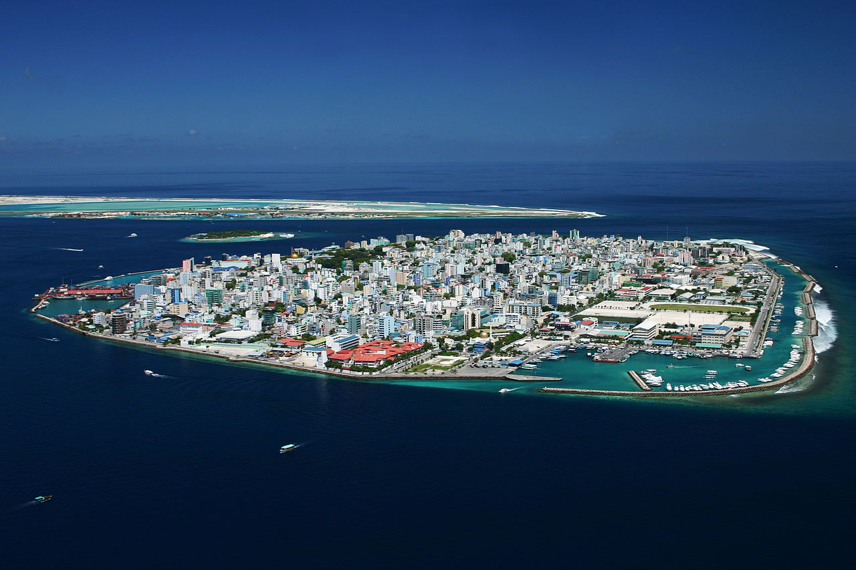
Island nations at risk
http://theislandpresident.com/synopsis/
Malé, capital of the Maldives (~100,000 inhabitants)

Slide 38
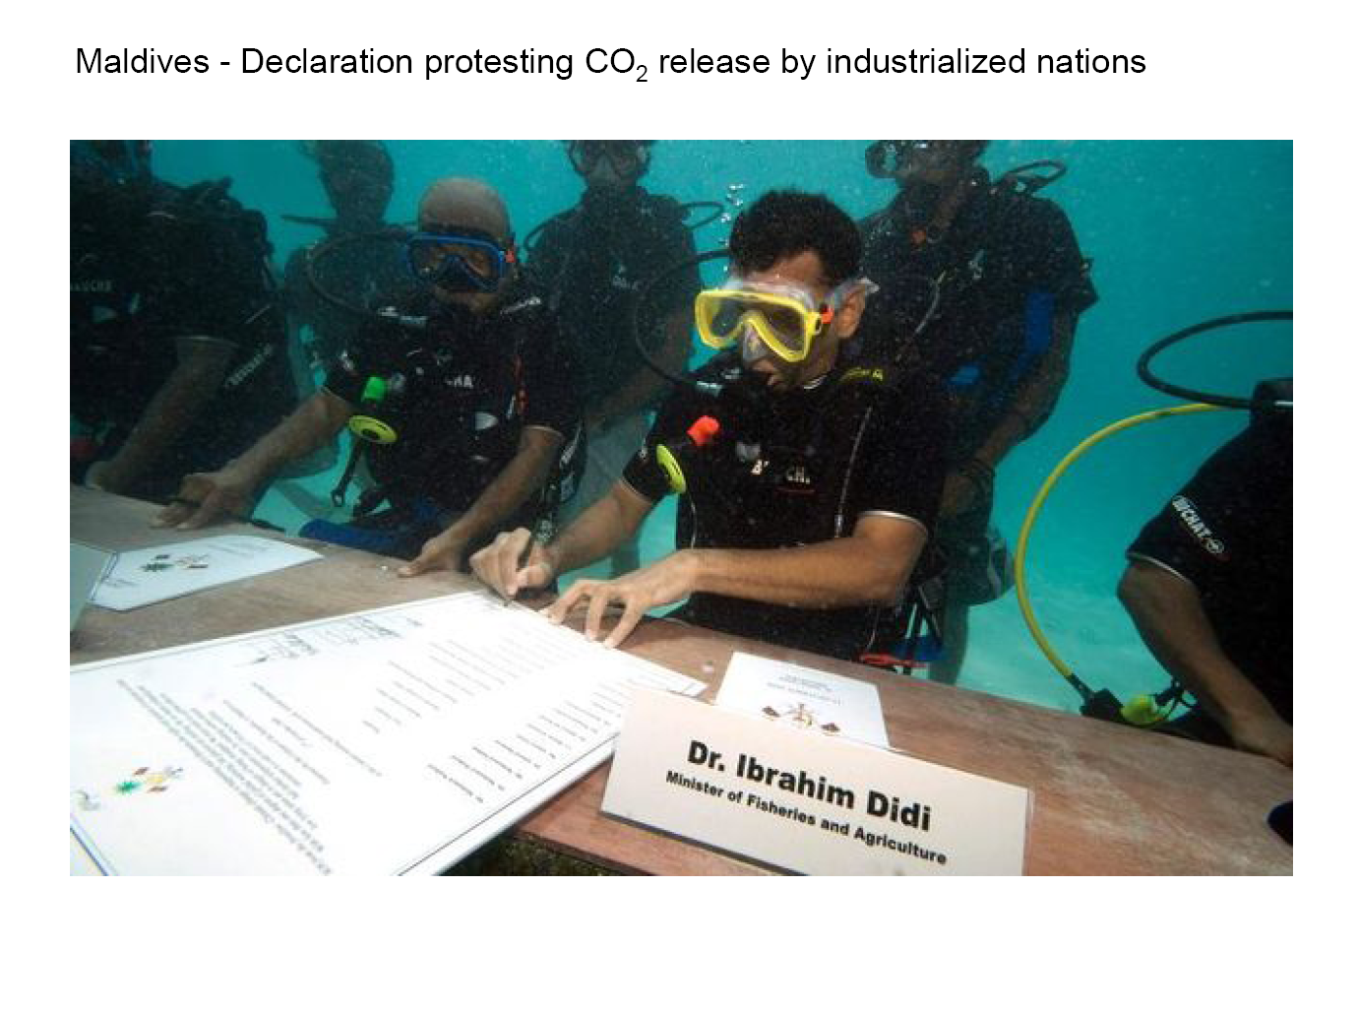
Notes:
38

Slide 39
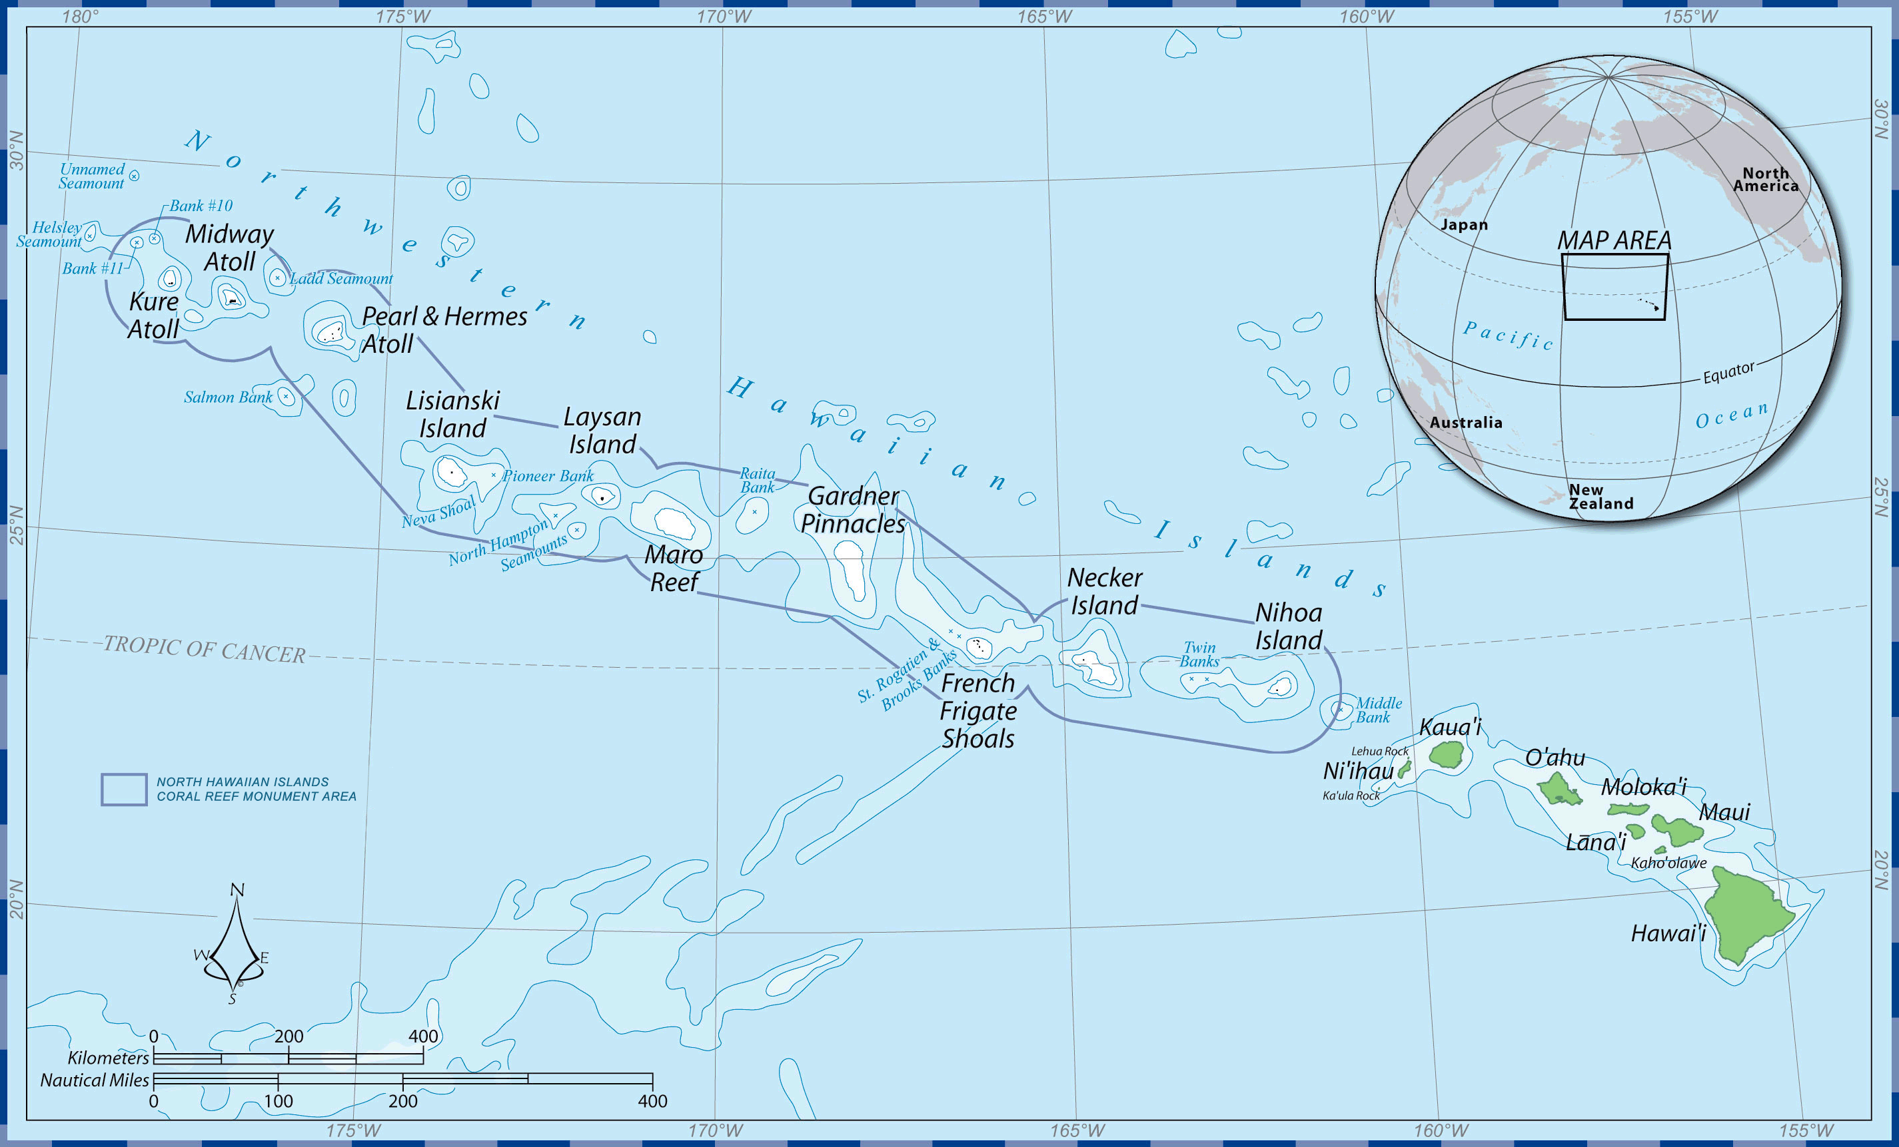
Northwestern Hawaiian Islands
National Monument
http://en.wikipedia.org/wiki/Papah%C4%81naumoku%C4%81kea_Marine_National_Monument

Slide 40
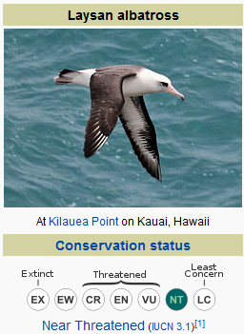
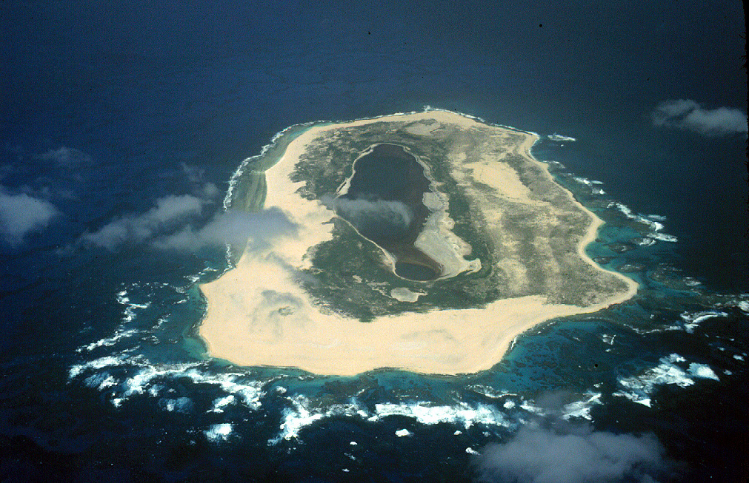
Papahānaumokuākea
Marine National Monument
Laysan atoll (~ 1 x 2 miles in size
http://en.wikipedia.org/wiki/Papah%C4%81naumoku%C4%81kea_Marine_National_Monument
http://en.wikipedia.org/wiki/Laysan_albatross
http://en.wikipedia.org/wiki/Laysan

Slide 41
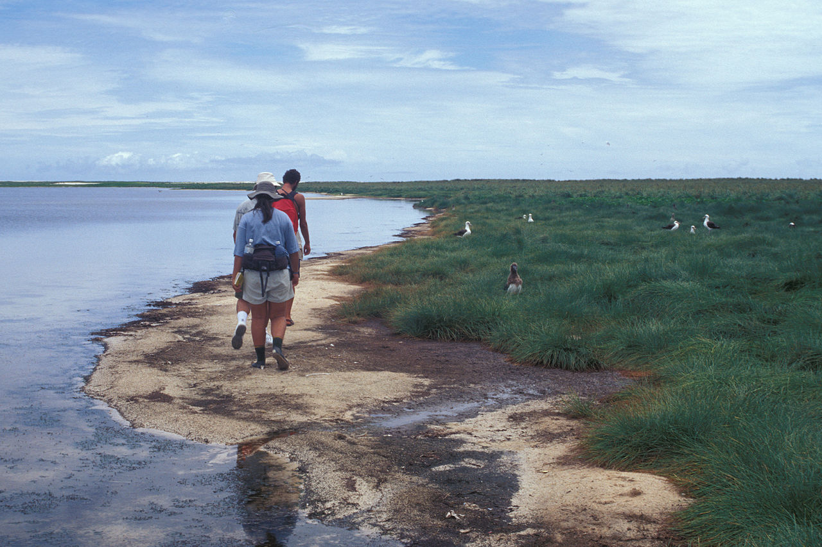

Laysan atoll (~ 1 x 2 miles in size
George W. Bush signing proclamation to establish the monument on June 15, 2006.
Even a small change in sea level
makes colonies more likely
to suffer from storm swells
http://en.wikipedia.org/wiki/Laysan_albatross
http://en.wikipedia.org/wiki/Laysan

Slide 42
Sea level rise will also have other impacts besides flooding:
Coastal erosion
Rising water tables
Saltwater intrusion
Biological effects
→ Many potentially affected areas:
- water resources
- agriculture
- human health
- fisheries
- tourism
- human settlements
Notes:
42

Slide 43
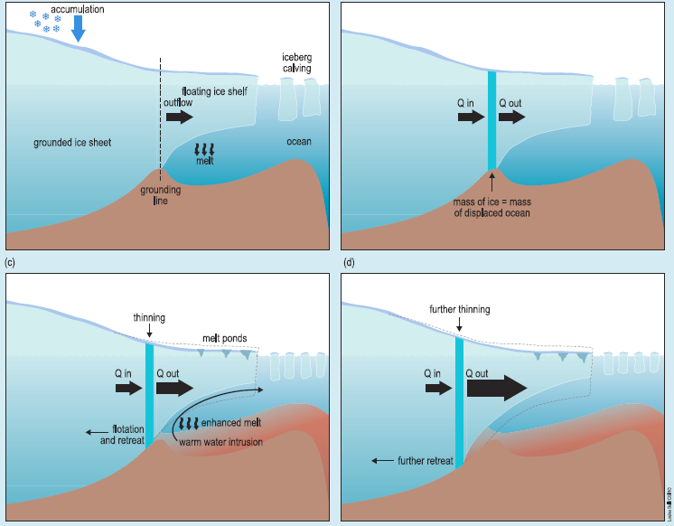
Scientists are concerned about
West Antarctic Ice Sheet (WAIS) stability:
Marine Ice Sheet Instability:
Grounding line retreat can destabilize the inland ice sheets
retreat and associated thinning of
Pine Island (PIG),
Thwaites (TG)
Smith glaciers

Slide 44
Scientists are concerned about
West Antarctic Ice Sheet (WAIS) stability:

Slide 45
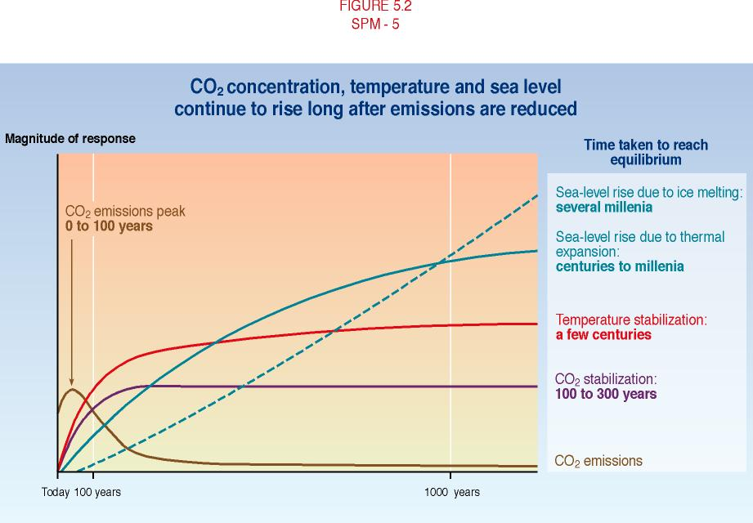
CO₂ concentrations, temperature and sea level continue to rise long after emissions are reduced
Notes:
45

Slide 46
Conclusions
Sea levels are rising at accelerated rates
Coastal areas can be greatly impacted by sea-level rise
Reducing greenhouse gas emissions would reduce the rate, although there is a clear long-term ‘commitment’ (due to the inertia of the system)
There are many uncertainties about global warming and sea-level rise, (role of ice sheets); more research is needed to reduce these uncertainties
Given the challenges of protecting low-lying coastlines, infrastructure & life, coastal ecosystems, planning for adaptation should take place now
Notes:
46

Slide 47
Note of caution:
Individual locations such as islands in the tropical Pacific
can have a wind-driven sea level change component that
leads to much faster sea level change rates in recent decades.
This local trend pattern must be distinguished from the
climate change related trends.

Slide 48
Sea Level Rise between 1992 and 2007 (mm/yr)
Spatial patterns reflect decadal variability not long-term trends
much of spatial variability related to changes in ocean’s thermal structure
→ In some regions (e.g., western Pacific), sea level has risen up to three
times faster than the global mean since 1993.
Notes:
48
Source: Nicholls and Cazenave,Science, 2010

Slide 49
Sea Level Rise between 1992 and 2007 (mm/yr)
Wind-stress explains most of the Pacific pattern
Timmermann et al, J. Clim, 2010
Notes:
49

