Slide 1
Climate change scenarios of the
21st century: Model simulations
Climate Change
Oliver Elison Timm ATM 306 Fall 2016
Lecture 8
Notes:
1

Slide 2
Climate change simulations
Objectives: Provide an overview on how climate scientists simulate the future climate
  Overview about climate models
    Hierarchy of climate models
    Coupled atmosphere-ocean general circulation models
  Climate forcing:
    Radiative forcing concept
    Representative Concentrations Pathway (RCP)
  Climate sensitivity
    Feedbacks in the climate system

Slide 3
SIRF course evaluation
Please take a moment and fill out an online course evaluation for this ATM306 course. Thank you!
The SIRF web page will be open
Nov 21st- Dec 13th (reading day)
http://www.albany.edu/ir/onlineSIRF-FAQ.html

Slide 4
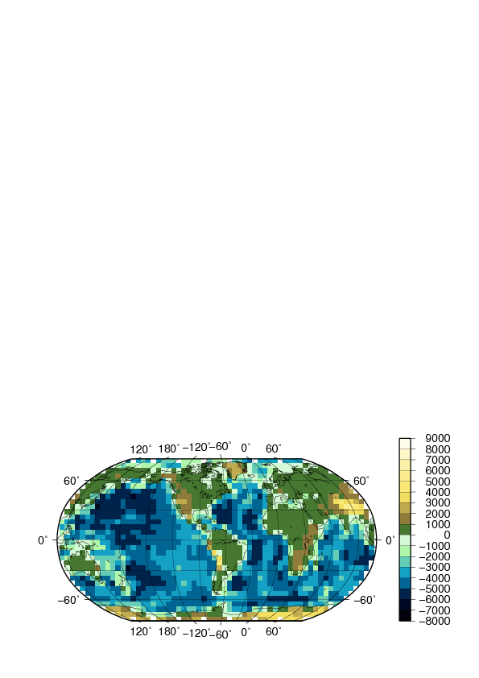
Numerical simulation of climate: increase in models’ grid resolution
Over the last 30 years the complexity of climate models has increased from about 500km x 500km horizontal resolution to about 100km x 100km resolution. The number of vertical levels increased, too.
First IPCC report (1990)

Slide 5
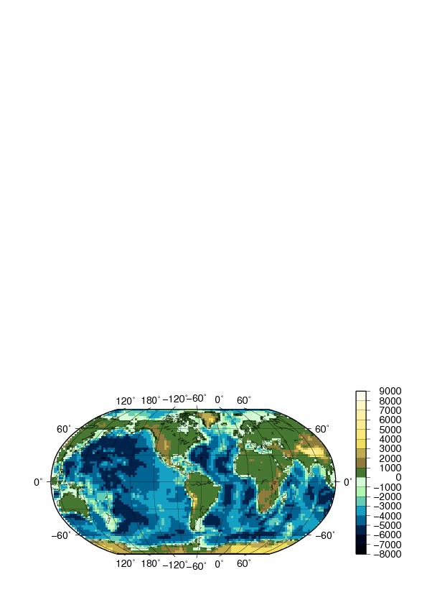
Numerical simulation of climate: increase in models’ grid resolution
Typical grid resolution of climate models
used in the second IPCC report (1996)

Slide 6
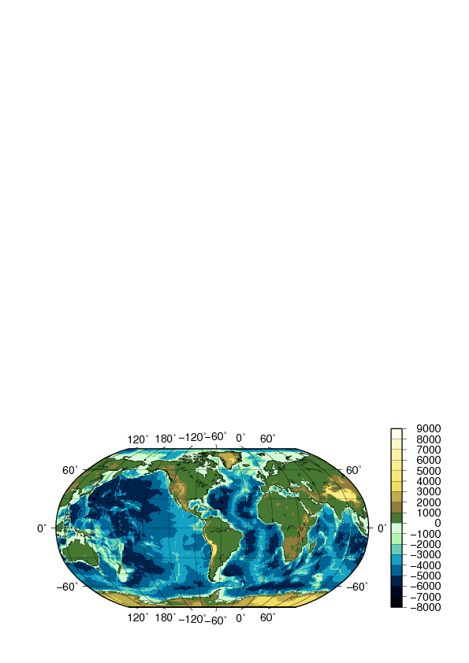
Numerical simulation of climate: increase in models’ grid resolution
IPCC AR5 report (2013): the higher resolution models have about 100 km x 100 km resolution)

Slide 7
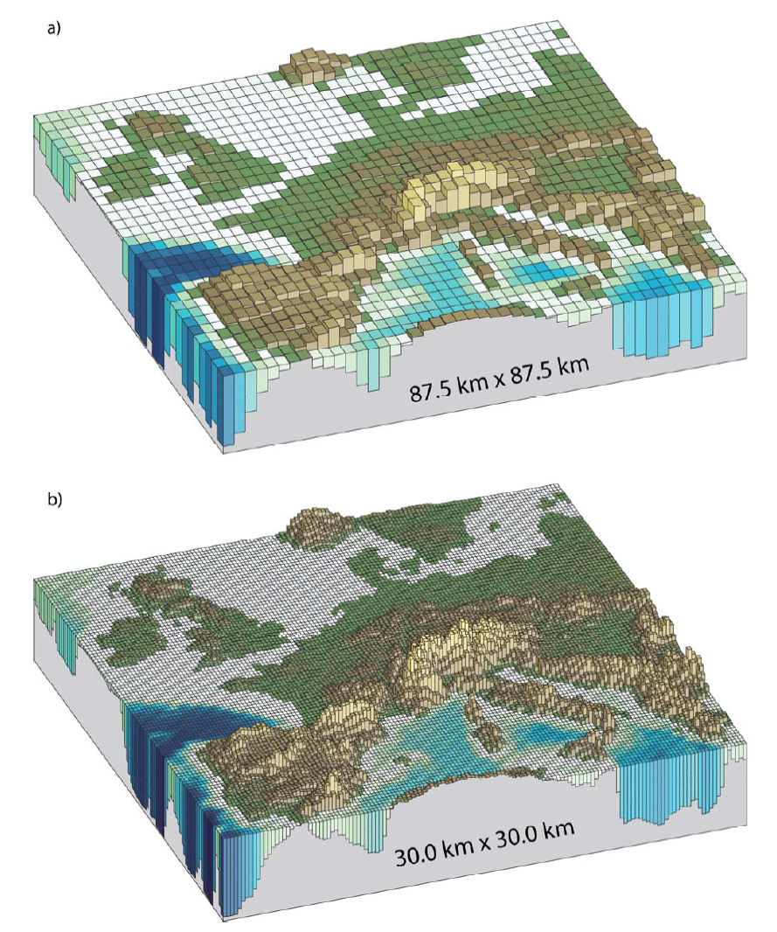
Numerical simulation of climate with
general circulation models (GCM)
Increase in spatial resolution
1990
2013
2000
latest
2007

Slide 8
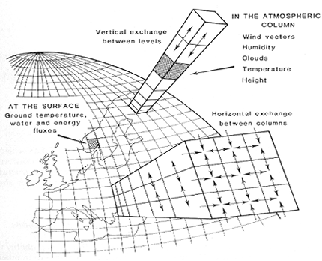
Numerical simulation of climate
The name “General Circulation Model” (GCM) is used for atmospheric climate models, global ocean models, and coupled atmosphere-ocean models
Key to the numerical simulation:
  Mathematical representation of the climate based on physical, biological and chemical principles.
  Numerical integration using discretized approximations to the mathematical equations.
  Gridded set of representative spatial points, and a discrete time integration step.

Slide 9
How many grid points do you have in a model with 100km X 100km resolution and 20 vertical levels ?
Notes:
With finer grid spacing, the time stepping must be become finer, too. Climate models use integration steps now as short as a few minutes from one step to the next in the simulation!

Slide 10
How many grid points do you have in a model with 100km X 100km resolution ?
If the average grid point spacing is 100km apart from the neighboring grid points, it represents an area of
100km*100km = 10,000 km² = 10¹⁰ m²
Earth area is 510,072,000 km² = 5.10*10¹⁴ m²
~ 50,000 horizontal grid points
With 20 vertical levels
=> ~ 100,000 grid points
For a doubling of grid resolution it takes 10 times more computing (CPU) time.
Notes:
For comparison: one NFL football field is about 5,000 m²
NY State has 141,300 km² (data from Wikipedia)
One grid point represents temperature, winds, humidity for this area (air volume)
Notes:
With finer grid spacing, the time stepping must be become finer, too. Climate models use integration steps now as short as a few minutes from one step to the next in the simulation!

Slide 11
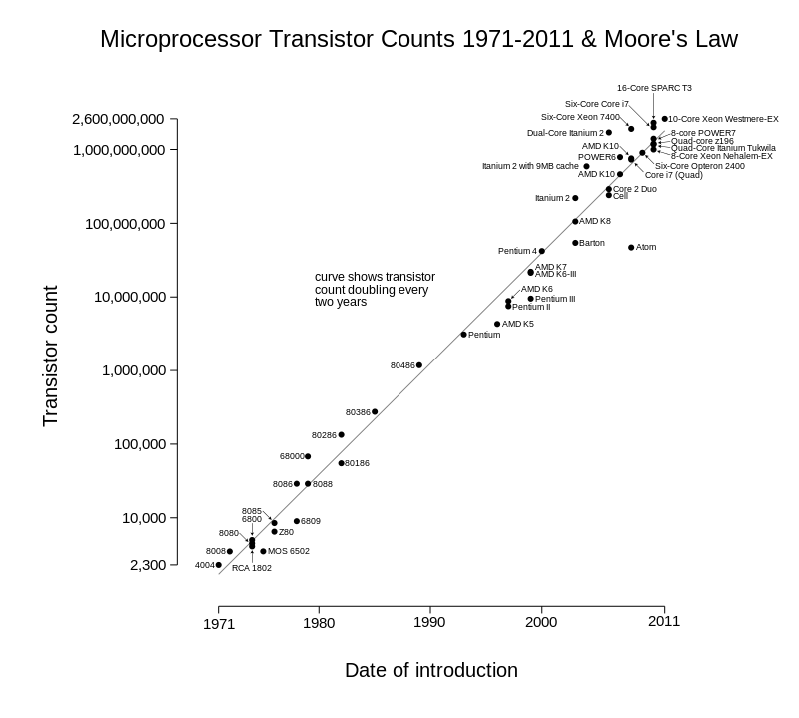
Improved climate model resolution supported by technological development
Computer power
increase supports
increasing climate
model resolution
From Wikipedia: Moore’s Law

Slide 12

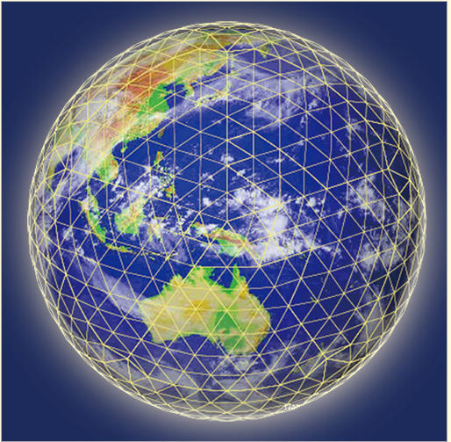
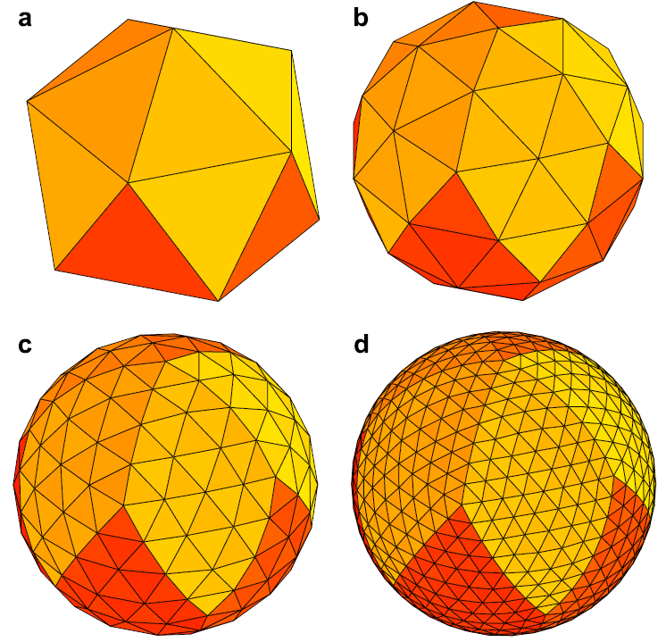
Example of modern computational methods: Nonhydrostatic Icosahedral Atmospheric Model (NICAM)
Grid designs that avoid pole singularity, and allow for equal fine-scale resolution around the globe.
http://www.jamstec.go.jp/e/hot_pictures/
Satoh et al, J. Computational Physics, 2008
Notes:
12

Slide 13
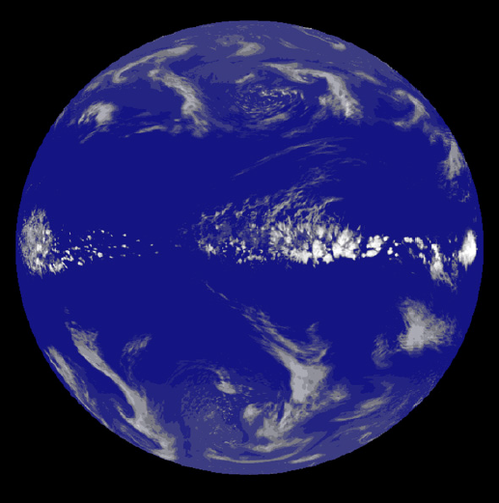
Nonhydrostatic ICosahedral Atmospheric Model (NICAM)
3.5km global resolution, cloud resolving model,
convective cloud processes
3.5km horizontal resolution,
10^9 nodes, 15s time step
http://www.jamstec.go.jp/e/hot_pictures/
Satoh et al, J. Computational Physics, 2008
Notes:
13

Slide 14
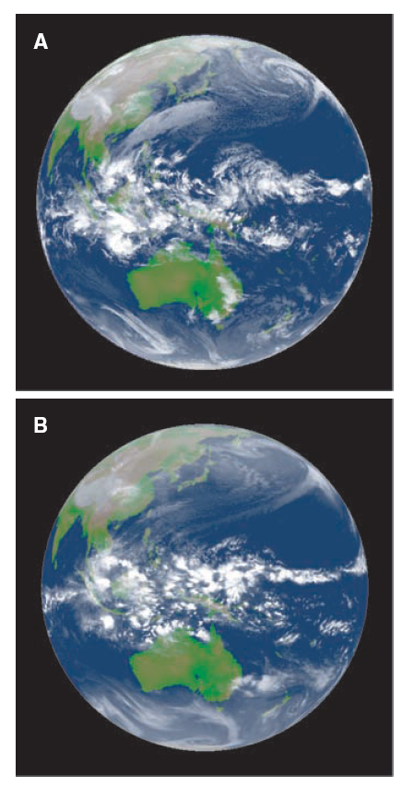
Example from NICAM 3.5 km
resolution GCM: Clouds in
GCM and from satellite observations
Snapshot:
outgoing longwave radiation at 00:00 UTC,
31 December 2006
Earth Simulator simulation at 3.5-km resolution
compared with
Infrared image from the Multi-Functional Transport Satellite (MTSAT-1R)
→ which one is which?
→ more realistic cloud-resolving simulations will become
possible in near future! (currently it is too
costly to simulate a 100 years into the future
Miura et al., 2007
Notes:
14

Slide 15
Example of high-resolution ocean modeling
Coupled atmosphere ocean models resolve now eddies in the ocean (0.1 degree resolution)
Link to GFDL animation

Slide 16
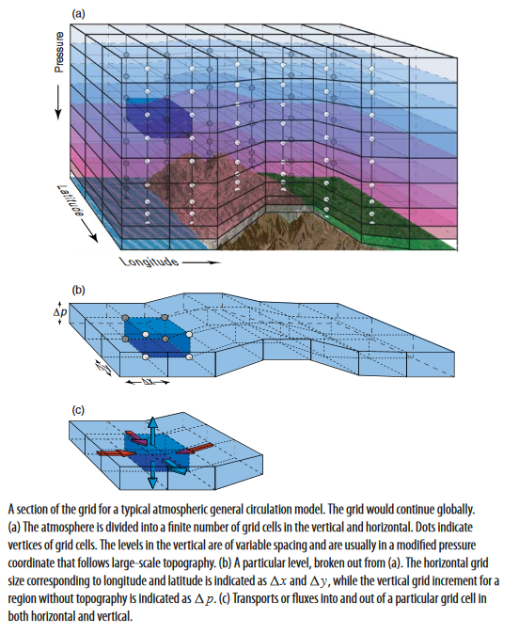
Numerical simulation of climate
For each grid point dynamical equations (acceleration forces acting on the air/ ocean parcels) must be computed
In addition physical processes must be calculated:
  Heating/cooling rates by radiation, heat advection (by winds)
  Hydrological processes: rainfall, evaporation, cloud processes (and chemical reactions)
  Sea ice formation, or melting and sea ice transport
  Momentum, heat, mass exchanges at the interfaces between ocean-ice-land-atmosphere
Notes:
Figure from Neelin

Slide 17
Numerical simulation of climate
Besides the numerical resolution,
a better representation of physical
and chemical processes is developed:
  Simple ‘swamp’ oceans were replaced
  by fully 3-dimensional ocean circulation
  models (including sea ice)
  Atmospheric chemistry
  (e.g ozone, aerosols) is now simulated
  Some models have dynamic vegetation
  together with more sophisticated
  land-atmosphere-vegetation interactions
  A few models (Earth system models)
  include now an active ocean carbon cycle (chemical + biological processes)
  Ice sheet models are still in progress to
  be fully coupled and implemented into
  the next generation climate models.

Slide 18
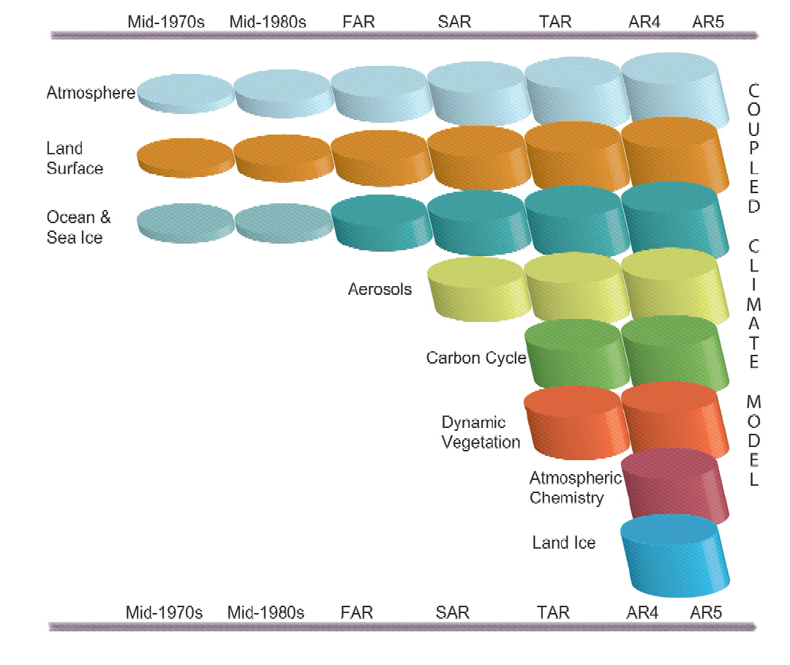
Numerical simulation of climate
Latest model developments
include also interactive
land ice (Greenland, Antarctica, glaciers)

Slide 19
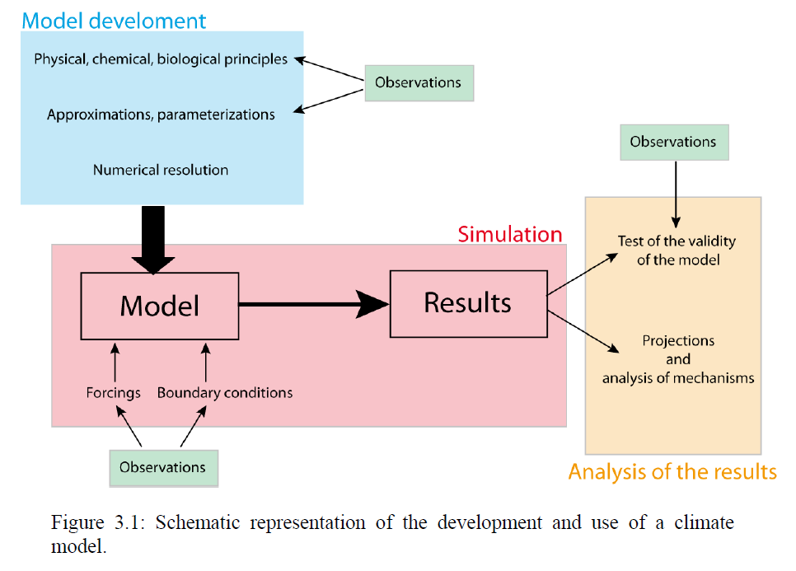
Application of climate models: Development, testing, and climate scenario simulation
Observations are of utmost importance for development,
testing (validation) of climate models
Chapter 3 in Goosse, Introduction to climate dynamics and climate modelling
http://www.climate.be/textbook

Slide 20
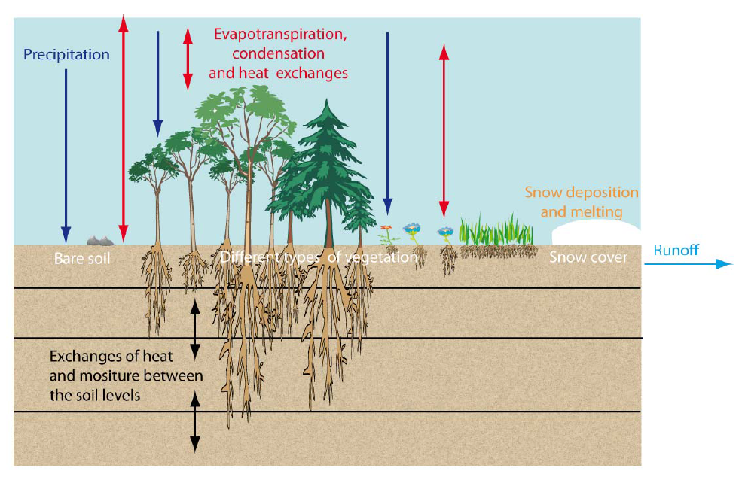
Representation of land vegetation in a climate model
Chapter 3 in Goosse, Introduction to climate dynamics and climate modelling
http://www.climate.be/textbook

Slide 21
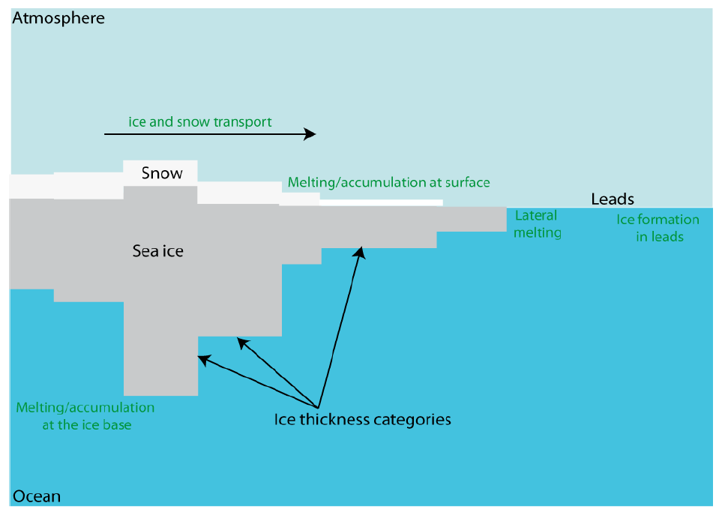
Representation of sea ice in a climate model
Chapter 3 in Goosse, Introduction to climate dynamics and climate modelling
http://www.climate.be/textbook

Slide 22
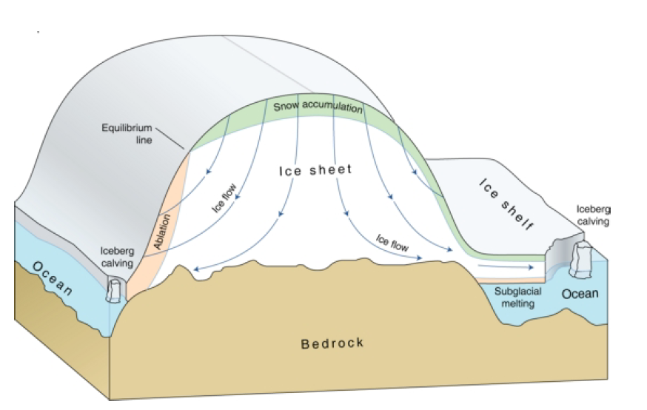
Processes involved in ice-sheet modeling
(2) Flow of the ice
(1) Surface Mass Balance:
Accumulation – Ablation
(surface melting - refreezing)
(3) Ocean-ice interface:
floating ice, melt rates,
calving
Chapter 3 in Goosse, Introduction to climate dynamics and climate modelling
http://www.climate.be/textbook

Slide 23
GCMs
Atmosphere and Ocean models have to solve two different type of problems:
  Dynamical processes:
    The dynamic behavior of the fluid (atmosphere, or ocean): winds / currents, wave propagation, advective processes; governed by fundamental physical laws (momentum, thermodynamics)
    Grid resolution and time step scheme resolve the most important aspects of the fluid dynamics
  Physical parameterizations:
    The method of incorporating ‘unresolved’ processes that happen inside the grid boxes. These fine-scale processes are represented by some functions that depend on the modeled grid-averaged values (e.g. temperature, humidity). These equations are guided by both theory and empirical
    (observations) studies.
    For example different types of cumulus convection, and rain production have been developed for climate models.

Slide 24
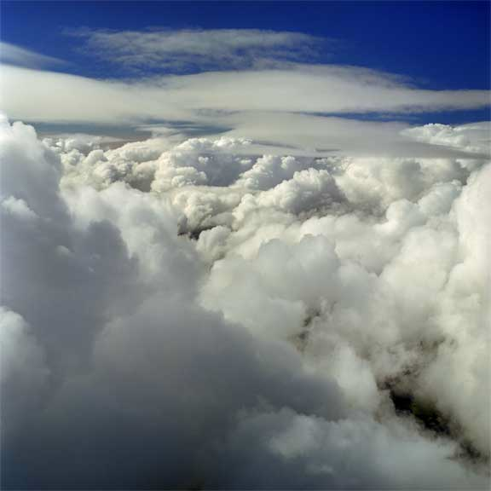
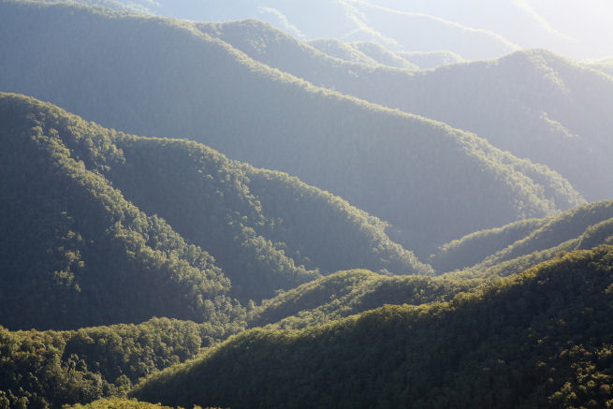
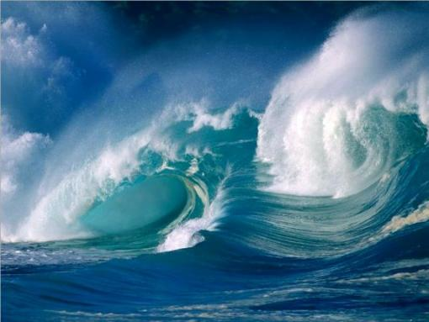
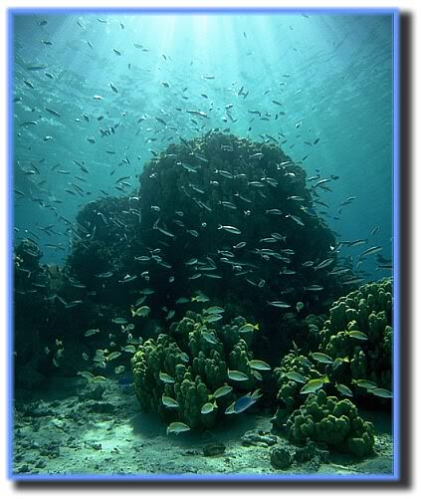
How to simulate historical and future climate trends with GCMs?
Forcing:
External factors with impact on the climate, which can change with time during the climate simulation:
Anthropogenic or natural:
Greenhouse gas concentrations, aerosols
Human-induced land cover change
Volcanic eruptions
Solar cycle
Climate model components
Atmosphere
Terrestrial
vegetation
Air-Land fluxes
albedo
air-sea fluxes
CO₂ fluxes
Ocean
Marine carbon cycle
Boundary conditions:
Constant conditions
(e.g prescribed ice-sheets on land, solar constant)

Slide 25
Representative Concentration Pathways (RCPs)
“The goal of working with scenarios is not to predict the future but to better understand uncertainties and alternative futures, in order to consider how robust different decisions or options may be under a wide range of possible futures”.
Source: IPCC Scenario Process for AR5
Note: a good introduction to RCPs is
“The Beginner's Guide to Representative Concentration Pathways”
which you can find on: http://www.skepticalscience.com/rcp.php

Slide 26
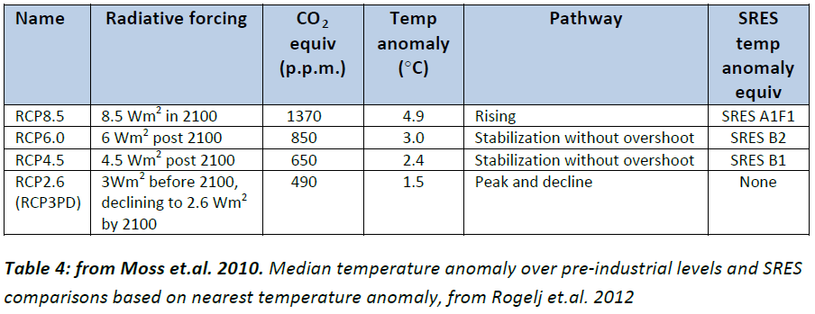
Representative Concentration Pathways
Notes:
RCP#.# : The number indicates the radiative forcing by the year 2100 that is induced by all forcing factors (greenhouse gases, aerosols, land cover change). Positive numbers indicate a net energy gain for the Earth’s climate system.
Note: SRES are earlier scenarios (IPCC SPECIAL REPORT EMISSIONS SCENARIOS)

Slide 27
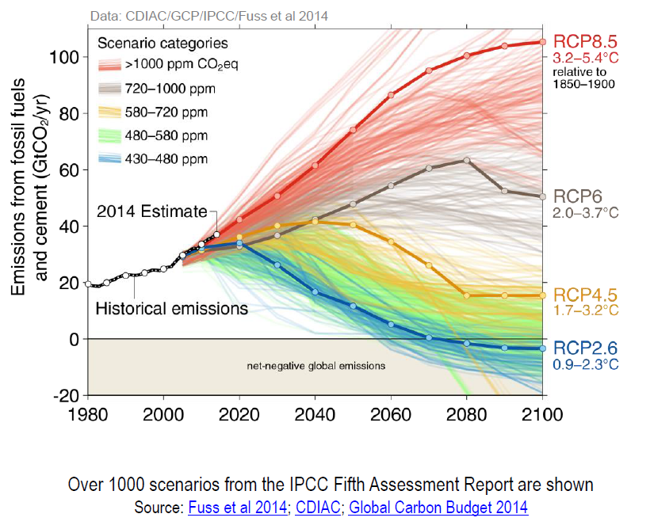
Four pathways to represent a multitude of alternative future scenarios
Carbon dioxide emissions
are the most important
among the greenhouse gas emissions now and in near future
In order to make
climate model scenarios
comparable and impacts studies feasible, four scenarios were selected that cover the wide range of scenarios.

Slide 28
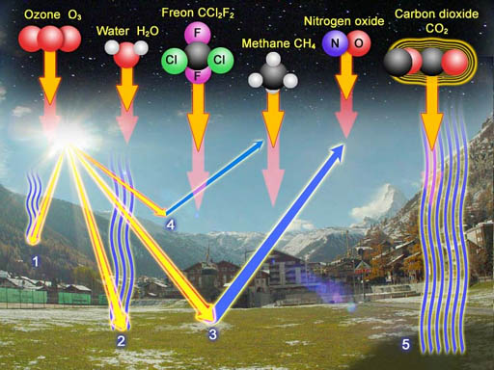
Other greenhouse gas emissions in the four RCPs
X
Climate models simulate
water vapor concentrations
=> Not an external forcing

Slide 29
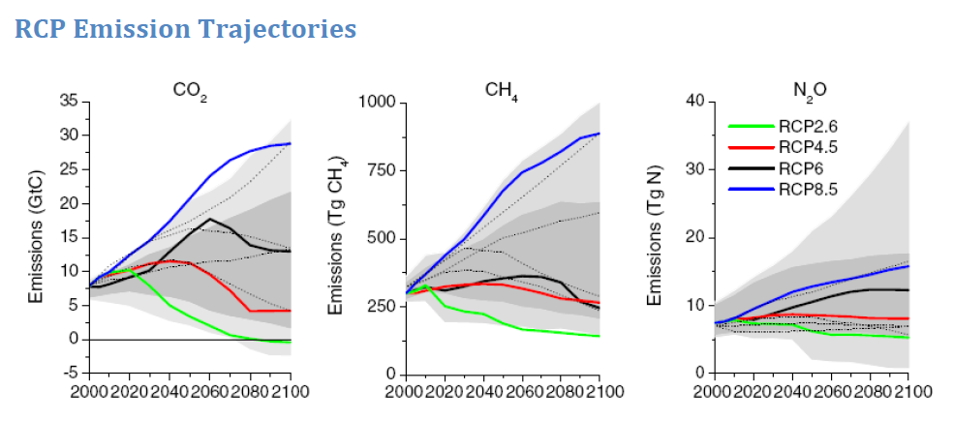
Greenhouse gas emissions in the four RCPs
Note: Other gases in the family of Halocarbones and Chlorofluorocarbons are considered

Slide 30
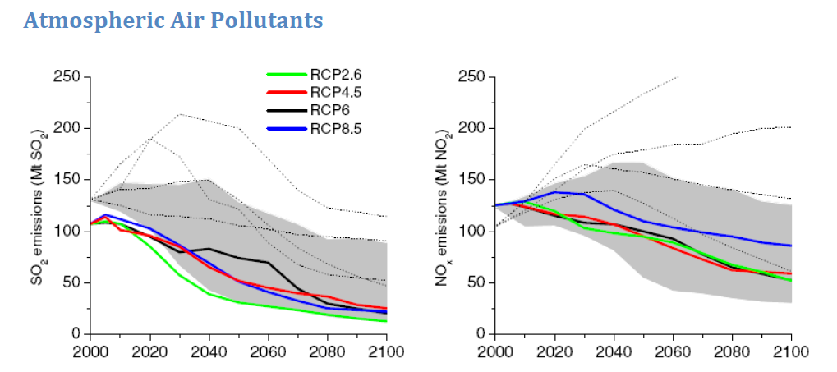
Air pollutants emissions in the four RCPs
sulfur dioxide
nitrogen dioxide
(nitric oxide)

Slide 31
CO₂ emissions 2000-2100
Figure shows annual CO₂ emissions out to 2100 associated with each RCP
RCP2.6: optimistic (complete phase-out of CO₂ emissions by 2070 and negative flux of CO₂ afterward (we would actively be pulling CO₂ out of the air through mitigation)
RCP8.5 pessimistic: scenario where CO₂ levels soar to >1300 ppm by 2100 and continue to rise. Unrealistic (?) as we may not be able to produce enough oil, coal and gas to emit that much CO₂.
What determines the different emissions scenarios?
Inman, Nature Climate Change, 2011

Slide 32
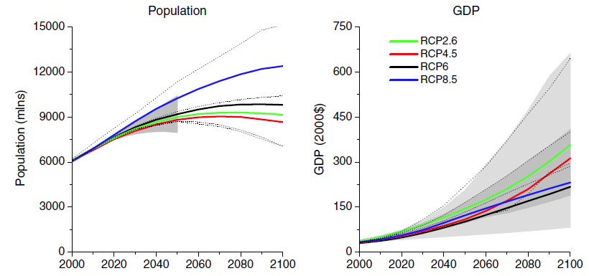
RCPs consider different world populations, and economic growth and technology development that are consistent with the GHG emissions
World Population
Gross Domestic Product
(representative global average)

Slide 33
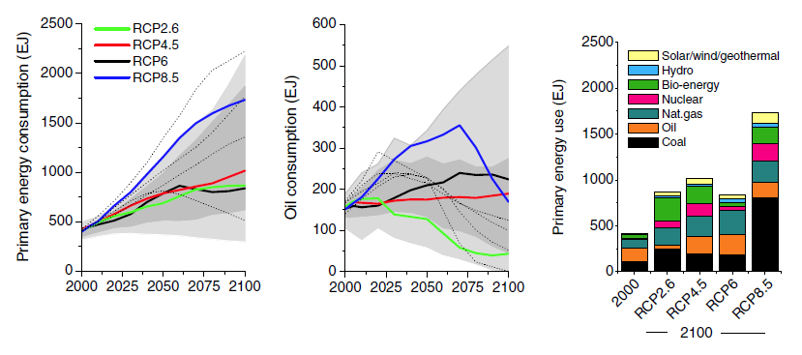
RCPs distinguish between different mixes in primary energy sources.

Slide 34

Kaya factors / Kaya Identity
RCPs allow a more detailed look at the future pathways and track the effects from population, development, technologies and productivity in their role for greenhouse gas emissions
F global CO2 emissions from human sources
P global population
G world GDP
E global energy consumption
G/P economic production
E/G energy intensity (depends on production goods and technology)
F/E carbon efficiency (primary energy sources, carbon sequestration)
See Wikipedia for more info, or https://www.e-education.psu.edu/meteo469/node/213

Slide 35
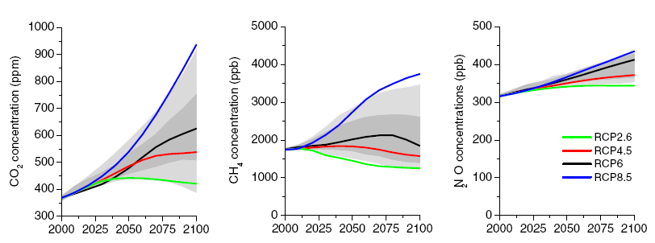
The resulting greenhouse gas concentrations for the RCPs are used as external forcing

