Slide 1
Climate change modelling: Role of carbon cycle for future CO₂ concentrations
Climate Change
Oliver Elison Timm ATM 306 Fall 2016
Lecture 8
Notes:
1

Slide 2
Objectives
Provide a qualitative and quantitative overview about sources, sinks, and fluxes of carbon dioxide between the carbon reservoirs
Relationship between energy production and carbon dioxide emissions
Relationship between CO₂ emissions and atmospheric CO₂ concentrations
Role of ocean carbon cycle and terrestrial vegetation for the projected future CO₂ concentrations.

Slide 3
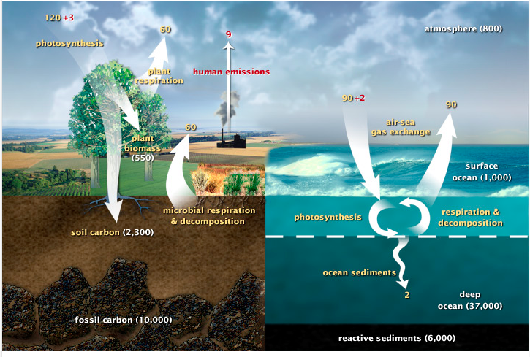
Carbon cycle: Natural and anthropogenic contributions (representative for ~2010)
120+3
60
+9
Fossil fuel burning
Cement production
Land use change
Units
Fluxes:
giga ton Carbon
per year
(GtC/yr)
(= PgC/yr)
Resevoirs:
GtC (=PgC)
90+2
90
60
Yellow numbers: natural fluxes Red: anthropogenic fluxes
Source: http://earthobservatory.nasa.gov/Features/CarbonCycle/ (retrieved 2014-09-15)

Slide 4
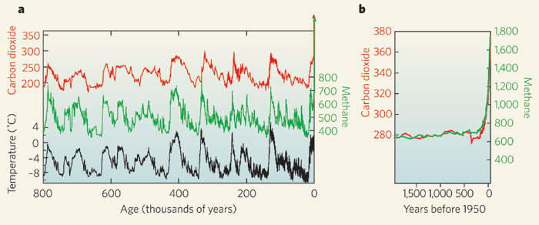
Past CO₂ variations in the natural Earth system were in the range between 190-300 ppm.
Glacial cycles on average repeated a cylce in ~ 100,000 years
Temperatures changes are representative for Antarctica.
They are based on Antarctic ice core records (oxygen isotopes).
Scaling factors apply to convert it into global mean (active research)
Image source: The Encyclopedia of Earth: http://www.eoearth.org/view/article/150101/
Notes:
4

Slide 5
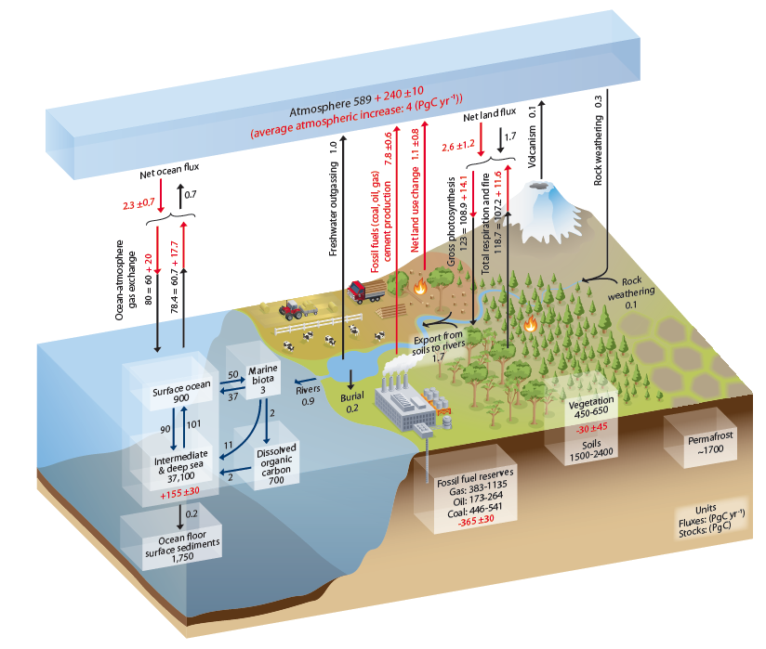
The Carbon Cycle
Schematic view on the global carbon cycle showing the major reservoirs and fluxes.
IPCC, AR5, WGI, Chapter 6, [2013], Fig. 6.1
Notes:
5

Slide 6
The Carbon Cycle
Atmospheric increase
4GtC/yr
Anthropogenic
emission: ~9 GtC/yr
Ocean sink:
2.3GtC/yr
Terrestrial
vegetation sink:
2.6 GtC
Simplified schematic of the global carbon cycle showing
the major reservoirs
IPCC, AR5, WGI, Chapter 6, [2013], Fig. 6.1
Notes:
6

Slide 7
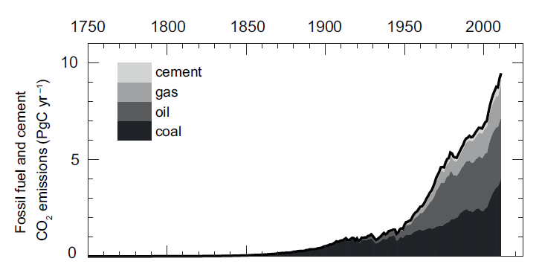
Estimated contributions to the global CO₂-emissions since industrial revolution
The integrated (cumulative) CO2 emissions are 555 GtC between
1750 and 2011. About half of the emissions remained in the atmosphere
(240 GtC)
Notes:
7

Slide 8
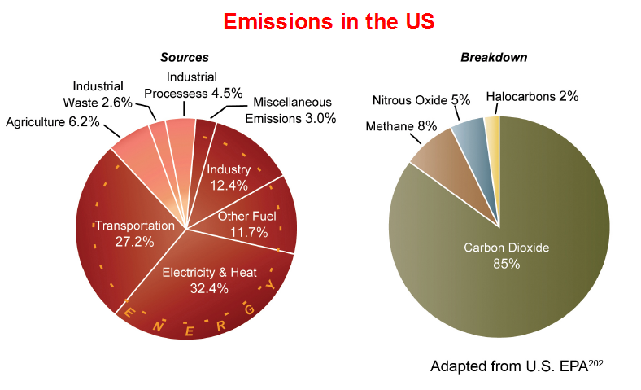
Majority of carbon dioxide emissions
in US from energy productions
US Global Change Research Program (2009)

Slide 9
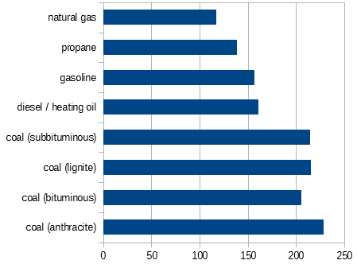
How much CO₂ is emitted
from coal, oil, and gas when converted to energy:
Pounds of CO2 emitted per
million British thermal units (Btu)
of energy for various fuels:
Coal (anthracite) 228.6
Coal (bituminous) 205.7
Coal (lignite) 215.4
Coal (subbituminous) 214.3
Diesel fuel and heating oil 161.3
Gasoline 157.2
Propane 139.0
Natural gas 117.0
Numbers obtained from the US Energy Information Agency http://www.eia.gov/tools/faqs/faq.cfm?id=73&t=11

Slide 10
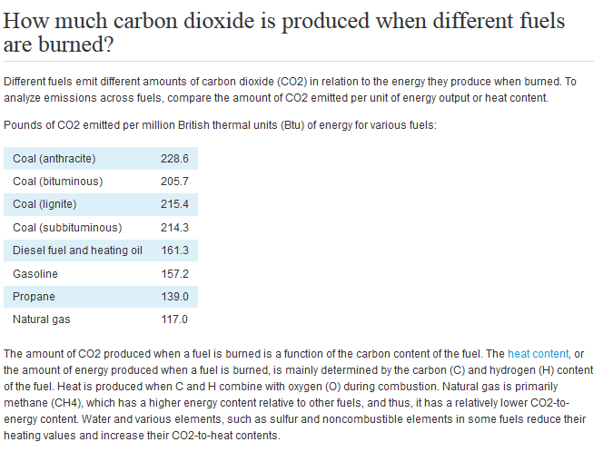
How much CO₂ is emitted
from coal, oil, and gas when converted to energy:
http://www.eia.gov/tools/faqs/faq.cfm?id=73&t=11

Slide 11
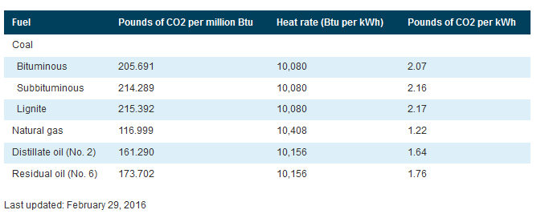
How much CO₂ is emitted
from coal, oil, and gas when converted to energy:
http://www.eia.gov/tools/faqs/faq.cfm?id=73&t=11

Slide 12
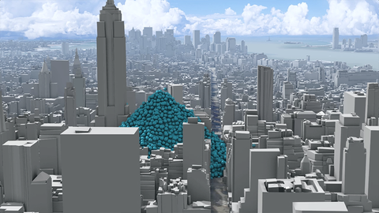
Visualizing carbon emissions
Source: http://www.carbonvisuals.com

Slide 13
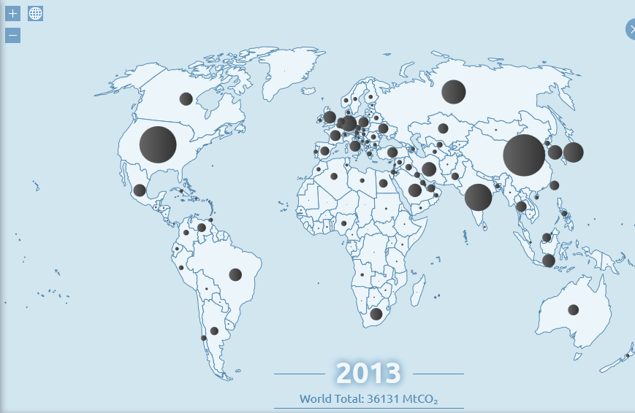
Online atlas for global carbon emissions
  http://www.globalcarbonatlas.org

Slide 14
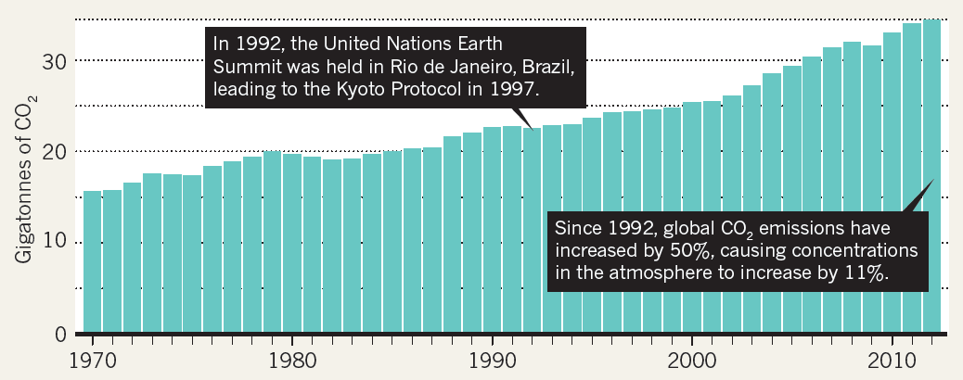
Change in global emissions over time
36 GtCO₂ = 10GtC/yr
Tollefson, Nature, 2013
Note: Reference level for Kyoto Protocol: targeted percentages of emissions reductions were expressed in % relative to 1990 values.
Paris climate conference [COP21], 2015: European Union’s goal is still referring to 1990 level.
“The framework contains a binding target to cut emissions in EU territory by at least 40% below 1990 levels by 2030.”
Notes:
14

Slide 15
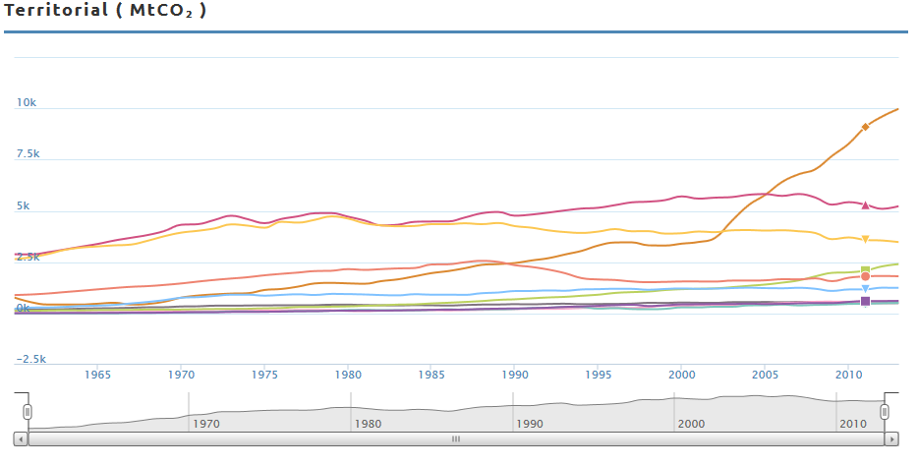
Emissions by country over time
USA
EUR
CHINA
RUSSIA
Notes:
The emissions per year in MtCO2: divide by 1000 and then multiply by (12/44) to get GtC (i.e 3600 is about 1GtC)
Guess who is who?
15

Slide 16
Emissions by country over time
USA
EUR
CHINA
RUSSIA
Notes:
The emissions per year in MtCO2: divide by 1000 and then multiply by (12/44) to get GtC (i.e 3600 is about 1GtC)
Guess who is who?
16

Slide 17
Emissions by country over time
CHINA
USA
RUSSIA
EUR
Notes:
NOTE: I changed CHINA and USA on purpose. CHINA is the leading emitter now!
The emissions per year in MtCO2: divide by 1000 and then multiply by (12/44) to get GtC (i.e 3600 is about 1GtC)
17

Slide 18
A different view on CO₂ emissions (including trade)
Davis and Caldeira, PNAS, 2010
Largest interregional fluxes of emissions embodied in trade (Mt CO₂ y⁻¹) from dominant net exporting countries (blue) to the dominant net importing countries (red).
Net import of emissions to the US (in 2004) 10.8% of total consumption-based emissions (2.4 tons CO₂ per person).
22.5% of the emissions produced in China in 2004 were exported
Notes:
“Moreover, the geographical separation of production and consumption complicates the fundamental
questions of who is responsible for emissions and how
the burden of mitigation ought to be shared”
18

Slide 19
Conversion factors:
Fluxes of carbon or carbon dioxide are expressed in two ways:
Mass CO₂ or mass carbon (C) per time.
The conversion factor is given by:
The atomic weight of carbon is 12.001115
The atomic weight of oxygen is 15.9994.
Total atomic weight of CO₂ is 43.999915.
The ratio of carbon dioxide to carbon is 43.999915/12.001115
or 3.6663 units of carbon
mass GtC x 3.7 = mass GtCO₂
mass GtCO₂ / 3.7 = mass GtC

Slide 20
Conversion factors:
mass GtC = mass PgC
Giga is 10^9
Peta is 10^15
A metric ton is 1000kg = 10^6g
Currently a first approximation for converting GtC into CO2 in ppm
is 1GtC = ½ ppm

Slide 21
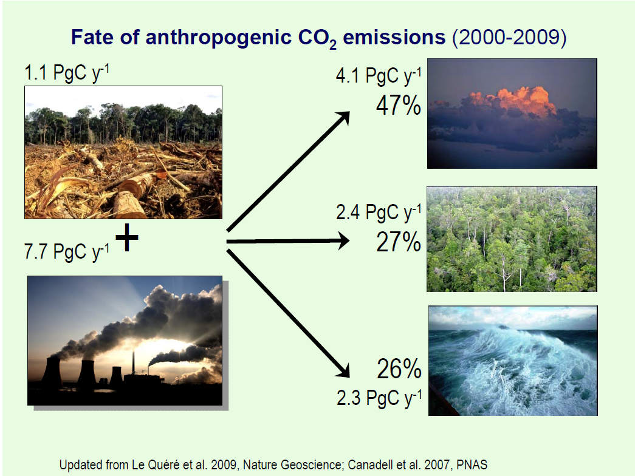
Figure from PPT by Corrine Le Quéré (UNFCCC, retrieved 2014-09-15)

Slide 22
Global carbon cycle
Facts worth the remember:
The perturbation of the natural
fluxes are small, but they disturb
the natural balance
Anthropogenic CO₂ Emission:
Nearly half is taken up
in ocean and on land
by physical and biological
processes
This ratio can change with
time (CO₂ fertilization effects
,changes in the solubility etc.)
Full removal of anthropogenic CO₂ from atmosphere
is a slow process (~100-1000 years)

Slide 23
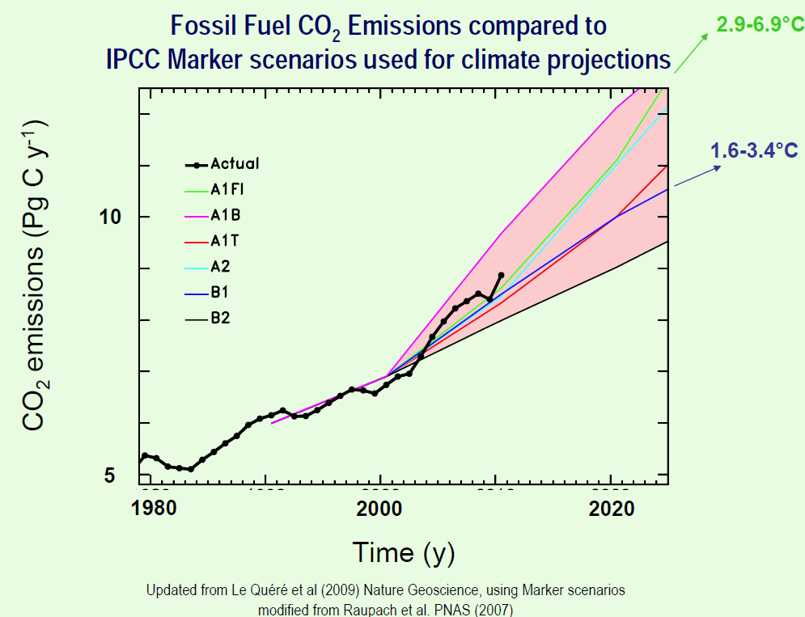
Figure from PPT by Corrine Le Quéré (UNFCCC, retrieved 2014-09-15)
Notes:
UNFCCC :United Nations Framework Convenction on Climate Change
23

Slide 24
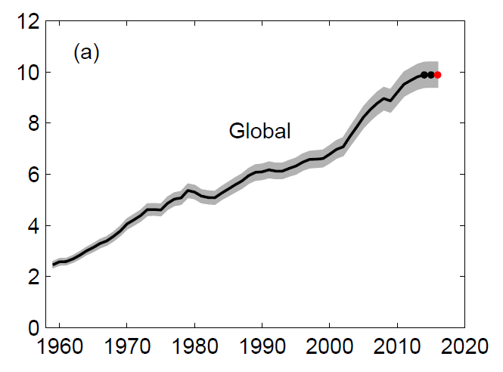
Just published new report shows a flattening in emissions
Last three years stabilization in
global emissions.
At this level it would take 50 years
to emit same amount as was in the
entire industrial period before.
Latest report from C. Le Quéré et al.: Global Carbon Budget 2016
(data available from http://dx.doi.org/10.3334/CDIAC/GCP_2016)
Notes:
UNFCCC :United Nations Framework Convenction on Climate Change
24

Slide 25
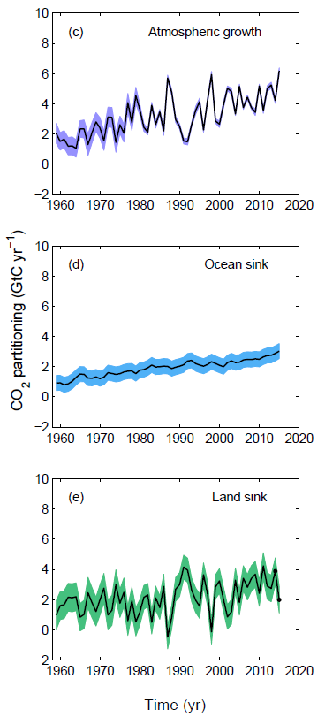
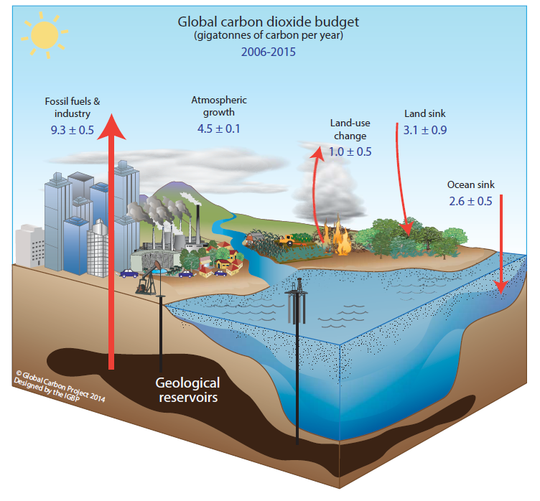
Latest report from C. Le Quéré et al.:
Global Carbon Budget 2016
Notes:
UNFCCC :United Nations Framework Convenction on Climate Change
25

Slide 26
An interesting thought experiment:
Can Redwoods take up anthropogenic carbon emissions?
According to a recent inventory study done by researchers,
forests in the northern part of Jedediah Smith Redwoods park stores
2,600 metric tons of carbon per hectare, that is on an area of 2.47 acres.
One hectare is 100m x 100m area = 10⁴m²
From that we get a carbon storage of 0.26 tC/m²
We know that the planet’s surface is in total about 5.10x10¹⁴m²
Let’ assume we could transform landscapes to have a similar biome with these giant
Jedediah Smith Redwoods and take would transform landscapes (with little vegetation
and low carbon storage) into these biomes with these giant trees, and let’s say
we want to convert an area equivalent to that of worldwide urbanized area.
How much carbon could that store (and thus be removed from the atmosphere)?
Ocean to land is a about 2/3 and 1/3 of the planet surface.
We start with an land area of 1.6x10¹⁴m²
Of that area of Earth => 5*10^10 * 2,6*10^3 tC = 13 *10^3 tC = 13000GtC
Only 1% of land covered by same vegetation:
1.7*10^12m^2 *0.26 tC/m^2 ~5*10^11 tC= 500GtC

Slide 27
An interesting thought experiment:
Can Redwoods take up anthropogenic carbon emissions?
Estimates for the urbanized land area are difficult, but let’s assume the area:
A_{urban} =1.0*10⁶ km²=1.0*10¹² m²
(We know that the planet’s surface is in total about 5.10x10¹⁴m²
Ocean to land is a about 2/3 and 1/3 of the planet surface.
So of the total land area of 1.6x10¹⁴m² s 1% is already to some form urbanized!(?)
see http://www.newgeography.com/content/001689-how-much-world-covered-cities)
Our carbon storage per area is
S_{c}=0.26 tC/m²
The math is simple here: multiplication gives: 2.6*10¹¹ tC = 260 GtC
This a budget calculation, but it does not tell us if it is at all possible to achieve
a green solution to the fossil fuel emissions problem.

Slide 28
An interesting thought experiment:
Can Redwoods take up anthropogenic carbon emissions?
The math is simple here: multiplication gives: 260 GtC
Today we have about 800 GtC in the air (400ppm). This would reduce the CO₂
concentrations by ca 130ppm to 270ppm, theoretically. This is a simple budget calculation,
it ignores completely the time it takes for the trees to grow and store that carbon,
And when the exchange between atmosphere and terrestrial sink
was to be changed this way or in another, then other feedbacks in the
system could change other fluxes in the natural carbon cycle, too (e.g. respiration,
ocean-atmosphere fluxes).
The interesting fact here is the following: The carbon sinks and sources on land
(and ocean, of course) are huge! Atmospheric CO2 is in that sense
just an intermediate storage place for the extra carbon released into the system.
Over the last 10000 years the natural system kept CO2 concentrations well in balance.
The current anthropogenic perturbation forces a response of the natural system.
But the regulating carbon fluxes are outpaced by the forcing. A return to the normal
state is possible, but it will take most likely 1000 years and longer before the carbon
footprint from fossil fuel emissions is taken out of the atmosphere and stored
elsewhere in the ocean and on land.

