Slide 1
Climate change scenarios of the
21st century: Model simulations
Climate Change
Oliver Elison Timm ATM 306 Fall 2016
Lecture 8
Notes:
1

Slide 2
CMIP5 model experiments
CMIP: Coupled Model Intercomparison Project
“A standard experimental protocol for studying the output of coupled atmosphere-ocean general circulation models (AOGCMs). CMIP provides a community-based infrastructure in support of climate model diagnosis, validation, intercomparison, documentation and data access. This framework enables a diverse community of scientists to analyze GCMs in a systematic fashion, a process which serves to facilitate model improvement. Virtually the entire international climate modeling community has participated in this project since its inception in 1995.”
(quoted from the main page: http://cmip-pcmdi.llnl.gov/)
The number behind CMIP indicates the different phases:
3 previous model generation,
5 is currently the latest generation,
6 is the next generation (in progress)

Slide 3
How good can climate models simulate our present climate?
All CMIP5 models were compared to observations:
Current average climate conditions (last 30 years)
Historical trends over the 20th century
Ability to reproduce natural variability
For the model validation (or better evaluation) a multitude of climate variables and spatial pattern are analyzed. For example:
Temperature, precipitation, sea level pressure wind, cloud cover, radiative fluxes
ocean SST, SSS, sea ice, ocean circulations, deep ocean temperatures, ocean oxygen/ nutrient concentrations
Zonally averaged circulation, heat transports
Annual mean pattern, seasonal cycle, ENSO variability, NAO, PDO variability

Slide 4
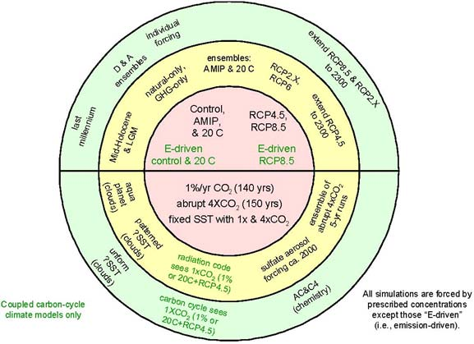
CMIP5 model experiments
The standard warming
scenarios used in AR5
report. More than 30
different models took
part.
Karl E. Taylor, Ronald J. Stouffer, and Gerald A. Meehl, 2012:
An Overview of CMIP5 and the Experiment Design.
Bull. Amer. Meteor. Soc., 93, 485–498.

Slide 5
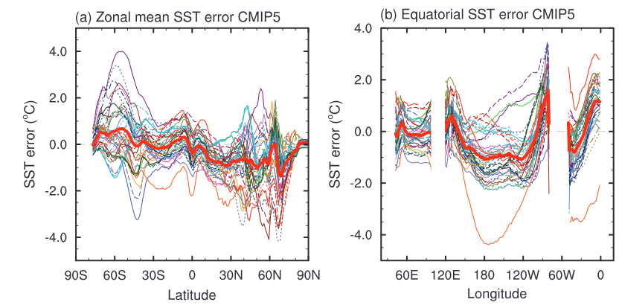
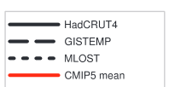
CMIP model evaluation: Zonally averaged SST and tropical SST
West East
Pacific
Indian
Ocean
Atlantic
Differences model model observed (present-day 30yr average SST)
Notes:
IPCC AR5 WG1, p. 779
Evaluation of Climate Models
Chapter 9
Figure 9.14
(a) Zonally averaged sea surface temperature (SST) error in CMIP5 models. (b) Equatorial SST error in CMIP5 models. (c) Zonally averaged multi-model mean SST
error for CMIP5 (red curve) and CMIP3 (blue curve), together with inter-model standard deviation (shading). (d) Equatorial multi-model mean SST in CMIP5 (red curve), CMIP3 (blue
curve) together with inter-model standard deviation (shading) and observations (black). Model climatologies are derived from the 1979–1999 mean of the historical simulations.
The Hadley Centre Sea Ice and Sea Surface Temperature (HadISST) (Rayner et al., 2003) observational climatology for 1979–1999 is used as reference for the error calculation (a),
(b), and (c); and for observations in (d).

Slide 6
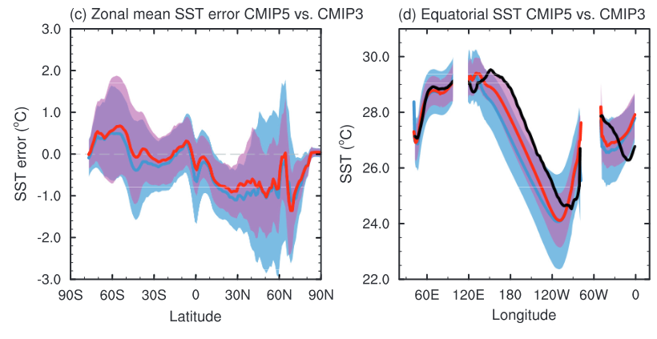
CMIP model evaluation: Zonally averaged SST and tropical SST
West East
Pacific
Indian
Ocean
Atlantic
Differences model minus observed
(present-day 30yr average SST)
Her we see a reduced uncertainty in 30N-60N
from previous model generation CMIP3 to CMIP5
The equatorial cold tongue problem is still existing
in most models in the Pacific, but the models have improved. In the Atlantic the cold SST in the eastern part is not reproduced.
Notes:
IPCC AR5 WG1, p. 779
Evaluation of Climate Models
Chapter 9
Figure 9.14
(a) Zonally averaged sea surface temperature (SST) error in CMIP5 models. (b) Equatorial SST error in CMIP5 models. (c) Zonally averaged multi-model mean SST
error for CMIP5 (red curve) and CMIP3 (blue curve), together with inter-model standard deviation (shading). (d) Equatorial multi-model mean SST in CMIP5 (red curve), CMIP3 (blue
curve) together with inter-model standard deviation (shading) and observations (black). Model climatologies are derived from the 1979–1999 mean of the historical simulations.
The Hadley Centre Sea Ice and Sea Surface Temperature (HadISST) (Rayner et al., 2003) observational climatology for 1979–1999 is used as reference for the error calculation (a),
(b), and (c); and for observations in (d).

Slide 7
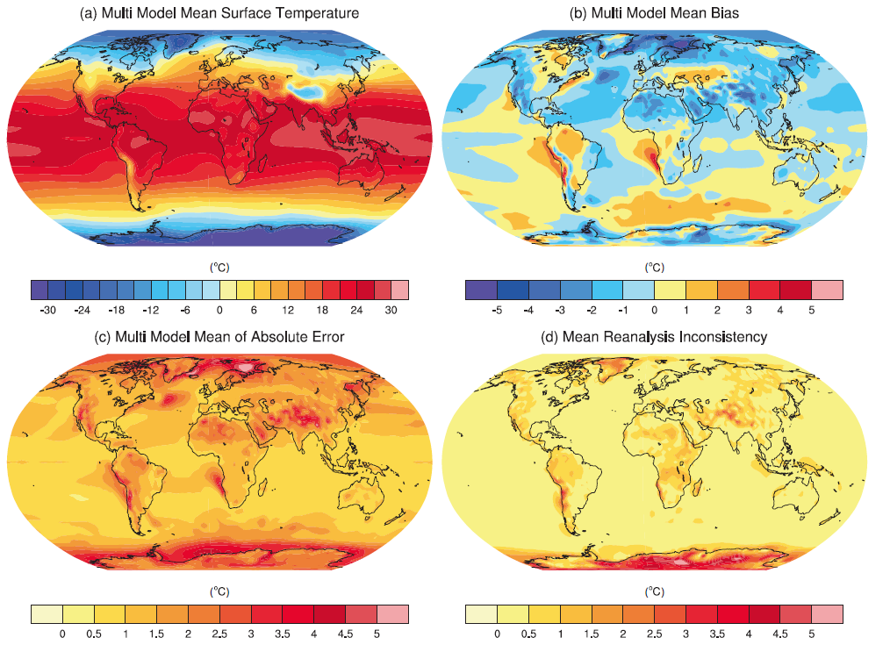
CMIP5 models: present-day 2m air temperature (1980-2005)
Model error compared to observations
Average error amplitude in models
Uncertainty in observations
IPCC, AR5, WG1, chapter 9, [2013]

Slide 8
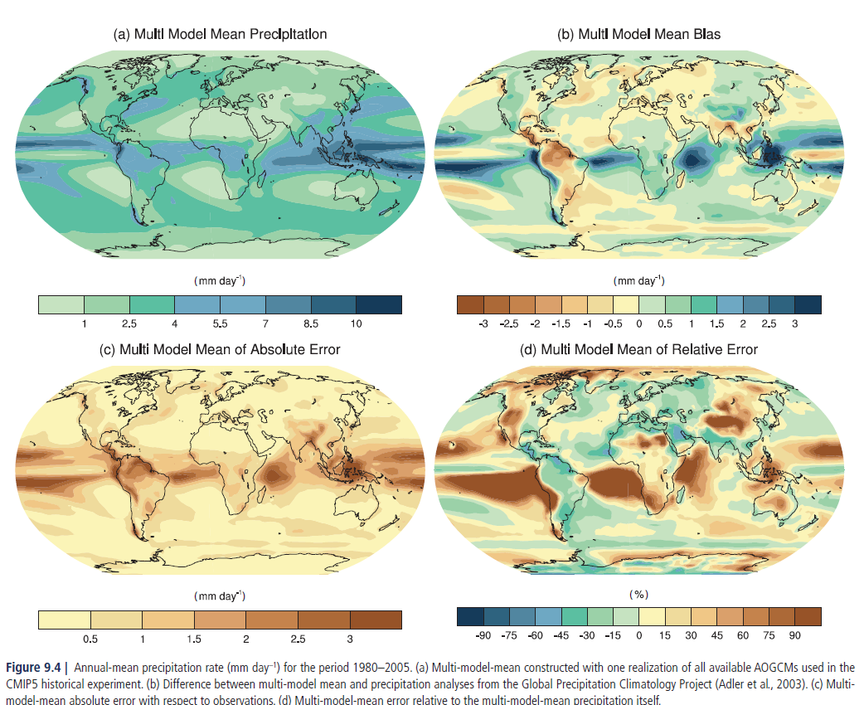
CMIP5 multi-model ensemble: annual precipitation
Relative error: Error / observed mean
IPCC, AR5, WG1, chapter 9, [2013]
Notes:
Relative to ERA interim
8

Slide 9
CMIP5 multi-model ensemble: annual precipitation
IPCC, AR5, WG1, chapter 9, [2013]
Notes:
Relative to ERA interim
9

Slide 10
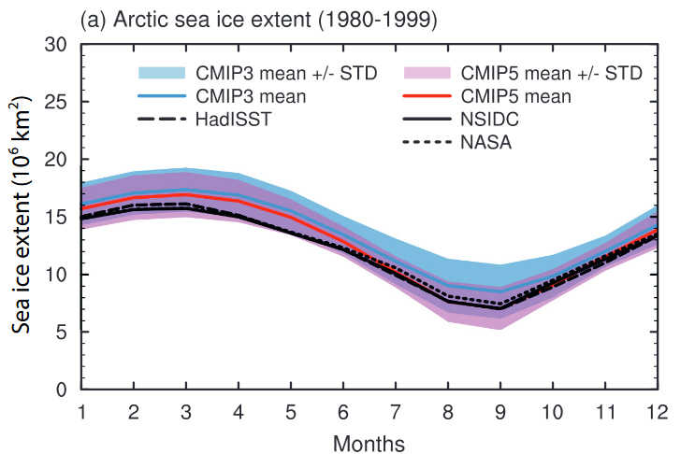
Model evaluation: Seasonal cycle in Arctic sea ice extent
Models overestimate winter sea ice
Models underestimated
summer sea ice in CMIP3
Now in CMIP5 they agree very well
Notes:
Figure 9.22 |
Mean (1980–1999) seasonal cycle of sea ice extent (the ocean area with
a sea ice concentration of at least 15%) in the Northern Hemisphere (upper) and the
Southern Hemisphere (lower) as simulated by 42 CMIP5 and 17 CMIP3 models. Each
model is represented with a single simulation. The observed seasonal cycles (1980–
1999) are based on the Hadley Centre Sea Ice and Sea Surface Temperature (HadISST;
Rayner et al., 2003), National Aeronautics and Space Administration (NASA; Comiso
and Nishio, 2008) and the National Snow and Ice Data Center (NSIDC; Fetterer et al.,
2002) data sets. The shaded areas show the inter-model standard deviation for each
ensemble. (Adapted from Pavlova et al., 2011.)

Slide 11
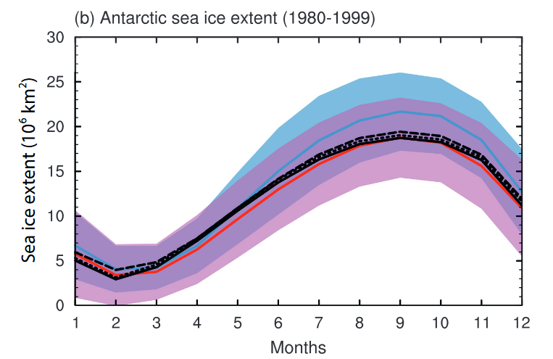
Model evaluation: Seasonal cycle in Antarctic sea ice extent
Models have significantly
improved from
CMIP3 to CMIP5
Notes:
Figure 9.22 |
Mean (1980–1999) seasonal cycle of sea ice extent (the ocean area with
a sea ice concentration of at least 15%) in the Northern Hemisphere (upper) and the
Southern Hemisphere (lower) as simulated by 42 CMIP5 and 17 CMIP3 models. Each
model is represented with a single simulation. The observed seasonal cycles (1980–
1999) are based on the Hadley Centre Sea Ice and Sea Surface Temperature (HadISST;
Rayner et al., 2003), National Aeronautics and Space Administration (NASA; Comiso
and Nishio, 2008) and the National Snow and Ice Data Center (NSIDC; Fetterer et al.,
2002) data sets. The shaded areas show the inter-model standard deviation for each
ensemble. (Adapted from Pavlova et al., 2011.)

Slide 12
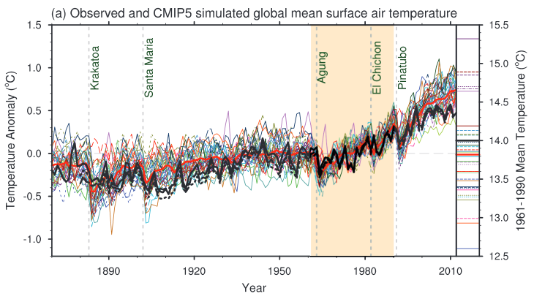
Model evaluation: Historical trend surface air temperature trends during 20th century
Thick black lines are observed temperatures
Thick red line is the multi-model ensemble average
Notes:
Note: Whereas the volcanic eruptions lead on average to a cooling in the year following the eruption, this signal is masked by natural variability. The cooling effect of volcanic eruptions is clearly seen in the ensemble mean.
Can you explain why this is the case?

Slide 13
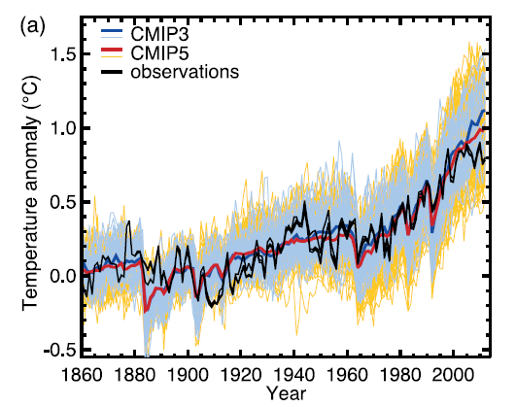
CMIP5 multi-model ensemble: global average annual mean temperatures
Before we continue: A quick check. Where are the observed temperatures in 2010?
Global temperature simulations:
The models were started from a preindustrial climate state. All models see the same external forcing:
historical anthropogenic forcing:
greenhouse gas concentrations
aerosols
land cover change
natural forcing:
volcanic eruptions
solar variability
IPCC, AR5, WG1, Technical Summary [2013]
Notes:
Note: CMIP5 multimodel ensemble consists of more than 40 climate models from various international climate modeling centers, with different versions (resolutions, and complexities).
13

Slide 14
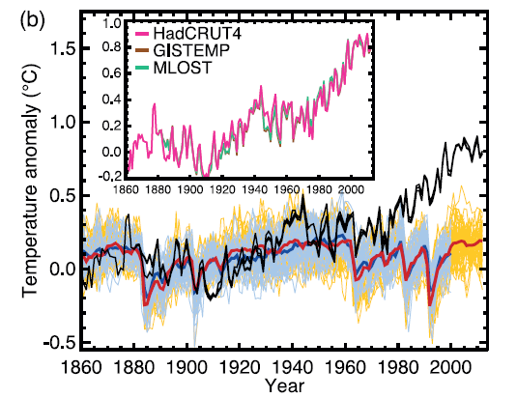
CMIP5 multi-model ensemble: global average annual mean temperatures
In another standardized experiment participating modelling centers started their model simulation from the same initial climate state. But then they prescribed as forcing:
historical natural forcing
volcanic eruptions
solar variability
In these simulations there is no anthropogenic forcing (e.g. CO2 remained at preindustrial levels, land cover did not change compared with year 1860)
IPCC, AR5, WG1, Technical Summary [2013]
Notes:
Relative to ERA interim
14

Slide 15
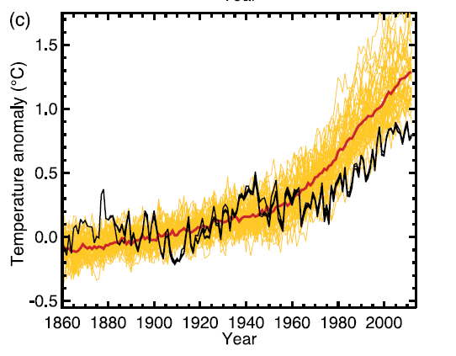
CMIP5 multi-model ensemble: global average annual mean temperatures
Here is another result from a standardized forcing experiment that the international modeling centers conducted: same initial climate state as in the simulations before.
With anthropogenic forcing
But no natural forcing
IPCC, AR5, WG1, Technical Summary [2013]
Notes:
Relative to ERA interim
15

Slide 16
CMIP5 multi-model ensemble: global average annual mean temperatures
Global temperature simulations
with anthropogenic forcing only
These experiments are firm evidence that
Greenhouse gases have contributed significantly to the global warming trend
Natural variability is important, too, but cannot explain the recent trend itself.
IPCC, AR5, WG1, Technical Summary [2013]
Notes:
Relative to ERA interim
16

Slide 17
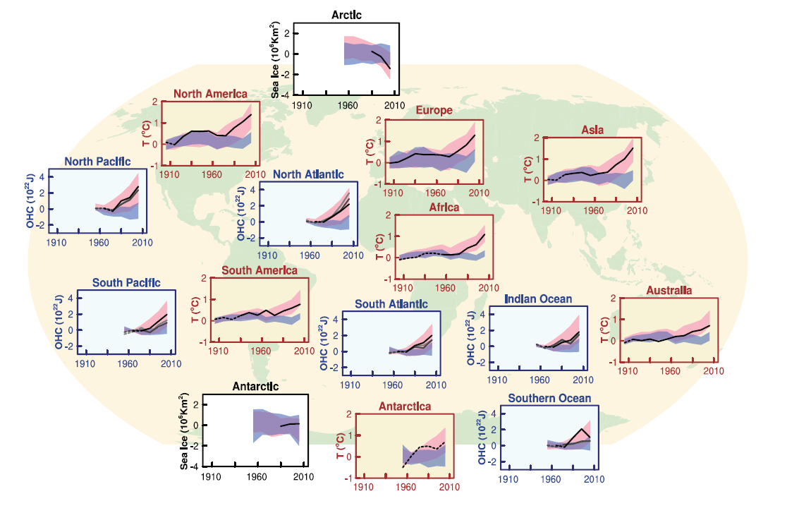
Regional changes are better simulated with natural + anthropogenic forcing
IPCC, AR5, WG1, Technical Summary [2013]
Notes:
Relative to ERA interim
17

Slide 18
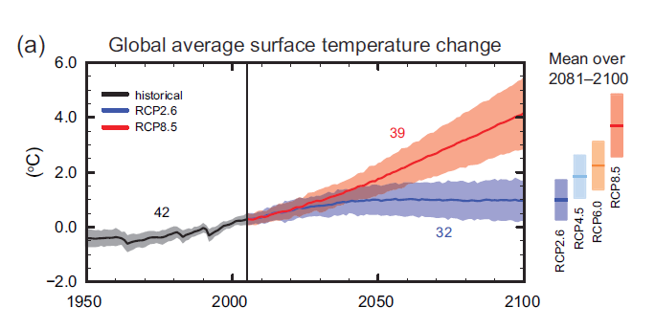
CMIP5 multi-model ensemble: global average annual mean temperatures projections for the 21st century
IPCC, AR5, WG1, Summary for Policymakers, Figure SPM7, [2013]
Notes:
Relative to ERA interim
18

Slide 19
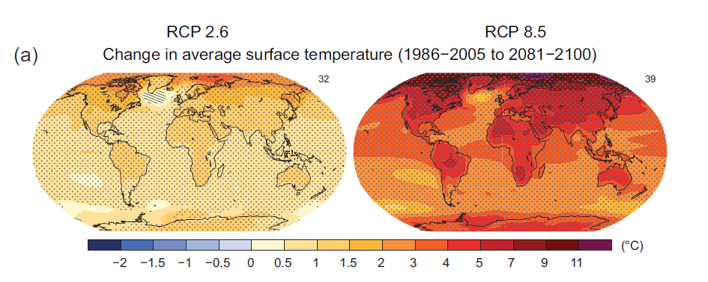
CMIP5 multi-model ensemble: global average annual mean temperatures projections for the 21st century
IPCC, AR5, WG1, Summary for Policymakers, Figure SPM8, [2013]
Notes:
Relative to ERA interim
19

Slide 20
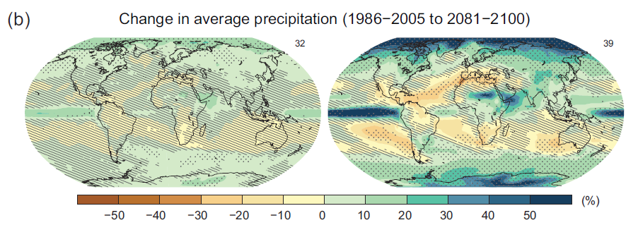
CMIP5 multi-model ensemble: global average annual mean precipitation projections for the 21st century
Striped areas indicate low confidence, due to large spread in the modeled
simulations.
Dotted areas show high confidence in the model results.
IPCC, AR5, WG1, Summary for Policymakers, Figure SPM8, [2013]
Notes:
Relative to ERA interim
20

Slide 21
Summary global climate models and climate change simulations
If greenhouse gas emissions continue at current rates and no effective removal of GHGs is developed, global temperatures will continue to increase:
Depending on the emission scenarios the temperature change by the end of the 21st century can range between:
0.3-1.7 deg C with low emission scenarios (RCP2.6)
2.6-4.8 degree C in very high emission scenarios (RCP8.5)
strongest warming in polar region in the northern hemisphere over land and in the Arctic.
This implies that the number of extreme hot days will increase and number of cold extremes will decrease
Coupled General Circulation Models have been improved over several model generations:
Refinement of the grid resolution, improved representation of physical process,
Interactive chemistry, vegetation
Beginning to include land ice dynamics
Coordinated international model intercomparison projects help to analyze different climate scenarios in a multi-model ensemble approach
More than 30 models contributed to the latest the IPCC report
A number of problems still exist in our current climate models (e.g. differences between the observed and simulated average precipitation pattern)
Research must help to understand the causes for the model deficits in order to improve the models (increasing resolution is not enough!)

