Slide 1
Radiative forcing, climate sensitivity and feedbacks
Notes:
Notes: mathematical notation following Roe et al., Science (2007)
1

Slide 2
“Our understanding of the climate system is complicated by feedbacks that either amplify or damp perturbations…”
Feedbacks
Notes:
2

Slide 3
“Our understanding of the climate system is complicated by feedbacks that either amplify or damp perturbations…”
Feedbacks
Describe the inter-related growth or decay of the components of a system.
A positive feedback exists…
Notes:
3

Slide 4
“Our understanding of the climate system is complicated by feedbacks that either amplify or damp perturbations…”
Feedbacks
Describe the inter-related growth or decay of the components of a system.
A positive feedback exists…
if an initial perturbation is amplified by other changes through the system.
Notes:
4

Slide 5
“Our understanding of the climate system is complicated by feedbacks that either amplify or damp perturbations…”
Feedbacks
Describe the inter-related growth or decay of the components of a system.
A positive feedback exists…
if an initial perturbation is amplified by other changes through the system.
A negative feedback exists…
if the perturbation is reduced after the system adjusts.
Negative feedbacks stabilize systems.
Notes:
5

Slide 6
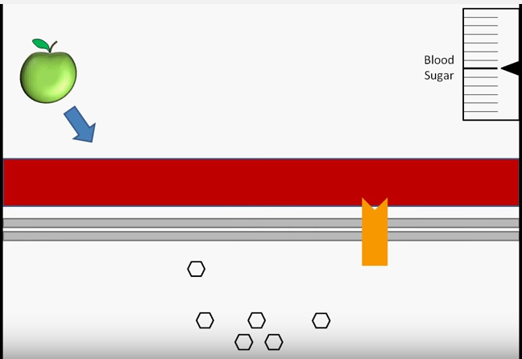
Feedback loops (examples from biology examples)
https://www.youtube.com/watch?v=_QbD92p_EVs

Slide 7
Ended on page 6 in last class

Slide 8
What activates feedback loops?
In the climate system we find many feedback loops, and most of these feedbacks are always active and contribute to the natural climate variability. (e.g. year to year sea ice variability in the Arctic).
Other feedback loops are currently in a stand-by mode.
A strong enough external radiative forcing (RF) can activate additional feedbacks in the climate system.
(e.g. thawing of permafrost and release of methane)
It is very important to study feedbacks in the climate system
if we want to understand and project climate change for the 21st century because they can amplify or dampen the direct anthropogenic forcing effect.
Notes:
In case you wonder why tropopause and not top of atmosphere (TOA):
before we simply talked about TOA radiative imbalance between net incoming and net outgoing radiative fluxes.
For climate modelers, it has become the norm to use the tropopause, because
The stratosphere responds very fast to radiative forcing, so measuring the ‘instantaneous’ radiative forcing is for this (and other reasons) more appropriate when we use the net radiative flux imbalance at the tropopause.
Note further, that for the surface temperature change the energy fluxes in and out of the tropopause are most important.

Slide 9
Radiative Forcing
Before we take a closer look at feedback loops, we need to quantify first of all how strong the anthropogenic forcing is.
How do we know that CO₂ is the main driver of the 20th century warming trend? And will it continue to be the single most important forcing factor in the next 2100 years?
What about other greenhouse gases? How do they compare to the CO₂ forcing?
Is there or compensation of the greenhouse gas forcing by aerosols (global dimming)?
Notes:
In case you wonder why tropopause and not top of atmosphere (TOA):
before we simply talked about TOA radiative imbalance between net incoming and net outgoing radiative fluxes.
For climate modelers, it has become the norm to use the tropopause, because
The stratosphere responds very fast to radiative forcing, so measuring the ‘instantaneous’ radiative forcing is for this (and other reasons) more appropriate when we use the net radiative flux imbalance at the tropopause.
Note further, that for the surface temperature change the energy fluxes in and out of the tropopause are most important.

Slide 10
Radiative Forcing
The purpose of defining ‘radiative forcing’ for climate change studies is:
To give us a quantitative measure how strong a specific forcing perturbs the climate system
This makes effects from aerosols comparable with CO2 forcing, for example.
Studies have shown that individual forcing factors applied at the same time behave additive for radiative forcing. (That means: if we know the radiative forcing CO2 and methane then we know the combined radiative forcing, too)

Slide 11
Radiative Forcing
For the definition of RF:
The climate system is in an equilibrium (incoming equals outgoing radiation)
In such a state the forcing is applied (most definitions use a constant forcing) and the imbalance in the radiative fluxes is calculated.
Units are watts per square meter (W/m^2)
As we will see from there on it depends on the exact definition how the induced change in the energy imbalance is measured.

Slide 12
Radiative Forcing
Change in the net balance of incoming and outgoing radiation at the tropopause
Notes:
In case you wonder why tropopause and not top of atmosphere (TOA):
before we simply talked about TOA radiative imbalance between net incoming and net outgoing radiative fluxes.
For climate modelers, it has become the norm to use the tropopause, because
The stratosphere responds very fast to radiative forcing, so measuring the ‘instantaneous’ radiative forcing is for this (and other reasons) more appropriate when we use the net radiative flux imbalance at the tropopause.
Note further, that for the surface temperature change the energy fluxes in and out of the tropopause are most important.

Slide 13
Radiative Forcing
Change in the net balance of incoming and outgoing radiation at the tropopause
after the stratosphere was allowed to adjust to the initial radiative perturbation

Slide 14
Radiative Forcing
Change in the net balance of incoming and outgoing radiation at the tropopause
after the stratosphere was allowed to adjust to the initial radiative perturbation
Surface and troposphere, however, have not responded yet (same as before the perturbation was introduced)

Slide 15
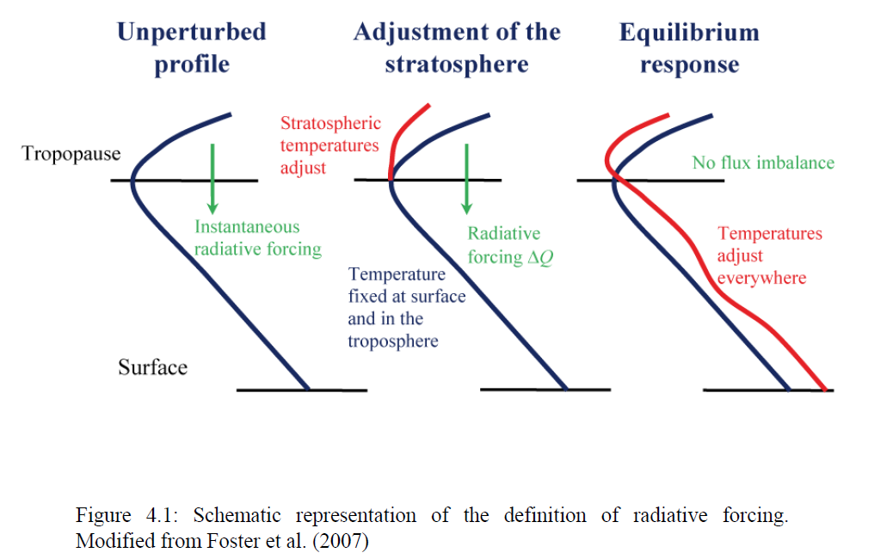
Goosse, Chapter 4.
Notes:
Atmosphere and ocean and land surface temperatures are in this ideal situation exactly the same to the state before the forcing is ‘switched on’.
Question: Why do we not simply wait until the new climate equilibrium is reached
and measure then the radiative forcing?
Answer: in the new equilibrium temperatures do not change, therefore the net incoming radiation must be equal to the net outgoing radiation. Hence, we cannot measure the radiative forcing. Further all kinds of changes in the system could happen and lead to feedbacks. So, we would not have a pure measure of the strength of the radiative forcing, and thus it would not allow us to compare
the magnitudes of different forcings (e.g. land cover change and CO2).

Slide 16
State at which we measure
radiative forcing in climate models
(special model experiments
are designed for this purpose)
Goosse, Chapter 4.
Notes:
Atmosphere and ocean and land surface temperatures are in this ideal situation exactly the same to the state before the forcing is ‘switched on’.
Question: Why do we not simply wait until the new climate equilibrium is reached
and measure then the radiative forcing?
Answer: in the new equilibrium temperatures do not change, therefore the net incoming radiation must be equal to the net outgoing radiation. Hence, we cannot measure the radiative forcing. Further all kinds of changes in the system could happen and lead to feedbacks. So, we would not have a pure measure of the strength of the radiative forcing, and thus it would not allow us to compare
the magnitudes of different forcings (e.g. land cover change and CO2).

Slide 17
How do we quantify radiative forcing?
Sophisticated radiative transfer models
1-dimensional column models with detailed
line-by-line (or band) absorption for each gas / substance in the air column
General circulation models (GCMs)
State-of-the-art climate models are run in 'specific modes': suppress changes in atmospheric and surface temperature changes, keep water vapor constant, etc.

Slide 18
How do we quantify radiative forcing?
For the most important greenhouse gases:
Approximated equations have been derived
They describe the global mean radiative forcing for a single forcing agent
(Remember: To good approximation, the radiative forcing is additive: the combined forcing from CO₂ and CH₄, N₂O, for example, is additive)

Slide 19
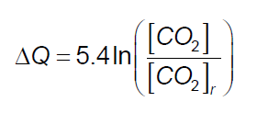
Comparison of radiative forcing: Carbon Dioxide vs Methane
Carbon Dioxide
Methane
CH₄ in units of ppb
CO₂ in units of ppm
subscript r indicates reference levels:
CO₂ ref : 280 ppm CH₄ ref: 700 ppb

Slide 20
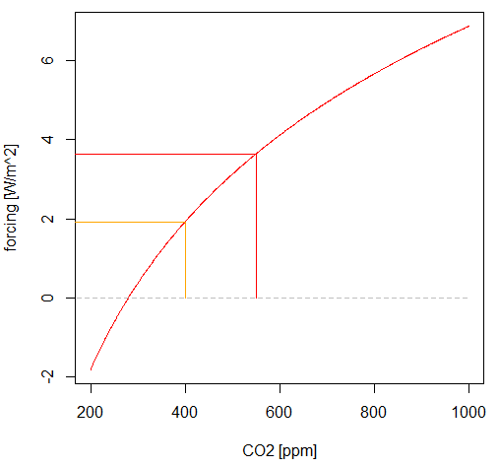
Comparison of radiative forcing: 1750 – present
Carbon Dioxide

Slide 21
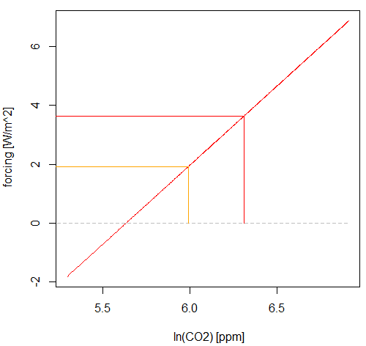
Comparison of radiative forcing: 1750 – present
Carbon Dioxide
Radiative forcing ~ logarithm of CO₂
Radiative forcing the same for CO₂
doubling: the reference level
[280 to 560, or 400 to 800]
is not important.

Slide 22
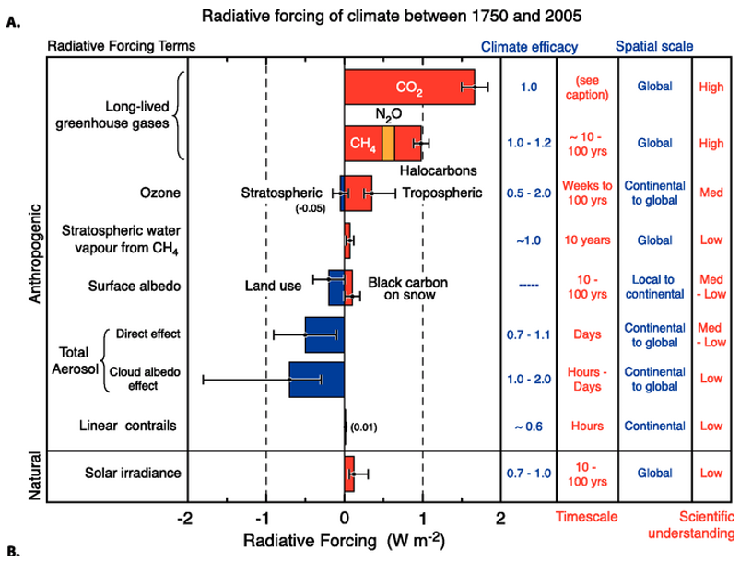
Summary of radiative forcing
IPCC report #4 (AR4) published in 2007

Slide 23
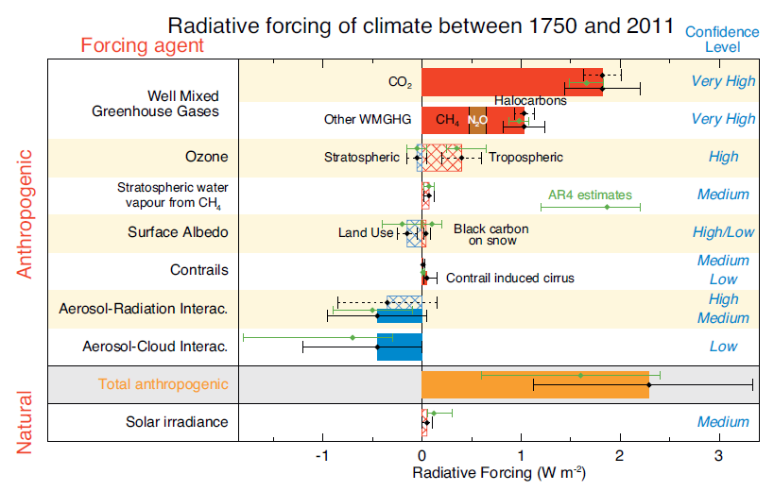
Summary of radiative forcing: Latest IPCC report
IPCC report #5 (AR5) published in 2013
Notes:
The comparison between the two IPCC reports shows:
In the years from 2005 to 2013 when these reports were published, the confidence has increase, uncertainty has decreased (not for all, but most)
The signs and best estimate values are very similar.
CO2, but methane and other greenhouse gases provide strongest radiative forcing -> increase in engery flux into the climate system
Strongest negative feedbacks due to aerosols (direct effect, and indirect effects
through modification of cloud properties)
Natural solar forcing is estimated to be small (e.g. solar sunspot cycles)

Slide 24
The next slides can be skipped (for time reason)

Slide 25
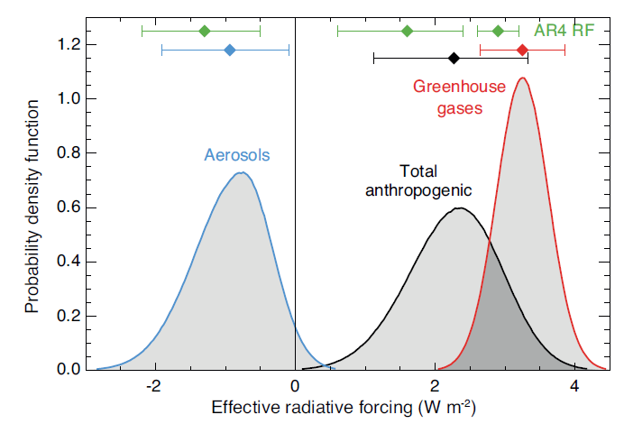
Summary of radiative forcing: Latest IPCC report
IPCC report #5 (AR5) published in 2013
In green:
Estimates in previous report
(IPCC, AR4, 2007)
~95% confidence that the correct value is in that range

Slide 26
Summary of radiative forcing: Latest IPCC report
IPCC report #5 (AR5) published in 2013
In green:
Estimates in previous report
(IPCC, AR4, 2007)

Slide 27
Effective Radiative Forcing (ERF)
From IPPC AR5 WG1 report: Chapter 8 Box 8.1 | Definition of Radiative Forcing and Effective Radiative Forcing:
“ERF is the change in net TOA downward radiative flux after allowing for atmospheric temperatures, water vapour and clouds to adjust, but with surface temperature or a portion of surface conditions unchanged. Although there are multiple methods to calculate ERF, we take ERF to mean the method in which sea surface temperatures and sea ice cover are fixed at climatological values unless otherwise specified. Land surface properties (temperature, snow and ice cover and vegetation) are allowed to adjust in this method”
Change in net downward radiative flux at the top of the atmosphere (TOA) after allowing for atmospheric temperatures, water vapor, clouds and land albedo to adjust, but with global mean surface temperature or ocean and sea ice conditions unchanged
Notes:
The reasons for using this measure of radiative forcing: These parts of the climate system adjust relatively fast in a few years, whereas the ocean SST warming depends on the ocean heat uptake and takes much longer to respond to the initial radiative forcing.
This type of measure for radiative forcing has also the convenient aspect that atmospheric models without an active ocean can be used to study radiative forcing.

Slide 28
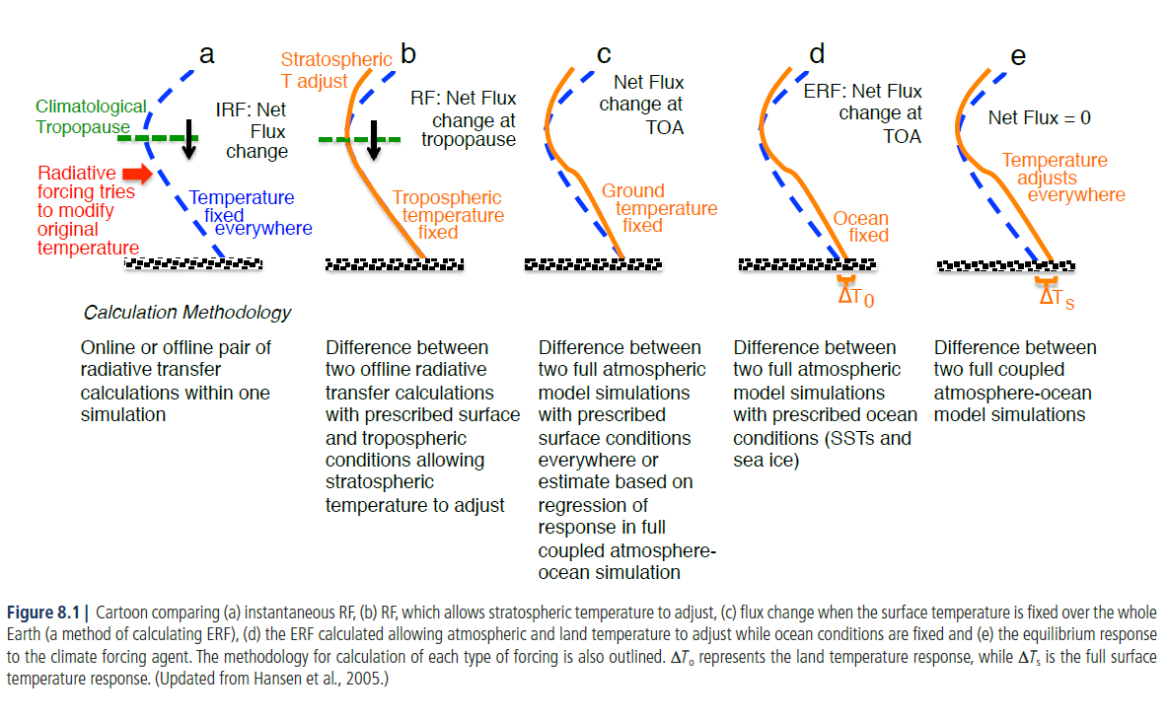
Comparison Radiative Forcing vs Effective Radiative Forcing (RF vs ERF)
RF
ERF
Notes:
So here we see that land surface temperature changes over land plus the atmospheric temperature changes will affect the outgoing long-wave radiation.
Thus we cannot compare directly the traditional RF with ERF.
In summary, the numbers and uncertainty ranges will depend on the definition of radiative forcing and the calculation therefore, too.

Slide 29
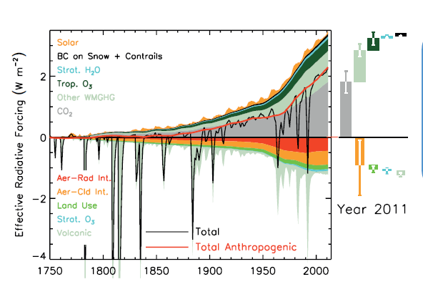
Effective Radiative Forcing over Industrial Era
Volcanic eruptions
have a strong but short-lived
negative radiative forcing.
But 30 or 50 years
with several eruptions can lower
the average temperature!
Fig. 8.18 from IPCC AR5 report WG 1:
Bars with the forcing and uncertainty ranges (5 to 95% confidence range) at present are given in the right part of the figure. The total anthropogenic forcing was 0.57 (0.29 to 0.85) W m–2 in 1950, 1.25 (0.64 to 1.86) W m–2 in 1980 and 2.29 (1.13 to 3.33) W m–2 in 2011.

Slide 30
Why is radiative forcing useful?
Surprisingly, the source (cause) of the radiative forcing does not matter for the system’s temperature response
Global surface temperature change is independent of the forcing agent:
e.g. whether CO₂ or surface albedo change cause 1 W/m² radiative forcing, we can expect the same global mean temperature response
BUT: different forcing agents can cause different regional responses
In addition to the global mean RF, the spatial distribution and temporal evolution of forcing, as well as climate feedbacks, play a role in determining the eventual impact of various drivers on climate.

Slide 31
Summary: radiative forcing
It is unequivocal that anthropogenic increases in the well-mixed greenhouse gases (WMGHGs) have substantially enhanced the greenhouse effect, and the resulting forcing continues to increase.
Total anthropogenic ERF over the industrial era (1750-present) is 2.3 (1.1 to 3.3) W/m²
There is very high confidence that natural forcing is a small fraction in relation to the anthropogenic forcing except for brief periods following large volcanic eruptions.

Slide 32
Summary: radiative forcing
The results regarding the relative importance of the anthropogenic versus natural forcing are robust and do not depend on the definition of radiative forcing and the details of how radiative forcing is calculated.
For the changes expected in the near future (next 100 years), individual radiative forcing factors are linear:
The total radiative forcing is the sum of all individual radiative forcings acting on the system.

Slide 33
Feedbacks in the climate system
The feedback parameter of a system relates the radiative forcing with temperature change:
Fin: Net SW flux
into the system
Fout: Net SW flux
out of the system
Surface temperature Ts

Slide 34
Feedbacks in the climate system
The feedback parameter of a system relates the radiative forcing with temperature change:
Radiative forcing from CO2 is positive (a gain for the climate system).
Radiative
forcing
Fin: Net SW flux
into the system
R
Fout: Net SW flux
out of the system
Surface temperature Ts

Slide 35
Feedbacks in the climate system
The feedback parameter of a system relates the radiative forcing with temperature change:
Radiative forcing from CO2 is positive (a gain for the climate system).
The system is not in radiative
balance -> changes inside the system take place and surface temperatures increase
Radiative
forcing
Fin: Net SW flux
into the system
R
Fout: Net SW flux
out of the system
Surface temperature Ts
ΔT

Slide 36
Feedbacks in the climate system
The feedback parameter of a system relates the radiative forcing with temperature change:
Radiative forcing from CO2 is positive (a gain for the climate system).
The system is not in radiative
balance -> changes inside the system take place and surface temperatures increase
Eventually a new equilibrium is reached: The processes in the climate system lead to an extra emission of LW radiation and/or more reflectance of SW radiation.
Radiative
forcing
Fin: Net SW flux
into the system
R
Fout: Net SW flux
out of the system
Surface temperature Ts
New
equilibrium:
Fout increased (compensates for R)
ΔT

Slide 37
Feedbacks in the climate system
The feedback parameter of a system relates the radiative forcing with temperature change:
Radiative forcing from CO2 is positive (a gain for the climate system).
The system is not in radiative
balance -> changes inside the system take place and surface temperatures increase
Eventually a new equilibrium is reached: The processes in the climate system lead to an extra emission of LW radiation and/or more reflectance of SW radiation.
Radiative
forcing
Fin: Net SW flux
into the system
R
Fout: Net SW flux
out of the system
Surface temperature Ts
New
equilibrium:
Fout increased (compensates for R)
ΔT
On its path to the new radiative balance negative feedbacks must overcome positive feedbacks.

Slide 38
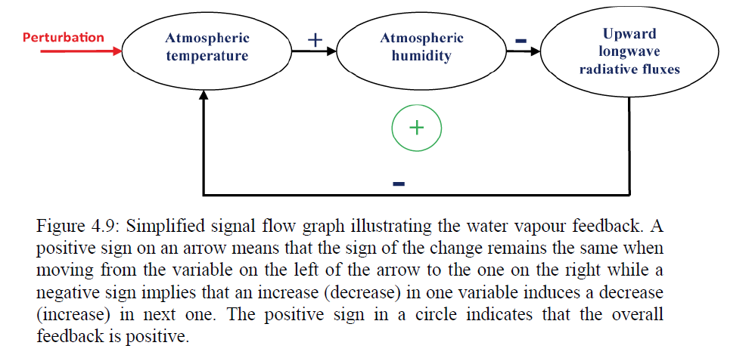
Water vapor feedback loop

Slide 39
Class activity: Feedback loops
Slides with class activity

Slide 40
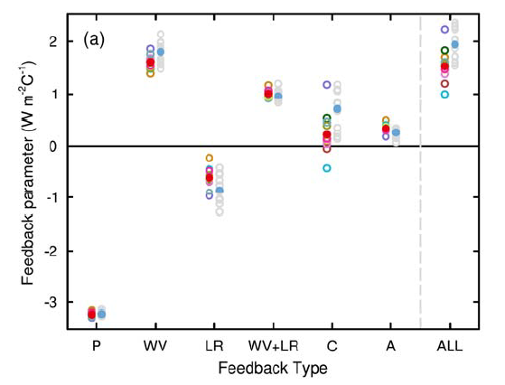
Strengths of individual feedbacks
Estimates are based on multiple
climate models from international climate modeling centers
Strengths of individual feedbacks for CMIP3 and CMIP5 models (left and right columns of symbols) for Planck (P), water vapor (WV), clouds (C), albedo (A), lapse rate (LR), combination of water vapor and lapse rate (WV+LR), and sum of all feedbacks except Planck (ALL),
IPCC AR5, WG1, chapter 9, [2013]
Notes:
Planck Feedback is a term used for the always present effect that with higher temperature more energy is emitted from a blackbody (or gray-body emitter).
This effect can be calculated using the Stefan-Boltzman Law I=sigma T^4.

Slide 41
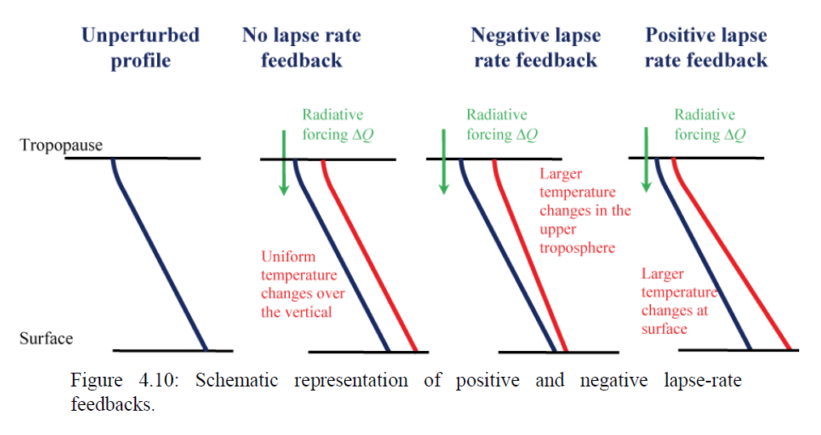
Lapse rate feedback: two competing effects

Slide 42
Lapse rate feedback: two competing effects
Tropical atmosphere
LW radiation
upward flux
more effective

Slide 43
Lapse rate feedback: two competing effects
High latitudes
The upward
LW flux less effective

Slide 44
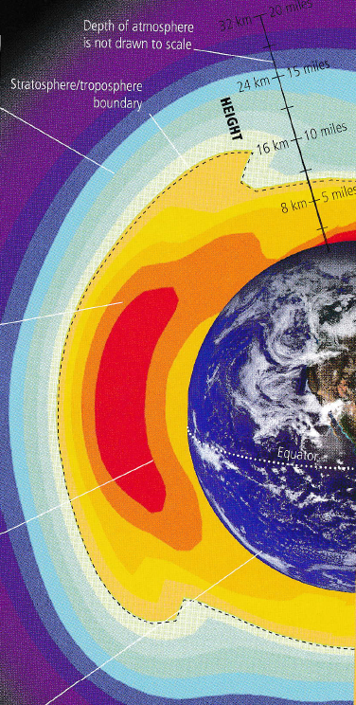
Lapse rate feedback: two competing effects
This figure illustrates the observed warming trends in the atmosphere (Man and Kump part 1, p. 39)
High latitudes
On global average, the tropical negative feedback wins in CO₂ doubling warming scenarios.
The upward
LW flux less effective

Slide 45
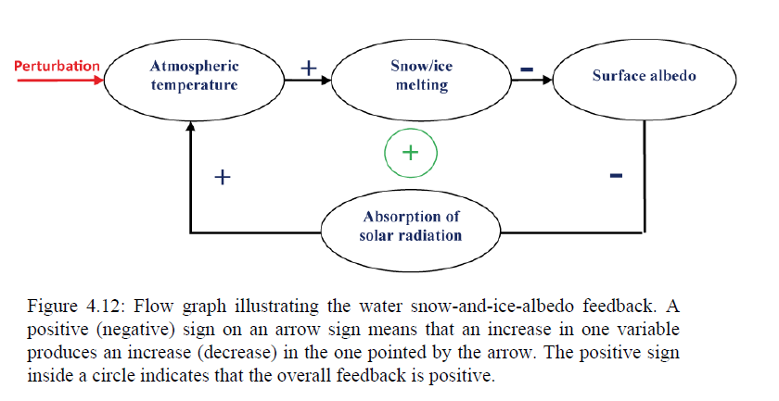
Snow-and-ice-albedo feedback

Slide 46
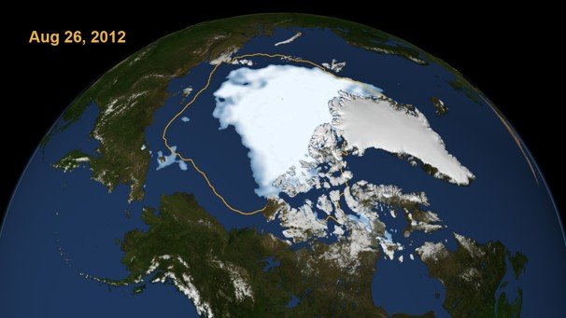
Arctic sea ice loss a positive feedback due to SW reflectance
Observed Northern Hemisphere Sea-Ice Extent
NASA Goddard Space Flight Center (orange line shows average minimum ice extent (for 1979-2010 period). 2012 has lowest sea ice extent in more than 30 years.

Slide 47
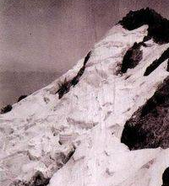
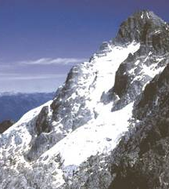
Snow-albedo-feedbacks due to glacial melt:
regionally important feedback
Observed Northern Hemisphere Sea-Ice Extent
Glacier Espejo, Pico Bolivar (5002 m)
Venezuela
< 2 km² of ice left in Venezuela
1910
1988
2008
Jahn [1931]; Schubert [1992, 1999]

Slide 48
Strengths of individual feedbacks
Estimates are based on multiple
climate models from international climate modeling centers
Strengths of individual feedbacks for CMIP3 and CMIP5 models (left and right columns of symbols) for Planck (P), water vapor (WV), clouds (C), albedo (A), lapse rate (LR), combination of water vapor and lapse rate (WV+LR), and sum of all feedbacks except Planck (ALL),
IPCC AR5, WG1, chapter 9, [2013]

Slide 49
Strengths of individual feedbacks
Estimates are based on multiple
climate models from international climate modeling centers
Water vapor and lapse rate effect
have compensate each other
(co-dependent feedbacks)
Strengths of individual feedbacks for CMIP3 and CMIP5 models (left and right columns of symbols) for Planck (P), water vapor (WV), clouds (C), albedo (A), lapse rate (LR), combination of water vapor and lapse rate (WV+LR), and sum of all feedbacks except Planck (ALL),
IPCC AR5, WG1, chapter 9, [2013]

Slide 50
Strengths of individual feedbacks
Cloud feedbacks largest uncertainty
Strengths of individual feedbacks for CMIP3 and CMIP5 models (left and right columns of symbols) for Planck (P), water vapor (WV), clouds (C), albedo (A), lapse rate (LR), combination of water vapor and lapse rate (WV+LR), and sum of all feedbacks except Planck (ALL),
IPCC AR5, WG1, chapter 9, [2013]

Slide 51
Cloud radiative effect
Present-day estimate of cloud radiative effect:
Satellite observations of the TOA radiative fluxes
(clear sky vs cloudy sky)
Shortwave: enhance the reflected outgoing SW radiation (-50W/m^2) (loss for surface)
Longwave: ~ +20-30W/m^2 (gain for the surface)
Net cloud radiative forcing: cooling effect
Note: Numbers from IPCC AR5 WG1 Ch. 7.2.1.2)

Slide 52
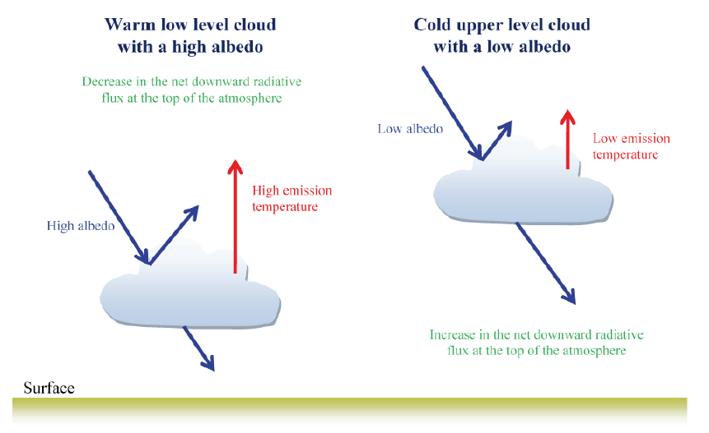
Two important radiative forcing effects from clouds:

Slide 53
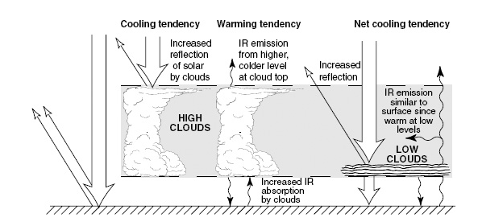
Two important radiative forcing effects from clouds:
Note: Cloud feedbacks are activated when the cloud fraction changes, or if the fractions of could types changes,
Notes:
Figure from Neelin p. 209 Fig. 6.8

Slide 54
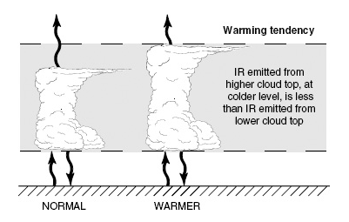
Two important radiative forcing effects from clouds:
Note: Changes in the cloud properties can lead to feedbacks: if convective clouds reach higher into the atmosphere a radiative forcing can result and form a feedback.
Notes:
Figure from Neelin p. 209 Fig. 6.9

Slide 55
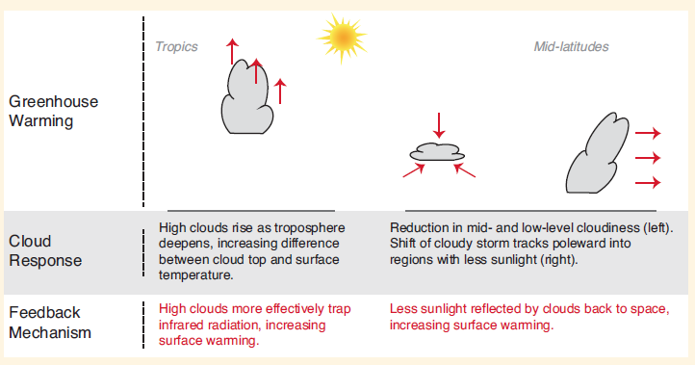
Cloud feedbacks

Slide 56
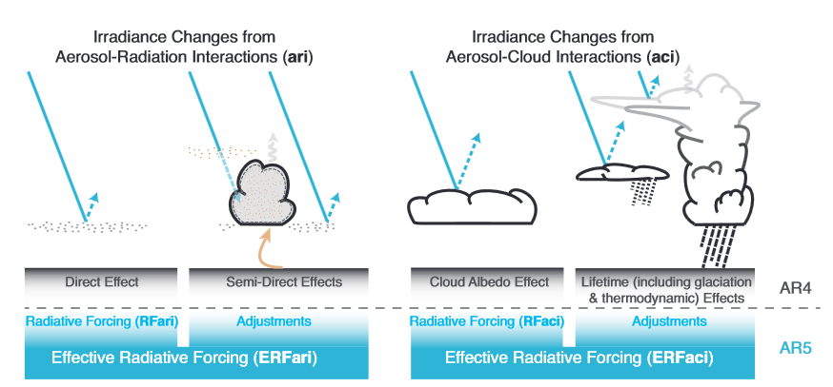
Aerosol radiative forcing

Slide 57
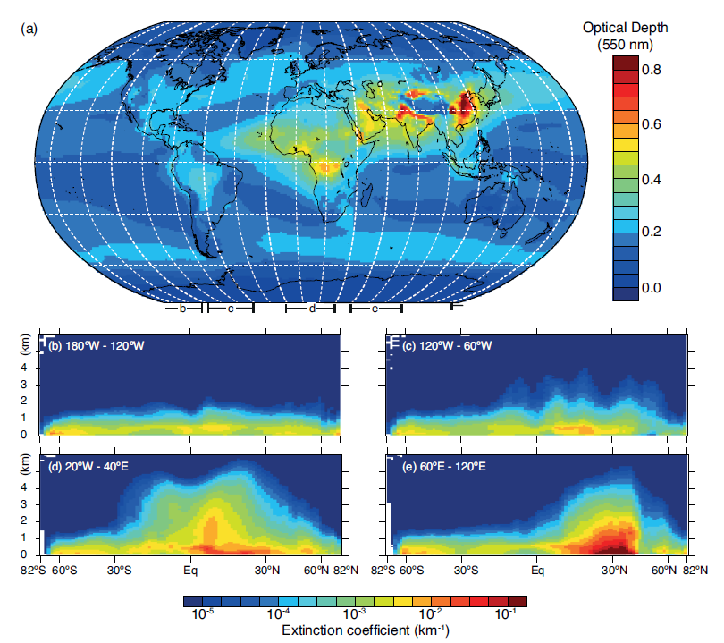
Radiative forcing associated with aerosols
Aerosols: solid or liquid partices of natural and anthropogenic origin
Typical lifetime days to a few weeks (troposphere)
Lifetime is up to a year or more in stratosphere
The larger the concentration of aerosols the 'more effective their absorption,
and scattering of radiation (expressed here as a remote-sensing quantity 'optical depth')

Slide 58
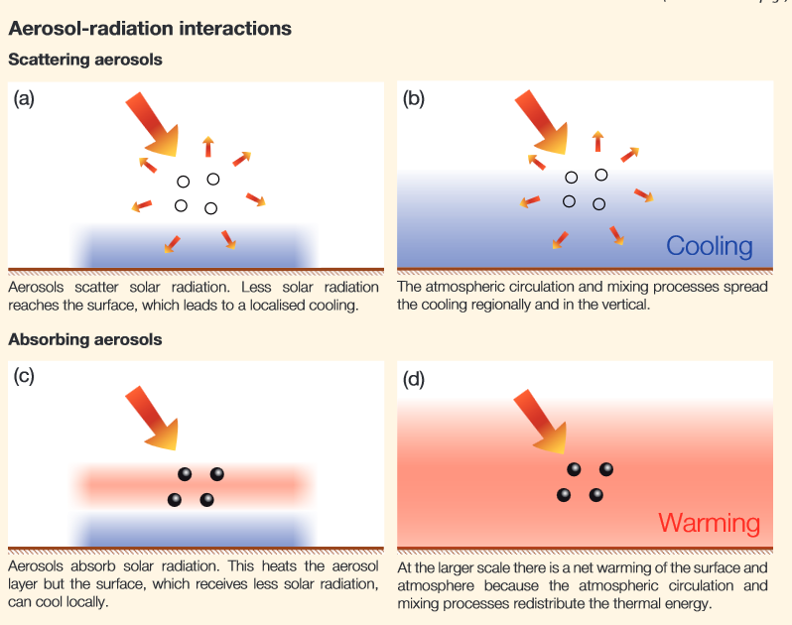

Slide 59
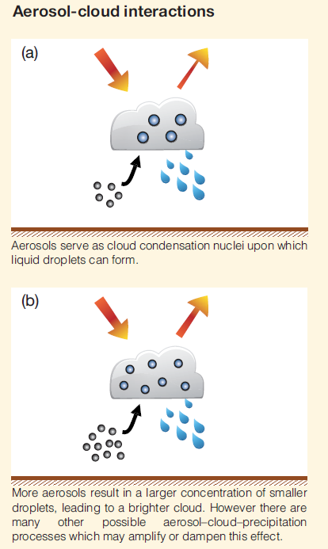
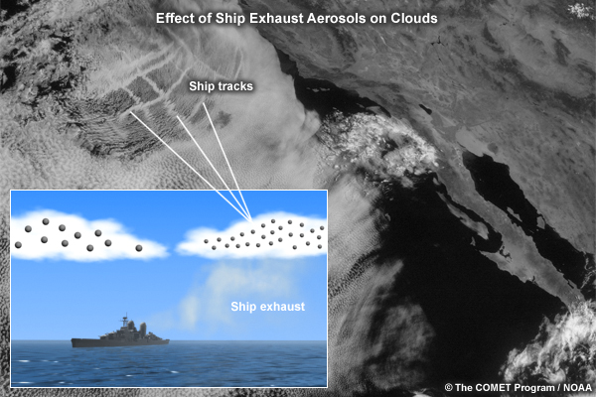
Aerosol particles can change the cloud microphysical properties

Slide 60
Radiative effect of aerosols is one of the most complex problems in radiative forcing
Black carbon aerosols are estimated to have a net warming effect.
The overall effect of all aerosols is a negative radiative forcing, and it is estimated to cool the surface of the planet.

Slide 61
Summary:
Radiative Forcing, Climate Sensitivity and Feedbacks
Radiative forcing (RF) measures how strong a forcing perturbs the radiative energy balance of our climate system.
A number of anthropogenic forcing have been identified and quantified. Their combined RF is a positive value and CO₂ is the largest contributor to the RF. → The climate system gains energy → surface warming
Several feedbacks are activated in the climate system in response to the radiative forcing. They determine the sensitivity of the climate system:
Positive feedbacks amplify the warming
Negative feedbacks reduce the warming
The larger the change in global mean surface temperature for a given RF, the more ‘sensitive’ the system is responding.
The combined feedback is negative and prevents a ‘runaway climate’ in the coming decades to centuries.
Notes:
Note: Uncertainties in aerosol-cloud radiative forcing and cloud feedbacks are still large and part of the reason why climate model simulations still show a considerable range of uncertainty in the amplitude of future temperature change.

