Slide 1
Climate variability and change Introduction to the physical climate system
“Climate is what you expect and weather is what you get."
“Climate tells you what clothes to buy, but weather tells you what clothes to wear."
Oliver Elison Timm ATM 306 Fall 2016
Lecture 1
Notes:
Presentation slide for courses, classes, lectures et al.

Slide 2
Lecture 1
Objectives
Motivation: What is climate variability and why study climate variability?
Weather vs climate
Climate variability vs climate change
Anthropogenic climate change and natural cycles
From “Invisible Blankets” to “Warming Hiatus”
Notes:
Objectives for instruction and expected results and/or skills developed from learning.

Slide 3
Weather and Climate
Notes:
Keywords: Climate, Weather, trend, prediction

Slide 4
Climate
The average condition of the atmosphere, ocean, land cover (snow, vegetation):
Climate is a long-term average over all types of fluctuations and processes (including weather). It has been (and still is) common practice to talk about 30 year averages.
In our life-time we will observe (with an attentive state of mind) 2 non-overlapping climate average periods.
Climate is not limited to the description of average atmospheric conditions! It includes land (vegetation), oceanic conditions, and ice.
Notes:
Objectives for instruction and expected results and/or skills developed from learning.

Slide 5
Lecture 1
Climate monitoring:
At a fixed location, ideally without human-made changes to the nearby environment:
daily temperatures, precipitation, humidity, wind, cloud cover, snow cover (typical meteorological measurements)
lake/ river levels (hydrological measurements)
Date of spring blossom, arrival of migrating birds
Ocean temperatures, salinity, sea ice concentration
Remote sensing:
Global coverage, global measures such as incoming and outgoing shortwave and longwave radiation.
Notes:
Objectives for instruction and expected results and/or skills developed from learning.

Slide 6
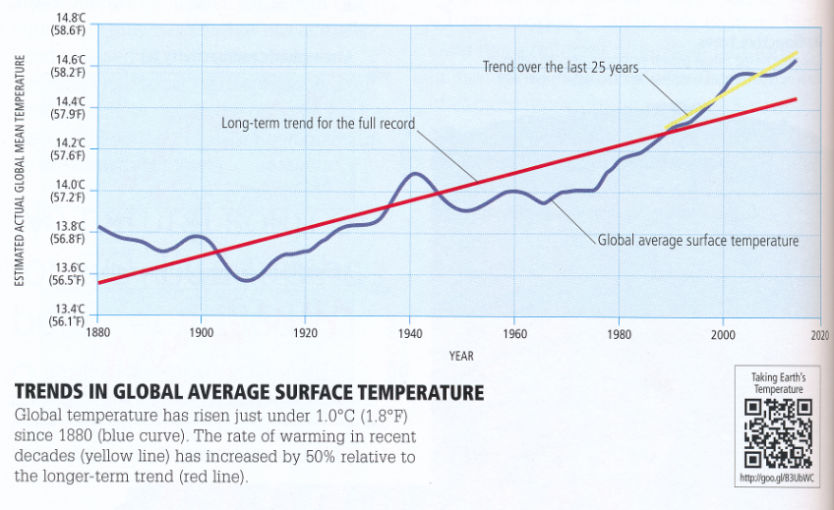
Global temperature trend 100% natural?
Notes:
From Mann and Kump 2015, p.34 (link to video is not so useful: talks about climate modeling, forcing and all combined)

Slide 7
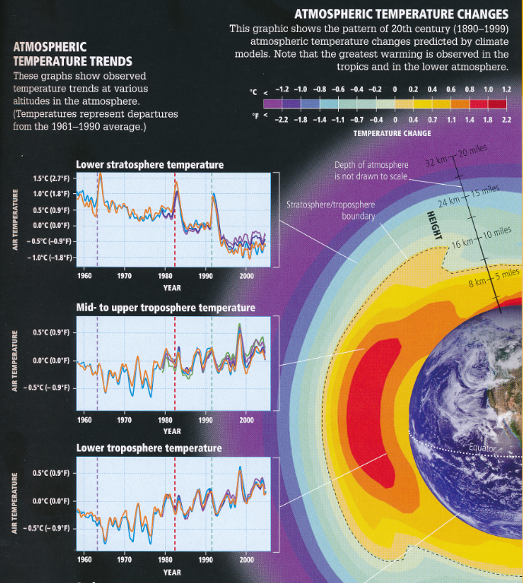
Global temperature trend 100% natural?
Increasing temperatures are found
in low middle and high levels of the tropopause.
Largest trends have been found in the tropical-subtropical troposphere in the mid-levels.
Notes:
From Mann and Kump 2015, p.39

Slide 8
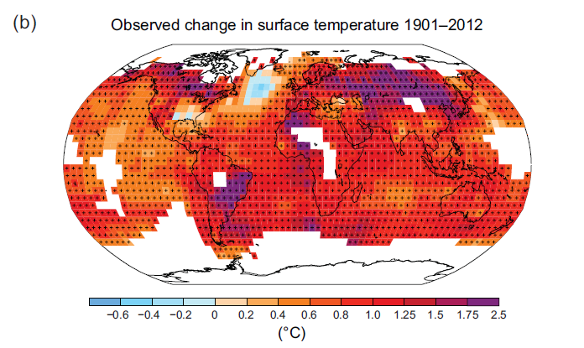
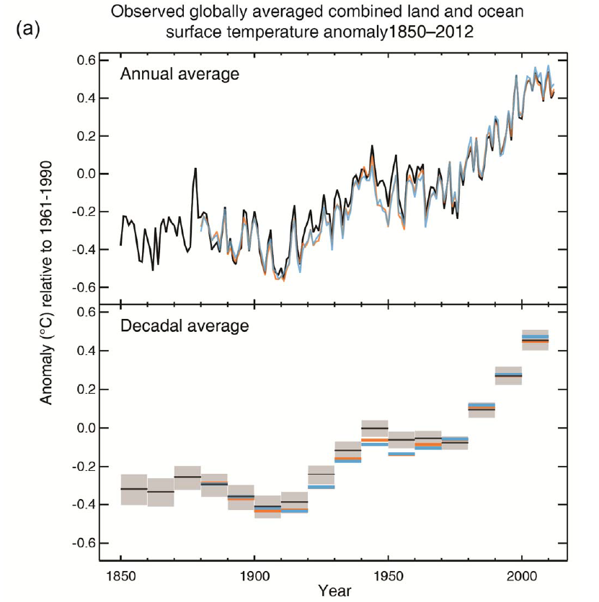
Global temperature trend 100% natural?
Surface temperature change:
change from 1901-2012.
(Linear trend estimate)
Notes:
IPCC2013, Summary for policymakers (SPM Fig. SMP1)

Slide 9
Global temperature trend 100% natural?
Discussion: Which of the inferences just drawn from these observed temperatures are correct?
There is an unusual warming trend in the data
The observations confirm that the world has been warming
The trend is part of a natural cycle
The trend is part of anthropogenic climate change
The trend is caused by volcanic activity and solar cycles
Surface temperature change:
change from 1901-2012.
(Linear trend estimate)
Notes:
And IPCC2013, Summary for policymakers (SPM)

Slide 10
The global warming hiatus debate: Has global warming slowed down?
In 2013, at the time when the IPCC report was released to the public in a press release
But media attention focused instead on another issue:
The fact that the last ~ 15 years the global temperatures a have not further increased.
This became to be known as the ‘global warming hiatus’
It has sparked an intensive scientific research in the past year (and it is still going on)
A number of explanations have been proposed
A unified explanation is still in the making

Slide 11
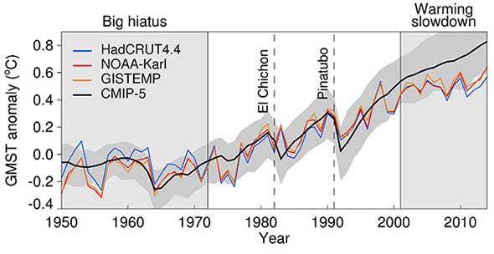
The global warming hiatus debate: Has global warming slowed down?
In 2013, at the time when the IPCC report was released to the public in a press release
But media attention focused instead on another issue:
The fact that the last ~ 15 years the global temperatures a have not further increased.
This became to be known as the ‘global warming hiatus’
It has sparked an intensive scientific research in the past year (and it is still going on)
A number of explanations have been proposed
A unified explanation is still in the making
GMST: Global mean surface temperature (Anomalies are relative to 1961–1990 climatology.)
Notes:
Figure from: http://www.nature.com/nclimate/journal/v6/n3/full/nclimate2938.html

