Slide 1
Climate variability and change Introduction to the physical climate system
Oliver Elison Timm ATM 306 Fall 2016
Lecture 3
Notes:
Presentation slide for courses, classes, lectures et al.

Slide 2
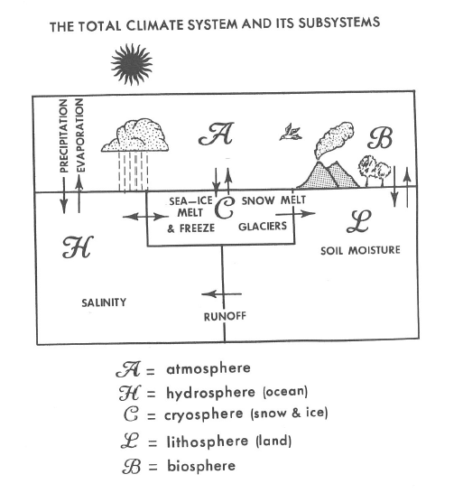
Introduction: Physical climate system
The Earth’s climate system is divided into subsystems:
The atmosphere (A), ocean
(hydrosphere H), and cryosphere (C) are the most important for understanding climate variability on time scales from years to decades.
On longer time scales, the biosphere and the cryosphere (land ice) become more important.
Notes:
A conceptual view of the Earth’s climate system taken from Peixoto and Oort ( Figure 2.1)

Slide 3
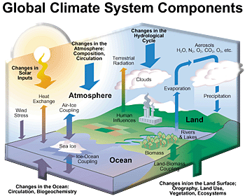
Coupled ocean-atmosphere-land system
Ultimate energy source:
Energy received from the sun:
Total solar irradiance
Notes:
Question: Is the sun part of the system?
(No, it is outside the system). Therefore, we have to draw somewhere a boundary and say compontent X is part of the system, component Z is not part of the system.

Slide 4
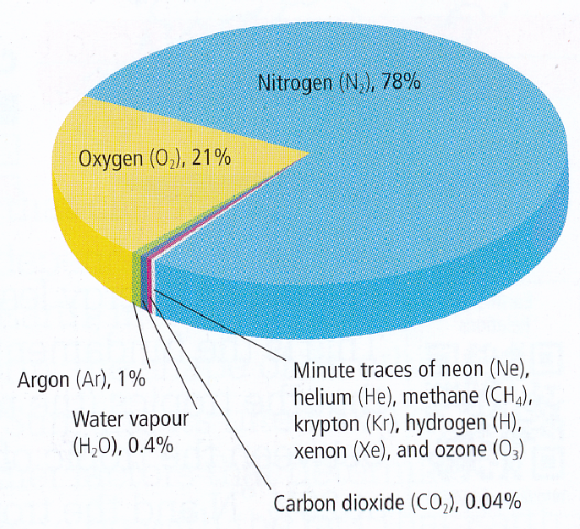
Earth’s Atmosphere
The mass of the atmosphere:
5.98*10²⁴ kg
78% N₂
21% O₂
1% Ar
₋₋₋₋₋₋₋₋₋₋₋₋₋₋₋₋₋
99% of dry air
0.4% H₂O
0.04% CO₂
CO₂ concentrations are usually given as part per million (volume air): currently ~400ppm
See the latest measurements
Notes:
Composition of the atmosphere: Note that gases are well mixed throughout the troposphere (except water vapor, and to lesser degree is CO₂ also varying regionally by season)

Slide 5
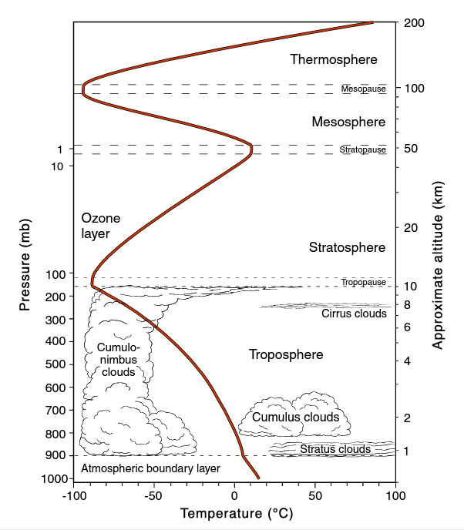
Vertical temperature profile: The ‘US standard atmosphere’
What determines the vertical temperature profile?
- Chemical composition
- Radiative energy fluxes
shortwave: sunlight in visible range, Ultraviolet (UV)
longwave: thermal radiation (infrared)
Convection and release of latent heat during condensation
Notes:
Further reading: Peixoto & Oort Chapter 2.3.1
(This figure is from Neelin (2011) Ch. 2, fig. 2.11)

Slide 6
Vertical temperature profile: The ‘US standard atmosphere’
Troposphere
Temperature decrease with height by 0.6K/100m
(can reach up to 1K/100m in dry air (“adiabiatic lapse rate”)
Tropopause height inversion of the temperature gradient
Stratosphere:
Ozone concentration leads to absorption of UV solar radiation and a warming with altitude
Notes:
Further reading: Peixoto & Oort Chapter 2.3.1
(This figure is from Neelin (2011) Ch. 2, fig. 2.11)

Slide 7
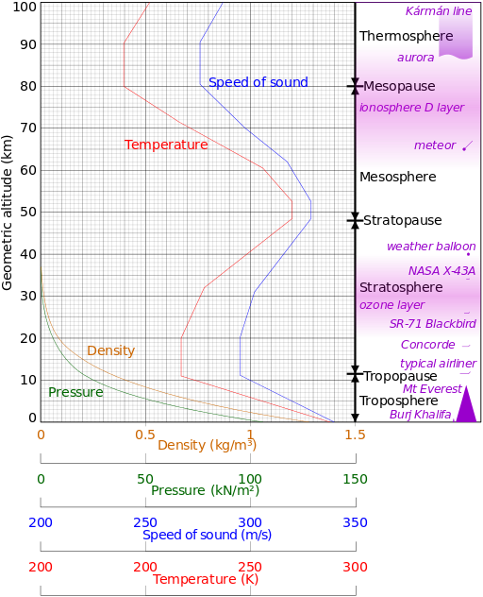
Vertical distribution of temperature, pressure, and density (mass)
Further remarks:
The pressure decreases “exponentially” with altitude
Half of the atmospheric mass is approximately in the Troposphere below 5km.
99% of the mass is below 30km
"Comparison US standard atmosphere 1962" by Cmglee - Own work. Licensed under CC BY-SA 3.0 via Commons - https://commons.wikimedia.org/wiki/File:Comparison_US_standard_atmosphere_1962.svg#/media/File:Comparison_US_standard_atmosphere_1962.svg
Notes:
Introductory notes.

Slide 8
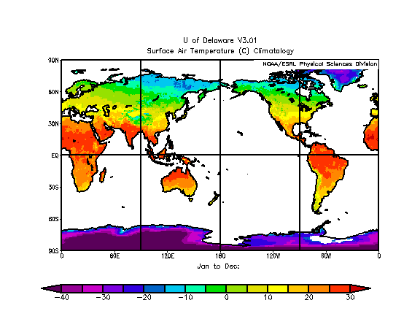
Introduction: Physical climate system Global Temperature Climatology
Annual average temperature on land
Surface Air Temperature
climate normal:
These are 30-year long-term average conditions, based on worldwide land-based station observations
Notes:
Introductory notes.

Slide 9
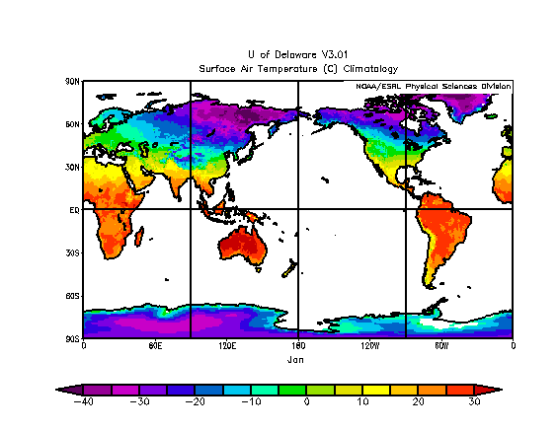
Introduction: Physical climate system Global Temperature Climatology
January average temperature on land
Surface Air Temperature
climate normal:
These are 30-year long-term average conditions, based on worldwide land-based station observations
Notes:
Introductory notes.

Slide 10
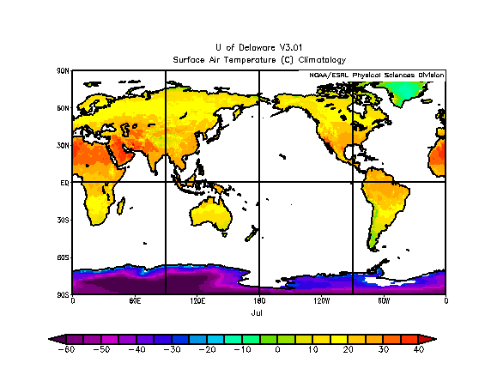
Introduction: Physical climate system Global Temperature Climatology
July average temperature on land
Surface Air Temperature
climate normal:
These are 30-year long-term average conditions, based on worldwide land-based station observations
Notes:
Introductory notes.

Slide 11
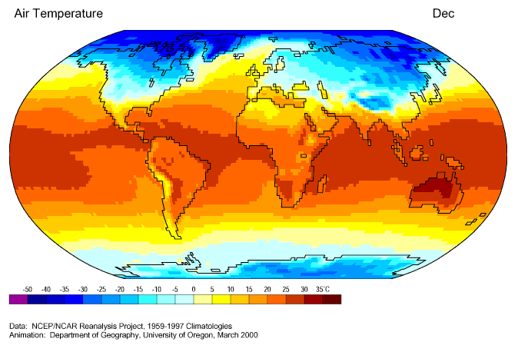
Introduction: Physical climate system Global Temperature Climatology
Surface Air Temperature
climate normal:
Long-term average conditions, based on worldwide (land, ocean, airborne, satellite)
observations.
Units is degree Celsius
Notes:
Introductory notes.

Slide 12
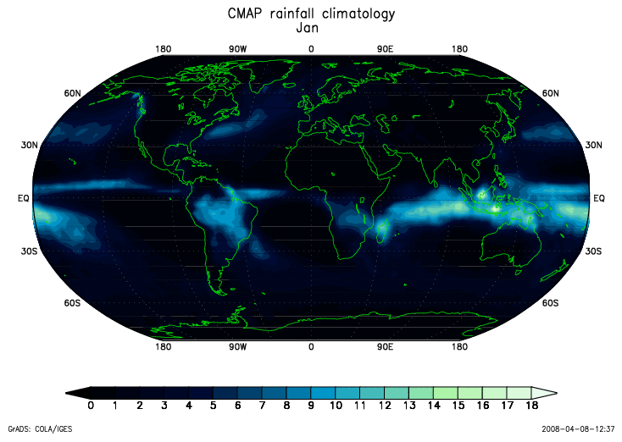
Introduction: Physical climate system Global Precipitation Climatology
Annual precipitation
climate normal:
These are 30-year long-term average conditions, based on worldwide station observations
and satellite
remote sensing
(1980-2000)
Units in mm/day: 10mm /day is about 300mm/month 12 inch/month
Notes:
Note: this does not look like much, but rainfall has a heavy tail in the statistical distribution: very high deviations from the mean can happen from year to year.

Slide 13
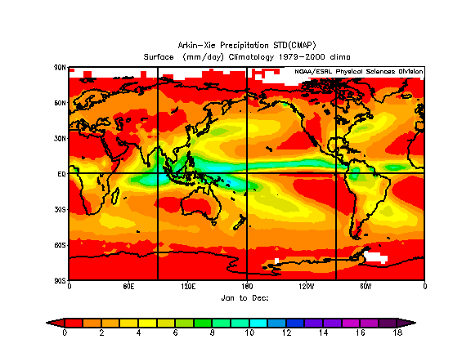
Global Precipitation Climatology
Annual precipitation
climate normal:
These are 30-year long-term average conditions, based on worldwide station observations
and satellite
remote sensing

Slide 14
Global Precipitation Climatology
Intertropical Convergence Zone (ITCZ):
Band with convective rainfall: north of the equator (ca. 5 deg N)
Release of enormous amounts of latent heat to the atmosphere
Annual precipitation
climate normal:
These are 30-year long-term average conditions, based on worldwide station observations
and satellite
remote sensing
Units in mm/day: 10mm /day is about 300mm/month 12 inch/month

Slide 15
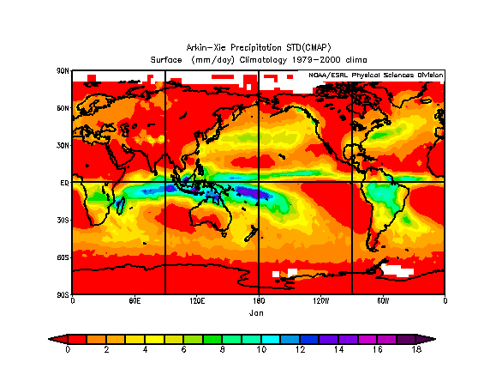
Global Precipitation Climatology
January precipitation
climate normal:
These are ~30-year long-term average conditions, based on worldwide station observations
and satellite
remote sensing
Units in mm/day: 10mm /day is about 300mm/month 12 inch/month
Notes:
Introductory notes.

Slide 16
Global Precipitation Climatology
ITCZ stays north of equator over Pacific Ocean
Tropical rain maxima shift over land to the southern hemisphere
January precipitation
climate normal:
These are ~30-year long-term average conditions, based on worldwide station observations
and satellite
remote sensing
Units in mm/day: 10mm /day is about 300mm/month 12 inch/month
Notes:
Introductory notes.

Slide 17
Global Precipitation Climatology
Extratropical storm tracks intensity in mid-latitudes in the winter hemisphere
January precipitation
climate normal:
These are ~30-year long-term average conditions, based on worldwide station observations
and satellite
remote sensing
Units in mm/day: 10mm /day is about 300mm/month 12 inch/month
Notes:
Introductory notes.

Slide 18
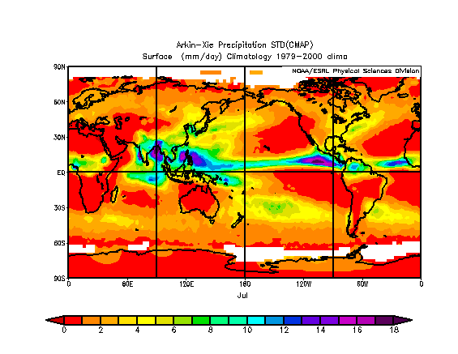
Global Precipitation Climatology
ITCZ intensifies in the warm hemisphere
Tropical rain maxima shift over land to the northern hemisphere
July precipitation
climate normal:
These are 30-year long-term average conditions, based on worldwide station observations
and satellite
remote sensing

Slide 19
Global monsoon system
Monsoon regions:
Found over continents
Strong seasonal contrast between dry and wet season and
reversal in wind direction between the summer and winter monsoons.
Source: Wang and Ding, 2006 in Geophysical Research Letters Volume 33, Issue 6, L06711, 25 MAR 2006 DOI: 10.1029/2005GL025347 http://onlinelibrary.wiley.com/doi/10.1029/2005GL025347/full#grl21099-fig-0001
Notes:
Sketch example for ‘annual range’
Annual range measures highest minus lowest monthly rainfall. Monsoons are regions in red at the top figure.

Slide 20
Global monsoon system
Monsoon regions:
Found over continents
Strong seasonal contrast between dry and wet season and
reversal in wind direction between the summer and winter monsoons.
Source: Wang and Ding, 2006 in Geophysical Research Letters Volume 33, Issue 6, L06711, 25 MAR 2006 DOI: 10.1029/2005GL025347 http://onlinelibrary.wiley.com/doi/10.1029/2005GL025347/full#grl21099-fig-0001
Notes:
Sketch example for ‘annual range’
Annual range measures highest minus lowest monthly rainfall. Monsoons are regions in red at the top figure.

Slide 21
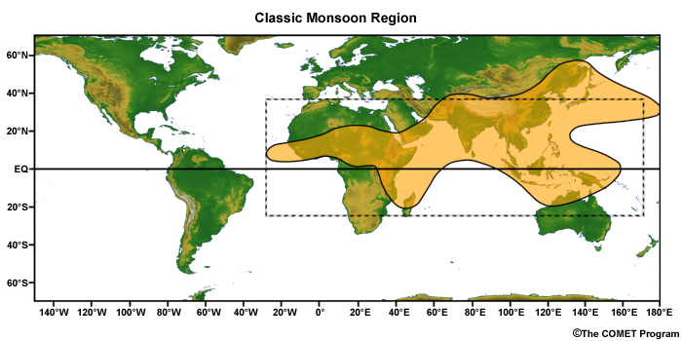
Global monsoon system
Figure retrieved from
COMET website
(08/2016)
South America and North America are also showing monsoon regions:
Strong seasonal cycle in rainfall.
More information to this figure can be found at the COMET website
Online textbook Introduction to Tropical Meteorology Section 3.5
Notes:
Copyright information:
"The source of this material is the COMET® Website at http://meted.ucar.edu/ of the University Corporation for Atmospheric Research (UCAR), sponsored in part through cooperative agreement(s) with the National Oceanic and Atmospheric Administration (NOAA), U.S. Department of Commerce (DOC). ©1997-2016 University Corporation for Atmospheric Research. All Rights Reserved."

Slide 22
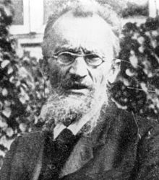
Climate Zones
Various classification schemes have been introduced, among them is the system of Wladimir Köppen
Precipitation and Temperatures
Annual mean and seasonal cycle
Alignment with vegetation zones
More information can be found for example here
Wladimir Köppen
(1846-1940)

Slide 23
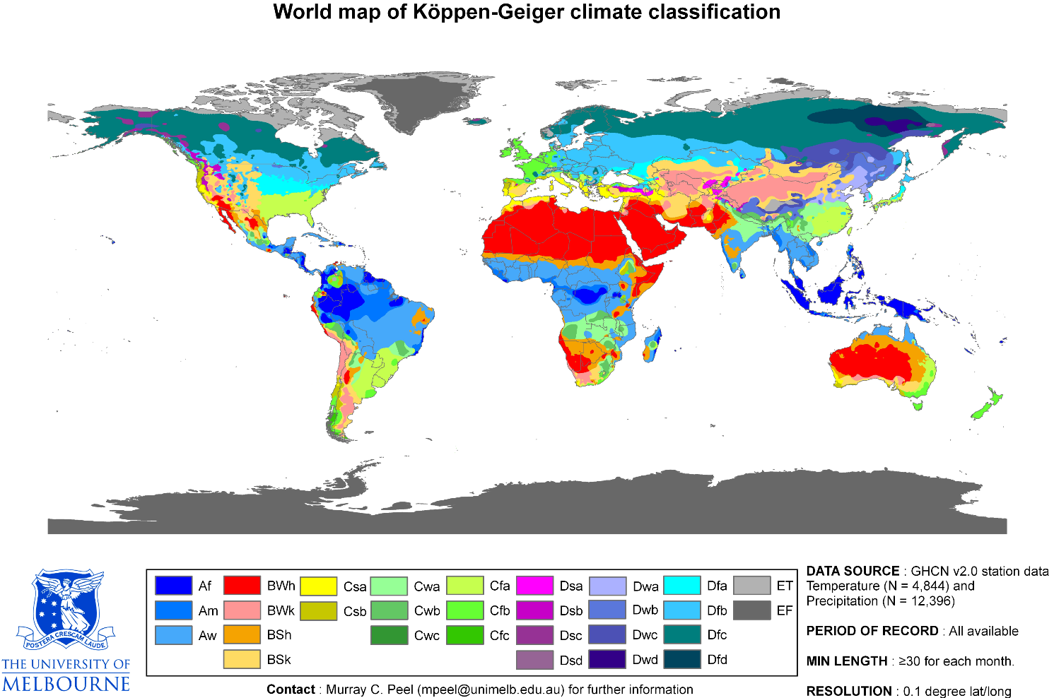
Köppen Climate Zones
Wladimir Köppen
(1846-1940)

Slide 24
Köppen Climate Zones
A strong latitudinal dependence
Maritime vs continental conditions
East-west gradients associated with prevailing winds and/or mountains and plateaus
Five major classes labeled A,B,C,D,E
Secondary and tertiary sub-classification
The Köppen Climate Classification has in total 29 classifications

Slide 25
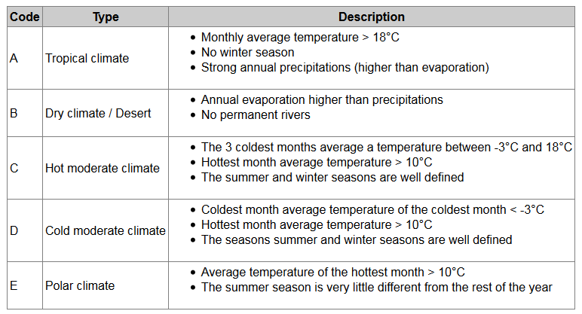
Köppen Climate Zones
x
Correction: T < 10C
Note: Compare the provided classification criteria with an independent resource at Britannica Online
Notes:
Note: Classification for A,C,D,E by temperatures. , only B is defined by precipitation as a first criterion
Class A only one more layer of sub-classes: small letter Am Aw Af

Slide 26
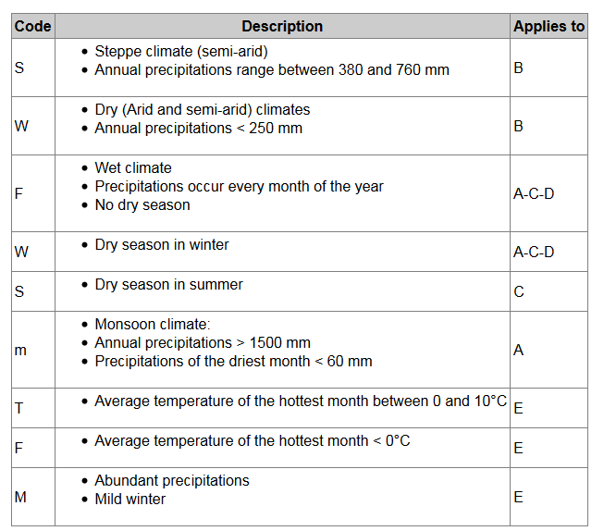
Köppen Climate Zones
Secondary level
(second letter in the
classification code)

Slide 27
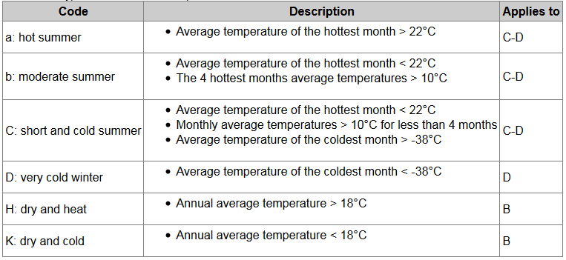
Köppen Climate Zones
Tertiary level(third letter in the classification code)

Slide 28
Köppen Climate Zones
Descriptive classification of the observations.
Based on average climatic conditions.
Not included: The aspect of climate variability

Slide 29
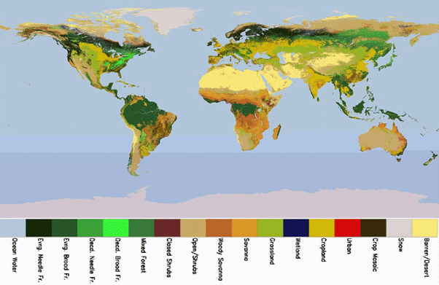
1.1 Introduction: The Land Surface
Figure 1.14

Slide 30
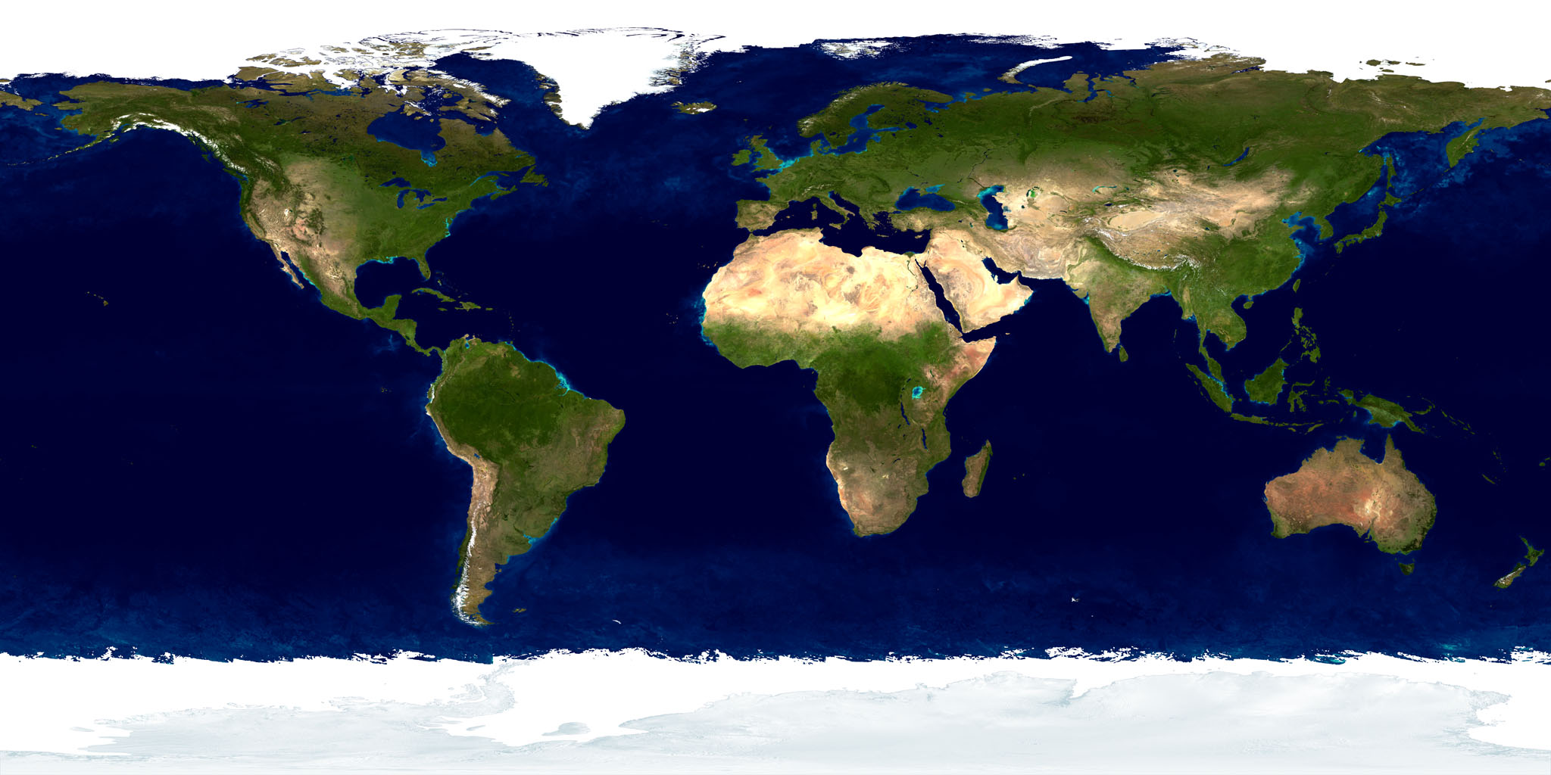
1.1 Introduction: The Land Surface
Figure 1.13

Slide 31
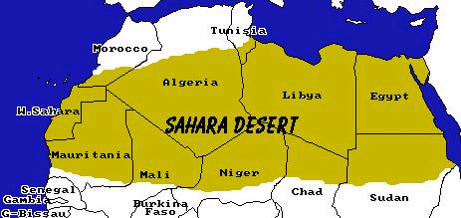
The Sahara (>20N)
The World’s Largest Desert
Size: 9,000,000 square miles
Temperature: 136F (58ºC)
Rainfall: Half of the Sahara receives < 0.79 inches per year
Dust: World’s Largest Dust Source

Slide 32
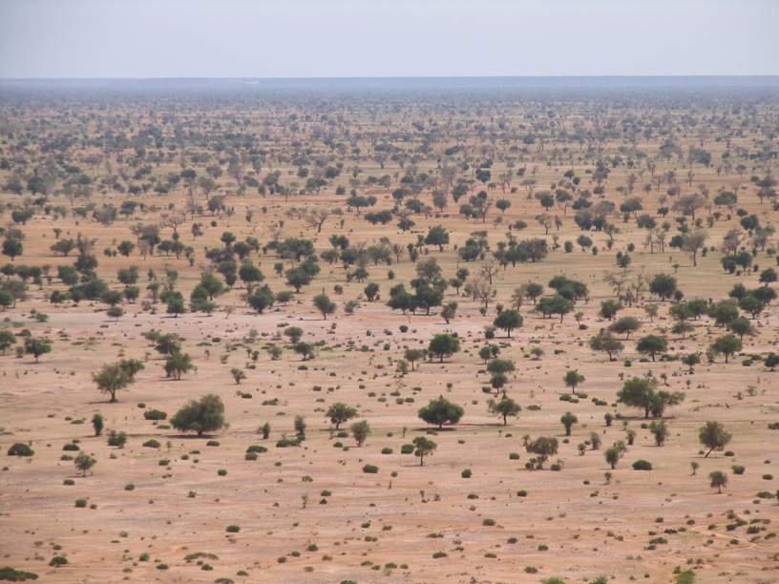
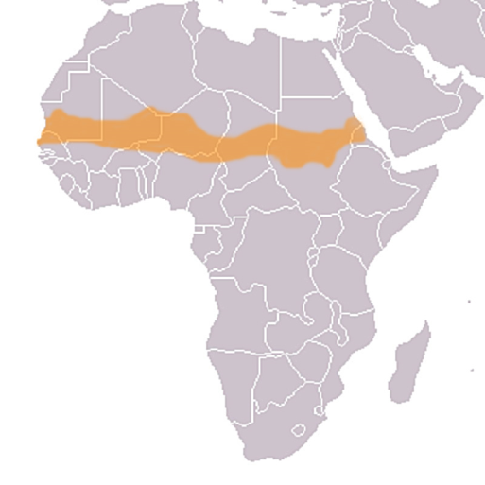
The Sahel (15-20N)

Slide 33
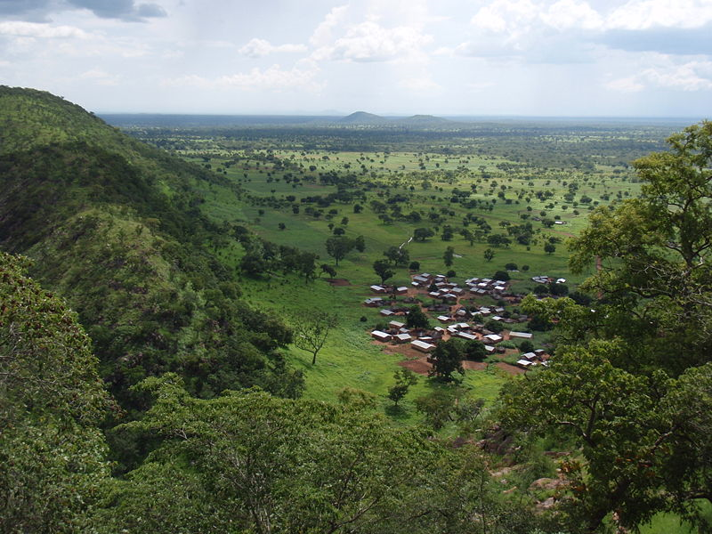
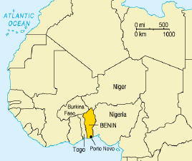
The Soudan (10N-15N)

Slide 34
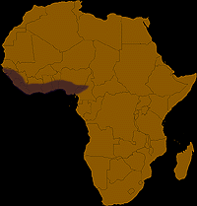
The Guinea Coast (10N-15N)

Slide 35
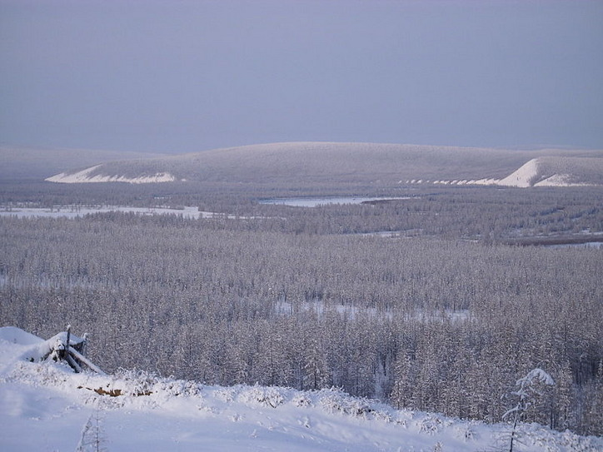
Sibiria in winter (Taiga landscape)
Notes:
Note: image from http://guides.wikinut.com/img/3bgftet7ikvmpo0p/The-taiga-near-Verkhoyansk,-Russia

Slide 36
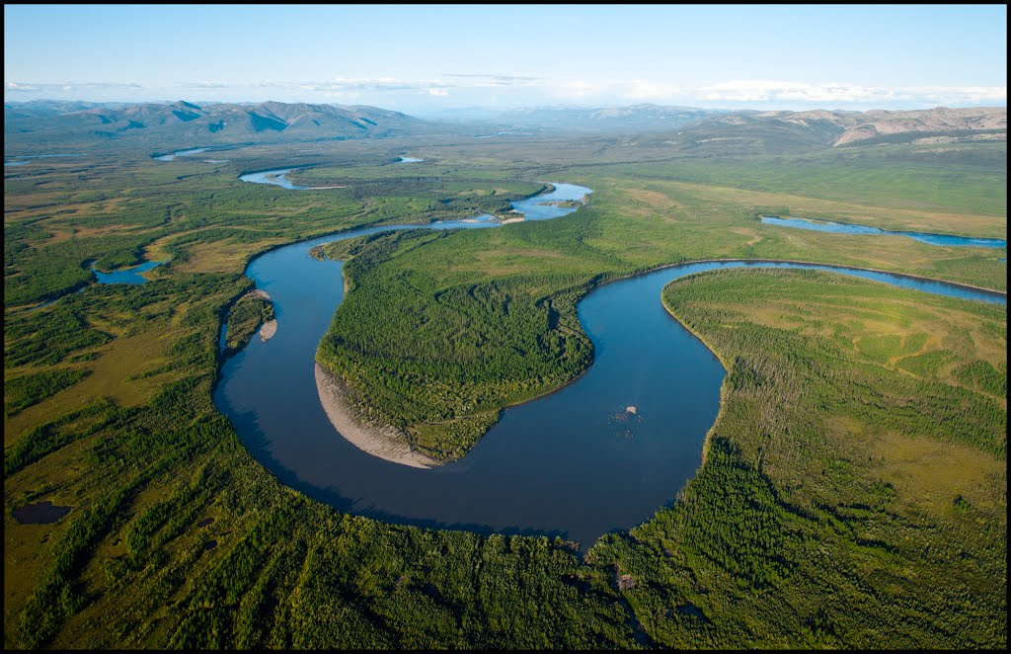
Sibiria in summer (Taiga landscape)
Notes:
Note: image from http://guides.wikinut.com/img/3bgftet7ikvmpo0p/The-taiga-near-Verkhoyansk,-Russia

Slide 37
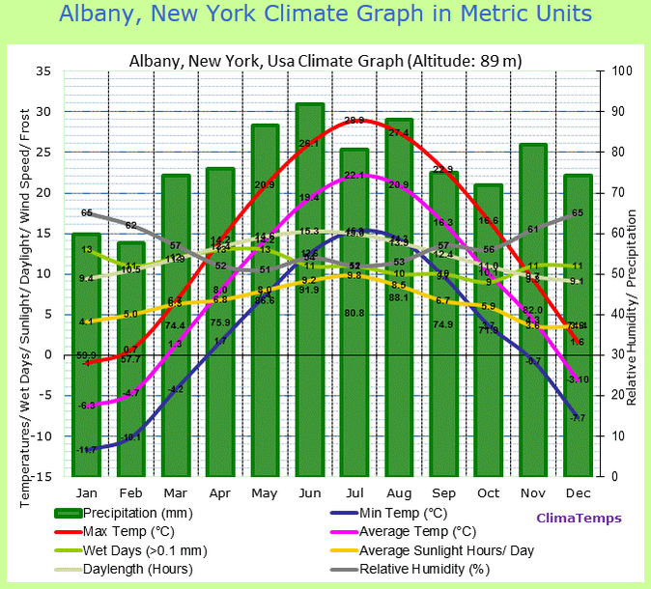
Homework (due next week 09/14 11:00am): Exploring Earth’s climate zones
http://www.climatemps.com/
Interactive web page with thousands to station-based climate data summarized in climate graphs (climate charts)
Homework question:
What parts of the world have the strongest seasonal temperature cycle?
What parts of the world have the most constant temperature?
Where are the regions with largest seasonal precipitation range?
Can we find a region with highest annual rainfall at a constant rate (small seasonal cycle)?
See handout and course page for details to this homework

Slide 38
Class activity: Exploring Earth’s climate zones
In groups of 3-5 people identify the climate graphs according to the main five Koppen Climate zones.
For at least one station in each of A, B, C, and D class:
Identify the secondary classification code
For the D classification: identifiy
the third classification code

Slide 39
Summary:
Climate system that we study consists of
Atmosphere
Ocean
Land
These sub-systems interact through exchange of mass, energy and momentum
Other systems (biosphere, lithosphere) are part of the environment outside of the system*
The main source of energy for the system is the sun
* In some cases we relax this strict separation, when we discuss the role of vegetation changes or ice sheet changes

Slide 40
Summary
Earth has a continuum of climate zones
One classification scheme is the Köppen classification into 5 major climate zones, and a total of 29 classes. Main criteria are
Annual mean temperatures, seasonality, coldest and hottest month thresholds
Annual mean precipitation, seasonality
Latitude, elevation, distance from ocean (continental vs maritime) are key factors that determine climates regionally.

Slide 41
Online resources
https://www.britannica.com/science/Koppen-climate-classification
Dire Predictions: atmospheric circulation:
https://media.pearsoncmg.com/ph/esm/esm_mann_dire_2/qr/pntip.html?qr21

