Slide 1
Climate variability and change Introduction to the physical climate system
Oliver Elison Timm ATM 306 Fall 2016
Lecture 3
Notes:
Presentation slide for courses, classes, lectures et al.

Slide 2
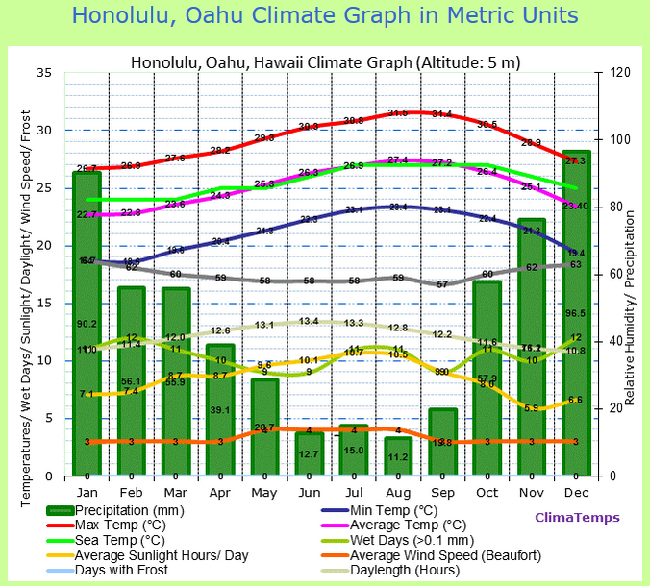
Class activity:
Climate graphs:
Classifiy stations according to weather graphs and Koeppen classification (two-level)

Slide 3
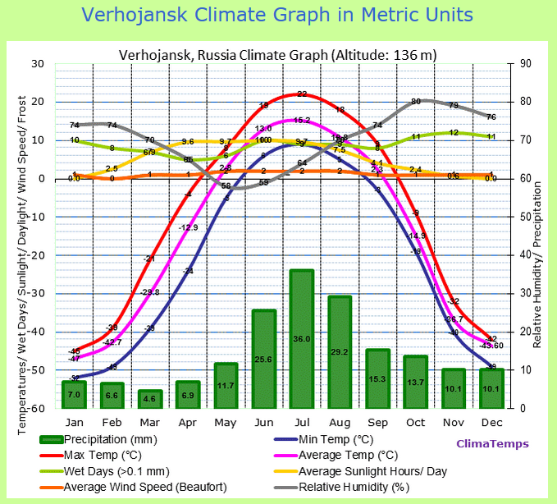
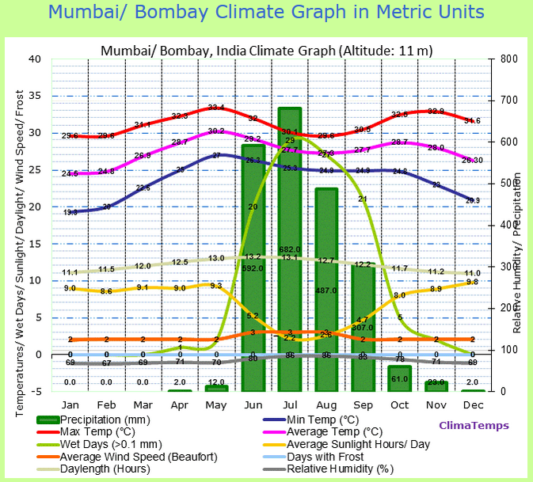
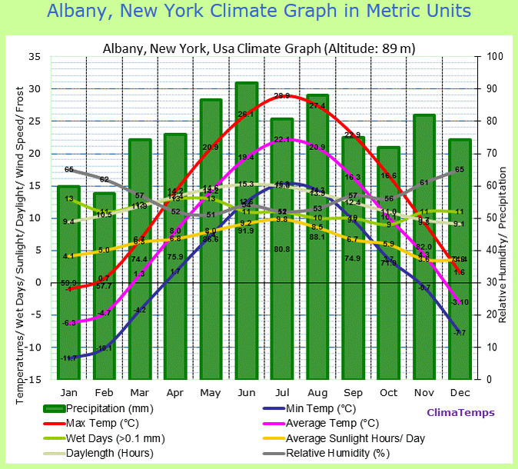

Slide 4
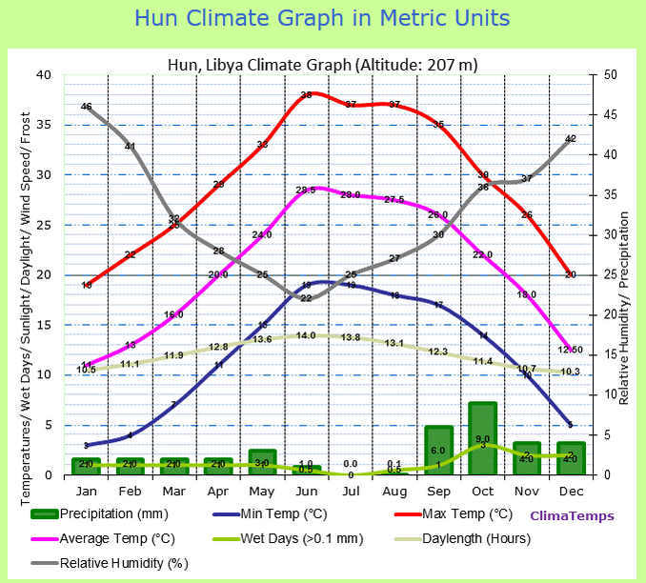
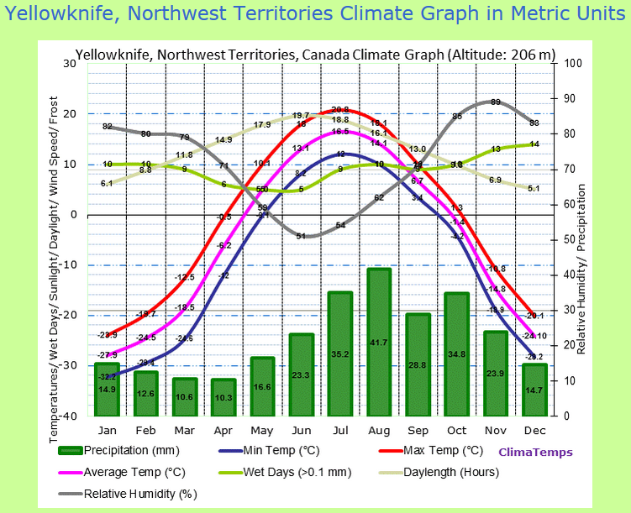
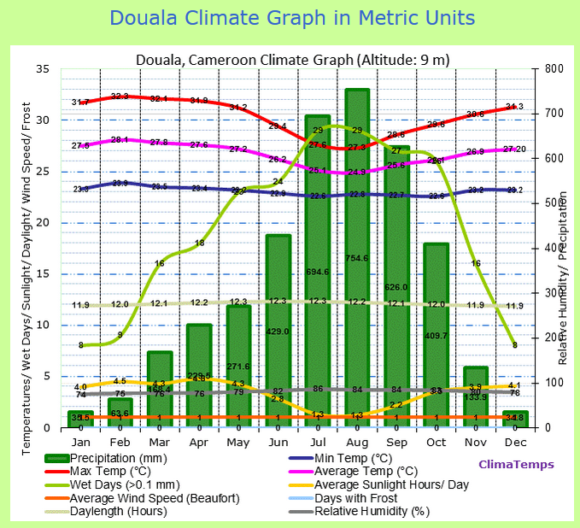
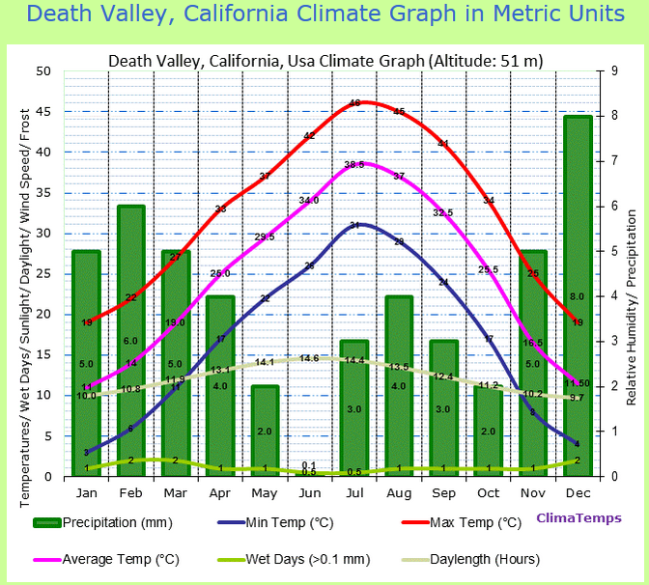

Slide 5
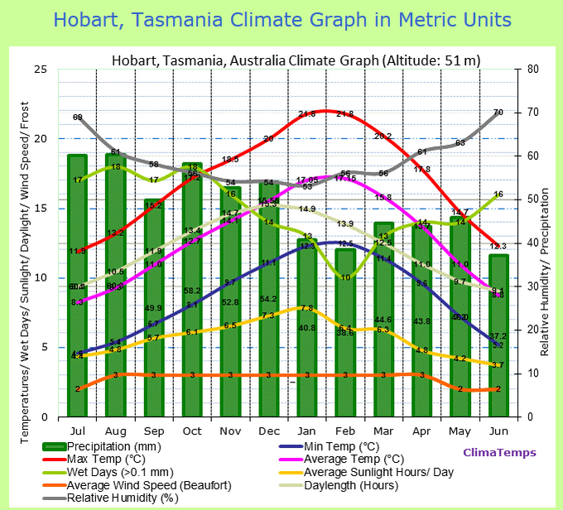
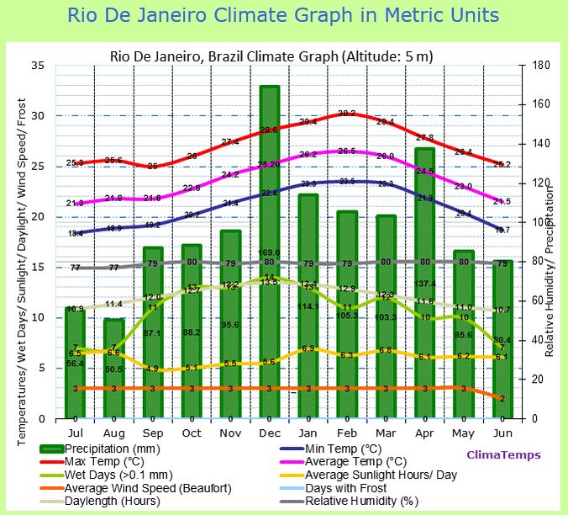

Slide 6
Class activity summary:
Station | lat/lon/elev[m] | Classification
Verkhoyansk | 67.6/133.4 | Dfd
Albany | 42.8/-73.8/89 | Dfa
Honolulu | 21.4/-157.9/5 | As
Mumbai/Bombay | 18.9/72.8/11 | Aw
Hun, Libya | 29.1/15.9/207 | BWh
Yellowknife, CAN | 62.5/-114.4, 20 | Dsc
Douala, Cameroon | 4/9.7/9 | Am
Death Valley | 36.5/-116.9/51 | BWh
Hobart, Tasmania | -42.9/147.3/51 | Cfb
Rio De Janeiro | -22.9/-43.2/5 | Aw

Slide 7
Online resources
https://www.britannica.com/science/Koppen-climate-classification
Dire Predictions: atmospheric circulation:
https://media.pearsoncmg.com/ph/esm/esm_mann_dire_2/qr/pntip.html?qr21

