Slide 1
Climate variability and change Introduction to the physical climate system
Description of the General Circulation of the Atmosphere
Oliver Elison Timm ATM 306 Fall 2016
Lecture 1
Notes:
Presentation slide for courses, classes, lectures et al.

Slide 2
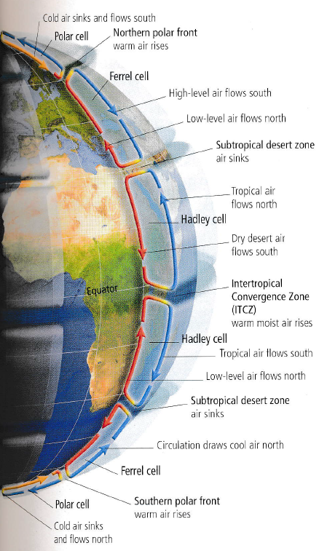
General Circulation of the Atmosphere
The motions of air masses fulfills a purpose:
Reducing the temperature contrast between high latitudes and tropical latitudes.
(ocean’s transport of water masses and heat is also important)
The Coriolis Force (an apparent force resulting
from the rotation of Earth) has a profound impact on the general circulation
Link to movie
Notes:
From Mann and Kump
Now the question is what determines the temperature gradient between pole and tropics.
And for climate variability and change: what happens to the circulation if we disturb the temperature balance of the Earth?

Slide 3
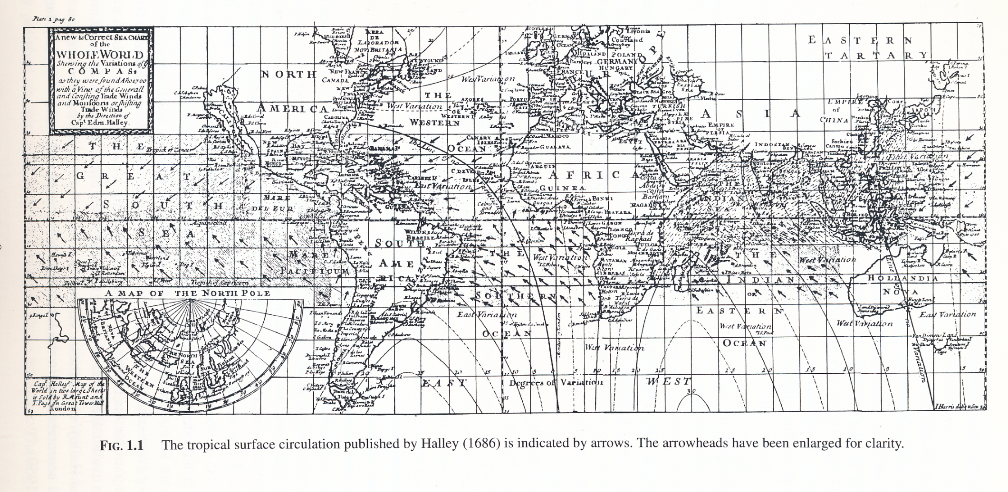
1686: Halley publishes his description of general atmospheric circulation
In the year 1686 Gabriel Daniel Fahrenheit, German inventor of mercury thermometer, was born
The city of Albany, NY, was officially chartered in 1686 under English rule.
1687 Newton publishes his Principia
Notes:
From Richard Grotjahn, Global Atmospheric Circulations, Oxford University Press, 1993

Slide 4
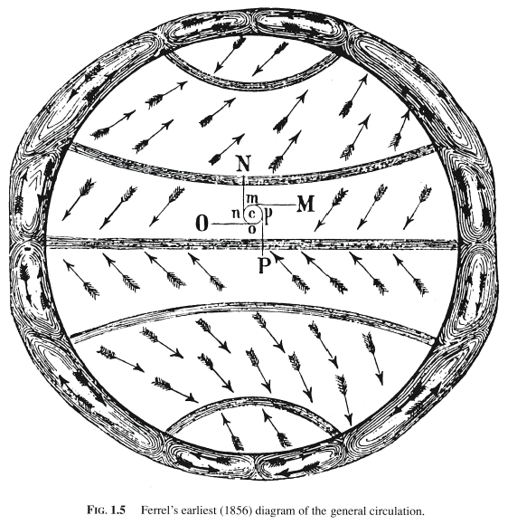
19th century view of the general circulation of the atmosphere (after Ferrel)
Idealized schematic view:
zonally averaged structure
(i.e. independent of longitude)
symmetric about the equator
Rising air in the tropics
with deep convective clouds and much rainfall
Ascending motion driver of
the Hadley Circulation
(Hadley Cell) with sinking air masses at ~30 degree latitude.
(Hadley published his ideas
to the tropical circulation and
trade winds in 1735)
Notes:
From Richard Grotjahn, Global Atmospheric Circulations, Oxford University Press, 1993

Slide 5
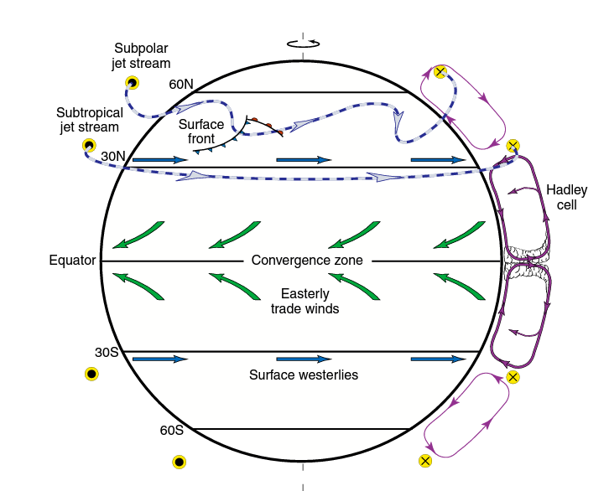
General Circulation of the Atmosphere
Idealized schematic view:
zonally averaged structure
(i.e. independent of longitude)
symmetric about the equator
Ferrel Cell
Rising air in the tropics
with deep convective clouds and much rainfall
Ascending motion driver of
the Hadley Circulation
(Hadley Cell) with sinking air masses at ~30 degree latitude
Notes:
From Neelin 2011 Fig. 2.12

Slide 6
General Circulation of the Atmosphere
Idealized schematic view:
zonally averaged structure
(i.e. independent of longitude)
symmetric about the equator
Ferrel Cell
Subtropical jet
Mid latitude westerly winds
Notes:
From Neelin 2011 Fig. 2.12
The dots and x symbols mark wind directions in this schematic view towards (dots) you, and away from you (x): This is like seeing an arrow coming towards you, or going away from you.
Not:e wind directions are given from the where the wind comes from. Westerly winds blow from west to east.

Slide 7
General Circulation of the Atmosphere
A note on these zonally averaged circulation cells
Winds in the atmosphere are decomposed into horizontal and vertical components
The horizontal wind vector is naturally given by a direction and magnitude
North
$$\vec{u}$$
West
East
Meridional: positive from south to north (southerly wind, v>0)
Zonal: positive from west to east (westerly wind, u>0)
South
Notes:
From Neelin 2011 Fig. 2.12
The dots and x symbols mark wind directions in this schematic view towards (dots) you, and away from you (x): This is like seeing an arrow coming towards you, or going away from you.
Not:e wind directions are given from the where the wind comes from. Westerly winds blow from west to east.

Slide 8
General Circulation of the Atmosphere
A note on these zonally averaged circulation cells
Winds in the atmosphere are decomposed into horizontal and vertical components
The horizontal wind vector is naturally given by a direction and magnitude
Zonally averaged variable A along one latitude belt:
[A] = $\int_{0}^{2π}{A dλ/2π}$
Notes:
From Neelin 2011 Fig. 2.12
The dots and x symbols mark wind directions in this schematic view towards (dots) you, and away from you (x): This is like seeing an arrow coming towards you, or going away from you.
Not:e wind directions are given from the where the wind comes from. Westerly winds blow from west to east.

Slide 9
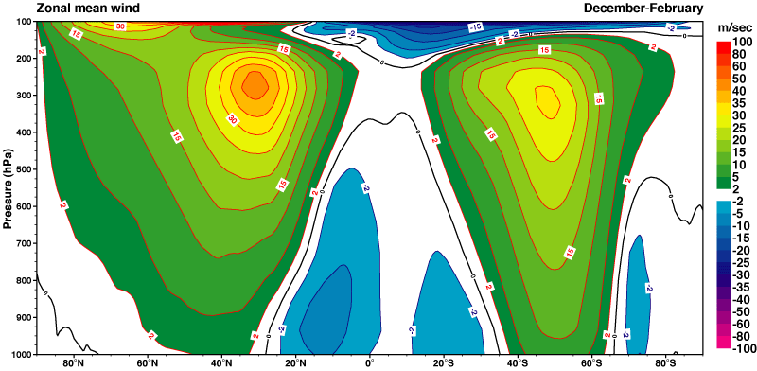
Vertical structure of the atmosphere
Zonal wind (DJF)
(east-west direction)
in a latitude-height cross section view.
Many aspects of the climate system are studied averaged along a circle of latitude at a certain height.
Height
(shown here in pressure coordinates)
90 degree north to 90 degree south

Slide 10
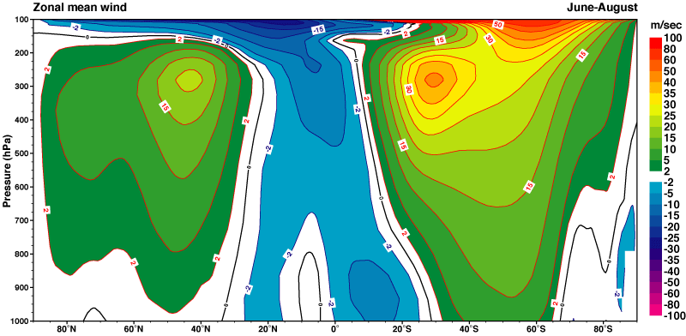
Vertical structure of the atmosphere
Zonal wind (JJA)
(east-west direction)
in a latitude-height cross section view.
Many aspects of the climate system are studied averaged along a circle of latitude at a certain height.
Height
(shown here in pressure coordinates)
90 degree north to 90 degree south

Slide 11
Vertical structure of the atmosphere
Zonal wind (JJA)
(east-west direction)
in a latitude-height cross section view.
Many aspects of the climate system are studied averaged along a circle of latitude at a certain height.
Height
(shown here in pressure coordinates)
90 degree north to 90 degree south

Slide 12
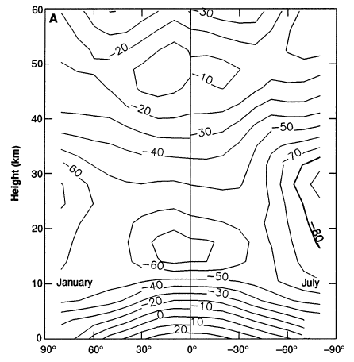
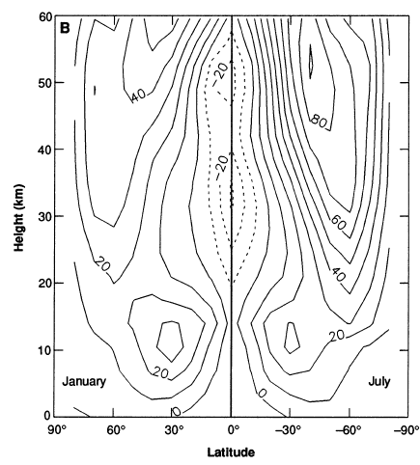
Vertical structure of the atmosphere: the stratosphere’s polar vortex
temperature
Zonal wind
NH winter | SH winter
NH winter | SH winter
Notes:
Note: This is an extra slide, since the question came up in class, why there is such a strong westerly wind in the high troposphere
(100hPa and above). The main reason is that during polar winter the sunlight is missing to warm the stratosphere. Longwave radiation however, is emitted from stratosphere into space, thus cooling the air masses. This spins up a strong cold-core vortex with westerly winds (since in colder air over the pole region the pressure drops faster than in mid-latitudes leading to strong horizontal pressure gradients).
From Mark R. Schoeberl and Dennis L. Hartmann, Science, 1991

Slide 13
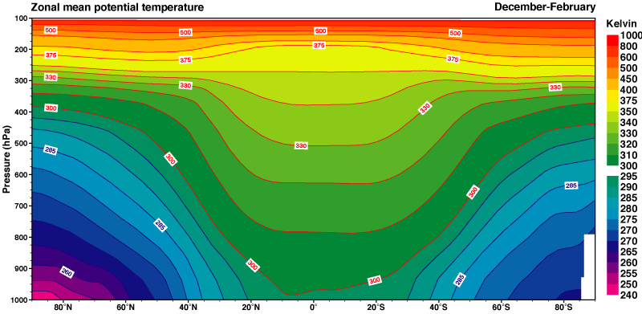
Vertical structure of the atmosphere
Potential temperature
Dec, Jan, Feb (DJF) season
(east-west direction)
in a latitude-height cross section view.
Many aspects of the climate system are studied averaged along a circle of latitude at a certain height.
Height
(shown here in pressure coordinates)
90 degree north to 90 degree south
Notes:
For background information on potential temperature see the background material from Hartmann’s Global Physical Climatology book (link is posted in the web page).

Slide 14
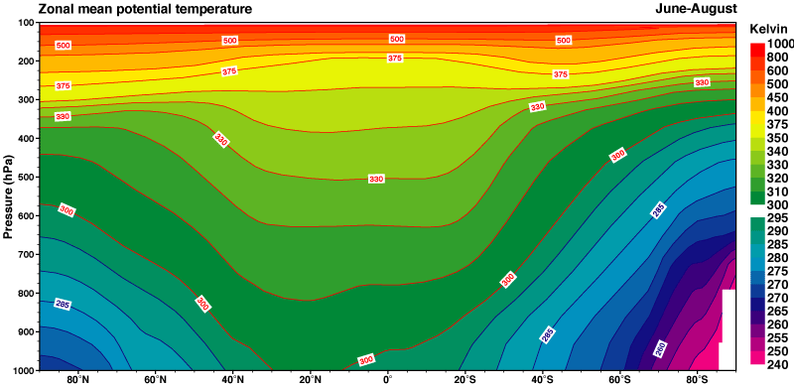
Vertical structure of the atmosphere
Potential temperature
Jun,Jul, Aug(JJA) season
(east-west direction)
in a latitude-height cross section view.
Many aspects of the climate system are studied averaged along a circle of latitude at a certain height.
Height
(shown here in pressure coordinates)
90 degree north to 90 degree south

Slide 15
Vertical structure of the atmosphere
Jets in the upper troposphere
Strongest in the winter hemisphere.
Thermal wind relation.
(Jets most intense when there is a strong temperature gradient between polar and subtropical/tropical regions.

Slide 16
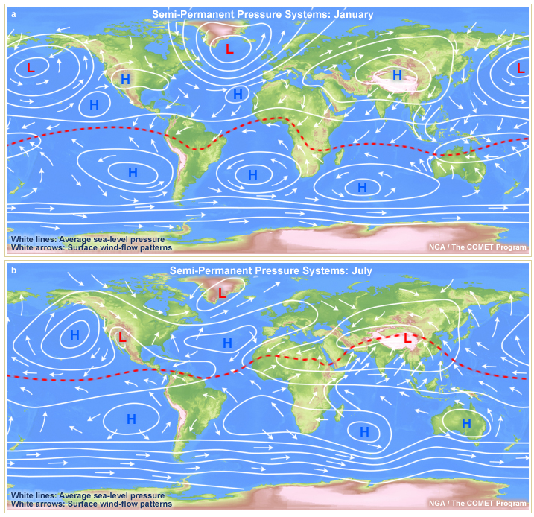
Surface winds and pressure systems
Northern hemisphere winter
(January)
Southern hemisphere winter
(July)
Notes:
From COMET web page:
http://www.goes-r.gov/users/comet/tropical/textbook_2nd_edition/navmenu.php_tab_4_page_2.3.0.htm

