Slide 1
Climate variability and change
Oliver Elison Timm ATM 306 Fall 2016
Notes:
Presentation slide for courses, classes, lectures et al.

Slide 2
Information
ATM 306
ES 232
Schedule
  Monday, Wednesday
  11:00am-12:20pm
  Office hours:
  Mon 12:30-1:30pm
  Thu 9:15-10:15am
  Or by appointment
Contact
  oelisontimm@albany.edu
Reading material:
  no textbook is required
  Selected book chapters will be provided in PDF
  Online Resources
Notes:
Beginning course details and/or books/materials needed for a class/project.

Slide 3
Information
Some book recommendations:
Dire Predictions –Understanding Climate Change by Michael E. Mann & Lee R. Kump (2nd edition, 2015) (‘The Visual Guide through the Findings of the IPCC’, easy to read) [MK2015]
Climate Change and Climate Modeling by J. David Neelin (Cambridge Univ. Press, 2011) (good to read, well structured, basic physical /mathematical principles covered)
[Neelin2011]
Physics of Climate by J.P. Peixoto and A. H. Oort, 1992 (the classic textbook giving a complete overview about the atmospheric and oceanic energy budget, temperatures, precipitation, and circulations) [Peixoto&Oort]
IPCC 2013: Climate Change 2013: The Physical Science Basis. Contribution of Working Group I to the Fifth Assessment Report of the Intergovernmental Panel on Climate Change (online http://www.ipcc.ch/) [IPCC2013] The technical summary (TS) chapter is of great value!
Notes:
Beginning course details and/or books/materials needed for a class/project.

Slide 4
Course Overview
  Introduction: Weather, climate and climate change
  Natural modes of climate variability
    Physics of climate
    Observed modes of variability
  Anthropogenic climate change
    Physics of climate change
  Climate change and society
    Environmental impacts, mitigation, adaptation
For further details: see syllabus
Notes:
Introductory notes.

Slide 5
Objectives:
  Provide an overview of the key processes of
  climate variability and commonly used climate diagnostics
  Explain physical concepts of climate variability,
  Introduce aspects of climate prediction and climate change projections
  Understand challenges we face using climate information in decision making/ planning
  Prepare you to participate in the climate change debate by communicating the basic physical processes, observational evidence, and levels of uncertainty.
Notes:
Objectives for instruction and expected results and/or skills developed from learning.

Slide 6
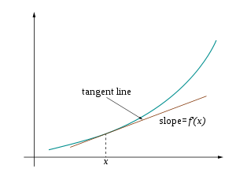
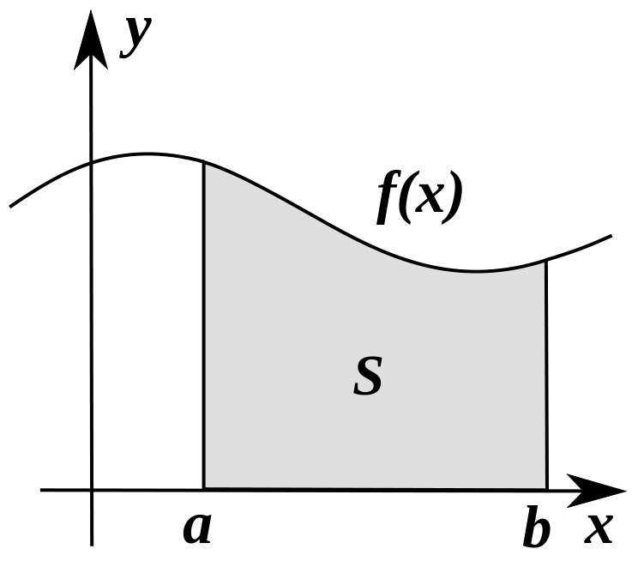
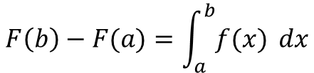

A note mathematical calculus
We will encounter problems that are best studied with mathematical tools: Calculus, some Linear Algebra (vectors) and some basic statistics
Differential calculus
for studying ‘the rate of change’
for a quick refresh, please visit https://en.wikipedia.org/wiki/Differential_calculus
Integral calculus
for studying the accumulative effects of a process
(often we apply numerical integration
or discrete summation)
https://en.wikipedia.org/wiki/Integral
y
$$f^{′}\left(x\right)= \frac{dy}{dx}$$
$$F\left(b\right)−F(a)=\int_{a}^{b}{f(x)} dx$$
f(x)

Slide 7
Tentative timeline
Class # | Date | Topic | Info/Notes/Ref
1 | 08/29 | Introduction to climate and climate change
2 | 08/31 | Is observed climate variability “all 100% natural” ? IPCC Summary for Policymakers Role of social media
3 | 09/07 | Review of atmosphere, ocean: physical & chemical properties
4 | 09/12 | Climate zones and classification schemes
5 | 09/14 | Tropical and extratropical climates large-scale circulation systems
6 | 09/19 | Causes of climate variability Tropical climate variability
7 | 09/21 | Tropical climate variability I: Southern Oscillation, Bjerknes Feedback, ENSO

Slide 8
Tentative timeline
Class # | Date | Topic | Info/Notes/Ref
8 | 09/26 | Tropical climate variability II: ENSO dynamics, Kelvin waves
9 | 09/28 | Extratropical climate variability I: North Pacific region
10 | 10/05 | Extratropical climate variability II: North Atlantic region
11 | 10/10 | Tropical-Extratropical teleconnections I
12 | 10/17 | Tropical-Extratropical teleconnections II
13 | 10/19 | Role of sea ice, ocean circulation, land cover changes
14 | 10/24 | Mid-term exam (ES232, 11:00-12:20) | You can submit: hand-written papers with figures and notes included, or electronic Word document submitted immediately at the end of class via email!

Slide 9
Tentative timeline
Class # | Date | Topic | Info/Notes/Ref
15 | 10/26 | Observed climate change I: Evidence of change in atmosphere, ocean, and on land
16 | 10/31 | Observed climate change II: Evidence of change in atmosphere, ocean, and on land
17 | 11/02 | Causes of climate change: Forcing and feedbacks
18 | 11/07 | Climate modeling: Reproducing current state and historical climate trends
19 | 11/09 | Climate change projections I: CMIP5, emissions scenarios, global and regional changes
20 | 11/14 | Climate change projections: II Changes in extremes (Tropical storms, droughts, heavy rains)
21 | 11/16 | Climate change projections: III Environmental impacts (ecosystems, hydrology, sea level)

Slide 10
Tentative timeline
Class # | Date | Topic | Info/Notes/Ref
22 | 11/21 | Adaptation to climate change I: Introduction
23 | 11/28 | Adaptation to climate change I Student presentations/discussion
24 | 11/30 | Mitigation of climate change I: Introduction
25 | 12/05 | Mitigation of climate change II Student presentations/discussion
26 | 12/07 | Long-term climate change and Earth system dynamics
27 | 12/12 | -- no class -- | (AGU Fall Conference in San Francisco)
28 | 12/14 | Final Exam (ES232, 3:30-5:30) | Same format as mid-term exam: Handwritten papers with figures and notes included, or Word document submitted at the end of your exam, before you leave the room ES232.

