Slide 1
Energy sources, fluxes, and sinks
Climate variability and change
Introduction to the physical climate system
Oliver Elison Timm ATM 306 Fall 2015
Lecture 2
Notes:
Presentation slide for courses, classes, lectures et al.
1

Slide 2
Energy sources, fluxes, and sinks
Climate variability and change
Introduction to the physical climate system
Oliver Elison Timm ATM 306 Fall 2015
Lecture 2
Notes:
Presentation slide for courses, classes, lectures et al.
2

Slide 3
Objectives
Objectives
  Introduction to the energy budget of the climate system
  The sun as the primary energy source
  Energetic fluxes in the atmosphere
  Thermodynamic and energetic aspects of the climate state:
    Forms of energy
    Sources and sinks
Further background information / suggested reading:
Peixoto and Oort: Chapter 6 Radiation Balance: 6.1, 6.2.1- 6.2.3, 6.3.1, 6.3.3-6.3.7
Coakley and Yang: Chapter 1 The Earth Energy Budget and Climate Change (1.1-1.4)
Notes:
Note: See scanned PDF version of the chapters for further reading.
3

Slide 4
Energy emitted by the sun
The energy emitted by the sun is isotropic, that is in every direction
in space it is the same intensity.
Irradiance:
Energy per time and unit area:
Units: watts per square meter W/m^2
r
Irradiance decreases with distance r from sun proportional to 1/r^2
Earth-Sun average distance:
r= 1.49*10^11 m
Satellites measure the incoming solar radiation flux
at Top of Atmosphere (TOA):
irradiance 1361 W/m^2
Q_{o} S_{o} used as symbols for this value (solar constant)
Notes:
Introductory notes.
4

Slide 5
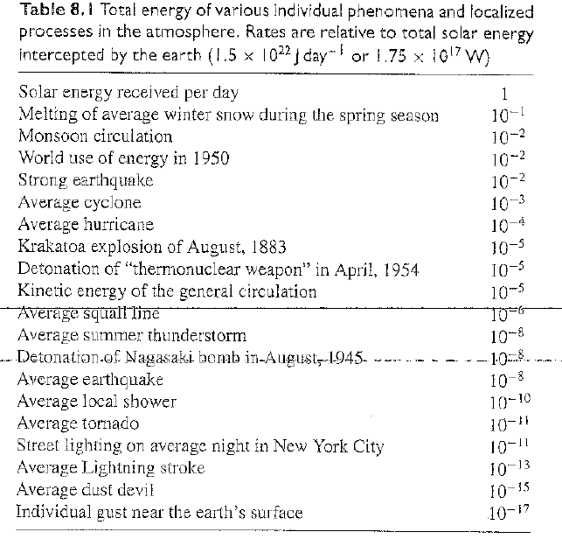
The sun is the largest energy source for the climate system
Notes:
Objectives for instruction and expected results and/or skills developed from learning.
5

Slide 6
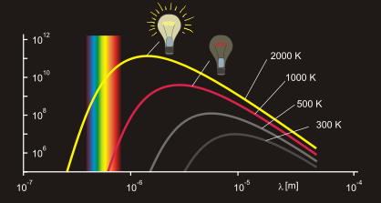
Energy emitted by the sun
Black-body radiation
at different temperatures
Sun's energy spectrum follows closely the
universal law of the black-body radiation.
Wien's Displacement Law:
  Peak energy at a temperature-dependent wavelength: the higher the temperature, the shorter the wavelength.
  Red stars are colder than the sun, blue stars are hotter than the sun
Earth peak emission in infrared range.
Notes:
Introductory notes.
6

Slide 7
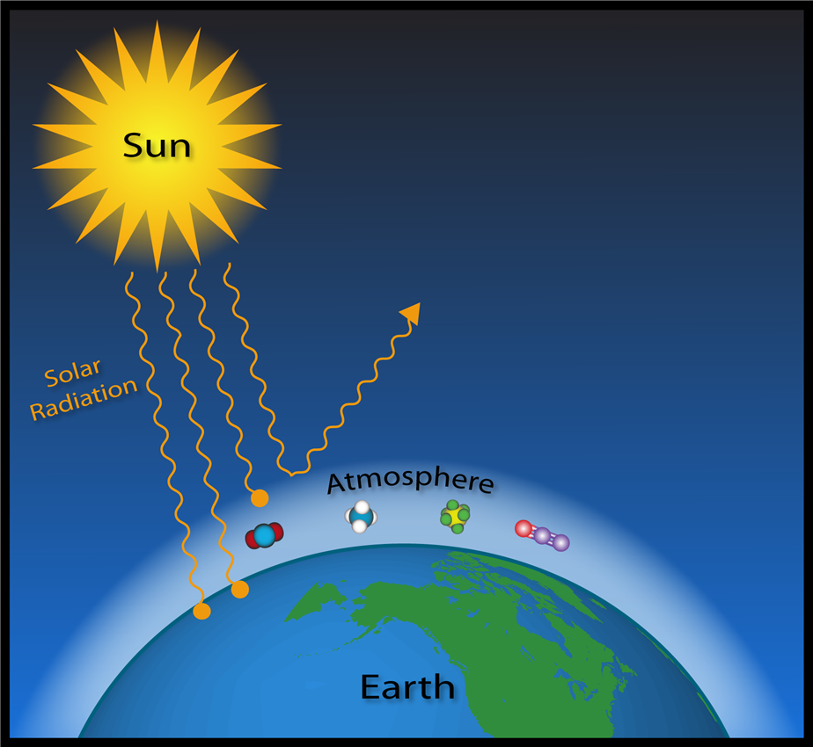
Solar radiation and thermal radiation
“Solar constant”
Q₀= 1361 W/m^2
Integrated over solar spectrum: Q₀
Shortwave radiation
(UV-visible-near infra red)
Longwave radiation
(Infra red, Microwave)
Notes:
Introductory notes. Solar constant -1360 W/m^2, Top of Atmosphere (TOA). Shortwave (SW) and longwave (LW) radiation
7

Slide 8
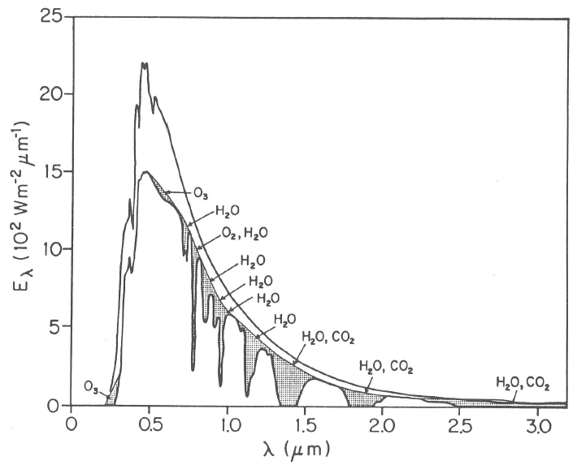
Absorption of electromagnetic radiation passing through the atmosphere
The sun’s spectral irradiance
Black-body radiation
at different temperatures
at the ‘top’ of the Earth
atmosphere
at the Earth surface
The atmosphere absorbs part of the black-body radiations
in specific ranges:
Water vapor, carbon dioxide, ozone, methane are the most important absorbers
in the troposphere and stratosphere
Notes:
Figure 6.1 of Peixoto and Oort
8

Slide 9
Absorption of electromagnetic radiation passing through the atmosphere
The sun’s spectral irradiance
Black-body radiation
at different temperatures
at the ‘top’ of the Earth
atmosphere
at the Earth surface
The atmosphere absorbs part of the black-body radiations
in specific ranges:
Water vapor, carbon dioxide, ozone, methane are the most important absorbers
in the troposphere and stratosphere
Notes:
Figure 6.1 of Peixoto and Oort
9

Slide 10
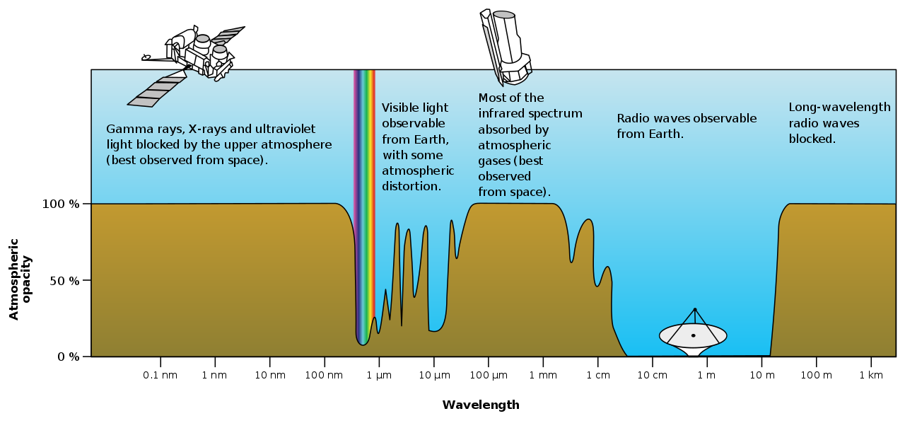
'Atmospheric Windows'
Absorption by gas molecules attenuates the incoming solar radiation:
Large portion of UV radiation absorbed by stratospheric ozone
Visible light passes through with little attenuation
In the infrared at 10 micrometers (10 µm) long-wave radiation can escape to space.
Note the radio wave spectrum has another atmospheric window, used in astronomy for space exploration
Notes:
Source: https://en.wikipedia.org/wiki/Visible_spectrum
10

Slide 11
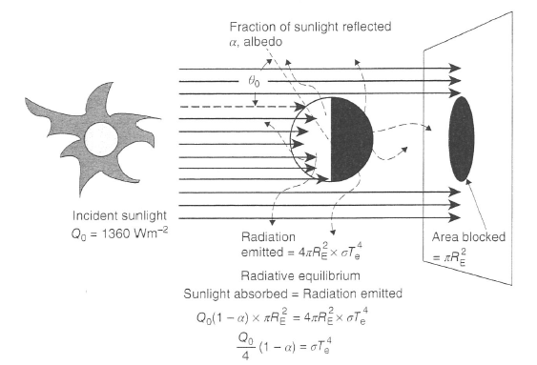
How much energy is coming in?
Why do work with the solar constant value
1360W/m^2/4 =340W/m^2
Over the course of a day the Earth rotates around it’s axis of rotation.
For simplicity (the error we make is small) assume Earth is a perfect sphere.
Surface area is 4πR²
Effective for receiving incoming flux is only the disc area πR²
Notes:
Figure from Coakley and Yang
11

Slide 12
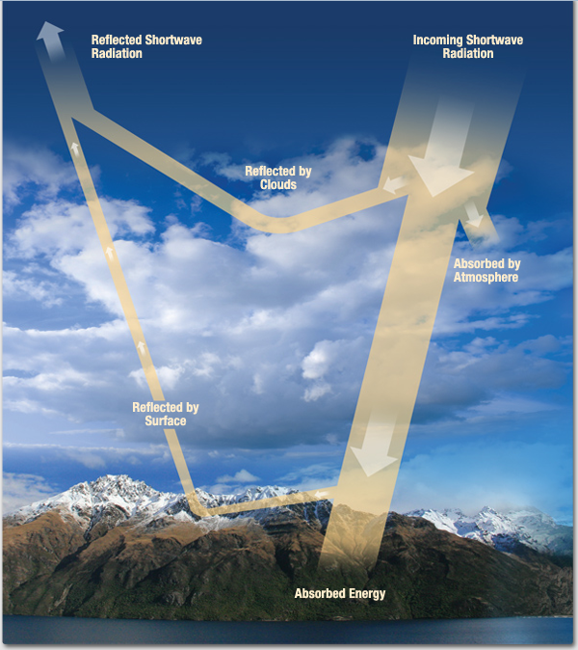
Solar radiation and thermal radiation
Earth Radiative Energy Budget:
Incoming Shortwave Radiation
Absorption by atmosphere & surface
Reflection by atmosphere & surface
The portion of electromagnetic waves that pass through without interacting with a gas molecule is
transmitted.
Notes:
Figure from http://missionscience.nasa.gov/ems/13_radiationbudget.html
12

Slide 13
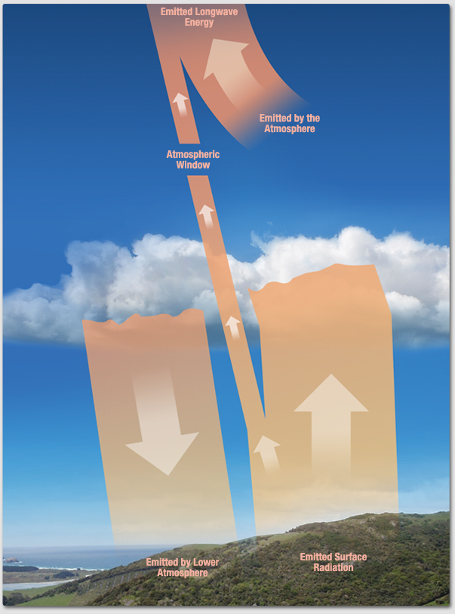
Solar radiation and thermal radiation
Earth Radiative Energy Budget:
Outgoing longwave radiation
Emitted from surface & atmospheric molecules
Absorption by atmospheric molecules & surface
Notes:
Figure from http://missionscience.nasa.gov/ems/13_radiationbudget.html
13

Slide 14
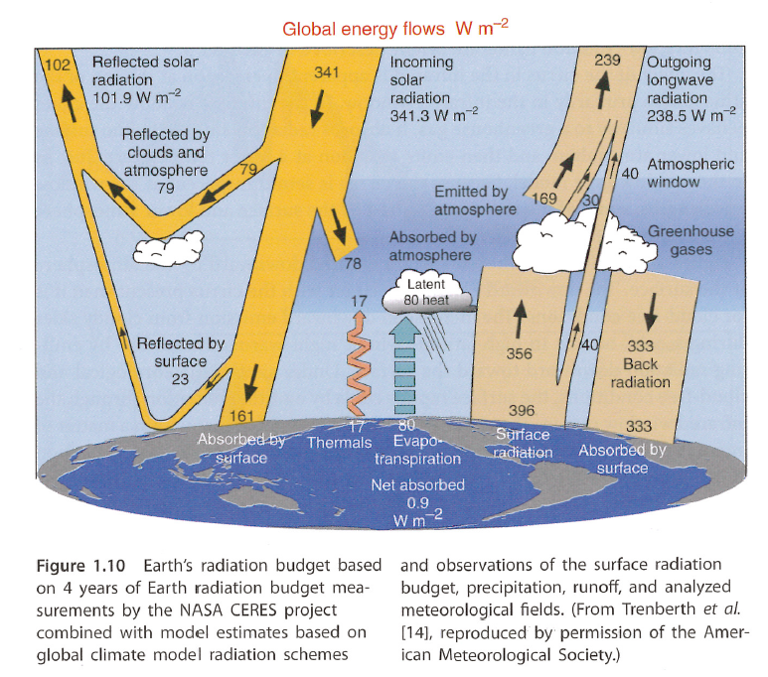
Solar radiation and thermal radiation
Earth Radiative Energy Budget:
This is the global energy budget of Earth’s climate system based on a thorough
data analysis including NASA satellite data from the CERES project
The incoming shortwave radiation from the sun is almost in balance with the outgoing longwave (infrared) radiation.
Top of atmosphere (TOA)
Net balance SW=341-102=+239
Net balance LW= -239
------------------------------------------
Notes:
Global mean long-term average budget of SW and LW radiative fluxes
14

Slide 15
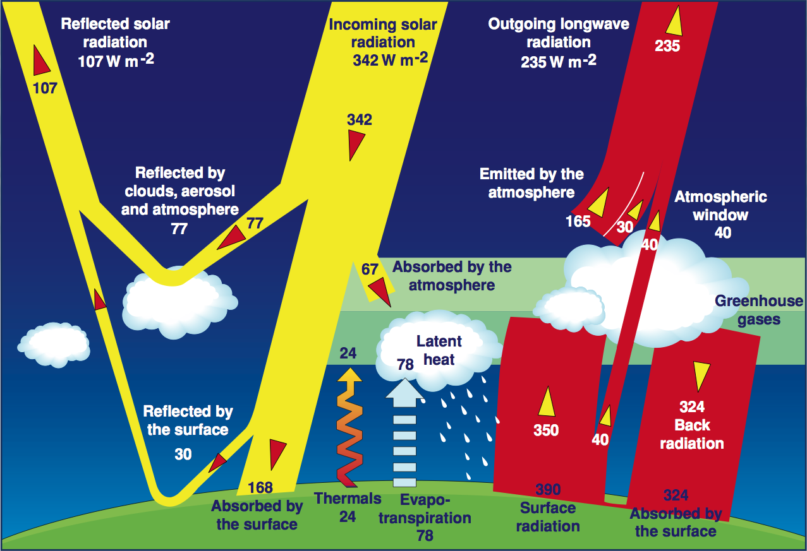
Solar radiation and thermal radiation
This figure shows the same data:
You see slight (few %) differences in the absolute values of individual terms.
But all terms are of the same order of magnitude.
Note on the “order of magnitude”: compare SW reflected by surface 23 vs 30 W/m^2 are still of the same order of magnitude.
If it was 3 or 5 vs 30W/m^2 the order of magnitudes would be considered different (differed by a factor of 10)
Notes:
Global mean long-term average budget of SW and LW radiative fluxes
.
15

Slide 16
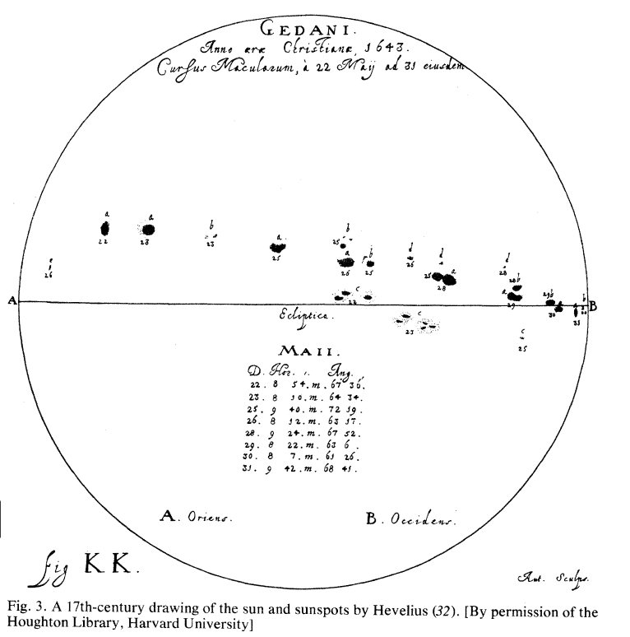
Concept of a constant solar irradiation 'Solar Constant'
The Solar Constant: 1361 W/m^2
Previous estimates were as high as 1370 W/m^2
Instrumentation changes rather than time-variations in the emitted solar energy.
Sunspot cycle: 11-yr cycle known in the western world from astronomical observations dating back to the 17th century.
More information on Wikipedia:
Maunder Minimum &
article by John A. Eddy in Science (1976)
Notes:
Introductory notes.
16

Slide 17
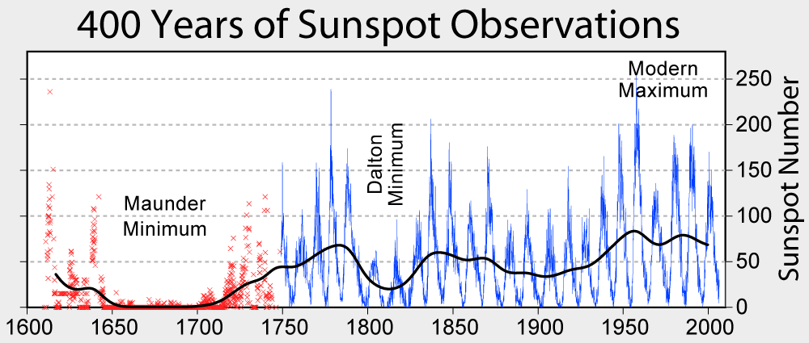
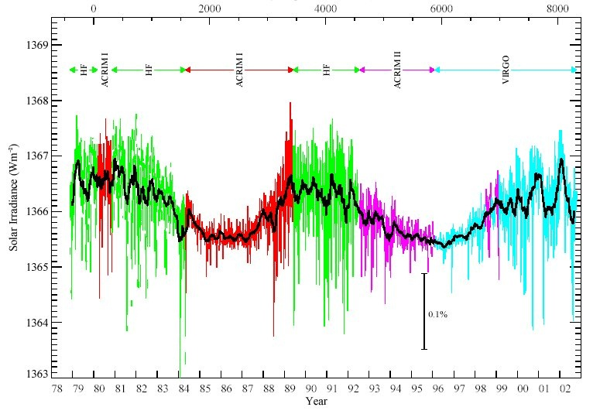
Concept of a constant solar irradiation 'Solar Constant'
The latest measurements for
TOA irradiance: 1361 W/m^2
The net effect of sun-spots on the
top of atmosphere incoming solar irradiance
is small (0.2%).
For long-term mean energy budget we can
work with the concept of a 'Solar Constant'
There is still active research on the question how the solar cycle affects climate.
Satellite measurements 1979-2003
(instrumental bias still included)
Notes:
Introductory notes.
17

Slide 18
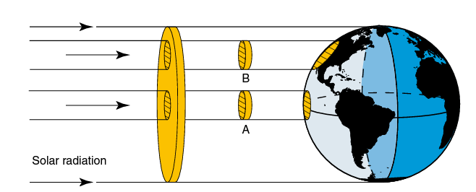
How is the incoming SW radiation distributed over the Earth’s surface?
The effect of Earth’s spherical shape:
The incoming solar radiation is highest near the equator, where the sun is in the zenith.
Some simple geometric
considerations show us the area illuminated by the incoming flux growths with the cosine of the angle
In this animation you can see the how the geometry changes with season
Link to the video from Mann and Kump (page 10)
Notes:
Figure from Neelin (2011)
18

Slide 19
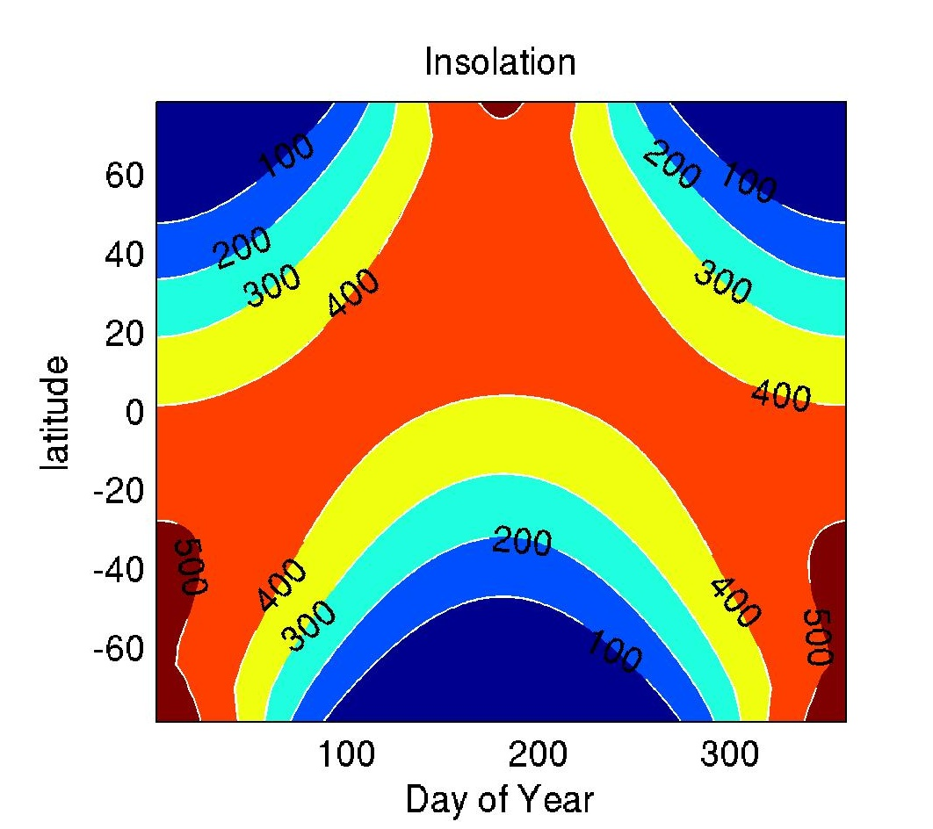
Solar irradiance as a function of season and latitude
Earth orbits around the sun on an ellipse
Distance varies with season
Northern Hemisphere winter: Earth closest to the sun => more irradiance
Declination (tilt of the axis of rotation)
=> latitude-dependence of the irradiance
varies with season.
Daily average irradiance in W/m^2
Notes:
Introductory notes.
19

Slide 20
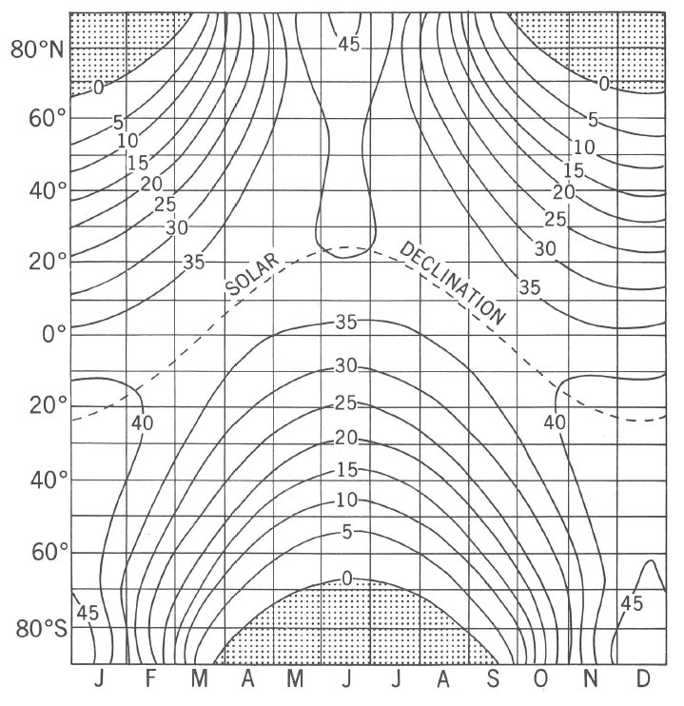
Solar irradiance as a function of season and latitude
Earth orbits around the sun on an ellipse
Distance varies with season
Northern Hemisphere winter: Earth closest to the sun => more irradiance
Declination (tilt of the axis of rotation)
=> latitude-dependence of the irradiance
varies with season.
Daily energy received at the top of atmosphere in units of 10^6 joule per meter squared [J/m^2].
Same information as it was shown
on the previous slide, but different figure style:
Contours plot instead of color shading
Change in units
Notes:
Introductory notes.
20

Slide 21
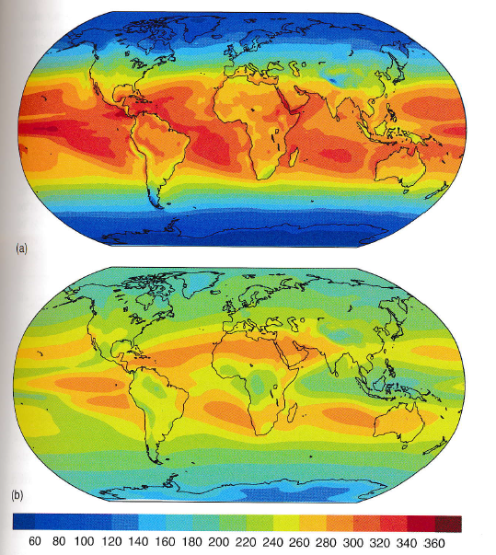
Solar radiation and thermal radiation
Spatial distribution of
Net SW and net LW
fluxes at TOA
This figure is derived from a climate model
simulation.
Notes:
Global mean long-term average budget of SW and LW radiative fluxes
Class activity: Draw a zonally averaged profile of incoming and outgoing long-wave radiation.
At which latitudes is a net gain of energy? At which latitude is a net loss of energy, and where are outgoing and incoming radiation balanced?
.
21

Slide 22
Solar radiation and thermal radiation
Class activity:
Draw a zonally averaged profile of incoming and outgoing long-wave radiation.
At which latitudes is a net gain of energy?
At which latitude is a net loss of energy?
Where are outgoing and incoming radiation approximately in balance?
Notes:
Global mean long-term average budget of SW and LW radiative fluxes
Class activity: Draw a zonally averaged profile of incoming and outgoing long-wave radiation.
At which latitudes is a net gain of energy? At which latitude is a net loss of energy, and where are outgoing and incoming radiation balanced?
.
22

Slide 23
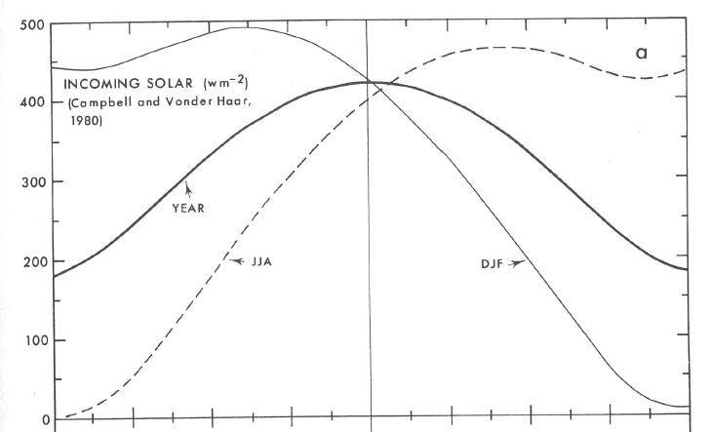
Incoming short wave radiation as a function of season and latitude
Annual budget & by season:
DJF: Dec-Jan-Feb average
JJA: Jun-Jul-Aug average
80S
Eq
80N
Notes:
From Peixoto and Oort
23

Slide 24
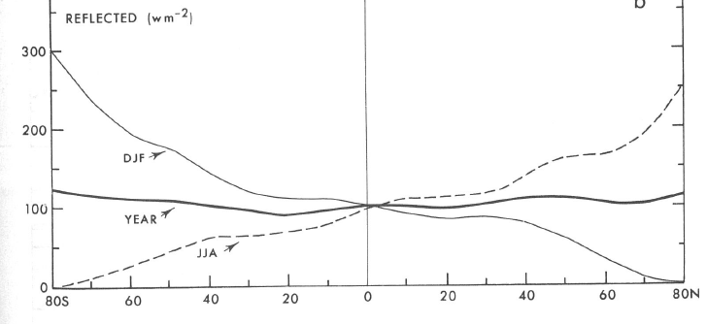
Reflected and scattered
shortwave radiation
Short wave radiation
reflected and
scattered back
to space by
clouds, land surface
ocean surface,
aerosols and
gas molecules
80S
Eq
80N
Notes:
From Peixoto and Oort
24

Slide 25
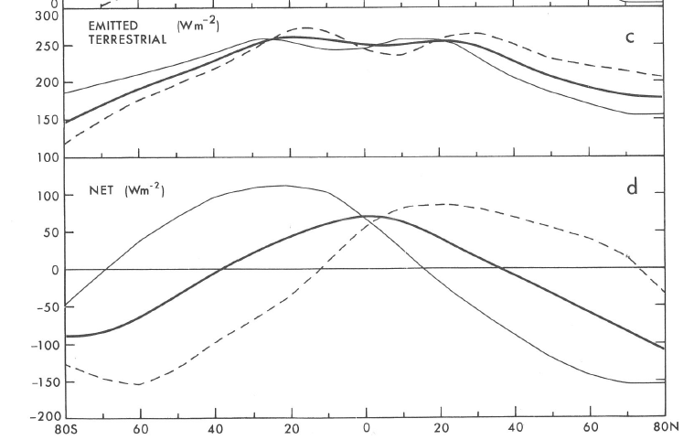
Net radiation balance of the Earth
Net radiation energy budget:
Balance between
incoming shortwave and
outgoing longwave
radiation at the top of atmosphere
Northern Hemisphere summer (JJA)
Annual mean (Jan-Dec)
Northern Hemisphere winter (DJF)
80S
Eq
80N
Notes:
From Peixoto and Oort
25

Slide 26
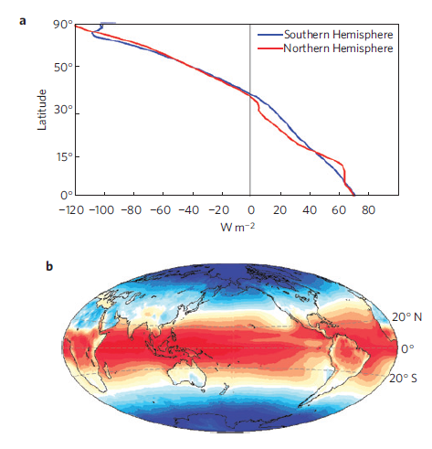

Net radiation balance of the Earth
Net radiation energy budget:
Balance between
incoming shortwave and
outgoing longwave
radiation at the top of atmosphere
Zonal average TOA net downward radiation in the Northern Hemisphere and
Southern Hemisphere
(averaged over period 2001-2010)
Eq
Notes:
From Frierson et al. 2013, based on latest satellite observations from CERES.
Zonal average TOA net downward radiation in the Northern Hemisphere and
Southern Hemisphere from CERES EBAF, 2001–2010
26

Slide 27
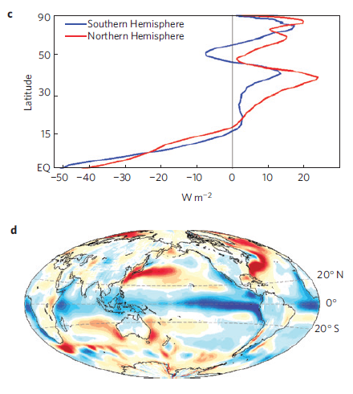
Estimated heat transports in atmosphere and ocean
From the imbalance in outgoing
and incoming radiation one can
estimate regions where oceans
and atmosphere transport
heat to compensate for the
surplus and deficit in the radiative
budget. This keeps the
Temperatures locally in balance.
Eq
Notes:
From Frierson et al. 2013, based on latest satellite observations from CERES.
Zonal average TOA net downward radiation in the Northern Hemisphere and
Southern Hemisphere from CERES EBAF, 2001–2010
27

Slide 28
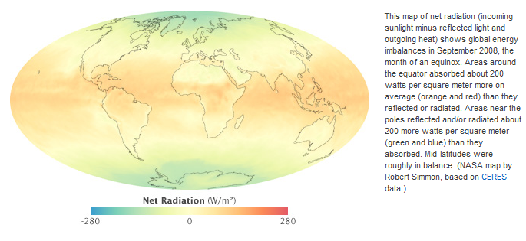
Earth's radiative energy balance September 2008 (NASA satellite observations)
Source: NASA http://earthobservatory.nasa.gov/Features/EnergyBalance/page3.php
Notes:
Note: this slide is reminding us that our climate system is variable and individual seasons can have great deviations from a balanced radiative energy budget.
28

Slide 29
Earth’s longwave radiation
From outer space Earth appears as a black-body emitter of radiation
Spectral peak at infrared (IR) wavelength
Emitted energy flux (irradiance) depends
on the absolute temperature of the emitting body
The Stefan-Boltzmann Law: Q(T) = σ T⁴
Total emitted black-body radiation is proportional to the body’s temperature to the power of 4
More information can be found in Peixoto & Oort (Ch. 6) or Coakley and Yang (Ch. 1)

Slide 30
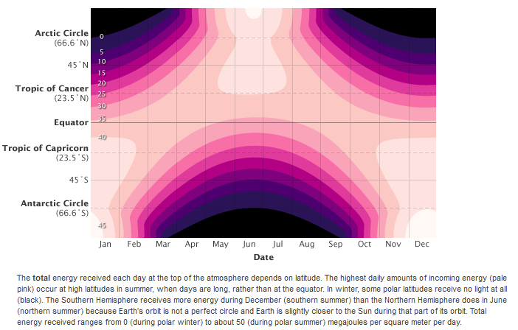
Solar irradiance as a function of season and latitude
Source: NASA http://earthobservatory.nasa.gov/Features/EnergyBalance/page3.php
Notes:
Introductory notes.
30

