Slide 1
Climate variability and change
Introduction to the physical climate system
Atmospheric Circulation
Oliver Elison Timm ATM 306 Fall 2016
Lecture 1
Notes:
Presentation slide for courses, classes, lectures et al.

Slide 2
Objectives
Objectives
  The general circulation of the atmosphere
    Winds and pressure systems
    Zonally averaged circulation
    Driving forces behind the general circulation
    Tropical and mid-latitude and polar circulation
  Regional circulation:
    Monsoon circulation
    Walker Circulation
Notes:
Objectives for instruction and expected results and/or skills developed from learning.

Slide 3
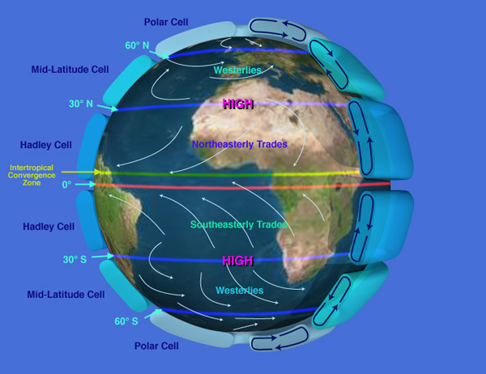
Atmospheric Circulation:
A first look at the general circulation is to concentrate on the prevailing winds systems:
zonally averaged and temporally averaged
Notes:
Zonal average: following a long a latitude circle in at given height level and average all the wind observations

Slide 4
Atmospheric Circulation:
Hadley Circulation
Warm air masses rise (deep convection)
At upper levels outflow towards the poles
At surface the circulation is closed by the trade winds that converge in the Intertropical Convergence Zone (ITCZ)
Notes:
Zonal average: following a long a latitude circle in at given height level and average all the wind observations

Slide 5
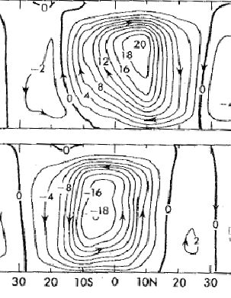
Hadley Circulation
DJF
200 hPa
If we average the meridional (south-north) wind and vertical motions along a given latitude circle and a given height we can produce a streamfunction* that shows us the
flow in the latitude-height plane.
*Streamfunction: A divergence-free circulation can be described by a scalar field.
The flow is parallel to the contour lines
Right-hand rule: Looking into direction where the wind is blowing to, higher values are to the right.
500 hPa
1000 hPa
JJA
Notes:
Hadley circulation is important for the transport energy to reduce temperature contrast between tropics and subtropical regions

Slide 6
Hadley Circulation
DJF
200 hPa
If we average the meridional (south-north) wind and vertical motions along a given latitude circle and a given height we can produce a streamfunction* that shows us the
flow in the latitude-height plane.
*Streamfunction: A divergence-free circulation can be described by a scalar field.
The flow is parallel to the contour lines.
The units of the streamfunction: kg/s
Right-hand rule: Looking into direction where the wind is blowing to, higher values are to the right.
500 hPa
1000 hPa
JJA
Notes:
Notes: The ascending branch is located off the equator favoring the warm summer hemisphere, whereas the
descending branch is located in the cooler hemisphere.

Slide 7
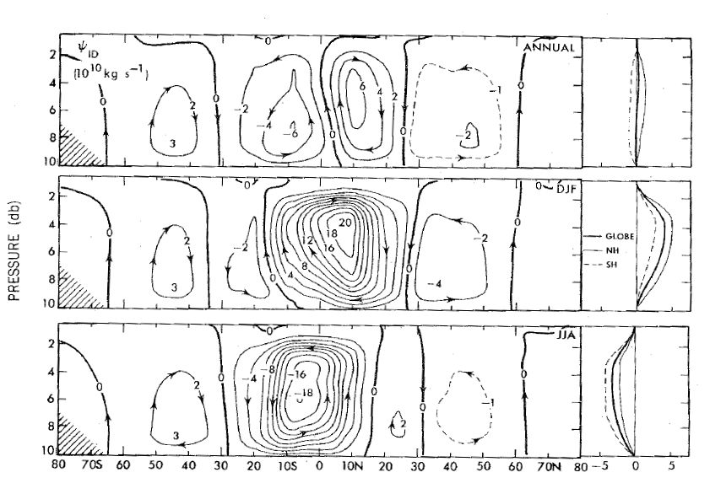
Meridional cross section through the troposphere
Annual mean
Annual mean circulation is much weaker than the seasonal circulation cells. It shows that the ascending motion is stronger north of the equator (consistent with the ITCZ position)
Dec Jan Feb
Jun Jul Aug
Notes:
Units of the streamfunction: kg/s
Note the vertical axis is height in pressure units of deka bar: 2 is height of tropopause (200hPa), 6 is 600 hPa, 10 is 1000hPa (surface level)

Slide 8
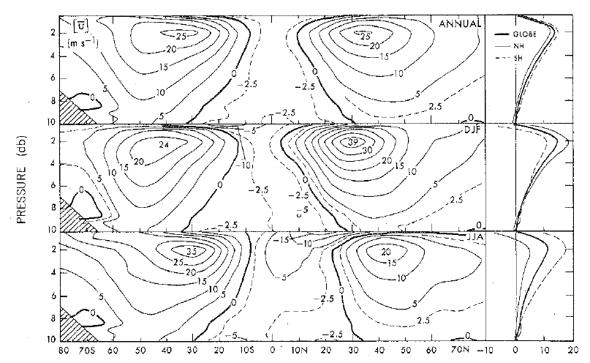
Zonal mean wind (m/s)

Slide 9
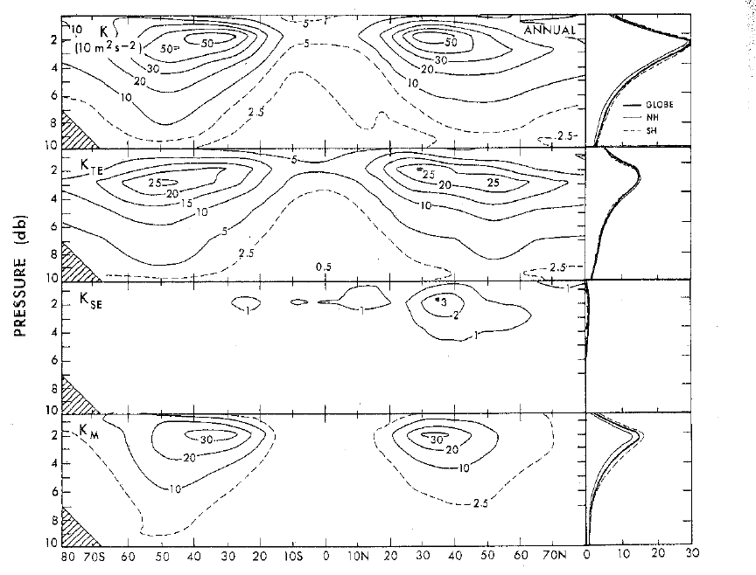
Kinetic Energy: Mean and Eddies* (*weather variability)
Sum of all terms
Eddy kinetic energy
(weather systems)
Energy in the average
stationary waves
Energy in the average
zonal mean circulation
Notes:
Annual mean

Slide 10
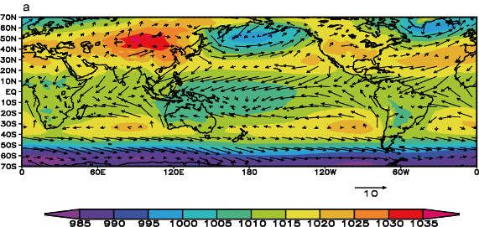
Sea Level Pressure (SLP) and near surface winds
hPa
Notes:
Which is the NH summer which is the winter season? (NH winter)

Slide 11
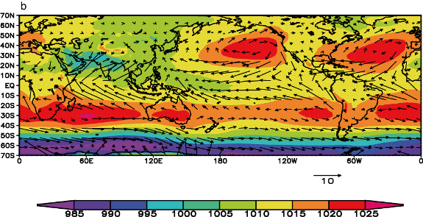
Sea Level Pressure (SLP) and near surface winds
hPa
Note: Regional circulation systems cannot be described in the framework of zonal mean
Monsoon flows.
Notes:
NH Summer

Slide 12
Sea Level Pressure (SLP) and near surface winds
monsoon
circulation
hPa
Notes:
NH Summer

Slide 13
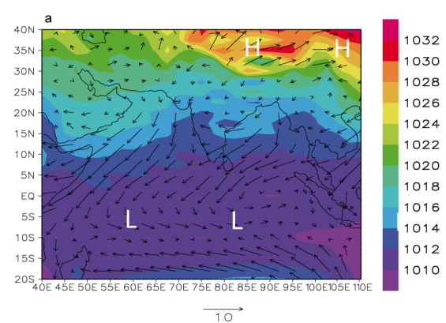
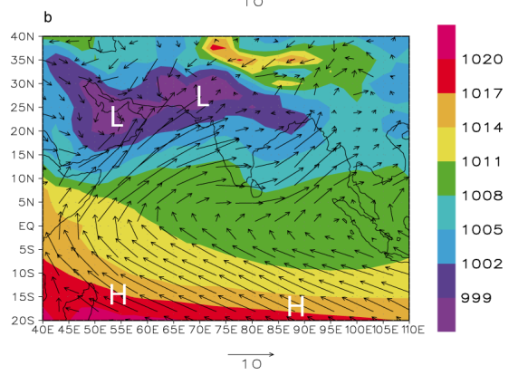
Monsoon circulation
Figure 1.6: 10 m winds (arrows, in m/s) and sea level pressure (colours, in hPa) in (a) January and (b) July illustrating the wind reversersal between the winter and the summer monsoon Data source: NCEP/NCAR reanalyses (Kalnay et al. 1996).
Source: http://www.climate.be/textbook/chapter1_node5.html

Slide 14
Sea Level Pressure (SLP) and near surface winds
Walker circulation
hPa
Notes:
NH Summer

Slide 15
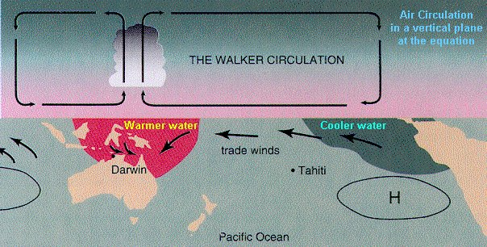
Walker Circulation
Western tropical Pacific warm pool.
Temperatures above 27 degree Celsius (about 81F)
Cooler waters in the eastern tropical Pacific
Pressure gradient at surface
Easterly winds over the equatorial Pacific
Notes:
Sir Gilbert Walker 14 June 1868 – 4 November 1958

Slide 16
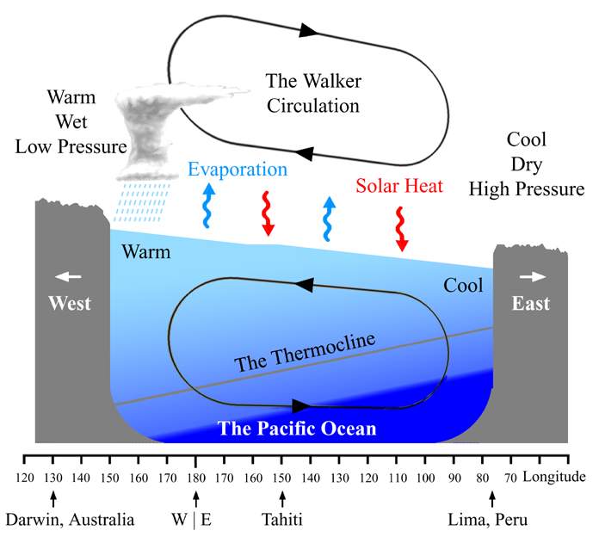
Walker Circulation
Conceptual view of the average conditions
We will see later how this state can be disturbed and lead to a shift of warm water sphere to the east
=> El Niño
Notes:
Sir Gilbert Walker 14 June 1868 – 4 November 1958

Slide 17
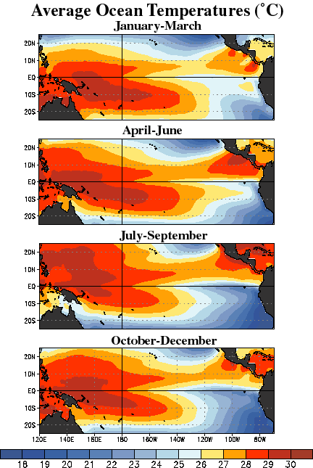
Walker Circulation
Western tropical Pacific warm pool.
Temperatures above 27 degree Celsius (about 81F)
Eastern tropical Pacific: Cold water ‘tongue’ caused by upwelling of colder deep ocean waters
Notes:
Sir Gilbert Walker 14 June 1868 – 4 November 1958

Slide 18
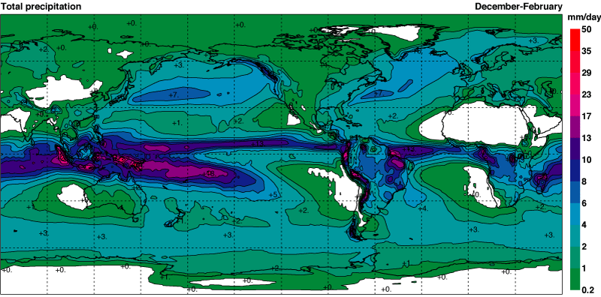
Tropical rainfall over oceans
Rainfall and sea surface temperatures (SST) are tightly coupled: Generally we find
highest rainfall over the warmest regions.
Note the lower rainfall over the eastern tropical Pacific
and compare with the western tropical Pacific

Slide 19
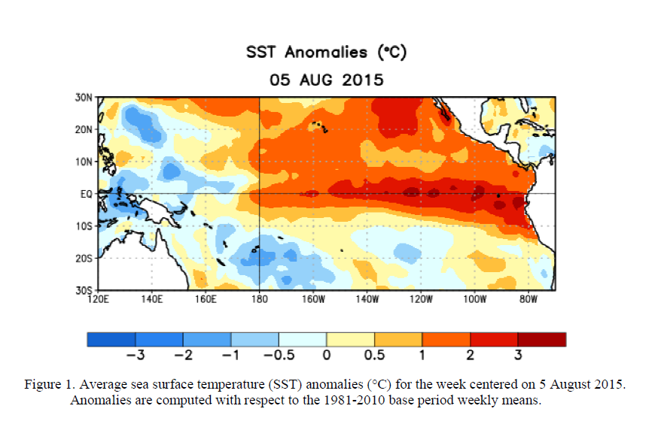
El Nino development in 2015
Notes:
This is from NOAA’s climate prediction center (Retrieved 2015-09-09) http://www.cpc.ncep.noaa.gov/products/analysis_monitoring/enso_advisory/

Slide 20
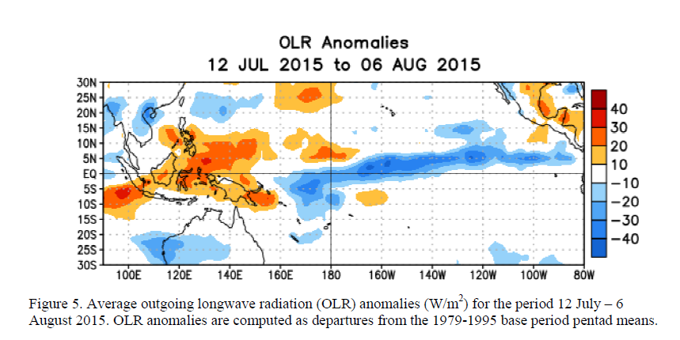
El Nino development in 2015
OLR: Outgoing longwave radiation measured by satellites
Notes:
This is from NOAA’s climate prediction center (Retrieved 2015-09-09) http://www.cpc.ncep.noaa.gov/products/analysis_monitoring/enso_advisory/

Slide 21
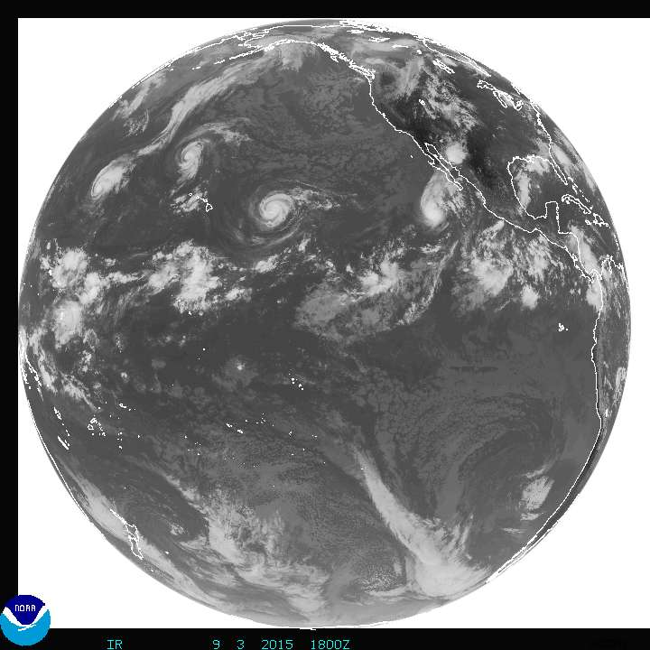
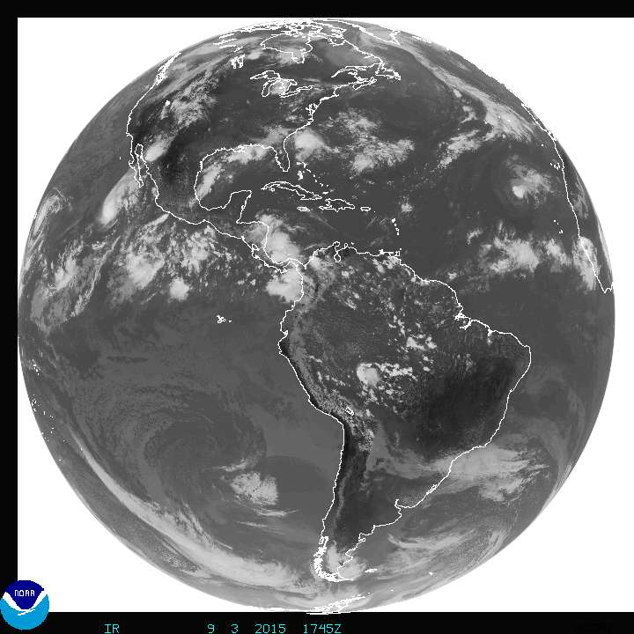
Satellite (IR) image from Sept. 3rd, 2015 at 18:00UTC
Higher than normal tropical storm activity in the Eastern tropical Pacific

Slide 22
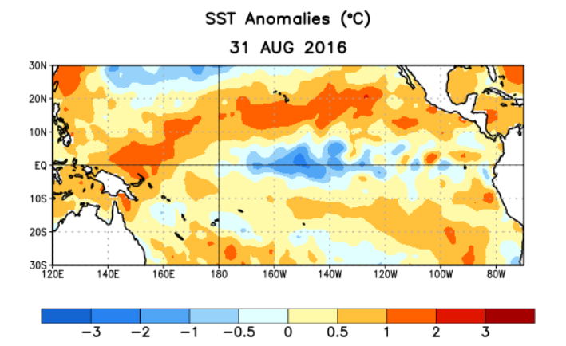
La Nina development in 2016
Notes:
This is from NOAA’s climate prediction center (Retrieved 2016-09-21) http://www.cpc.ncep.noaa.gov/products/analysis_monitoring/enso_advisory/

Slide 23
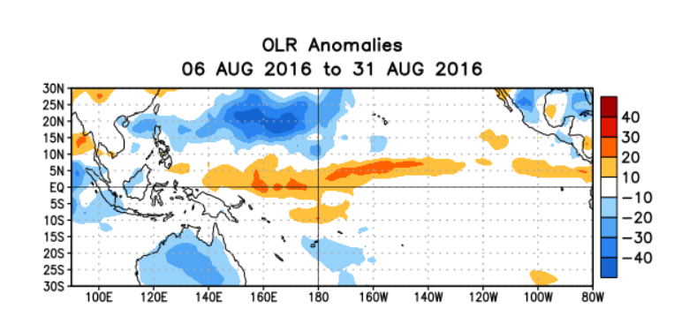
La Nina development in 2016
OLR: Outgoing longwave radiation measured by satellites
Notes:
This is from NOAA’s climate prediction center (Retrieved 2016-09-21) http://www.cpc.ncep.noaa.gov/products/analysis_monitoring/enso_advisory/

Slide 24
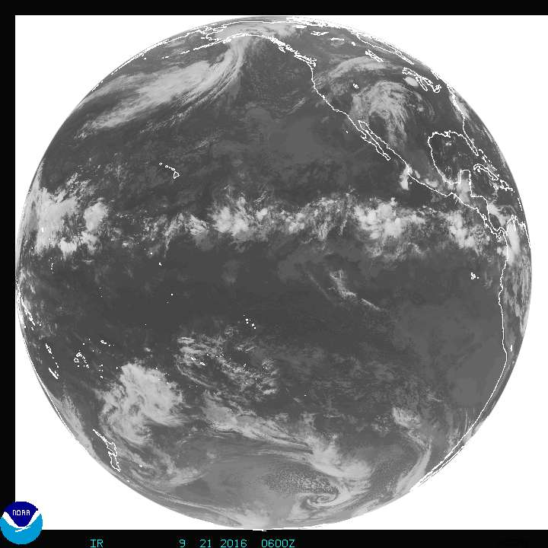
Satellite (IR) image from Sept. 21st, 2016 at 18:00UTC
This snapshot is a beautiful example showing the ITCZ across the tropical Pacific.

