Slide 1
Climate variability and change
Introduction to the physical climate system
Ocean Circulation
Oliver Elison Timm ATM 306 Fall 2016
Lecture 1
Notes:
Presentation slide for courses, classes, lectures et al.

Slide 2
Objectives
Provide an overview of the ocean circulation
  Surface currents
  Wind-driven circulation
  Atlantic and Pacific circulation
Pressure forces and circulation
Ekman Transport and Ekman Pumping
Western intensification of surface currents
Notes:
Objectives for instruction and expected results and/or skills developed from learning.

Slide 3
Temperature & Salinity of Ocean Water Masses
Just as in the atmosphere the temperature is important to characterize a water mass
Salinity is equally important
Temperature and Salinity determine the density of ocean water, together with the pressure
Notes:
Question to students
All three, but in different ways, some responsible for deep ocean circulation, others more for the surface. We will explore in this lecture the general ocean circulation in a descriptive way. We will touch upon some important physical processes that help us to understand the general circulation, and we will need those concepts later to explain climate variability.

Slide 4
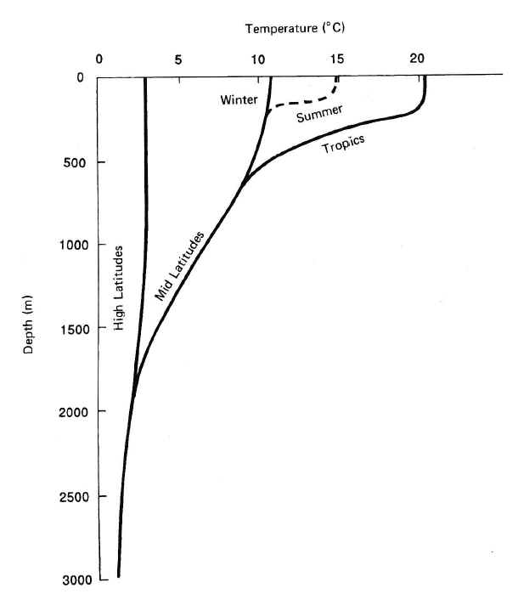
Temperature in the oceans
Mixed layer (~50-200 meter)
Thermocline: layer with rapid
change in temperatures
Deep ocean:
temperature < 5 deg C
Typical vertical temperature
profile
Notes:
Figure from John A. Knauss, Introduction to Physical Oceanography (2nd edition)

Slide 5
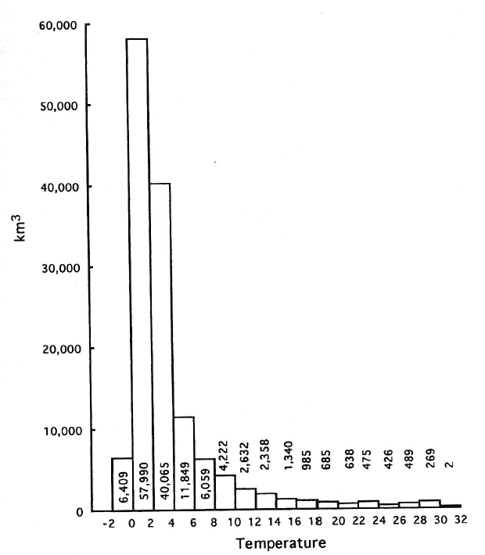
Temperature in the oceans
Ocean water samples:
Histogram showing how many
sampled temperature
measurements from the global
ocean fall into the specified
temperature bins from (-2 to 0,
0 to 2 deg C, and so forth)
About 75% is in range
0 to +4 deg C
Notes:
Figure from John A. Knauss, Introduction to Physical Oceanography (2nd edition)

Slide 6
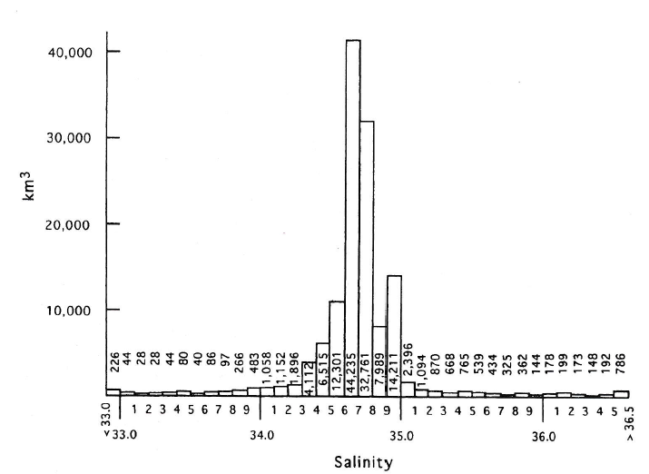
Salinity in the oceans
Ocean water samples:
Histogram showing how many
sampled salinity
measurements from the global
ocean fall into the specified
salinity bin.
Notes:
Figure from John A. Knauss, Introduction to Physical Oceanography (2nd edition)
Note: most ocean water has a salinity between 34-35 (PSU: practical salinity unit is often used to give the numbers a unit)
Further note that water with salinity values

Slide 7
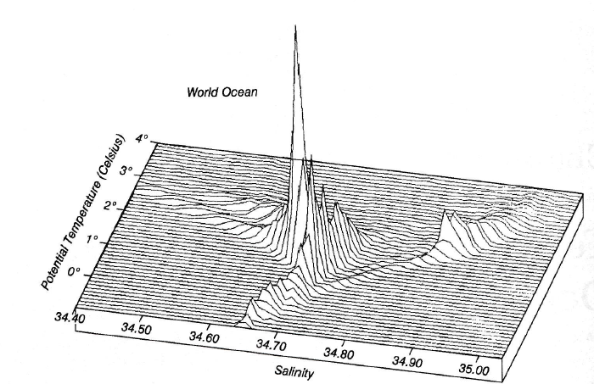
Salinity in the oceans
Distribution of ocean water by
temperature and salinity
(for the cold waters below 4 degC)
Temperature and salinity are both important, because they determine the density of water.
Density is important for the vertical and horizontal motions in the oceans
Notes:
Figure from Robert Stewart, Introduction to Physical Oceanography

Slide 8
Introduction: Ocean general circulation
Ocean interaction with the atmosphere
  Heat exchange
  Mass exchange
  Momentum exchange
Which of these interactions drives ocean circulation?
Notes:
Question to students
All three, but in different ways, some responsible for deep ocean circulation, others more for the surface. We will explore in this lecture the general ocean circulation in a descriptive way. We will touch upon some important physical processes that help us to understand the general circulation, and we will need those concepts later to explain climate variability.

Slide 9
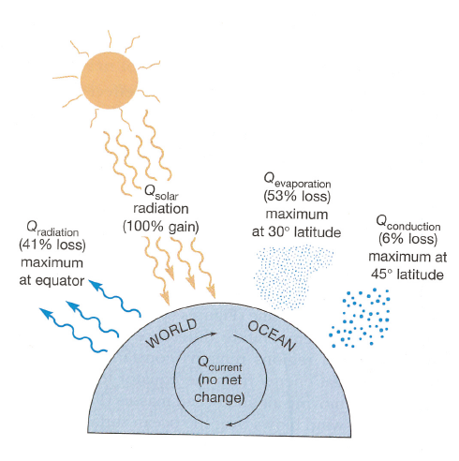
Ocean’s heat budget
Radiative fluxes
  Incoming shortwave
  Outgoing longwave
Latent heat flux due to
evaporation
Conduction of heat
(sensible heat flux)
Ocean circulation
transport of heat
and mass
Notes:
Question to students
All three, but in different ways, some responsible for deep ocean circulation, others more for the surface. We will see in this lecture about the general ocean circulation in a descriptive way. We will touch upon some important physical processes that help us to understand the general circulation, and we will need those concepts later to explain climate variability.

Slide 10
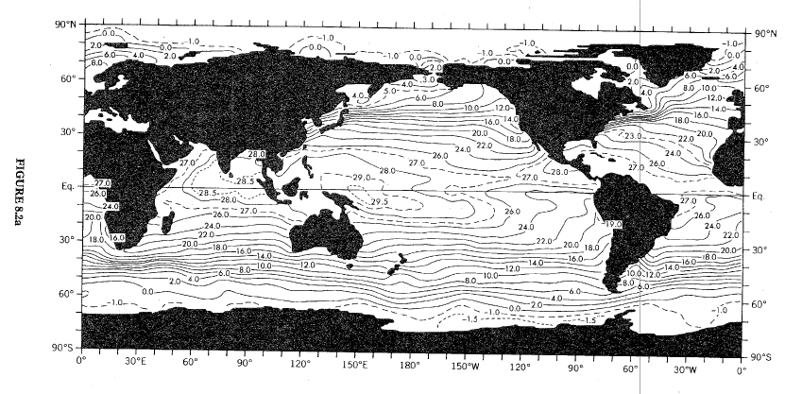
Ocean sea surface temperatures (SST) climatological annual mean.
Warm pool
Cold tongue
Zonal gradient
Regions of largest meridional temperature gradient
Notes:
We have seen before that warmest waters are the tropics and coolest in the polar oceans. The contour lines show a concentration of lines of equal temperature
but zonal asymmetries exist for example in the Pacific: western trop. Pac Warm Pool 5 K warmer than eastern trop. Pacific cold tongue.

Slide 11
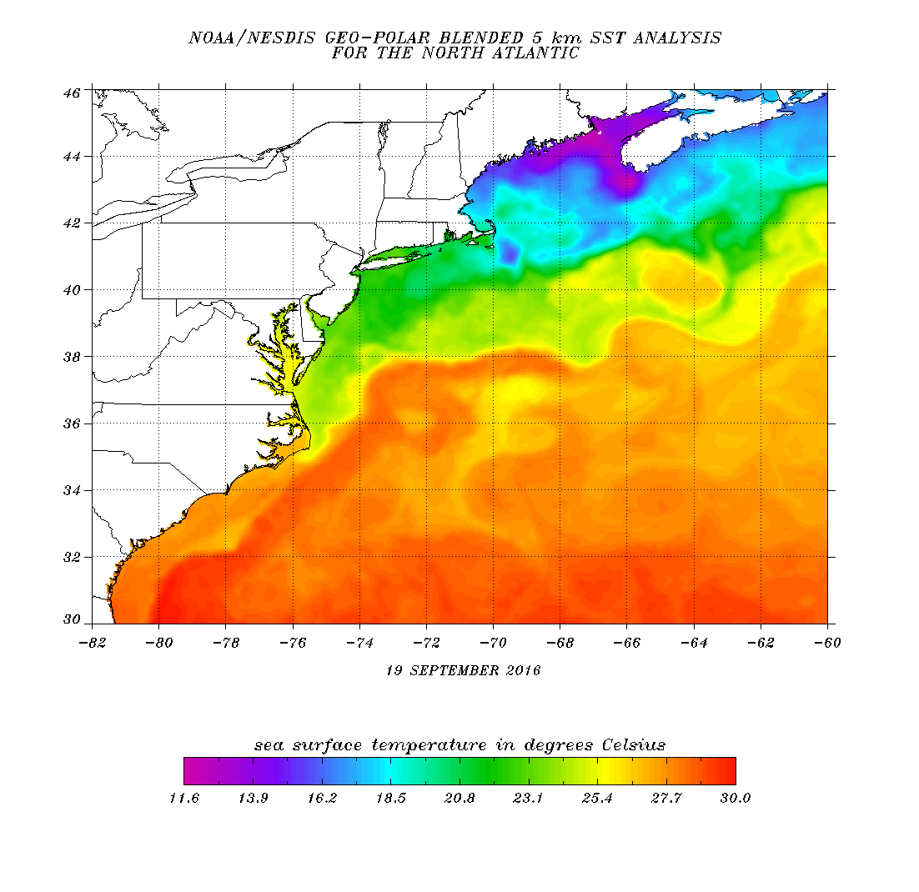
Ocean sea surface temperatures (SST) climatological annual mean.
Warm pool
Cold tongue
Zonal gradient
Regions of largest meridional temperature gradient
Notes:
Current image, satellite product retrieved from http://www.ospo.noaa.gov/Products/ocean/sst/contour/
On Sep 21st, 2016

Slide 12
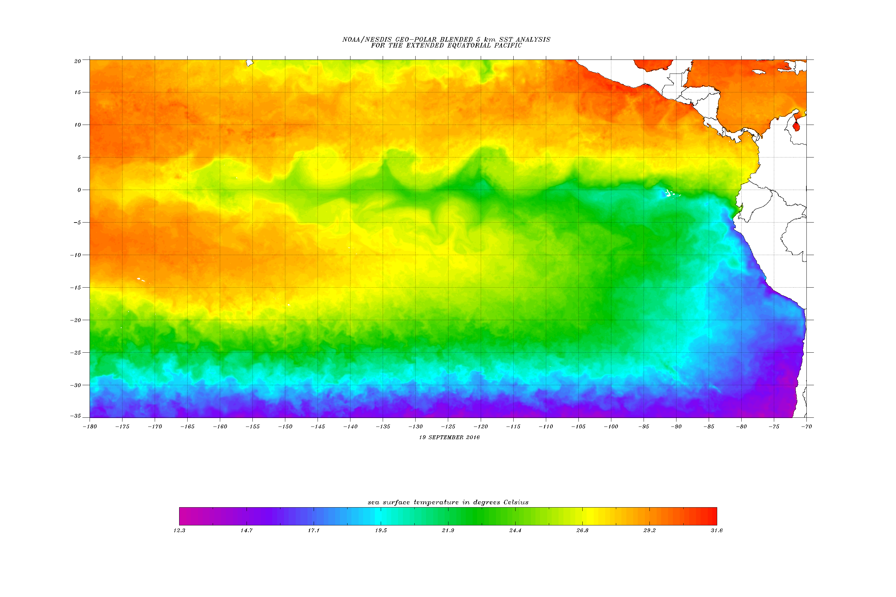
Ocean sea surface temperatures (SST) climatological annual mean.
Warm pool
Cold tongue
Notes:
Current image, satellite product retrieved from http://www.ospo.noaa.gov/Products/ocean/sst/contour/
Sep 21st, 2016

Slide 13
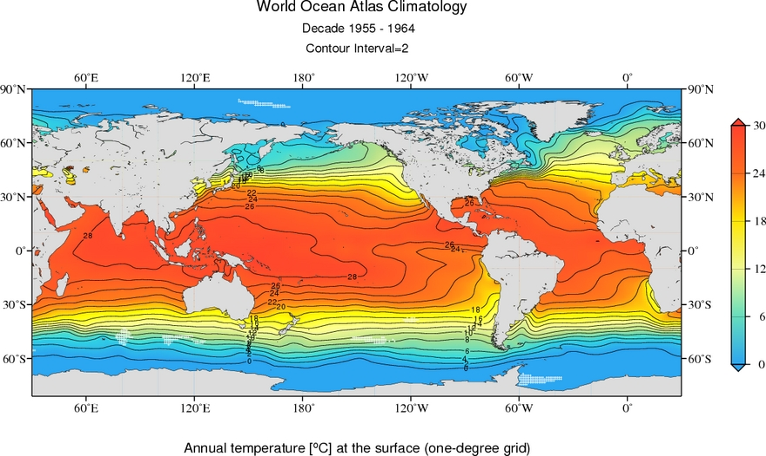
Ocean sea surface temperatures (SST) climatological annual mean: 1955-1964.
Link to World Ocean Atlas
Notes:
Figures from https://www.nodc.noaa.gov/cgi-bin/OC5/woa13fv2/woa13fv2.pl

Slide 14
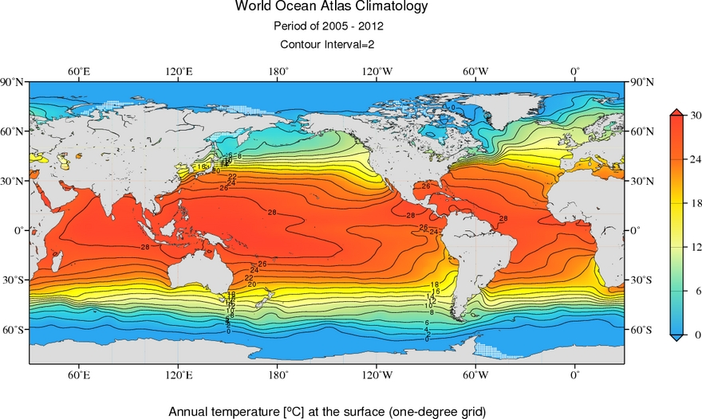
Ocean sea surface temperatures (SST) climatological annual mean: 2005-2012.
Notes:
Figures from https://www.nodc.noaa.gov/cgi-bin/OC5/woa13fv2/woa13fv2.pl

Slide 15
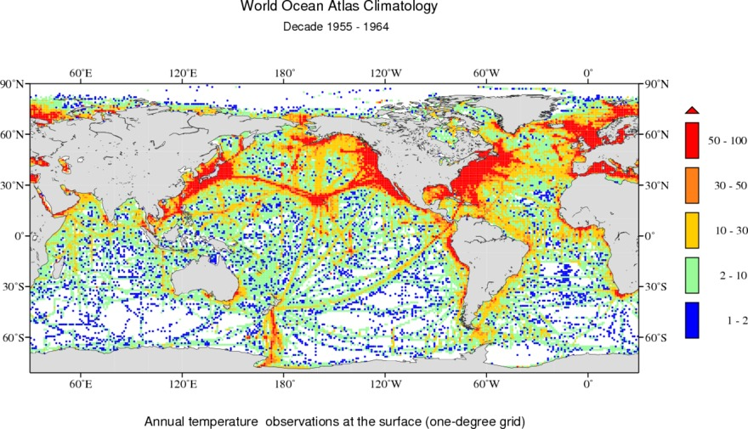
Ocean sea surface temperatures (SST) climatological annual mean: 1955-1964.
Average observations per year
Link to World Ocean Atlas
Notes:
Figures from https://www.nodc.noaa.gov/cgi-bin/OC5/woa13fv2/woa13fv2.pl

Slide 16
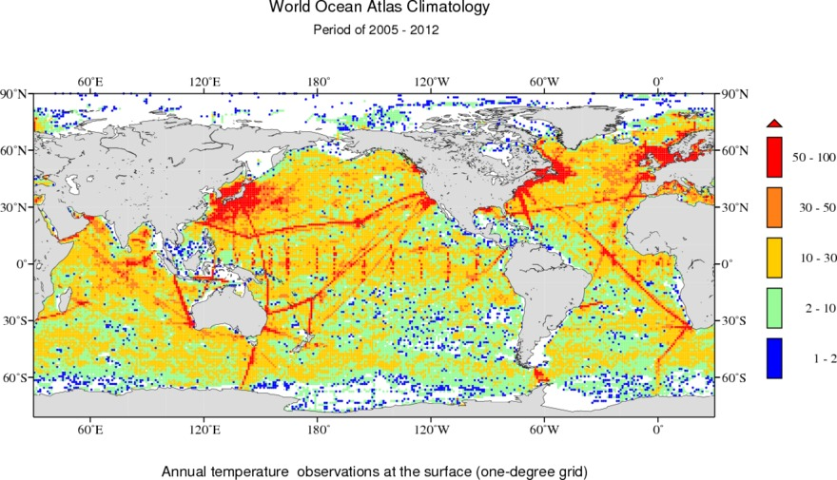
Ocean sea surface temperatures (SST) climatological annual mean: 2005-2012.
Average observations per year
Link to World Ocean Atlas
Notes:
Figures from https://www.nodc.noaa.gov/cgi-bin/OC5/woa13fv2/woa13fv2.pl

Slide 17
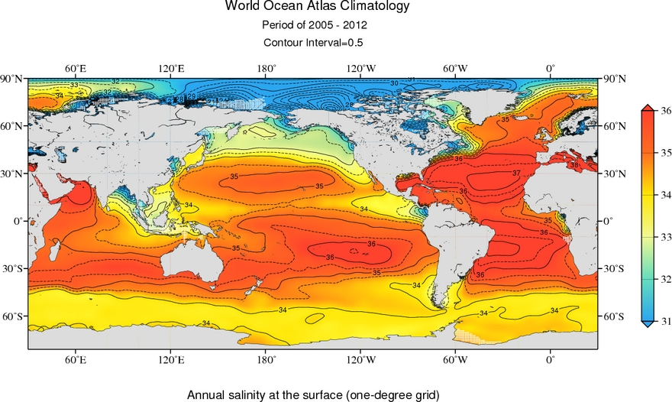
Ocean surface salinity (SSS) climatological annual mean: 2005-2012.
Notes:
Figures from https://www.nodc.noaa.gov/cgi-bin/OC5/woa13fv2/woa13fv2.pl

Slide 18
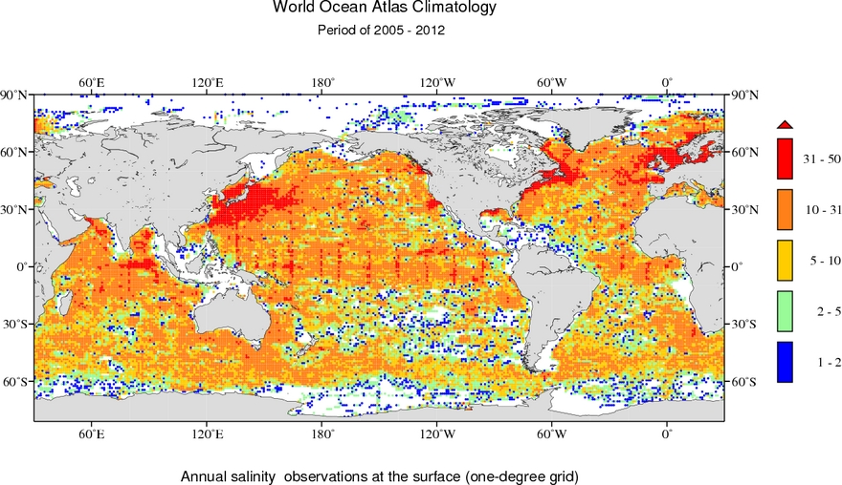
Ocean surface salinity (SSS) climatological annual mean: 2005-2012.
Notes:
Figures from https://www.nodc.noaa.gov/cgi-bin/OC5/woa13fv2/woa13fv2.pl

Slide 19
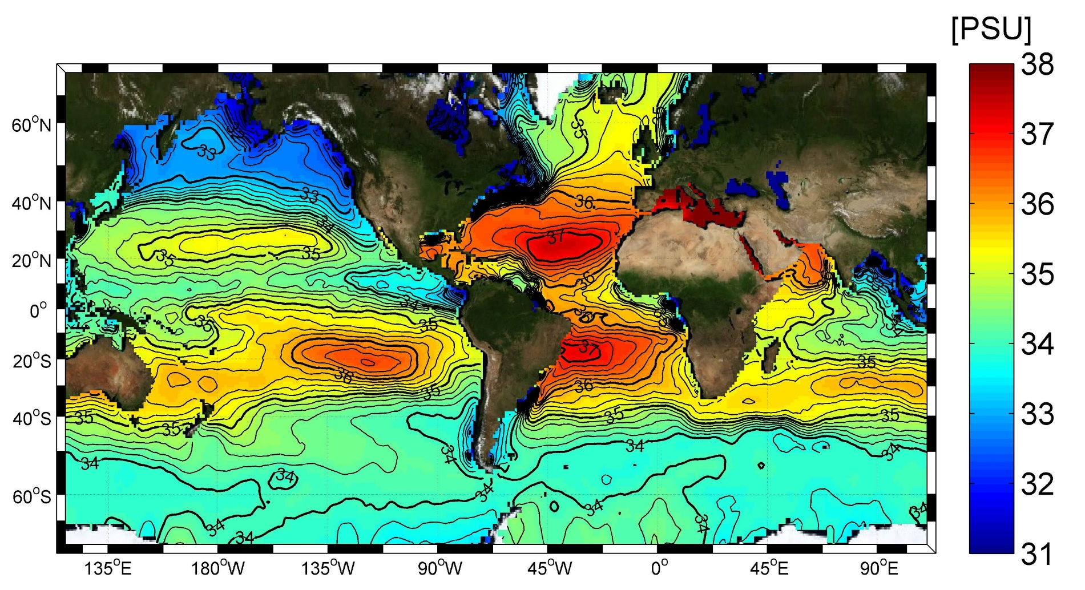
Global sea surface salinity from World Ocean Atlas (2005)
Source: http://www.salinityremotesensing.ifremer.fr/sea-surface-salinity/salinity-distribution-at-the-ocean-surface
Notes:
PSU ‘Practical Salinity Unit’: Red salty waters, we see subtropical ‘desert belt’ not only land deserts but
lack of precipitation and high evaporation leads to salty waters in subtropics.

Slide 20
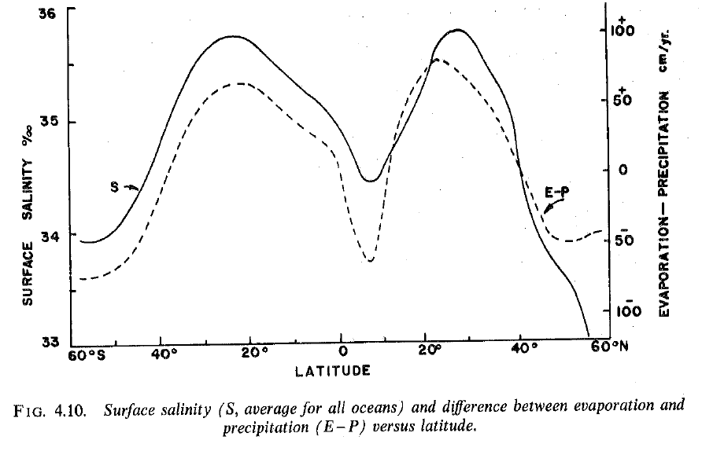
Global sea surface salinity and evaporation – precipitation
Source: http://www.salinityremotesensing.ifremer.fr/sea-surface-salinity/salinity-distribution-at-the-ocean-surface
Notes:
PSU ‘Practical Salinity Unit’: Red salty waters, we see subtropical ‘desert belt’ not only land deserts but
lack of precipitation and high evaporation leads to salty waters in subtropics.

Slide 21
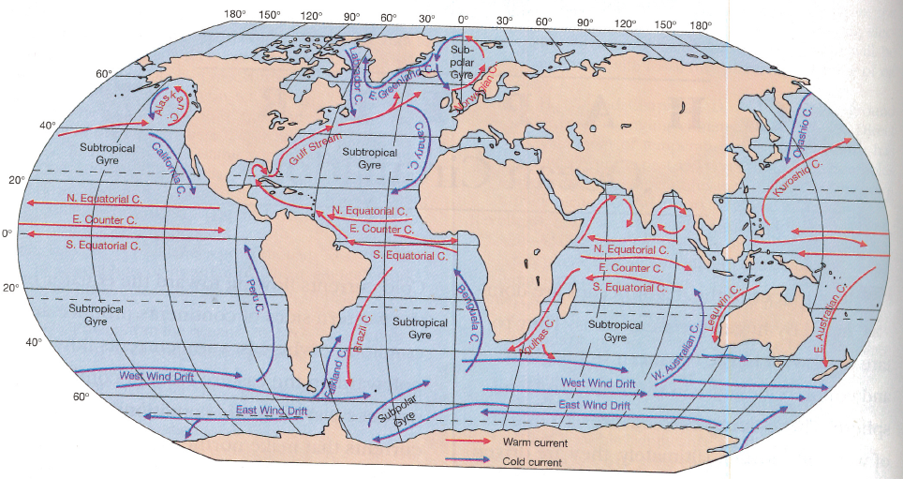
Surface currents of the world oceans
Idealized view on the average surface currents (after Sverdrup 1942).
Notes:
Worth to mention: Still used today to explain the general picture of the wind-driven circulation .

Slide 22
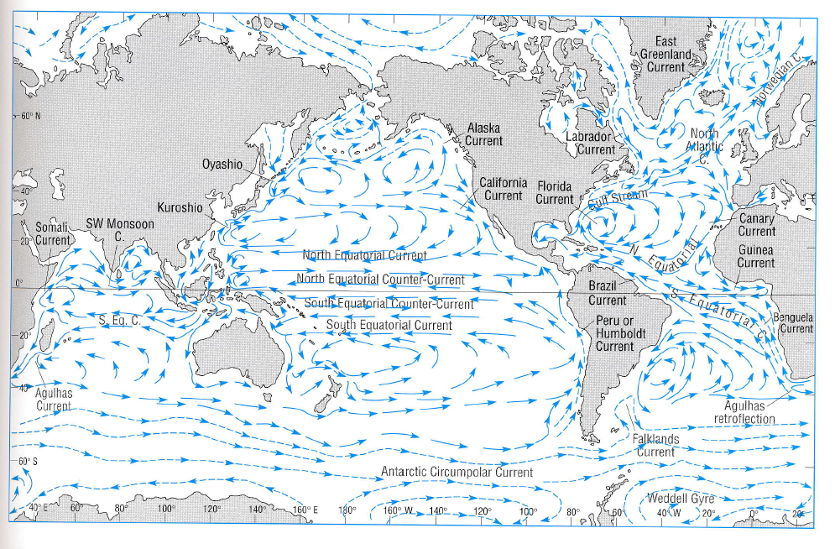
Surface currents of the world oceans
Notes:
From Ocean Circulation, Open University Course Team
Figure 3.1

Slide 23
Surface currents of the world oceans
Tropical Pacific and Atlantic share similar features* :
  A 3-current system:
    northern equatorial current (NEC) going east to west
    equatorial counter current going (ECC) west to east
    Southern equatorial current (SEC) going east to west
  in the extratropical regions a gyre circulation:
    western boundary currents flowing poleward
    currents transporting cold waters equatorward in the eastern ocean basin
    West to east flowing currents in the mid-latitudes
Notes:
* Indian Ocean has similar current systems, but the monsoonal wind reversal and confinement to lower latitudes in the northern hemisphere distinguish it from Pacific and Altantic ocean

Slide 24
Effects of wind on surface waters
Winds create waves but also net currents
Wind stress at the interface between atmosphere and ocean accelerates the water masses
Fridtjof Nansen observed while his ship was frozen in the sea ice near Fram Strait that the ice drifted at an angle of 20-40 deg to the right of the wind direction
Ekman worked on the theoretical model that explains this observation (in the year 1902).
Notes:
Wind stress is known to be approximately proportional to the windspeed ^2. Rule of thumb: 3% of the windspeed

Slide 25
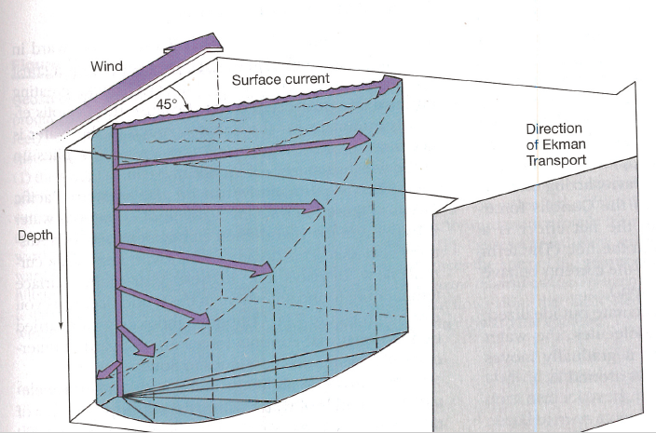
Ekman Spiral and Ekman Transport
Winds causes a stress at ocean surface
Interior stresses in the ocean and Coriolis force lead to a depth-dependent weakening of the flow and further anticlockwise rotation.
The uppermost waters move at 45 degree to the wind
Integrated over the affected ocean layer*:
A net transport at right angles to the surface wind!
(*Ekman layer thickness about 100m)
Northern hemisphere: anti-clockwise rotation
Southern hemisphere: clockwise rotation
Notes:
This Ekman transport is important for upwelling processes along the Equator and along coasts.
Final note, same balance forces apply in the atmospheric boundary layer, but this Ekman spiral is hardly observed in nature.
Yet the integrated Ekman transport exists and describes very well many features of the ocean circulations.

Slide 26
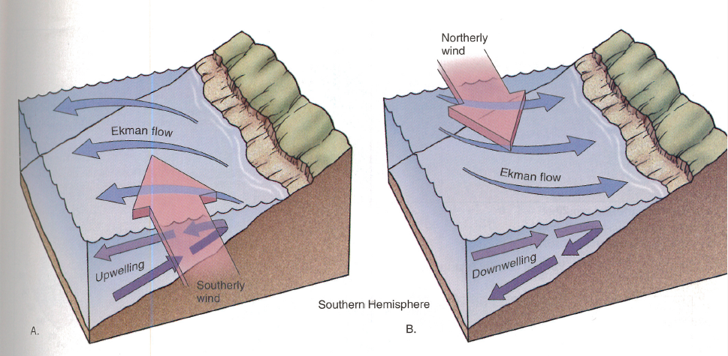
Coastal upwelling and downwelling
Example situation for the Southern Hemisphere:
The Coriolis force is now leading to transports a 90deg angle to the left relative to wind direction
Notes:
This Ekman transport is important for upwelling processes along the Equator and along coasts.

Slide 27
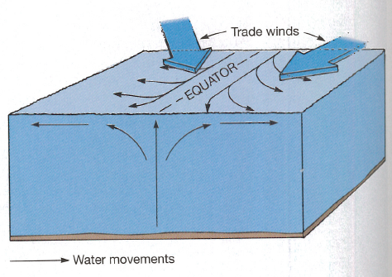
Equatorial upwelling
N
W
Northern
hemisphere
Southern
hemisphere
Notes:
The Coriolis force changes the sign at the equator. That means that the prevailing trade winds have a steady easterly wind component.
In northern hemisphere that pushes waters 90 degrees to the right, hence northward away from equator. On southern hemisphere the transport goes at right angles, but to the left, hence away from equator. Continuity of mass requires upwelling of ocean water on the equator

Slide 28
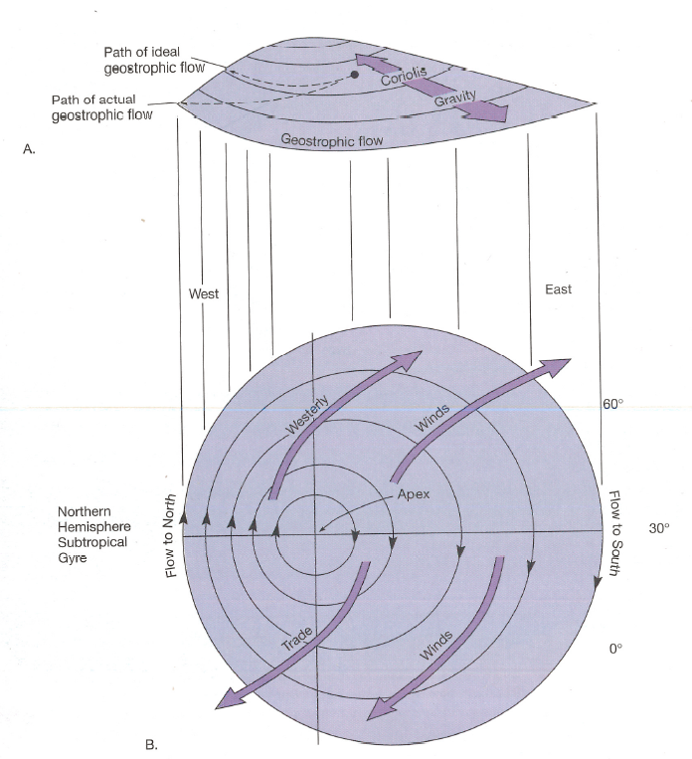
Geostrophic flow in ocean
Perspective view on a subtropical gyre circulation in the northern hemisphere
The wind stress drives anticyclonic circulation
Coriolis force and rotation of the flow (‘vorticity’) force an intensification of the flow in the western section.
View from top

Slide 29
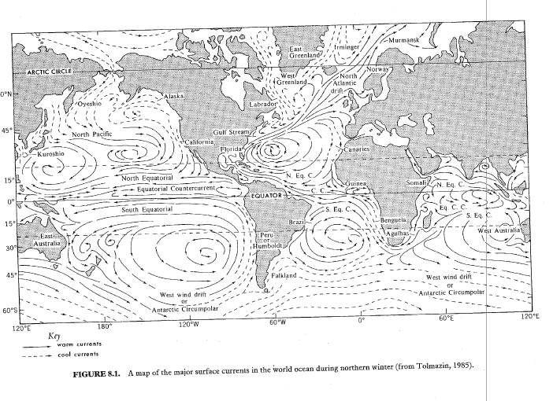
Global surface currents
North Pacific Subtropical Gyre

Slide 30
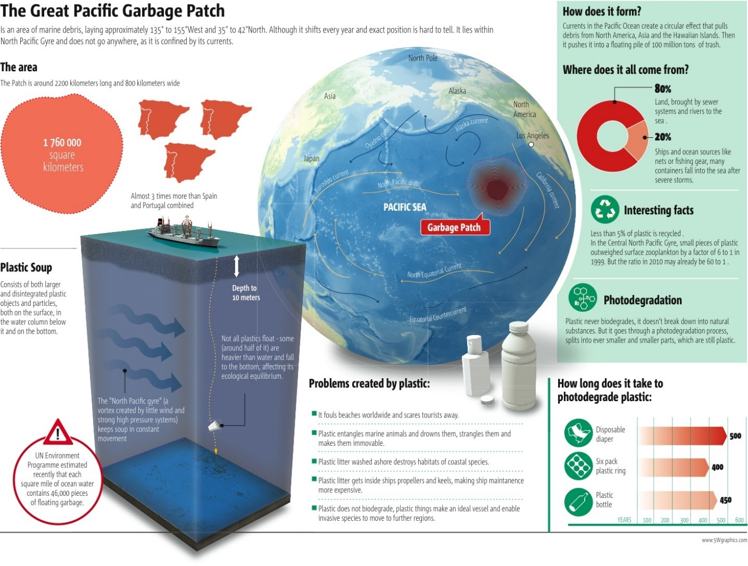
Subtropical gyres: The ocean’s garbage patches
Notes:
Hand out to students: copy of this slide
2-3 min reading.
Task: What is it, and what is the reason for the high plastic concentration in that region of the ocean?
Homework hand out:
Let them read the questions, if questions come up, say they should email me.
Use time to setup the internet with the youtube video. (next slide)
Check time: 30 minutes-45 minutes (11:45am)
Last part: Looking a little more into the interior ocean, the ocean stratification.

Slide 31
Ocean stratification
The global ocean has a characteristic density structure
A permanent pycnocline exists in the ocean
Link to youtube video
Notes:
Video is a bout 12 minutes.
Allow for questions and answers 5 minutes
So here we have about 20 min left.
10 minutes for last few slides.

Slide 32
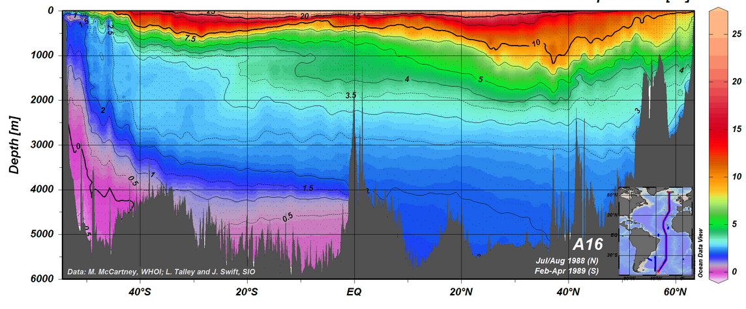
Global Ocean cross section temperature in depth –latitude
Research ships equipped to measure vertical profiles of temp, salinity. Numerous
legs (ship tracks) have been sampled and compiled into a global data base.
Digital archive World Ocean Circulation Experiment: http://www.ewoce.org
Notes:
Note: potential temperature is shown

Slide 33
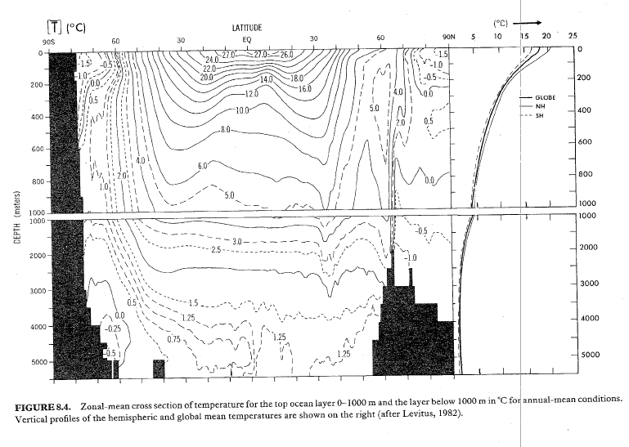
Global Ocean cross section temperature in depth –latitude

Slide 34
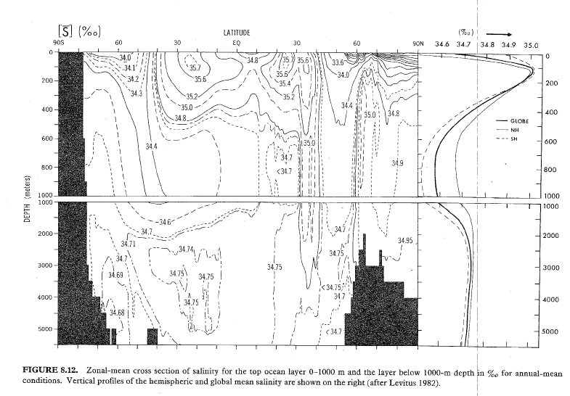
Global Ocean cross section salinity in depth –latitude

Slide 35
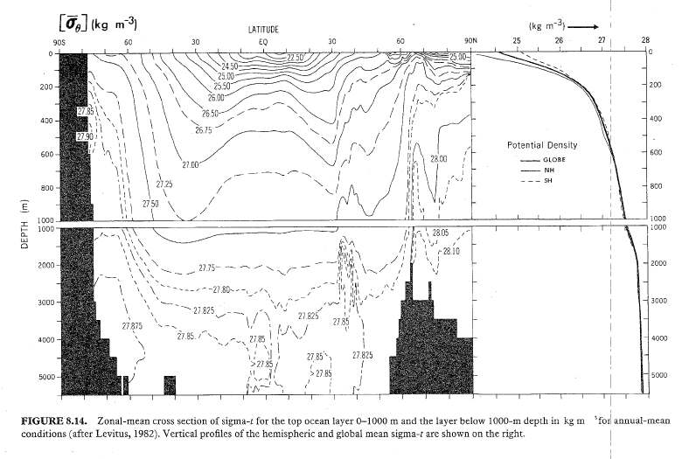
Global Ocean cross section density in depth –latitude
Notes:
Note: oceanographers use potential temperature and salinity to calculate a potential density.

Slide 36
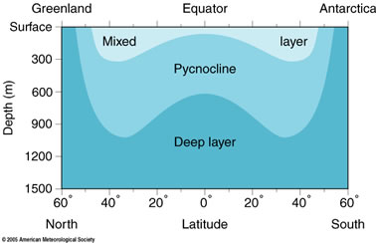
Vertical ‘spheres’ of the ocean
Notes:
Temperature: mixed layer: first 100m, where we find a seasonal cycle in temperatures (in extratropics), the
Pycnoclin
From Wikipedia: “A pycnocline is the cline or layer where the density gradient (∂ρ/∂z) is greatest within a body of watere and below the deep ocean.”

Slide 37
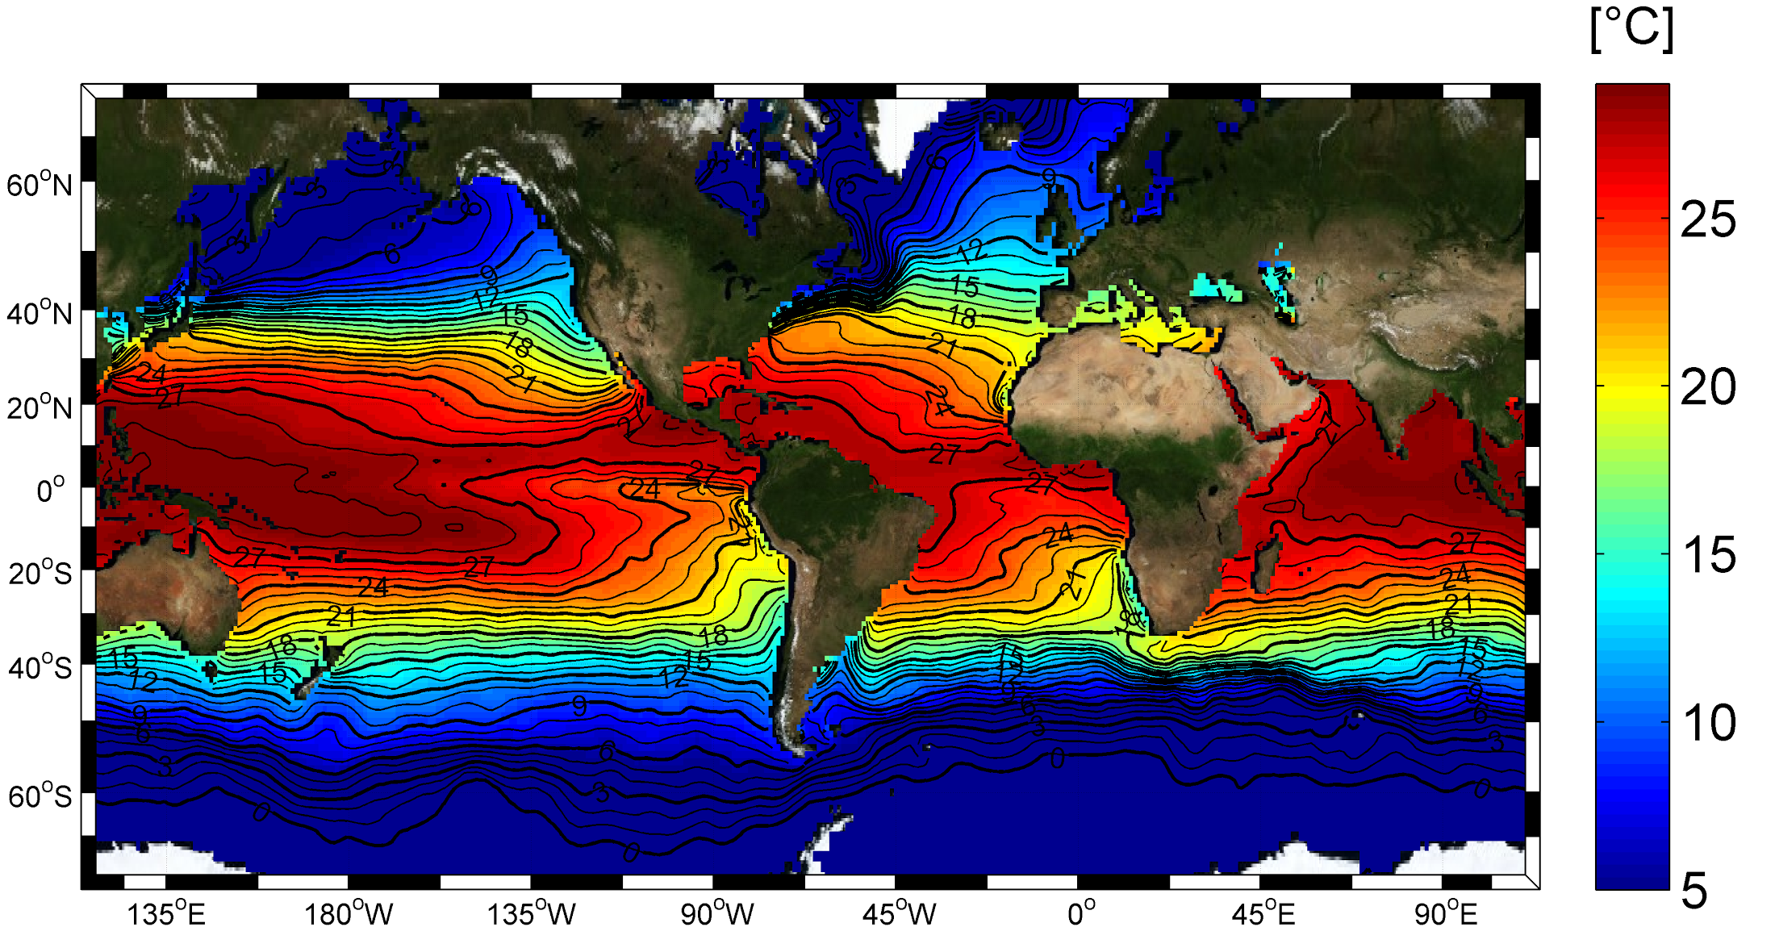
Global sea surface temperature from World Ocean Atlas (2005)
Image source : http://www.salinityremotesensing.ifremer.fr/sea-surface-salinity/salinity-distribution-at-the-ocean-surface
Notes:
To illustrate the temperature with modern data and in colors

Slide 38
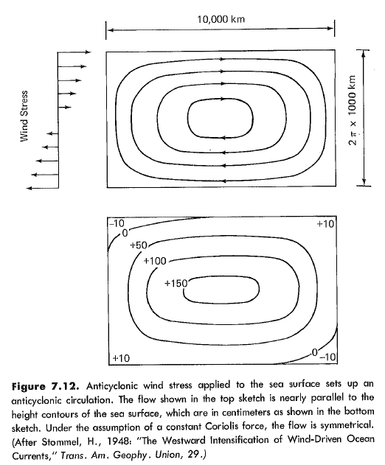
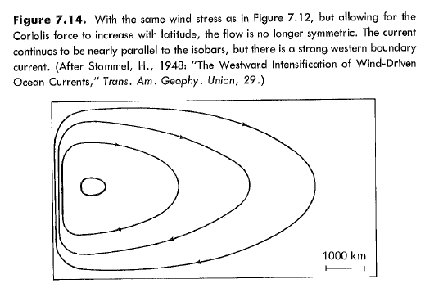
Western intensification

Slide 39
Further references / internet resources
World Ocean Atlas data products
  https://www.nodc.noaa.gov/OC5/indprod.html
  NOAA Marine Debris Program
  Youtube video (5min):
  The North Pacific Garbage Patch

