Slide 1
ENSO IMPACTS and SEASONAL FORECASTS
Oliver Elison Timm ATM 306 Fall 2016
Lecture 5
Notes:
Presentation slide for courses, classes, lectures et al.
1

Slide 2
Impacts of El Niño and La Niña events: Peru’s fisheries
Peru’s food production highly sensitive to climate fluctuations:
El Niño years unfavorable for fishing
damaging floods along the coastal plain and in the western Andean foothills in the northern part of the country.
La Niña are welcomed by fishermen, but farmers suffer from drought and crop failures.
Source: http://www.pmel.noaa.gov/tao/elnino/impacts.html
Notes:
Prognostic equation:
A time derivative on the left hand side of the equation (change in wind, currents, or any other variable) is related to an instantaneous state of the system(e.g. pressure gradient)

Slide 3
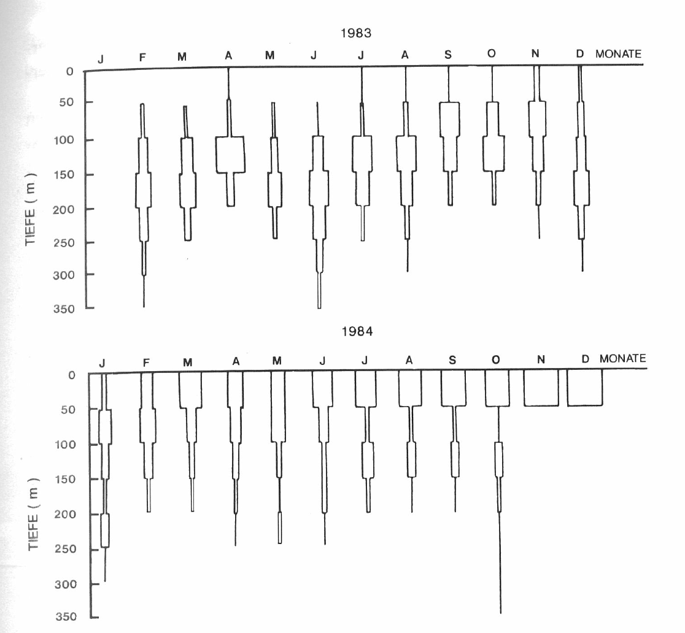
Impacts of El Niño and La Niña events: Peru’s fisheries
El Niño 1982/83
had significant impact on
the fisheries of Peru.
Top: Echolot shows fishes
were in deeper waters
(Surface waters were nutrient
depleted and short of plankton
disrupting the food chain)
Bottom: 1984 upwelling
was back and with that
fish abundance in surface waters
water depth
water depth

Slide 4
Impacts of El Niño and La Niña events
During El Niño:
Decreased primary production in the tropical Pacific, due to weakened upwelling of nutrient rich waters
Reduced productivity affects the geographic distribution of marine mammals, sea birds, and commercially valuable fish species [Stenseth et al., Science, 2002]
Massive and widespread episode of bleaching during the 1997–1998 El Niño, when 16% of the world's reef-building coral died [Walther et al., Nature, 2002]
Source: http://www.pmel.noaa.gov/pubs/outstand/mcph2969/mcph2969.shtml
Notes:
Prognostic equation:
A time derivative on the left hand side of the equation (change in wind, currents, or any other variable) is related to an instantaneous state of the system(e.g. pressure gradient)

Slide 5
Impacts of El Niño and La Niña events
During El Niño
Heavy rains in northern Peru, southern Brazil
Droughts in southern Peru & Bolivia, Brazilian Nordeste
Dry conditions and widespread forest fires in South East Asia, with haze and respiratory health problems
Source: http://www.pmel.noaa.gov/pubs/outstand/mcph2969/mcph2969.shtml
Notes:
Prognostic equation:
A time derivative on the left hand side of the equation (change in wind, currents, or any other variable) is related to an instantaneous state of the system(e.g. pressure gradient)

Slide 6
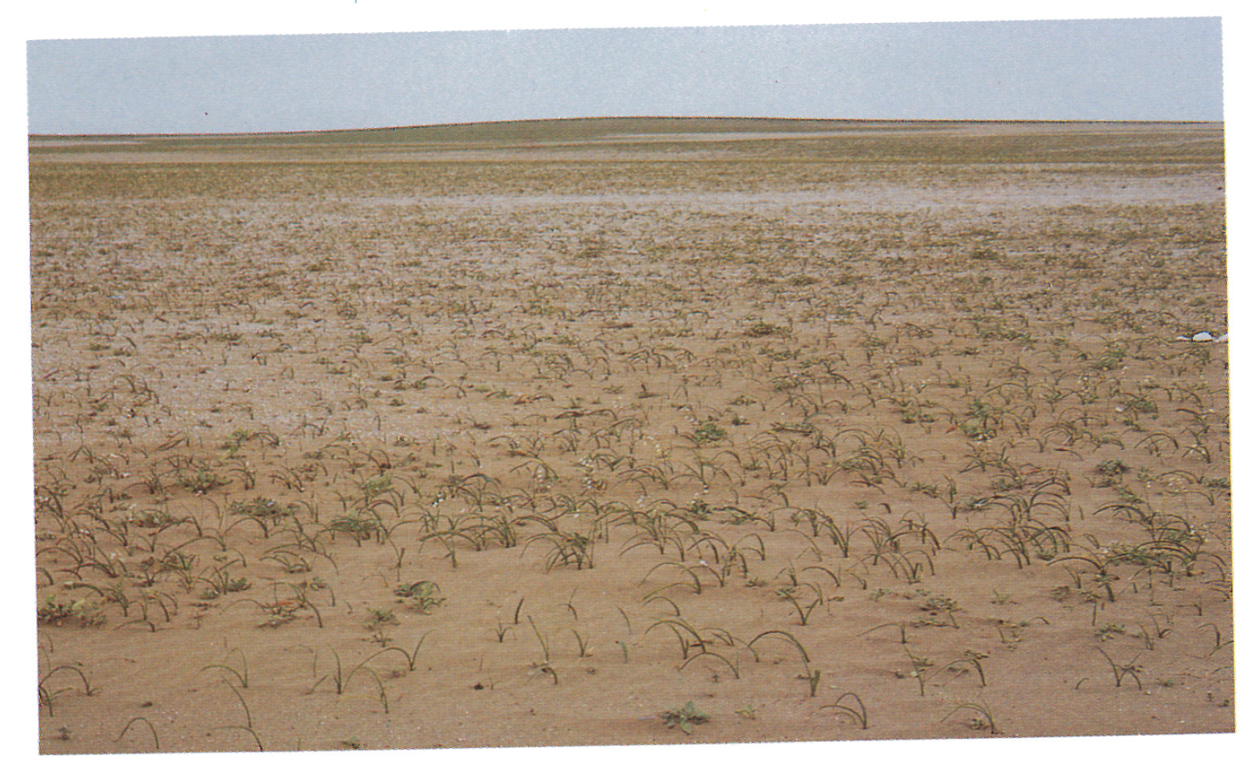
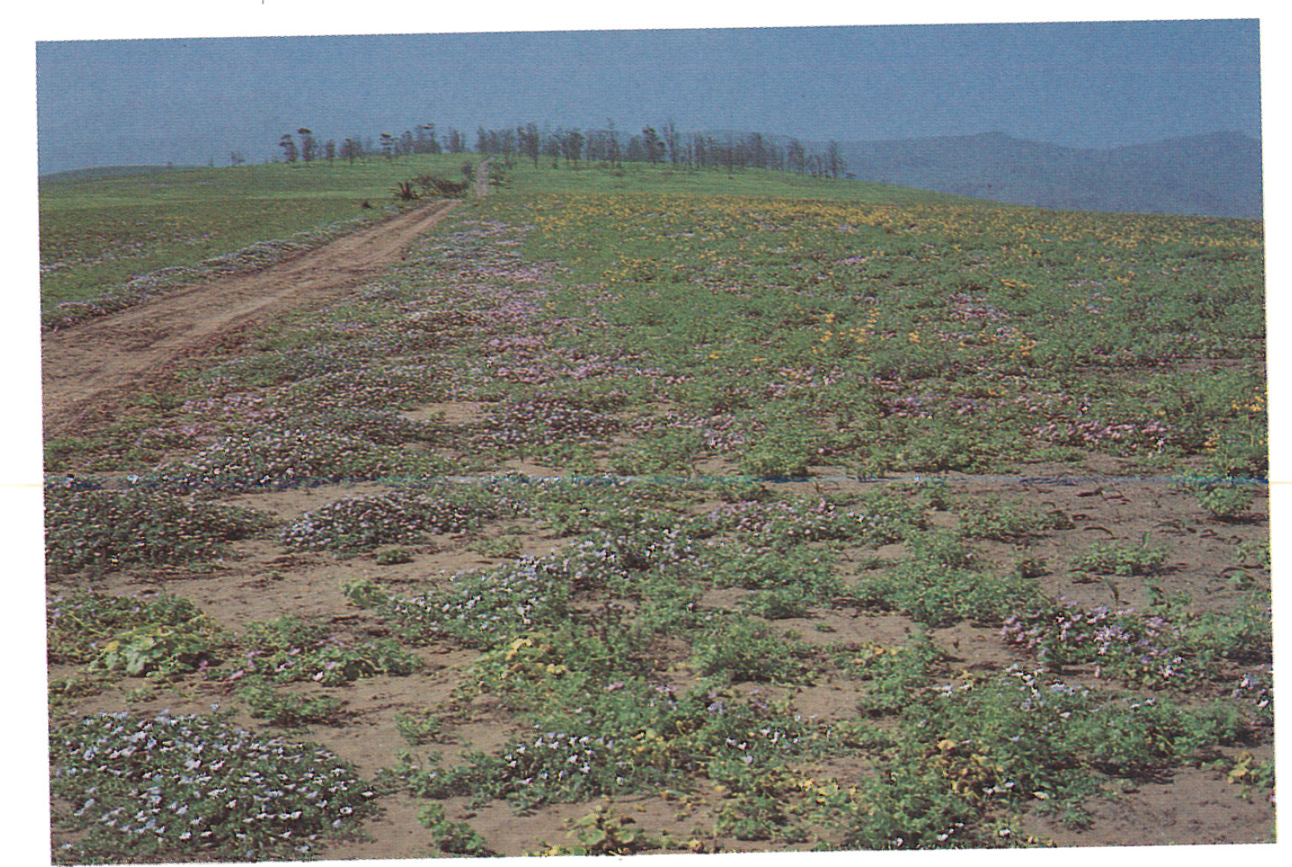
Impacts of El Niño and La Niña events
Desert regions in the Andes obtain significant rainfall during
El Niño years with a fast vegetation / land cover response.

Slide 7
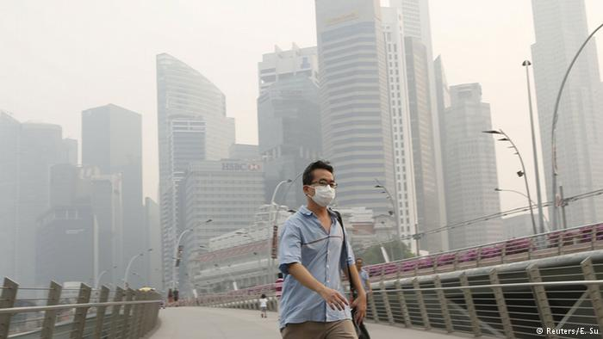
ENSO in the news in summer/fall 2015 air quality in SE-Asia
Increased forest fires plus changes
in winds caused in several
Asian countries smog conditions.
http://www.channelnewsasia.com/news/asiapacific/forest-fires-in-sumatra/2116854.html
http://www.channelnewsasia.com/news/asiapacific/haze-penang-mca-wants/2170098.html
http://www.dw.com/en/alarm-as-haze-from-indonesian-fires-spreads-in-southeast-asia/a-18756909

Slide 8
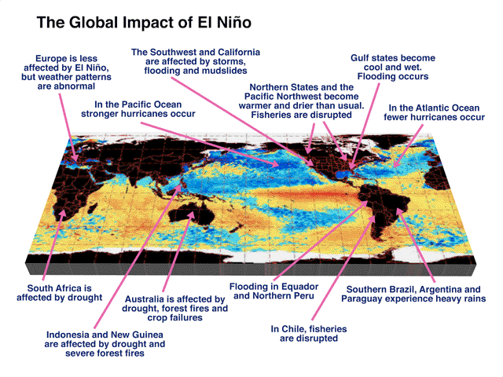

Slide 9
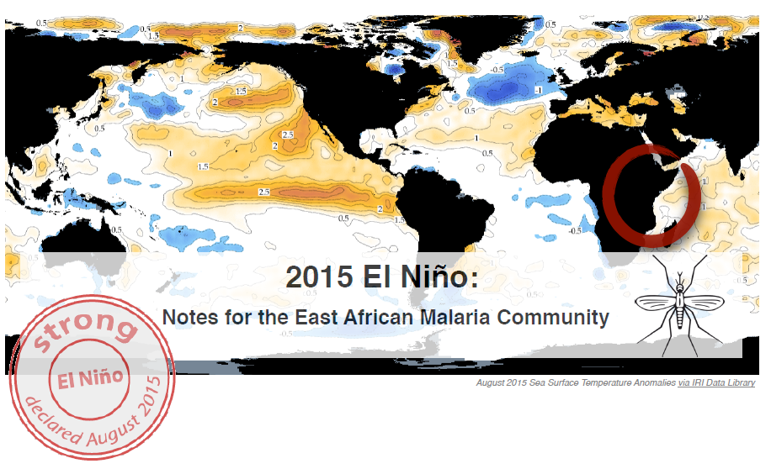
ENSO forecasting → Malaria Risk Analysis and Preparations (based on past El Niño year experiences)

Slide 10
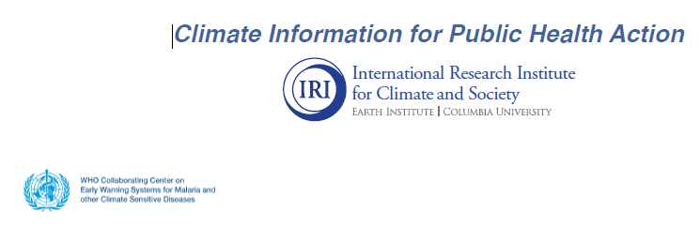
ENSO forecasting → Malaria Risk Analysis and Preparations (based on past El Niño year experiences)
Research centers specialized on trans-disciplinary research:
They work on connecting climate research, operational seasonal climate forecasts with regional impact studies, decision making and planning

Slide 11
Quotes from the IRI’s report:
“If national climate experts and meteorological services identify a high likelihood of dangerous conditions (e.g. a heavy flood season), malaria workers are encouraged to activate epidemic preparedness efforts in advance, such as reviewing contingency plans, medical stocks, the availability of essential personnel, activating early warning systems, and the functioning of response systems. Particular attention should be paid to the preparedness of hospitals and health clinics to avoid damage and to provide emergency health response in disasters.”

Slide 12
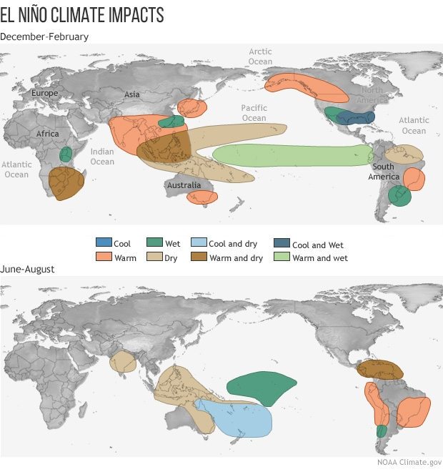
Winter and Summer season rainfall and temperature anomalies during El Niño.
December-February
June-August
Notes:
Source: http://www.pmel.noaa.gov/elnino/impacts-of-el-nino

Slide 13
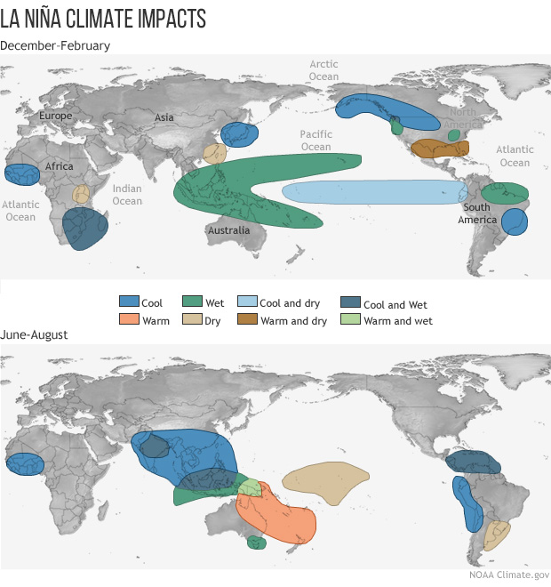
Winter and Summer season rainfall and temperature anomalies during La Niña.
December-February
June-August
Notes:
Source: http://www.pmel.noaa.gov/elnino/impacts-of-el-nino

Slide 14
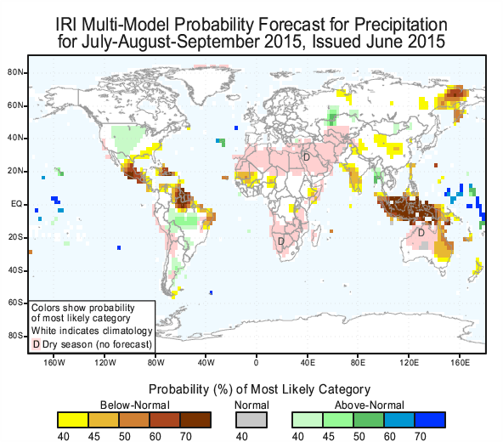
Seasonal forecast for winter 2015/2016
(issued June 2015)
We see that the seasonal outlook
on rainfall was a typical El Niño pattern.
The current seasonal outlook maps and the archived forecasts can be found at:
http://iri.columbia.edu/our-expertise/climate/forecasts/seasonal-climate-forecasts/

Slide 15
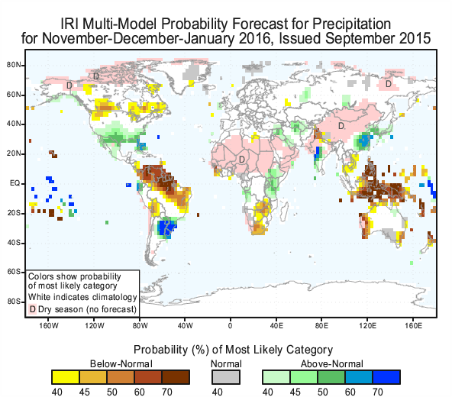
Seasonal forecast for winter 2015/2016
(issued September 2015)
We see that the seasonal outlook
on rainfall was a typical El Niño pattern.
Notes:
Note: we see many regional precipitation anomalies that resemble the classical El Niño type pattern that were observed in the past.

Slide 16
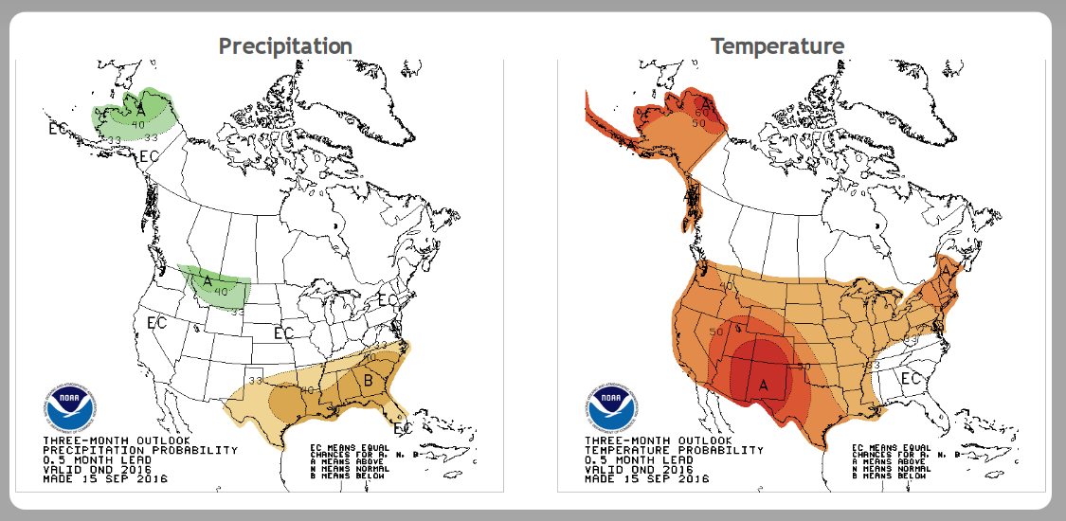
Forecast for winter 2015/16 (issued by NOAA in September 2015)
Dec-Feb
Notes:
Prognostic equation:
A time derivative on the left hand side of the equation (change in wind, currents, or any other variable) is related to an instantaneous state of the system(e.g. pressure gradient)

Slide 17
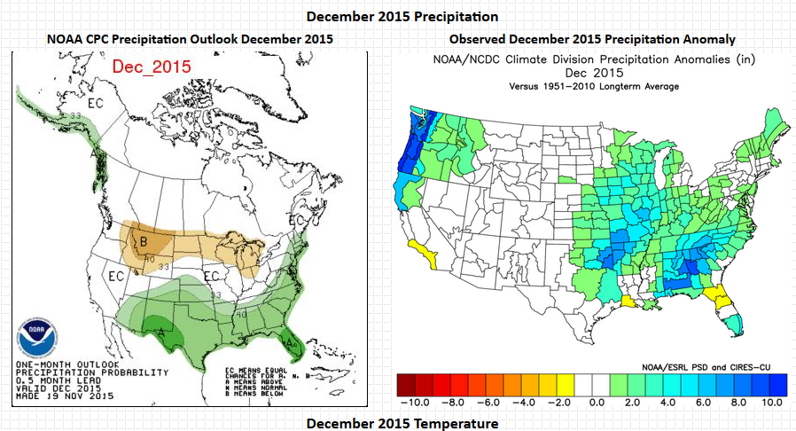
Forecast for winter 2015/16 (issued by NOAA in September 2015)
compared to the observed climate anomalies
Images from http://ggweather.com/cpc/2016/
Notes:
Prognostic equation:
A time derivative on the left hand side of the equation (change in wind, currents, or any other variable) is related to an instantaneous state of the system(e.g. pressure gradient)

Slide 18
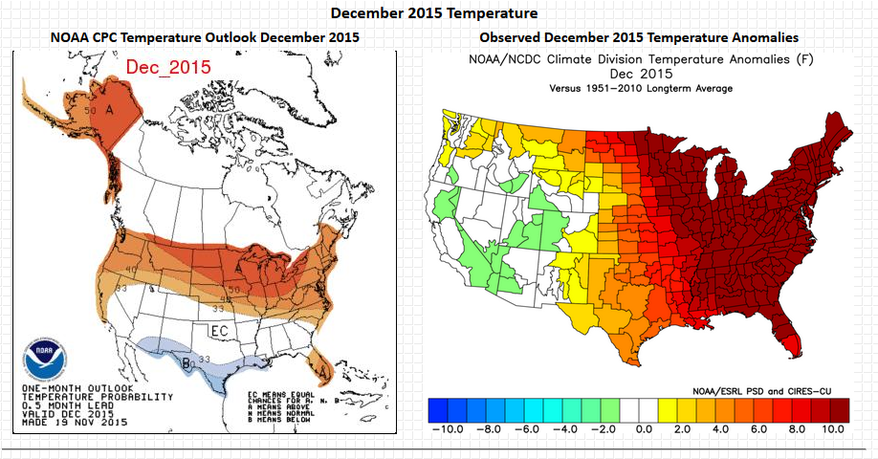
Forecast for winter 2015/16 (issued by NOAA in September 2015)
compared to the observed climate anomalies
Images from http://ggweather.com/cpc/2016/
Notes:
Source: http://ggweather.com/cpc/2016/ retrieved 10/04/2016

Slide 19
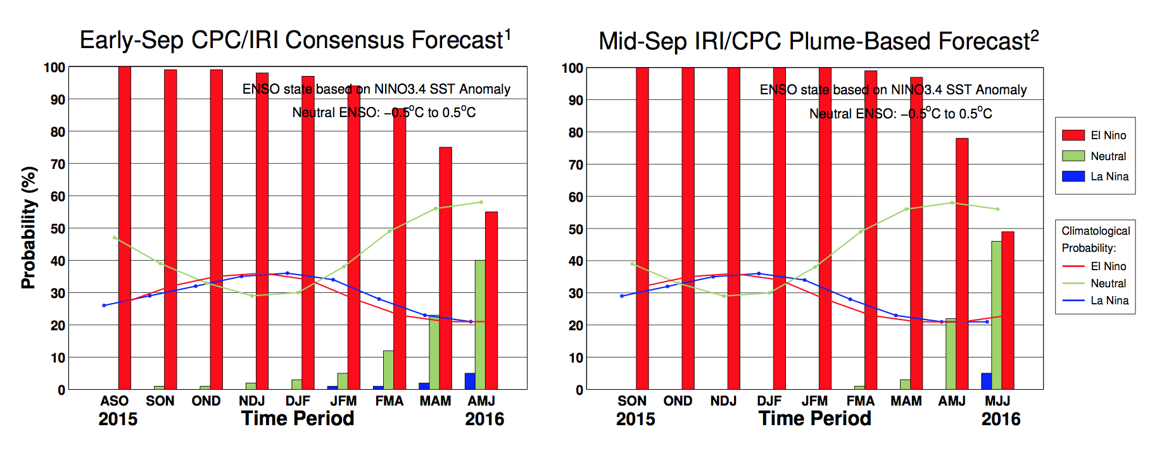
Forecast for last winter 2015/16: Strong El Niño was predicted early summer 2016
90% chance for El Nino conditions until Jan-Mar 2016.
Notes:
Prognostic equation:
A time derivative on the left hand side of the equation (change in wind, currents, or any other variable) is related to an instantaneous state of the system(e.g. pressure gradient)

Slide 20
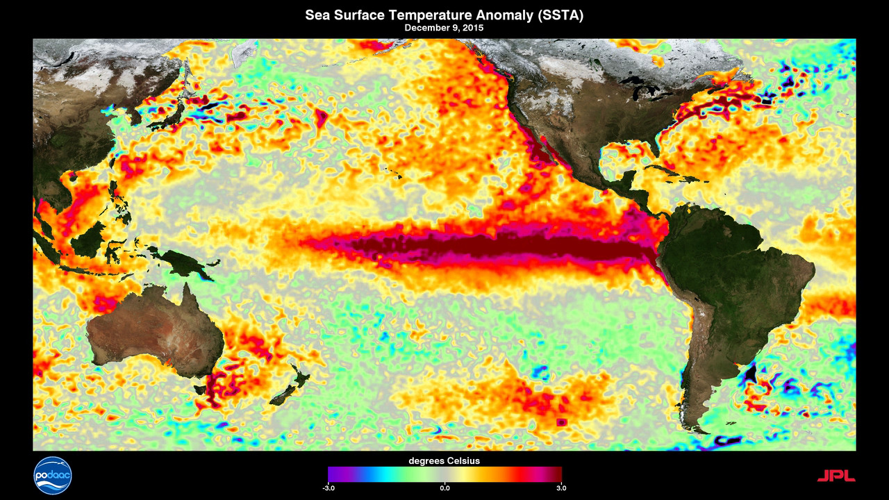
Observed sea surface temperature anomalies
(December 2015)
El Niño prediction was correct!
El Niño pattern
For an animation see NASA’s webpage
Notes:
https://svs.gsfc.nasa.gov/30645

Slide 21
Forecast for winter 2016/17
Notes:
Prognostic equation:
A time derivative on the left hand side of the equation (change in wind, currents, or any other variable) is related to an instantaneous state of the system(e.g. pressure gradient)

Slide 22
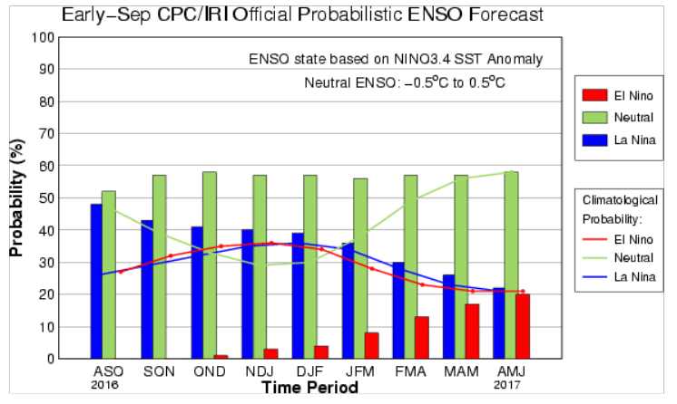
Forecast for last winter 2016/17: La Niña to neutral conditions early spring 2017
40% chance for La Niña conditions until Jan-Mar 2017
Notes:
Prognostic equation:
A time derivative on the left hand side of the equation (change in wind, currents, or any other variable) is related to an instantaneous state of the system(e.g. pressure gradient)

Slide 23
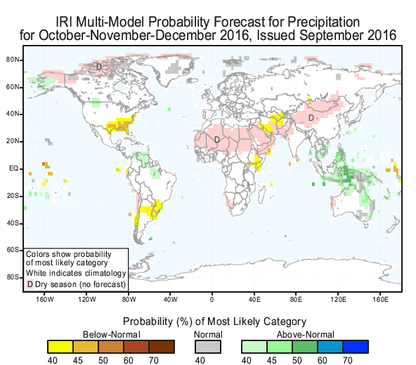
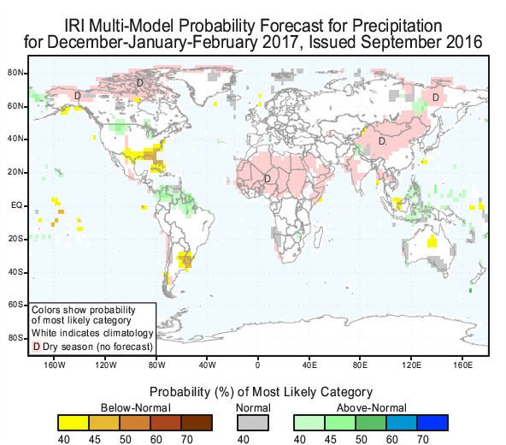
Seasonal forecast for fall/winter 2016/17
(issued Aug/Sep 2016)
La Niña type pattern
The IRI also measure the forecast skill: Note that different to weather forecast verifications, for a particular season it takes many years to develop reliable
verification scores. Here you can find the skill scores on the IRI web pages
Notes:
Prognostic equation:
A time derivative on the left hand side of the equation (change in wind, currents, or any other variable) is related to an instantaneous state of the system(e.g. pressure gradient)

Slide 24
Forecast for winter 2016/17 (issued by NOAA in September 2016)
Notes:
Prognostic equation:
A time derivative on the left hand side of the equation (change in wind, currents, or any other variable) is related to an instantaneous state of the system(e.g. pressure gradient)

Slide 25
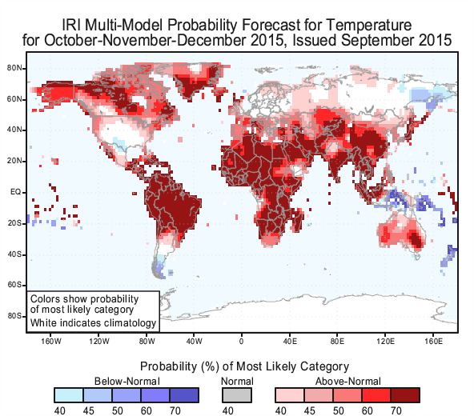
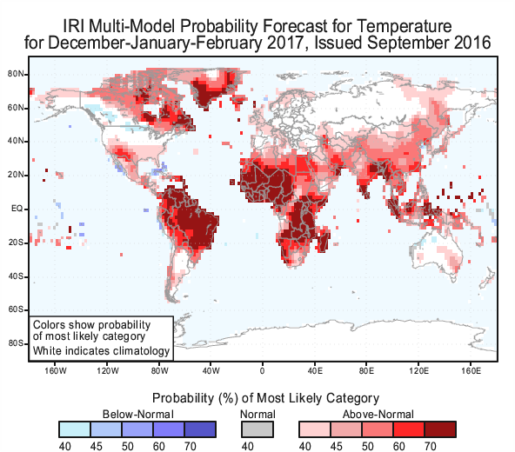
Seasonal forecasts for temperature anomalies:
The reference climate base period matters!
La Niña 2016/2017
El Niño 2015/2016
Note: the temperature (precipitation) forecasts are relative
the climatological base period 1981-2010.
Thus there is also a long-term warming trend included in the seasonal prediction

Slide 26
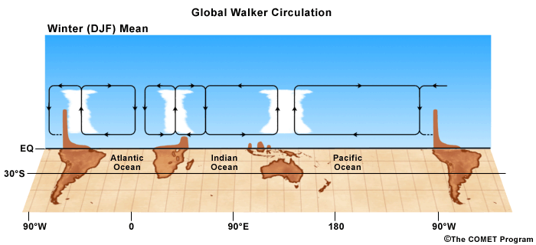
Walker Circulation: A Global Atmopheric Teleconnection Pattern in the Tropics
Walker Circulation connects tropical Pacific ocean-atmosphere interactions all around the tropics
During El Niño or La Niña conditions the convective regions (low surface pressure ) and regions with sinking motions (high surface pressure) are shifted, strengthened, or weakened.
Notes:
Note: for the extratropical teleconnection the Pacific-North American Pattern is important. We’ll discuss this when we talk about extratropical climate variability.

Slide 27
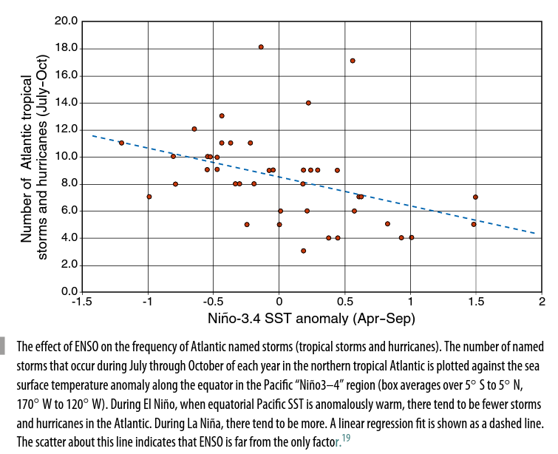
Another impact of ENSO: More Atlantic tropical storms during La Niña years less during El Niño years
La Niña
El Niño
Notes:
Figure from Neelin’s textbook ‘Climate Change and Climate Modeling’

