Slide 1
ENSO variability
ENSO variability Connecting observations with theoretical models
Oliver Elison Timm ATM 306 Fall 2016
Lecture 5
Notes:
Presentation slide for courses, classes, lectures et al.
1

Slide 2
Key facts from last class
Walker Circulation: Atmospheric circulation cell in the tropical Pacific
Typical ocean state in the tropical Pacific:
thermocline tilted with deeper mixed layer in the west, shallower mixed layer in the eastern sector.
El Niño event: warm SST anomalies in eastern tropical Pacific,
La Niña event: cold SST anomalies in the eastern tropical Pacific
ENSO indices (SST based):
NINO3.4 index (central and eastern equatorial Pacific SST )
Southern Oscillation Index (SOI): Pressure differences Tahiti-Darwin
Notes:
Note: SST: sea surface temperature
2

Slide 3
ENSO online resources
Useful El Niño pages:
http://iri.columbia.edu/our-expertise/climate/enso/
http://www.pmel.noaa.gov/tao/elnino/nino-home.html
ENSO: Online course Introduction to Tropical Meteorology
Notes:
3

Slide 4
Objectives
Theoretical description of ENSO variability
Bjerknes feedback
Tropical ocean currents
Wave propagation in the tropical Pacific
Kelvin waves, Rossby waves
Delayed Oscillator
(Recharge Oscillator)
Role of westerly wind bursts
Notes:
Objectives for instruction and expected results and/or skills developed from learning.
4

Slide 5
It started with a hypothesis:
In 1969 Jacob Bjerknes looked at atmospheric and oceanic climate variables and formulated a hypothesis that the tight interactions between ocean and atmosphere (ocean-atmosphere coupling) are essential for the development of El Niño.
Later the ideas further developed into a feedback loop that is now known as the “Bjerknes feedback”.
Notes:
NOTE: this section is updated with material from David Neelin’s book “Climate Change and Climate Modelling”.
5

Slide 6
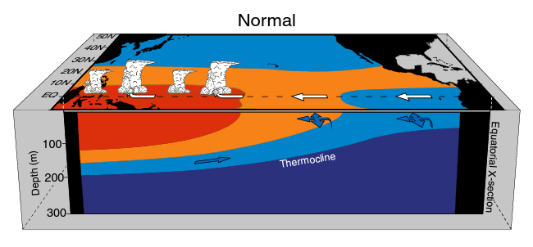
Tropical ocean-atmosphere interaction –
El Niño Southern Oscillation
Normal conditions in the tropical Pacific
Perspective view:
Colors indicate warm to cold water masses.
White arrows are surface winds (zonal component in east-west direction)
Blue arrows are ocean currents
Clouds indicate high convective activity with rain
Notes:
Note: the high cloud tops
Are very cold and emit less longwave radiation escaping the atmosphere [outgoing longwave radiation]).
6

Slide 7
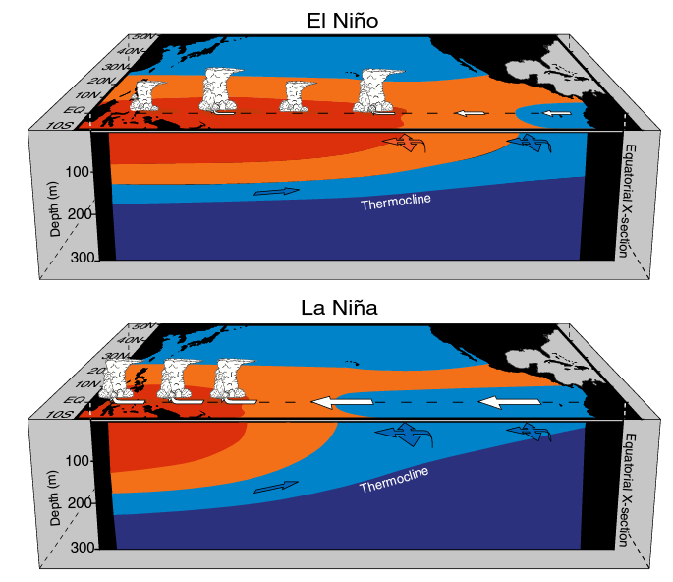
Tropical ocean-atmosphere interaction –
El Niño Southern Oscillation
El Niño conditions:
Wind stress piles up waters in the western part of the ocean.
If trade winds are interrupted in the western/central Pacific
this allows a spread of the warm waters to the east, a shift in the convective activity and further reduction in trade winds in the central Pacific.
La Niña condition: Trade winds are very strong in the eastern/central Pacific. This forces the cold tongue to extend further west. Winds pile up the warm water, increase SST in the western sector, leading to stronger convection and stronger Walker Circulation.
Notes:
7

Slide 8
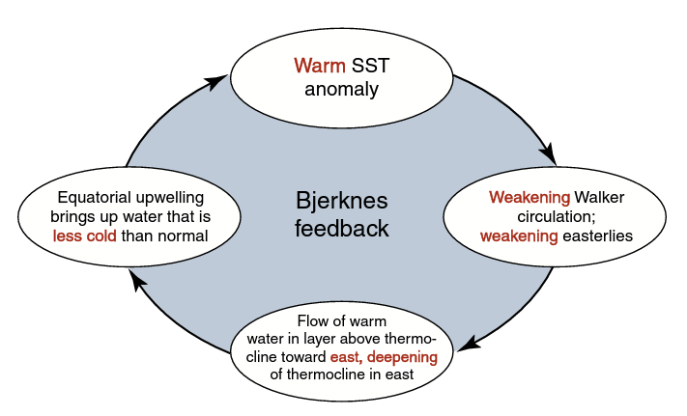
Tropical ocean-atmosphere interaction –
El Niño Southern Oscillation
*In the central/eastern tropical Pacific
*
Bjerknes feedback loop describing the strengthening of El Niño conditions
Notes:
8

Slide 9
Class activity: Construct El Niño, La Niña and neutral climate states
In two teams combine SST and SST anomaly maps with the corresponding wind and sea level pressure maps and the best matching precipitation anomaly maps.
Assign the ENSO states El Niño, La Niña, and neutral to your stacked climate anomaly state.
How many El Niño and La Niña events are in the stack?
10 minutes!

Slide 10
Theory of ENSO
The “Bjerknes Feedback”: A mechanism for growth of El Niño or La Niña
BUT WHAT LEADS TO THE DECAY OR THE REVERSAL?
Time series show El Niño -La Niña cycles take about 3-7 years on average.
We need mechanisms that can explain vacillations (or oscillations)
Notes:
10

Slide 11
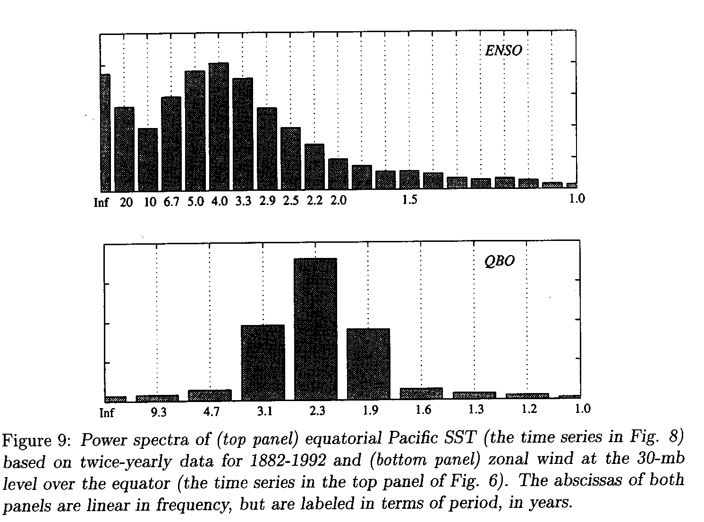
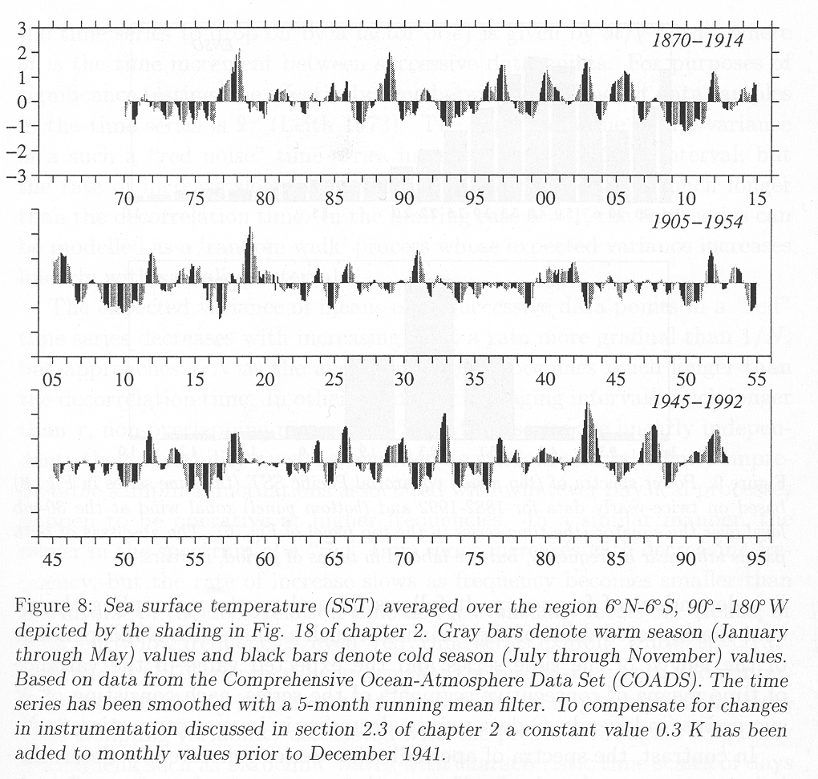
Power Spectrum
What determines the 3-7year periodicity?
Notes:
11

Slide 12
Theory of ENSO
The Delayed Oscillator
Notes:
12

Slide 13
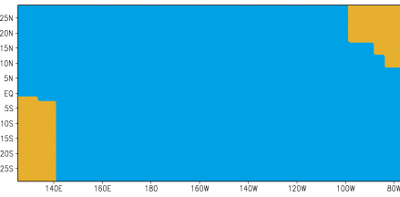
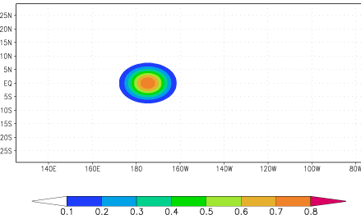
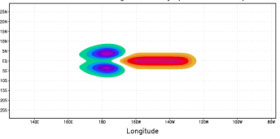
How does the phase of ENSO reverse?
Delayed Oscillator Theory
Battisti and Hirst, 1989; Suarez and Schopf, 1988
Idealized model domain
for the tropical Pacific
Westerly winds force downwelling on Equator and upwelling to North and South
=> Excites Kelvin and Rossby waves
Thermocline depth
Figures from IRI: http://iri.columbia.edu/climate/ENSO/theory/
Notes:
13

Slide 14
Equatorial Waves
The dynamics of oceanic and atmospheric waves can be described with prognostic* mathematical equations
Navier-Stokes equations (on a rotating sphere)
Approximate solutions use simplified sets of equations:
Scale analysis of the magnitude of the individual terms
Shallow water equations:
2 layer models: One upper ocean mixed layer and a lower water layer separated by a ‘sharp’ pycnocline.
[ Note: In reality, of course, the ocean is continuously stratified (vertical temperature, salinity, density profile) ]
Notes:
Prognostic equation:
A time derivative on the left hand side of the equation (change in wind, currents, or any other variable) is related to an instantaneous state of the system(e.g. pressure gradient)

Slide 15
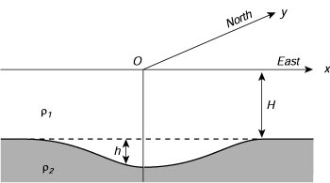
Equatorial Waves
Note that in the interior ocean
'reduced gravity' acts as a restoring force when the thermocline is perturbed.
Sketch of the two-layer model of the equatorial ocean used
to calculate planetary waves in those regions. From Philander (1990)

Slide 16
Delayed Oscillator Theory 2 Response to initial perturbation
Downwelling Kelvin wave:
Thermocline depth deeper than normal h>0 (red)
Equatorial Kelvin waves are centered on the equator
Sea surface height anomalies are small compared with the internal thermocline displacements.
Notes:
16

Slide 17
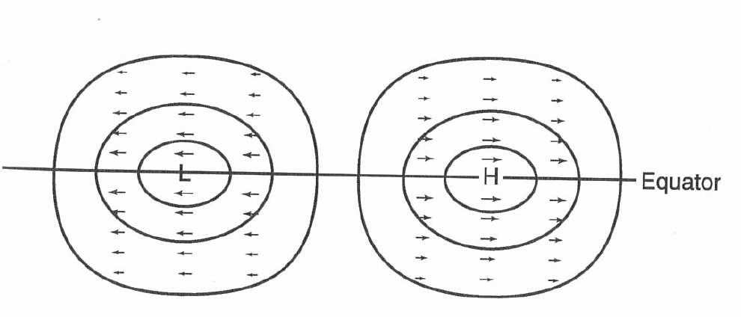
Equatorial Kelvin Wave
Phase Speed ~ 2.8 m/s eastward propagation
Maximum
amplitude on Equator
Rapid decay in amplitude
within 5 degree N
and 5 degree S
Zonal current anomalies
(No meridional flow!)
(here positive anomaly)
Contours of equal thermocline anomaly
(here negative)

Slide 18
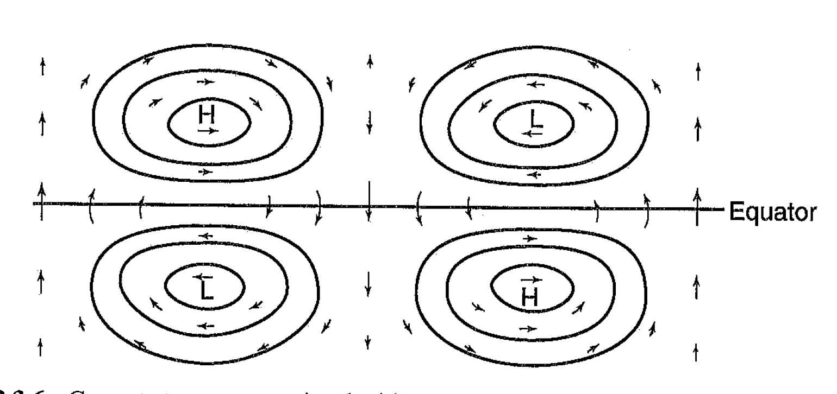
Equatorial Rossby Waves
Phase speed: westward propagation
1/3 or less of Kelvin phase speed
Maximum pressure amplitudes
(height anomalies)
off the equator
(with strongest zonal wind
anomalies)
Strongest meridional wind
amplitudes on equator
Equatorial Rossby can be symmetric or
asymmetric with respect to the equator
(Example of an asymmetric Rossby wave)

Slide 19
Delayed Oscillator Theory: Response to initial perturbation
Upwelling Rossby waves
(symmetric mode)
Downwelling Kelvin wave
EQ
Notes:
19

Slide 20
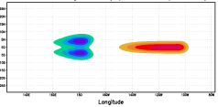
Delayed Oscillator Theory: Response to initial perturbation
Upwelling Rossby waves
(symmetric mode)
t+25d
Downwelling Kelvin wave
EQ
Notes:
20

Slide 21
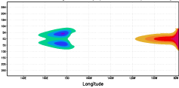
Delayed Oscillator Theory: Response to initial perturbation
Upwelling Rossby waves
(symmetric mode)
t+50d
Downwelling Kelvin wave
EQ
Notes:
21

Slide 22
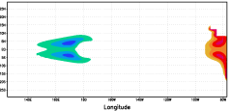
Delayed Oscillator Theory: Response to intial perturbation
Upwelling Rossby waves
(symmetric mode)
t+75d
Coastal Kelvin waves and reflection
EQ
Notes:
22

Slide 23
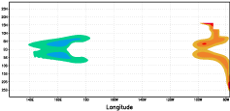
Delayed Oscillator Theory: Response to initial perturbation
Upwelling Rossby waves
(symmetric mode)
Off-equatorial downwelling Rossby waves
t+100d
EQ
Notes:
23

Slide 24
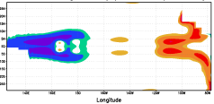
Delayed Oscillator Theory: Response to initial perturbation
Upwelling Rossby waves
(symmetric mode)
t+125d
Downwelling Rossby waves
EQ
Notes:
24

Slide 25
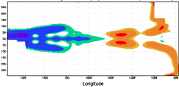
Delayed Oscillator Theory: Response to initial perturbation
t+175d
Downwelling Rossby waves
EQ
Reflection and start of upwelling equatorial Kelvin wave
Notes:
25

Slide 26
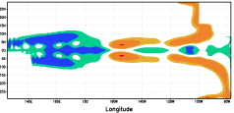
Delayed Oscillator Theory: Response to initial perturbation
t+225d
Downwelling Rossby waves
EQ
Reflected Rossby waves: upwelling Kelvin wave
Notes:
26

Slide 27
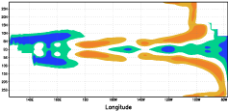
Delayed Oscillator Theory: Response to initial perturbation
t+275d
Downwelling Rossby waves
EQ
Reflected Rossby waves and upwelling Kelvin wave
Notes:
27

Slide 28
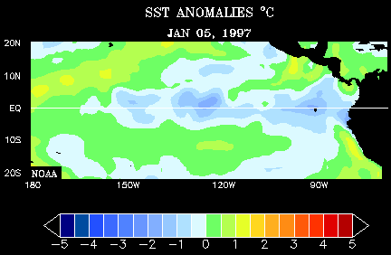
Temporal Evolution of El Niño/La Niña

Slide 29
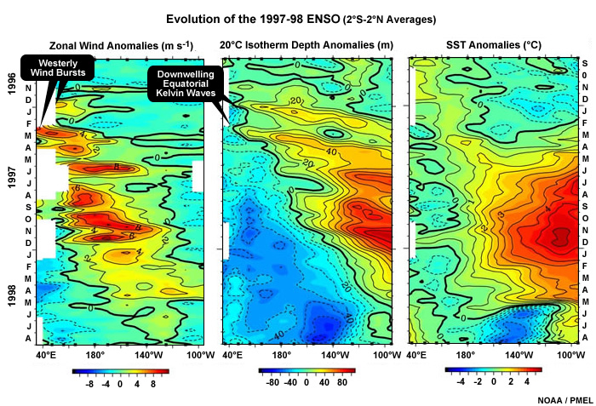
Notes:
Hovmoeller plots: a time longitude or time latitude time depth phase spcce view on the temporal evolution of temperatures, precipitation, or any other type of variables.

Slide 30
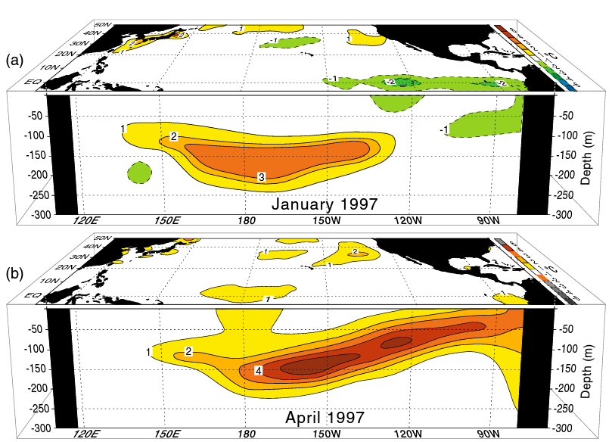
Development of the El Niño 1997/98 and the reversal to La Niña
Subsurface temperature
anomalies
(and SST anomalies)

Slide 31
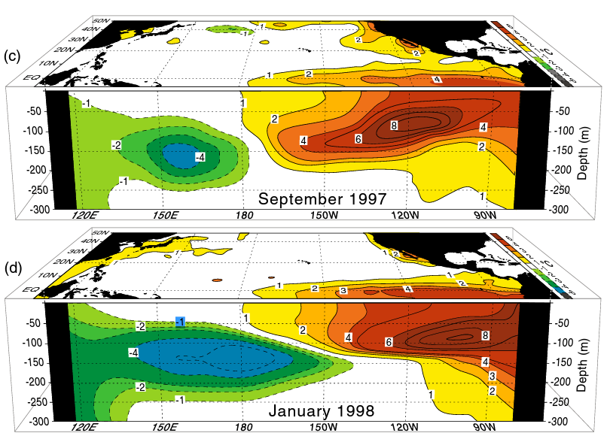
Development of the El Niño 1997/98 and the reversal to La Niña
Subsurface temperature
anomalies
(and SST anomalies)
An important component in the termination and reversal of SST anomalies:
Inflow/outflow of water masses from the off-equatorial regions

Slide 32
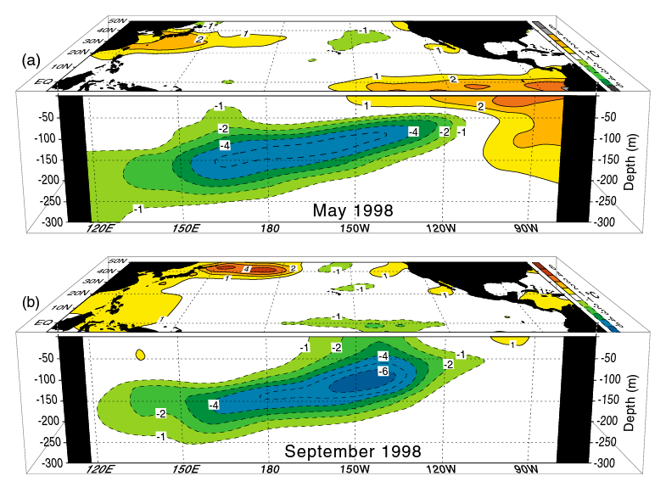
Development of the El Niño 1997/98 and the reversal to La Niña
Subsurface temperature
anomalies
(and SST anomalies)

Slide 33
Equatorial Waves
Equatorial waves in the ocean are believed to play an important role in the onset and variability of ENSO
Two types:
Kelvin waves (propagate eastward along the equator and also along coasts)
Rossby waves (long waves propagate westward)
The relevant waves are baroclinic: internal to the ocean, propagating along the density contrast of the thermocline
Equatorial Kelvin waves travel 3 times faster than the fastest equatorial Rossby waves
Notes:
33

