Slide 1
North Atlantic Oscillation
Modes of climate Variability
Oliver Elison Timm ATM 306 Fall 2016
Lecture 6
Notes:
Presentation slide for courses, classes, lectures et al.
1

Slide 2
Objectives
Historical remarks
Spatial structure
Temporal characteristics
Ocean-Atmosphere interactions
Impacts on storms, rainfall, sea ice
Ecological impacts
Notes:
Prognostic equation:
A time derivative on the left hand side of the equation (change in wind, currents, or any other variable) is related to an instantaneous state of the system(e.g. pressure gradient)

Slide 3
Historical background
1780 first temperature measurements in Greenland
Dove (1841) and Hann (1890) found anticorrelations in temperature records between Europe and Greenland
De Bort (1883) made use of pressure observations and introduced the concept of “centers of action”: Icelandic Low
Azores High (and Siberian High)
Hildebrandsson (1897) inverse relation between Azores High pressure and Icelandic Low
Earliest description of NAO-type teleconnections in winter climates noted by seafaring Scandinavians
Danish missionary Hans Egede Saabye (around 1745) described in his diary cold winters in Denmark were accompanied by mild winters in Greenland
Records of 1709-1800 sea ice conditions were documented for Greenland (whale and seal hunting industry) and provided qualitative information about Greenland winter climate & variability
Source : Stephenson et al. “The History of Scientific Research on the North Atlantic Oscillation
(In the book “The North Atlantic Oscillation: Climatic Significance and Environmental Impact)”
Notes:
Source : Stephenson et al. “The History of Scientific Research on the North Atlantic Oscillation (in The North Atlantic Oscillation: Climatic Significance and Environmental Impact, edited by Hurrell, Kushnir, Ottersen, Visbeck, AGU monograph 134, 2003)
Further note:
Daniel Gabriel Fahrenheit (1686-1736) was the German physicist who invented the alcohol thermometer in 1709, and the mercury thermometer in 1714. In 1724, he introduced the temperature scale that bears his name - Fahrenheit Scale.
And finally: Pearson published his mathemathical derivation of regression lines and the correlation coefficient.
(the idea of correlations and regressionl lines was not new though in the at least has been used graphically in the mid 19th century)
http://www.amstat.org/publications/jse/v9n3/stanton.html

Slide 4
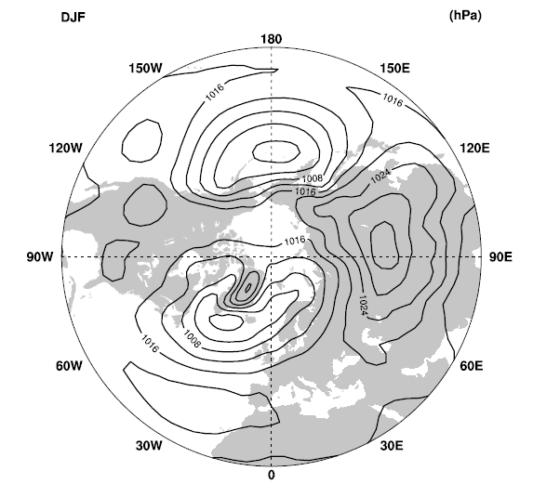
The climatological average circulation
Winter season (DJF)
Sea level pressure
Aleutian
Low
Siberian
High
Icelandic Low
Azores High

Slide 5
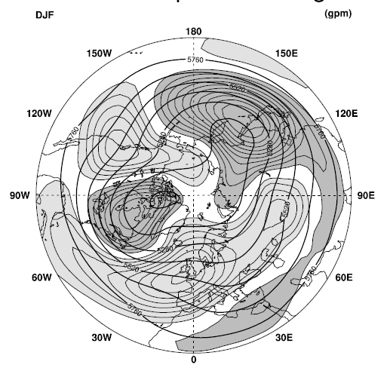
The climatological average circulation
Winter season (DJF)
500 hPa geopotential height (contours)
Deviations from the zonal average:
light shading higher than zonal average
dark shading lower than zonal average

Slide 6
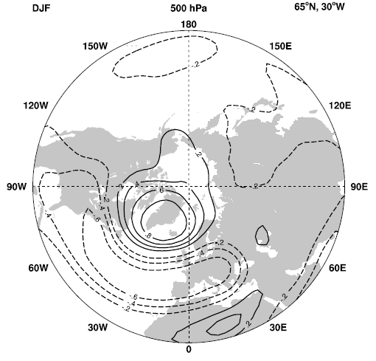
One-point correlation map
Winter season (DJF)
500 hPa geopotential height time series from
the Icelandic Low center with all time series in the gridded data set
(years 1958-2001)
Positive
Cor.
x
Negative
correlation
Notes:
Correlation map: We take the sea level pressure time series from Iceland
and compare it with all other sea level pressure time series:
Calculate the correlation coefficient and then use contours to illustrate the
regions with correlations 0f 0.2, 0.4, 0.6 0.8 (-0.2, -0.4 …)

Slide 7
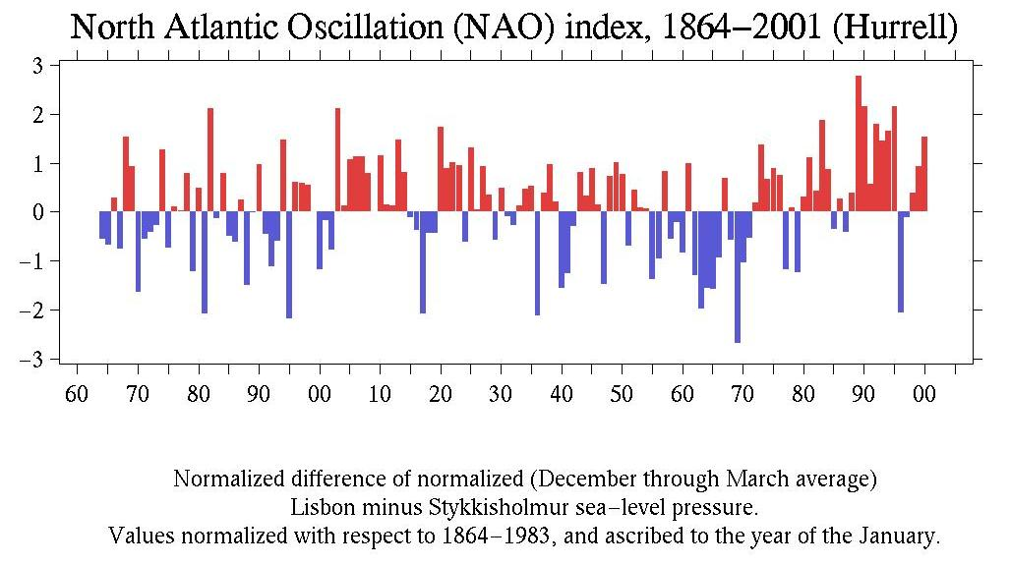
Station-based NAO index
http://research.jisao.washington.edu/data_sets/nao/

Slide 8
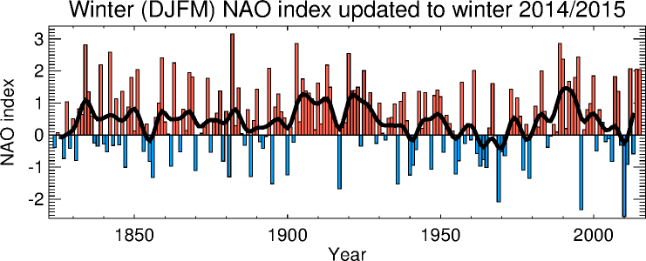
Station-based NAO index:
“Jones” NAO index
SW Iceland (Reykjavik), Gibraltar and Ponta Delgada (Azores)
Note that the reference period for standardizing the pressure anomalies
has not been updated, and the long-term average of this index is not zero.
(usually we prefer index time series centered to zero)
http://www.cru.uea.ac.uk/~timo/datapages/naoi.htm

Slide 9
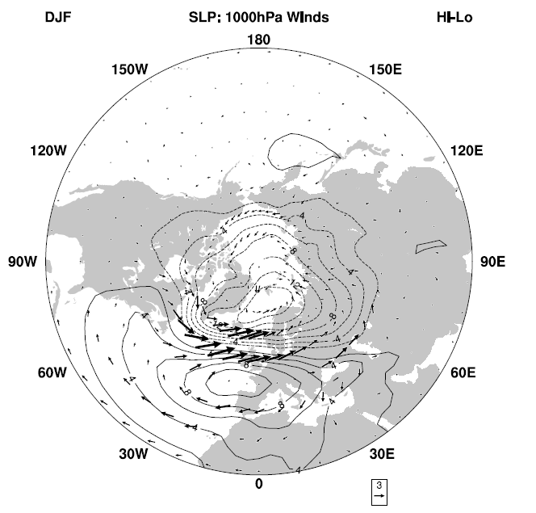
Difference between positive and negative NAO phase
Winter season (DJF)
Sea level pressure difference positive NAO minus negative NAO phase
(based on NCEP/NCAR
reanalysis over 1958-2001)
Negative SLP anomalies
The arrows show wind anomalies:
Stronger westerlies over the North Atlantic
(caused by the enhanced pressure gradient)
Trade winds stronger than normal

Slide 10
Regional Climate anomalies
Positive NAO index phase:
Stronger than usual subtropical high pressure center and a deeper than normal Icelandic low.
The increased pressure difference associated with more and stronger winter storms crossing the Atlantic Ocean on a more northerly track.
More warm air advection towards Europe Scandinavia (Russia) and warm and wet winters in Europe
cold and dry winters in northern Canada and Greenland due to more polar air masses
The eastern US experiences mild and wet winter conditions
Mediterranean rainfall reduced
Negative NAO index phase:
Weaker than usual subtropical high pressure center and weaker than normal Icelandic low
The decreased pressure difference associated with fewer winter storms crossing the Atlantic Ocean on a more southerly track.
More cold air advection in Europe Scandinavia (Russia) and colder and dryer winters in Europe
milder winters in northern Canada and Greenland due to less polar air masses
colder winter conditions in eastern US (less precip but more snow?)
Mediterranean rainfall increased

Slide 11
First task : Creating a schematic map showing the impacts of the NAO
Put the described relationships on a map:
Mark specific locations with plus sign + or with negative sign –
Rule: use the plus sign for the NAO is in a positive phase and the temperature is warmer than normal, pressure is higher than normal, wind is stronger than normal (plus the wind direction)
negative signs where you observe the opposite behavior.
Extrapolate your positive/ negative correlations and draw lines or shadings for regions where you can expect similar signs in the correlations.
Temperature
Precipitation
Sea level pressure
Wind vectors
Ocean SST*
(sea ice)
*use knowledge from what we learned about the PDO

Slide 12
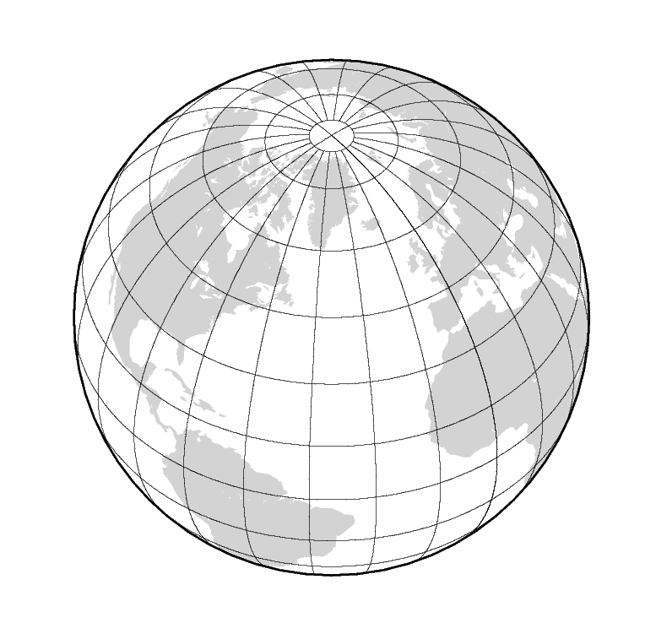
Positive NAO phase
Greenland
Iceland
NE US
Scandinavia
Azores
A
Atlantic
Ocean

Slide 13
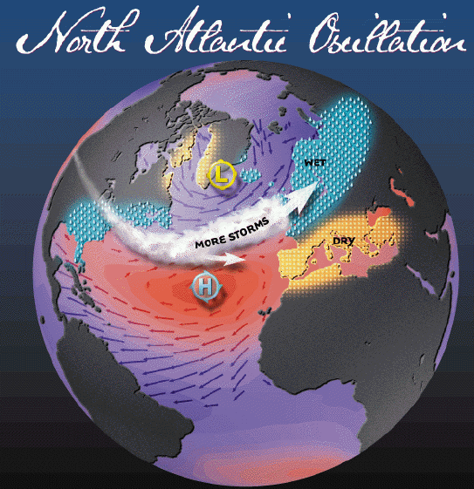
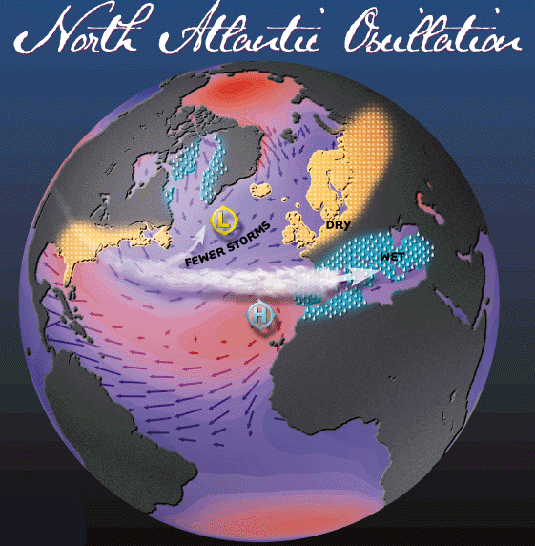
Positive NAO vs negative NAO phase

Slide 14
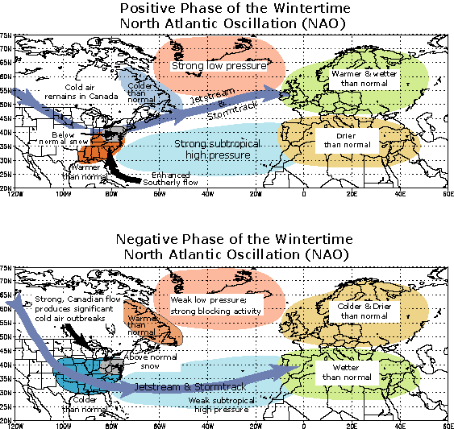
NAO variability and regional climate response
We see positive phases and negative phases produce similar patterns of regional climate impacts in winter temperature and precipitation but with opposite sign
That indicates that the NAO impacts show a linear response:
y'(t) = a*x'(t)
with x'(t) an NAO index time series.
regional impact y'(t)
(Note: the ' sign indicates anomalies
from the climate average)

Slide 15
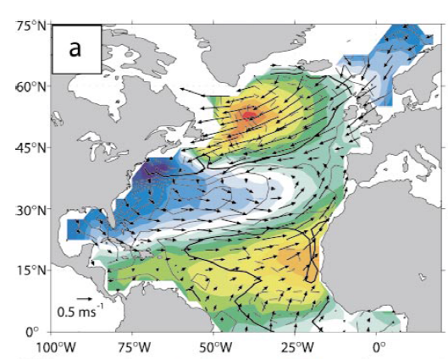
Atmosphere-Ocean Interaction
Observation-based pattern
in the SST anomalies (colors) and wind anomalies associated with a negative phase of the NAO
Tripole SST anomaly pattern dominates the interannual variability of the NAO
Warm SST anomalies caused by reduced wind speed
Coastal regions affected by cold air advection
In addition wind-driven Ekman
transport anomalies cause SSTA
Negative phase of the NAO (weaker Iceland Low)
http://www.cru.uea.ac.uk/~timo/datapages/naoi.htm

Slide 16
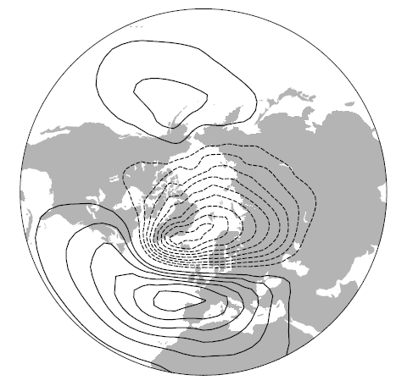
Atmospheric forcing of the ocean
A number of model and observational studies have shown that the North Atlantic ocean responds to the sea level pressure anomalies
In the 1970s the stochastic climate theory was formulated:
Temperature
change
$$\frac{{dT}_{o}}{dt}=−{aT}_{o}+N\left(t\right)$$
Atmosphere random process (“white noise”)
Memory effect (large heat capacity of ocean mixed layer
→ exponential decay)

Slide 17

Oceanic forcing of the NAO
The ocean feedback:
  SST anomalies change the temperature gradient between atmosphere and ocean
  Change in heat flux:
    Heat flux anomaly can affect atmosphere (weak response)
  On decadal and multidecadal time scales the ocean feedback becomes important
  The weak feedback enhances the atmospheric memory and low-frequency variability (decadal and multidecadal variability)
The extended stochastic climate model
proposed by Barsugli and Battisti (1998)
Note: The first equation is for the
atmospheric temperature (Ta),
the second is for the ocean temperature.
(weak) feedback from ocean to atmosphere
(strong) forcing from atmosphere to ocean

Slide 18
Seasonal prediction
Prediction of upcoming winter season NAO index phases:
Using Atlantic SST pattern information:
  statistical models
  Coupled ocean-atmosphere general circulation models (GCMs)
Using the strength of the polar vortex in the stratosphere:
  a strong polar vortex in the stratosphere induces a strengthening of the westerly winds and a positive NAO phase

Slide 19
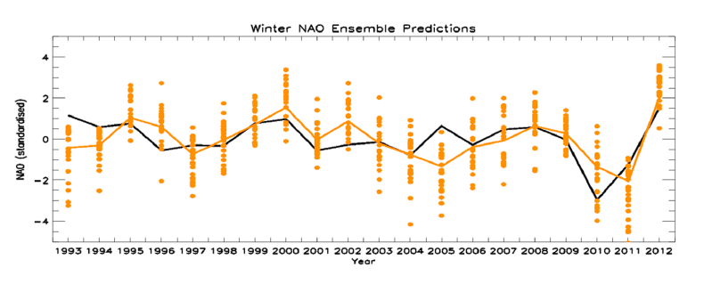
Seasonal predictions with climate models
A global climate model (with Ocean and Atmosphere) is initialized with observation-based best estimates for the atmospheric and oceanic state (and land conditions)
Start date of the simulations is around Nov. 1st of each year.
Then the model forecasts the next season (DJF)
Using small perturbations in the beginning, 24 different simulations are run
(This method is called “ensemble simulations”; used also in weather or Hurricane forecasts)
Met Office Global Seasonal forecast System 5 (GloSea5) using Scaife et al, GRL, 2014)

Slide 20
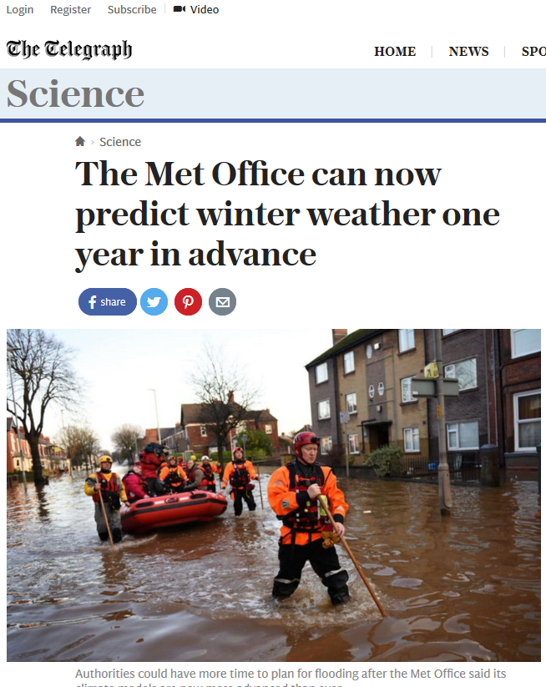
Seasonal predictions with climate models
Brand new research making news:
UK scientists find a way to simulate one
year in advance the phase of the NAO!
(to the newspaper article)
(Nature Geoscience article, Oct 2016)

Slide 21
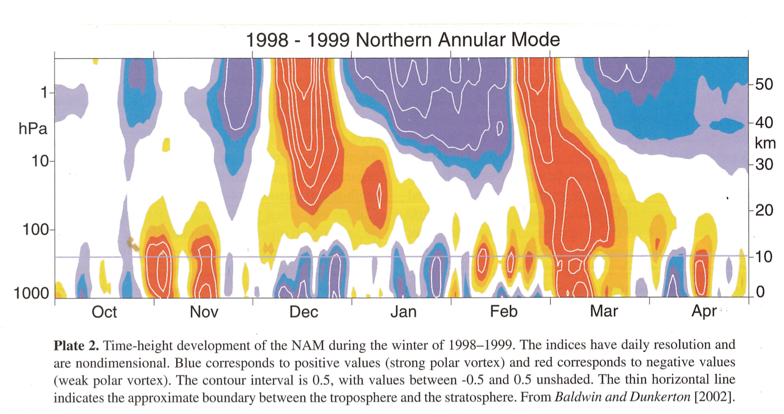
Seasonal prediction using
stratospheric polar vortex strength

Slide 22
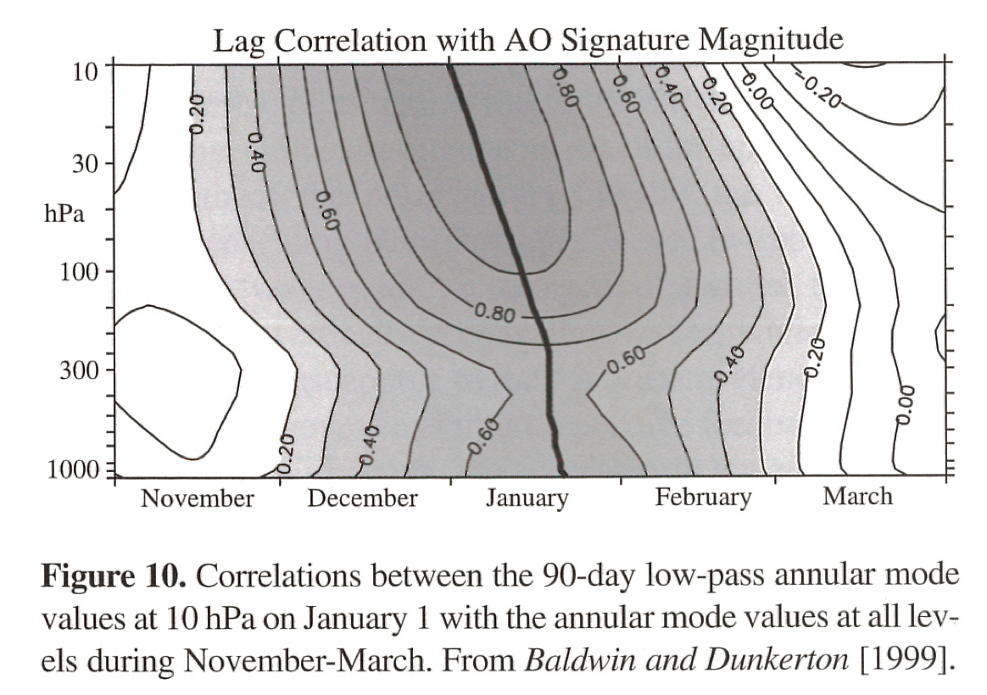
Seasonal prediction using
stratospheric polar vortex strength
“Northern Annular
Mode” (NAM) is mode that
measures the polar
vortex strength through
the stratosphere and
troposphere.
It is very strongly linked
both physically as
statistically with the
North Atlantic Oscillation
(There is also a dynamical counterpart in the Southern Hemisphere, the Southern
Annular Mode (SAM).)
Downward signal
propagation

Slide 23
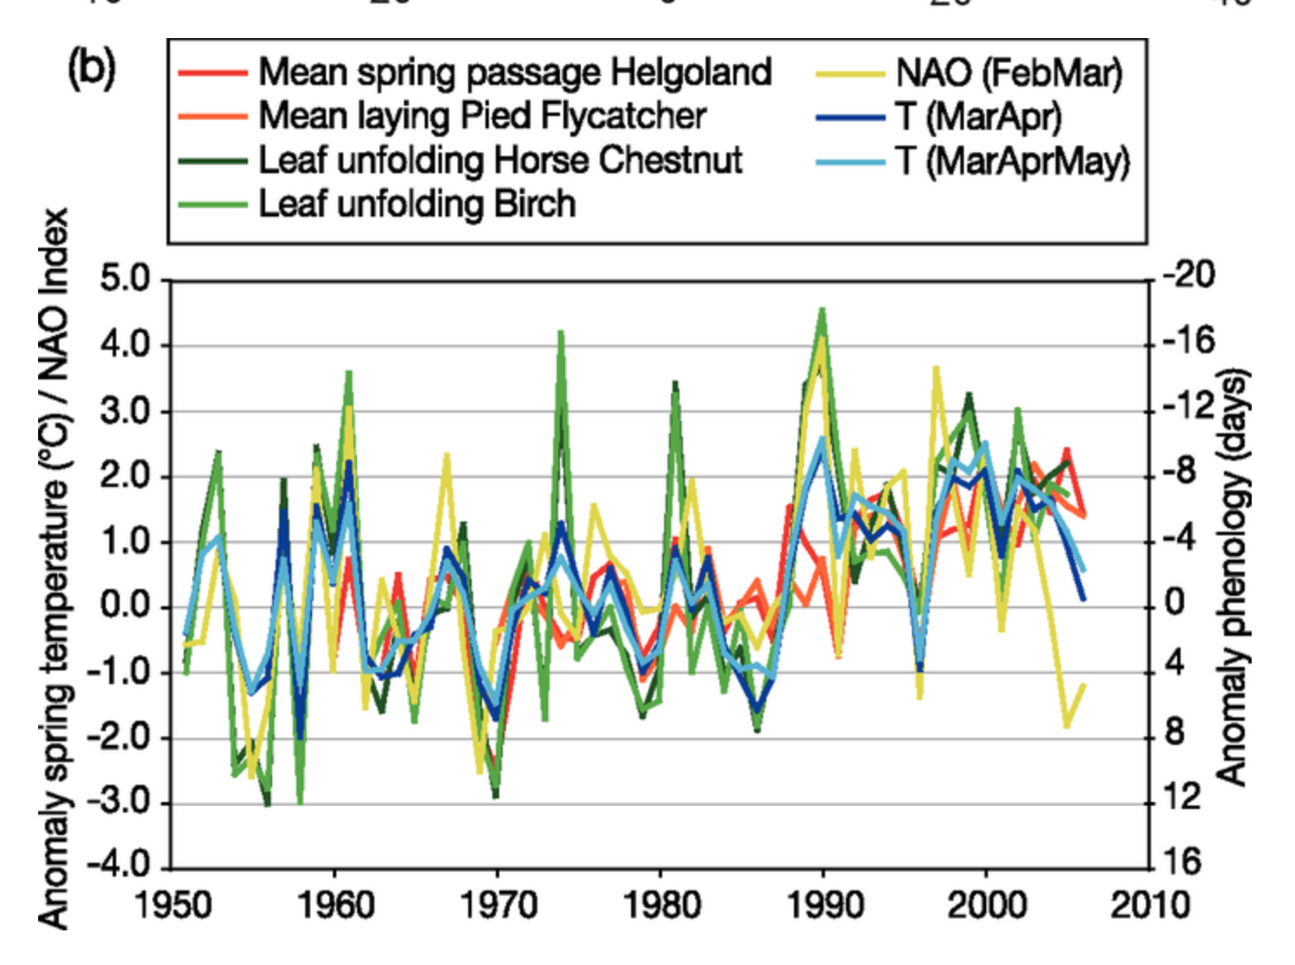
Response of terrestrial ecosystems
to NAO-related climate anomalies
In many parts of Europe
warm winters are followed
by early spring events in
the ecosystems:
Arrival of migratory birds
Blossom of flowers
Leaf unfolding on trees
Long-term phenological*
observations at specific
sites can be compared
with NAO index
* See also https://www.nwf.org/Wildlife/Wildlife-Conservation/Phenology.aspx
Notes:
From IPCC AR 4
https://www.ipcc.ch/publications_and_data/ar4/wg2/en/figure-1-4.html
Phenology: Study of the life cycle in plants and animals,
Climate-driven
Seaonsal changes in temperature, precipitation, sunlight, snow cover, sil moisture

Slide 24
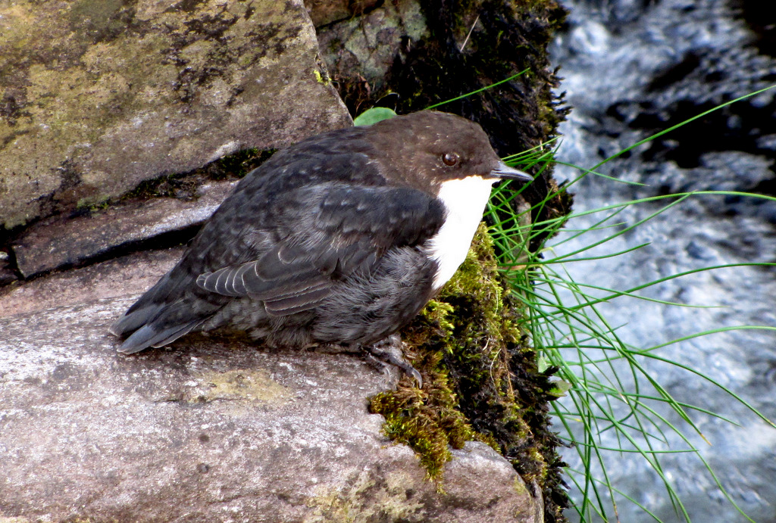
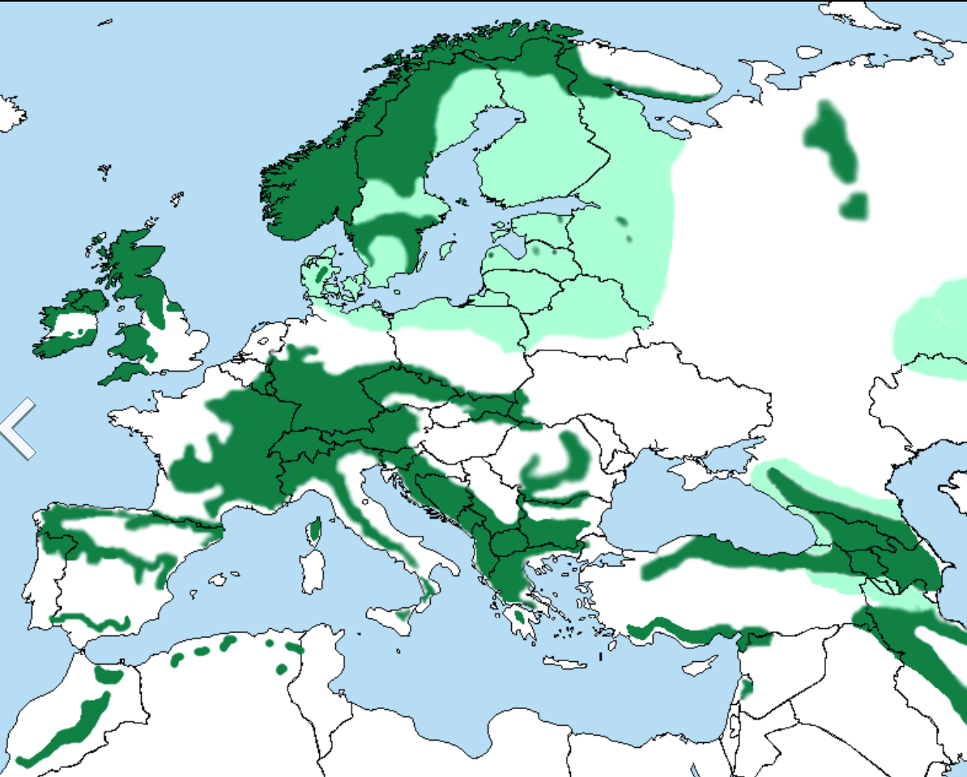
Effects of NAO variability on European birds – Example White-throated dipper (Cinclus cinclus)
Southern Norway 1978-1997
Habitat regions in Europe
Southern Norway
White-throated dipper feeds on insects under water
In winter it leaves higher lands when rivers freeze in search for open waters
Images source: Wikipedia (retrieved Oct 18th 2015)

Slide 25
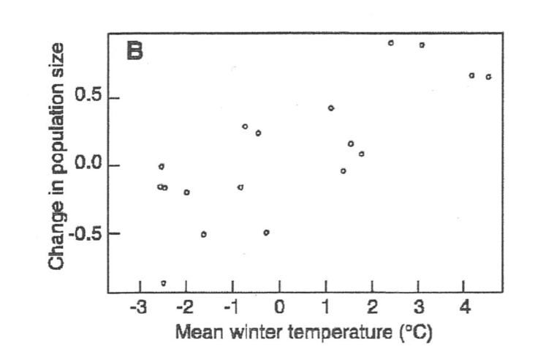
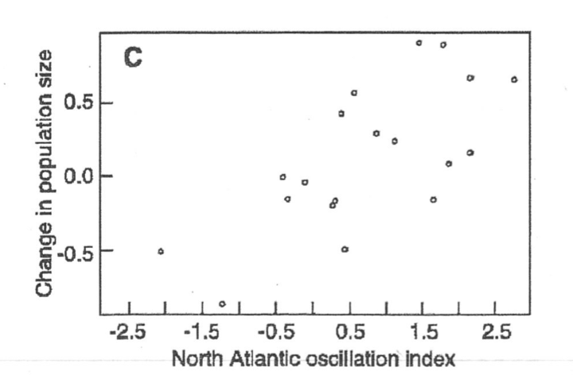
Effects of NAO variability on European birds – Example White-throated dipper (Cinclus cinclus)
Southern Norway 1978-1997
After Saether et al., 2000
NAO positive phase:
More winter storms in Atlantic
Milder temperatures
More open waters and better food supply
during winter
Population growth is higher following positive NAO winters
Negative NAO phase:
Population decline after severe winter

Slide 26
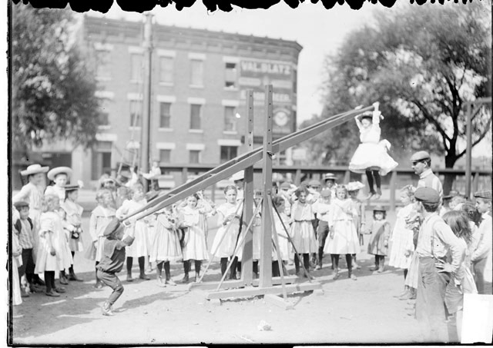
Summary: North Atlantic Oscillation
North Atlantic Oscillation:
Defined by the sea level pressure systems over the North Atlantic with centers of action near Icelandic Low and the Azores High
NAO most active (strongest) during winter season
Sea level pressure anomalies show a dipole mode (anti-correlation between Icelandic Low and Azores High)
Large-scale effects on winter temperatures precipitation in Europe, Greenland, eastern North America
Atmosphere-Ocean interaction: Atmosphere acts as a random (white noise) forcing on the ocean, => ocean SST time series more low frequency variability
ocean SST anomalies have a weak feedback on the atmosphere
NAO acts like a pressure seesaw
+
-
Seesaw concept:
Icelandic low pressure –
Azores high pressure +

