Slide 1
Pacific Decadal Oscillation
Modes of climate Variability
Oliver Elison Timm ATM 306 Fall 2016
Lecture 6
Notes:
Presentation slide for courses, classes, lectures et al.

Slide 2
Objectives
Spatial structure
Temporal characteristics
Ocean-Atmosphere interactions
Ecological impacts
Notes:
Prognostic equation:
A time derivative on the left hand side of the equation (change in wind, currents, or any other variable) is related to an instantaneous state of the system(e.g. pressure gradient)

Slide 3
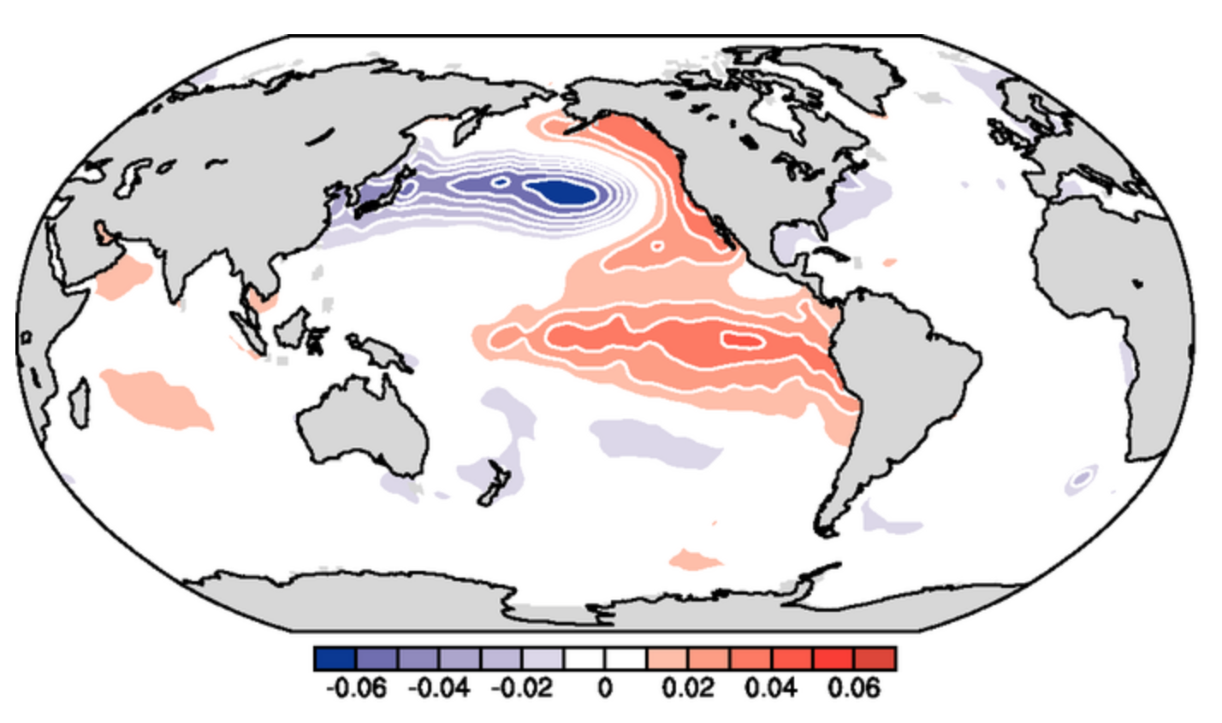
Spatial Pattern of the Pacific Decadal Oscillation
PDO is a mode defined by sea surface temperature anomalies in the Pacific Ocean
Note: The original
'definition' of the
PDO mode is done by multivariate statistical analysis of monthly SST anomalies north of 20N in the Pacific.
Notes:
Prognostic equation:
A time derivative on the left hand side of the equation (change in wind, currents, or any other variable) is related to an instantaneous state of the system(e.g. pressure gradient)

Slide 4
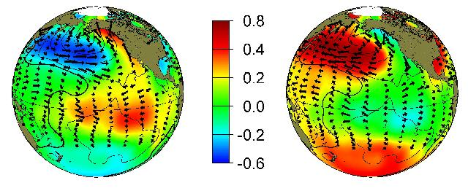
Ocean-atmosphere states during positive and negative PDO phases
Positive PDO phase
Negative PDO phase
Typical wintertime Sea Surface Temperature (colors),
Sea Level Pressure (contours) and surface windstress (arrows) anomaly patterns during warm and cool phases of PDO
Notes:
Source:
http://research.jisao.washington.edu/pdo/

Slide 5
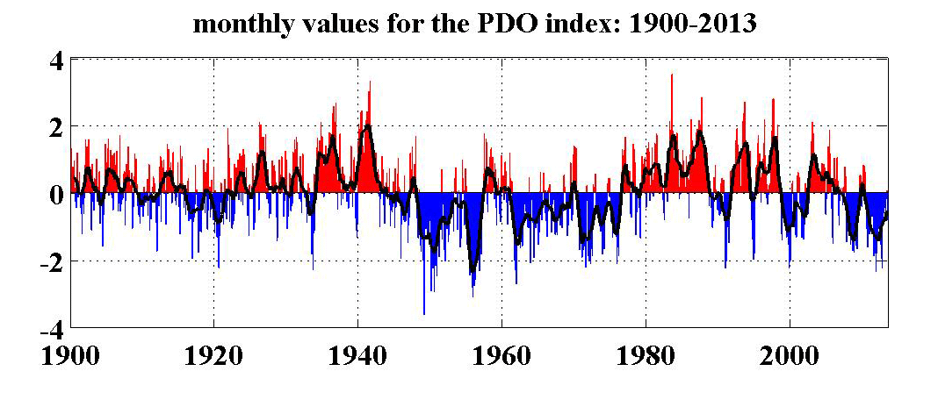
Pacific Decadal Oscillation time evolution
Pacific Decadal Oscillation shows long periods with primarily positive
index values, followed by decades with more frequent negative values.
This is expressed with the term “decadal” in the name.

Slide 6
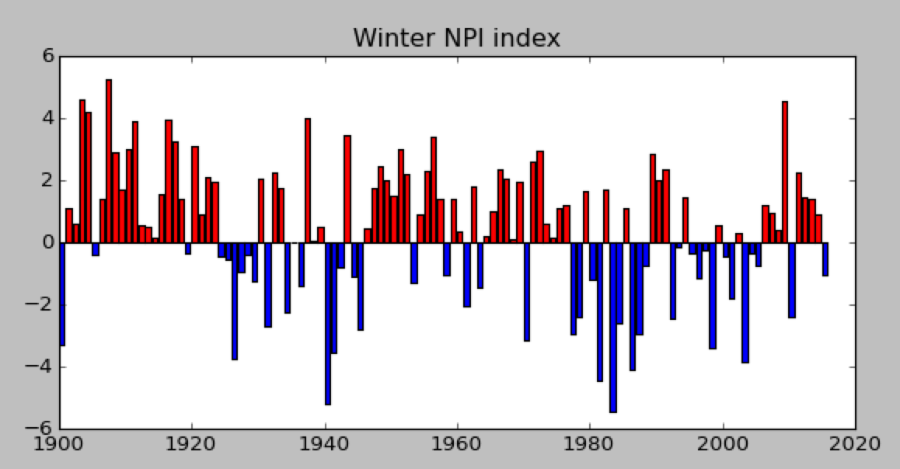
North Pacific Index:
Measure of the strength of the Aleutian Low
North Pacific Index (NP index or NPI) is the area-weighted sea level pressure over the region 30°N-65°N, 160°E-140°W.
Defined for winter season
Notes:
NP Index Data provided by the Climate Analysis Section, NCAR, Boulder, USA, Trenberth and Hurrell (1994). Updated Regularly. Accessed DD Month YYYY [list date you accessed the data]. - See more at: https://climatedataguide.ucar.edu/climate-data/north-pacific-np-index-trenberth-and-hurrell-monthly-and-winter#sthash.v2MgYS0o.dpuf
The North Pacific Index (NP index or NPI) is the area-weighted sea level pressure over the region 30°N-65°N, 160°E-140°W. The NP index is defined to measure interannual to decadal variations in the atmospheric circulation. The dominant atmosphere-ocean relation in the North Pacific is one where atmospheric changes lead changes in sea surface temperatures by one to two months. However, strong ties exist with events in the tropical Pacific, with changes in tropical Pacific SSTs leading SSTs in the north Pacific by three months. - See more at: https://climatedataguide.ucar.edu/climate-data/north-pacific-np-index-trenberth-and-hurrell-monthly-and-winter#sthash.v2MgYS0o.dpuf

Slide 7
What is the connection between Aleutian Low strength and North Pacific SST anomalies?
What is the statistical relationship?
What is the physical
connection?
Notes:
NP Index Data provided by the Climate Analysis Section, NCAR, Boulder, USA, Trenberth and Hurrell (1994). Updated Regularly. Accessed DD Month YYYY [list date you accessed the data]. - See more at: https://climatedataguide.ucar.edu/climate-data/north-pacific-np-index-trenberth-and-hurrell-monthly-and-winter#sthash.v2MgYS0o.dpuf

Slide 8
What is the connection between Aleutian Low strength and North Pacific SST anomalies?
Statistical relationship:
Physical relationship:
Notes:
NP Index Data provided by the Climate Analysis Section, NCAR, Boulder, USA, Trenberth and Hurrell (1994). Updated Regularly. Accessed DD Month YYYY [list date you accessed the data]. - See more at: https://climatedataguide.ucar.edu/climate-data/north-pacific-np-index-trenberth-and-hurrell-monthly-and-winter#sthash.v2MgYS0o.dpuf

Slide 9
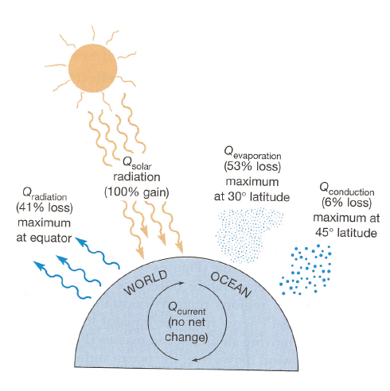
Ocean Atmosphere Interaction in the North Pacific
Recall: 2.5m ocean layer has the same
heat capacity as the troposphere
The ocean mixed layer is about
100-200m in North Pacific => huge heat capacity
Sensible heat flux depends on
SST, air temperature, winds
Latent heat flux depends on SST
relative humidity, winds
SST anomalies are damped by
latent and sensible heat fluxes

Slide 10
Ocean Atmosphere Interaction in the North Pacific
Shortwave, longwave,
sensible and latent heat flux
Ocean is the 'flywheel' of the climate system. It stores 'excessive' heat fluxes coming from the atmosphere and compensates 'shortages' in the atmospheric energy demand.
The extratropical atmospheric circulation shows irregular/random/chaotic variations
Mixed layer
Ocean temperature anomalies are more persistent than atmospheric
temperature anomalies
Damping time scale of ocean SST anomalies: 3-6 months
Interior Ocean

Slide 11
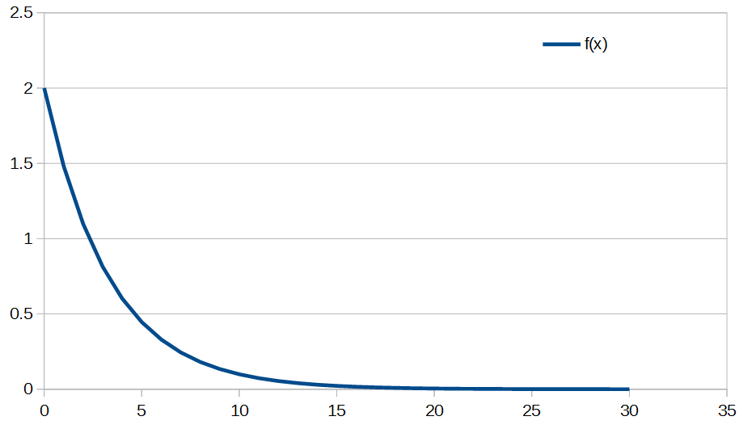
Exponential decay & damping time scale
SST Anomaly [deg C]
Initial value
Half value
2.5 month half time
e-folding time: 4 month
Time in month

Slide 12
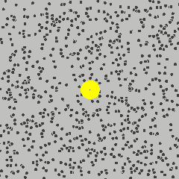
Sea Surface Temperature (SST) as a response to stochastic atmopsheric forcing
In the 1970s climate scientists
adopted the concept of “Brownian
Motion” to the theory of climate variability:
Atmosphere with fast random
variations and short damping time scales .
Ocean has to respond to these variations.
Ocean is the 'slowly moving' system
(large heat capacity) that integrates atmospheric forcing.
Link to youtube video
https://www.youtube.com/watch?v=FAdxd2Iv-UA
Notes:
Figures from Deser et al. 2003
Reemergence mechanism

Slide 13
Extratropical ocean-atmosphere climate as a stochastically forced system
Atmosphere:
fast internal processes (from weather to monthly and interannual,
even decadal time scales, variations appear random)
→ random force
Ocean:
slow response to random atmospheric forcing
The generalized concept is called “Stochastic Climate Models”
Notes:
The groundbreaking work was published by Hasselmann in 1976
Hasselmann, K., 1976: Stochastic climate models. Part I: Theory. Tellus, 28, 473-485.

Slide 14
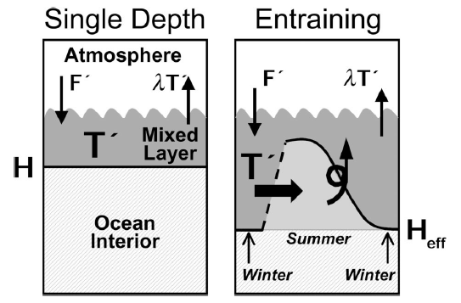
Mixed-layer temperatures
Pycnocline separates less dense upper ocean water mass from the cool dense water below. Mixing these two water masses requires strong wind stress (and turbulence) in the ocean.
Cold season: cooling at surface + strong storm activity leads to
a deepening of the mixed layer Warm season: warming of upper ocean water => formation of shallow mixed layer.
F': heat flux anomaly (positive if ocean gains energy from atmosphere)
T': ocean mixed-layer temperature anomaly
λ (lambda): damping feedback: ocean restores back to the unperturbed temperature
Notes:
Figures from Deser et al. 2003
Reemergence mechanism

Slide 15
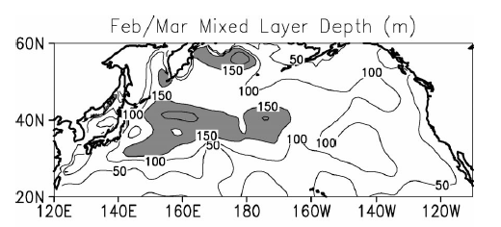
Observation-based estimate of the mixed layer depth
Note: Winter mixed layer thicker than during summer. Summer mixed layer (20-30m) isolates the deeper winter-mixed layer
heat anomalies during summer. The following fall and winter: old heat anomalies 're-emerge'
and influence the sea surface temperature in the next winter.

Slide 16
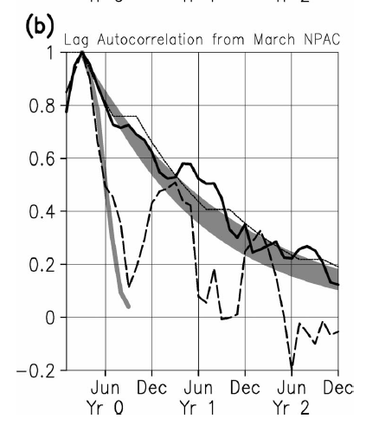
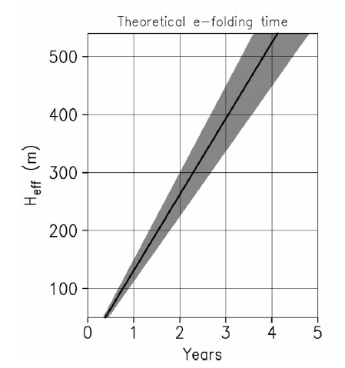
Memory for SST anomalies in the North Pacific
Mixed layer heat content
observations
With growing
mixed layer depth
the ‘memory effect’ is increasing
Gray shade: the stochastic model
Notes:
Note: information on auto-correlation function.
Correlate a time series with itself, but shifted by one month, two month, etc. The shifted time series acts like a second time series, and the correlation coefficient can be calculated.
For each specific 'time-shift' (lag) we obtain one
Correlation coefficient.
Figure from Clara Deser's paper in J. Climate 2003
Observed monthly lag autocorrelation curves from Mar for heat content (thick black) and SST (dashed) anomalies in the (a) NATL and (b) NPAC regions. The broad band of shading denotes the theoretical autocorrelation function from the extended simple sto- chastic climate model. The thin gray curve that ends in Sep of year 0 denotes the theoretical autocorrelation function from the original model. The thin black curve denotes the theoretical autocorrelation function from the extended simple stochastic climate model with zero damping in summer (see text for details).

Slide 17
Summary of the important mechanisms for the PDO
Notes:
The Pacific decadal oscillation, revisited
Matthew Newman1,2*, Michael A. Alexander2, Toby R. Ault3, Kim M.
Cobb4, Clara Deser5, Emanuele Di Lorenzo4, Nathan J. Mantua6, Arthur J.
Miller7, Shoshiro Minobe8, Hisashi Nakamura9, Niklas Schneider10,
Daniel J. Vimont11, Adam S. Phillips5, James D. Scott1,2, and Catherine A.
Smith1,2
Submitted to BAMS, 2015.

Slide 18
Impacts of the PDO
Statistical methods are used to detect and to quantify connections between
regional temperatures, rainfall, streamflow etc. with the PDO
At least two difficulties we face with this approach:
(a) we need long time series, since PDO variability contains
decadal to multidecadal variability
(100 years of continuous observations needed)
(b) there is a danger of attributing regional variability to the 'wrong cause'
Because ENSO, North Pacific atmosphere and ocean are not independently evolving, but they are connected.

Slide 19
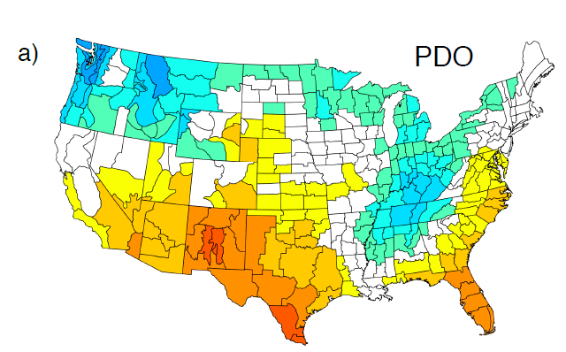
Impacts on rainfall In North America
Correlation between
PDO and rainfall
(Nov-Mar season)
1901-2004
Blue colors: negative correlation between PDO
index and county-averaged rainfall anomalies.
Red colors: positive correlation

Slide 20
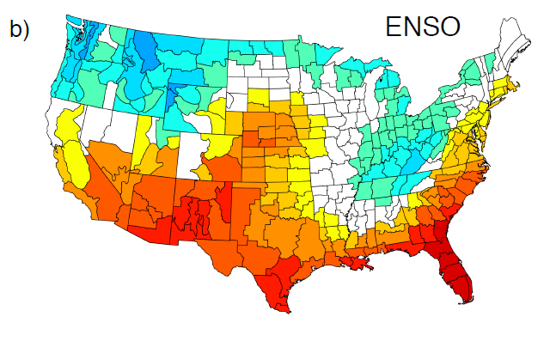
Impacts on rainfall In North America
Correlation between
ENSO index
and rainfall
(Nov-Mar season)
1901-2004
Blue colors: negative correlation between PDO
index and county-averaged rainfall anomalies.
Red colors: positive correlation

Slide 21
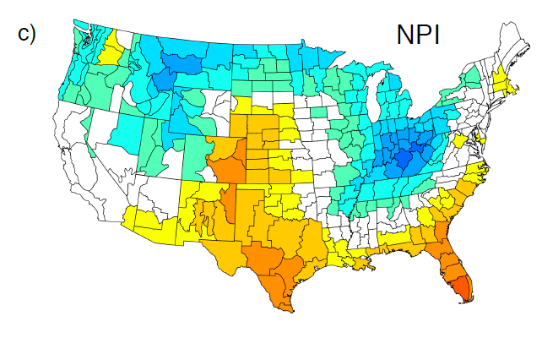
Impacts on rainfall In North America
Correlation between
NPI (strength
of Aleutian Low)
and rainfall
(Nov-Mar season)
1901-2004
Blue colors: negative correlation between PDO
index and county-averaged rainfall anomalies.
Red colors: positive correlation

Slide 23
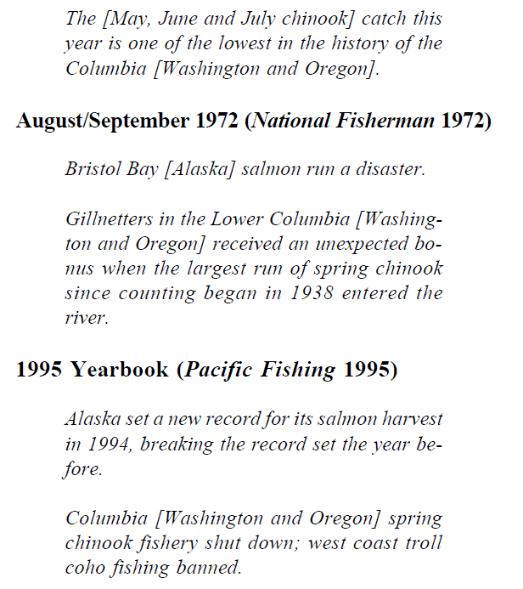

Slide 24
Impact of the PDO on commercial fisheries
Rapid changes in the production levels of major commercial fish stocks have been connected to interdecadal climate variability in the northeast
Pacific (Alaska, Washington, Oregon, California)

Slide 25
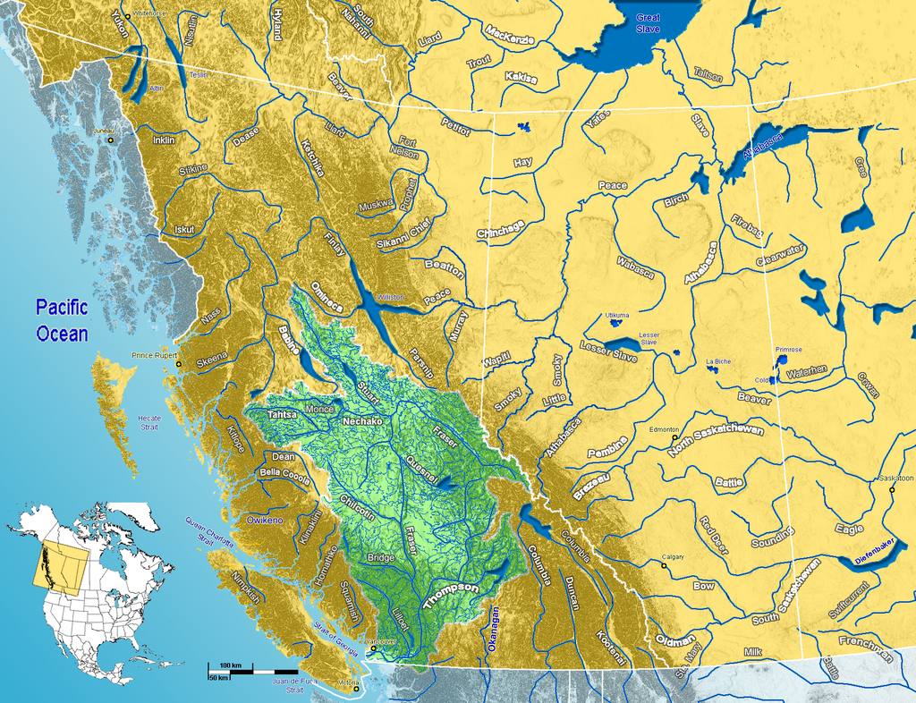
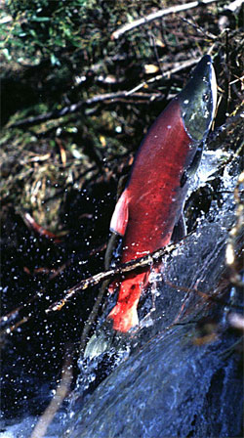
Impact of the PDO on commercial fisheries
Sockeye Salmon
Rapid changes in the production levels of major commercial fish stocks have been connected to interdecadal climate variability in the northeast Pacific (Alaska, Washington, Oregon, California)
Fraser River
Watershed
Pictures from Wikipedia:
https://en.wikipedia.org/wiki/Sockeye_salmon

Slide 26
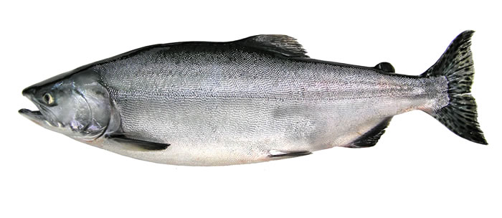
Impact of the PDO on commercial fisheries
Pink (Humpy) Salmon
Oncorhynchus gorbuscha
3-5 lb
5-8 lb
Sockeye (Red) Salmon
Oncorhynchus nerka
http://wdfw.wa.gov/fishing/salmon/species.html

Slide 27
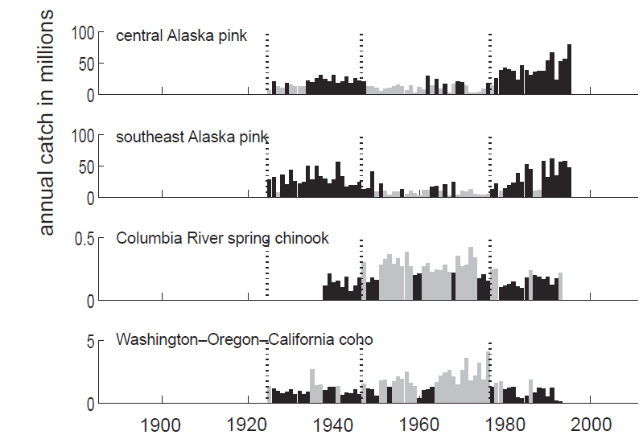
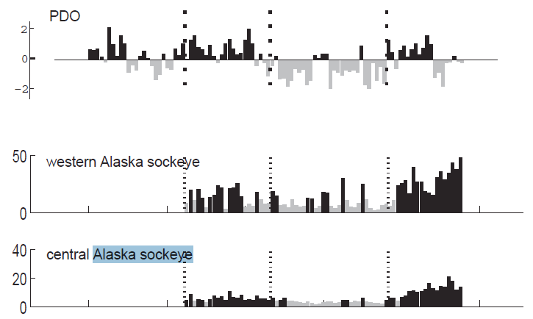
Impact of the PDO on commercial fisheries
PDO index
Notes:
From Mantua et al. 1997 (BAMS) article

Slide 28
Impact of the PDO on commercial fisheries
3-5 lb
5-8 lb

Slide 29
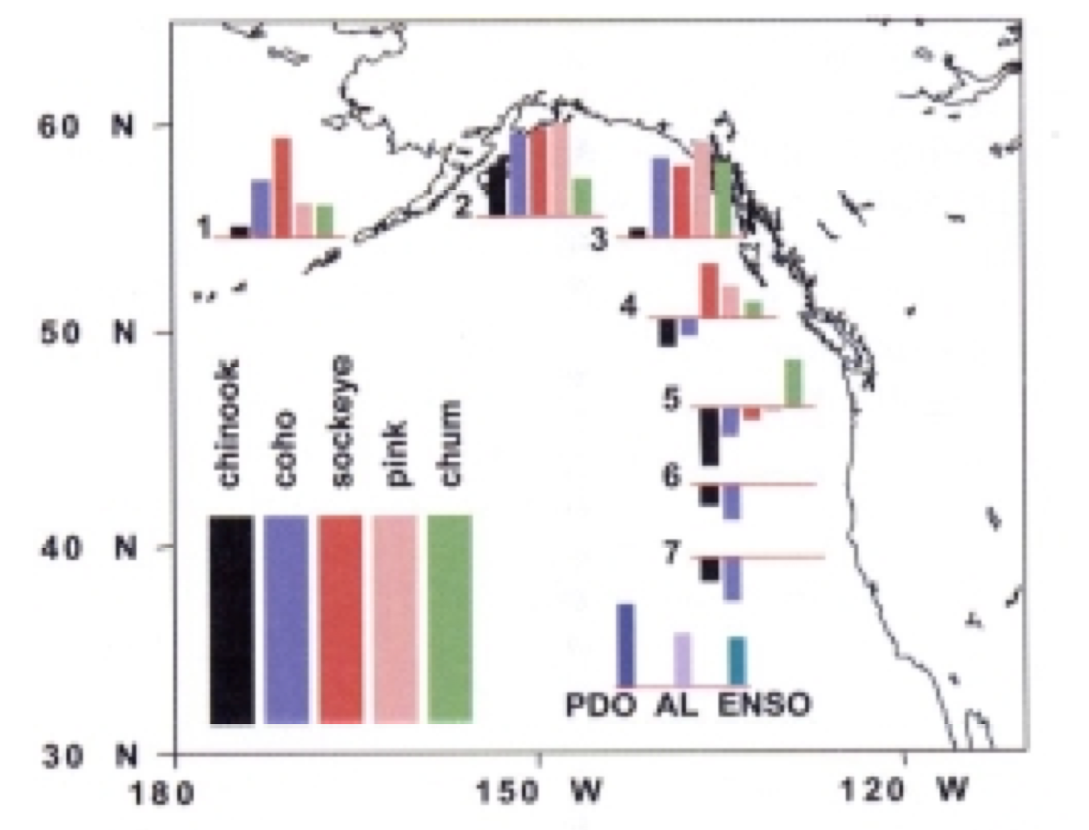
Impact of the PDO on commercial fisheries
Multivariate analysis:
Combined look at climate index time series of the PDO, Aleutian Low, and ENSO (representing atmospheric and oceanic climate variability) plus 30 time series of fish catch (various regions and species)
The longer the bar the higher the correlation. Sign of correlation is indicated here by the direction of
the bars relative to the base line.
Notes:
From Mantua et al, J. Oceanography 2002

Slide 30
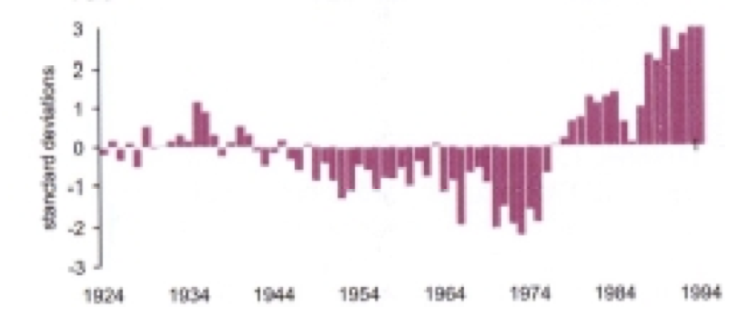
Impact of the PDO on commercial fisheries
Multivariate time series index and correlation pattern show:
PDO was in negative phase 1940s - 1970s
Shift into positive phase 1970s – 1990s
Central, western and southeast Alaska catch records for Salmon show strong positive correlations with PDO
Weaker negative correlation with some (chinook & coho) species further south along the US Pacific coast.

Slide 31
Impact of the PDO on commercial fisheries
Ecological response to the PDO-related environmental changes:
Ocean SST, mixed layer thickness, river streamflow
=> Changes in nutrient concentrations
Phytoplankton and zooplankton (base of the food chain) works its way up to top-level predators like salmon
For Alaskan salmon:
positive PDO year brings enhanced streamflows and nearshore ocean mixed-layer conditions favorable to high biological productivity
Southwards along the Pacific Northwest:
negative PDO years bring favorable conditions for Salmon

Slide 32
Source: IPCC AR4 report 2007, Ch. 3.6
https://www.ipcc.ch/publications_and_data/ar4/wg1/en/ch3s3-6.html#3-6-1

Slide 33
