Slide 1
Teleconnection Pattern and Modes of climate Variability
Oliver Elison Timm ATM 306 Fall 2016
Lecture 6
Notes:
Presentation slide for courses, classes, lectures et al.
1

Slide 2
Objectives
Description of major teleconnection pattern and most widely discussed natural modes of climate variability
Methods used to describe modes of climate variability
Regional impacts (temperature, precipitation, extreme events)
(Aspects of predictions)
Notes:
Prognostic equation:
A time derivative on the left hand side of the equation (change in wind, currents, or any other variable) is related to an instantaneous state of the system(e.g. pressure gradient)

Slide 3
Objectives
Pacific sector:
Pacific - North American Pattern (PNA)
Pacific Decadal Oscillation (PDO)
Interdecadal Pacific Oscillation(IPO)
Atlantic sector:
North Atlantic Oscillation (NAO)
Atlantic Multidecadal Oscillation (AMO)
Notes:
Prognostic equation:
A time derivative on the left hand side of the equation (change in wind, currents, or any other variable) is related to an instantaneous state of the system(e.g. pressure gradient)

Slide 4
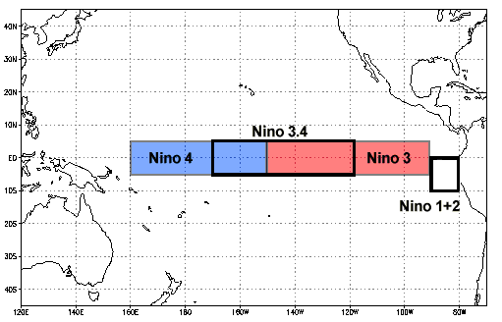
Measuring the ‘pulse’ of ENSO:
Use of time series indices to describe climate variability
Traditional indices rely on average temperature conditions in the tropical Pacific
(NINO 1,2, 3, 4 and NINO 3.4 indices)
obtain monthly averaged SST data
get a reference ‘normal’ SST state (e.g. 30-yr average)
Calculated for each time step SST anomaly SSTA(t) = SST(t) -Climatology
(Do some temporal smoothing, seasonal averaging etc)

Slide 5
Measuring the ‘pulse’ of ENSO:
Use of time series indices to describe climate variability
We have seen that ENSO is tightly linked to the atmosphere (sea level pressure anomalies, winds, rainfall).
A new method of measuring ENSO variability makes use of these different ocean-atmosphere variables.
With the aid of statistical methods all this information was combined into one index: Multivariate ENSO index (MEI).

Slide 6
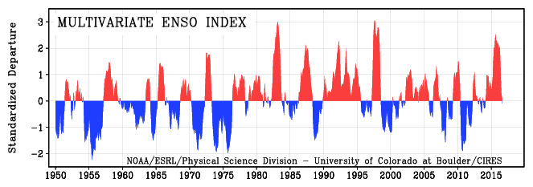
Multivariate ENSO Index (up to Sept. 2015)
http://www.esrl.noaa.gov/psd/people/klaus.wolter/MEI/
Index is based on 6 parameters relevant to phase of ENSO:
sea level pressure zonal and meridional wind at surface
sea surface temperature air temperature
cloudiness
Notes:
6

Slide 7
Multivariate ENSO Index (up to Sept. 2015)
http://www.esrl.noaa.gov/psd/people/klaus.wolter/MEI/
August 2016:
MEI= -0.10
Index is based on 6 parameters relevant to phase of ENSO:
sea level pressure zonal and meridional wind at surface
sea surface temperature air temperature
cloudiness
Notes:
7

Slide 8
Measuring the impacts of ENSO in remote regions such as the US, Africa, or Antarctica
Studying the impact of ENSO on the global climate
Observation-based statistical analysis methods:
With the index for ENSO variability we can compare
temperature, precipitation time series from all parts of the world with the ENSO index.
Model-based analysis of ENSO impacts:
Global climate models (the standard term is “General Circulation Model”, GCM) can be used to study:
How does the atmosphere respond to a prescribed SST anomaly typical for El Nino or La Nina events
Coupled ocean-atmosphere models These models generate their own ENSO variability => allows for statistical analysis in same way as with observations

Slide 9
Mechanisms for Remote Impacts of ENSO variability
Teleconnections

Slide 10
Mechanisms for remote impacts
Latent heating associated with tropical precipitation anomalies excites waves in the atmosphere:
Atmospheric equatorial Kelvin and Rossby waves propagate zonally.
Associated subsidence warms troposphere and suppresses precipitation
Rossby waves can also propagate into extratropics (especially in winter) causing large-scale circulation anomalies which impact weather.
(Note that propagation requires a westerly mean flow and the relevant Rossby waves have an eastward group velocity)

Slide 11
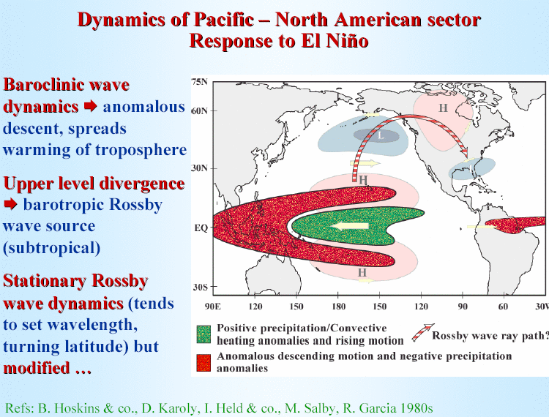
Source: D. Neelin
Notes:
11
Stationary wave number Ks=sqrt(beta/u); k is set by forcing

Slide 12
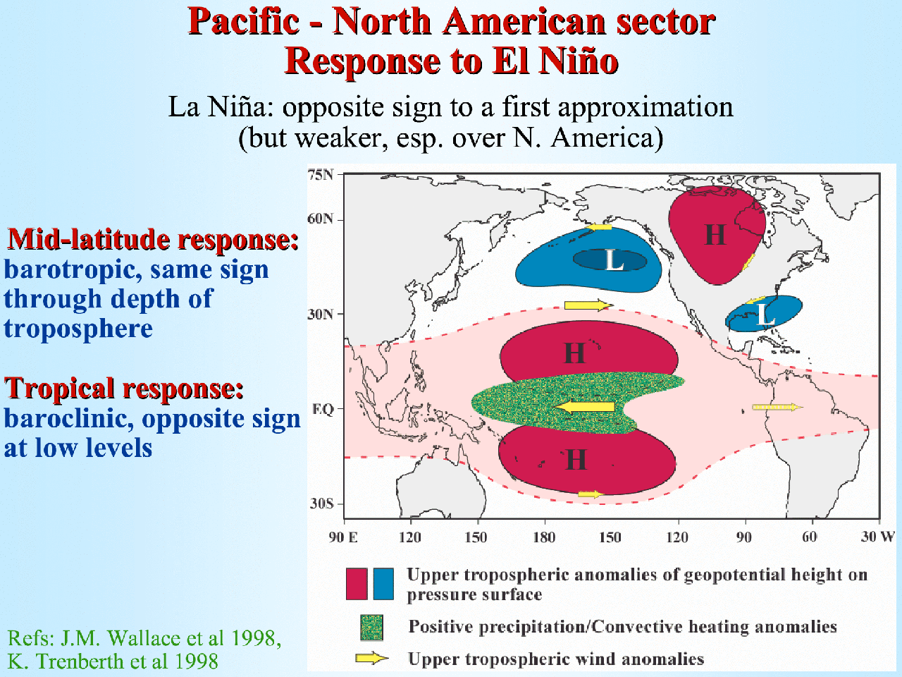
Source: D. Neelin

Slide 13
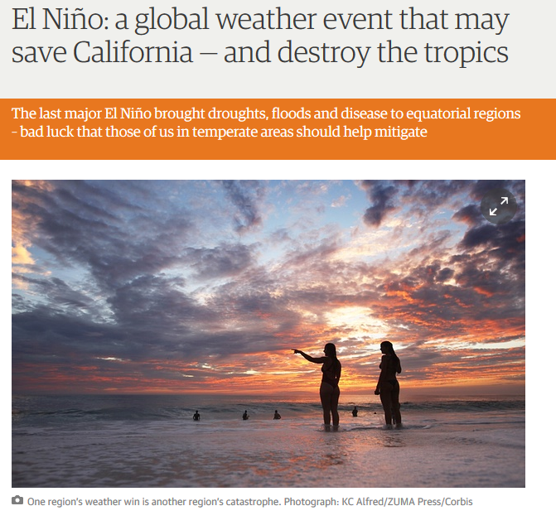
Anticipated
teleconnections
make headlines in
news media (a blog commented in fall 2015 on the upcoming El Nino)

Slide 14
What about the daily weather in the mid-latitudes? Does it really care about the tropics?
Remember that El Nino and La Nina events develop over months, usually peak in their amplitude during the months Dec-Feb, and then decay thereafter.
But the mid-latitude weather is highly variable in daily to weekly time scales.

Slide 15
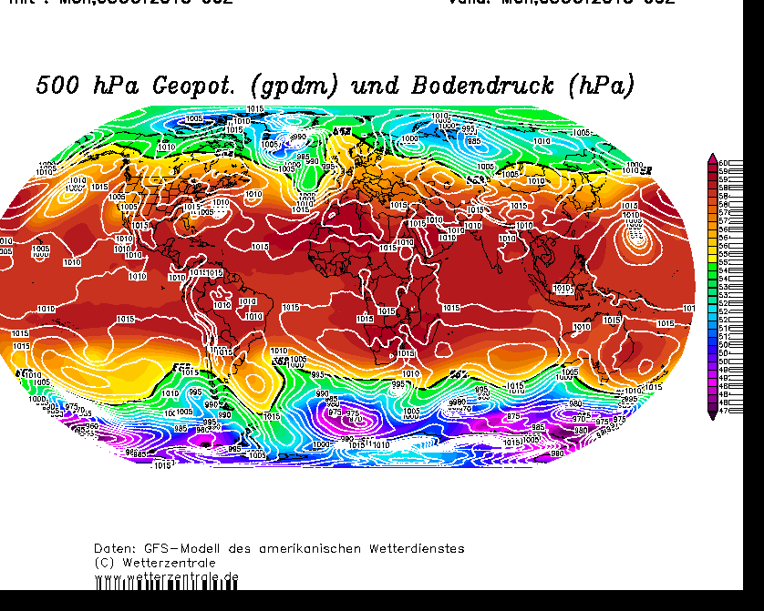
Daily weather maps dominated by transient waves and eddies
500hPa Geopotential height (colors) and sea level pressure

Slide 16
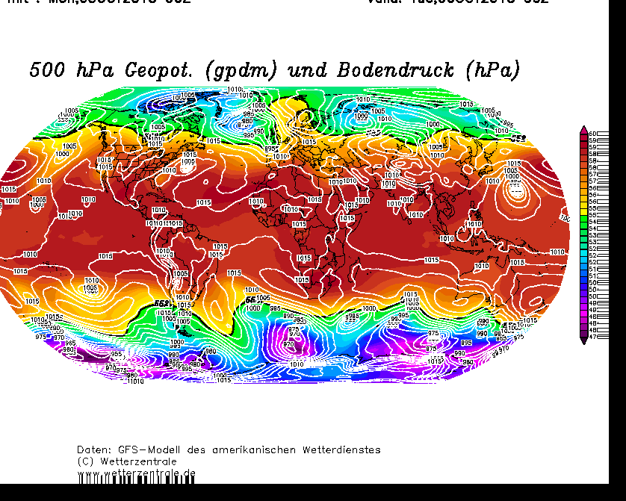
Daily weather maps dominated by transient waves and eddies
500hPa Geopotential height (colors) and sea level pressure
+24h

Slide 17
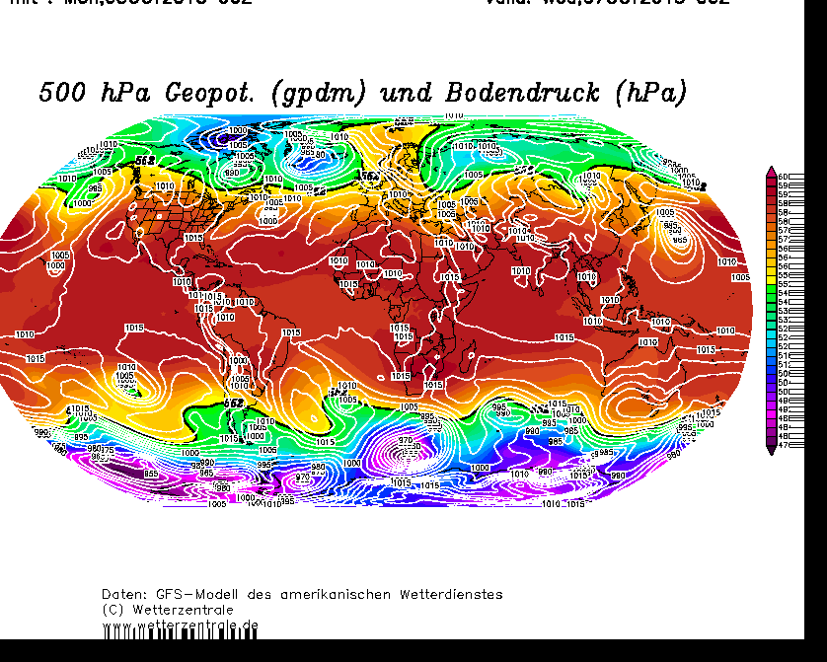
Daily weather maps dominated by transient waves and eddies
500hPa Geopotential height (colors) and sea level pressure
+48h

Slide 18
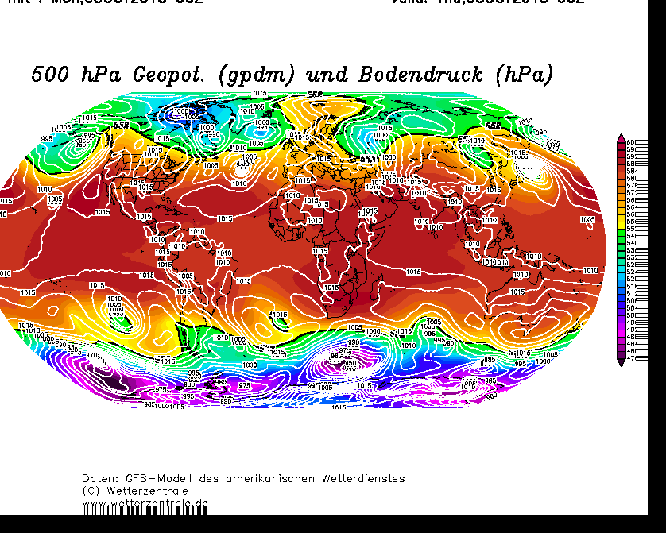
Daily weather maps dominated by transient waves and eddies
500hPa Geopotential height (colors) and sea level pressure
+72h

Slide 19
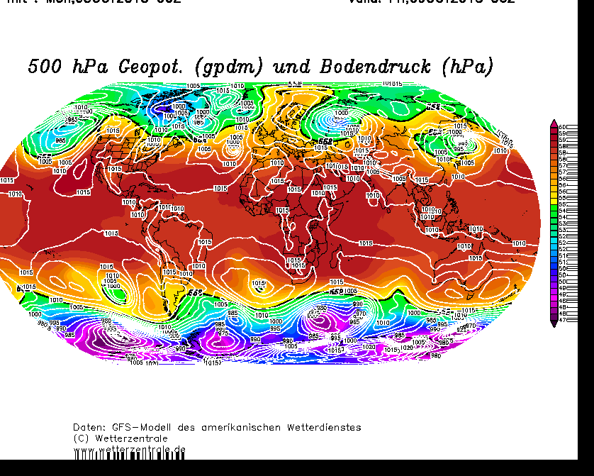
Daily weather maps dominated by transient waves and eddies
500hPa Geopotential height (colors) and sea level pressure
+96h

Slide 20
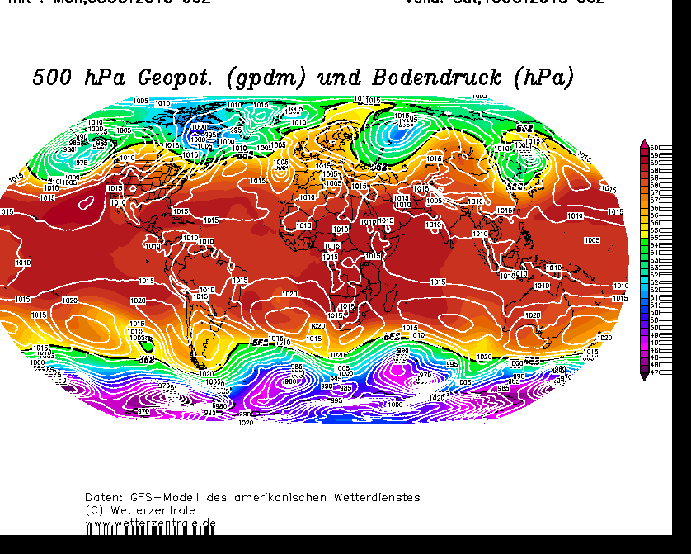
Daily weather maps dominated by transient waves and eddies
500hPa Geopotential height (colors) and sea level pressure
+120h

Slide 21
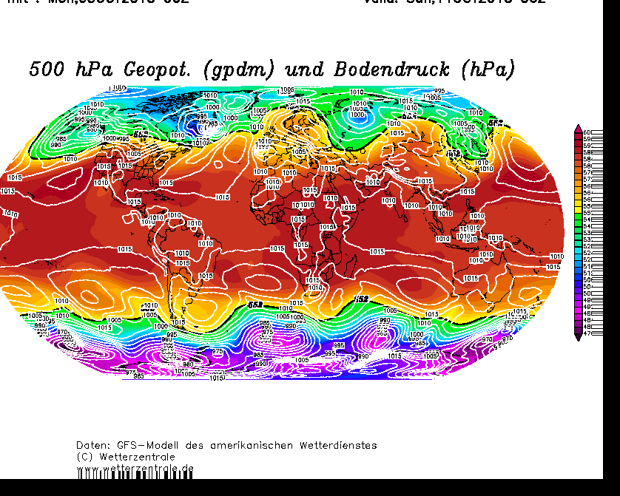
Daily weather maps dominated by transient waves and eddies
500hPa Geopotential height (colors) and sea level pressure
+144h

Slide 22
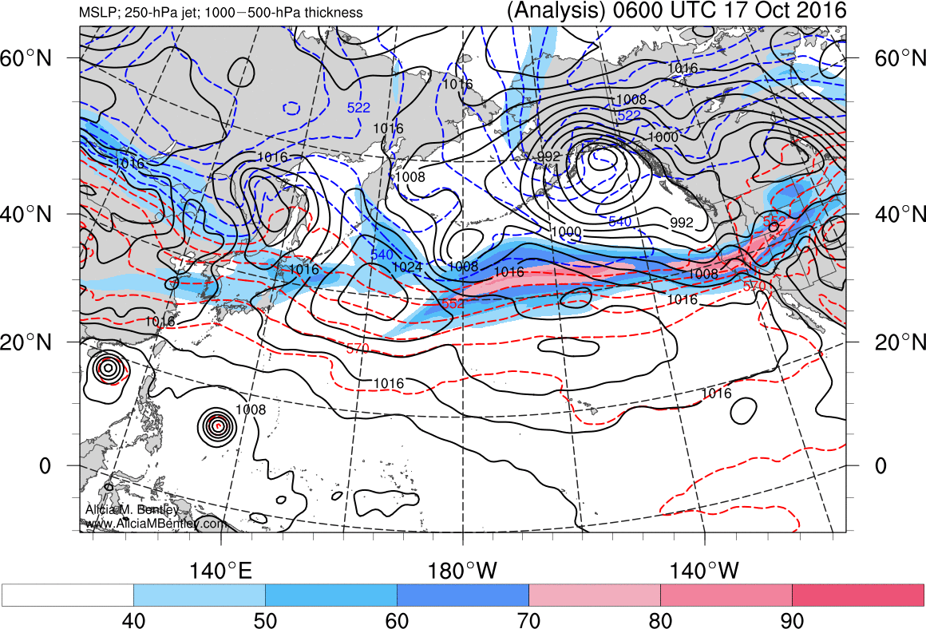
Tip: You can see the synoptic weather variability nicely on the web page of Alicia Bently (PhD student at DAES)
Homepage of Alicia Bentley
(PhD student
at DAES)
Shown here
is pressure at sea level
wind jet at 250hPa
(color shading)

Slide 23
Seasonal mean statistics
Daily weather maps dominated by transient waves and eddies
El Nino related SST anomalies in the tropics last over entire seasons
Teleconnections and climatic anomalies show up in the seasonal average conditions:
Typical seasonal averages used in the study of climate variability:
Dec-Jan-Feb (DJF), Mar-Apr-May (MAM)
Jun-Jul-Aug (JJA), (Sep-Oct-Nov) (SON)
Climate variability is then studied in terms of seasonal anomalies with respect to a long-term (usually 30-year or longer) average
(current NOAA climate norms are defined as average 1981-2010)

Slide 24
Mechanisms for remote impacts
A constant excitation of Rossby waves
in the central tropical Pacific over a season
→ a stationary wave train forms
troughs and ridges at preferred geographical locations
→ seasonal mean circulation anomalies
→ regions with warmer and colder than normal conditions and more or less than average rainfall

Slide 25
Source: D. Neelin
Notes:
25
Stationary wave number Ks=sqrt(beta/u); k is set by forcing

Slide 26
Teleconnections in the Atmosphere
Imagine you have observed winter sea level pressure
(or temperatures, rainfall) at two locations separated by
several thousand miles.
When you plot the time series you may find some remarkable
coherence in the deviations from their long-term average.
(we use the term 'anomalies')
1
2

Slide 27
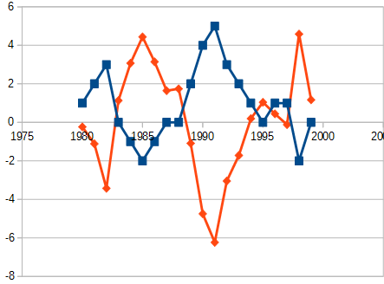
Teleconnections in the Atmosphere
Imagine you have observed winter sea level pressure
(or temperatures, rainfall) at two locations separated by
several thousand miles.
When you plot the time series you may find some remarkable
coherence in their anomalies.
They can agree in sign or as shown
here they can have a tendency to have opposite signs.
1
2
Example of a negative correlation
between two time series

Slide 28
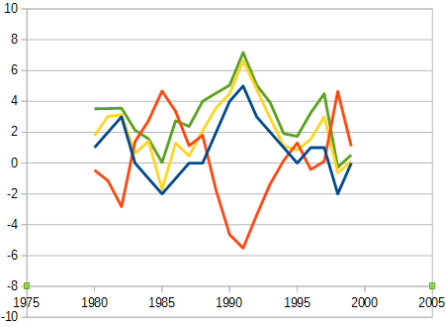
Teleconnections in the Atmosphere
Wave processes and advection
processes can link temperature
fluctuations (anomalies)
between remote regions.
Statistical methods are useful to identify and describe such
teleconnections.
Multivariate statistics:
Climatic observations at many
locations, or on regular longitude-latitude grids
3 4
1
2

Slide 29
Climate index time series
In order to describe coherent climate variations in a multivariate data set (e.g. global sea level pressure data on a 2.5 by 2.5 degree grid) researchers create one representative time series index.
This is an approximation that describes the temporal variability seen in a larger data set with a single representative time series
Inevitably, information gets lost in that process.
→ A simplified view of the essential processes and variability

Slide 30
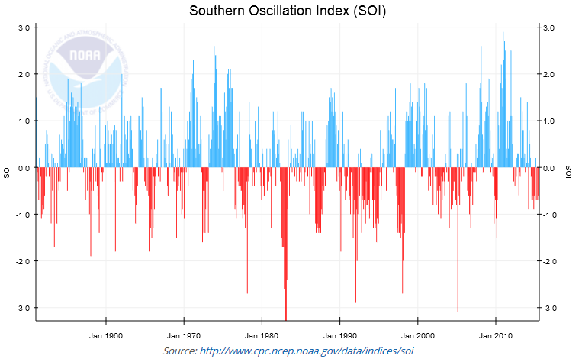
The Southern Oscillation as an example for a 'climate index'

Slide 31
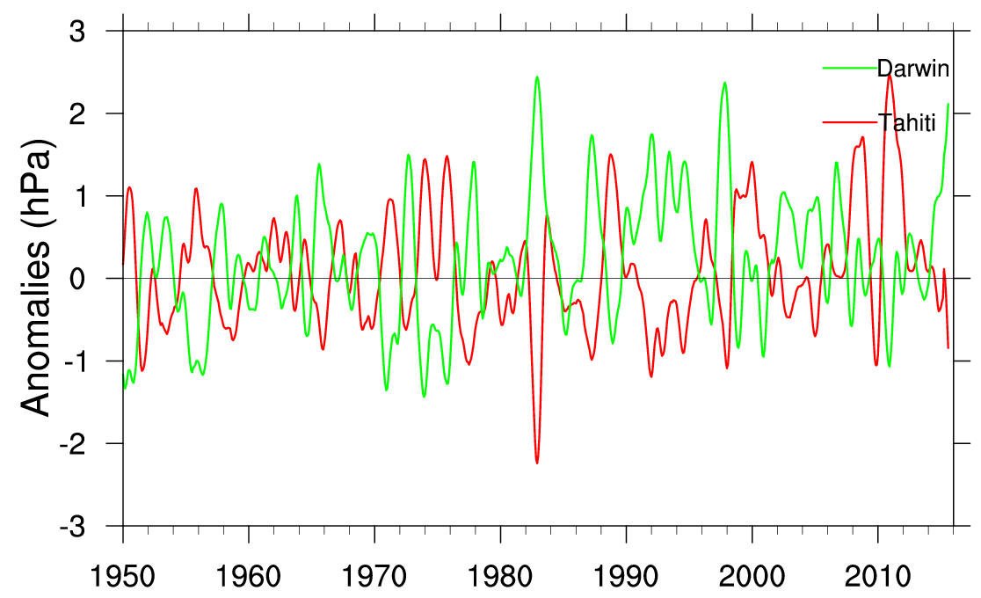
Tahiti and Darwin sea level pressure anomalies
(source: http://www.cgd.ucar.edu/cas/catalog/climind/soi.html)

Slide 32
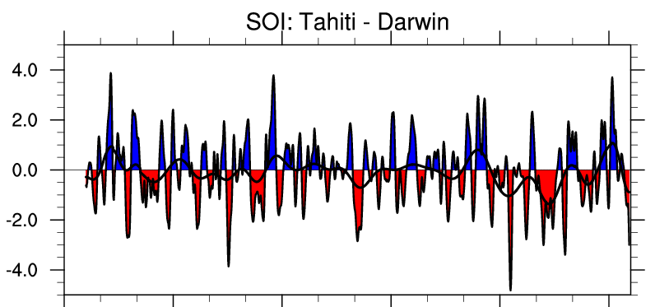
SOI index
(source: http://www.cgd.ucar.edu/cas/catalog/climind/soi.html)
Note: 8-month smoothing filter was applied

Slide 33
SOI index
(source: http://www.cgd.ucar.edu/cas/catalog/climind/soi.html)
El Nino 1982/1983
Note: 8-month smoothing filter was applied

Slide 34
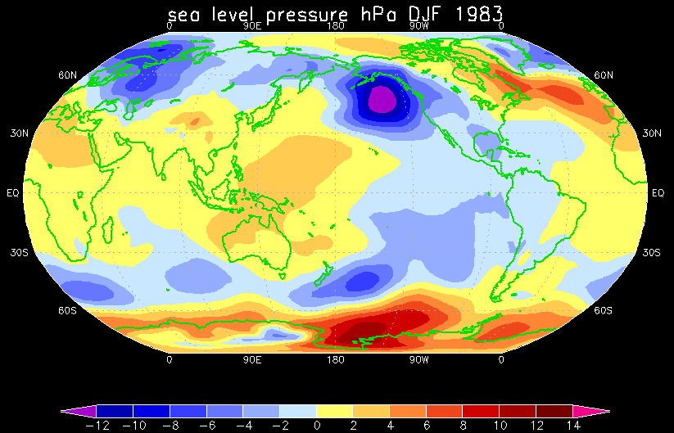
El Nino 1982/1983: Global anomaly pattern

Slide 35
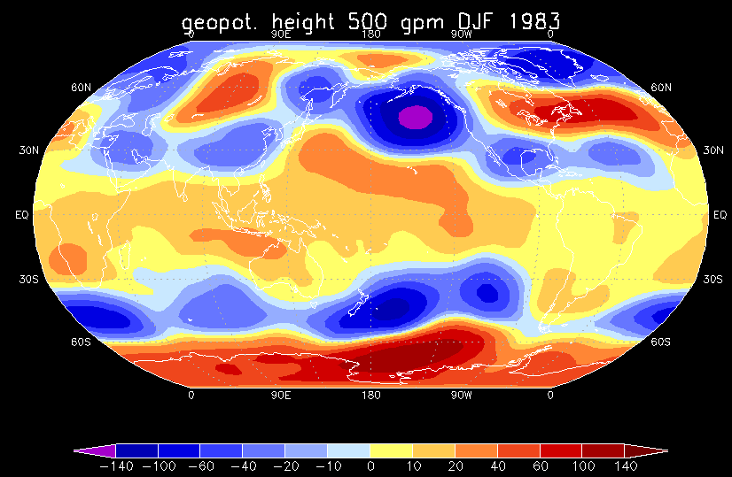
El Nino 1982/1983: Global anomaly pattern
Notes:
Data source NCEP reanalysis
Processed with CDO and GrADS
(Oct 2015, DAES computing resources: snow cluster)

Slide 36
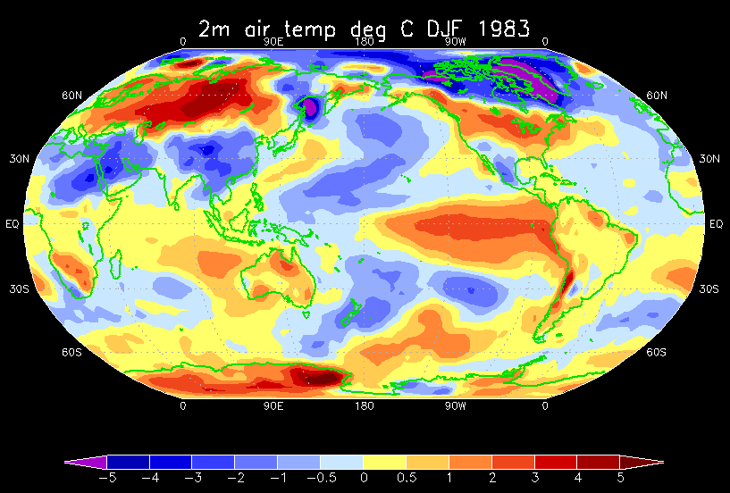
El Nino 1982/1983: Global anomaly pattern

Slide 37
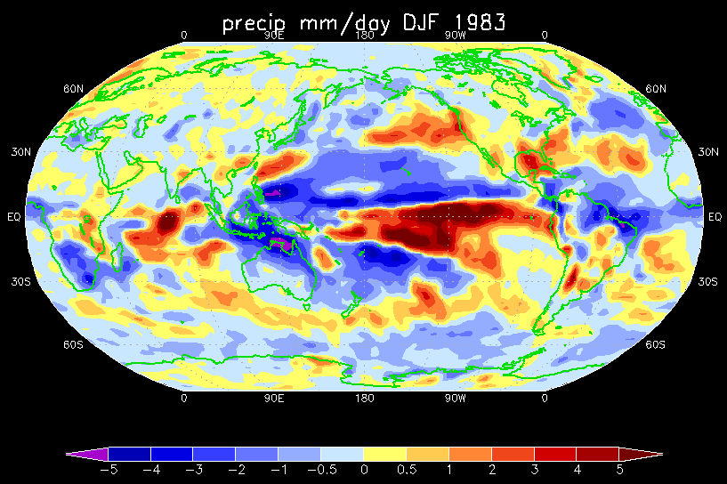
El Nino 1982/1983: Global anomaly pattern

Slide 38
Why we need statistical analysis tools
studying climate modes and variability we must be cautious in our reasoning:
“One swallow does not make a summer!”
We cannot infer from one unusual year with warm tropical SST anomalies in the eastern equatorial Pacific and an observed unusual wet winter in East Africa that all El Nino events are associated with the same regional rainfall anomaly (nor can we say for certain that there is a causal relation) → We look at a large number of events and average, or we deploy measures of correlation to find out how strong the relationships are.

Slide 39
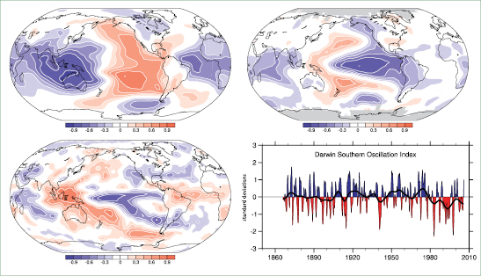
With the SOI index we can illustrate teleconnections:
Correlation between SOI and local time series
sea level pressure
surface temperatures
precipitation
Notes:
Figure 3.27. Correlations with the SOI, based on normalised Tahiti minus Darwin sea level pressures, for annual (May to April) means for sea level pressure (top left) and surface temperature (top right) for 1958 to 2004, and GPCP precipitation for 1979 to 2003 (bottom left), updated from Trenberth and Caron (2000). The Darwin-based SOI, in normalized units of standard deviation, from 1866 to 2005 (Können et al., 1998; lower right) features monthly values with an 11-point low-pass filter, which effectively removes fluctuations with periods of less than eight months (Trenberth, 1984). The smooth black curve shows decadal variations (see Appendix 3.A). Red values indicate positive sea level pressure anomalies at Darwin and thus El Niño conditions.
Figure from IPCC report
http://www.ipcc.ch/publications_and_data/ar4/wg1/en/ch3s3-6-2.html

Slide 40
Pacific North- American Pattern: A climate pattern under the spell of ENSO!

Slide 41
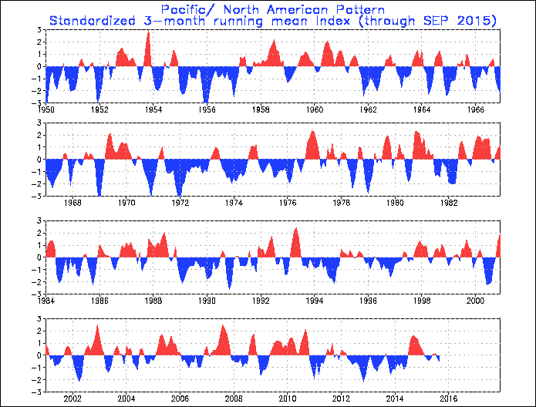
Index for the Pacific-North American (PNA) pattern
Red:
Positive PNA index
Blue:
Negative
PNA index
http://www.cpc.noaa.gov/data/teledoc/pna_ts.shtml

Slide 42
Index for the Pacific-North American (PNA) pattern
Red:
Positive PNA index
Blue:
Negative
PNA index
http://www.cpc.noaa.gov/data/teledoc/pna_ts.shtml

Slide 43
Index for the Pacific-North American (PNA) pattern
Red:
Positive PNA index
Blue:
Negative
PNA index
Usually a threshold
is used to define
positive and negative
phases of a climate
mode.
(E.g. anomalies
> 1 standard deviation
Or smaller -1 std. dev.)
http://www.cpc.noaa.gov/data/teledoc/pna_ts.shtml
Notes:
Let's look at the anomalies for DJF 1972

Slide 44
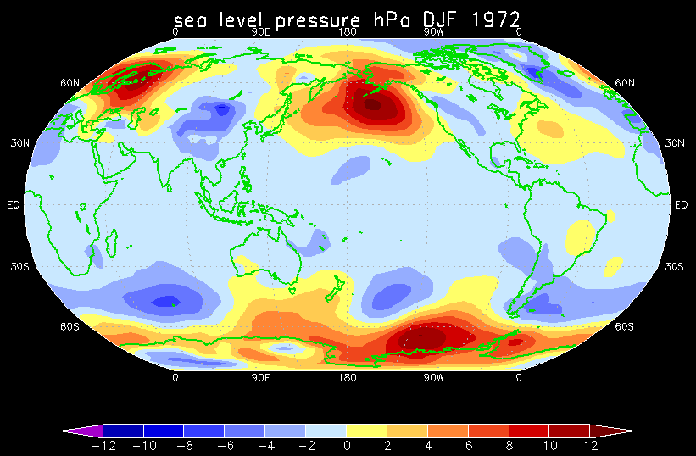
Strong negative PNA phase 1971/1972
Notes:
Data source NCEP reanalysis
Processed with CDO and GrADS
(Oct 2015, DAES computing resources: snow cluster)
Note geopotential height anomalies relative to the 1981-2010 period.
Global warming has lead to a genreal increase in the 500hPa height level. Therefore many regions appear uniformly blue (lower than the norm) for 1973.

Slide 45
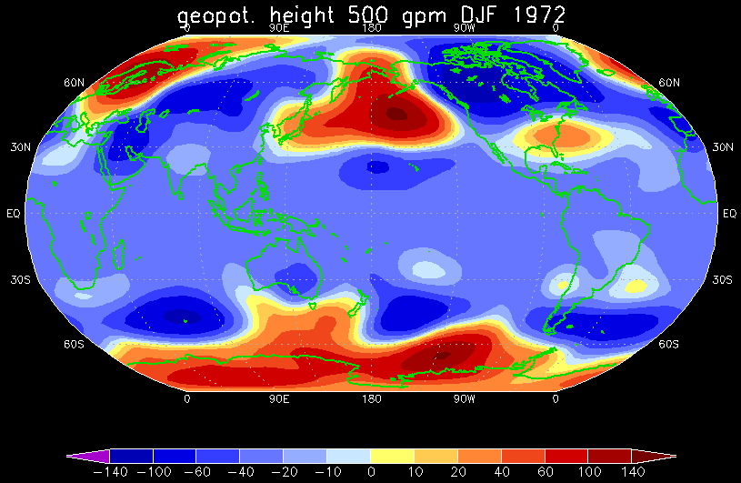
Strong negative PNA phase 1971/1972
Notes:
Data source NCEP reanalysis
Processed with CDO and GrADS
(Oct 2015, DAES computing resources: snow cluster)
Note geopotential height anomalies relative to the 1981-2010 period.
Global warming has lead to a genreal increase in the 500hPa height level. Therefore many regions appear uniformly blue (lower than the norm) for 1973.

Slide 46
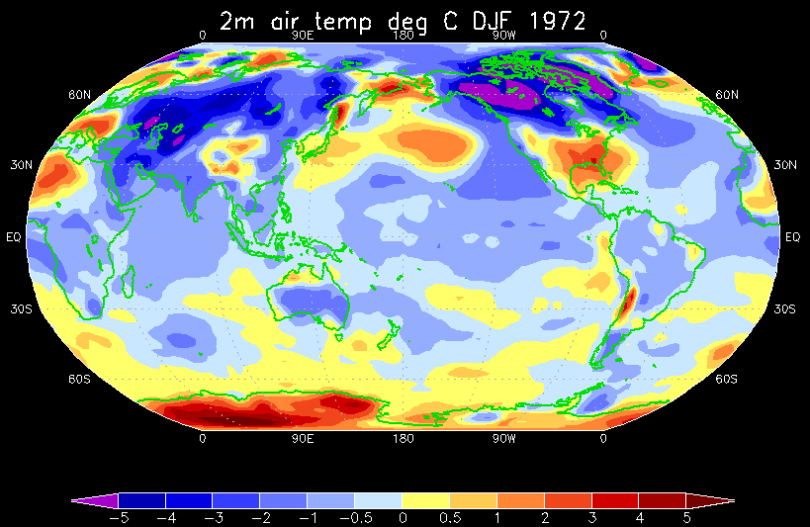
Strong negative PNA phase 1971/1972
Notes:
Data source NCEP reanalysis
Processed with CDO and GrADS
(Oct 2015, DAES computing resources: snow cluster)
Note geopotential height anomalies relative to the 1981-2010 period.
Global warming has lead to a genreal increase in the 500hPa height level. Therefore many regions appear uniformly blue (lower than the norm) for 1973.

Slide 47
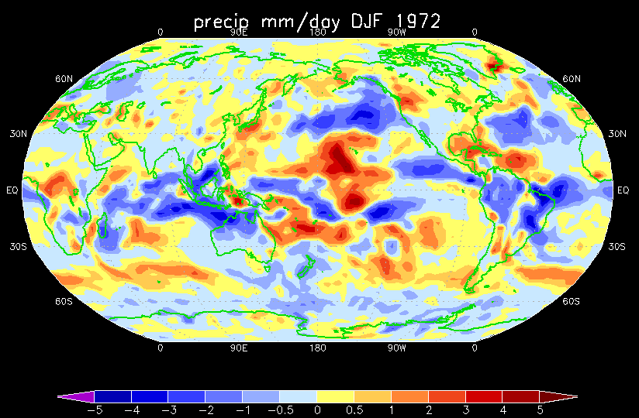
Strong negative PNA phase 1971/1972
Notes:
Data source NCEP reanalysis
Processed with CDO and GrADS
(Oct 2015, DAES computing resources: snow cluster)

Slide 48
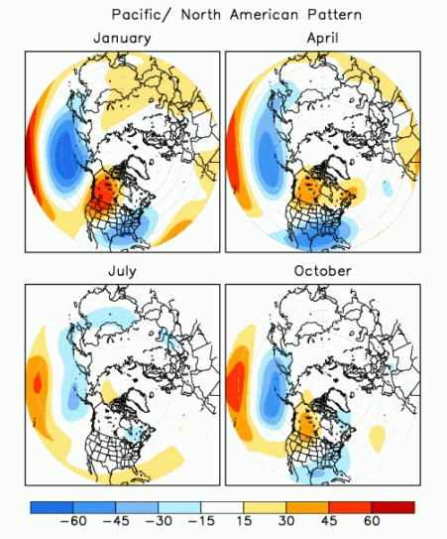
'Average' pattern for a positive phase of the PNA
Colors represent the 500 hpa
Geopotential height anomalies
[geopotential meters]
during a positive PNA index
with magnitude of
+1 std. deviation.
Deeper Aleutian Low
Note: PNA strongest signal
during winter months
Notes:
Here is shown the linear regression coefficient: that is the correlation between the local geopotential height anomalies and the defined PNA index
(which can be created in several ways, a simple method is to choose three representative locations in the centers of the Aleutian Low the high pressure over NW US/ Canada and tropical central Pacific and create a weighted average)

Slide 49
Positive phase of the PNA
above-average geopotential heights (pressure) in the vicinity of Hawaii and over the intermountain region of North America
below-average geopot. heights located south of the Aleutian Islands and over the southeastern United States.
above-average temperatures over western Canada and the extreme western United States
below-average temperatures across the south-central and southeastern U.S
More information: http://www.cpc.ncep.noaa.gov/data/teledoc/pna_map.shtml

Slide 50
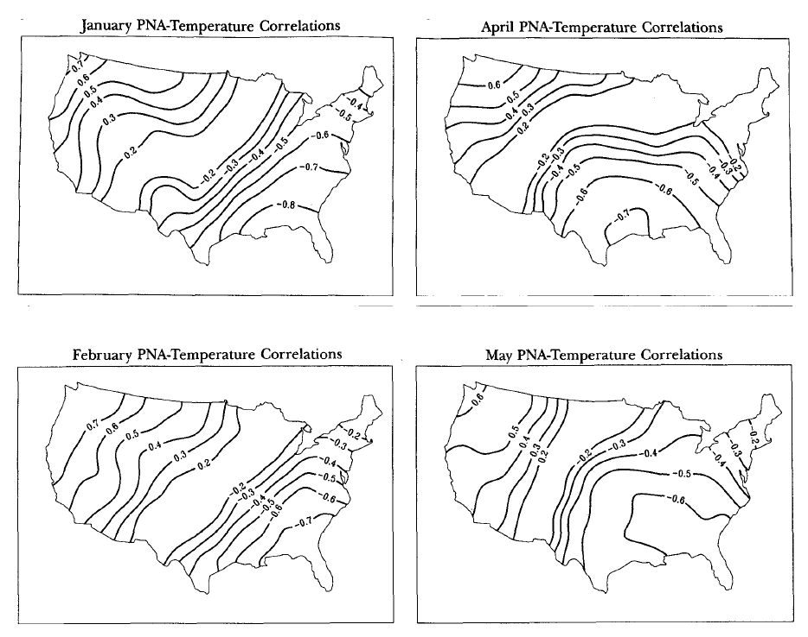
Influence of PNA variability on US climate
Effect on
Temperatures:
Positive correlations:
Above average
temperatures when
PNA is in a positive
phase.
Negative correlations:
Below average temp.
when PNA in positive
phase
Notes:
The Pacific/North American Teleconnection Pattern and United States Climate. Part I: Regional Temperature and Precipitation Associations
Daniel J. Leathers
J. Clim. 1991

Slide 51
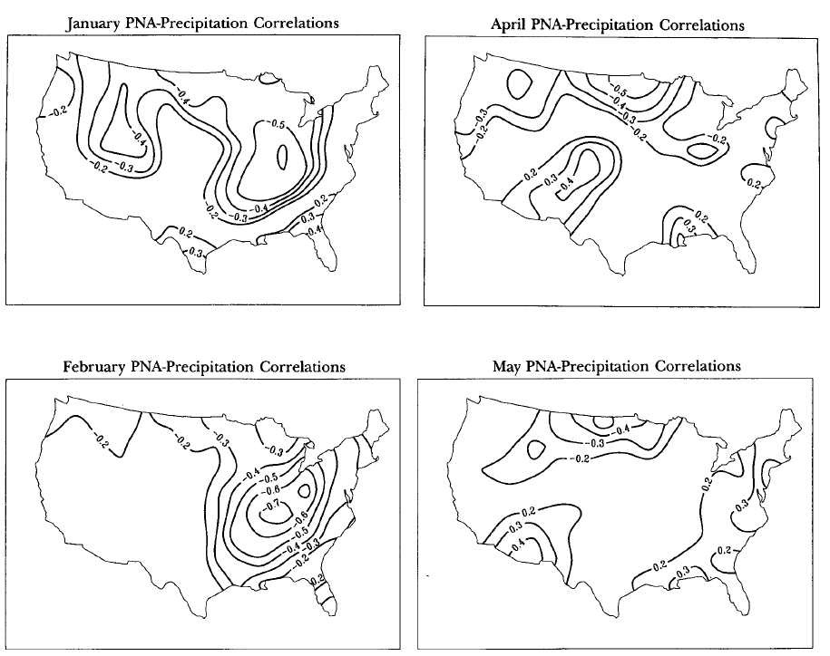
Influence of PNA variability on US climate
Effect on
Rainfall:

Slide 52
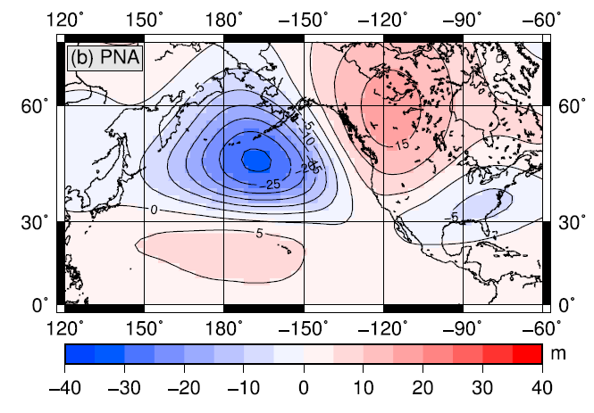
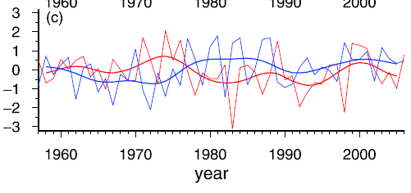
Pattern for a positive phase of the PNA
Typical Oct-April geopotenial height anomalies of the 500hPa level associated with a positive
PNA index value
of one standard deviation
unit.
Blue: October-April PNA index
(red: Oct-Apr SOI index)

Slide 53
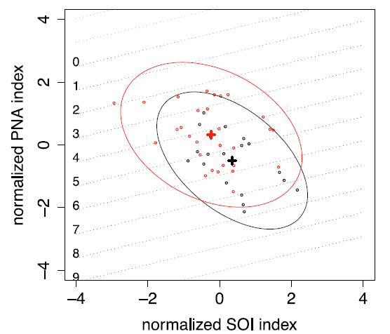
Relationship between SOI and PNA and long-term changes
Presentation of the tropical and North Pacific atmospheric circulation with the SOI and PNA index for periods 1958–1976 and 1977–2005.
each black dot marks one Oct-April
season from 1958-1976
each red dot marks a season from 1977-2005
(crosses are the averages of the two periods)
(Elison Timm et al., 2011)
Notes:
From Elison Timm et al. 2011

Slide 54
Relationship between SOI and PNA and long-term changes
Presentation of the tropical and North Pacific atmospheric circulation with the SOI and PNA index for periods 1958–1976 and 1977–2005.
each black dot marks one Oct-April
season from 1958-1976
each red dot marks a season from 1977-2005
(crosses are the averages of the two periods)
“Mid 1970s North
Pacific climate shift”
(Elison Timm et al., 2011)
Notes:
From Elison Timm et al. 2011

Slide 55
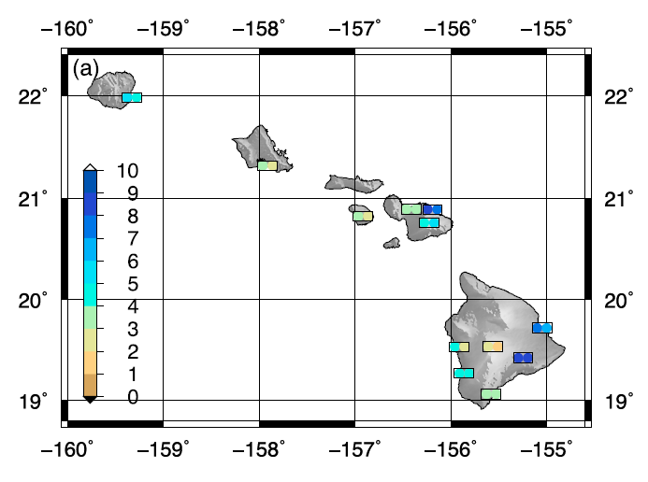
Regional Impacts: Rainfall in Hawaii
“Mid 1970s North
Pacific climate shift”
Left color: number of heavy rain days before 1976
Right color: number of heavy rain days after 1976
The average rainfall has decreased in recent decades and number of heavy rain days per season has gone down (at 12 stations).
(Elison Timm et al., 2011)
Notes:
From Elison Timm et al. 2011

Slide 56
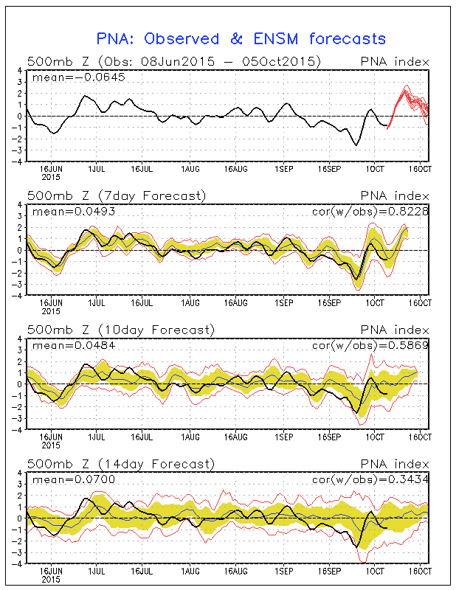
Daily PNA index forecast:
Part of routine weather forecast
operations:
7-10 day outlook
Good validation with past
Can we do more than the
weather prediction time scale?
Source: NOAA Climate Prediction Center

Slide 57
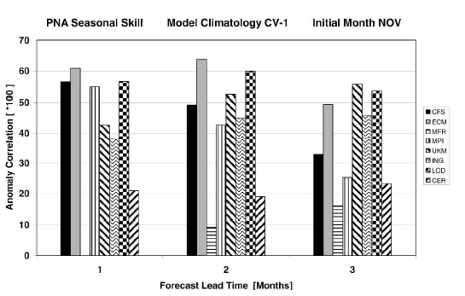
Seasonal PNA index forecast:
Notes:
The skill for seasonal forecasts of the PNA pattern are currently investigated.
But most of the PNA seasonal forecast skill is depending on the tropical Pacific and ENSO.

Slide 58
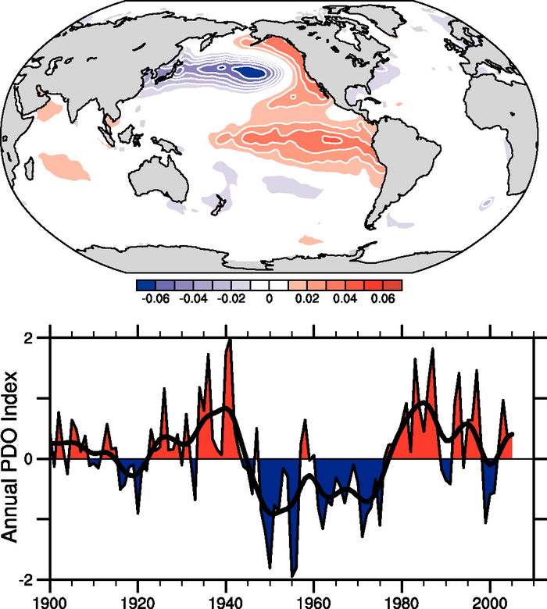
Pacific Decadal Oscillation (PDO)
Observed pattern of SST
anomalies in the
North Pacific Ocean
Notes:
Figure 3.28. Pacific Decadal Oscillation: (top) SST based on the leading EOF SST pattern for the Pacific basin north of 20°N for 1901 to 2004 (updated; see Mantua et al., 1997; Power et al., 1999b) and projected for the global ocean (units are nondimensional); and (bottom) annual time series (updated from Mantua et al., 1997). The smooth black curve shows decadal variations (see Appendix 3.A).
From IPCC AR4

