Slide 1
Winter-Quiz- Intermezzo
On each slide you will find a screenshot from R-studio / or some previous
theoretical statistical class material. You can find program code or
description/definition for the presented screenshot’s content in the class slides
in http://www.atmos.albany.edu/facstaff/timm/ATM315spring14/
You can also check on how easy it was to come to an answer.
Multiple choices are sometimes possible.
What R commands created exactly
this output?
Criteria | Check | Too easy | Just right | Hard | Way to hard
^{paste(1,2,4,8,16)}
^{c(1,2,4,8,16)} | +
^{print(1,2,4,8,16)}
^{read.table(1,2,4,8,16)}

Slide 2
Winter-Break Quiz
What R command created
this output at the command console >?
Criteria | Check | Too easy | Just right | Hard | Way to hard
 | +
 | +

Slide 3
Winter-Break Quiz
[1] 5
What R commands created
this output at the command console >?
Criteria | Check | Too easy | Just right | Hard | Way to hard
 | +
 | +

Slide 4
Winter-Break Quiz
What R commands created
this output at the command console >?
Criteria | Check | Too easy | Just right | Hard | Way to hard
 | +
 | +
 | +

Slide 5
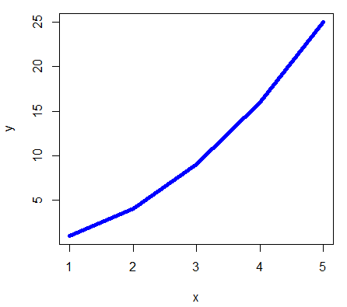
Winter-Break Quiz
What R commands created
this output at the command console >?
Criteria | Check | Too easy | Just right | Hard | Way to hard
 | +

Slide 6
Winter-Break Quiz
What R commands created
this output at the command console >?
Criteria | Check | Too easy | Just right | Hard | Way to hard
 | +
 | +

Slide 7
Winter-Break Quiz
What R-code gives this result?
Criteria | Check | Too easy | Just right | Hard | Way to hard
 | +
 | +
 | +

Slide 8
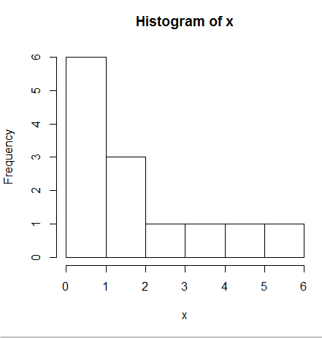
Winter-Break Quiz
What R-code gives this result?
Criteria | Check | Too easy | Just right | Hard | Way to hard
 | +

Slide 9
Winter-Break Quiz
Consider you have been given the following daily minimum temperatures
all in units of degree Celsius [C]:
-1, 4, -10, -19, 0, 20, 3, 4, -5, -6
Later it turned out, the 20 C was an error and should have been 2.
You calculated the arithmetic mean with the erroneous value included.
How much do you expect the error to affect the mean estimation
Criteria | Check | Too easy | Just right | Hard | Way to hard
 | +
 | +
Less than 10%
About 2 degrees C
About 10% of the error in the erroneous value
The random error cancels out in the calculations

Slide 10
Winter-Break Quiz
Consider you have been given the following daily minimum temperatures
all in units of degree Celsius [C]:
-1, 4, -10, -19, 0, 20, 3, 4, -5, -6
Later it turned out, the 20 C was an error and should have been 2
You calculated the median with the erroneous value included.
How much do you expect the error to affect the median estimation?
Criteria | Check | Too easy | Just right | Hard | Way to hard
 | +
9 degrees
In general less than the mean
In general more than the mean
The sample size is even,
and median estimate makes no sense

Slide 11
Winter-Break Quiz
Consider you have been given the following daily minimum temperatures
all in units of degree Celsius [C]:
-1, 4, -10, -19, 0, 20, 3, 4, -5, -6
Later it turned out, the 20 C was a error and should have been 2
You calculated the variance with the erroneous value included.
What effect does this outlier have on the variance estimate ?
Criteria | Check | Too easy | Just right | Hard | Way to hard
 | +
 | +
It increases the variance by no more than 10%
The variance is overestimated
The variance increases by about 10 deg C
The variance is about 2 time larger if the
erroneous value is included

Slide 12
Winter-Break Quiz
Consider you have been given the task
to measure the size of a rectangular parking lot: You measure both sides a, b 5 times in
units of ft, independently from each other.
(i.e. you first measure a, afterwards b)
For b you get: 510, 498, 512, 495, 497
For a you get: 150, 151, 148, 149, 152
What is the best estimate for mean of the area F?
Area F
a
b
Criteria | Check | Too easy | Just right | Hard | Way to hard
 | +
First I calculate the averages for a and b, then I
multiply them.
I use the five values of a and the five of b,
and multiply them to get five estimates for F
and then I get the average for F
I use all 25 combinations from the five length measurements of a
and the five of b to estimate the area F,
then I calculate the average.
I only need one pair of values from the measurements.
Using more does not reduce the error in my estimate,
because they are independent samples of the same quantities

Slide 13
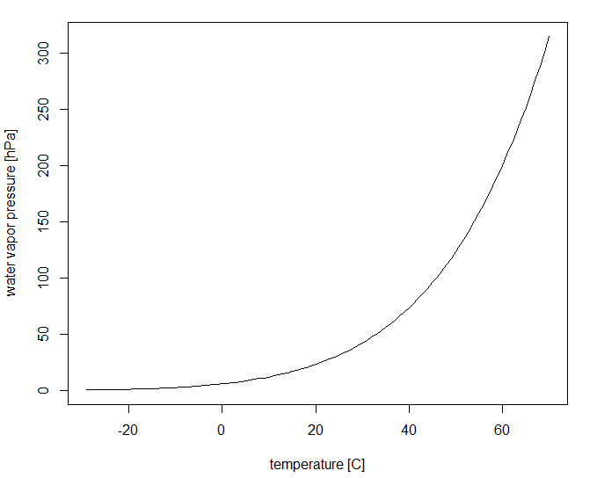
Winter-Break Quiz
Magnus formula:
Consider you have been given temperature
observations in degree Celsius on a summer day: 20, 24, 21, 30, 32, 18, 19
But no direct observations for water vapor saturation pressure was possible.
What is the best estimate for saturation pressure of water vapor on that day using the Magnus formula (see web directory scripts/myfunctions.R)?
Criteria | Check | Too easy | Just right | Hard | Way to hard
 | +
Either way, I first average the temperature and convert the average
temperature with the Magnus formula, or I can calculate for each
temperature the saturation pressure and then take the average
First I calculate the average temperature and then
use the Magnus formula with the average temperature
Who cares? Statistics is only a theoretical concept.
I trust the measurements more than the statistical estimates.
To avoid a bias in my estimated mean saturation pressure, I first
calculate for each temperature the saturation pressure, and then
I take the average of the 7 pressure values.

Slide 14
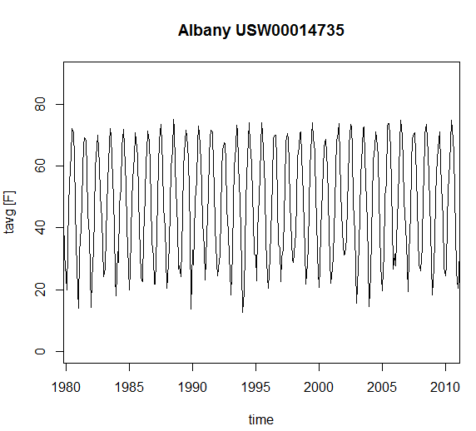
Winter-Break Quiz
You have plotted the monthly mean air temperatures
from Albany airport over the last 30 years.
What is the periodic cycle in this figure?
Criteria | Check | Too easy | Just right | Hard | Way to hard
 | +
In fact all these ups and downs are random,
they just appear organized in this type of plot.
The seasonal cycle with coldest temperatures
during winter and warmest during summer
There is no evidence for a dominant periodic cycle.
Thirty years are way too short to see any cycles.

Slide 15
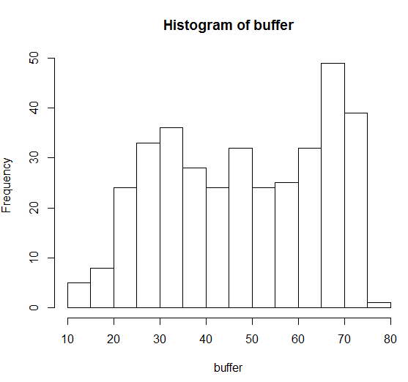
Winter-Break Quiz
The temperature data from the previous plot are
plotted here in a histogram with temperatures
on the x-axis in F. What does it mean when you see
the bar located just below the 70F mark on the x-axis
reaches the mark 50 on the y-axis?
Criteria | Check | Too easy | Just right | Hard | Way to hard
 | +
The histogram shows the climatological seasonal cycle.
maximum temperatures were reached in the middle of the cycle
after 50% was completed. Starting in January, that means in July.
Histograms are just a fancy way for statisticians
to manipulate the real meaning of the data. There is no relation between frequencies and temperatures
The histogram shows how often temperatures fall
into a specific temperature range. The temperature
range 65-70 F was observed in about 50 months.
The Histogram measures the period of the cycles in the time
series. A frequency of 50 means a period of half a year.
The bar at 65-70 F is our seasonal cycle.

Slide 16
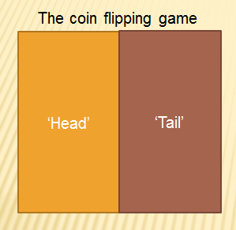
Winter-Break Quiz
You observe a gambler on the street having a
winning streak of 19 consecutive wins
(i.e. he predicted the top side of the coin 19 times right). What are the chances he/she extends
in the next game his streak to a phenomenal 20?
(Assume a fair game: no coin manipulation)
Criteria | Check | Too easy | Just right | Hard | Way to hard
 | +
1/2 to the power of 20 (<0.0001%)
After 19 times guessing right, it is long overdue
That the gambler looses on his/her next guess.
His chances decrease with every toss by 1/2
His chances are 50%

Slide 17
Winter-Break Quiz
You observe a gambler on the street having a
winning streak of 19 consecutive wins
(i.e. he predicted the top side of the coin 19 times right). With every win he doubled his previous prize
money. He had $2 after the first, $4 after
the second. How much money is on the table for
the gambler, if he/she wins the 20th toss again.
Criteria | Check | Too easy | Just right | Hard | Way to hard
 | +
 | +
2*$20=$40
$2^20=1048576
$20^2=$400
More than a million

Slide 18
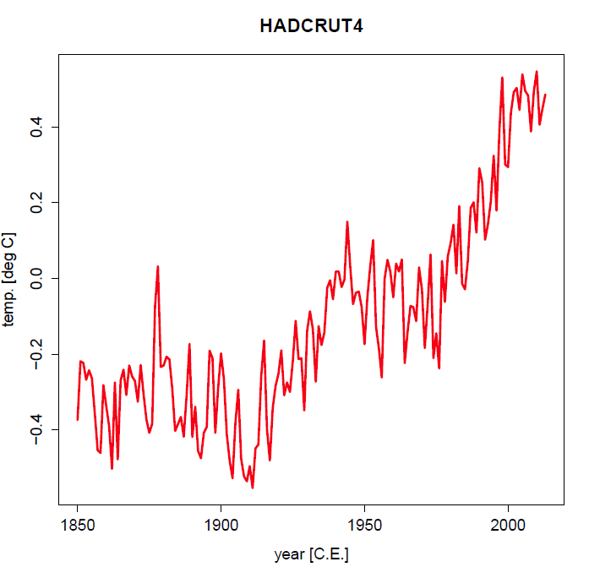
Winter-Break Quiz
Shown on the left is the global mean temperature
Anomaly time series (annual means) from 1850 to 2010.
If two gamblers played the game of predicting the global
mean temperatures from 1950 to 2010.
Player 1 always puts $1 on “next year will be cooler than this year”
Player 2 always puts $1 on “next year will be warmer than this year”
Who would have made more money by the end of 2010?
The winner earns the $2.
Criteria | Check | Too easy | Just right | Hard | Way to hard
 | +
Both will have more or less the same, because the fluctuations are still randomly going up and down.
Player 1 will have more, because there are more sharp kinks
downward than upward.
Player 2 will have more, because there is a general upward
trend on top of the random fluctuations.
Since weather is not predictable for more than 5, 10 maybe 14
days there exists no predictable trend in the climate. Both players
are loosing in the end trying to predict the unpredictable.

Slide 19
Winter-Break Quiz
Shown on the left is the global mean temperature
Anomaly time series (annual means) from 1850 to 2010.
If two gamblers played the game of predicting the global
mean temperatures from 1950 to 2010.
Player 1 always puts $1 on “next year will be cooler than 1950”
Player 2 always puts $1 on “next year will be warmer than 1950”
Who would have made more money by the end of 2010?
The winner earns the $2.
Criteria | Check | Too easy | Just right | Hard | Way to hard
 | +
Both will have more or less the same, because the fluctuations are still randomly going up and down.
Player 1 will have more, because there are more sharp kinks
downward than upward.
Player 2 will have more, because there is a general upward
trend on top of the random fluctuations.
Since weather is not predictable for more than 5, 10 maybe 14
days there exists no predictable trend in the climate. Both players
are loosing in the end trying to predict the unpredictable.

Slide 20
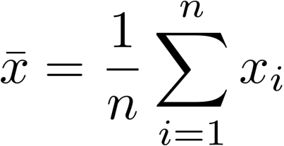
Winter-Break Quiz
Consider you have taken already 30 measurements
of the daily rainfall amounts at one station here in NY.
(your research focus is on days with measurable
rainfall during mid-latitude storms).
You already calculated the average rainfall.
The next day a tropical storm dumps 10 times
the average rain amounts. How much do you expect the
average to change when you include this extreme event?
Criteria | Check | Too easy | Just right | Hard | Way to hard
 | +
 | +
I can expect about a 30% change from the old
to the new average rainfall estimate.
With already 30 measurements a single get’s only
a small weight of 1/30 (about 3%).
This depends on the actual values. Without that I cannot make any quantitative statement.
I decide to exclude this observation, because my
research project is about extra-tropical storms.

