Slide 1
Introduction to Unix/Linux, WRF-Python, and NCAR Supercomputing system
AATM 419/563
Fall 2025

Slide 2
Throughout the course, we are going to be using text-based commands to make sure the necessary files are in the appropriate place and to run the model.
There are many options for getting access to the “terminal” or its equivalent, depending on your system.
Will show methods that you can run from your own device along with a JupyterHub solution.

Slide 3
Mac users
It is best to use the terminal app from Applications/Utilities
You need to install XQuartz, if you do not have it already. Terminal will launch XQuartz when needed. https://www.xquartz.org
iPad users can download an app, such as Termius
Windows users
You can download MobaXTerm to create a terminal
This is present on UAlbany machines

Slide 4

NCAR Supercomputing System
The NCAR supercomputing system consists of two primary components: Derecho and Casper. We will use both
  Derecho – CPU and GPU-based system that can be used to carry out large calculations. All of the model runs will be carried out on this system
Derecho can be accessed from the Terminal by connecting to one of the login nodes, which is how you run the modeling system
Access through ssh: yourncarid@derecho.hpc.ucar.edu
  Need to enter password and accept the DUO push notification
You only access the login nodes, you never access the actual computing system (more later)

Slide 5
Login 1
Login 2
Login 3
Login 4
Login 5
Login 6
Scheduling System or Queue (PBS)
Manages jobs, sets priority, makes sure system is being utilized well
CPU Nodes (2488)
GPU Nodes (82)

Slide 6
Number of Cores | 145,152 processor cores | 2.3-GHz Intel Xeon E5-2697V4 (Broadwell) processors. 16 flops per clock | 323,712 processor cores | 3rd Gen AMD EPYC™ 7763 Milan processors
Number of Nodes | 4,032 comp nodes | Dual-socket nodes, 18 cores per socket | 2,488 CPU-only computation nodes + 82 GPU nodes | Dual-socket nodes, 64 cores per socket 256GB DDR4 memory per node. GPUs are Single-socket nodes, 64 cores per socket 512GB DDR4 memory per node, 4 x NVIDIA 1.41 GHz A100 Tensor Core GPUs per node and 600 GB/s NVIDIA NVLink GPU intercont.
Number of Login Nodes | 6 login nodes | Dual-socket nodes, 18 cores per socket. 256 GB memory/node | 6 CPU login nodes + 2 GPU develop and testing nodes | Dual-socket nodes with AMD EPYC™ 7763 Milan CPUs, 64 cores per socket, 512GB DDR4-3200 memory. Dual-socket nodes with AMD EPYC™ 7543 Milan CPUs, 32 cores per socket, 2 NVIDIA 1.41 GHz A100 Tensor Core GPUs per node 512GB DDR4-3200 memory
Total Memory | 313 TB total system memory | 64 GB/node on 3,168 nodes, DDR4-2400. 128 GB/node on 864 nodes, DDR4-2400 | 692 TB total system memory | 637 TB DDR4 memory on 2,488 CPU nodes 42 TB DDR4 memory on 82 GPU nodes 13 TB HBM2 memory on 82 GPU nodes
Interconnect | Mellanox EDR InfiniBand high-speed interconnect | Partial 9D Enhanced Hypercube single-plane interconnect topology. Bandwidth: 25 GBps bidirectional per link Latency: MPI ping-pong < 1 µs; hardware link 130 ns | HPE Slingshot v11 high-speed interconnect | Dragonfly topology, 200 Gb/sec per port per direction. 1.7-2.6 usec MPI latency. CPU-only nodes - one Slingshot injection port. GPU nodes - 4 Slingshot injection ports per node
Sust Equiv Perf (SEP) | 3 times Yellowstone computational capacity | Comparison based on the relative performance of CISL High Performance Computing Benchmarks run on each system. | ~3.5 times Cheyenne computational capacity | Comparison based on the relative performance of CISL's High Performance Computing Benchmarks run on each system.
Peak Performance | 3.5x Yellowstone peak perf | 5.34 peak petaflops (vs. 1.504) | 3.5x Cheyenne peak perf | 19.87 peak petaflops (vs 5.34)

Slide 7
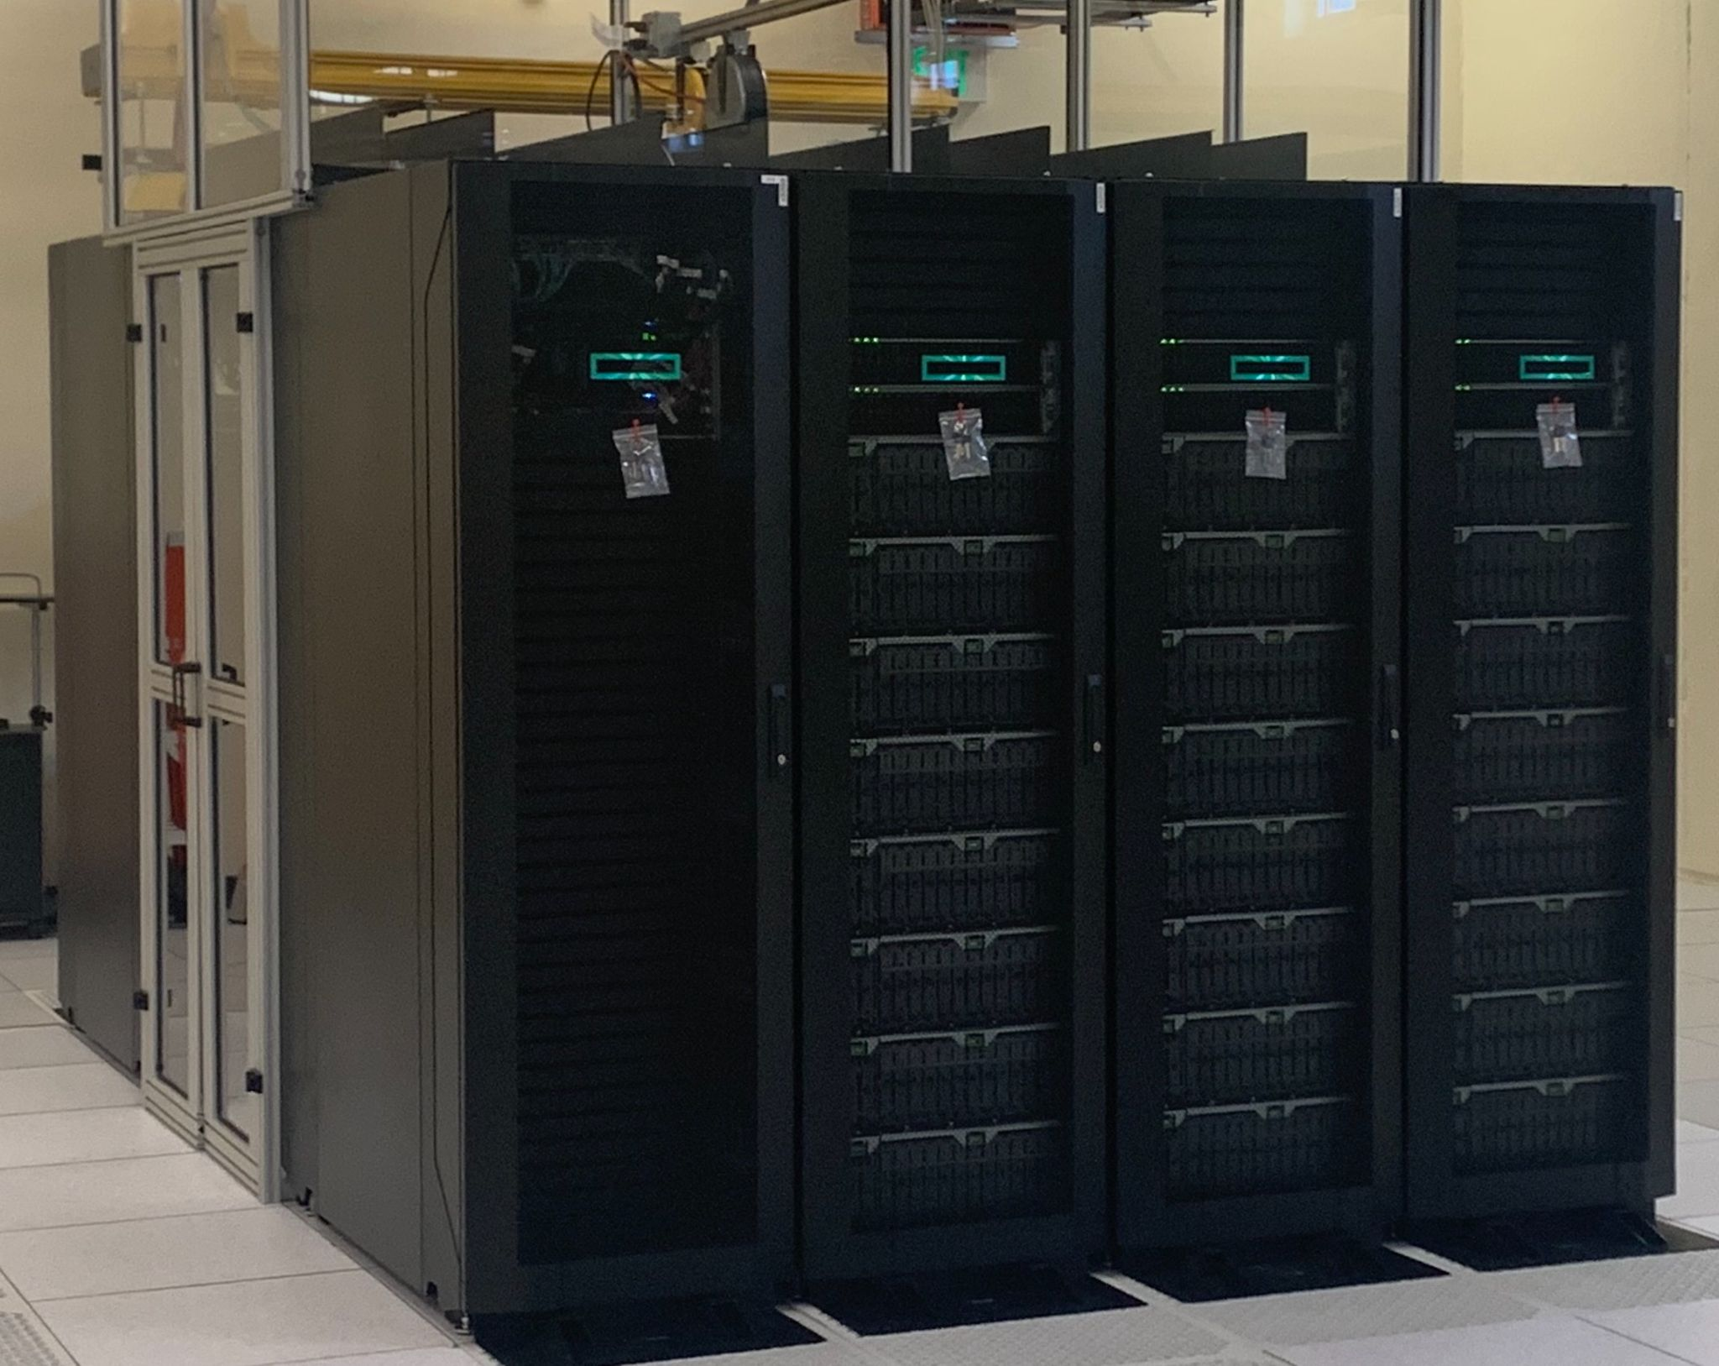
Glade File System
Each person will have two spaces:
  /glade/home
  /glade/scratch
/glade/home is your home directory. This space is small, but backed up. JupyterHub instances will use this directory. This space is best for keeping code and things you want to save.
/glade/scratch is a work directory. This is a large space, but not backed up. The items in this directory are deleted after a period of time, so do not store anything you don’t want to eventually delete.

Slide 8
Casper
Casper – Data analysis and visualization cluster. This system is best used for running JupyterHub instances and creating output plots
To access: ssh yourncarid@casper.hpc.ucar.edu
Has access to all of the /glade directories that are on derecho
This computer has different architecture than derecho. Cannot run model created on derecho on Casper

Slide 9
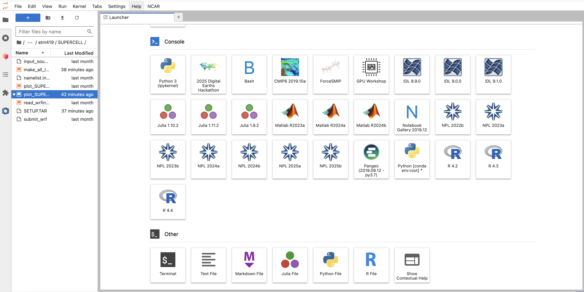
Jupyterhub
Both derecho and casper support Jupyterhub instances, which can be accessed via: https://jupyterhub.hpc.ucar.edu/
  Select derecho or casper after launch (be patient)
  Derecho or casper nodes cost computing time
Can also access terminal to derecho and casper via terminal option:

Slide 10
Jupyterhub
When you are finished, make sure to:
  File -> Close and Shut Down
  NCAR -> My Servers, click STOP
This makes sure resources are available to others!

Slide 11
Text editing
Options for editing text files:
  vi editor: the old and venerable (worth learning). See “How to use the vi editor” document on class web page
  nano or emacs: available on the headnodes
  Via Jupyter notebook [most common]
    Launch notebook, create/use a symbolic link to your scratch space

Slide 12
Log onto derecho
From Mac or Linux:
ssh -Y yourncarid@derecho.hpc.ucar.edu
From Windows using MobaXTerm:
from the Sessions menu, choose “New session”
from the Sessions settings window, select “SSH”
in Basic SSH settings, enter as “remote host” derecho.hpc.ucar.edu and select “specify username” (and enter your NCAR ID)
Once you enter your password, you will be prompted to accept duo notification. You can also put a comma after password and add duo code afterward
PLEASE LOG ON NOW

Slide 13
Some Unix basics
(basis of Linux and Mac OS X)
The command prompt is $ (don’t type, prompt)
Unix commands presented in Courier font
$ ls
[lists your “visible” files]
$ ls -a
[lists all files, including invisible]
$ ls -al
[lists all files, includes size & other info]
$ pwd
[print working directory - shows your location]

Slide 14
Some Unix basics
(continued)
$ mkdir TEST
[makes a directory called “TEST” – upper case]
$ cd TEST
[changes directory to “TEST”]
$ cd ..
[moves UP in directory hierarchy]
$ cd TeST
[command should FAIL… Unix is usually CASE SENSITIVE – though it usually isn’t on Mac]

Slide 15
Some Unix basics
(continued)
$ touch crap.txt
[makes an empty file]
$ cp crap.txt crap.txt.backup
[make a copy with cp] [Filename extensions are generally meaningless in Unix]
$ rm -i crap.txt
[the remove command. Asks for confirmation.]
$ \rm crap.txt
[removes without confirmation. Think before hitting ENTER!]
Notes:
Learn to use vi
File extensions are meaningless in Unix. You can have long, cumbersome filenames w/ multiple punctuation marks

Slide 16
Some Unix basics
(continued)
$ mkdir BACKUP
[makes a new directory]
$ cp crap.txt.backup BACKUP/.
[type exactly as written - there is NO space before the period]
[the period here means “keep the same name”]
[in this particular application, the period is optional]
[now there are 2 independent versions of this empty file]
$ ls -l BACKUP/
[see the file is in the new location]
Notes:
Got to here 2021 Class 1

Slide 17
Some Unix basics
(continued)
$ mkdir BACKUP/more_backup
[a new subdirectory in a directory]
$ cd BACKUP/more_backup
[move to new subdirectory]
$ cd
$ pwd
[cd by itself always takes you to your home directory]
Notes:
Got to here 2022/1

Slide 18
Some Unix basics
(continued)
$ cp /network/rit/lab/atm419lab/DATA/part* .
[asterisk is wild card character. There IS a space before the period]
[this copies all files matching text pattern to your directory]
$ ls part*
[lists files matching pattern]
$ cat part1 part2 > both_parts
[concatenates files]
[greater-than sign is output redirect]
$ more both_parts
[more lists contents, one screen at a time]
[hit space bar for next screenful; type “q” to quit]

Slide 19
Tab completion can save typing!
Tab completion → start typing out a filename, then hit TAB key to see if system can figure out what you’re interested in
  You usually have to provide several characters starting out
  System will stop completing at point where more than one possible destination exists
Try this – and keep in mind you can use tab completion more than once per line
$ more /glade/work/torn/REALLY-REALLY:LONG_AND:ANNOYING-FILENAME.TxT

Slide 20
“Piping”
Piping is routing output from one command as input to another command issued on the same line.
  The pipe command is the vertical line symbol sharing the backslash key: “|”
  Multiple pipes are permitted
Examples
$ w | grep bash
$ qstat | grep torn

Slide 21
ls vs. ls -a
By default, Unix hides files and directories that start with a period. Compare these commands:
$ ls
$ ls -a
One of these hidden directories is .snapshot, which contains your automatic backups.

Slide 22
Your Unix PATH
$ cp /glade/u/home/torn/atm419/execute_me .
$ ls execute_me
$ execute_me
- The PATH is an environment variable that tells Unix where to find stuff, and the order in which to look
- if you receive execute_me: command not found your PATH does not look in your current directory
$ ./execute_me
- Including ./ forces Unix to look in the current directory for the program you are requesting
Notes:
Got to here class 1 2020

Slide 23
Fortran compiler
Try this command
$ which ifort
If you get this… we definitely need to alter your Unix environment
$ ifort: Command not found
Notes:
Got to here 2019

Slide 24
The following modifications are for NEW NCAR USERS ONLY

Slide 25
Which shell are you using?
$ ps -p $$
PID TTY TIME CMD
16511 pts/32 00:00:00 bash
Unix/Linux supports several “shells” (environments
that interpret commands): bash, sh, csh, tcsh, ksh, zsh
If your shell is NOT bash or tcsh, let me know.
Notes:
Kevin now gives new users bash

Slide 26
Preparation for new bash users ONLY
$ cd
$ mv .bashrc .bashrc_old
[mv is move command]
[.bashrc is script file of commands, paths, etc., executed for every new terminal window] {this file may not exist}
$ cp /glade/u/home/torn/atm419/atm419_bashrc .bashrc
[type exactly as shown. Consider tab completion.]
$ source .bashrc
[changes to script file in present window do not take effect until “sourced”]
$ which ifort
[see: /glade/u/apps/derecho/24.12/spack/opt/spack/ncarcompilers/1.0.0/oneapi/2024.2.1/3aiv/bin/ifort]

Slide 27
Preparation for new tcsh users ONLY
$ cd
$ mv .cshrc .cshrc_old
[mv is move command]
[.cshrc is script file of commands, paths, etc., executed for every new terminal window] [many of you do not have this file yet]
$ cp /glade/u/home/torn/atm419/atm419_cshrc .cshrc
[type exactly as shown. Consider tab completion.]
$ source .cshrc
[changes to script file in present window do not take effect until “sourced”]
$ which ifort
[see: /glade/u/apps/derecho/24.12/spack/opt/spack/ncarcompilers/1.0.0/oneapi/2024.2.1/3aiv/bin/ifort]
Notes:
The “rc” in cshrc = “run commands”

Slide 28
Home and lab space
Your home directory is
/glade/u/home/yourncarid
Your class lab directory will be
/glade/derecho/scratch/yournetid/atm419
NOTE: Your lab space will be removed after end of semester

Slide 29
Make links to your scratch space
$ cd
$ pwd
$ mkdir –p /glade/derecho/scratch/yournetid/atm419
$ ln –sf /glade/derecho/scratch/yournetid/atm419 lab
$ cd /glade/derecho/scratch/yournetid/atm419
$ pwd
This makes sure you can access the workspace when using JupyterHub since it can only see your home directory.

Slide 30
Shortcuts
$LAB proxy for /glade/work/torn/atm419/
lab alias for cd /glade/derecho/scratch/yournetid/atm419
[For $LAB, the $ is part of the proxy, not the Unix prompt]

Slide 31
Plotting with Python on Casper
[WRF-python and matplotlib]
Example: WRF idealized 2D
sea-breeze simulation

Slide 32
Preparation for seabreeze case
Create the EXAMPLE directory in your lab space
$ lab
$ mkdir EXAMPLE
$ cd EXAMPLE
Copy into it the example notebook
$ cp $LAB/EXAMPLE/plot_seabreeze2D.ipynb .

Slide 33
Running jupyter on NCAR Computers
In your web browser, go to https://jupyterhub.hpc.ucar.edu
Log on with your NCAR ID and password, validate with duo
You may be asked to select an option from a drop down menu: select “Casper login”
You will start in your home directory.
  Sort by “Last modified” (button at upper right of file list).
  Click twice to bring latest files in view.
Click on your scratch link. Then click on EXAMPLE folder
Then click on the plot_seabreeze2D.ipynb notebook
Select npl-2024b kernel
Don’t forget File > Close and Shut Down and NCAR > My Servers (Stop) when you are done

Slide 34
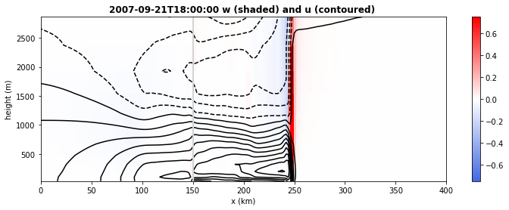
Vertical x-section at 13th output time
plot_seabreeze2D.ipynb
Notes:
Showing more of the domain than did w/ GrADS version

Slide 35
Tour of notebook - 1
plot_seabreeze2D.ipynb
import numpy as np
from math import pi, cos, sin
import matplotlib.pyplot as plt
from matplotlib.cm import get_cmap
from matplotlib.colors import LinearSegmentedColormap
# WRF stuff
from netCDF4 import Dataset
from wrf import (getvar, to_np, get_cartopy, latlon_coords,
vertcross, ll_to_xy,
cartopy_xlim, cartopy_ylim, interpline,
CoordPair, destagger, interplevel, ALL_TIMES)

Slide 36
Tour of notebook - 2
plot_seabreeze2D.ipynb
# specify where our wrfout files are located
location = "/glade/work/torn/atm419/EXAMPLE/SEABREEZE_30LAT/"
file = "wrfout_d01_2007-09-21_06:00:00”
ncfile = Dataset(location + file)
# get WRF variables for all times in our output collection
# these are xarrays, so sometimes we need ".values" to strip out metadata
z = getvar(ncfile, "z") # height coordinate
ua = getvar(ncfile, "ua", units="m s-1",timeidx=ALL_TIMES) # U on mass points
va = getvar(ncfile, "va", units="m s-1",timeidx=ALL_TIMES) # V on mass points
wa = getvar(ncfile, "wa", units="m s-1",timeidx=ALL_TIMES) # W on mass points
theta = getvar(ncfile, "theta", units="K",timeidx=ALL_TIMES) # THETA on mass points
# 10 m wind speed: 2nd column of uvmet10_wspd_wdir is wdir
wspd10 = getvar(ncfile, "uvmet10_wspd_wdir", units="m s-1",timeidx=ALL_TIMES)[0,:]
# output times
time = getvar(ncfile, "Times", timeidx=ALL_TIMES) # time is a datetime variable

Slide 37
Tour of notebook - 3
plot_seabreeze2D.ipynb
########################################################################
# 2D x-z plot of cross-shore and vertical velocity at a specified time
########################################################################
# specify time for plotting and extract variables for that time
print(" we have ",ua.shape[0]," times available ")
itime = 12 # our time selection. keep in mind this is numbered from zero!
# define our plotting variables (subsets of our WRF variables)
height=z[:,0,0]
uwind=ua[itime,:,0,:]
wwind=wa[itime,:,0,:]
theta2D=theta[itime,:,0,:]
timenow=time[itime]
# define the x-axis for this idealized domain
x=np.arange(0,uwind.shape[1],1)
# extent of the x domain
xextent=(uwind.shape[1]-1)*2.0 # assumed 2 km grid spacing
print(" extent of x-axis is ",xextent," km")

Slide 38
Tour of notebook - 4
plot_seabreeze2D.ipynb
# ------------------------------------------------------------------------------
# create the figure
# ------------------------------------------------------------------------------
plt.figure(figsize=(12, 4))
# color-shaded plot - vertical velocity
norm = plt.Normalize(-0.75, 0.75)
colors = ['royalblue', 'white','red']
cmap = LinearSegmentedColormap.from_list('name', colors)
cm = plt.pcolormesh(x,height[0:12],wwind[0:12,:],shading='flat',norm=norm, cmap=cmap)
plt.colorbar(cm, orientation="vertical")
# contour plot - horizontal cross-shore (u) velocity
levels=np.arange(-10,10)
plt.contour(x,height[0:12],uwind[0:12,:],colors='k',levels=levels)
plt.ylabel("height (m)")
# control labels on x-axis. each grid point is 2 km apart. this is hardcoded.
xlabels=np.arange(0,xextent+50,50,dtype=int) # specify labels for x-axis ticks
locs, labels = plt.xticks() # default locations and tick labels for x-axis ticks
plt.xlabel(" x (km) ")
# add on the coastline marker
plt.axvline(x=75, lw=2,c='lightgrey’)
[…]

Slide 39
Tour of notebook - 5
plot_seabreeze2D.ipynb
#######################################################################
# Hovmoller plot of 10 m wind speed
#######################################################################
u_hov = wspd10[:,0,:] # 10 m wind speed
print(" shape of u_hov ",u_hov.shape)
# define the time dimension for this idealized domain
# hardcoded to 1-h increments
t=np.arange(0,ua.shape[0],1)
plt.figure(figsize=(10, 8))
# color-shaded plot - 10m wind speed
norm = plt.Normalize(0,6)
colors = ['white','red']
cmap = LinearSegmentedColormap.from_list('name', colors)
cm = plt.pcolormesh(x,t,u_hov,shading='flat',norm=norm, cmap=cmap)
plt.colorbar(cm, orientation="vertical")
# contour the 10m wind speed too
levels=np.arange(0,6.5,0.5)
plt.contour(x,t,u_hov,colors='k',levels=levels)
plt.ylabel("time (h)")

Slide 40
Tour of notebook - 6
plot_seabreeze2D.ipynb
# control labels on x-axis. each grid point is 2 km apart. this is hardcoded.
xlabels=np.arange(0,xextent+50,50,dtype=int) # specify labels for x-axis ticks
locs, labels = plt.xticks() # default locations and tick labels for x-axis ticks
#print(locs,labels)
plt.xlabel(" x (km) ")
# add on the coastline marker
plt.axvline(x=75, lw=2,c='lightgrey')
plt.title(" Hovmoller of 10m wind speed ",fontweight="bold")
plt.savefig("seabreeze_hov.png", bbox_inches = 'tight')
plt.show()

Slide 41
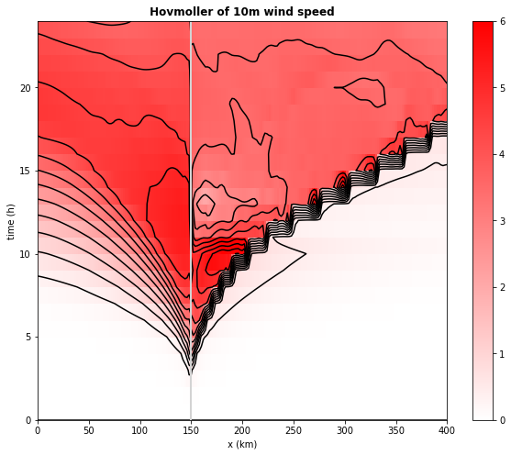
Why does the sea-breeze
front appear to “lurch”?
plot_seabreeze2D.ipynb

Slide 42
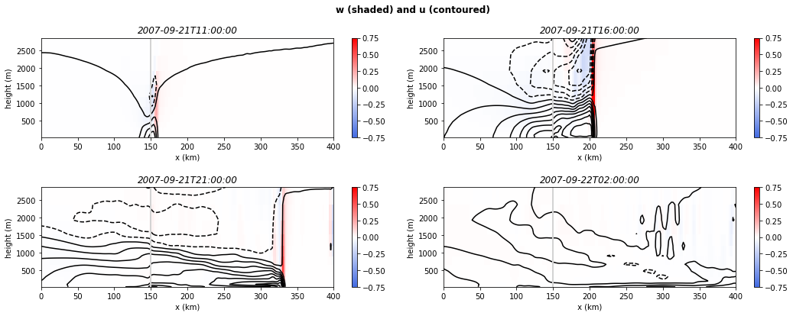
4-panel plot of different times
[uses add_subplot]
plot_seabreeze2D.ipynb
Don’t forget to close and halt when you’re done!
We don’t need 4 identical colorbars, so some improvement can be made
Notes:
Improvements: don’t need 4 identical colorbars, or vertical axis labels for top right and bottom right plots

Slide 43
Some references
WRF model users’ page
  https://www2.mmm.ucar.edu/wrf/users/
WRF version 4.6 namelist
  https://www2.mmm.ucar.edu/wrf/users/wrf_users_guide/build/html/namelist_variables.html
WRF-ARW version 4.6 user guide (HTML)
  https://www2.mmm.ucar.edu/wrf/users/wrf_users_guide/build/html/index.html
NetCDF documentation
  https://www.unidata.ucar.edu/software/netcdf/
WRF-python
  https://wrf-python.readthedocs.io/en/latest/
Matplotlib
  https://matplotlib.org

