Slide 1
What is a numerical weather prediction model?

Slide 2
Everyone has their favorite modeling site….
https://www.tropicaltidbits.com/analysis/models/
https://polarwx.com/models
But how are these created?

Slide 3
“The integration of the governing equations of hydrodynamics by numerical methods subject to specified initial conditions” - AMS Glossary
  Application of the physical equations you learned in other courses
Often a collection of different models into a single software package
NWP requires trade off between speed and accuracy. Forecast must be finished soon enough to be useful for prediction

Slide 4

NWP System Flowchart
Observations
Post Processed Information
Dynamical Model (equations)
Initial State
(Data Assimilation)
Dynamical Core
Graphical Info.
Parameterizations
Other Models
Boundary Information (regional models)

Slide 5
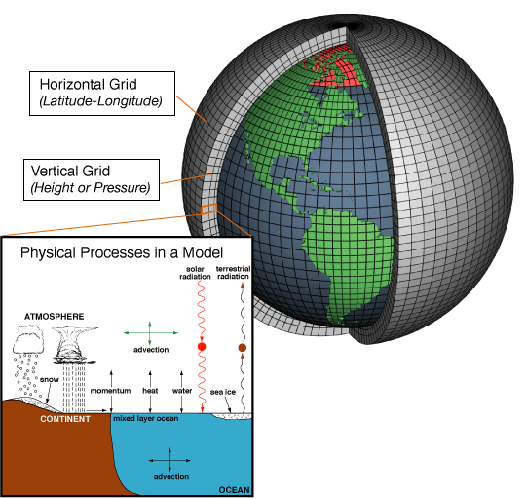
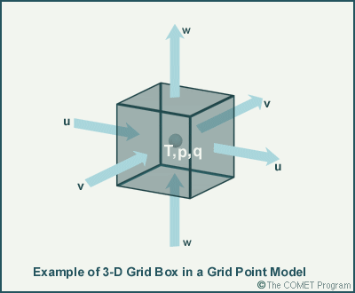
Model Grids
Courtesy: NOAA

Slide 6
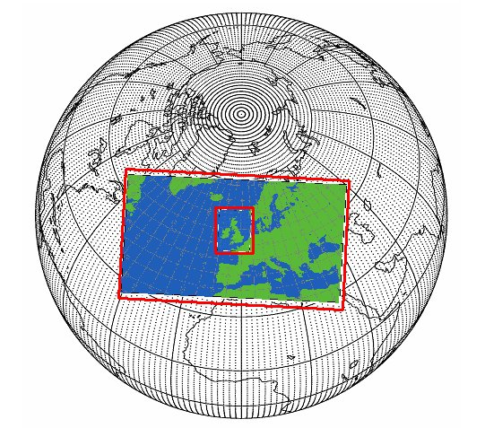
Global Model
  Simulates atmosphere everywhere on the globe
  Requires many grid points, including places you may not be interested in
Limited-Area Model
  Model simulations are performed over a smaller region
  Can limit simulation to area of interest
  Allows for higher resolution
  Requires information on what is going on at the edges of domain
Brown 2008

Slide 7
Initialization
Models need a starting point, often in form of a gridded analysis
Can start with previous model forecast valid at initialization time
  Contains errors and biases
Observations tell you information about what the atmosphere looks like
  Not regularly distributed around the globe
  Do not always directly measure model variables
Data Assimilation is the process that tries to combine the information from observations with a gridded short term forecast
Each source has unique errors associated with it that needs to be accounted for

Slide 8
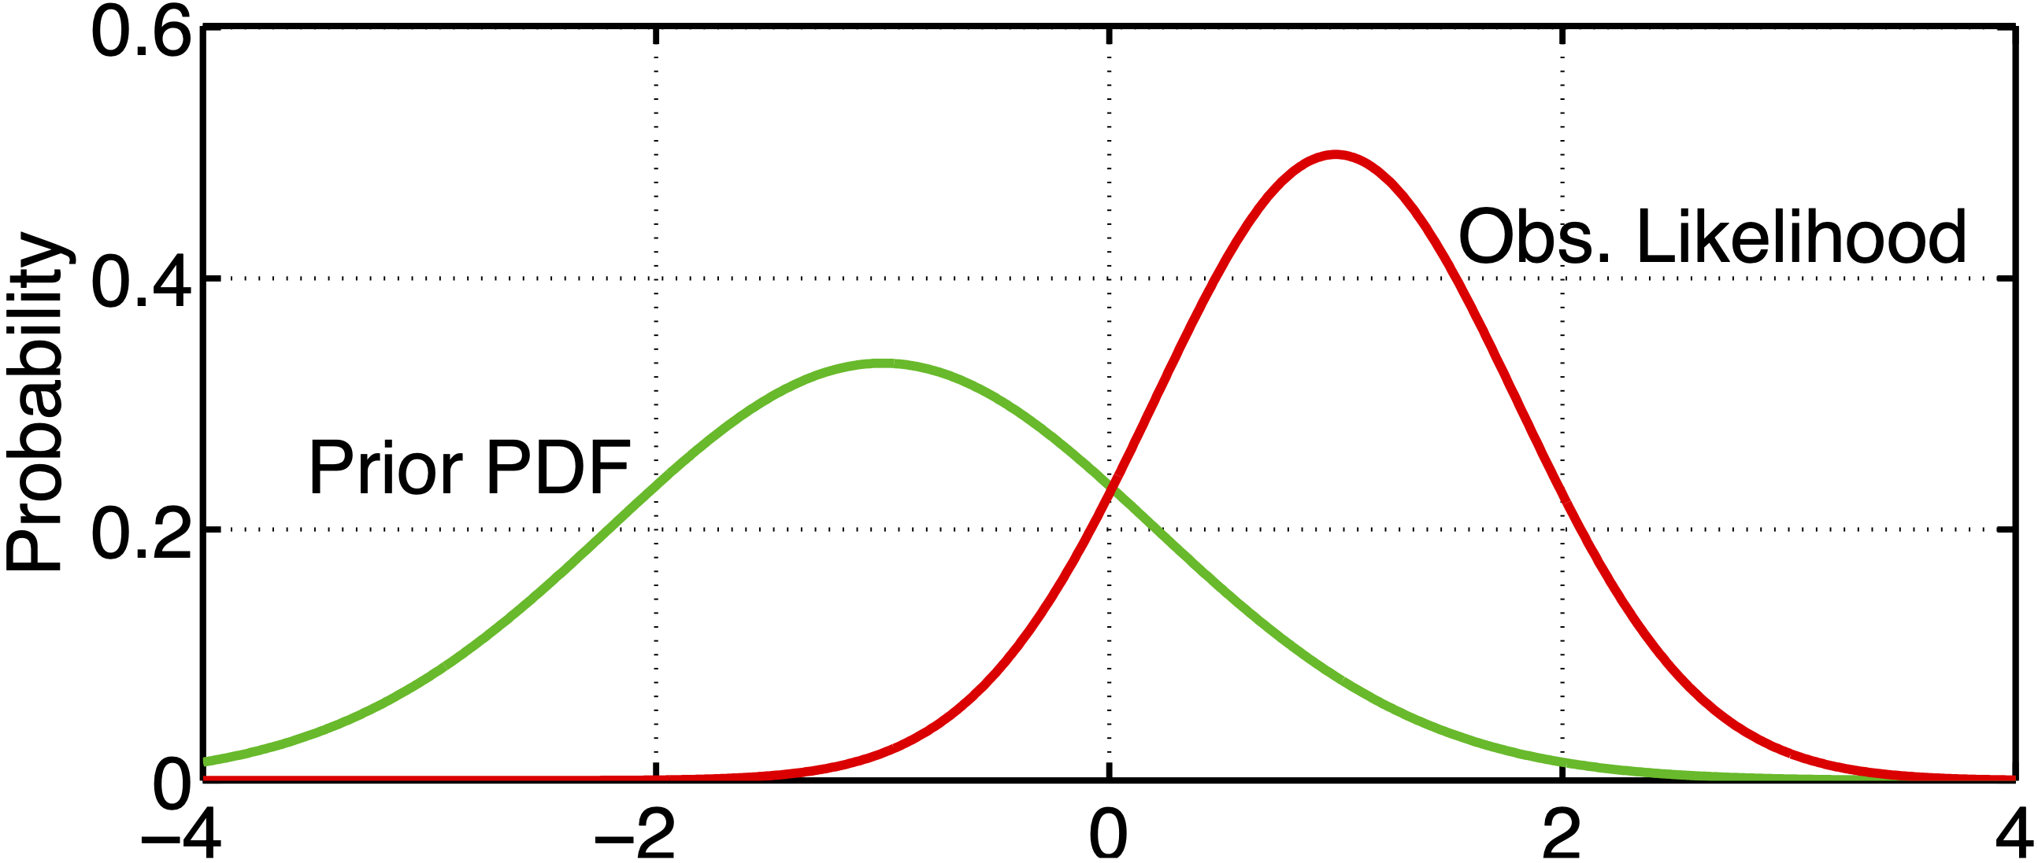
Data Assimilation Research Testbed

Slide 9
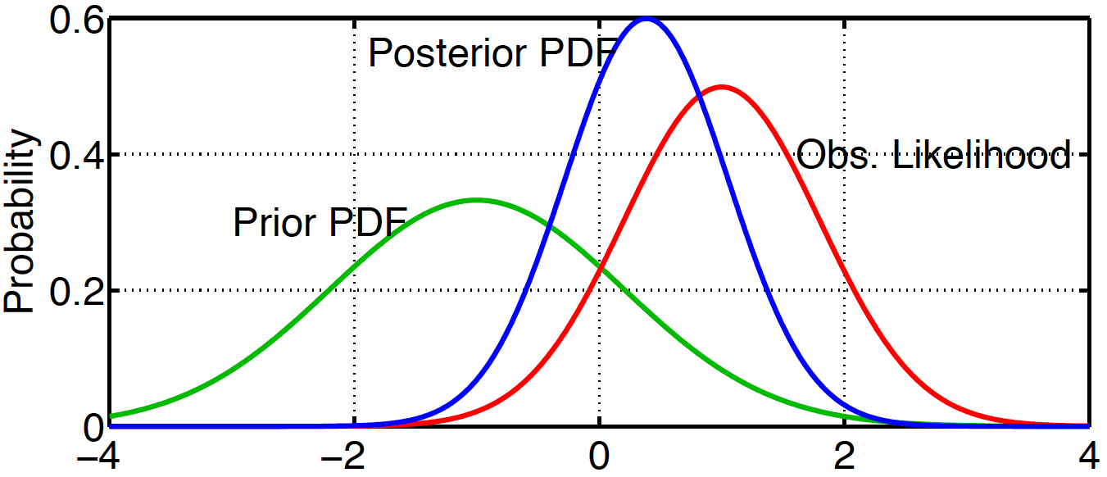
Data Assimilation Research Testbed

Slide 10
Most observations are not at the grid points. Need to adjust model variables on non-regular grid
Also need to adjust other model variables for that new observation. Think geostrophic or thermal wind balance
Done through statistical relationships known as covariances

Slide 11
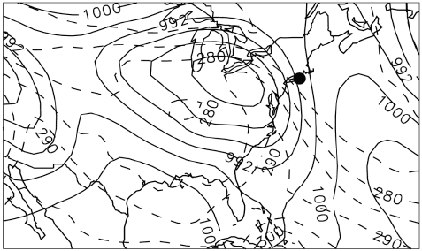
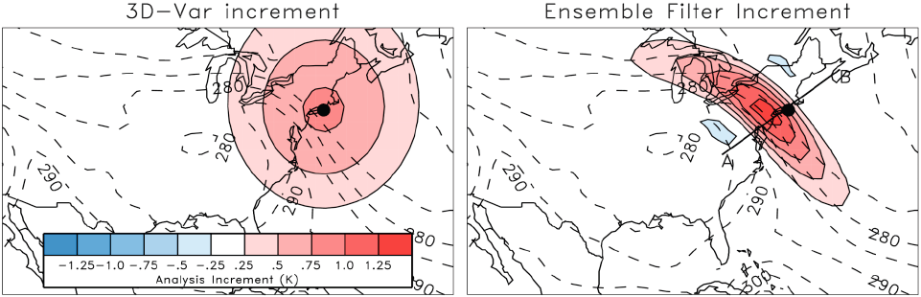
Covariances
Courtesy: Tom Hamill

Slide 12
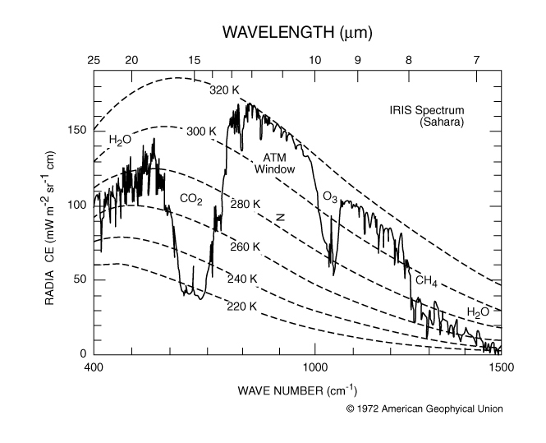
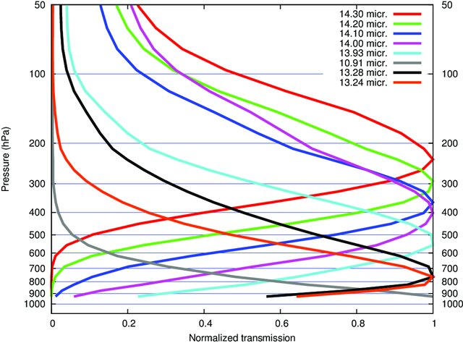
Stubenrauch et al. (2010)

Slide 13
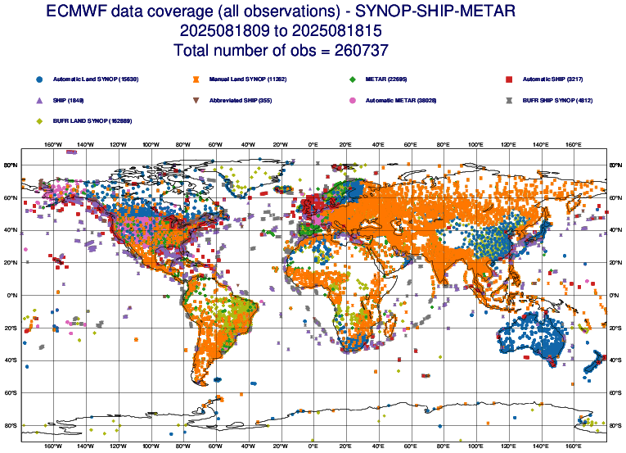

Slide 14
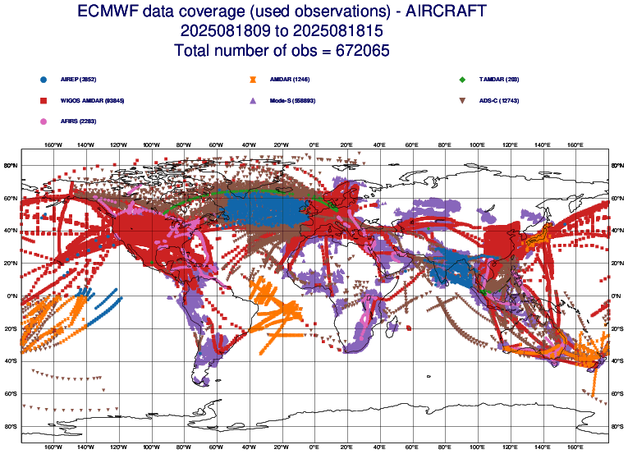

Slide 15
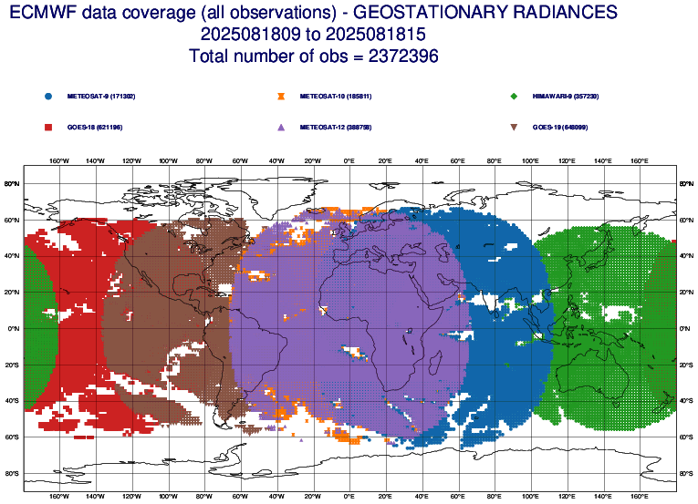

Slide 16
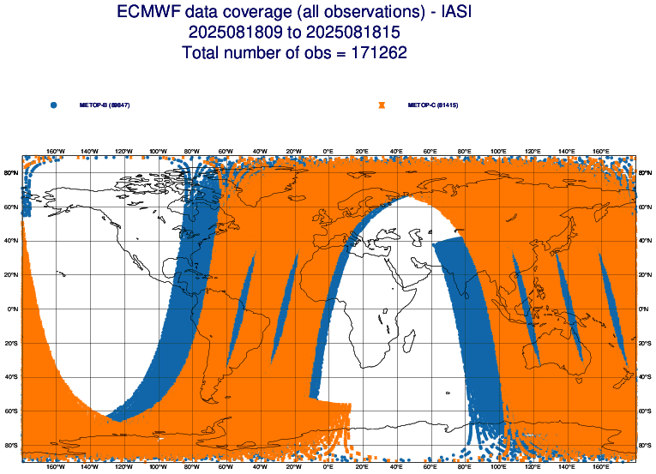

Slide 17
ECMWF Observation Monitoring
https://charts.ecmwf.int/catalogue/packages/monitoring/products/dcover

Slide 18
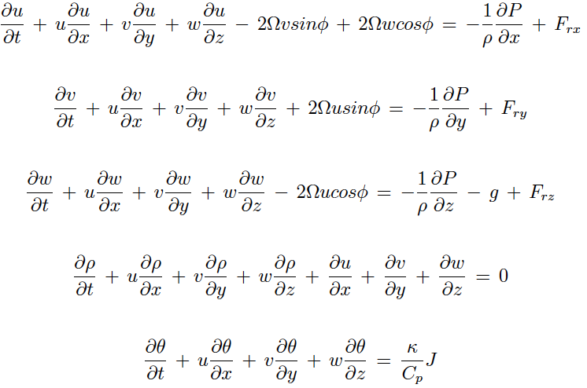
Conservation of Momentum
Newton’s 2nd Law
Conservation of Mass
Conservation of Energy
First Law of Thermo.
Five equations, five unknowns
Non-linear differential equations

Slide 19

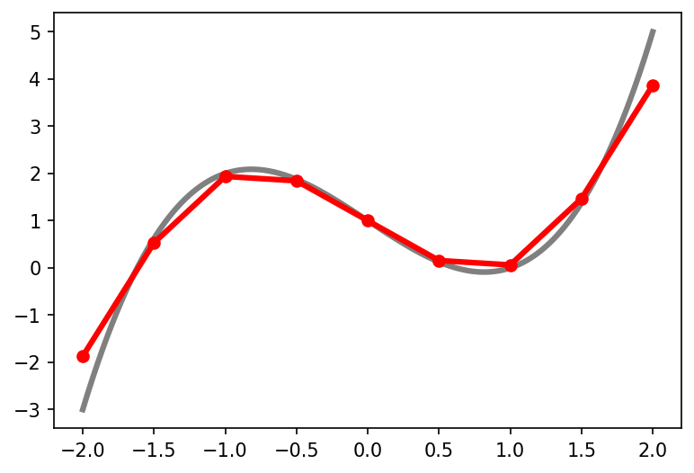
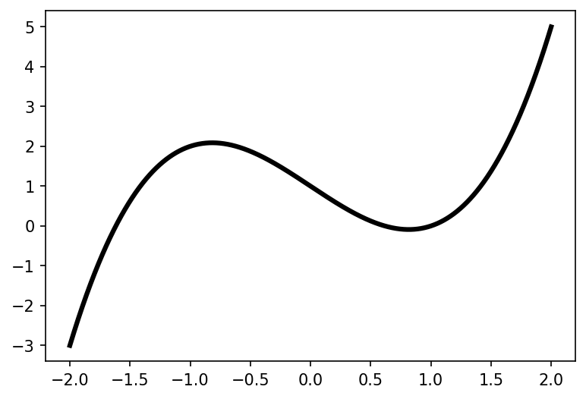
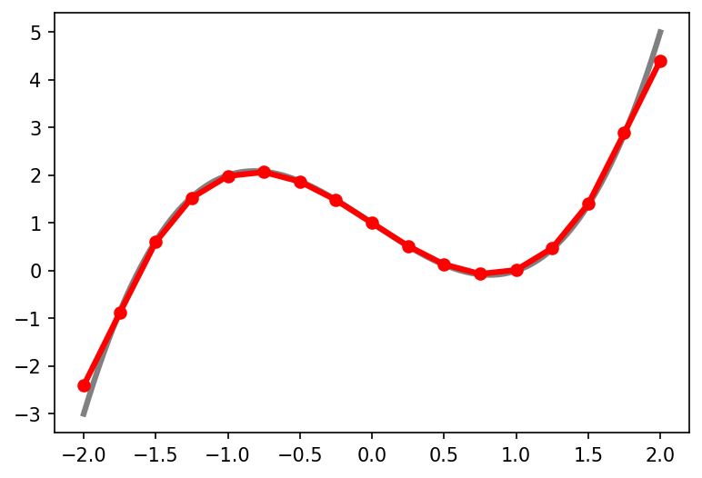
Calculating RHS can be expensive!
Decreasing spacing can be more accurate, but requires more calculations
Time step is a function of grid spacing
Doubling grid spacing = 8x more computing power needed (2x for east-west direction, 2x for north-south direction, 2x for shorter time step)
Compute Right Hand Side (RHS) of equation at current time
Update forecast fields at new time based on RHS
Δt

Slide 20
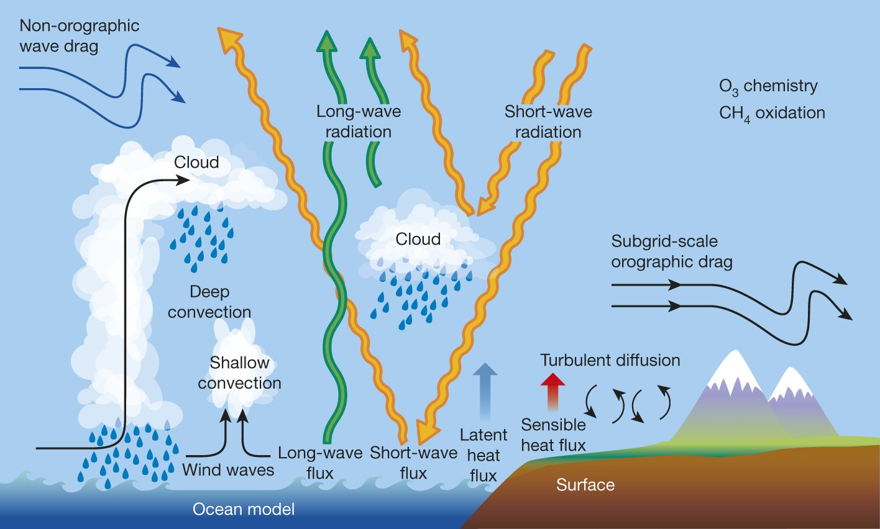
Bauer et al. 2015

Slide 21
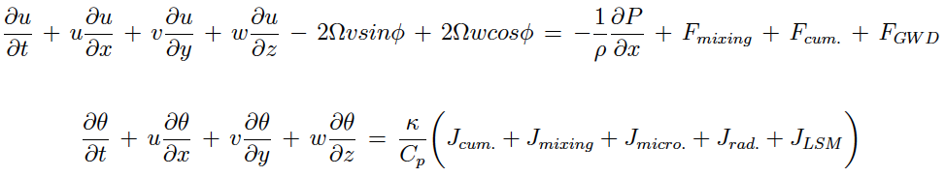
Parameterizations
Conservation laws do not account for all critical physical processes, such as clouds, turbulence, and radiative energy transfer
Accounted for using parameterizations, which are often statistical representations of sub-gridscale processes
  Many tunable parameters and processes
Interact with the full model as source/sink terms on the grid-scale conservation laws

Slide 22
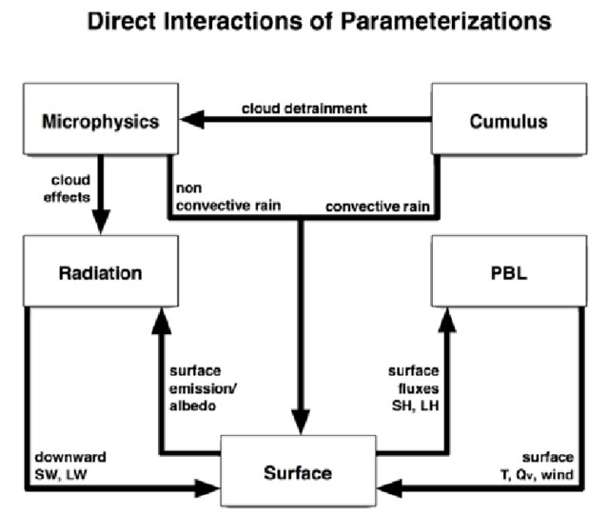
Dudhia, J. (2014), DOI:10.1007/s13143-014-0031-8

Slide 23
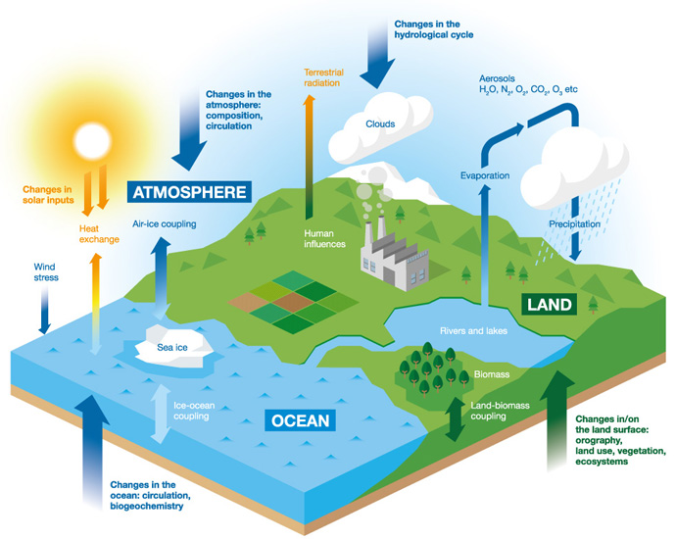
Other Potential Interactive Components:
Ocean
Waves
Land
Snow
Sea Ice
Chemistry
Hydrology (rivers)
Aerosols
Ecological
Upper Atmos.
ECMWF

Slide 24
Once models run, you have grids of forecast output, but it may not contain the quantities that you are looking for
Post Processing of model output can consist of a number of different components:
  Bias correction
  Creating derived products
  Graphics

Slide 25
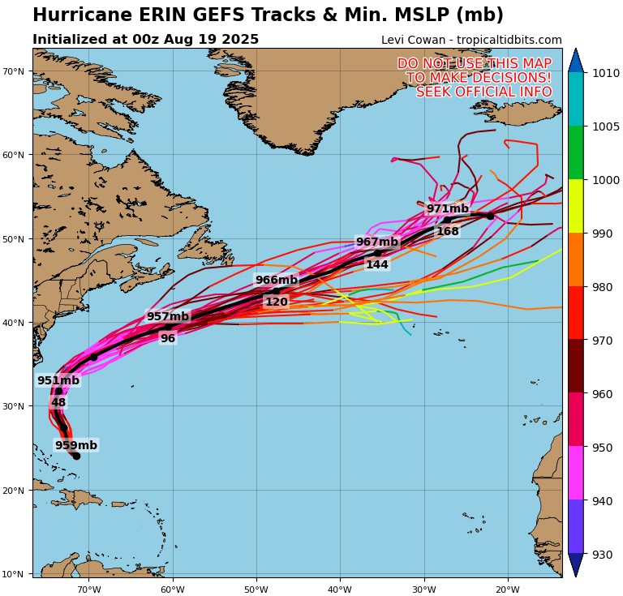
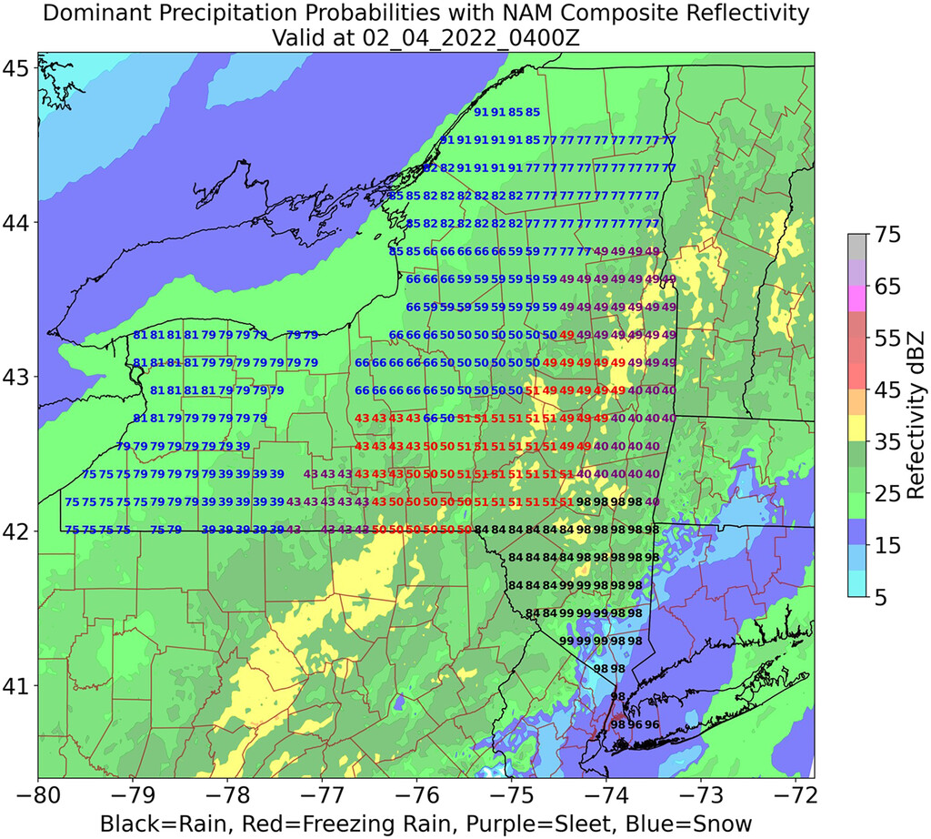
Filipiak et al. 2023

Slide 26
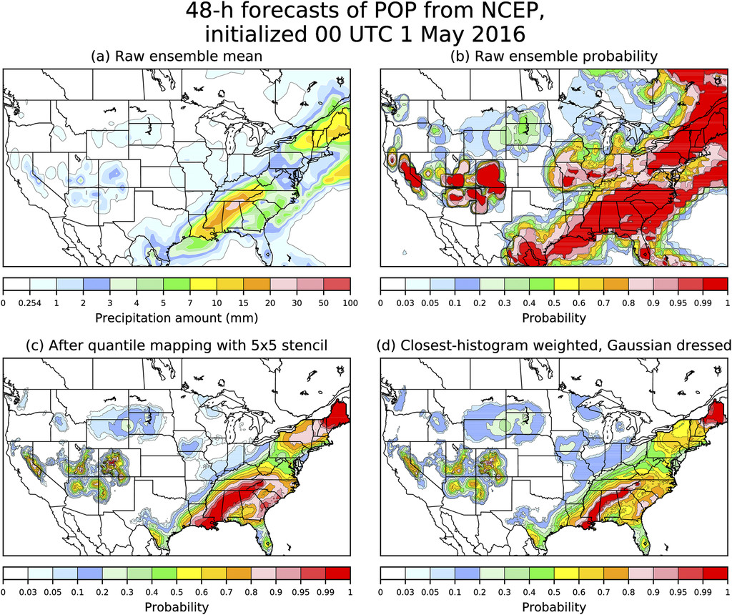
Hamill and Scheuerer (2018)

Slide 27
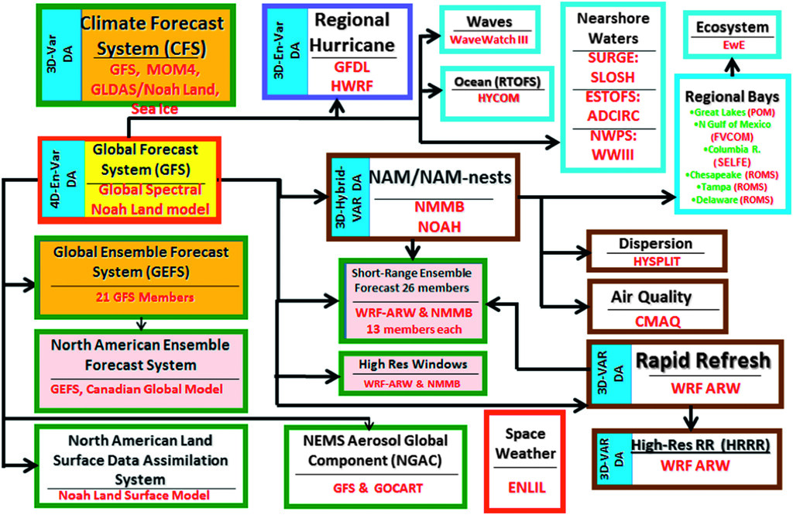
Bernardet et al. 2017

Slide 28
NCEP EMC

Slide 29
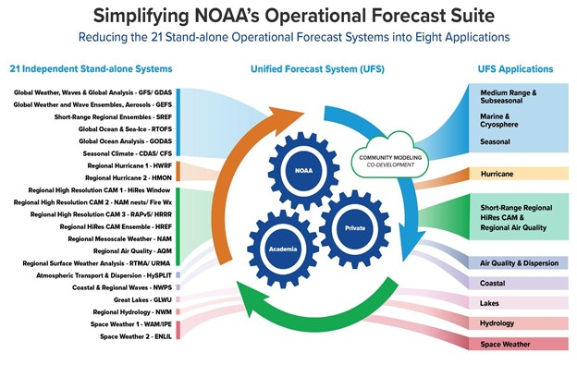
NOAA EPIC

Slide 30
Forecasting systems have numerous sources of errors, including both initial conditions and the formulation of the model itself
These errors tend to become larger with time, want to quantify the uncertainty that could be in the forecast
Ensemble systems are a way of quantifying uncertainty
Multiple forecasts starting at the same time, but with different initial conditions, model physics, and/or sources of uncertainty within the model

Slide 31
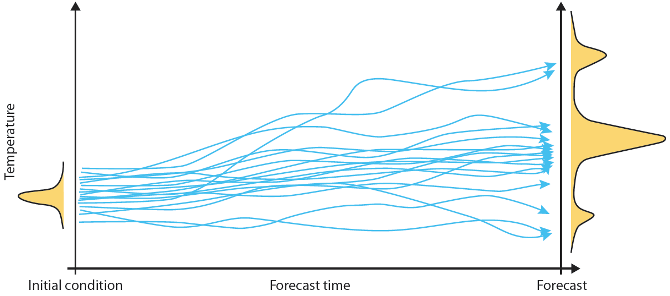
ECMWF

Slide 32
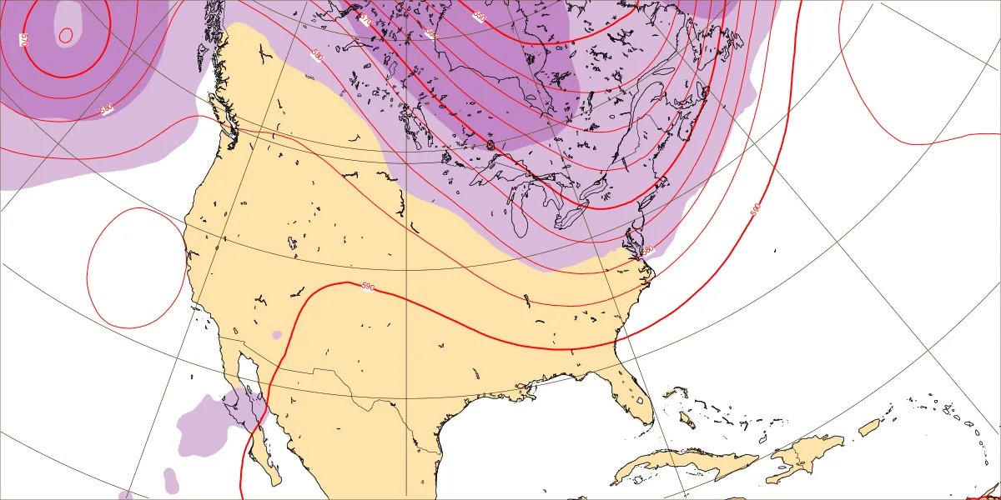
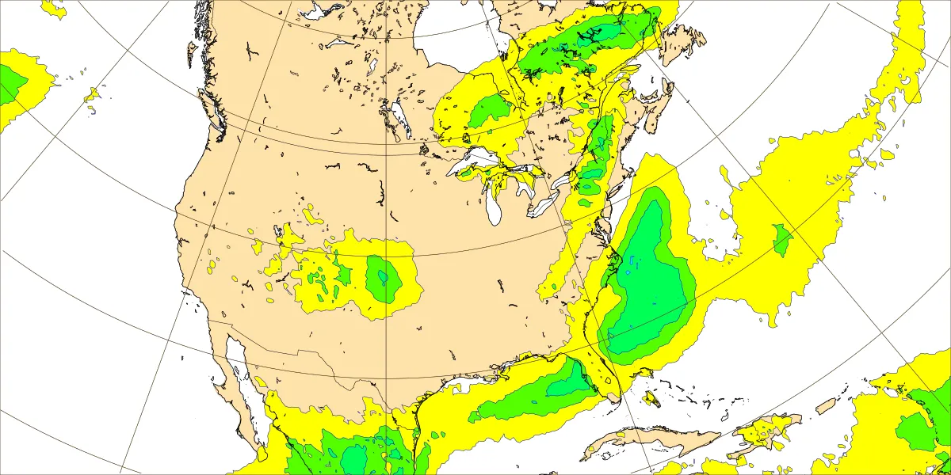
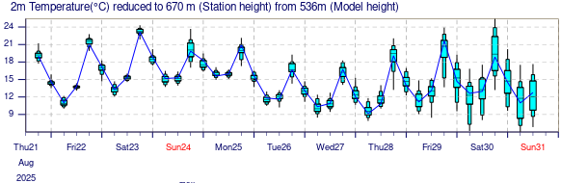
ECMWF

Slide 33
Recently, a number of data-driven forecasting models have been developed that use machine learning techniques, such as graphical neural networks
These models do not have any direct information about the physics of the atmosphere, they learn the evolution of the atmosphere from historical analyses of the atmosphere, such as a reanalysis
After training, they are very fast, accurate and require little to no computing power! You can run on a desktop computer in minutes.

Slide 34
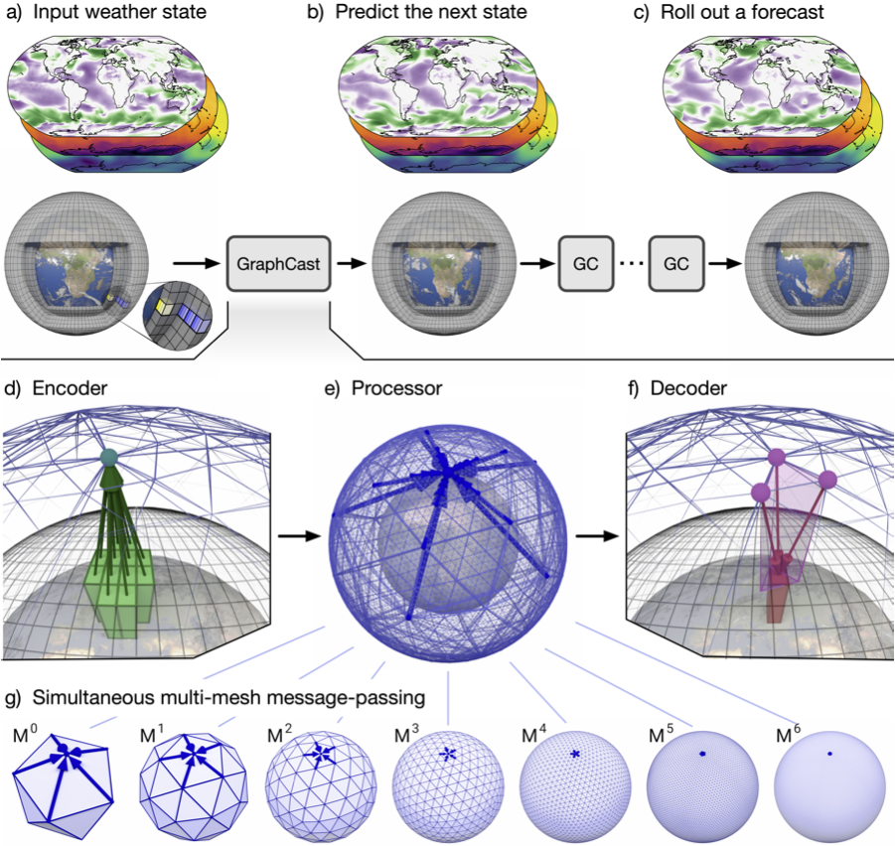
Lam et al. 2024

Slide 35
https://charts.ecmwf.int/

