Slide 1
A Brief History of NWP
AATM 419/563
Fall 2025

Slide 2


“The one area in which our predictions are making extraordinary progress, however, is perhaps the most unlikely field… The holy grail of meteorology, scientists realized, was dynamic weather prediction — programs that simulate the physical systems that produce clouds and cold fronts.”

Slide 3
Vilhelm Bjerknes
“If it is true . . . that atmospheric states develop according to physical law, then … the conditions for the rational solution of forecasting problems are:
1. An accurate knowledge of the state of the atmosphere at the initial time.
2. An accurate knowledge of the physical laws according to which one state . . . develops from another.”
Bjerknes (1904)

Slide 4
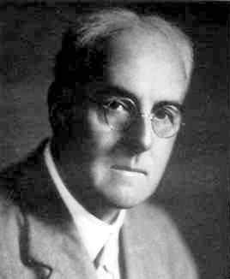
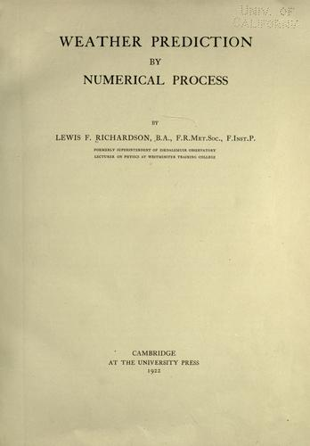
History of NWP
Lewis Richardson the first to propose numerical weather prediction based on equations of motion (1922)
Proposed having room of people who are carrying out calculations and passing around results via a “conductor”
Estimated it would take 60,000 people to carry out
1920s

Slide 5
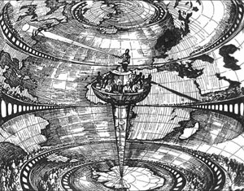
Calculated a 146 hPa change in 6 h. This occurred due to observation distribution and containing more than just atmospheric information, including sound waves

Slide 6
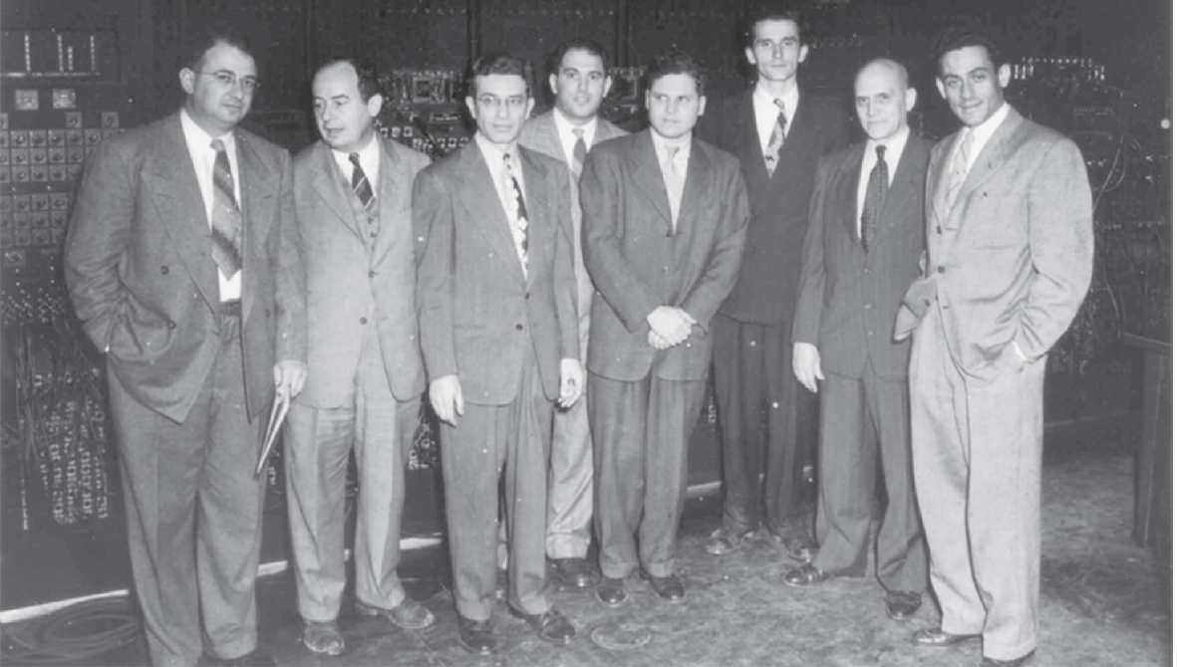
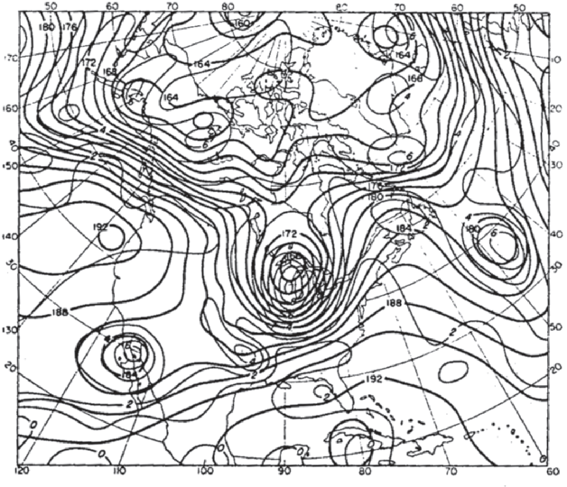
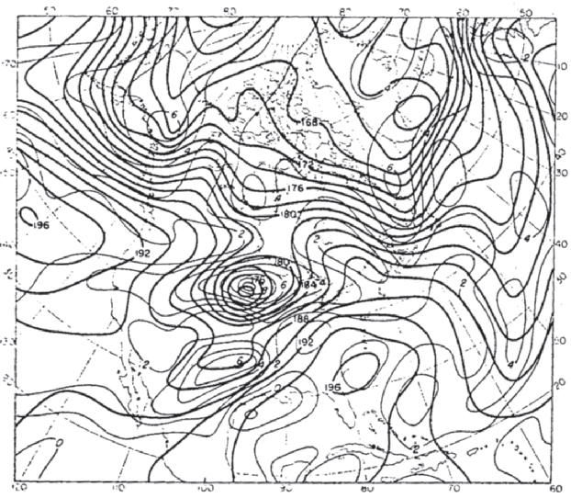
History of NWP
Fjortoft and vonNeuman: First forecast using one-layer model (1949)
Charney: First full equation forecast on one level using ENIAC (1951)
First operational NWP forecast in Sweden (BESK; 1954)
Lorenz identifies chaotic properties of the atmosphere (1961)
Lynch 2008
1950s

Slide 7
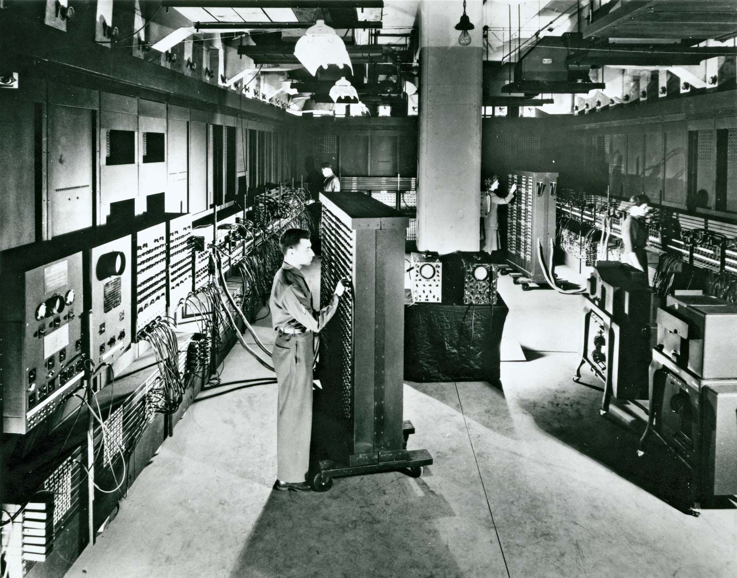
Electronic Numerical Integrator and Computer; ENIAC), c. 1946., Univ. of Pennsylvania
Charney, Fjørtoft and von Neuman experiments were not first NWP forecast, but were the first to use primitive filtered equations, rather than a single level (i.e., barotropic model). One day forecast
Used analysis based on hand-drawn analysis! Large potential for errors and time-consuming for person.

Slide 8
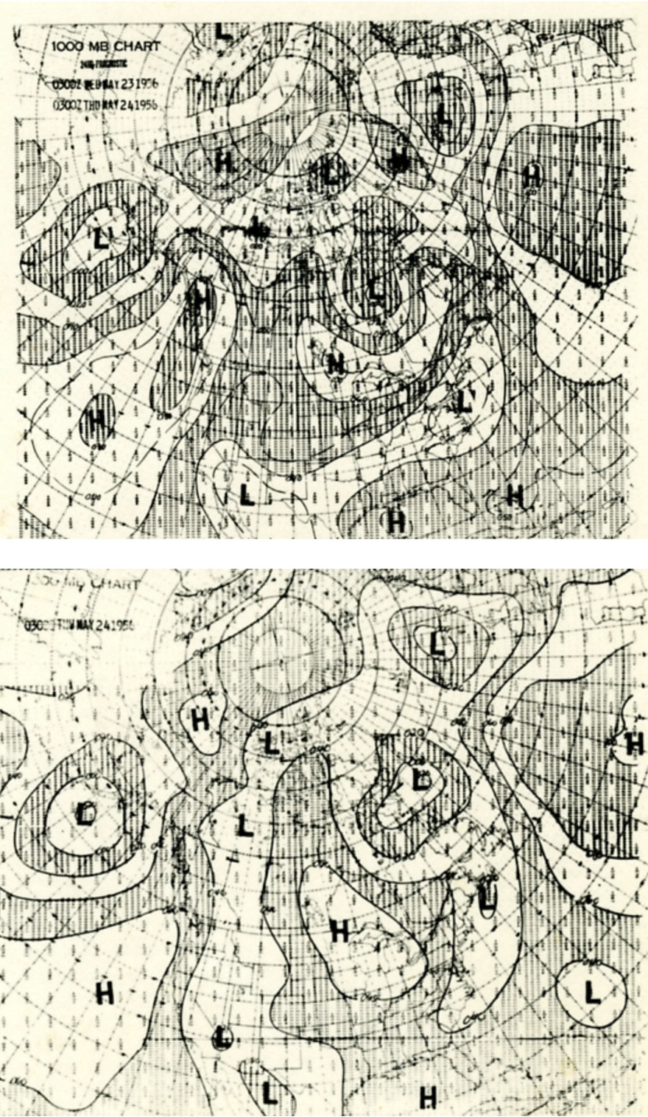
First operational NWP forecast done in Sweden in 1954, direct result of Charney’s forecast success
First US-based forecasts come from Joint Numerical Weather Prediction Unit six months later, only over NH
Early forecasts could not compete with human forecasters, too much deepening with cyclones
Led to a downgrade from three-layer primitive equation model to a single level QG barotropic model
Multiple vertical levels added back as new supercomputers come online
NOAA WPC Archive

Slide 9
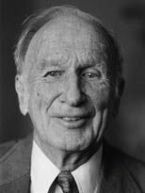

Ed Lorenz
MIT Press
Pioneered chaos theory, meaning that in a nonlinear system, small errors in the estimate of the initial state will amplify with time, often referred to as the “butterfly effect” after speech in 1967. Big implications on predictability
https://youtu.be/q3kNHomvU0k

Slide 10
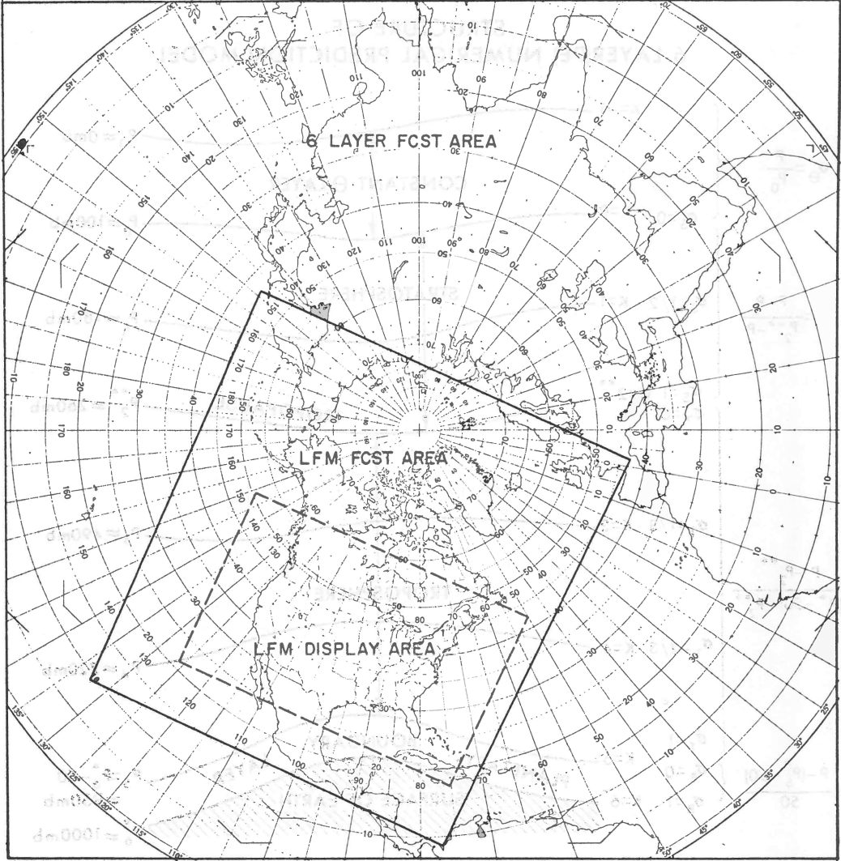
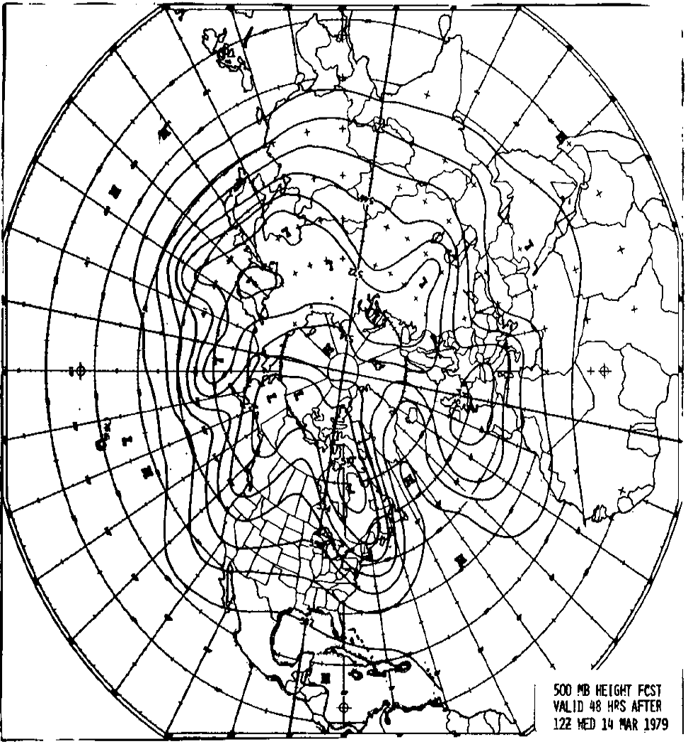
History of NWP
Limited-area model (LFM) 1971
  190 km resolution
  24 h forecast
  6-layer primitive equation model
First global model in US (1980)
  R30 (~250 km)
  48 h forecast
  12-layer full physics model
NOAA TPB-67
Sela 1980
1970s

Slide 11
NCEP Global Model Evolution
Benjamin et al. 2019
Current: C768 (13 km), L127

Slide 12
NCEP Regional Model Evolution
Benjamin et al. 2019

Slide 14
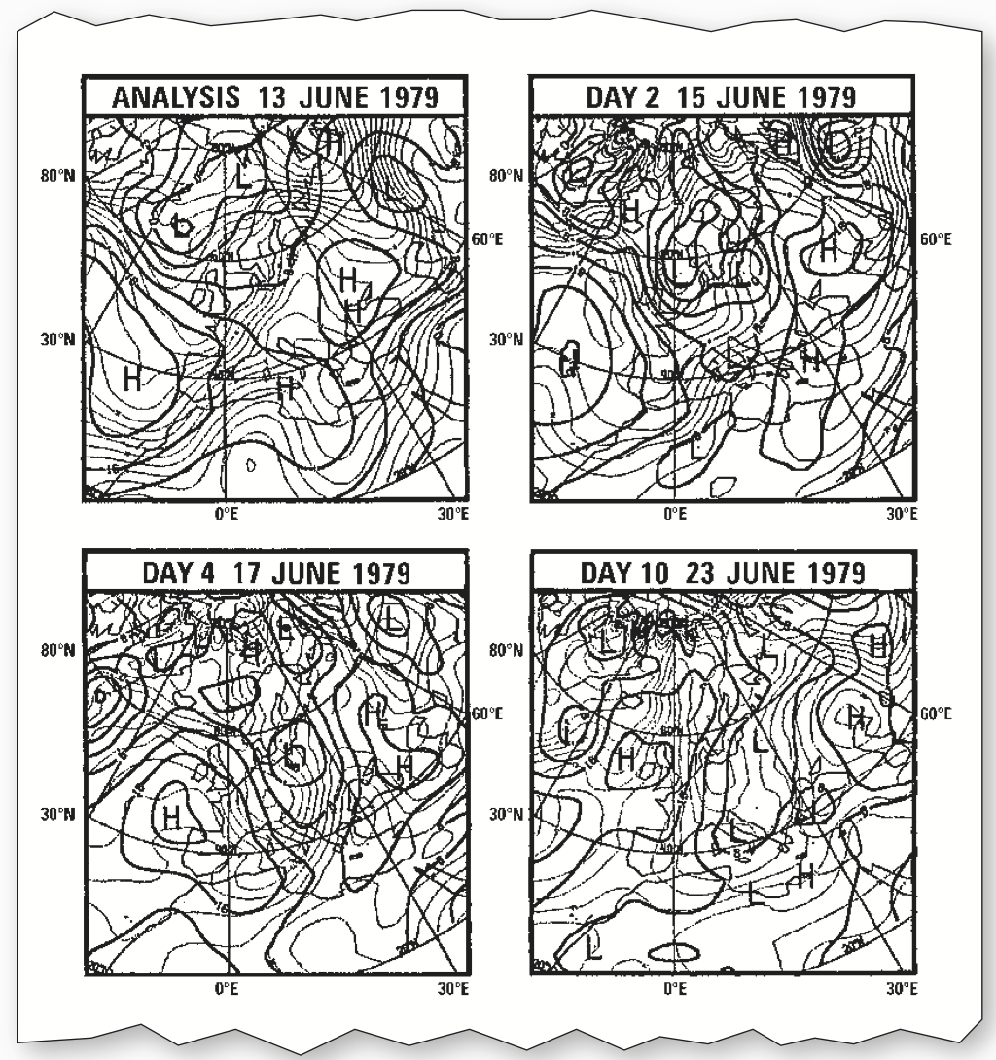
Alliance of European Countries, pooling resources to do global model prediction
Global modeling is only purpose, no regional models
Quickly becomes the world’s leader in NWP development
Peter Deuben, ECMWF

Slide 15
ECMWF

Slide 16
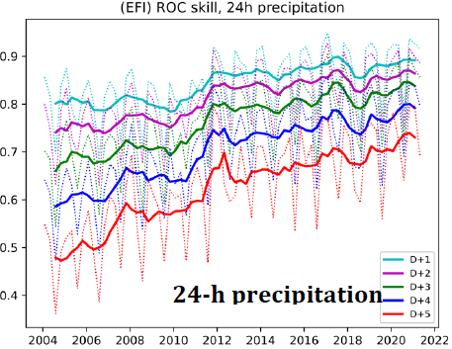
Benjamin et al. 2019

Slide 17
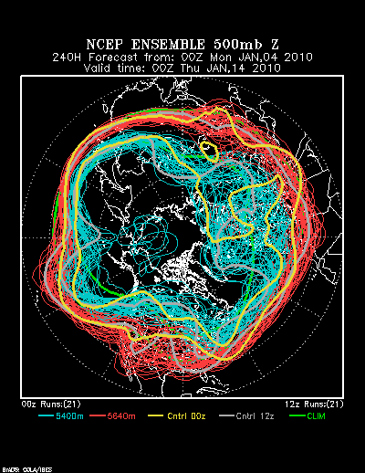
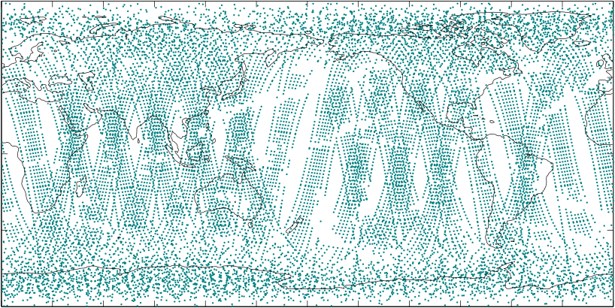
History of NWP
Introduction of variational data assimilation
Incorporation of satellite radiances
Operational ensemble forecasts
Non hydrostatic models (e.g., MM5, WRF)
1990s

Slide 18
First objective data assimilation systems were known as successive correction method, interpolation of observations onto a grid
  Difficult to deal with sparse observations, left large holes (5,000,000 grid points vs. 10,000 observations)
Next type of analyses took into account previous forecast, data assimilation becomes a correction of past forecast
  Weights originally were subjective, became more objective and based on statistics with time (e.g., Optimum Interpolation), and eventually an ensemble of forecasts
Variational methods (3DVAR, 4DVAR) debut in early 1990s, find analysis through minimization process
  Opens up new observations that are not model state variables, such as satellite data
OI, Kalman Filter Methods
3DVAR
4DVAR

Slide 19
Retrievals -> Radiances
Clear sky -> All sky assimilation
Thépaut et al. 2025

Slide 20
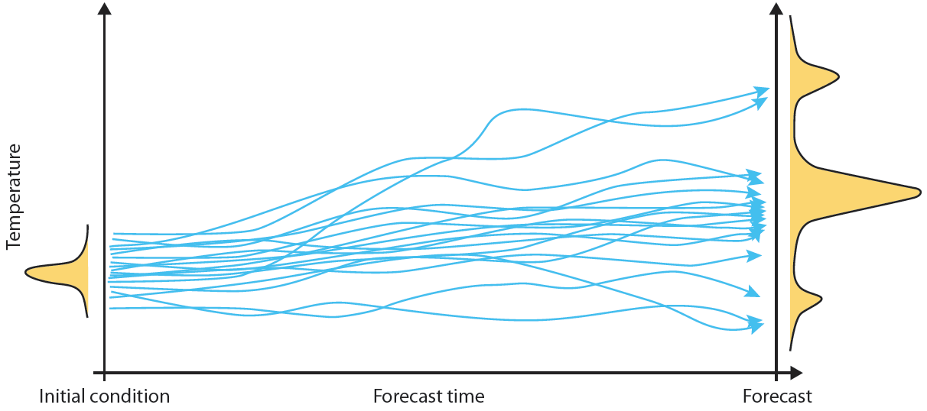
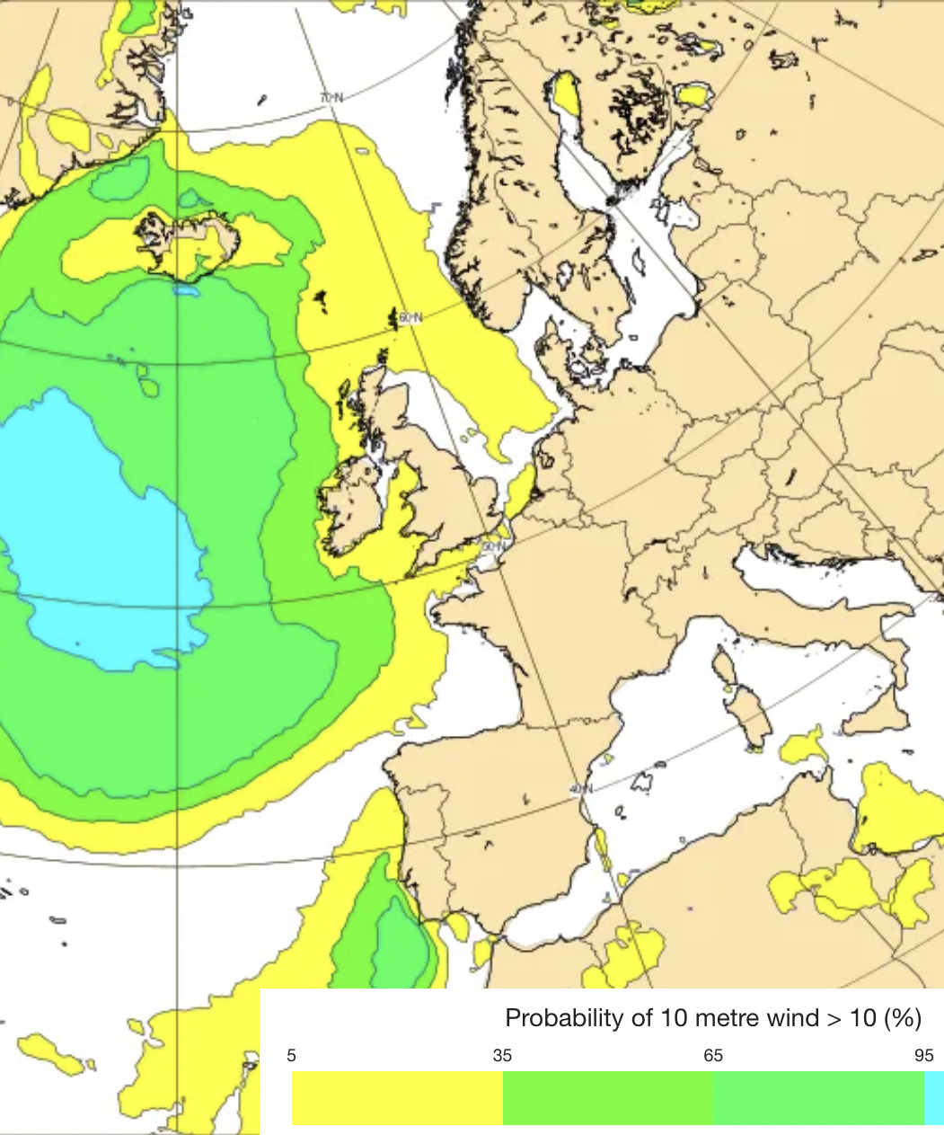
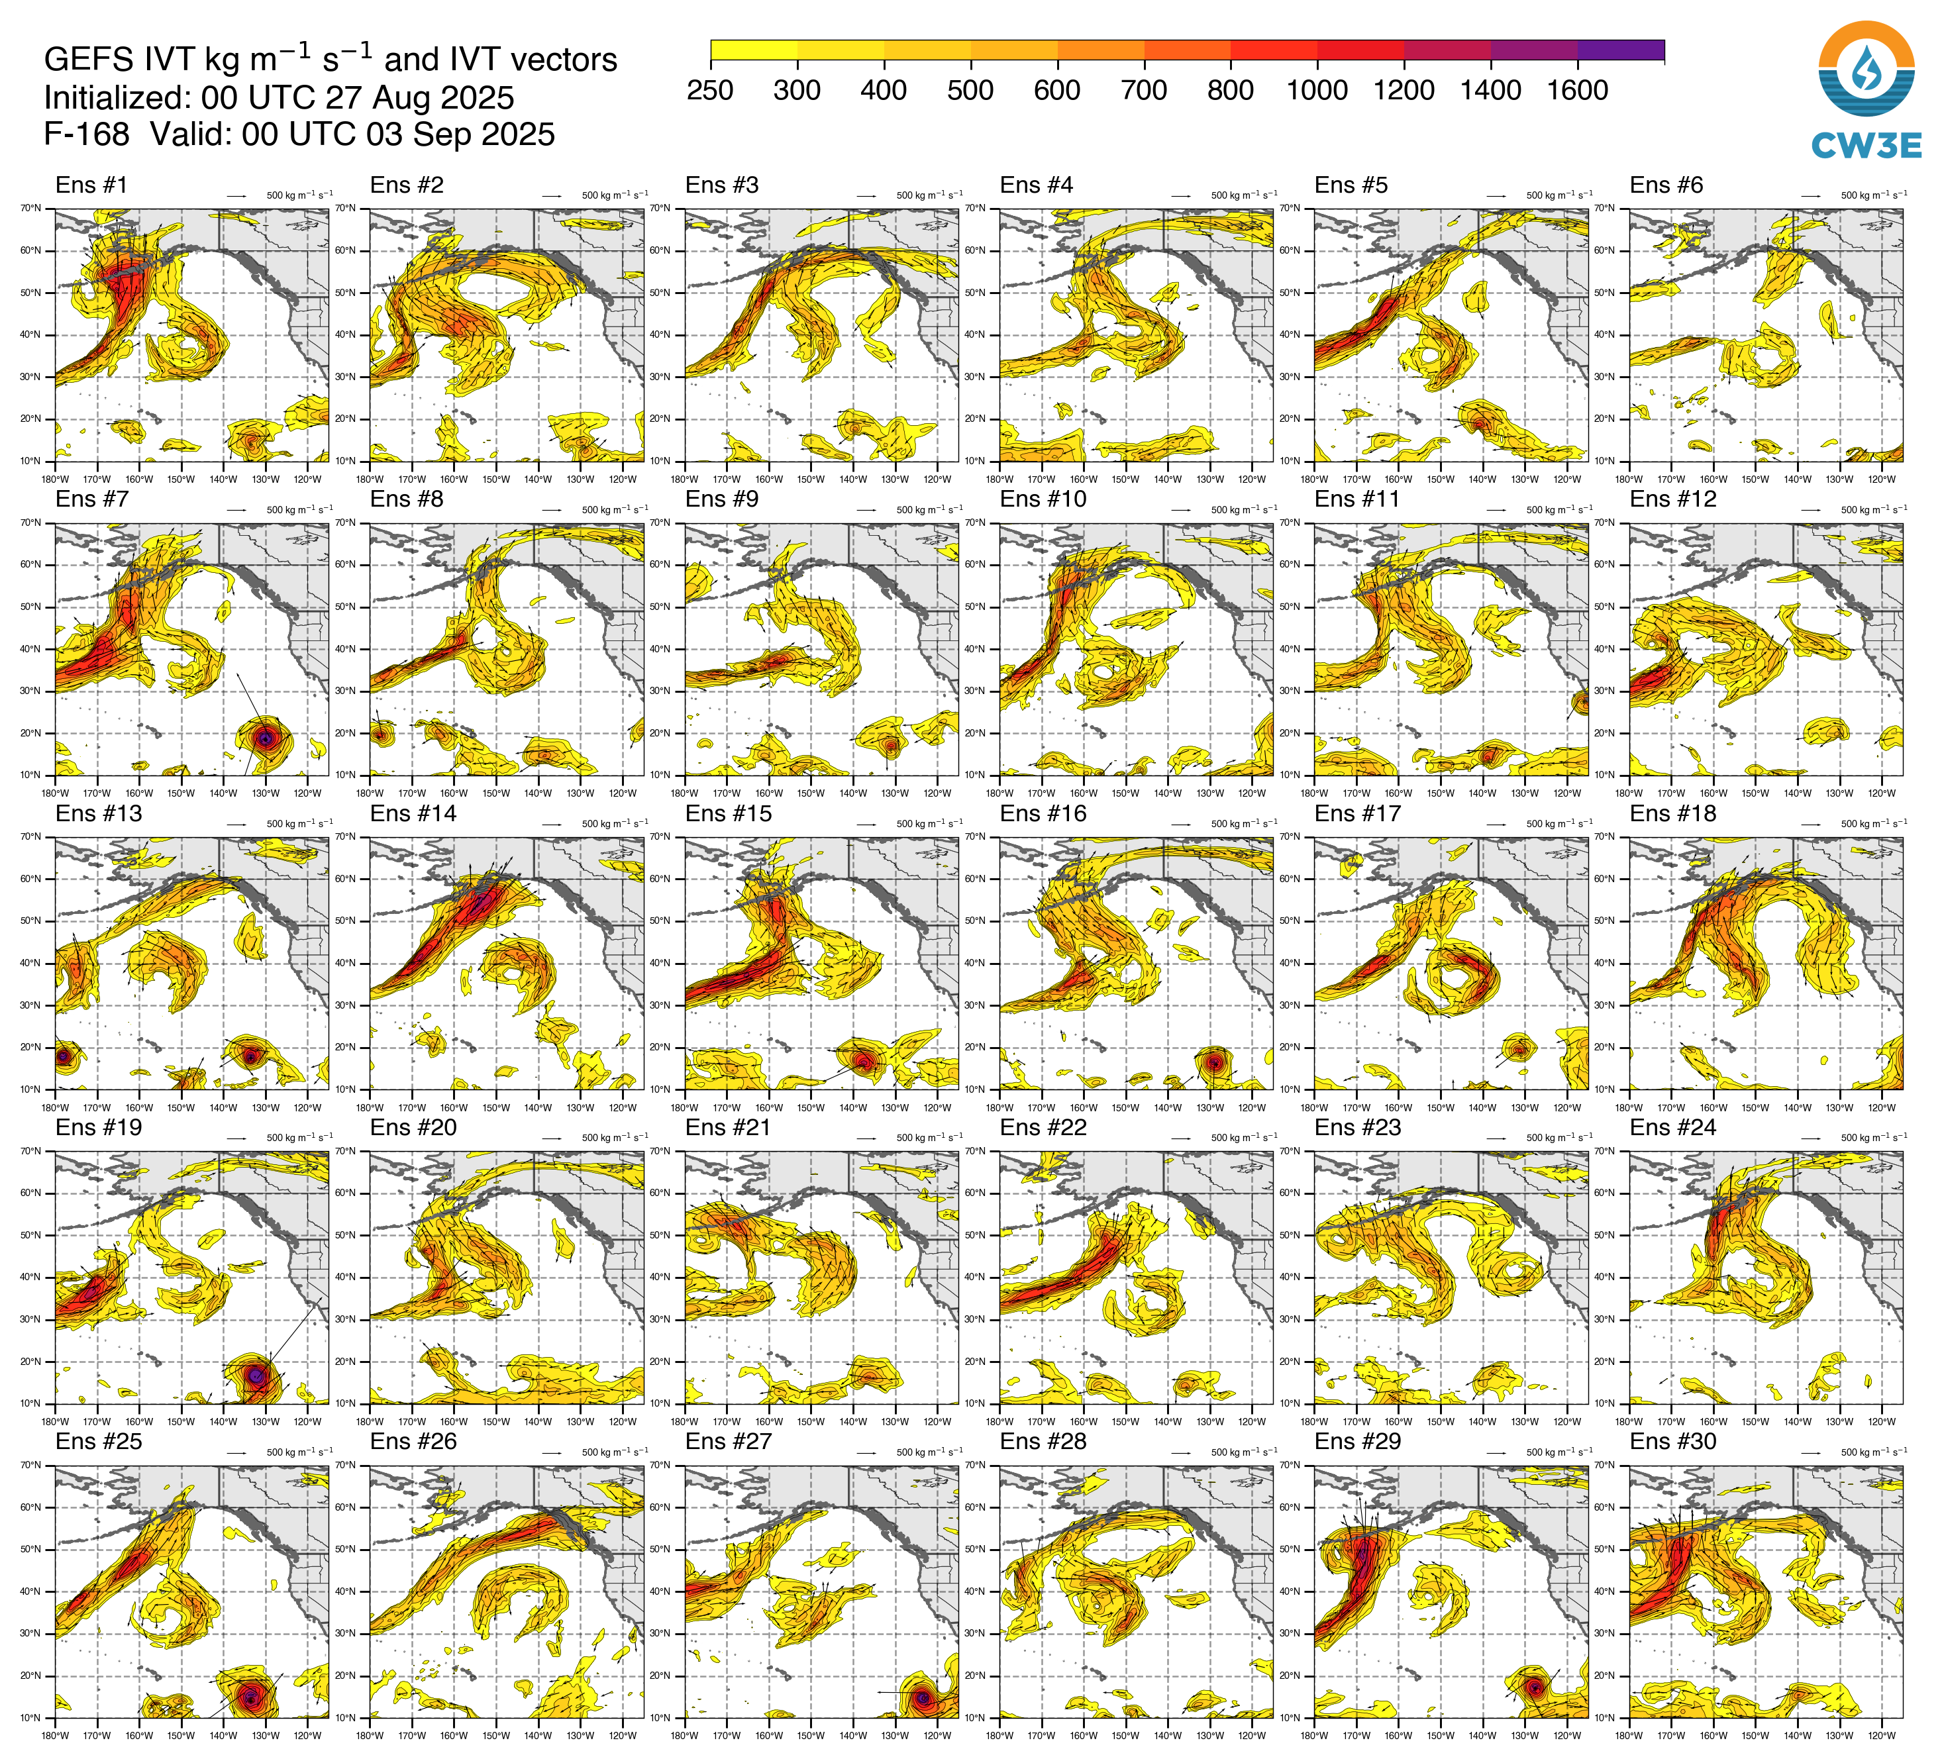
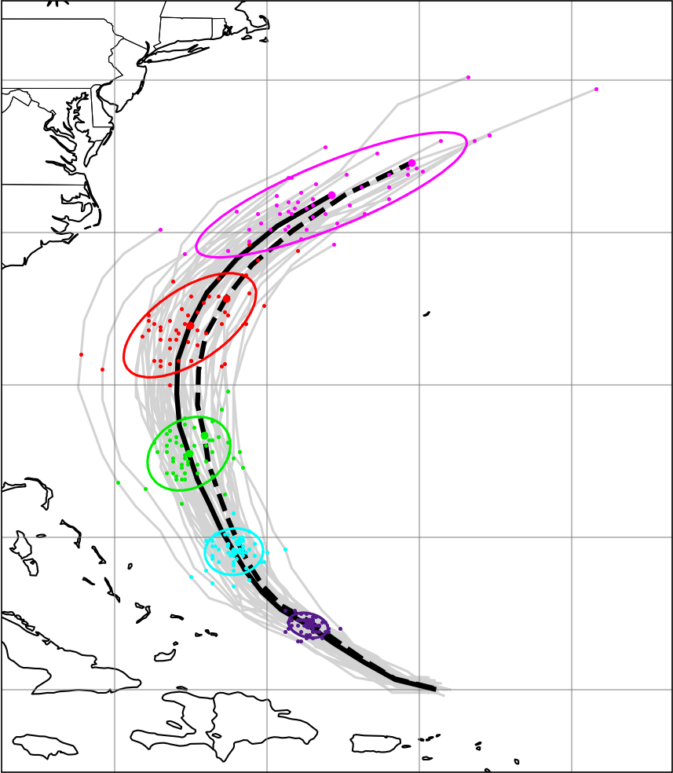
Ensemble Forecasting
Accounts for chaotic properties
Combination of: initial condition, multi model, multi-physics, stochastic systems
Ensemble uncertainty should predict error
Errors need to grow!

Slide 21
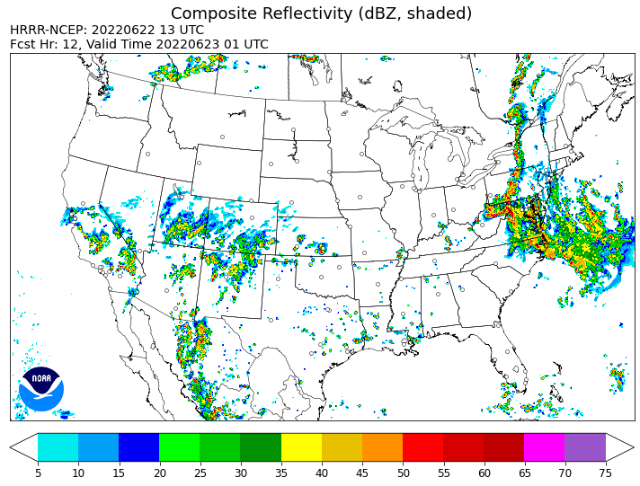
History of NWP
Thunderstorm-resolving operational models (HRRR)
Sub-seasonal modeling
AI/ML Modeling storms out of the box
2010s

Slide 22
Global Model resolutions quickly reaching grid resolutions of regional models
Cumulus parameterization can be removed, potential gain in forecast skill from tropical systems
Turbulent mixing now becoming an issue
Philippe Lopez, ECMWF

Slide 23
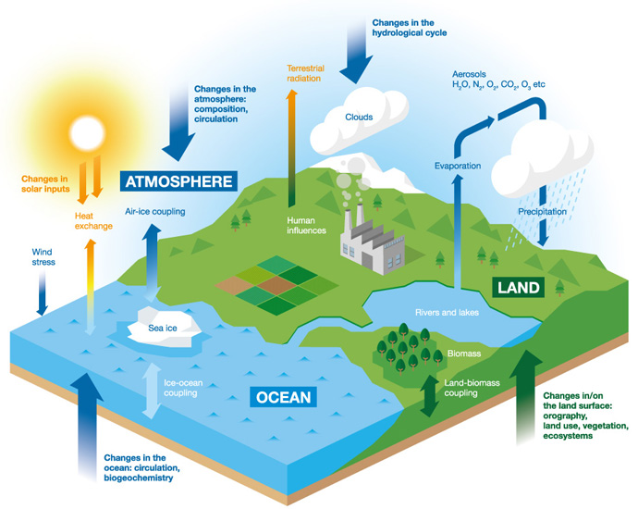
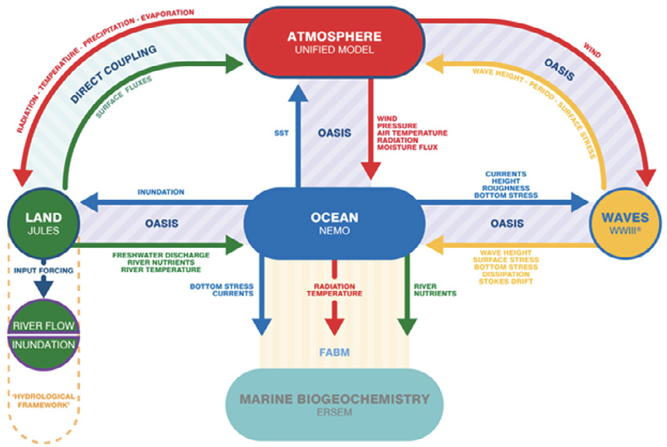
Siddorn et al. 2022
Weather models transitioning to Earth System models, including ocean, wave, land, hydrology, ice
Necessary for subseasonal and seasonal forecasting, other short-term applications
Will be part of next GEFS implementation
ECMWF

Slide 24
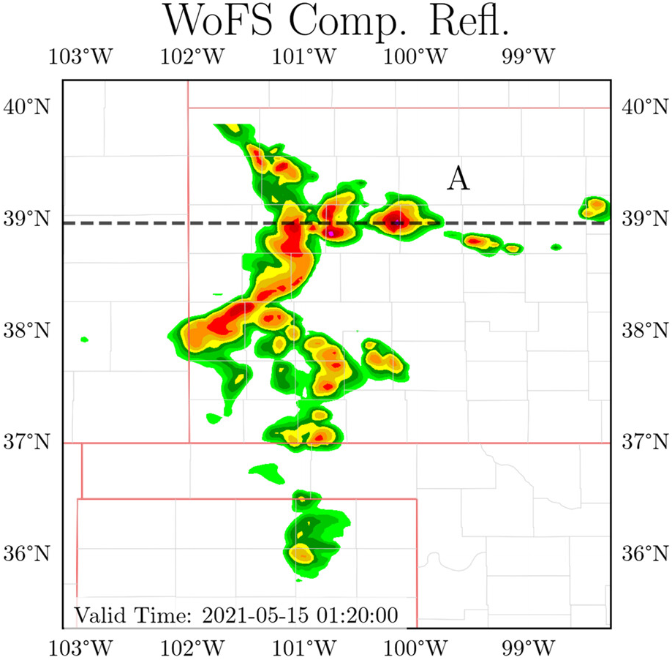
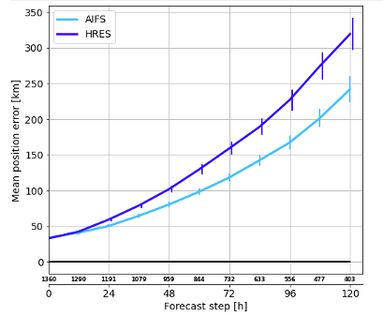
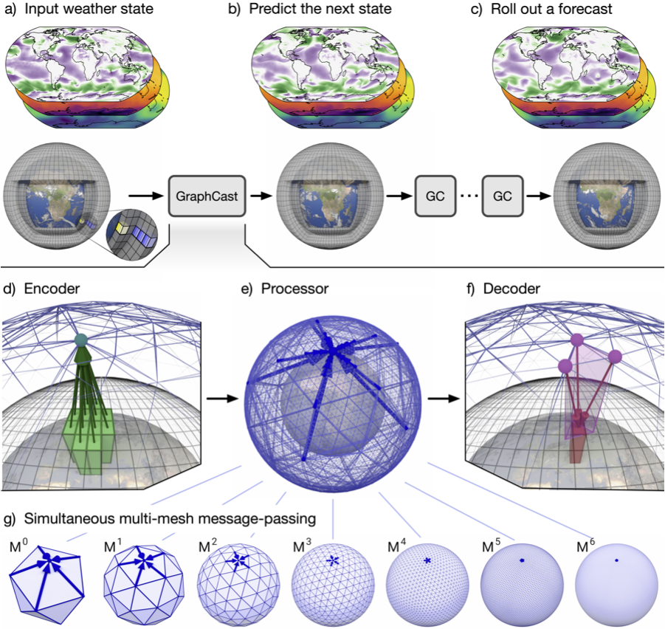
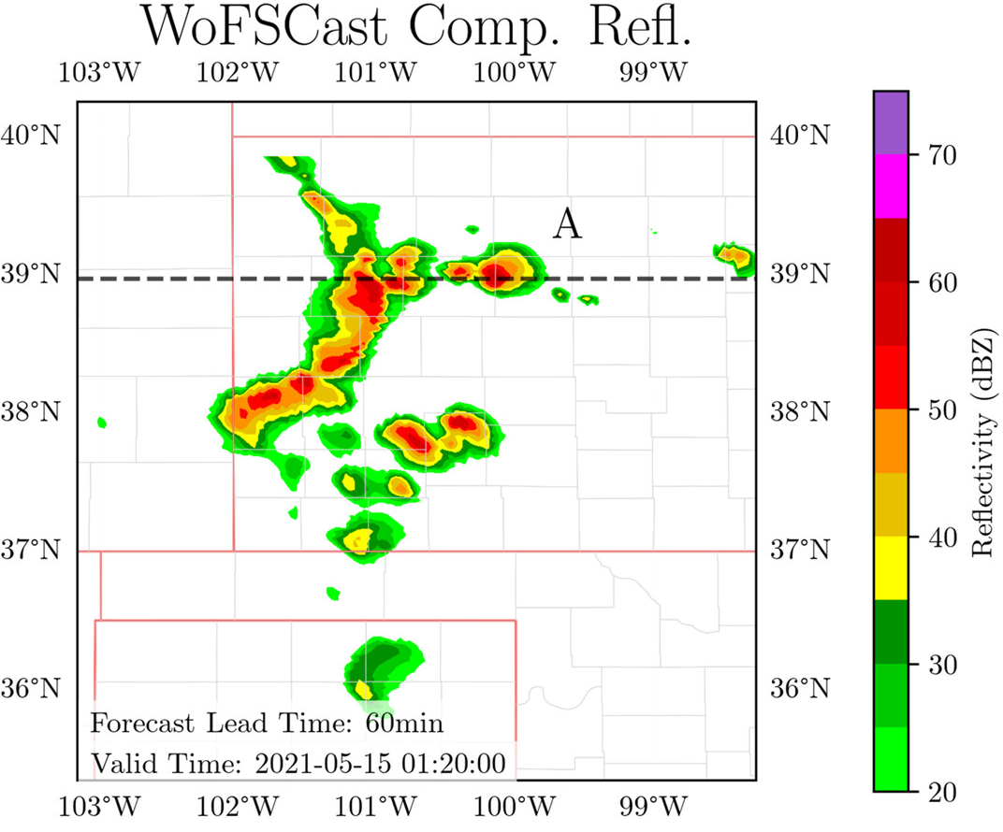
AI/ML-based Forecasting Systems
Flora and Potvan, 2025

