Slide 1
Supercell storms: In-class demo
ATM 419/563
Fall 2025
Torn

Slide 2
Goals
Start idealized WRF 3D run to simulate a splitting supercell thunderstorm (in-class demo)
Submit WRF job to the derecho cluster
Review supercell storm structure and behavior (while model runs)
Analyze demo simulation using Python

Slide 3
Setup [see script]
Create a folder called SUPERCELL in your lab space
  $ lab
  $ mkdir SUPERCELL
  $ cd SUPERCELL
Copy /glade/work/torn/atm419/SUPERCELL/SETUP.TAR there and unpack
  $ cp $LAB/SUPERCELL/SETUP.TAR .
  $ tar –xvf SETUP.TAR
  Files included: make_all_links.sh, namelist.input, input_sounding, read_wrfinput.py, submit_wrf, plot_SUPERCELL.ipynb
Pre-configured for a 1-h run in a 120 km by 120 km domain at 2 km horizontal grid spacing
  Initial sounding derived from Weisman and Klemp (1982)
  “quarter-circle” wind profile favors storm splitting and right-mover
  Purdue-Lin microphysics (mp_physics = 2)
  Time step 6 seconds
  History output every 5 min
Notes:
read_wrfinput.py
WK sounding was slightly modified from original

Slide 4
Outline
ideal.exe program reads in input_sounding and namelist.input and creates wrfinput_d01, the input file for the WRF model
wrf.exe program reads in namelist.input and wrfinput_d01 and creates output file(s) called wrfout_d01…
Most file extensions are meaningless in Unix.

Slide 5
input_sounding
surface pressure (mb) surface theta (K) surface vapor (g/kg)
1000.0000 300.0000 14.000000
10.0000 300.0061 14.000000 -8.0998 -4.9419
35.0000 300.0291 14.000000 -8.0976 -4.7968
100.0000 300.1083 14.000000 -8.0802 -4.4199
200.0000 300.2575 14.000000 -8.0208 -3.8426
300.0000 300.4275 14.000000 -7.9222 -3.2706
400.0000 300.6125 14.000000 -7.7848 -2.7067
500.0000 300.8095 14.000000 -7.6092 -2.1535
600.0000 301.0167 14.000000 -7.3963 -1.6136
700.0000 301.2327 14.000000 -7.1470 -1.0894
800.0000 301.4566 14.000000 -6.8626 -0.5835
900.0000 301.6877 14.000000 -6.5442 -0.0982
[…]
height (m) theta (K) water vapor (g/kg) u (m/s) v (m/s)
[For information. You do not need to edit this file at this time.]
[These data will be interpolated onto the WRF vertical grid, yet to be specified]
Notes:
Got to here 2022

Slide 6
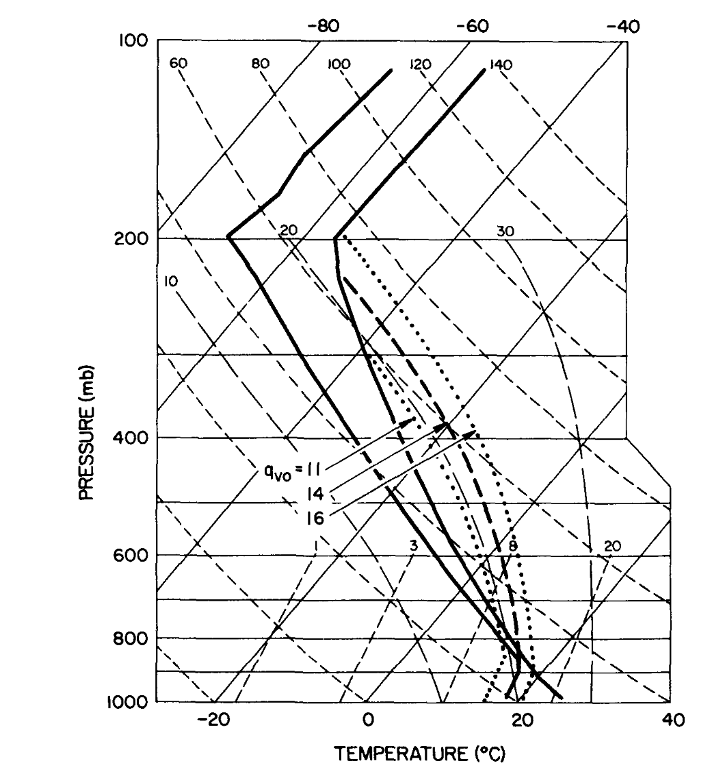
Copies of papers cited in this
course available on class page
Boundary layer mixing
ratio is 14 g/kg in
input_sounding
Weisman and Klemp (1982)

Slide 7
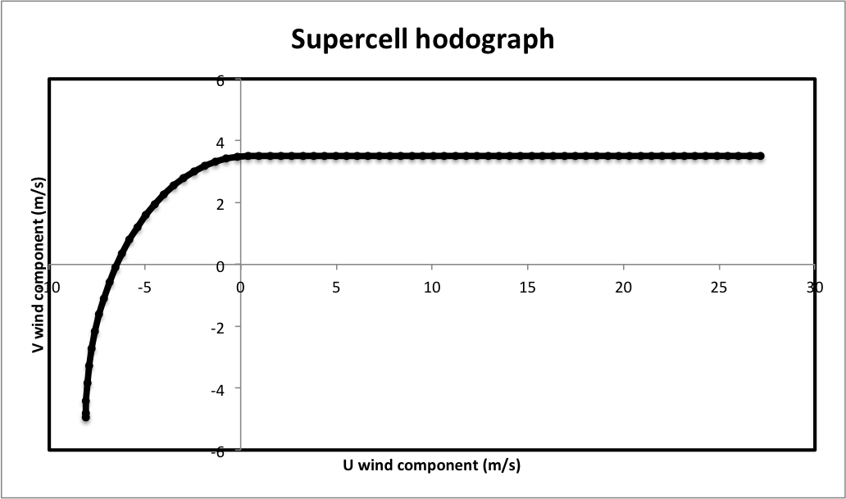
Hodograph
(see input_sounding)
2 km AGL
7 km AGL
surface

Slide 8
Part of namelist.input
&time_control
run_days = 0,
run_hours = 0,
run_minutes = 60,
run_seconds = 0,
start_year = 0001,
start_month = 01,
start_day = 01,
start_hour = 00,
start_minute = 00,
start_second = 00,
end_year = 0001,
end_month = 01,
end_day = 01,
end_hour = 00,
end_minute = 60,
end_second = 00,
history_interval = 5,
frames_per_outfile = 1000,
&domains
time_step = 6,
time_step_fract_num = 0,
time_step_fract_den = 1,
max_dom = 1,
s_we = 1,
e_we = 60,
s_sn = 1,
e_sn = 60,
s_vert = 1,
e_vert = 41,
dx = 2000,
dy = 2000,
ztop = 20000,
6 second time step
60 x 60 grid points
41 model levels
2000 m horizontal grid spacing
Model top at 20000 m
Run for 60 min with 5 min outputs
[For information. You do not need to edit this file at this time.]

Slide 9
Using the batch system
Look at the file submit_wrf:
#!/bin/bash
# Job name:
#PBS -A UALB0053
#PBS -N atm419_supercell
#PBS -q develop
#PBS -l walltime=00:05:00
#PBS -l select=1:ncpus=4:mpiprocs=4
echo "running real"
./ideal.exe
echo "running WRF"
mpiexec ./wrf.exe
Account to charge computing time to (do not change)
Change to your name [optional]
Nodes/queue to submit to (do not change)
Run for a maximum of 5 minutes
Requests 4 cpus on 1 node
[For information. You do not need to edit this file at this time.]

Slide 10
Queue Commands
qsub – submit the following job into the queue system. You can also specify job information (length, account, nodes) at this time
qstat – lists all of the jobs in the queue at the current time (both running and waiting)
  myjobs – alias that lists only your jobs
qhist –J JOB_ID: Obtain information about specific jobs that you submitted. Useful for determining how long a job ran and how much memory it took up
qdel JOB_ID – delete a specific job from the queue (useful for when you do something wrong)

Slide 11
Initialize and run model
A configuration file. Not interchangeable
between real and ideal experiments, and
among ideal experiments either.
sh make_all_links.sh
Submit your batch job:
  $ qsub submit_wrf
Check on your job
  $ myjobs
What is the lowest scalar model level height? [see next slide]
  dopython
  python read_wrfinput.py wrfinput_d01
Notes:
Lowest scalar height: 285 m. Not uncommon for cloud model simulations. Not even trying to capture PBL properly. There is no PBL.
dopython executes script in extras.csh or extras.bash to set up more modern envirionment than default on headnode

Slide 12
$ python read_wrfinput.py wrfinput_d01
The filename is wrfinput_d01
terrain height 0.0 meters
----------------------------------------------------------------
model level 01 W height 0.00 S height 284.70
model level 02 W height 569.41 S height 850.65
model level 03 W height 1131.89 S height 1409.49
model level 04 W height 1687.09 S height 1960.53
model level 05 W height 2233.98 S height 2503.62
model level 06 W height 2773.26 S height 3039.37
model level 07 W height 3305.48 S height 3568.30
model level 08 W height 3831.11 S height 4090.82
model level 09 W height 4350.53 S height 4607.30
model level 10 W height 4864.07 S height 5118.05
model level 11 W height 5372.03 S height 5623.34
model level 12 W height 5874.66 S height 6123.44
model level 13 W height 6372.21 S height 6618.55
model level 14 W height 6864.88 S height 7108.88
model level 15 W height 7352.88 S height 7594.63
model level 16 W height 7836.39 S height 8075.98
model level 17 W height 8315.58 S height 8553.11
model level 18 W height 8790.63 S height 9026.17
model level 19 W height 9261.71 S height 9495.35
model level 20 W height 9728.99 S height 9960.81
model level 21 W height 10192.62 S height 10422.71
model level 22 W height 10652.79 S height 10881.23
model level 23 W height 11109.67 S height 11336.55
model level 24 W height 11563.44 S height 11788.86
model level 25 W height 12014.27 S height 12240.10
model level 26 W height 12465.92 S height 12693.85
model level 27 W height 12921.77 S height 13151.99
model level 28 W height 13382.21 S height 13614.90
model level 29 W height 13847.59 S height 14082.97
model level 30 W height 14318.35 S height 14556.67
model level 31 W height 14794.98 S height 15036.48
model level 32 W height 15277.99 S height 15522.98
model level 33 W height 15767.98 S height 16016.79
model level 34 W height 16265.60 S height 16518.60
model level 35 W height 16771.61 S height 17029.22
model level 36 W height 17286.83 S height 17549.54
model level 37 W height 17812.24 S height 18080.58
[more]
As we will see, vertical velocity (W)
and scalars (S) are defined at
different physical heights.
The lowest W height is zero (ground)
The lowest S height is 284.7 m
The model top is a W height, located
at 20040.07 m

Slide 13
As the model runs…
The model writes output to four kinds of files (in addition to wrfout…)
  rsl.out.XXXX (numbered 0000 to 1-n, n =number of cores requested; we requested 6 cores)
  rsl.error.XXXX (numbered as above; not really error)
  atm419_supercell.XXX (timing and other info when job completed)
As the model runs, you can monitor progress with
  $ trsl
  [This is an alias for tail -f rsl.out.0000]
  [type ‘CTRL-c’ to quit/escape from this]
  Look for SUCCESS COMPLETE WRF

Slide 14
Supercell structure and behavior

Slide 15
Supercells
Characterized by rotating updrafts (vertical velocity and vertical vorticity co-located)
  Mesocyclone and “hook echo”
Develop in environments with large vertical wind shear
Evolve from ordinary cells by “splitting” into “left-movers” and “right-movers”
Clockwise directional vertical wind shear favors right-movers

Slide 16
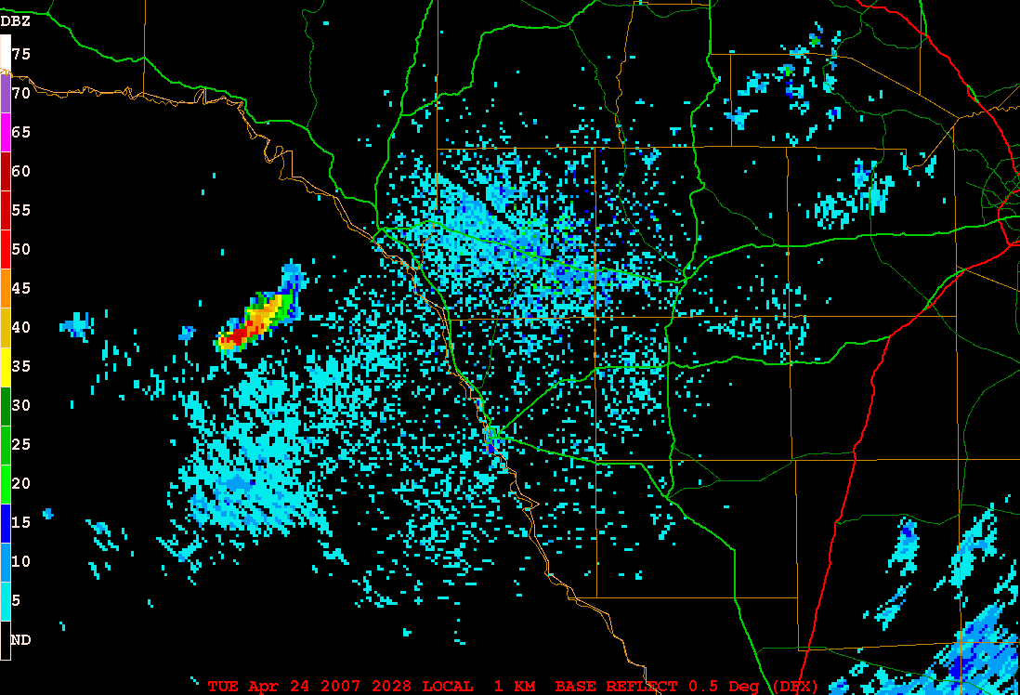
Split
L mover weaker
R mover turns right
R mover hook
Purple = hail
Notes:
24apr2006_split_dfx_n0r01.GIF

Slide 17
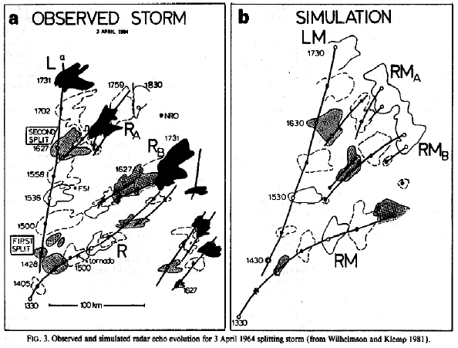
Splitting storms
Wilhelmson and Klemp (1981)

Slide 18
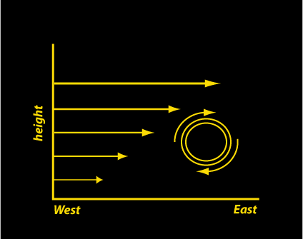
Shear-induced horizontal vorticity

Slide 19
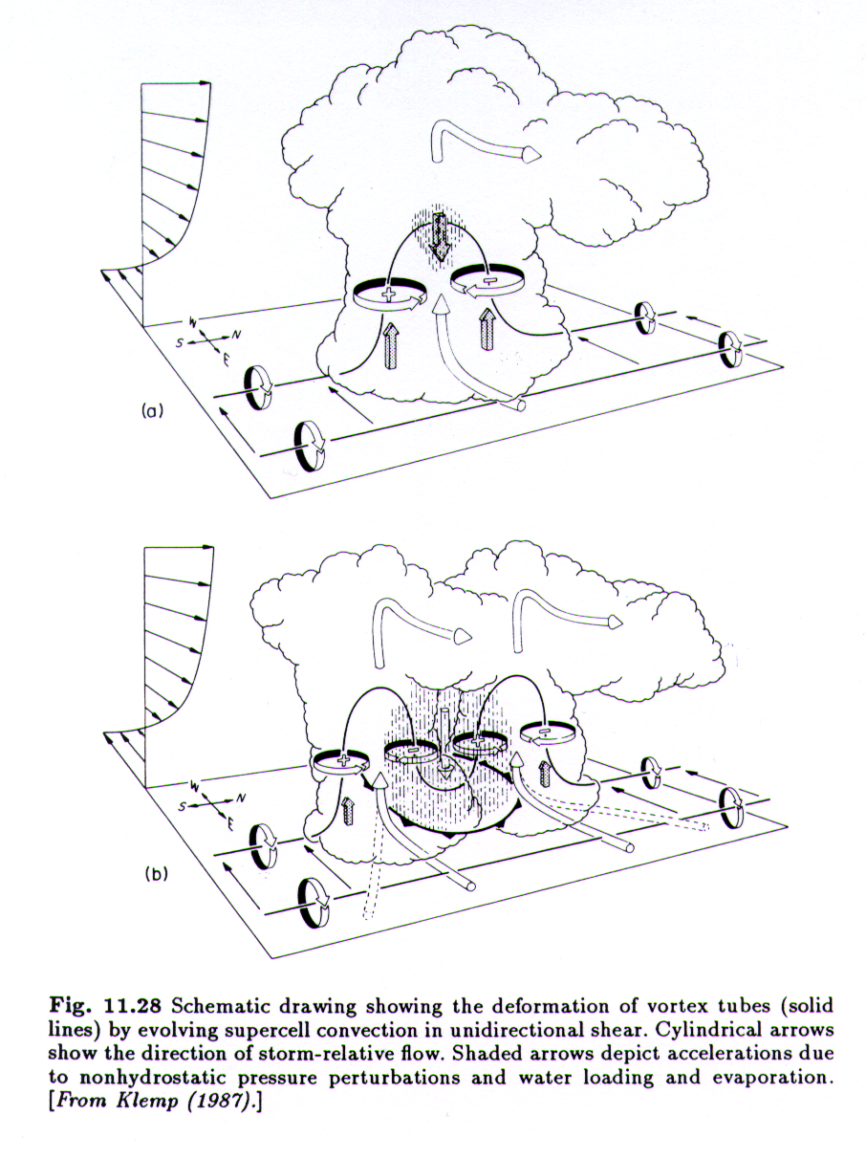
Dynamics of storm splitting
• Lifting of vortex tubes by updraft
creates counter-rotating vortices
(vertical vorticity)
• Low perturbation pressure develops
that establishes new updrafts on
flanks of original storm
• New cells are rotational: CCW or CW
• Old cell dies, giving appearance of
split
• Actually, precipitation does NOT
cause the updraft split!
Notes:
Bottom panel appears to show the new split cells are NOT rotating but instead have counterrotating vortices on THEIR sides as well. That is not consistent with our modern understanding

Slide 20
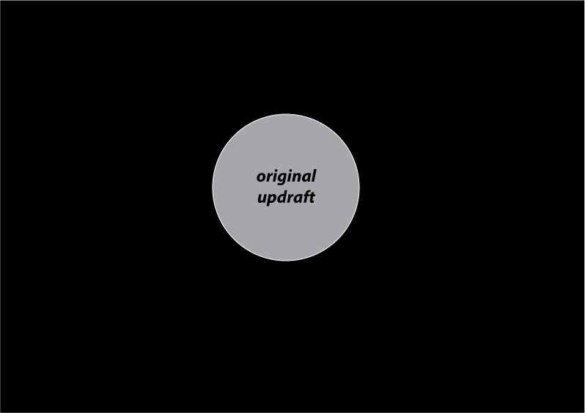
Original updraft
Updraft is *not* rotating

Slide 21
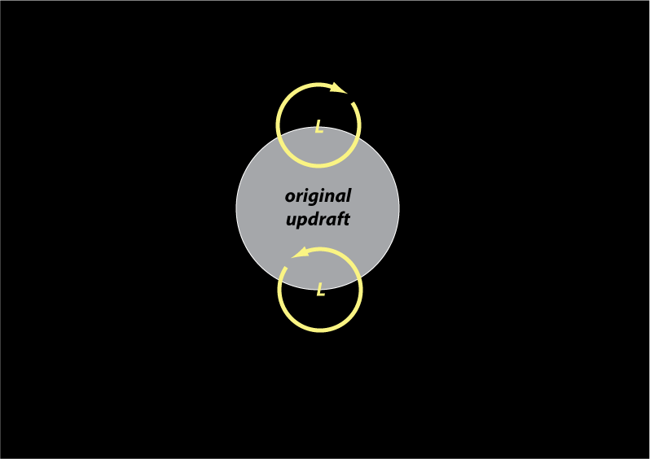
Counter-rotating vortices
Cyclostrophic lows

Slide 22
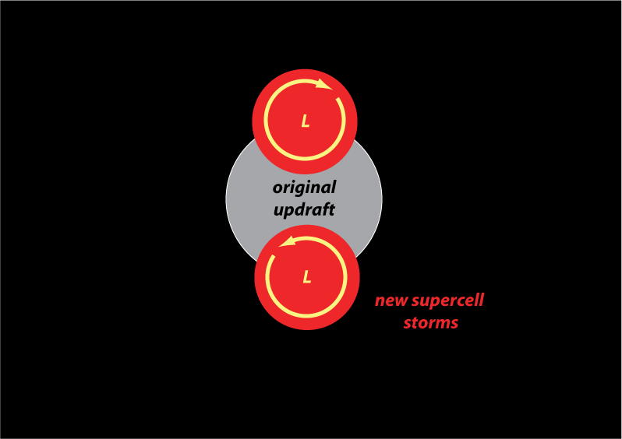
New storms form on flanks
New updrafts ARE rotating

Slide 23
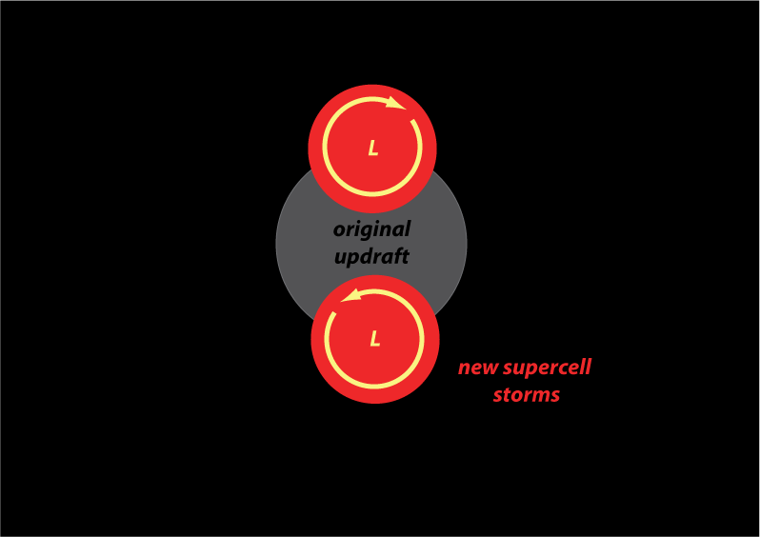
Old cell decays

Slide 24
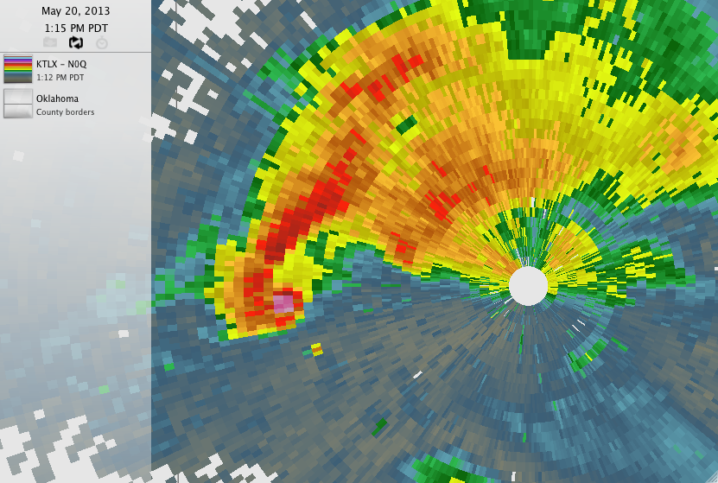
reflectivity
> 65+ dBZ
(hail or airborne debris)
hook echo

Slide 25
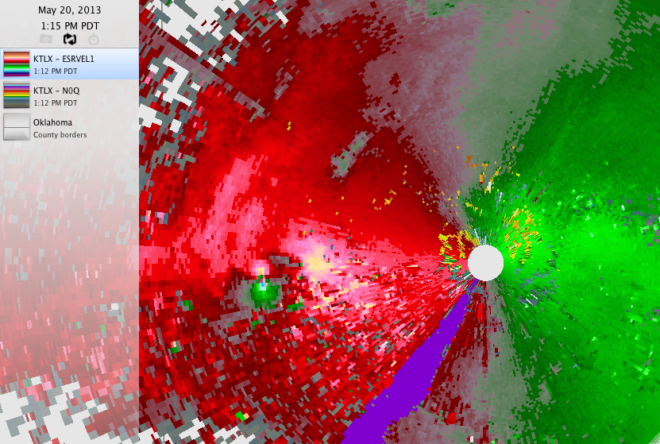
radial velocity

Slide 26
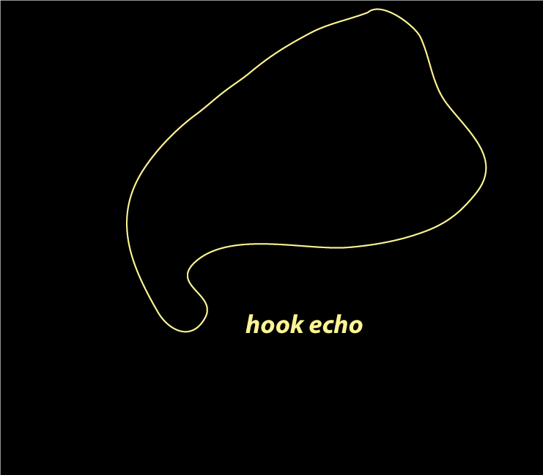
Supercell conceptual
model

Slide 27
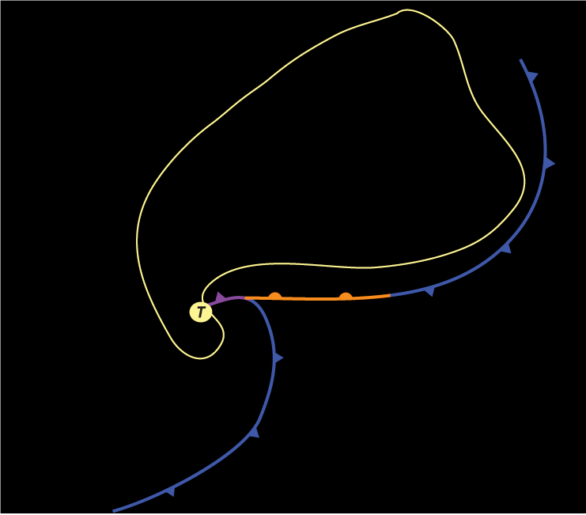
Storm-scale fronts
T = tornado location

Slide 28
mesocyclone
meso = Gk., middle

Slide 29
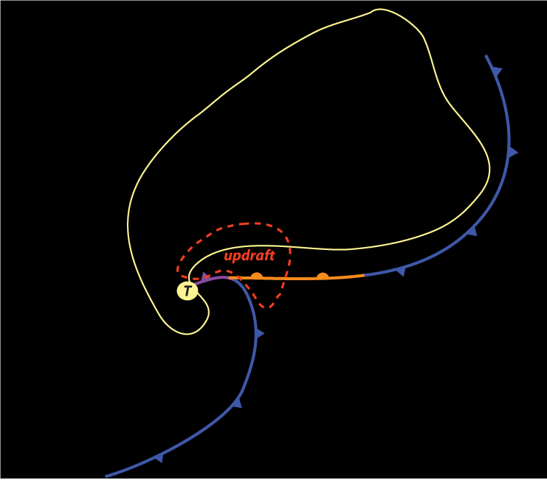
Updraft velocities can easily
exceed 100 mph

Slide 30
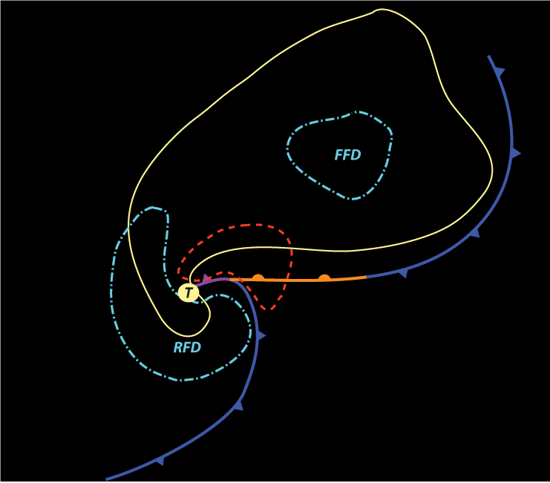
RFD = rear flank downdraft
FFD = forward flank downdraft

Slide 31
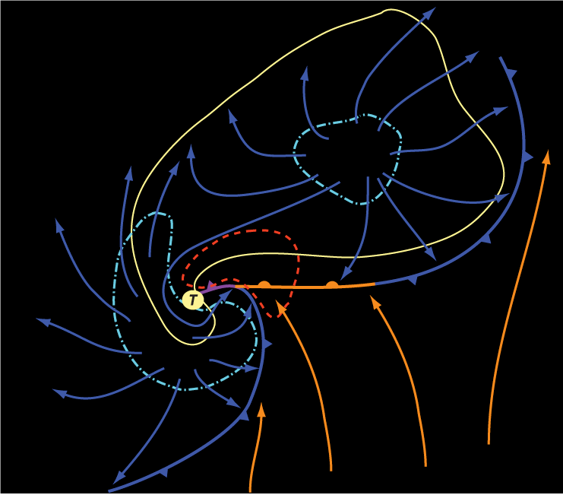
warm, moist air
lifted into updraft

Slide 32
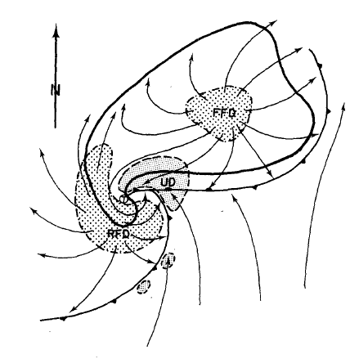
Supercell storm structure
Plan view at surface
UD = updraft
FFD = forward flank downdraft
RFD = rear flank downdraft
Gust front
Hook echo
Dot ~ tornado location
Lemon and Doswell (1979)

Slide 33
[After simulation finishes…]

Slide 34
Visualizing the supercell simulation with WRF-Python

Slide 35
The wrfout output file
Your WRF output file is called wrfout_d01_0001-01-01_00:00:00. It contains 13 output times, every 5 min for 1 hour (including the initial time)
  Because this was a short simulation that did not generate much output, we allowed WRF to write all output fields and times into a single file
  In more demanding applications, we might write fields at each output time into a separate file

Slide 36
Launch NCAR JupyterHub
https://jupyterhub.hpc.ucar.edu
Choose a Casper login node
Choose the npl-2024b kernel
Click on your LAB link in your home directory
Click on your SUPERCELL directory
Launch the notebook plot_SUPERCELL.ipynb

Slide 37
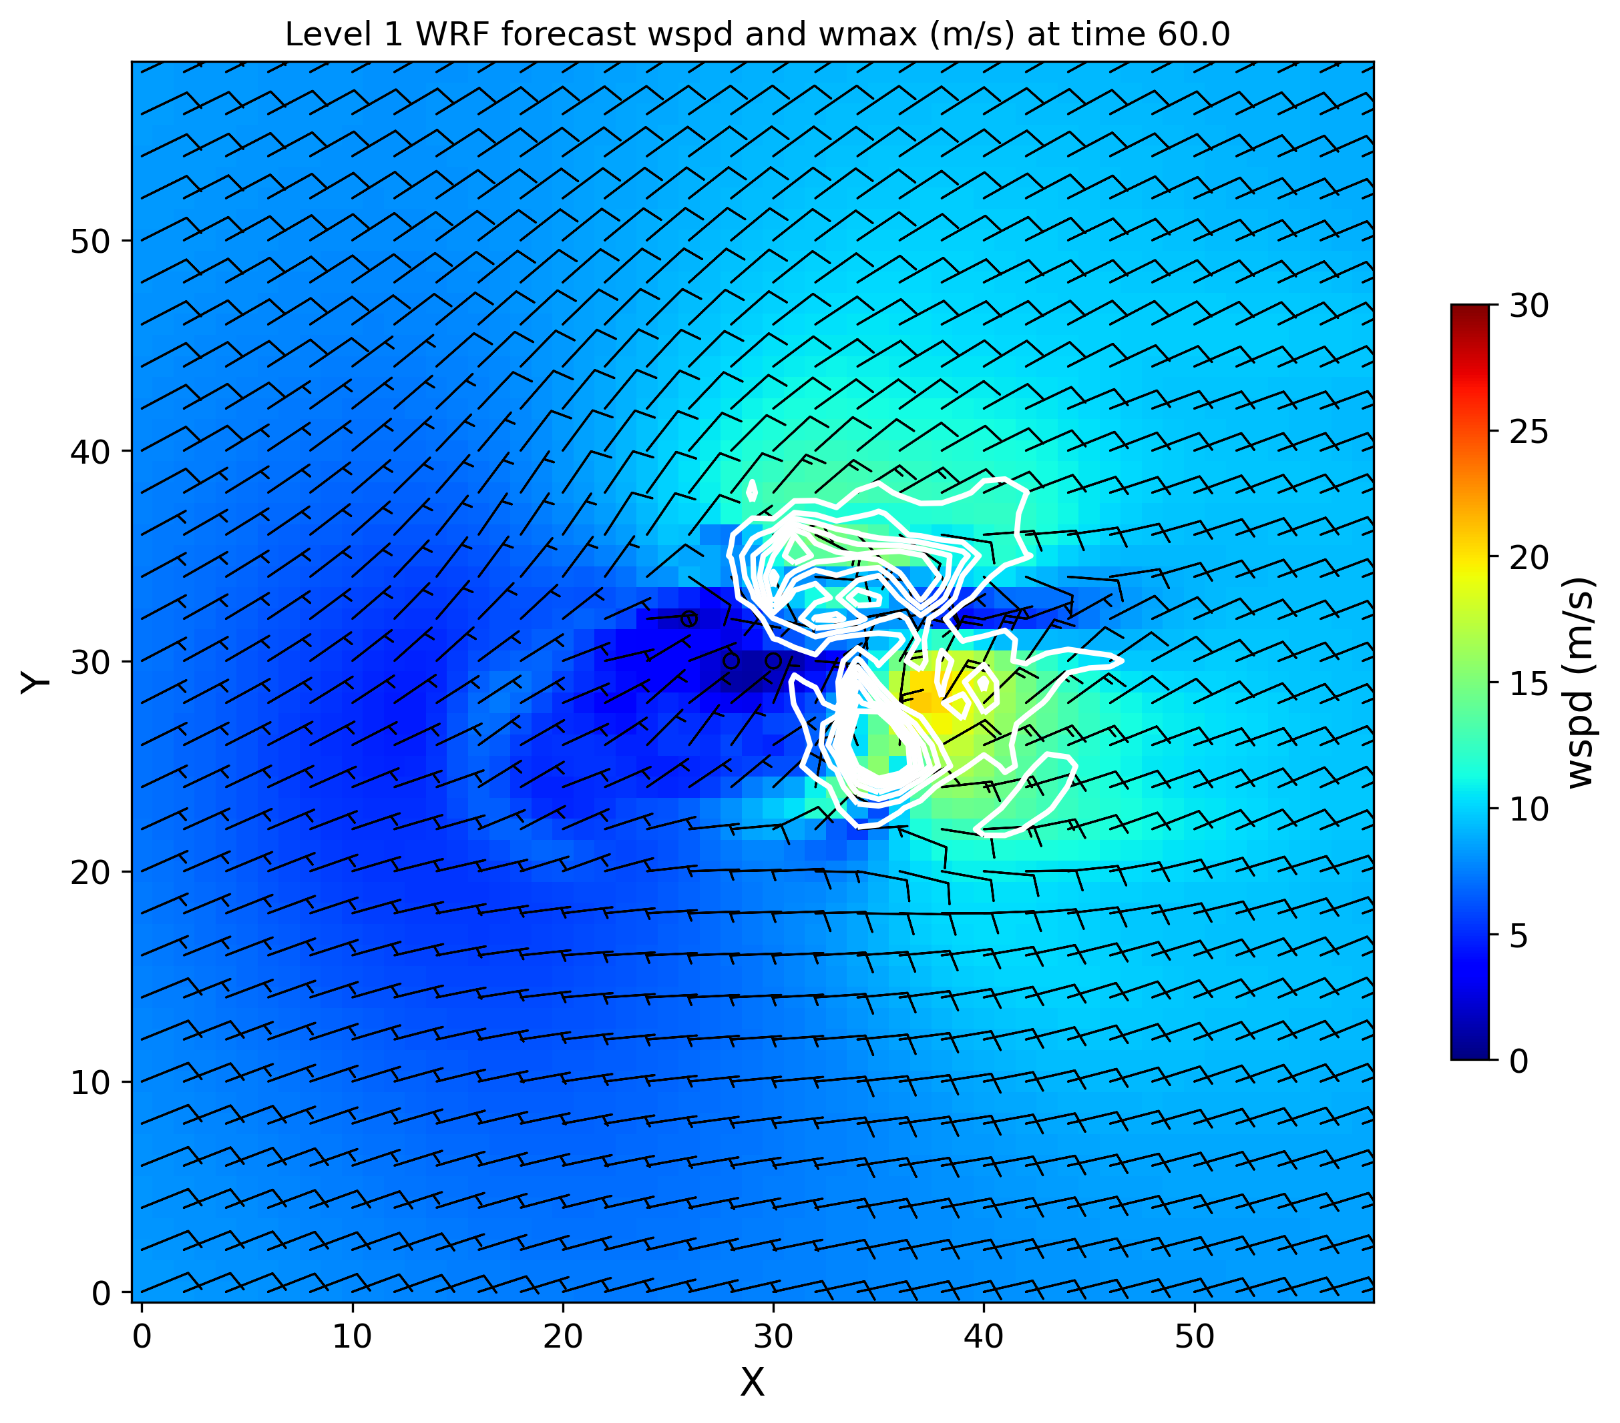
Horizontal wind speed (colored and barbs, m/s), column max vertical velocity (white contours)
X,Y axes labeled as grid points, not distance in km. We should change that.

Slide 38
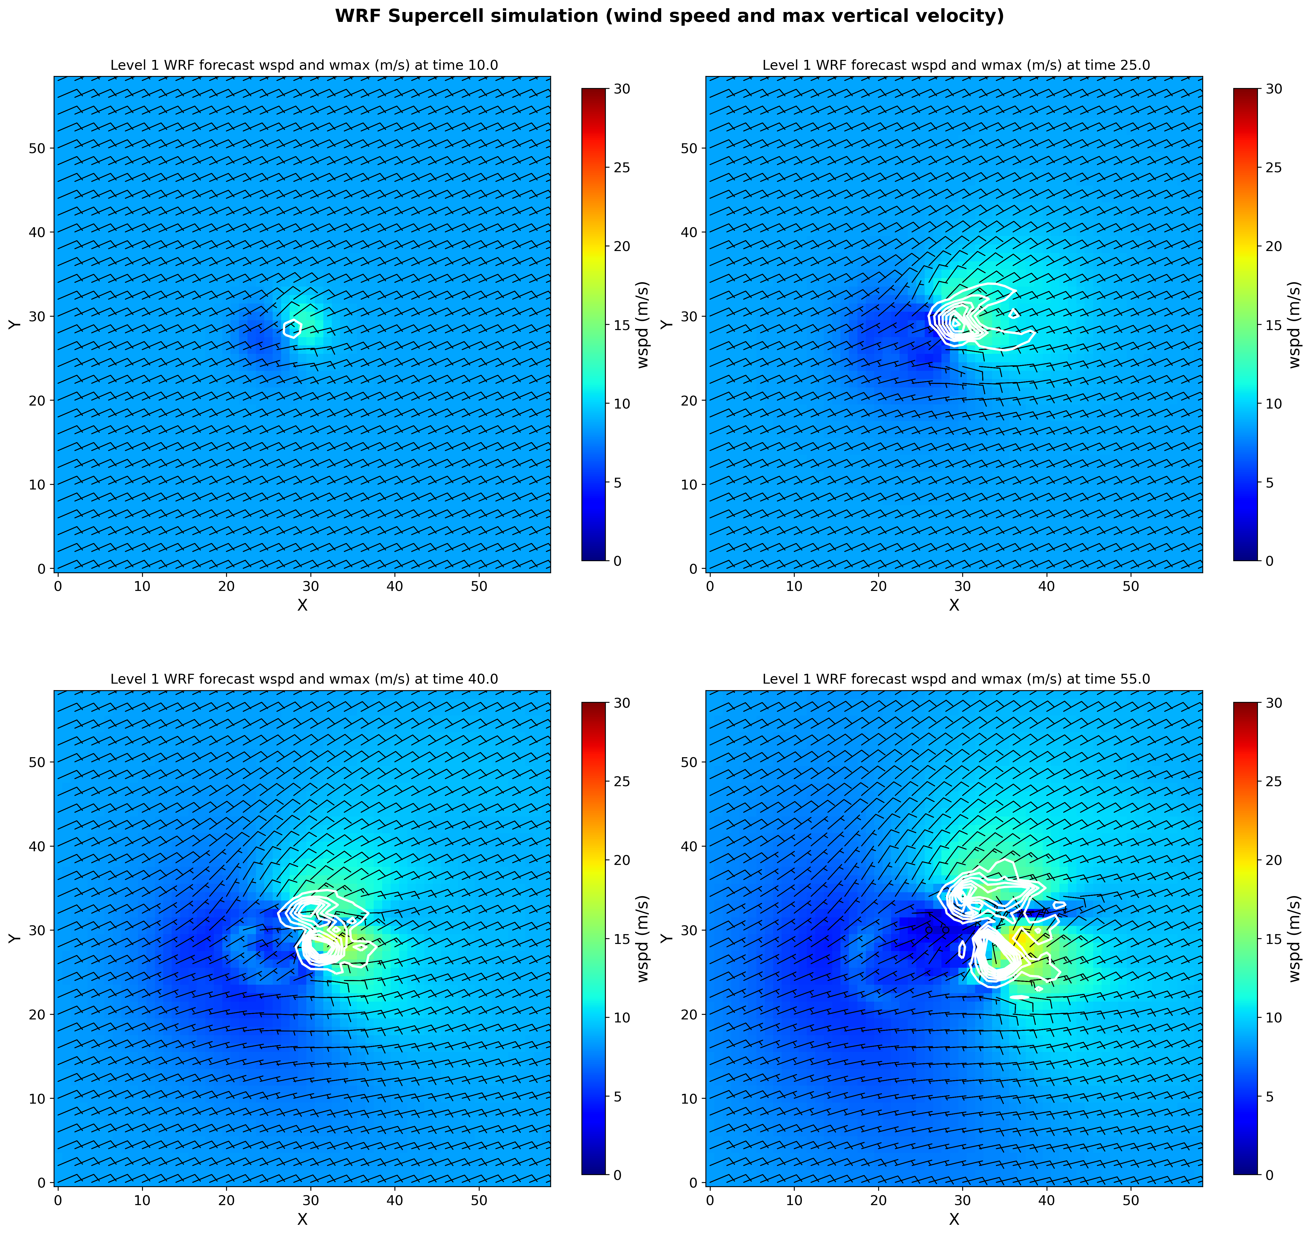
We do not need same colorbar on each plot. We should change that.
Notes:
Can improve by removing redundant colorbars and unneeded labels, etc.

Slide 39
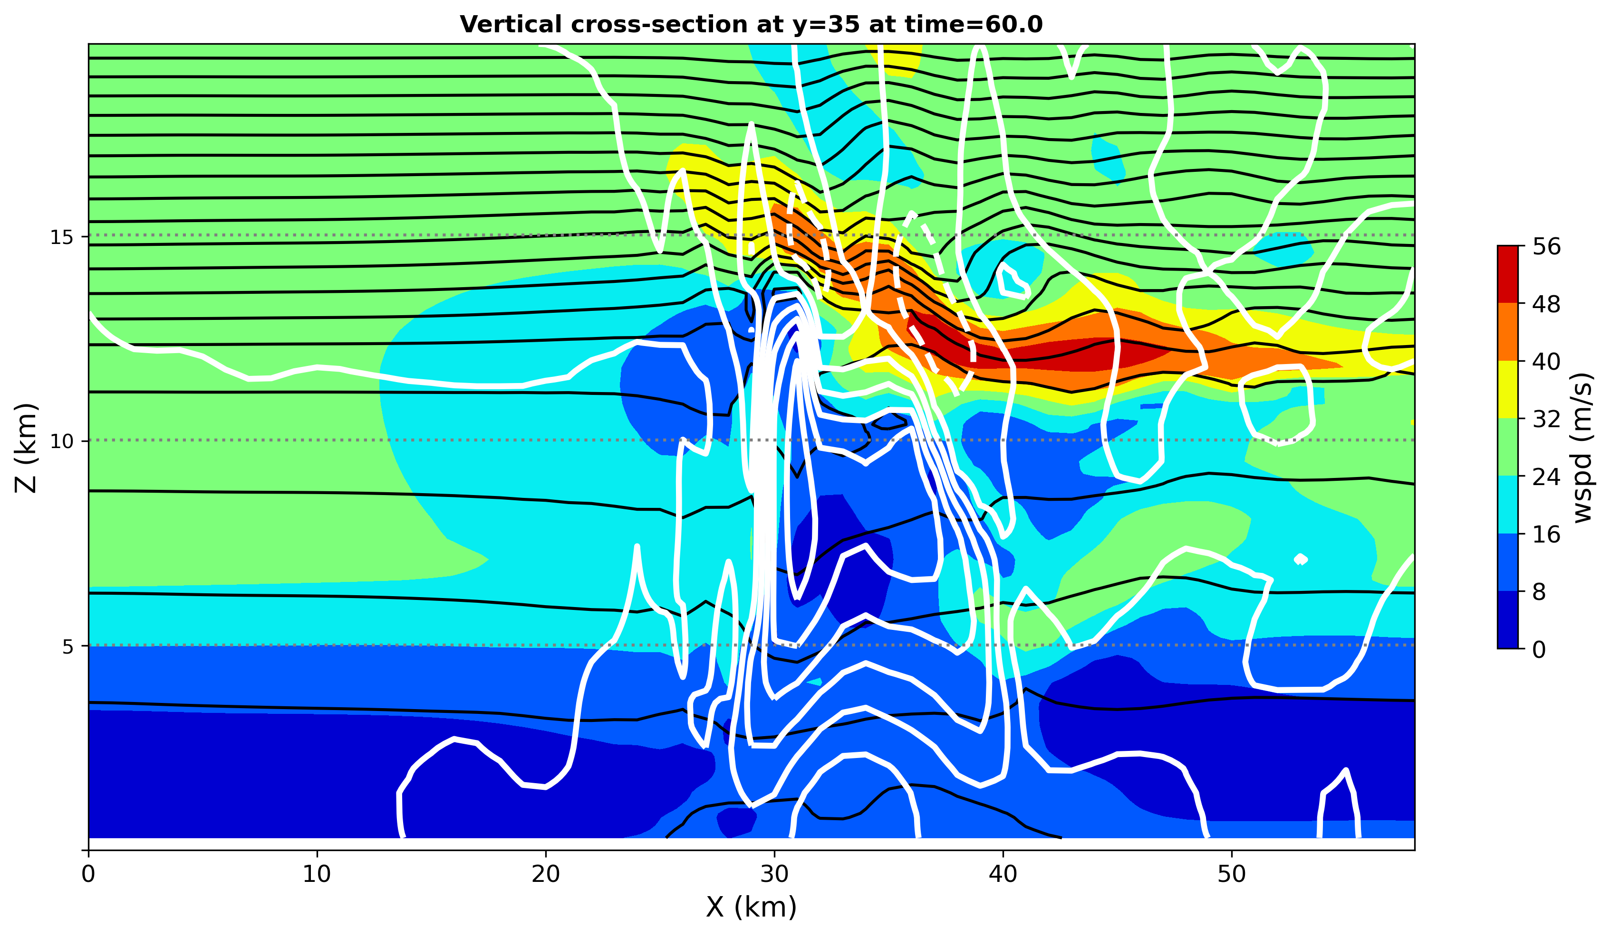
Horizontal wind speed (colored), vertical velocity (white contours), theta (black contours)

Slide 40
Where to go from here?
Change the sounding and/or hodograph
Change the model physics
Change the horizontal model grid spacing
Change the model vertical grid spacing
[etc.]

Slide 41
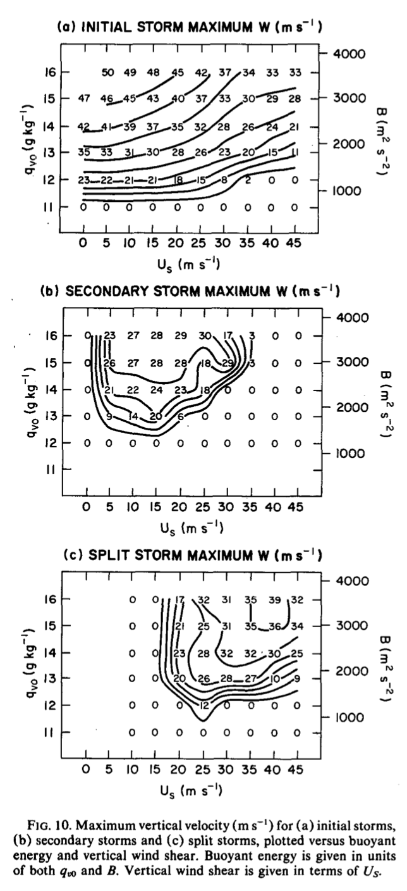
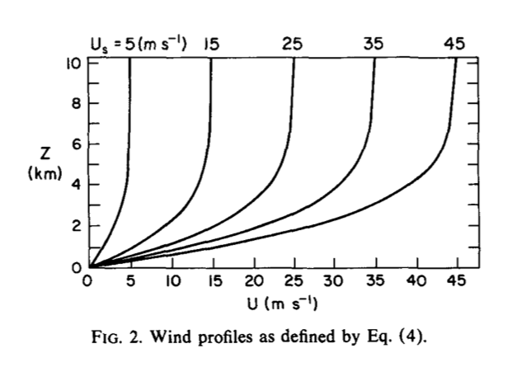
Weisman and Klemp (1982) varied the sounding’s
buoyancy B (= CAPE) by changing the mixing ratio
profile (qv0), and varied the wind profile’s
unidirectional shear Us, investigating the effect of
CAPE and shear on storm mode: supercell (“split
storm”) vs. multicell (“secondary storm”)
Weisman and Klemp (1982)
Notes:
Because shear was unidirectional, and started with a symmetric bubble, simulations remained symmetric, with mirror-image R and L movers

Slide 42
[end]
Notes:
“courier du bois” = runner of the woods

