Slide 1
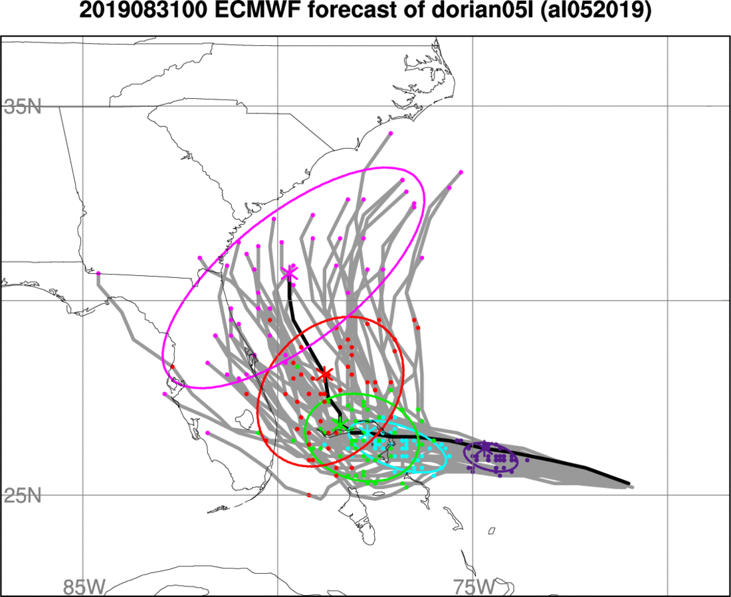
Metrics could be:
latitude or longitude of the TC at an individual time
distance along axis of largest variability

Slide 2
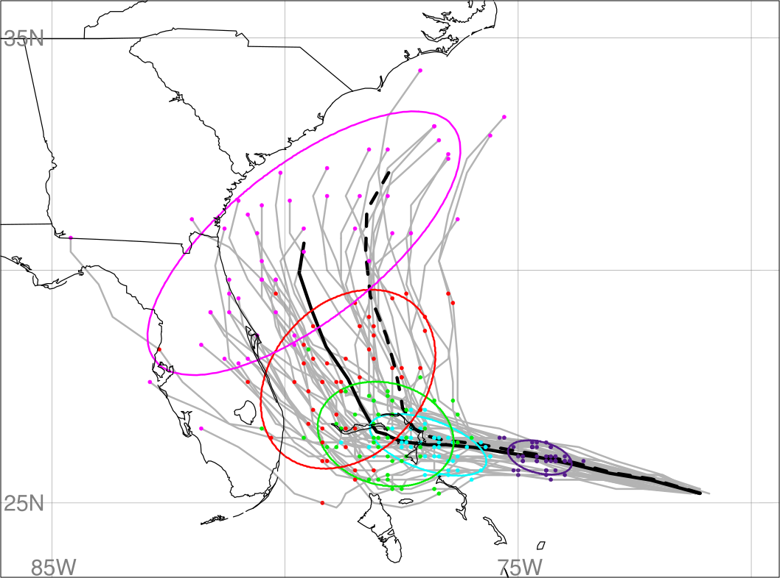
Compute EOF of TC lat/lon as a function of time. Metric is principal component of the first EOF (measure of how close each ensemble member is to particular forecast trajectory). Extends method of computing sensitivity for a single time to multiple lead times

Slide 3
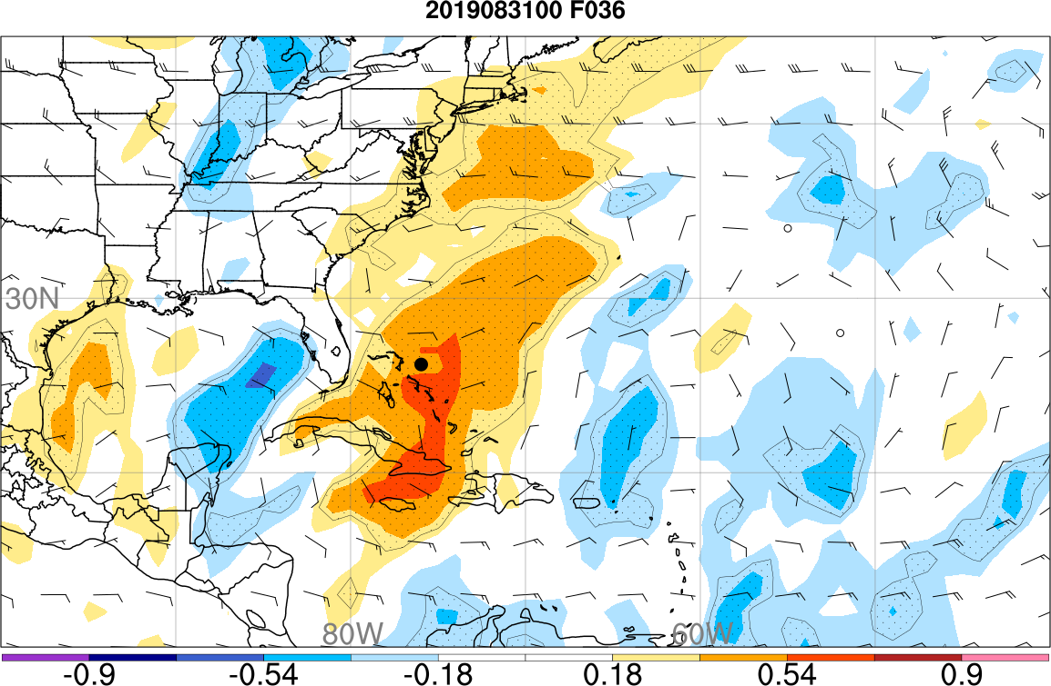
Steering Wind
valid 12Z 1 Sept.
Sensitivity of Dorian’s position forecast to the 36 h forecast of steering wind component

Slide 4
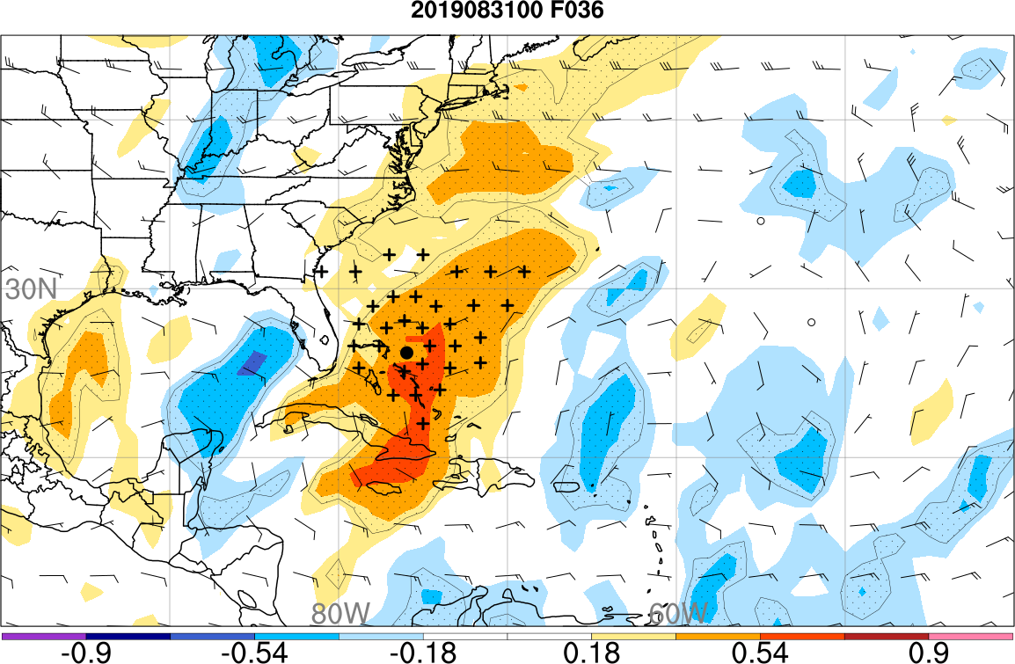
Steering Wind
valid 12Z 1 Sept.

Slide 5
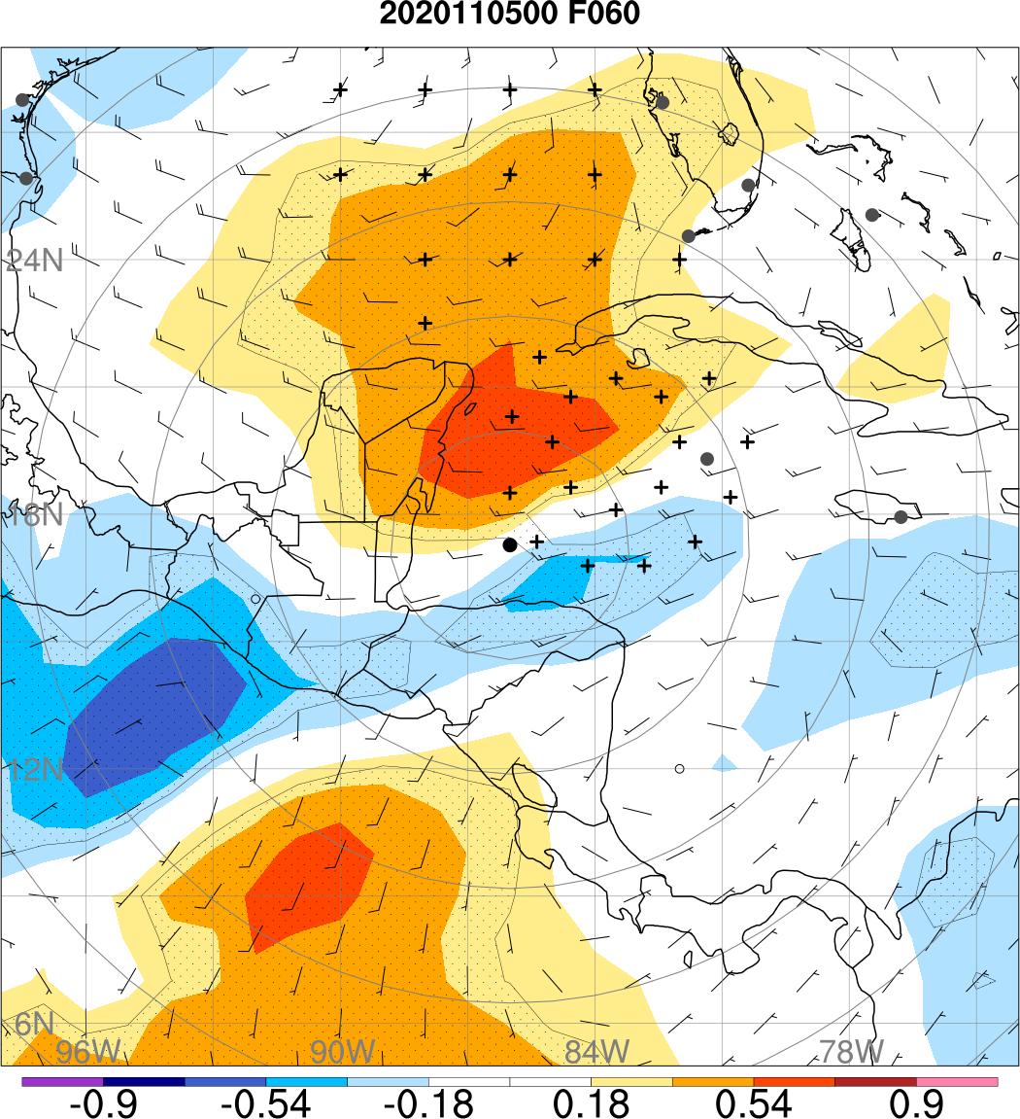
Tropical Storm Eta
1200 UTC
7 November 2020
Sensitivity to the near-storm TC steering flow and to the trough coming into the Gulf of Mexico

