Slide 1


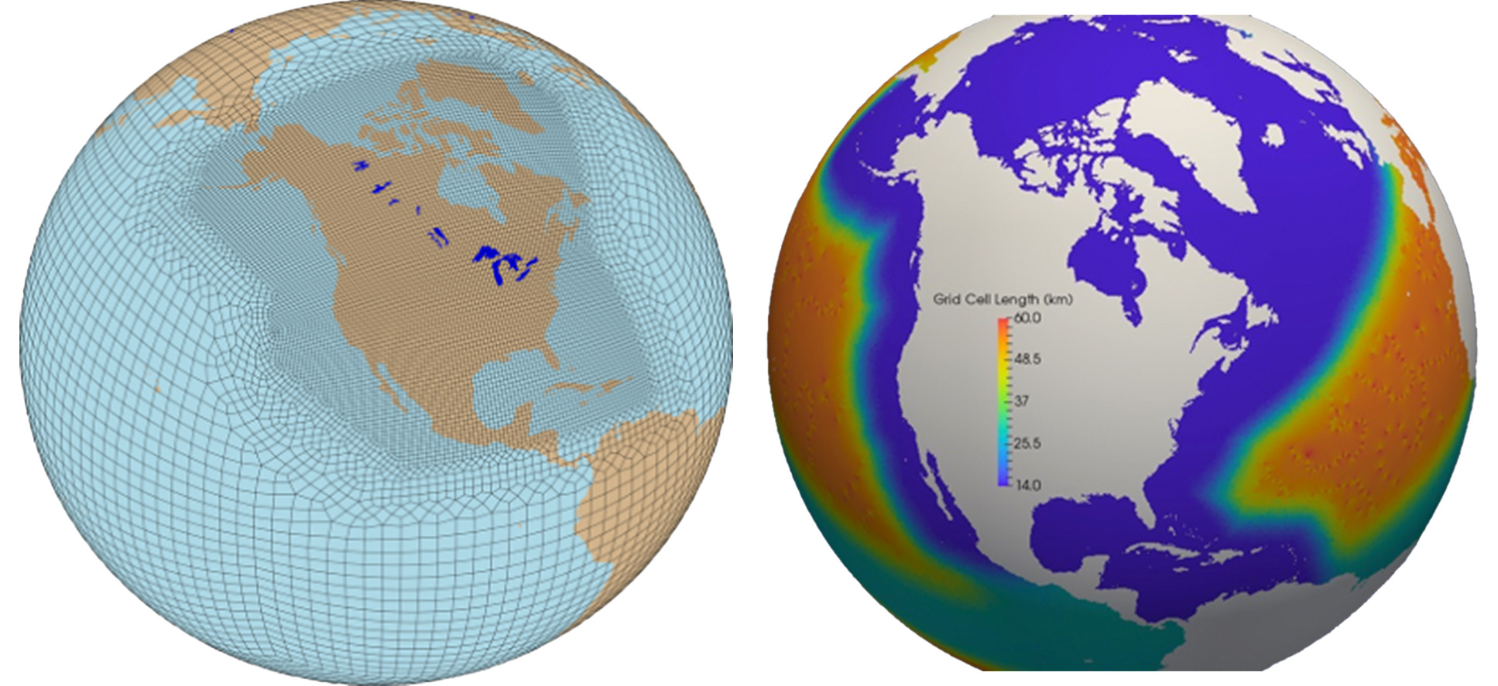
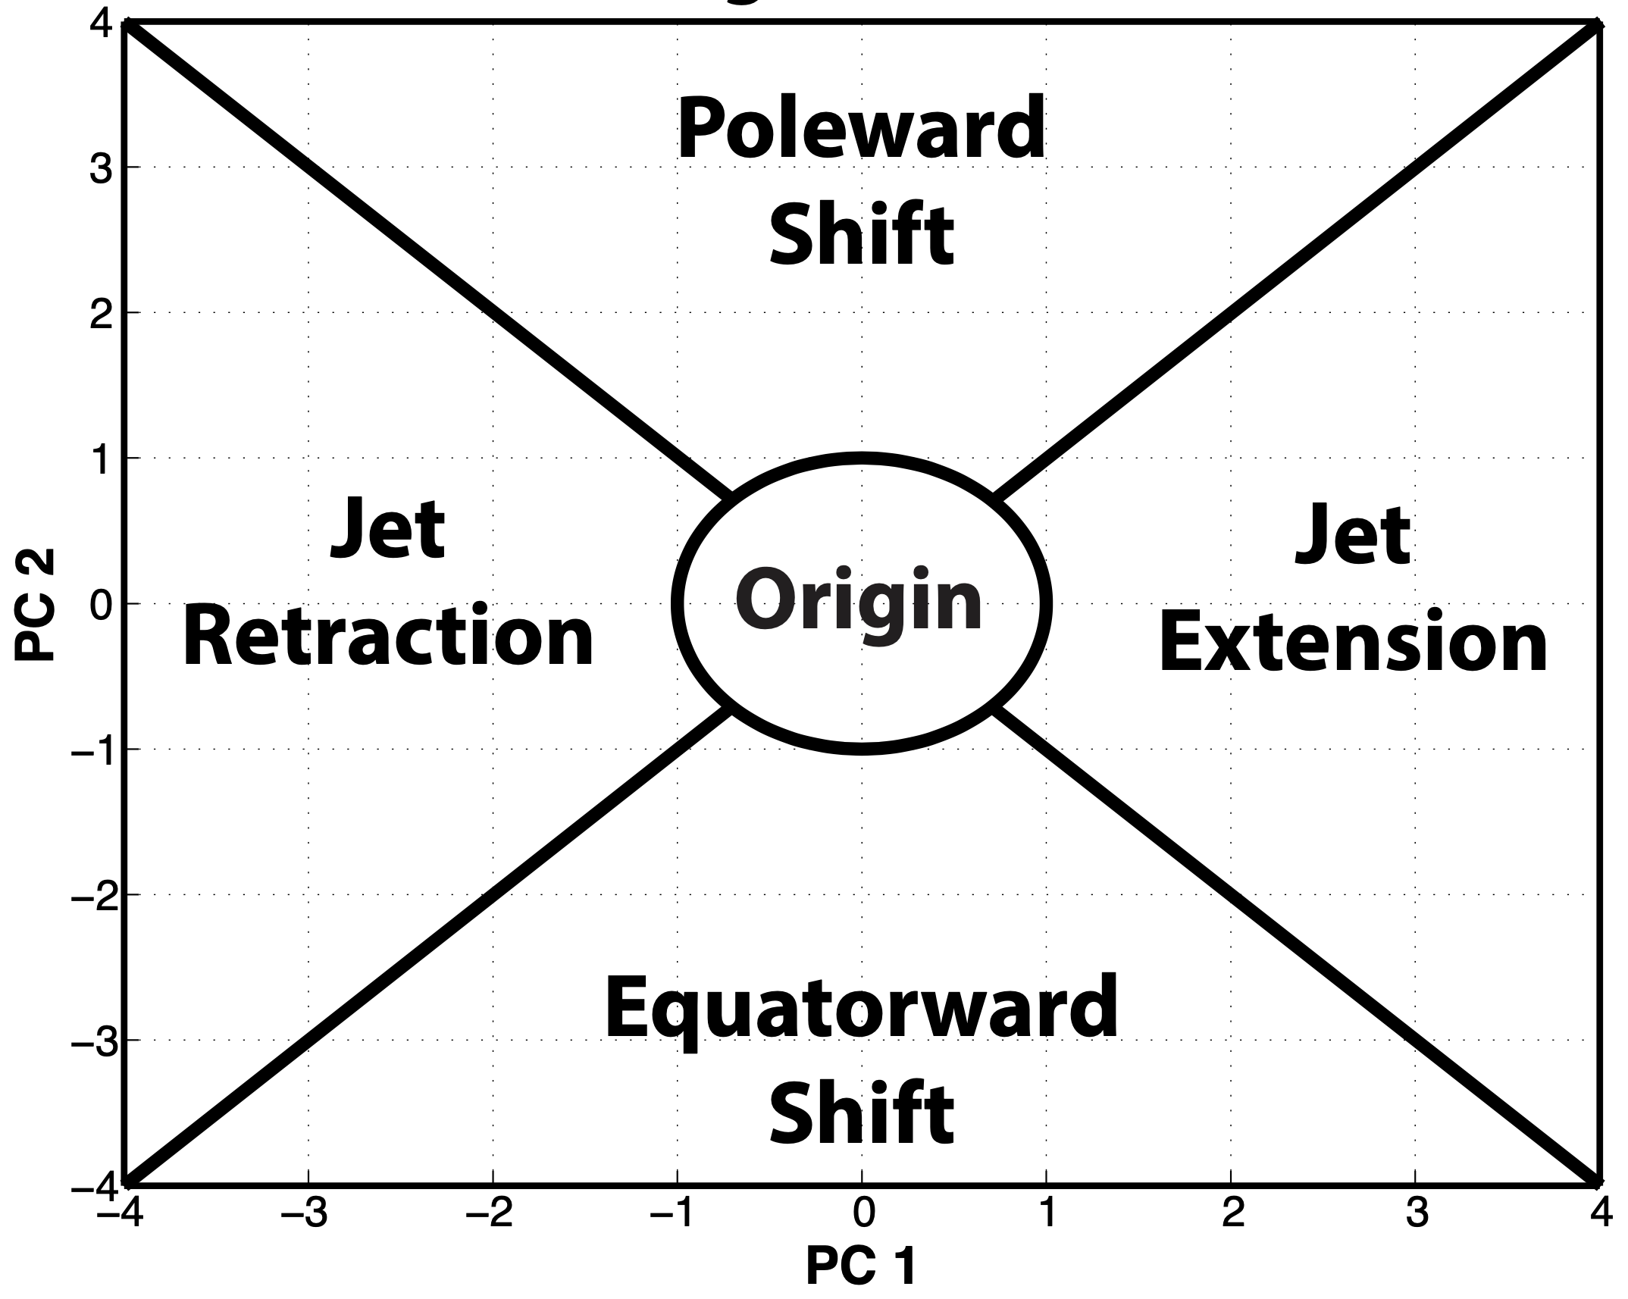
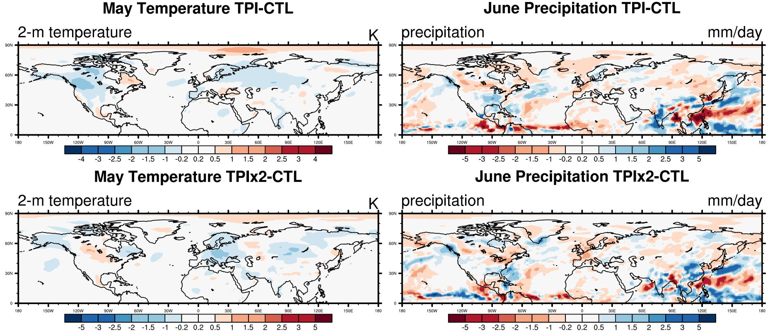
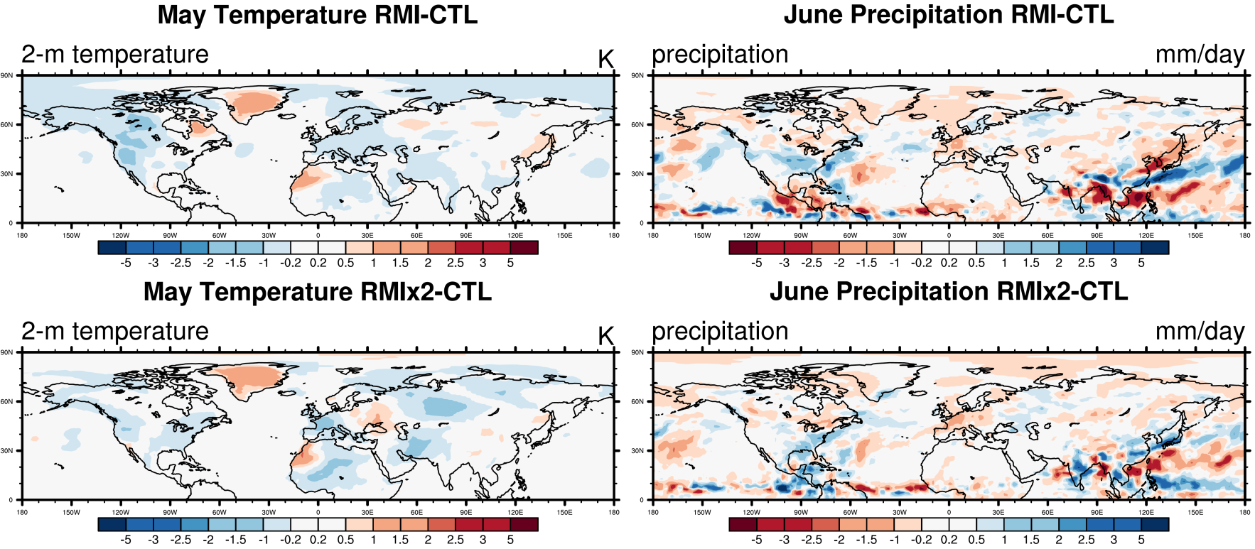
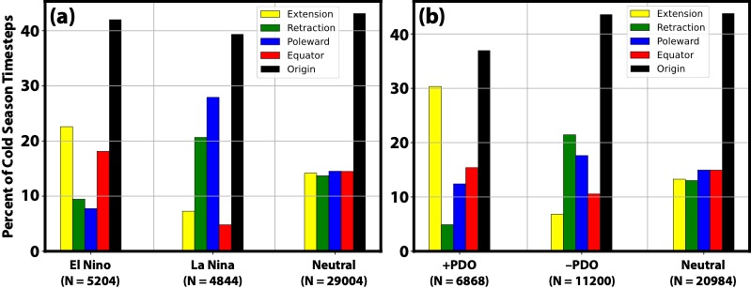
Elevated Land Surface Heat Anomalies as Sources of U.S. Summer Hydroclimate Predictability:
E3SMv2 Low-Level Jet and Precursor Event Sensitivities
Ryan D. Torn¹, Qi Tang², Andrew Winters³
(1) University at Albany, State University of New York, (2) Lawrence Livermore National Lab, (3) University of Colorado, Boulder
Introduction and Motivation
There is growing recognition within the subseasonal-to-seasonal (S2S) climate forecast community that the land surface state (i.e., soil moisture, soil temperature, snow, and vegetation) provides a significant source of predictability at shorter time scales. Potentially the largest source regions for land-forced climate variability are elevated regions, including the Tibetan Plateau and Rocky Mountain Cordillera. In these locations, the land is providing thermal and dynamic forcing in the middle troposphere (i.e., 500-hPa) that has been shown to enforce and/or modulate a Rossby wavenumber-5 train. The recent international Impact of Initialized Land Temperature and Snowpack on Sub-seasonal to Seasonal Prediction Experiment (LS4P)-Phase 1 revealed that May surface heating anomalies over the Tibetan Plateau explain more June precipitation variability over the western U.S. than ocean SST anomalies. The Tibetan Plateau–North American teleconnection is strongest during April–May, before the North Pacific jet has shifted poleward, and before Pacific and Atlantic subtropical highs emerge; therefore, to fully harvest the potential 2–4 week lead predictability embedded in the Tibetan Plateau–North American teleconnection, Earth system models must accurately represent spring–summer shoulder season land–atmosphere interactions, including snow cover/snowmelt dynamics.
North American RRM (NARRM) grids for the atmosphere and land (left, 25->100km) and for the ocean and sea ice (right, 14->60km).
Extension/Retraction
Results
Poleward/Equator Shift
Objectives
FIG. 2. Schematic illustrating the classification scheme for analysis times with respect to the NPJ phase diagram.
Identify and diagnose systematic E3SMv2 time-mean model biases in land states (i.e., snow, soil moisture, soil temperature), land–atmosphere coupled processes, and atmospheric teleconnections.
2) Quantify and spatially demarcate E3SMv2 El Niño-Southern Oscillation (ENSO)- and Pacific Decadal Oscillation (PDO)-related December–March temperature, soil moisture, and snow anomalies over CONUS.
3) Understand and characterize the conditions under which Tibetan Plateau and Rocky Mountain surface heating anomalies modulate E3SMv2’s representation of the western Asia–North America teleconnection.
4) Evaluate E3SMv2 5-, 10-, 15-, 20-, and 60-day lead forecast skill, and diagnose the degree to which regional and remote land surface heating anomalies, and related land–atmosphere interactions, affect precipitating system dynamics.
5) Integrate supporting tools into E3SM Diagnostic Tools
FIG. 5. Difference in (left) 2-m temperature and (right) precipitation between the control and simulations where land surface temperature is nudged in the Tibetan Plateau Region (TPI). The bottom row shows the experiment that doubles the temperature masking.
FIG. 1. (a) September–May 250-hPa mean zonal wind is contoured in black every 5 m s⁻¹ above 20 m s⁻¹, and the regression of 250-hPa zonal wind anomaly data onto standardized PC 1 (i.e., EOF 1) of is shaded (m s⁻¹). The variance of 250-hPa zonal wind anomalies explained by EOF 1 is listed in the top left of the panel. (b) As in (a), but for the regression of 250-hPa zonal wind anomaly data onto standardized PC 2 (i.e., EOF 2). EOF 1 represents a jet extension/retraction mode and EOF 2 represents a poleward equatorward shift mode for the North Pacific jet.
FIG. 3. (a) The percent frequency of each NPJ regime at times during which the NPJ is outside of the unit circle on the NPJ phase diagram and characterized by each phase of the ENSO. The numbers in parentheses below each category indicate the number of analysis times in each category. (b) As in (a), but for the PDO.
(a)
(b)
(c)
(d)
(e)
FIG. 6. Difference in (left) 2-m temperature and (right) precipitation between the control and simulations where land surface temperature is nudged in the Rocky Mountain Region (RMI). The bottom row shows the experiment that doubles the temperature masking.
Summary
El Nino favors jet extensions and equatorward jet shifts, opposite for La Nina
+PDO favors jet extensions, with near equal chances of jet retractions and poleward shift during -PDO
Greater preference for coupled LLJs in the Central Plains during jet retractions and poleward shifts.
TPI alleviates dry bias in Yangtze River, with the TPIx2 better. Over Southern Great Plains, TPI and TPIx2 have better results relative to CTL
RMIx2 has alleviated dry bias in Yangtze River while RMI does not; RMI alleviates the dry bias across US while RMIx2’s alleviation is less.
FIG. 4. (a) The percent frequency of days during March–May that feature a Coupled LLJ (i.e., those LLJs linked to an upper-level trough) is shaded, whereas the frequency of Uncoupled LLJs (i.e., those not linked to an upper-level trough) is contoured. As in (a), but showing the difference in LLJ frequency relative to climatology during (b) jet extensions, (c) jet retractions, (d) poleward shifts, (e) equatorward shifts.
This work is supported by DE‐SC0024002, Questions: rtorn@albany.edu

