Slide 1
Unexpectedly heavy mesoscale snowstorm in portions of the Colorado Front Range on 28 Jan 2019
A case of NW flow aloft with northerly flow on the plains turning south of Larimer County in a Longmont anticyclone pattern
Creating a zone of speed convergence at low levels displaced to the east of the foothills
Deep moist adiabatic lapse rate with unidirectional increasing winds aloft – CSI?
Longer range global models (lots of model fields from Weather.us site, HRRR fields from COD site until the government returned to business)
Both the ECMWF and UKMO especially showed an area of precipitation Boulder-Denver County, displaced at times too far west, and not quite enough, but with max values up to ~0.4”
GFS slowest to come around and generally too dry
FV3 fields do not have a county map but look a little better than the GFS, not as good as the EC

Slide 2
Unexpectedly heavy mesoscale snowstorm in portions of the Colorado Front Range on 28 Jan (continued)
Higher res models
Earliest HRRR run from 12z/Sunday/27 Jan certainly showed banding
But bands were not correctly located
And precip amounts were too low
No HRRRX for this time
For 00z/28 Jan also have HRRRX
HRRR now has one main area of snow, it is shifted too far south but includes parts of the Denver area, while NAM Nest is a bit farther north
Both show FCL getting skunked
While amounts are too low, if we double the 10:1 ratio would be getting some 3-6” type totals
HRRR & HRRRX forecasts – general comments
There is a trend towards better forecasts late in the afternoon on Sunday (note reflectivity forecasts for example, and HRRRX)
Potential got better, trending off a more Palmer Divide/western Denver foothills forecast
Still tricky to get band shifted enough to the east or with high enough amounts

Slide 3
The snowfall max seemed to follow the Boulder Turnpike into Denver, unfortunately during morning rush hour.

Slide 4
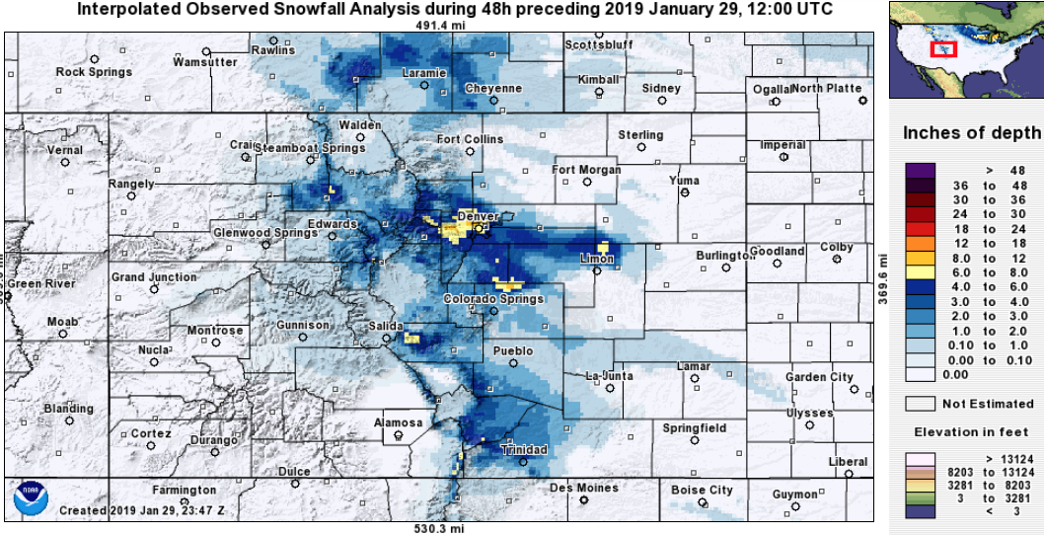
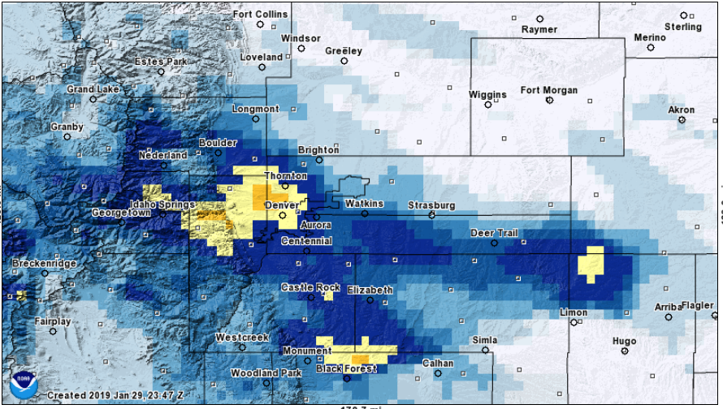

Slide 5
Haven’t done the analysis but moist adiabatic saturated layer with unidirectional winds increasing with height ~650 to ~450 mb would support presence of CSI.

Slide 6
Obs showing the initial surge – first nwly on the plains then second more northerly surge (see CYS obs)

Slide 7
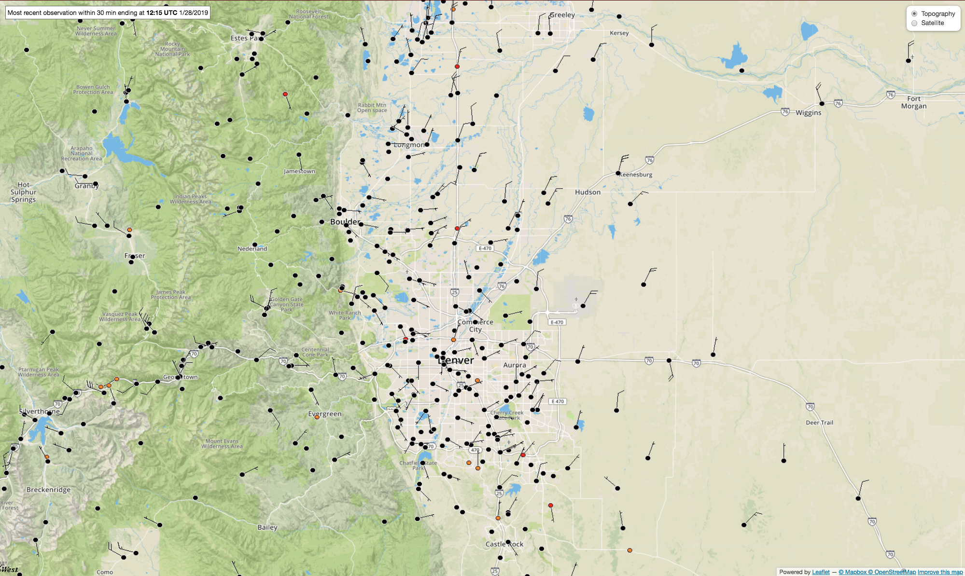
Obs at 12z on 28 Jan 2019
It looks like maybe 2 or 3 bands oriented NNW-SSE have set up by 12z. We now have much broader turning of the flow into the northeast with good speed convergence ~west of I-25 generally south of FCL.

Slide 8
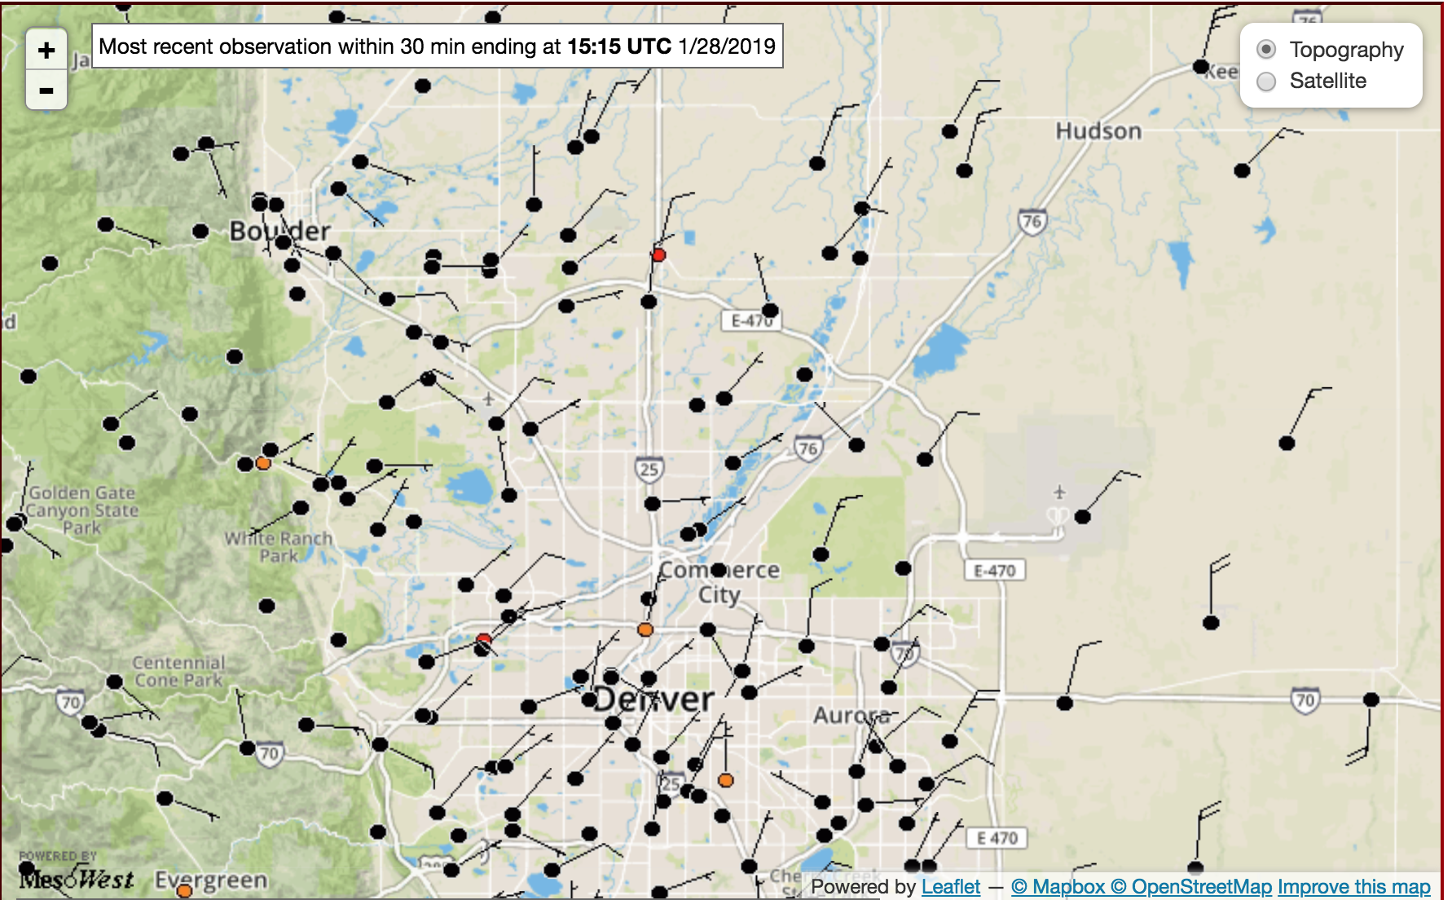
Obs at 15z on 28 Jan 2019
Could still argue that there may be 3 bands in there, otherwise certainly an area of quite heavy snow. Speed convergence continues to be seen in the obs, though from Denver southward there is also a component of upslope all the way to the foothills, which is in agreement with the snow distribution.

