Slide 1
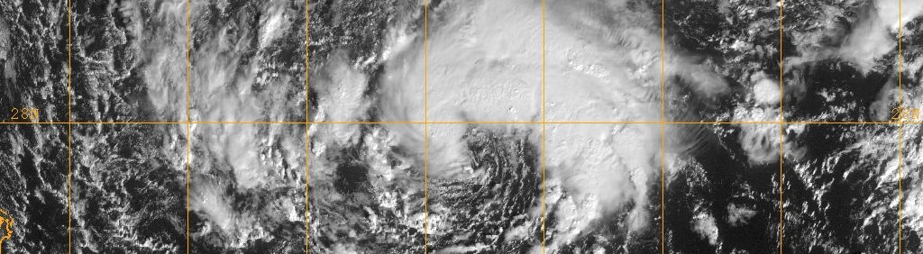
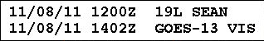
Upper-Tropospheric Precursors Associated
with Subtropical Cyclone Formation
in the North Atlantic Basin
Subtropical Storm Sean
8 November 2011
28N
72W
68W
64W
Alicia M. Bentley
University at Albany, SUNY
M.S. Thesis Presentation
15 June 2014
Research support provided by NSF Grant AGS-0935830

Slide 2
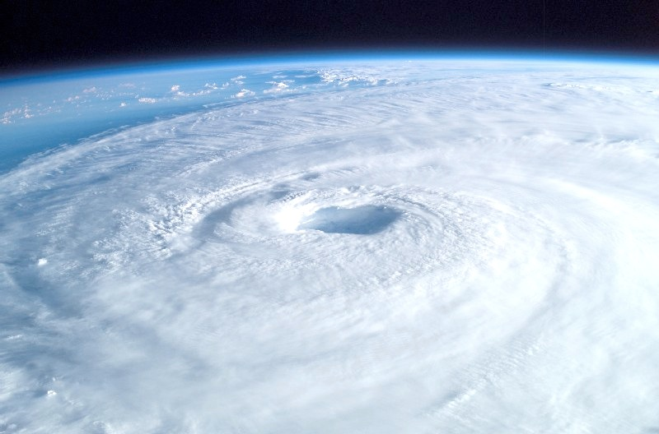
Subtropical Cyclones
Operational Definition
“A non-frontal low-pressure system that has characteristics of both tropical and extratropical cyclones.”
“Unlike tropical cyclones, subtropical cyclones derive a significant portion of their energy from baroclinic sources…
often being associated with an upper-level low or trough.”
− National Hurricane Center Online Glossary (2012)
Notes:
http://www.nhc.noaa.gov/aboutgloss.shtml ←------- Actually defintion, even with the random hyphens

Slide 3
Motivation
There is currently no objective set of characteristics used
to define subtropical cyclones (STCs)
The hybrid nature of STCs makes them likely candidates
to become tropical cyclones (TCs) via the tropical transition (TT) process
Few studies address the relationship between STCs,
TC development, and high-impact weather events
Notes:
Say wind speed criteria for a subtropical storm but also then the wind speed for a subtropical depression

Slide 4
Outline
Adapt Davis (2010) methodology for STC identification
Formulate objective STC identification technique and apply to baroclinically influenced tropical cyclogenesis cases over
the North Atlantic to construct STC climatology
Perform a cyclone-relative composite analysis of the
upper-tropospheric features linked to STC formation
Examine the upper-tropospheric features linked to STC formation using an illustrative case study
Notes:
Say wind speed criteria for a subtropical storm but also then the wind speed for a subtropical depression

Slide 5
Adapt Davis (2010) Methodology
Davis (2010) methodology:
  Based on Ertel potential vorticity (PV)
  Formulated in terms of two PV metrics that quantify the relative contributions of baroclinic processes and condensation heating to the evolution of individual cyclones
Davis (2010) methodology is similar to Hart (2003) cyclone phase space diagrams
Notes:
Say wind speed criteria for a subtropical storm but also then the wind speed for a subtropical depression

Slide 6
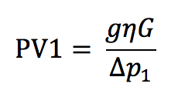


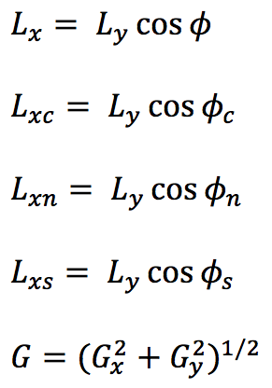
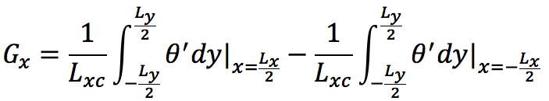
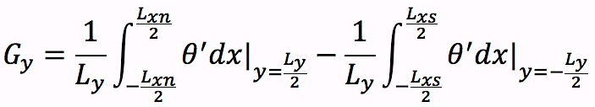


Adapt Davis (2010) Methodology
absolute vorticity
Lower-tropospheric
baroclinic processes:
(near-surface potential
temperature anomaly)
425 hPa
Potential temperature anomaly
Length of 6° of latitude
Notes:
Say wind speed criteria for a subtropical storm but also then the wind speed for a subtropical depression

Slide 7
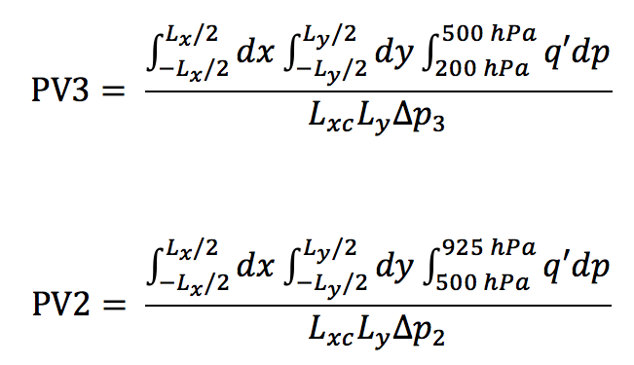

Adapt Davis (2010) Methodology
absolute vorticity
Lower-tropospheric
baroclinic processes:
(near-surface potential
temperature anomaly)
Midtropospheric
latent heat release:
(interior PV anomaly)
425 hPa
Potential temperature anomaly
Length of 6° of latitude
Ertel PV anomaly
Notes:
Say wind speed criteria for a subtropical storm but also then the wind speed for a subtropical depression

Slide 8
Adapt Davis (2010) Methodology
200 hPa
925 hPa
Notes:
Say wind speed criteria for a subtropical storm but also then the wind speed for a subtropical depression

Slide 9
Adapt Davis (2010) Methodology
Upper-tropospheric
dynamical processes:
(upper-tropospheric
PV anomaly)
Midtropospheric
latent heat release:
(interior PV anomaly)
Lower-tropospheric
baroclinic processes:
(near-surface potential
temperature anomaly)
200 hPa
925 hPa
Lower-tropospheric
baroclinic processes (PV1)
Notes:
Say wind speed criteria for a subtropical storm but also then the wind speed for a subtropical depression

Slide 10
Adapt Davis (2010) Methodology
Upper-tropospheric
dynamical processes:
(upper-tropospheric
PV anomaly)
Midtropospheric
latent heat release:
(interior PV anomaly)
Lower-tropospheric
baroclinic processes:
(near-surface potential
temperature anomaly)
200 hPa
925 hPa
Lower-tropospheric
baroclinic processes (PV1)
Notes:
Say wind speed criteria for a subtropical storm but also then the wind speed for a subtropical depression

Slide 11
Adapt Davis (2010) Methodology
Upper-tropospheric
dynamical processes:
(upper-tropospheric
PV anomaly)
Midtropospheric
latent heat release:
(interior PV anomaly)
Lower-tropospheric
baroclinic processes:
(near-surface potential
temperature anomaly)
200 hPa
500 hPa
Midtropospheric
latent heat release
(PV2)
925 hPa
Lower-tropospheric
baroclinic processes (PV1)
Notes:
Say wind speed criteria for a subtropical storm but also then the wind speed for a subtropical depression

Slide 12

Adapt Davis (2010) Methodology
Introduce additional metric to diagnose upper-tropospheric dynamical processes
Upper-tropospheric
dynamical processes:
(upper-tropospheric
PV anomaly)
Ertel PV anomaly
300 hPa
Length of 6° of latitude
Notes:
Say wind speed criteria for a subtropical storm but also then the wind speed for a subtropical depression

Slide 13
Adapt Davis (2010) Methodology
Upper-tropospheric
dynamical processes:
(upper-tropospheric
PV anomaly)
Midtropospheric
latent heat release:
(interior PV anomaly)
Lower-tropospheric
baroclinic processes:
(near-surface potential
temperature anomaly)
200 hPa
500 hPa
Midtropospheric
latent heat release
(PV2)
925 hPa
Lower-tropospheric
baroclinic processes (PV1)
Notes:
Say wind speed criteria for a subtropical storm but also then the wind speed for a subtropical depression

Slide 14
Adapt Davis (2010) Methodology
Upper-tropospheric
dynamical processes:
(upper-tropospheric
PV anomaly)
Midtropospheric
latent heat release:
(interior PV anomaly)
Lower-tropospheric
baroclinic processes:
(near-surface potential
temperature anomaly)
Upper-
tropospheric
dynamical processes
(PV3)
200 hPa
500 hPa
Midtropospheric
latent heat release
(PV2)
925 hPa
Lower-tropospheric
baroclinic processes (PV1)
Notes:
Say wind speed criteria for a subtropical storm but also then the wind speed for a subtropical depression

Slide 15
Adapt Davis (2010) Methodology
PV3/PV2 : measure
of the contribution of
upper-tropospheric
dynamical processes
relative to the
contribution of
condensation heating
PV1/PV2 : measure
of the contribution of
lower-tropospheric
baroclinic processes
relative to the
contribution of
condensation heating
Upper-
tropospheric
dynamical processes
(PV3)
200 hPa
500 hPa
Midtropospheric
latent heat release
(PV2)
925 hPa
Lower-tropospheric
baroclinic processes (PV1)
Notes:
Say wind speed criteria for a subtropical storm but also then the wind speed for a subtropical depression

Slide 16
Adapt Davis (2010) Methodology
PV3/PV2 : measure
of the contribution of
upper-tropospheric
dynamical processes
relative to the
contribution of
condensation heating
PV1/PV2 : measure
of the contribution of
lower-tropospheric
baroclinic processes
relative to the
contribution of
condensation heating
Upper-
tropospheric
dynamical processes
(PV3)
200 hPa
500 hPa
Midtropospheric
latent heat release
(PV2)
925 hPa
Lower-tropospheric
baroclinic processes (PV1)
Notes:
Say wind speed criteria for a subtropical storm but also then the wind speed for a subtropical depression

Slide 17
Adapt Davis (2010) Methodology
PV3/PV2 : measure
of the contribution of
upper-tropospheric
dynamical processes
relative to the
contribution of
condensation heating
PV1/PV2 : measure
of the contribution of
lower-tropospheric
baroclinic processes
relative to the
contribution of
condensation heating
Upper-
tropospheric
dynamical processes
(PV3)
200 hPa
500 hPa
Midtropospheric
latent heat release
(PV2)
925 hPa
Lower-tropospheric
baroclinic processes (PV1)
Notes:
Say wind speed criteria for a subtropical storm but also then the wind speed for a subtropical depression

Slide 18
STC Identification
Apply adapted Davis (2010) methodology to baroclinically influenced tropical cyclogenesis cases over the North Atlantic
during 1979–2010 identified in McTaggart-Cowan et al. (2013)
Cyclone tracks obtained from the International Best Track Archive for Climate Stewardship (IBTrACS) dataset
Extended cyclone tracks backward 36 h from first IBTrACS
position using a reverse steering flow calculation (McTaggart-
Cowan et al. 2008)
Notes:
Caveat: Size of the cyclone matters when applying Davis (2010)…
Size of surface disturbance compared to upper-tropospheric cold anomaly important for

Slide 19
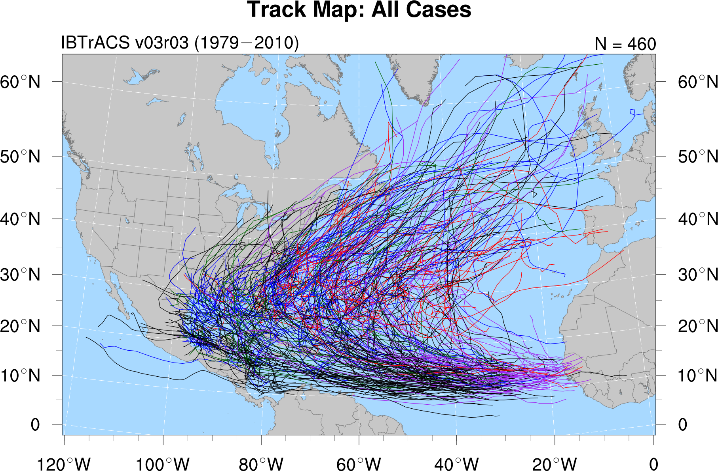
STC Identification
N = 460
Strong TT
Weak TT
Trough induced
Low-level baroclinic
Nonbaroclinic
Notes:
Caveat: Size of the cyclone matters when applying Davis (2010)…
Size of surface disturbance compared to upper-tropospheric cold anomaly important for

Slide 20
STC Identification
Strong TT
Weak TT
Trough induced
Low-level baroclinic
Nonbaroclinic
Upper-level disturbance with strong
lower-level thermal gradients
Upper-level disturbance with
moderate lower-level thermal
gradients
Upper-level disturbance without
appreciable lower-level thermal
gradients
Strong lower-level thermal gradients
without an upper-level disturbance
No appreciable baroclinic influences
Notes:
Caveat: Size of the cyclone matters when applying Davis (2010)…
Size of surface disturbance compared to upper-tropospheric cold anomaly important for

Slide 21
STC Identification
Strong TT
Weak TT
Trough induced
Low-level baroclinic
Nonbaroclinic
Upper-level disturbance with strong
lower-level thermal gradients
Upper-level disturbance with
moderate lower-level thermal
gradients
Upper-level disturbance without
appreciable lower-level thermal
gradients
Strong lower-level thermal gradients
without an upper-level disturbance
No appreciable baroclinic influences
Notes:
Caveat: Size of the cyclone matters when applying Davis (2010)…
Size of surface disturbance compared to upper-tropospheric cold anomaly important for

Slide 22
STC Identification
Strong TT
Weak TT
Trough induced
Low-level baroclinic
Nonbaroclinic
Upper-level disturbance with strong
lower-level thermal gradients
Upper-level disturbance with
moderate lower-level thermal
gradients
Upper-level disturbance without
appreciable lower-level thermal
gradients
Strong lower-level thermal gradients
without an upper-level disturbance
No appreciable baroclinic influences
Notes:
Caveat: Size of the cyclone matters when applying Davis (2010)…
Size of surface disturbance compared to upper-tropospheric cold anomaly important for

Slide 23
STC Identification
N = 460
Strong TT
Weak TT
Trough induced
Low-level baroclinic
Nonbaroclinic
Notes:
Caveat: Size of the cyclone matters when applying Davis (2010)…
Size of surface disturbance compared to upper-tropospheric cold anomaly important for

Slide 24
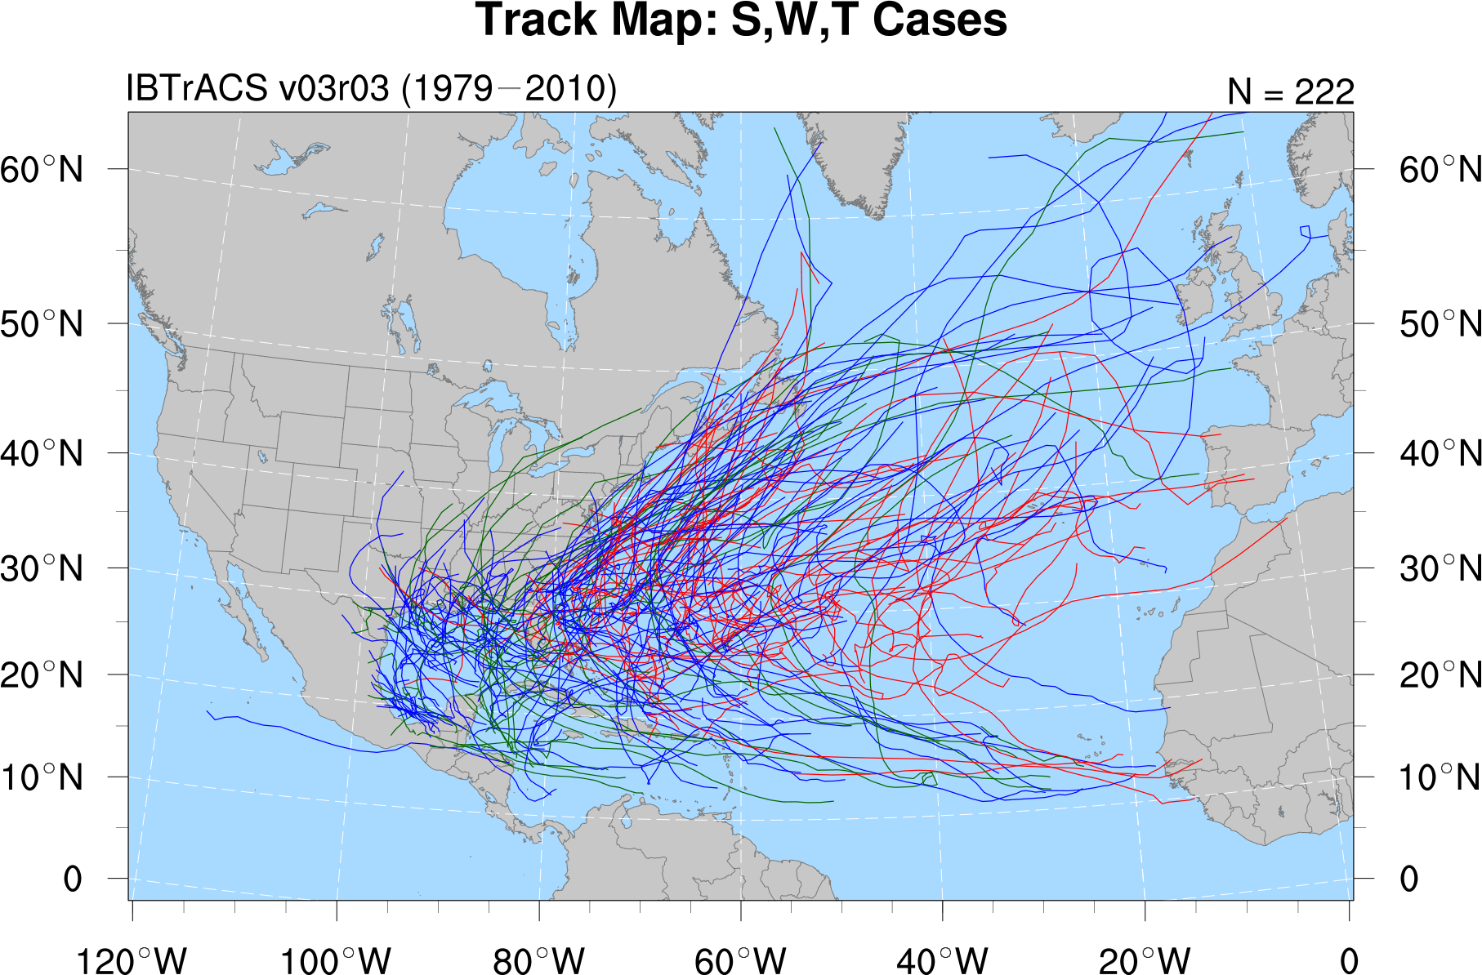
STC Identification
N = 222
Strong TT
Weak TT
Trough induced
Notes:
Caveat: Size of the cyclone matters when applying Davis (2010)…
Size of surface disturbance compared to upper-tropospheric cold anomaly important for

Slide 25
STC Identification
Formulate objective identification technique for detecting STC formation that incorporates PV2 and PV3
Apply objective identification technique to detect STC formation using the 0.5° Climate Forecast System Reanalysis (CFSR) dataset
Determine the time and location of STC formation in the subset
of baroclinically influenced tropical cyclogenesis cases during
1979–2010 using objective identification technique
Use the time and location of STC formation to construct
STC climatology
Notes:
Caveat: Size of the cyclone matters when applying Davis (2010)…
Size of surface disturbance compared to upper-tropospheric cold anomaly important for

Slide 26
STC Identification
STC identified the first time (t = t₀) at which the following criteria are met:
1) There is a positive upper-tropospheric PV anomaly and positive
lower-tropospheric PV anomaly over the cyclone center
(i.e., PV3 > 0 and PV2 > 0 at t = t₀)
Notes:
Caveat: Size of the cyclone matters when applying Davis (2010)…
Size of surface disturbance compared to upper-tropospheric cold anomaly important for

Slide 27
STC Identification
STC identified the first time (t = t₀) at which the following criteria are met:
1) There is a positive upper-tropospheric PV anomaly and positive
lower-tropospheric PV anomaly over the cyclone center
(i.e., PV3 > 0 and PV2 > 0 at t = t₀)
2) The upper-tropospheric PV anomaly begins to be eroded by
midtropospheric latent heat release
(i.e., d(PV3)/dt < 0 at t = t₀ + 6 h and t₀ + 12 h)
Notes:
Caveat: Size of the cyclone matters when applying Davis (2010)…
Size of surface disturbance compared to upper-tropospheric cold anomaly important for

Slide 28
STC Identification
STC identified the first time (t = t₀) at which the following criteria are met:
1) There is a positive upper-tropospheric PV anomaly and positive
lower-tropospheric PV anomaly over the cyclone center
(i.e., PV3 > 0 and PV2 > 0 at t = t₀)
2) The upper-tropospheric PV anomaly begins to be eroded by
midtropospheric latent heat release
(i.e., d(PV3)/dt < 0 at t = t₀ + 6 h and t₀ + 12 h)
3) The magnitude of the upper-tropospheric PV anomaly decreases
faster than the magnitude of the lower-tropospheric PV anomaly
(i.e., d(PV3/PV2)/dt < 0 at t = t₀ and t₀ + 6 h)
Notes:
Caveat: Size of the cyclone matters when applying Davis (2010)…
Size of surface disturbance compared to upper-tropospheric cold anomaly important for

Slide 29
STC Identification
STC identified the first time (t = t₀) at which the following criteria are met:
1) There is a positive upper-tropospheric PV anomaly and positive
lower-tropospheric PV anomaly over the cyclone center
(i.e., PV3 > 0 and PV2 > 0 at t = t₀)
2) The upper-tropospheric PV anomaly begins to be eroded by
midtropospheric latent heat release
(i.e., d(PV3)/dt < 0 at t = t₀ + 6 h and t₀ + 12 h)
3) The magnitude of the upper-tropospheric PV anomaly decreases
faster than the magnitude of the lower-tropospheric PV anomaly
(i.e., d(PV3/PV2)/dt < 0 at t = t₀ and t₀ + 6 h)
4) The cyclone has not been classified by NHC as a hurricane (HU)
or tropical storm (TS) at t = t₀, or as a tropical depression (TD)
for ≥ 12 h prior to t = t₀
Notes:
Caveat: Size of the cyclone matters when applying Davis (2010)…
Size of surface disturbance compared to upper-tropospheric cold anomaly important for

Slide 30
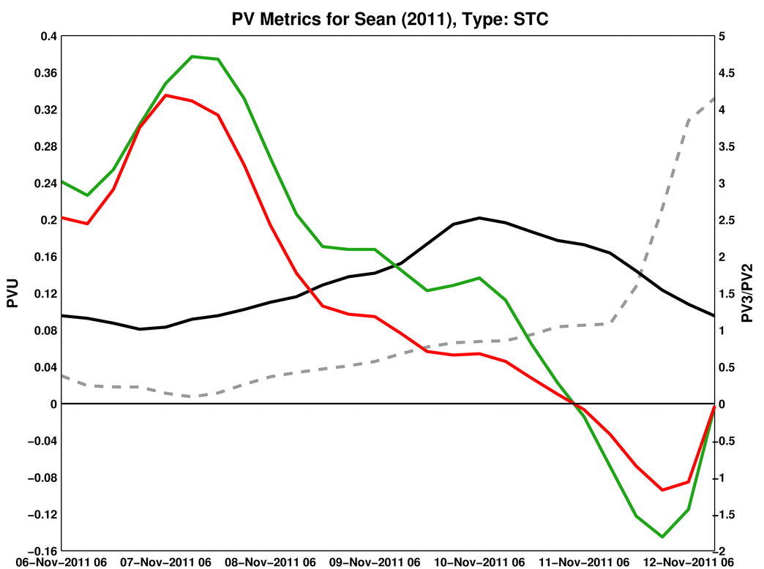
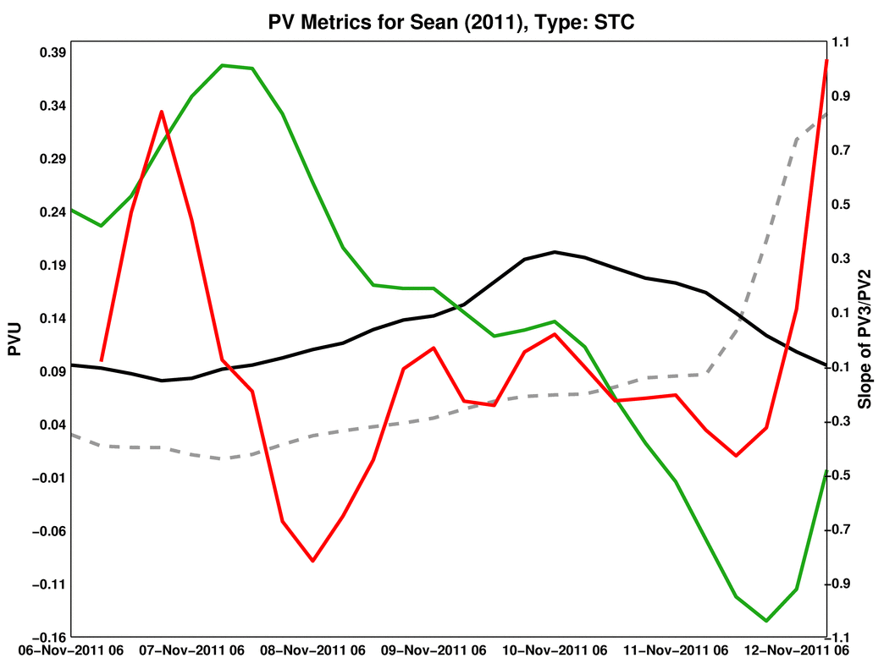
STC Identification
STC Sean (2011)
Criteria:
PV3
PV3
PV2
PVU
PV2
PV3/PV2
PV1
EX LO SS TS EX
7 Nov
8 Nov
9 Nov
10 Nov
11 Nov
12 Nov
EX
LO
SS
TS
= Extratropical
= Low pressure
= Subtropical storm
= Tropical storm
Notes:
Caveat: Size of the cyclone matters when applying Davis (2010)…
Size of surface disturbance compared to upper-tropospheric cold anomaly important for

Slide 31
STC Identification
STC Sean (2011)
Criteria:
PV3 > 0 and PV2 > 0
at t = t₀
PV3
PV3
PV2
PVU
PV2
PV3/PV2
PV1
EX LO SS TS EX
7 Nov
8 Nov
9 Nov
10 Nov
11 Nov
12 Nov
EX
LO
SS
TS
= Extratropical
= Low pressure
= Subtropical storm
= Tropical storm
Notes:
Caveat: Size of the cyclone matters when applying Davis (2010)…
Size of surface disturbance compared to upper-tropospheric cold anomaly important for

Slide 32
STC Identification
STC Sean (2011)
Criteria:
PV3 > 0 and PV2 > 0
at t = t₀
d(PV3)/dt < 0 at
t = t₀ + 6 h and t₀ + 12 h
PV3
PV3
PV2
PVU
PV2
PV3/PV2
PV1
EX LO SS TS EX
7 Nov
8 Nov
9 Nov
10 Nov
11 Nov
12 Nov
EX
LO
SS
TS
= Extratropical
= Low pressure
= Subtropical storm
= Tropical storm
Notes:
Caveat: Size of the cyclone matters when applying Davis (2010)…
Size of surface disturbance compared to upper-tropospheric cold anomaly important for

Slide 33
STC Identification
STC Sean (2011)
Criteria:
PV3 > 0 and PV2 > 0
at t = t₀
d(PV3)/dt < 0 at
t = t₀ + 6 h and t₀ + 12 h
d(PV3/PV2)/dt < 0 at
t = t₀ and t₀ + 6 h
PV3
PV3
PV2
PVU
PV2
PV3/PV2
PV1
EX LO SS TS EX
7 Nov
8 Nov
9 Nov
10 Nov
11 Nov
12 Nov
EX
LO
SS
TS
= Extratropical
= Low pressure
= Subtropical storm
= Tropical storm
Notes:
Caveat: Size of the cyclone matters when applying Davis (2010)…
Size of surface disturbance compared to upper-tropospheric cold anomaly important for

Slide 34
STC Identification
STC Sean (2011)
Criteria:
PV3 > 0 and PV2 > 0
at t = t₀
d(PV3)/dt < 0 at
t = t₀ + 6 h and t₀ + 12 h
d(PV3/PV2)/dt < 0 at
t = t₀ and t₀ + 6 h
Not classified by NHC as a TS at t = t₀
PV3
PV3
PV2
PVU
PV2
PV3/PV2
PV1
EX LO SS TS EX
7 Nov
8 Nov
9 Nov
10 Nov
11 Nov
12 Nov
EX
LO
SS
TS
= Extratropical
= Low pressure
= Subtropical storm
= Tropical storm
Notes:
Caveat: Size of the cyclone matters when applying Davis (2010)…
Size of surface disturbance compared to upper-tropospheric cold anomaly important for

Slide 35
STC Identification
STC Sean (2011)
Criteria:
PV3 > 0 and PV2 > 0
at t = t₀
d(PV3)/dt < 0 at
t = t₀ + 6 h and t₀ + 12 h
d(PV3/PV2)/dt < 0 at
t = t₀ and t₀ + 6 h
Not classified by NHC as a TS at t = t₀
PV3
PV3
PV2
PVU
PV2
PV3/PV2
PV1
EX LO SS TS EX
= STC identified
7 Nov
8 Nov
9 Nov
10 Nov
11 Nov
12 Nov
EX
LO
SS
TS
= Extratropical
= Low pressure
= Subtropical storm
= Tropical storm
Notes:
Caveat: Size of the cyclone matters when applying Davis (2010)…
Size of surface disturbance compared to upper-tropospheric cold anomaly important for

Slide 36
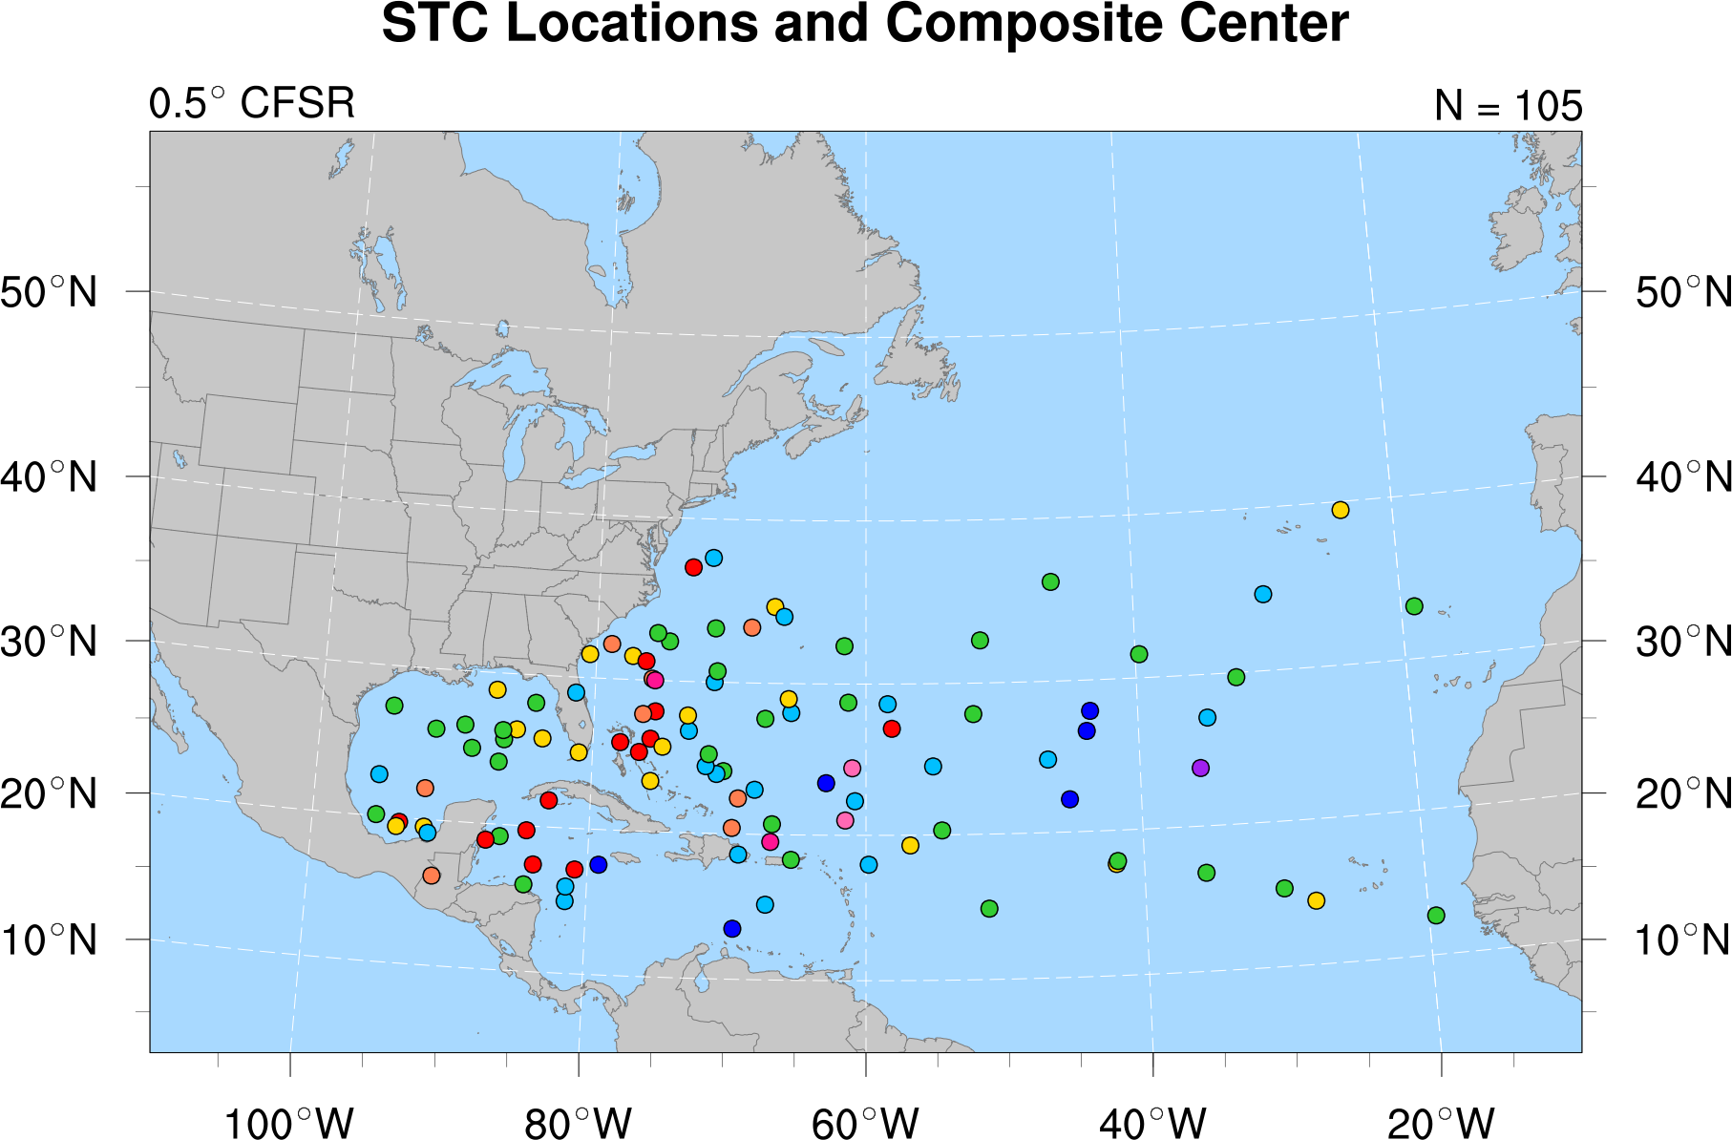
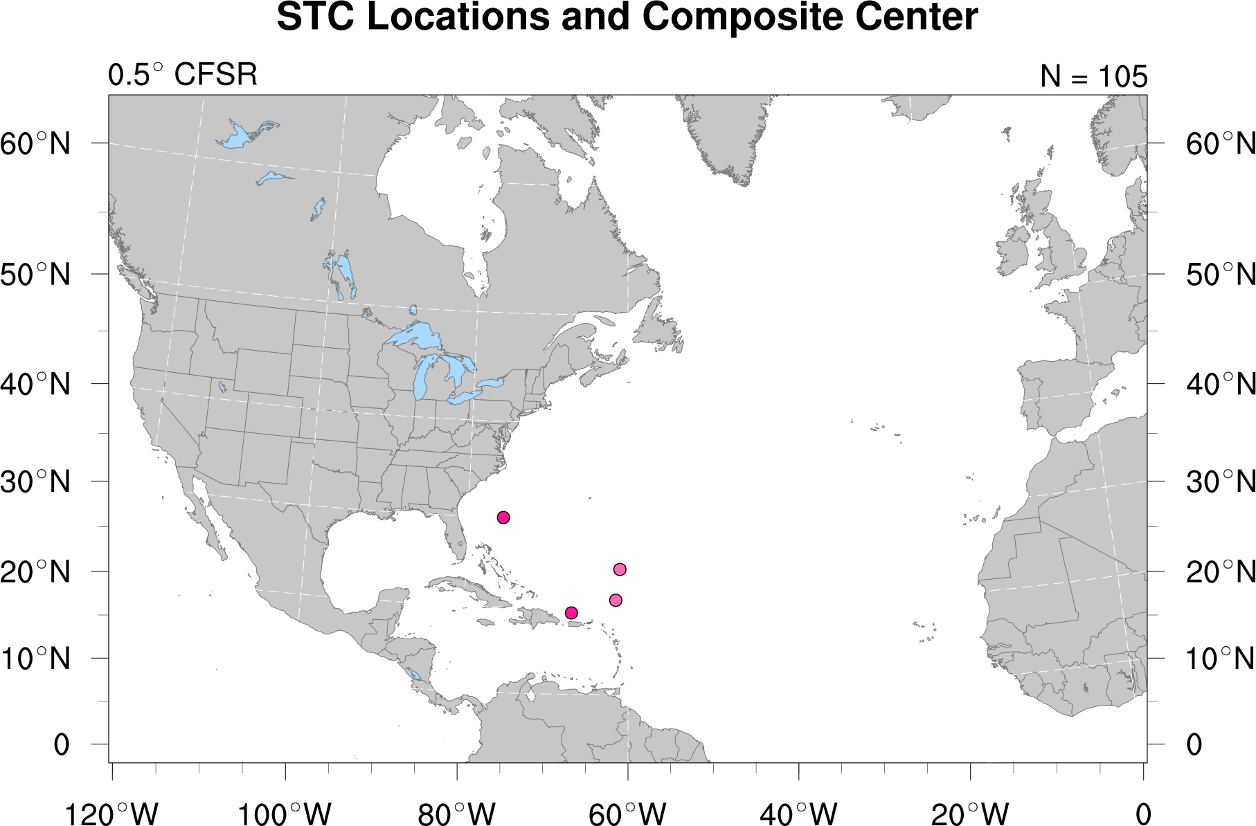
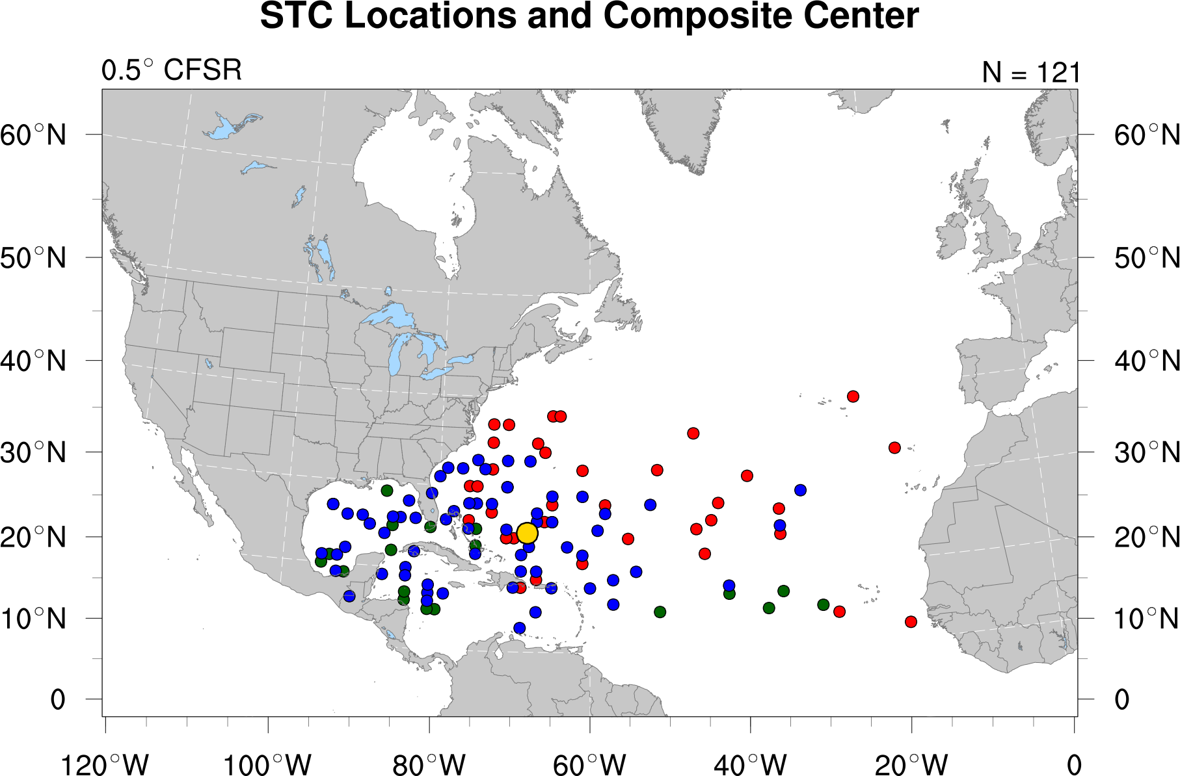
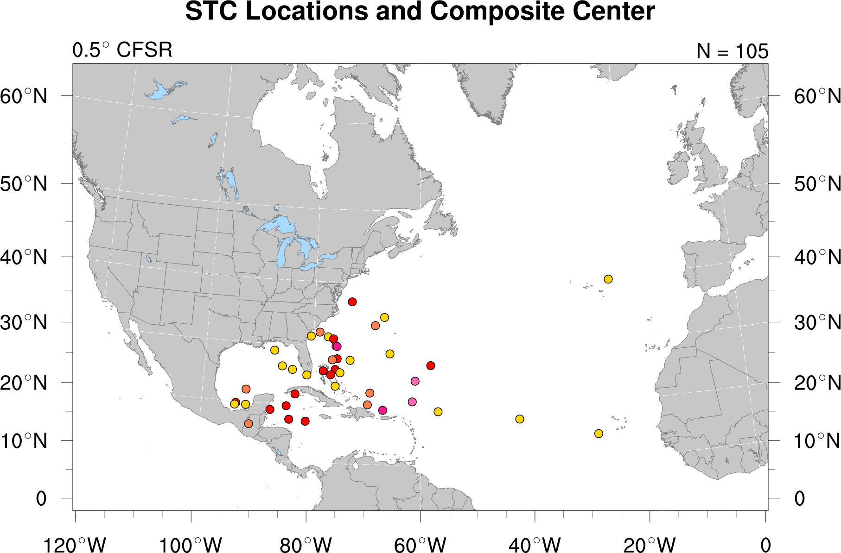
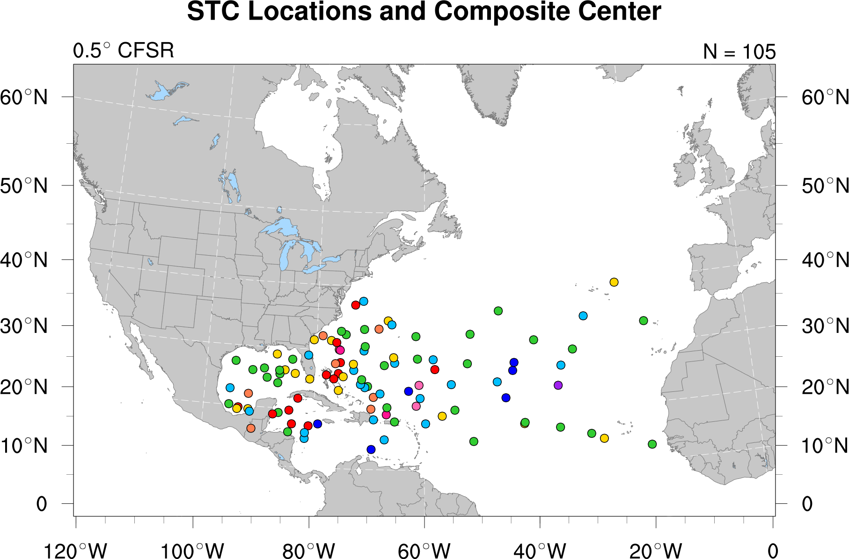
STC Climatology (1979–2010)
Intraseasonal Variability
N = 105
April
May
June
July
August
September
October
November
December
~3 STCs/year
Notes:
Caveat: Size of the cyclone matters when applying Davis (2010)…
Size of surface disturbance compared to upper-tropospheric cold anomaly important for

Slide 37
STC Climatology (1979–2010)
Intraseasonal Variability
N = 105
April
May
June
July
August
September
October
November
December
~3 STCs/year
Notes:
Caveat: Size of the cyclone matters when applying Davis (2010)…
Size of surface disturbance compared to upper-tropospheric cold anomaly important for

Slide 38
STC Climatology (1979–2010)
Intraseasonal Variability
N = 105
April
May
June
July
August
September
October
November
December
~3 STCs/year
Notes:
Caveat: Size of the cyclone matters when applying Davis (2010)…
Size of surface disturbance compared to upper-tropospheric cold anomaly important for

Slide 39
STC Climatology (1979–2010)
Intraseasonal Variability
N = 105
34
22
17
13
8
6
2
2
1
Notes:
Caveat: Size of the cyclone matters when applying Davis (2010)…
Size of surface disturbance compared to upper-tropospheric cold anomaly important for

Slide 40
Upper-Tropospheric Precursors
Identify the most common upper-tropospheric features linked to STC formation in 1979–2010 climatology
Separate STCs included in 1979–2010 climatology into five clusters representing the most common upper-tropospheric features linked to STC formation: 1) PV Streamer, 2) Cutoff, 3) Midlatitude Trough, 4) Subtropical Disturbance, and 5) PV Debris
Perform a cyclone-relative composite analysis on the upper-tropospheric features linked to STC formation within each cluster
Examine the upper-tropospheric features linked to STC formation using an illustrative case study
Notes:
One of our final tasks was to identify the most common upper-tropospheric precursors linked to STC formation in our climatology.

Slide 41

Upper-Tropospheric Precursors
Cluster: PV Streamer
350 K
isentropic
surface
AWB
STC formation is associated with a PV streamer injected into the subtropics during the initial stages of an upstream anticyclonic wave breaking (AWB) event
PV streamer must maintain a clear connection with midlatitudes at the time of STC formation (t₀)
Notes:
Unfortunately don’t have time to show you all of the clusters today, but I have just enough time to show you one.
The cut off cluster was chosen because that is the cluster that TC Sean (2011) would have been included in, had it occurred within the window of our climatology.
STCs that form in the cutoff cluster form in association with a region of relatively high….

Slide 42
Upper-Tropospheric Precursors
Cluster: Cutoff
AWB
350 K
isentropic
surface
STC formation is associated with a region of relatively high upper-tropospheric PV cut off in the subtropics during the latter stages of
an upstream AWB event
Region of relatively high upper-tropospheric PV must be entirely removed from the midlatitude flow at t₀
Notes:
Unfortunately don’t have time to show you all of the clusters today, but I have just enough time to show you one.
The cut off cluster was chosen because that is the cluster that TC Sean (2011) would have been included in, had it occurred within the window of our climatology.
STCs that form in the cutoff cluster form in association with a region of relatively high….

Slide 43
Upper-Tropospheric Precursors
Cluster: Midlatitude Trough
350 K
isentropic
surface
STC formation is associated with a broad midlatitude trough that does not develop as a result of upstream AWB
Region surrounding the location of STC formation is preconditioned
for the development of deep convection by a precursor upper-tropospheric disturbance
Notes:
Unfortunately don’t have time to show you all of the clusters today, but I have just enough time to show you one.
The cut off cluster was chosen because that is the cluster that TC Sean (2011) would have been included in, had it occurred within the window of our climatology.
STCs that form in the cutoff cluster form in association with a region of relatively high….

Slide 44
Upper-Tropospheric Precursors
Cluster: Subtropical Disturbance
350 K
isentropic
surface
H
STC formation is associated with a small-scale PV filament progressing around the northern periphery of an upper-tropospheric subtropical anticyclone
PV filament is considerably smaller in meridional extent than PV streamers, cutoffs, or midlatitude troughs
Notes:
Unfortunately don’t have time to show you all of the clusters today, but I have just enough time to show you one.
The cut off cluster was chosen because that is the cluster that TC Sean (2011) would have been included in, had it occurred within the window of our climatology.
STCs that form in the cutoff cluster form in association with a region of relatively high….

Slide 45
Upper-Tropospheric Precursors
Cluster: PV Debris
H
350 K
isentropic
surface
STC formation is associated with a disorganized region of relatively
high upper-tropospheric PV (i.e., PV debris) injected into the subtropics several days prior to STC formation
PV debris must be moving westward on the southern periphery of a broad upper-tropospheric subtropical anticyclone at t₀
Notes:
Unfortunately don’t have time to show you all of the clusters today, but I have just enough time to show you one.
The cut off cluster was chosen because that is the cluster that TC Sean (2011) would have been included in, had it occurred within the window of our climatology.
STCs that form in the cutoff cluster form in association with a region of relatively high….

Slide 46
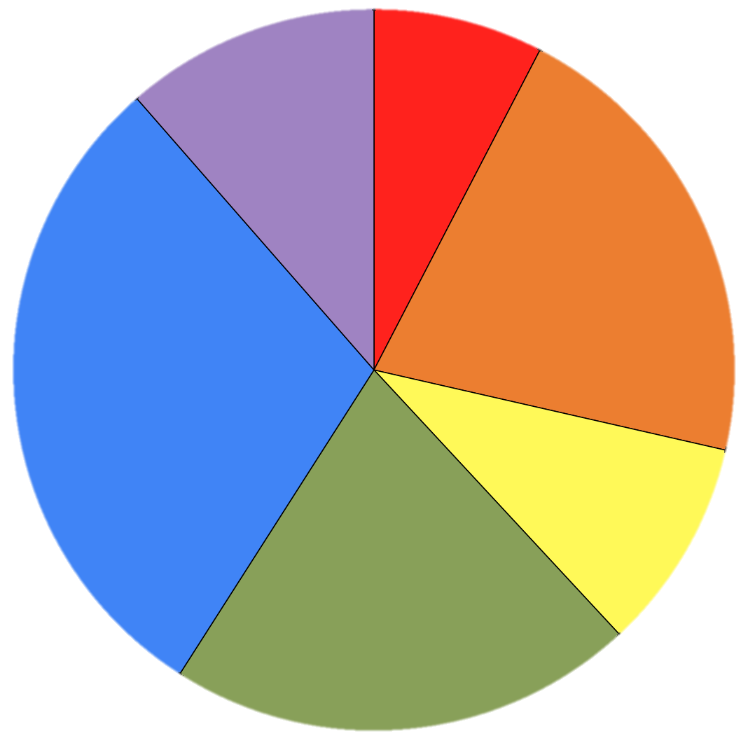
Upper-Tropospheric Precursors
Unclassifiable
PV Streamer
N = 105
11.43%
7.62%
(12)
(8)
Cutoff
20.95%
(22)
PV Debris
29.52%
(31)
9.52%
(10)
Midlatitude
Trough
20.95%
(22)
Subtropical Disturbance
Notes:
Unfortunately don’t have time to show you all of the clusters today, but I have just enough time to show you one.
The cut off cluster was chosen because that is the cluster that TC Sean (2011) would have been included in, had it occurred within the window of our climatology.
STCs that form in the cutoff cluster form in association with a region of relatively high….

Slide 47
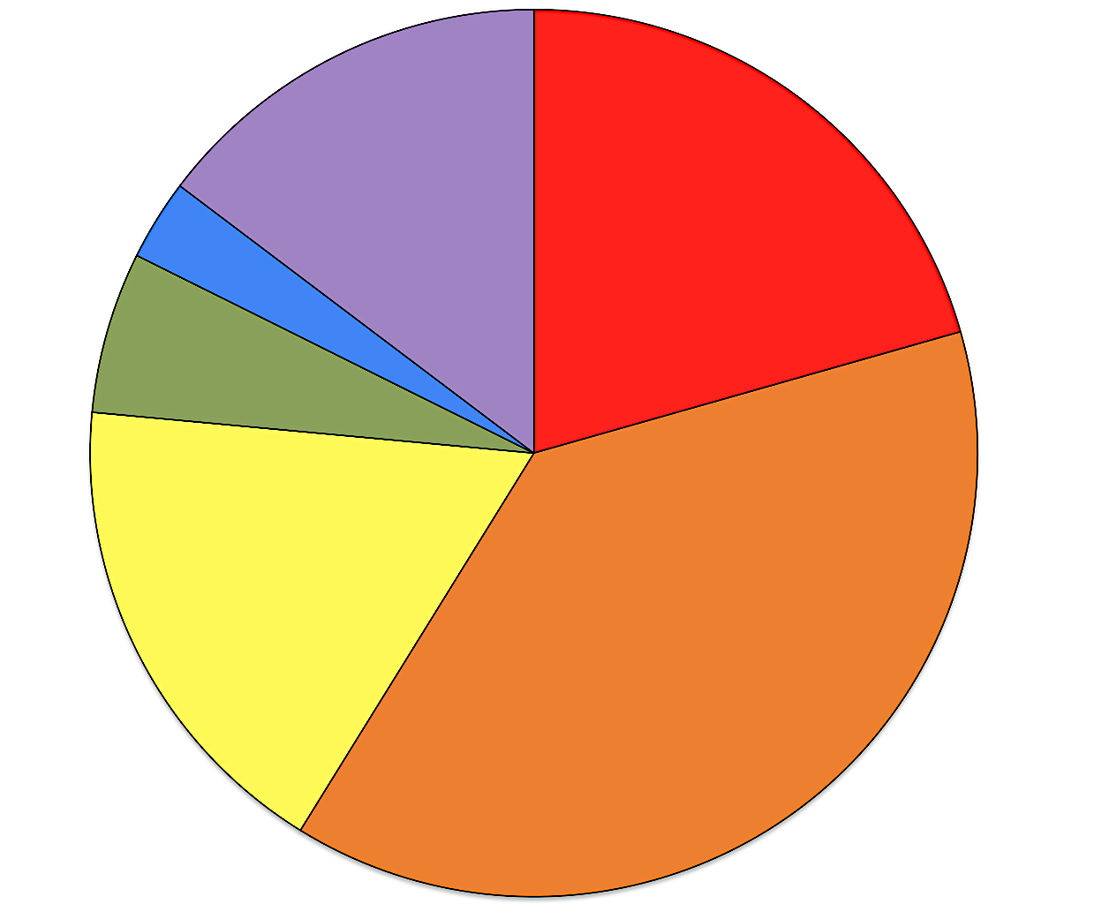
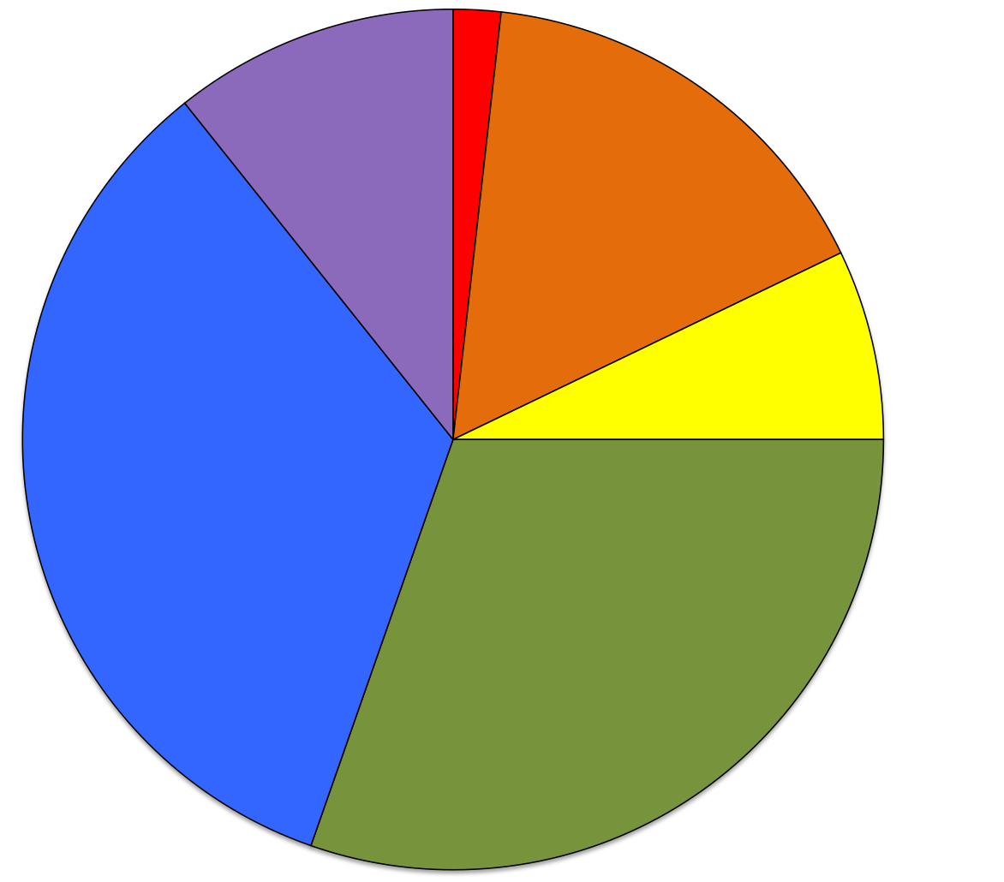
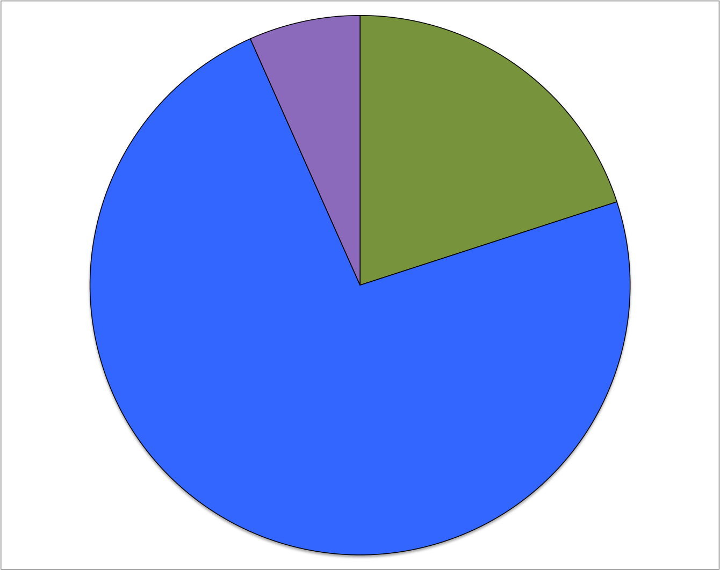
Upper-Tropospheric Precursors
Strong TT
(N = 34)
Weak TT
(N = 56)
N = 105
1.79%
(1)
2.94%
14.71%
10.71%
(1)
(5)
20.59%
(6)
16.07%
5.88%
(7)
(9)
(2)
7.14%
(4)
33.93%
17.65%
(19)
(6)
38.24%
30.36%
(13)
(17)
6.67%
(1)
Trough induced
(N = 15)
PV Streamer
20.00%
Cutoff
(3)
Midlatitude Trough
Subtropical Disturbance
73.33%
PV Debris
(11)
Unclassifiable
Notes:
Unfortunately don’t have time to show you all of the clusters today, but I have just enough time to show you one.
The cut off cluster was chosen because that is the cluster that TC Sean (2011) would have been included in, had it occurred within the window of our climatology.
STCs that form in the cutoff cluster form in association with a region of relatively high….

Slide 48
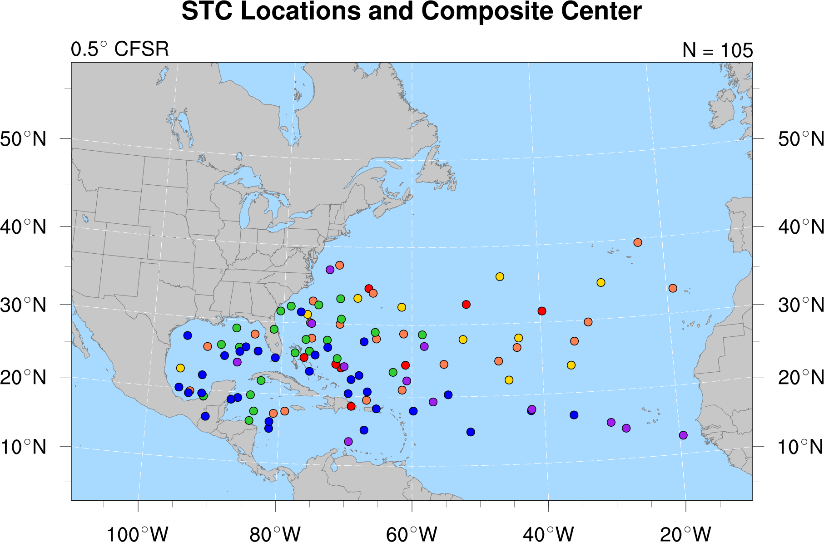
Upper-Tropospheric Precursors
STC Location
N = 105
PV Streamer
Cutoff
Midlatitude Trough
Subtropical Disturbance
PV Debris
Unclassifiable
Notes:
Caveat: Size of the cyclone matters when applying Davis (2010)…
Size of surface disturbance compared to upper-tropospheric cold anomaly important for

Slide 49
Upper-Tropospheric Precursors
STC Location
N = 105
PV Streamer
Cutoff
Midlatitude Trough
Subtropical Disturbance
PV Debris
Unclassifiable
Notes:
Caveat: Size of the cyclone matters when applying Davis (2010)…
Size of surface disturbance compared to upper-tropospheric cold anomaly important for

Slide 50
Upper-Tropospheric Precursors
STC Location
N = 105
PV Streamer
Cutoff
Midlatitude Trough
Subtropical Disturbance
PV Debris
Unclassifiable
Notes:
Caveat: Size of the cyclone matters when applying Davis (2010)…
Size of surface disturbance compared to upper-tropospheric cold anomaly important for

Slide 51
Upper-Tropospheric Precursors
STC Location
N = 105
PV Streamer
Cutoff
Midlatitude Trough
Subtropical Disturbance
PV Debris
Unclassifiable
Notes:
Caveat: Size of the cyclone matters when applying Davis (2010)…
Size of surface disturbance compared to upper-tropospheric cold anomaly important for

Slide 52
Upper-Tropospheric Precursors
STC Location
N = 105
PV Streamer
Cutoff
Midlatitude Trough
Subtropical Disturbance
PV Debris
Unclassifiable
Notes:
Caveat: Size of the cyclone matters when applying Davis (2010)…
Size of surface disturbance compared to upper-tropospheric cold anomaly important for

Slide 53
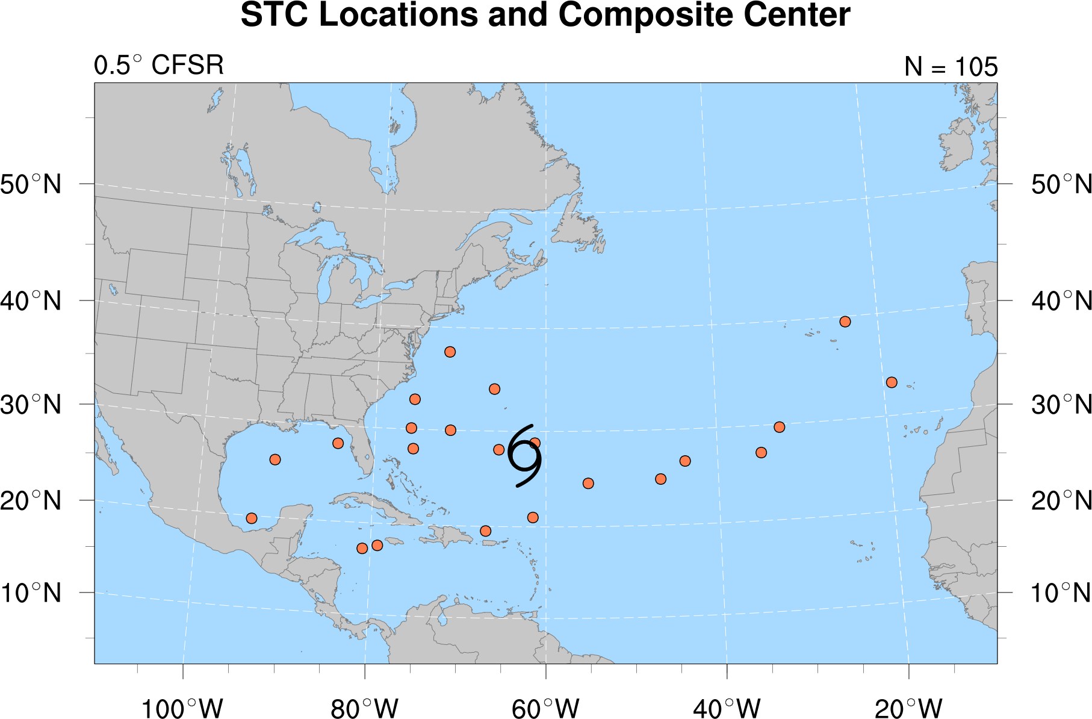
Upper-Tropospheric Precursors
STC Location
N = 22
Cutoff
Average Cutoff location
Notes:
Caveat: Size of the cyclone matters when applying Davis (2010)…
Size of surface disturbance compared to upper-tropospheric cold anomaly important for

Slide 54
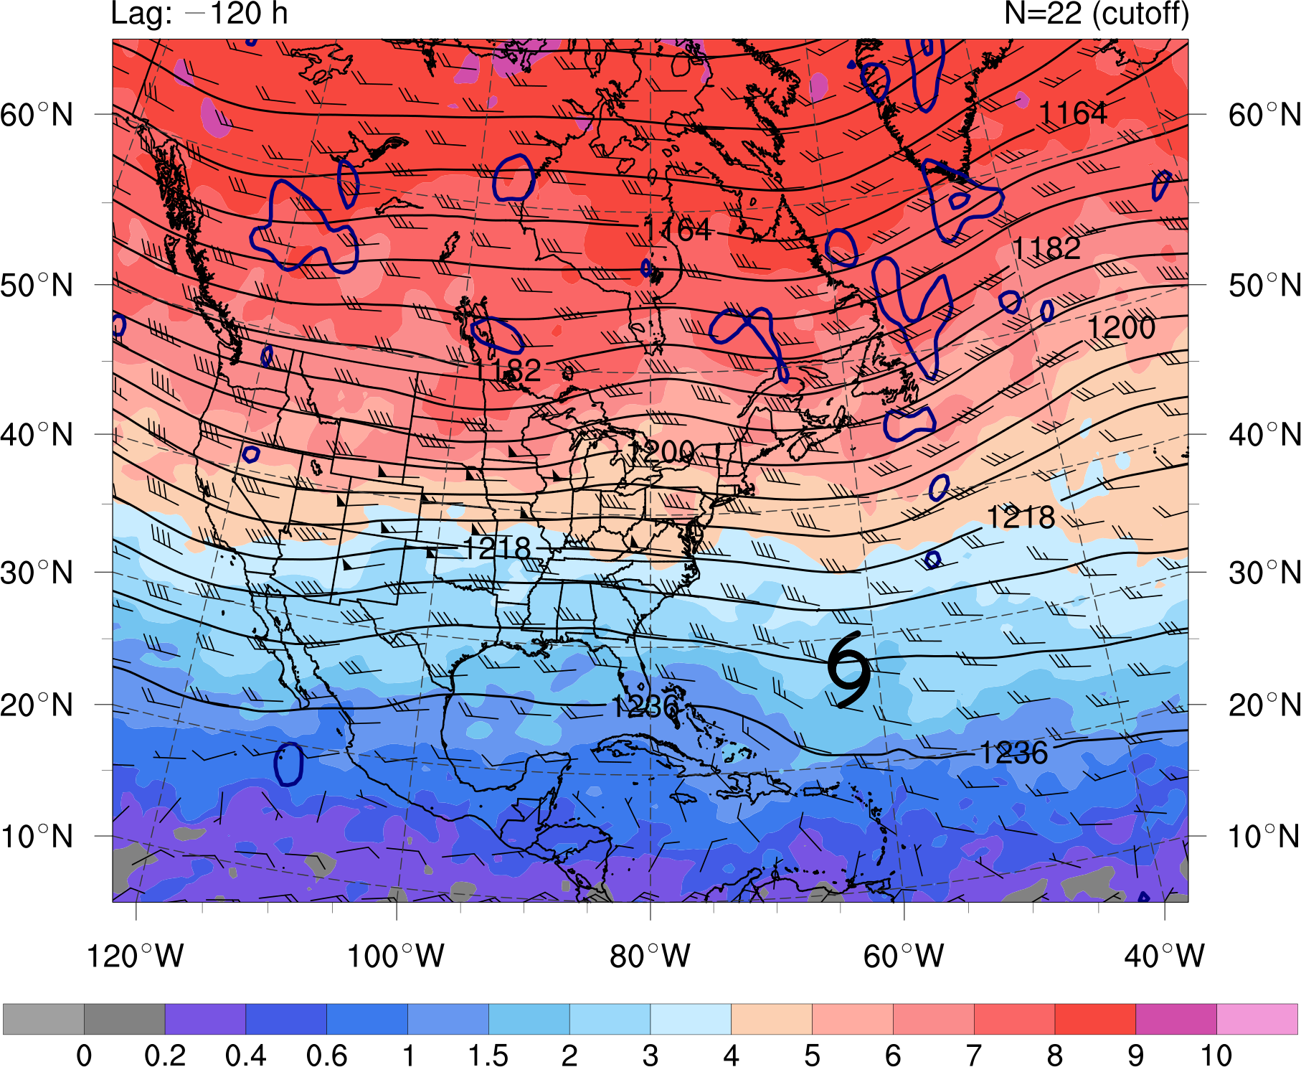
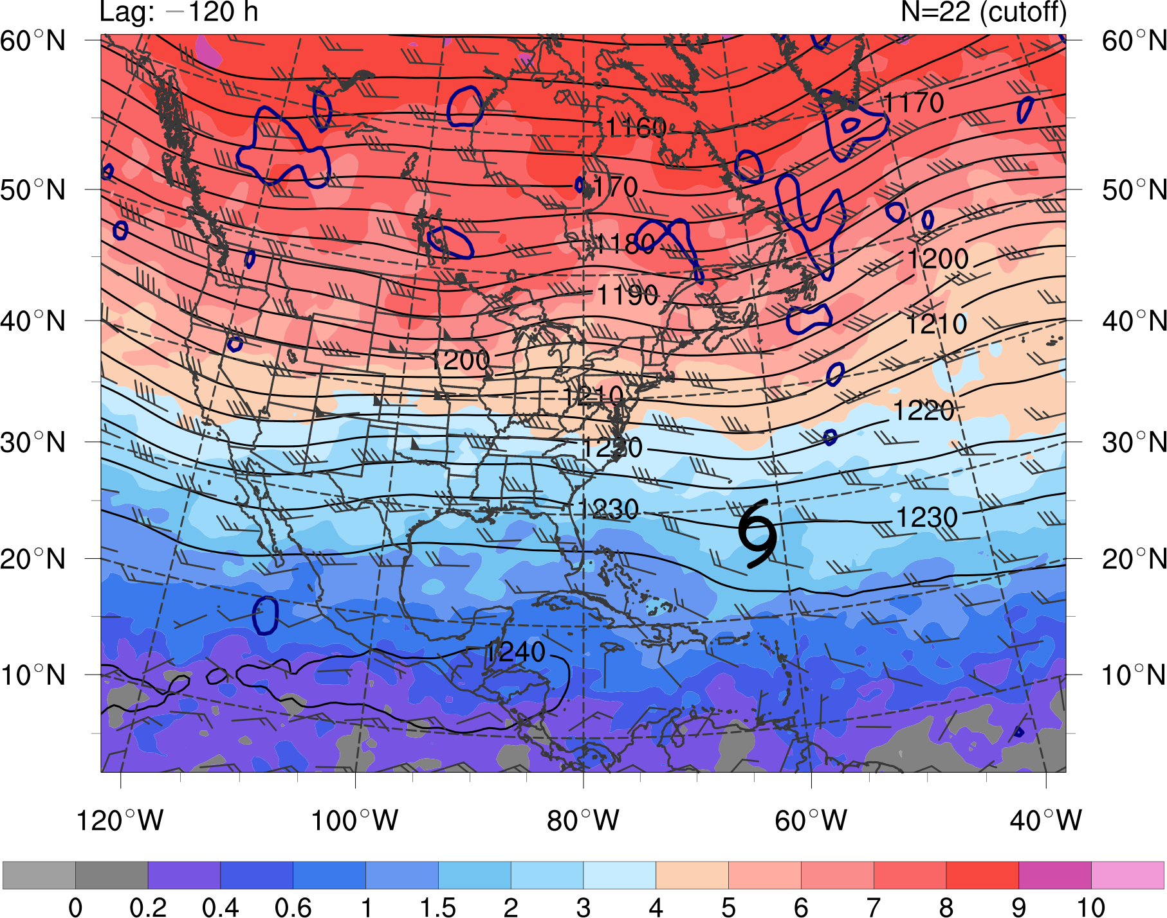
Composite Analysis: Cutoff
0 0.2 0.4 0.6 1 1.5 2 3 4 5 6 7 8 9 10
PVU
STC
at t₀
t₀ − 120 h
N = 22
PV (shaded, PVU) and winds (barbs, kts) on the 350 K isentropic surface,
200-hPa geopotential height (black contours, dam), and
925–850-hPa layer-averaged cyclonic relative vorticity (blue contours, every 1.5 × 10⁻⁵ s⁻¹)
Notes:
Caveat: Size of the cyclone matters when applying Davis (2010)…
Size of surface disturbance compared to upper-tropospheric cold anomaly important for

Slide 55
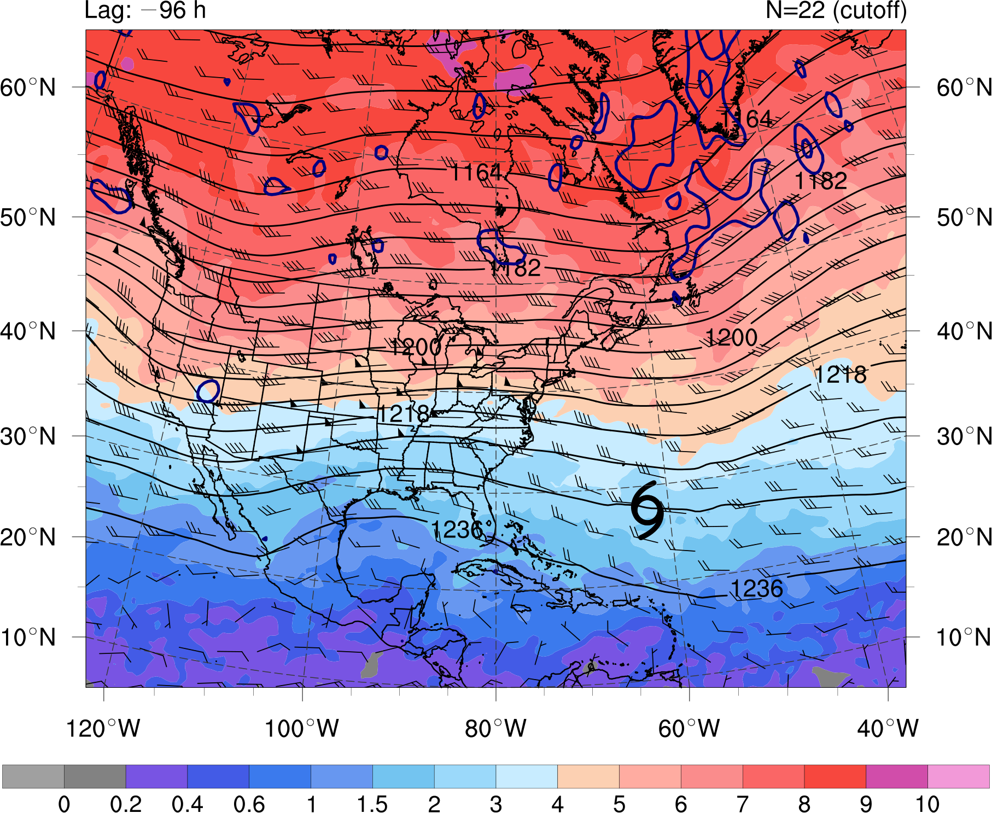
Composite Analysis: Cutoff
0 0.2 0.4 0.6 1 1.5 2 3 4 5 6 7 8 9 10
PVU
STC
at t₀
t₀ − 96 h
N = 22
PV (shaded, PVU) and winds (barbs, kts) on the 350 K isentropic surface,
200-hPa geopotential height (black contours, dam), and
925–850-hPa layer-averaged cyclonic relative vorticity (blue contours, every 1.5 × 10⁻⁵ s⁻¹)
Notes:
Caveat: Size of the cyclone matters when applying Davis (2010)…
Size of surface disturbance compared to upper-tropospheric cold anomaly important for

Slide 56
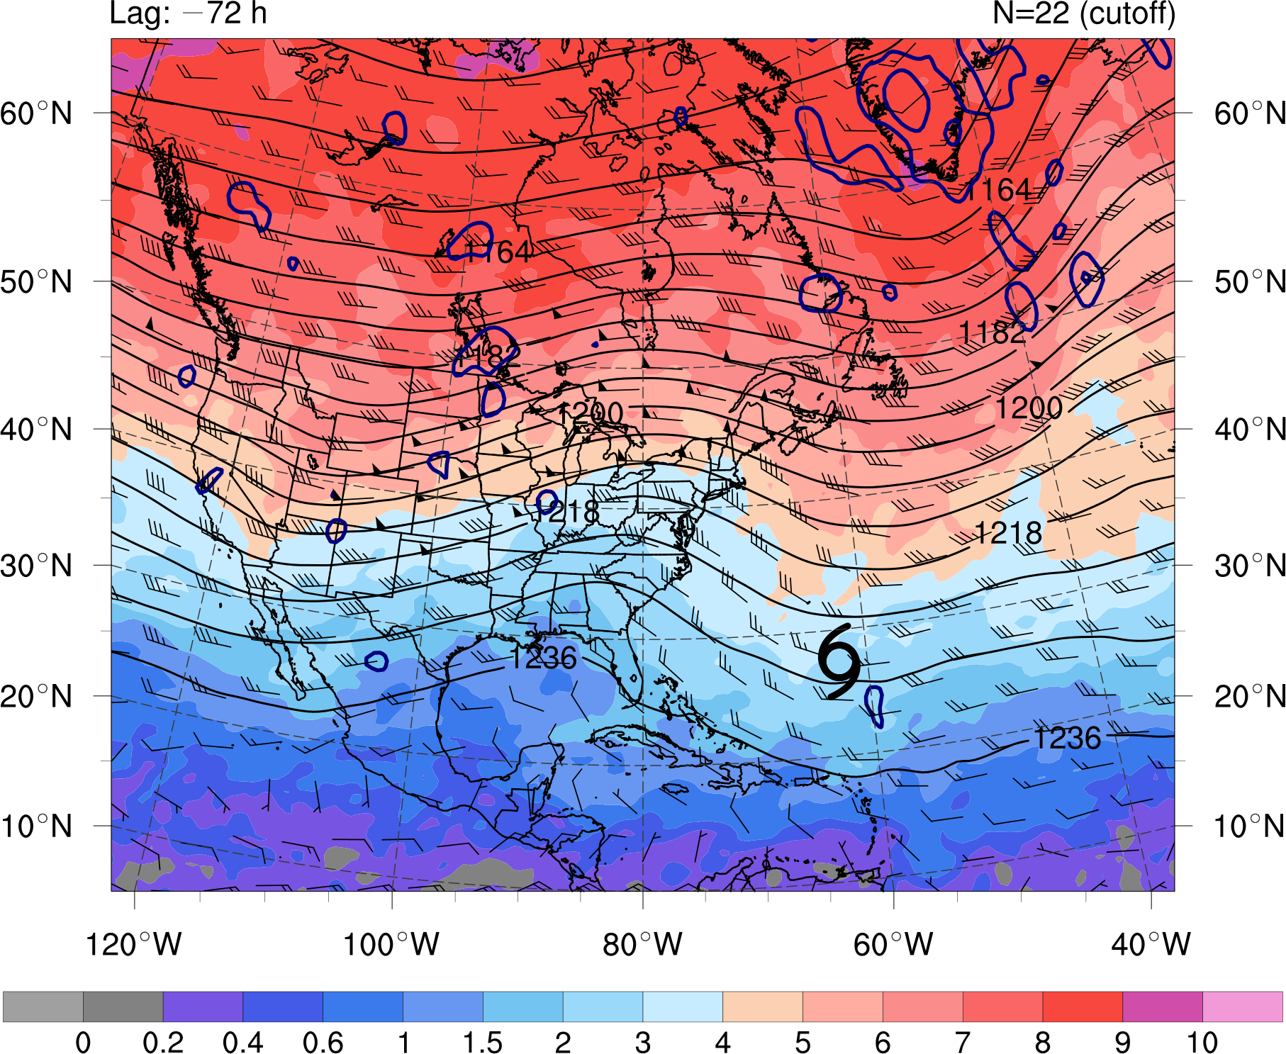
Composite Analysis: Cutoff
0 0.2 0.4 0.6 1 1.5 2 3 4 5 6 7 8 9 10
PVU
STC
at t₀
t₀ − 72 h
N = 22
PV (shaded, PVU) and winds (barbs, kts) on the 350 K isentropic surface,
200-hPa geopotential height (black contours, dam), and
925–850-hPa layer-averaged cyclonic relative vorticity (blue contours, every 1.5 × 10⁻⁵ s⁻¹)
Notes:
Caveat: Size of the cyclone matters when applying Davis (2010)…
Size of surface disturbance compared to upper-tropospheric cold anomaly important for

Slide 57
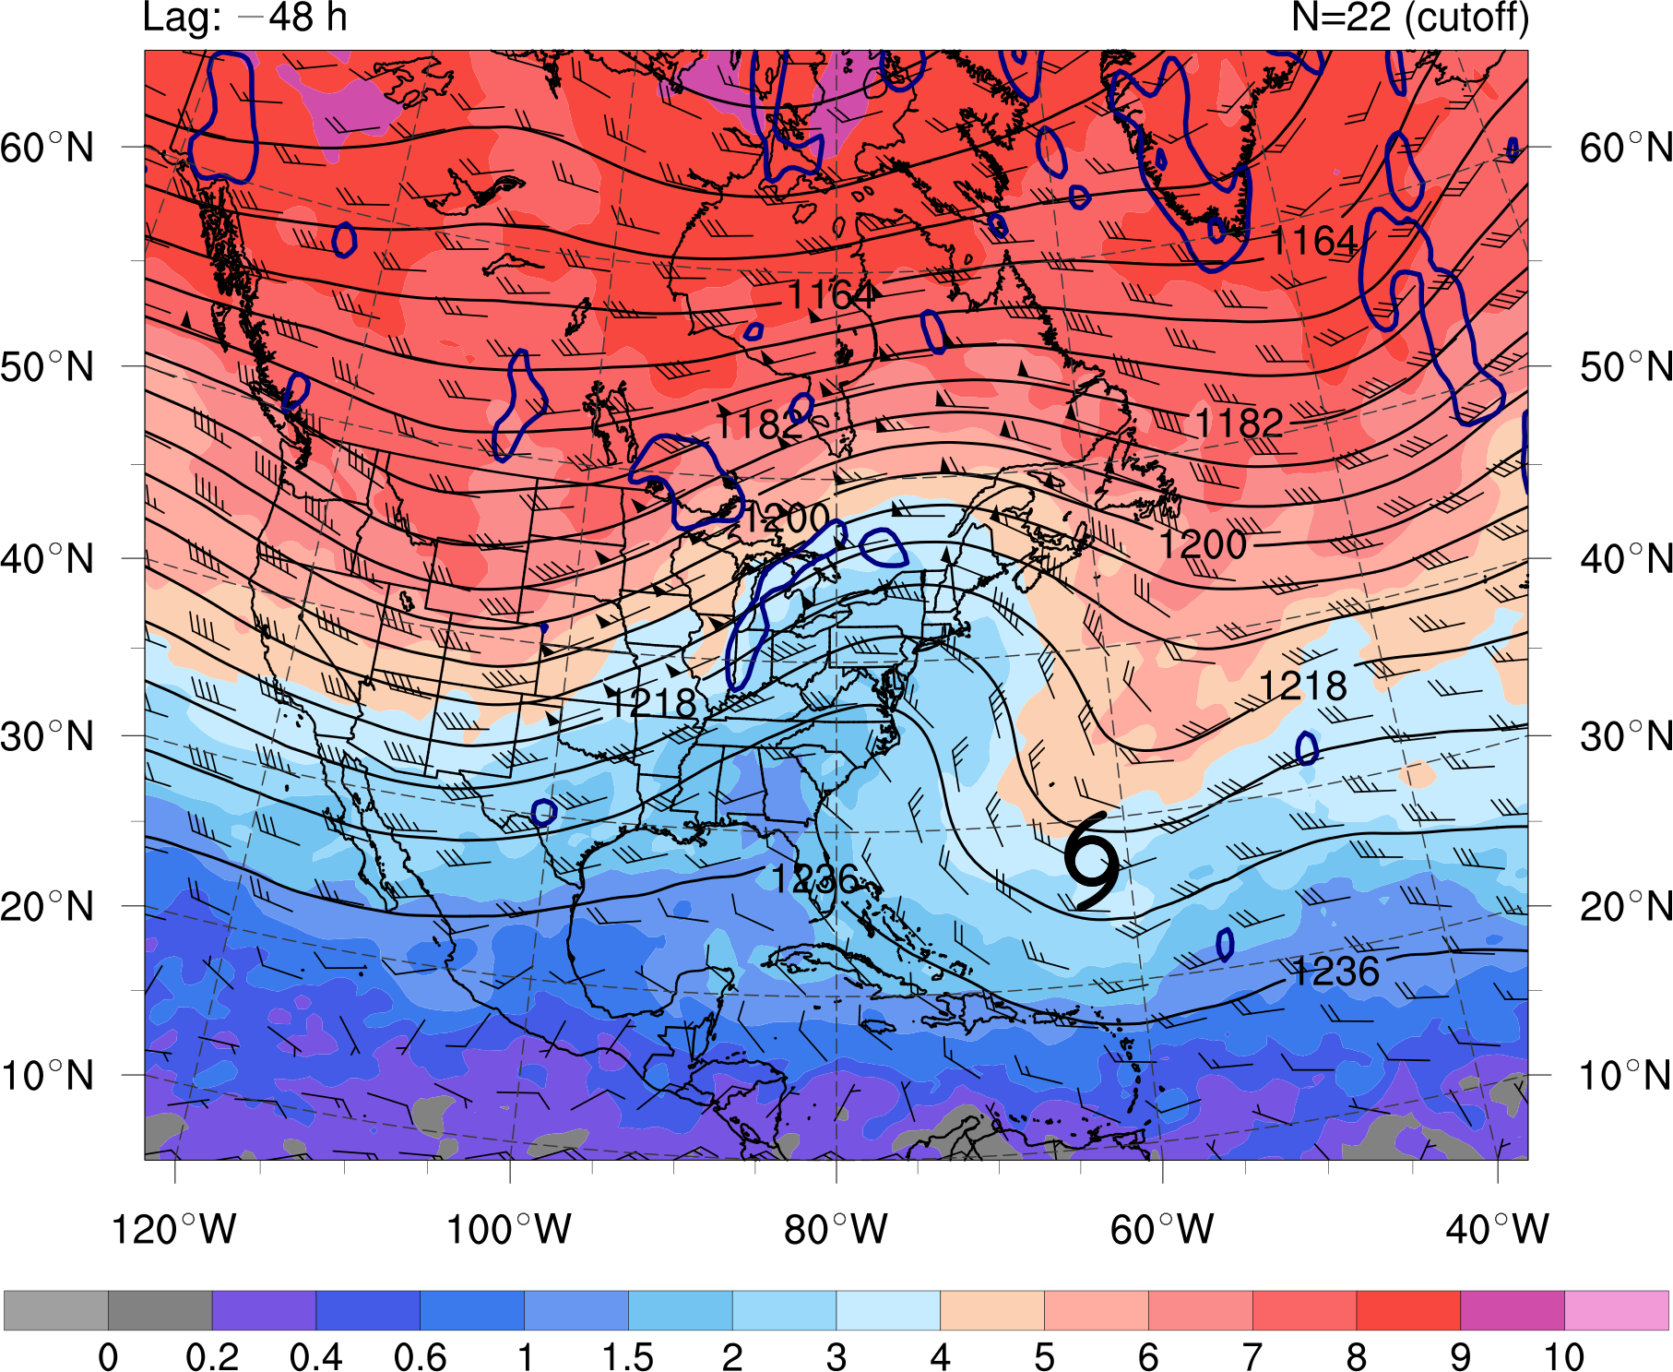
Composite Analysis: Cutoff
0 0.2 0.4 0.6 1 1.5 2 3 4 5 6 7 8 9 10
PVU
STC
at t₀
t₀ − 48 h
N = 22
PV (shaded, PVU) and winds (barbs, kts) on the 350 K isentropic surface,
200-hPa geopotential height (black contours, dam), and
925–850-hPa layer-averaged cyclonic relative vorticity (blue contours, every 1.5 × 10⁻⁵ s⁻¹)
Notes:
Caveat: Size of the cyclone matters when applying Davis (2010)…
Size of surface disturbance compared to upper-tropospheric cold anomaly important for

Slide 58
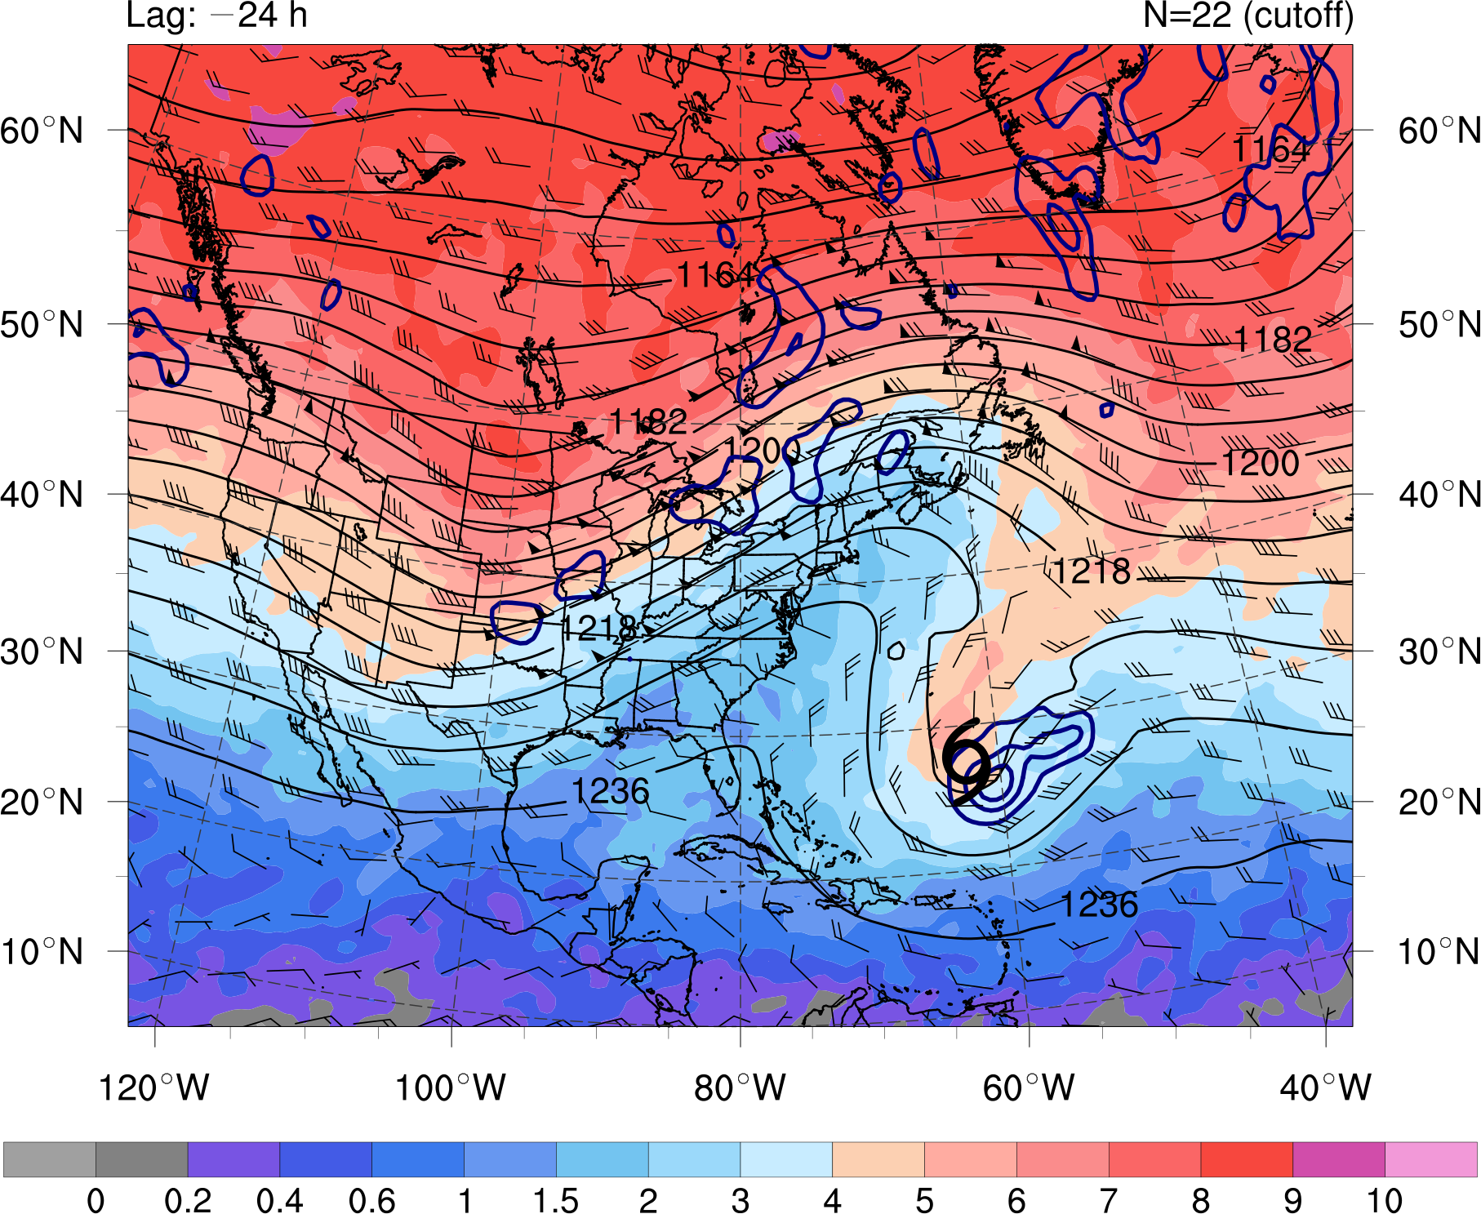
Composite Analysis: Cutoff
0 0.2 0.4 0.6 1 1.5 2 3 4 5 6 7 8 9 10
PVU
STC
at t₀
t₀ − 24 h
N = 22
PV (shaded, PVU) and winds (barbs, kts) on the 350 K isentropic surface,
200-hPa geopotential height (black contours, dam), and
925–850-hPa layer-averaged cyclonic relative vorticity (blue contours, every 1.5 × 10⁻⁵ s⁻¹)
Notes:
Caveat: Size of the cyclone matters when applying Davis (2010)…
Size of surface disturbance compared to upper-tropospheric cold anomaly important for

Slide 59
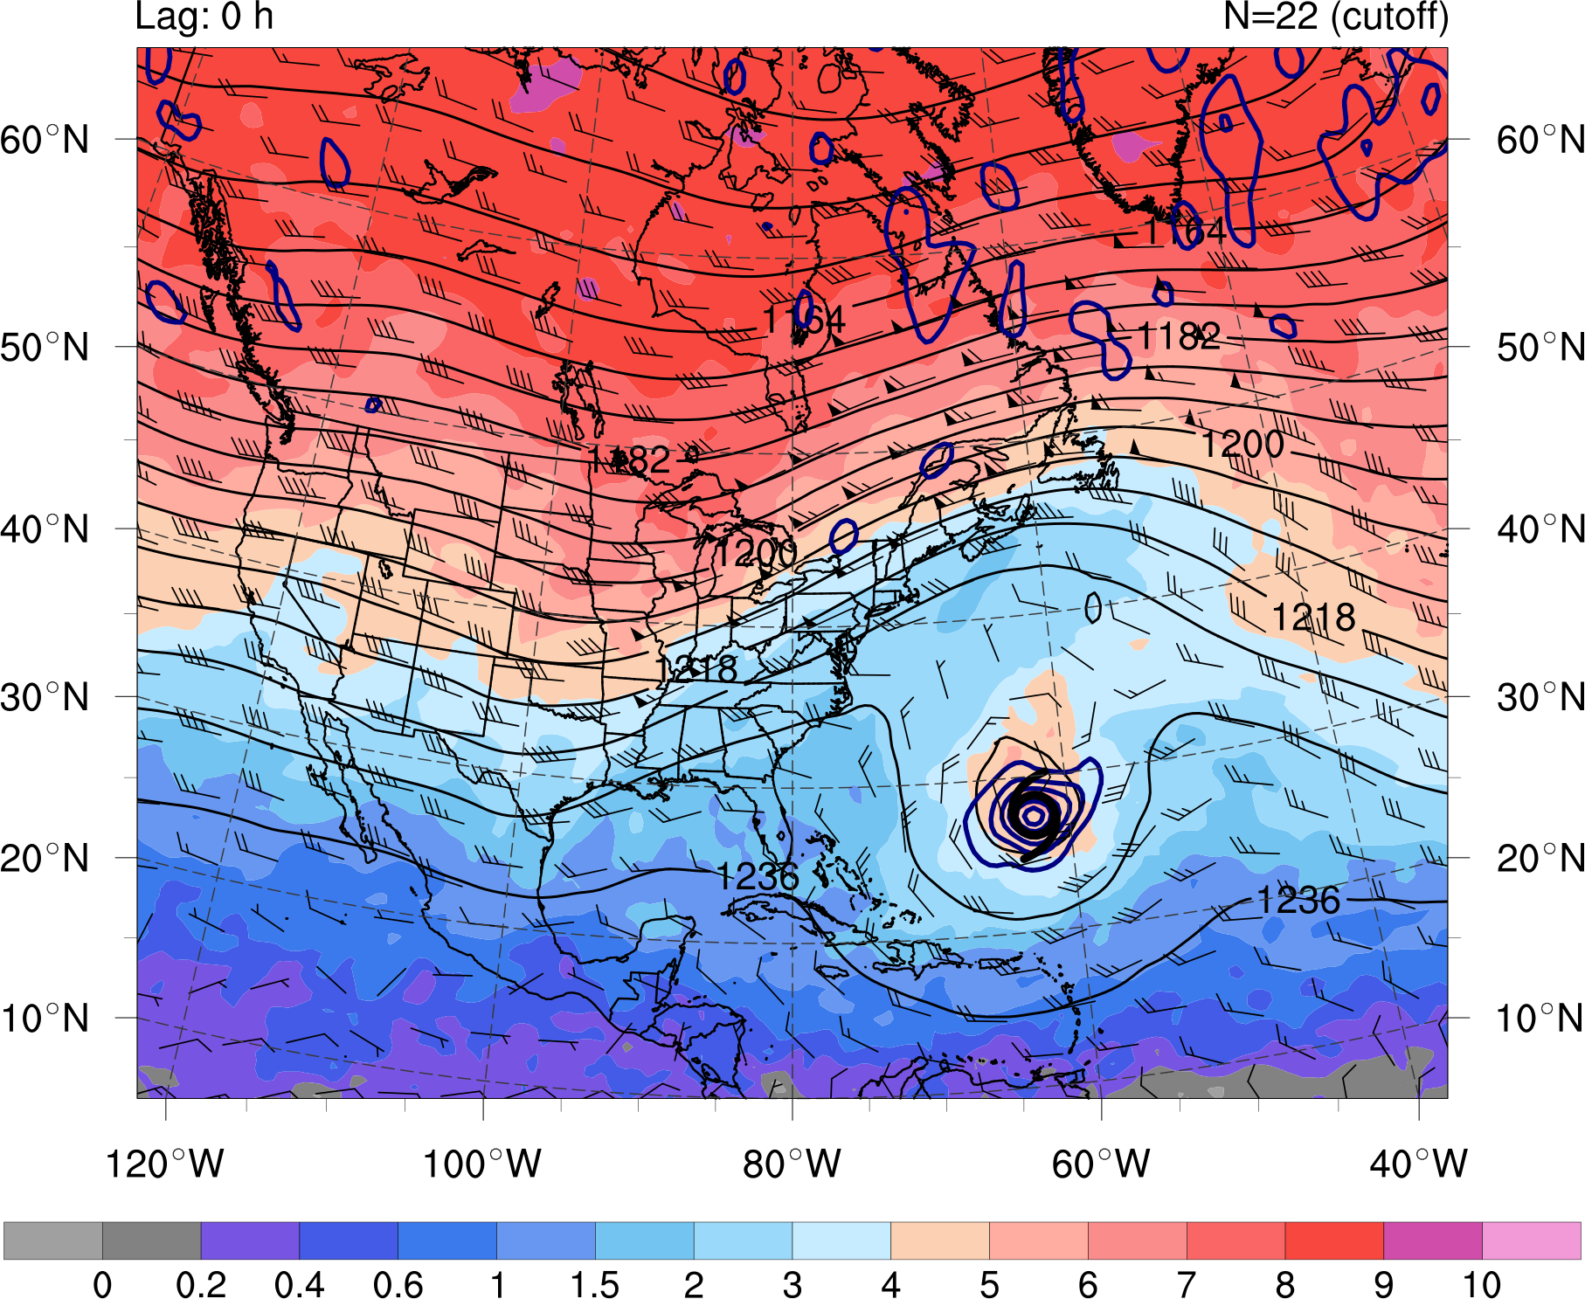
Composite Analysis: Cutoff
0 0.2 0.4 0.6 1 1.5 2 3 4 5 6 7 8 9 10
PVU
STC
at t₀
t₀
N = 22
PV (shaded, PVU) and winds (barbs, kts) on the 350 K isentropic surface,
200-hPa geopotential height (black contours, dam), and
925–850-hPa layer-averaged cyclonic relative vorticity (blue contours, every 1.5 × 10⁻⁵ s⁻¹)
Notes:
Caveat: Size of the cyclone matters when applying Davis (2010)…
Size of surface disturbance compared to upper-tropospheric cold anomaly important for

Slide 60
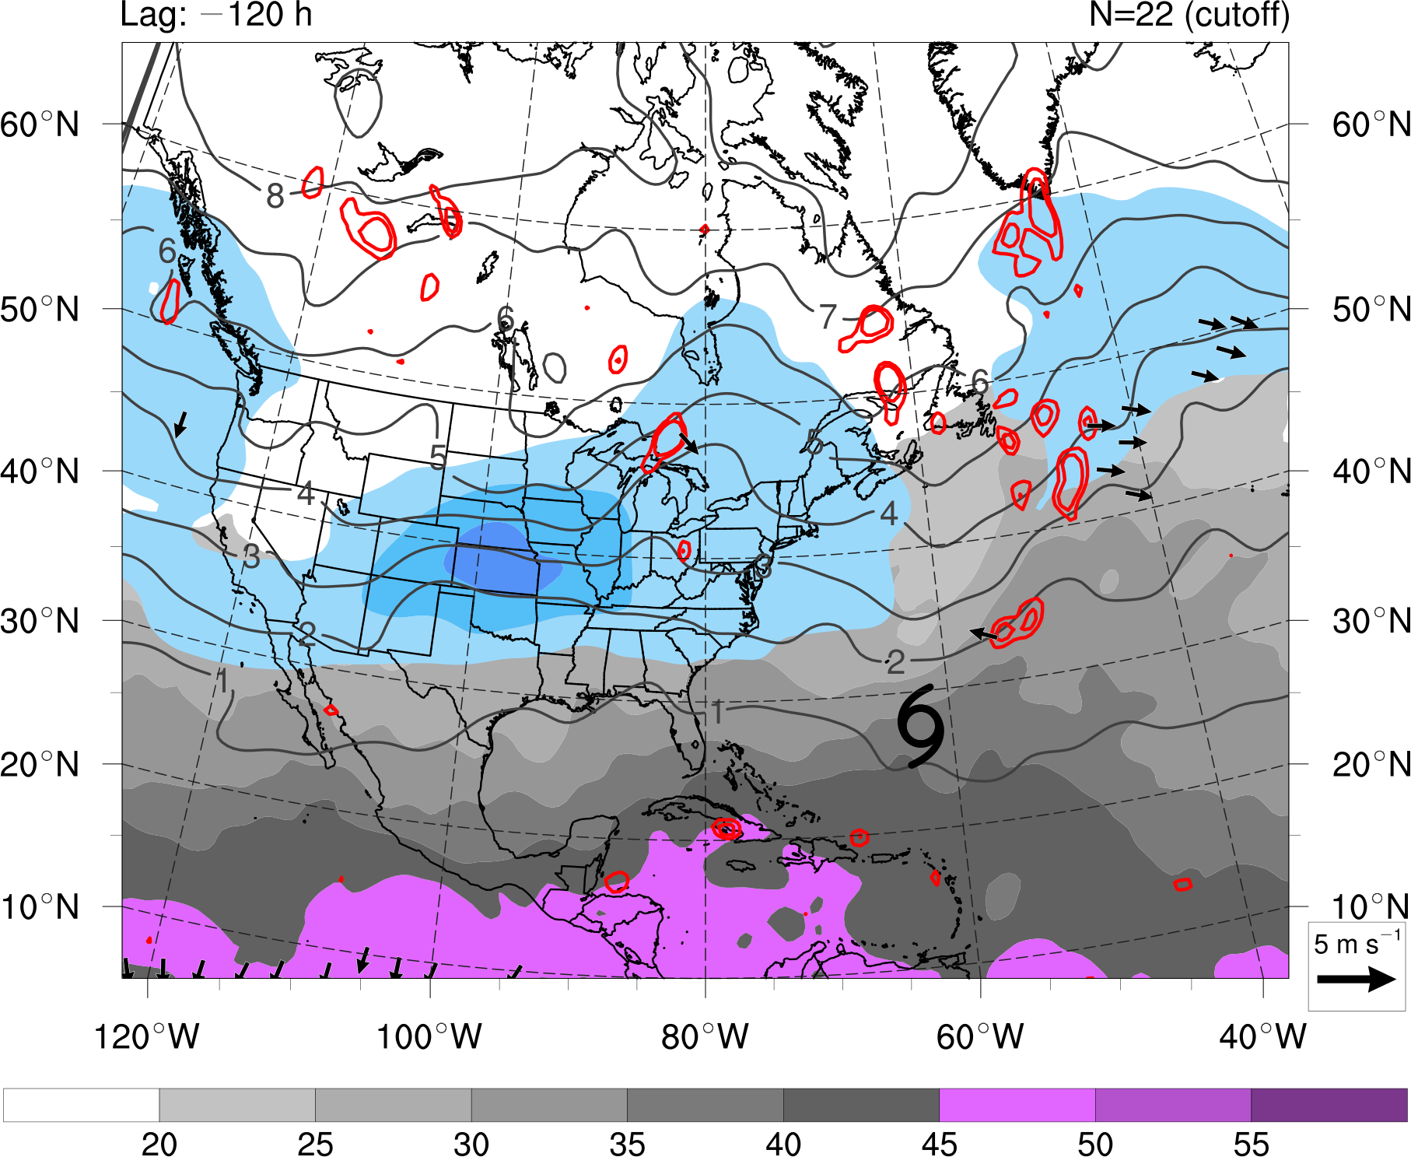
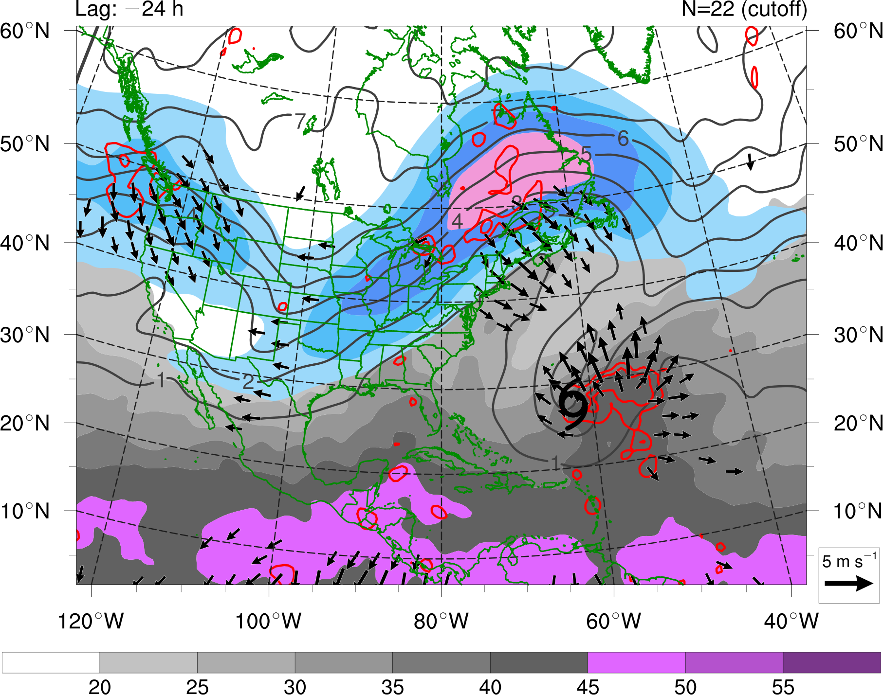
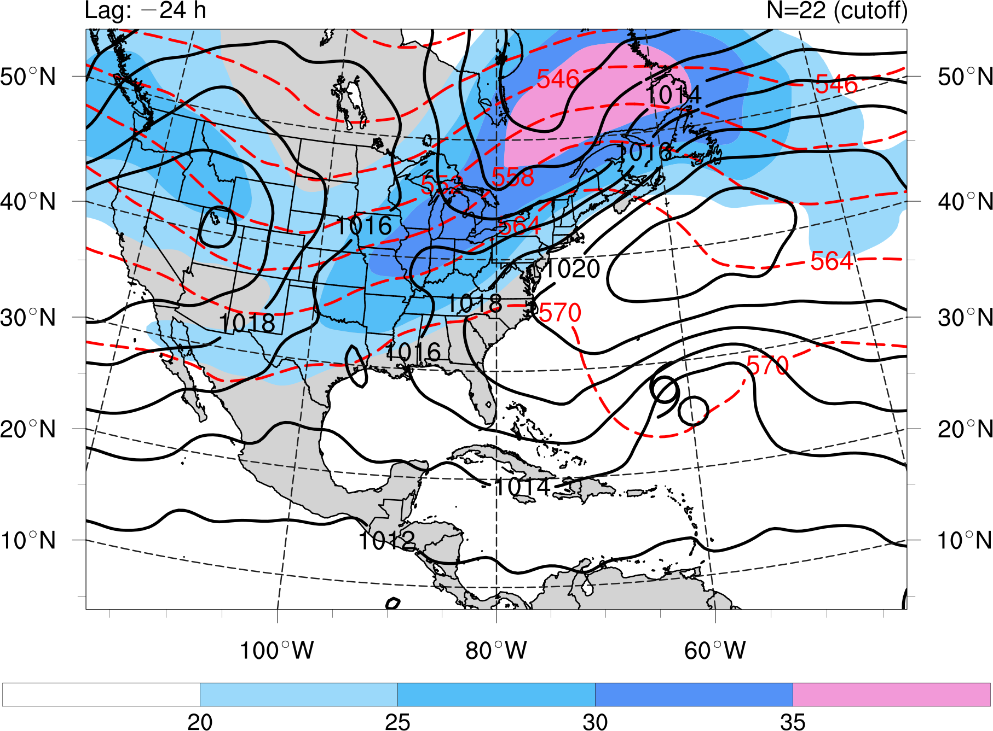
Composite Analysis: Cutoff
20 25 30 35 40 45
mm
20 25 30 35
m s⁻¹
STC
at t₀
t₀ − 120 h
N = 22
Precipitable water (gray shading, mm), 200-hPa PV (gray contours, PVU) and wind speed (shaded, m s⁻¹),
600–400-hPa layer-averaged ascent (red contours, every 1 × 10⁻³ hPa s⁻¹), and
300–200-hPa layer-averaged irrotational wind (vectors, starting at 2 m s⁻¹)
Notes:
Caveat: Size of the cyclone matters when applying Davis (2010)…
Size of surface disturbance compared to upper-tropospheric cold anomaly important for

Slide 61
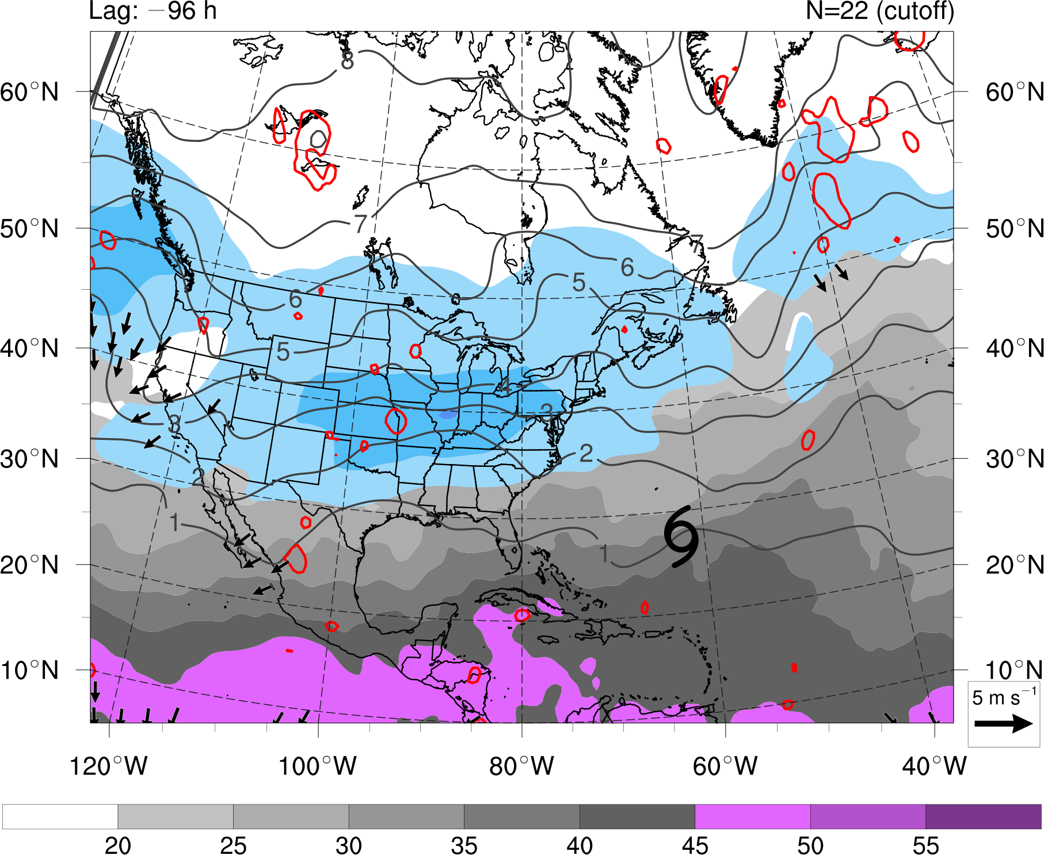
Composite Analysis: Cutoff
20 25 30 35 40 45
mm
20 25 30 35
m s⁻¹
STC
at t₀
t₀ − 96 h
N = 22
Precipitable water (gray shading, mm), 200-hPa PV (gray contours, PVU) and wind speed (shaded, m s⁻¹),
600–400-hPa layer-averaged ascent (red contours, every 1 × 10⁻³ hPa s⁻¹), and
300–200-hPa layer-averaged irrotational wind (vectors, starting at 2 m s⁻¹)
Notes:
Caveat: Size of the cyclone matters when applying Davis (2010)…
Size of surface disturbance compared to upper-tropospheric cold anomaly important for

Slide 62
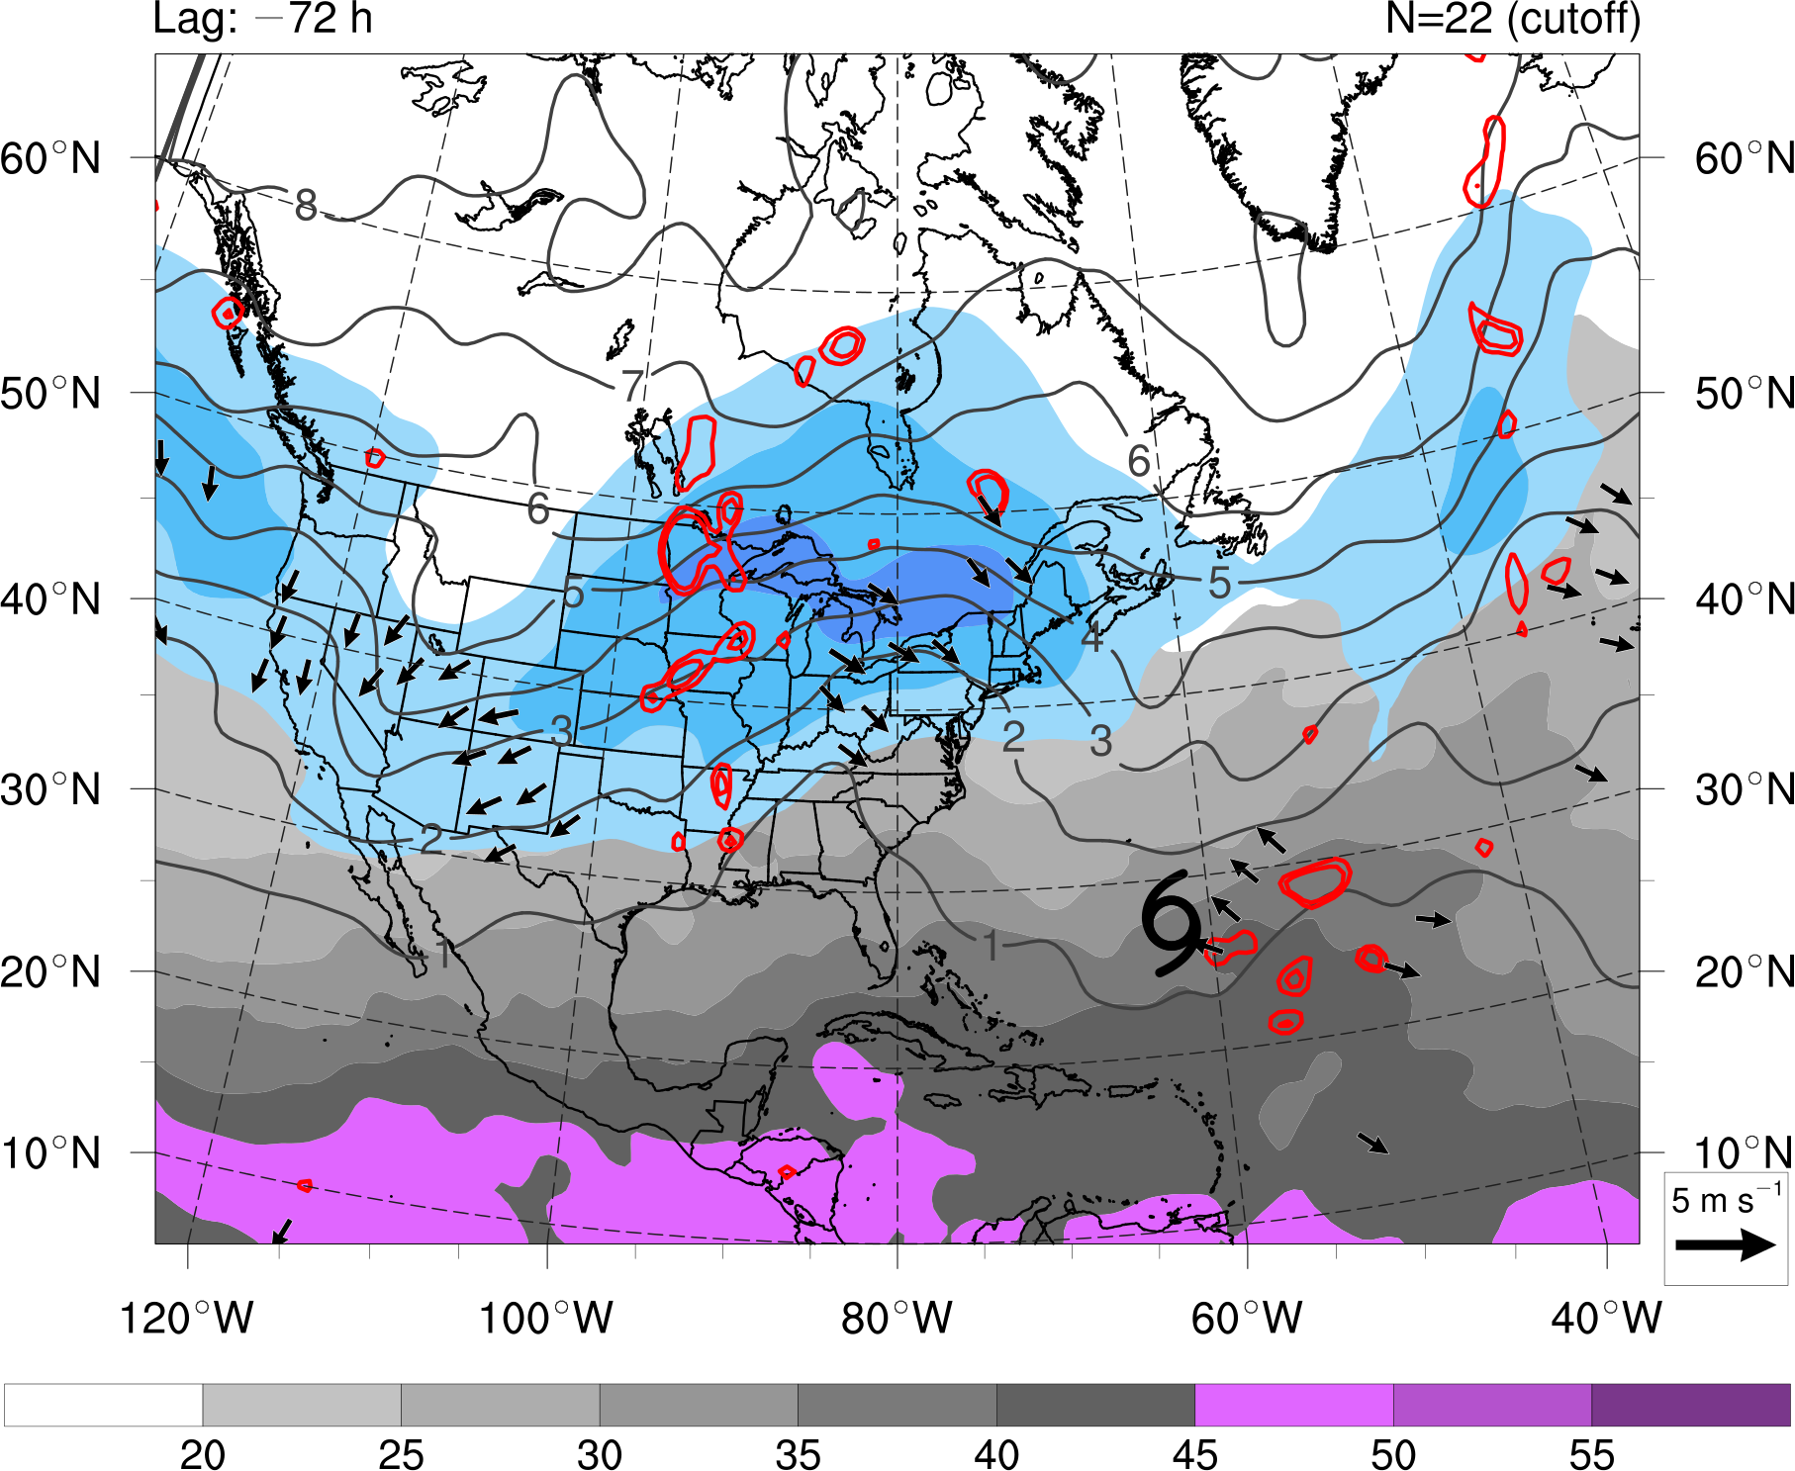
Composite Analysis: Cutoff
20 25 30 35 40 45
mm
20 25 30 35
m s⁻¹
STC
at t₀
t₀ − 72 h
N = 22
Precipitable water (gray shading, mm), 200-hPa PV (gray contours, PVU) and wind speed (shaded, m s⁻¹),
600–400-hPa layer-averaged ascent (red contours, every 1 × 10⁻³ hPa s⁻¹), and
300–200-hPa layer-averaged irrotational wind (vectors, starting at 2 m s⁻¹)
Notes:
Caveat: Size of the cyclone matters when applying Davis (2010)…
Size of surface disturbance compared to upper-tropospheric cold anomaly important for

Slide 63
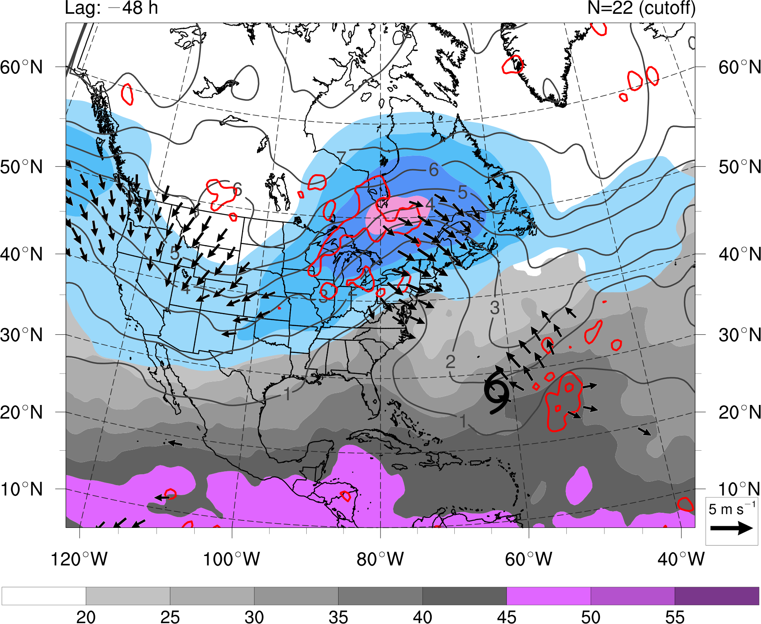
Composite Analysis: Cutoff
20 25 30 35 40 45
mm
20 25 30 35
m s⁻¹
STC
at t₀
t₀ − 48 h
N = 22
Precipitable water (gray shading, mm), 200-hPa PV (gray contours, PVU) and wind speed (shaded, m s⁻¹),
600–400-hPa layer-averaged ascent (red contours, every 1 × 10⁻³ hPa s⁻¹), and
300–200-hPa layer-averaged irrotational wind (vectors, starting at 2 m s⁻¹)
Notes:
Caveat: Size of the cyclone matters when applying Davis (2010)…
Size of surface disturbance compared to upper-tropospheric cold anomaly important for

Slide 64
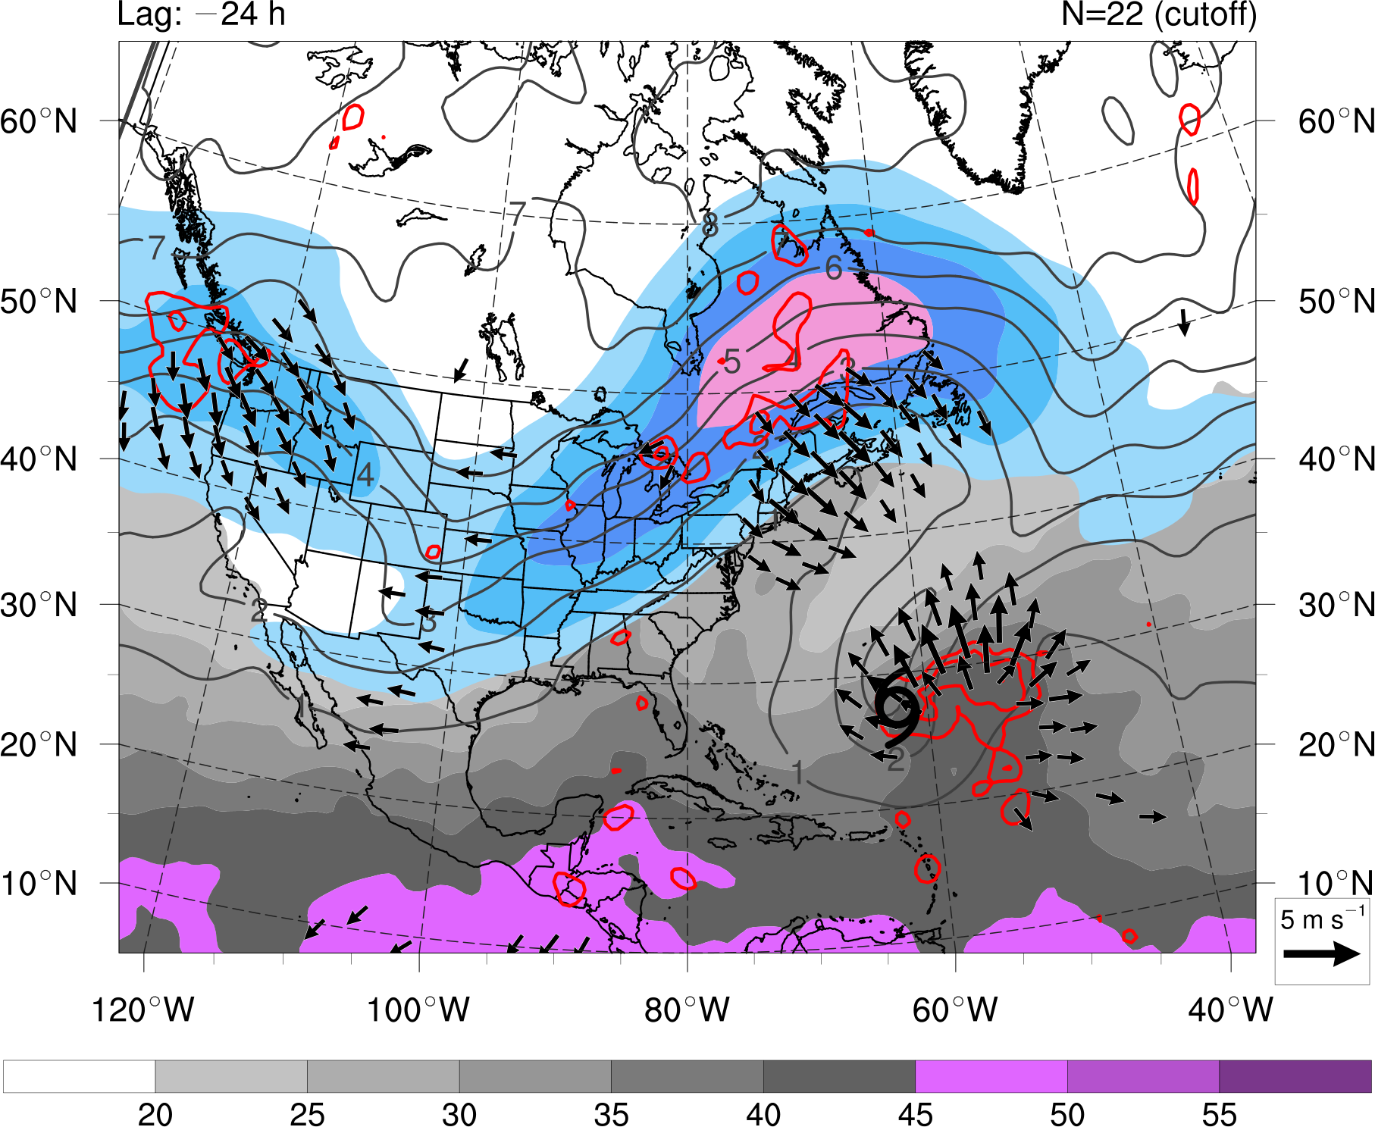
Composite Analysis: Cutoff
20 25 30 35 40 45
mm
20 25 30 35
m s⁻¹
STC
at t₀
t₀ − 24 h
N = 22
Precipitable water (gray shading, mm), 200-hPa PV (gray contours, PVU) and wind speed (shaded, m s⁻¹),
600–400-hPa layer-averaged ascent (red contours, every 1 × 10⁻³ hPa s⁻¹), and
300–200-hPa layer-averaged irrotational wind (vectors, starting at 2 m s⁻¹)
Notes:
Caveat: Size of the cyclone matters when applying Davis (2010)…
Size of surface disturbance compared to upper-tropospheric cold anomaly important for

Slide 65
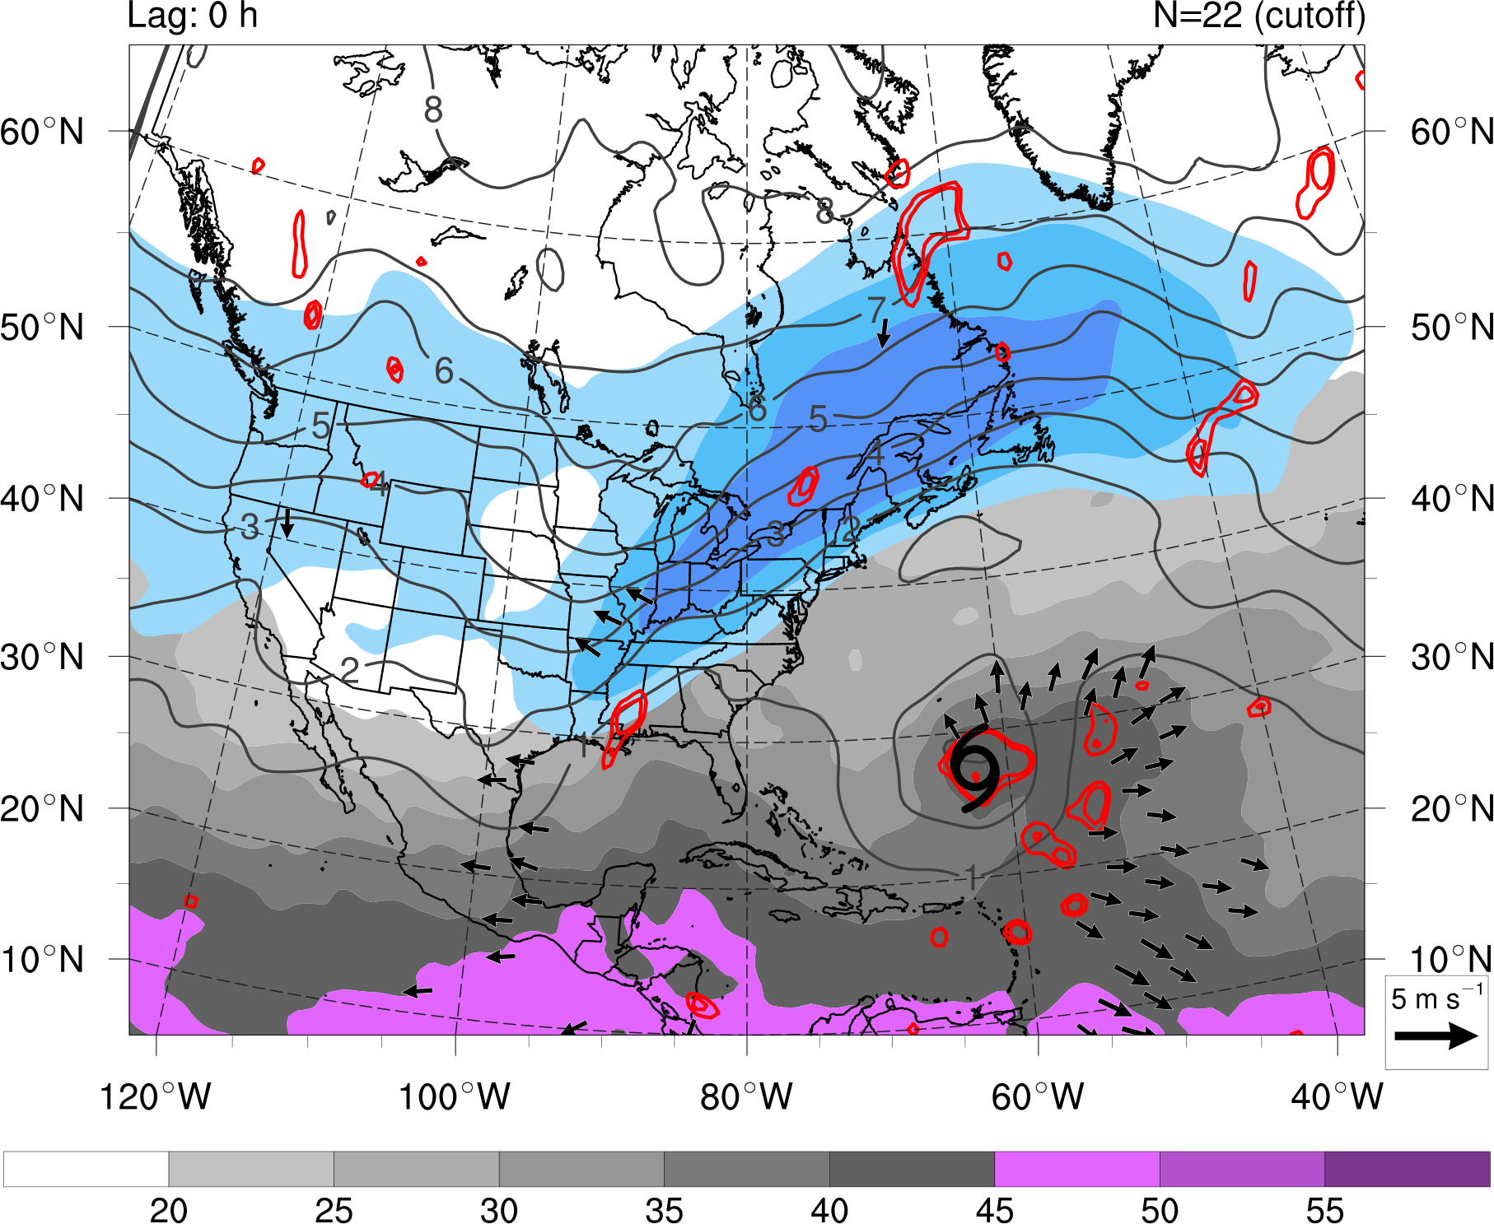
Composite Analysis: Cutoff
20 25 30 35 40 45
mm
20 25 30 35
m s⁻¹
STC
at t₀
t₀
N = 22
Precipitable water (gray shading, mm), 200-hPa PV (gray contours, PVU) and wind speed (shaded, m s⁻¹),
600–400-hPa layer-averaged ascent (red contours, every 1 × 10⁻³ hPa s⁻¹), and
300–200-hPa layer-averaged irrotational wind (vectors, starting at 2 m s⁻¹)
Notes:
Caveat: Size of the cyclone matters when applying Davis (2010)…
Size of surface disturbance compared to upper-tropospheric cold anomaly important for

Slide 66
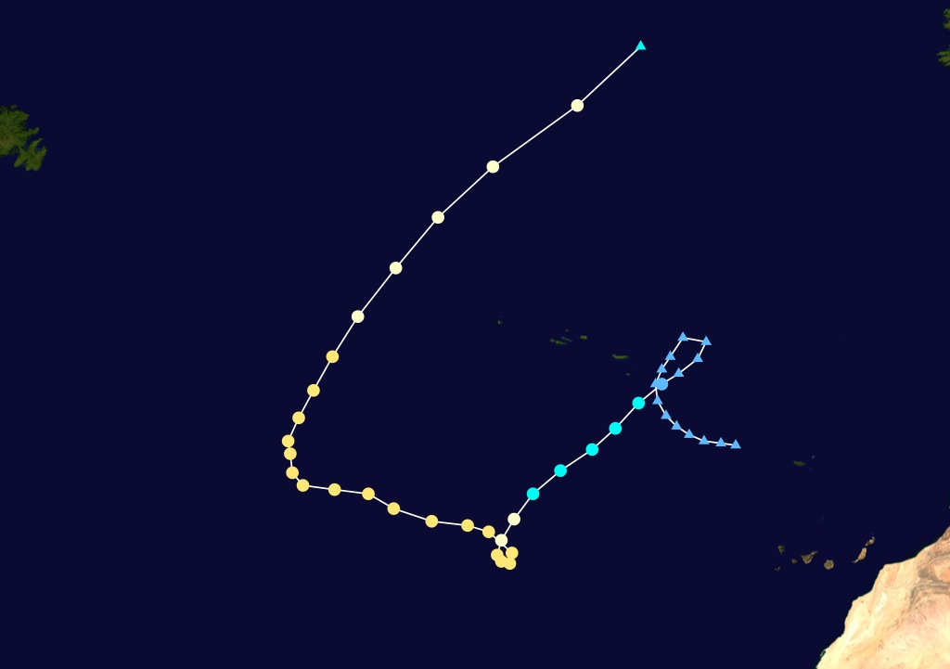


Case Study: Cutoff
Hurricane Ivan (1980)
(1 October – 12 October)
Ireland
Tropical cyclone
Newfoundland
Subtropical cyclone
Extratropical cyclone / Remnant low
Azores
Canary Islands
Image courtesy of the National Climatic Data Center
Notes:
Caveat: Size of the cyclone matters when applying Davis (2010)…
Size of surface disturbance compared to upper-tropospheric cold anomaly important for

Slide 67
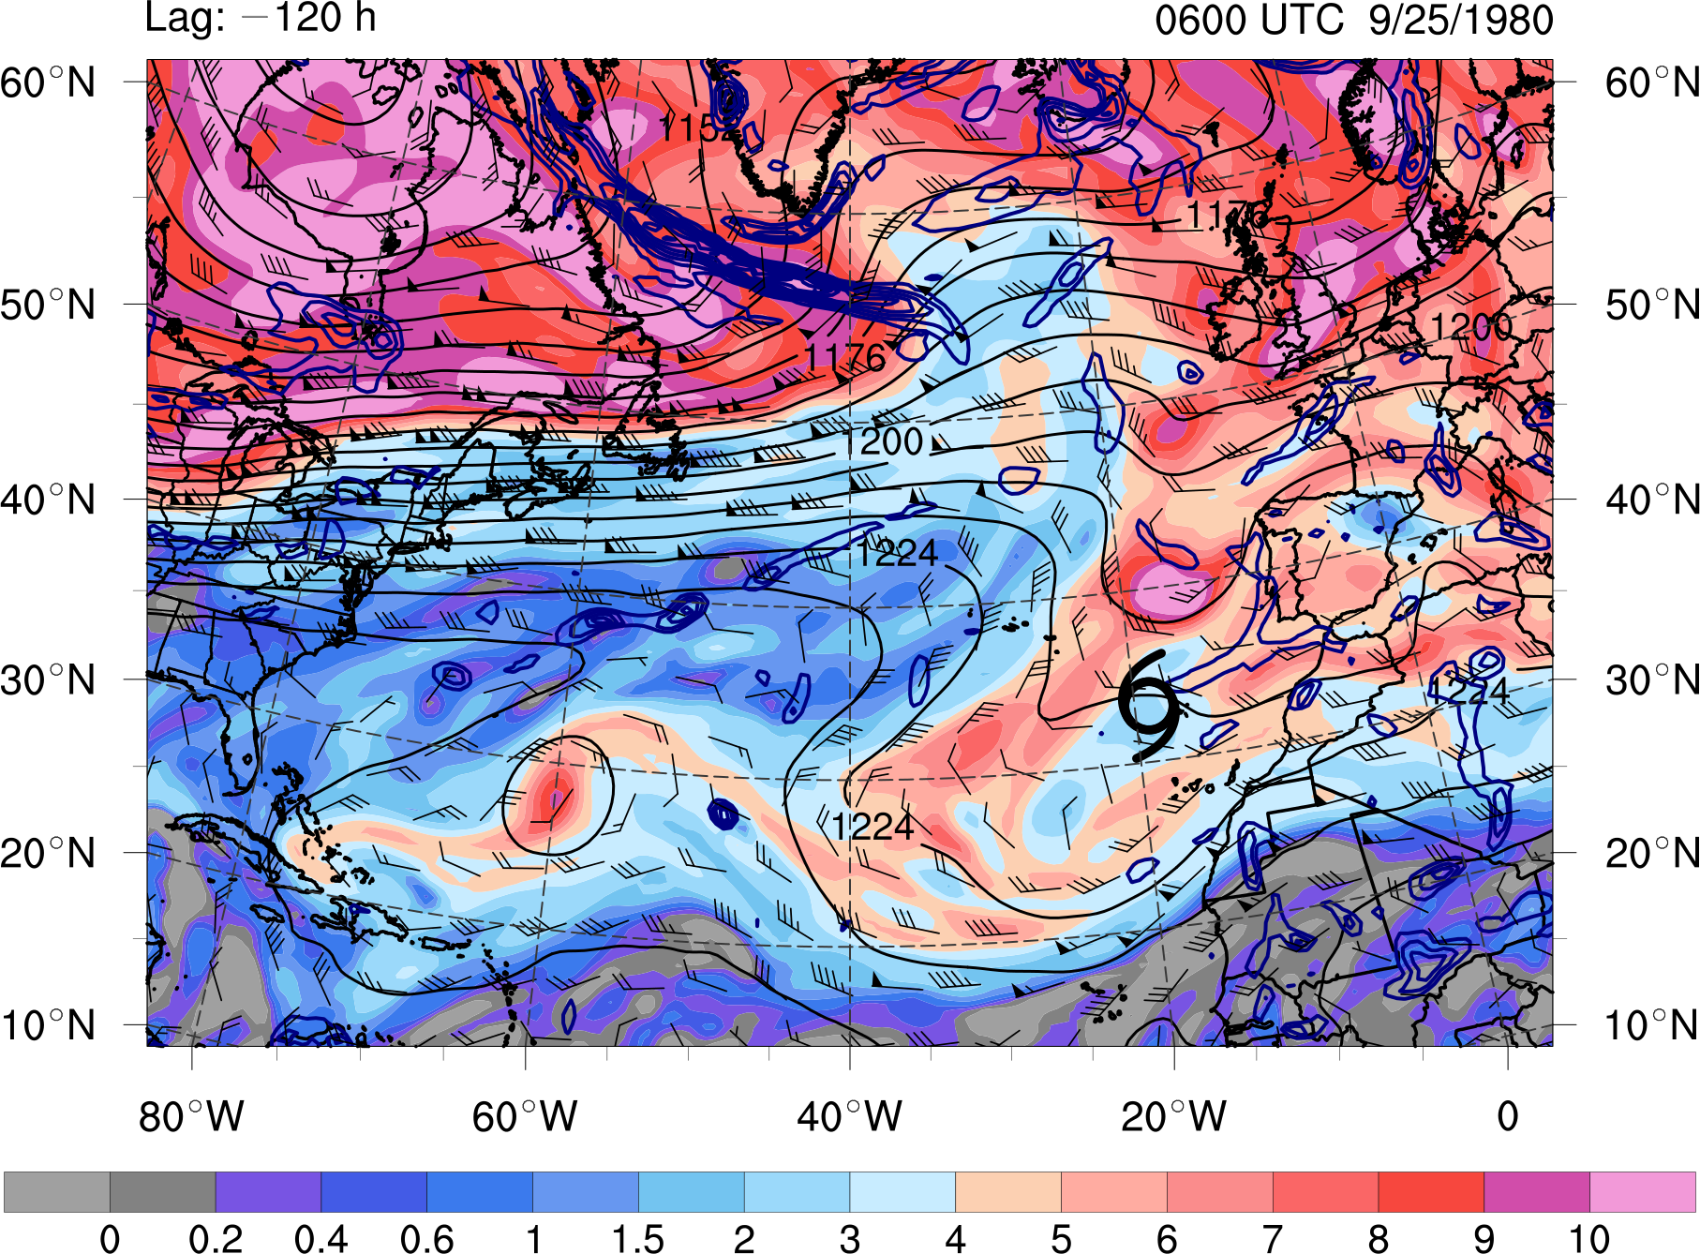
Case Study: Cutoff
0 0.2 0.4 0.6 1 1.5 2 3 4 5 6 7 8 9 10
PVU
STC
at t₀
t₀ − 120 h
0600 UTC 25 SEP 1980
PV (shaded, PVU) and winds (barbs, kts) on the 350 K isentropic surface,
200-hPa geopotential height (black contours, dam), and
925–850-hPa layer-averaged cyclonic relative vorticity (blue contours, every 0.5 × 10⁻⁴ s⁻¹)
Notes:
Caveat: Size of the cyclone matters when applying Davis (2010)…
Size of surface disturbance compared to upper-tropospheric cold anomaly important for

Slide 68
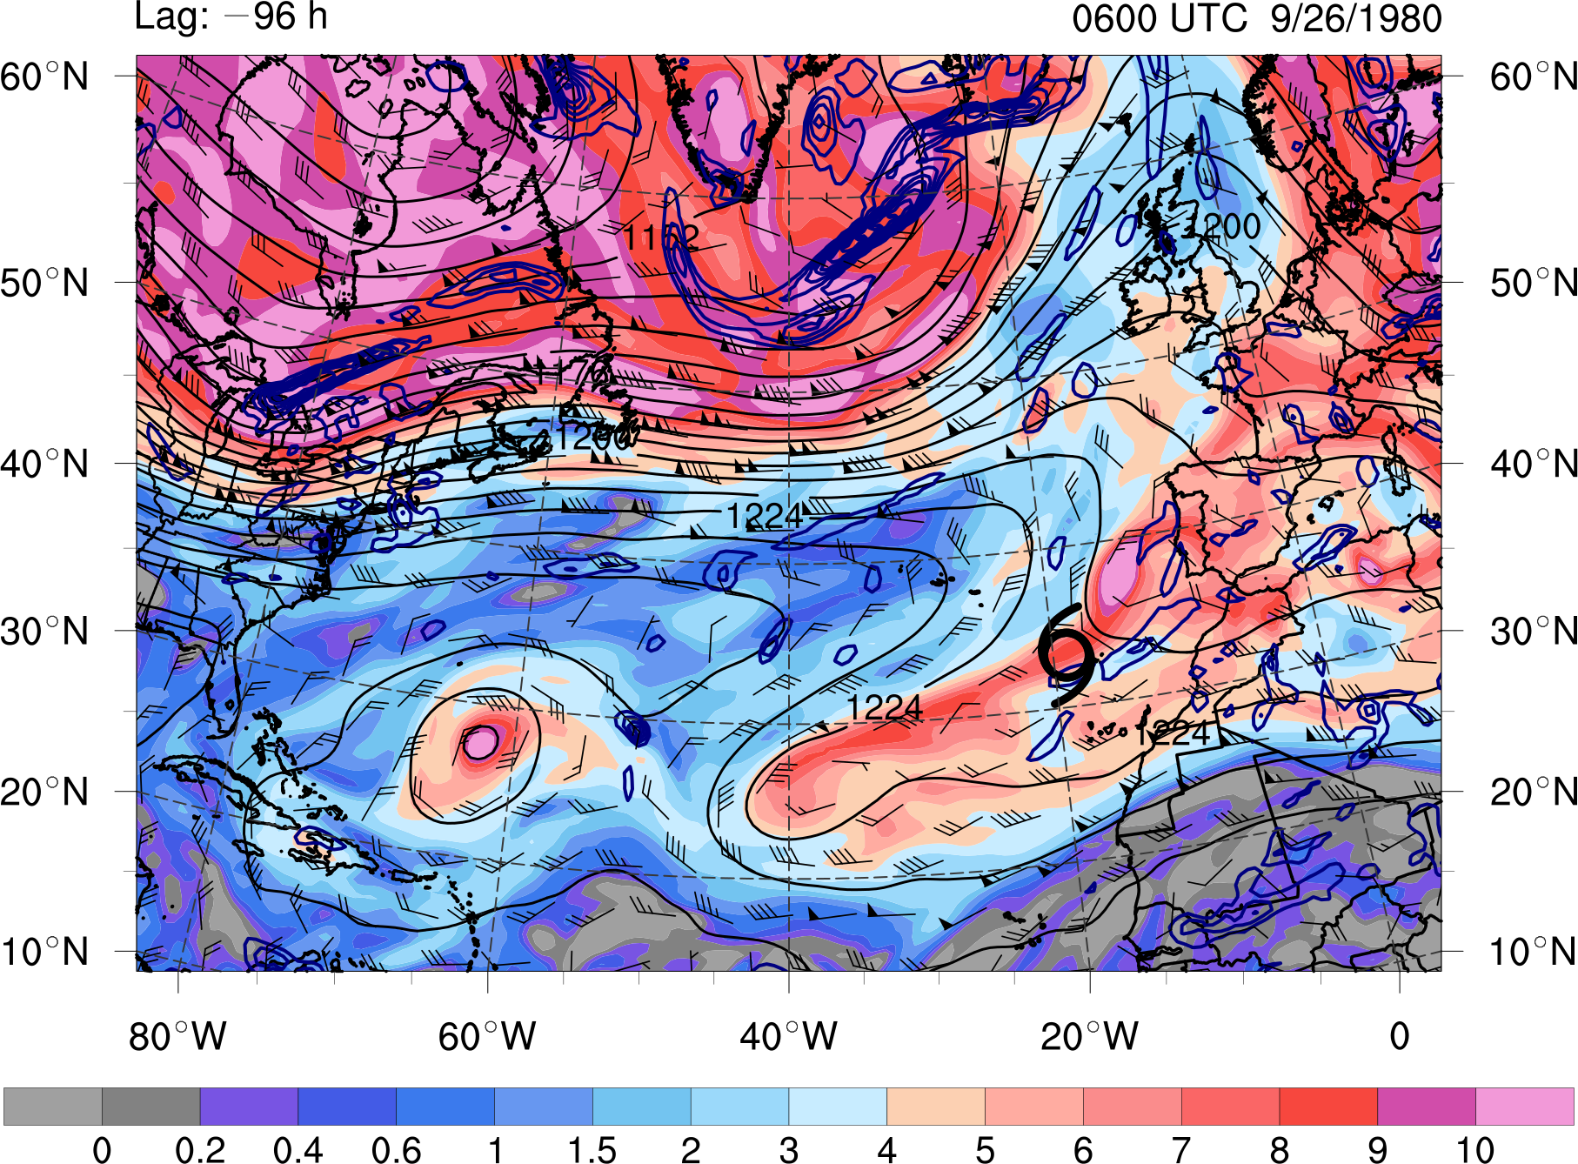
Case Study: Cutoff
0 0.2 0.4 0.6 1 1.5 2 3 4 5 6 7 8 9 10
PVU
STC
at t₀
t₀ − 96 h
0600 UTC 26 SEP 1980
PV (shaded, PVU) and winds (barbs, kts) on the 350 K isentropic surface,
200-hPa geopotential height (black contours, dam), and
925–850-hPa layer-averaged cyclonic relative vorticity (blue contours, every 0.5 × 10⁻⁴ s⁻¹)
Notes:
Caveat: Size of the cyclone matters when applying Davis (2010)…
Size of surface disturbance compared to upper-tropospheric cold anomaly important for

Slide 69
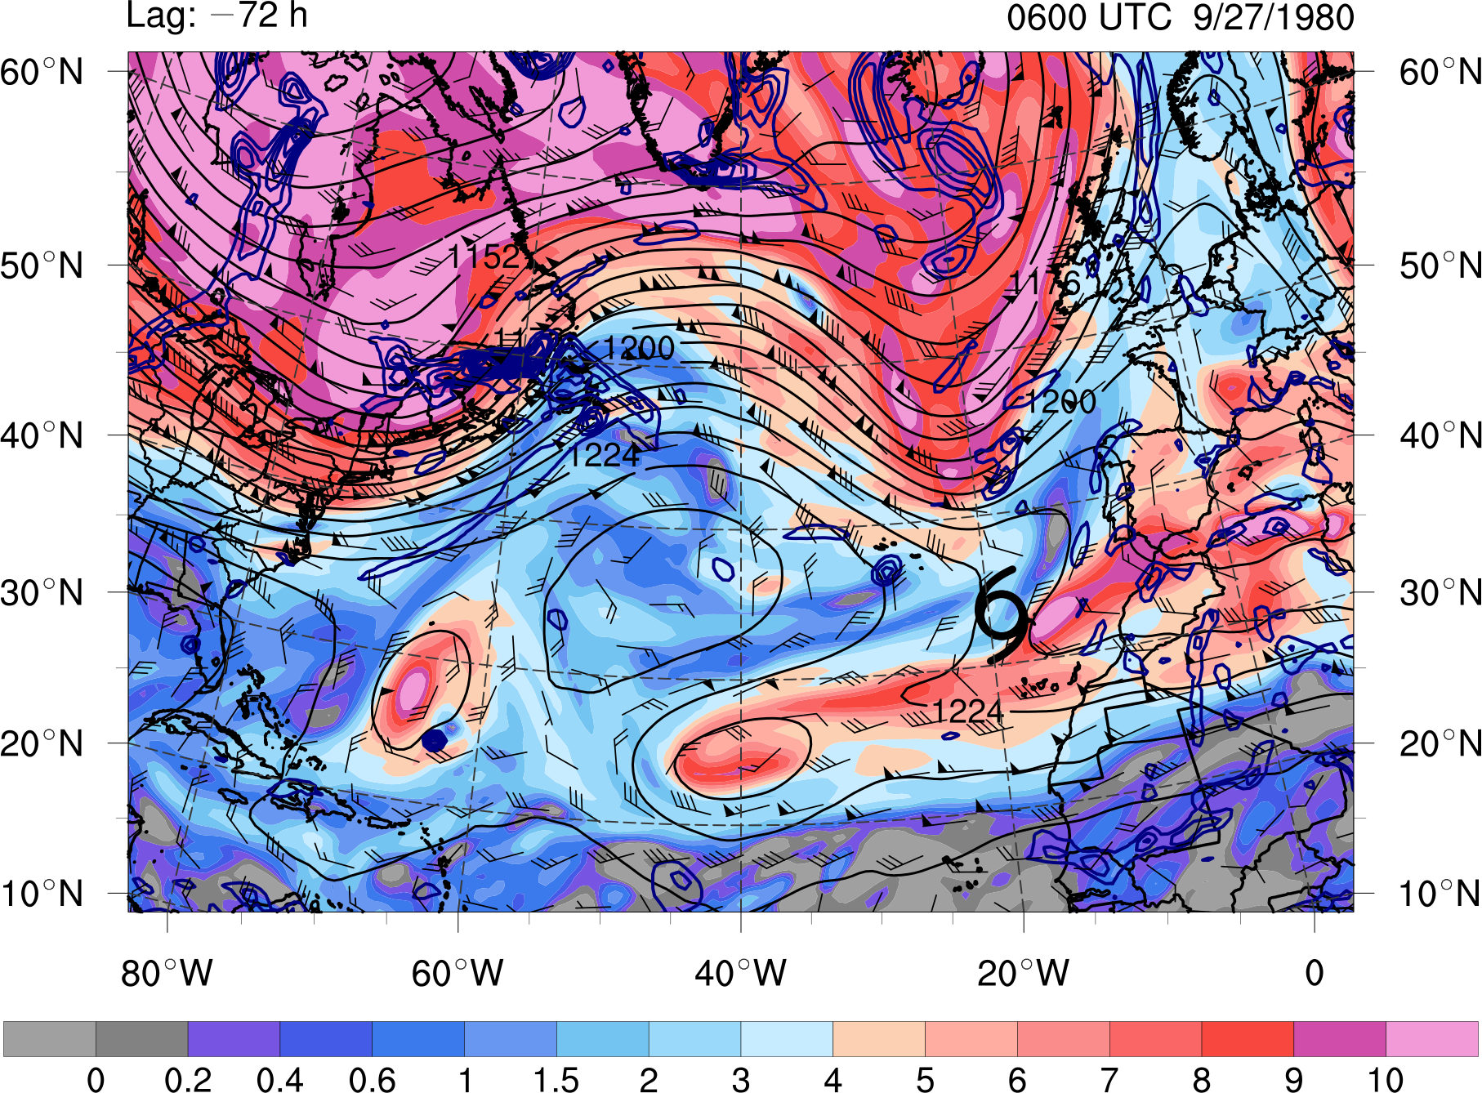
Case Study: Cutoff
0 0.2 0.4 0.6 1 1.5 2 3 4 5 6 7 8 9 10
PVU
STC
at t₀
t₀ − 72 h
0600 UTC 27 SEP 1980
PV (shaded, PVU) and winds (barbs, kts) on the 350 K isentropic surface,
200-hPa geopotential height (black contours, dam), and
925–850-hPa layer-averaged cyclonic relative vorticity (blue contours, every 0.5 × 10⁻⁴ s⁻¹)
Notes:
Caveat: Size of the cyclone matters when applying Davis (2010)…
Size of surface disturbance compared to upper-tropospheric cold anomaly important for

Slide 70
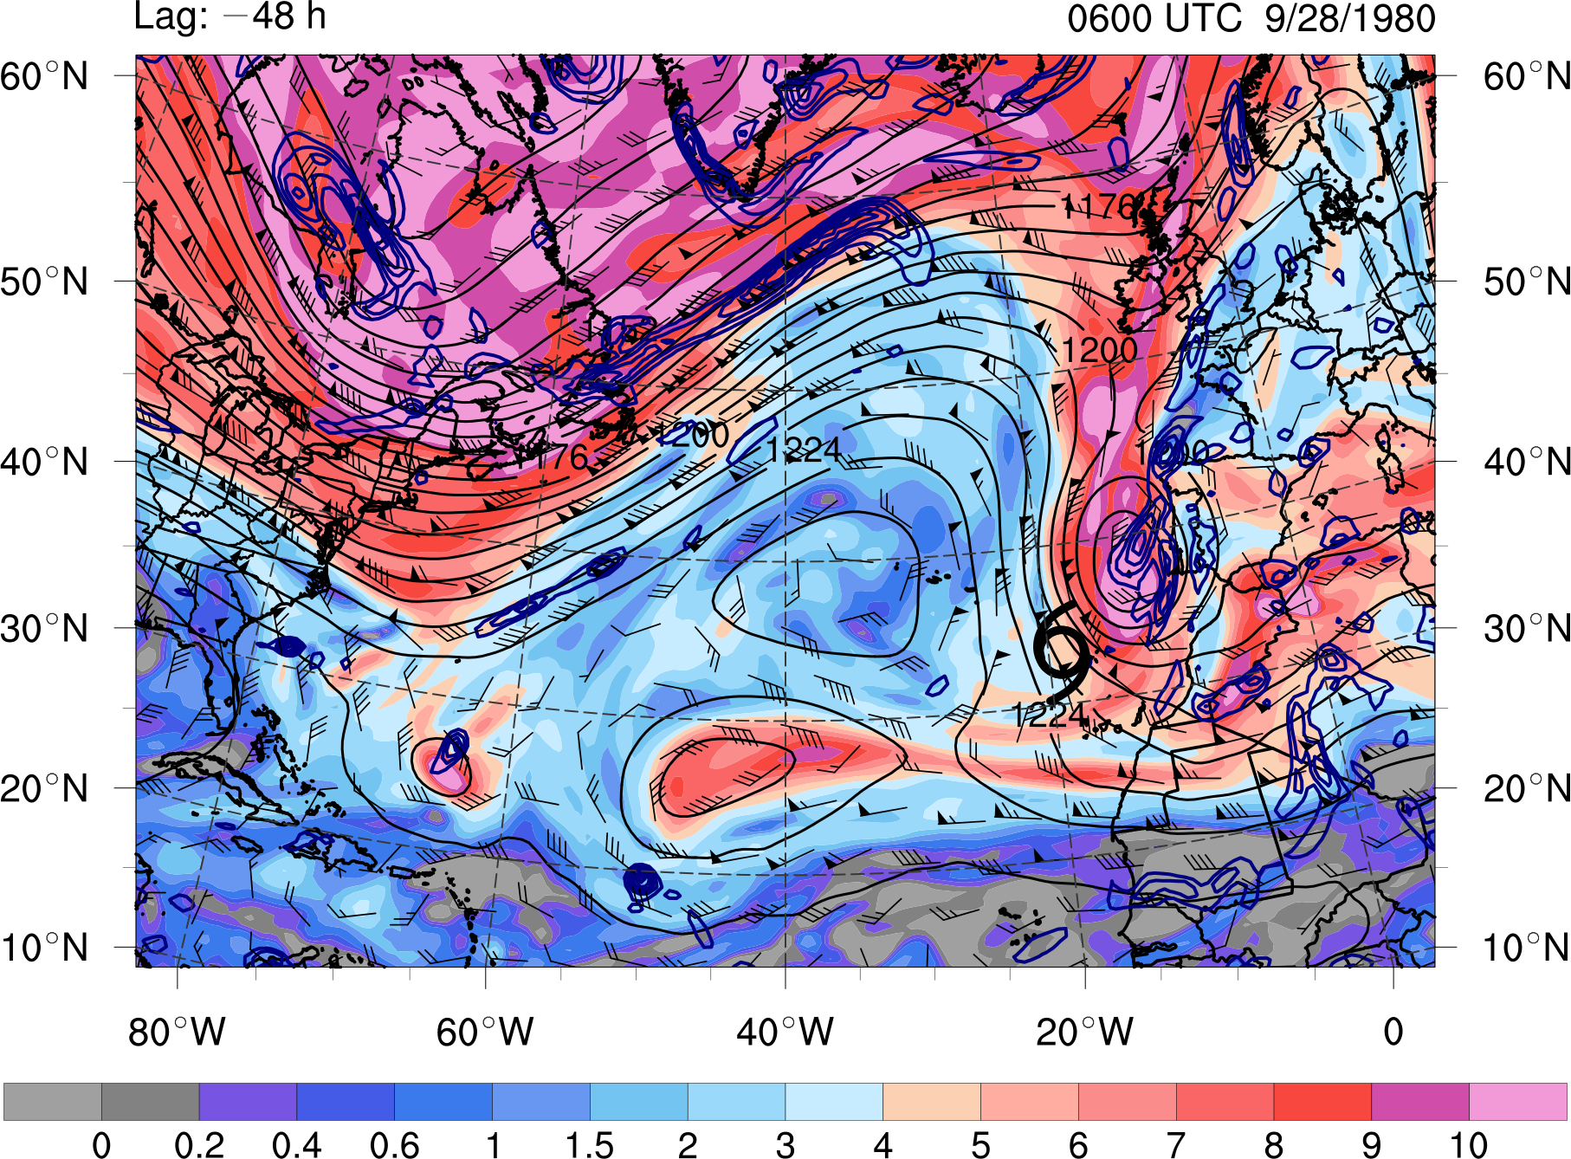
Case Study: Cutoff
0 0.2 0.4 0.6 1 1.5 2 3 4 5 6 7 8 9 10
PVU
STC
at t₀
t₀ − 48 h
0600 UTC 28 SEP 1980
PV (shaded, PVU) and winds (barbs, kts) on the 350 K isentropic surface,
200-hPa geopotential height (black contours, dam), and
925–850-hPa layer-averaged cyclonic relative vorticity (blue contours, every 0.5 × 10⁻⁴ s⁻¹)
Notes:
Caveat: Size of the cyclone matters when applying Davis (2010)…
Size of surface disturbance compared to upper-tropospheric cold anomaly important for

Slide 71
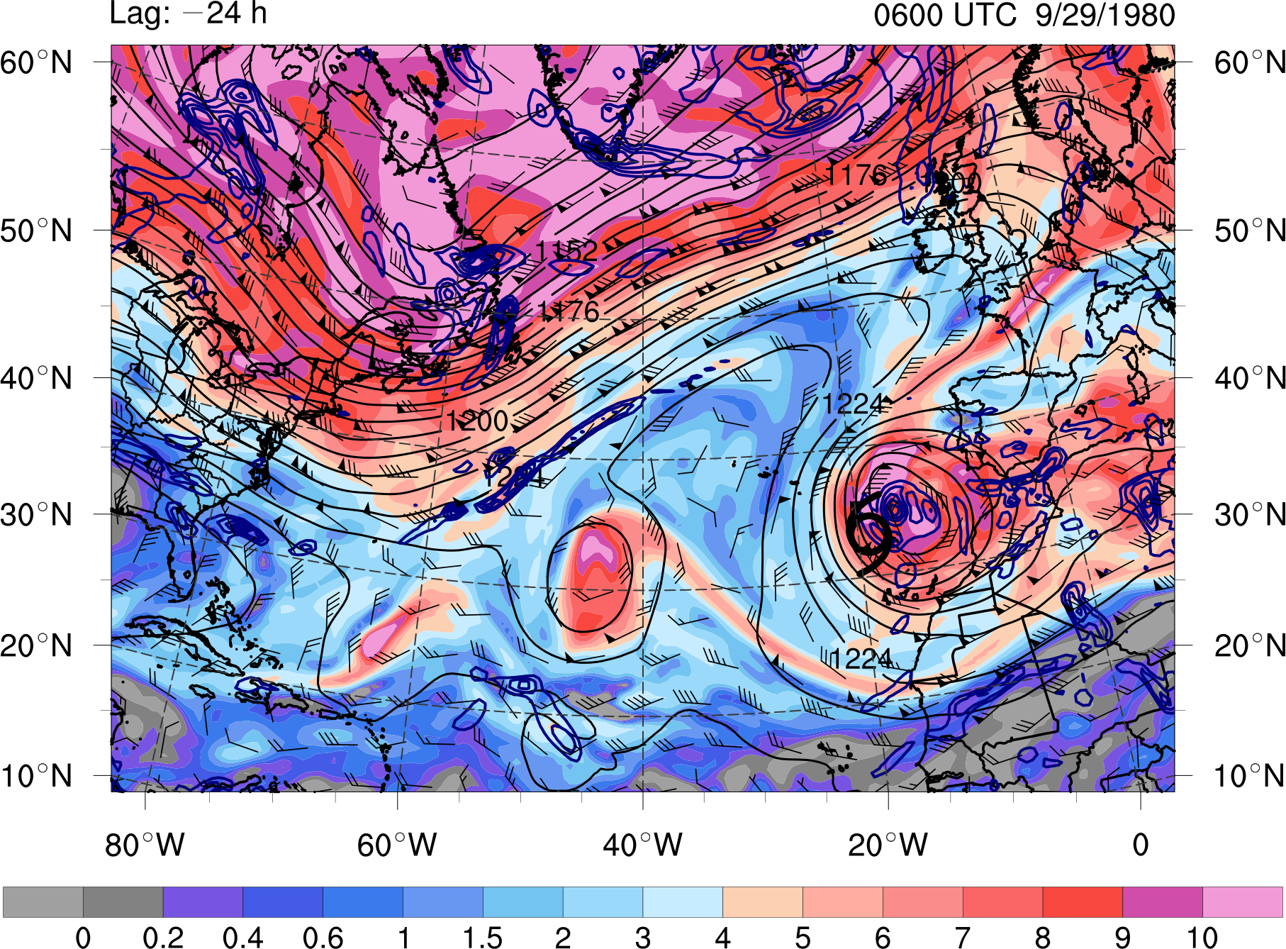
Case Study: Cutoff
0 0.2 0.4 0.6 1 1.5 2 3 4 5 6 7 8 9 10
PVU
STC
at t₀
t₀ − 24 h
0600 UTC 29 SEP 1980
PV (shaded, PVU) and winds (barbs, kts) on the 350 K isentropic surface,
200-hPa geopotential height (black contours, dam), and
925–850-hPa layer-averaged cyclonic relative vorticity (blue contours, every 0.5 × 10⁻⁴ s⁻¹)
Notes:
Caveat: Size of the cyclone matters when applying Davis (2010)…
Size of surface disturbance compared to upper-tropospheric cold anomaly important for

Slide 72
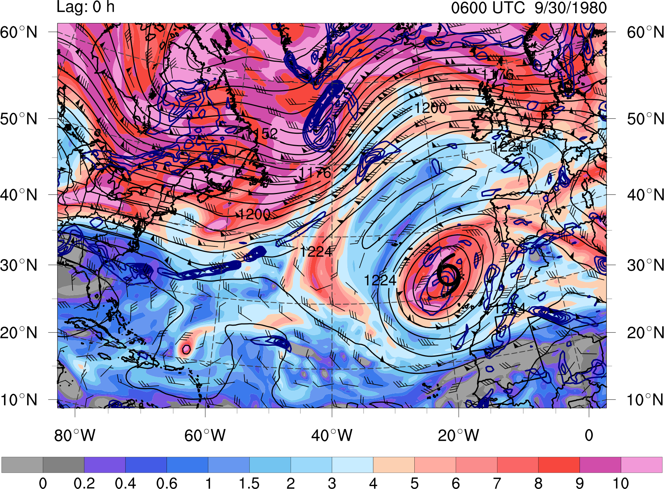
Case Study: Cutoff
0 0.2 0.4 0.6 1 1.5 2 3 4 5 6 7 8 9 10
PVU
STC
at t₀
t₀
0600 UTC 30 SEP 1980
PV (shaded, PVU) and winds (barbs, kts) on the 350 K isentropic surface,
200-hPa geopotential height (black contours, dam), and
925–850-hPa layer-averaged cyclonic relative vorticity (blue contours, every 0.5 × 10⁻⁴ s⁻¹)
Notes:
Caveat: Size of the cyclone matters when applying Davis (2010)…
Size of surface disturbance compared to upper-tropospheric cold anomaly important for

Slide 73
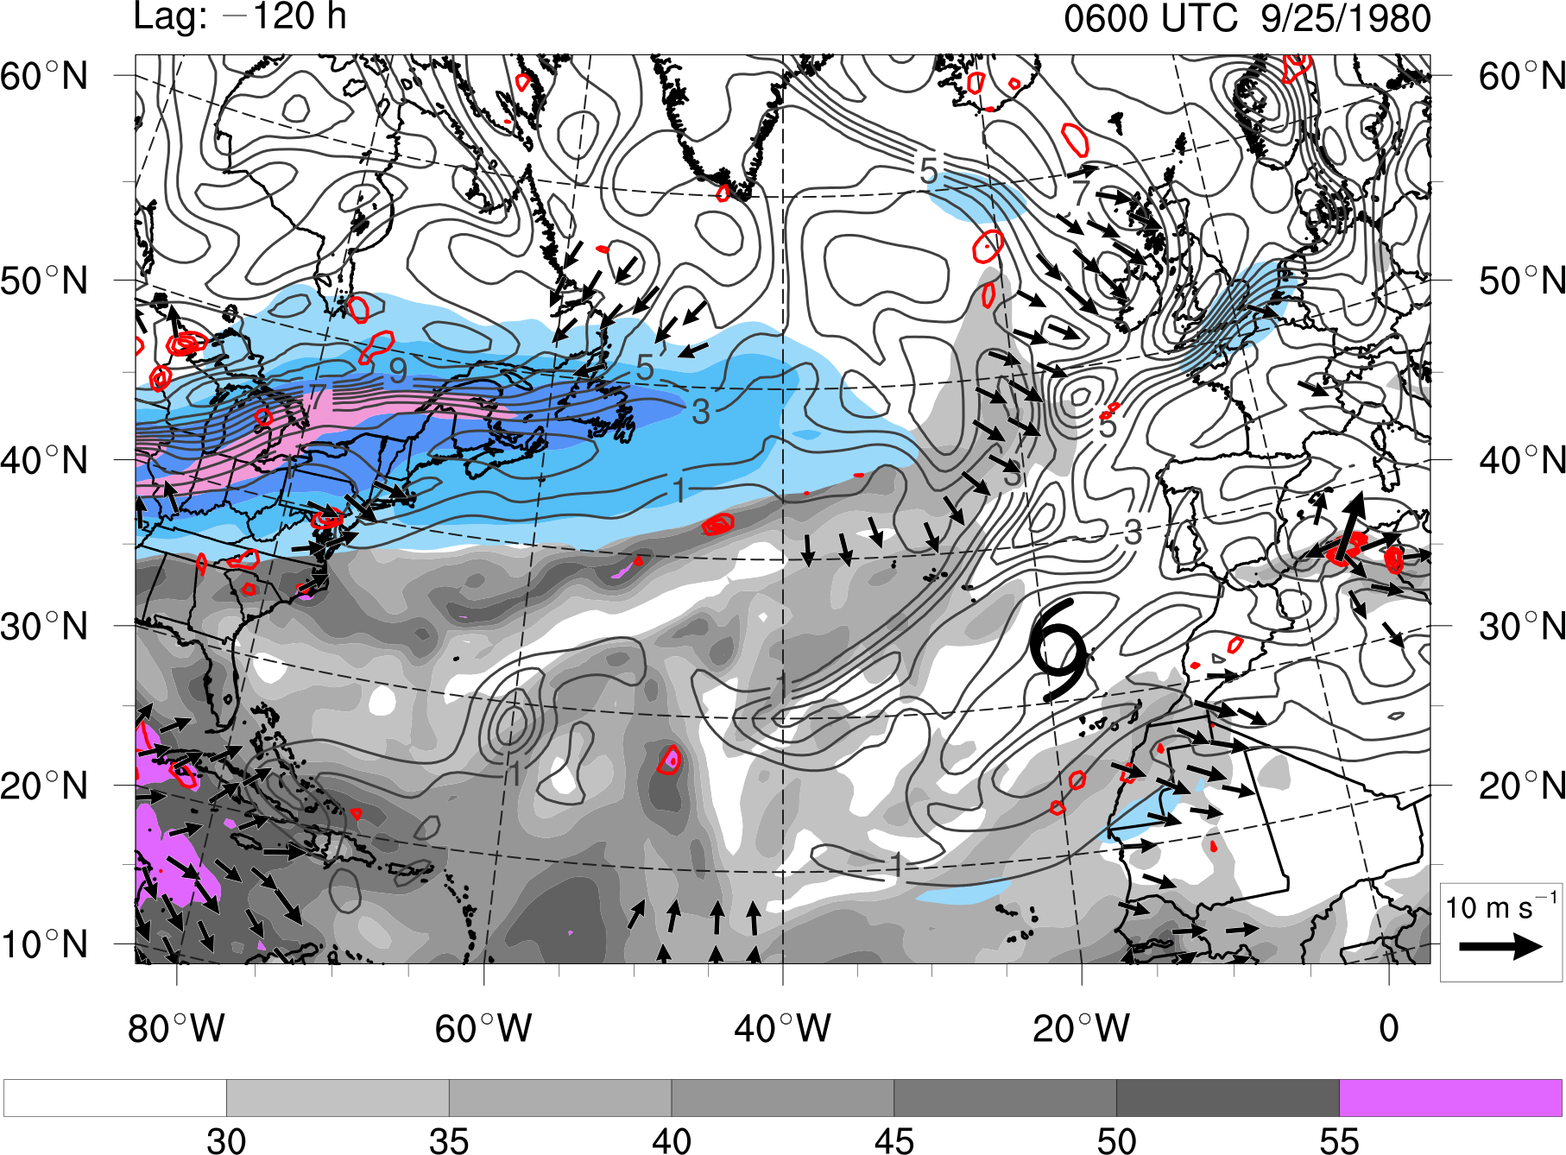
Case Study: Cutoff
30 35 40 45 50 55
mm
30 40 50 60
m s⁻¹
STC
at t₀
t₀ − 120 h
0600 UTC 25 SEP 1980
Precipitable water (gray shading, mm), 200-hPa PV (gray contours, PVU) and wind speed (shaded, m s⁻¹),
600–400-hPa layer-averaged ascent (red contours, every 5 × 10⁻³ hPa s⁻¹), and
300–200-hPa layer-averaged irrotational wind (vectors, starting at 4 m s⁻¹)
Notes:
Caveat: Size of the cyclone matters when applying Davis (2010)…
Size of surface disturbance compared to upper-tropospheric cold anomaly important for

Slide 74
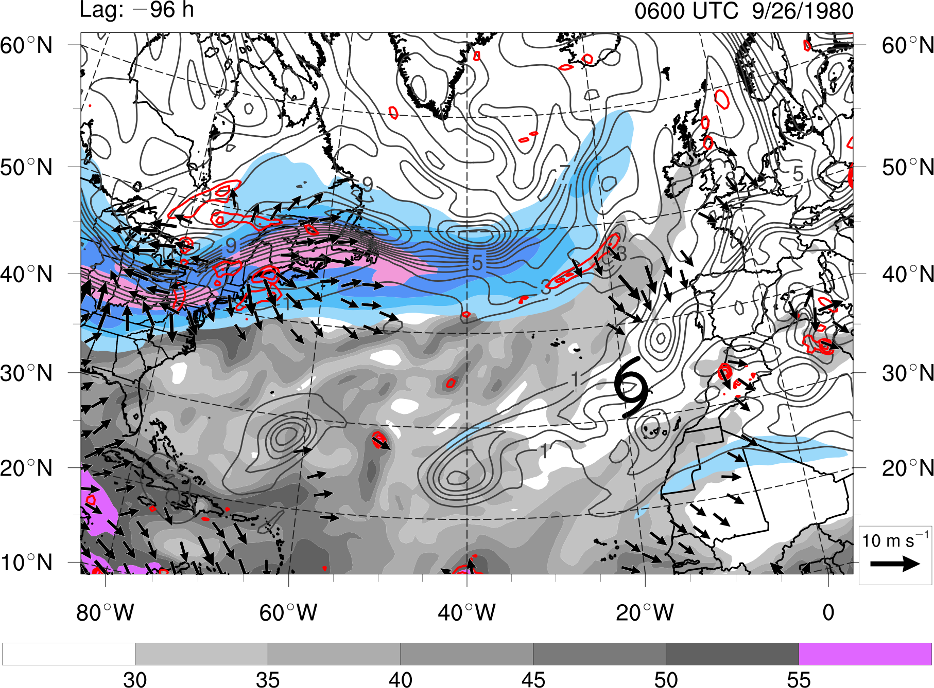
Case Study: Cutoff
30 35 40 45 50 55
mm
30 40 50 60
m s⁻¹
STC
at t₀
t₀ − 96 h
0600 UTC 26 SEP 1980
Precipitable water (gray shading, mm), 200-hPa PV (gray contours, PVU) and wind speed (shaded, m s⁻¹),
600–400-hPa layer-averaged ascent (red contours, every 5 × 10⁻³ hPa s⁻¹), and
300–200-hPa layer-averaged irrotational wind (vectors, starting at 4 m s⁻¹)
Notes:
Caveat: Size of the cyclone matters when applying Davis (2010)…
Size of surface disturbance compared to upper-tropospheric cold anomaly important for

Slide 75
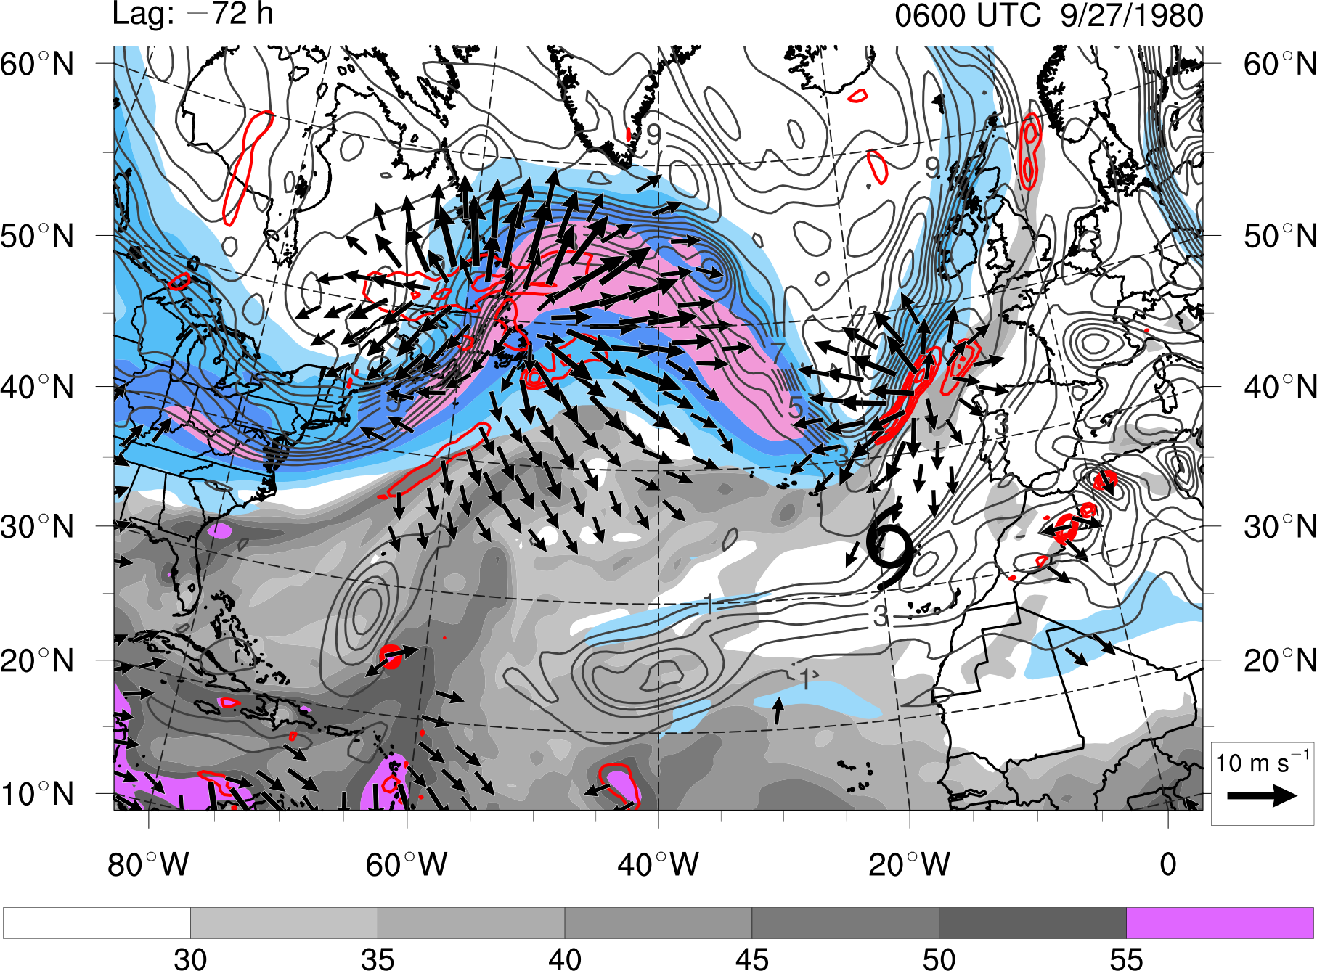
Case Study: Cutoff
30 35 40 45 50 55
mm
30 40 50 60
m s⁻¹
STC
at t₀
t₀ − 72 h
0600 UTC 27 SEP 1980
Precipitable water (gray shading, mm), 200-hPa PV (gray contours, PVU) and wind speed (shaded, m s⁻¹),
600–400-hPa layer-averaged ascent (red contours, every 5 × 10⁻³ hPa s⁻¹), and
300–200-hPa layer-averaged irrotational wind (vectors, starting at 4 m s⁻¹)
Notes:
Caveat: Size of the cyclone matters when applying Davis (2010)…
Size of surface disturbance compared to upper-tropospheric cold anomaly important for

Slide 76
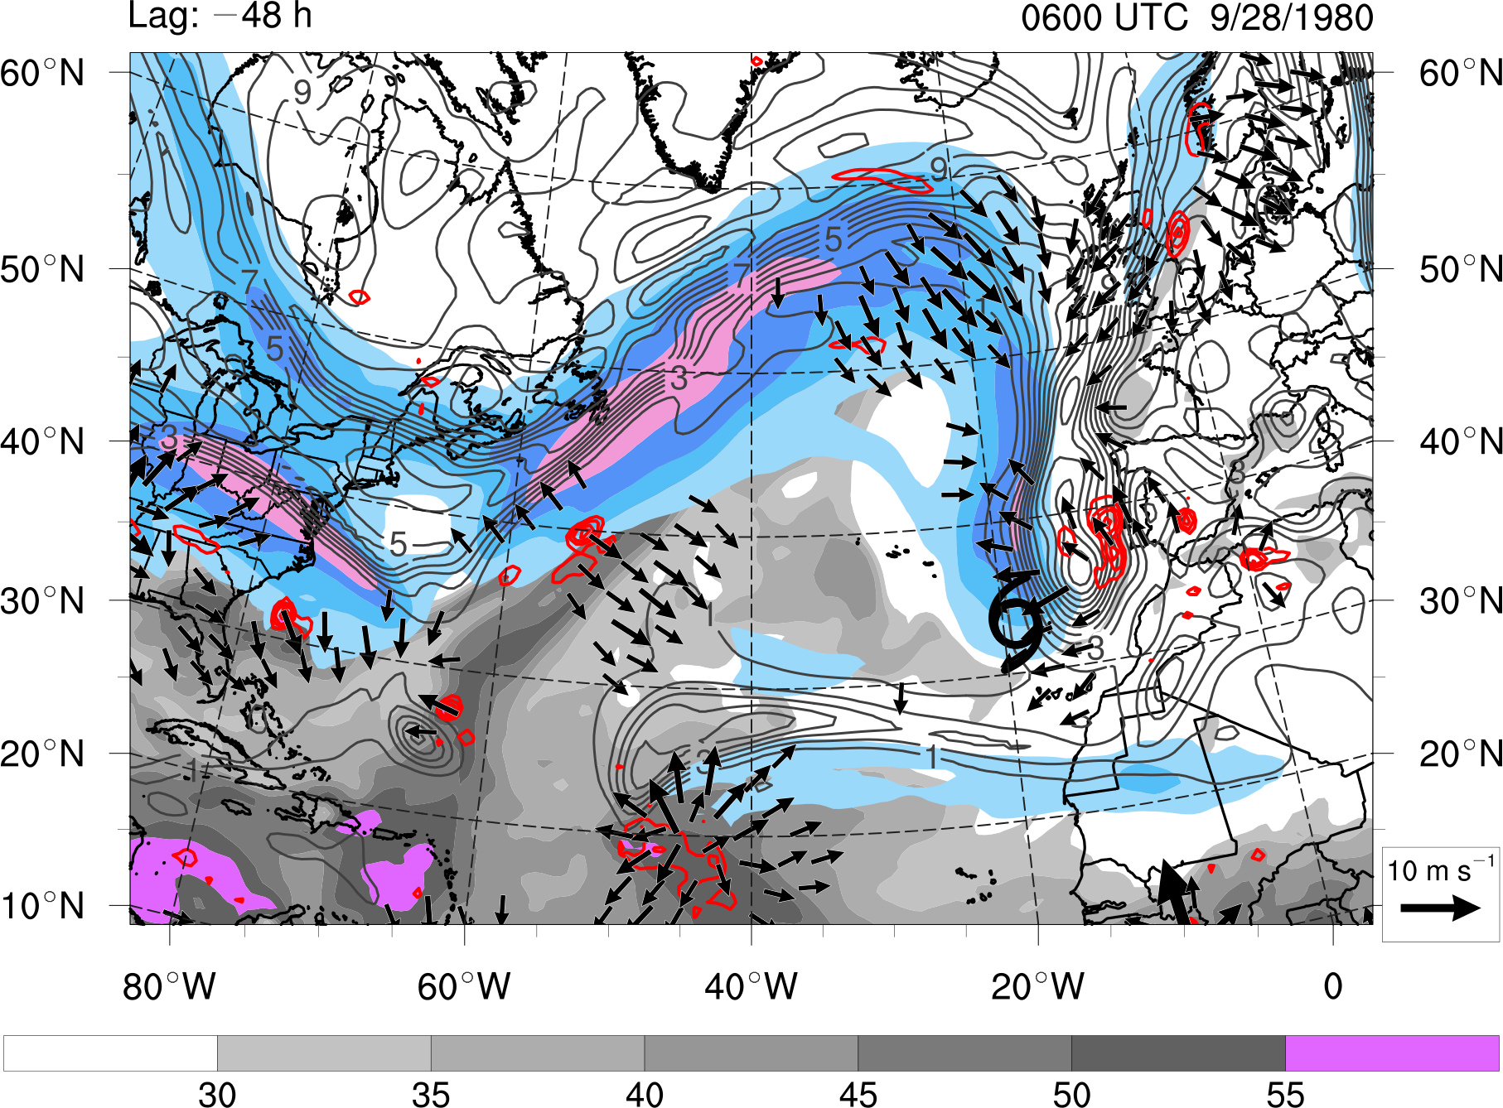
Case Study: Cutoff
30 35 40 45 50 55
mm
30 40 50 60
m s⁻¹
STC
at t₀
t₀ − 48 h
0600 UTC 28 SEP 1980
Precipitable water (gray shading, mm), 200-hPa PV (gray contours, PVU) and wind speed (shaded, m s⁻¹),
600–400-hPa layer-averaged ascent (red contours, every 5 × 10⁻³ hPa s⁻¹), and
300–200-hPa layer-averaged irrotational wind (vectors, starting at 4 m s⁻¹)
Notes:
Caveat: Size of the cyclone matters when applying Davis (2010)…
Size of surface disturbance compared to upper-tropospheric cold anomaly important for

Slide 77
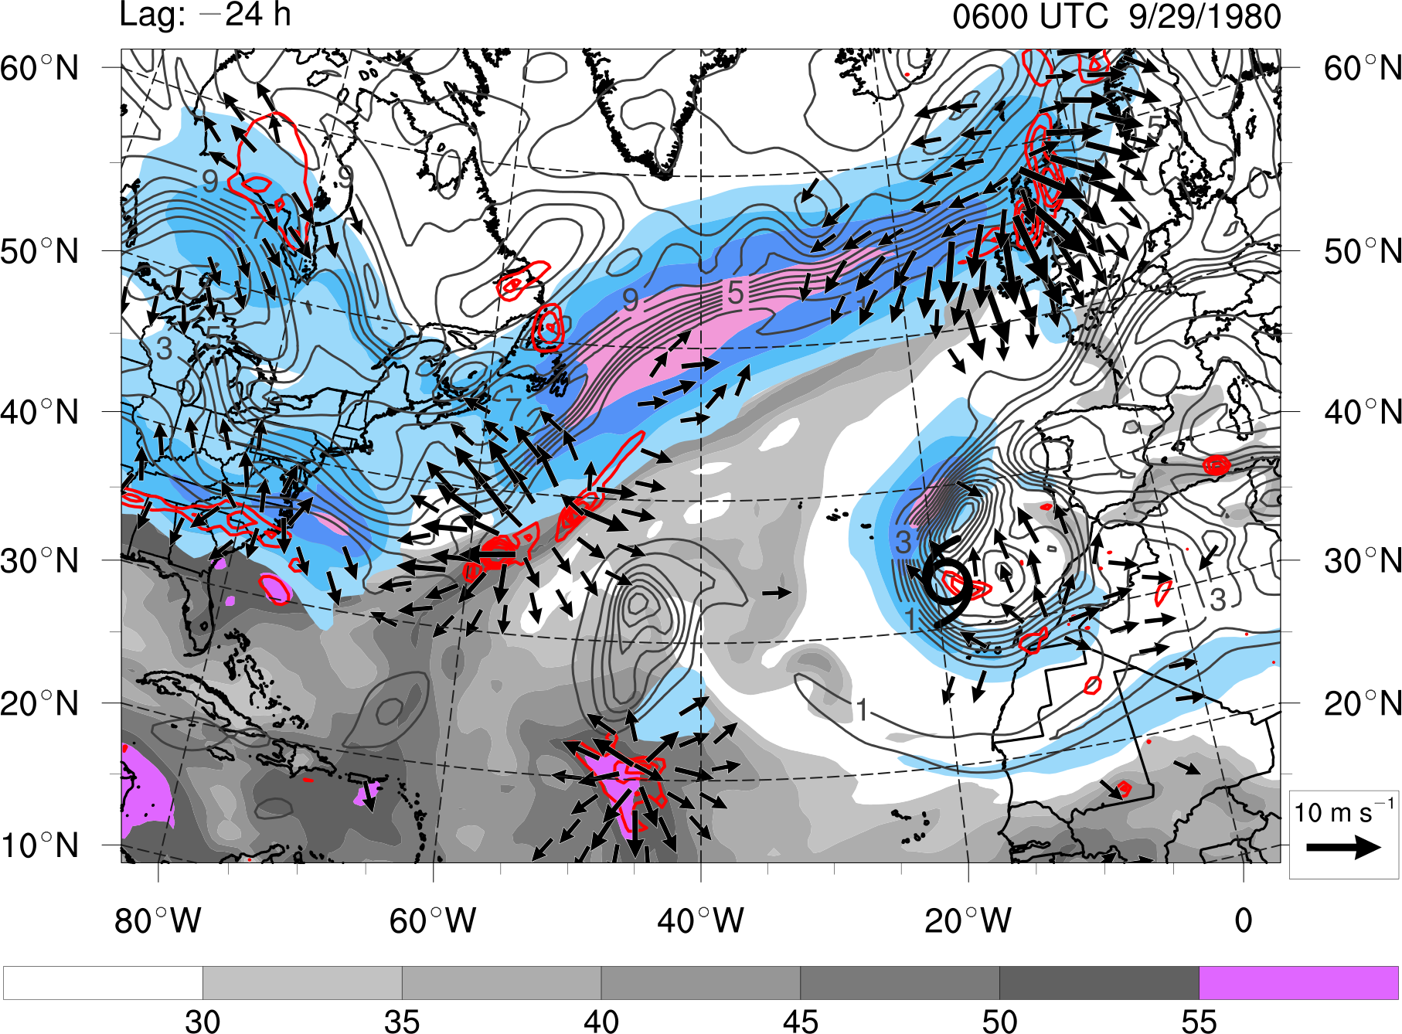
Case Study: Cutoff
30 35 40 45 50 55
mm
30 40 50 60
m s⁻¹
STC
at t₀
t₀ − 24 h
0600 UTC 29 SEP 1980
Precipitable water (gray shading, mm), 200-hPa PV (gray contours, PVU) and wind speed (shaded, m s⁻¹),
600–400-hPa layer-averaged ascent (red contours, every 5 × 10⁻³ hPa s⁻¹), and
300–200-hPa layer-averaged irrotational wind (vectors, starting at 4 m s⁻¹)
Notes:
Caveat: Size of the cyclone matters when applying Davis (2010)…
Size of surface disturbance compared to upper-tropospheric cold anomaly important for

Slide 78

Case Study: Cutoff
30 35 40 45 50 55
mm
30 40 50 60
m s⁻¹
STC
at t₀
t₀
0600 UTC 30 SEP 1980
Precipitable water (gray shading, mm), 200-hPa PV (gray contours, PVU) and wind speed (shaded, m s⁻¹),
600–400-hPa layer-averaged ascent (red contours, every 5 × 10⁻³ hPa s⁻¹), and
300–200-hPa layer-averaged irrotational wind (vectors, starting at 4 m s⁻¹)
Notes:
Caveat: Size of the cyclone matters when applying Davis (2010)…
Size of surface disturbance compared to upper-tropospheric cold anomaly important for

Slide 79
Conclusions
Adapted Davis (2010) methodology refined and used to construct STC climatology (1979–2010)
STC climatology revealed that intraseasonal variability is
associated with the location and frequency of STC formation
STC formation primarily occurs over the southern Gulf Stream
and western Caribbean Sea during April–July and expands over
the central and eastern North Atlantic during August–December
STC formation occurs most frequently during September–October, with a secondary peak in June
Notes:
2) That is similar, but not identical, to the intraseasonal variability associated to TC formation

Slide 80
Conclusions
PV streamers, cutoffs, midlatitude troughs, subtropical disturbances, and PV debris are the most common upper-tropospheric features linked to STC formation
A variety of upper-tropospheric features can be linked to STC formation within each of the development pathways identified
in McTaggart-Cowan et al. (2013)
Cyclone-relative composite analysis revealed that STC formation can be associated with AWB events in the midlatitudes that inject regions of relatively high upper-tropospheric PV into the subtropics
Notes:
2) That is similar, but not identical, to the intraseasonal variability associated to TC formation

Slide 81
Conclusions
(a)
t₀ − 96 h
Conceptual Model
(Cutoff)
L
1500 km
Key
1500 km
(b)
t₀ − 48 h
PV contour on the
350 K isentropic surface
upper-tropospheric jet
anticyclonic wave breaking
300–200-hPa layer-averaged
irrotational wind
precipitable water
500-hPa ascent
L
AWB
AWB
1500 km
1500 km
(c)
t₀
AWB
1500 km
1500 km
Notes:
Caveat: Size of the cyclone matters when applying Davis (2010)…
Size of surface disturbance compared to upper-tropospheric cold anomaly important for

Slide 82

Thank you!
Hurricane Danny (20 July 1997)
My Family
Dan and Lance
Our Support Staff
My Classmates
Kyle, Kristen, and Larry
Notes:
Caveat: Size of the cyclone matters when applying Davis (2010)…
Size of surface disturbance compared to upper-tropospheric cold anomaly important for

Slide 83
Thank you!
Hurricane Danny (20 July 1997)
My Family
Dan and Lance
Our Support Staff
My Classmates
Kyle, Kristen, and Larry
Questions?
Notes:
Caveat: Size of the cyclone matters when applying Davis (2010)…
Size of surface disturbance compared to upper-tropospheric cold anomaly important for

