Slide 1

Subtropical Cyclones
Diabatic
Energy Sources
TCs
Subtropical cyclones
Frontal cyclones
Baroclinic
Energy Sources
Adapted from Fig. 9 in Beven (2012)
30th Conference on Hurricanes and Tropical Meteorology
Notes:
Say wind speed criteria for a subtropical storm but also then the wind speed for a subtropical depression

Slide 2
Adapted Davis (2010) Methodology
Davis (2010) methodology:
  Based on Ertel potential vorticity (PV)
  Formulated in terms of two PV metrics that quantify the relative contributions of baroclinic processes and condensation heating to the evolution of individual cyclones
Davis (2010) methodology is similar to Hart (2003) cyclone phase space diagrams
Notes:
Say wind speed criteria for a subtropical storm but also then the wind speed for a subtropical depression

Slide 3
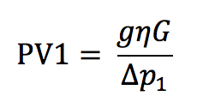




Adapted Davis (2010) Methodology
absolute vorticity
Lower-tropospheric
baroclinic processes:
(near-surface potential
temperature anomaly)
425 hPa
Length of 6° box centered on cyclone
Potential temperature anomaly
Notes:
Say wind speed criteria for a subtropical storm but also then the wind speed for a subtropical depression

Slide 4
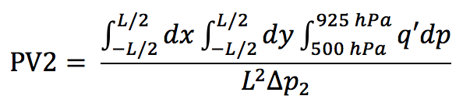

Adapted Davis (2010) Methodology
absolute vorticity
Lower-tropospheric
baroclinic processes:
(near-surface potential
temperature anomaly)
Midtropospheric
latent heat release:
(interior PV anomaly)
425 hPa
Length of 6° box centered on cyclone
Potential temperature anomaly
Ertel PV anomaly
PV1/PV2 : measure of the contribution of lower-tropospheric
baroclinic processes relative to the contribution of condensation heating
Notes:
Say wind speed criteria for a subtropical storm but also then the wind speed for a subtropical depression

Slide 5
Adapted Davis (2010) Methodology
200 hPa
925 hPa
Notes:
Say wind speed criteria for a subtropical storm but also then the wind speed for a subtropical depression

Slide 6
Adapted Davis (2010) Methodology
Lower-tropospheric
baroclinic processes:
(near-surface potential
temperature anomaly)
200 hPa
925 hPa
Lower-tropospheric
baroclinic processes (PV1)
Notes:
Say wind speed criteria for a subtropical storm but also then the wind speed for a subtropical depression

Slide 7
Adapted Davis (2010) Methodology
Lower-tropospheric
baroclinic processes:
(near-surface potential
temperature anomaly)
Midtropospheric
latent heat release:
(interior PV anomaly)
200 hPa
925 hPa
Lower-tropospheric
baroclinic processes (PV1)
Notes:
Say wind speed criteria for a subtropical storm but also then the wind speed for a subtropical depression

Slide 8
Adapted Davis (2010) Methodology
Lower-tropospheric
baroclinic processes:
(near-surface potential
temperature anomaly)
Midtropospheric
latent heat release:
(interior PV anomaly)
200 hPa
500 hPa
Midtropospheric
latent heat release
(PV2)
925 hPa
Lower-tropospheric
baroclinic processes (PV1)
PV1/PV2 : measure of the contribution of lower-tropospheric
baroclinic processes relative to the contribution of condensation heating
Notes:
Say wind speed criteria for a subtropical storm but also then the wind speed for a subtropical depression

Slide 9
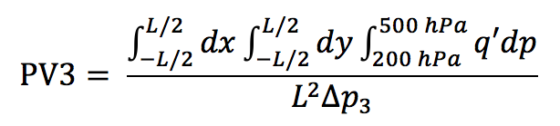

Adapted Davis (2010) Methodology
Additional metric introduced to diagnose upper-tropospheric dynamical processes
Upper-tropospheric
dynamical processes:
(upper-tropospheric
PV anomaly)
Ertel PV anomaly
300 hPa
Length of 6° box centered on cyclone
Notes:
Say wind speed criteria for a subtropical storm but also then the wind speed for a subtropical depression

Slide 10
Adapted Davis (2010) Methodology
Lower-tropospheric
baroclinic processes:
(near-surface potential
temperature anomaly)
Midtropospheric
latent heat release:
(interior PV anomaly)
200 hPa
500 hPa
Midtropospheric
latent heat release
(PV2)
925 hPa
Lower-tropospheric
baroclinic processes (PV1)
PV1/PV2 : measure of the contribution of lower-tropospheric
baroclinic processes relative to the contribution of condensation heating
Notes:
Say wind speed criteria for a subtropical storm but also then the wind speed for a subtropical depression

Slide 11
Adapted Davis (2010) Methodology
Lower-tropospheric
baroclinic processes:
(near-surface potential
temperature anomaly)
Midtropospheric
latent heat release:
(interior PV anomaly)
Upper-tropospheric
dynamical processes:
(upper-tropospheric
PV anomaly)
Upper-
tropospheric
dynamical processes
(PV3)
200 hPa
500 hPa
Midtropospheric
latent heat release
(PV2)
925 hPa
Lower-tropospheric
baroclinic processes (PV1)
PV1/PV2 : measure of the contribution of lower-tropospheric
baroclinic processes relative to the contribution of condensation heating
Notes:
Say wind speed criteria for a subtropical storm but also then the wind speed for a subtropical depression

Slide 12
Adapted Davis (2010) Methodology
Upper-
tropospheric
dynamical processes
(PV3)
200 hPa
Calculated from the
0.5° Climate Forecast
System Reanalysis
V2 dataset
500 hPa
Midtropospheric
latent heat release
(PV2)
925 hPa
Lower-tropospheric
baroclinic processes (PV1)
PV1/PV2 : measure of the contribution of lower-tropospheric
baroclinic processes relative to the contribution of condensation heating
Notes:
Say wind speed criteria for a subtropical storm but also then the wind speed for a subtropical depression

Slide 13
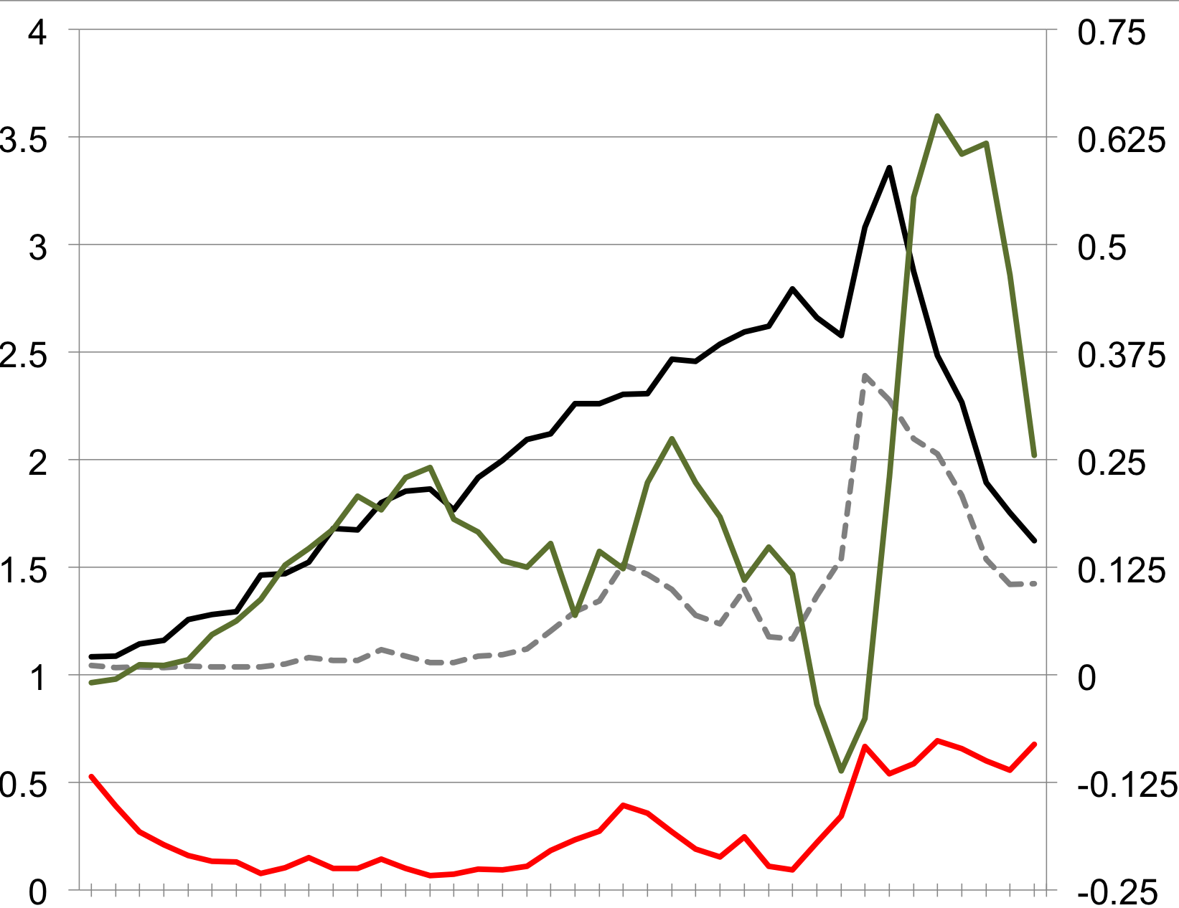
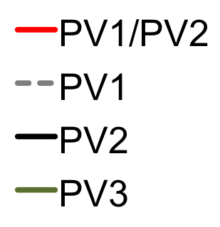
Hurricane Sandy: 6° × 6° box,
NHC Best Track
Peaks in PV3
PV1/PV2
PVU
22 October
23 October
24 October
25 October
26 October
27 October
28 October
29 October
30 October
31 October

Slide 14
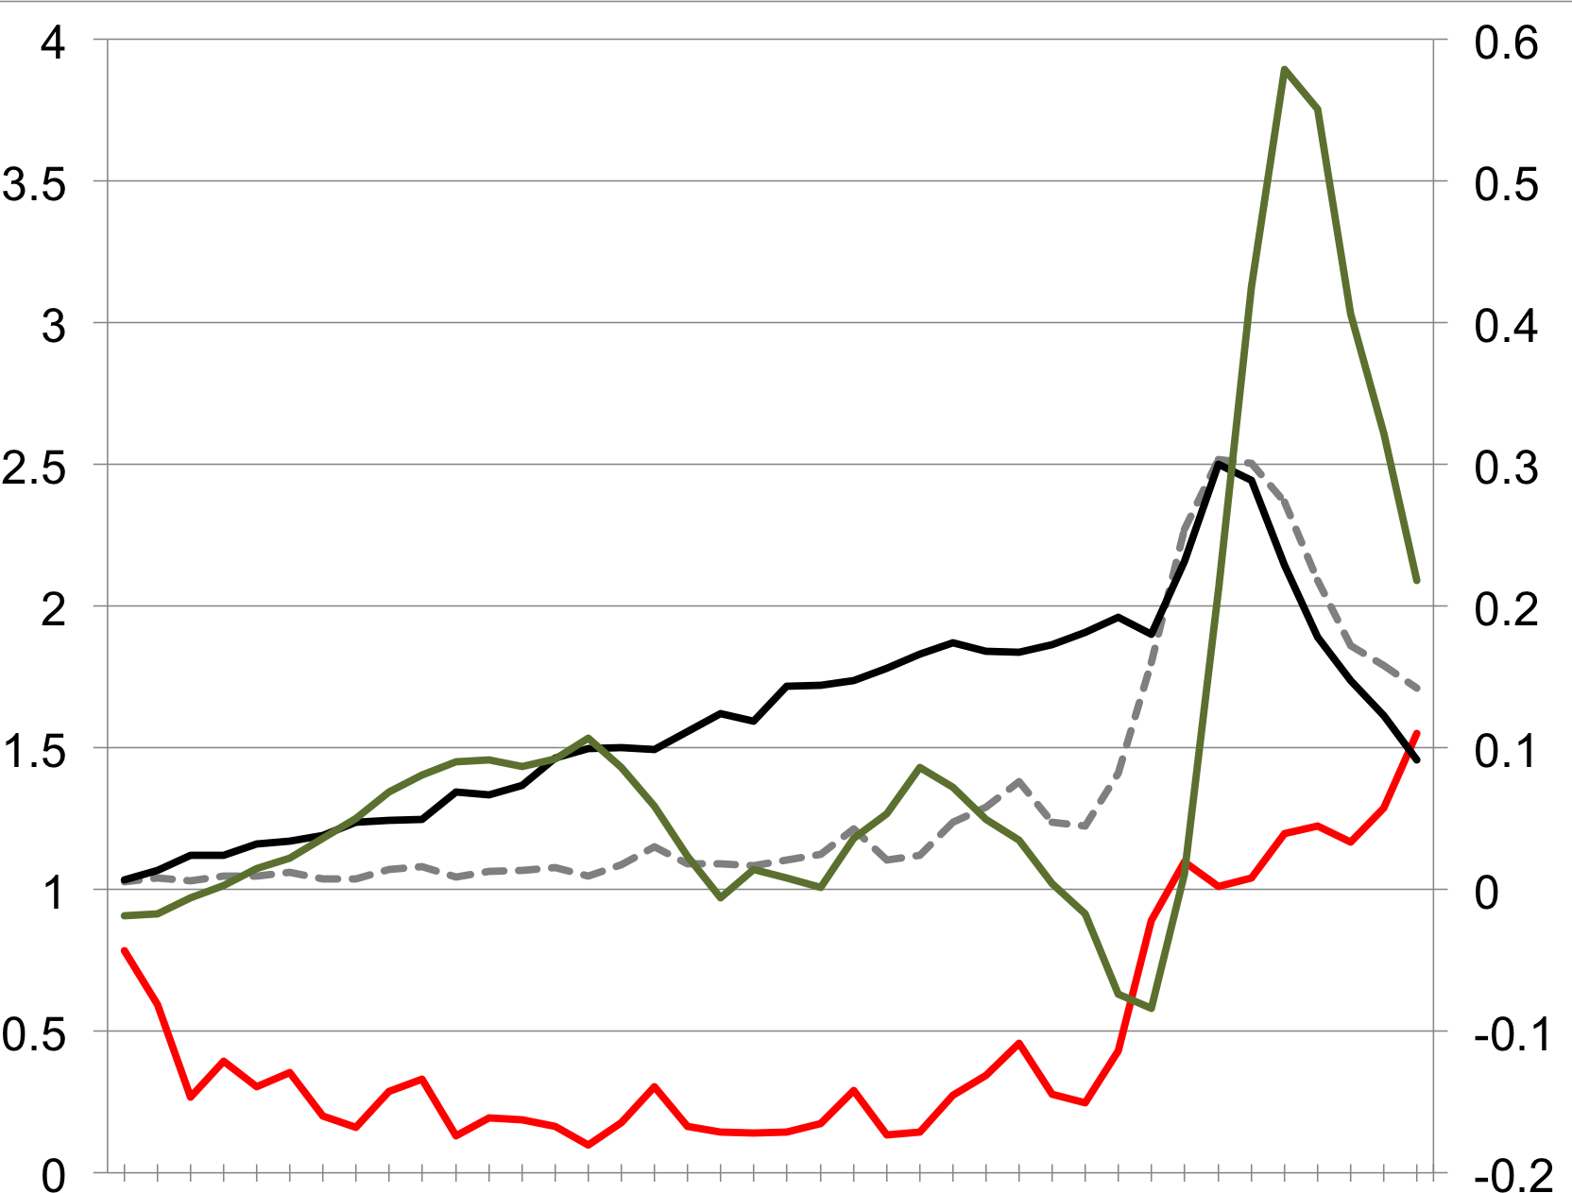
Hurricane Sandy: 10° × 10° box,
NHC Best Track
Peaks in PV3
PV1/PV2
PVU
22 October
23 October
24 October
25 October
26 October
27 October
28 October
29 October
30 October
31 October

Slide 15
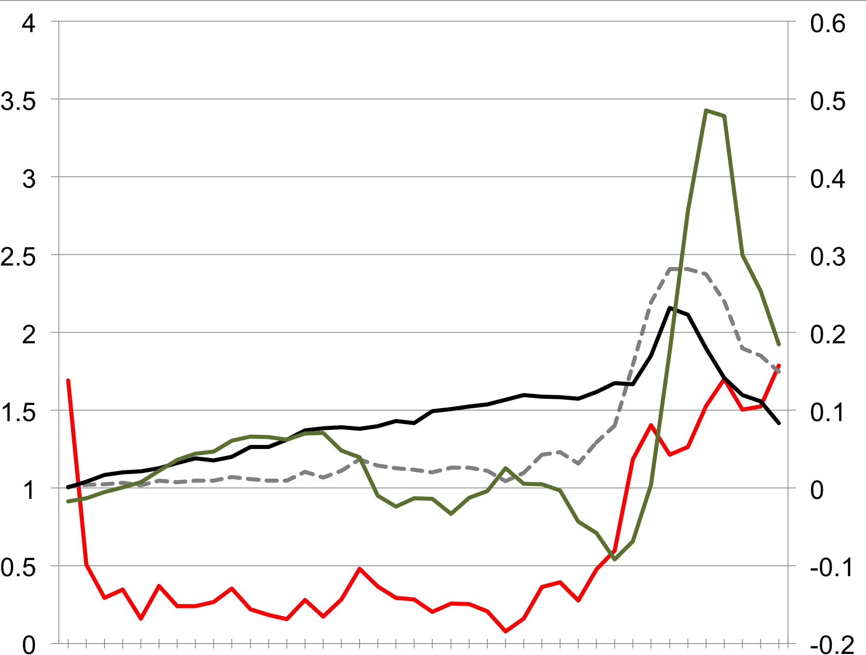
Hurricane Sandy: 12° × 12° box,
NHC Best Track
Peaks in PV3
PV1/PV2
PVU
22 October
23 October
24 October
25 October
26 October
27 October
28 October
29 October
30 October
31 October

Slide 16
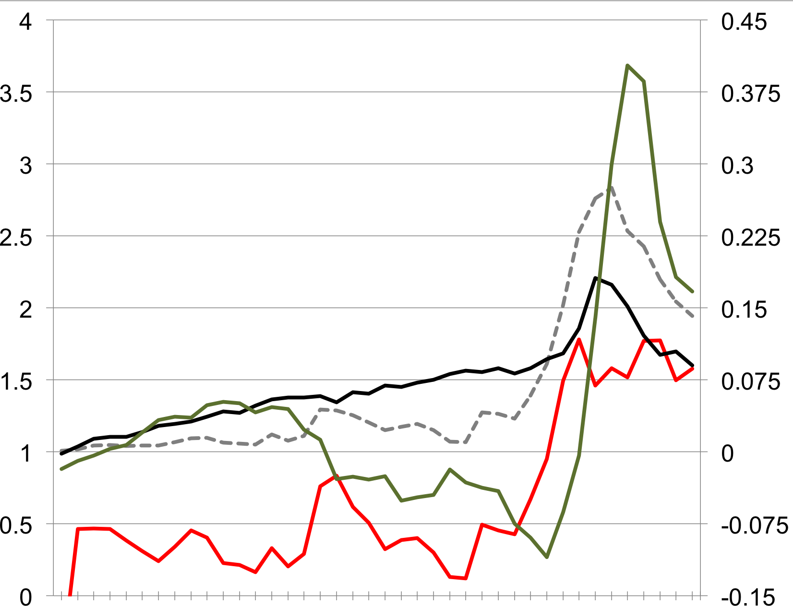
Hurricane Sandy: 14° × 14° box,
NHC Best Track
Peaks in PV3
PV1/PV2
PVU
22 October
23 October
24 October
25 October
26 October
27 October
28 October
29 October
30 October
31 October

Slide 17
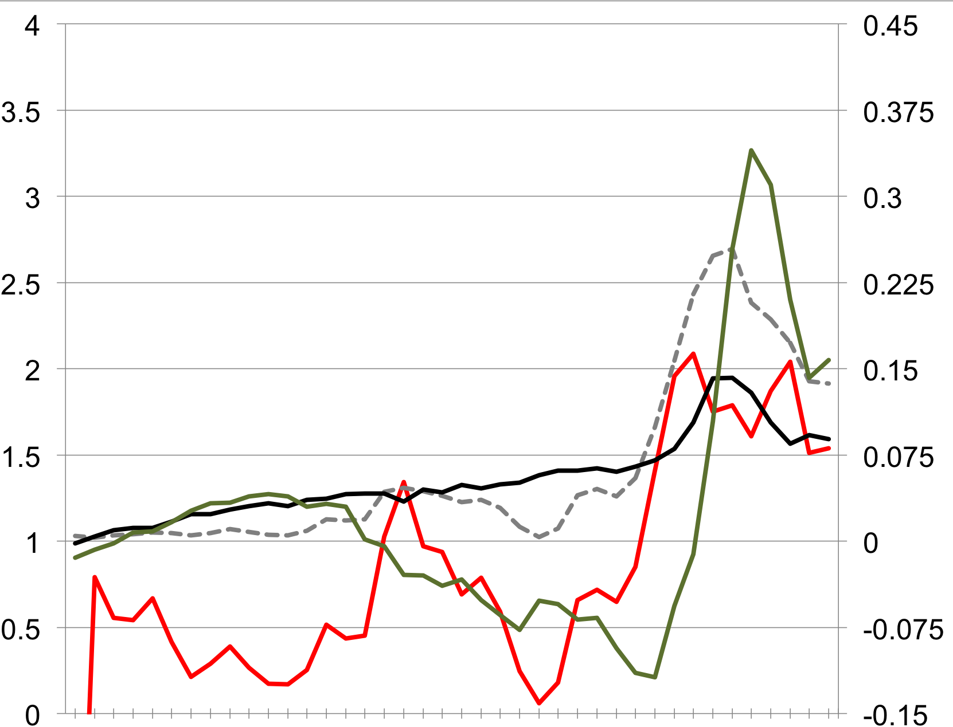
Hurricane Sandy: 16° × 16° box,
NHC Best Track
Peaks in PV3
PV1/PV2
PVU
22 October
23 October
24 October
25 October
26 October
27 October
28 October
29 October
30 October
31 October

Slide 18
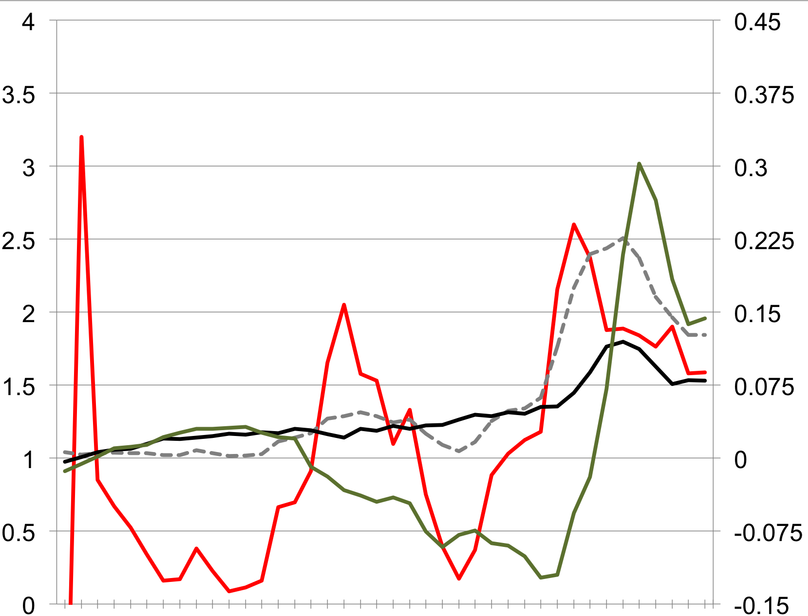
Hurricane Sandy: 18° × 18° box,
NHC Best Track
Peaks in PV3
PV1/PV2
PVU
22 October
23 October
24 October
25 October
26 October
27 October
28 October
29 October
30 October
31 October

Slide 19
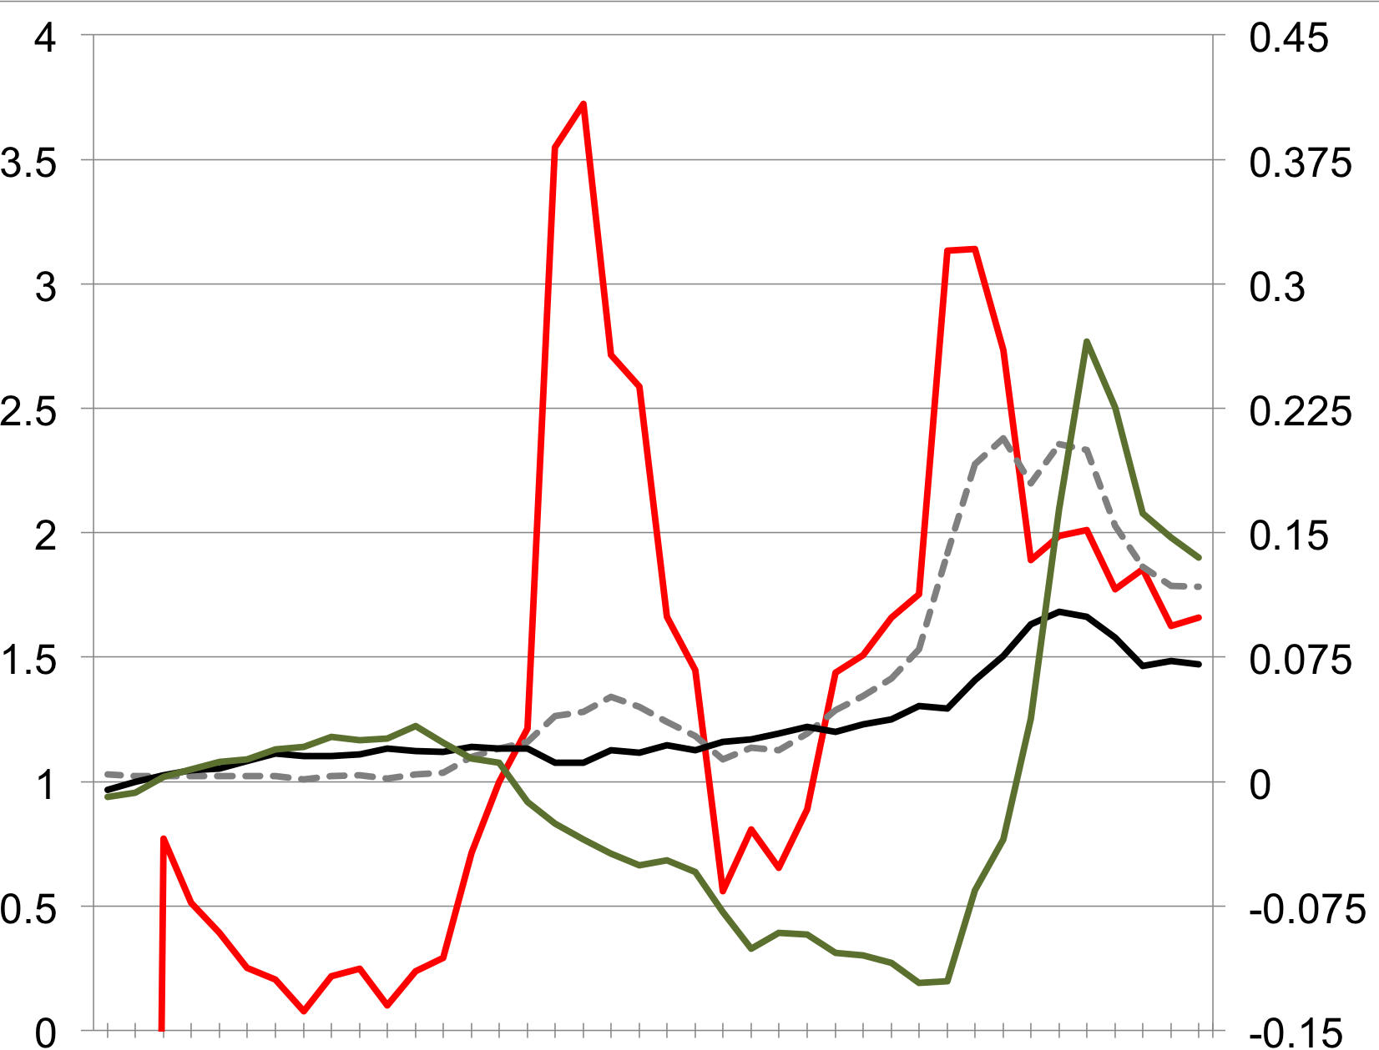
Hurricane Sandy: 20° × 20° box,
NHC Best Track
Peaks in PV3
PV1/PV2
PVU
22 October
23 October
24 October
25 October
26 October
27 October
28 October
29 October
30 October
31 October

Slide 20
Adapted Davis (2010) Methodology
Lower-tropospheric
baroclinic processes:
(near-surface potential
temperature anomaly)
Midtropospheric
latent heat release:
(interior PV anomaly)
Upper-tropospheric
dynamical processes:
(upper-tropospheric
PV anomaly)
Upper-
tropospheric
dynamical processes
(PV3)
200 hPa
500 hPa
Midtropospheric
latent heat release
(PV2)
925 hPa
Lower-tropospheric
baroclinic processes (PV1)
PV1/PV2 : measure of the contribution of lower-tropospheric
baroclinic processes relative to the contribution of condensation heating
Notes:
Say wind speed criteria for a subtropical storm but also then the wind speed for a subtropical depression

Slide 21
Adapted Davis (2010) Methodology
Lower-tropospheric
baroclinic processes:
(near-surface potential
temperature anomaly)
Midtropospheric
latent heat release:
(interior PV anomaly)
Upper-tropospheric
dynamical processes:
(upper-tropospheric
PV anomaly)
Upper-
tropospheric
dynamical processes
(PV3)
200 hPa
300 hPa
Midtropospheric
latent heat release
(PV2)
925 hPa
Lower-tropospheric
baroclinic processes (PV1)
PV1/PV2 : measure of the contribution of lower-tropospheric
baroclinic processes relative to the contribution of condensation heating
Notes:
Say wind speed criteria for a subtropical storm but also then the wind speed for a subtropical depression

Slide 22
Hurricane Sandy: 6° × 6° box,
500 hPa, NHC Best Track
Peaks in PV3
PV1/PV2
PVU
22 October
23 October
24 October
25 October
26 October
27 October
28 October
29 October
30 October
31 October

Slide 23
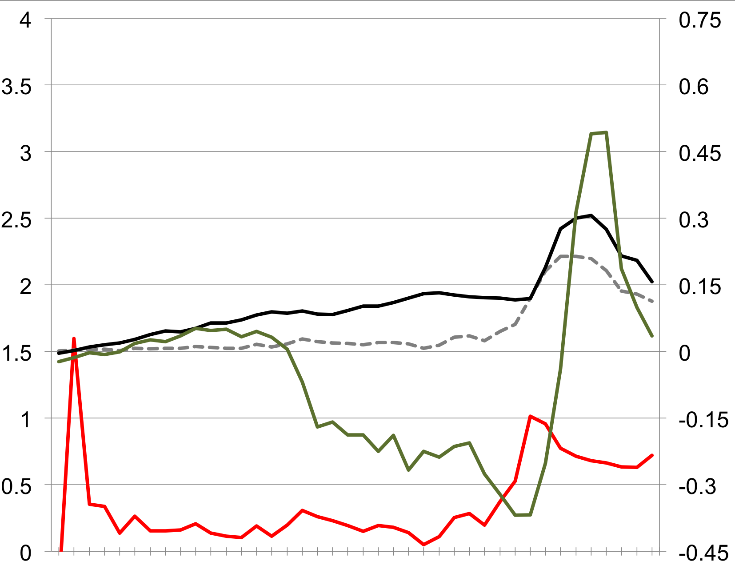
Hurricane Sandy: 6° × 6° box,
300 hPa, NHC Best Track
Peaks in PV3
PV1/PV2
PVU
22 October
23 October
24 October
25 October
26 October
27 October
28 October
29 October
30 October
31 October

Slide 24
Adapted Davis (2010) Methodology
Lower-tropospheric
baroclinic processes:
(near-surface potential
temperature anomaly)
Midtropospheric
latent heat release:
(interior PV anomaly)
Upper-tropospheric
dynamical processes:
(upper-tropospheric
PV anomaly)
Upper-
tropospheric
dynamical processes
(PV3)
200 hPa
300 hPa
Midtropospheric
latent heat release
(PV2)
925 hPa
Lower-tropospheric
baroclinic processes (PV1)
PV1/PV2 : measure of the contribution of lower-tropospheric
baroclinic processes relative to the contribution of condensation heating
Notes:
Say wind speed criteria for a subtropical storm but also then the wind speed for a subtropical depression

Slide 25
Adapted Davis (2010) Methodology
Upper-
tropospheric
dynamical processes
(PV3)
200 hPa
Calculated from the
0.5° Climate Forecast
System Reanalysis
V2 dataset
500 hPa
Midtropospheric
latent heat release
(PV2)
925 hPa
Lower-tropospheric
baroclinic processes (PV1)
PV1/PV2 : measure of the contribution of lower-tropospheric
baroclinic processes relative to the contribution of condensation heating
Notes:
Say wind speed criteria for a subtropical storm but also then the wind speed for a subtropical depression

