Slide 1
1200 UTC 17 October 2012
1200 UTC 19 October 2012
Precipitable water (shaded, mm); 700-hPa wind speed (barbs, kts), temperature (dashed red contours, °C), and geopotential height (black solid contours, dam)

Slide 2
1200 UTC 21 October 2012
1200 UTC 23 October 2012
Precipitable water (shaded, mm); 700-hPa wind speed (barbs, kts), temperature (dashed red contours, °C), and geopotential height (black solid contours, dam)

Slide 3
1200 UTC 17 October 2012
10.0 m s⁻¹
Dynamic tropopause (DT, 1.5-PVU surface) potential temperature (shaded, K) and wind (barbs, kts), 925–850-hPa layer-averaged cyclonic relative vorticity (black contours every 0.5 × 10⁻⁴ s⁻¹)
250-hPa wind speed (shaded, m s⁻¹), 300–200-hPa layer-averaged PV (gray contours, PVU), PW (gray scale, mm), 600–400-hPa layer-averaged ascent (red contours every 5.0 × 10⁻³ hPa s⁻¹), 250-hPa irrotational wind (vectors, m s⁻¹)

Slide 4
0000 UTC 21 October 2012
10.0 m s⁻¹
Dynamic tropopause (DT, 1.5-PVU surface) potential temperature (shaded, K) and wind (barbs, kts), 925–850-hPa layer-averaged cyclonic relative vorticity (black contours every 0.5 × 10⁻⁴ s⁻¹)
250-hPa wind speed (shaded, m s⁻¹), 300–200-hPa layer-averaged PV (gray contours, PVU), PW (gray scale, mm), 600–400-hPa layer-averaged ascent (red contours every 5.0 × 10⁻³ hPa s⁻¹), 250-hPa irrotational wind (vectors, m s⁻¹)

Slide 5
1200 UTC 24 October 2012
10.0 m s⁻¹
Dynamic tropopause (DT, 1.5-PVU surface) potential temperature (shaded, K) and wind (barbs, kts), 925–850-hPa layer-averaged cyclonic relative vorticity (black contours every 0.5 × 10⁻⁴ s⁻¹)
250-hPa wind speed (shaded, m s⁻¹), 300–200-hPa layer-averaged PV (gray contours, PVU), PW (gray scale, mm), 600–400-hPa layer-averaged ascent (red contours every 5.0 × 10⁻³ hPa s⁻¹), 250-hPa irrotational wind (vectors, m s⁻¹)

Slide 6
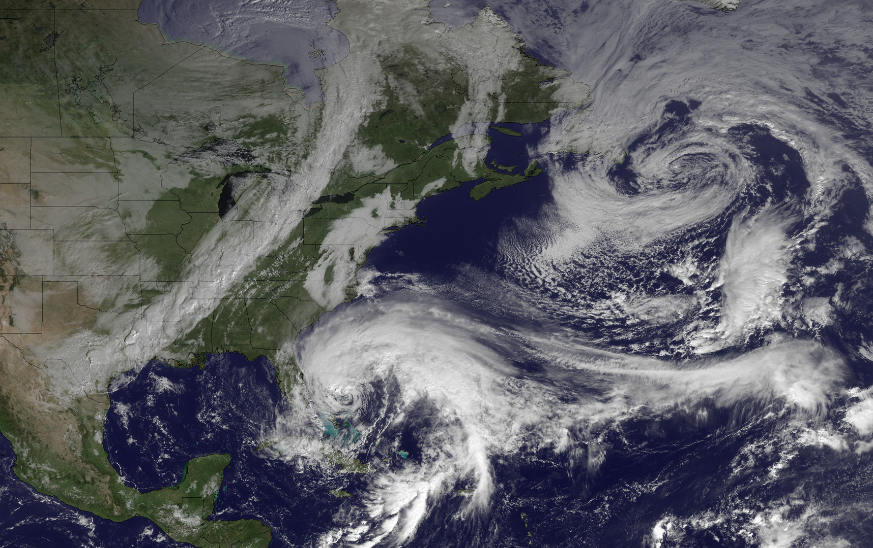
1445 UTC 26 October 2012
Image courtesy of the NOAA’s Environmental Visualization Laboratory

Slide 7
0000 UTC 27 October 2012
10.0 m s⁻¹
Dynamic tropopause (DT, 1.5-PVU surface) potential temperature (shaded, K) and wind (barbs, kts), 925–850-hPa layer-averaged cyclonic relative vorticity (black contours every 0.5 × 10⁻⁴ s⁻¹)
250-hPa wind speed (shaded, m s⁻¹), 300–200-hPa layer-averaged PV (gray contours, PVU), PW (gray scale, mm), 600–400-hPa layer-averaged ascent (red contours every 5.0 × 10⁻³ hPa s⁻¹), 250-hPa irrotational wind (vectors, m s⁻¹)

Slide 8
0000 UTC 28 October 2012
10.0 m s⁻¹
Dynamic tropopause (DT, 1.5-PVU surface) potential temperature (shaded, K) and wind (barbs, kts), 925–850-hPa layer-averaged cyclonic relative vorticity (black contours every 0.5 × 10⁻⁴ s⁻¹)
250-hPa wind speed (shaded, m s⁻¹), 300–200-hPa layer-averaged PV (gray contours, PVU), PW (gray scale, mm), 600–400-hPa layer-averaged ascent (red contours every 5.0 × 10⁻³ hPa s⁻¹), 250-hPa irrotational wind (vectors, m s⁻¹)

Slide 9
0000 UTC 29 October 2012
10.0 m s⁻¹
Dynamic tropopause (DT, 1.5-PVU surface) potential temperature (shaded, K) and wind (barbs, kts), 925–850-hPa layer-averaged cyclonic relative vorticity (black contours every 0.5 × 10⁻⁴ s⁻¹)
250-hPa wind speed (shaded, m s⁻¹), 300–200-hPa layer-averaged PV (gray contours, PVU), PW (gray scale, mm), 600–400-hPa layer-averaged ascent (red contours every 5.0 × 10⁻³ hPa s⁻¹), 250-hPa irrotational wind (vectors, m s⁻¹)

Slide 10
1200 UTC 29 October 2012
10.0 m s⁻¹
Dynamic tropopause (DT, 1.5-PVU surface) potential temperature (shaded, K) and wind (barbs, kts), 925–850-hPa layer-averaged cyclonic relative vorticity (black contours every 0.5 × 10⁻⁴ s⁻¹)
250-hPa wind speed (shaded, m s⁻¹), 300–200-hPa layer-averaged PV (gray contours, PVU), PW (gray scale, mm), 600–400-hPa layer-averaged ascent (red contours every 5.0 × 10⁻³ hPa s⁻¹), 250-hPa irrotational wind (vectors, m s⁻¹)

Slide 11
0000 UTC 30 October 2012
10.0 m s⁻¹
Dynamic tropopause (DT, 1.5-PVU surface) potential temperature (shaded, K) and wind (barbs, kts), 925–850-hPa layer-averaged cyclonic relative vorticity (black contours every 0.5 × 10⁻⁴ s⁻¹)
250-hPa wind speed (shaded, m s⁻¹), 300–200-hPa layer-averaged PV (gray contours, PVU), PW (gray scale, mm), 600–400-hPa layer-averaged ascent (red contours every 5.0 × 10⁻³ hPa s⁻¹), 250-hPa irrotational wind (vectors, m s⁻¹)

Slide 12
HAZEL/1938-HURR

Slide 13
0000 UTC 15 October 1954
0000 UTC 16 October 1954
250-hPa wind speed (shaded, m s⁻¹), temperature (dashed red contours, °C), and geopotential height (black solid contours, dam)

Slide 14
0000 UTC 15 October 1954
0000 UTC 16 October 1954
250-hPa wind speed (shaded, m s⁻¹), 1000–500-hPa thickness (dashed red/blue contours, dam), and mean sea level pressure (black solid contours, hPa)

Slide 15
0000 UTC 15 October 1954
0000 UTC 16 October 1954
850-hPa frontogenesis [shaded, K (100 km) ⁻¹ (3 h) ⁻¹], temperature (dashed red contours, °C), and geopotential height (black solid contours, dam)

Slide 16
0000 UTC 21 September 1938
0000 UTC 22 September 1938
250-hPa wind speed (shaded, m s⁻¹), temperature (dashed red contours, °C), and geopotential height (black solid contours, dam)

Slide 17
0000 UTC 21 September 1938
0000 UTC 22 September 1938
250-hPa wind speed (shaded, m s⁻¹), 1000–500-hPa thickness (dashed red/blue contours, dam), and mean sea level pressure (black solid contours, hPa)

Slide 18
0000 UTC 21 September 1938
0000 UTC 22 September 1938
850-hPa frontogenesis [shaded, K (100 km) ⁻¹ (3 h) ⁻¹], temperature (dashed red contours, °C), and geopotential height (black solid contours, dam)

Slide 19
THAT WAS STUPID

