Slide 1
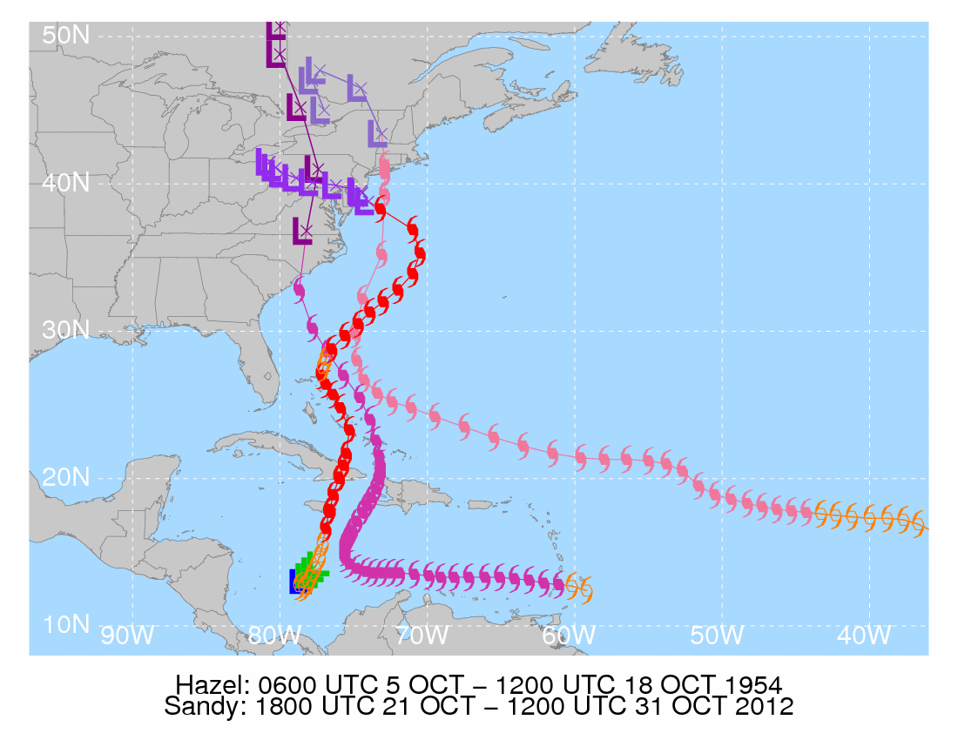
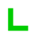
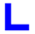

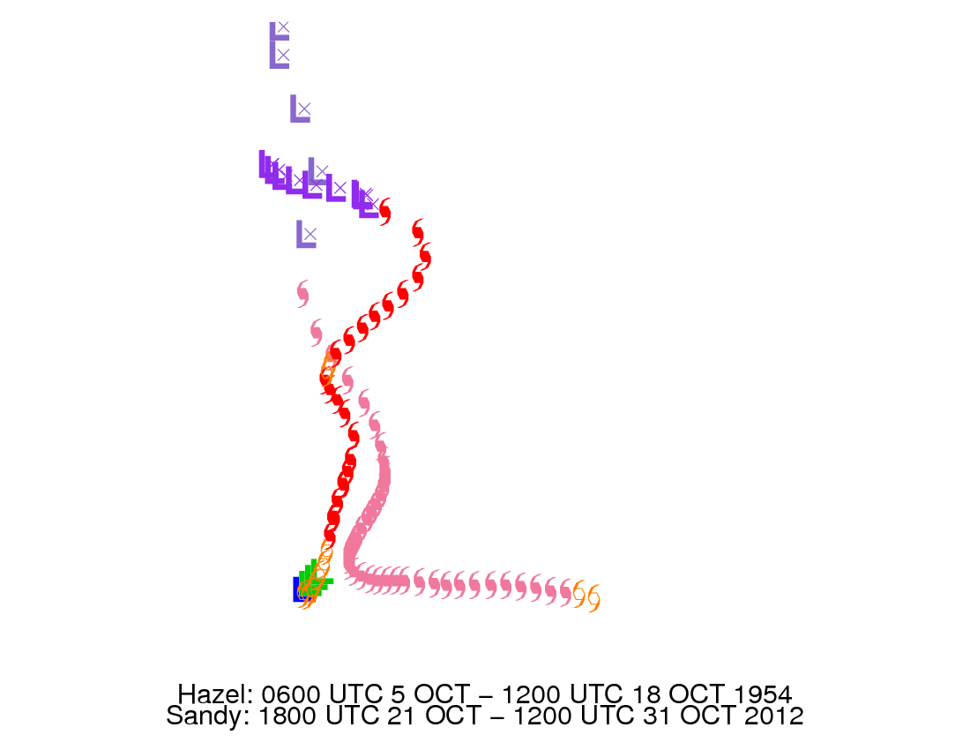
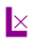

Low pressure
Tropical depression
Tropical storm
Hurricane (Sandy)
Hurricane (Hazel)
Hurricane (38-Hurr)
Extratropical (Sandy)
Extratropical (Hazel)
Extratropical (38-Hurr)
Sandy: 1800 UTC 21 October – 1200 UTC 31 October 2012
Hazel: 0600 UTC 5 October – 1200 UTC 18 October 1954
1938 New England Hurricane: 1200 UTC 9 September – 0000 UTC 23 September 1938

Slide 2
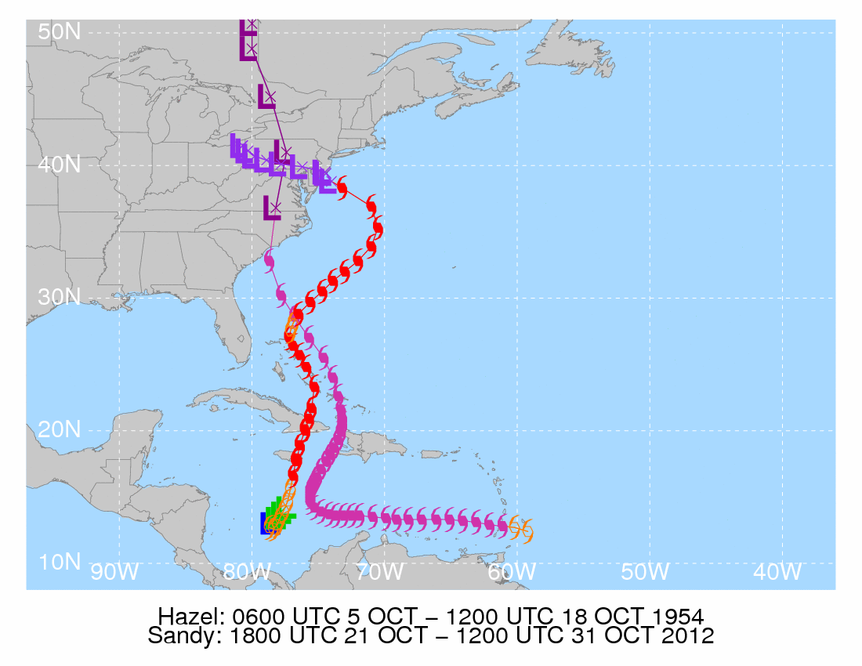



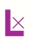
Low pressure
Tropical depression
Tropical storm
Hurricane (Sandy)
Hurricane (Hazel)
Extratropical (Sandy)
Extratropical (Hazel)
Sandy: 1800 UTC 21 October – 1200 UTC 31 October 2012
Hazel: 0600 UTC 5 October – 1200 UTC 18 October 1954

Slide 3
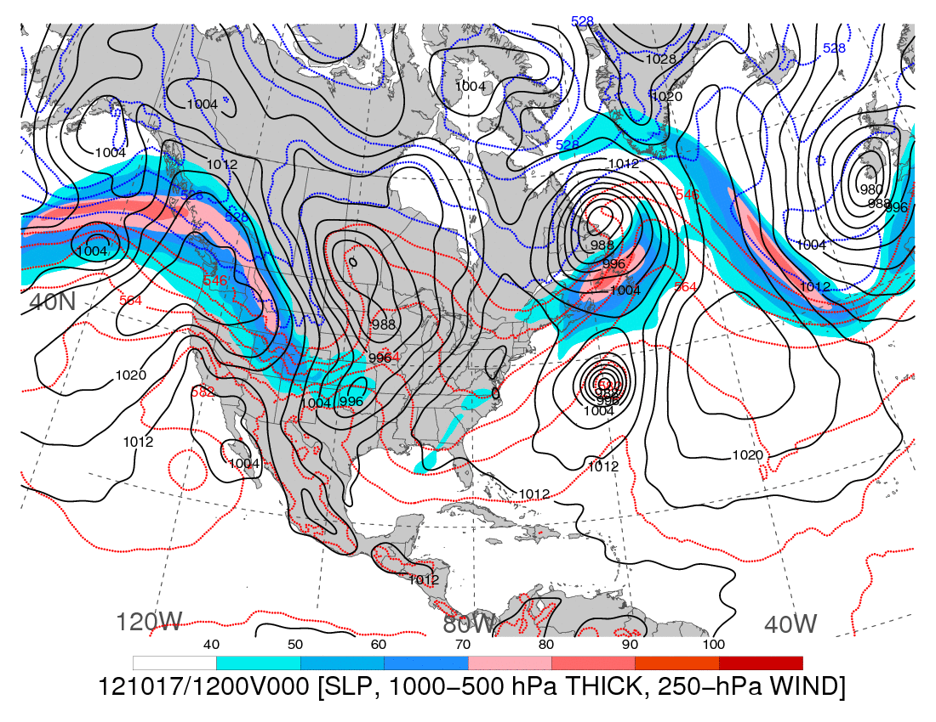
1200 UTC 17 October 2012
250-hPa wind speed (shaded, m s⁻¹), 1000–500-hPa thickness (dashed red/blue contours, dam),
and mean sea level pressure (black solid contours, hPa)

Slide 4
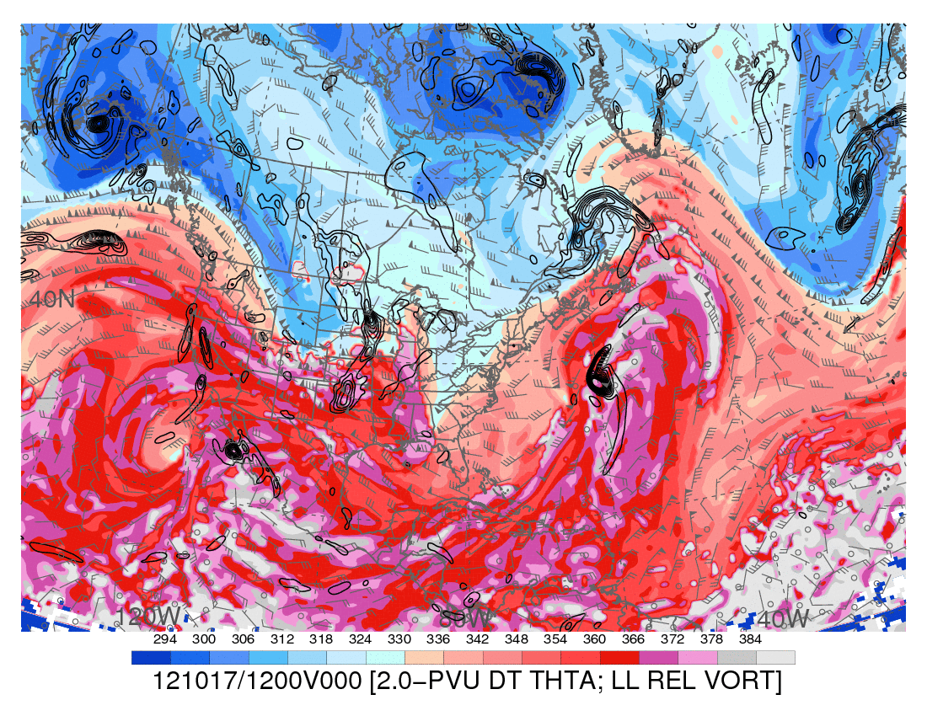
1200 UTC 17 October 2012
Dynamic tropopause (DT, 1.5-PVU surface) potential temperature (shaded, K) and wind (barbs, kts),
925–850-hPa layer-averaged cyclonic relative vorticity (black contours every 0.5 × 10⁻⁴ s⁻¹)

Slide 5
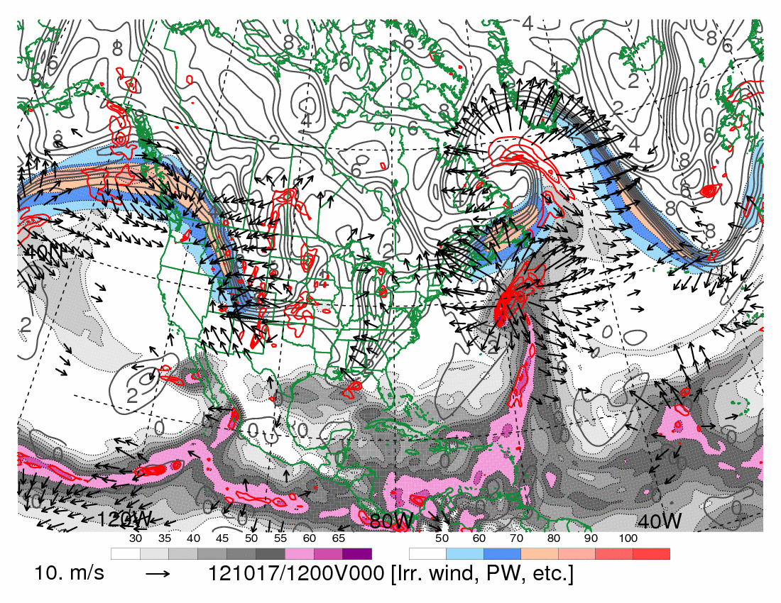
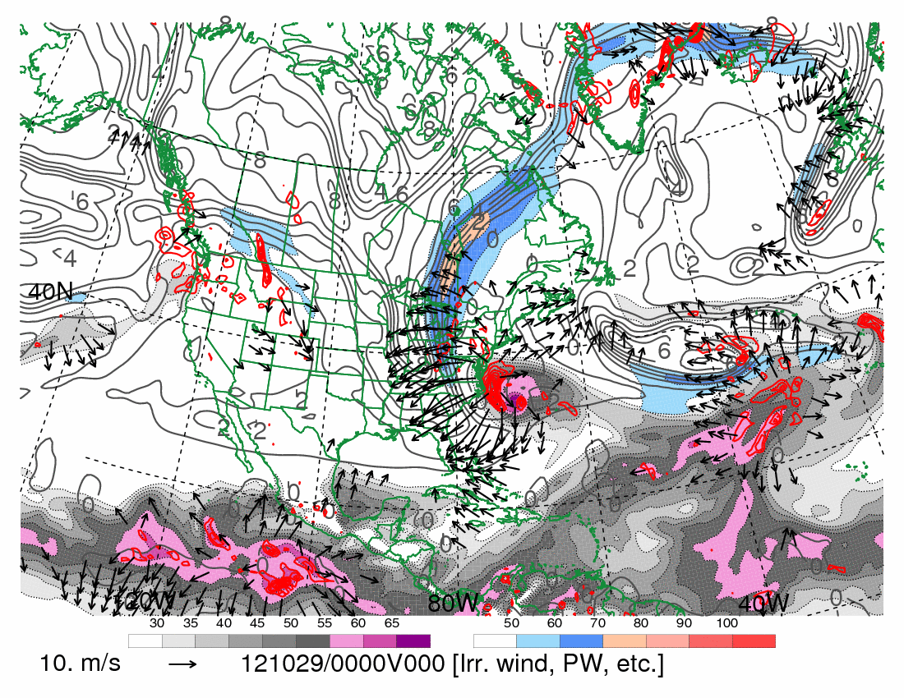
1200 UTC 17 October 2012
250-hPa wind speed (shaded, m s⁻¹), 300–200-hPa layer-averaged PV (gray contours every 1 PVU),
PW (shaded according to gray scale, mm), 600–400-hPa layer-averaged ascent (red contours every
5 × 10⁻³ hPa s⁻¹, negative values only), and 250-hPa irrotational wind (vectors starting at 5 m s⁻¹)

Slide 6
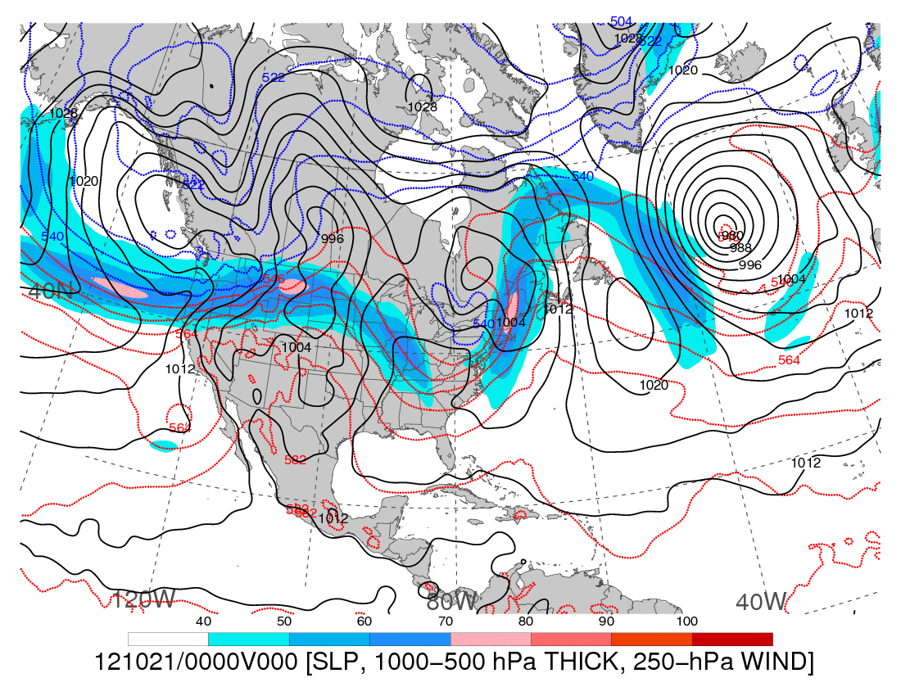
0000 UTC 21 October 2012
250-hPa wind speed (shaded, m s⁻¹), 1000–500-hPa thickness (dashed red/blue contours, dam),
and mean sea level pressure (black solid contours, hPa)

Slide 7
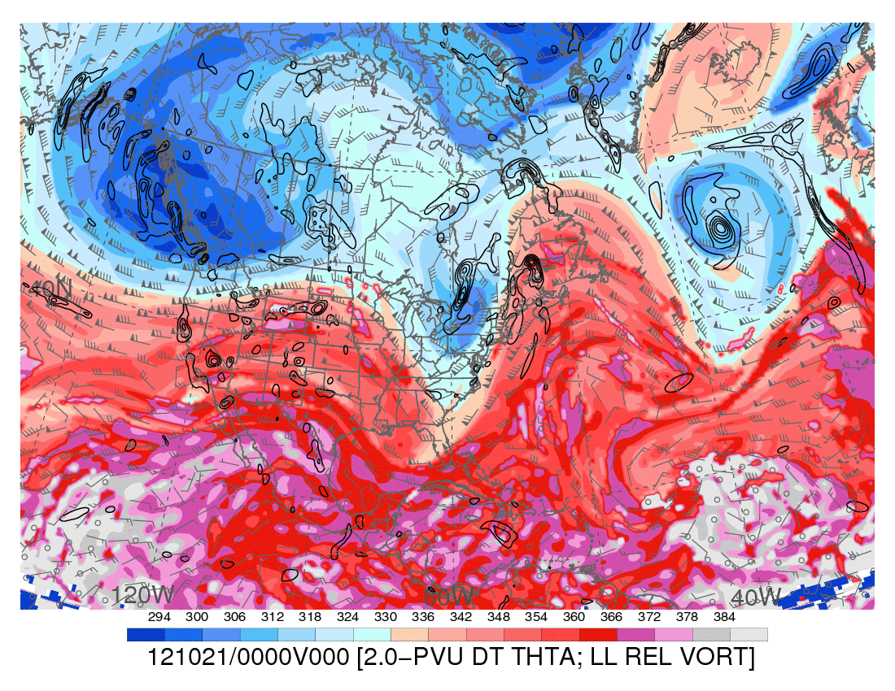
0000 UTC 21 October 2012
Dynamic tropopause (DT, 1.5-PVU surface) potential temperature (shaded, K) and wind (barbs, kts),
925–850-hPa layer-averaged cyclonic relative vorticity (black contours every 0.5 × 10⁻⁴ s⁻¹)

Slide 8
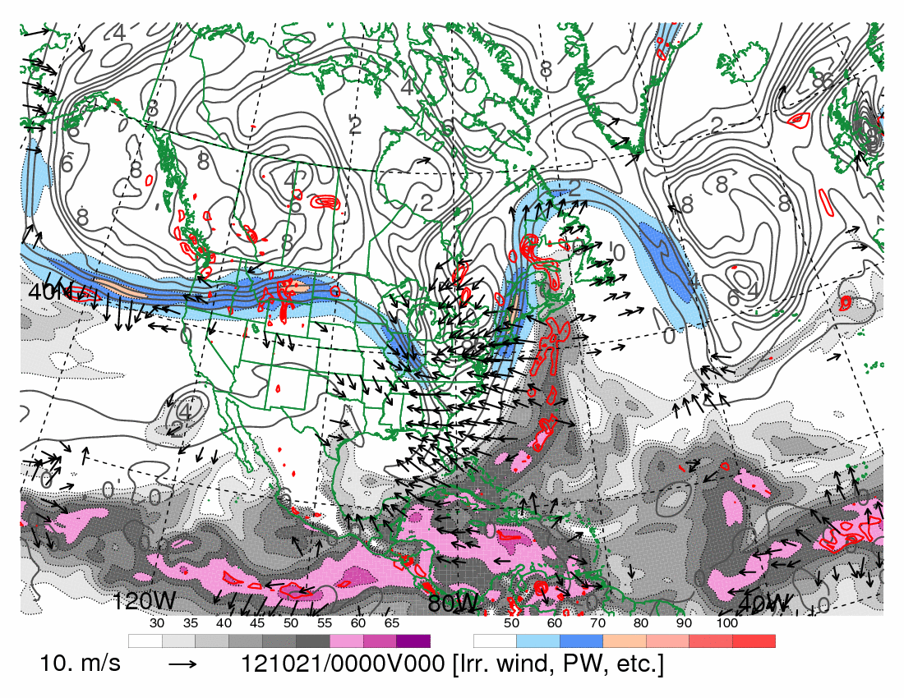
0000 UTC 21 October 2012
250-hPa wind speed (shaded, m s⁻¹), 300–200-hPa layer-averaged PV (gray contours every 1 PVU),
PW (shaded according to gray scale, mm), 600–400-hPa layer-averaged ascent (red contours every
5 × 10⁻³ hPa s⁻¹, negative values only), and 250-hPa irrotational wind (vectors starting at 5 m s⁻¹)

Slide 9
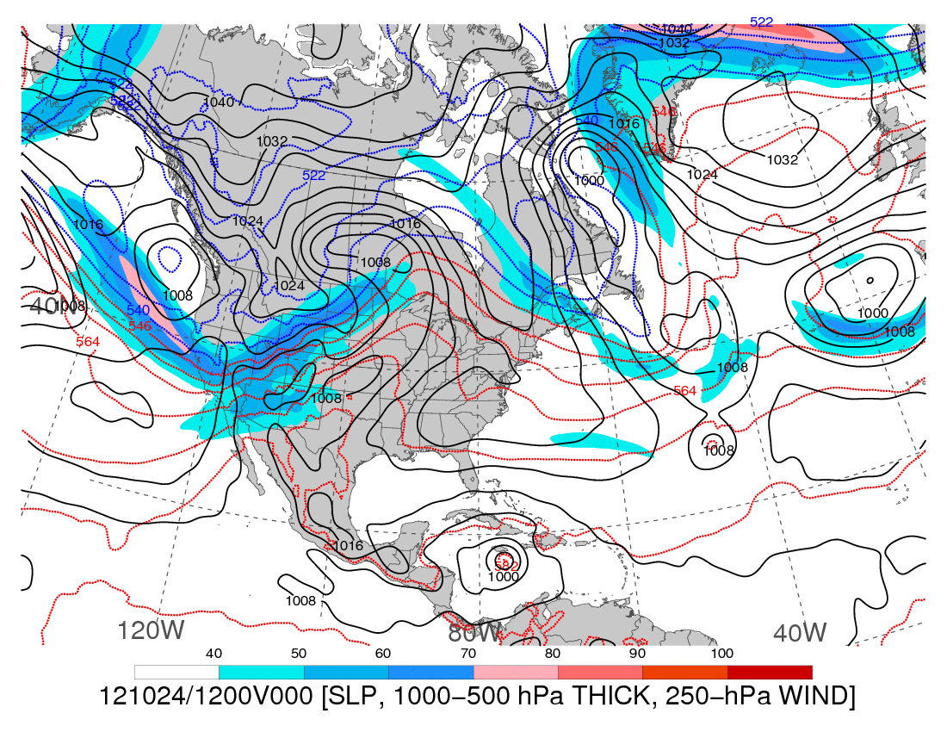
1200 UTC 24 October 2012
250-hPa wind speed (shaded, m s⁻¹), 1000–500-hPa thickness (dashed red/blue contours, dam),
and mean sea level pressure (black solid contours, hPa)

Slide 10
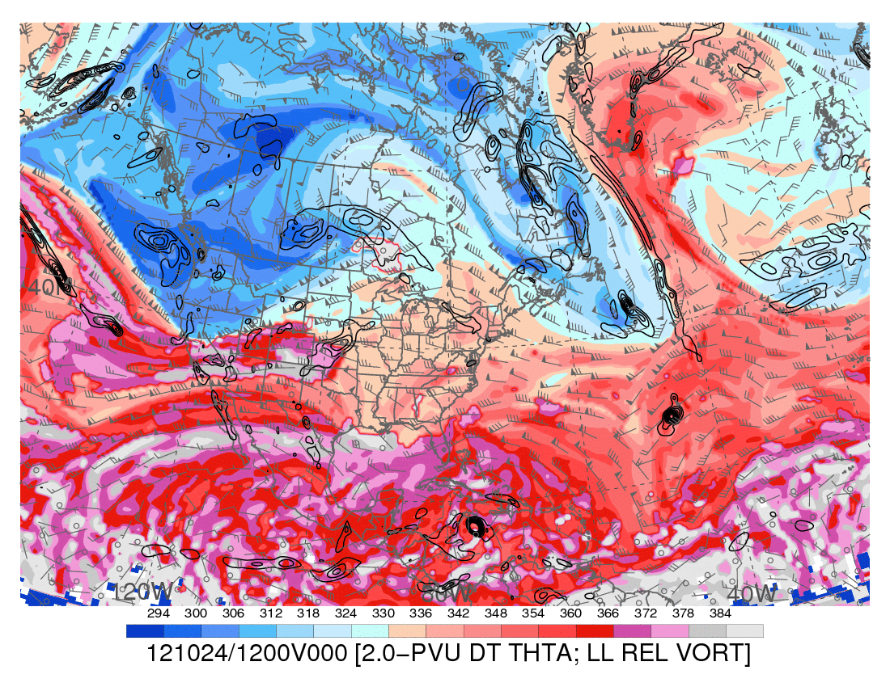
1200 UTC 24 October 2012
Dynamic tropopause (DT, 1.5-PVU surface) potential temperature (shaded, K) and wind (barbs, kts),
925–850-hPa layer-averaged cyclonic relative vorticity (black contours every 0.5 × 10⁻⁴ s⁻¹)

Slide 11
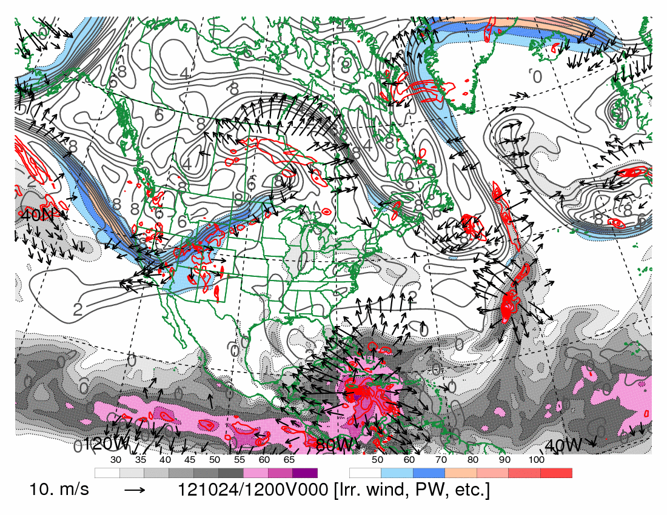
1200 UTC 24 October 2012
250-hPa wind speed (shaded, m s⁻¹), 300–200-hPa layer-averaged PV (gray contours every 1 PVU),
PW (shaded according to gray scale, mm), 600–400-hPa layer-averaged ascent (red contours every
5 × 10⁻³ hPa s⁻¹, negative values only), and 250-hPa irrotational wind (vectors starting at 5 m s⁻¹)

Slide 12
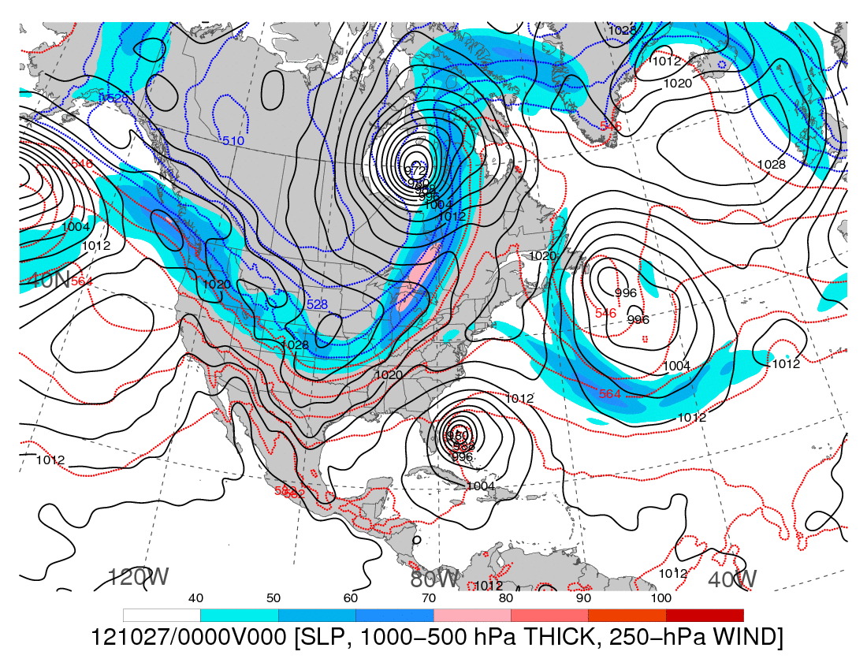
0000 UTC 27 October 2012
250-hPa wind speed (shaded, m s⁻¹), 1000–500-hPa thickness (dashed red/blue contours, dam),
and mean sea level pressure (black solid contours, hPa)

Slide 13
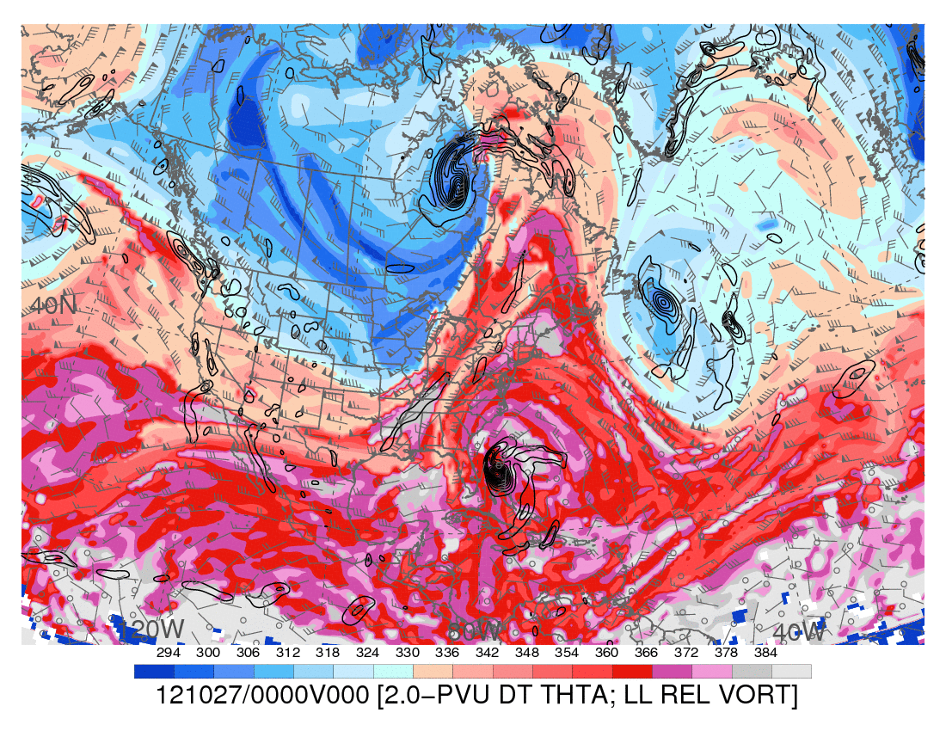
0000 UTC 27 October 2012
Dynamic tropopause (DT, 1.5-PVU surface) potential temperature (shaded, K) and wind (barbs, kts),
925–850-hPa layer-averaged cyclonic relative vorticity (black contours every 0.5 × 10⁻⁴ s⁻¹)

Slide 14
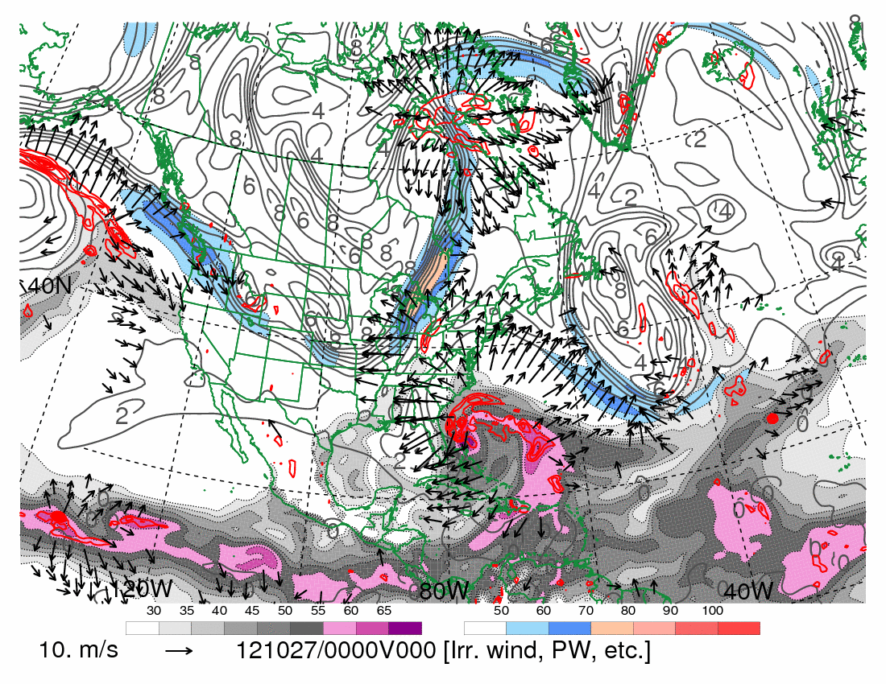
0000 UTC 27 October 2012
250-hPa wind speed (shaded, m s⁻¹), 300–200-hPa layer-averaged PV (gray contours every 1 PVU),
PW (shaded according to gray scale, mm), 600–400-hPa layer-averaged ascent (red contours every
5 × 10⁻³ hPa s⁻¹, negative values only), and 250-hPa irrotational wind (vectors starting at 5 m s⁻¹)

Slide 15
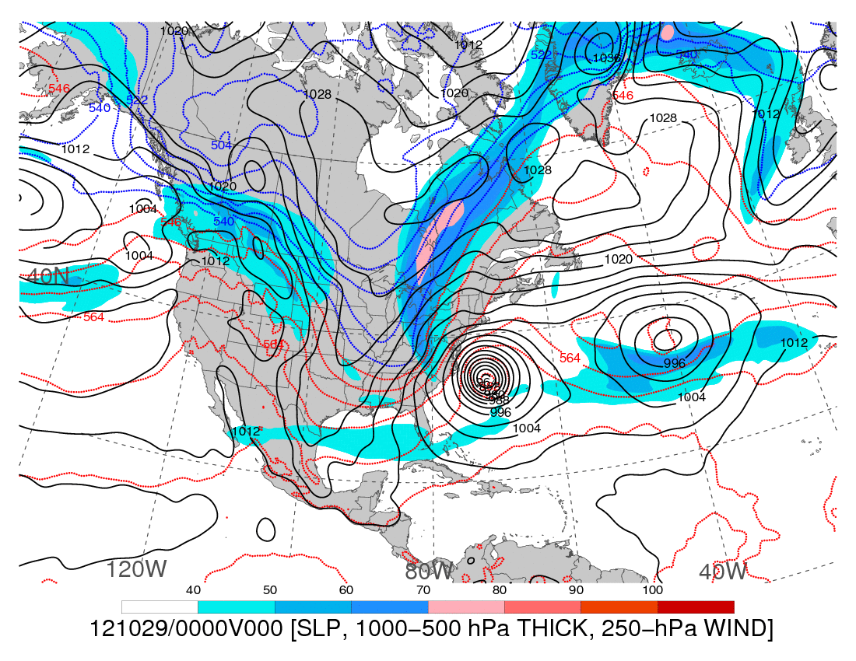
0000 UTC 29 October 2012
250-hPa wind speed (shaded, m s⁻¹), 1000–500-hPa thickness (dashed red/blue contours, dam),
and mean sea level pressure (black solid contours, hPa)

Slide 16
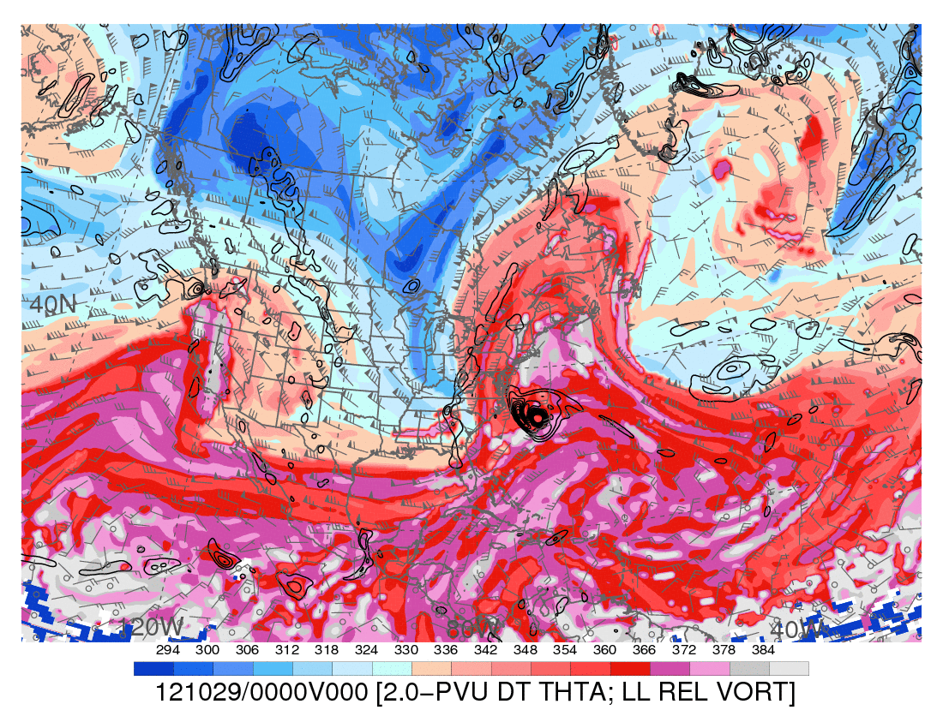
0000 UTC 29 October 2012
Dynamic tropopause (DT, 1.5-PVU surface) potential temperature (shaded, K) and wind (barbs, kts),
925–850-hPa layer-averaged cyclonic relative vorticity (black contours every 0.5 × 10⁻⁴ s⁻¹)

Slide 17
0000 UTC 29 October 2012
250-hPa wind speed (shaded, m s⁻¹), 300–200-hPa layer-averaged PV (gray contours every 1 PVU),
PW (shaded according to gray scale, mm), 600–400-hPa layer-averaged ascent (red contours every
5 × 10⁻³ hPa s⁻¹, negative values only), and 250-hPa irrotational wind (vectors starting at 5 m s⁻¹)

Slide 18
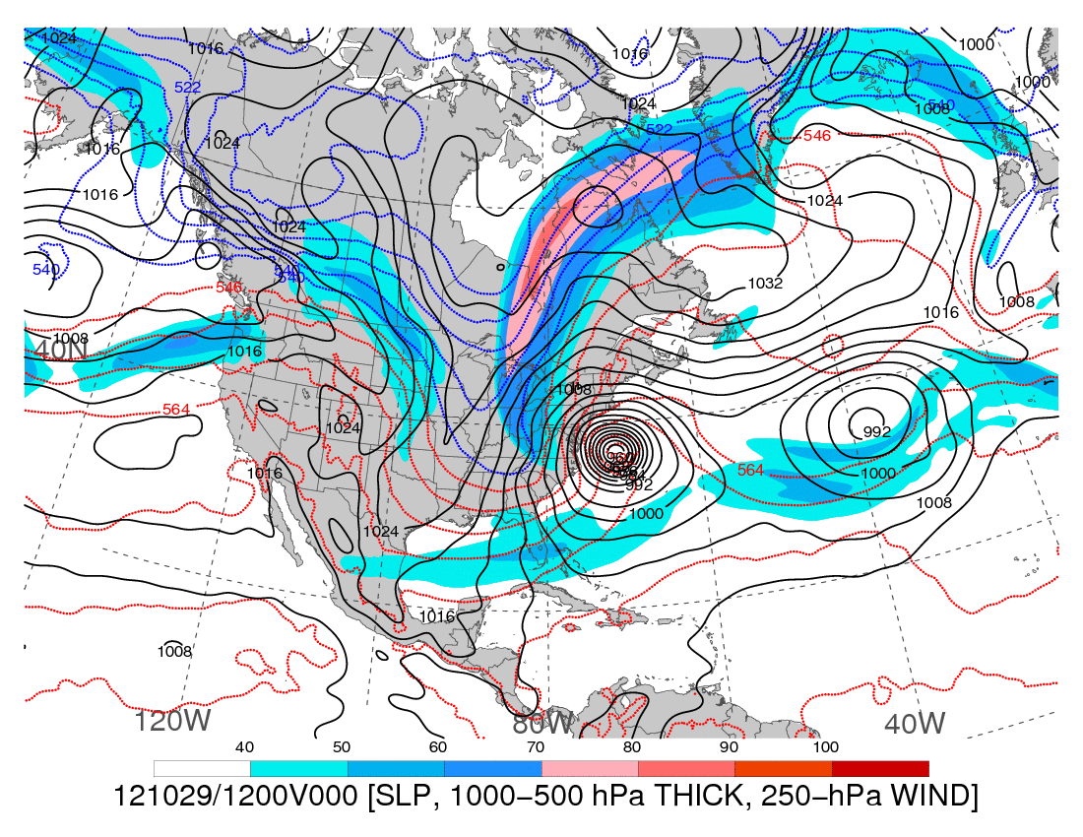
1200 UTC 29 October 2012
250-hPa wind speed (shaded, m s⁻¹), 1000–500-hPa thickness (dashed red/blue contours, dam),
and mean sea level pressure (black solid contours, hPa)

Slide 19
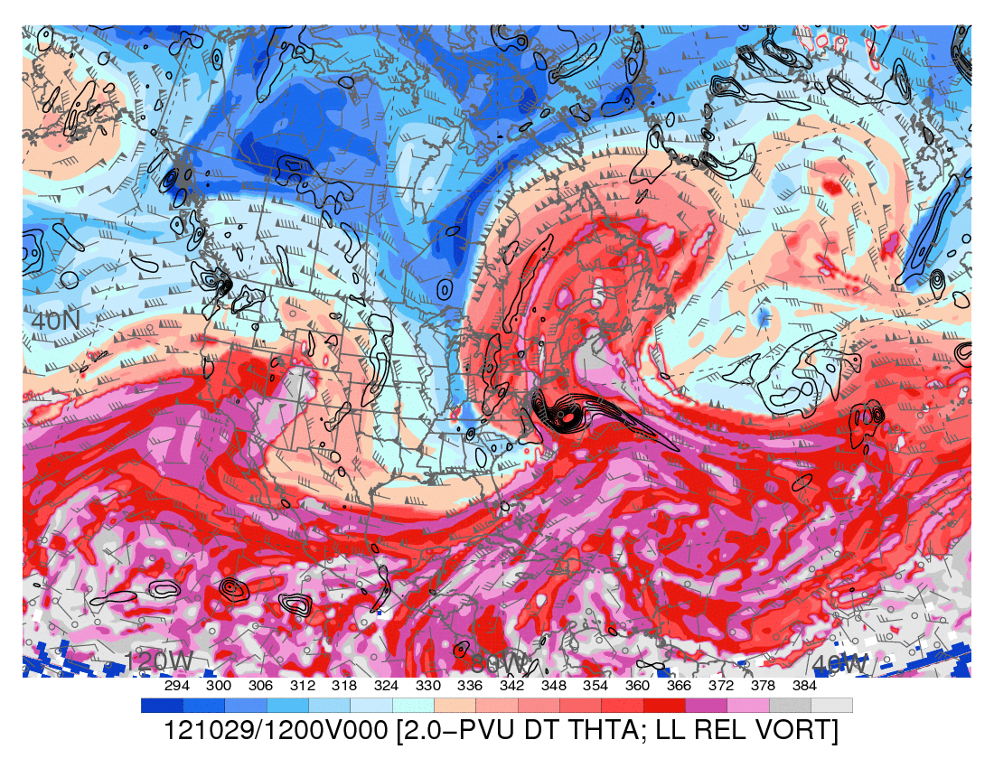
1200 UTC 29 October 2012
Dynamic tropopause (DT, 1.5-PVU surface) potential temperature (shaded, K) and wind (barbs, kts),
925–850-hPa layer-averaged cyclonic relative vorticity (black contours every 0.5 × 10⁻⁴ s⁻¹)

Slide 20
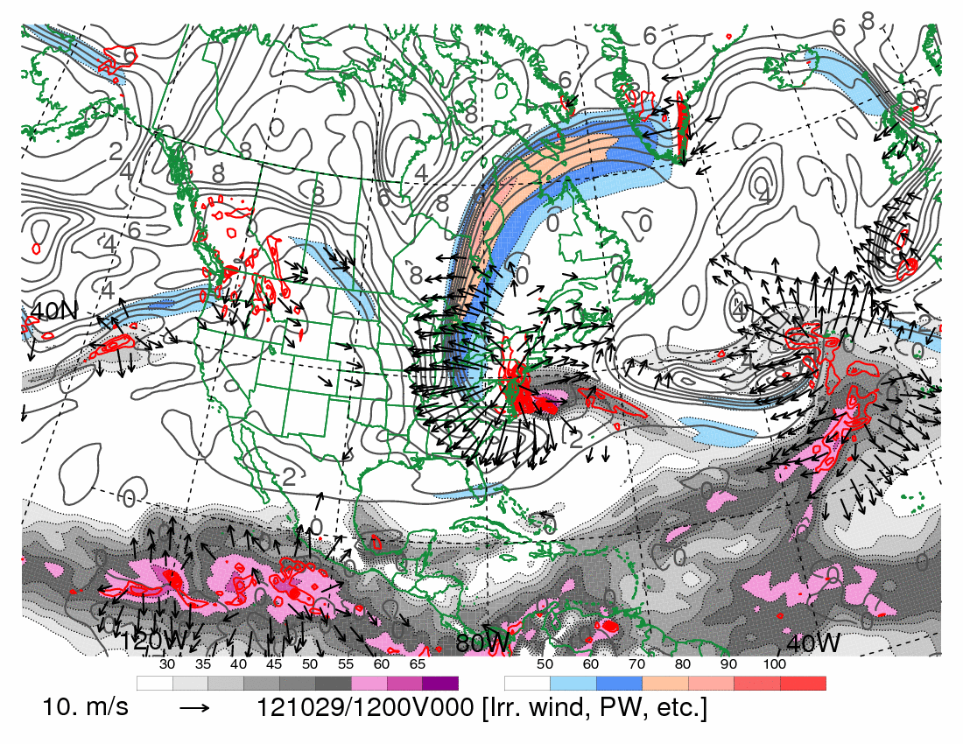
1200 UTC 29 October 2012
250-hPa wind speed (shaded, m s⁻¹), 300–200-hPa layer-averaged PV (gray contours every 1 PVU),
PW (shaded according to gray scale, mm), 600–400-hPa layer-averaged ascent (red contours every
5 × 10⁻³ hPa s⁻¹, negative values only), and 250-hPa irrotational wind (vectors starting at 5 m s⁻¹)

Slide 21
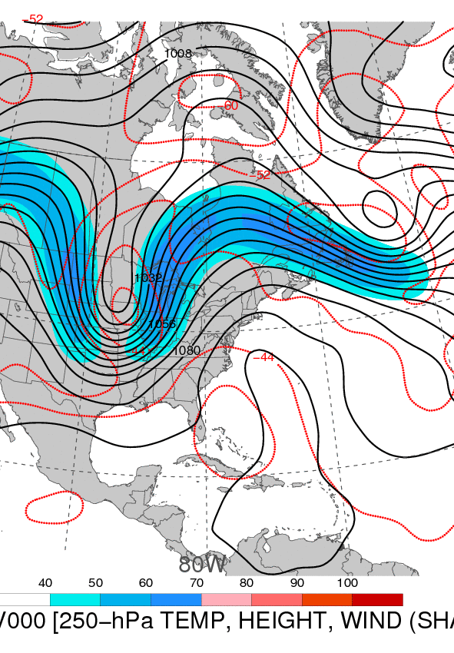
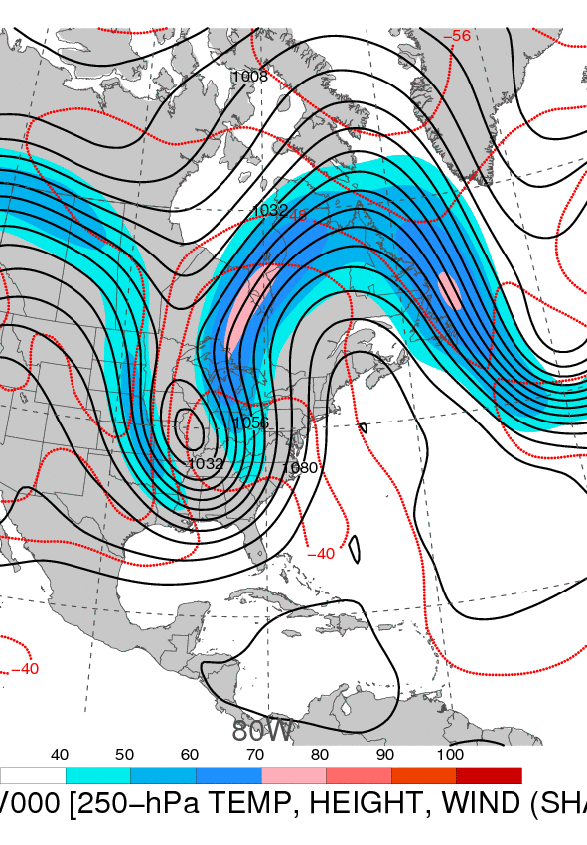
0000 UTC 15 October 1954
0000 UTC 16 October 1954
250-hPa wind speed (shaded, m s⁻¹), temperature (dashed red contours, °C),
and geopotential height (black solid contours, dam)

Slide 22
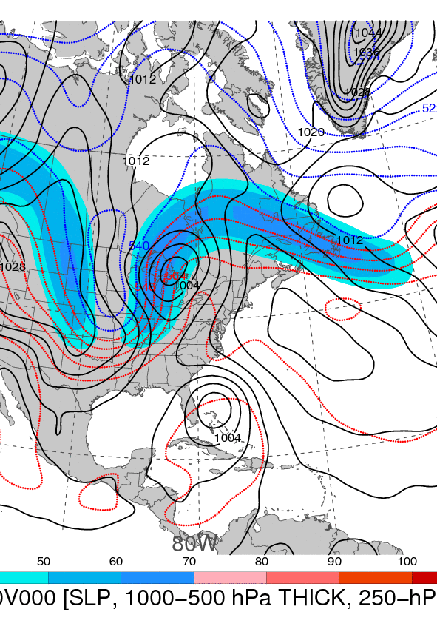
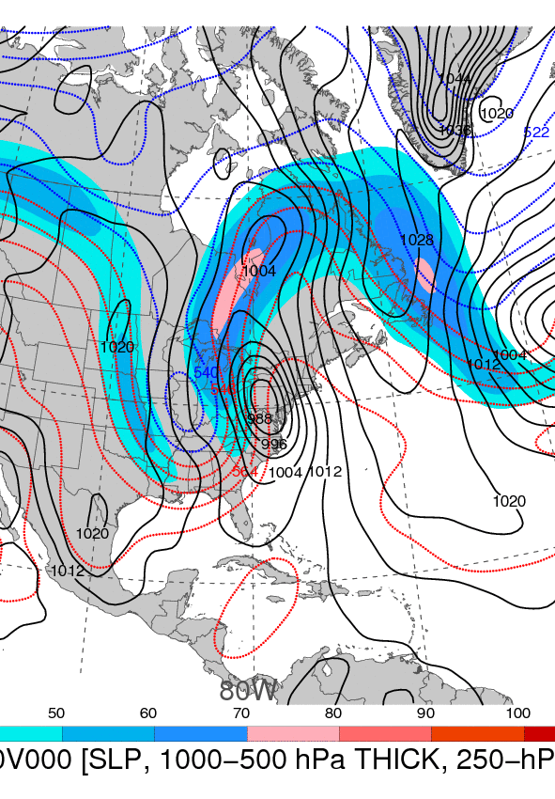
0000 UTC 15 October 1954
0000 UTC 16 October 1954
250-hPa wind speed (shaded, m s⁻¹), 1000–500-hPa thickness (dashed red/blue contours, dam), and mean sea level pressure (black solid contours, hPa)

Slide 23
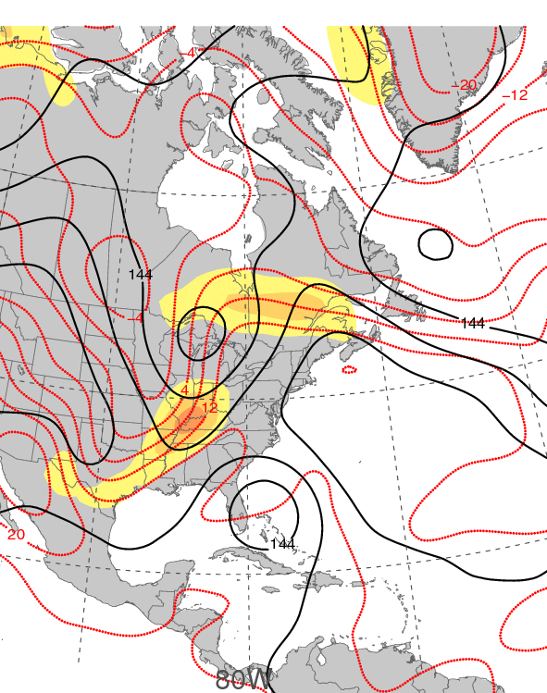
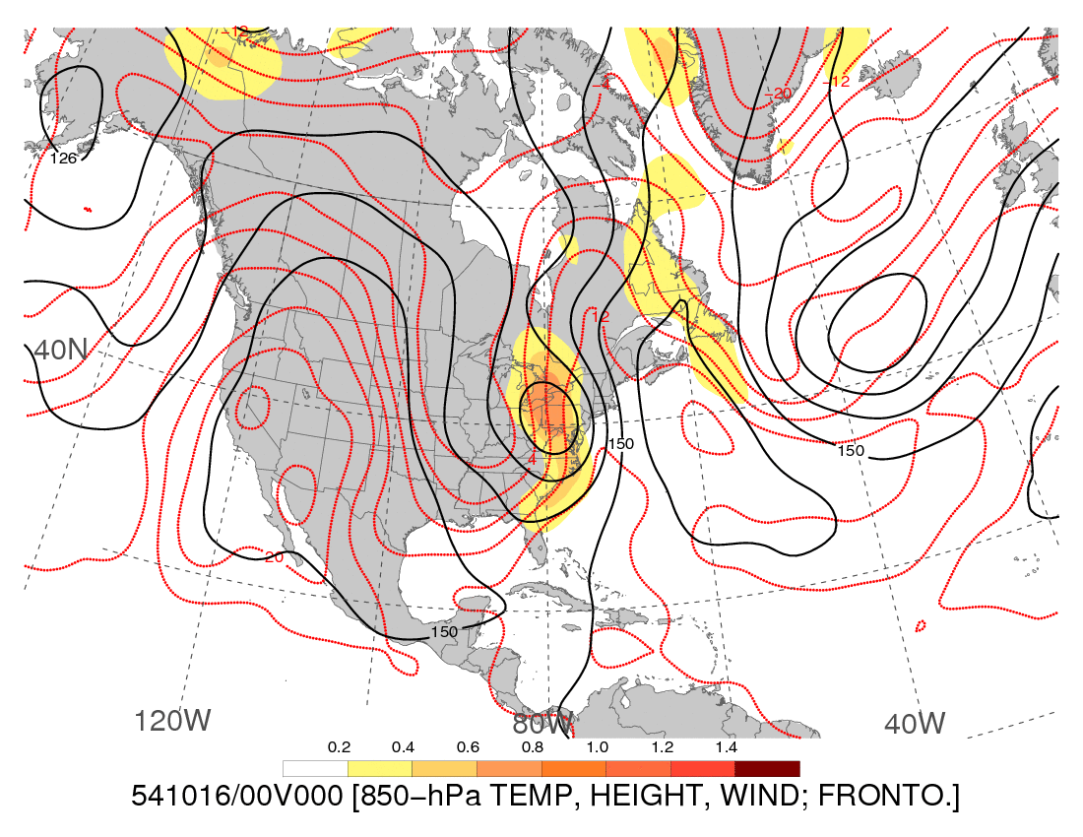
0000 UTC 15 October 1954
0000 UTC 16 October 1954
850-hPa frontogenesis [shaded, K (100 km) ⁻¹ (3 h) ⁻¹], temperature (dashed red contours, °C), and geopotential height (black solid contours, dam)

Slide 24
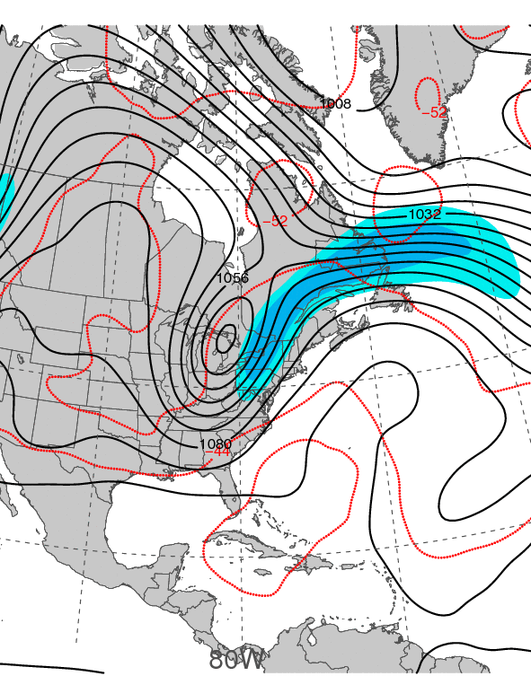
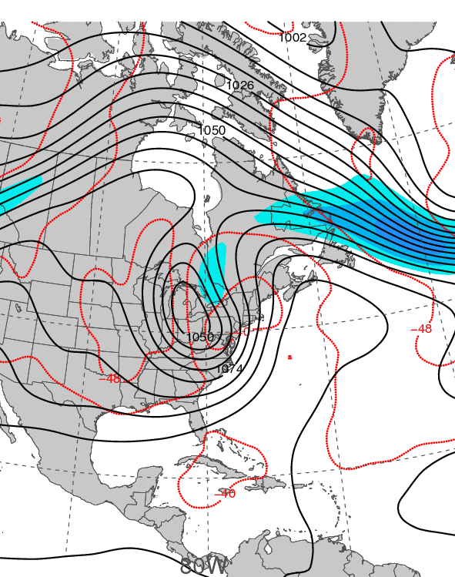
0000 UTC 21 September 1938
0000 UTC 22 September 1938
250-hPa wind speed (shaded, m s⁻¹), temperature (dashed red contours, °C),
and geopotential height (black solid contours, dam)

Slide 25
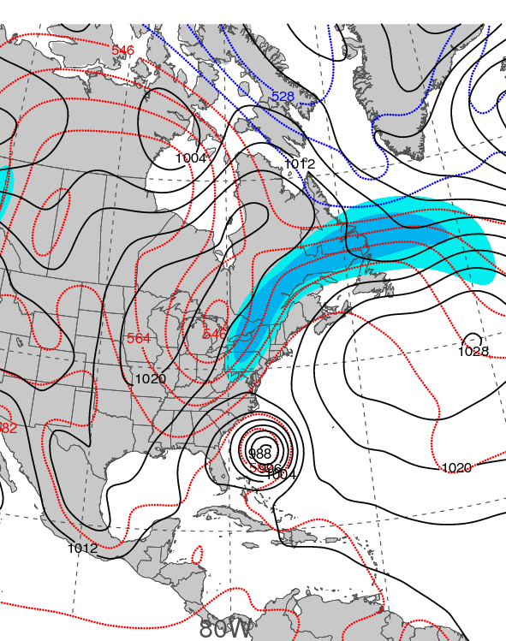
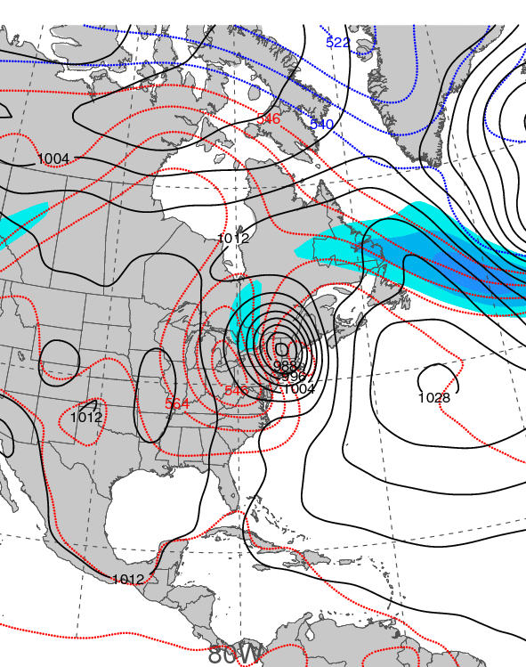
0000 UTC 21 September 1938
0000 UTC 22 September 1938
250-hPa wind speed (shaded, m s⁻¹), 1000–500-hPa thickness (dashed red/blue contours, dam), and mean sea level pressure (black solid contours, hPa)

Slide 26
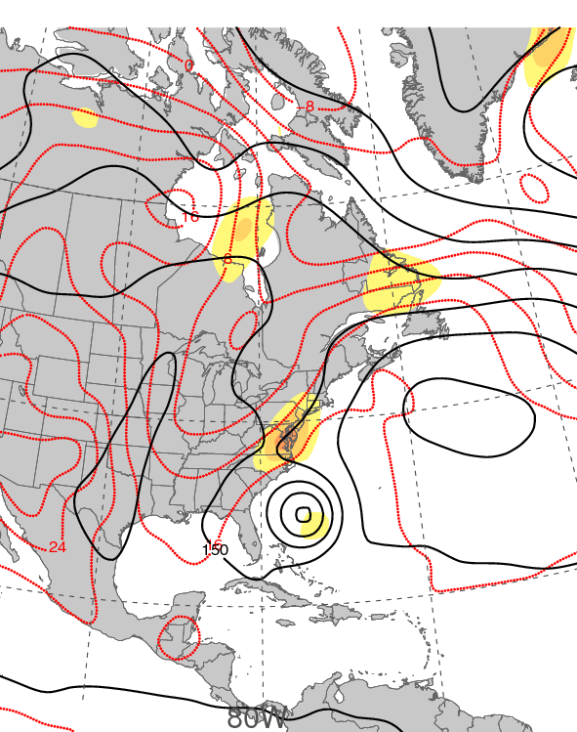
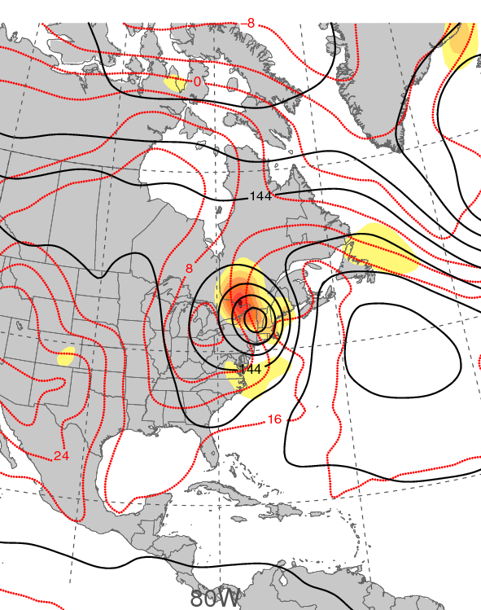
0000 UTC 21 September 1938
0000 UTC 22 September 1938
850-hPa frontogenesis [shaded, K (100 km) ⁻¹ (3 h) ⁻¹], temperature (dashed red contours, °C), and geopotential height (black solid contours, dam)

Slide 27
SUNDAY NIGHT ADDITIONS

Slide 28
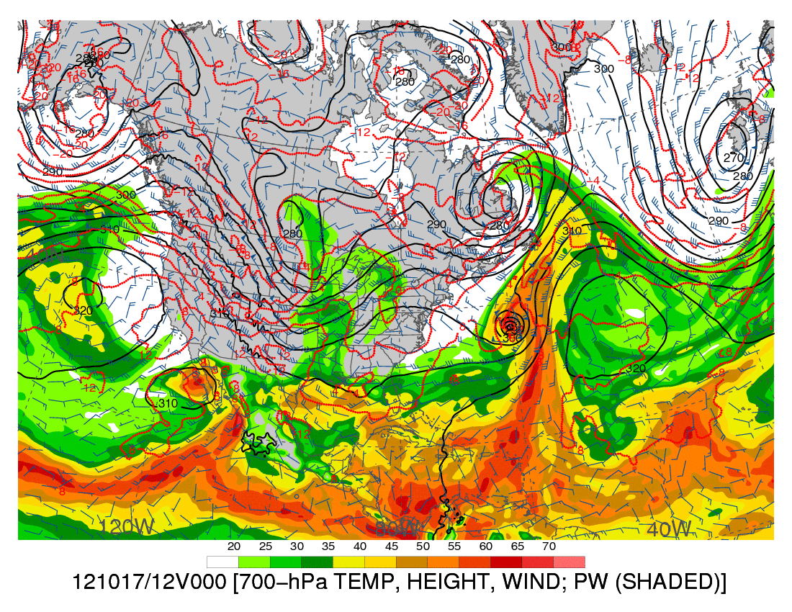
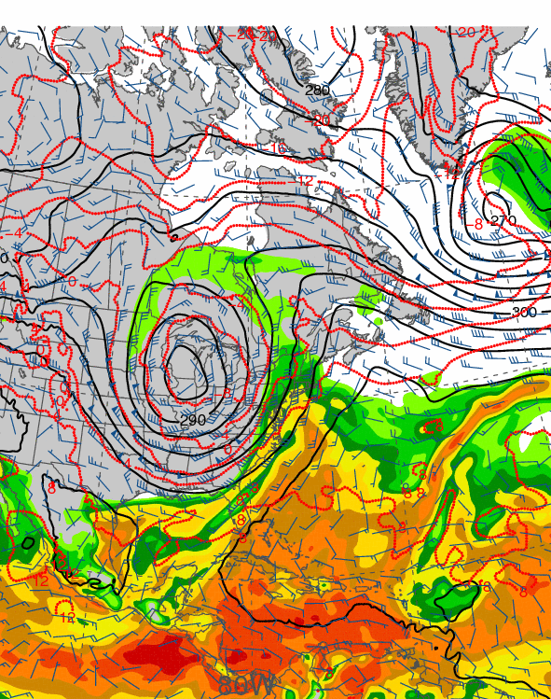
1200 UTC 17 October 2012
1200 UTC 19 October 2012
Precipitable water (shaded, mm); 700-hPa wind speed (barbs, kts), temperature
(dashed red contours, °C), and geopotential height (black solid contours, dam)

Slide 29
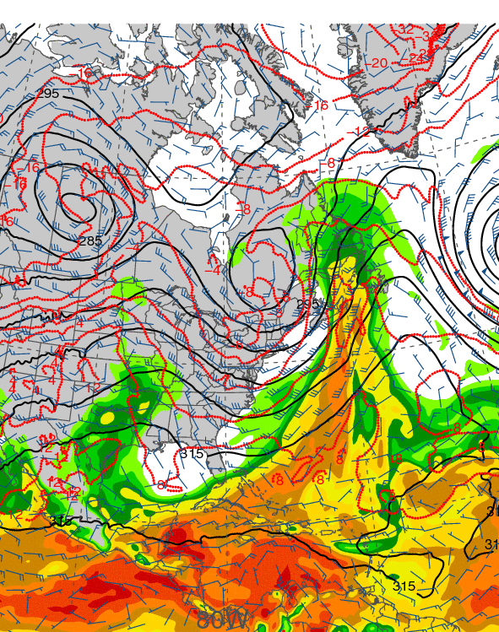
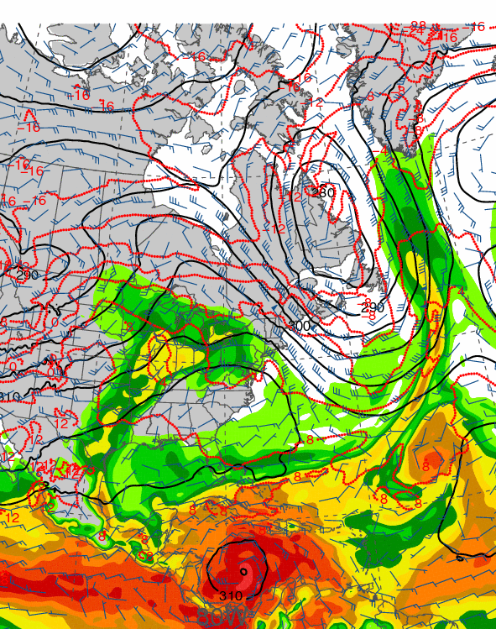
1200 UTC 21 October 2012
1200 UTC 23 October 2012
Precipitable water (shaded, mm); 700-hPa wind speed (barbs, kts), temperature
(dashed red contours, °C), and geopotential height (black solid contours, dam)

Slide 30
1200 UTC 17 October 2012
Dynamic tropopause (DT, 1.5-PVU surface) potential
temperature (shaded, K) and wind (barbs, kts),
925–850-hPa layer-averaged cyclonic relative vorticity
(black contours every 0.5 × 10⁻⁴ s⁻¹)
250-hPa wind speed (shaded, m s⁻¹), 300–200-hPa layer-averaged PV (gray contours, PVU), PW (gray scale, mm),
600–400-hPa layer-averaged ascent (red contours every 5 × 10⁻³ hPa s⁻¹), and 250-hPa irrotational wind (vectors, m s⁻¹)

Slide 31
0000 UTC 21 October 2012
Dynamic tropopause (DT, 1.5-PVU surface) potential
temperature (shaded, K) and wind (barbs, kts),
925–850-hPa layer-averaged cyclonic relative vorticity
(black contours every 0.5 × 10⁻⁴ s⁻¹)
250-hPa wind speed (shaded, m s⁻¹), 300–200-hPa layer-averaged PV (gray contours, PVU), PW (gray scale, mm),
600–400-hPa layer-averaged ascent (red contours every 5 × 10⁻³ hPa s⁻¹), and 250-hPa irrotational wind (vectors, m s⁻¹)

Slide 32
1200 UTC 24 October 2012
Dynamic tropopause (DT, 1.5-PVU surface) potential
temperature (shaded, K) and wind (barbs, kts),
925–850-hPa layer-averaged cyclonic relative vorticity
(black contours every 0.5 × 10⁻⁴ s⁻¹)
250-hPa wind speed (shaded, m s⁻¹), 300–200-hPa layer-averaged PV (gray contours, PVU), PW (gray scale, mm),
600–400-hPa layer-averaged ascent (red contours every 5 × 10⁻³ hPa s⁻¹), and 250-hPa irrotational wind (vectors, m s⁻¹)

Slide 33
0000 UTC 27 October 2012
Dynamic tropopause (DT, 1.5-PVU surface) potential
temperature (shaded, K) and wind (barbs, kts),
925–850-hPa layer-averaged cyclonic relative vorticity
(black contours every 0.5 × 10⁻⁴ s⁻¹)
250-hPa wind speed (shaded, m s⁻¹), 300–200-hPa layer-averaged PV (gray contours, PVU), PW (gray scale, mm),
600–400-hPa layer-averaged ascent (red contours every 5 × 10⁻³ hPa s⁻¹), and 250-hPa irrotational wind (vectors, m s⁻¹)

Slide 34
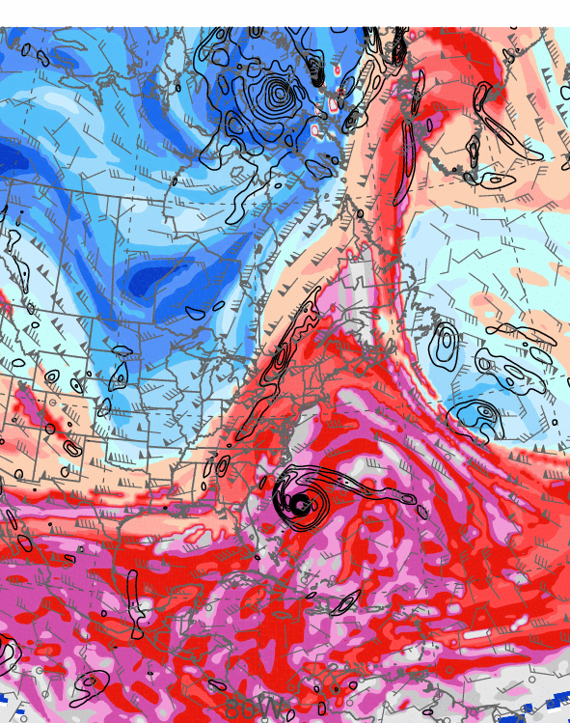
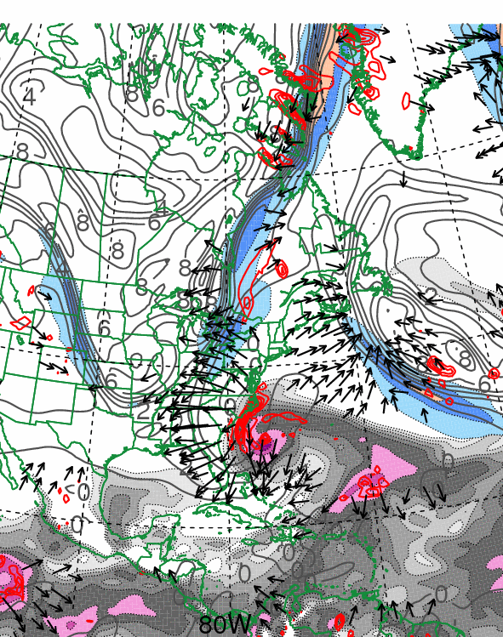
0000 UTC 28 October 2012
Dynamic tropopause (DT, 1.5-PVU surface) potential
temperature (shaded, K) and wind (barbs, kts),
925–850-hPa layer-averaged cyclonic relative vorticity
(black contours every 0.5 × 10⁻⁴ s⁻¹)
250-hPa wind speed (shaded, m s⁻¹), 300–200-hPa layer-averaged PV (gray contours, PVU), PW (gray scale, mm),
600–400-hPa layer-averaged ascent (red contours every 5 × 10⁻³ hPa s⁻¹), and 250-hPa irrotational wind (vectors, m s⁻¹)

Slide 35
0000 UTC 29 October 2012
Dynamic tropopause (DT, 1.5-PVU surface) potential
temperature (shaded, K) and wind (barbs, kts),
925–850-hPa layer-averaged cyclonic relative vorticity
(black contours every 0.5 × 10⁻⁴ s⁻¹)
250-hPa wind speed (shaded, m s⁻¹), 300–200-hPa layer-averaged PV (gray contours, PVU), PW (gray scale, mm),
600–400-hPa layer-averaged ascent (red contours every 5 × 10⁻³ hPa s⁻¹), and 250-hPa irrotational wind (vectors, m s⁻¹)

Slide 36
1200 UTC 29 October 2012
Dynamic tropopause (DT, 1.5-PVU surface) potential
temperature (shaded, K) and wind (barbs, kts),
925–850-hPa layer-averaged cyclonic relative vorticity
(black contours every 0.5 × 10⁻⁴ s⁻¹)
250-hPa wind speed (shaded, m s⁻¹), 300–200-hPa layer-averaged PV (gray contours, PVU), PW (gray scale, mm),
600–400-hPa layer-averaged ascent (red contours every 5 × 10⁻³ hPa s⁻¹), and 250-hPa irrotational wind (vectors, m s⁻¹)

Slide 37
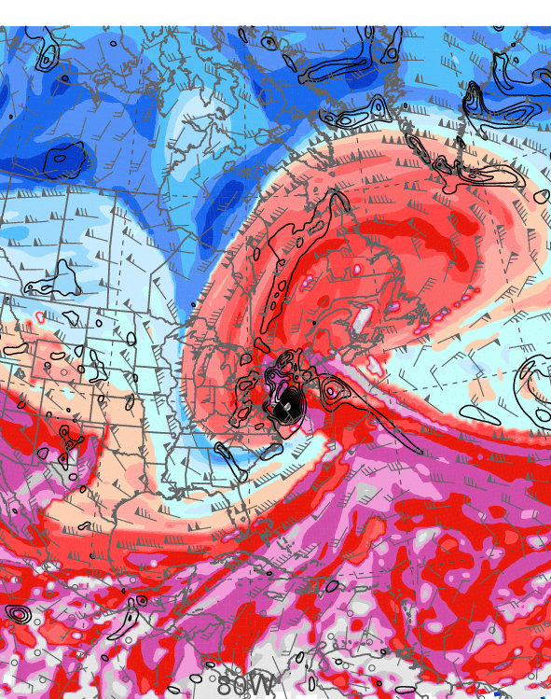
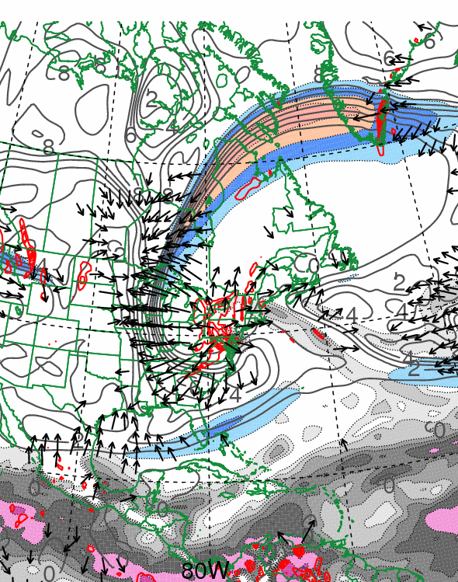
0000 UTC 30 October 2012
Dynamic tropopause (DT, 1.5-PVU surface) potential
temperature (shaded, K) and wind (barbs, kts),
925–850-hPa layer-averaged cyclonic relative vorticity
(black contours every 0.5 × 10⁻⁴ s⁻¹)
250-hPa wind speed (shaded, m s⁻¹), 300–200-hPa layer-averaged PV (gray contours, PVU), PW (gray scale, mm),
600–400-hPa layer-averaged ascent (red contours every 5 × 10⁻³ hPa s⁻¹), and 250-hPa irrotational wind (vectors, m s⁻¹)

Slide 38
Schematic representation of three trough interactions that occurred during the life cycle of TC Sandy. Blue, purple, and red lines represent idealized 0.4 PVU, 0.8 PVU, and 2.0 PVU contours on the 330–335K layer-averaged potential temperature surface. Black contours depict 925–850-hPa layer-averaged cyclonic relative vorticity associated with TC Sandy (every 0.5 × 10⁻⁴ s⁻¹). Shading depicts the magnitude of the 250-hPa wind (m s⁻¹) at 1800 UTC 29 October 2012. Inset shows the total rainfall (green shading) and snowfall (blue shading) in inches associated with TC Sandy (adapted from NOAA/NWS WPC).

Slide 39
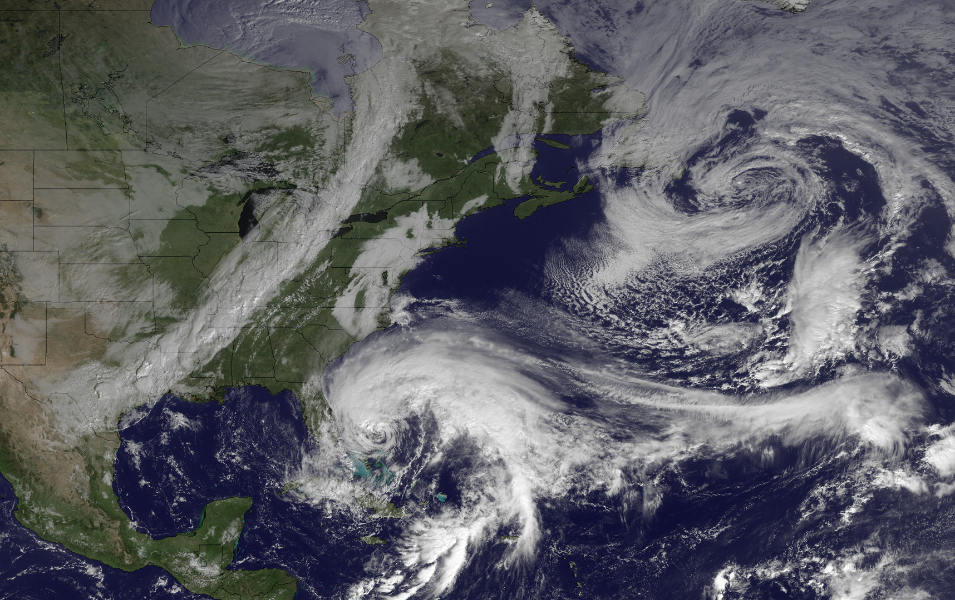
1445 UTC 26 October 2012
Image courtesy of the
NOAA’s Environmental
Visualization Laboratory

Slide 40
THAT’S ALL, FOLKS!

