Slide 5
Schematic representation of three trough interactions that occurred during the life cycle of TC Sandy. Blue, purple, and red lines represent idealized 0.4 PVU, 0.8 PVU, and 2.0 PVU contours on the 330–335K layer-averaged potential temperature surface. Black contours depict 925–850-hPa layer-averaged cyclonic relative vorticity associated with TC Sandy (every 0.5 × 10⁻⁴ s⁻¹). Shading depicts the magnitude of the 250-hPa wind (m s⁻¹) at 1800 UTC 29 October 2012.

Slide 6
Schematic representation of three trough interactions that occurred during the life cycle of TC Sandy. Blue, purple, and red lines represent idealized 0.4 PVU, 0.8 PVU, and 2.0 PVU contours on the 330–335K layer-averaged potential temperature surface. Black contours depict 925–850-hPa layer-averaged cyclonic relative vorticity associated with TC Sandy (every 0.5 × 10⁻⁴ s⁻¹). Shading depicts the magnitude of the 250-hPa wind (m s⁻¹) at 1800 UTC 29 October 2012.

Slide 7
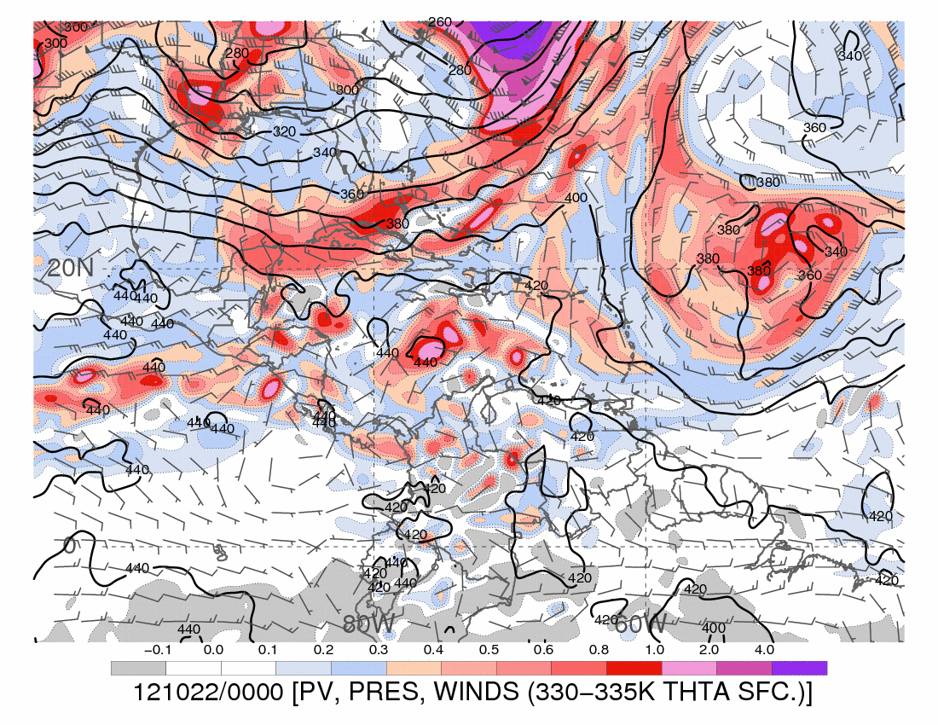

Slide 8
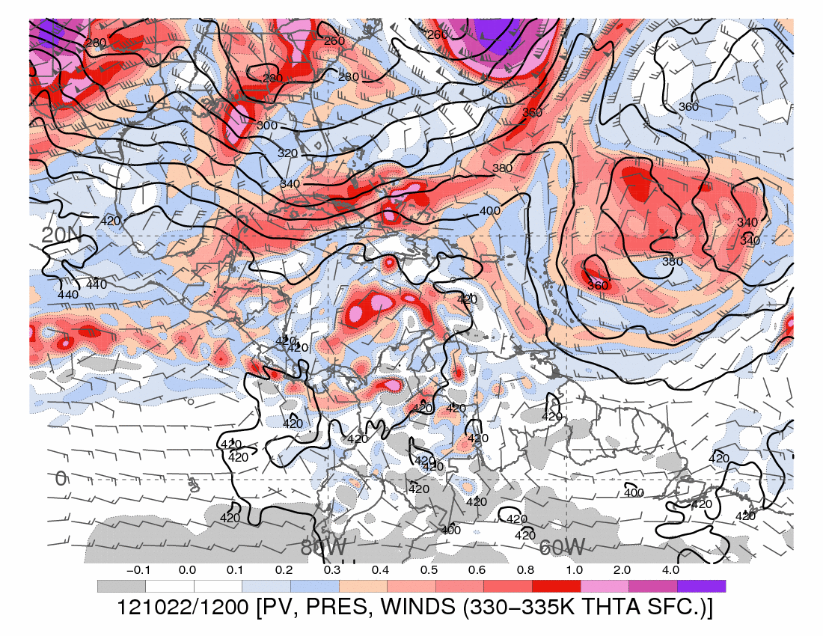

Slide 9
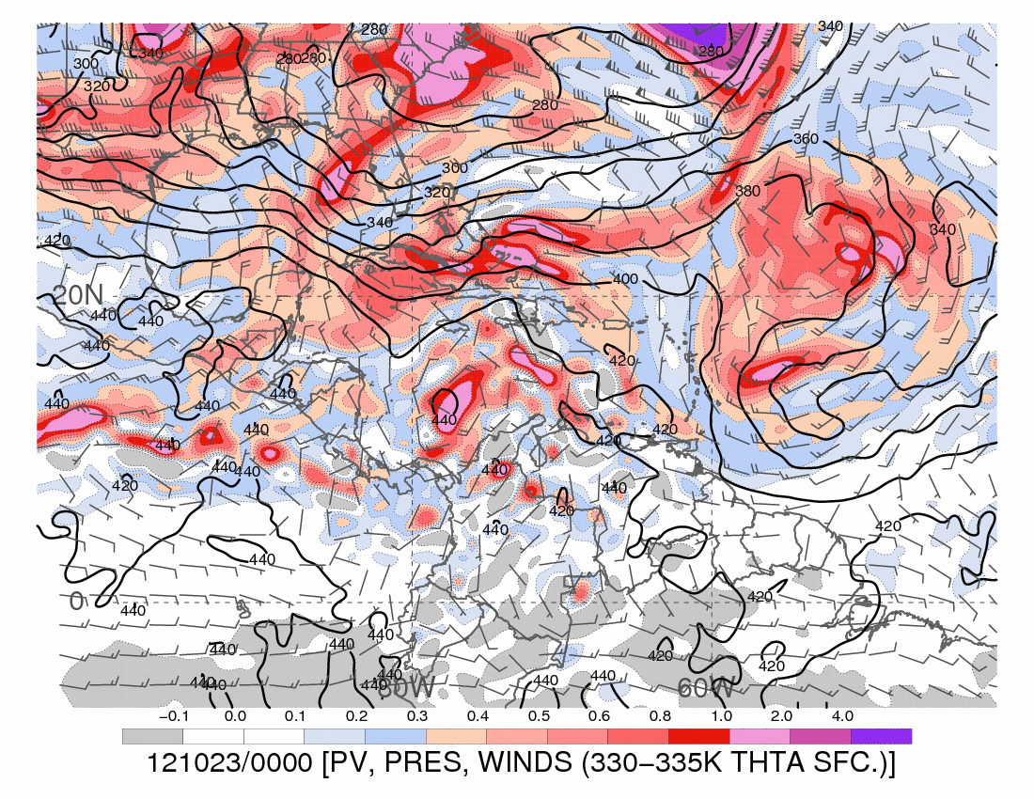

Slide 10
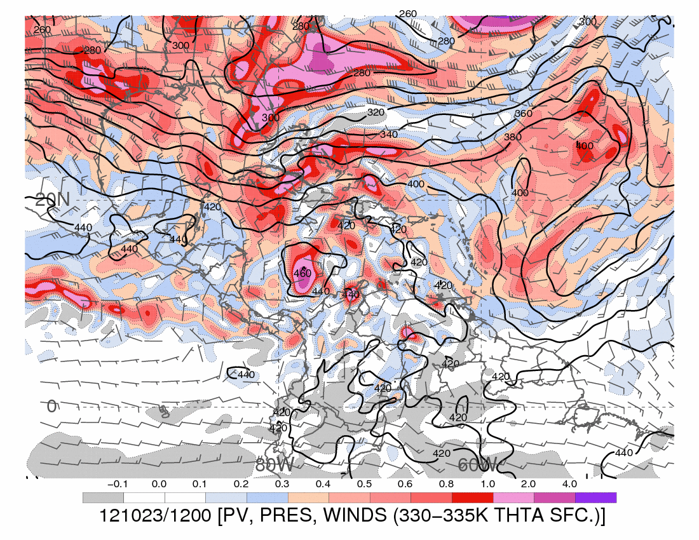

Slide 11
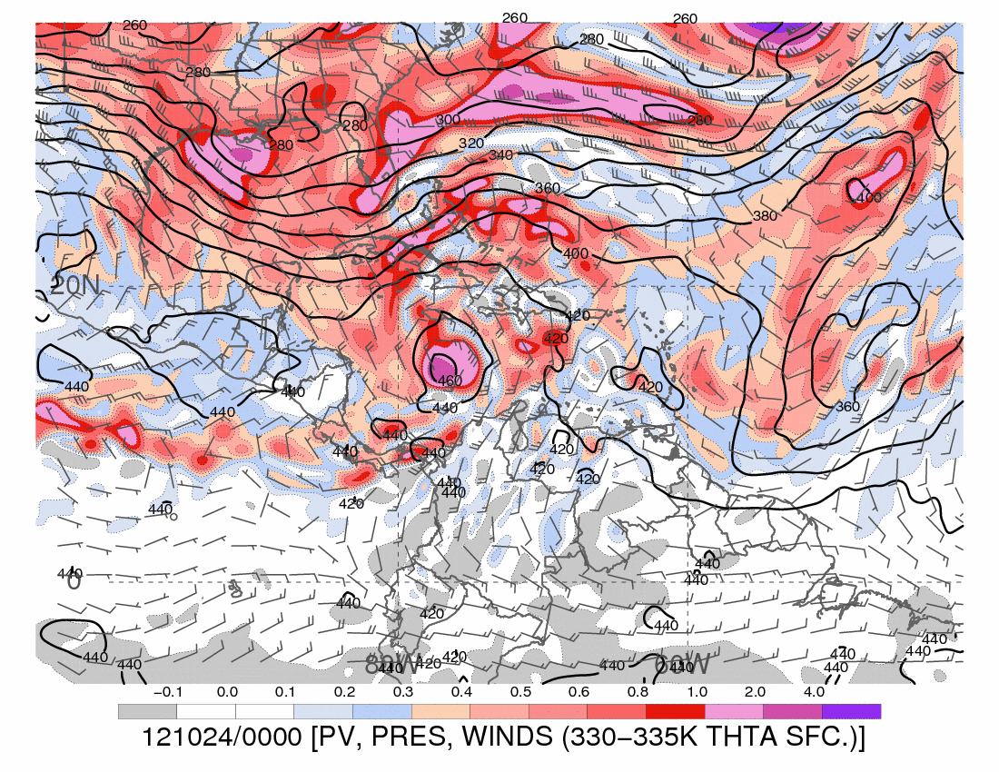

Slide 12
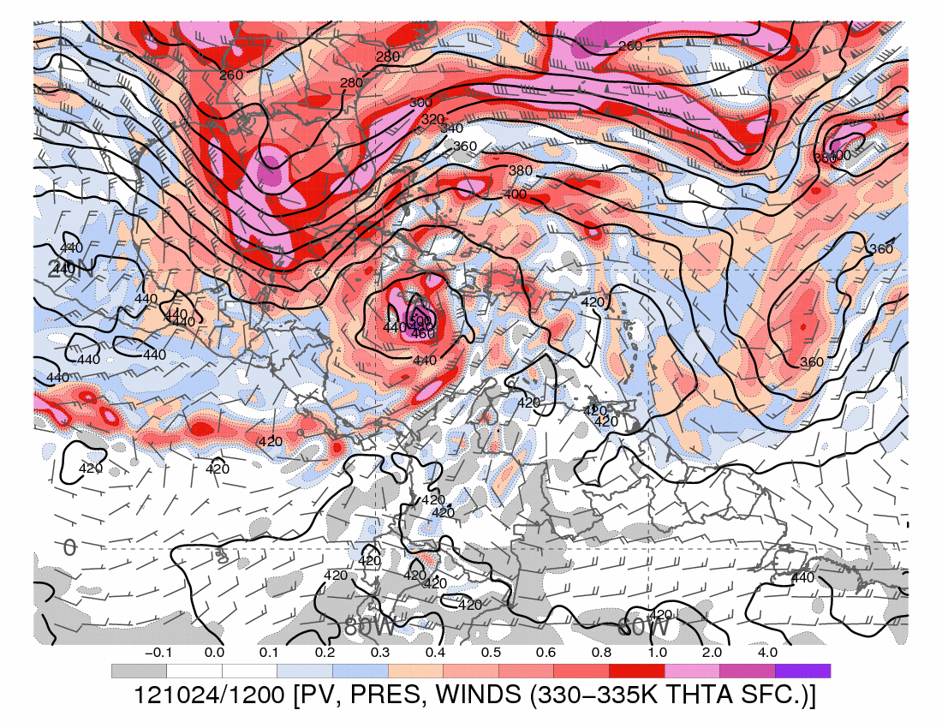

Slide 13
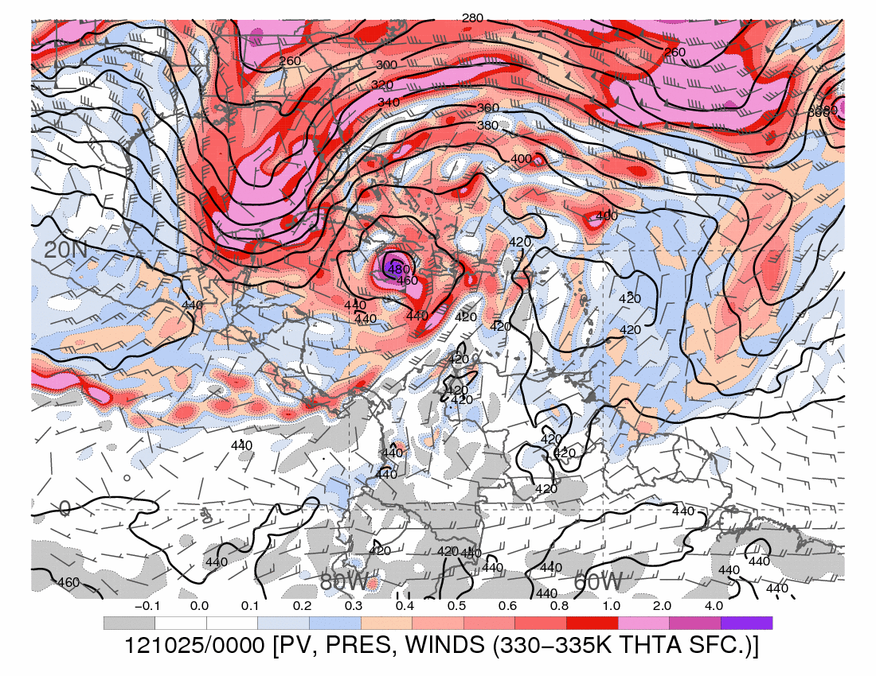

Slide 14
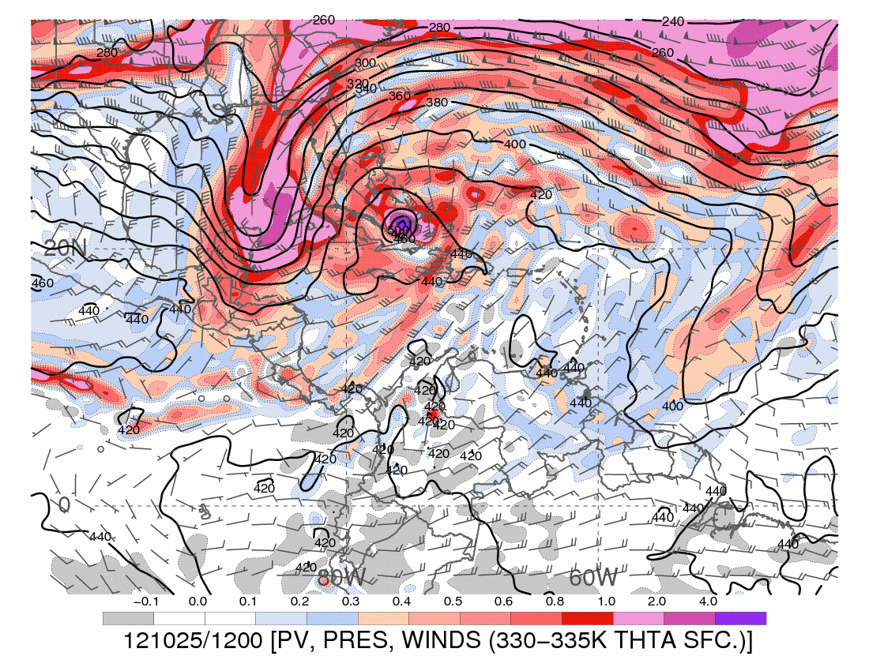

Slide 15
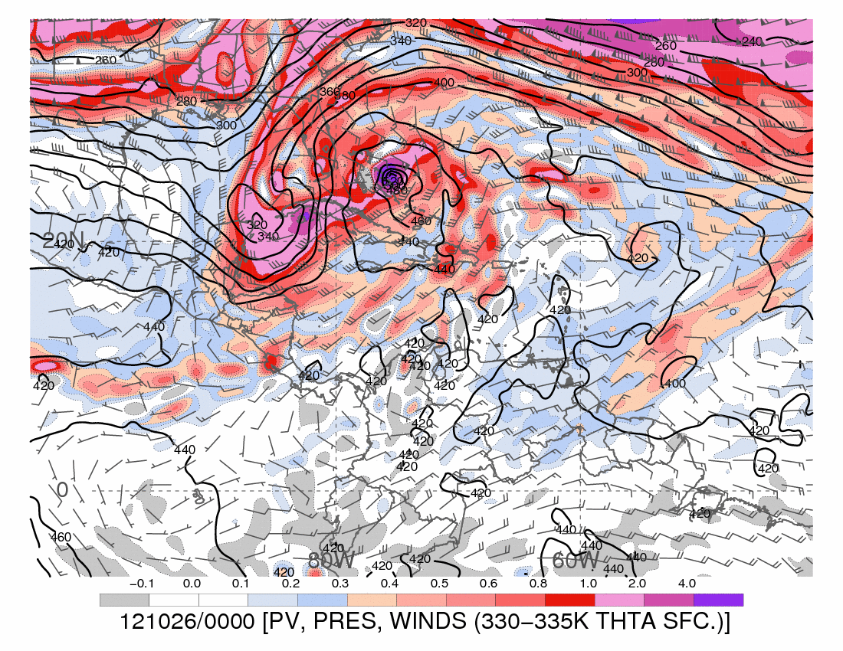

Slide 16
Alicia’s Sandy images:
http://www.atmos.albany.edu/student/abentley/research_images/sandy/

