Slide 1
Hurricane Sandy (2012):
A Multiscale Trough Interaction Perspective
Lance F. Bosart, Alicia M. Bentley, Chip N. Helms, and Philippe P. Papin
Department of Atmospheric and Environmental Sciences
University at Albany, State University of New York, Albany, NY 12222
31st Conference on Hurricanes and Tropical Meteorology
San Diego, California
Tuesday 1 April 2014
Support provided by NSF Grant AGS-1240502

Slide 2
Motivation
Hurricane Sandy, a storm of historical proportions, provided a serendipitous research opportunity to examine a well-sampled and well-documented storm from pre-genesis to post-landfall (soup-to-nuts).
Noteworthy aspects of Hurricane Sandy's lifecycle included multiple trough interactions, an unusual "Hazel (1954)-like" track, and an unprecedented post-landfall Appalachian snowstorm.

Slide 3
Outline
Pre-genesis environment
First trough interaction
Second trough interaction
Third trough interaction
Sandy vs. Hazel (1954) and 38’ Hurricane
Conclusions

Slide 4
Sandy Track Map
0000 UTC 16 October – 1800 UTC 2 November 2012

Slide 5
Pre-Genesis Environment

Slide 6
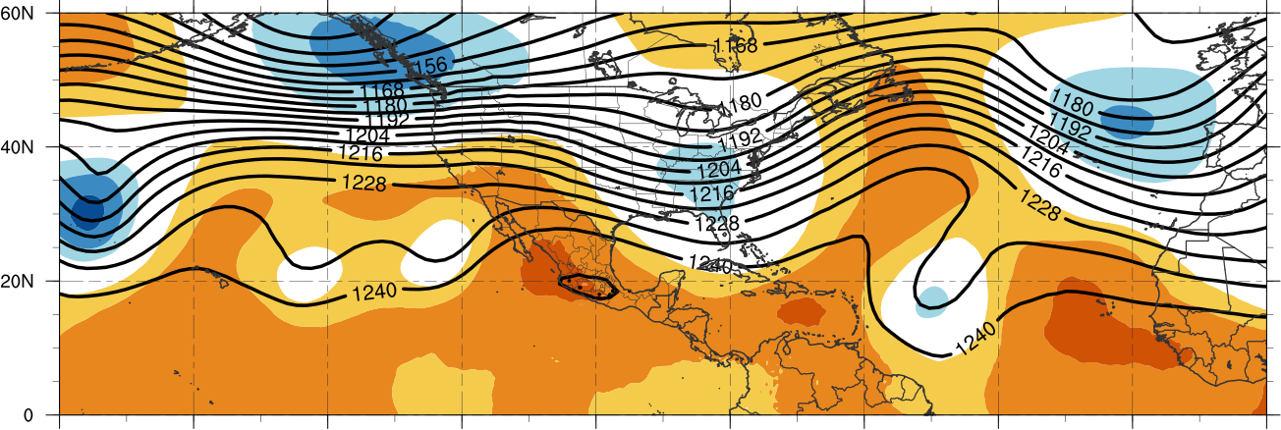
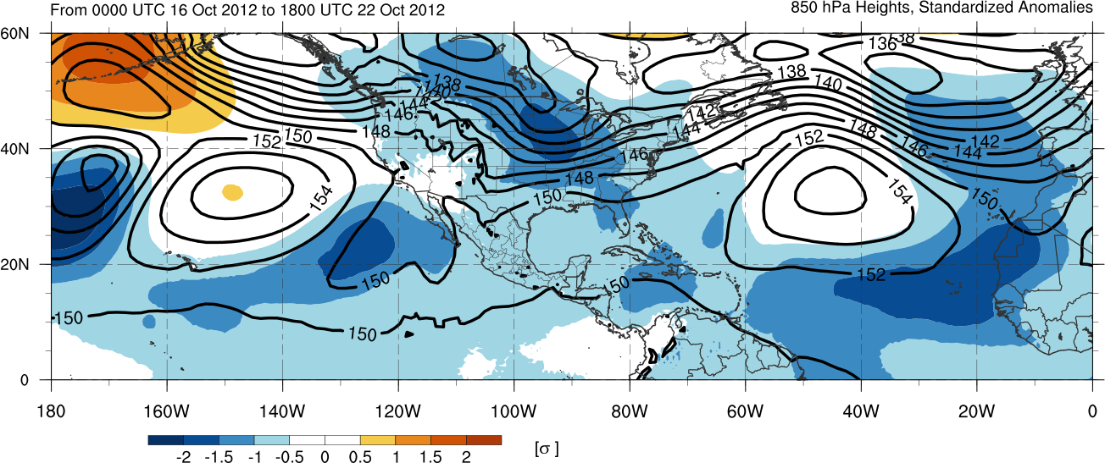
200-hPa Geopotential Height
850-hPa Geopotential Height
Mean and Standardized Anomalies 16–22 Oct 2012

Slide 7
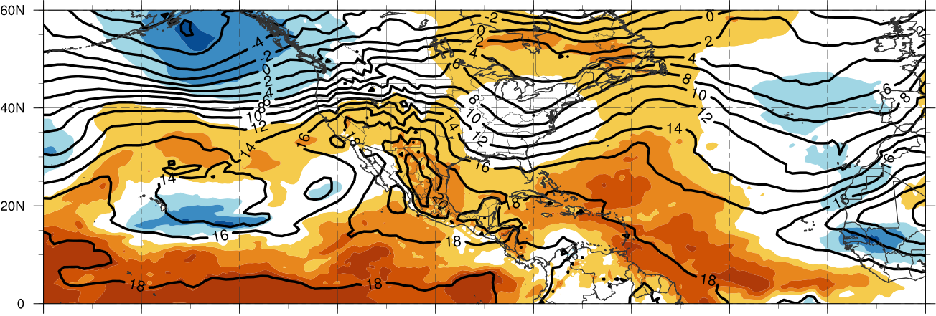
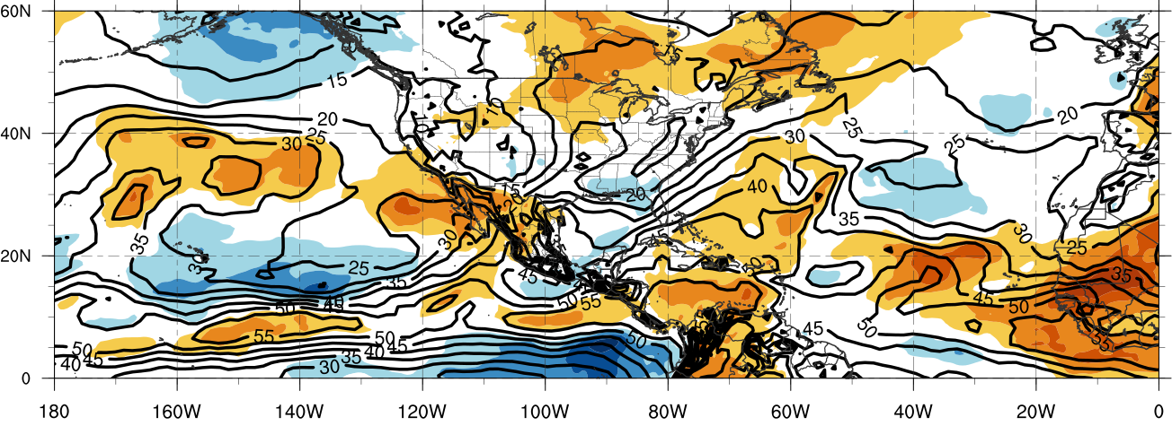
850-hPa Temperature
Precipitable Water
Mean and Standardized Anomalies 16–22 Oct 2012

Slide 8
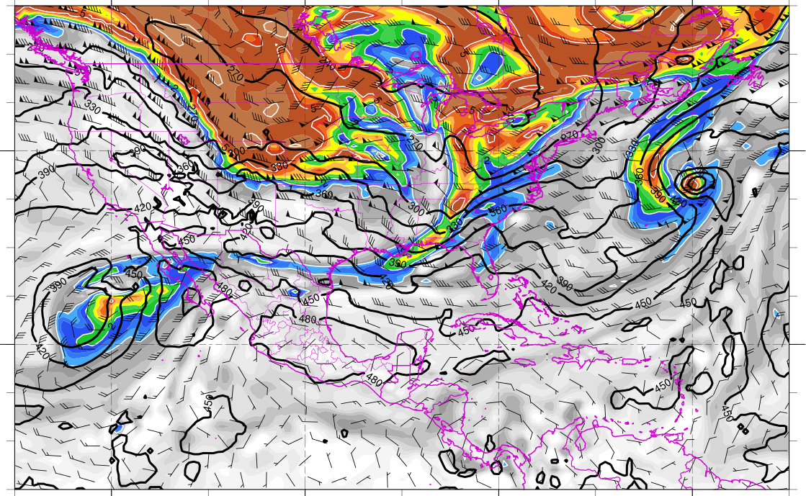
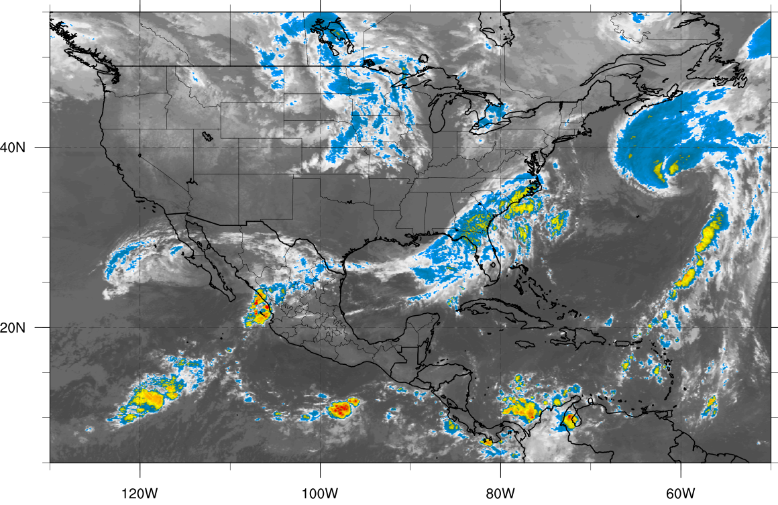
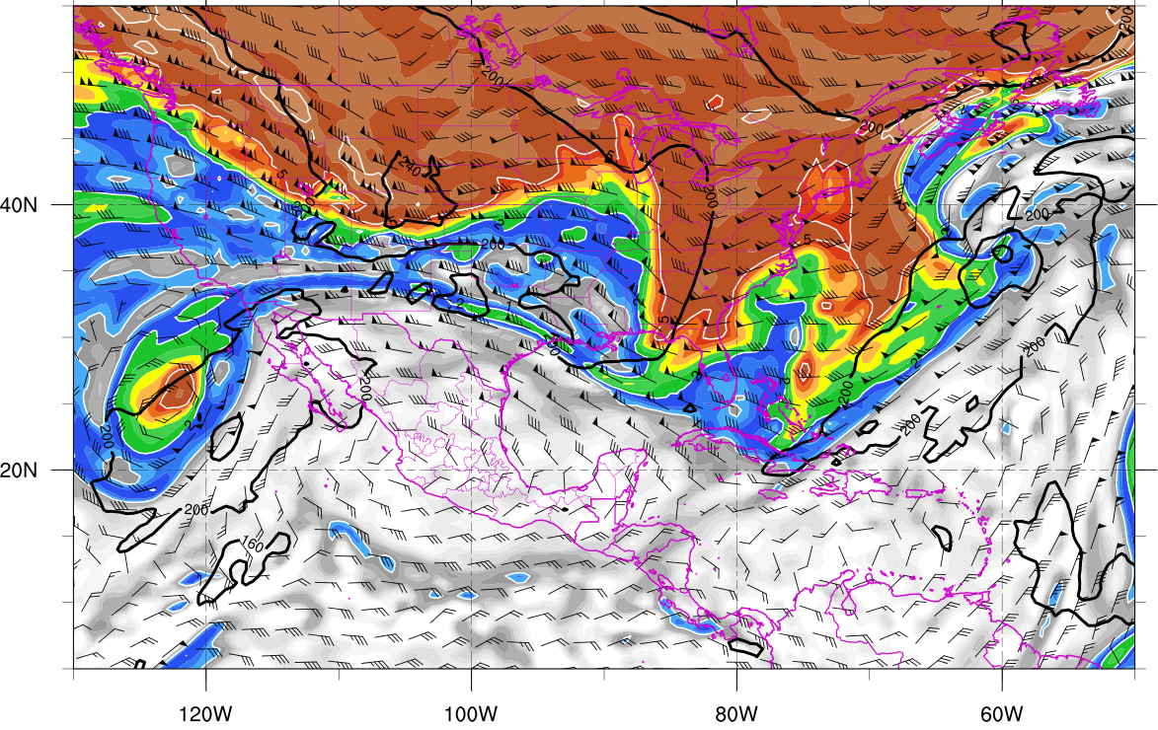
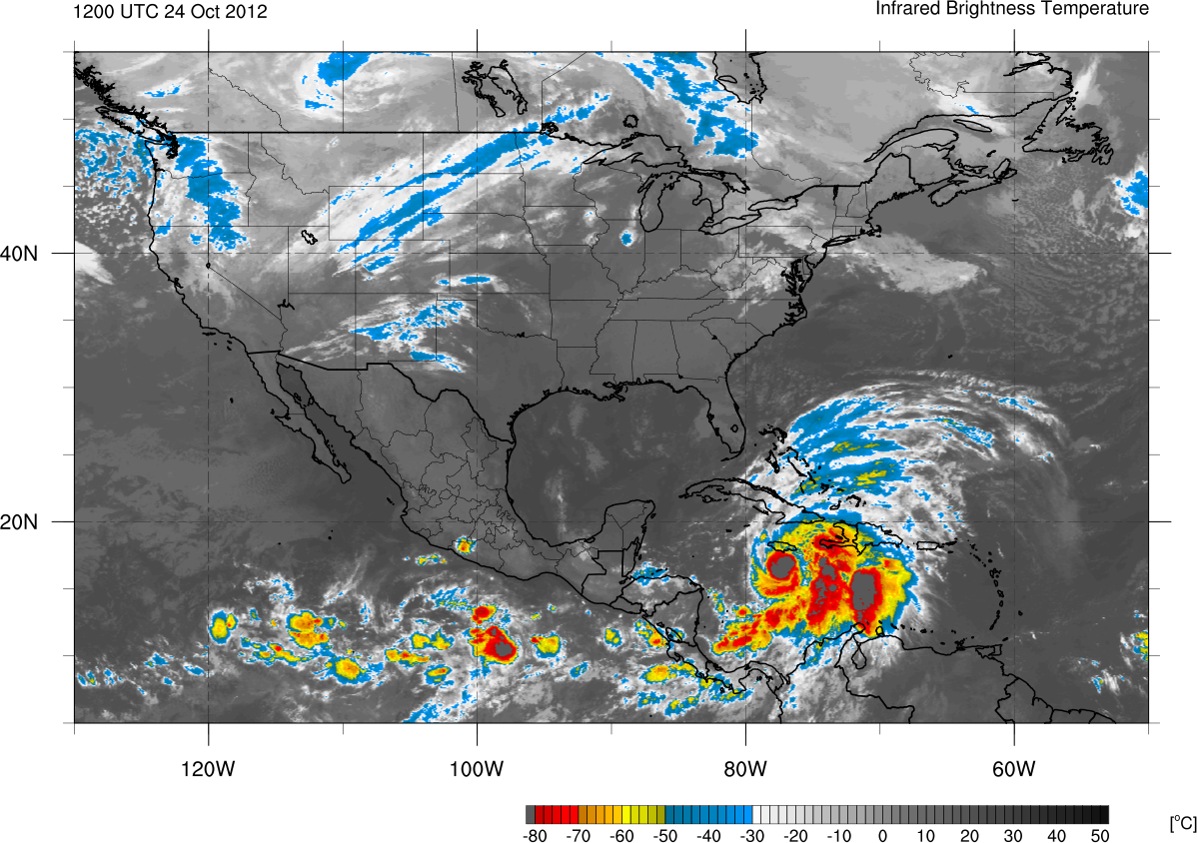
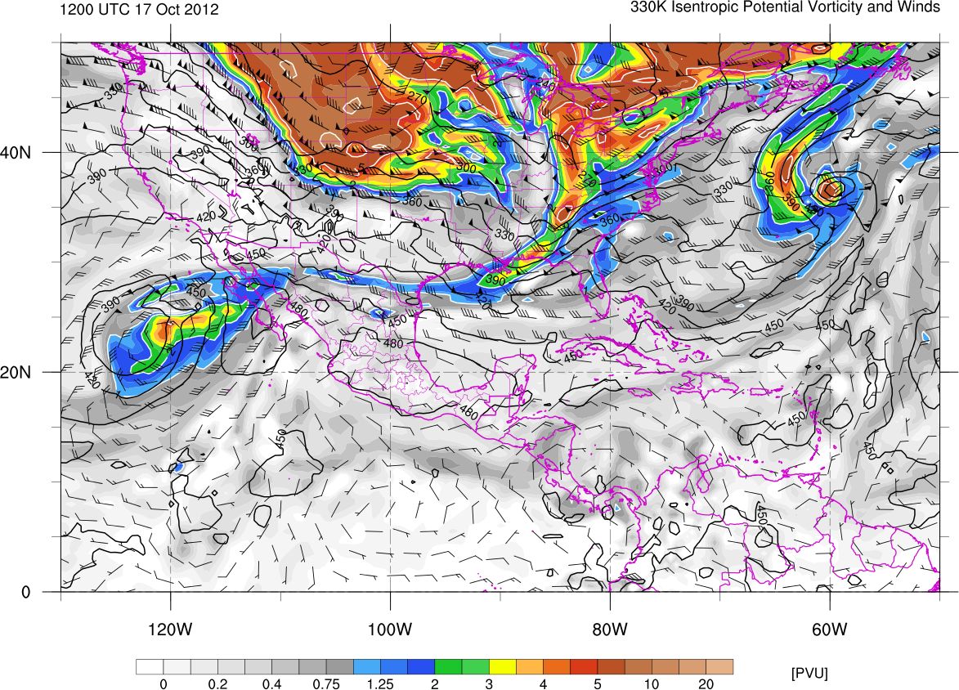
1200 UTC 17 October 2012
330K Surface
IR Satellite
350K Surface
Potential vorticity (shaded, PVU), pressure (contours, hPa),
winds (barbs, m s⁻¹)

Slide 9
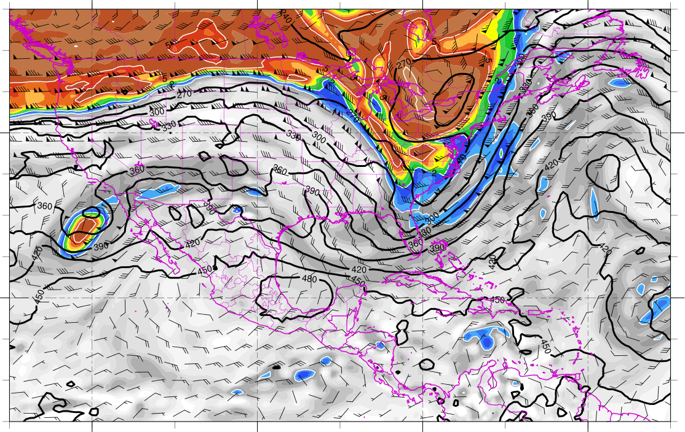
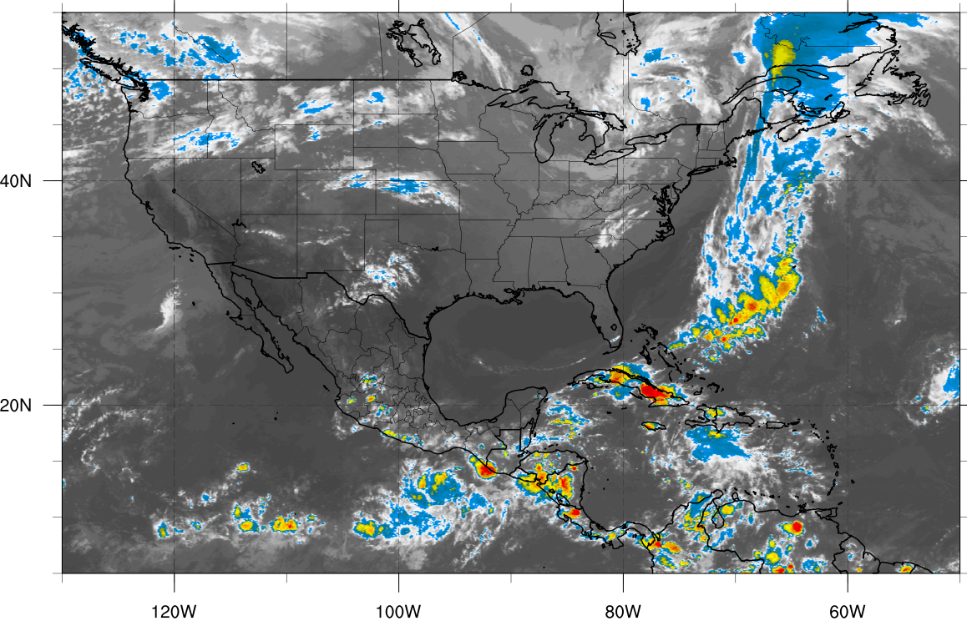
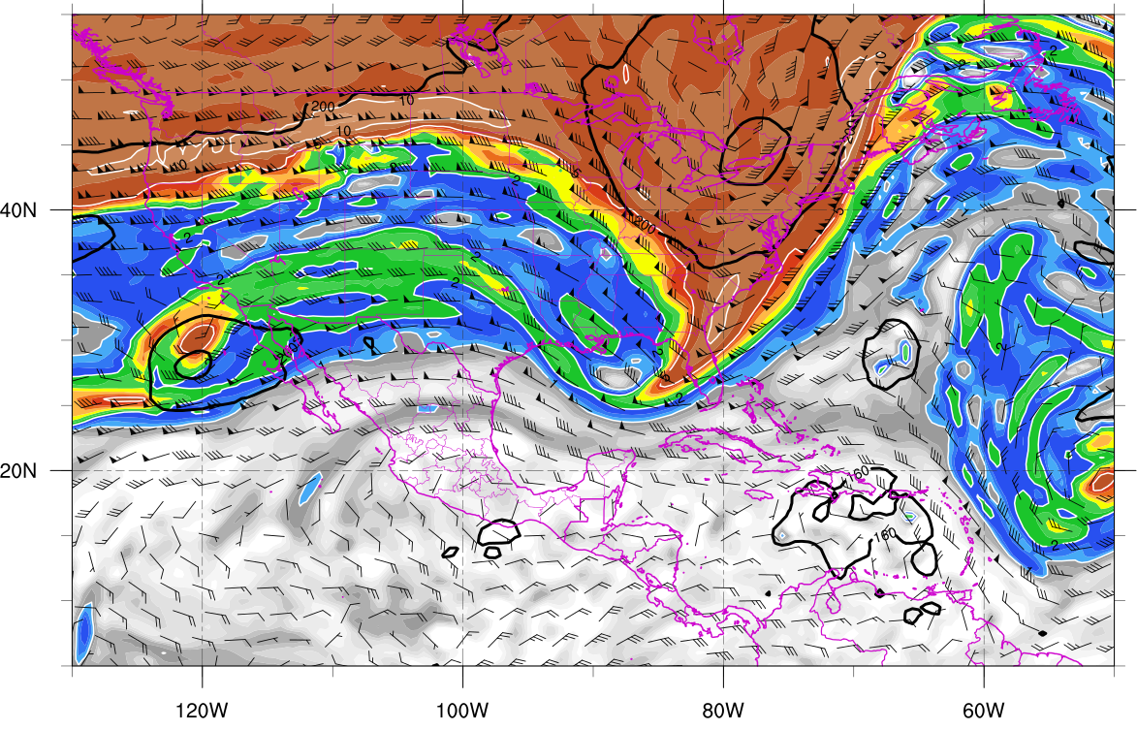
0000 UTC 21 October 2012
330K Surface
IR Satellite
350K Surface
Potential vorticity (shaded, PVU), pressure (contours, hPa),
winds (barbs, m s⁻¹)

Slide 10
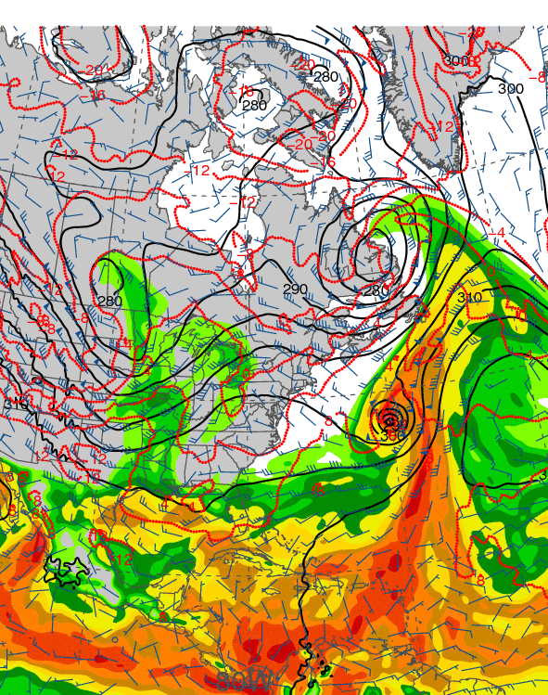
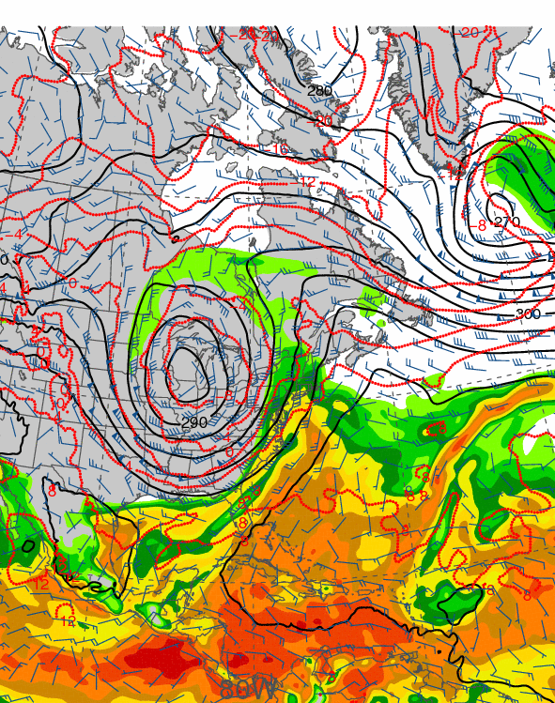
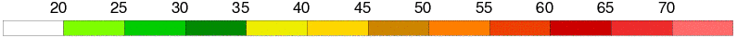
1200 UTC 17 October 2012
1200 UTC 19 October 2012
Precipitable water (shaded, mm); 700-hPa wind speed (barbs, kts), temperature
(dashed red contours, °C), and geopotential height (black solid contours, dam)

Slide 11
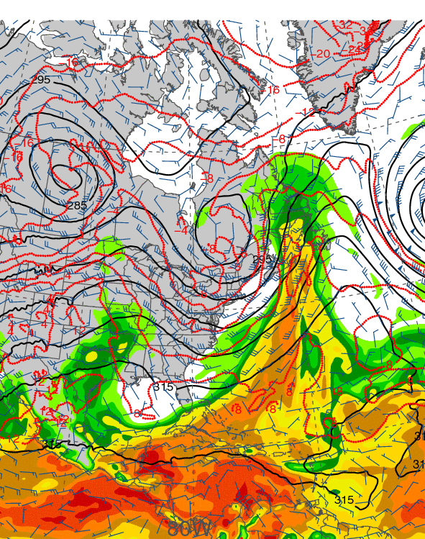
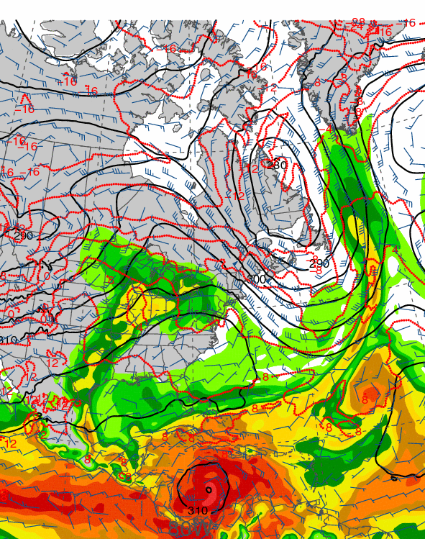
1200 UTC 21 October 2012
1200 UTC 23 October 2012
Precipitable water (shaded, mm); 700-hPa wind speed (barbs, kts), temperature
(dashed red contours, °C), and geopotential height (black solid contours, dam)

Slide 12
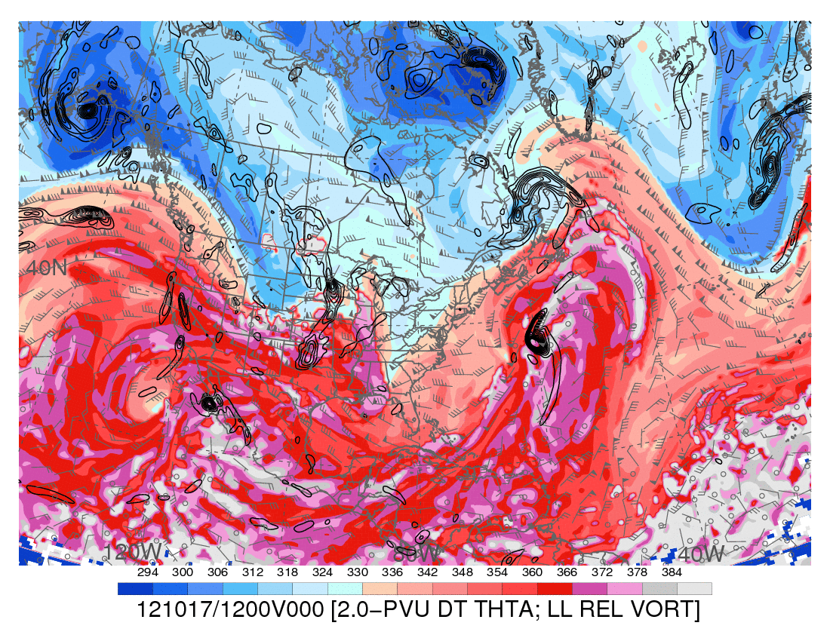
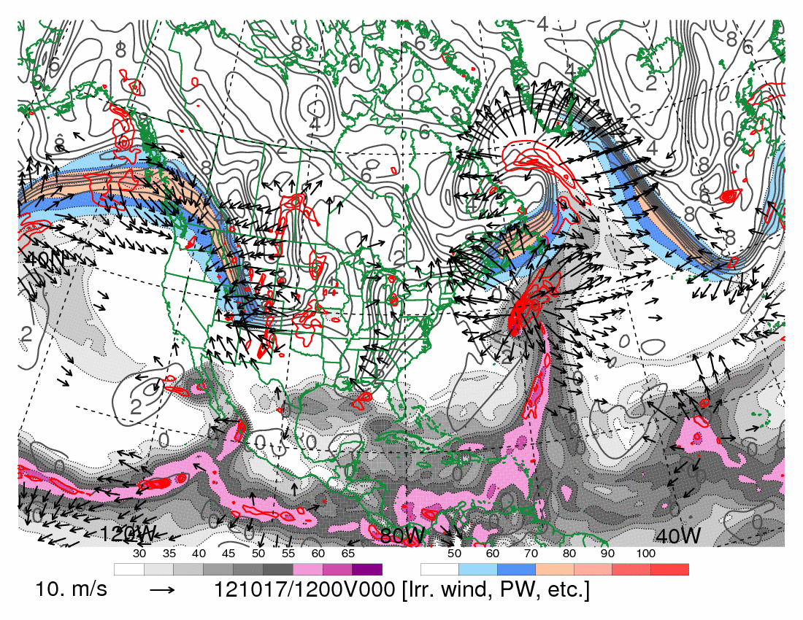
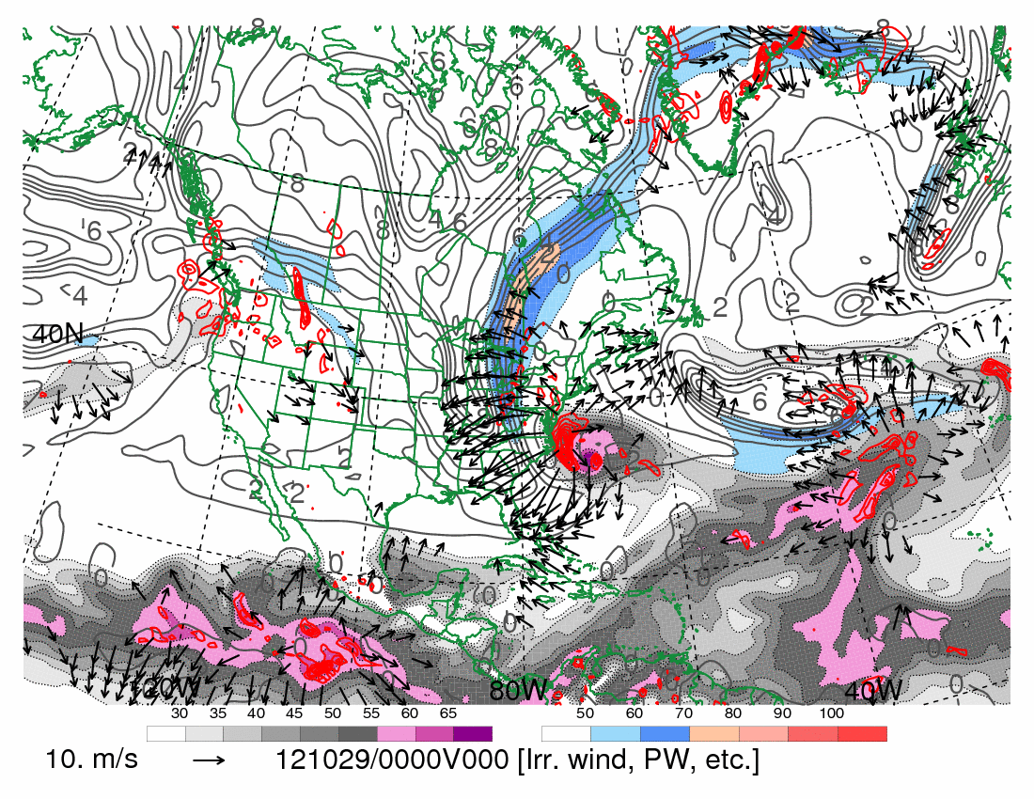
1200 UTC 17 October 2012
10.0 m s⁻¹
Dynamic tropopause (DT, 1.5-PVU surface) potential
temperature (shaded, K) and wind (barbs, kts),
925–850-hPa layer-averaged cyclonic relative vorticity
(black contours every 0.5 × 10⁻⁴ s⁻¹)
250-hPa wind speed (shaded, m s⁻¹), 300–200-hPa layer-averaged PV (gray contours, PVU), PW (gray scale, mm),
600–400-hPa layer-averaged ascent (red contours every
5.0 × 10⁻³ hPa s⁻¹), 250-hPa irrotational wind (vectors, m s⁻¹)

Slide 13
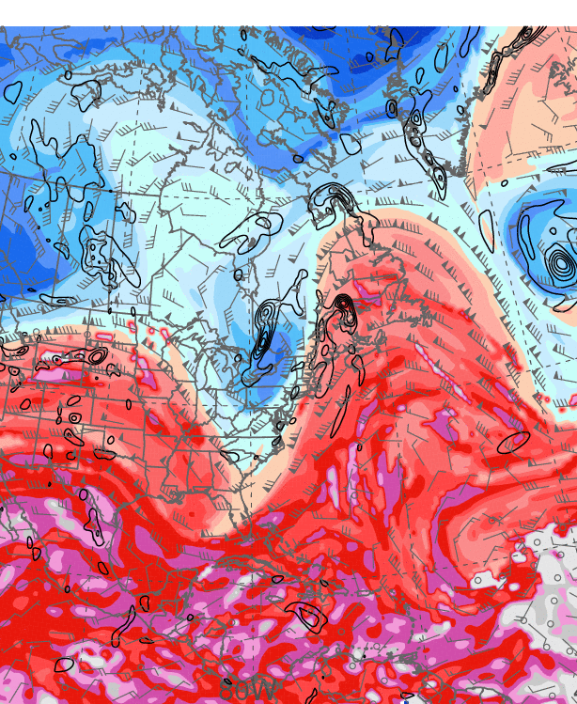
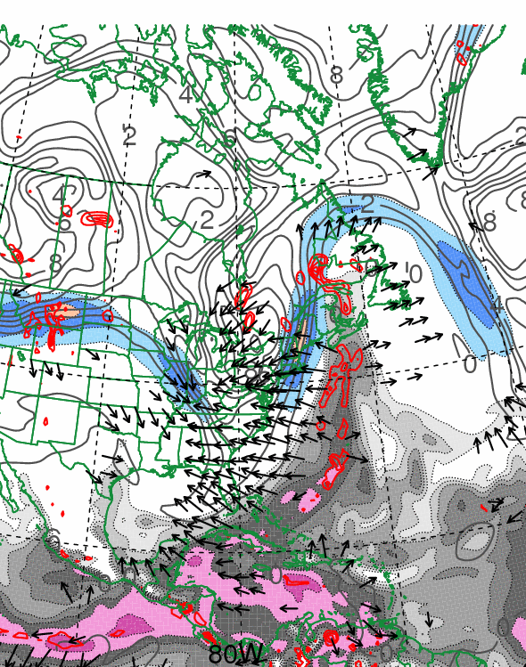
0000 UTC 21 October 2012
10.0 m s⁻¹
Dynamic tropopause (DT, 1.5-PVU surface) potential
temperature (shaded, K) and wind (barbs, kts),
925–850-hPa layer-averaged cyclonic relative vorticity
(black contours every 0.5 × 10⁻⁴ s⁻¹)
250-hPa wind speed (shaded, m s⁻¹), 300–200-hPa layer-averaged PV (gray contours, PVU), PW (gray scale, mm),
600–400-hPa layer-averaged ascent (red contours every
5.0 × 10⁻³ hPa s⁻¹), 250-hPa irrotational wind (vectors, m s⁻¹)

Slide 14
First Trough Interaction: Poleward Convective Cloud Expansion

Slide 15
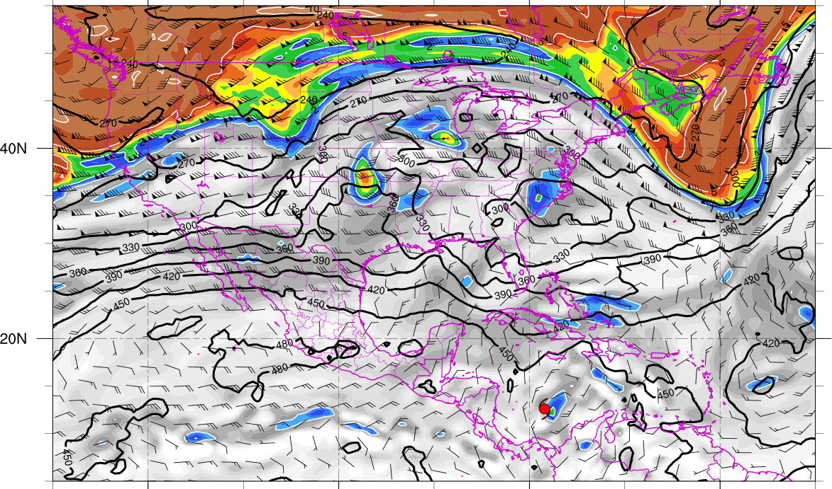
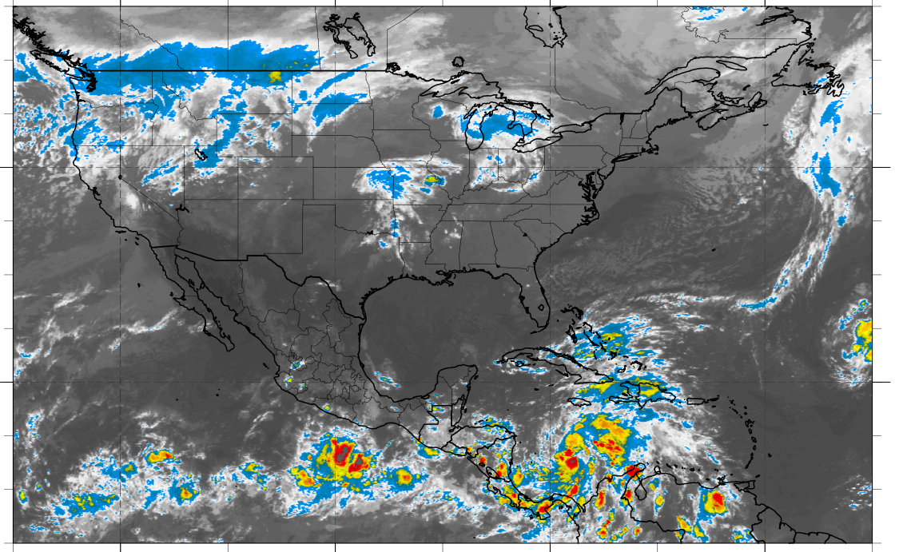
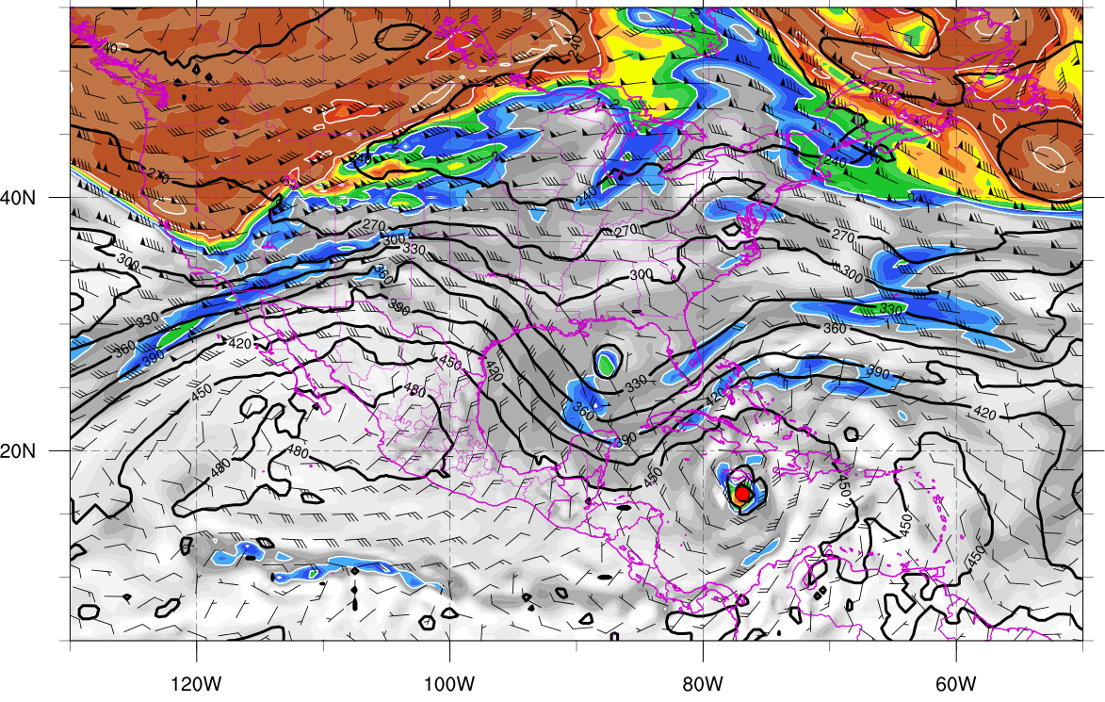
330K Surface and IR 0000 UTC 23 Oct
330K Surface and IR 1200 UTC 24 Oct
Potential vorticity (shaded, PVU), pressure (contours, hPa), winds (barbs, m s⁻¹)

Slide 16
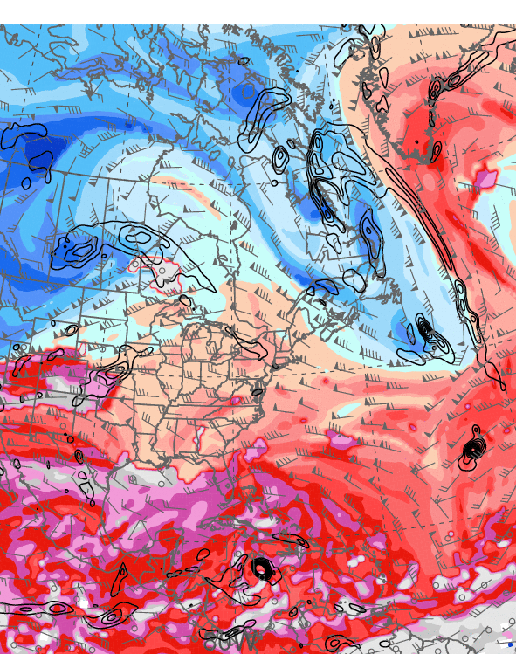
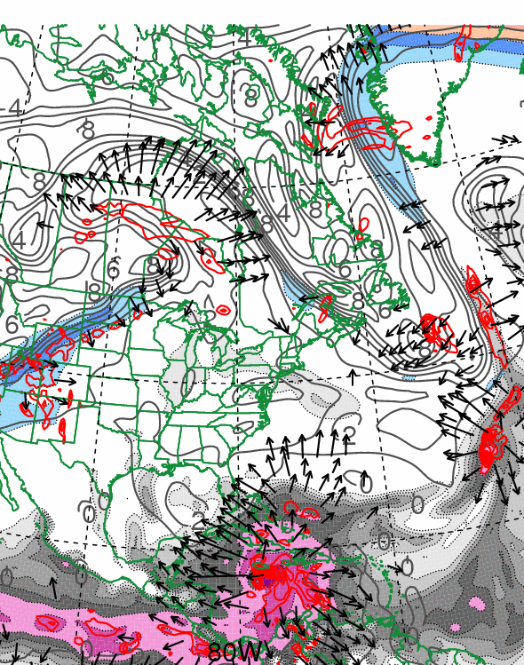
1200 UTC 24 October 2012
10.0 m s⁻¹
Dynamic tropopause (DT, 1.5-PVU surface) potential
temperature (shaded, K) and wind (barbs, kts),
925–850-hPa layer-averaged cyclonic relative vorticity
(black contours every 0.5 × 10⁻⁴ s⁻¹)
250-hPa wind speed (shaded, m s⁻¹), 300–200-hPa layer-averaged PV (gray contours, PVU), PW (gray scale, mm),
600–400-hPa layer-averaged ascent (red contours every
5.0 × 10⁻³ hPa s⁻¹), 250-hPa irrotational wind (vectors, m s⁻¹)

Slide 17
Second Trough Interaction:
First Westward Turn

Slide 18
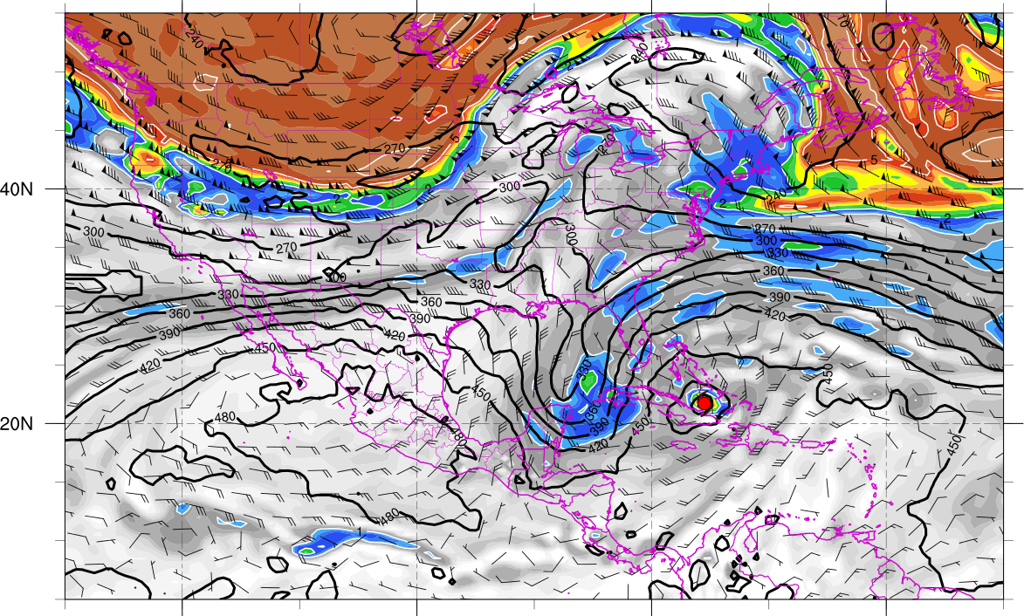
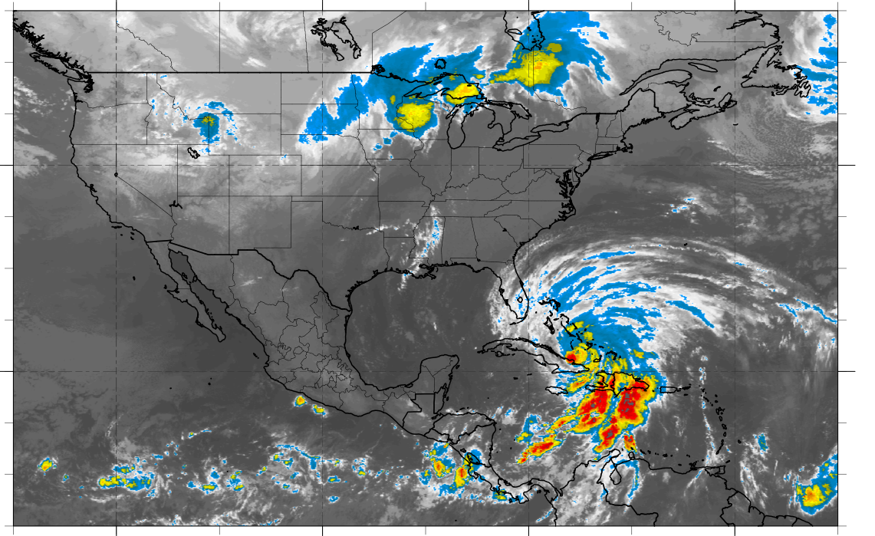
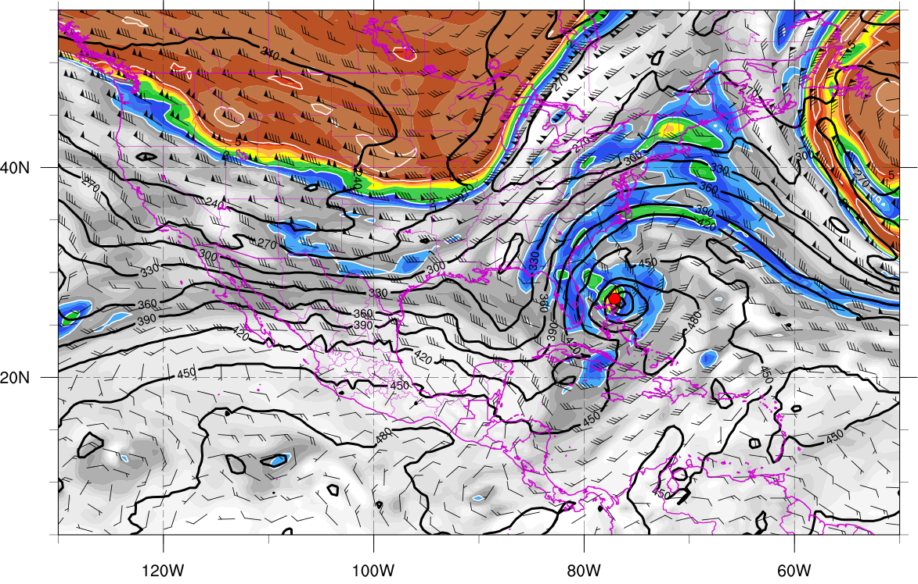
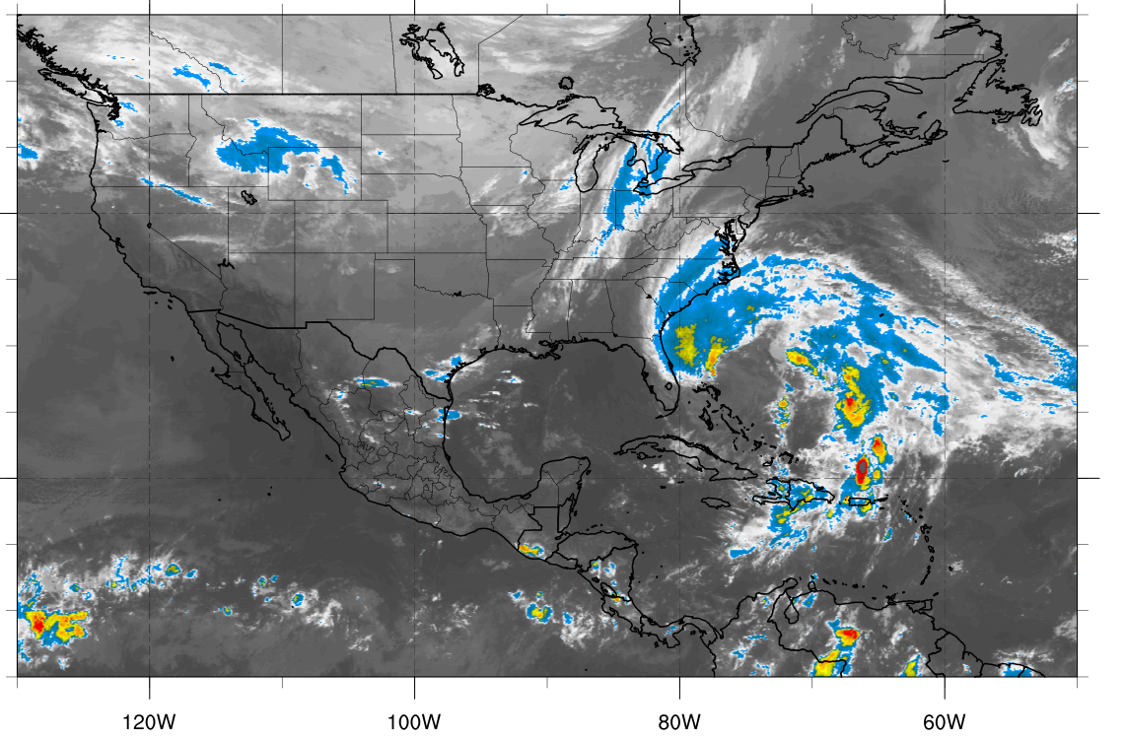
330K Surface and IR 1200 UTC 25 Oct
330K Surface and IR 0000 UTC 27 Oct
Potential vorticity (shaded, PVU), pressure (contours, hPa), winds (barbs, m s⁻¹)

Slide 19
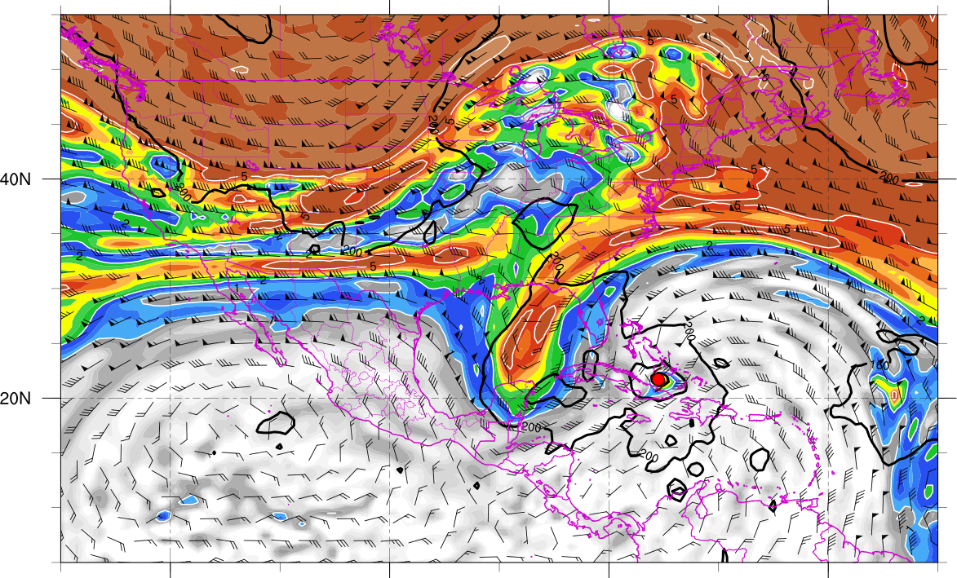
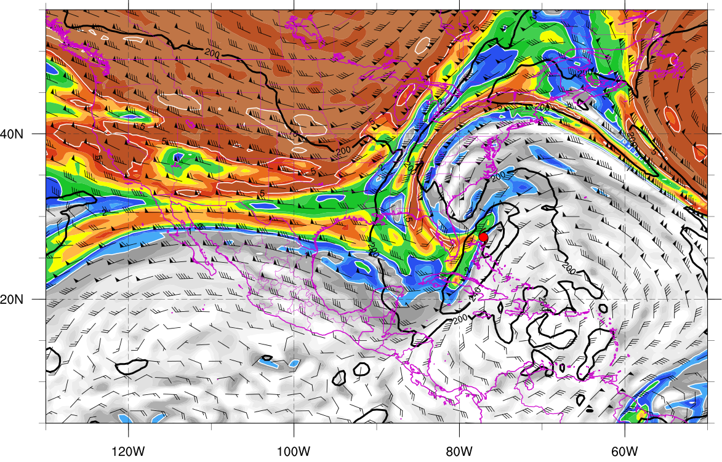
350K Surface and IR 1200 UTC 25 Oct
350K Surface and IR 0000 UTC 27 Oct
Potential vorticity (shaded, PVU), pressure (contours, hPa), winds (barbs, m s⁻¹)

Slide 20
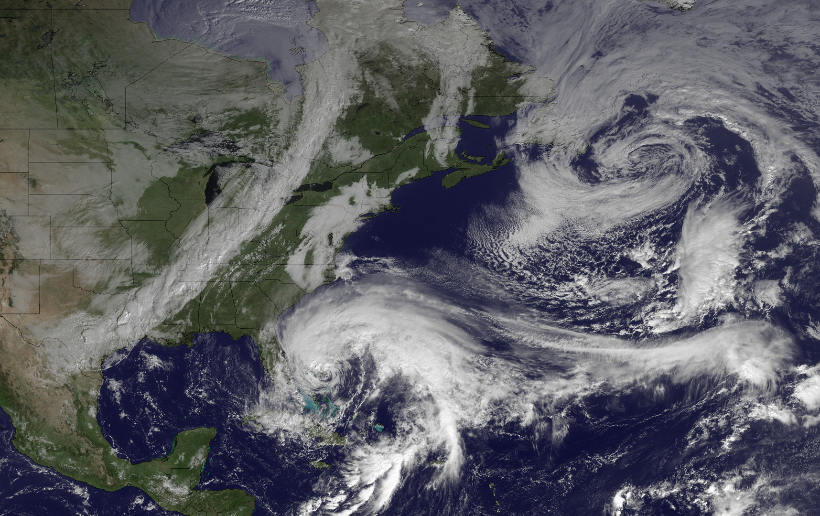
1445 UTC 26 October 2012
Image courtesy of the
NOAA’s Environmental
Visualization Laboratory

Slide 21
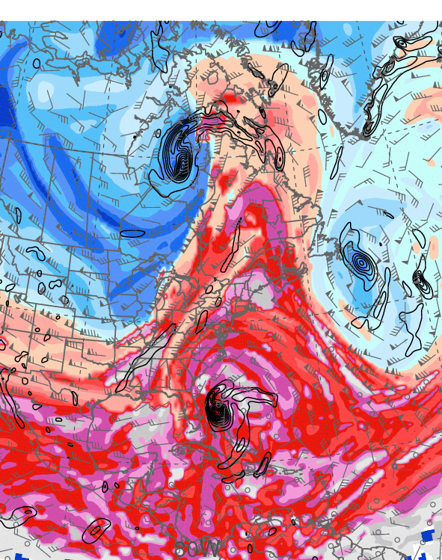
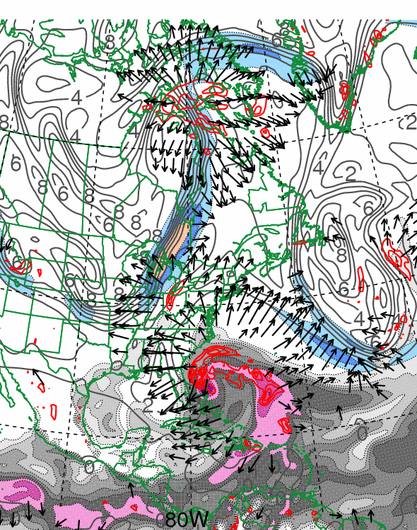
0000 UTC 27 October 2012
10.0 m s⁻¹
Dynamic tropopause (DT, 1.5-PVU surface) potential
temperature (shaded, K) and wind (barbs, kts),
925–850-hPa layer-averaged cyclonic relative vorticity
(black contours every 0.5 × 10⁻⁴ s⁻¹)
250-hPa wind speed (shaded, m s⁻¹), 300–200-hPa layer-averaged PV (gray contours, PVU), PW (gray scale, mm),
600–400-hPa layer-averaged ascent (red contours every
5.0 × 10⁻³ hPa s⁻¹), 250-hPa irrotational wind (vectors, m s⁻¹)

Slide 22
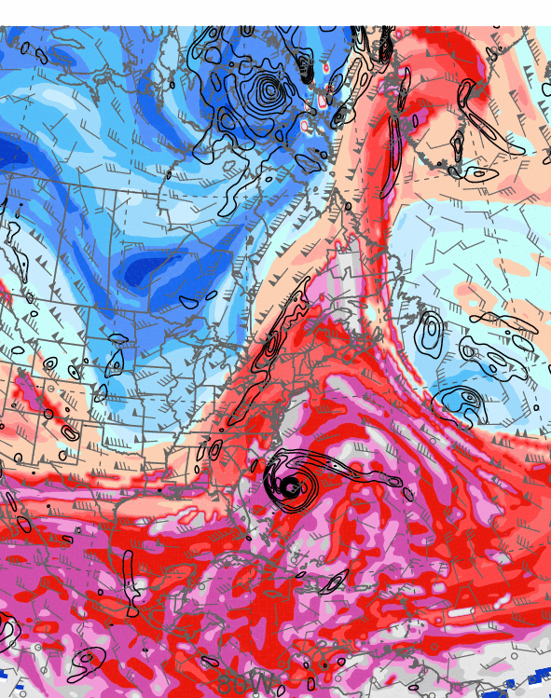
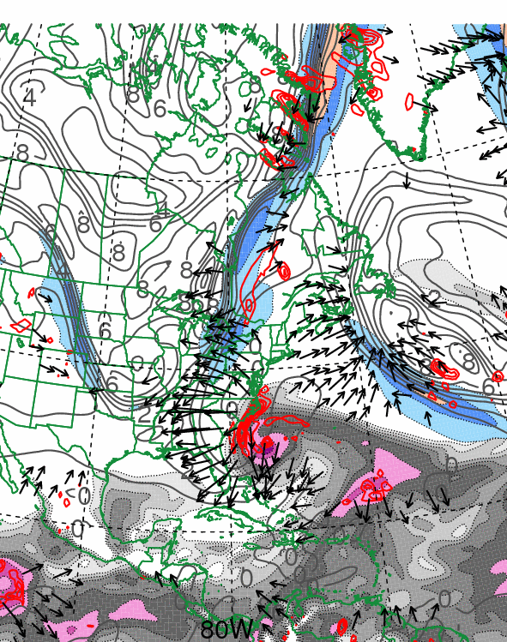
0000 UTC 28 October 2012
10.0 m s⁻¹
Dynamic tropopause (DT, 1.5-PVU surface) potential
temperature (shaded, K) and wind (barbs, kts),
925–850-hPa layer-averaged cyclonic relative vorticity
(black contours every 0.5 × 10⁻⁴ s⁻¹)
250-hPa wind speed (shaded, m s⁻¹), 300–200-hPa layer-averaged PV (gray contours, PVU), PW (gray scale, mm),
600–400-hPa layer-averaged ascent (red contours every
5.0 × 10⁻³ hPa s⁻¹), 250-hPa irrotational wind (vectors, m s⁻¹)

Slide 23
Third Trough Interaction:
Second Westward Turn and Landfall

Slide 24
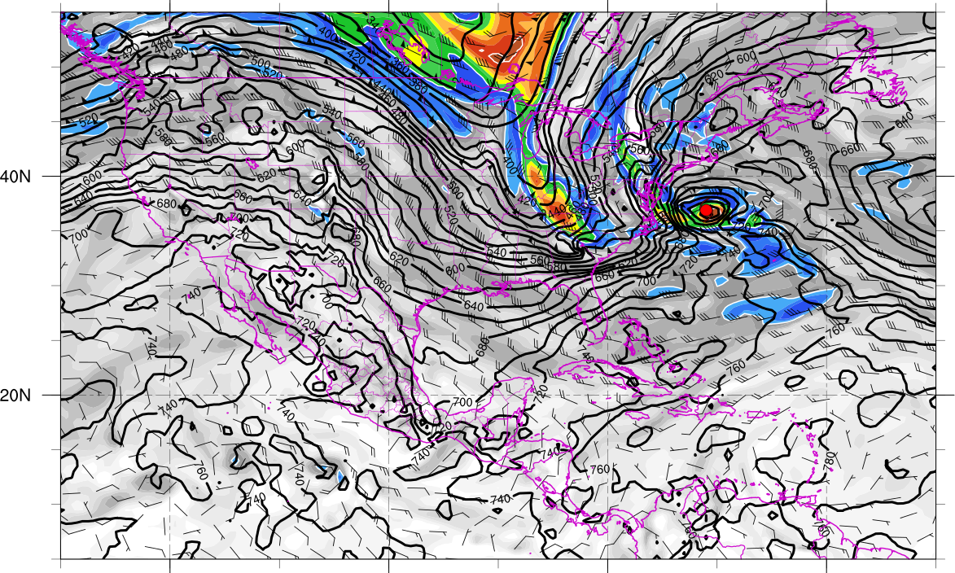
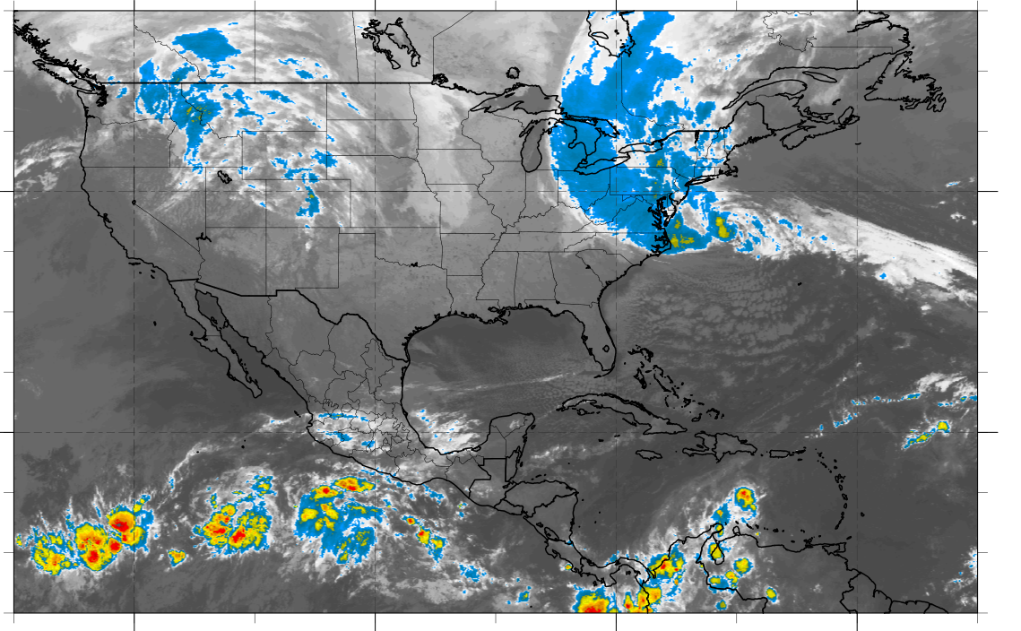
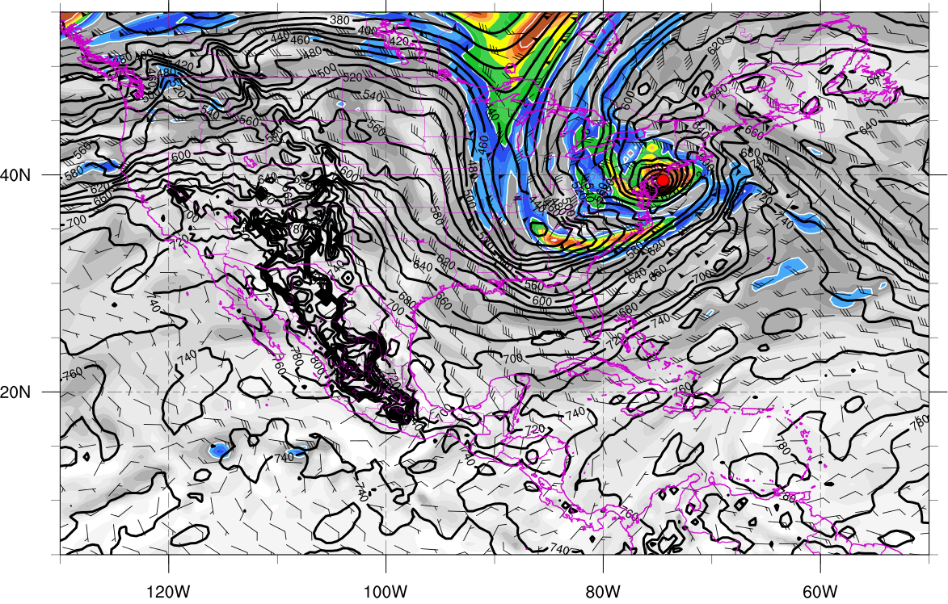
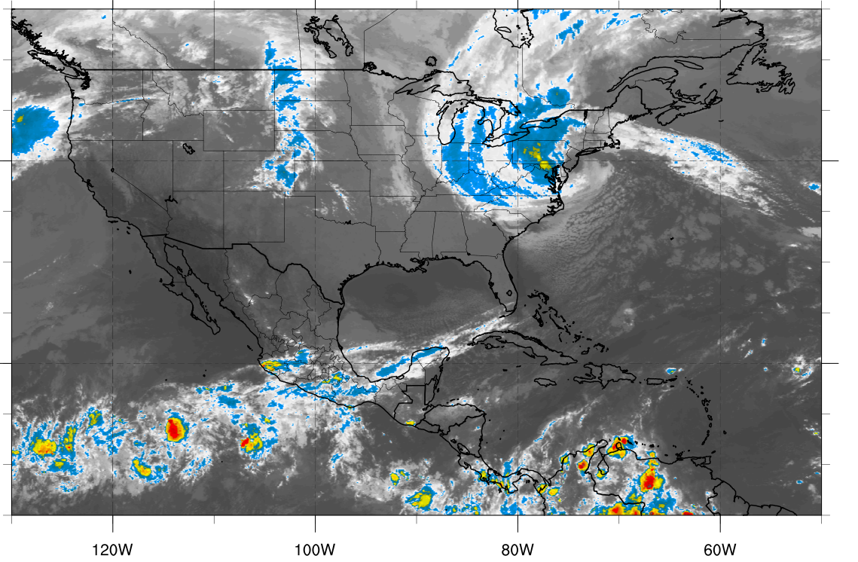
310K Surface and IR 1200 UTC 29 Oct
310K Surface and IR 0000 UTC 30 Oct
Potential vorticity (shaded, PVU), pressure (contours, hPa), winds (barbs, m s⁻¹)

Slide 25
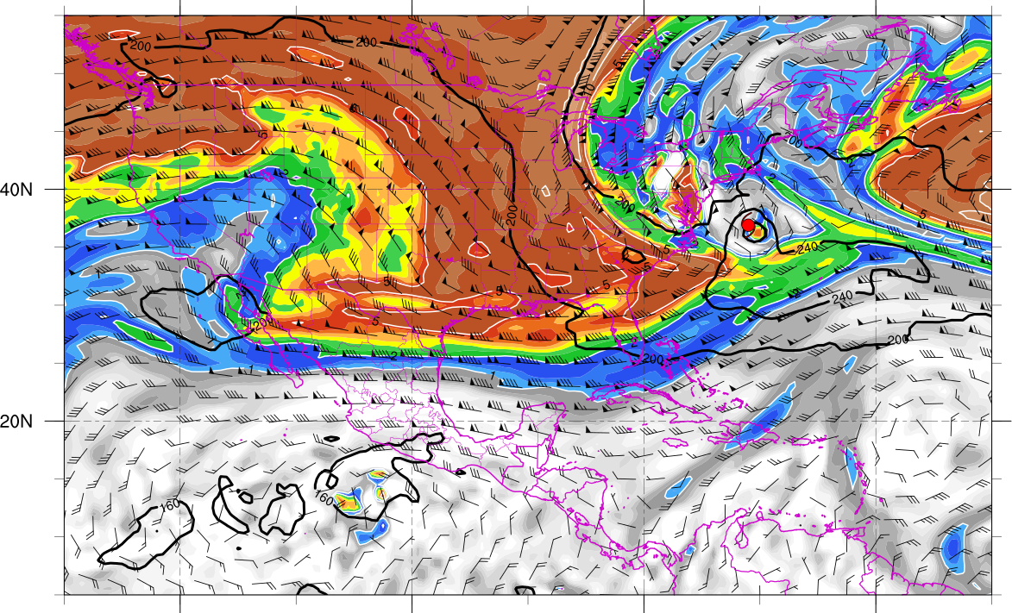
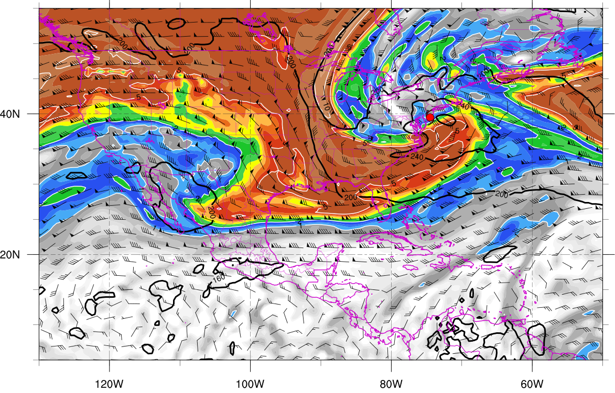
350K Surface and IR 1200 UTC 29 Oct
350K Surface and IR 0000 UTC 30 Oct
Potential vorticity (shaded, PVU), pressure (contours, hPa), winds (barbs, m s⁻¹)

Slide 26
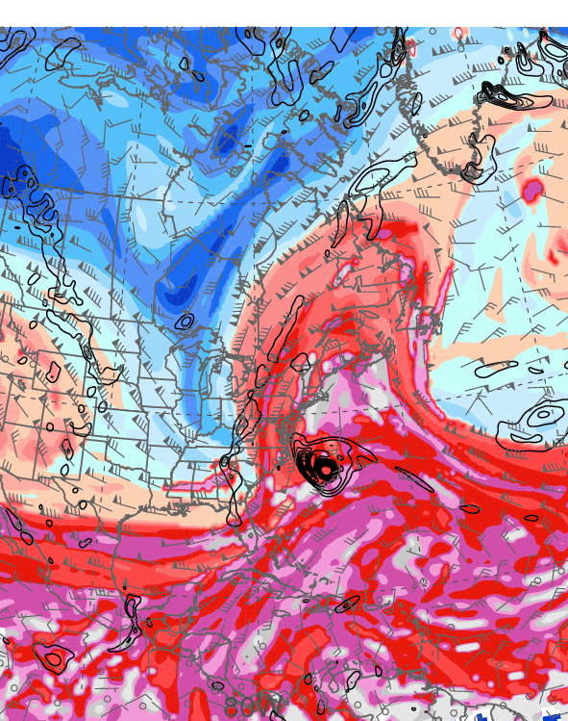
0000 UTC 29 October 2012
10.0 m s⁻¹
Dynamic tropopause (DT, 1.5-PVU surface) potential
temperature (shaded, K) and wind (barbs, kts),
925–850-hPa layer-averaged cyclonic relative vorticity
(black contours every 0.5 × 10⁻⁴ s⁻¹)
250-hPa wind speed (shaded, m s⁻¹), 300–200-hPa layer-averaged PV (gray contours, PVU), PW (gray scale, mm),
600–400-hPa layer-averaged ascent (red contours every
5.0 × 10⁻³ hPa s⁻¹), 250-hPa irrotational wind (vectors, m s⁻¹)

Slide 27
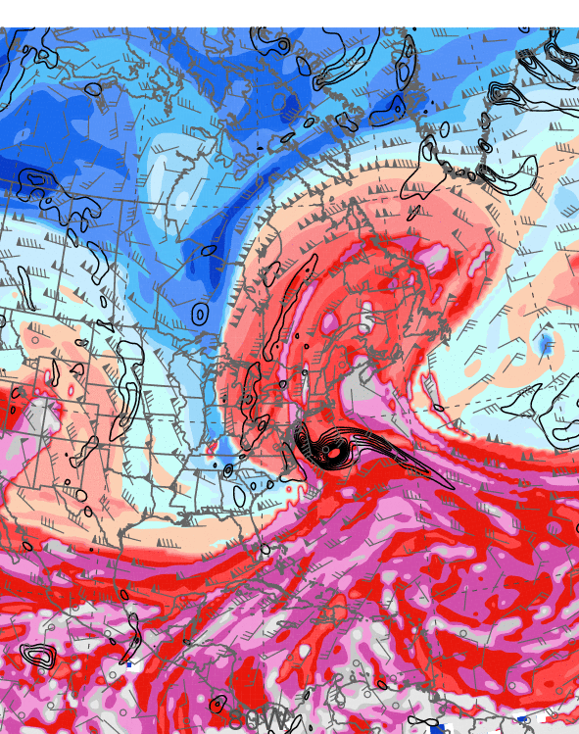
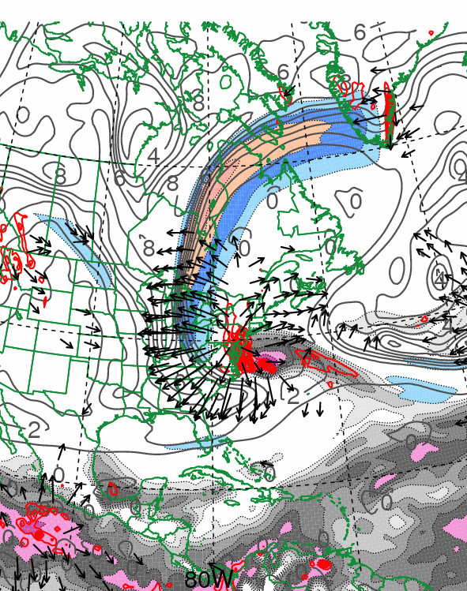
1200 UTC 29 October 2012
10.0 m s⁻¹
Dynamic tropopause (DT, 1.5-PVU surface) potential
temperature (shaded, K) and wind (barbs, kts),
925–850-hPa layer-averaged cyclonic relative vorticity
(black contours every 0.5 × 10⁻⁴ s⁻¹)
250-hPa wind speed (shaded, m s⁻¹), 300–200-hPa layer-averaged PV (gray contours, PVU), PW (gray scale, mm),
600–400-hPa layer-averaged ascent (red contours every
5.0 × 10⁻³ hPa s⁻¹), 250-hPa irrotational wind (vectors, m s⁻¹)

Slide 28
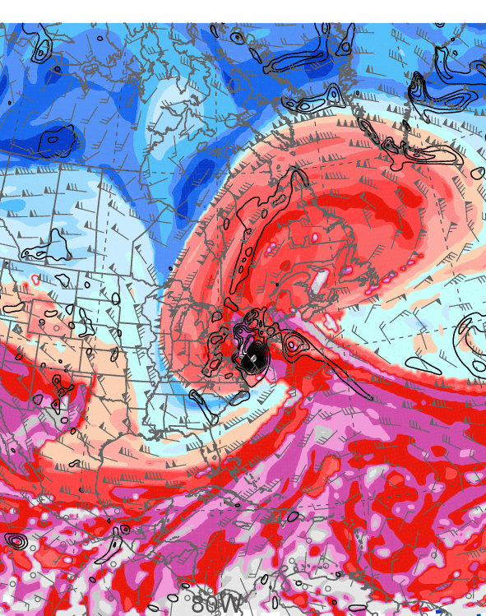
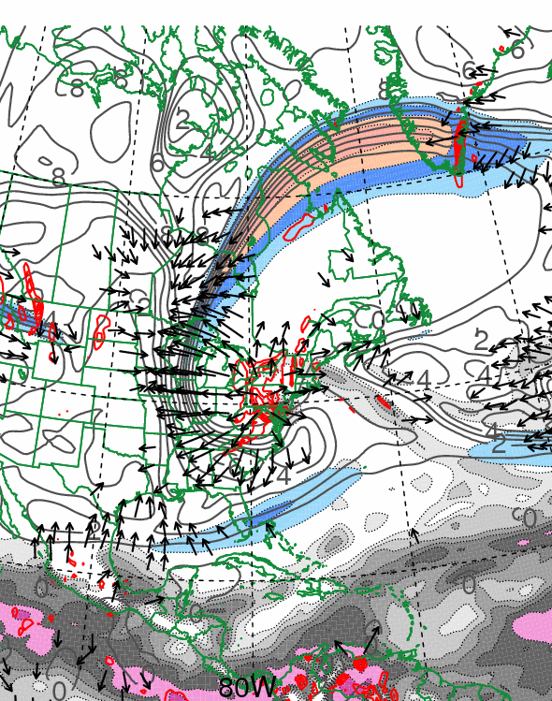
0000 UTC 30 October 2012
10.0 m s⁻¹
Dynamic tropopause (DT, 1.5-PVU surface) potential
temperature (shaded, K) and wind (barbs, kts),
925–850-hPa layer-averaged cyclonic relative vorticity
(black contours every 0.5 × 10⁻⁴ s⁻¹)
250-hPa wind speed (shaded, m s⁻¹), 300–200-hPa layer-averaged PV (gray contours, PVU), PW (gray scale, mm),
600–400-hPa layer-averaged ascent (red contours every
5.0 × 10⁻³ hPa s⁻¹), 250-hPa irrotational wind (vectors, m s⁻¹)

Slide 29
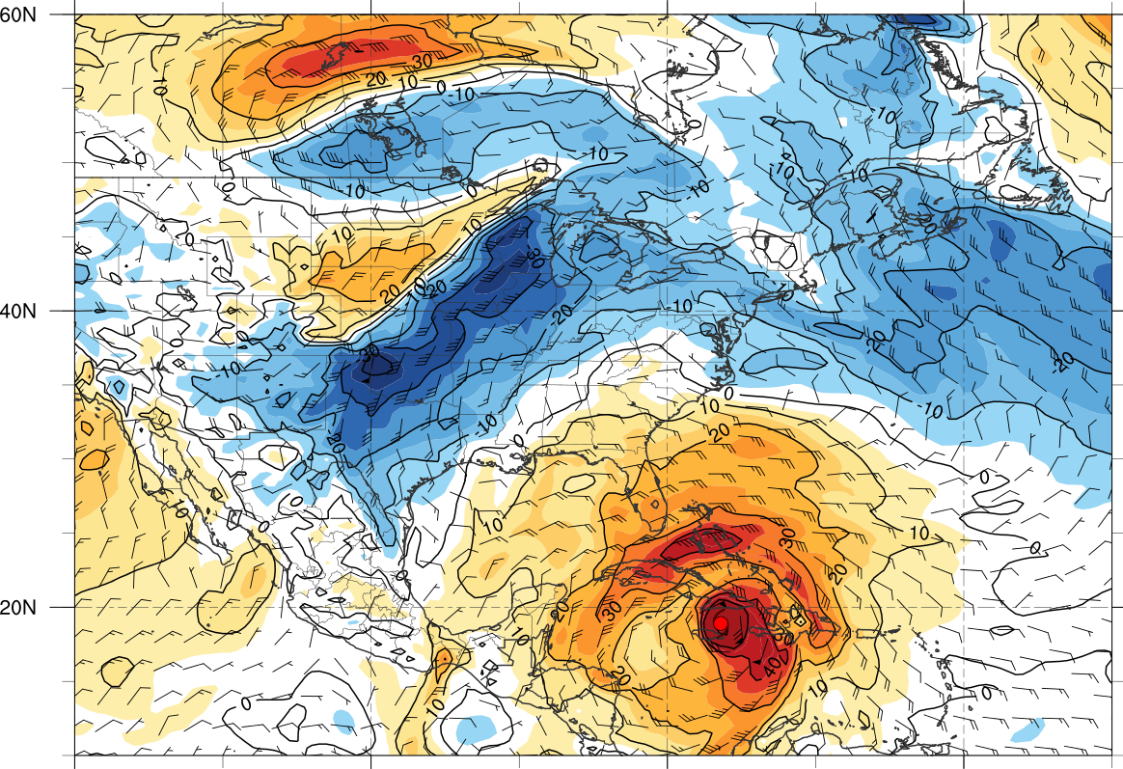




850-hPa tangential wind (shaded) and total wind (barbs) centered on TC Sandy
0000 UTC 25 Oct
0000 UTC 27 Oct
0000 UTC 28 Oct
0000 UTC 30 Oct

Slide 30
Sandy (2012), Hazel (1954) and the 1938 New England Hurricane: A Perspective

Slide 31







Sandy: 1800 UTC 21 October – 1200 UTC 31 October 2012
Hazel: 0600 UTC 5 October – 1200 UTC 18 October 1954
1938 New England Hurricane: 1200 UTC 9 September – 0000 UTC 23 September 1938
Low pressure
Tropical depression
Tropical storm
Hurricane (Sandy)
Hurricane (Hazel)
Hurricane (38-Hurr)
Extratropical (Sandy)
Extratropical (Hazel)
Extratropical (38-Hurr)
Sandy
Hazel
1938 New England Hurricane

Slide 32



0000 UTC 15 October 1954
0000 UTC 16 October 1954
250-hPa wind speed (shaded, m s⁻¹), temperature (dashed red contours, °C),
and geopotential height (black solid contours, dam)

Slide 33


0000 UTC 15 October 1954
0000 UTC 16 October 1954
250-hPa wind speed (shaded, m s⁻¹), 1000–500-hPa thickness (dashed red/blue contours, dam), and mean sea level pressure (black solid contours, hPa)

Slide 34


0000 UTC 15 October 1954
0000 UTC 16 October 1954
850-hPa frontogenesis [shaded, K (100 km) ⁻¹ (3 h) ⁻¹], temperature (dashed red contours, °C), and geopotential height (black solid contours, dam)

Slide 35


0000 UTC 21 September 1938
0000 UTC 22 September 1938
250-hPa wind speed (shaded, m s⁻¹), temperature (dashed red contours, °C),
and geopotential height (black solid contours, dam)

Slide 36


0000 UTC 21 September 1938
0000 UTC 22 September 1938
250-hPa wind speed (shaded, m s⁻¹), 1000–500-hPa thickness (dashed red/blue contours, dam), and mean sea level pressure (black solid contours, hPa)

Slide 37


0000 UTC 21 September 1938
0000 UTC 22 September 1938
850-hPa frontogenesis [shaded, K (100 km) ⁻¹ (3 h) ⁻¹], temperature (dashed red contours, °C), and geopotential height (black solid contours, dam)

Slide 38
Synopsis of Sandy Trough Interactions
(m s⁻¹)
330–335K layer-averaged 0.4 (blue), 0.8 (purple), and 2.0 (red) PVU curves for 1200 UTC 23 Oct, 1200 UTC 27 Oct, and 1800 UTC 29 Oct 2012, respectively. 925–850-hPa layer-averaged cyclonic relative vorticity (black contours every 0.5 × 10⁻⁴ s⁻¹). 250-hPa wind speed (shaded, m s⁻¹) at 1800 UTC 29 Oct 2012. Inset shows total rainfall (snowfall) in green (blue) shading in inches (adapted from NOAA/NWS/WPC).

Slide 39
Conclusions
Antecedent baroclinic zone over Gulf of Mexico supports warm-air advection with first trough interaction and results in a poleward cloud expansion
Sandy expands in size, but remains warm core as it turns northwestward during second trough interaction
Sandy-induced westward-directed negative PV advection helps to establish a well-defined PV hook during third trough interaction
“Sandy-like” storm tracks have occurred previously (e.g., Hazel 1954 and the 1938 New England Hurricane)

