Slide 1
Hurricane Sandy (2012):
A Multiscale Trough Interaction Perspective
Lance F. Bosart, Alicia M. Bentley, Chip N. Helms, and Philippe P. Papin
Department of Atmospheric and Environmental Sciences
University at Albany, State University of New York, Albany, NY 12222
31st Conference on Hurricanes and Tropical Meteorology
San Diego, California
Tuesday 1 April 2014
Support provided by NSF Grant AGS-1240502

Slide 2
Motivation
Hurricane Sandy, a storm of historical proportions, provided a serendipitous research opportunity to examine a well-sampled and well-documented storm from pre-genesis to post-landfall (soup-to-nuts).
Noteworthy aspects of Hurricane Sandy's lifecycle included multiple trough interactions, an unusual "Hazel (1954)-like" track, and an unprecedented post-landfall Appalachian snowstorm.

Slide 3
Outline
Pre-genesis environment
First trough interaction
Second trough interaction
Third trough interaction
Sandy vs. Hazel (1954) and 38’ Hurricane
Conclusions

Slide 4
Sandy Track Map
0000 UTC 16 October – 1800 UTC 2 November 2012

Slide 5
Pre-Genesis Environment

Slide 6
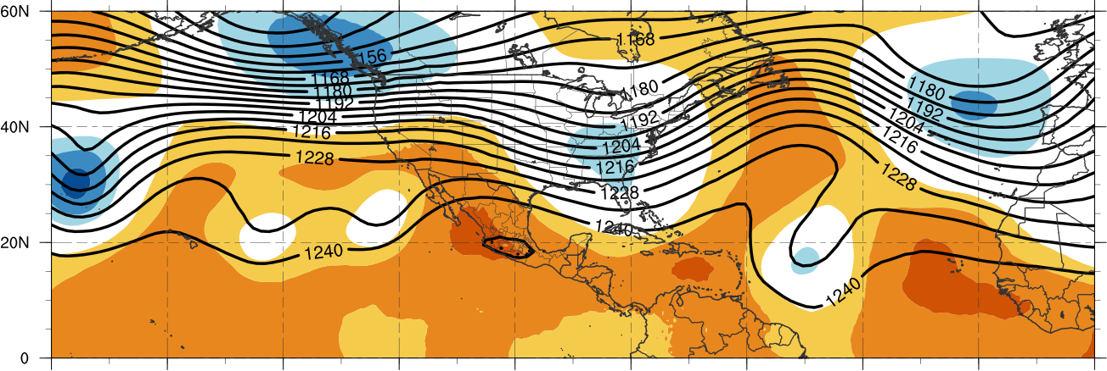
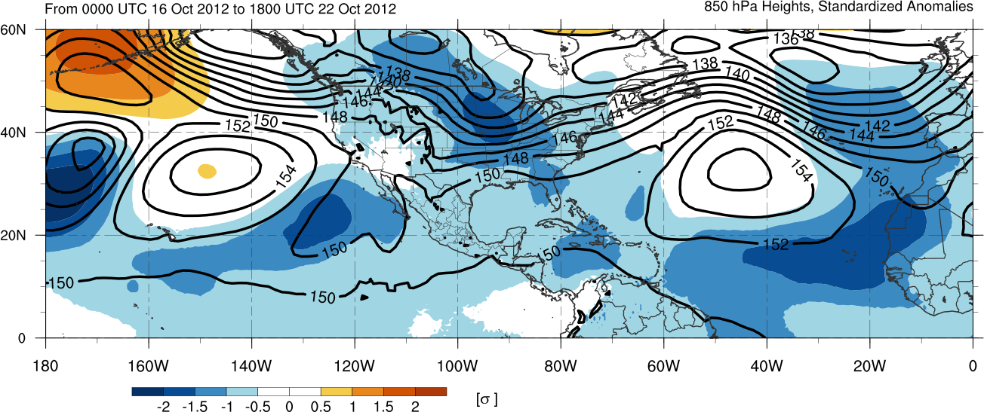
200-hPa Geopotential Height
850-hPa Geopotential Height
Mean and Standardized Anomalies 16–22 Oct 2012

Slide 7
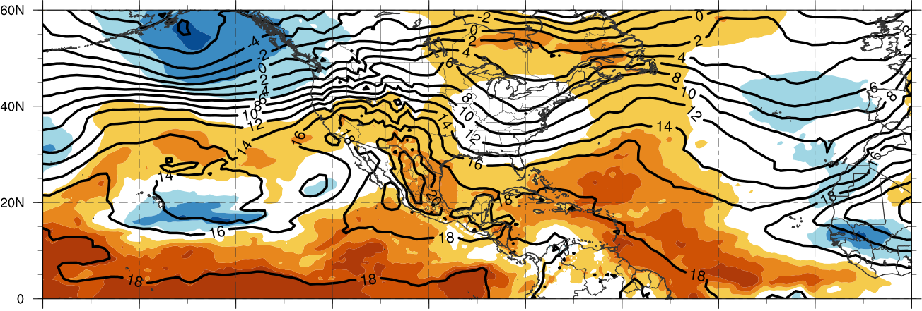
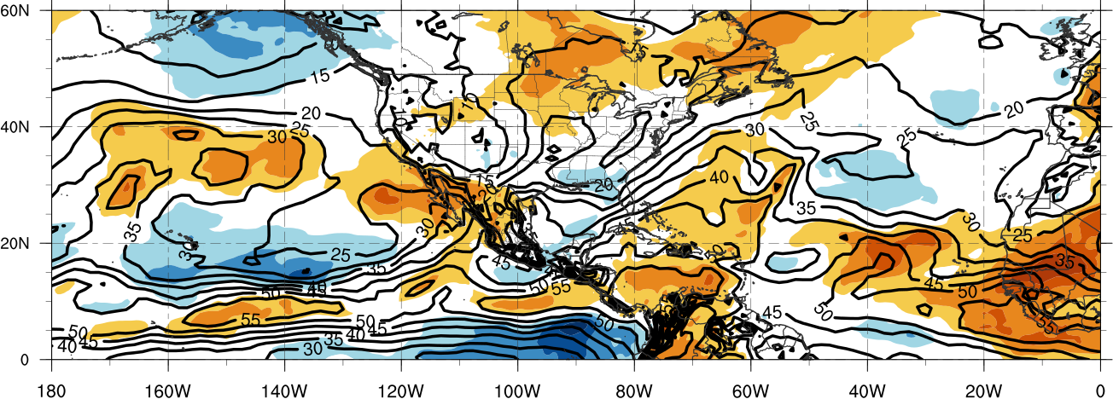
850-hPa Temperature
Precipitable Water
Mean and Standardized Anomalies 16–22 Oct 2012

Slide 8
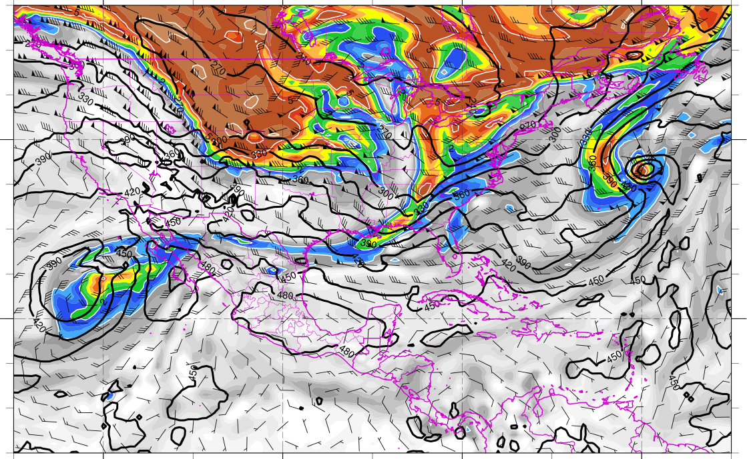
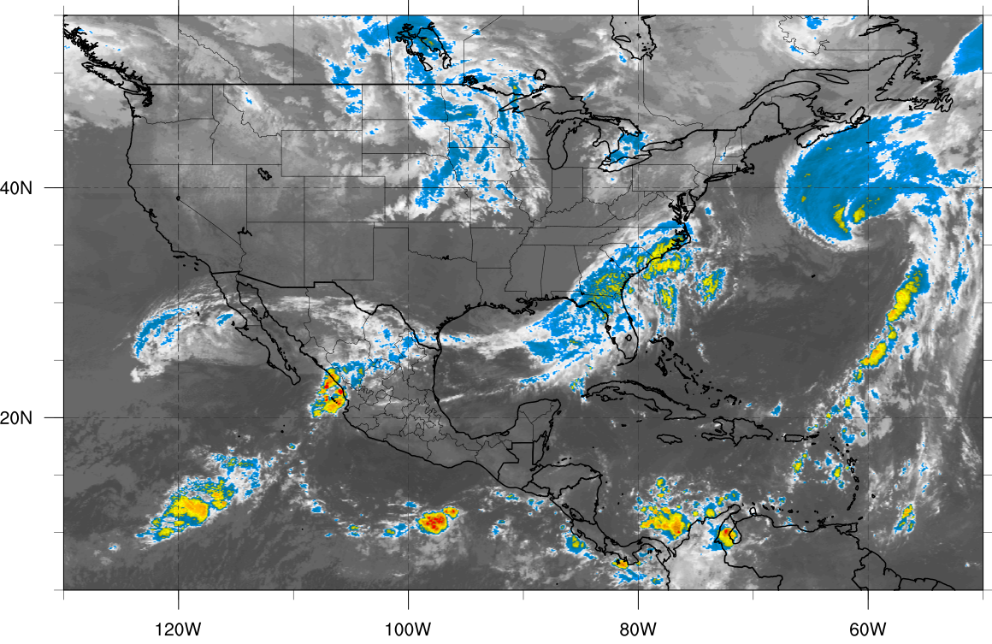
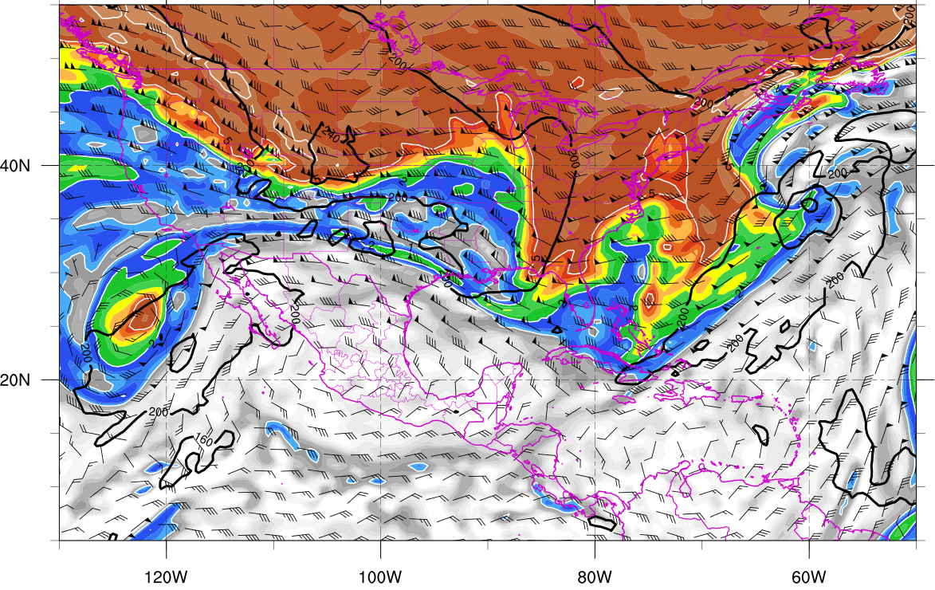
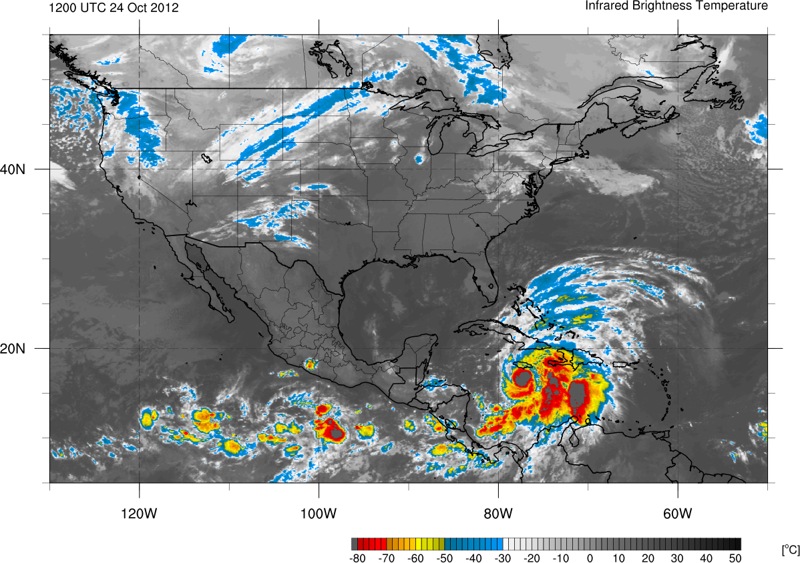
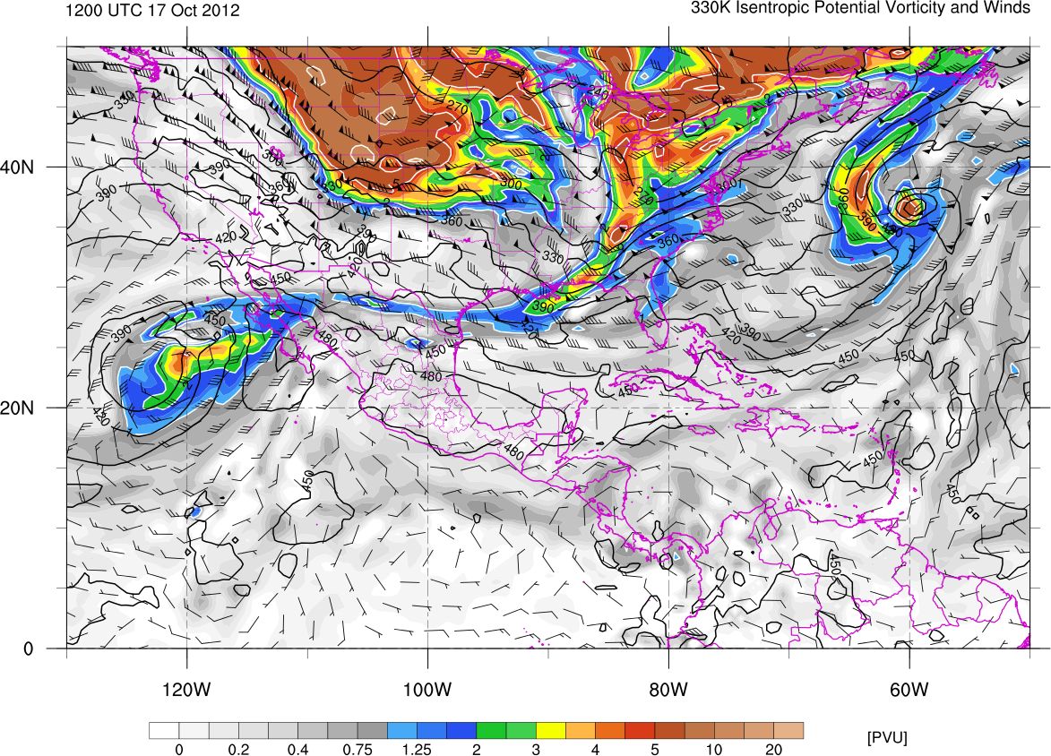
1200 UTC 17 October 2012
330K Surface
IR Satellite
350K Surface
Potential vorticity (shaded, PVU), pressure (contours, hPa),
winds (barbs, m s⁻¹)

Slide 9
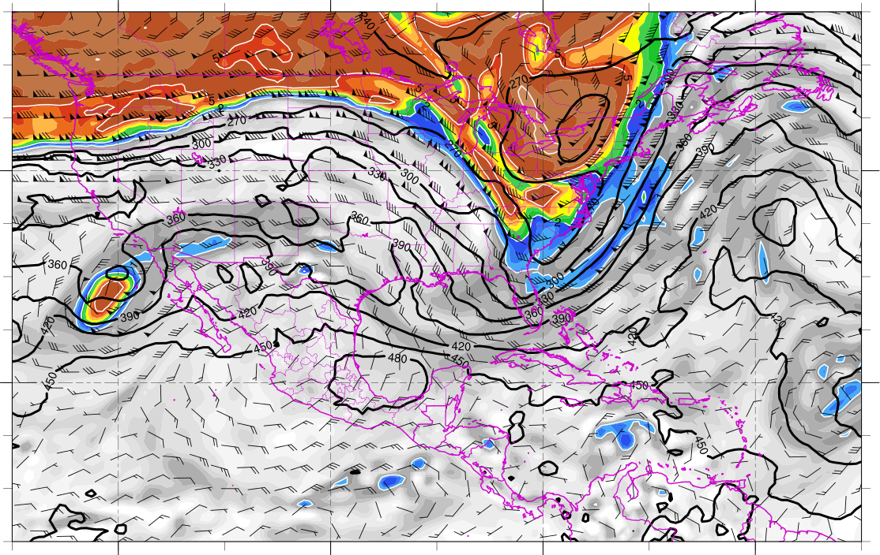
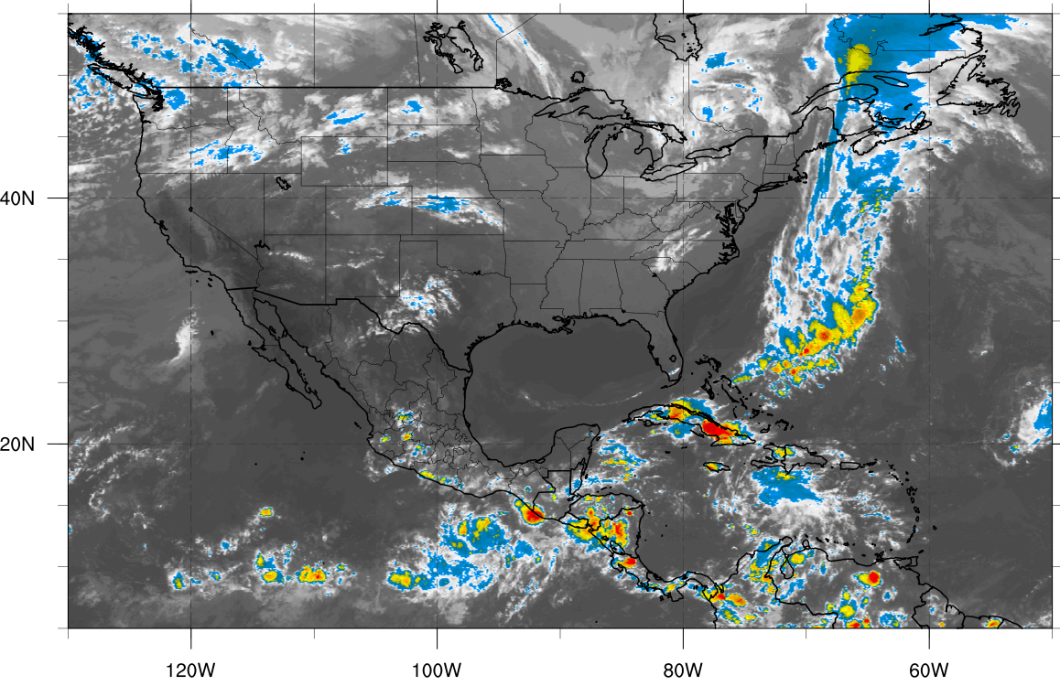
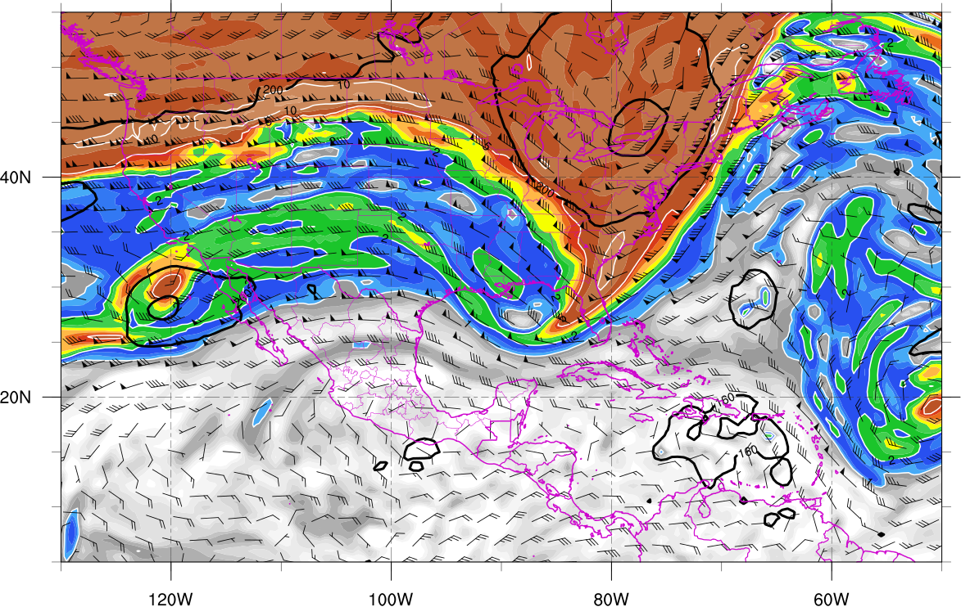
0000 UTC 21 October 2012
330K Surface
IR Satellite
350K Surface
Potential vorticity (shaded, PVU), pressure (contours, hPa),
winds (barbs, m s⁻¹)

Slide 10
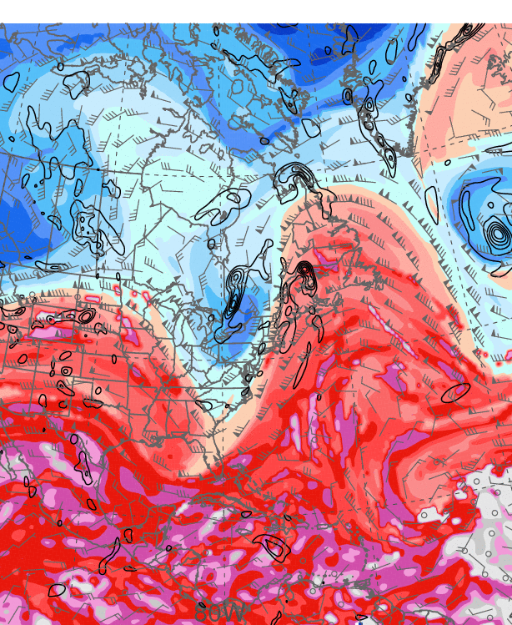
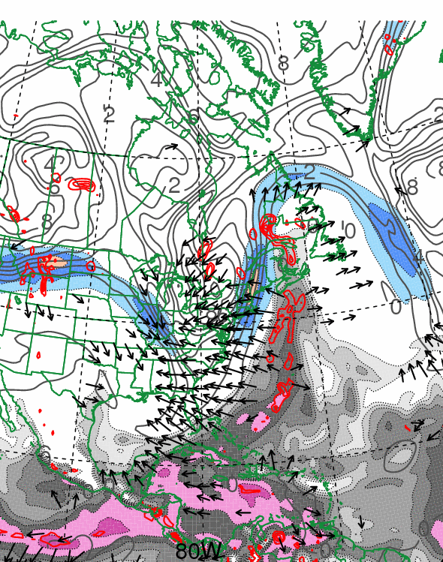
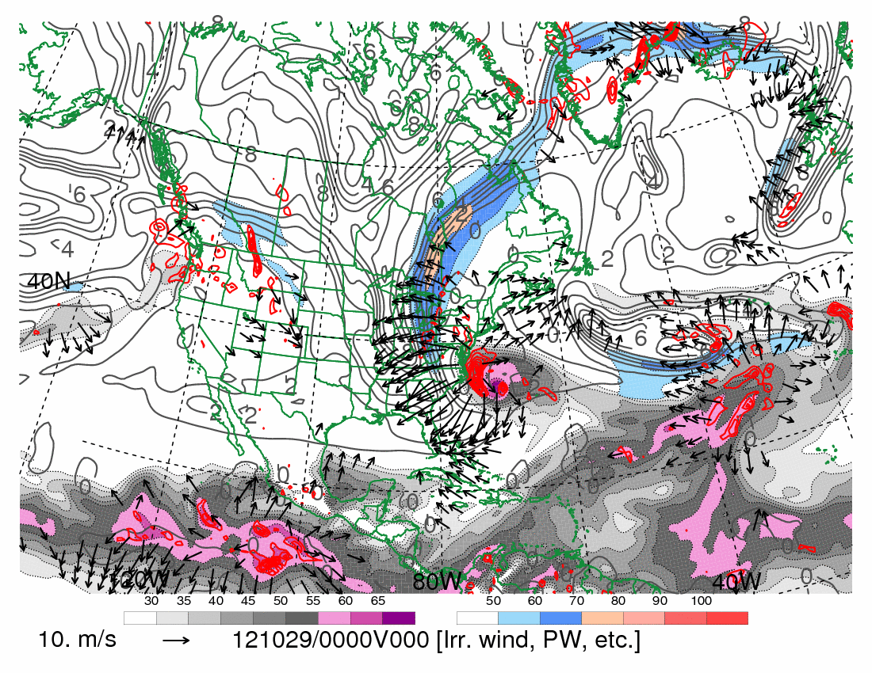
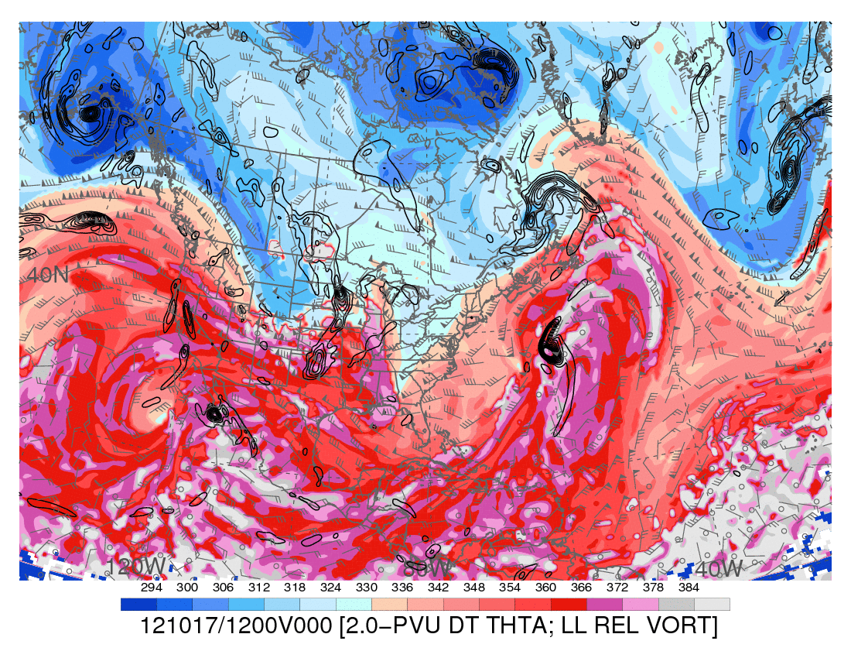
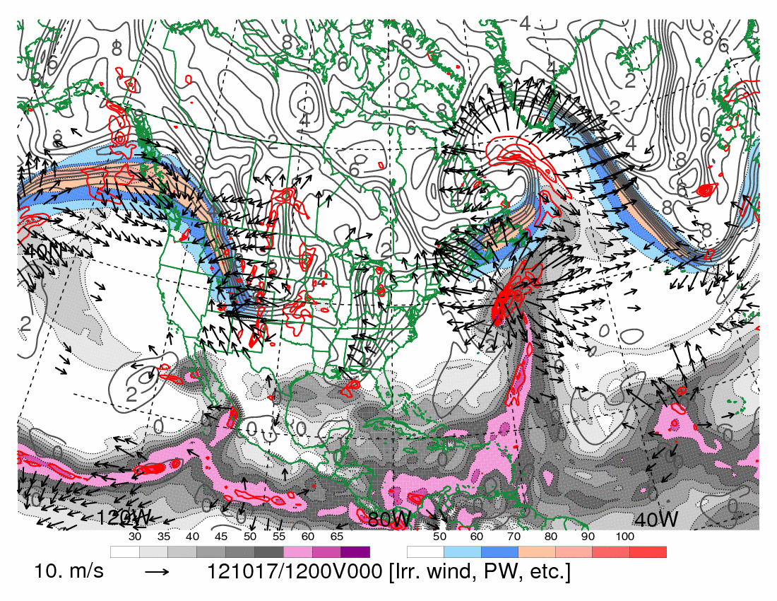
0000 UTC 21 October 2012
10.0 m s⁻¹
Dynamic tropopause (DT, 1.5-PVU surface) potential
temperature (shaded, K) and wind (barbs, kts),
925–850-hPa layer-averaged cyclonic relative vorticity
(black contours every 0.5 × 10⁻⁴ s⁻¹)
250-hPa wind speed (shaded, m s⁻¹), 300–200-hPa layer-averaged PV (gray contours, PVU), PW (gray scale, mm),
600–400-hPa layer-averaged ascent (red contours every
5.0 × 10⁻³ hPa s⁻¹), 250-hPa irrotational wind (vectors, m s⁻¹)

Slide 11
First Trough Interaction: Poleward Convective Cloud Expansion

Slide 12
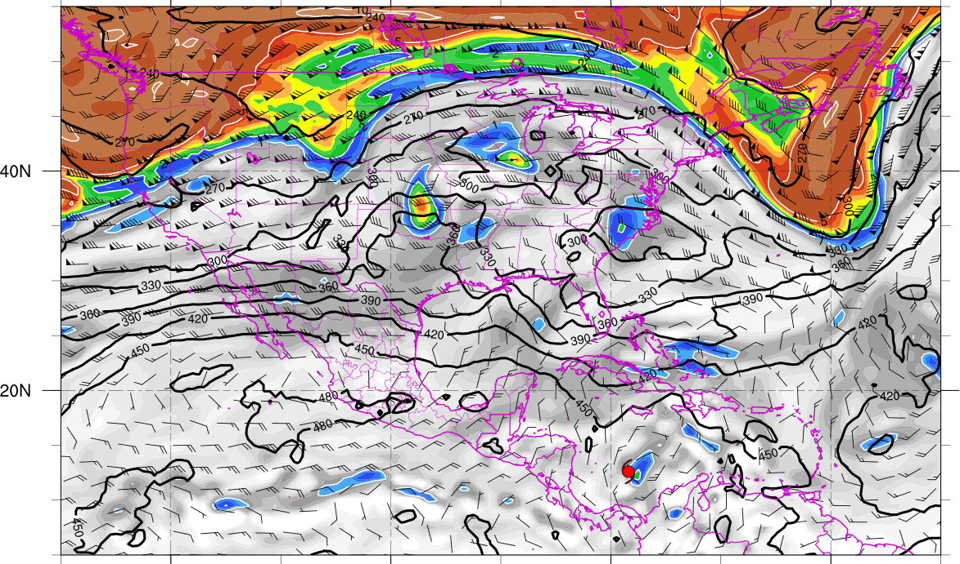
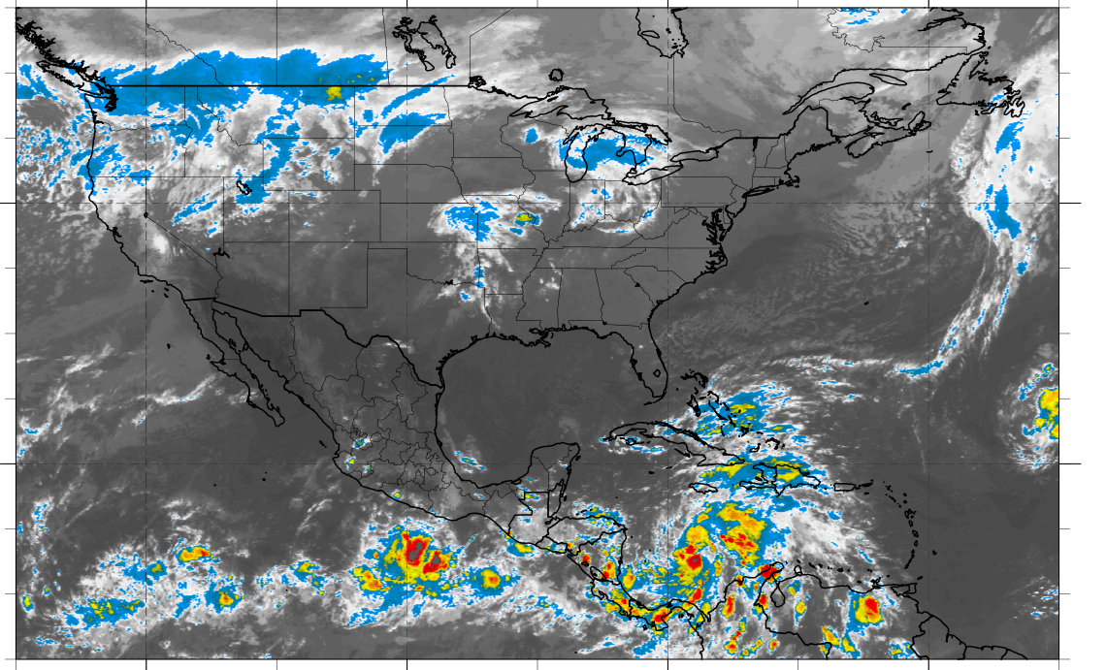
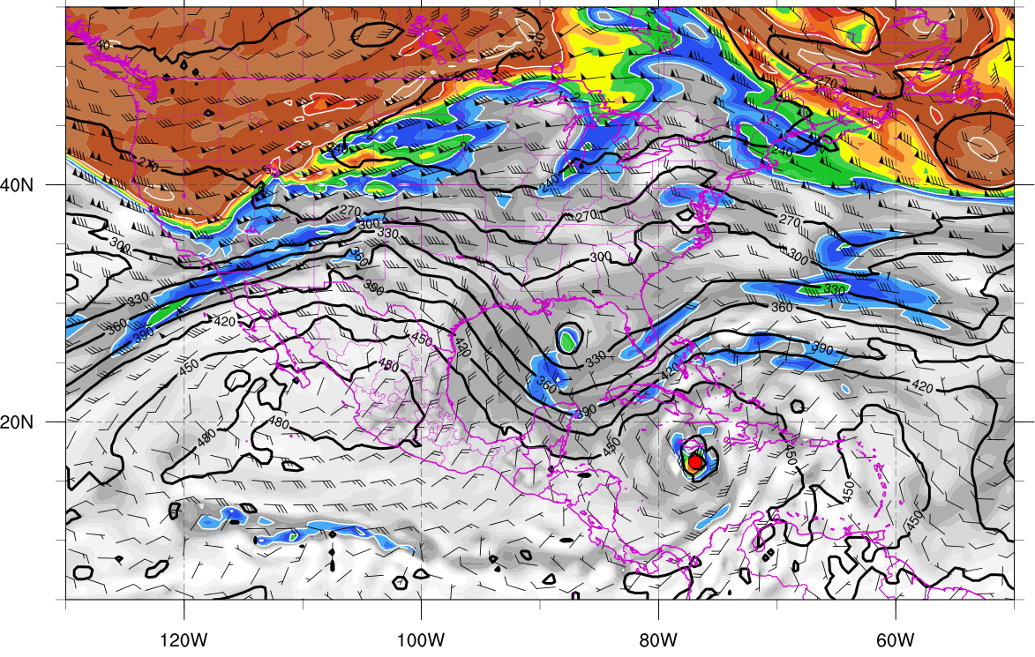
330K Surface and IR 0000 UTC 23 Oct
330K Surface and IR 1200 UTC 24 Oct
Potential vorticity (shaded, PVU), pressure (contours, hPa), winds (barbs, m s⁻¹)

Slide 13
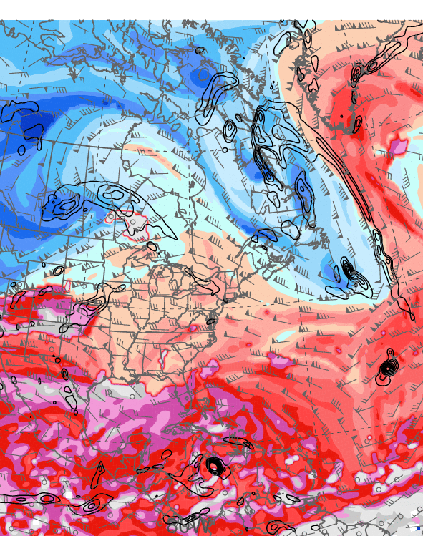
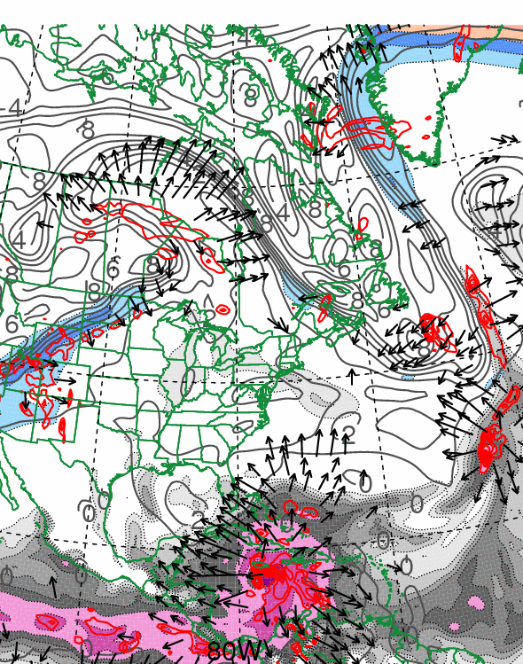
1200 UTC 24 October 2012
10.0 m s⁻¹
Dynamic tropopause (DT, 1.5-PVU surface) potential
temperature (shaded, K) and wind (barbs, kts),
925–850-hPa layer-averaged cyclonic relative vorticity
(black contours every 0.5 × 10⁻⁴ s⁻¹)
250-hPa wind speed (shaded, m s⁻¹), 300–200-hPa layer-averaged PV (gray contours, PVU), PW (gray scale, mm),
600–400-hPa layer-averaged ascent (red contours every
5.0 × 10⁻³ hPa s⁻¹), 250-hPa irrotational wind (vectors, m s⁻¹)

Slide 14
Second Trough Interaction:
First Westward Turn

Slide 15
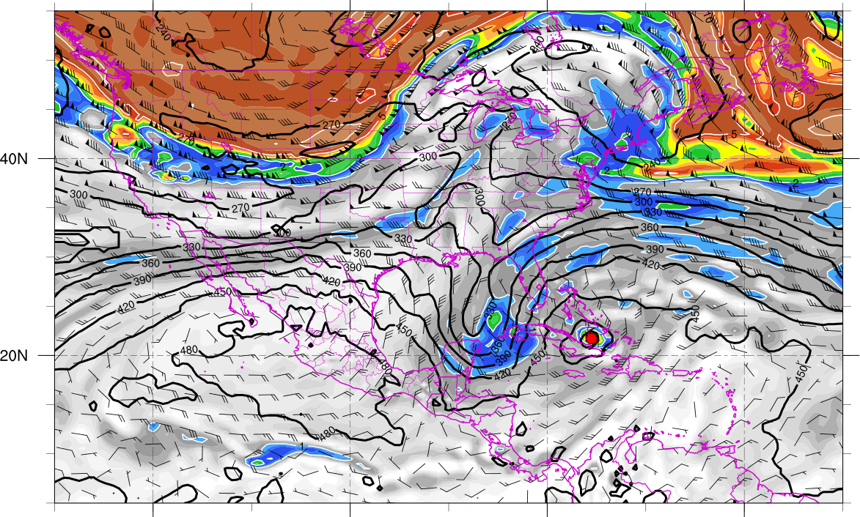
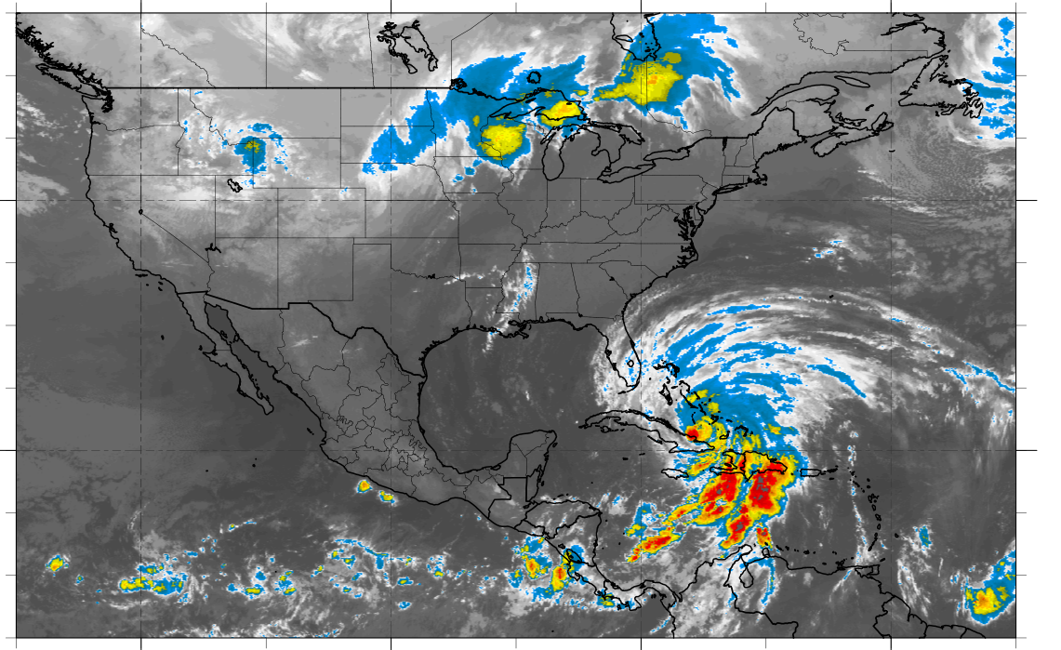
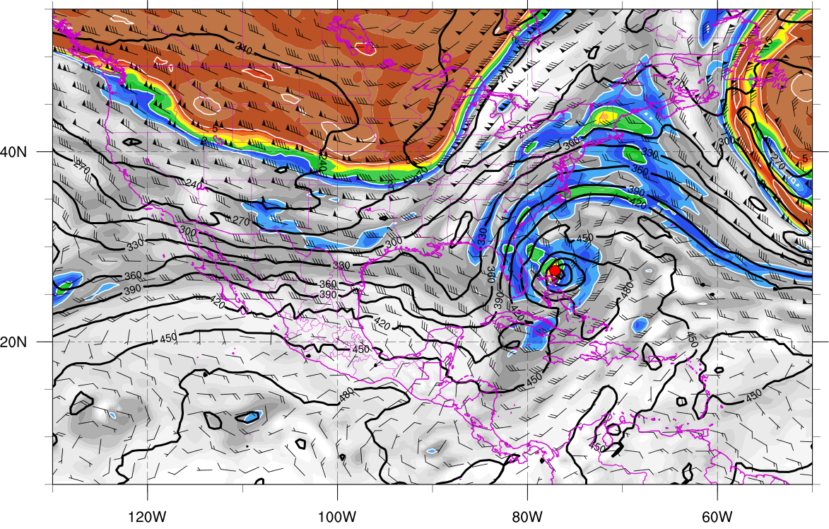
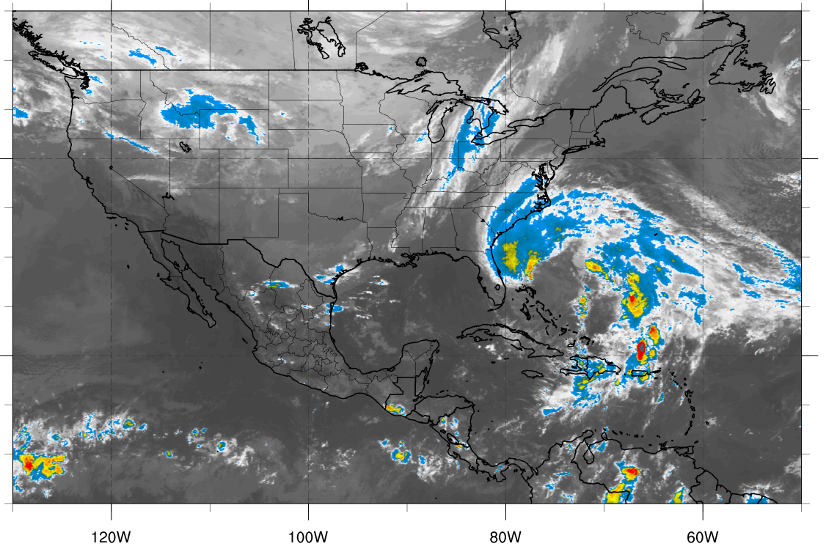
330K Surface and IR 1200 UTC 25 Oct
330K Surface and IR 0000 UTC 27 Oct
Potential vorticity (shaded, PVU), pressure (contours, hPa), winds (barbs, m s⁻¹)

Slide 16
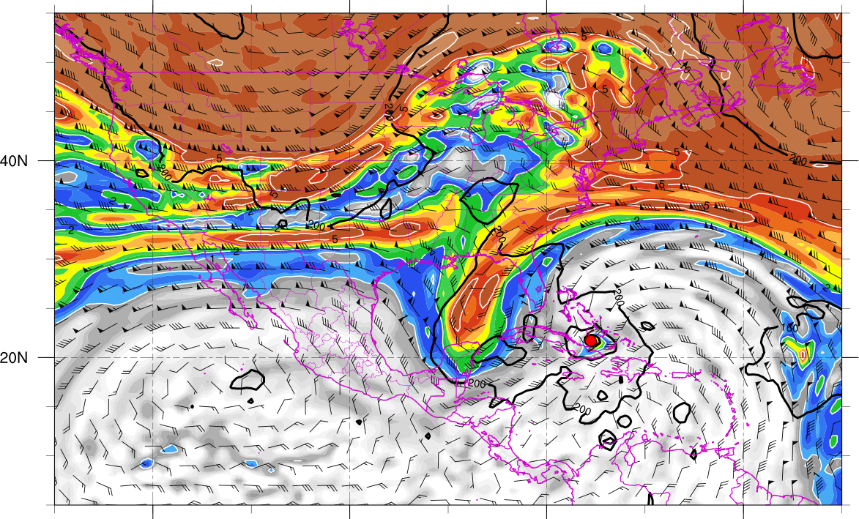
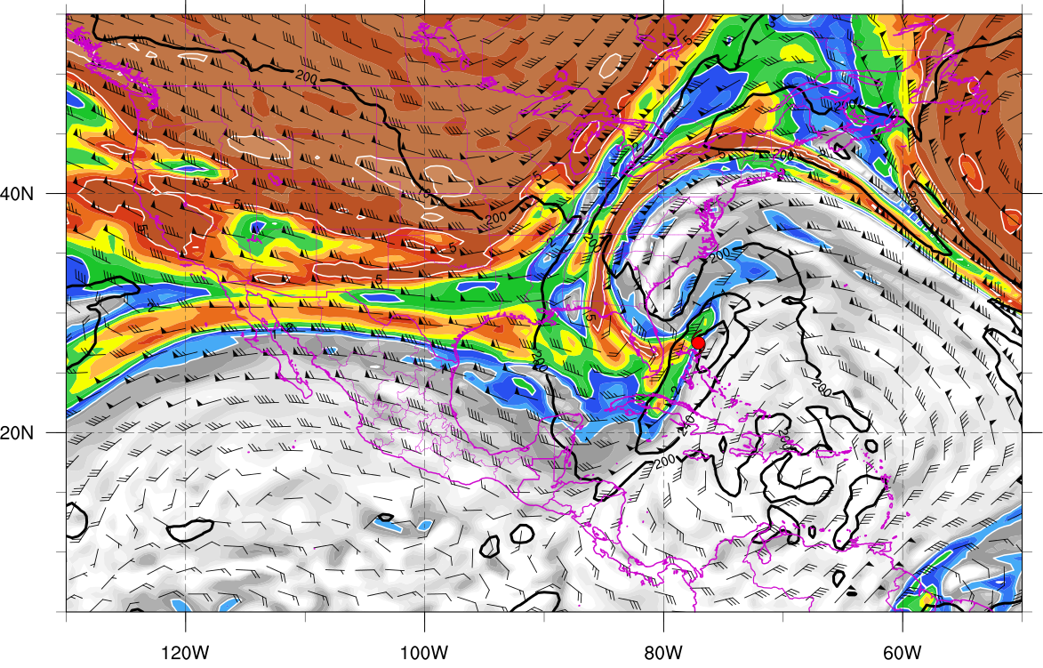
350K Surface and IR 1200 UTC 25 Oct
350K Surface and IR 0000 UTC 27 Oct
Potential vorticity (shaded, PVU), pressure (contours, hPa), winds (barbs, m s⁻¹)

Slide 17
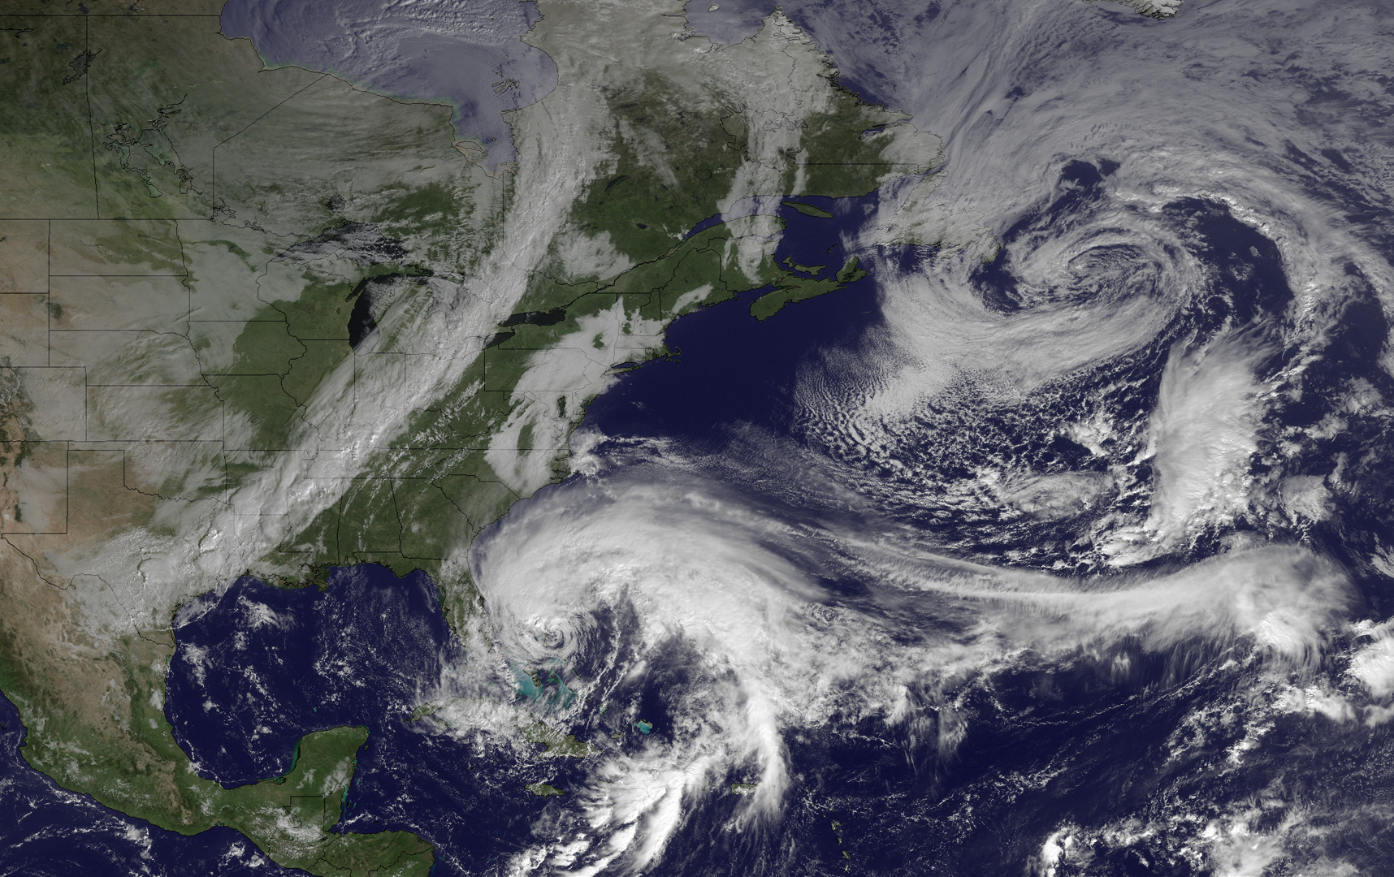
1445 UTC 26 October 2012
Image courtesy of the
NOAA’s Environmental
Visualization Laboratory

Slide 18
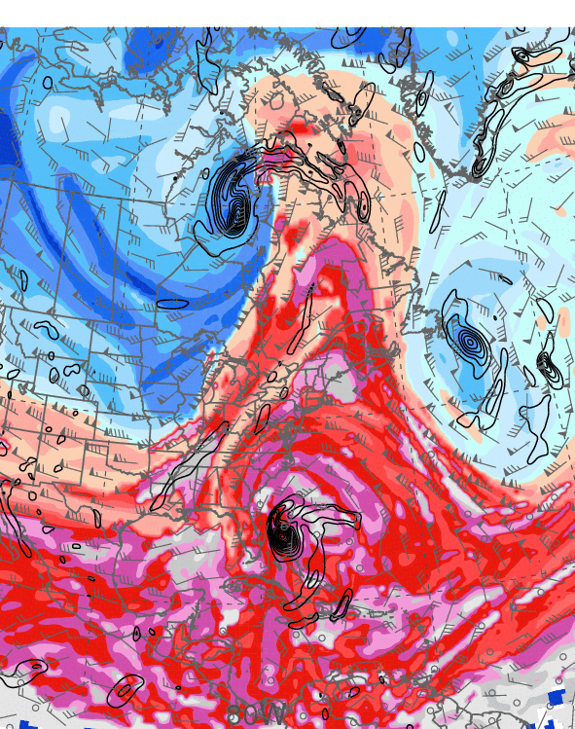
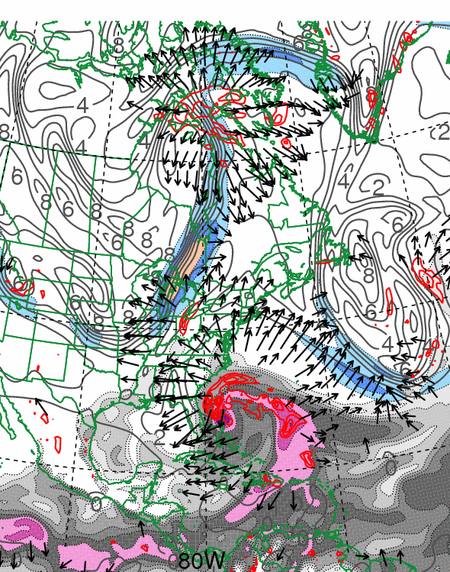
0000 UTC 27 October 2012
10.0 m s⁻¹
Dynamic tropopause (DT, 1.5-PVU surface) potential
temperature (shaded, K) and wind (barbs, kts),
925–850-hPa layer-averaged cyclonic relative vorticity
(black contours every 0.5 × 10⁻⁴ s⁻¹)
250-hPa wind speed (shaded, m s⁻¹), 300–200-hPa layer-averaged PV (gray contours, PVU), PW (gray scale, mm),
600–400-hPa layer-averaged ascent (red contours every
5.0 × 10⁻³ hPa s⁻¹), 250-hPa irrotational wind (vectors, m s⁻¹)

Slide 19
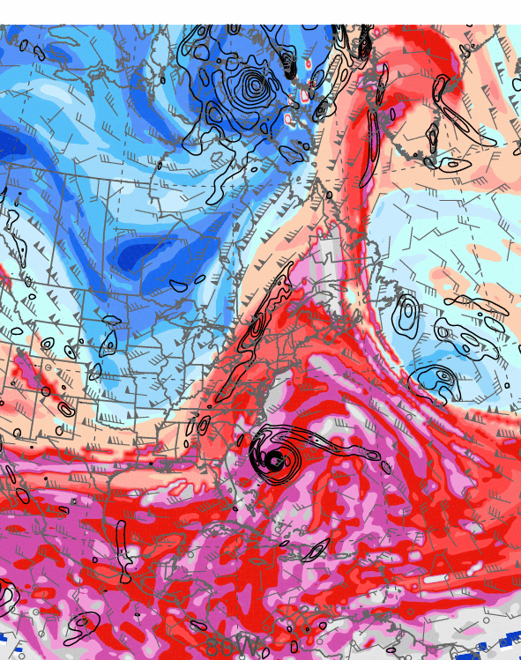
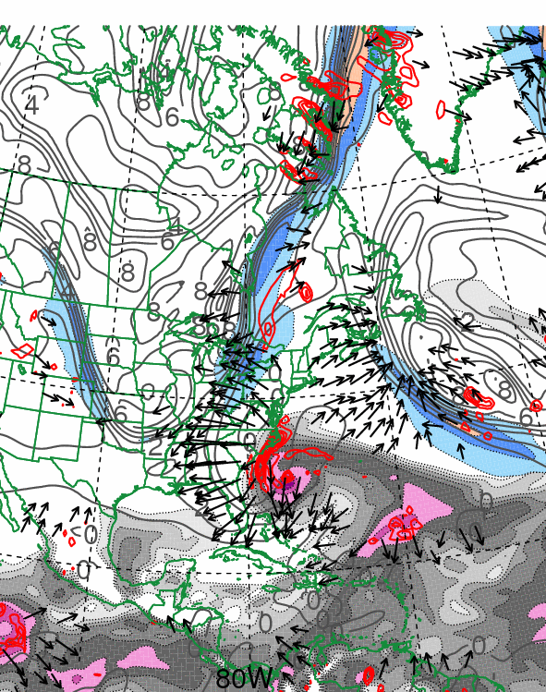
0000 UTC 28 October 2012
10.0 m s⁻¹
Dynamic tropopause (DT, 1.5-PVU surface) potential
temperature (shaded, K) and wind (barbs, kts),
925–850-hPa layer-averaged cyclonic relative vorticity
(black contours every 0.5 × 10⁻⁴ s⁻¹)
250-hPa wind speed (shaded, m s⁻¹), 300–200-hPa layer-averaged PV (gray contours, PVU), PW (gray scale, mm),
600–400-hPa layer-averaged ascent (red contours every
5.0 × 10⁻³ hPa s⁻¹), 250-hPa irrotational wind (vectors, m s⁻¹)

Slide 20
Third Trough Interaction:
Second Westward Turn and Landfall

Slide 21
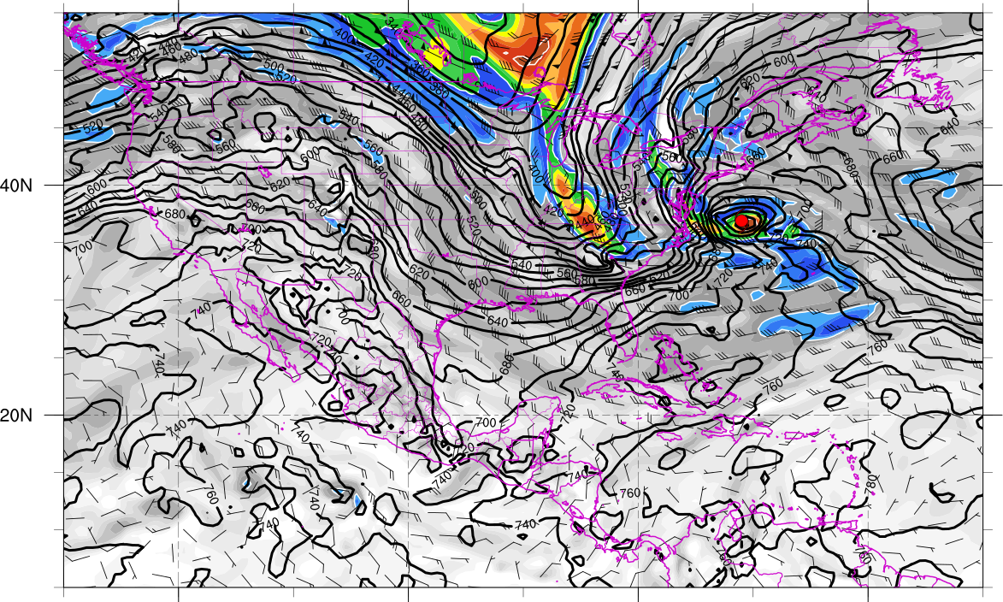
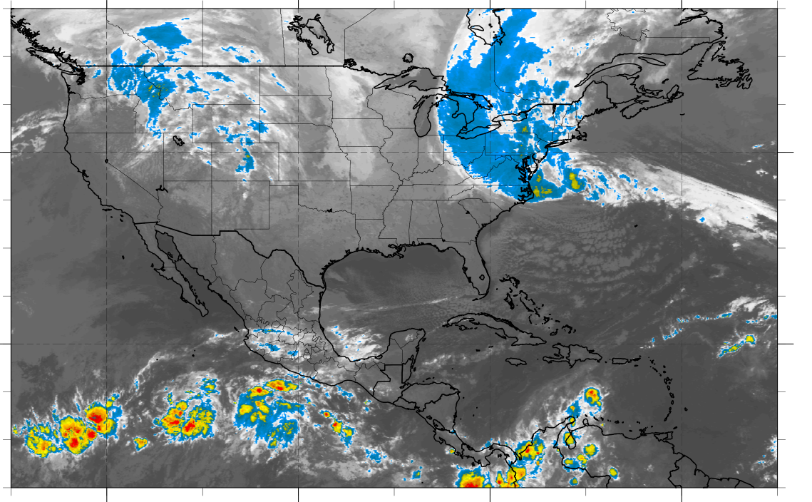
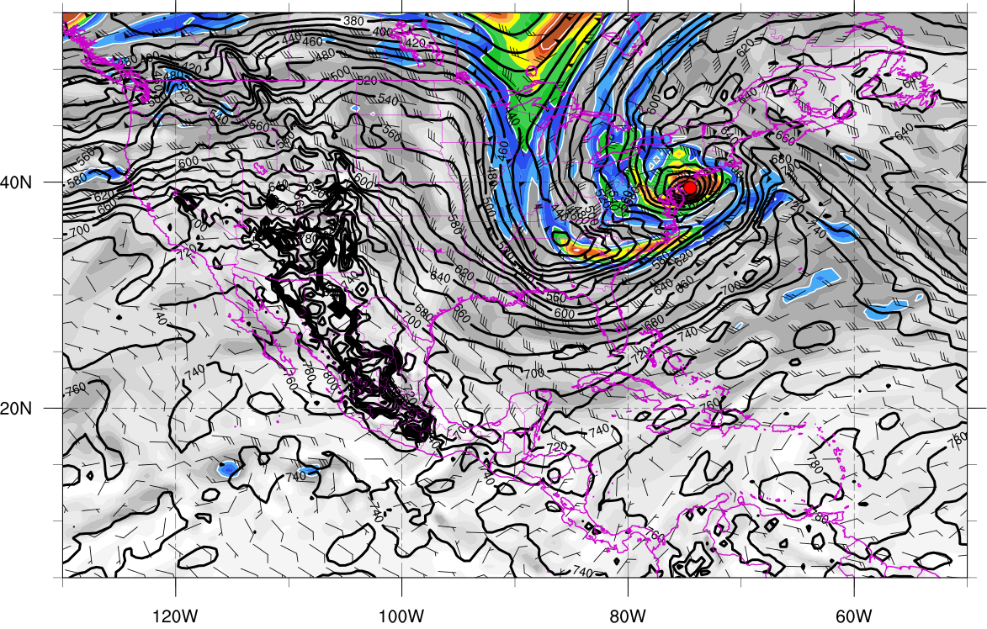
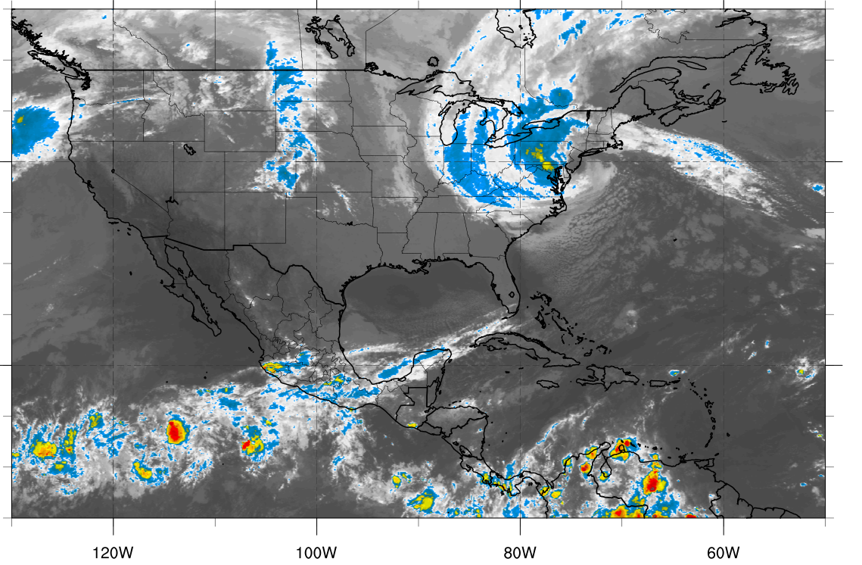
310K Surface and IR 1200 UTC 29 Oct
310K Surface and IR 0000 UTC 30 Oct
Potential vorticity (shaded, PVU), pressure (contours, hPa), winds (barbs, m s⁻¹)

Slide 22
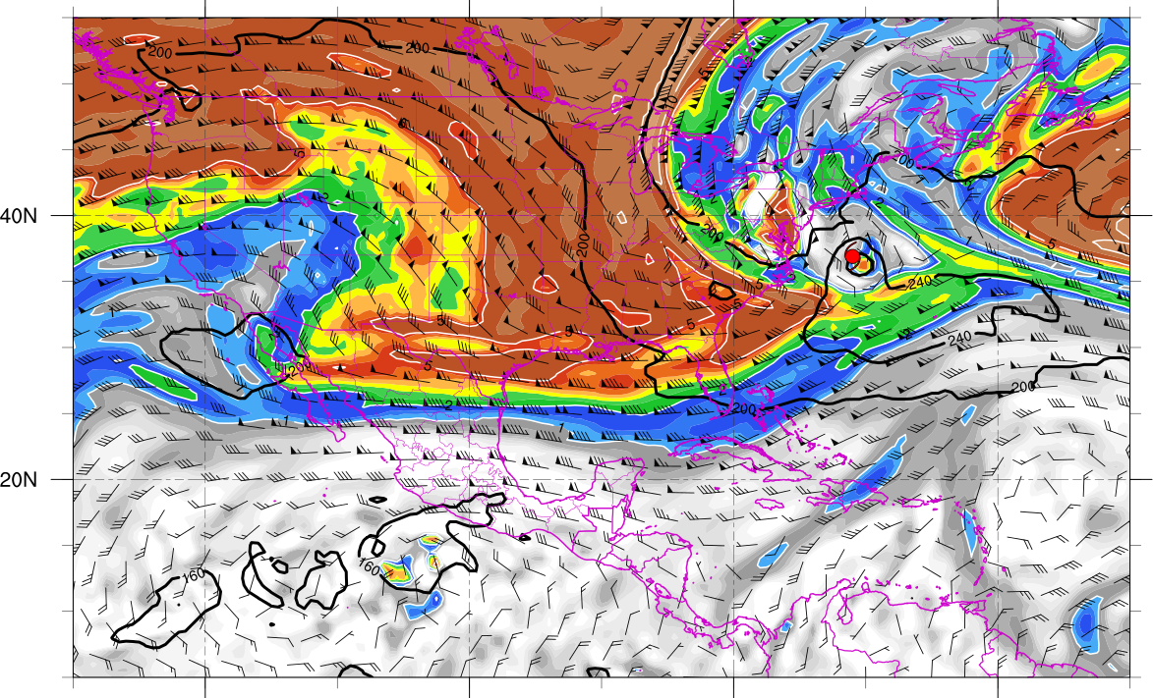
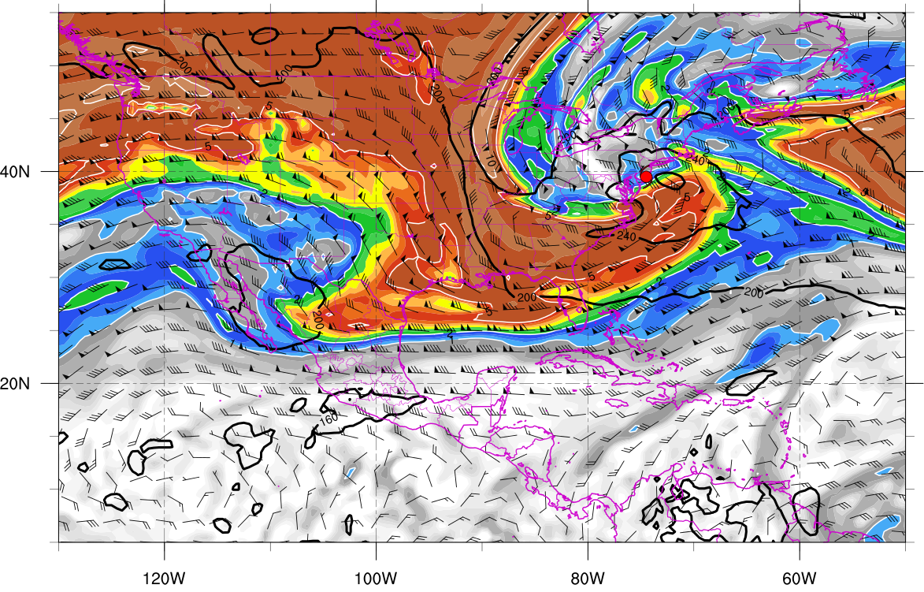
350K Surface and IR 1200 UTC 29 Oct
350K Surface and IR 0000 UTC 30 Oct
Potential vorticity (shaded, PVU), pressure (contours, hPa), winds (barbs, m s⁻¹)

Slide 23
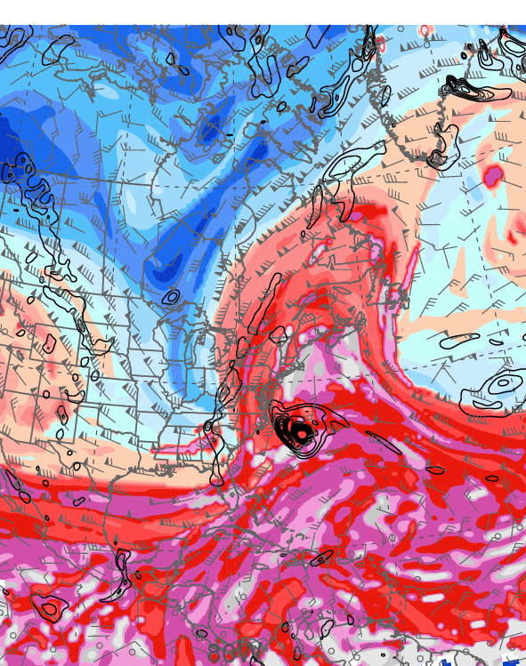
0000 UTC 29 October 2012
10.0 m s⁻¹
Dynamic tropopause (DT, 1.5-PVU surface) potential
temperature (shaded, K) and wind (barbs, kts),
925–850-hPa layer-averaged cyclonic relative vorticity
(black contours every 0.5 × 10⁻⁴ s⁻¹)
250-hPa wind speed (shaded, m s⁻¹), 300–200-hPa layer-averaged PV (gray contours, PVU), PW (gray scale, mm),
600–400-hPa layer-averaged ascent (red contours every
5.0 × 10⁻³ hPa s⁻¹), 250-hPa irrotational wind (vectors, m s⁻¹)

Slide 24
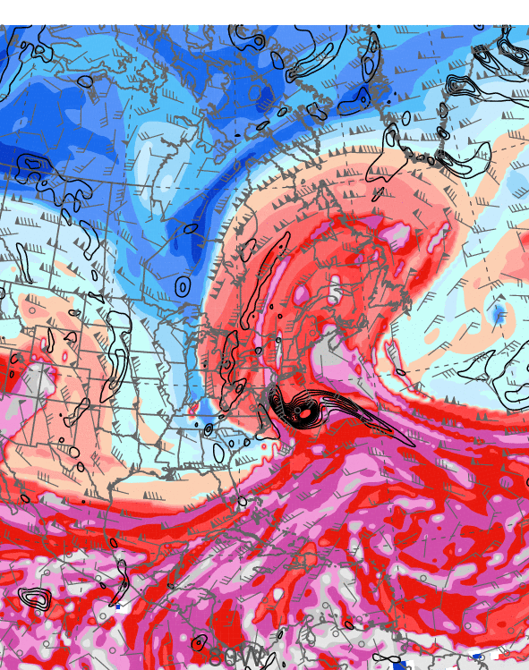
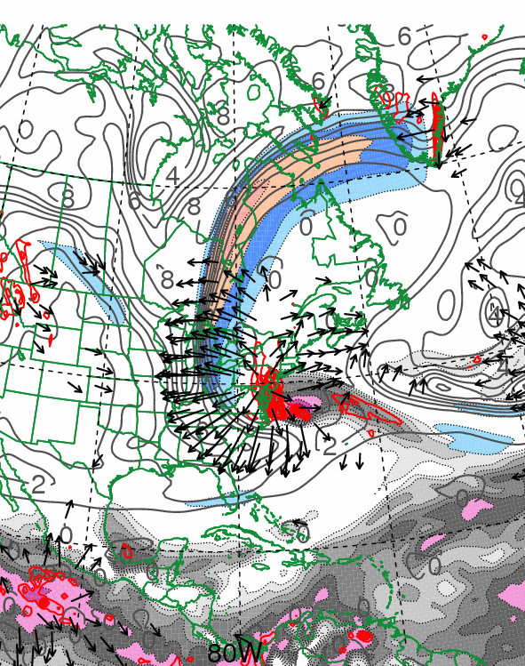
1200 UTC 29 October 2012
10.0 m s⁻¹
Dynamic tropopause (DT, 1.5-PVU surface) potential
temperature (shaded, K) and wind (barbs, kts),
925–850-hPa layer-averaged cyclonic relative vorticity
(black contours every 0.5 × 10⁻⁴ s⁻¹)
250-hPa wind speed (shaded, m s⁻¹), 300–200-hPa layer-averaged PV (gray contours, PVU), PW (gray scale, mm),
600–400-hPa layer-averaged ascent (red contours every
5.0 × 10⁻³ hPa s⁻¹), 250-hPa irrotational wind (vectors, m s⁻¹)

Slide 25
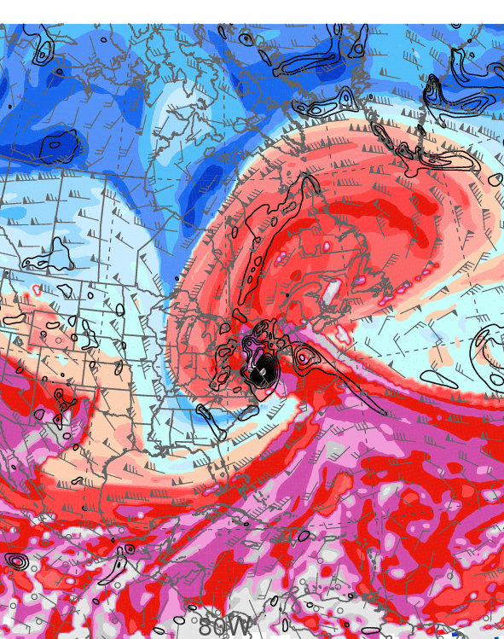
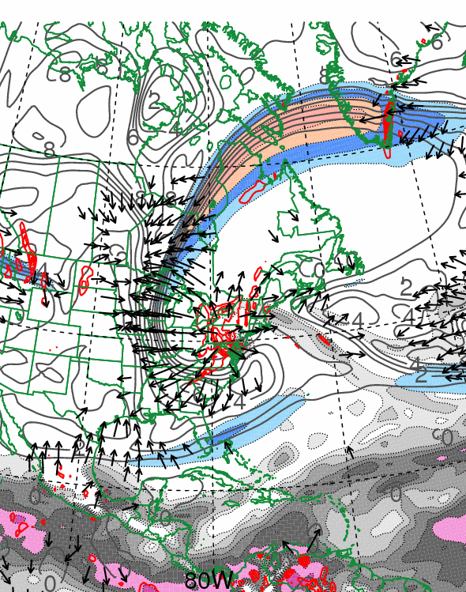
0000 UTC 30 October 2012
10.0 m s⁻¹
Dynamic tropopause (DT, 1.5-PVU surface) potential
temperature (shaded, K) and wind (barbs, kts),
925–850-hPa layer-averaged cyclonic relative vorticity
(black contours every 0.5 × 10⁻⁴ s⁻¹)
250-hPa wind speed (shaded, m s⁻¹), 300–200-hPa layer-averaged PV (gray contours, PVU), PW (gray scale, mm),
600–400-hPa layer-averaged ascent (red contours every
5.0 × 10⁻³ hPa s⁻¹), 250-hPa irrotational wind (vectors, m s⁻¹)

Slide 26
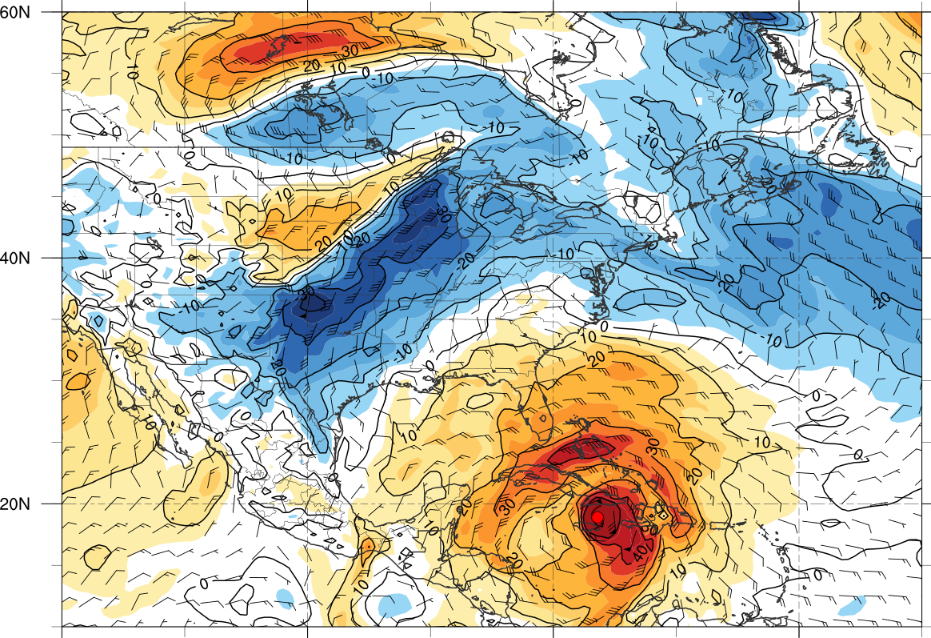
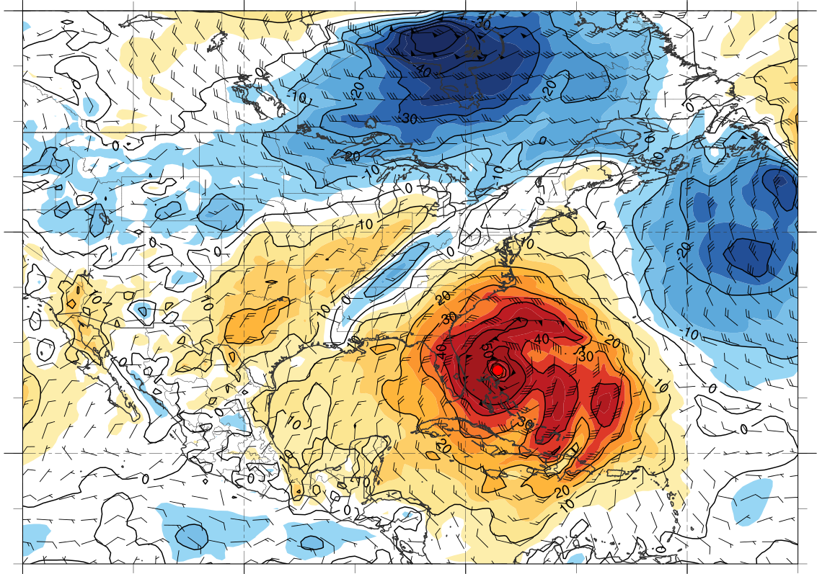
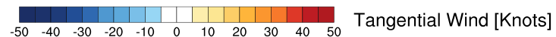
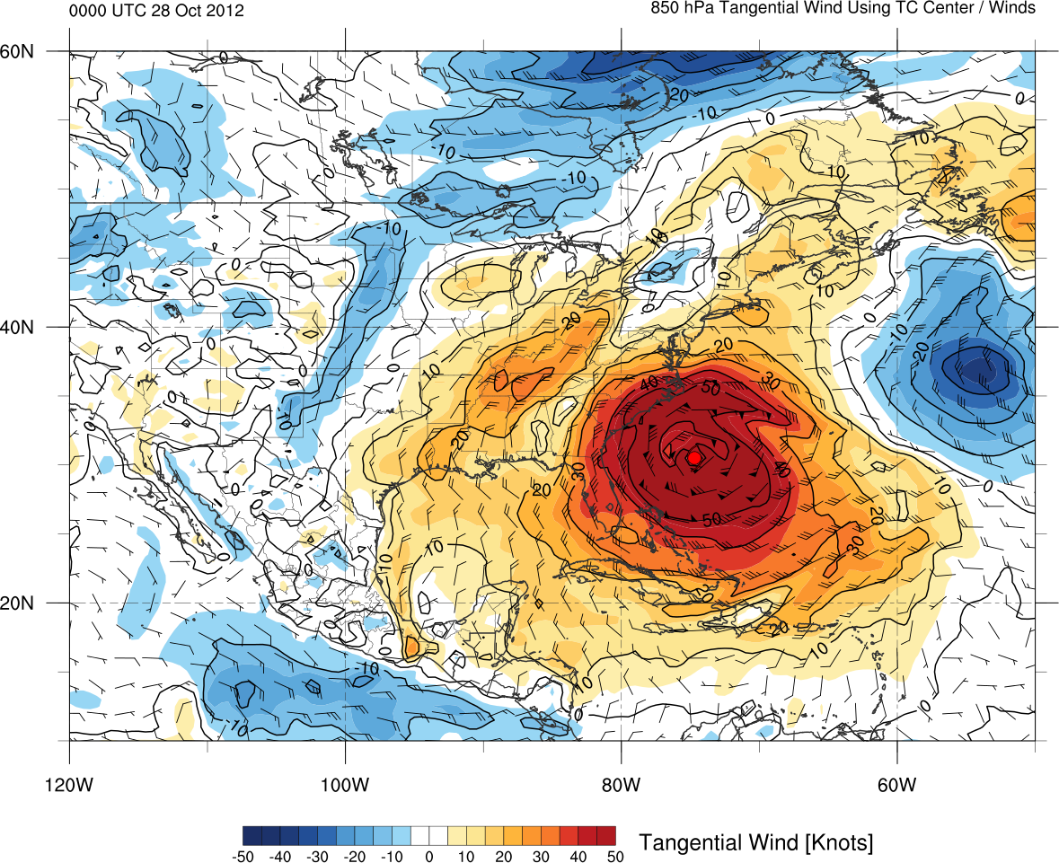
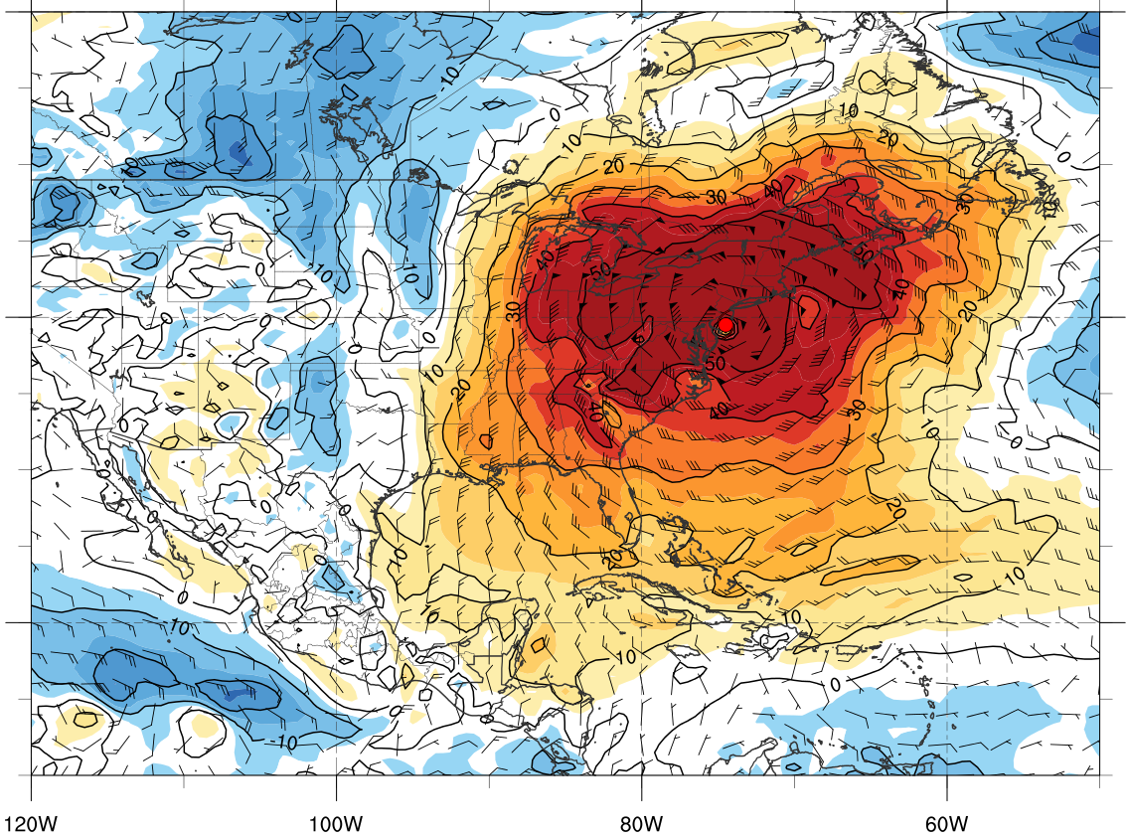
850-hPa tangential wind (shaded) and total wind (barbs) centered on TC Sandy
0000 UTC 25 Oct
0000 UTC 27 Oct
0000 UTC 28 Oct
0000 UTC 30 Oct

Slide 27
Sandy (2012), Hazel (1954) and the 1938 New England Hurricane: A Perspective

Slide 28
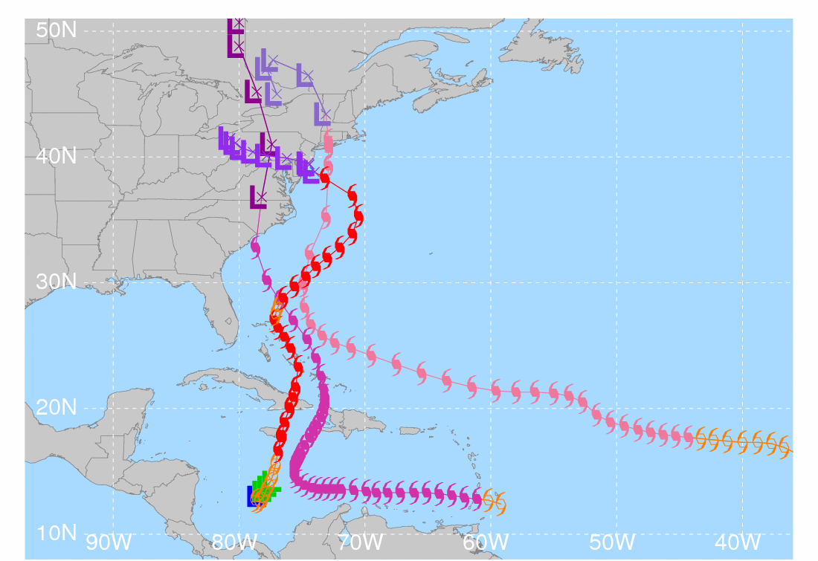






Sandy: 1800 UTC 21 October – 1200 UTC 31 October 2012
Hazel: 0600 UTC 5 October – 1200 UTC 18 October 1954
1938 New England Hurricane: 1200 UTC 9 September – 0000 UTC 23 September 1938
Low pressure
Tropical depression
Tropical storm
Hurricane (Sandy)
Hurricane (Hazel)
Hurricane (38-Hurr)
Extratropical (Sandy)
Extratropical (Hazel)
Extratropical (38-Hurr)
Sandy
Hazel
1938 New England Hurricane

Slide 29



0000 UTC 15 October 1954
0000 UTC 16 October 1954
250-hPa wind speed (shaded, m s⁻¹), temperature (dashed red contours, °C),
and geopotential height (black solid contours, dam)

Slide 30


0000 UTC 15 October 1954
0000 UTC 16 October 1954
250-hPa wind speed (shaded, m s⁻¹), 1000–500-hPa thickness (dashed red/blue contours, dam), and mean sea level pressure (black solid contours, hPa)

Slide 31


0000 UTC 15 October 1954
0000 UTC 16 October 1954
850-hPa frontogenesis [shaded, K (100 km) ⁻¹ (3 h) ⁻¹], temperature (dashed red contours, °C), and geopotential height (black solid contours, dam)

Slide 32


0000 UTC 21 September 1938
0000 UTC 22 September 1938
250-hPa wind speed (shaded, m s⁻¹), temperature (dashed red contours, °C),
and geopotential height (black solid contours, dam)

Slide 33


0000 UTC 21 September 1938
0000 UTC 22 September 1938
250-hPa wind speed (shaded, m s⁻¹), 1000–500-hPa thickness (dashed red/blue contours, dam), and mean sea level pressure (black solid contours, hPa)

Slide 34


0000 UTC 21 September 1938
0000 UTC 22 September 1938
850-hPa frontogenesis [shaded, K (100 km) ⁻¹ (3 h) ⁻¹], temperature (dashed red contours, °C), and geopotential height (black solid contours, dam)

Slide 35
Synopsis of Sandy Trough Interactions
(m s⁻¹)
330–335K layer-averaged 0.4 (blue), 0.8 (purple), and 2.0 (red) PVU curves for 1200 UTC 23 Oct, 1200 UTC 27 Oct, and 1800 UTC 29 Oct 2012, respectively. 925–850-hPa layer-averaged cyclonic relative vorticity (black contours every 0.5 × 10⁻⁴ s⁻¹). 250-hPa wind speed (shaded, m s⁻¹) at 1800 UTC 29 Oct 2012. Inset shows total rainfall (snowfall) in green (blue) shading in inches (adapted from NOAA/NWS/WPC).

Slide 36
Conclusions
Antecedent baroclinic zone over Gulf of Mexico supports warm-air advection with first trough interaction and results in a poleward cloud expansion
Sandy expands in size, but remains warm core as it turns northwestward during second trough interaction
Sandy-induced westward-directed negative PV advection helps to establish a well-defined PV hook during third trough interaction
“Sandy-like” storm tracks have occurred previously (e.g., Hazel 1954 and the 1938 New England Hurricane)

