Slide 1
The Uber Jet and
the Widespread Disruptive Ice Storm
of 21–23 December 2013
Lance F. Bosart, Alicia M. Bentley, and Philippe P. Papin
Department of Atmospheric and Environmental Sciences
University at Albany, State University of New York, Albany, NY 12222
39th Annual Northeastern Storm Conference
Rutland, VT
Saturday 8 March 2014

Slide 2
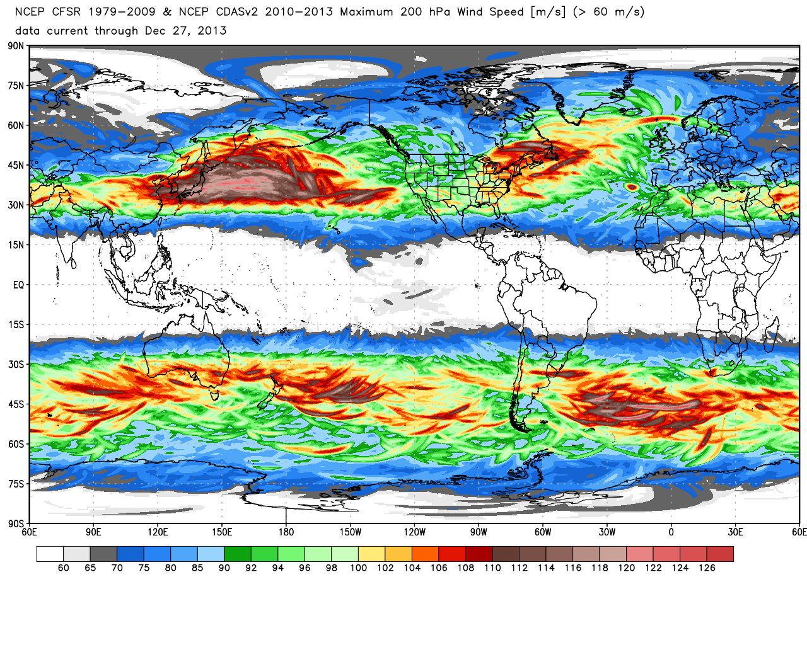
200-hPa maximum wind speed (m s⁻¹)
0.5° Climate Forecast System Reanalysis: 1979–2013
Source: Dr. Ryan Maue
Notes:
When starting talk, define education–research interface and introduce Alicia and Kyle as current and previous TAs in upper-division thermodynamics and introductory graduate dynamics that I presently teach at UAlbany.

Slide 3
200-hPa maximum wind speed (m s⁻¹)
0.5° Climate Forecast System Reanalysis: 1979–2013
Source: Dr. Ryan Maue
Notes:
When starting talk, define education–research interface and introduce Alicia and Kyle as current and previous TAs in upper-division thermodynamics and introductory graduate dynamics that I presently teach at UAlbany.

Slide 4
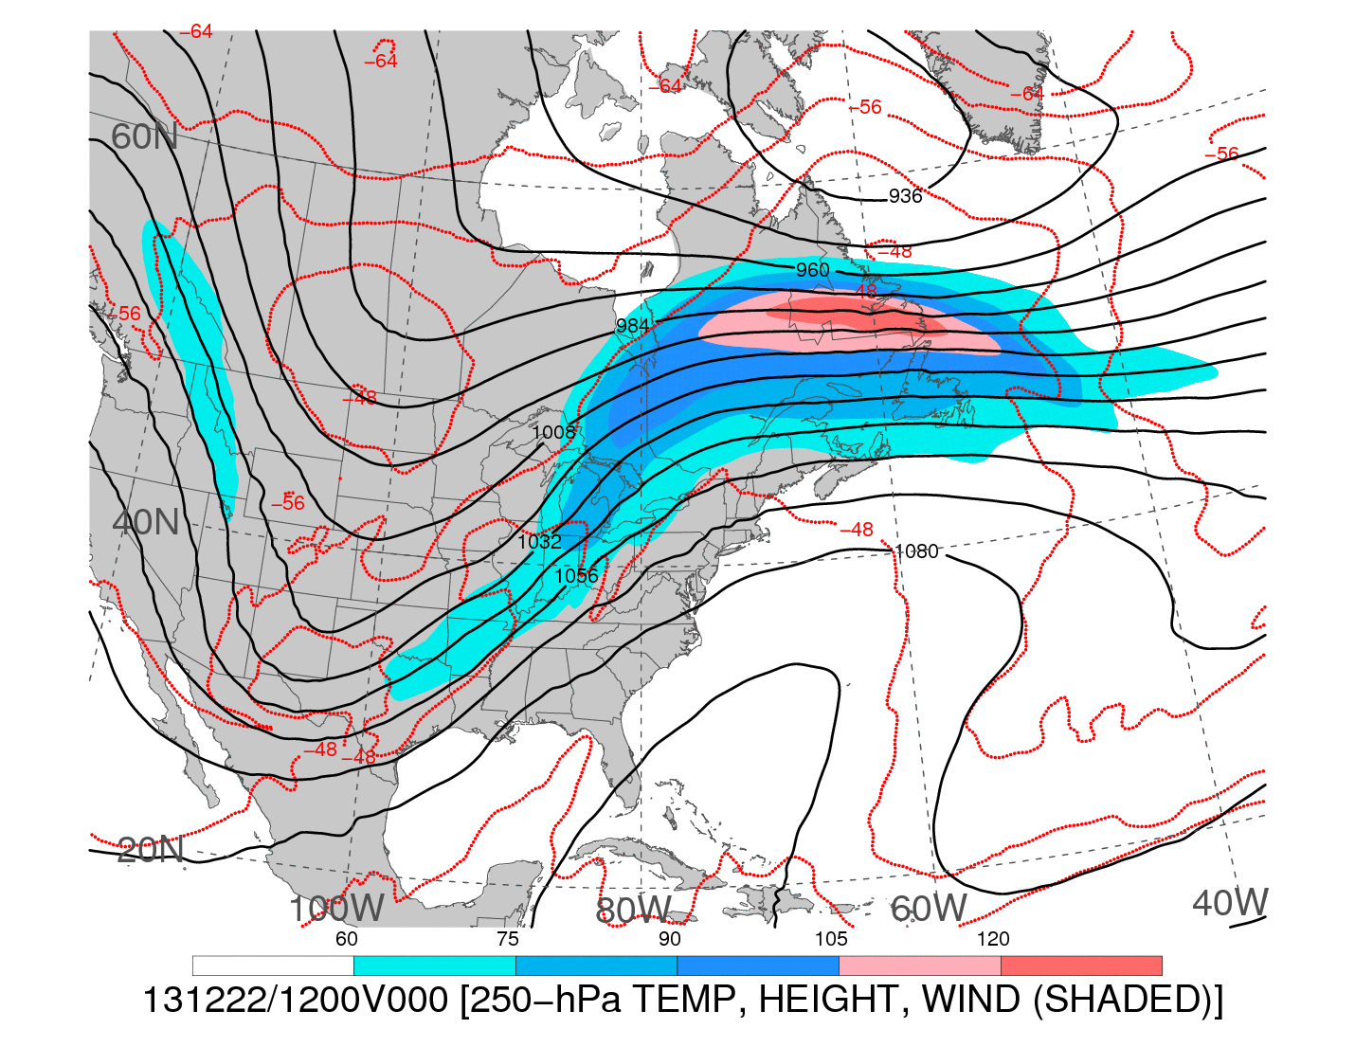
1200 UTC 22 December 2013
250-hPa wind speed (shaded, m s⁻¹; barbs, kts), geopotential height (black contours, dam),
and temperature (red dashed contours, °C)
Notes:
When starting talk, define education–research interface and introduce Alicia and Kyle as current and previous TAs in upper-division thermodynamics and introductory graduate dynamics that I presently teach at UAlbany.

Slide 5

1200 UTC 22 December 2013
−−
250-hPa wind speed (shaded, m s⁻¹; barbs, kts), geopotential height (black contours, dam),
and temperature (red dashed contours, °C)
Notes:
When starting talk, define education–research interface and introduce Alicia and Kyle as current and previous TAs in upper-division thermodynamics and introductory graduate dynamics that I presently teach at UAlbany.

Slide 6
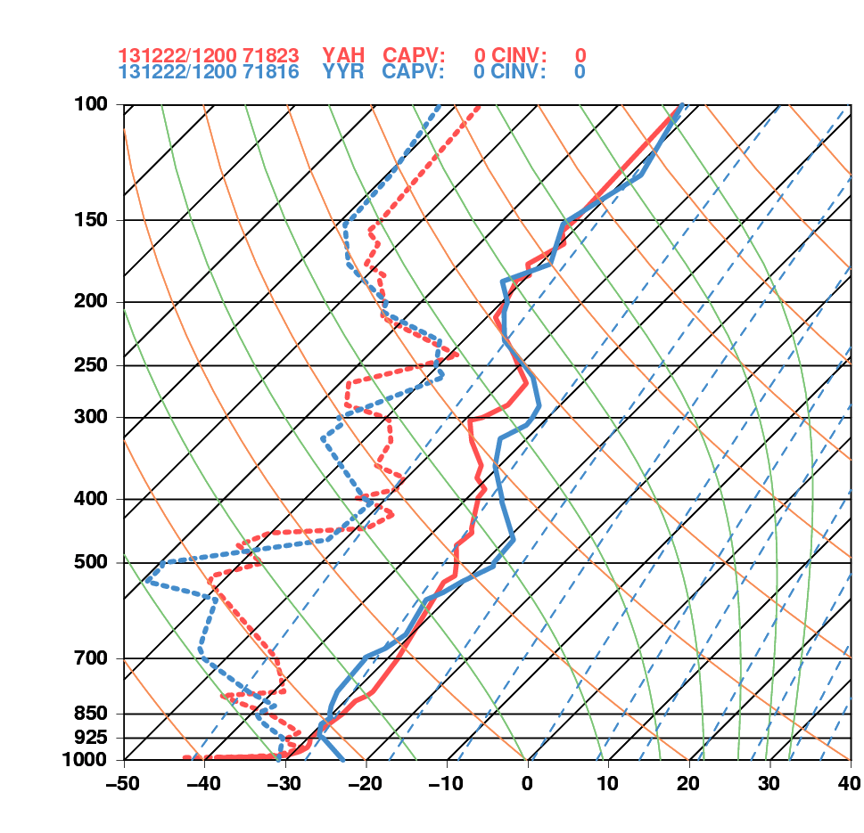
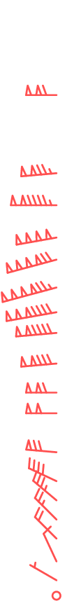
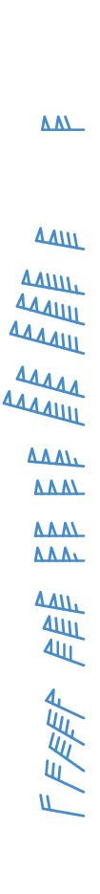
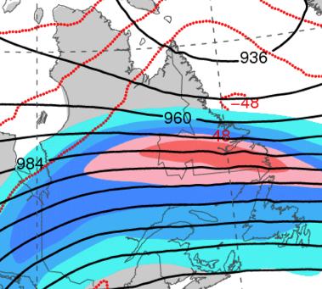
1200 UTC 22 December 2013
La Grande, QC Goose Bay, NL
Goose Bay, NL
La Grande, QC

Slide 7
DT & MSLP LOOPS
Notes:
When starting talk, define education–research interface and introduce Alicia and Kyle as current and previous TAs in upper-division thermodynamics and introductory graduate dynamics that I presently teach at UAlbany.

Slide 8
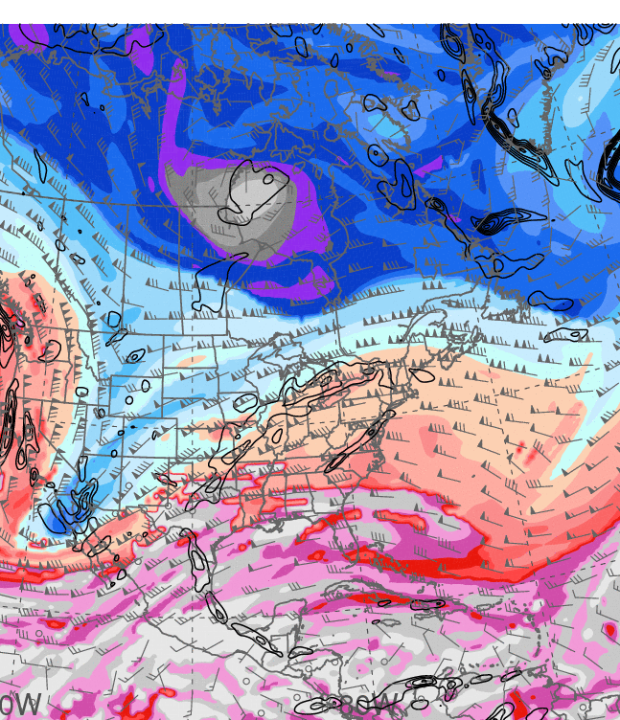
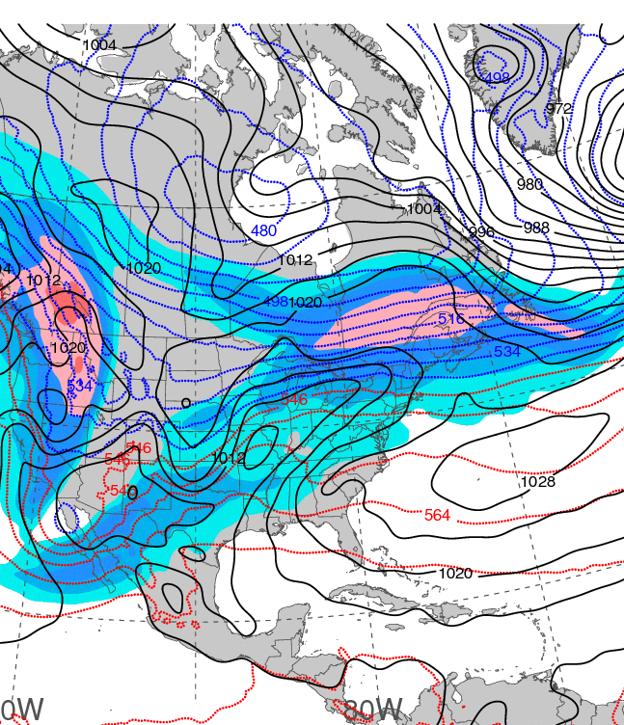
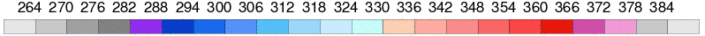
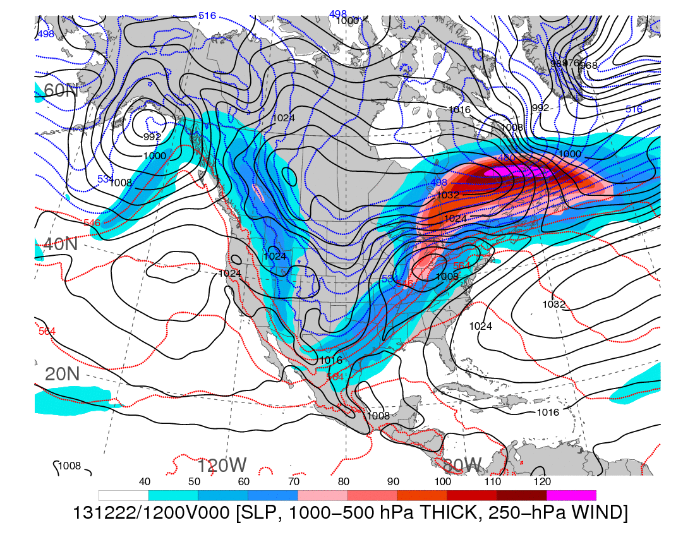
1200 UTC 20 December 2013
Dynamic tropopause (DT, 1.5-PVU surface) potential
temperature (shaded, K) and wind (barbs, kts),
925–850-hPa layer-averaged cyclonic relative vorticity
(black contours every 0.5 × 10⁻⁴ s⁻¹)
250-hPa wind speed (shaded, m s⁻¹), 1000–500-hPa thickness (blue contours ≤ 540 dam,
red contours > 540 dam), MSLP (black contours, hPa)

Slide 9
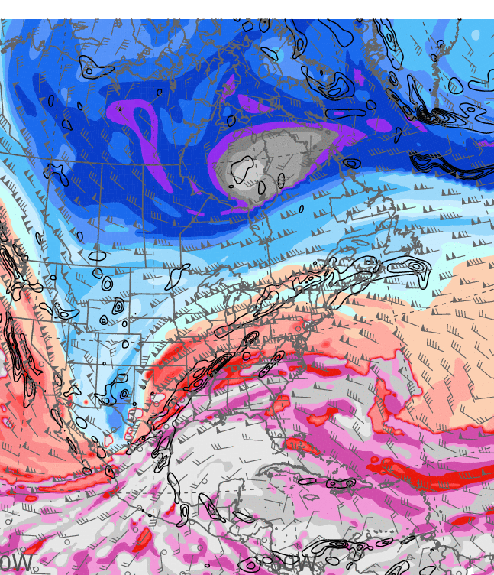
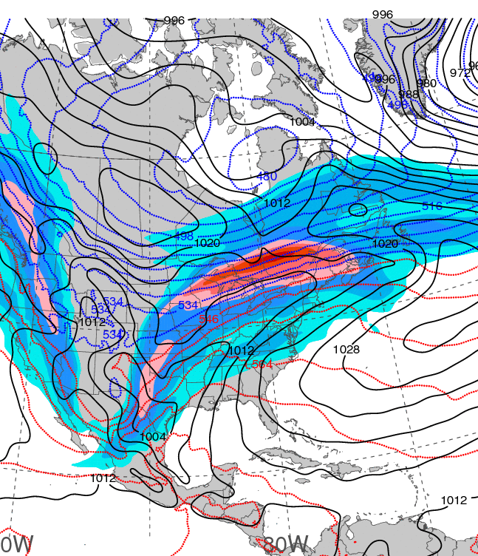
1200 UTC 21 December 2013
Dynamic tropopause (DT, 1.5-PVU surface) potential
temperature (shaded, K) and wind (barbs, kts),
925–850-hPa layer-averaged cyclonic relative vorticity
(black contours every 0.5 × 10⁻⁴ s⁻¹)
250-hPa wind speed (shaded, m s⁻¹), 1000–500-hPa thickness (blue contours ≤ 540 dam,
red contours > 540 dam), MSLP (black contours, hPa)

Slide 10
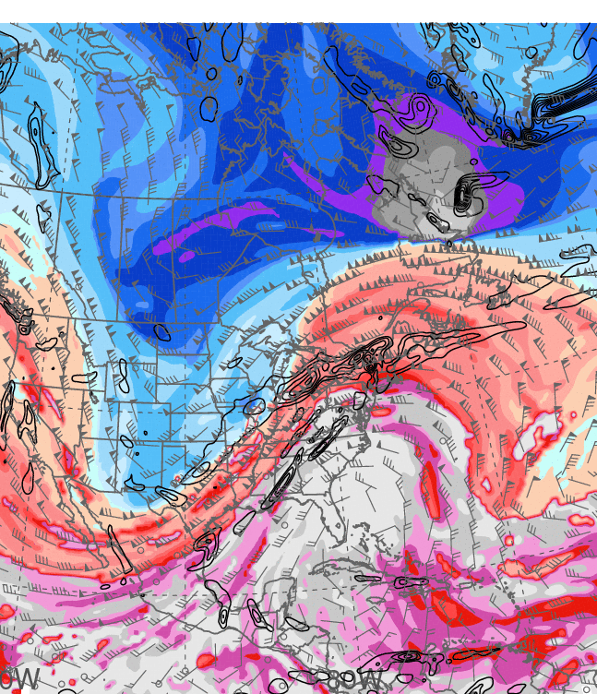
1200 UTC 22 December 2013
Dynamic tropopause (DT, 1.5-PVU surface) potential
temperature (shaded, K) and wind (barbs, kts),
925–850-hPa layer-averaged cyclonic relative vorticity
(black contours every 0.5 × 10⁻⁴ s⁻¹)
250-hPa wind speed (shaded, m s⁻¹), 1000–500-hPa thickness (blue contours ≤ 540 dam,
red contours > 540 dam), MSLP (black contours, hPa)

Slide 11
PW & ANOM. LOOPS
Notes:
When starting talk, define education–research interface and introduce Alicia and Kyle as current and previous TAs in upper-division thermodynamics and introductory graduate dynamics that I presently teach at UAlbany.

Slide 12
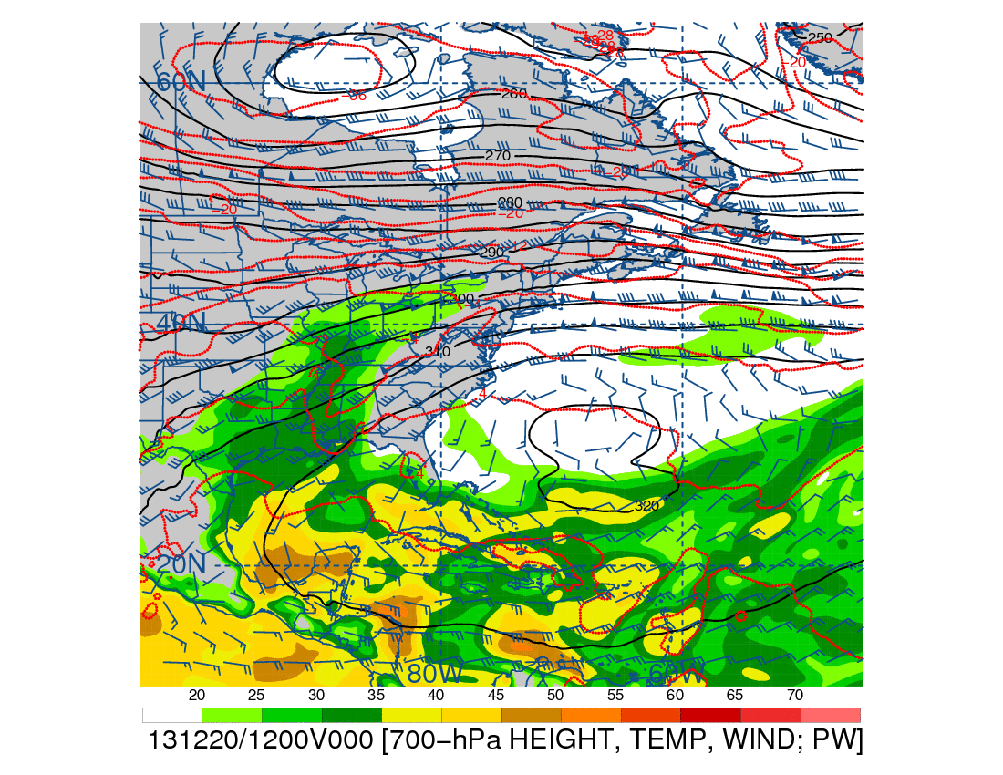
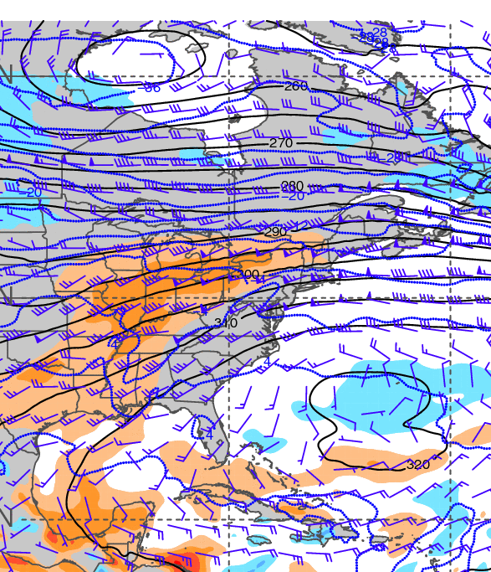
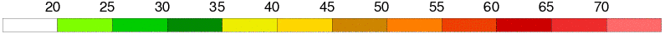
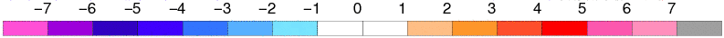
1200 UTC 20 December 2013
700-hPa geopotential height (black contours, dam),
temperature (red contours, °C), wind (barbs, kts),
and precipitable water (shaded, mm)
700-hPa geopotential height (black contours, dam),
temperature (blue contours, °C), wind (barbs, kts),
and precipitable water standardized anomalies (shaded, σ)

Slide 13
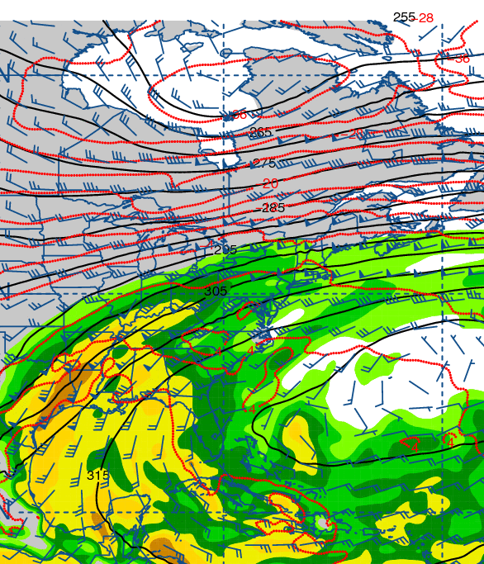
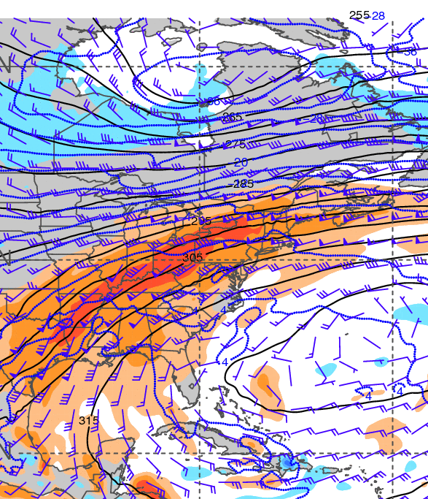
1200 UTC 21 December 2013
700-hPa geopotential height (black contours, dam),
temperature (red contours, °C), wind (barbs, kts),
and precipitable water (shaded, mm)
700-hPa geopotential height (black contours, dam),
temperature (blue contours, °C), wind (barbs, kts),
and precipitable water standardized anomalies (shaded, σ)

Slide 14
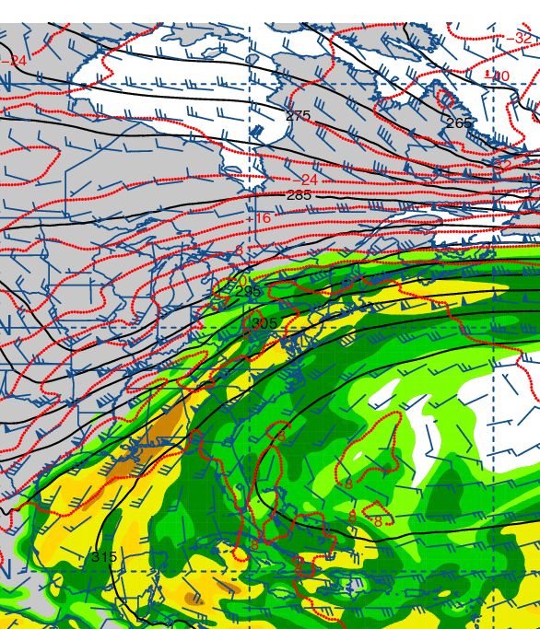
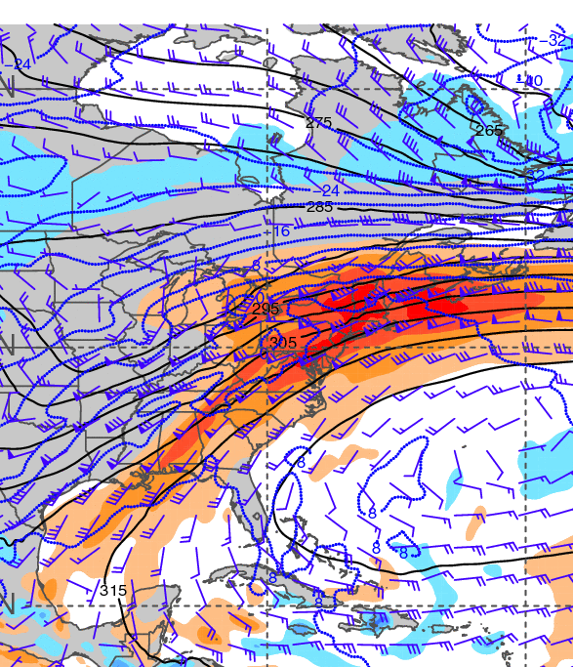
1200 UTC 22 December 2013
700-hPa geopotential height (black contours, dam),
temperature (red contours, °C), wind (barbs, kts),
and precipitable water (shaded, mm)
700-hPa geopotential height (black contours, dam),
temperature (blue contours, °C), wind (barbs, kts),
and precipitable water standardized anomalies (shaded, σ)

Slide 15
925-hPa temp. and anom.
Notes:
When starting talk, define education–research interface and introduce Alicia and Kyle as current and previous TAs in upper-division thermodynamics and introductory graduate dynamics that I presently teach at UAlbany.

Slide 16
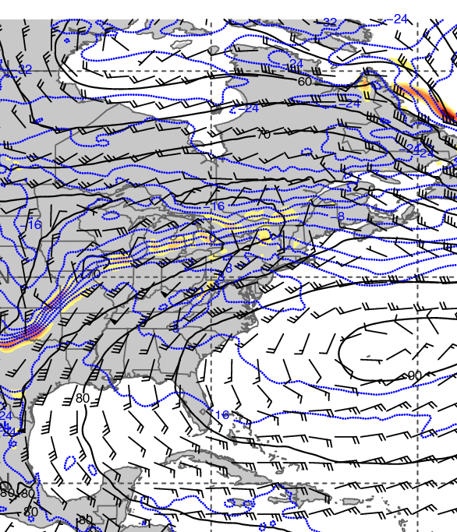
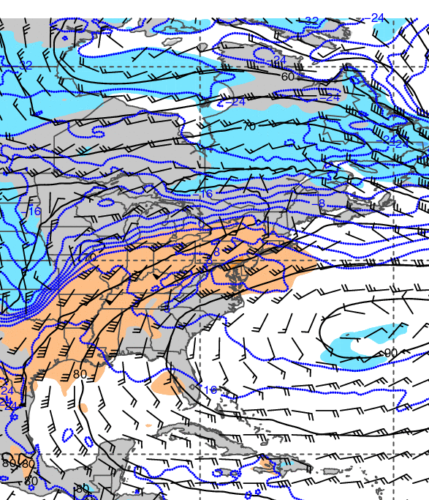
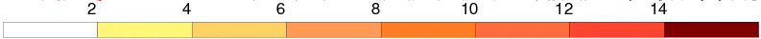
1200 UTC 20 December 2013
925-hPa geopotential height (black contours, dam),
temperature (blue contours, °C), wind (barbs, kts),
and frontogenesis (shaded, K [100 km]⁻¹ [3 h]⁻¹)
925-hPa geopotential height (black contours, dam),
temperature (blue contours, °C), wind (barbs, kts),
and temperature standardized anomalies (shaded, σ)

Slide 17
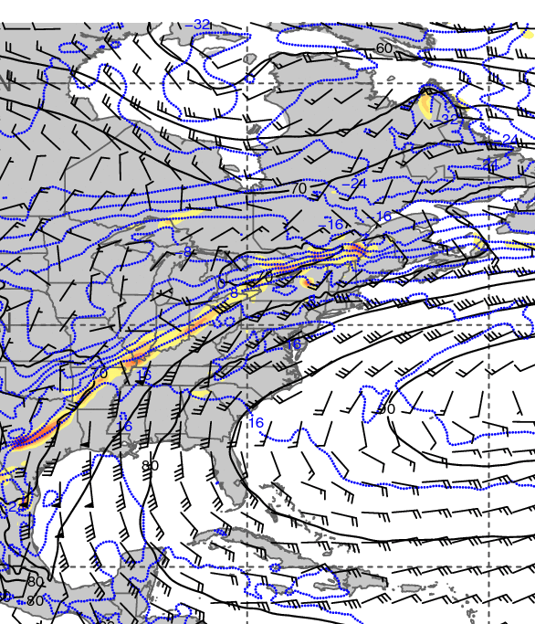
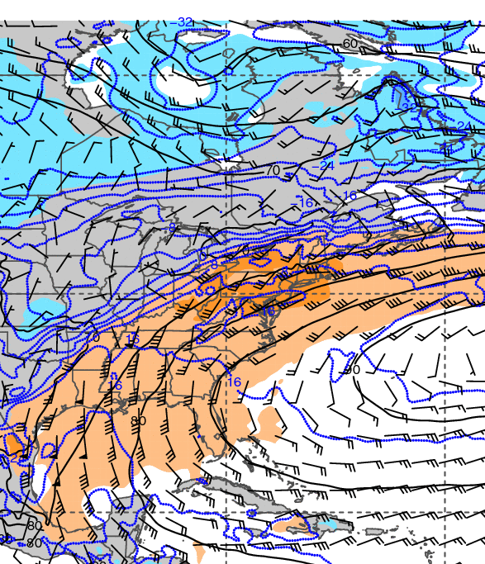
1200 UTC 21 December 2013
925-hPa geopotential height (black contours, dam),
temperature (blue contours, °C), wind (barbs, kts),
and frontogenesis (shaded, K [100 km]⁻¹ [3 h]⁻¹)
925-hPa geopotential height (black contours, dam),
temperature (blue contours, °C), wind (barbs, kts),
and temperature standardized anomalies (shaded, σ)

Slide 18
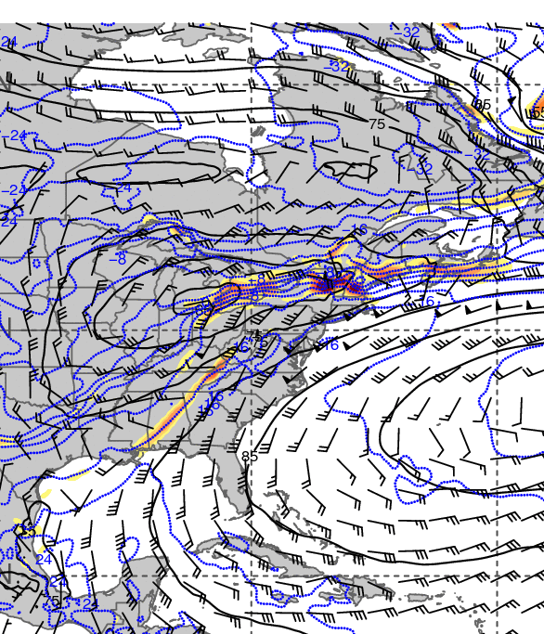
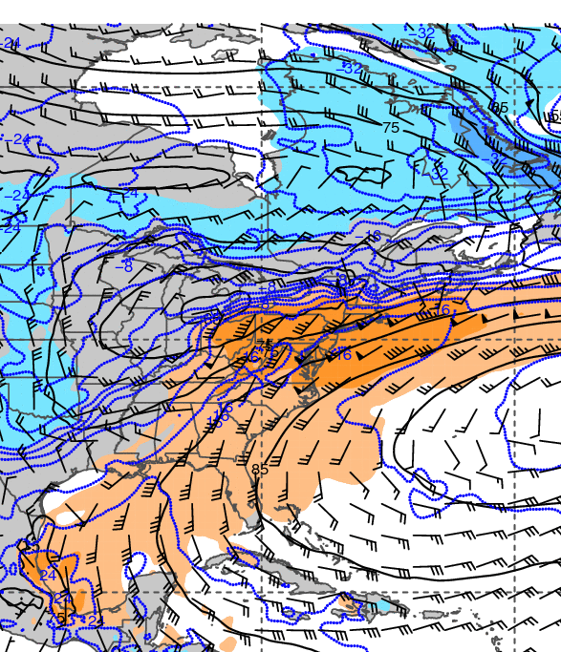
1200 UTC 22 December 2013
925-hPa geopotential height (black contours, dam),
temperature (blue contours, °C), wind (barbs, kts),
and frontogenesis (shaded, K [100 km]⁻¹ [3 h]⁻¹)
925-hPa geopotential height (black contours, dam),
temperature (blue contours, °C), wind (barbs, kts),
and temperature standardized anomalies (shaded, σ)

Slide 19
Maplist Images
Notes:
When starting talk, define education–research interface and introduce Alicia and Kyle as current and previous TAs in upper-division thermodynamics and introductory graduate dynamics that I presently teach at UAlbany.

Slide 20
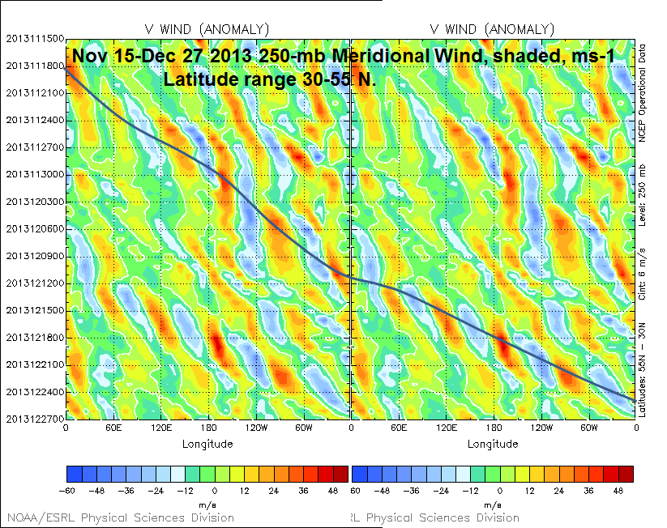
15 Nov
21 Nov
27 Nov
Time
3 Dec
9 Dec
c_{g} = ~18 m s⁻¹
15 Dec
21 Dec
27 Dec
−60 −48 −36 −24 −12 0 12 24 36 48
Source: Dr. Mel Shapiro
Notes:
When starting talk, define education–research interface and introduce Alicia and Kyle as current and previous TAs in upper-division thermodynamics and introductory graduate dynamics that I presently teach at UAlbany.

Slide 21
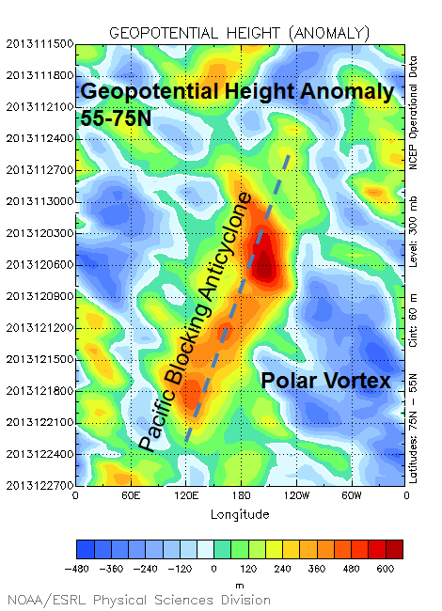
15 Nov
300-hPa
21 Nov
600
480
360
240
120
0
−120
−240
−360
−480
27 Nov
Time
3 Dec
9 Dec
15 Dec
c_{p} = ~−2 m s⁻¹
21 Dec
27 Dec
Source: Dr. Mel Shapiro
Notes:
When starting talk, define education–research interface and introduce Alicia and Kyle as current and previous TAs in upper-division thermodynamics and introductory graduate dynamics that I presently teach at UAlbany.

Slide 22
CYYZ – Toronto, ON
CYYZ – Toronto, ON
120 h backward trajectories ending at:
0000 UTC 22 December 2013
72 h forward trajectories starting at:
0000 UTC 22 December 2013
Source: NOAA HYSPLIT MODEL
Notes:
When starting talk, define education–research interface and introduce Alicia and Kyle as current and previous TAs in upper-division thermodynamics and introductory graduate dynamics that I presently teach at UAlbany.

Slide 23
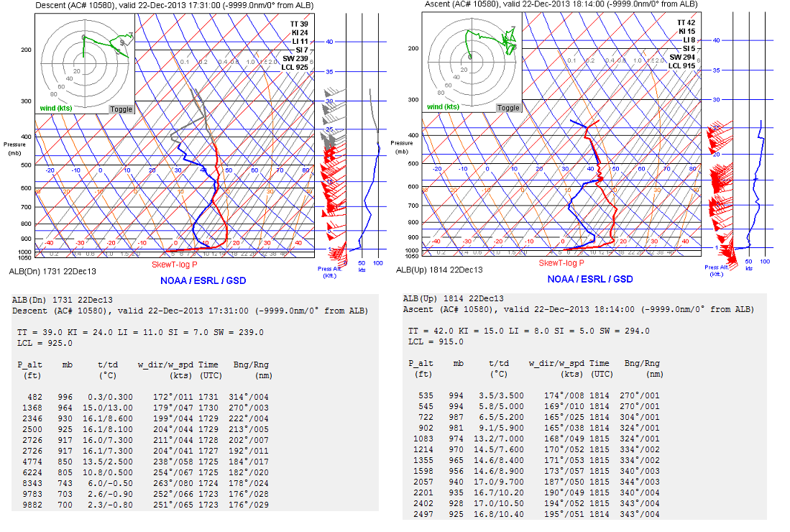
ALB (Albany, NY) Aircraft Soundings
1731 UTC 22 December 2013 1814 UTC 22 December 2013
Descent
Ascent
Source: Jonathan Blaes
Notes:
When starting talk, define education–research interface and introduce Alicia and Kyle as current and previous TAs in upper-division thermodynamics and introductory graduate dynamics that I presently teach at UAlbany.

Slide 24
Additional Soundings
Notes:
When starting talk, define education–research interface and introduce Alicia and Kyle as current and previous TAs in upper-division thermodynamics and introductory graduate dynamics that I presently teach at UAlbany.

Slide 25
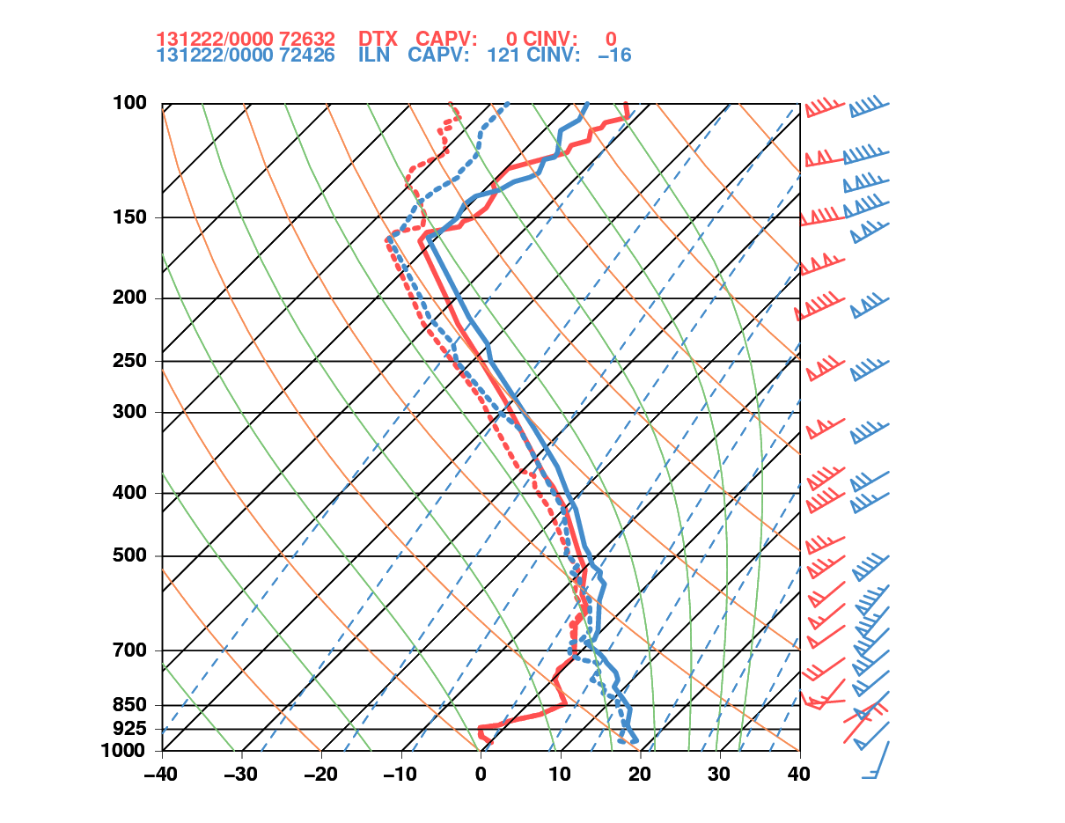
0000 UTC 22 December 2013
Detroit, MI Wilmington, OH
PW = 28.9 mm
CAPE = 0.0 J kg⁻¹
Thickness = 5546 m
PW = 37.4 mm*
CAPE = 99.3 J kg⁻¹
Thickness = 5645 m
*Record

Slide 26
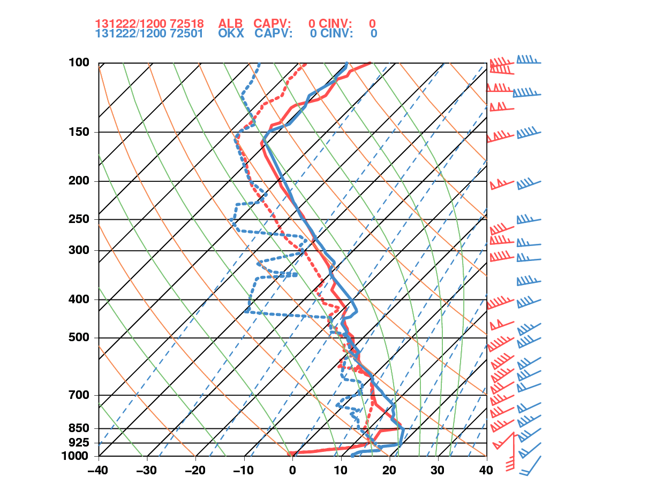
1200 UTC 22 December 2013
Albany, NY Upton, NY
PW = 36.8 mm*
CAPE = 0.0 J kg⁻¹
Thickness = 5629 m
PW = 36.2 mm
CAPE = 0.0 J kg⁻¹
Thickness = 5676 m
*2nd Highest

Slide 27
Cross Sections
Adapted From Newton and Palmen (1963)

Slide 28
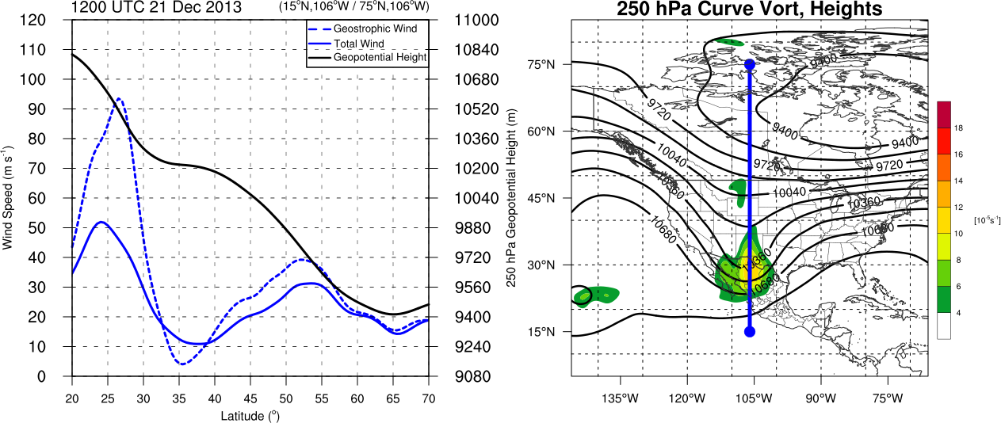
Trough Cross Section 1200 UTC 21 December 2013
Adapted From Newton and Palmen (1963)
250-hPa geopotential height (black contour, m)
geostrophic wind (blue dotted contour m s⁻¹)
total wind (blue contour, m s⁻¹)
250-hPa geopotential heights (black contours, m)
Observed cyclonic curvature vorticity (shaded, 10⁻⁵ s⁻¹)

Slide 29
Trough Cross Section 1200 UTC 21 December 2013
Adapted From Newton and Palmen (1963)
250-hPa geopotential height (black contour, m)
geostrophic wind (blue dotted contour m s⁻¹)
total wind (blue contour, m s⁻¹)
250-hPa geopotential heights (black contours, m)
Observed cyclonic curvature vorticity (shaded, 10⁻⁵ s⁻¹)
Maximum Cyclonic Curvature Vorticity at Base of Trough Along Jet

Slide 30
Trough Cross Section 1200 UTC 21 December 2013
Adapted From Newton and Palmen (1963)
250-hPa geopotential height (black contour, m)
geostrophic wind (blue dotted contour m s⁻¹)
total wind (blue contour, m s⁻¹)
250-hPa geopotential heights (black contours, m)
Observed cyclonic curvature vorticity (shaded, 10⁻⁵ s⁻¹)
Maximum Cyclonic Curvature Vorticity at Base of Trough Along Jet
Subgeostrophic Flow at Trough Axis Along Subtropical and Polar Jets

Slide 31
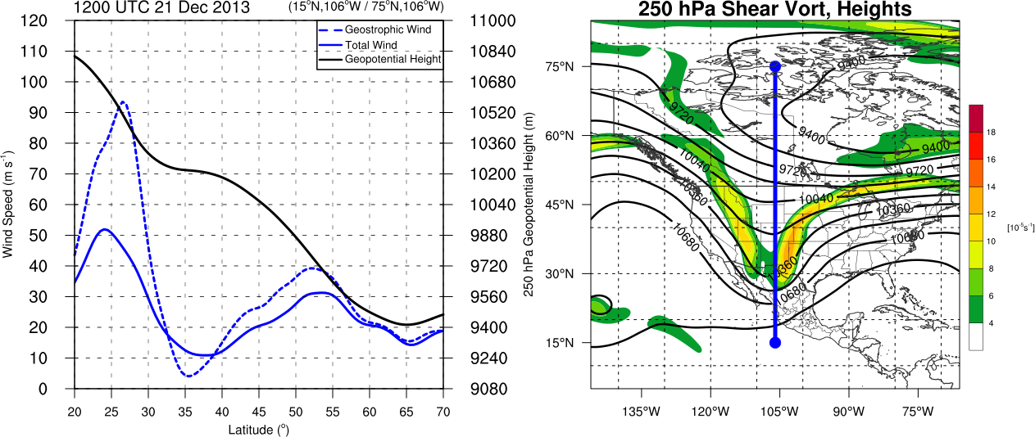
Trough Cross Section 1200 UTC 21 December 2013
Adapted From Newton and Palmen (1963)
250-hPa geopotential height (black contour, m)
geostrophic wind (blue dotted contour m s⁻¹)
total wind (blue contour, m s⁻¹)
250-hPa geopotential heights (black contours, m)
Observed cyclonic shear vorticity (shaded, 10⁻⁵ s⁻¹)
Maximum Cyclonic Curvature Vorticity at Base of Trough Along Jet
Subgeostrophic Flow at Trough Axis Along Subtropical and Polar Jets
Maximum Shear Vorticity at Strongest Height Gradient Along Jets

Slide 32
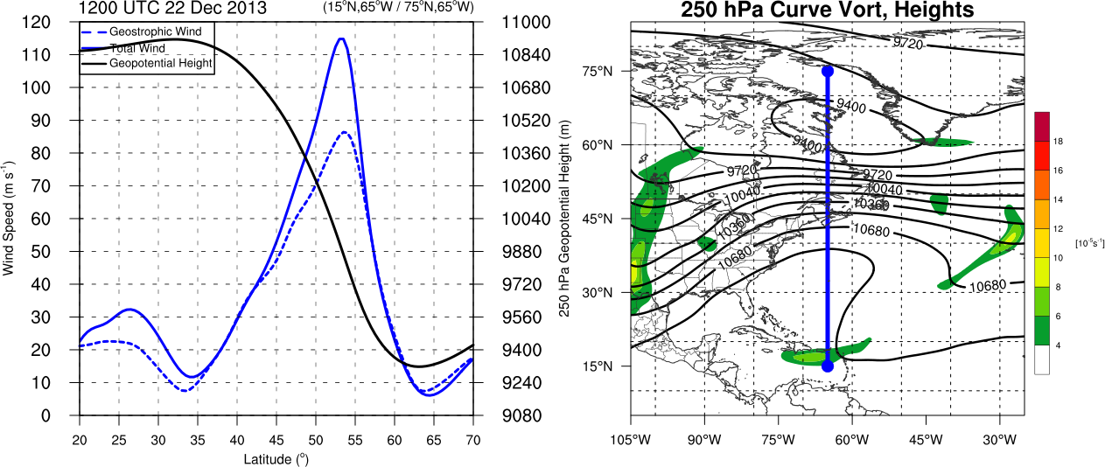
Ridge Cross Section 1200 UTC 22 December 2013
Adapted From Newton and Palmen (1963)
250-hPa geopotential height (black contour, m)
geostrophic wind (blue dotted contour m s⁻¹)
total wind (blue contour, m s⁻¹)
250-hPa geopotential heights (black contours, m)
Observed cyclonic curvature vorticity (shaded, 10⁻⁵ s⁻¹)

Slide 33
Ridge Cross Section 1200 UTC 22 December 2013
Adapted From Newton and Palmen (1963)
250-hPa geopotential height (black contour, m)
geostrophic wind (blue dotted contour m s⁻¹)
total wind (blue contour, m s⁻¹)
250-hPa geopotential heights (black contours, m)
Observed cyclonic curvature vorticity (shaded, 10⁻⁵ s⁻¹)
Little to No Cyclonic Curvature Vorticity at Base of Ridge Along Jet

Slide 34
Ridge Cross Section 1200 UTC 22 December 2013
Adapted From Newton and Palmen (1963)
250-hPa geopotential height (black contour, m)
geostrophic wind (blue dotted contour m s⁻¹)
total wind (blue contour, m s⁻¹)
250-hPa geopotential heights (black contours, m)
Observed cyclonic curvature vorticity (shaded, 10⁻⁵ s⁻¹)
Little to No Cyclonic Curvature Vorticity at Base of Ridge Along Jet
Supergeostrophic Flow at Ridge Axis Along Merged Subtropical and Polar Jets

Slide 35
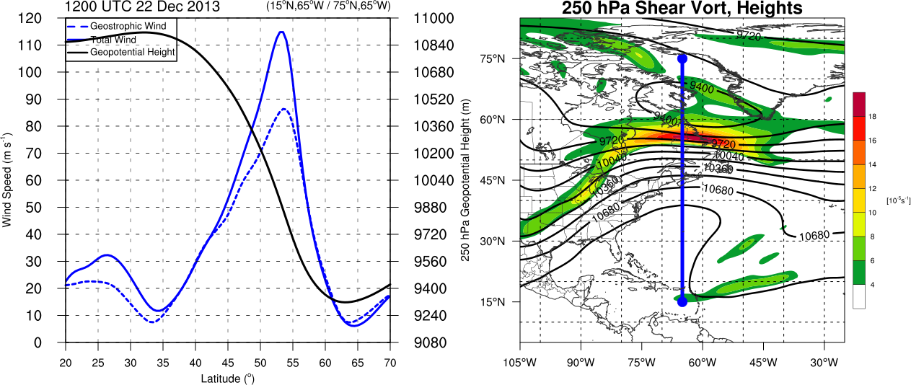
Ridge Cross Section 1200 UTC 22 December 2013
Adapted From Newton and Palmen (1963)
250-hPa geopotential height (black contour, m)
geostrophic wind (blue dotted contour m s⁻¹)
total wind (blue contour, m s⁻¹)
250-hPa geopotential heights (black contours, m)
Observed cyclonic curvature vorticity (shaded, 10⁻⁵ s⁻¹)
Little to No Cyclonic Curvature Vorticity at Base of Ridge Along Jet
Supergeostrophic Flow at Ridge Axis Along Merged Subtropical and Polar Jets
Maximum Cycloinc Shear Vorticity Poleward of Jet Core (Along Broad Trough Axis)

Slide 36
Cross Sections
Jet Entrance and Jet Exit

Slide 37
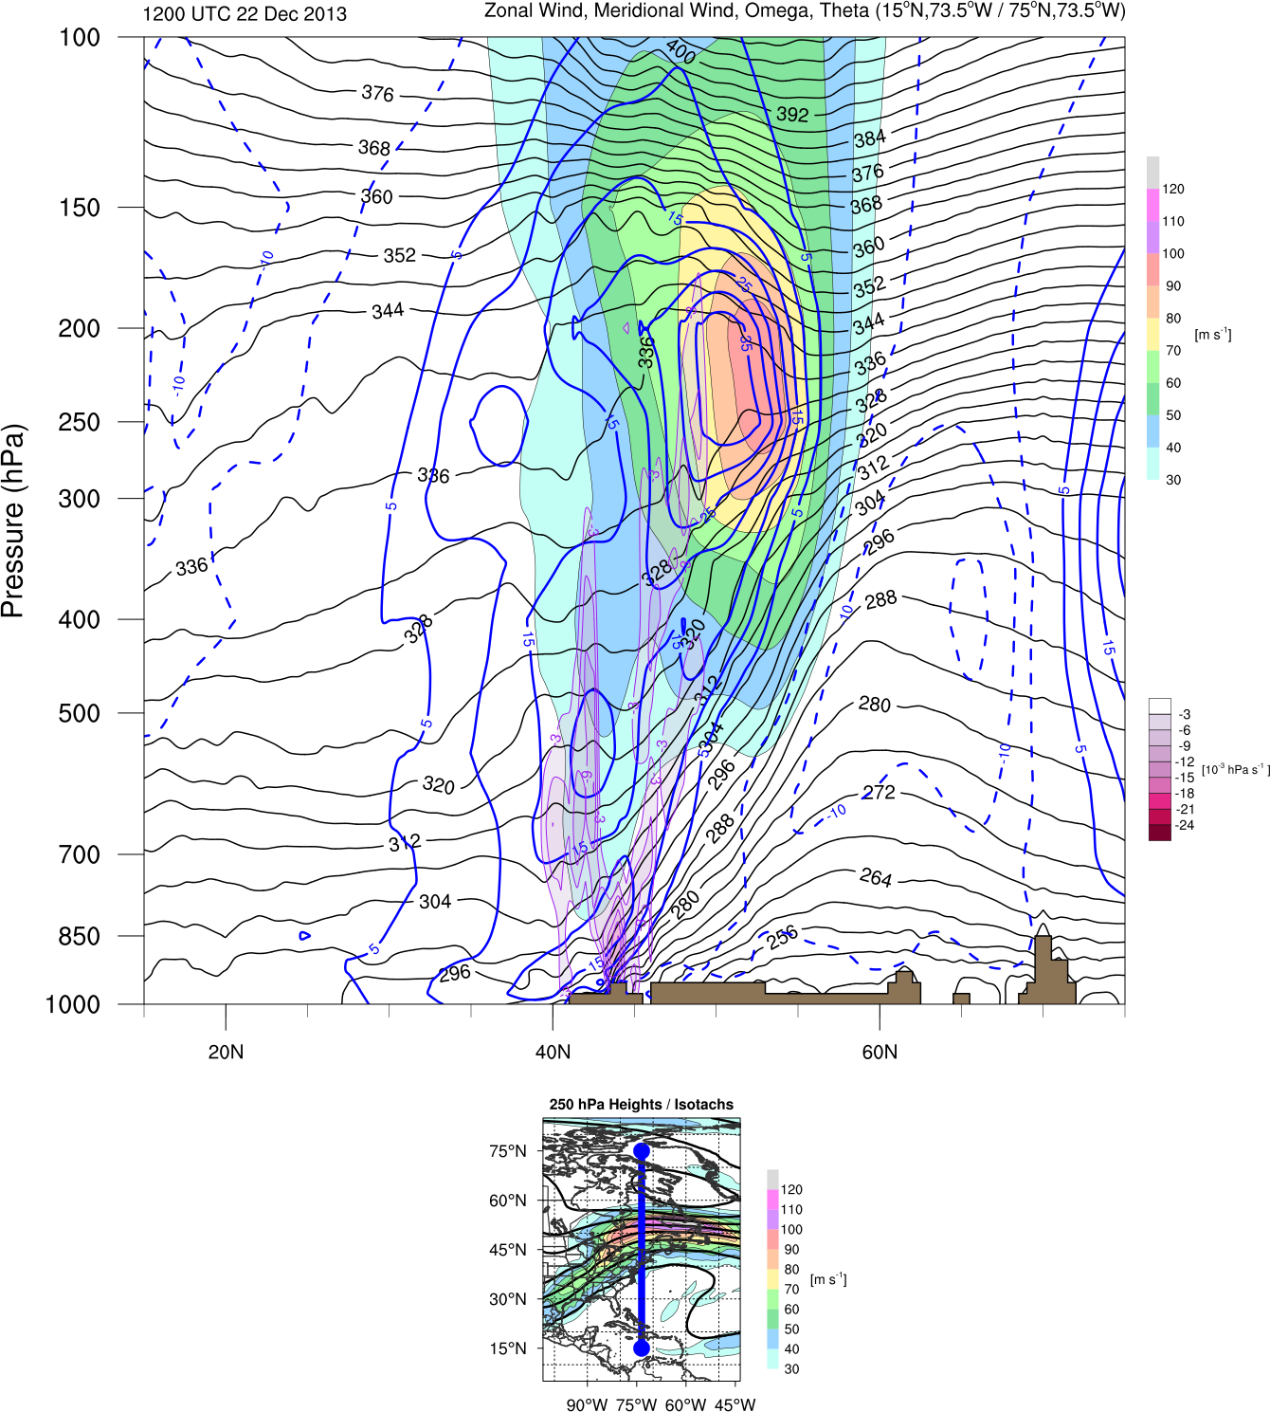
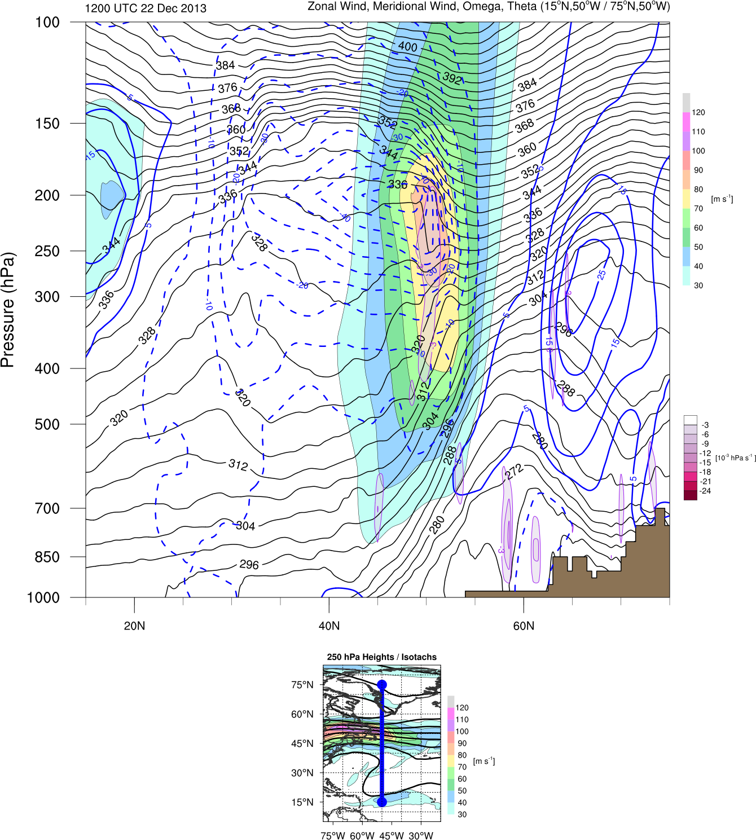
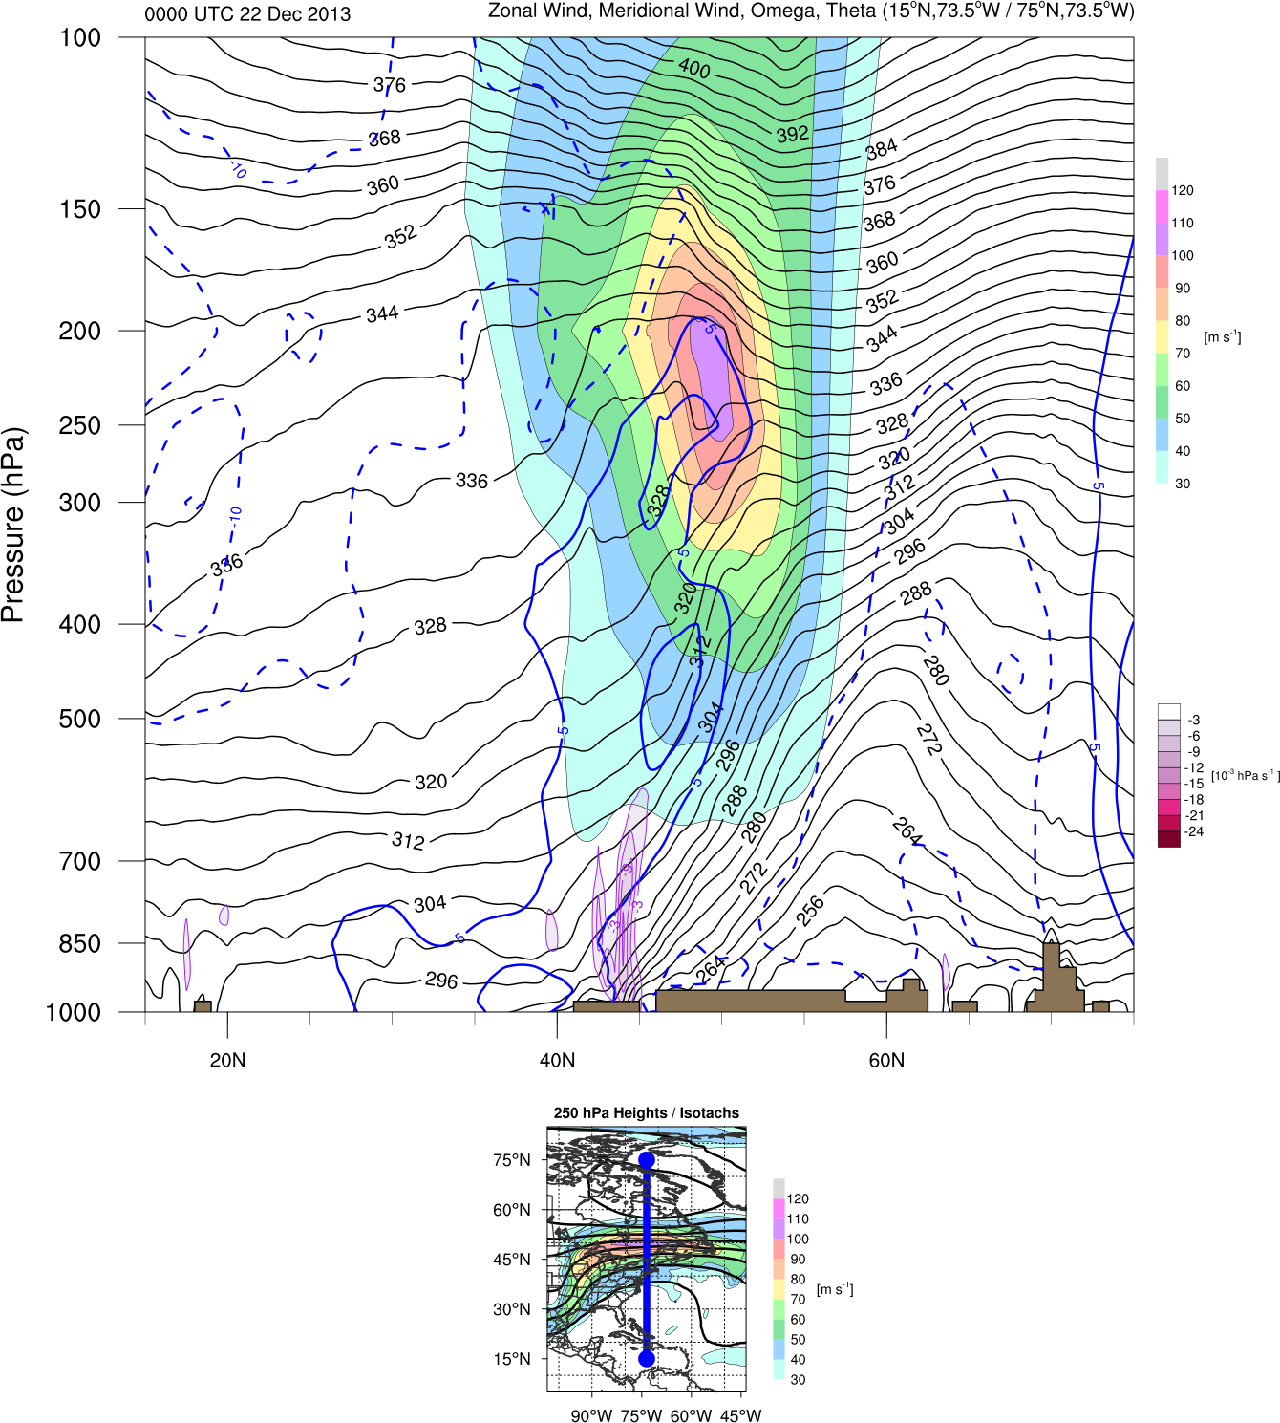
1200 UTC 22 December 2013
Jet Entrance
(15ºN,73.5ºW / 75ºN,73.5ºW)
Jet Exit
(15ºN,50ºW / 75ºN,50ºW)
CYUL
Zonal Wind (shaded, m s⁻¹), Meridional Wind (blue contours, m s⁻¹)
Omega (purple contours, 10⁻³ Pa s⁻¹), Theta (black contours, K)
Inset: 250-hPa Total Wind (shaded, m s⁻¹), 250-hPa Geopotential Height (black contours, m)

Slide 38
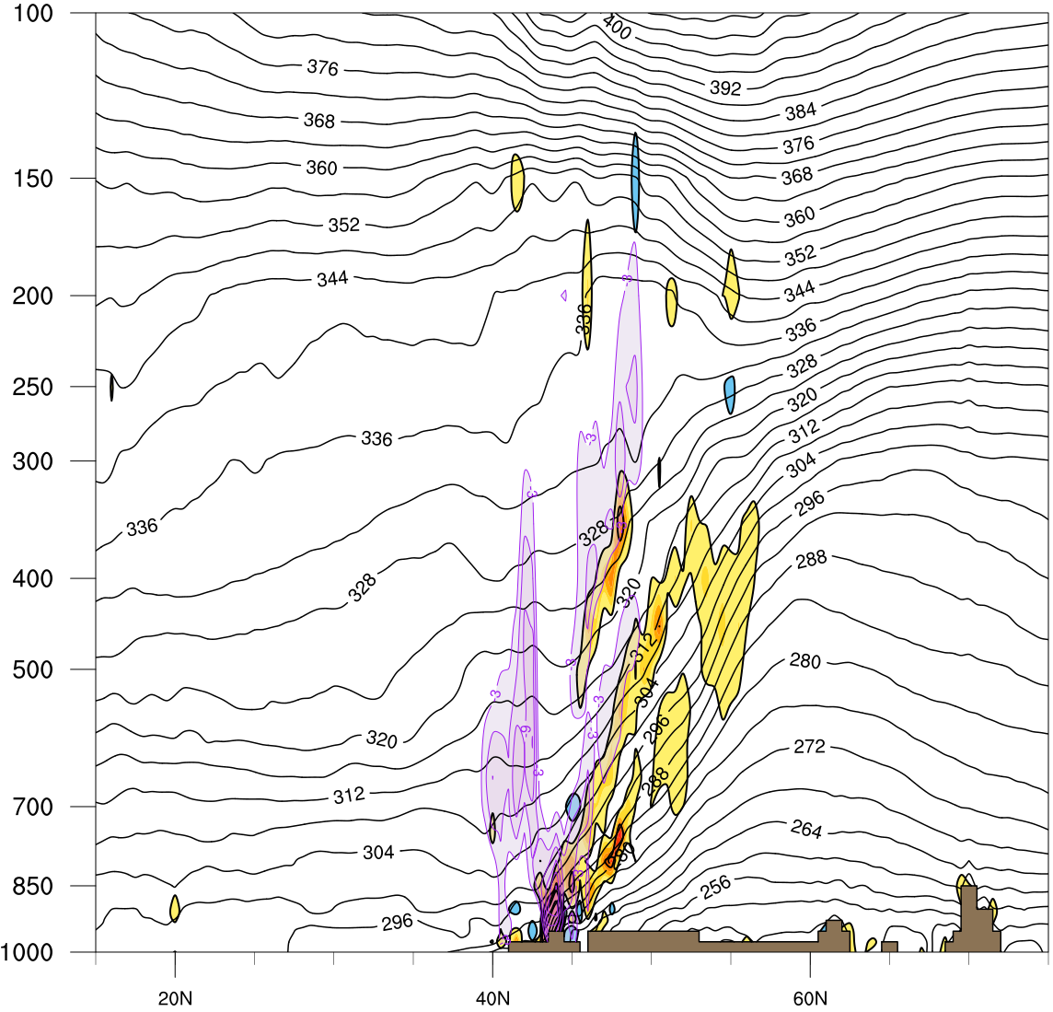
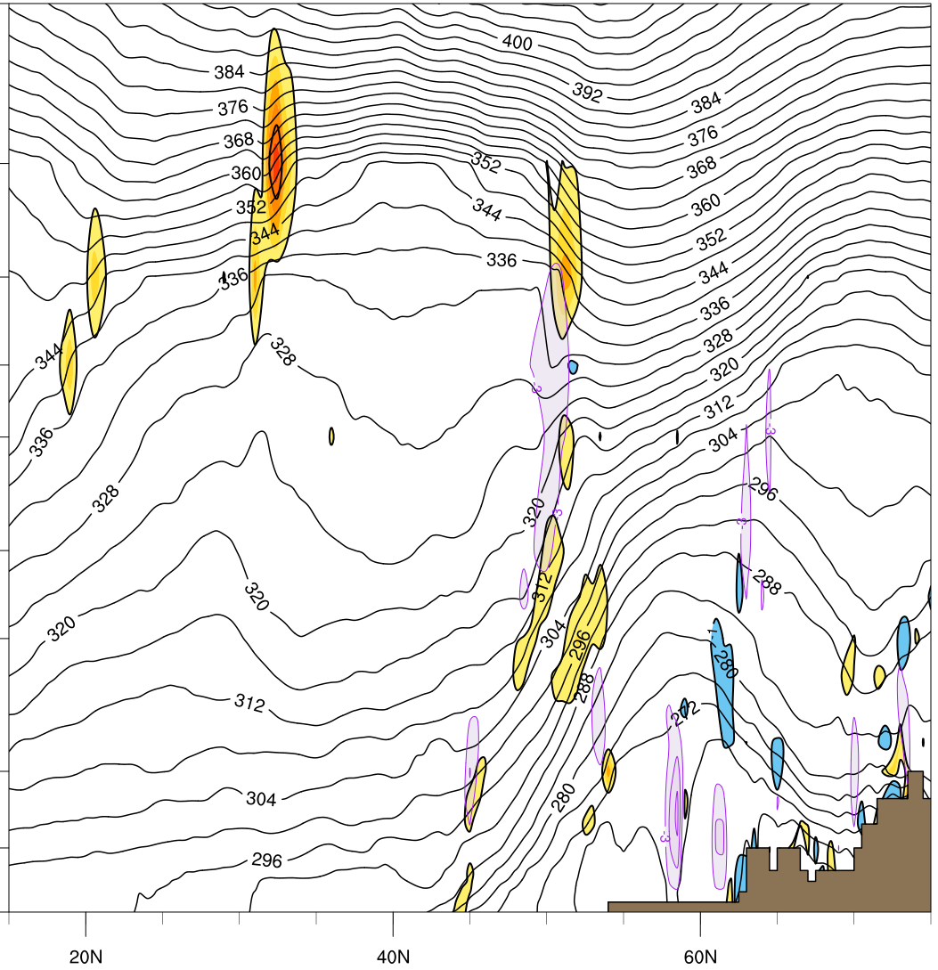
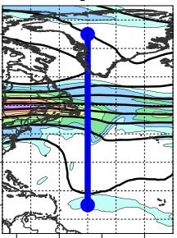
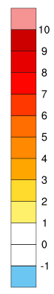
1200 UTC 22 December 2013
Jet Entrance
(15ºN,73.5ºW / 75ºN,73.5ºW)
Jet Exit
(15ºN,50ºW / 75ºN,50ºW)
CYUL
Frontogenesis (shaded, K [100 km]⁻¹ [3 h]⁻¹)
Omega (purple contours, 10⁻³ Pa s⁻¹), Theta (black contours, K)
Inset: 250-hPa Total Wind (shaded, m s⁻¹), 250-hPa Geopotential Height (black contours, m)

Slide 39
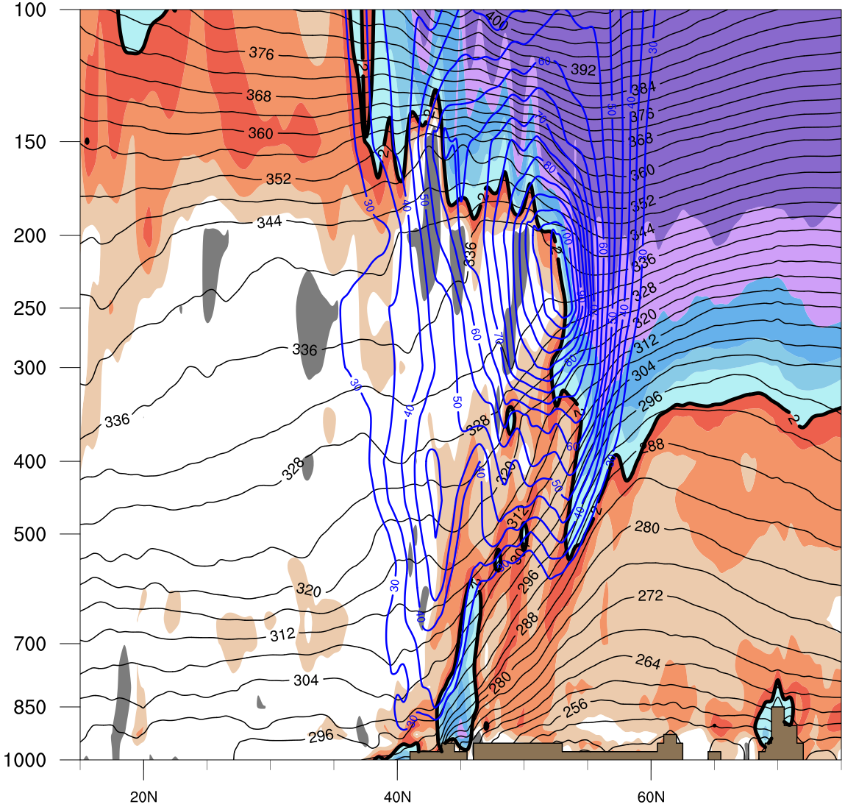
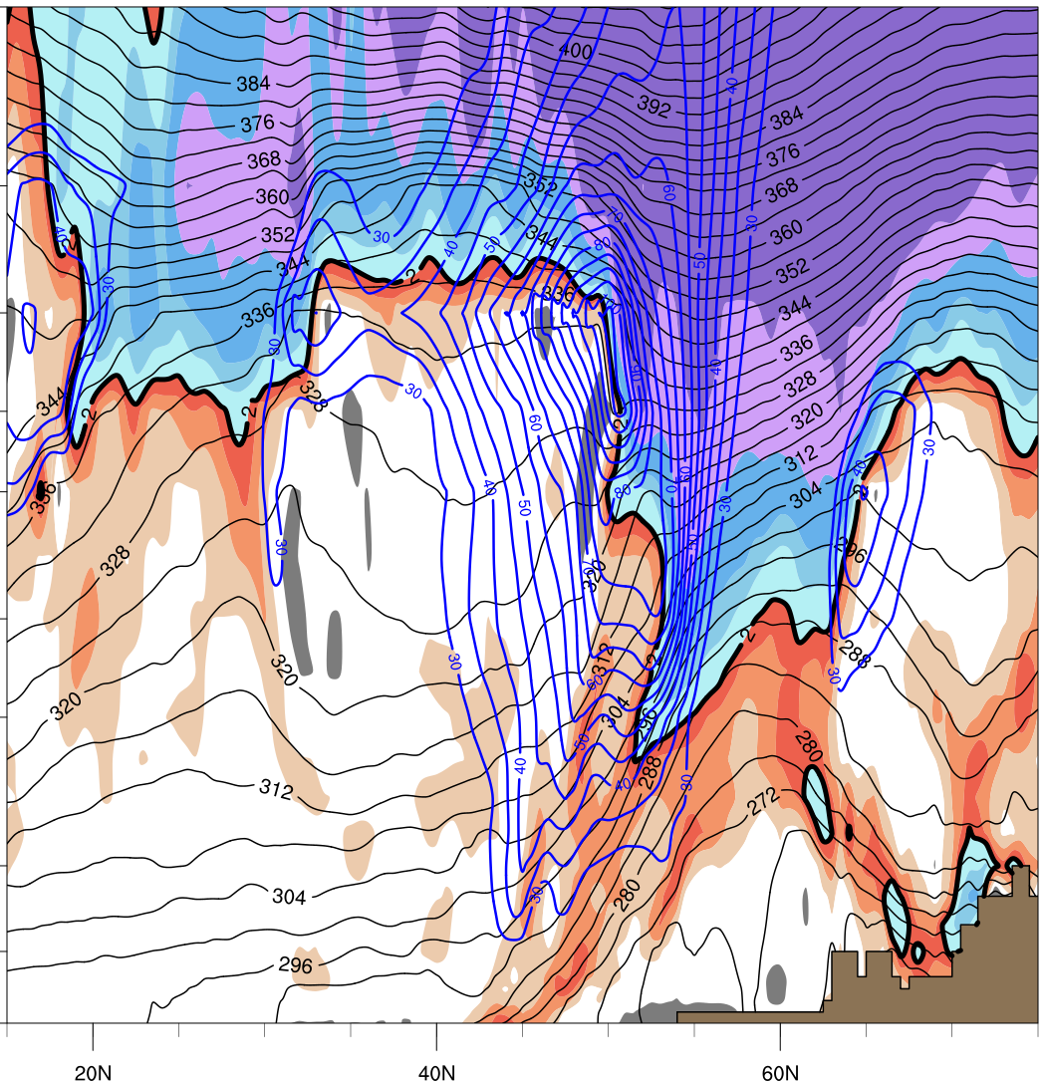
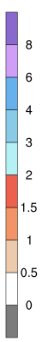
1200 UTC 22 December 2013
Jet Entrance
(15ºN,73.5ºW / 75ºN,73.5ºW)
Jet Exit
(15ºN,50ºW / 75ºN,50ºW)
CYUL
Potential Vorticity (shaded, PVU)
Total Wind (blue contours, m s⁻¹), Theta (black contours, K)
Inset: 250-hPa Total Wind (shaded, m s⁻¹), 250-hPa Geopotential Height (black contours, m)

Slide 40
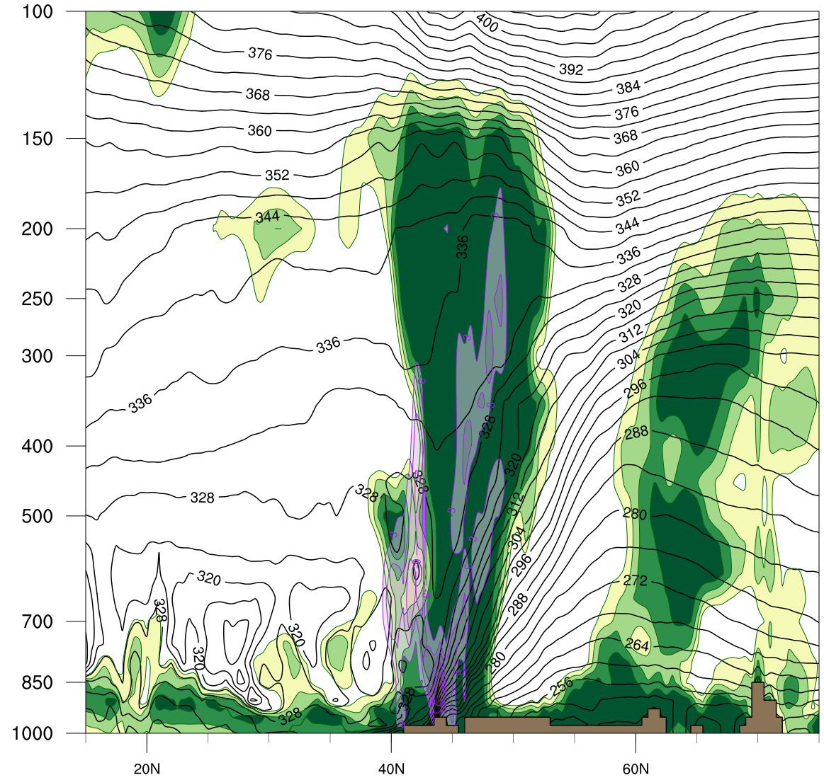
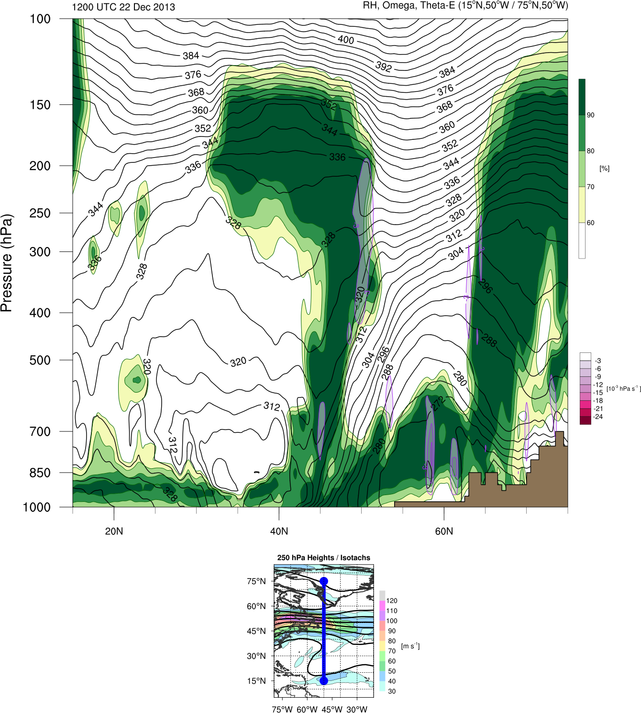
1200 UTC 22 December 2013
Jet Entrance
(15ºN,73.5ºW / 75ºN,73.5ºW)
Jet Exit
(15ºN,50ºW / 75ºN,50ºW)
CYUL
Relative Humidity (shaded, %)
Omega (purple contours, 10⁻³ Pa s⁻¹), Theta-e (black contours, K)
Inset: 250-hPa Total Wind (shaded, m s⁻¹), 250-hPa Geopotential Height (black contours, m)

Slide 41
Surface Obs

Slide 42
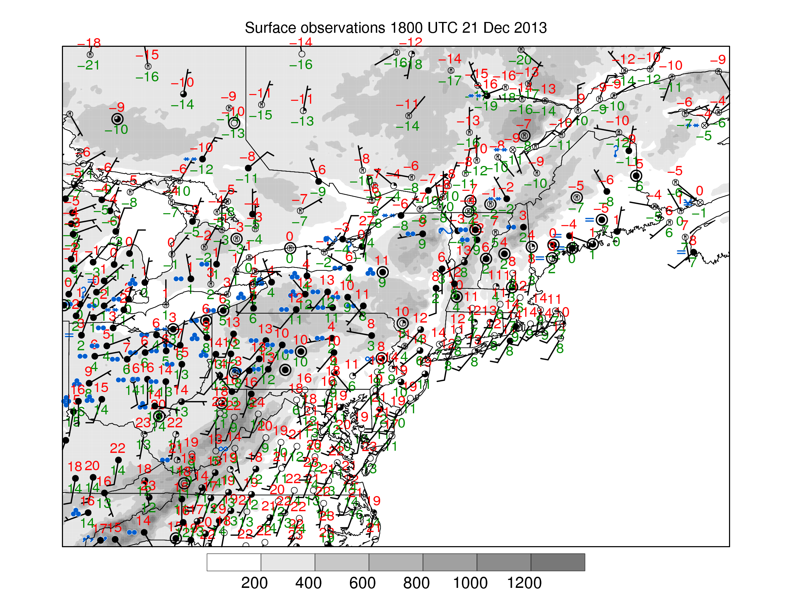
1800 UTC 21 December 2013
KDDH (244m): 12ºC
KALB (92m): 8ºC
Surface METAR Observations and Elevation (shaded, m)

Slide 43

1800 UTC 22 December 2013
KDDH (244m): 18ºC
KALB (92m): 1ºC
Surface METAR Observations and Elevation (shaded, m)

Slide 44
Summary Schematic

Slide 45



Summary Schematic on 1200 UTC 22 Dec
J
F_{gen}
L
V₈₅₀₋₇₀₀
>20 m s⁻¹
0ºC
0ºC
PW > 25mm
250-hPa geopotential height (solid black contours, every 12 dam) 250-hPa Wind Speed (color shading, m s⁻¹),
2 meter 0ºC Isotherm (red dotted line), 850-700 hPa layer mean 0ºC Isotherm (orange dotted line)
precipitable water (values > 25 mm shaded in green), concentrated 925-hPa frontogenesis (purple shading)
850-700 hPa wind vector (speed > 20 m s⁻¹ ), elevation (hatched, > 300 m)

Slide 46
THE END
Notes:
When starting talk, define education–research interface and introduce Alicia and Kyle as current and previous TAs in upper-division thermodynamics and introductory graduate dynamics that I presently teach at UAlbany.

