Slide 1
The Uber Jet and
the Widespread Disruptive Ice Storm
of 21–23 December 2013
Lance F. Bosart, Alicia M. Bentley, and Philippe P. Papin
Department of Atmospheric and Environmental Sciences
University at Albany, State University of New York, Albany, NY 12222
39th Annual Northeastern Storm Conference
Rutland, VT
Saturday 8 March 2014
Notes:
When starting talk, define education–research interface and introduce Alicia and Kyle as current and previous TAs in upper-division thermodynamics and introductory graduate dynamics that I presently teach at UAlbany.

Slide 2
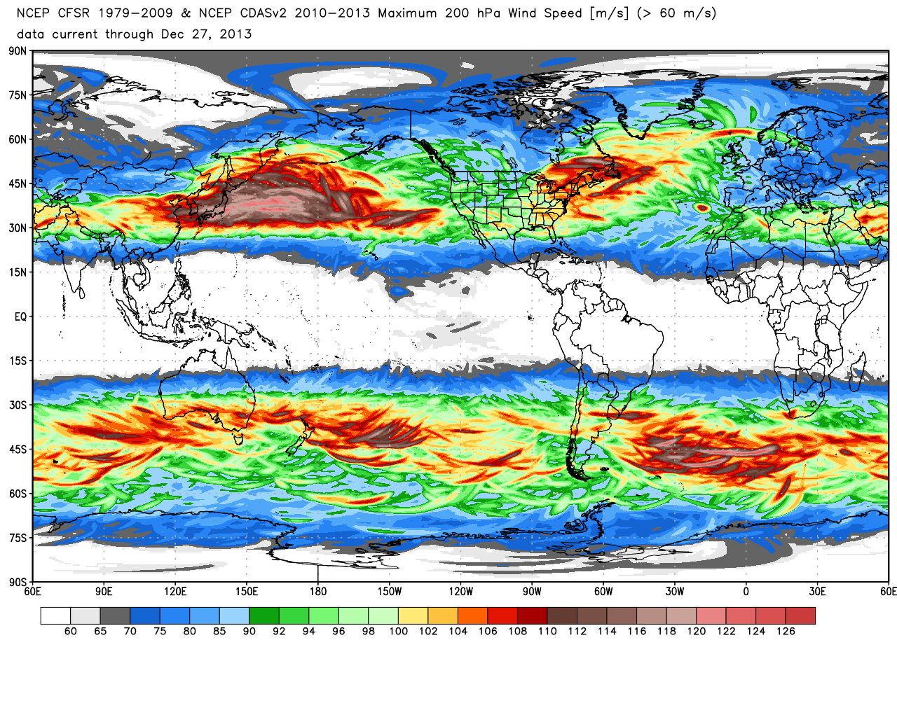
0.5° Climate Forecast System Reanalysis (1979–2013)
200-hPa maximum wind speed (m s⁻¹)
Image credit: Dr. Ryan Maue – www.models.weatherbell.com
Notes:
When starting talk, define education–research interface and introduce Alicia and Kyle as current and previous TAs in upper-division thermodynamics and introductory graduate dynamics that I presently teach at UAlbany.

Slide 3
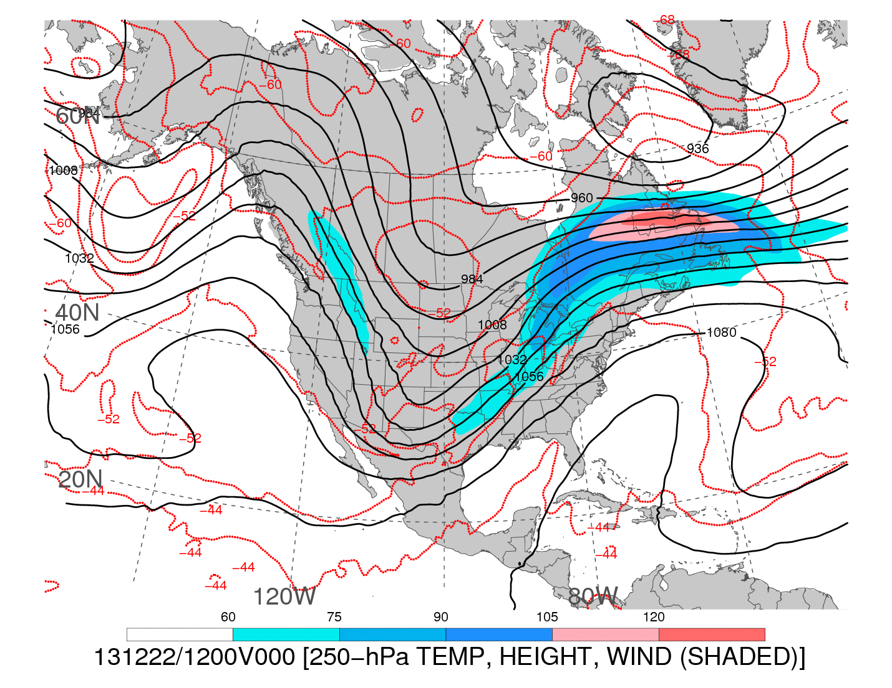
1200 UTC 22 December 2013
250-hPa wind speed (shaded, m s⁻¹), geopotential height (black contours, dam),
and temperature (red dashed contours, °C)
Notes:
When starting talk, define education–research interface and introduce Alicia and Kyle as current and previous TAs in upper-division thermodynamics and introductory graduate dynamics that I presently teach at UAlbany.

Slide 4
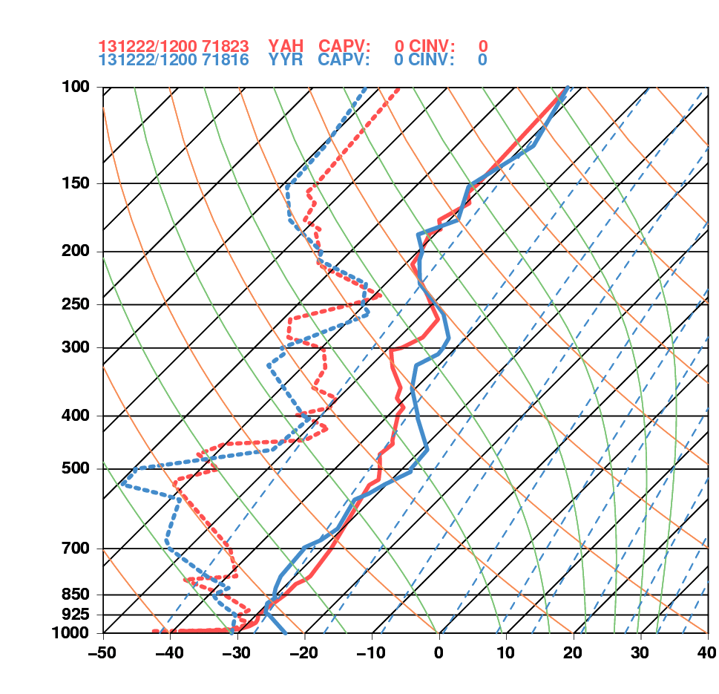
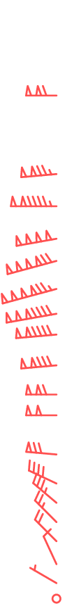
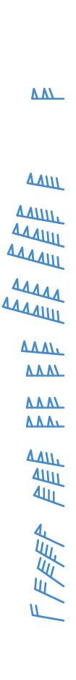
1200 UTC 22 December 2013
La Grande, QC Goose Bay, NL

Slide 5
Additional Soundings
Notes:
When starting talk, define education–research interface and introduce Alicia and Kyle as current and previous TAs in upper-division thermodynamics and introductory graduate dynamics that I presently teach at UAlbany.

Slide 6
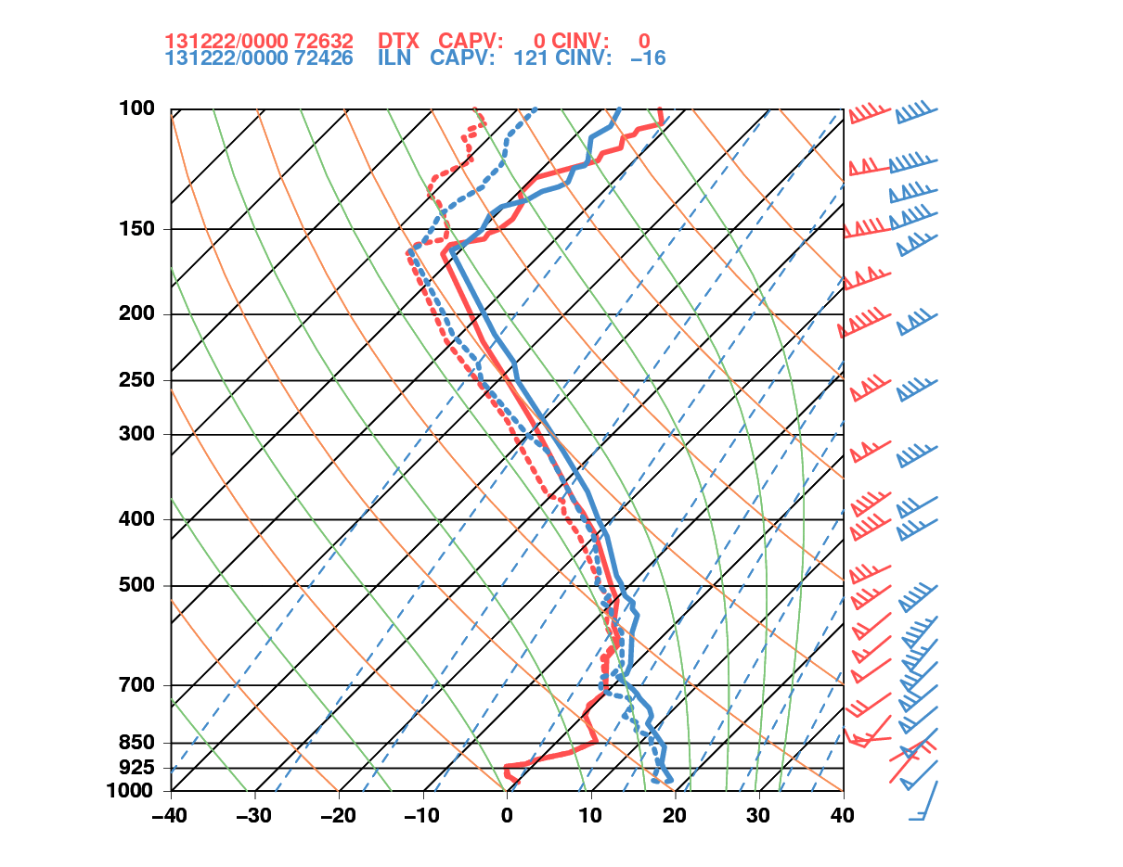
0000 UTC 22 December 2013
Detroit, MI Wilmington, OH

Slide 7
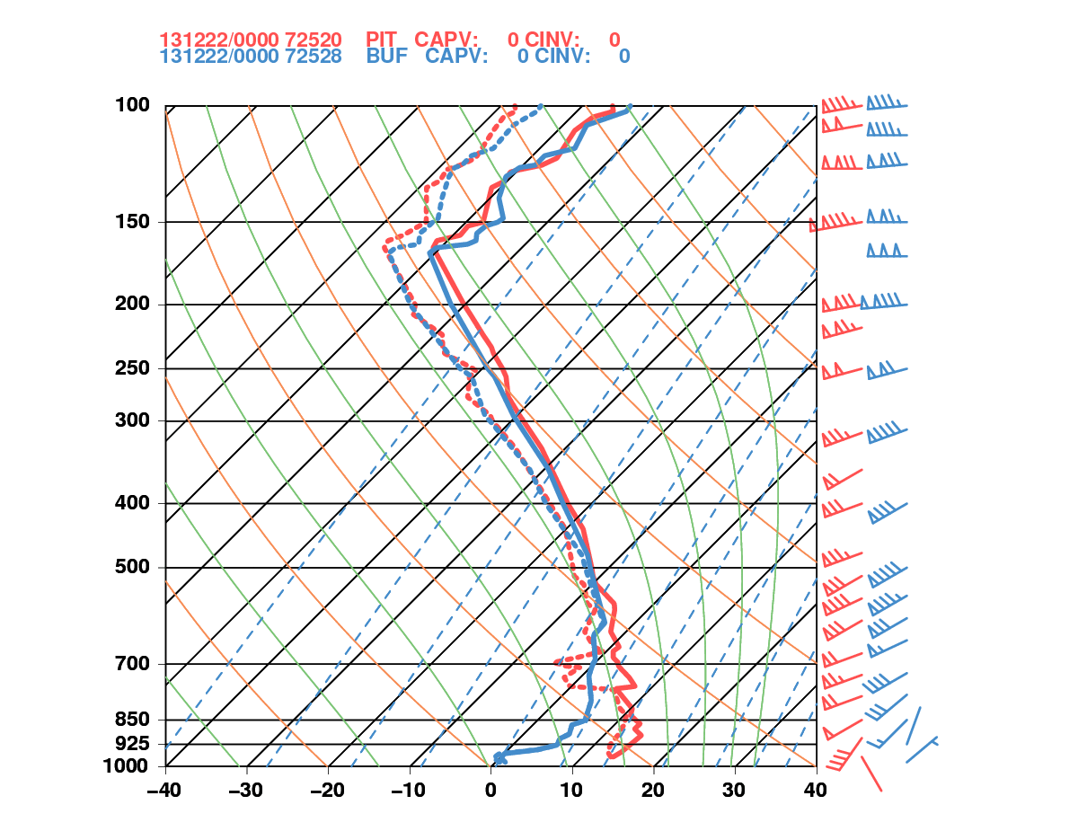
0000 UTC 22 December 2013
Pittsburgh, PA Buffalo, NY

Slide 8
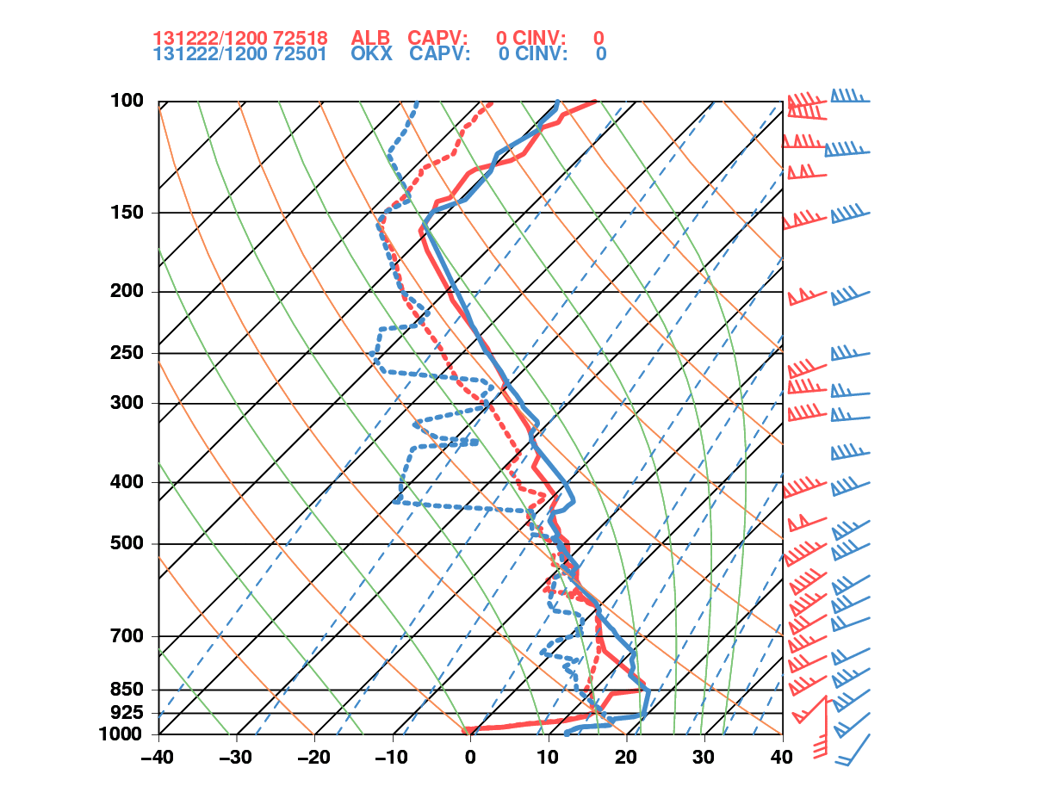
1200 UTC 22 December 2013
Albany, NY Upton, NY

Slide 9
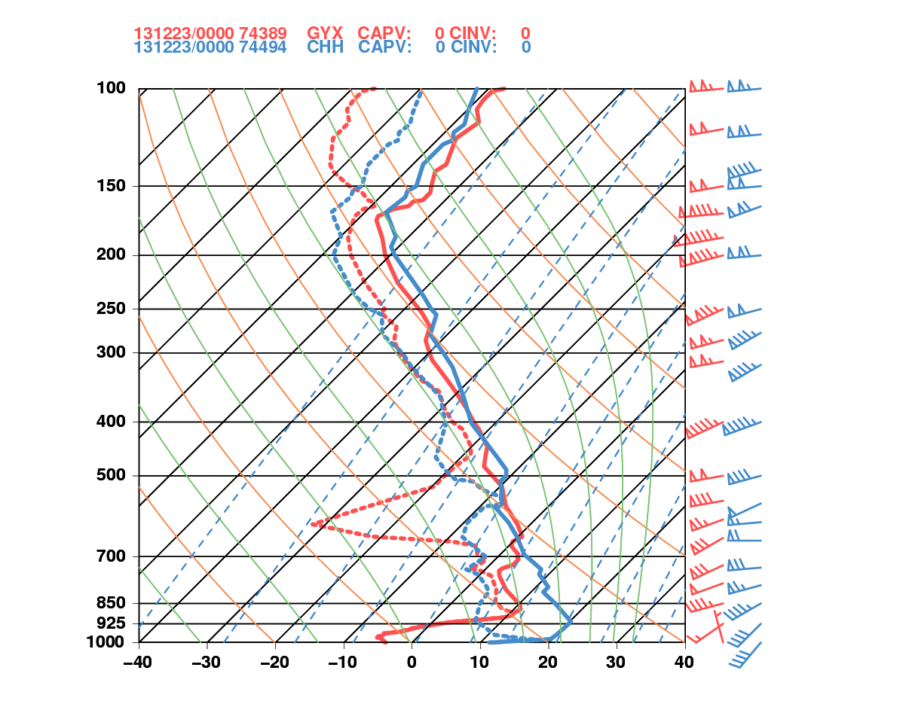
0000 UTC 23 December 2013
Gray, ME Chatham, MA

