Slide 1
The Uber Jet and
the Widespread Disruptive Ice Storm
of 21–23 December 2013
Lance F. Bosart, Alicia M. Bentley, and Philippe P. Papin
Department of Atmospheric and Environmental Sciences
University at Albany, State University of New York, Albany, NY 12222
39th Annual Northeastern Storm Conference
Rutland, VT
Saturday 8 March 2014
Notes:
When starting talk, define education–research interface and introduce Alicia and Kyle as current and previous TAs in upper-division thermodynamics and introductory graduate dynamics that I presently teach at UAlbany.

Slide 2
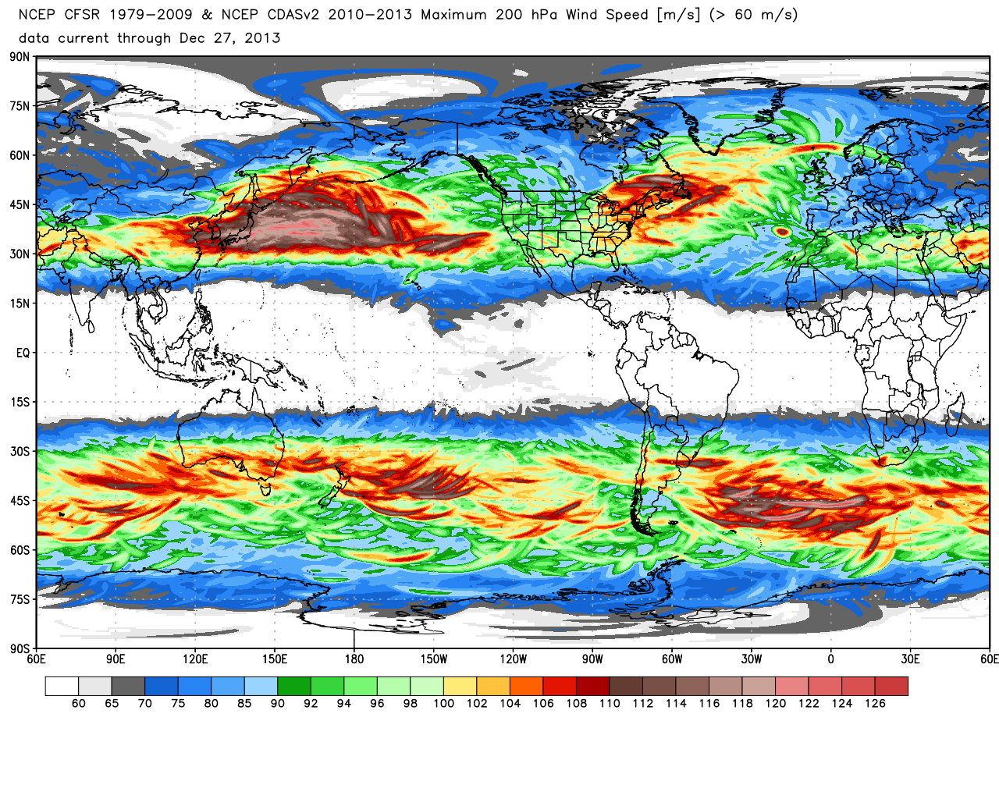
200-hPa maximum wind speed (m s⁻¹)
0.5° Climate Forecast System Reanalysis: 1979–2013
Source: Dr. Ryan Maue
Notes:
When starting talk, define education–research interface and introduce Alicia and Kyle as current and previous TAs in upper-division thermodynamics and introductory graduate dynamics that I presently teach at UAlbany.

Slide 3
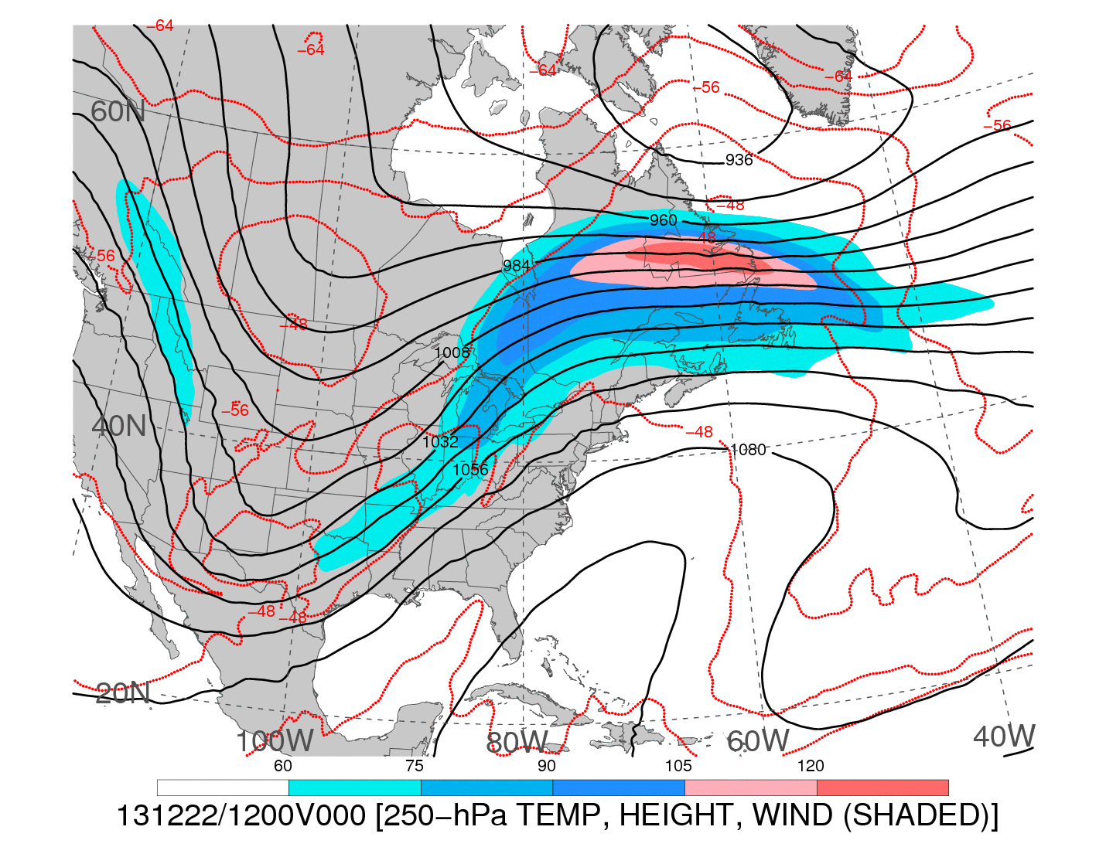
1200 UTC 22 December 2013
250-hPa wind speed (shaded, m s⁻¹; barbs, kts), geopotential height (black contours, dam),
and temperature (red dashed contours, °C)
Notes:
When starting talk, define education–research interface and introduce Alicia and Kyle as current and previous TAs in upper-division thermodynamics and introductory graduate dynamics that I presently teach at UAlbany.

Slide 4
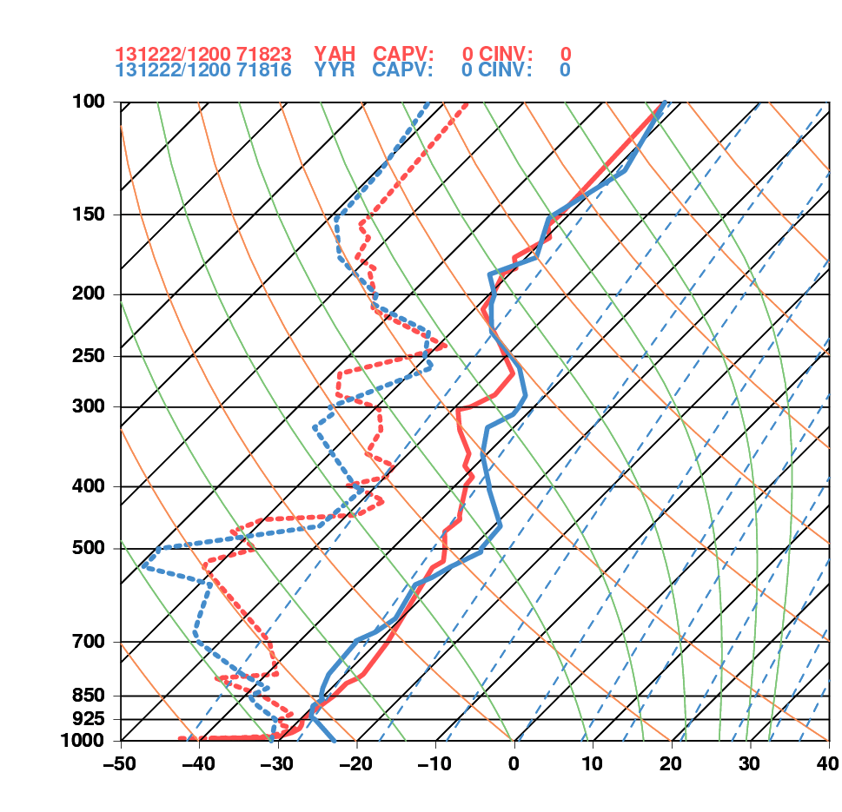
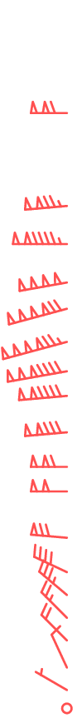
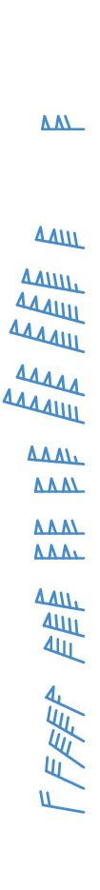
1200 UTC 22 December 2013
La Grande, QC Goose Bay, NL

Slide 5
Additional Soundings
Notes:
When starting talk, define education–research interface and introduce Alicia and Kyle as current and previous TAs in upper-division thermodynamics and introductory graduate dynamics that I presently teach at UAlbany.

Slide 6
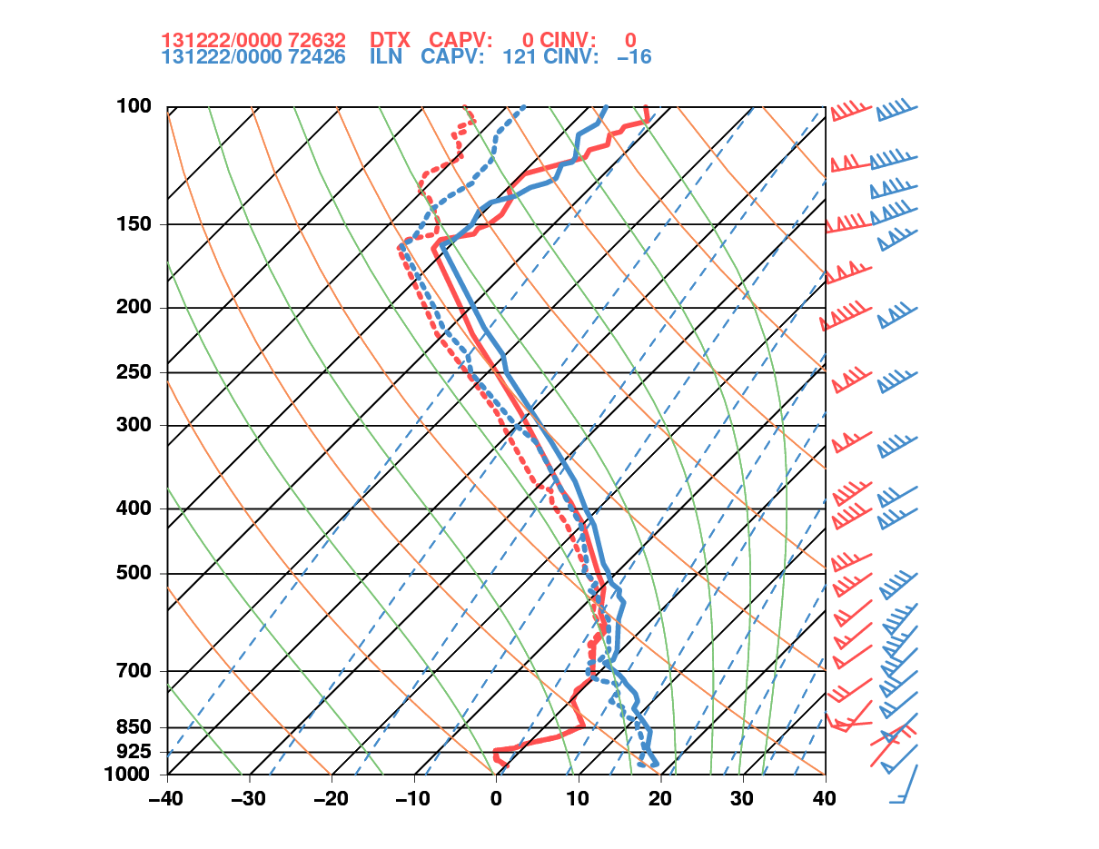
0000 UTC 22 December 2013
Detroit, MI Wilmington, OH

Slide 7
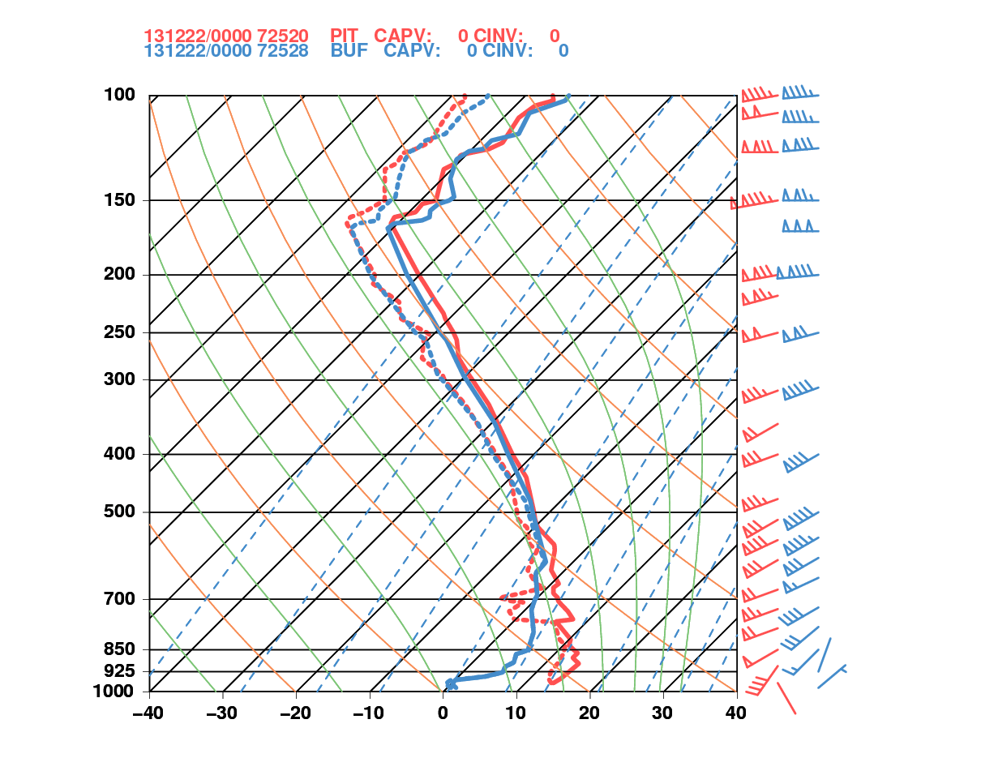
0000 UTC 22 December 2013
Pittsburgh, PA Buffalo, NY

Slide 8
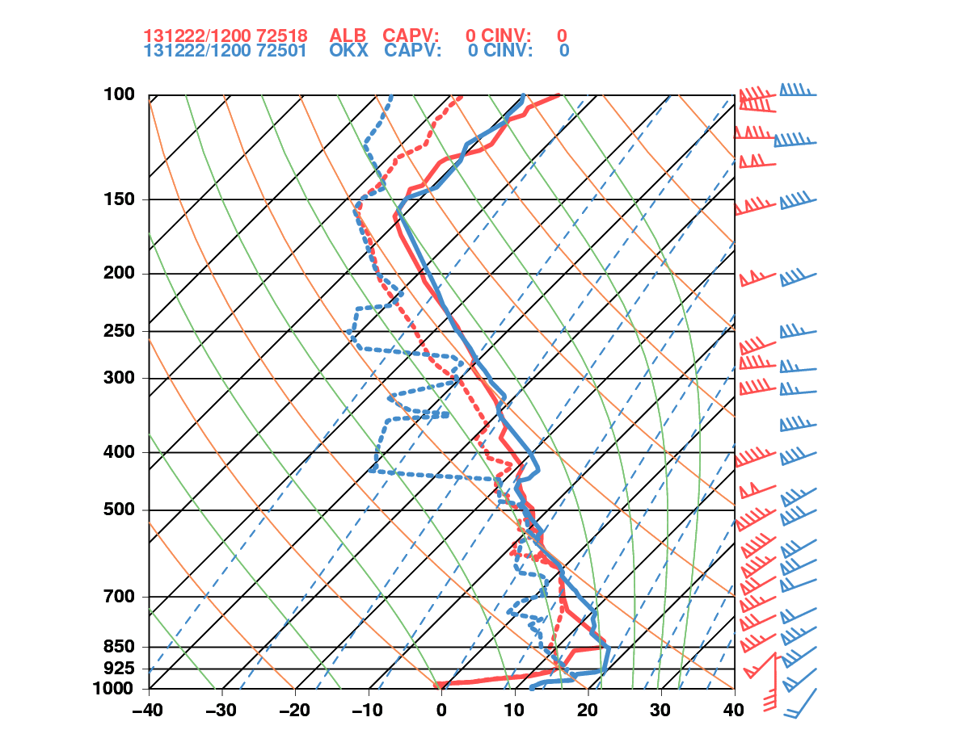
1200 UTC 22 December 2013
Albany, NY Upton, NY

Slide 9
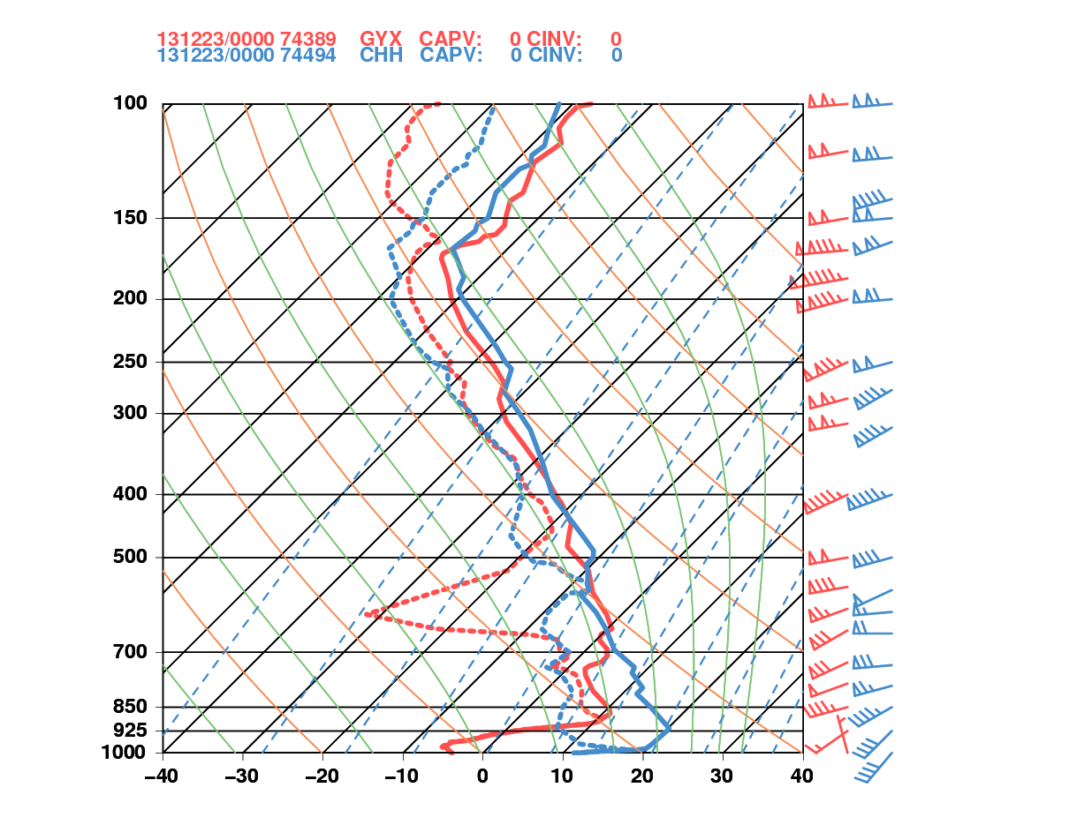
0000 UTC 23 December 2013
Gray, ME Chatham, MA

Slide 10
Maplist Images
Notes:
When starting talk, define education–research interface and introduce Alicia and Kyle as current and previous TAs in upper-division thermodynamics and introductory graduate dynamics that I presently teach at UAlbany.

Slide 11
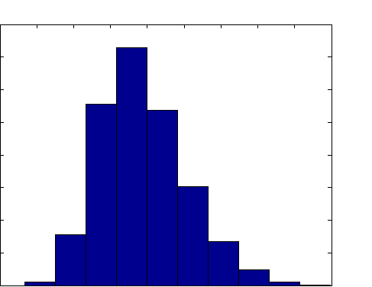
Histogram of 250-hPa maximum wind speed
NCEP–NCAR Reanalysis: 1979–2012
Domain: 40°–60°N and 90°–60°W
4000
3500
3000
2500
2000
1500
1000
500
0
Occurrences (1979–2012)
20 30 40 50 60 70 80 90 100 110
250-hPa Wind Speed (m s⁻¹)
Source: Dr. Jason Cordeira
Notes:
When starting talk, define education–research interface and introduce Alicia and Kyle as current and previous TAs in upper-division thermodynamics and introductory graduate dynamics that I presently teach at UAlbany.

Slide 12
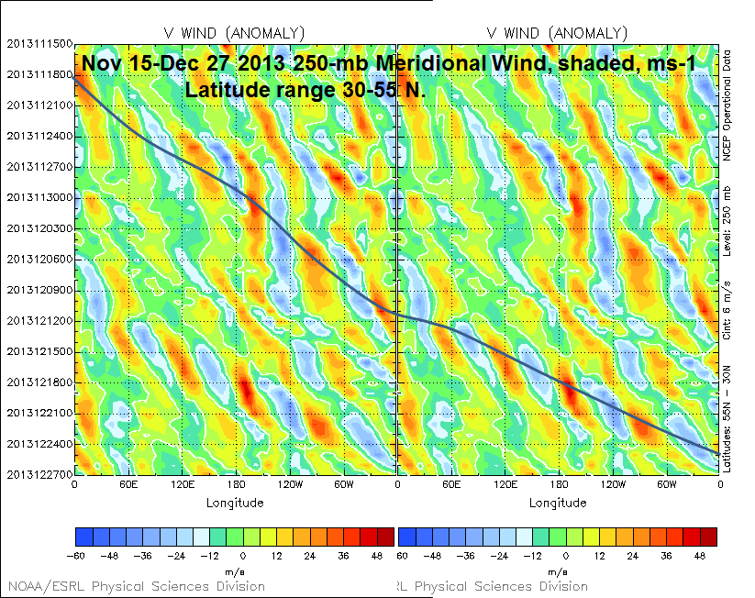
−60 −48 −36 −24 −12 0 12 24 36 48
Source: Dr. Mel Shapiro
Notes:
When starting talk, define education–research interface and introduce Alicia and Kyle as current and previous TAs in upper-division thermodynamics and introductory graduate dynamics that I presently teach at UAlbany.

Slide 13
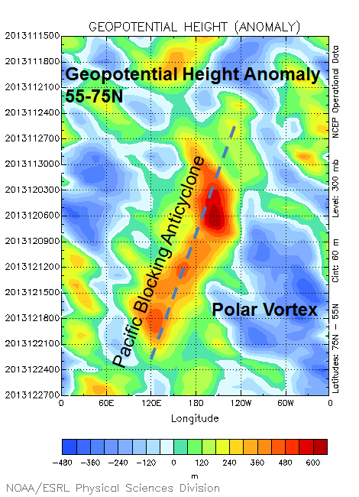
600
480
360
240
120
0
−120
−240
−360
−480
Source: Dr. Mel Shapiro
Notes:
When starting talk, define education–research interface and introduce Alicia and Kyle as current and previous TAs in upper-division thermodynamics and introductory graduate dynamics that I presently teach at UAlbany.

Slide 14
Backward Trajectories
Notes:
When starting talk, define education–research interface and introduce Alicia and Kyle as current and previous TAs in upper-division thermodynamics and introductory graduate dynamics that I presently teach at UAlbany.

Slide 15
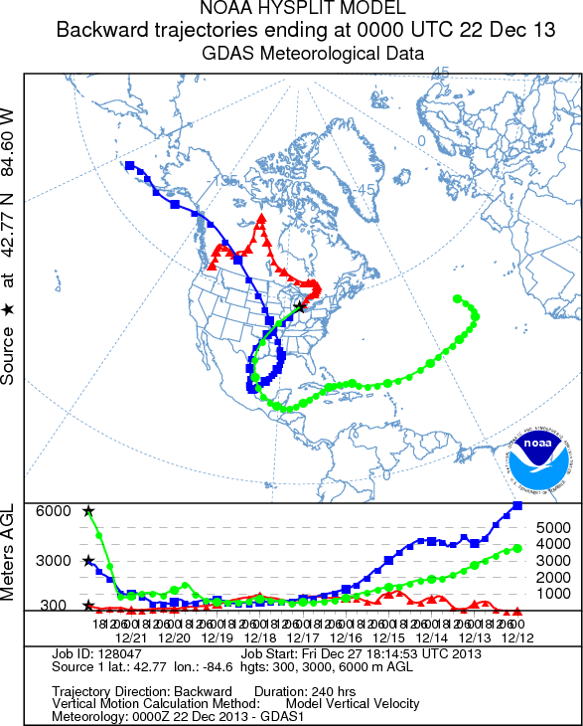
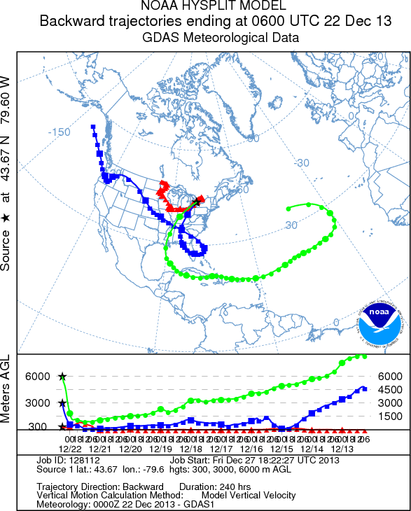
KLAN – Lansing, MI
CYYZ – Toronto, ON
240 h backward trajectories ending at:
0000 UTC 22 December 2013
240 h backward trajectories ending at:
0600 UTC 22 December 2013
Source: NOAA HYSPLIT MODEL
Notes:
When starting talk, define education–research interface and introduce Alicia and Kyle as current and previous TAs in upper-division thermodynamics and introductory graduate dynamics that I presently teach at UAlbany.

Slide 16
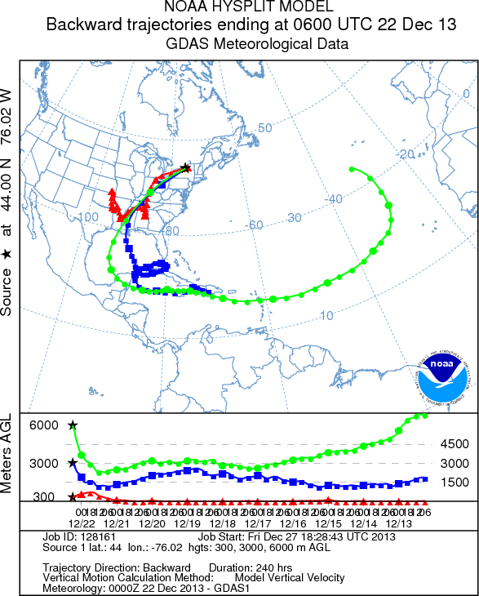
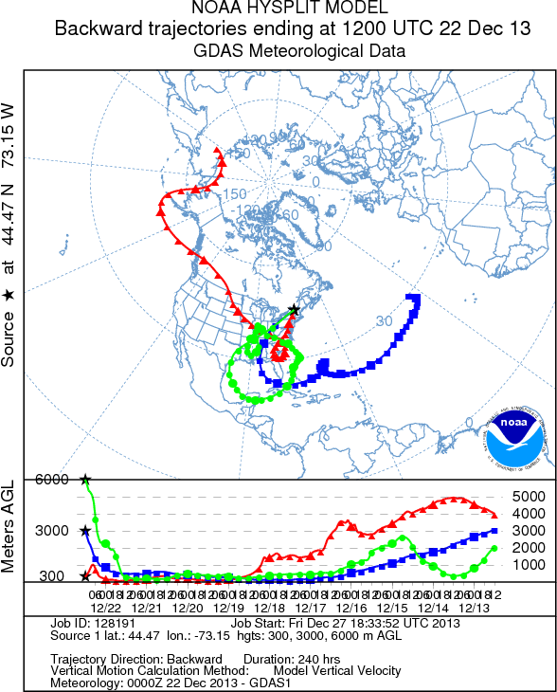
KART – Watertown, NY
KBTV – Burlington, VT
240 h backward trajectories ending at:
0600 UTC 22 December 2013
240 h backward trajectories ending at:
1200 UTC 22 December 2013
Source: NOAA HYSPLIT MODEL
Notes:
When starting talk, define education–research interface and introduce Alicia and Kyle as current and previous TAs in upper-division thermodynamics and introductory graduate dynamics that I presently teach at UAlbany.

Slide 17
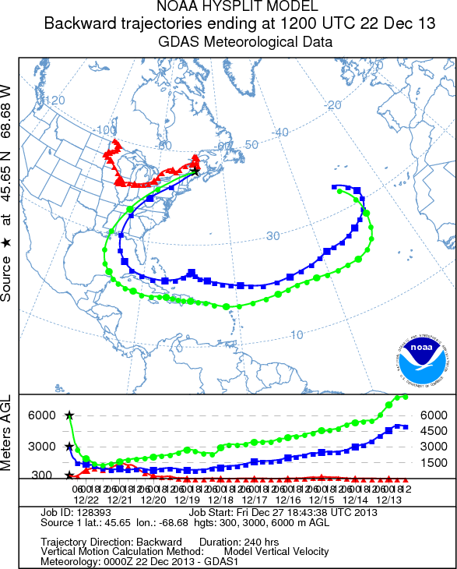
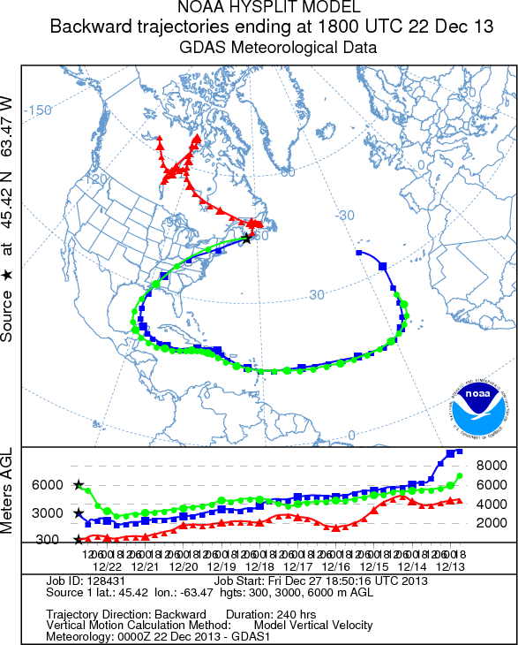
KMLT – Millinocket, ME
CZDB – Debert, NS
240 h backward trajectories ending at:
1200 UTC 22 December 2013
240 h backward trajectories ending at:
1800 UTC 22 December 2013
Source: NOAA HYSPLIT MODEL
Notes:
When starting talk, define education–research interface and introduce Alicia and Kyle as current and previous TAs in upper-division thermodynamics and introductory graduate dynamics that I presently teach at UAlbany.

Slide 18
Backward/Forward Trajectories
Notes:
When starting talk, define education–research interface and introduce Alicia and Kyle as current and previous TAs in upper-division thermodynamics and introductory graduate dynamics that I presently teach at UAlbany.

Slide 19
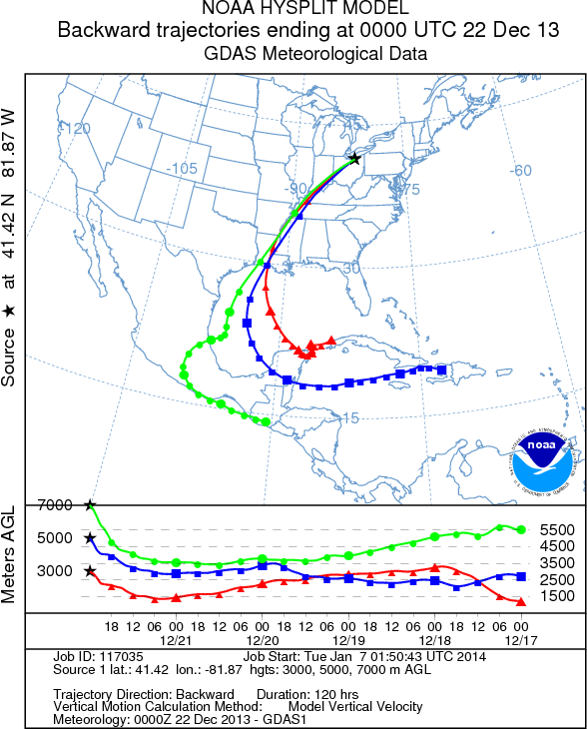
KCLE – Cleveland, OH
KCLE – Cleveland, OH
120 h backward trajectories ending at:
0000 UTC 22 December 2013
72 h forward trajectories starting at:
0000 UTC 22 December 2013
Source: NOAA HYSPLIT MODEL
Notes:
When starting talk, define education–research interface and introduce Alicia and Kyle as current and previous TAs in upper-division thermodynamics and introductory graduate dynamics that I presently teach at UAlbany.

Slide 20
CYYZ – Toronto, ON
CYYZ – Toronto, ON
120 h backward trajectories ending at:
0000 UTC 22 December 2013
72 h forward trajectories starting at:
0000 UTC 22 December 2013
Source: NOAA HYSPLIT MODEL
Notes:
When starting talk, define education–research interface and introduce Alicia and Kyle as current and previous TAs in upper-division thermodynamics and introductory graduate dynamics that I presently teach at UAlbany.

Slide 21
CYUL – Montreal, QC
CYUL – Montreal, QC
120 h backward trajectories ending at:
0000 UTC 22 December 2013
72 h forward trajectories starting at:
0000 UTC 22 December 2013
Source: NOAA HYSPLIT MODEL
Notes:
When starting talk, define education–research interface and introduce Alicia and Kyle as current and previous TAs in upper-division thermodynamics and introductory graduate dynamics that I presently teach at UAlbany.

Slide 22
CYSC – Sherbrooke, QC
CYSC – Sherbrooke, QC
120 h backward trajectories ending at:
1200 UTC 22 December 2013
72 h forward trajectories starting at:
1200 UTC 22 December 2013
Source: NOAA HYSPLIT MODEL
Notes:
When starting talk, define education–research interface and introduce Alicia and Kyle as current and previous TAs in upper-division thermodynamics and introductory graduate dynamics that I presently teach at UAlbany.

Slide 23
THE END
Notes:
When starting talk, define education–research interface and introduce Alicia and Kyle as current and previous TAs in upper-division thermodynamics and introductory graduate dynamics that I presently teach at UAlbany.

