Slide 1
Motivation
Introduction
Methodology
Results
Conclusion
A Multiscale Analysis of the Rainband and Cellular Structure in Hurricanes Harvey and Irma (2017) Using the NCAR Ensemble
Dylan Card
University at Albany, State University of New York Albany, New York

Slide 2
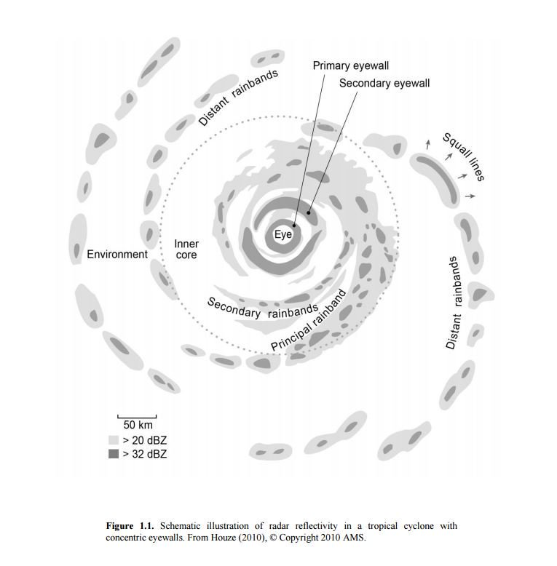
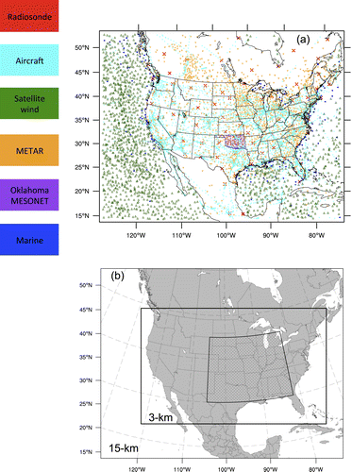
Motivation
Introduction
Methodology
Results
Conclusion
Presentation Outline:
Motivation
What is the NCAR Ensemble?
NCAR Ensemble Structure and Environment of Hurricane Harvey (2017)
NCAR Cell Type Analysis of Hurricanes Harvey and Irma (2017)

Slide 3
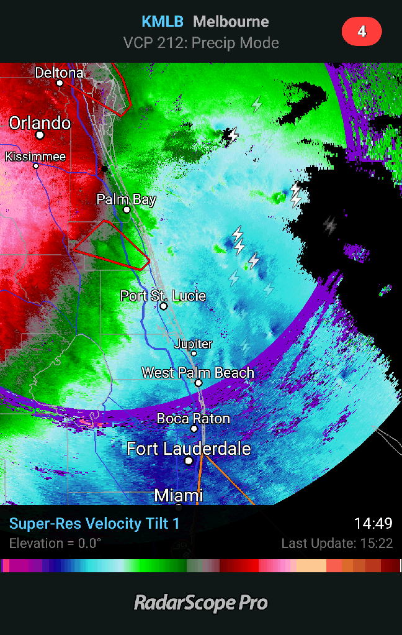
Motivation
Introduction
Methodology
Results
Conclusion
Irma: Base Velocity (MLB) ~18z 10 September

Slide 4
Motivation
Introduction
Methodology
Results
Conclusion
Irma: Base Velocity (MLB) ~18z 10 September
Why do we care about these rotating supercells?

Slide 5
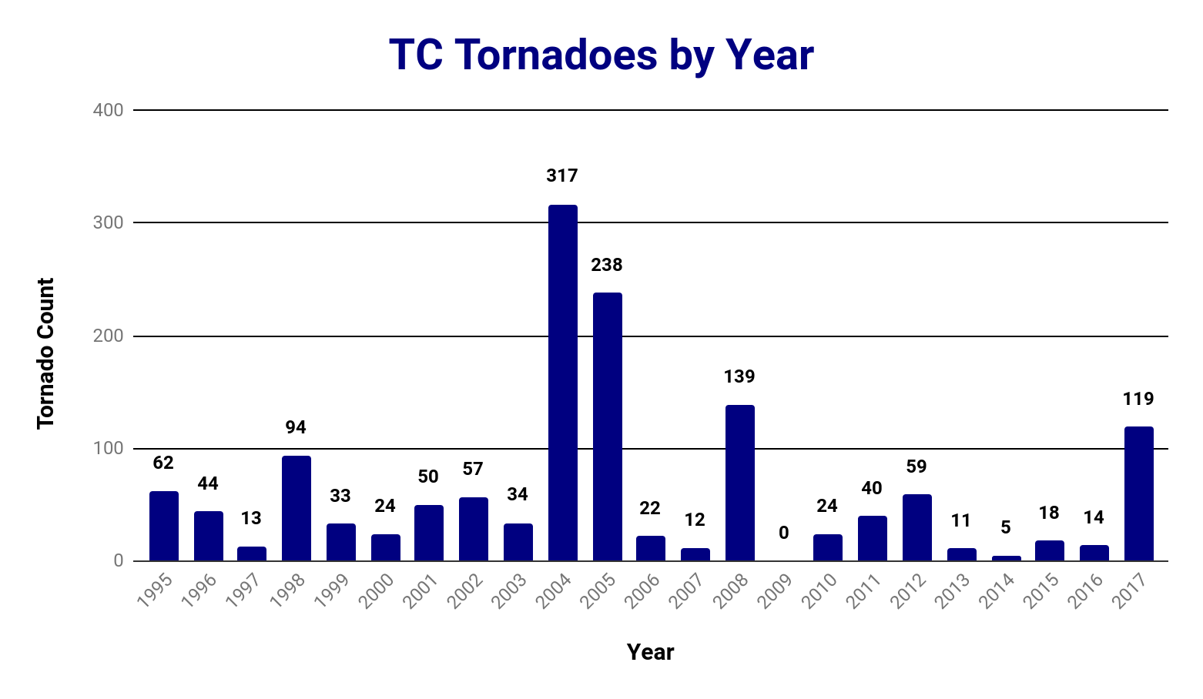
Motivation
Introduction
Methodology
Results
Conclusion
1163 U.S. Tornadoes resulted from tropical cyclones from 1995-2010 (~6%).
That number has risen to 1429 at the end of 2017.
2017 was the fourth most active year for tropical cyclone tornadoes.
Adapted from Edwards 2010, TCTOR dataset

Slide 6
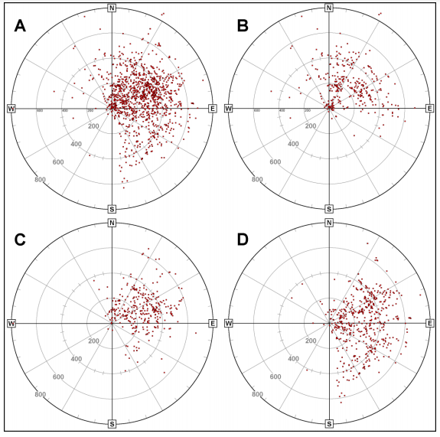
Motivation
Introduction
Methodology
Results
Conclusion
All
Hurricanes
Most hurricane tornadoes occurrences are concentrated in the northeast quadrant with respect to geographic North. (Hill et al 1966, Orton 1970, Novlan 1974, and Edwards 2012 )
TS
TD

Slide 7
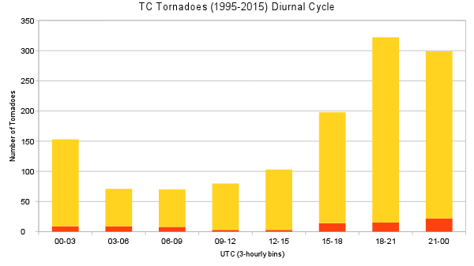
Motivation
Introduction
Methodology
Results
Conclusion
<EF2
307
15
277
22
>=EF2
184
14
TC Tornado reports have a diurnal cycle, being most prominent in the late afternoon.
144
9
100
3
62
9
62
8
77
3
Adapted from Edwards 2010, TCTOR dataset

Slide 8
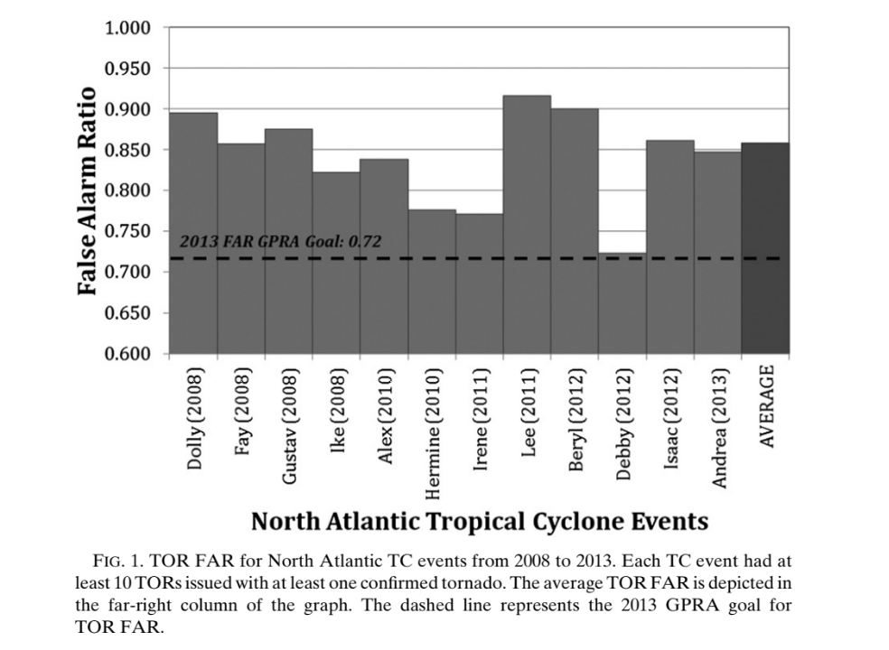
Motivation
Introduction
Methodology
Results
Conclusion
Tornado False Alarm Ratio
North Atlantic TCs from 2008 to 2013 produced an average tornado warning False Alarm Ratio (FAR) of 0.858.
(Martinaitis 2017)

Slide 9
Motivation
Introduction
Methodology
Results
Conclusion
Tornado False Alarm Ratio
North Atlantic TCs from 2008 to 2013 produced an average tornado warning False Alarm Ratio (FAR) of 0.858.
Above the threshold of acceptable FAR from the NWS Government Performance Requirements Act (GPRA) of 0.72.
(Martinaitis 2017)

Slide 10
Motivation
Introduction
Methodology
Results
Conclusion
Tornado False Alarm Ratio
North Atlantic TCs from 2008 to 2013 produced an average tornado warning False Alarm Ratio (FAR) of 0.858.
Above the threshold of acceptable FAR from the NWS Government Performance Requirements Act (GPRA) of 0.72.
FAR for non-tropical cyclone tornado warnings from 2000 to 2004 is about 0.70.
(Martinaitis 2017)

Slide 11
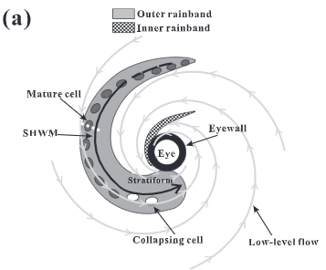
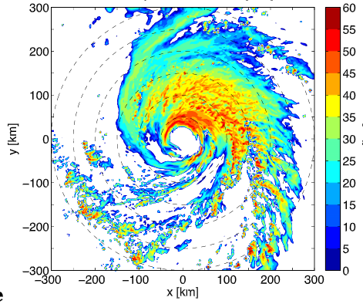
Motivation
Introduction
Methodology
Results
Conclusion
75% of tropical cyclone tornadoes happen outside of 200 km from the eye.
Outside of 200 km is typically referred to as the outer rainband region.
Rainbands contain the convective cells that spawn these tropical cyclone tornadoes.
It is important to understand if the structure of these rainbands is being accurately depicted.
(Li and Wang 2012)
(Moon and Nolan 2015a)

Slide 12
Motivation
Introduction
Methodology
Results
Conclusion
What is the NCAR Ensemble?
Inner 3-km convective allowing domain.
10 ensemble members were run once a day initialized at 00z.
Uses continuously cycling EAKF (ensemble adjustment Kalman filter).
Each ensemble member was run using the same physics and dynamics options, meaning they are only altering the initial and boundary conditions.
Final run was at 00z 31 December 2017
(Schwartz et al. 2015)

Slide 13
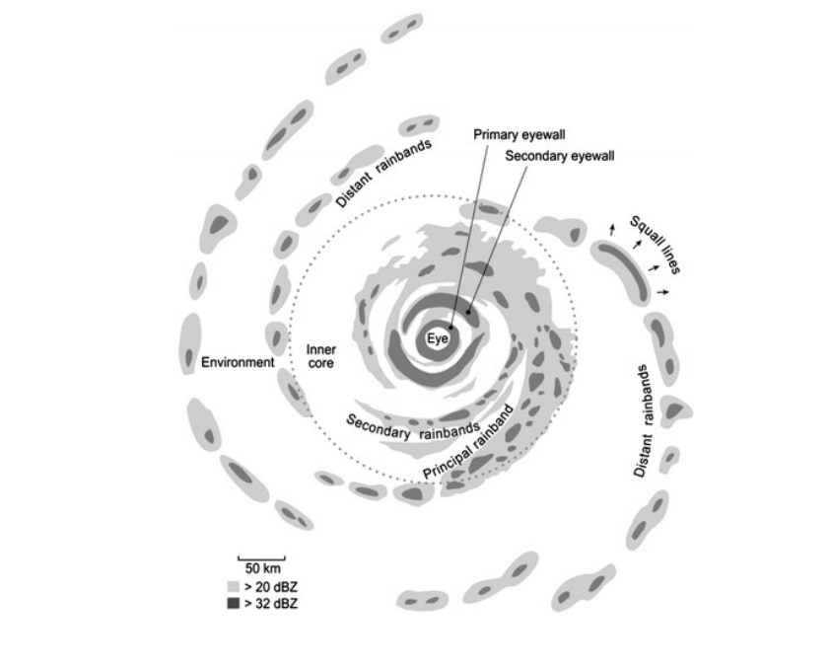
Motivation
Introduction
Methodology
Results
Conclusion
(Houze 2010)

Slide 14
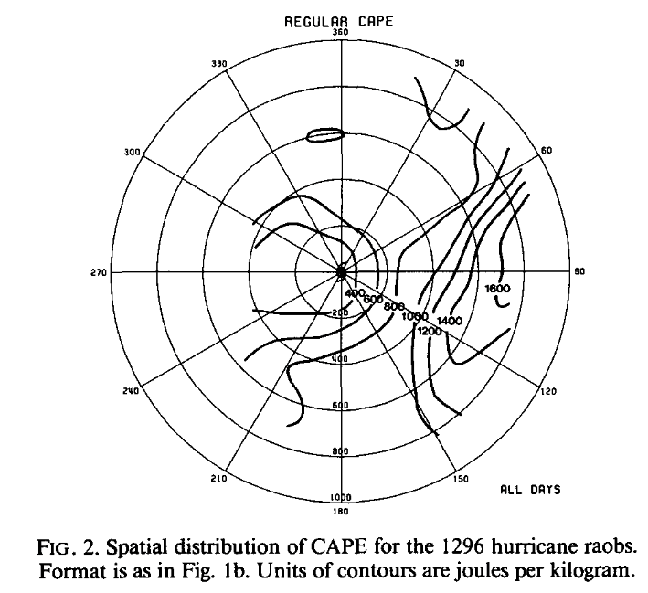
Motivation
Introduction
Methodology
Results
Conclusion
High CAPE outer core region, with mid-level dew point depressions
Low CAPE Inner core region, very moist
(Houze 2010)
(McCaul 1991)

Slide 15
Motivation
Introduction
Methodology
Results
Conclusion
High CAPE outer core region, with mid-level dew point depressions
Low CAPE Inner core region, very moist
(Houze 2010)
(McCaul 1991)

Slide 16
Motivation
Introduction
Methodology
Results
Conclusion
Principal Rainband
12km
Principal rainbands are defined by radial inflow at the surface, with a vertical updraft extending to upwards of 12 km. A midlevel jet is present in the low levels around 3 km.
9km
6km
3km
Eye
Updraft
Downdraft
Jet
>40 DBZ
(Houze (2010), Li and Wang (2012), and Moon and Nolan (2015a))

Slide 17
Motivation
Introduction
Methodology
Results
Conclusion
NCAR Ensemble Structure and Environment of Hurricane Harvey (2017)

Slide 18
Motivation
Introduction
Methodology
Results
Conclusion
Research Questions:
Does the NCAR Ensemble produce similar rainband structures to those observed and modeled?
Does the NCAR Ensemble produce realistic tropical cyclone environments compared to past observations?
How do supercell environments in the NCAR Ensemble compare to those typically seen in the midlatitudes?
NCAR Ensemble Structure and Environment

Slide 19
Motivation
Introduction
Methodology
Results
Conclusion
How to look at the structure?

Slide 20
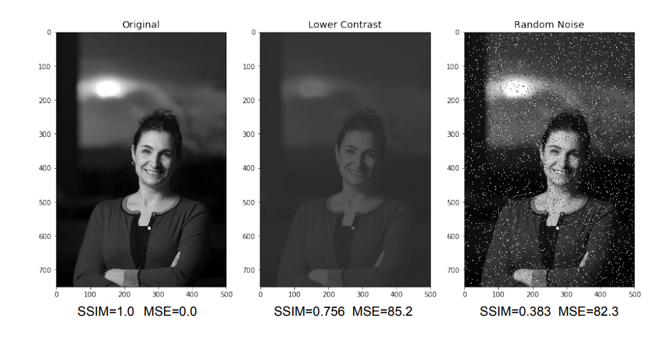
Motivation
Introduction
Methodology
Results
Conclusion
How to look at the structure?
Why Structural Similarity Index (SSIM)?
Comparison tools like mean square error and root mean square error are sensitive to contrast and therefore sensitive to individual convective differences.
The values of SSIM range from -1 to 1
-1 being perfect dissimilarity (think inverse)
0 being not similar at all
1 being a perfect match

Slide 21
Motivation
Introduction
Methodology
Results
Conclusion
How to look at the structure?
Why Structural Similarity Index (SSIM)?
Comparison tools like mean square error and root mean square error are sensitive to contrast and therefore sensitive to individual convective differences.
The values of SSIM range from -1 to 1
-1 being perfect dissimilarity (think inverse)
0 being not similar at all
1 being a perfect match

Slide 22
Motivation
Introduction
Methodology
Results
Conclusion
How to look at the structure?
*MSE cannot distinguish between changes in contrast and random noise
Why Structural Similarity Index (SSIM)?

Slide 23
Motivation
Introduction
Methodology
Results
Conclusion
How to look at the structure?
Ensemble Member 8
Observed Radar

Slide 24
Motivation
Introduction
Methodology
Results
Conclusion
How to look at the structure?
More Similar
Ensemble Member 8
Observed Radar
Less Similar

Slide 25
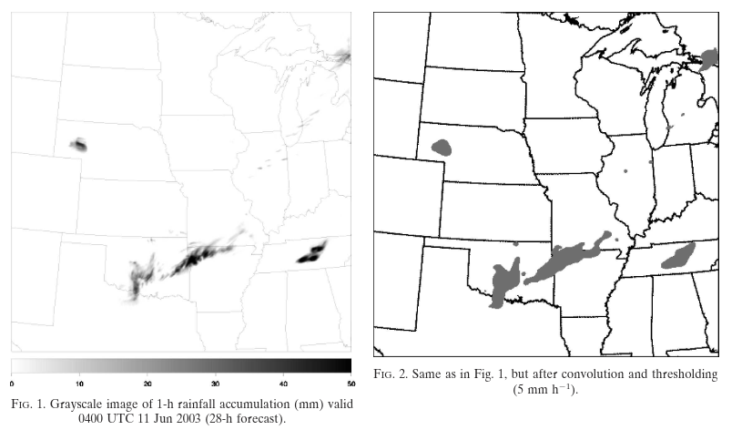
Motivation
Introduction
Methodology
Results
Conclusion
How to look at the structure?
Useful comparison tool:
Model Evaluation Tools (MET) verification package, Method for Object-Bases Diagnostic Evaluation (MODE).
Benefit to this tool is that it is well documented in the literature of atmospheric science (Davis et al. 2006a;b) so will work as a great comparison tool to the SSIM results.
(Davis et al. 2006b)

Slide 26
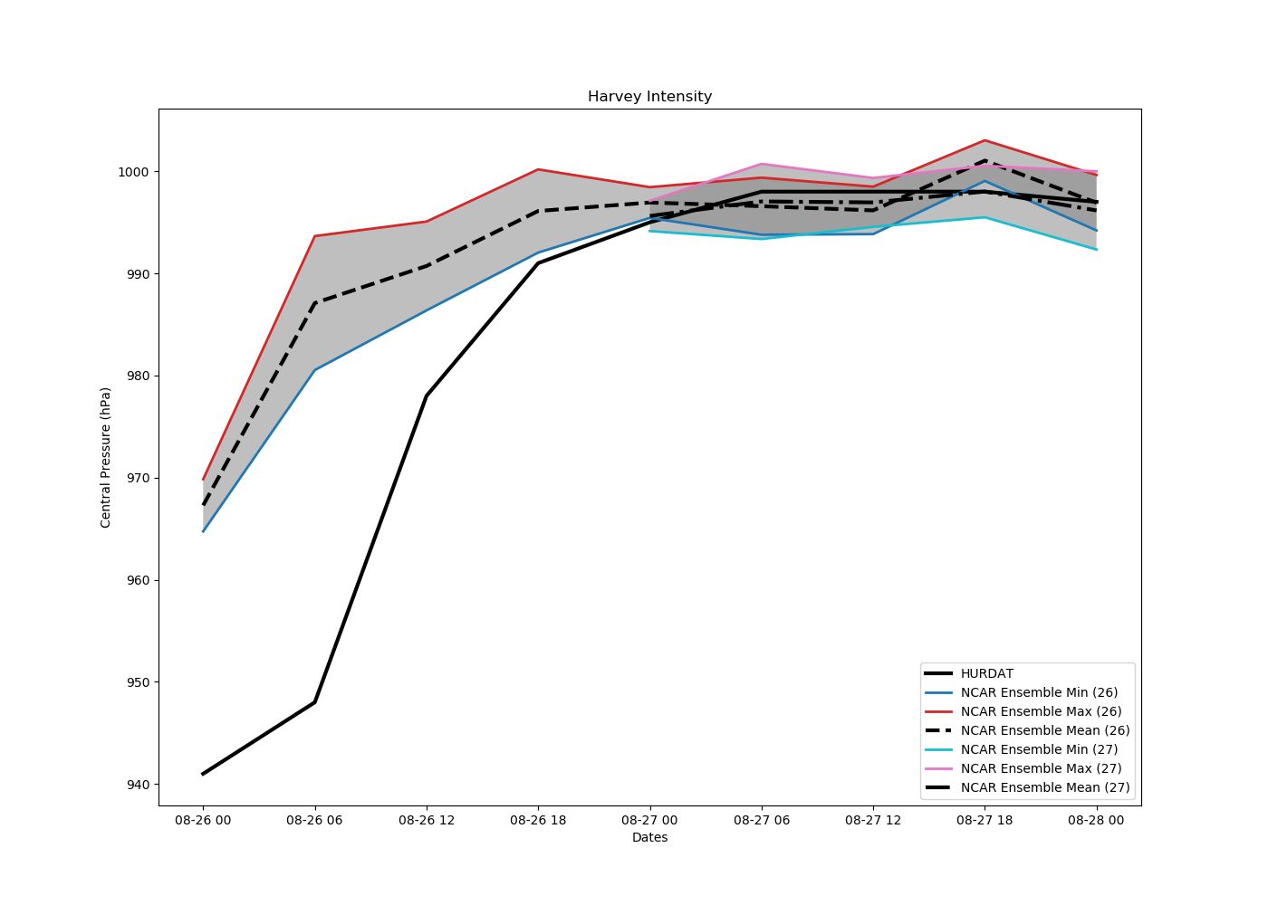
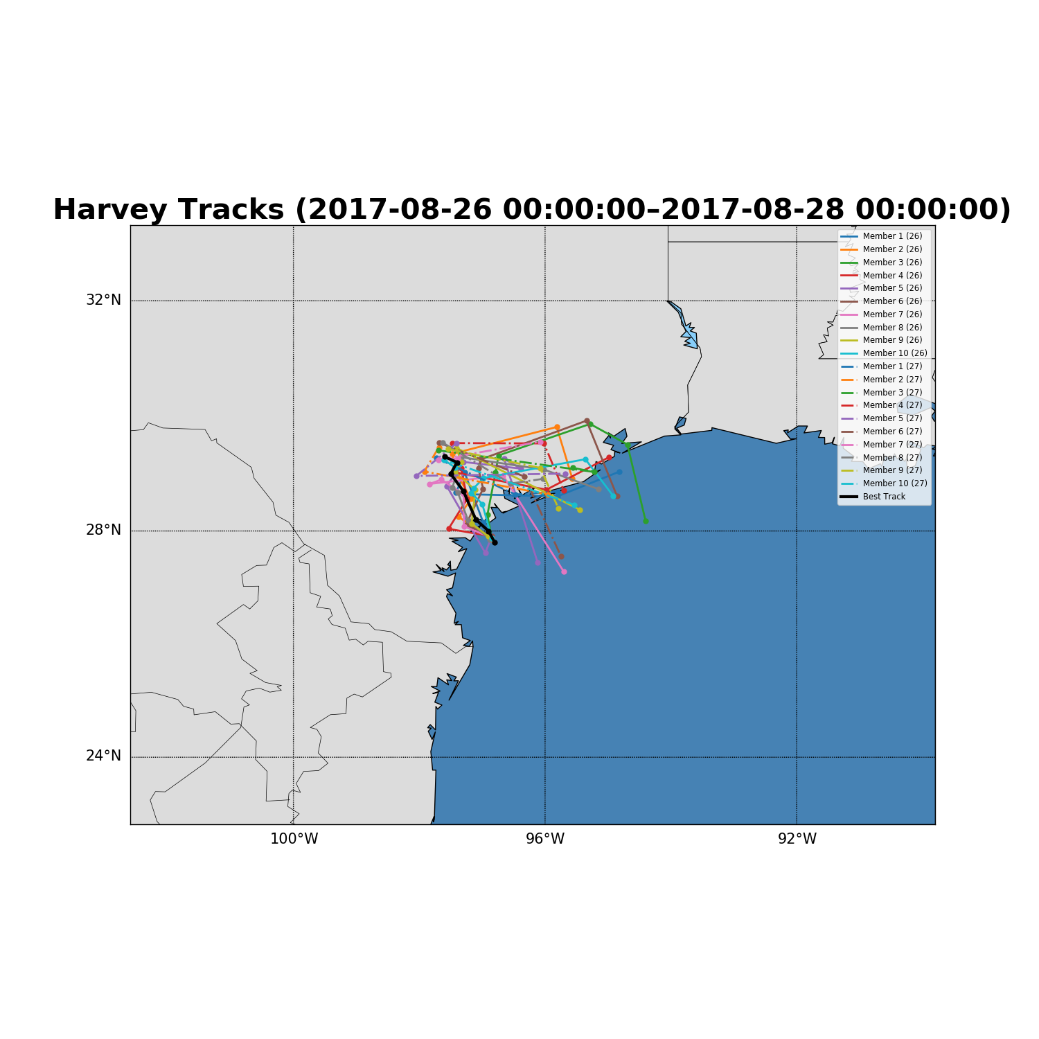
Motivation
Introduction
Methodology
Results
Conclusion
Harvey (2017):
Harvey Tracks and Intensity (2017-08-26 0000Z through 2017-08-27 0000Z)
NCAR Boundary

Slide 27
Motivation
Introduction
Methodology
Results
Conclusion
Harvey (2017):
a)
SSIM- There is an increase in SSIM in the first few hours of the 0000 UTC 26 August run coinciding with the storm spinning up just after the initialization.
The SSIM increases after 20 UTC on 26 August as convective differences in the in the storm decrease and the eye fills in with precipitation.
b)
Initialized at 0000 UTC 26 August

Slide 28
Motivation
Introduction
Methodology
Results
Conclusion
Harvey (2017):
a)
Area ratio- Less than one showing that the model is producing a larger storm than in radar observations.
There is a lot of variability in the area ratio at times when the SSIM is increasing.
b)
Initialized at 0000 UTC 26 August

Slide 29
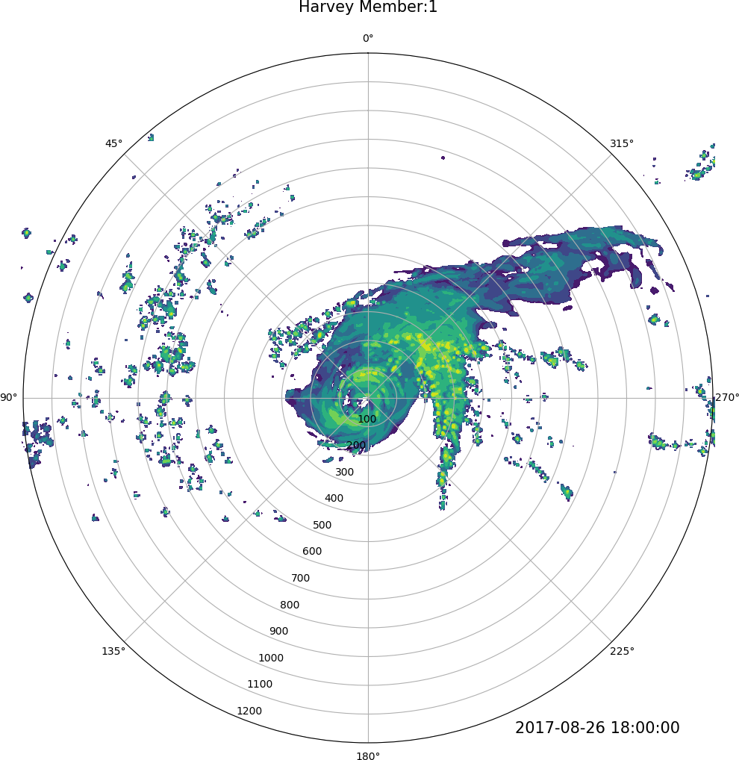
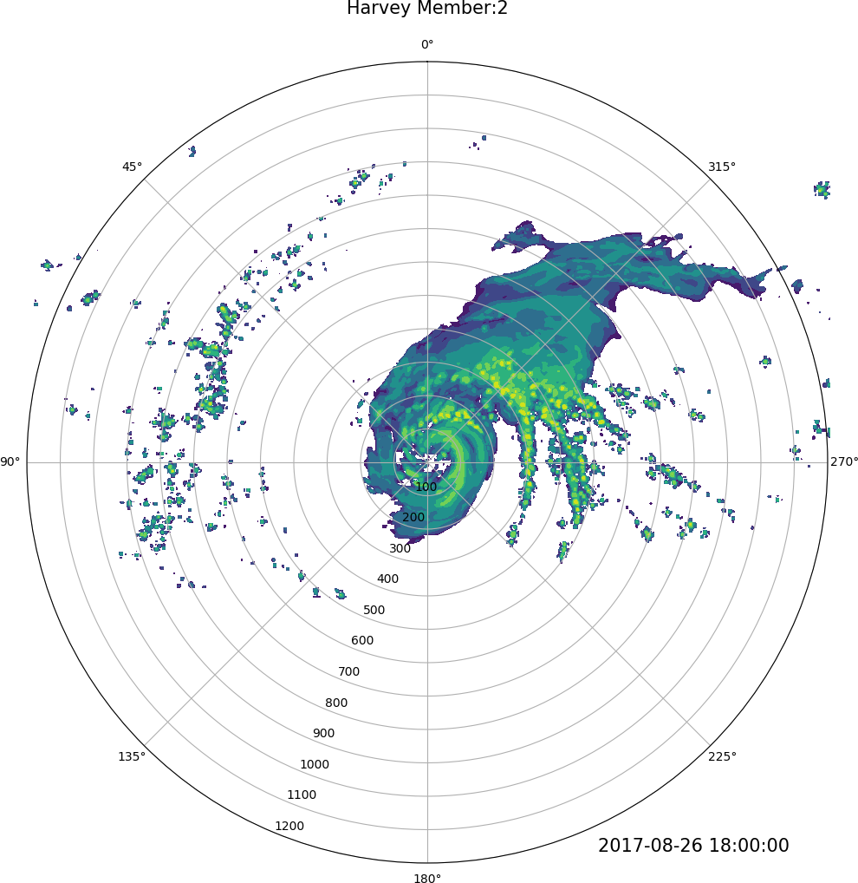
Motivation
Introduction
Methodology
Results
Conclusion
Harvey (2017):
Ensemble members 1 & 2 exhibited very similar tracks and intensities for the model initialized at 0000 UTC 26 August.
Ensemble member 1 shows one distinct rainband and member 2 shows many rainband features.

Slide 30
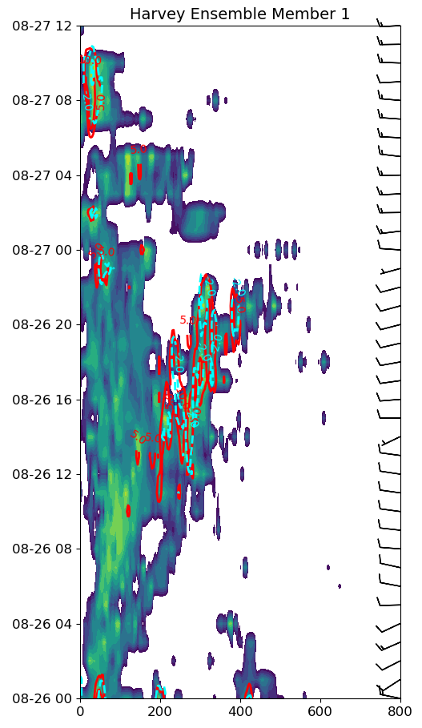
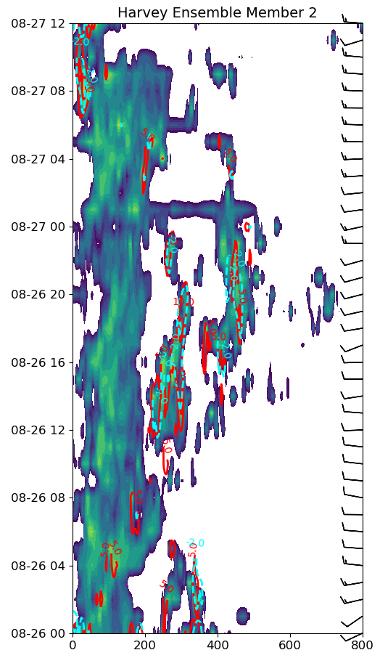
Motivation
Introduction
Methodology
Results
Conclusion
Harvey (2017):
Ensemble members 1 & 2 exhibited very similar tracks and intensities for the model initialized at 0000 UTC 26 August.
Ensemble member 1 shows one distinct rainband and member 2 shows many rainband features.
Focus on 1800 UTC 26 August.

Slide 31
Motivation
Introduction
Methodology
Results
Conclusion
Harvey (2017):
Ensemble members 1 & 2 exhibited very similar tracks and intensities for the model initialized at 0000 UTC 26 August.
Ensemble member 1 shows one distinct rainband and member 2 shows many rainband features.

Slide 32
Motivation
Introduction
Methodology
Results
Conclusion
Harvey (2017):
Ensemble members 1
Take a vertical cross section across the rainband (black line)

Slide 33
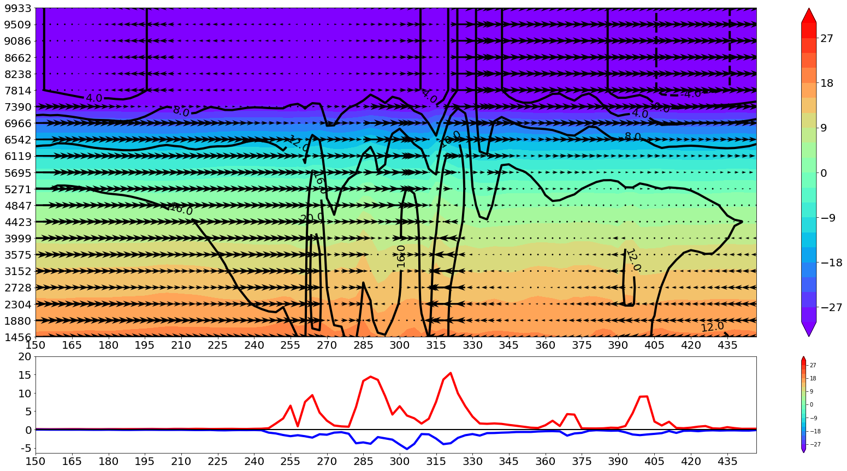
Motivation
Introduction
Methodology
Results
Conclusion
Harvey (2017):
Harvey: Member 1 (2017-08-26 18:00:00)
Temperature (C)
Height (m)
Radius (km)→

Slide 34
Motivation
Introduction
Methodology
Results
Conclusion
Harvey (2017):
Harvey: Member 1 (2017-08-26 18:00:00)
Temperature (C)
Height (m)
Radius (km)→

Slide 35
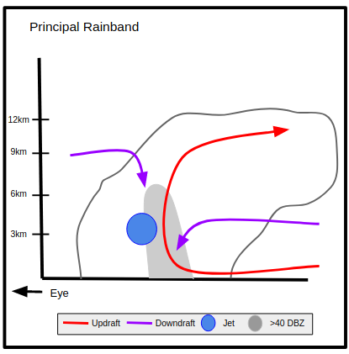
Motivation
Introduction
Methodology
Results
Conclusion
Harvey (2017):
Harvey: Member 1 (2017-08-26 18:00:00)
Height (m)
Radius (km)→

Slide 36
Motivation
Introduction
Methodology
Results
Conclusion
Harvey (2017):
Harvey: Member 1 (2017-08-26 18:00:00)
Height (m)
Radius (km)→

Slide 37
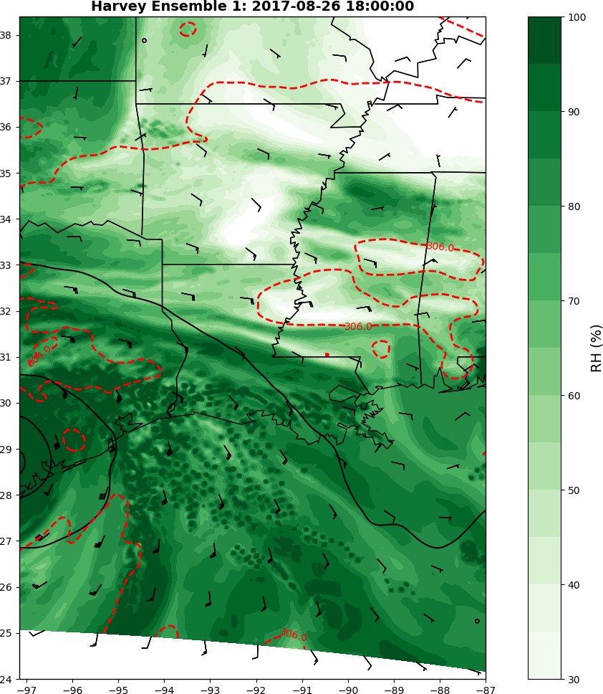
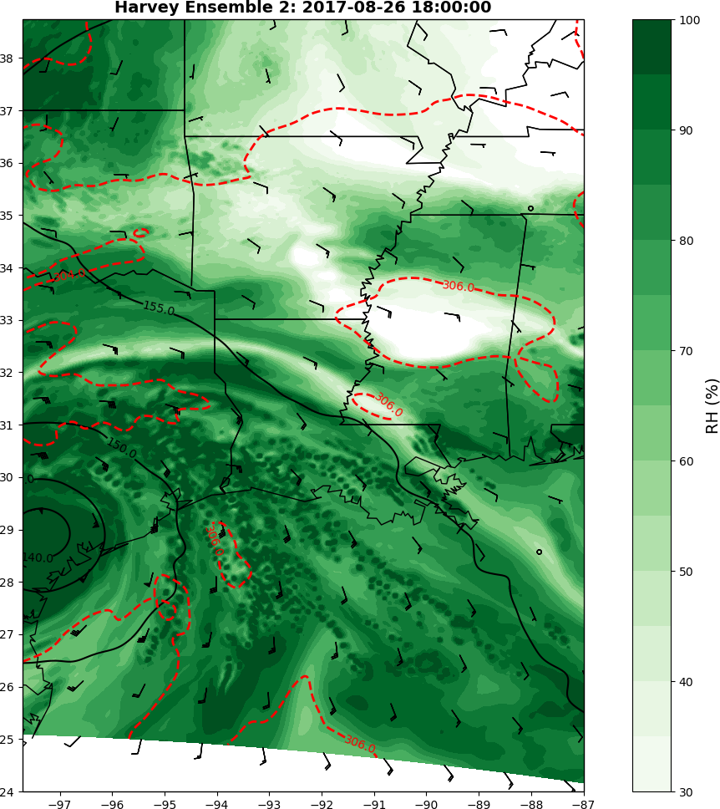
Motivation
Introduction
Methodology
Results
Conclusion
Harvey (2017):
As described in Houze (2010) the inner-core is characterized by high relative humidity.
In the outer rainband region areas of lower relative humidity in between the rainbands is apparent.
Co-located with this dry air, especially to the southeast (right of shear) of the strom’s center, locally warmer potential temperature can be seen at 850 hPa.
Possible evidence of weak baroclinic forcing, particularly right of shear.

Slide 38
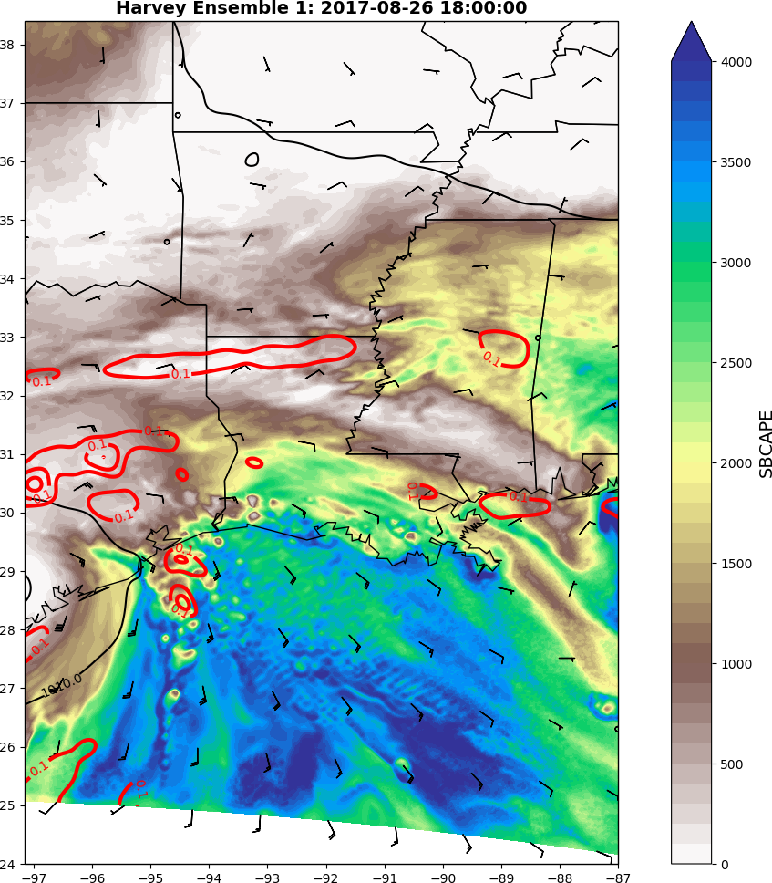
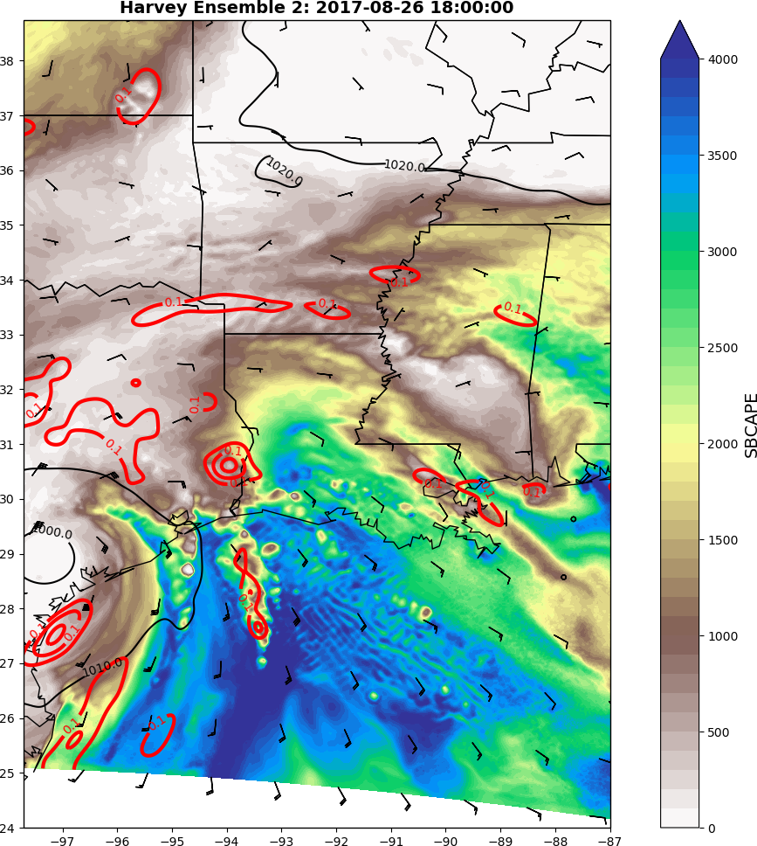
Motivation
Introduction
Methodology
Results
Conclusion
Harvey (2017):
Surface based CAPE (SBCAPE) is generally concentrated in the right of shear quadrants.
Some cells have convergence of the 80-m winds along the radially outward side.

Slide 39
Motivation
Introduction
Methodology
Results
Conclusion
Harvey (2017):
Most Unstable CAPE (MUCAPE)
The NCAR Ensemble did a poor job representing the values of MUCAPE at 00z 27 August (under prediction). At 00z 26 August the observed value of MUCAPE was very close to the ensemble median.
In the midlatitudes typically supercell environment have MUCAPE >= 1000 J kg⁻¹

Slide 40
Motivation
Introduction
Methodology
Results
Conclusion
Harvey (2017):
0–3-km Storm Relative Helicity (SRH)
The NCAR Ensemble did a good job representing the values of SRH. In most cases the observed value of SRH fell within the range represented by the 10 ensemble members or very close.
In the midlatitudes typically supercell environment have 0–3-km SRH >= 250 m² s⁻²

Slide 41
Motivation
Introduction
Methodology
Results
Conclusion
1. Does the NCAR Ensemble produce similar rainband structures to those observed and modeled?
As seen in the cross section and planar plots, the NCAR Ensemble produces similar rainband structure to those documented in both observational and modeling studies for Hurricane Harvey.
Hurricane Irma also shows similar structures
(Houze (2010), Li and Wang (2012), and Moon and Nolan (2015a))
(Houze 2010)

Slide 42
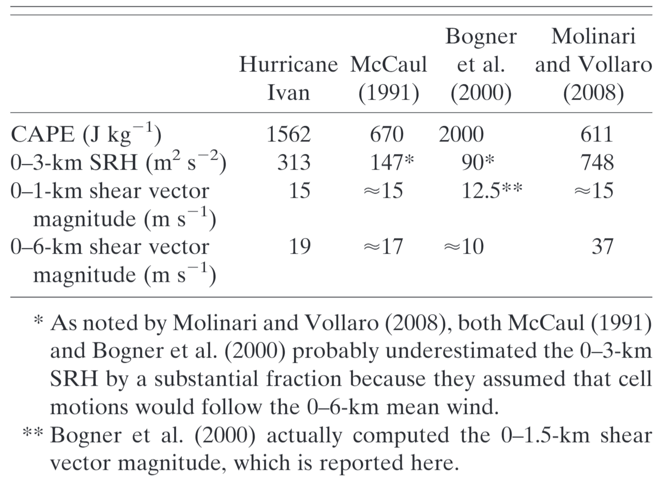
Motivation
Introduction
Methodology
Results
Conclusion
2. Does the NCAR Ensemble produce realistic tropical cyclone environments compared to past observations?
As seen in the planar plots and the sounding analysis, the NCAR Ensemble produces similar values and distributions of CAPE, and also showed values of SRH that have been documented in observational studies for Hurricane Harvey.
Similar results were found for Hurricane Irma.
< 300 km from TC toronado in RF quadrant
Category 4 hurricane soundings
0--500 km range bin from Ivan’s RF quadrant
Hurricane Bonnie
–
(McCaul 1991)
(Baker et al. 2009)

Slide 43
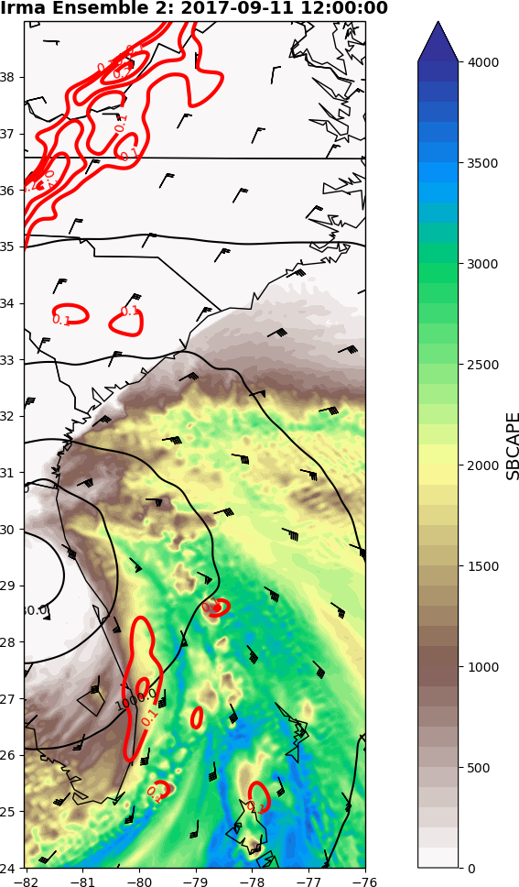
Motivation
Introduction
Methodology
Results
Conclusion
3. How do supercell environments in the NCAR Ensemble compare to those typically seen in the midlatitudes?
CRP showed MUCAPE less than that needed to sustain midlatitude supercells; however, the rainband analysis showed that right of shear has high SBCAPE in both Harvey and Irma.
1000 J kg⁻¹

Slide 44
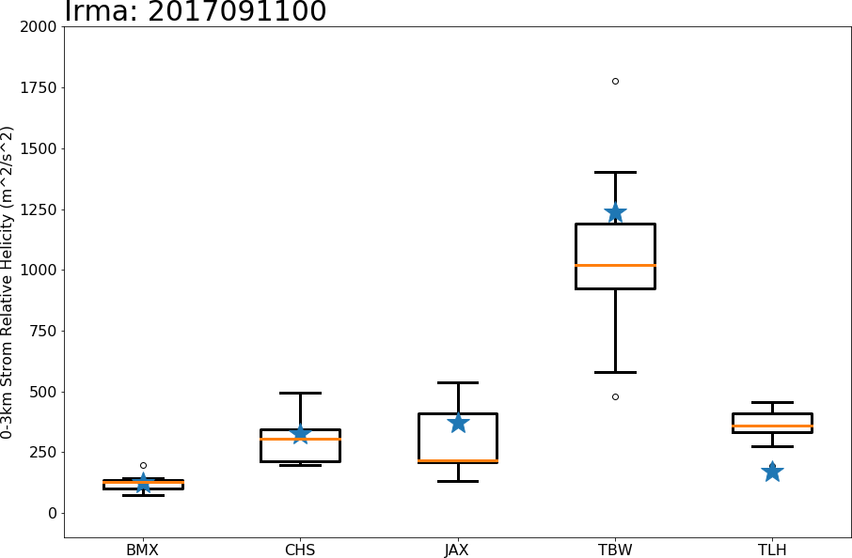
Motivation
Introduction
Methodology
Results
Conclusion
3. How do supercell environments in the NCAR Ensemble compare to those typically seen in the midlatitudes?
The model sounding at CRP showed 0–3-km SRH just below the threshold for sustained midlatitude supercells, however CRP is located left of shear in an area typically lacking high SRH.
Most of the sounding sites showed 0–3-km SRH greater than that needed to sustain midlatitude supercells in Hurricane Irma.
250 m² s⁻²

Slide 45
Motivation
Introduction
Methodology
Results
Conclusion
NCAR Cell Type Analysis of Hurricanes Harvey and Irma (2017)

Slide 46
Motivation
Introduction
Methodology
Results
Conclusion
Research Questions:
How are the distributions of rotating and non-rotating convection organized in the tropical cyclone?
Does the NCAR Ensemble produce realistic numbers of rotating cells in the rainbands?
NCAR Cell Type Analysis

Slide 47
Motivation
Introduction
Methodology
Results
Conclusion
Convective cells in the outer rainbands initiate in the upshear-right quadrant.
Shear

Slide 48
Motivation
Introduction
Methodology
Results
Conclusion
Convective cells in the outer rainbands initiate in the upshear-right quadrant.
These cells mature as they move to the downshear-right quadrant.
Shear

Slide 49
Motivation
Introduction
Methodology
Results
Conclusion
Convective cells in the outer rainbands initiate in the upshear-right quadrant.
These cells mature as they move to the downshear-right quadrant.
The mature cells then begin to decay as the move into the downshear-left quadrant.
Shear

Slide 50
Motivation
Introduction
Methodology
Results
Conclusion
How cell type is determined:

Slide 51
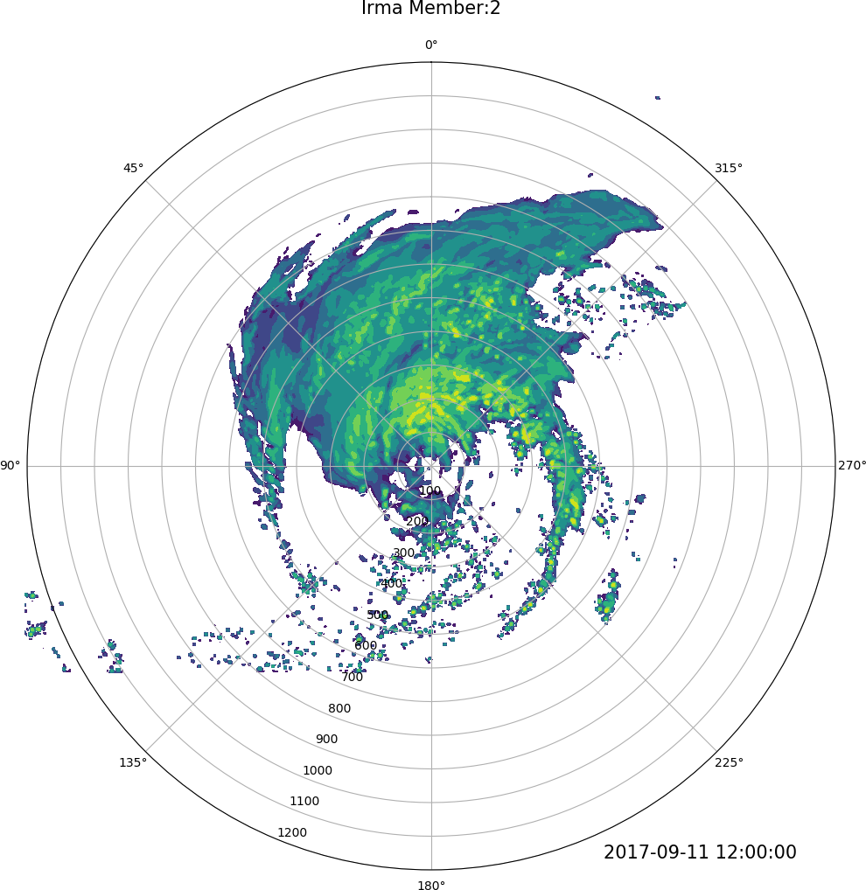
Motivation
Introduction
Methodology
Results
Conclusion
How cell type is determined:
Model
Reflectivity > 99.9th percentile

Slide 52
Motivation
Introduction
Methodology
Results
Conclusion
How cell type is determined:
Model
Reflectivity > 99.9th percentile
Updraft Helicity > 99.9th percentile*
*Carroll-Smith et al. (2019)

Slide 53
Motivation
Introduction
Methodology
Results
Conclusion
How cell type is determined:
Model
Reflectivity > 99.9th percentile
Updraft Helicity > 99.9th percentile*
Rotating Cells
*Carroll-Smith et al. (2019)

Slide 54
Motivation
Introduction
Methodology
Results
Conclusion
How cell type is determined:
Model
Reflectivity > 99.9th percentile
Updraft Helicity < 5th percentile
and
Maximum Hourly Updraft > 99.9th percentile
Updraft Helicity > 99.9th percentile*
Rotating Cells
*Carroll-Smith et al. (2019)

Slide 55
Motivation
Introduction
Methodology
Results
Conclusion
How cell type is determined:
Model
Reflectivity > 99.9th percentile
Updraft Helicity < 5th percentile
and
Maximum Hourly Updraft > 99.9th percentile
Updraft Helicity > 99.9th percentile*
Rotating Cells
Non-Rotating Cells
*Carroll-Smith et al. (2019)

Slide 56
Motivation
Introduction
Methodology
Results
Conclusion
How cell type is determined:
Observations
Reflectivity > 99.95th percentile

Slide 57
Motivation
Introduction
Methodology
Results
Conclusion
How cell type is determined:
Observations
Reflectivity > 99.95th percentile
∇ Base Velocity > 99.9th percentile

Slide 58
Motivation
Introduction
Methodology
Results
Conclusion
How cell type is determined:
Observations
Reflectivity > 99.95th percentile
∇ Base Velocity > 99.9th percentile
Rotating Cells

Slide 59
Motivation
Introduction
Methodology
Results
Conclusion
How cell type is determined:
Observations
Reflectivity > 99.95th percentile
∇ Base Velocity > 99.9th percentile
∇ Base Velocity < 5th percentile
Rotating Cells

Slide 60
Motivation
Introduction
Methodology
Results
Conclusion
How cell type is determined:
Observations
Reflectivity > 99.95th percentile
∇ Base Velocity > 99.9th percentile
∇ Base Velocity < 5th percentile
Rotating Cells
Non-Rotating Cells

Slide 61
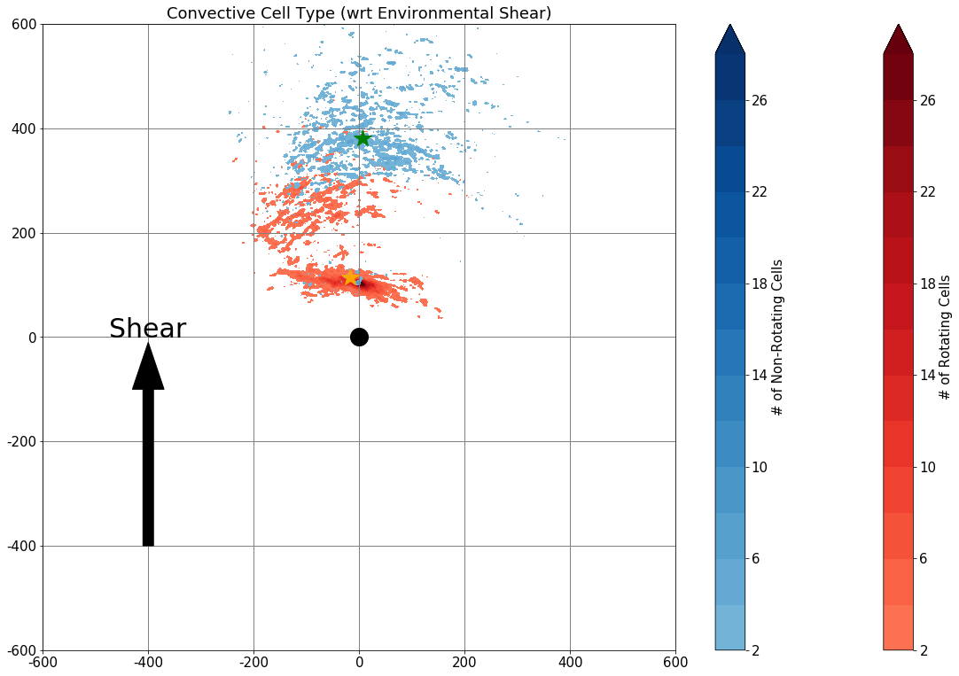
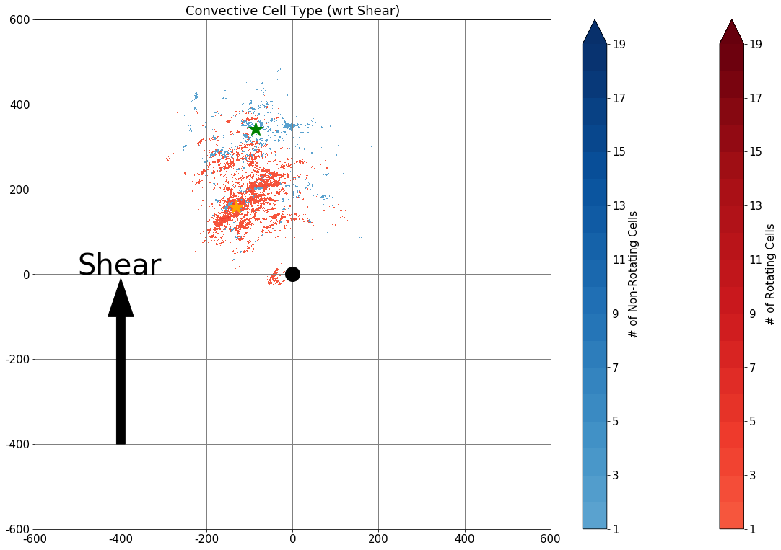
Motivation
Introduction
Methodology
Results
Conclusion
Harvey (2017): 00z 26–12z 27 August
Non-rotating Cells
Rotating Cells
All Ensemble Members
Observations
Ensemble
Observations

Slide 62
Motivation
Introduction
Methodology
Results
Conclusion
Harvey (2017):
Rotating Cells-
The number in the ensemble through 00z 27 August is fairly stable but peaks later in the ensemble members around 09z 27 August.
In the observations then number is fairly stable throughout the entire period.
Obs
Obs

Slide 63
Motivation
Introduction
Methodology
Results
Conclusion
Harvey (2017):
Non-Rotating Cells-
The number in the ensemble peaks at 18z 26 August and is very low and stable over the rest of the times.
The observations show a peak at around 18z 26 August (~1 pm LT), coinciding very closely to the peak seen in the ensemble members.
Obs
Obs

Slide 64
Motivation
Introduction
Methodology
Results
Conclusion
Harvey (2017):
About 4 times more rotating cells were identified in observations.
About 4 times more non-rotating cells were identified in observations.
Obs
Obs

Slide 65
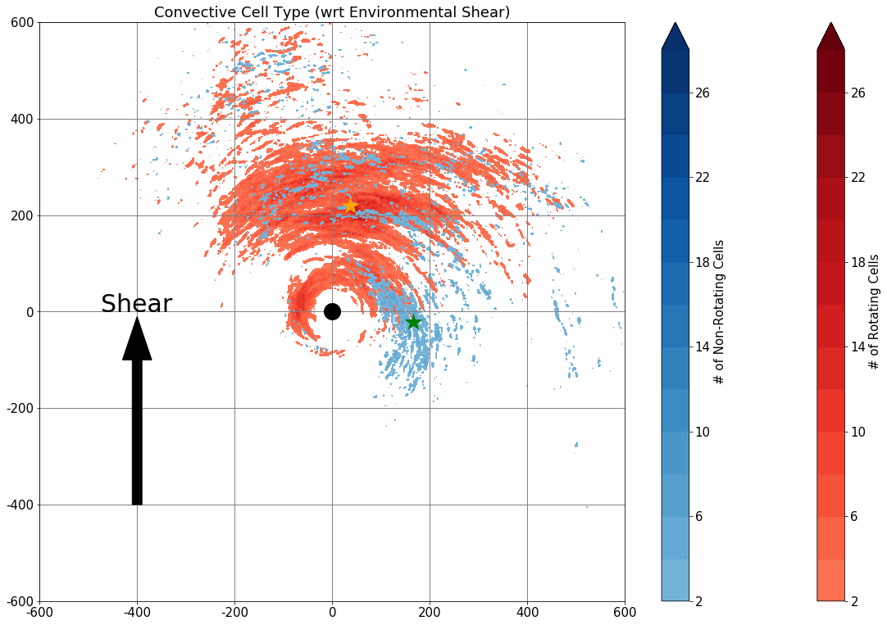
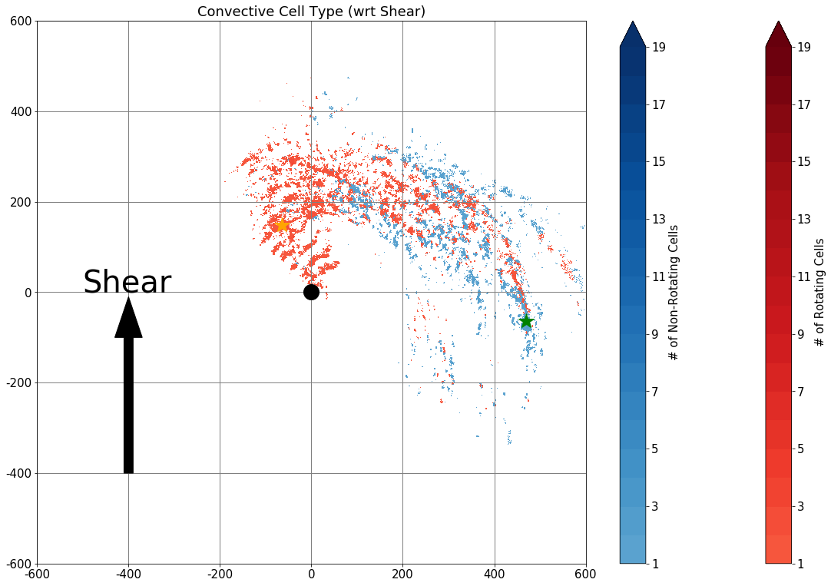
Motivation
Introduction
Methodology
Results
Conclusion
Irma (2017): 12z 10–00z 12 September
Non-rotating Cells
All Ensemble Members
Observations
Rotating Cells
Ensemble
Observations

Slide 66
Motivation
Introduction
Methodology
Results
Conclusion
Irma (2017):
Rotating Cells-
The number in the ensemble through 00z 11 September is fairly stable but decreases over time after that.
Similar to what is seen in observations the number through 06z 11 September is fairly stable but there is a peak around 15z 11 September.
Obs
Obs

Slide 67
Motivation
Introduction
Methodology
Results
Conclusion
Irma (2017):
Non-Rotating Cells-
There is a peak in the number around 18z on both 10 and 11 September in the observations (~2 pm LT) .
The number in the ensemble shows a few members peaking just around 19z on both 10 and 11 September.
Obs
Obs

Slide 68
Motivation
Introduction
Methodology
Results
Conclusion
Irma (2017):
About 3 times more rotating cells were identified in observations.
About 4 times more non-rotating cells were identified in observations.
Obs
Obs

Slide 69
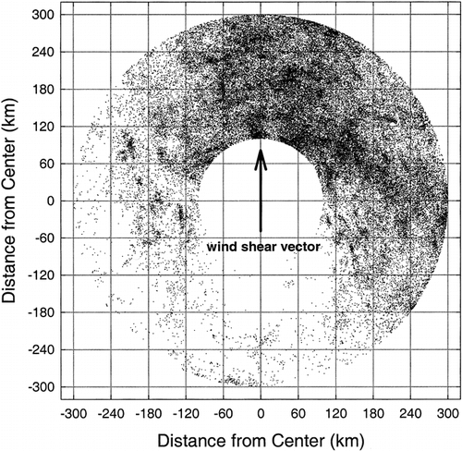
Motivation
Introduction
Methodology
Results
Conclusion
1. How are the distributions of rotating and non-rotating convection organized in the tropical cyclone?
In Harvey non-rotating cells tend to be present downshear but further out radially than the rotating cells.
In Irma most rotating cells are located directly downshear with most non-rotating cells located to the right of shear.
Lightning is generally organized downshear and downshear right, as evident in Corbosiero and Molinari 2002.
Lightning
(Corbosiero and Molinari 2002)
Ensemble
Irma
Harvey

Slide 70
Motivation
Introduction
Methodology
Results
Conclusion
2. Does the NCAR Ensemble produce realistic numbers of rotating cells in the rainbands?
In general there were many more rotating cells identified in the observation compared to the NCAR Ensemble.
Irma: ~3 times more rotating cells in observations
Harvey: ~4 times more rotating cells in observations
Irma (2017):
Harvey (2017):
Obs
Obs

Slide 71
Motivation
Introduction
Methodology
Results
Conclusion
Other Points:
The NCAR Ensemble shows no conclusive diurnal signal in the rotating cells for Hurricane Irma but does show one in Hurricane Harvey.
The observations for Hurricane Irma show a weak diurnal signal in rotating convection but Hurricane Harvey does not.
Adapted from Edwards 2010, TCTOR dataset
Irma (2017):
Harvey (2017):
Obs
Obs

Slide 72
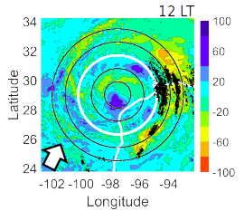
Motivation
Introduction
Methodology
Results
Conclusion
Image courtesy of Sarah Ditchek
Other Points:
The NCAR Ensemble and observations both show a diurnal signal in non-rotating convection. With peaks occurring around 1–2 pm LT in both Harvey and in some Irma ensemble members.
This peak in convection in Harvey aligns very well with the development and propagation of a diurnal pulse.
Irma (2017):
Harvey (2017):
Obs
Obs

Slide 73
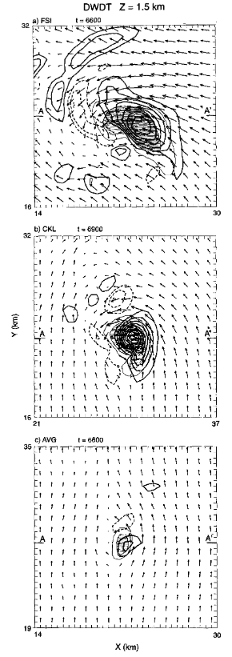
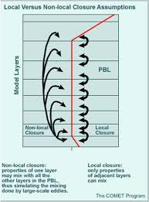
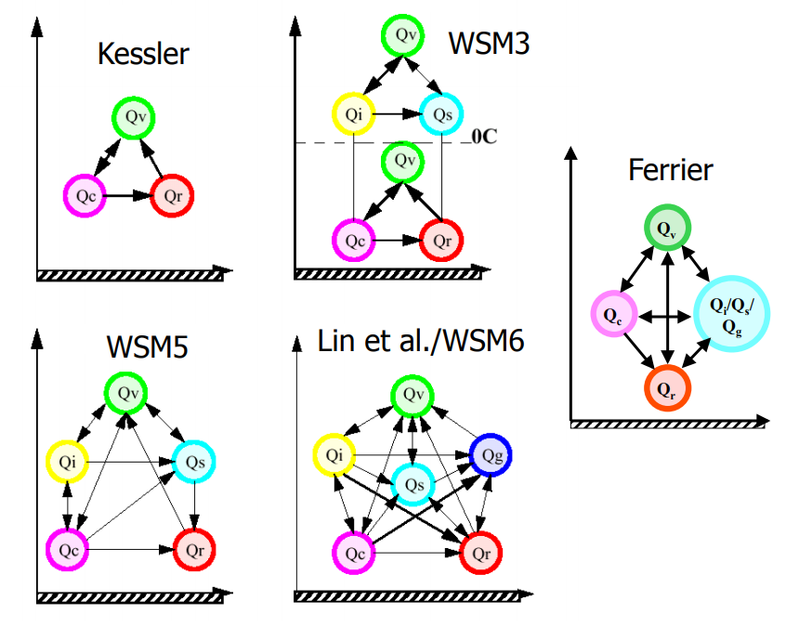
Motivation
Introduction
Methodology
Results
Conclusion
Future Work:
Use high horizontal and vertical resolution modeling to understand the structure of individual rotating and non-rotating convective cells.
Examine how model physics (PBL and Microphysics) effect the structure of these cells and the distribution of these cells in tropical cyclones.
Numerical simulations conducted on the meso- to micro- scales will allow for the comparison of tropical cyclone supercells to the supercells of the midlatitudes, which will increase the understanding of the cells that can eventually spawn tropical cyclone tornadoes.
(McCaul and Weisman 1996)

Slide 74
Motivation
Introduction
Methodology
Results
Conclusion
Thank You For Your Attention

Slide 75
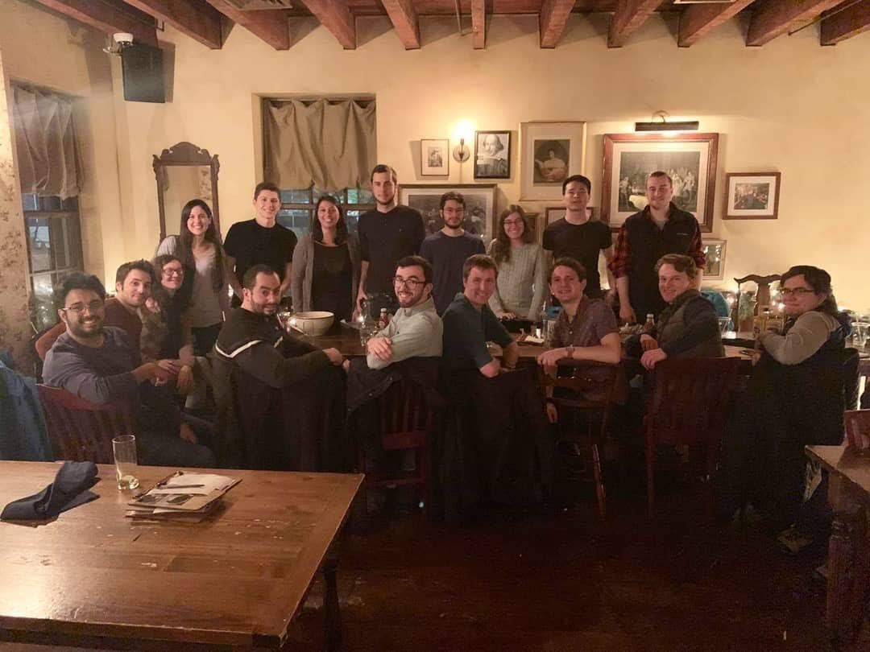
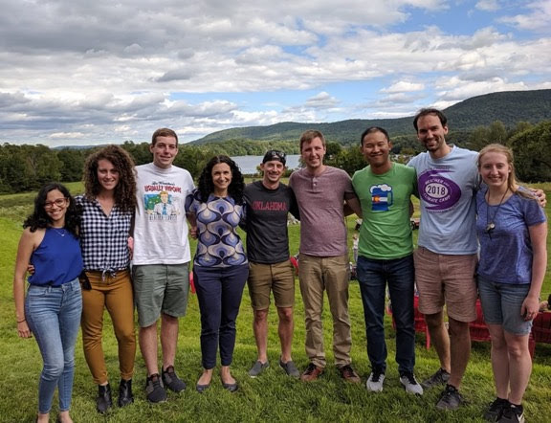
Big Thanks To...
My Family
My Boyfriend (Adam)
My Academic Mom- Kristen Corbosiero
My Academic Dad- Brian Tang
Tropical Dynasty
DAES Office and Computing Staff
My Office Mates in ES 330
All my other friends at UAlbany

Slide 76
Motivation
Introduction
Methodology
Results
Conclusion
Extra Materials

Slide 77
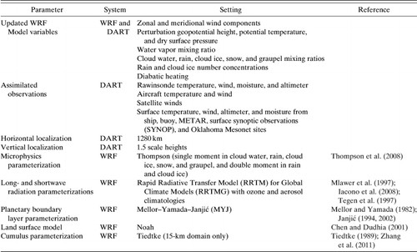
Motivation
Introduction
Methodology
Results
Conclusion
(Schwartz et al. 2015)

Slide 78
Motivation
Introduction
Methodology
Results
Conclusion
NCAR Ensemble | Model Reflectivity (dBz) | Maximum Updraft Helicity (m^2/s^2) | Hourly Maximum Updraft Velocity (m/s)
Hurricane Harvey (2017) | 50.6 (99.9th Percentile) | 29.5 (99.9th Percentile) 7.38 (5th Percentile) | 14.79
Hurricane Irma (2017) | 49.49 (99.9th Percentile) | 33.9 (99.9th Percentile) 8.48 (5th Percentile) | 12.32
Observations | Level II Base Reflectivity (dBz) | Gradients in Level II Base Radial Velocity (1/s)
Hurricane Harvey (2017) | 49 (99.95th Percentile) | 40.5 (99.9th Percentile) 9.1 (5th Percentile) | -
Hurricane Irma (2017) | 41.5 (99.95th Percentile) | 42.5 (99.9th Percentile) 10.3 (5th Percentile) | -
Thresholds

Slide 79
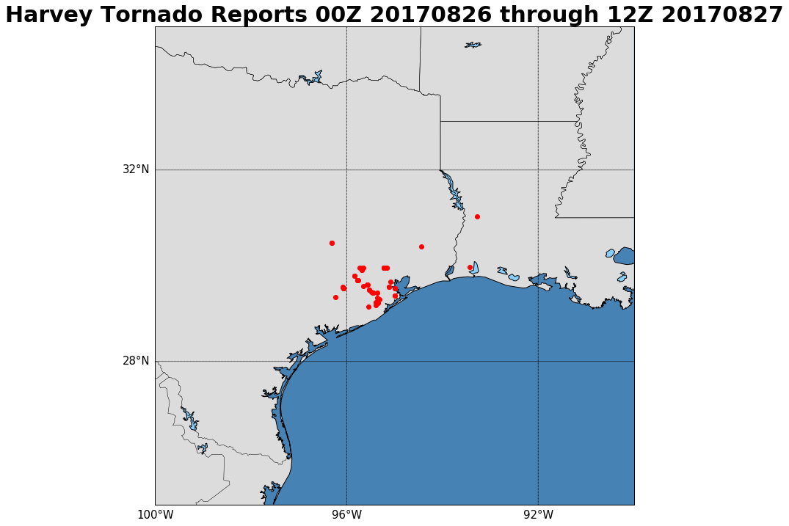
Harvey Tornado Reports (00Z 2017-08-26 through 12Z 2017-08-27)
N=52

Slide 80
N=18

Slide 81
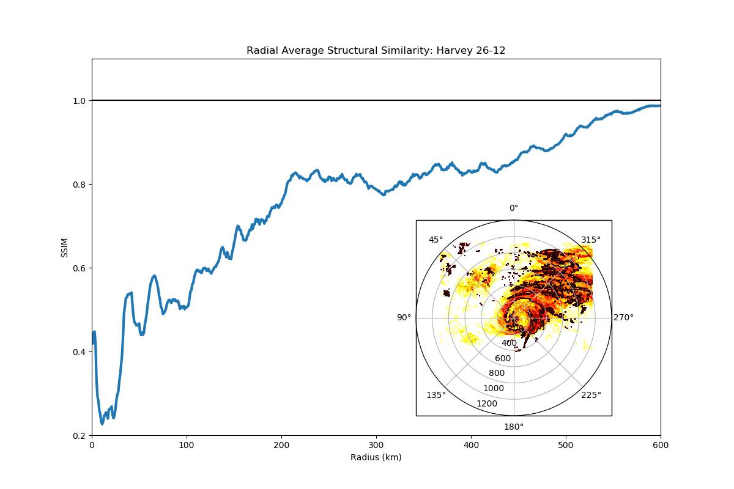
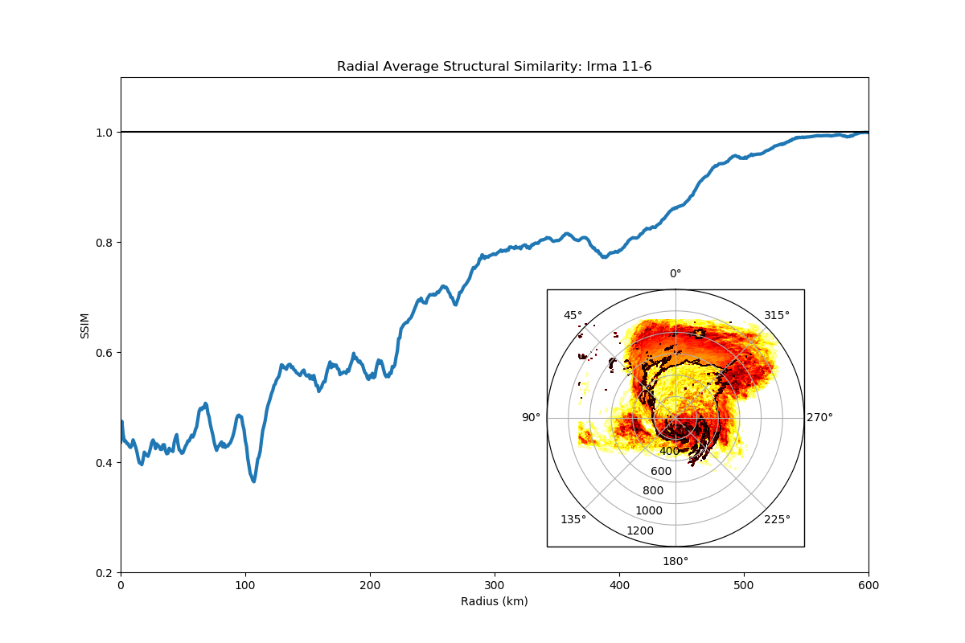
Motivation
Introduction
Methodology
Results
Conclusion
Irma (2017):
Harvey (2017):
High Similarity
Radial Average SSIM 9/11/2017 06 UTC
Radial Average SSIM 8/26/2017 12 UTC
Low Similarity

Slide 82
Motivation
Introduction
Methodology
Results
Conclusion
Irma (2017):
Harvey (2017):
High Similarity
Radial Average SSIM 9/11/2017 06 UTC
Radial Average SSIM 8/26/2017 12 UTC
Low Similarity

Slide 83
Motivation
Introduction
Methodology
Results
Conclusion
Irma (2017):
Harvey (2017):
High Similarity
Radial Average SSIM 9/11/2017 06 UTC
Radial Average SSIM 8/26/2017 12 UTC
Low Similarity

Slide 84
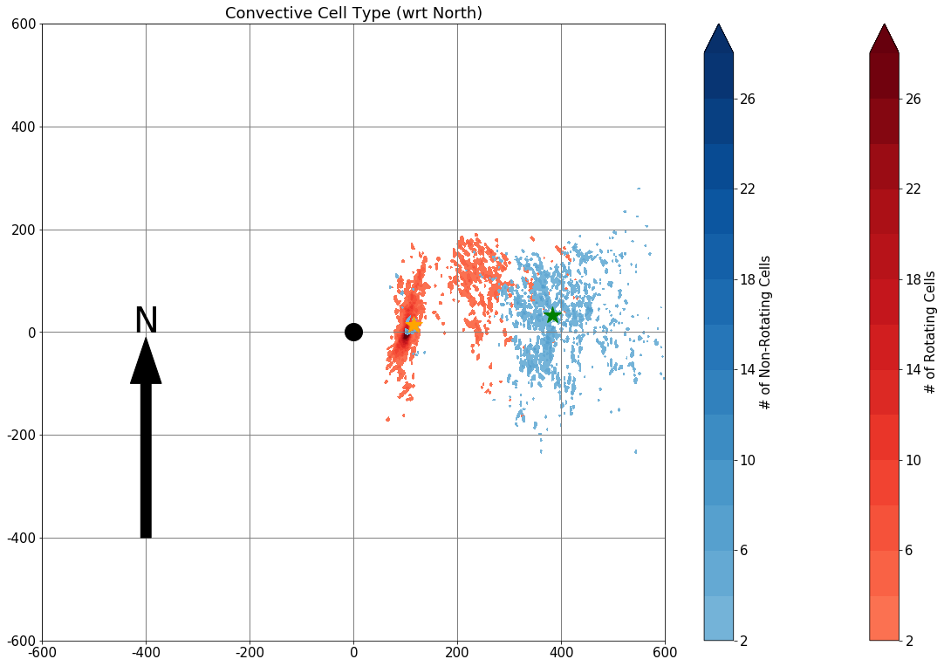
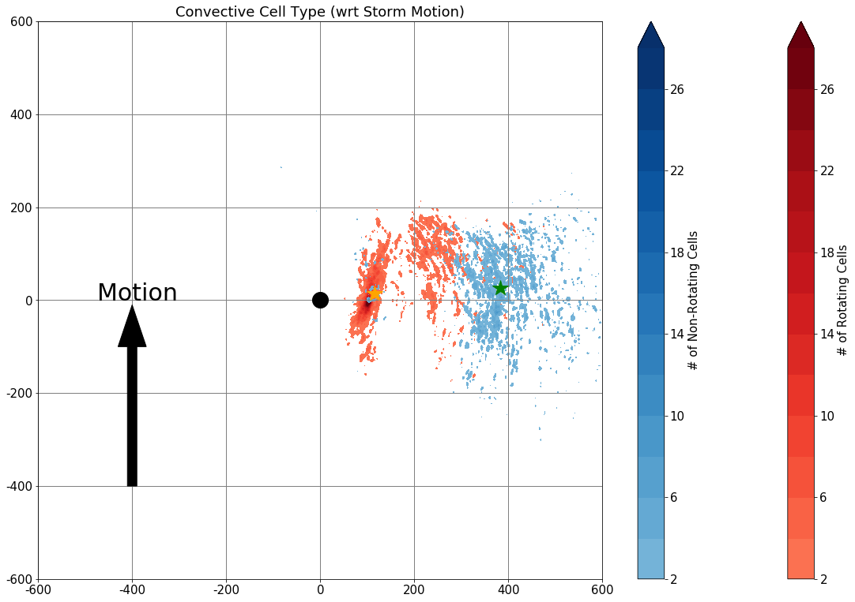
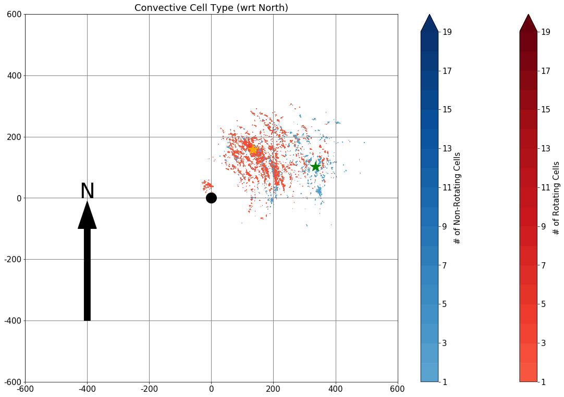
Harvey
Ensemble
Observations

Slide 85
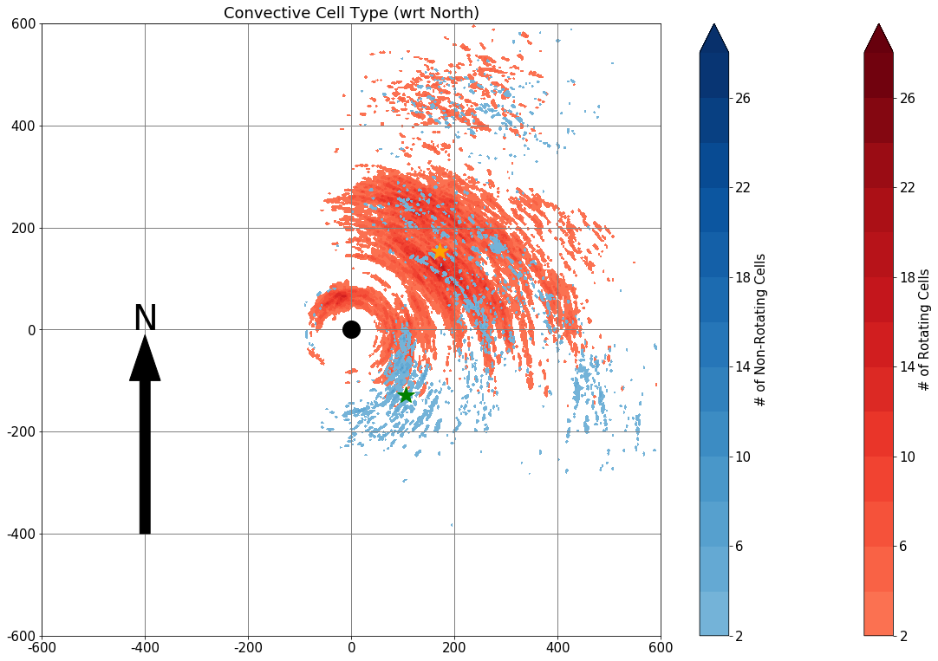
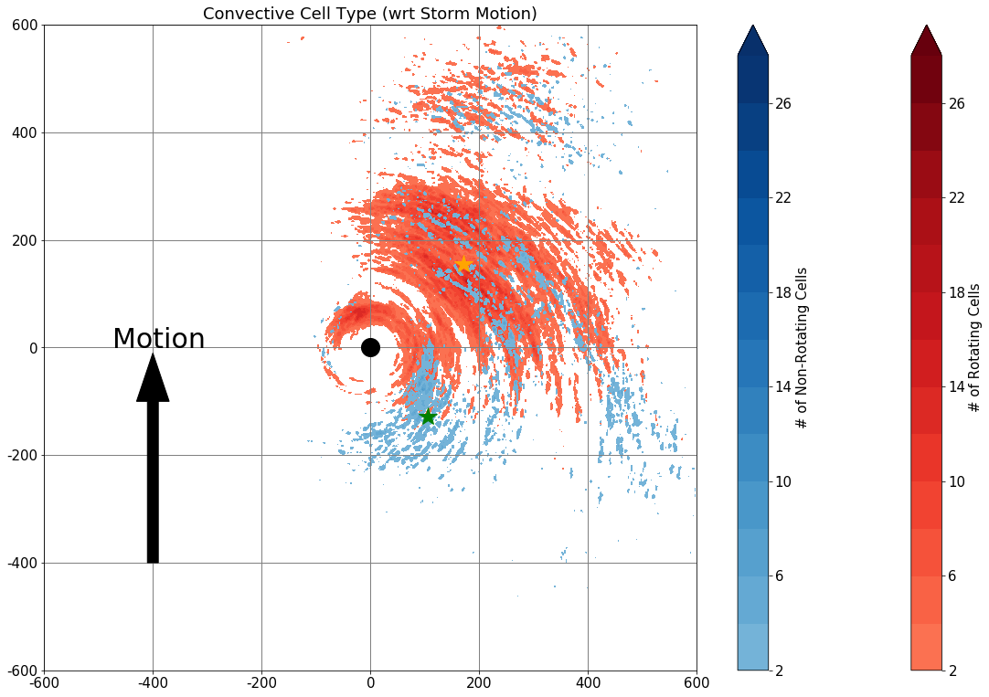
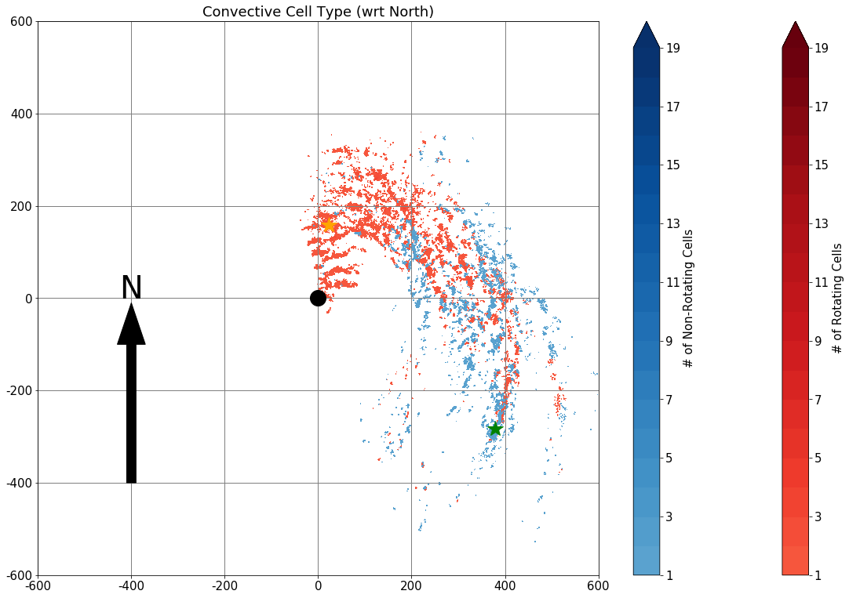
Irma
Ensemble
Observations

Slide 86
Motivation
Introduction
Methodology
Results
Conclusion
Irma (2017):
Irma Tracks and Intensity (2017-09-10 1200Z through 2017-09-12 1200Z)

Slide 87
Motivation
Introduction
Methodology
Results
Conclusion
Irma (2017):
a)
SSIM- Generally decreases steadily over time as vertical wind shear displaces convection and reflectivity.
The initialization on 0000 UTC 11 September has higher SSIM across all forecast hours which it overlaps with the 0000 UTC 10 September run.
b)
Initialized at 0000 UTC 10 September (Solid)
Initialized at 0000 UTC 11 September (Dashed)

Slide 88
Motivation
Introduction
Methodology
Results
Conclusion
Irma (2017):
a)
Area ratio- Less than one showing that the model is producing a larger storm than in radar observations. Again generally decreasing steadily over time as seen in the SSIM.
b)
Initialized at 0000 UTC 10 September (Solid)
Initialized at 0000 UTC 11 September (Dashed)

Slide 89
Motivation
Introduction
Methodology
Results
Conclusion
Irma (2017):
Ensemble members 2 & 5 exhibited very similar tracks and intensities for the initialization at 0000 UTC 11 September.
Ensemble member 2 shows one distinct rainband and possible second rainband forming radially inward.
Member 5 shows many distinct rainbands.

Slide 90
Motivation
Introduction
Methodology
Results
Conclusion
Irma (2017):
Ensemble members 2
Take a vertical cross section across the rainband (black line)

Slide 91
Motivation
Introduction
Methodology
Results
Conclusion
Irma (2017):
Irma: Member 2 (2017-09-11 12:00:00)
Height (m)
Radius (km)→

Slide 92
Motivation
Introduction
Methodology
Results
Conclusion
Irma (2017):
Irma: Member 2 (2017-09-11 12:00:00)
Height (m)
Radius (km)→

Slide 93
Motivation
Introduction
Methodology
Results
Conclusion
Irma (2017):
The different number of distinct rainbands seen in the model reflectivity is also seen in the PV analysis.
The convective cells within the rainbands generate PV as a result of gradients in diabatic heating.
More areal coverage of PV in ensemble member 5.

Slide 94
Motivation
Introduction
Methodology
Results
Conclusion
Irma (2017):
As described in Houze (2010) the inner-core is characterized by high relative humidity.
In the outer rainband region areas of lower relative humidity in between the rainbands is apparent.
Colocated with this dry air, especially to the southeast (upshear right) of the strom’s center, locally warmer potential temperature can be seen at 850 hPa.
Possible evidence of weak baroclinic forcing, particularly upshear right.

Slide 95
Motivation
Introduction
Methodology
Results
Conclusion
Irma (2017):
Surface based CAPE (SBCAPE) is generally concentrated upshear-right and downshear-right quadrants.
Some cells have convergence of the 80-m winds along the radially outward side.

Slide 96
Motivation
Introduction
Methodology
Results
Conclusion
Irma (2017):
Most Unstable CAPE (MUCAPE)
The NCAR Ensemble did a good job representing the values of MUCAPE for the various sounding locations near Irma. In most cases the observed value of MUCAPE falls within the range represented by the 10 ensemble members.
In the midlatitudes typically supercell environment have MUCAPE >= 1000 J kg⁻¹

Slide 97
Motivation
Introduction
Methodology
Results
Conclusion
Irma (2017):
Storm Relative Helicity (SRH)
The NCAR Ensemble also did a good job representing the values of SRH for the various sounding locations near Irma. In most cases the observed value of SRH fall within the range represented by the 10 ensemble members. Many locations also exceed the 250 m² s⁻² SRH defined by the SPC to be favorable for the formation of supercells.
In the midlatitudes typically supercell environment have 0–3-km SRH >= 250 m² s⁻²

Slide 98
Motivation
Introduction
Methodology
Results
Conclusion
Harvey (2017):
The different number of distinct rainbands seen in the model reflectivity is also seen in the PV analysis, just as in Irma (2017).
The convective cells within the rainbands generate PV as a result of diabatic heating.
In the multi-band ensemble member PV maxima extend further north and radially outward.

Slide 99
Motivation
Introduction
Methodology
Results
Conclusion
How cell type is determined:
Model
Cells are first identified using model reflectivity exceeding 99.9th percentile.
Cells are then considered rotating if the updraft helicity (UH) exceeds the 99.9th percentile.
Cells were considered non-rotating if the UH did not exceed the 5th percentile and the maximum hourly updraft (MHU) exceeds the 99.9th percentile.
Reflectivity > 99.9th percentile
UH < 5th percentile
and
MHU> 99.9th percentile
UH > 99.9th percentile
**All percentiles are based on values across all hours and ensemble members.**
Rotating Cells
Non-Rotating Cells

Slide 100
Motivation
Introduction
Methodology
Results
Conclusion
How cell type is determined:
Observations
Cells are first identified using level II base reflectivity exceeding 99.95th percentile.
Cells are then considered rotating if the gradient in level II base velocity (BV) exceeds the 99.9th percentile.
Cells were considered non-rotating if the gradient in level II base velocity (BV) did not exceed the 5th percentile.
Reflectivity > 99.95th percentile
∇ BV > 99.9th percentile
∇ BV < 5th percentile
**All percentiles are based on values across all times.**
Rotating Cells
Non-Rotating Cells

Slide 101
Motivation
Introduction
Methodology
Results
Conclusion

Slide 102
Motivation
Introduction
Methodology
Results
Conclusion

Slide 103
Motivation
Introduction
Methodology
Results
Conclusion

Slide 104
Motivation
Introduction
Methodology
Results
Conclusion

