Slide 1
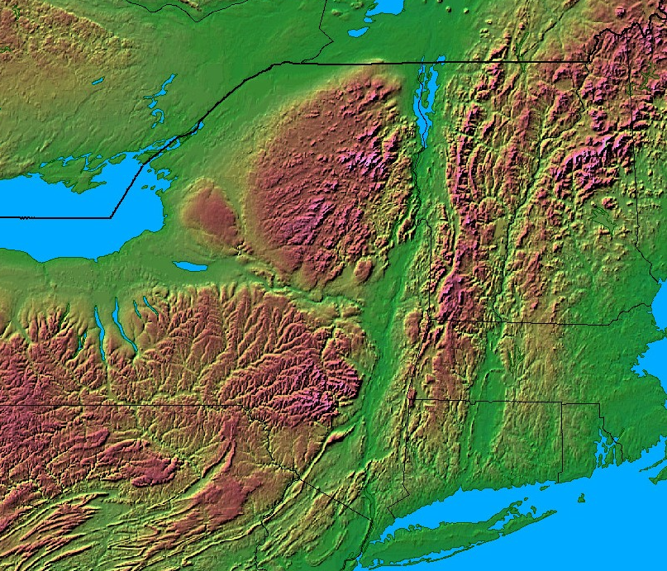
Champlain Valley
Adirondack
Mountains
Green
Mountains
Mohawk Valley
Catskill
Mountains
Berkshire
Mountains
Hudson Valley
Fig. 1. Topographic depiction of Eastern New York The black dot represents the location of Albany, New York. Courtesy of Johns Hopkins University (http://fermi.jhuapl.edu/states/states.html)

Slide 2
Pure Warm Season MHC Events (n=19)
Year | Month | Day | Time of Maximum Reflectivity (UTC)
2003 | 7 | 24 | 18
 | 8 | 17 | 18
2004 | 5 | 15 | 18
 | 8 | 4 | 00
2005 | 6 | 29 | 18
 | 8 | 1 | 18
2006 | 6 | 1 | 18
 |  | 19 | 18
 |  | 29 | 18
 | 9 | 9 | 18
2010 | 7 | 21 | 18
2011 | 6 | 1 | 18
 |  | 8 | 18
 |  | 25 | 18
 | 7 | 13 | 18
 | 9 | 4 | 18
2012 | 5 | 29 | 18
 | 7 | 23 | 18
2014 | 8 | 5 | 18
Pure Cold Season MHC Events (n=12)
Year | Month | Day | Time of Maximum Reflectivity (UTC)
2002 | 11 | 27 | 18
 | 12 | 16 | 00
2003 | 1 | 24 | 00
2005 | 1 | 17 | 12
2007 | 1 | 29 | 06
 | 2 | 23 | 06
2008 | 1 | 2 | 12
 | 12 | 19 | 12
 |  | 31 | 18
2011 | 1 | 12 | 18
 | 10 | 30 | 06
2013 | 9 | 13 | 18
Table. 2. Dates and time of maximum reflectivity for Pure Cold MHC Cases
Table. 1. Dates and time of maximum reflectivity for Pure Warm MHC Cases

Slide 3
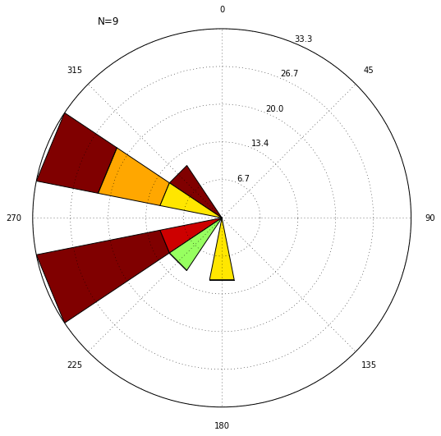
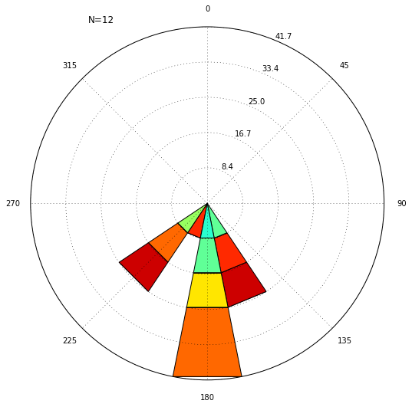
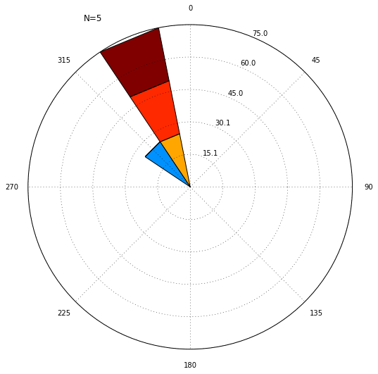
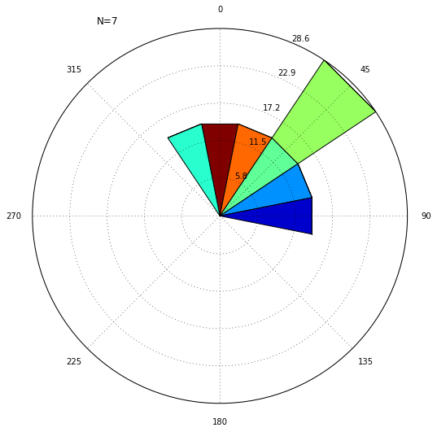
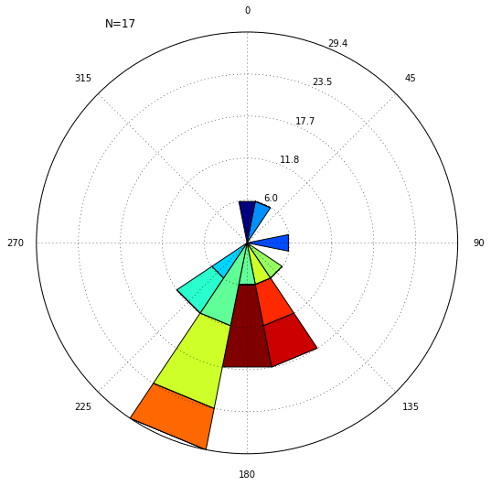
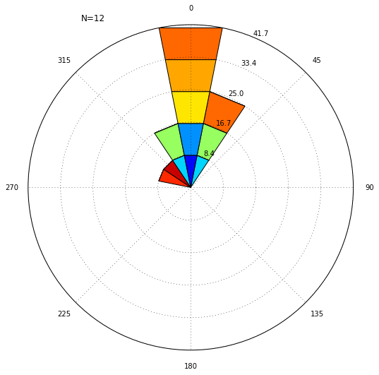
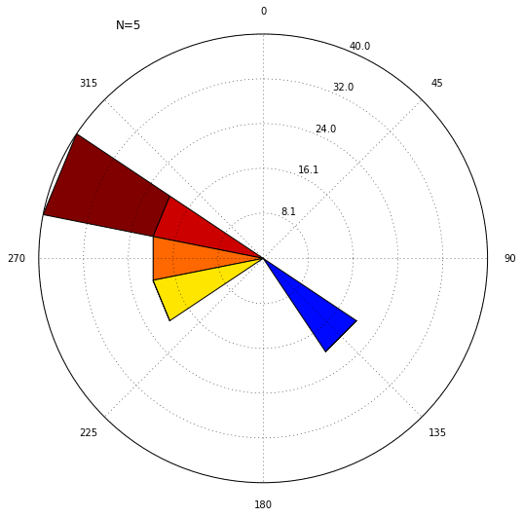
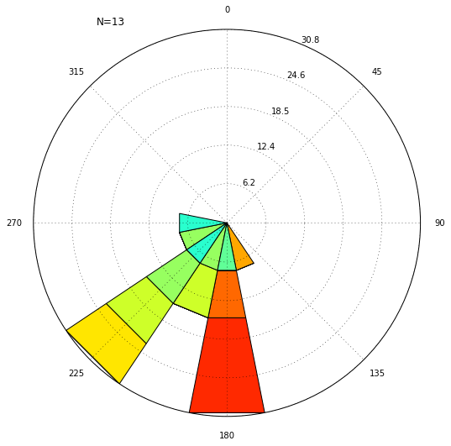
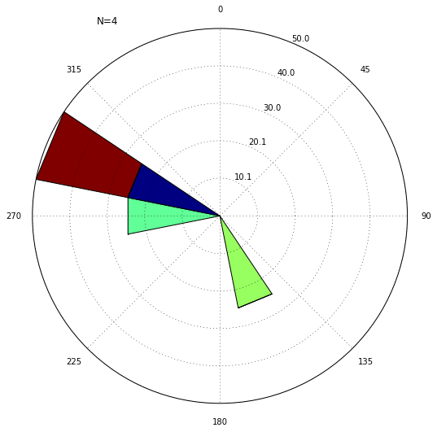
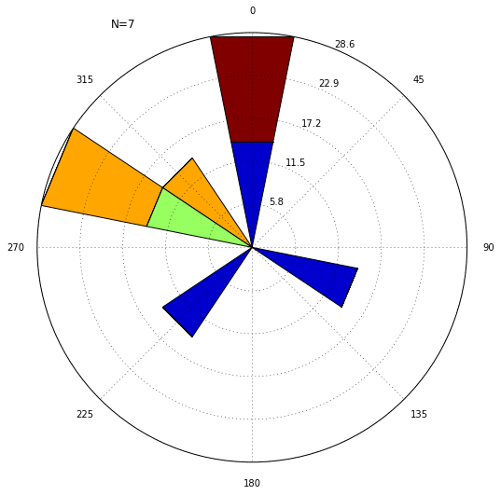
a)
N=9
N=12
b)
N=5
N=7
KRME
KGFL
KRME
KGFL
N=17
N=12
KALB
KALB
N=5
N=13
N=4
N=7
KUCA
KPOU
KUCA
KPOU
0
1
2
3
4
5
6
7
8
9
10
11
12
13
14
>15
Fig. 2. Wind rose of cases created from the automated surface observation systems (ASOS) data. Shaded bars represent the wind magnitude and the radial units show the percentage of occurrence for each wind direction. a) warm and b) cold MHC cases.

Slide 4
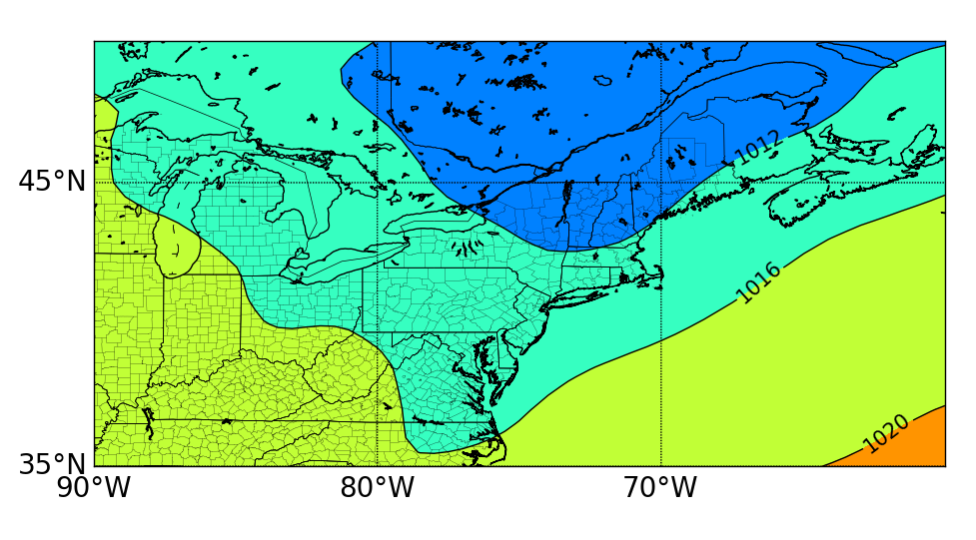
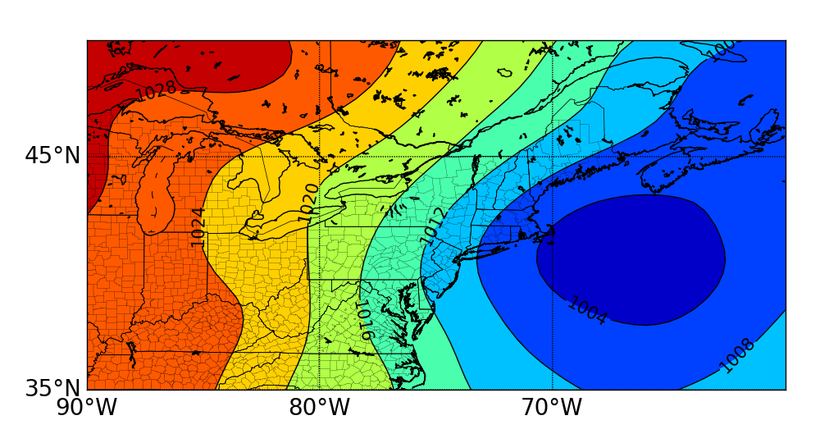
a)
Fig. 3. Composite mean sea level pressure (hPa, shaded) for a) warm and b) cold MHC cases.
b)

Slide 5
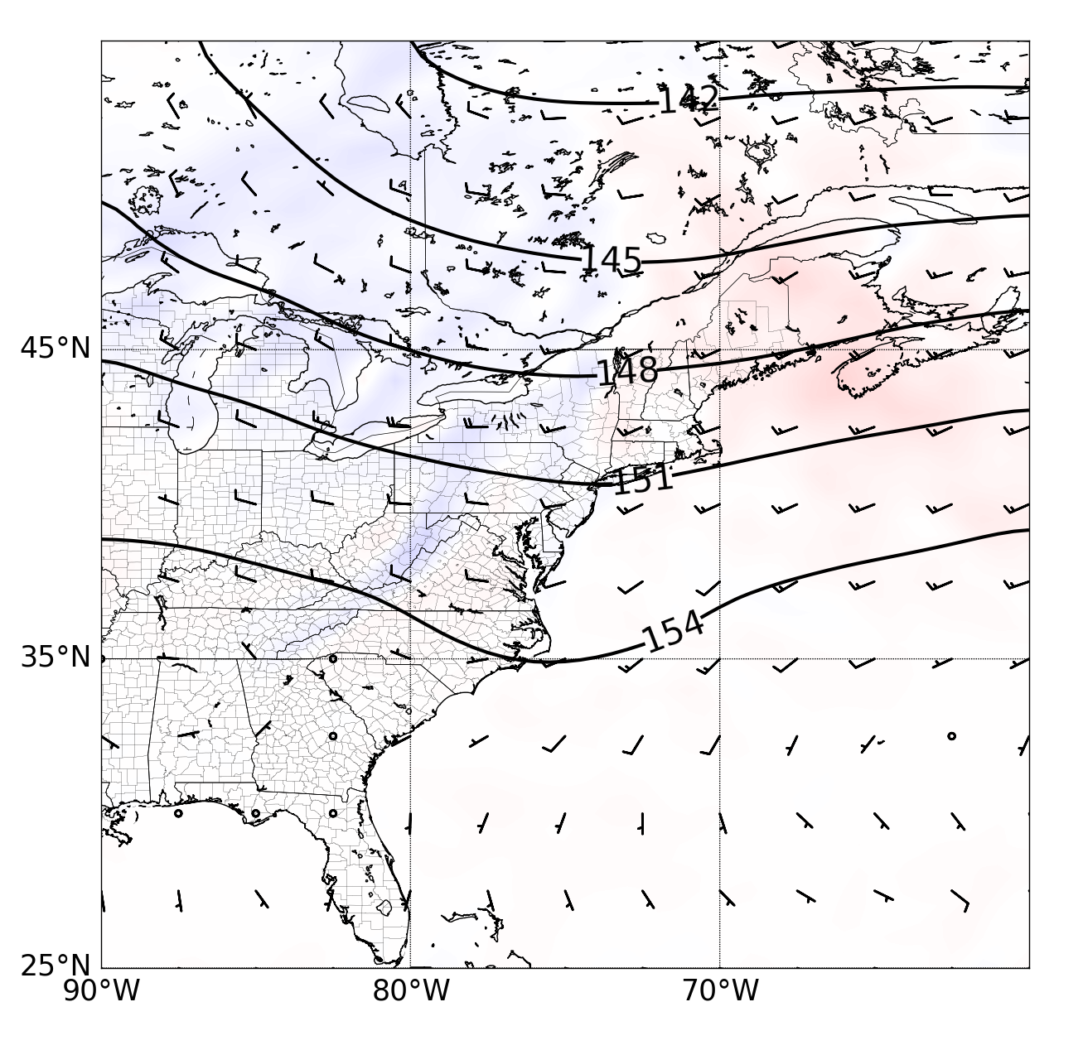
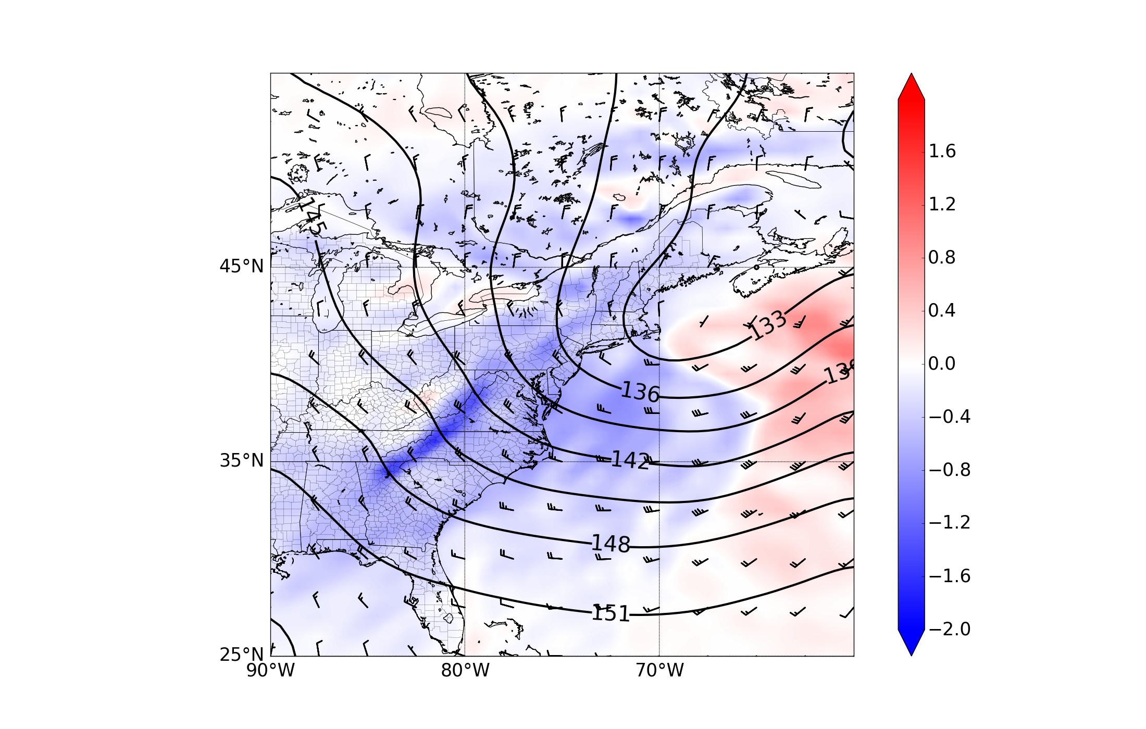
a)
b)
a)
b)
Fig. 4. Composite 850-hPa heights (dam, contours), winds (kt, barbs; pennant, full barb, and half barb denote 50, 10, and 5 kt, respectively), and 850-hPa temperature advection (°C h⁻¹ , shaded) for a) warm and b) cold MHC cases.

Slide 6
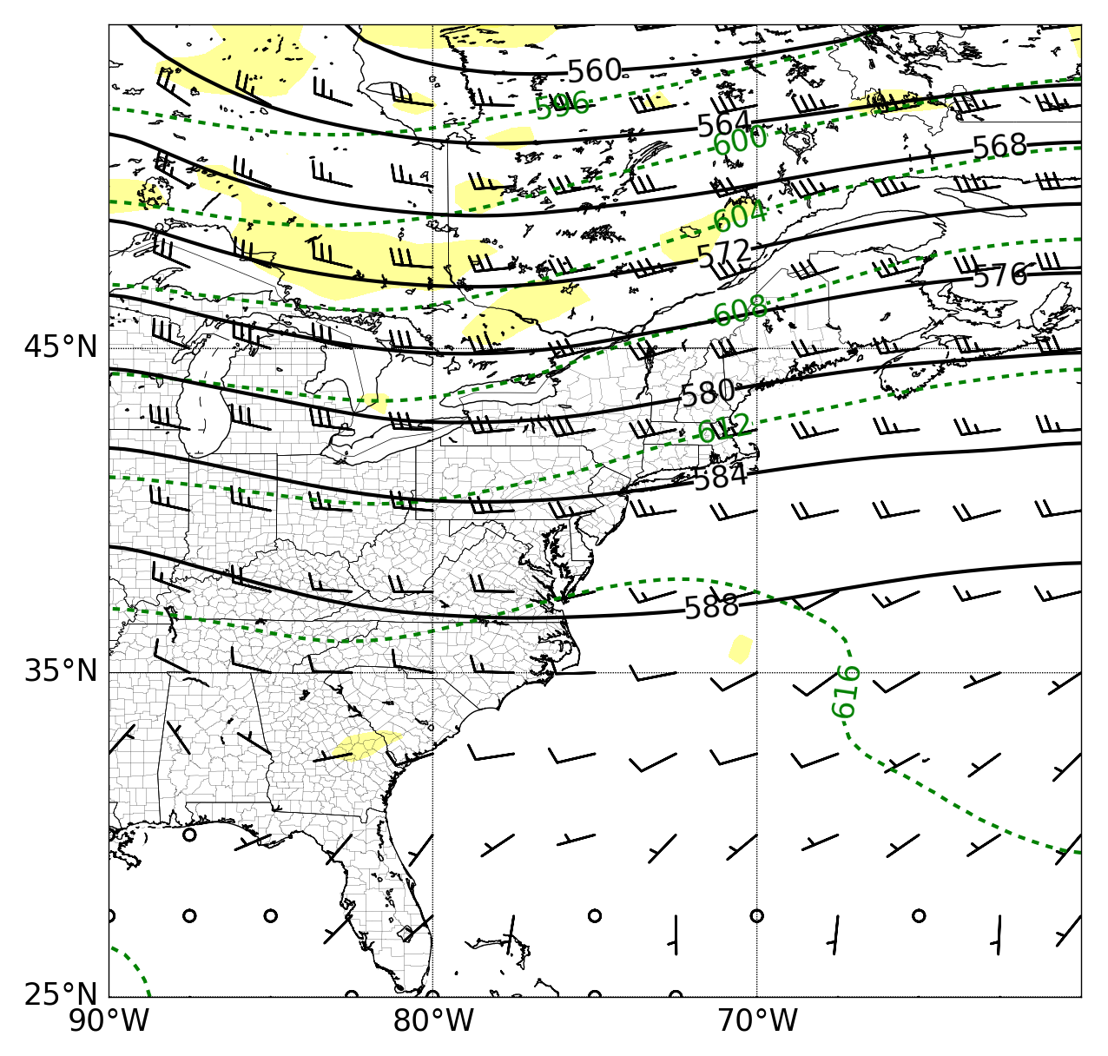
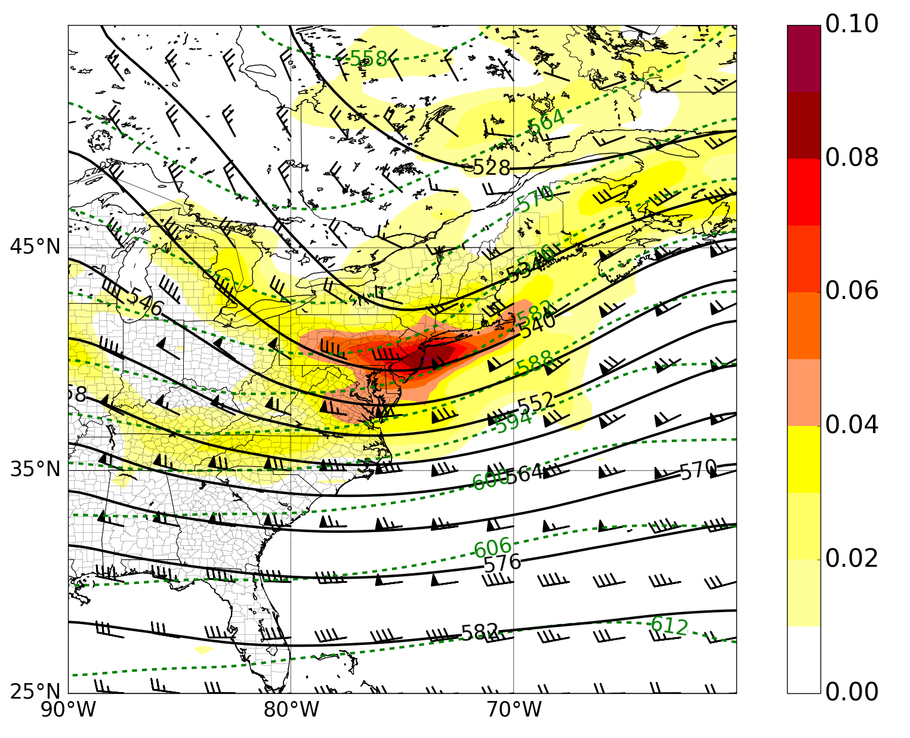
a)
b)
Fig. 5. Composite 500-hPa heights (dam, contours), 700-300 hPa thickness (dam, dashed), winds (kt, barbs; pennant, full barb, and half barb denote 50, 10, and 5 kt, respectively), and 500-hPa relative vorticity (x 10⁻⁵ s⁻¹, shaded) for a) warm and b) cold MHC cases.

Slide 7
a)
Fig. 6. Composite 300-hPa heights (dam, black contours), divergence (s⁻¹, green contours), winds (kt, barbs; pennant, full barb, and half barb denote 50, 10, and 5 kt, respectively), and 300-hPa isotachs (kt, shaded) for a) warm and b) cold MHC cases.
b)

Slide 8
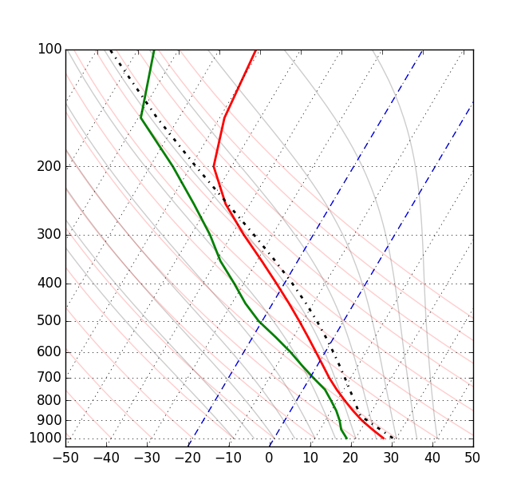
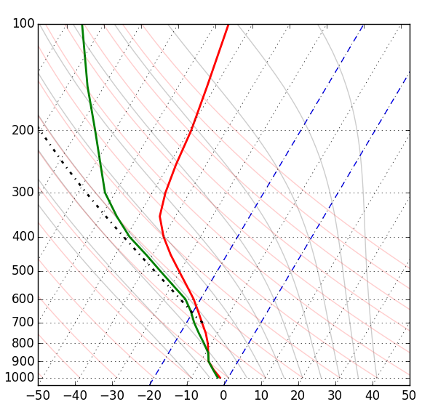
a)
b)
Fig. 7. Composite soundings for a) warm and b) cold MHC cases. Temperature (°C, red), dew point (°C, green), and winds (kt; full pennant, barb, and half barb denote wind speeds of 50, 10, and 5 kt, respectively).

Slide 9
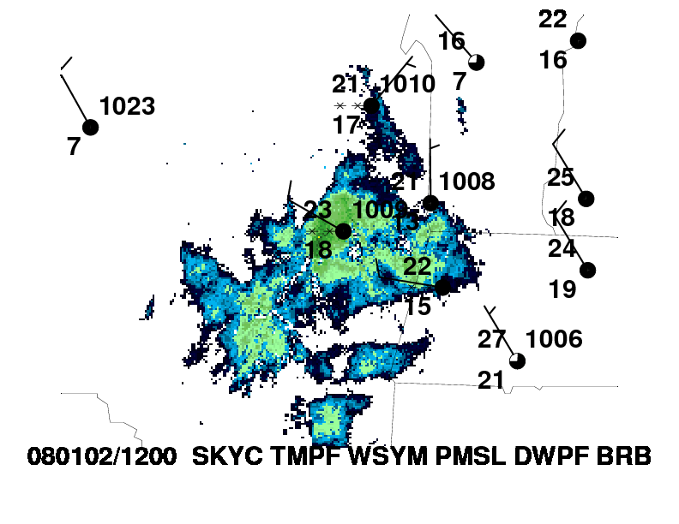
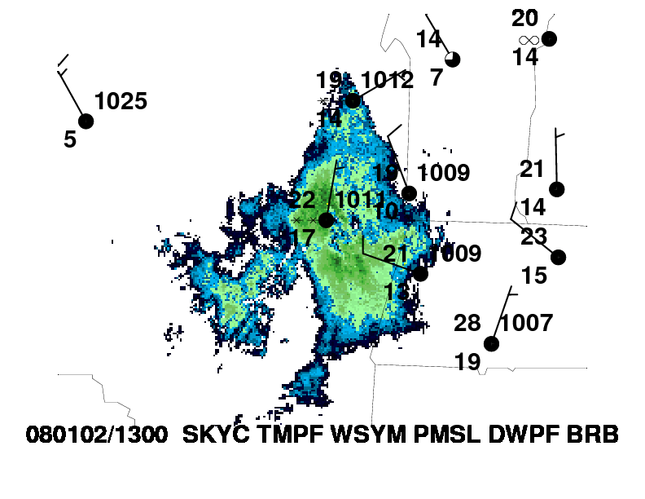
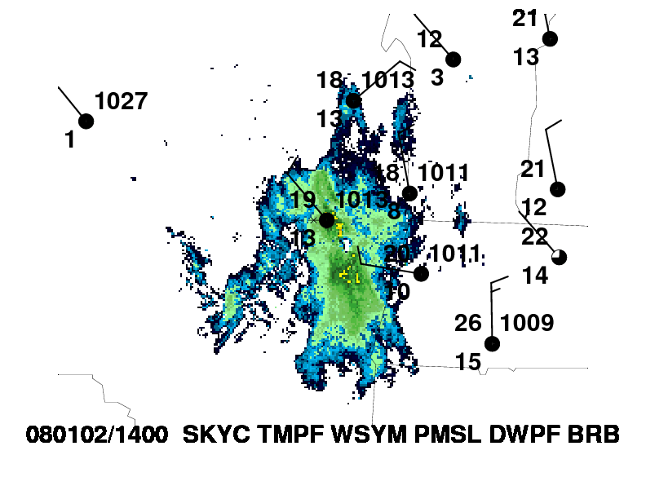
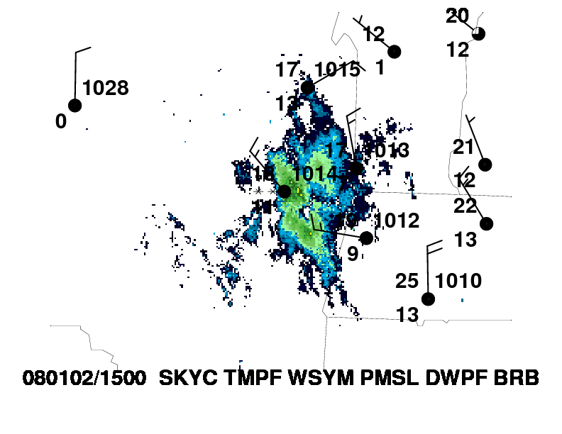
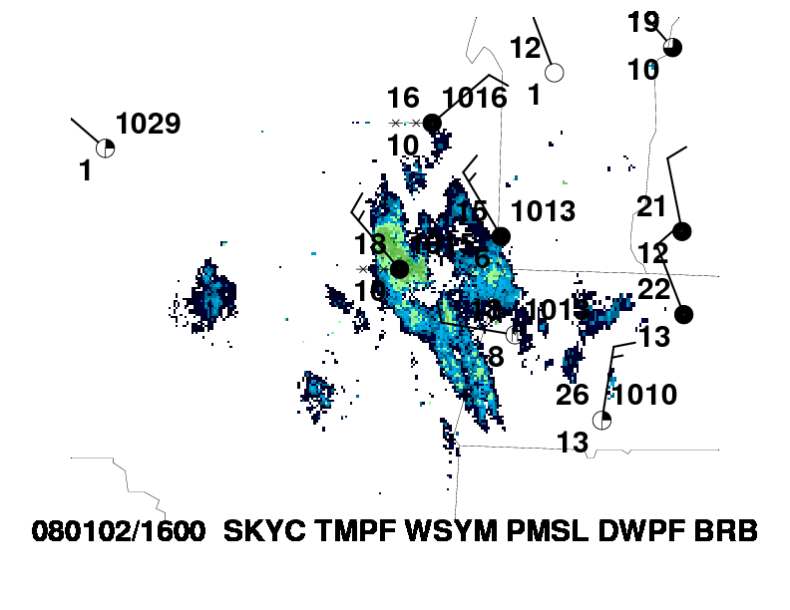
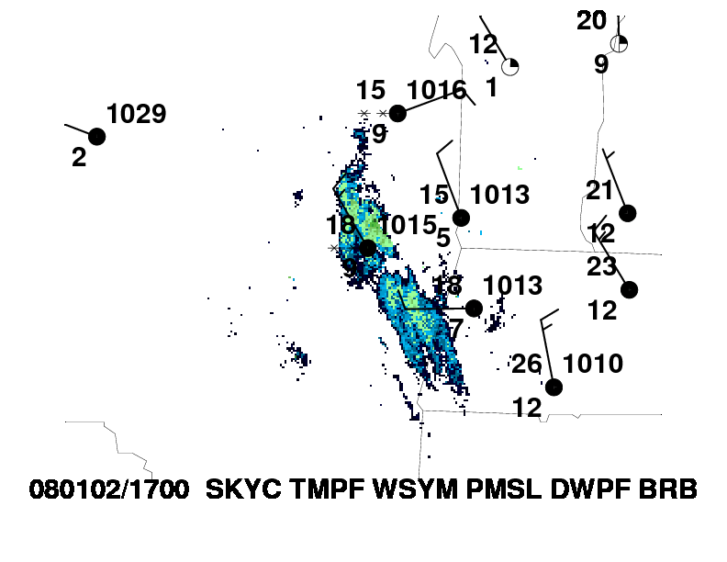
Fig. 8. Surface observations with radar overlay during the MHC Event 02 January 2008. Cohoes, NY is labeled in the red dot.

Slide 10
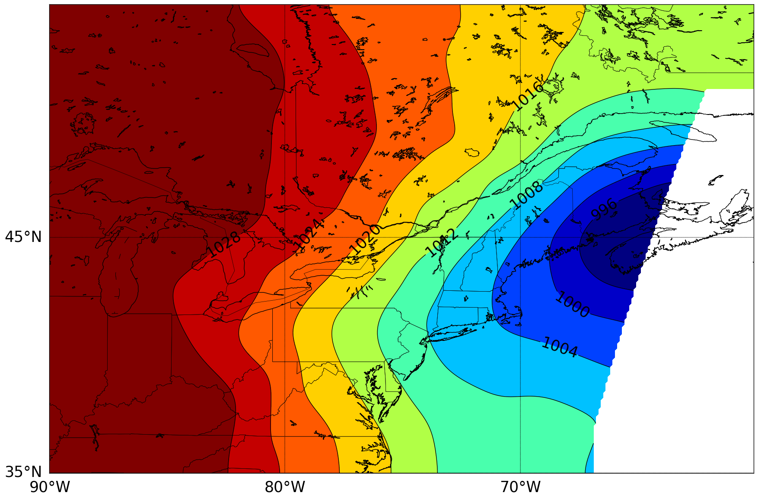
Fig. 9. Mean sea level pressure (hPa, shaded) for 1200 UTC 2 January 2008.

Slide 11
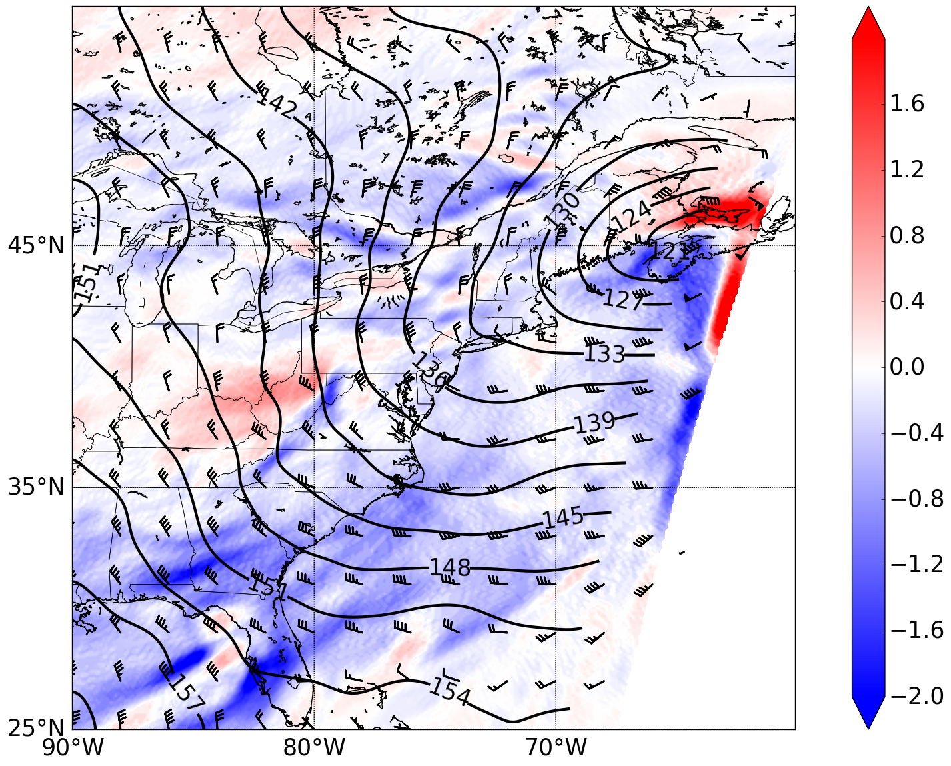
Fig. 10. 850-hPa heights (dam, contours), winds (kt, barbs; pennant, full barb, and half barb denote 50, 10, and 5 kt, respectively), and 850-hPa temperature advection (°C h⁻¹ , shaded) for 1200 UTC 2 January 2008.

Slide 12
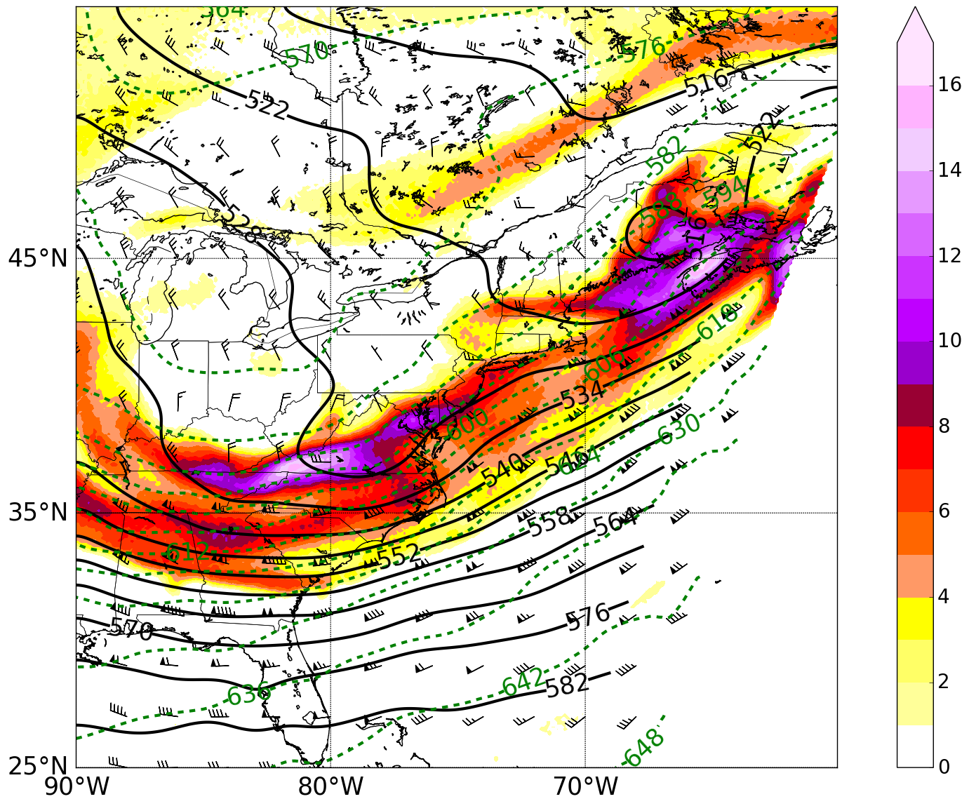
Fig. 11. 500-hPa heights (dam, contours), 700-300 hPa thickness (dam, dashed), winds (kt, barbs; pennant, full barb, and half barb denote 50, 10, and 5 kt, respectively), and 500-hPa relative vorticity (x 10⁻⁵ s⁻¹, shaded) for 1200 UTC 2 January 2008.

Slide 13
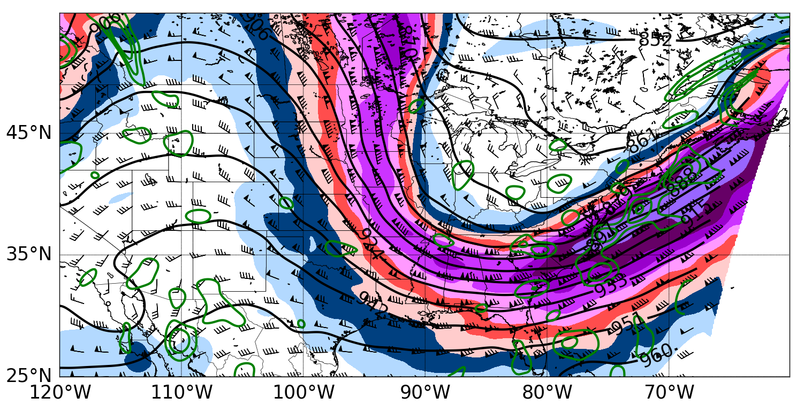
Fig. 12. 300-hPa heights (dam, black contours), divergence (s⁻¹, green contours), ( winds (kt, barbs; pennant, full barb, and half barb denote 50, 10, and 5 kt, respectively), and 300-hPa isotachs (kt, shaded) for 1200 UTC 2 January 2008.

Slide 14
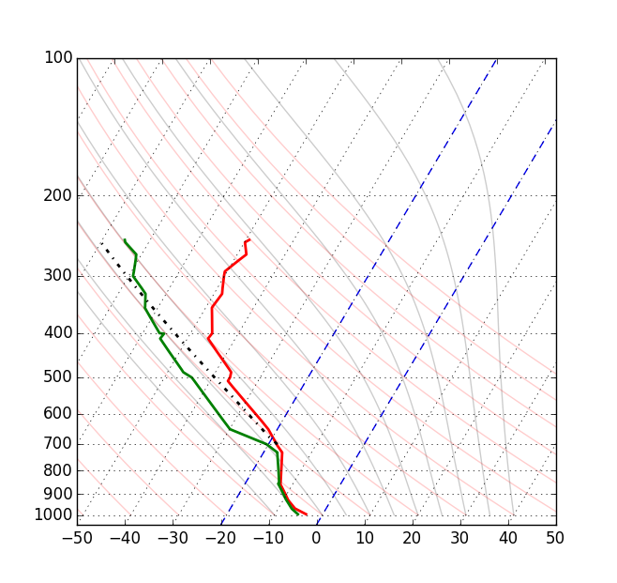
Fig. 13. Same as Fig. 7, except for the observed KALB sounding at 1200 UTC 2 January 2008.

Slide 15
Warm-MHC:
Surface cyclone located in southern Quebec inducing geostrophic southwesterly flow over New York
South-southwesterly wind from 6 to 12 knots at KALB
Low-level warm air advection in the Eastern region of New York ahead of the approaching cold front
Low-level surface convergence
Moist surface, steep mid-level lapse rates and deep layer CAPE
Mid-Level cyclonic vorticity advection
Cold-MHC:
Surface cyclone located just east of Cape Cod inducing geostrophic north/northwesterly flow over New York
Northerly wind from 0 to 13 knots at KALB
Low-level warm air advection
Low-level surface convergence
Saturated boundary layer
Mid-level anticyclonic vorticity advection
Fig. 14. Checklist for forecasters to help determine if Mohawk-Hudson Convergence is probable.

Slide 16
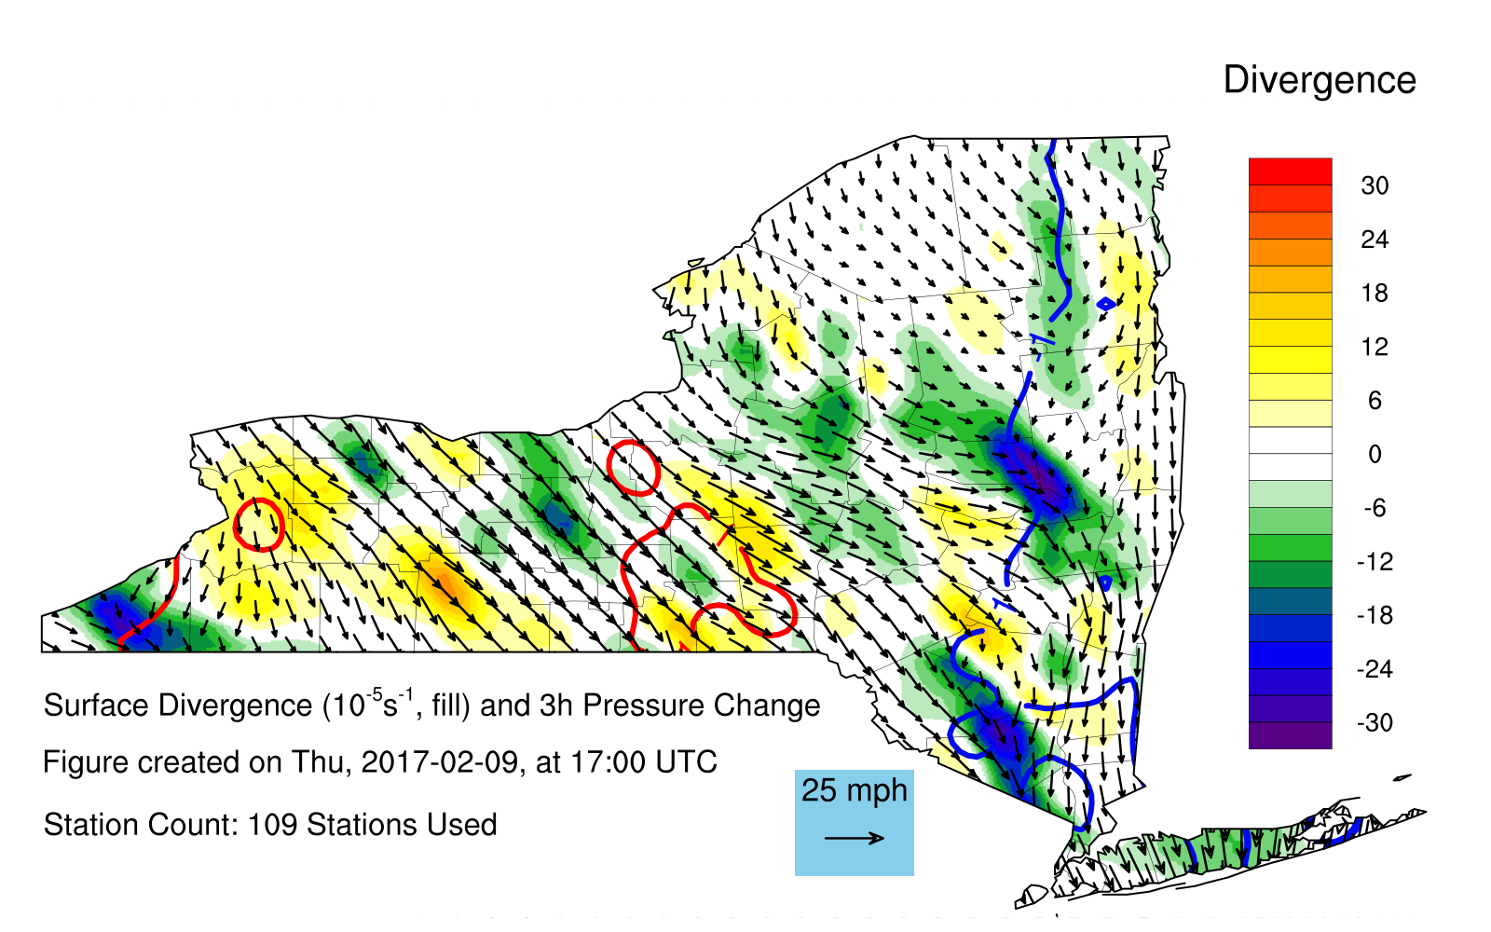
Fig. 15. Surface wind observations (arrows) derived surface convergence (shaded) for the 9 February 2017 case of enhanced cold-MHC

Slide 17
EXTRA FIGURES

Slide 18
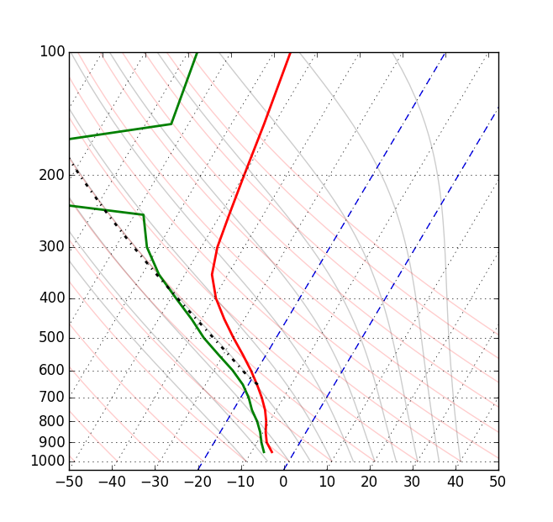
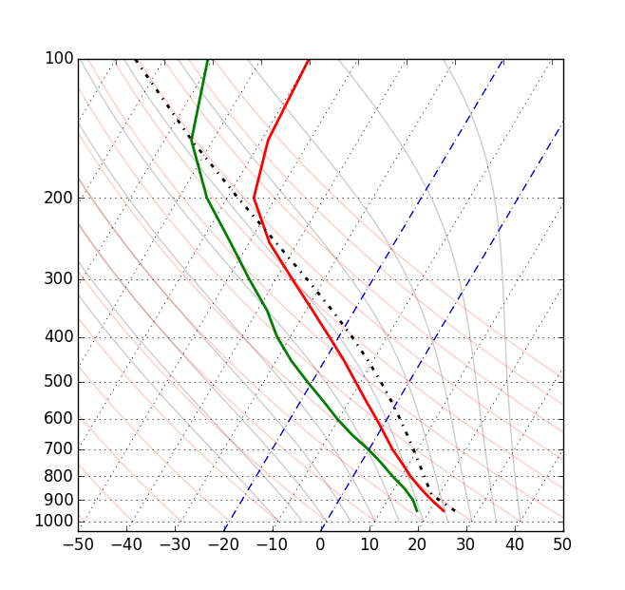
Fig. 12. Composite sounding of cold cases in skew-T-logp format. Plotted with Rapid Update Cycle (RUC) and Rapid Refresh (RAP) data nearest to the maxima of each case. Wind barbs on the right. Full pennant, barb, and half barb denote wind speeds of 50, 10, and 5 knots respectively.
Fig. 14. Composite sounding of warm cases in skew-T-logp format. Plotted with Rapid Update Cycle (RUC) and Rapid Refresh (RAP) data nearest to the maxima of each case. Wind barbs on the right. Full pennant, barb, and half barb denote wind speeds of 50, 10, and 5 knots respectively.

Slide 19
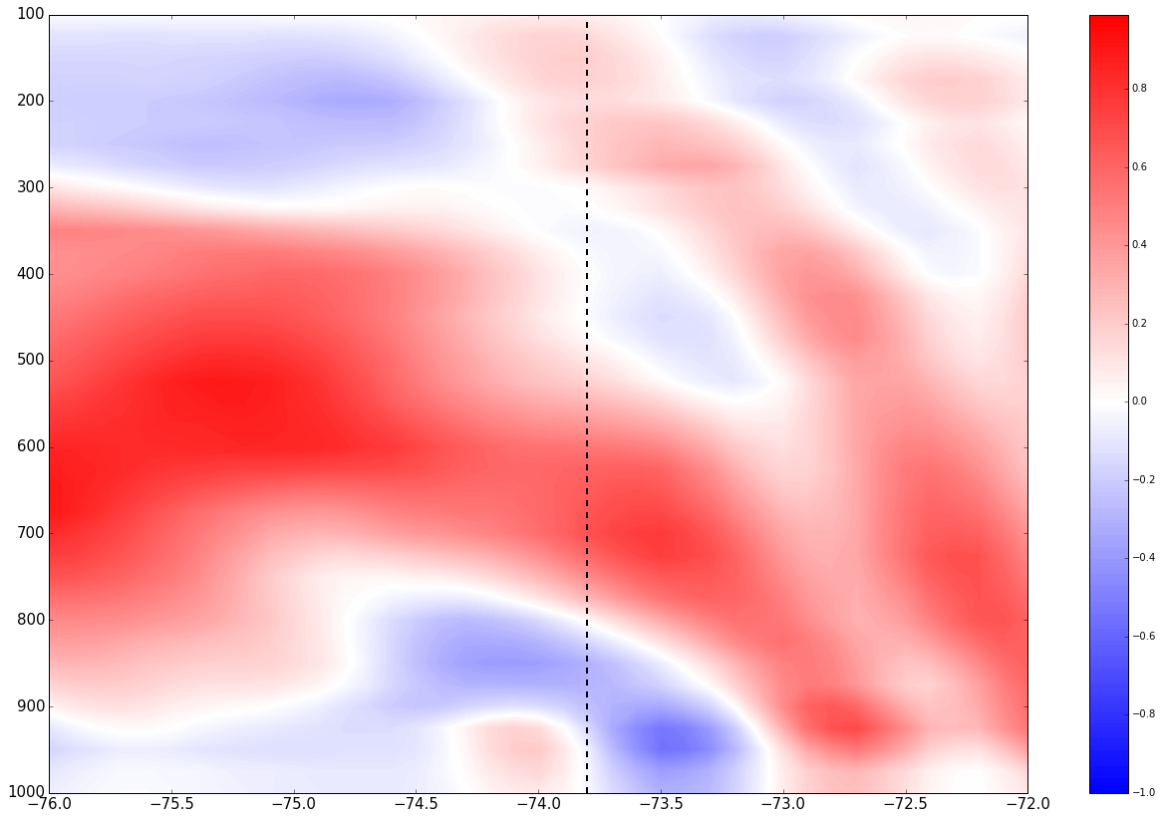
Vertical motion cross section across MHC Case. Dashed line represents the location of KALB.

