Slide 1
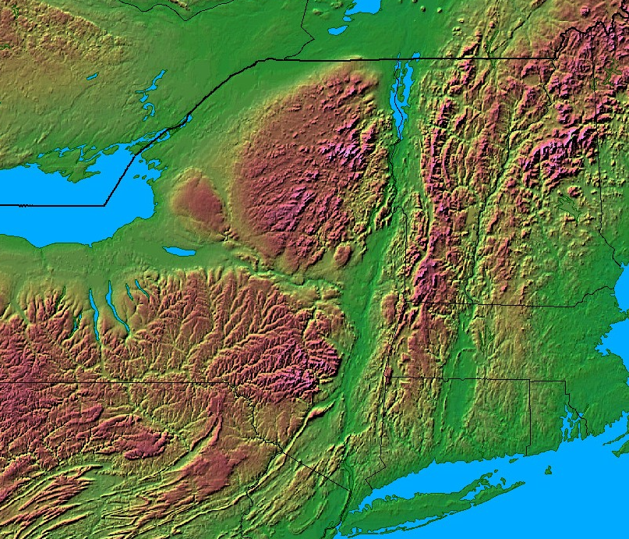
Champlain Valley
Adirondack
Mountains
Green
Mountains
Mohawk Valley
Catskill
Mountains
Berkshire
Mountains
Hudson Valley
Fig. 1. Topographic depiction of eastern New York. The black dot represents the location of Albany, New York. Courtesy of Johns Hopkins University (http://fermi.jhuapl.edu/states/states.html).

Slide 2
Pure Warm Season MHC Events (n=19)
Year | Month | Day | Time of maximum reflectivity (UTC)
2003 | 7 | 24 | 18
 | 8 | 17 | 18
2004 | 5 | 15 | 18
 | 8 | 4 | 00
2005 | 6 | 29 | 18
 | 8 | 1 | 18
2006 | 6 | 1 | 18
 |  | 19 | 18
 |  | 29 | 18
 | 9 | 9 | 18
2010 | 7 | 21 | 18
2011 | 6 | 1 | 18
 |  | 8 | 18
 |  | 25 | 18
 | 7 | 13 | 18
 | 9 | 4 | 18
2012 | 5 | 29 | 18
 | 7 | 23 | 18
2014 | 8 | 5 | 18
Pure Cold Season MHC Events (n=12)
Year | Month | Day | Time of maximum reflectivity (UTC)
2002 | 11 | 27 | 18
 | 12 | 16 | 00
2003 | 1 | 24 | 00
2005 | 1 | 17 | 12
2007 | 1 | 29 | 06
 | 2 | 23 | 06
2008 | 1 | 2 | 12
 | 12 | 19 | 12
 |  | 31 | 18
2011 | 1 | 12 | 18
 | 10 | 30 | 06
2013 | 9 | 13 | 18
Table. 2. Dates and time of maximum reflectivity for cold-MHC events.
Table. 1. Dates and time of maximum reflectivity for warm-MHC events.

Slide 3
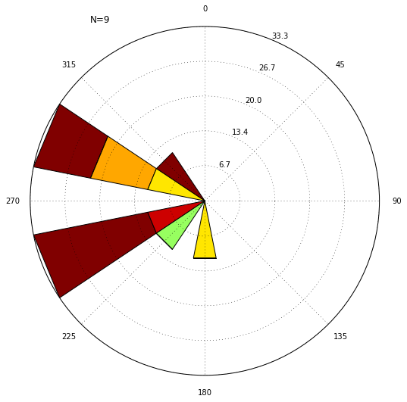
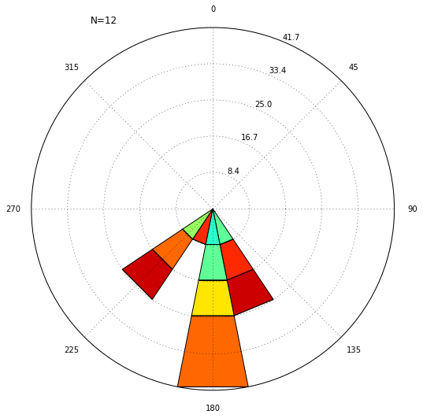
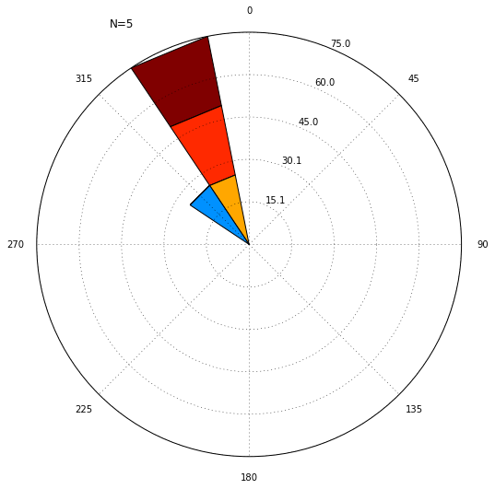
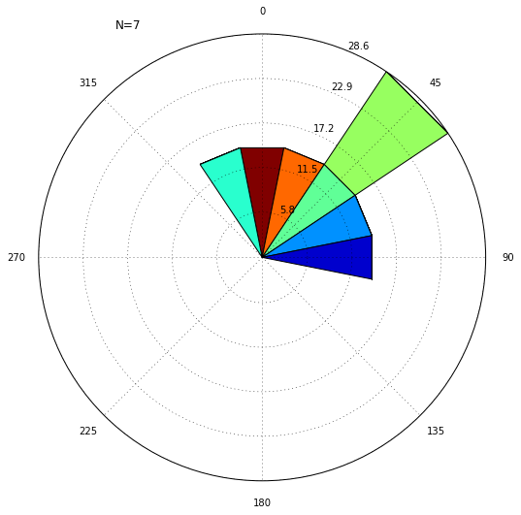
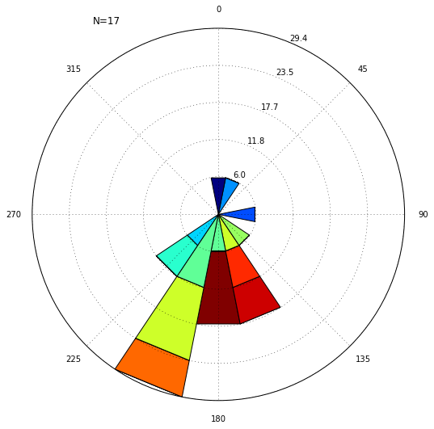
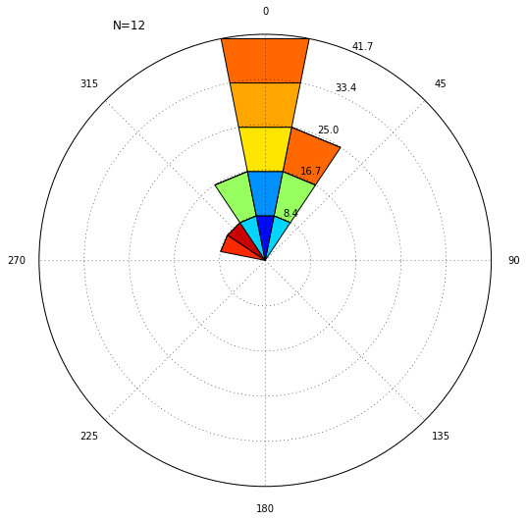
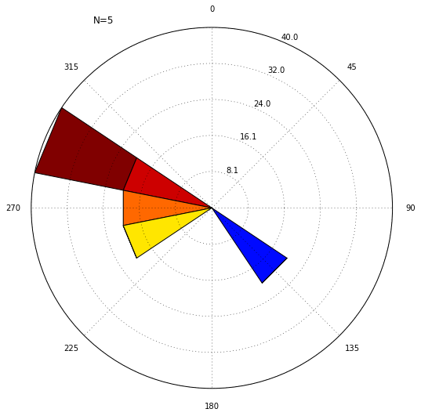
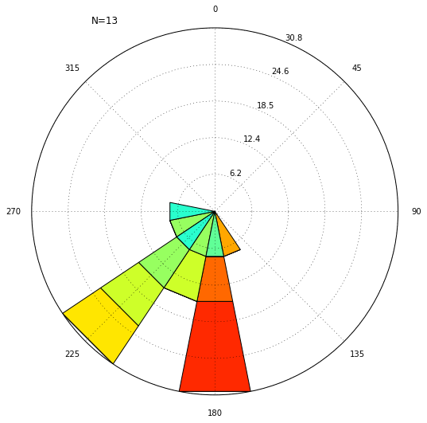
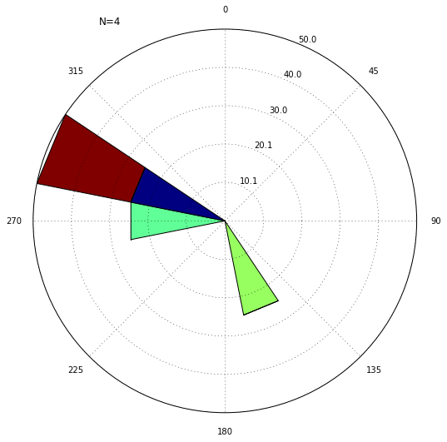
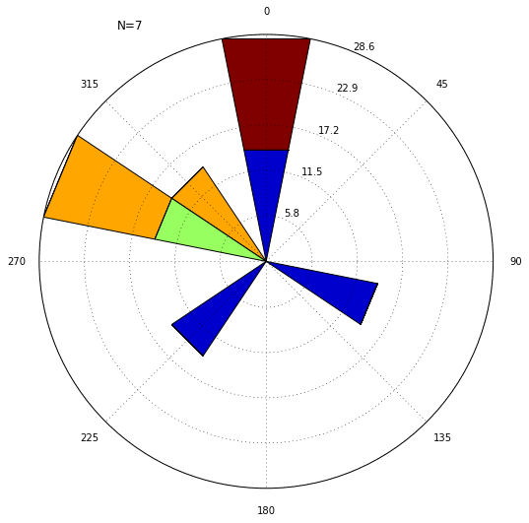
a)
N=9
N=12
b)
N=5
N=7
KRME
KGFL
KRME
KGFL
N=17
N=12
KALB
KALB
N=5
N=13
N=4
N=7
KUCA
KPOU
KUCA
KPOU
0
1
2
3
4
5
6
7
8
9
10
11
12
13
14
>15
Fig. 2. Wind roses for warm- and cold-MHC cases created from ASOS data. Shaded bars represent the wind magnitude and the radial units show the percentage of occurrence for each wind direction.

Slide 4
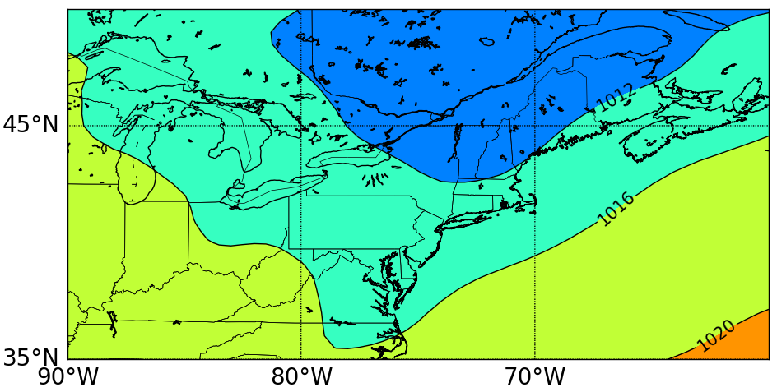
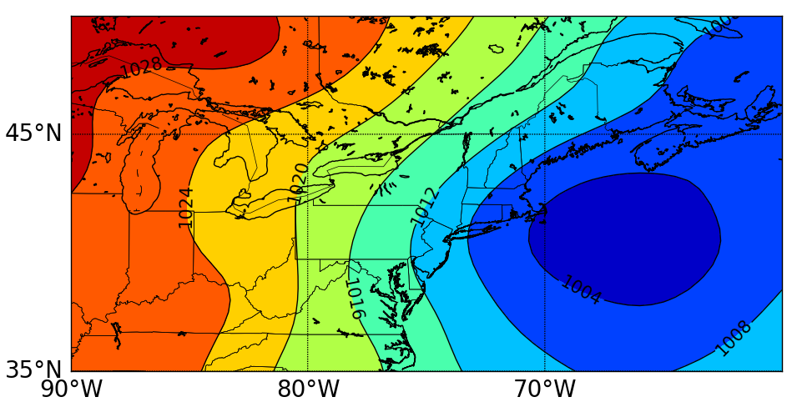
a)
Fig. 3. Composite mean sea-level pressure (hPa) for a) warm- and b) cold-MHC cases.
b)

Slide 5
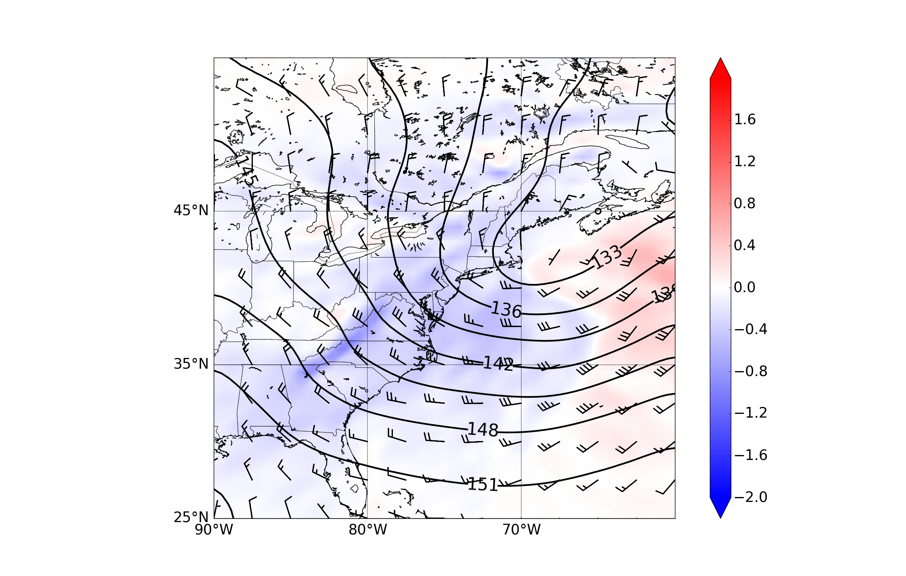
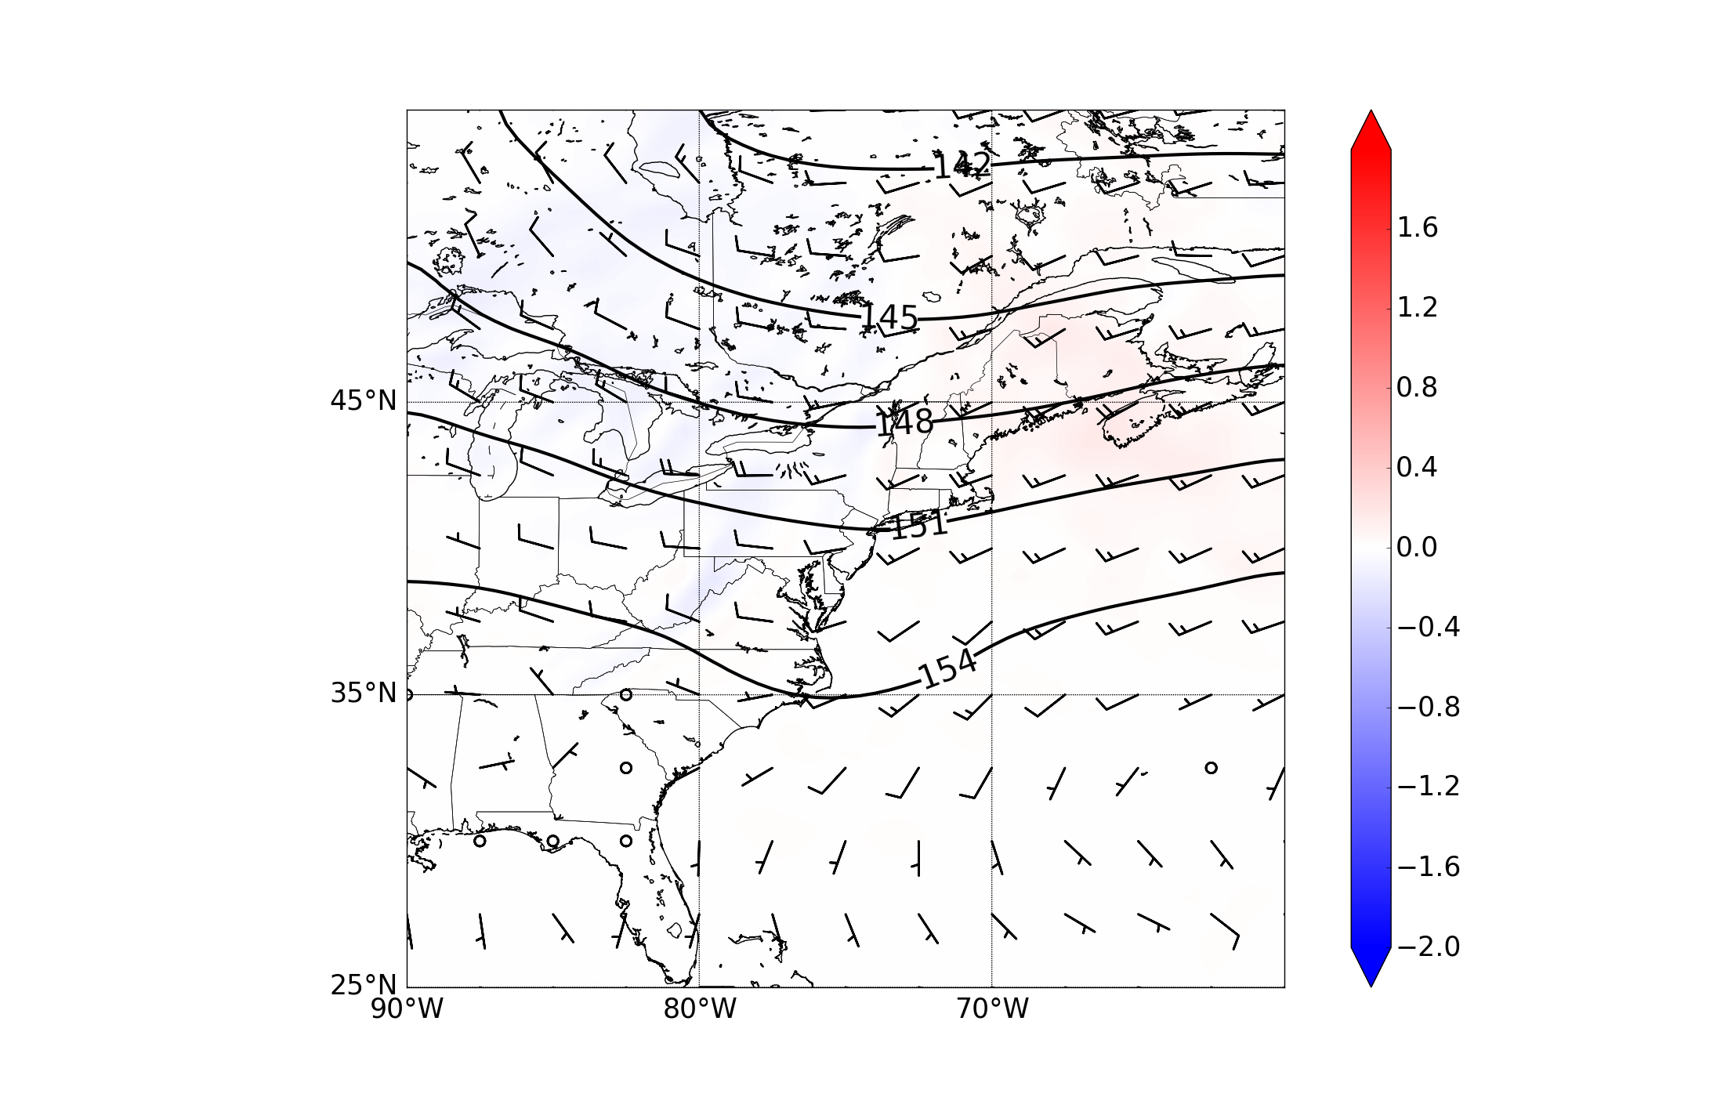
a)
b)
Fig. 4. Composite 850-hPa heights (dam, contours), winds (kt, barbs; pennant, full barb, and half barb denote 50, 10, and 5 kt, respectively), and 850-hPa temperature advection (x 10⁻² °C h⁻¹ , shaded) for a) warm- and b) cold-MHC cases.

Slide 6
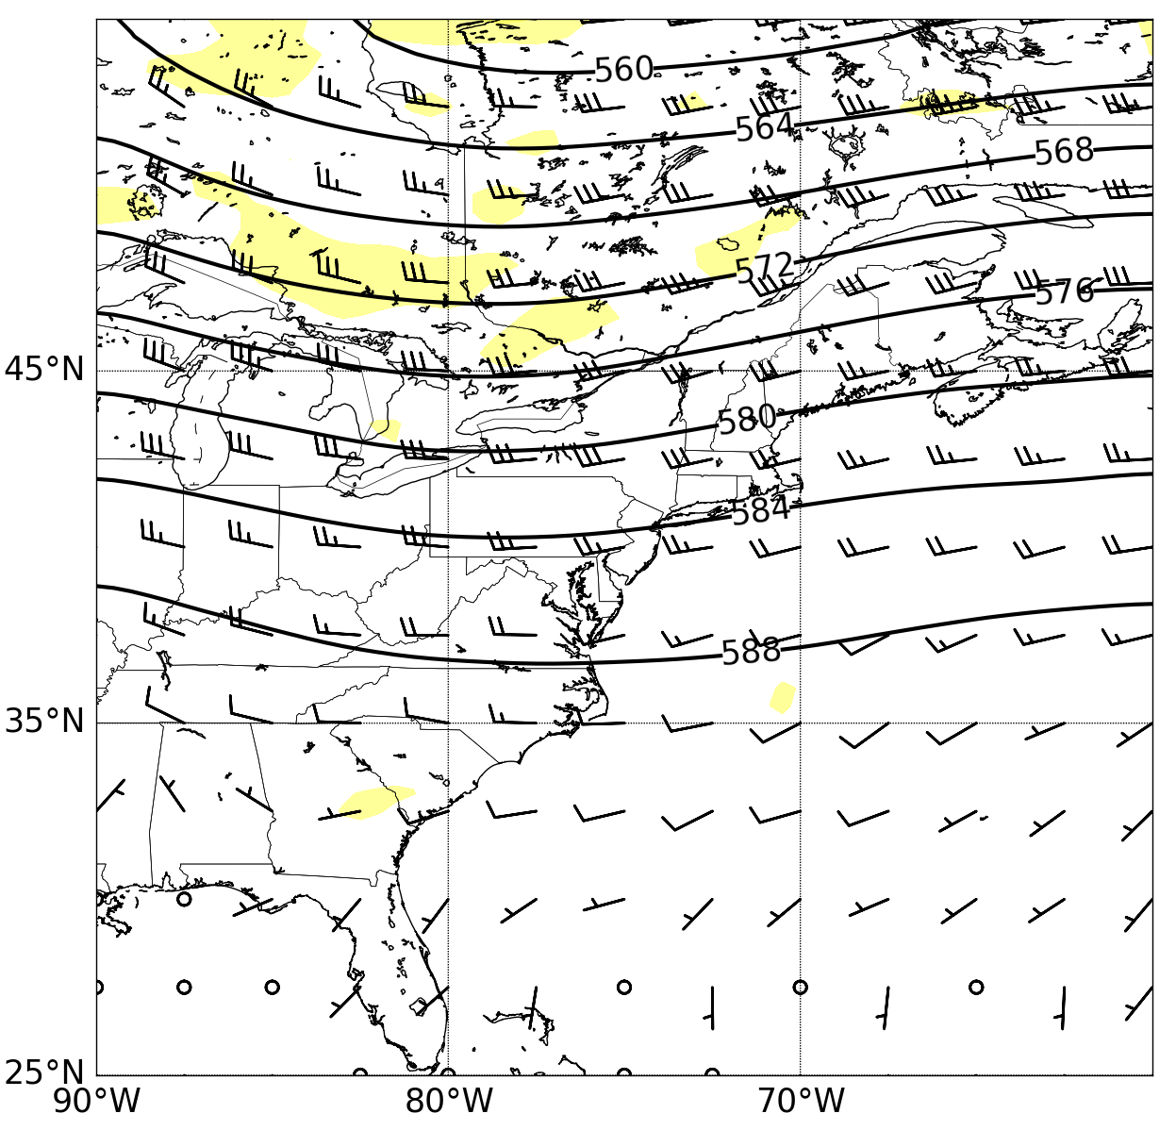
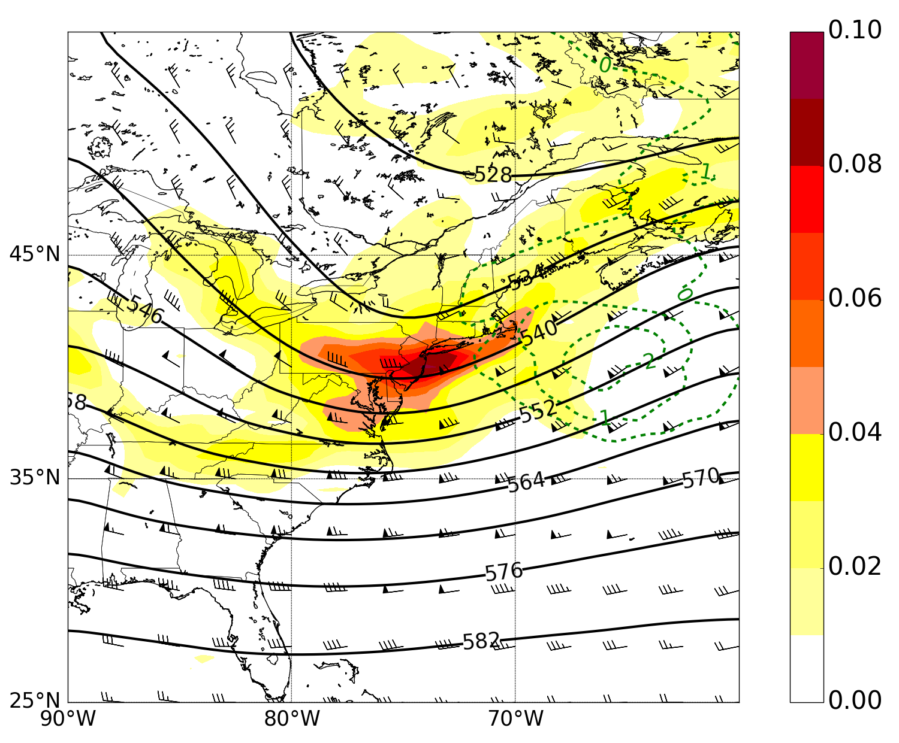
a)
b)
Fig. 5. Composite 500-hPa heights (dam, contours), 700–300-hPa thickness (dam, dashed), winds (kt, barbs; pennant, full barb, and half barb denote 50, 10, and 5 kt, respectively), 500-hPa relative vorticity advection (x 10⁻¹⁰ s⁻¹, dashed) and 500-hPa relative vorticity (x 10⁻⁵ s⁻¹, shaded) for a) warm- and b) cold-MHC cases.

Slide 7
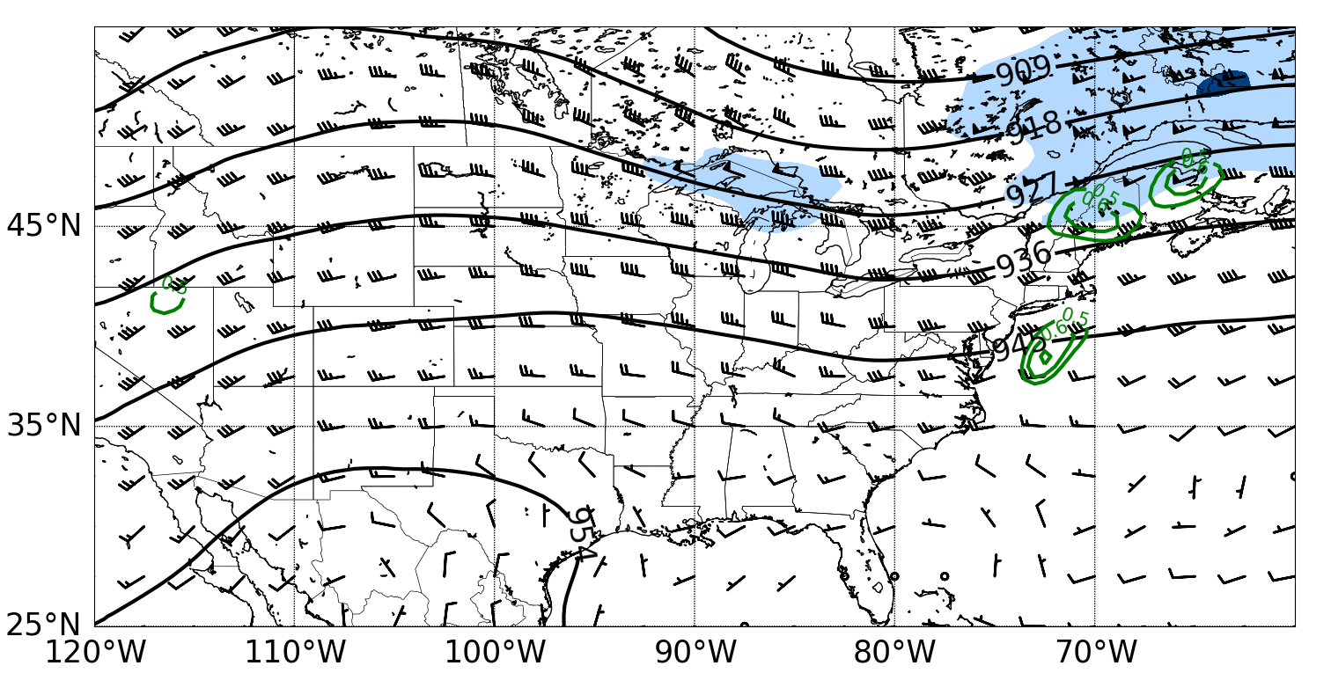
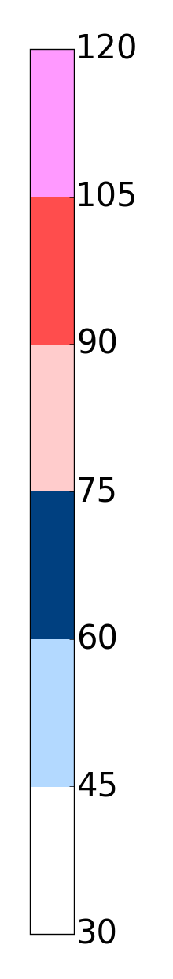
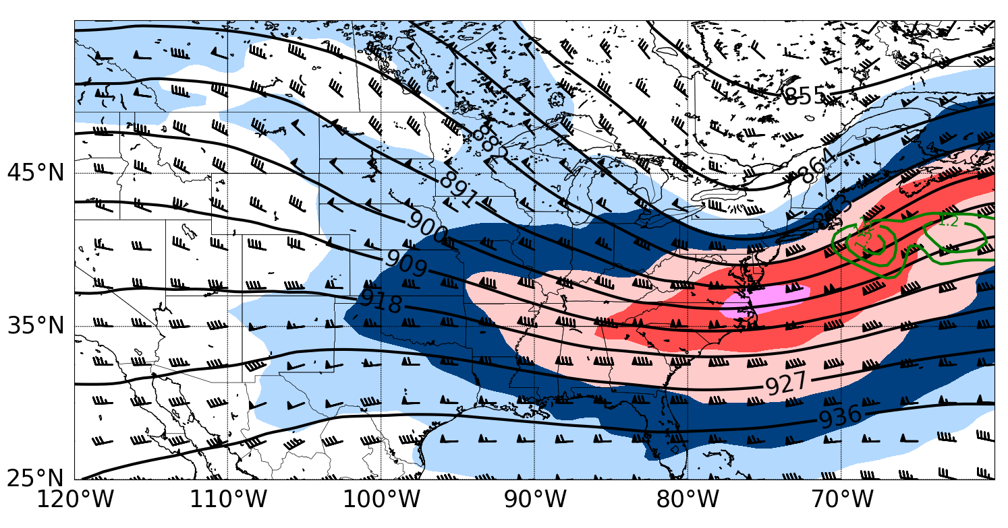
a)
Fig. 6. Composite 300-hPa heights (dam, black contours), divergence (x 10⁻⁷ s⁻¹, green contours), winds (kt, barbs; pennant, full barb, and half barb denote 50, 10, and 5 kt, respectively), and 300-hPa isotachs (kt, shaded) for a) warm- and b) cold-MHC cases.
b)

Slide 8
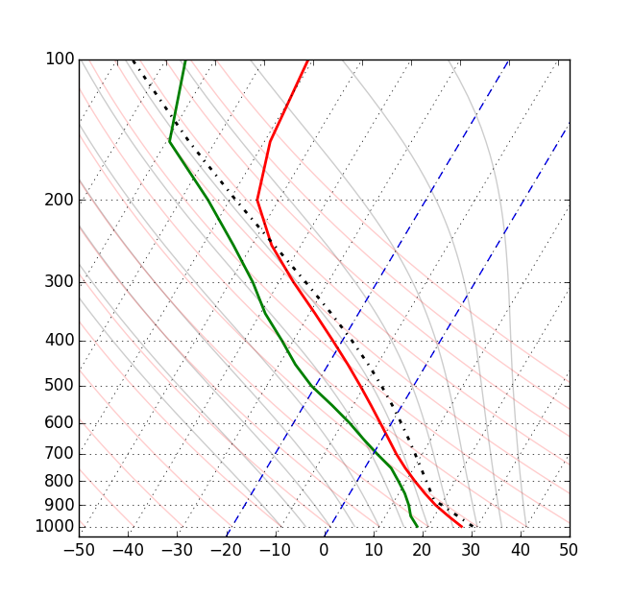

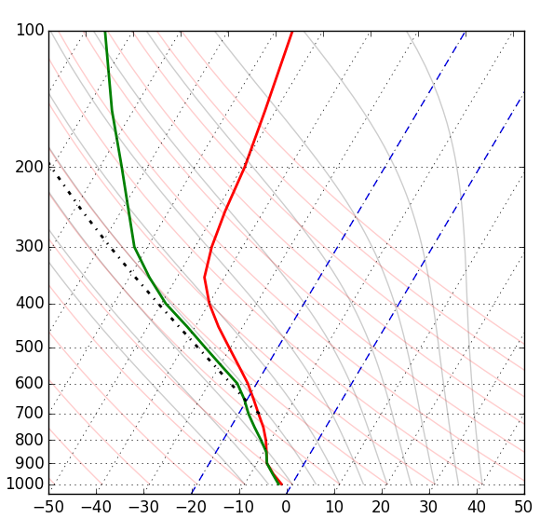
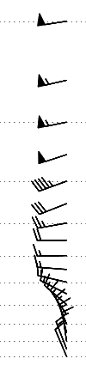
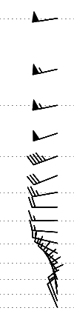
a)
b)
Fig. 7. Composite soundings for a) warm- and b) cold-MHC cases. Temperature (°C, red), dew point (°C, green), and winds (kt; full pennant, barb, and half barb denote wind speeds of 50, 10, and 5 kt, respectively).

Slide 9
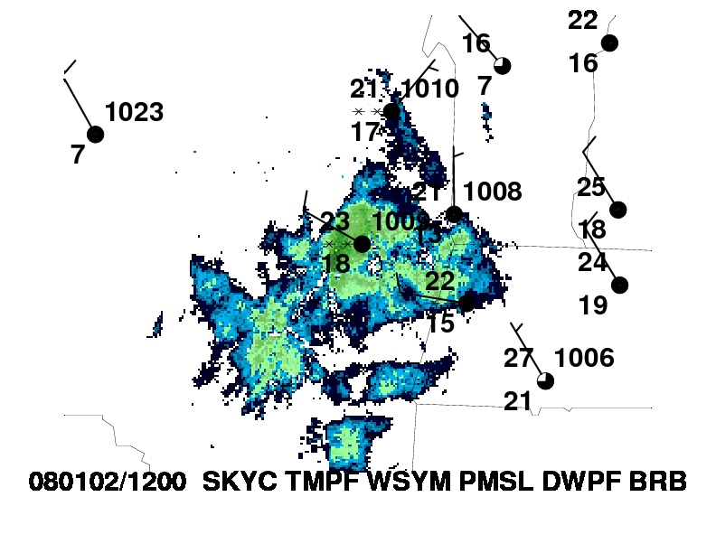
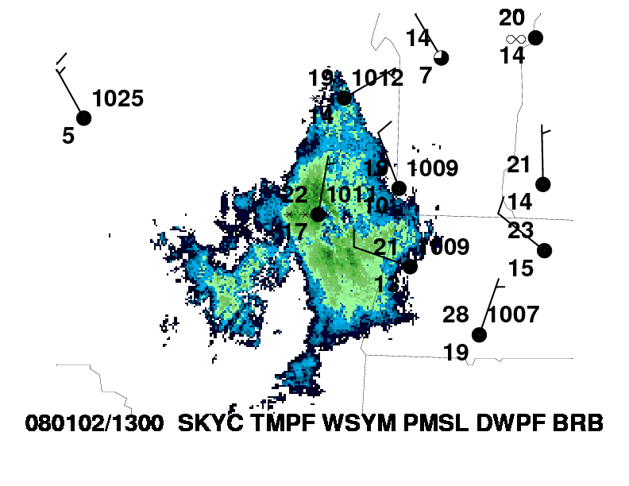
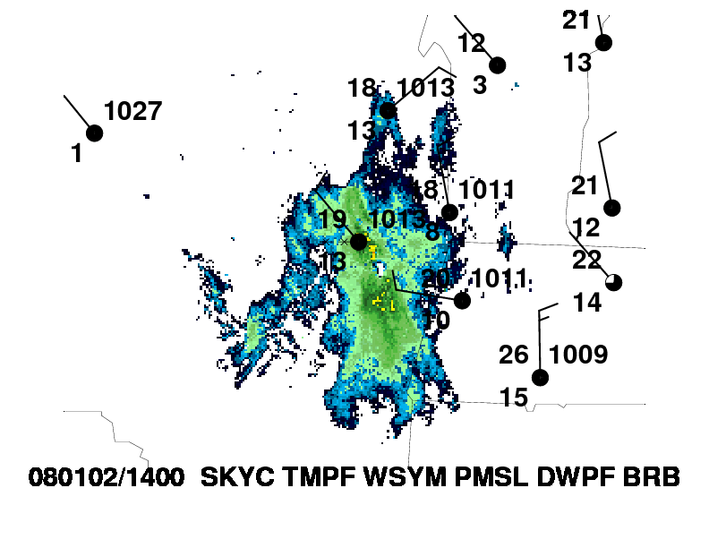
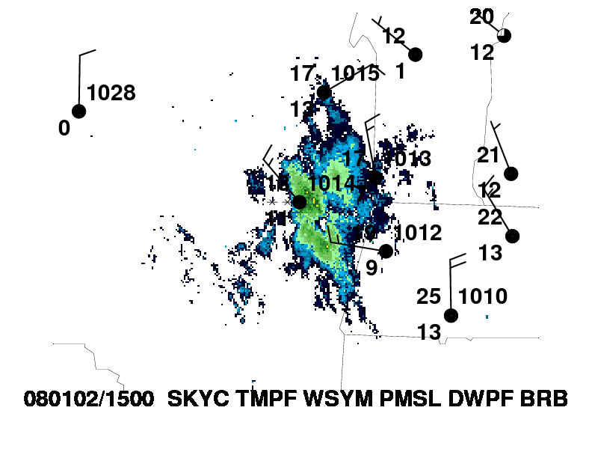
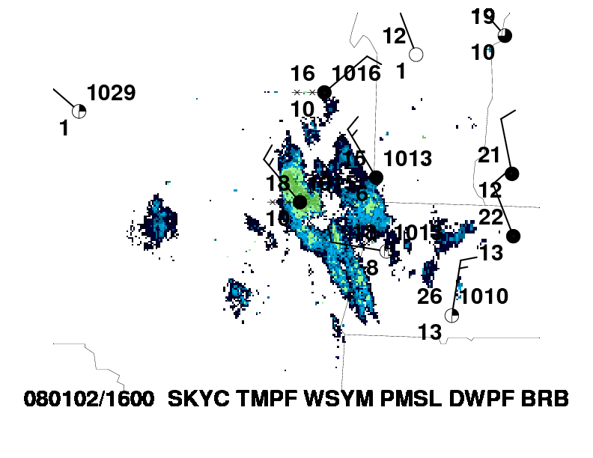
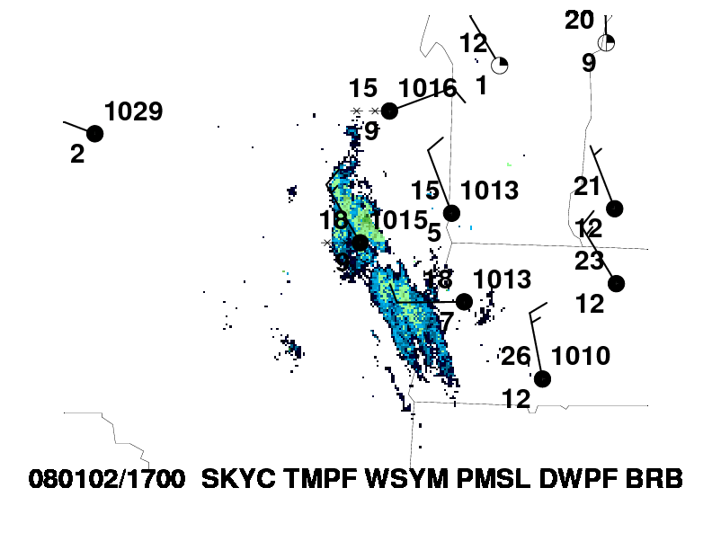
a
b
c
d
e
f
Fig. 8. Surface observations with KENX radar during the cold-MHC event on 02 January 2008. Cohoes, NY is labeled marked by the red dot.

Slide 10
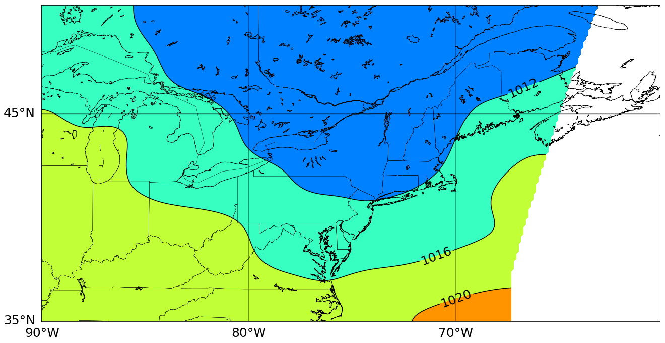
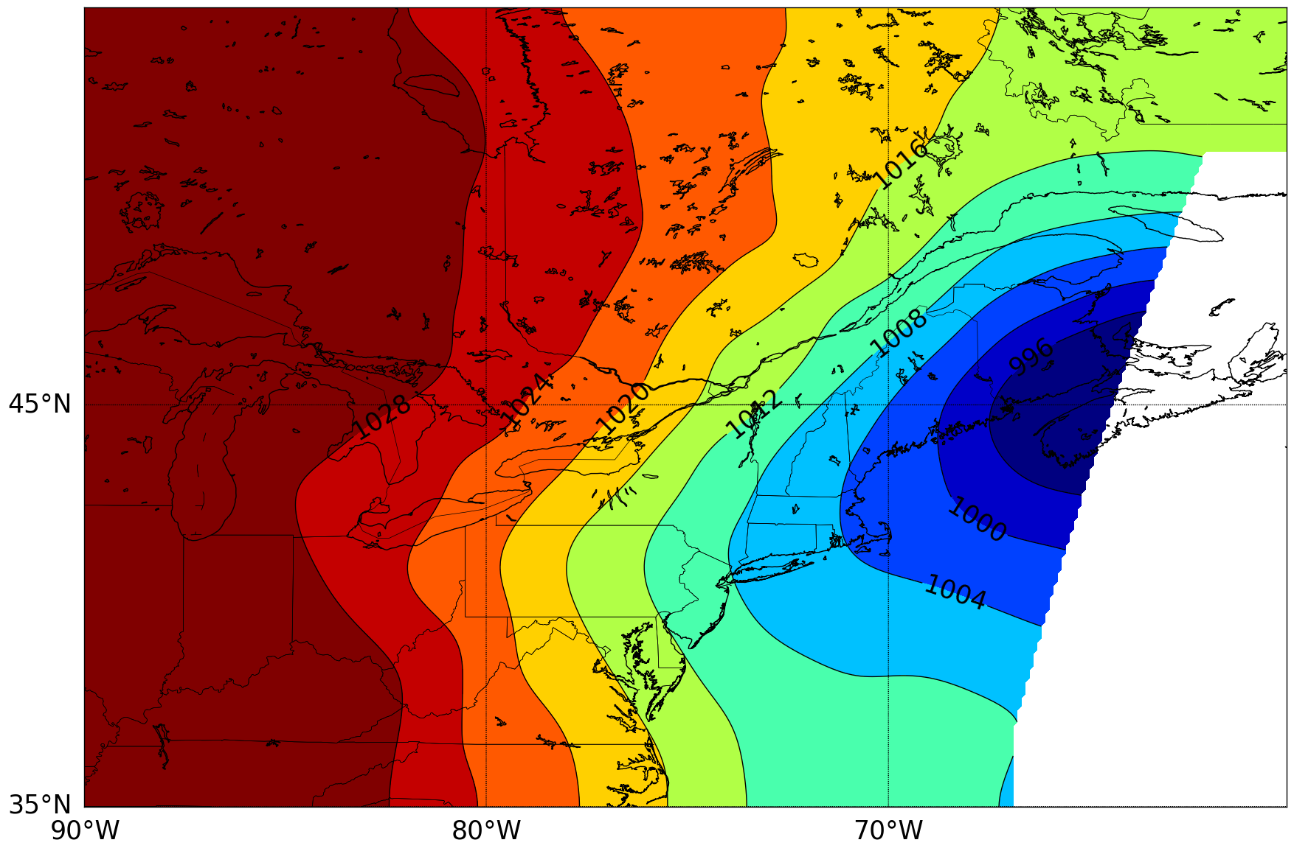
a)
1010 hPa
L
Fig. 9. Mean sea level pressure (hPa), surface low locations denoted from WPC surface analysis at a) 1800 UTC 21 July 2010 1200 UTC and b) 2 January 2008 .
b)
986 hPa
L

Slide 11
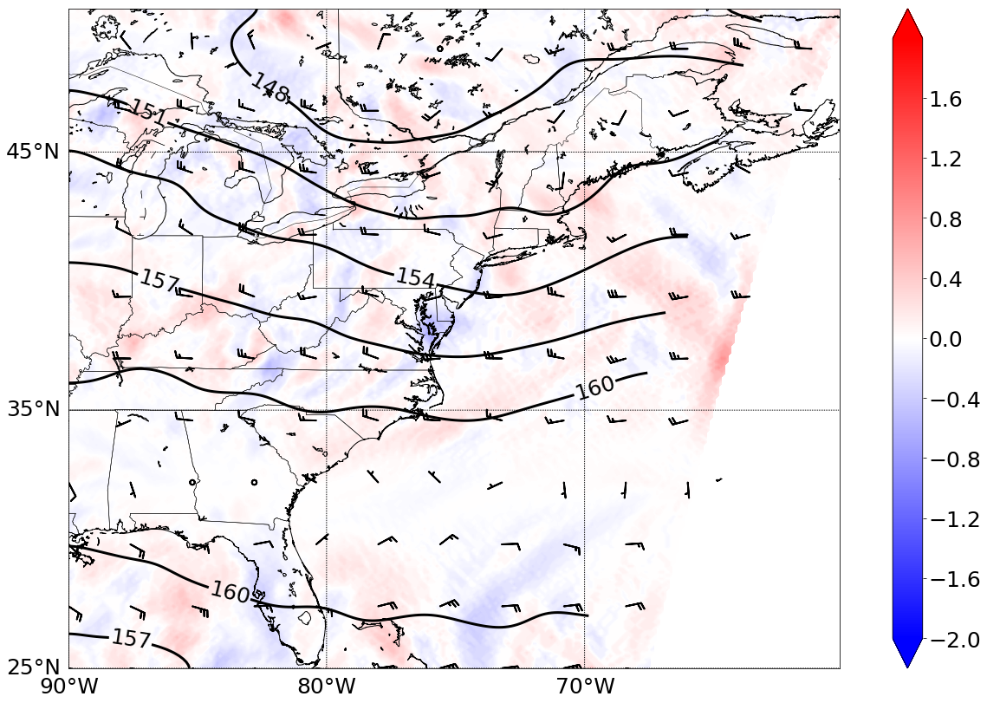
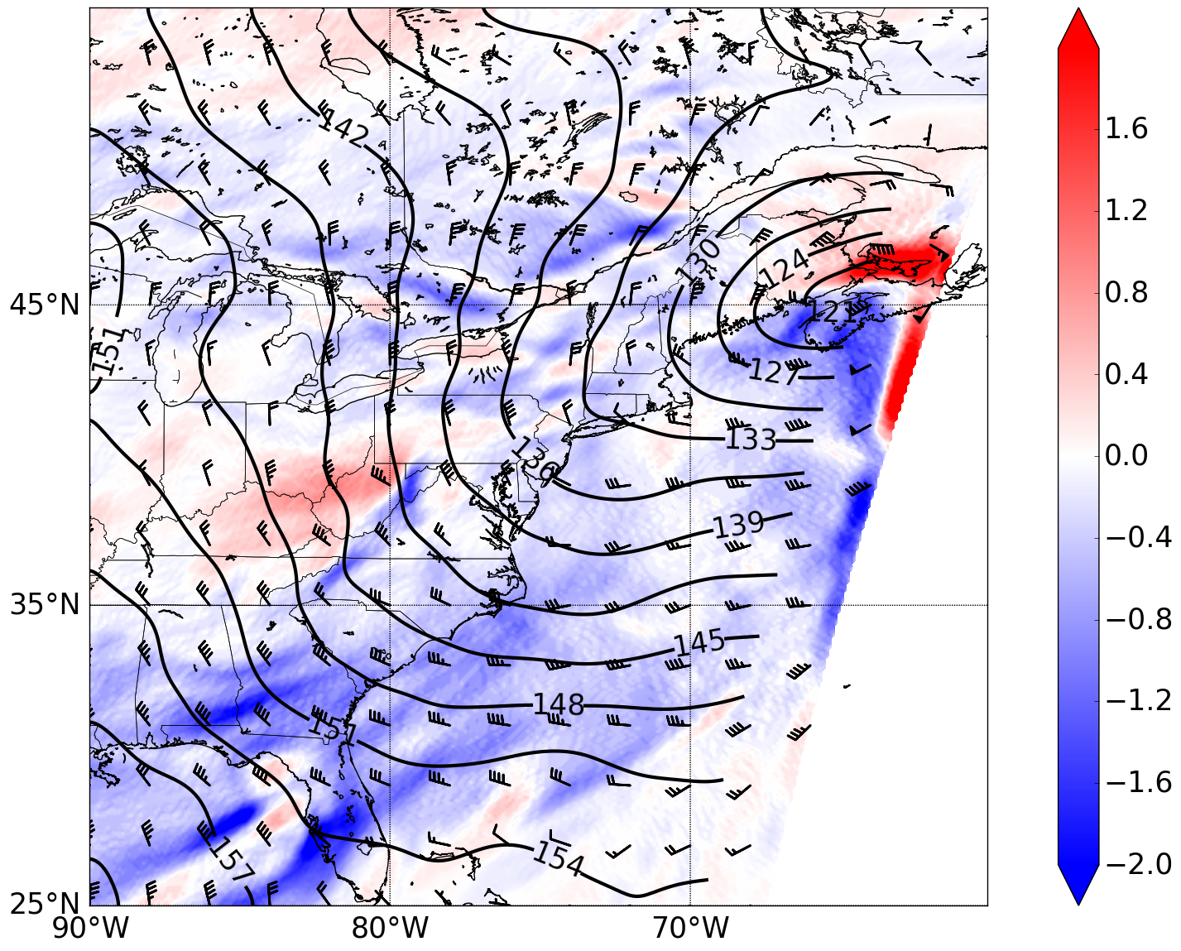
a)
b)
Fig. 10. 850-hPa heights (dam, contours), winds (kt, barbs; pennant, full barb, and half barb denote 50, 10, and 5 kt, respectively), and 850-hPa temperature advection (°C h⁻¹ , shaded) at a) 1800 UTC 21 July 2010 and b)1200 UTC 2 January 2008.

Slide 12
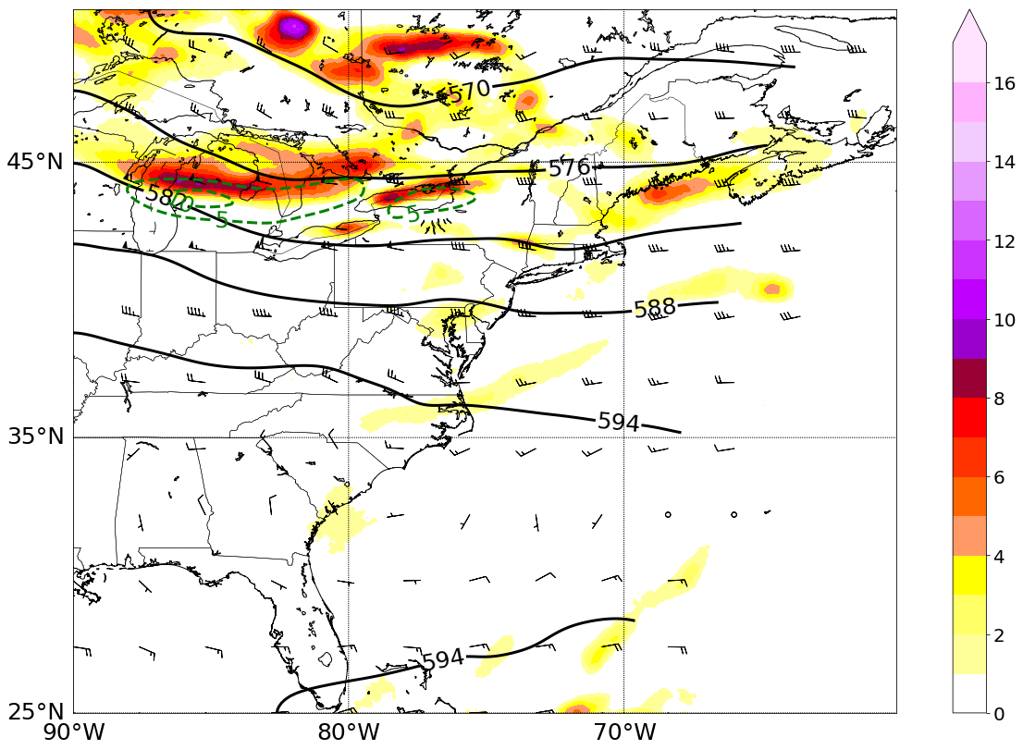
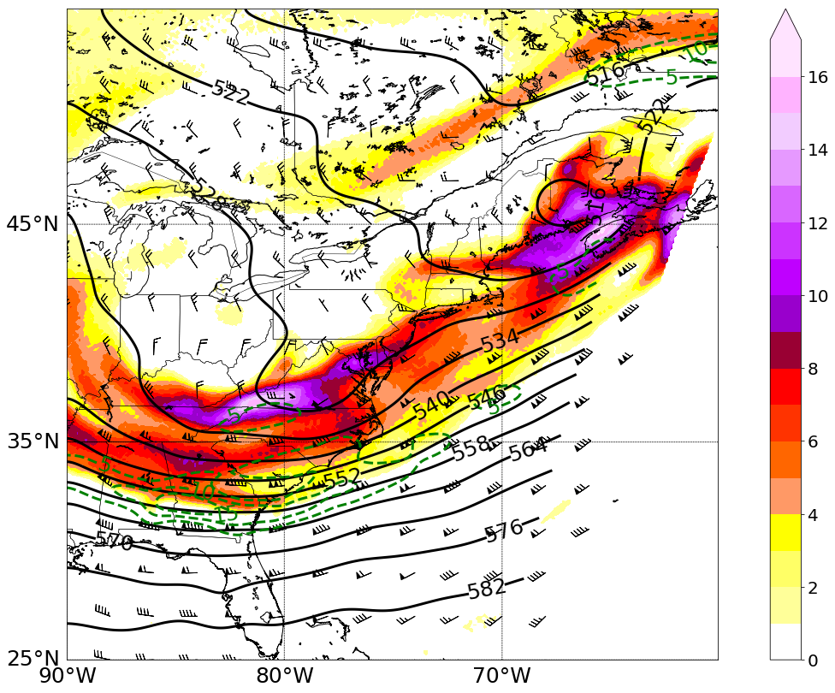
a)
b)
Fig. 11. 500-hPa heights (dam, contours), 700-300 hPa thickness (dam, dashed), winds (kt, barbs; pennant, full barb, and half barb denote 50, 10, and 5 kt, respectively), 500-hPa relative vorticity advection (x 10⁻¹⁰ s⁻¹ ,dashed) and 500-hPa relative vorticity (x 10⁻⁵ s⁻¹, shaded) at a) 1800 UTC 21 July 2010 and b)1200 UTC 2 January 2008.

Slide 13
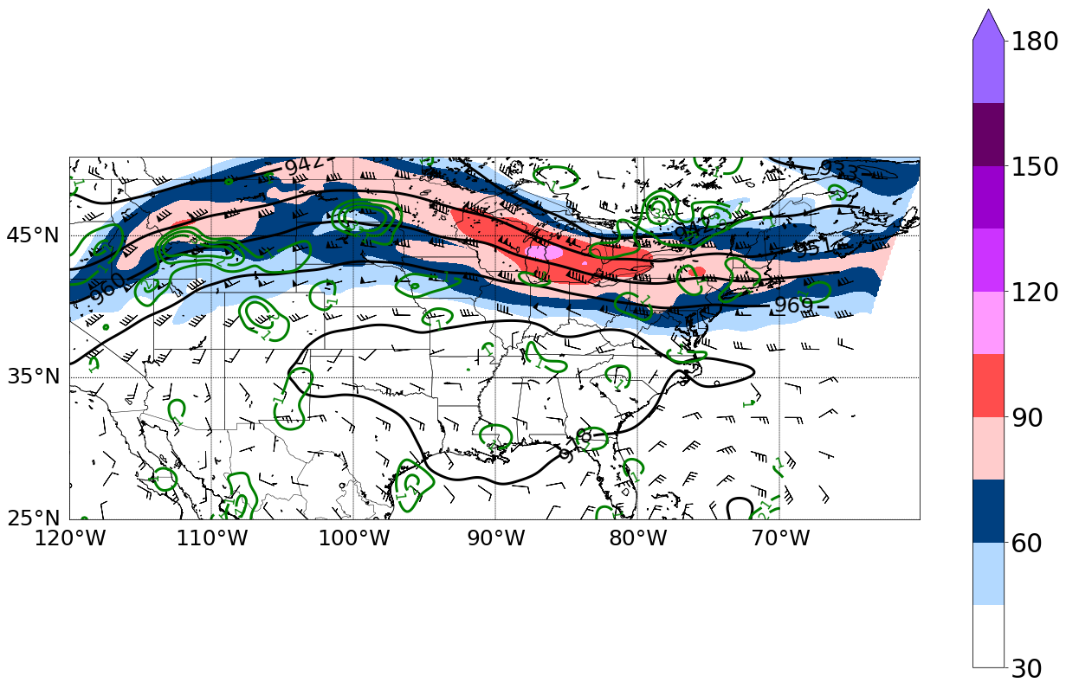
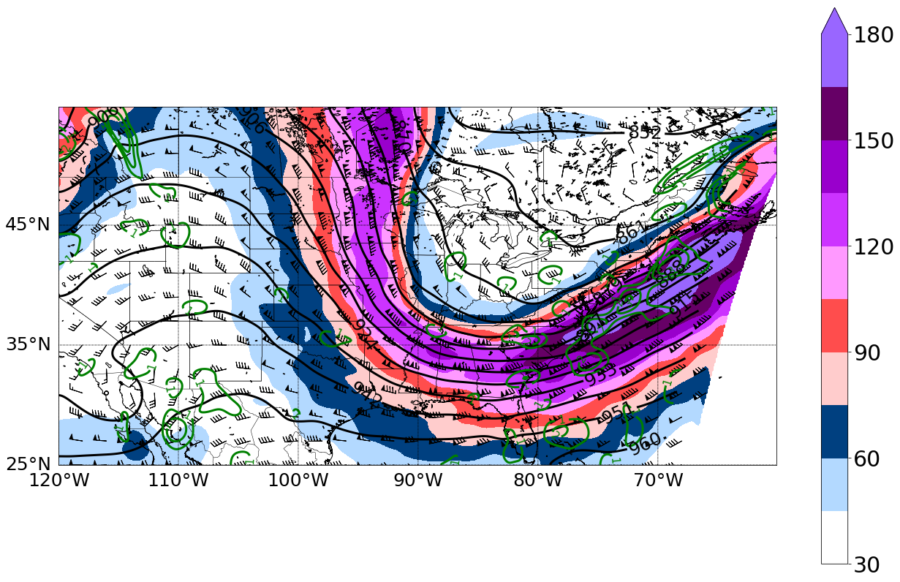
a)
Fig. 12. 300-hPa heights (dam, black contours), divergence (x 10⁻⁵ s⁻¹, green contours), ( winds (kt, barbs; pennant, full barb, and half barb denote 50, 10, and 5 kt, respectively), and 300-hPa isotachs (kt, shaded) at a) 1800 UTC 21 July 2010 and b)1200 UTC 2 January 2008.
b)

Slide 14
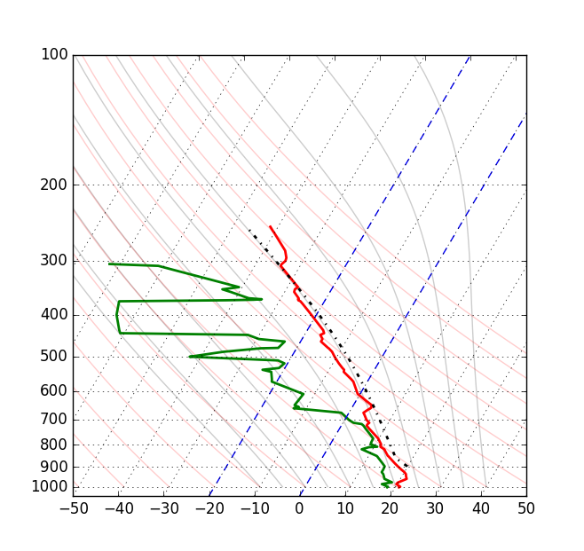
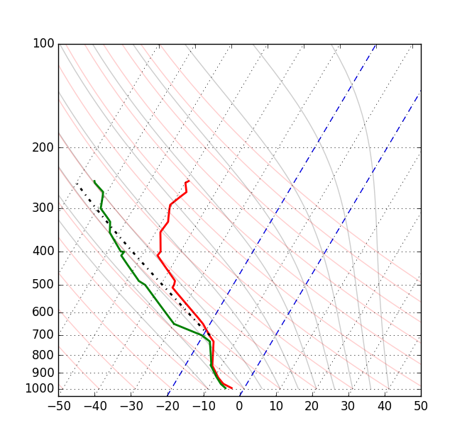
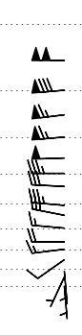
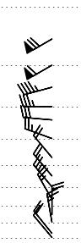
a)
b)
Fig. 13. Same as Fig. 7, except for the observed KALB sounding at 1200 UTC 21 July 2010 and b) 1200 UTC 2 January 2008.

Slide 15
Warm-MHC:
Broad, weak, surface cyclone located in southern Quebec or Western New York inducing geostrophic southwesterly flow over New York
Weak to moderate south-southwesterly wind at KALB
Low-level warm air advection in the Eastern region of New York ahead of the approaching cold front or prefrontal trough
Low-level surface convergence at the junction of the Mohawk and Hudson River valleys
Cold-MHC:
Surface cyclone located just east of Cape Cod inducing geostrophic north-northeasterly flow over New York
Weak to moderate northerly wind at KALB
Low-level warm air advection, possibly a result of down-slope flow off the Adirondack Mountains
Low-level surface convergence at the junction of the Mohawk and Hudson River valleys
Saturated boundary layer
Mid-level anticyclonic vorticity advection
Fig. 14. Checklist for forecasters to help determine if the synoptic-scale conditions favorable for Mohawk–Hudson convergence are present.

Slide 16
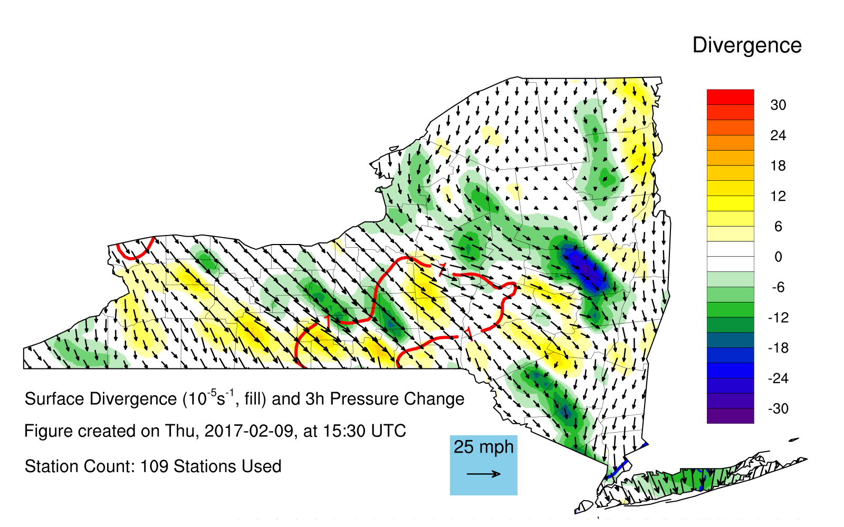
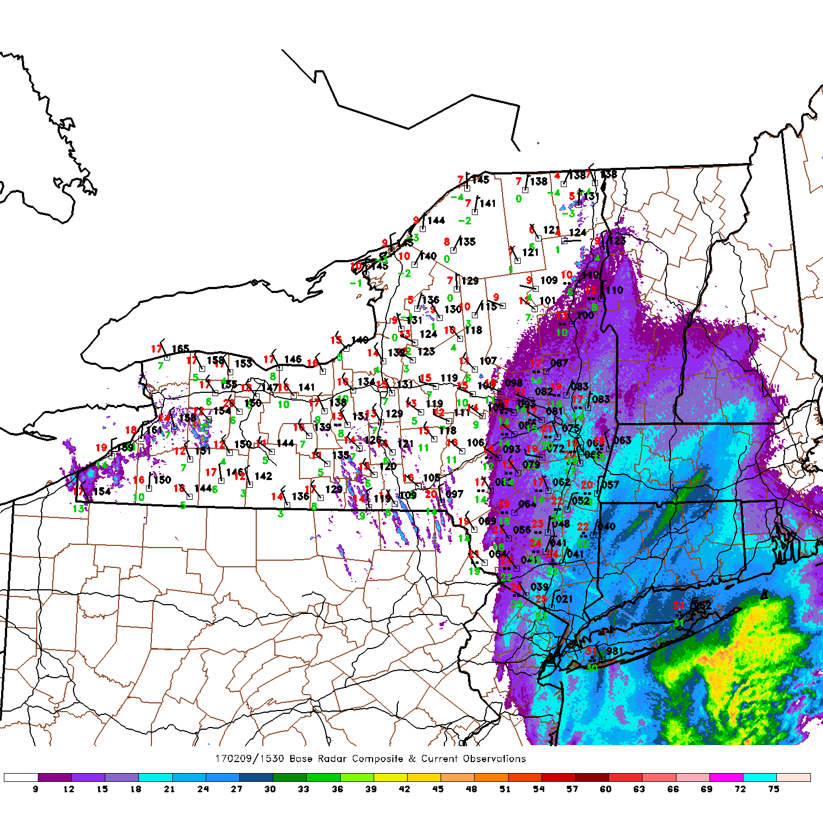
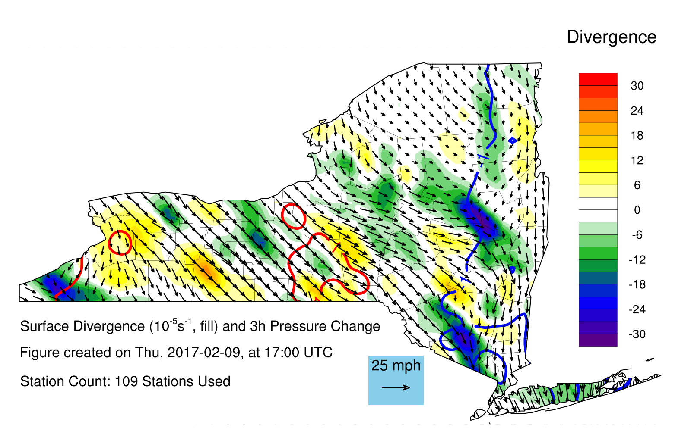
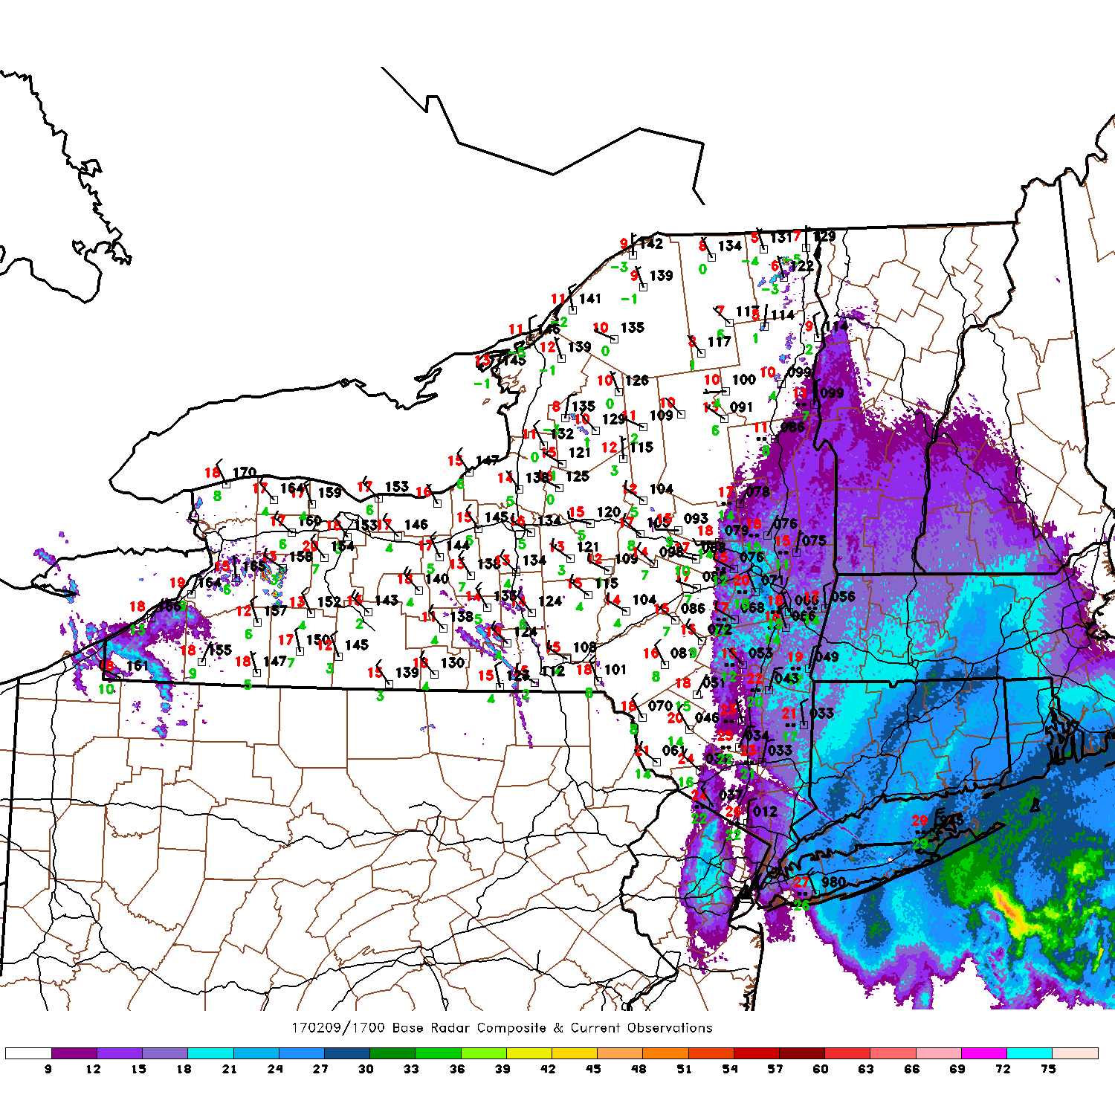
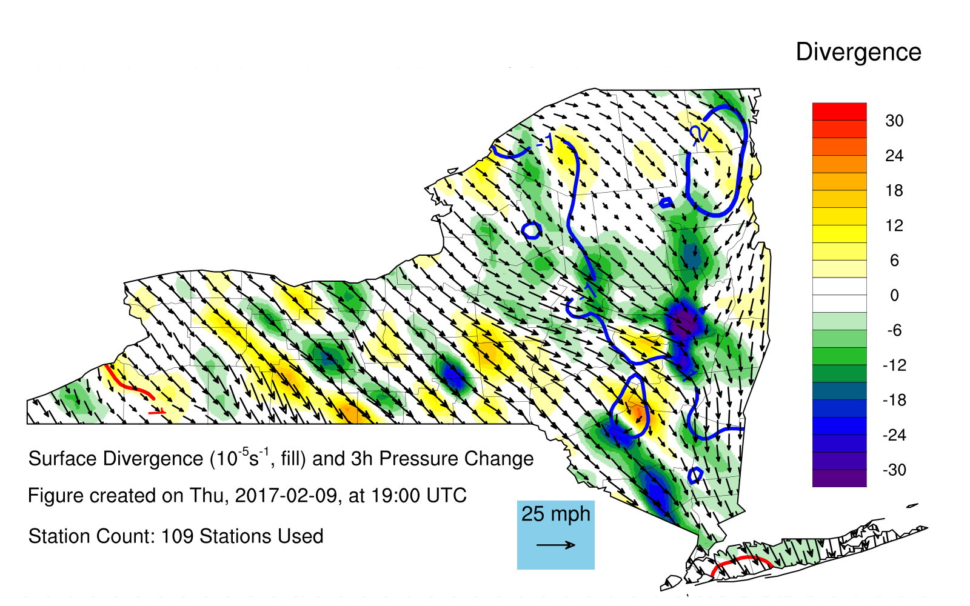
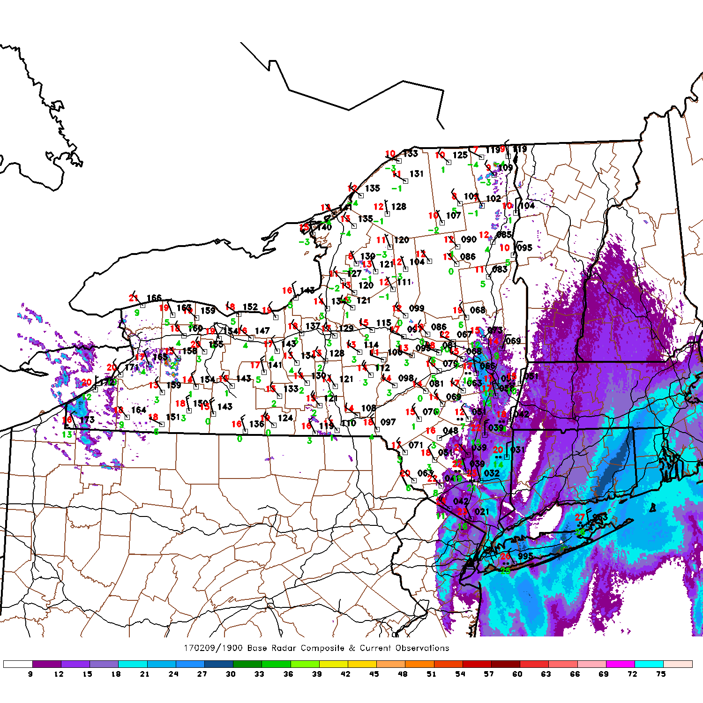
Fig. 15. Surface wind observations (arrows), derived surface convergence (shaded), and three hour pressure change (contoured) (left) and radar with surface observations (right) for the 9 February 2017 case of enhanced cold-MHC.

Slide 17
EXTRA FIGURES

Slide 18
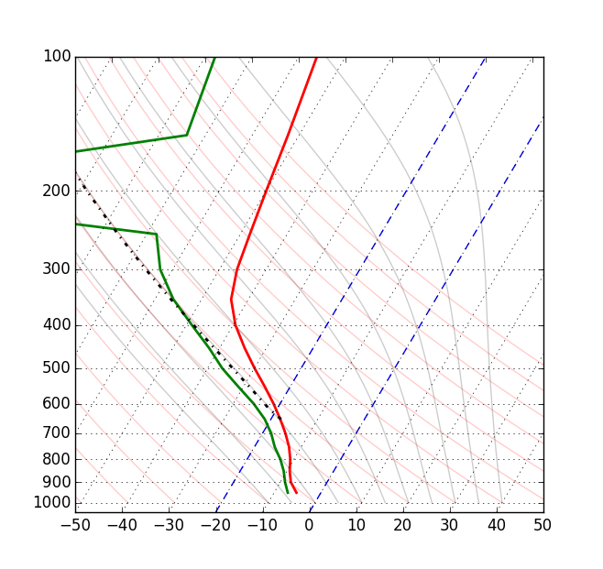
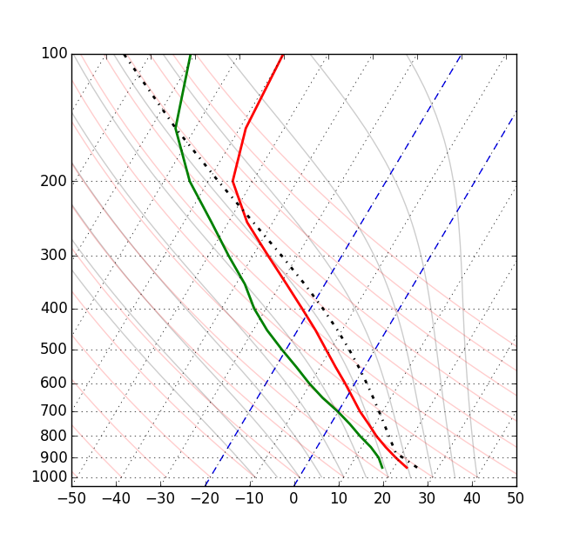


Fig. 12. Composite sounding of cold cases in skew-T-logp format. Plotted with Rapid Update Cycle (RUC) and Rapid Refresh (RAP) data nearest to the maxima of each case. Wind barbs on the right. Full pennant, barb, and half barb denote wind speeds of 50, 10, and 5 knots respectively.
Fig. 14. Composite sounding of warm cases in skew-T-logp format. Plotted with Rapid Update Cycle (RUC) and Rapid Refresh (RAP) data nearest to the maxima of each case. Wind barbs on the right. Full pennant, barb, and half barb denote wind speeds of 50, 10, and 5 knots respectively.

Slide 19

Vertical motion cross section across MHC Case. Dashed line represents the location of KALB.

Slide 20
Warm MHC Composite Sounding
Cold MHC Composite Sounding

Slide 21



