Slide 1

Precipitation events associated with terrain-generated convergence in the Mohawk and Hudson River valleys of New York
Motivation
Introduction
Methodology
Results
Conclusion
Dylan Card, Kristen L. Corbosiero, and Ross Lazear
University at Albany, State University of New York
Albany, New York
Hugh Johnson
National Weather Service Forecast Office
Albany, New York
Michael Augustyniak
WCCO
Minneapolis, MN
Tropical Dynasty March 20, 2017

Slide 2
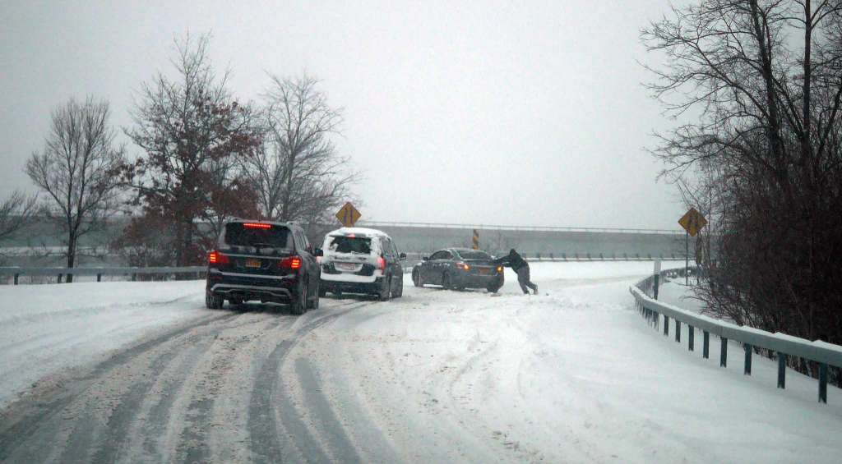
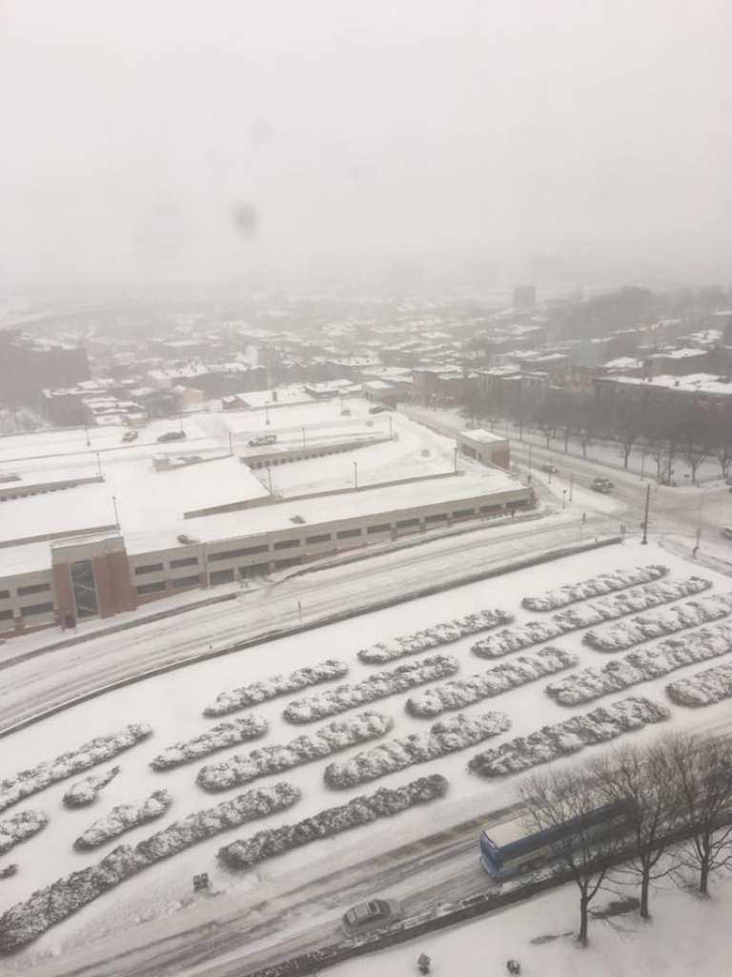
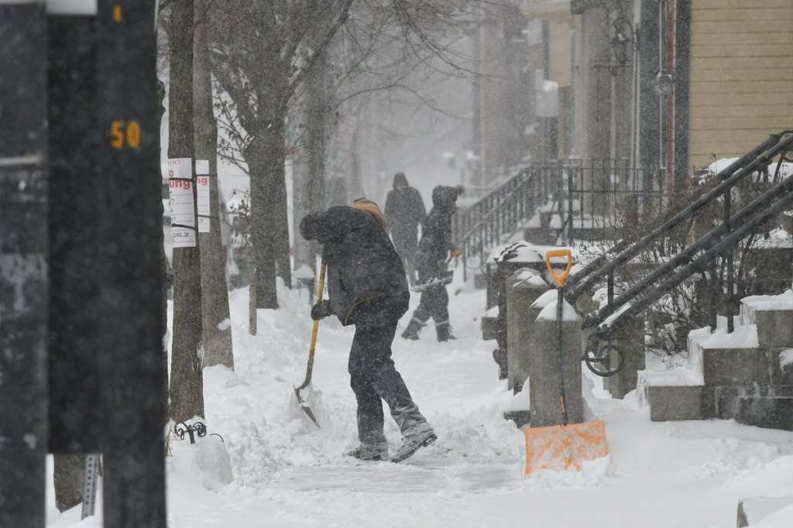
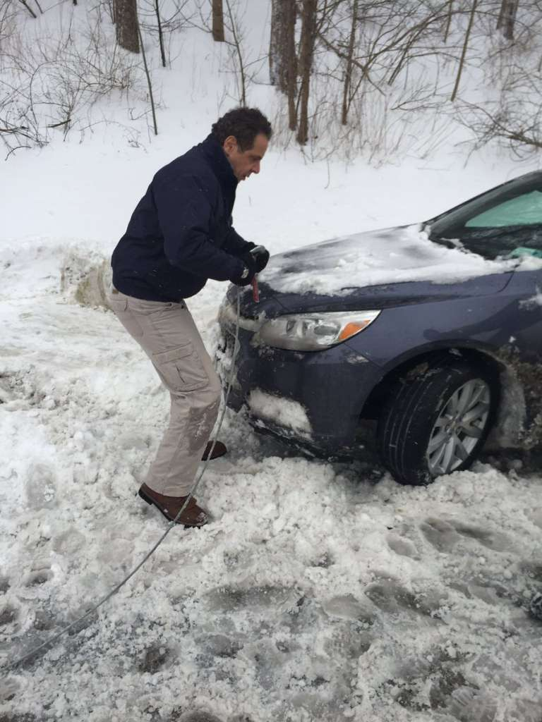
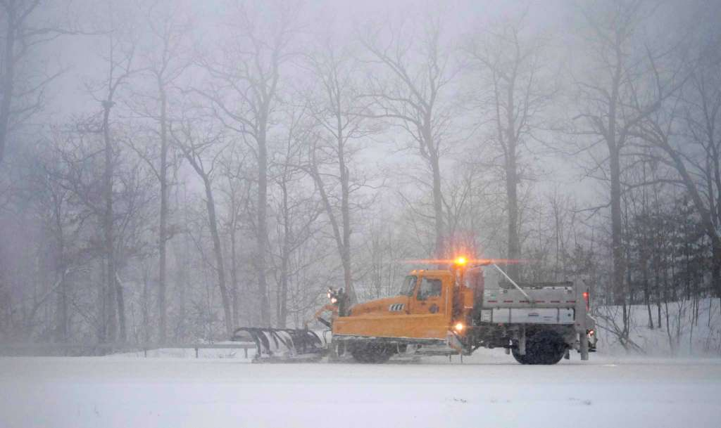
Motivation
Introduction
Methodology
Results
Conclusion
9–10 February 2017

Slide 3
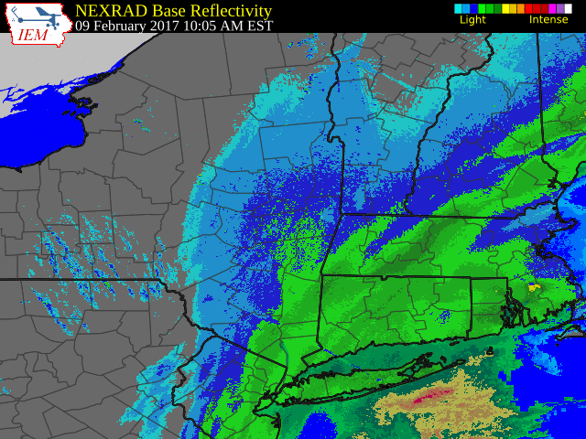
Motivation
Introduction
Methodology
Results
Conclusion

Slide 4
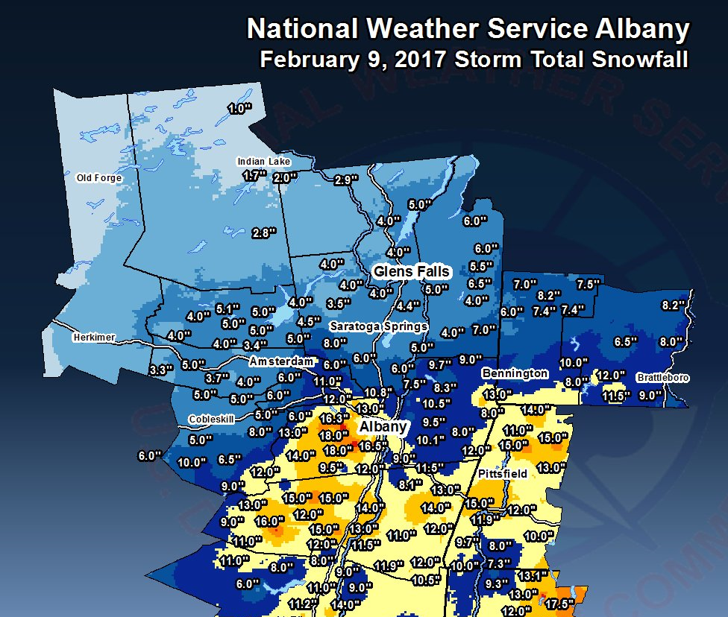
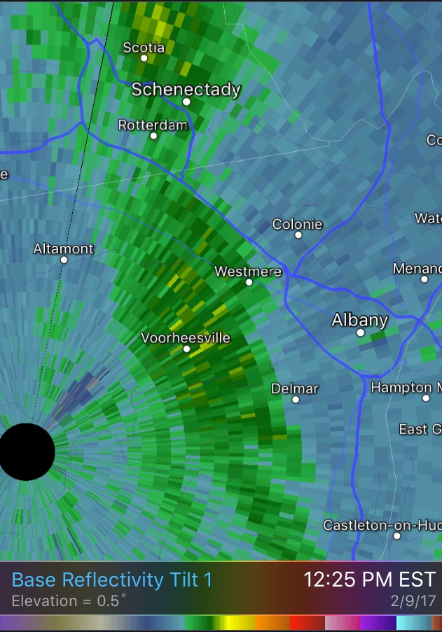
Motivation
Introduction
Methodology
Results
Conclusion
“My house is located approximately due N of Voorheesville and due W of Westmere on the radar. Snow is falling at the rate of 2-3” per hour and we have accumulated ~12” so far.”
-Lance Bosart

Slide 5
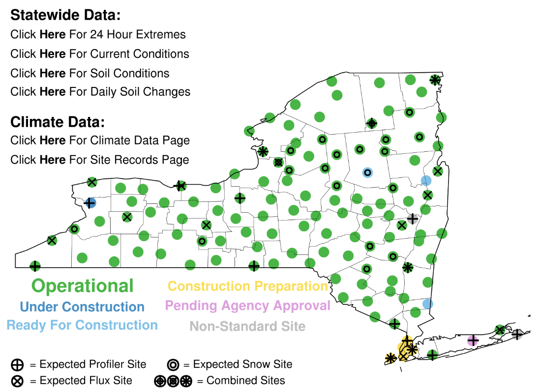
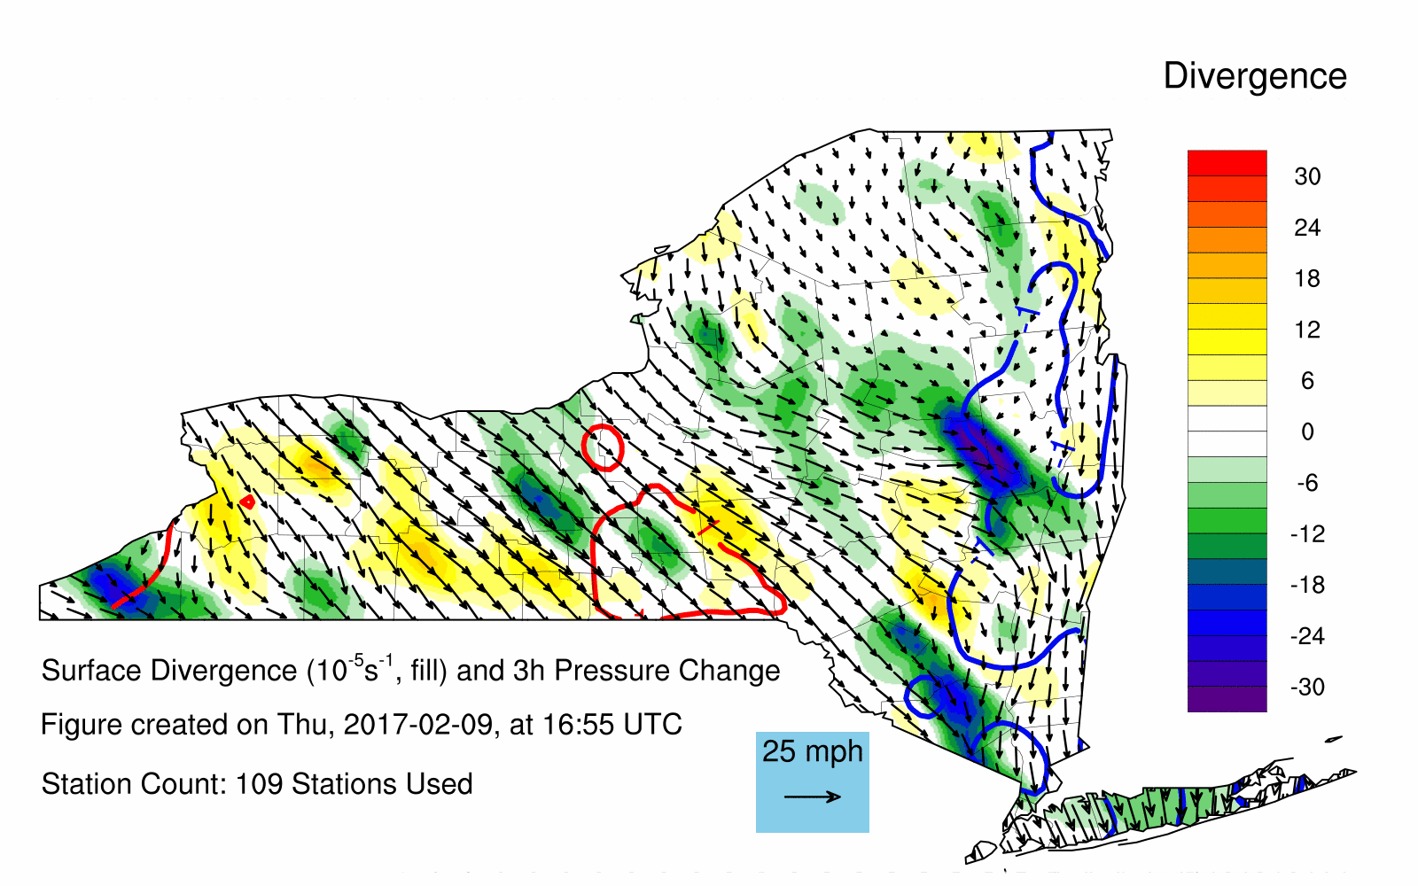
Motivation
Introduction
Methodology
Results
Conclusion
Courtesy of Nick Bassill

Slide 6
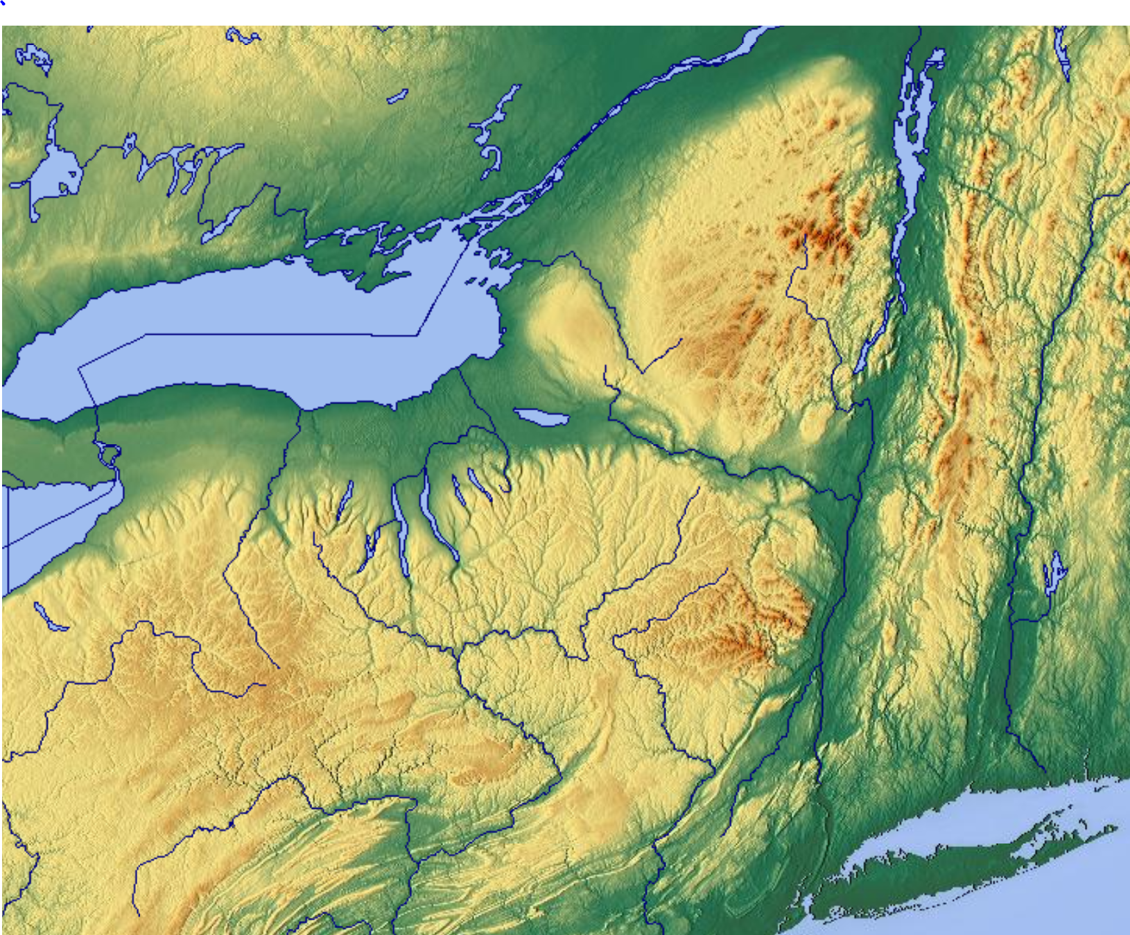
Motivation
Introduction
Methodology
Results
Conclusion

Slide 7
Motivation
Introduction
Methodology
Results
Conclusion
Champlain Valley
Mohawk River Valley
Green Mountains
Adirondack Mountains
Berkshire Mountains
Catskill Mountains
Hudson River Valley

Slide 8
Motivation
Introduction
Methodology
Results
Conclusion
Cold season
Mohawk–Hudson convergence (MHC):
Northerly, channeled flow in the Hudson Valley and westerly, channeled flow in the Mohawk Valley

Slide 9
Motivation
Introduction
Methodology
Results
Conclusion
Cold season
Mohawk–Hudson convergence (MHC):
Northerly, channeled flow in the Hudson Valley and westerly, channeled flow in the Mohawk Valley
L

Slide 10
Motivation
Introduction
Methodology
Results
Conclusion
Cold season
Mohawk–Hudson convergence (MHC):
Northerly, channeled flow in the Hudson Valley and westerly, channeled flow in the Mohawk Valley
L

Slide 11
Motivation
Introduction
Methodology
Results
Conclusion
Case selection of cold MHC events
Pure cold season MHC events (n=12)
Year | Month | Day | Time of maximum reflectivity (UTC)
2002 | 11 | 27 | 1800
 | 12 | 16 | 0000
2003 | 1 | 24 | 0000
2005 | 1 | 17 | 1200
2007 | 1 | 29 | 0600
 | 2 | 23 | 0600
2008 | 1 | 2 | 1200
 | 12 | 19 | 1200
 |  | 31 | 1800
2011 | 1 | 12 | 1800
 | 10 | 30 | 0600
2013 | 9 | 13 | 1800
Cases had to lack strong synoptic scale forcing in the Capital District Region and had to be independent of lake-effect snow
12 identified cases from November 2002 to September 2013

Slide 12
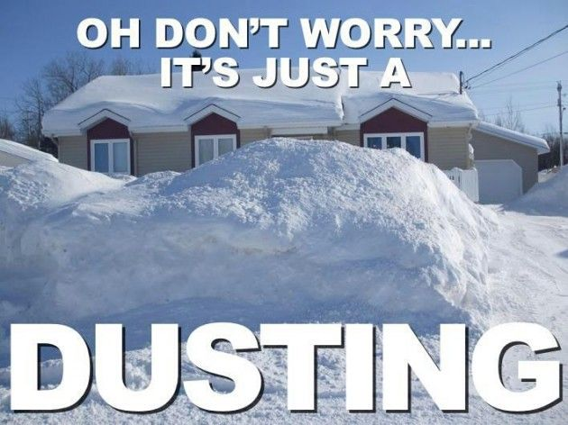
Motivation
Introduction
Methodology
Results
Conclusion
Composited using the 0.5° Climate Forecast Reanalysis System (CFSR), centered on the time of maximum reflectivity
Coarse resolution for a mesoscale event, but simply using the CFSR to determine the overall synoptic setup for these events
13-km Rapid Update Cycle (RUC) initialized at 1200 UTC was used for the case study of 2 January 2008

Slide 13
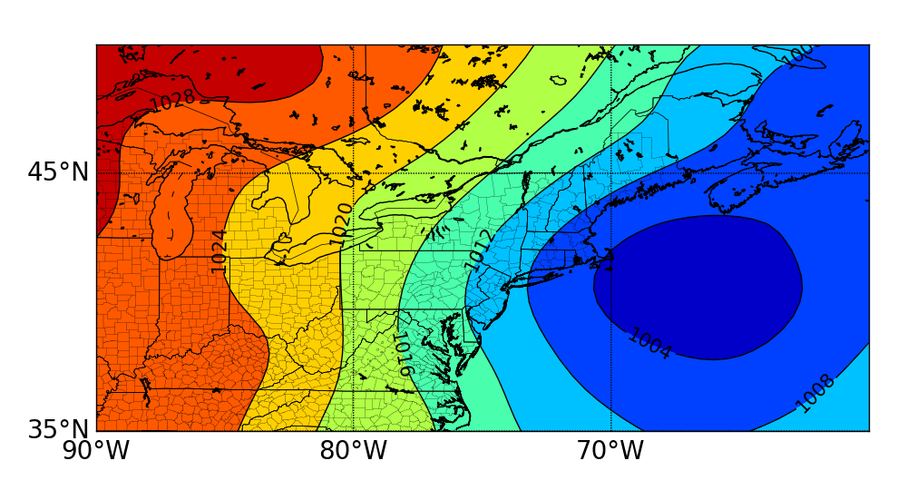
Motivation
Introduction
Methodology
Results
Conclusion
Mean sea level pressure

Slide 14
Motivation
Introduction
Methodology
Results
Conclusion
Mean sea level pressure
L

Slide 15
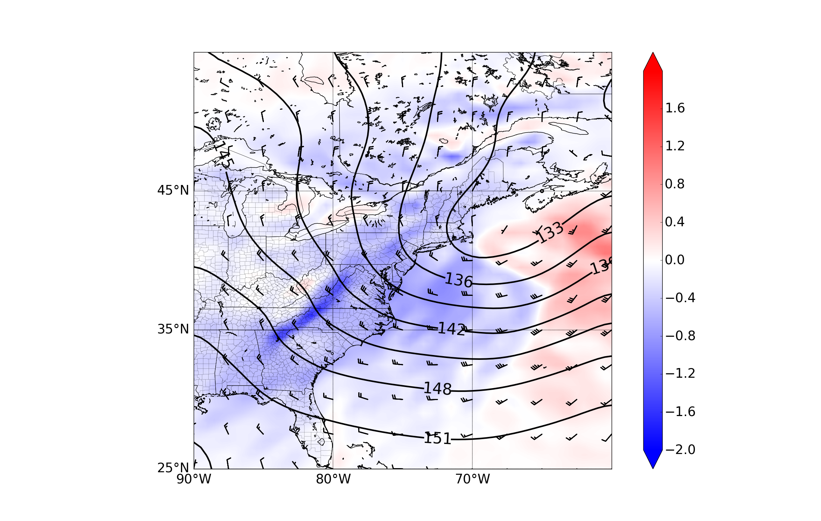
Motivation
Introduction
Methodology
Results
Conclusion
850-hPa temperature advection
At 850-hPa cold air advection dominates

Slide 16
Motivation
Introduction
Methodology
Results
Conclusion
850-hPa temperature advection
At 850-hPa cold air advection dominates
Nearly neutral temperature advection occurs in the Capital District

Slide 17
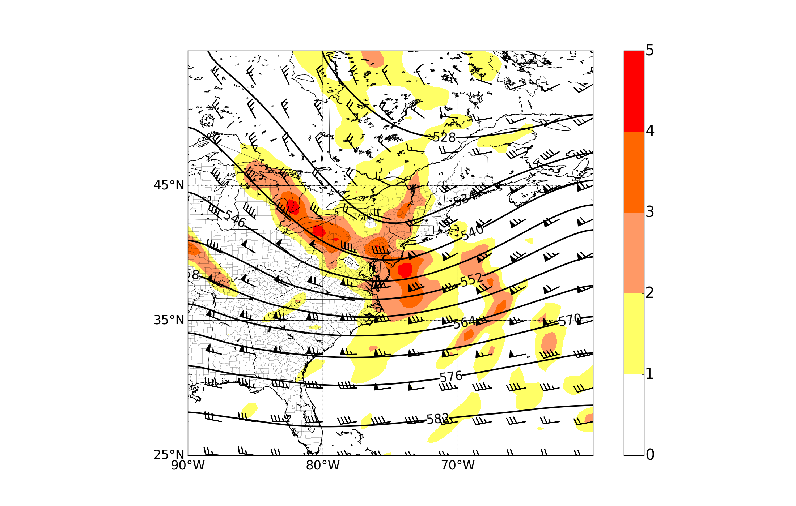
Motivation
Introduction
Methodology
Results
Conclusion
500-hPa relative vorticity
Maximum 500-hPa relative vorticity over eastern NY

Slide 18
Motivation
Introduction
Methodology
Results
Conclusion
500-hPa relative vorticity
Maximum 500-hPa relative vorticity over eastern NY
Implied anticyclonic relative vorticity advection upstream of the trough axis

Slide 19
Motivation
Introduction
Methodology
Results
Conclusion
500-hPa relative vorticity
Maximum 500-hPa relative vorticity over eastern NY
Implied anticyclonic relative vorticity advection upstream of the trough axis
Signals upper-level descent, at least in the layer

Slide 20
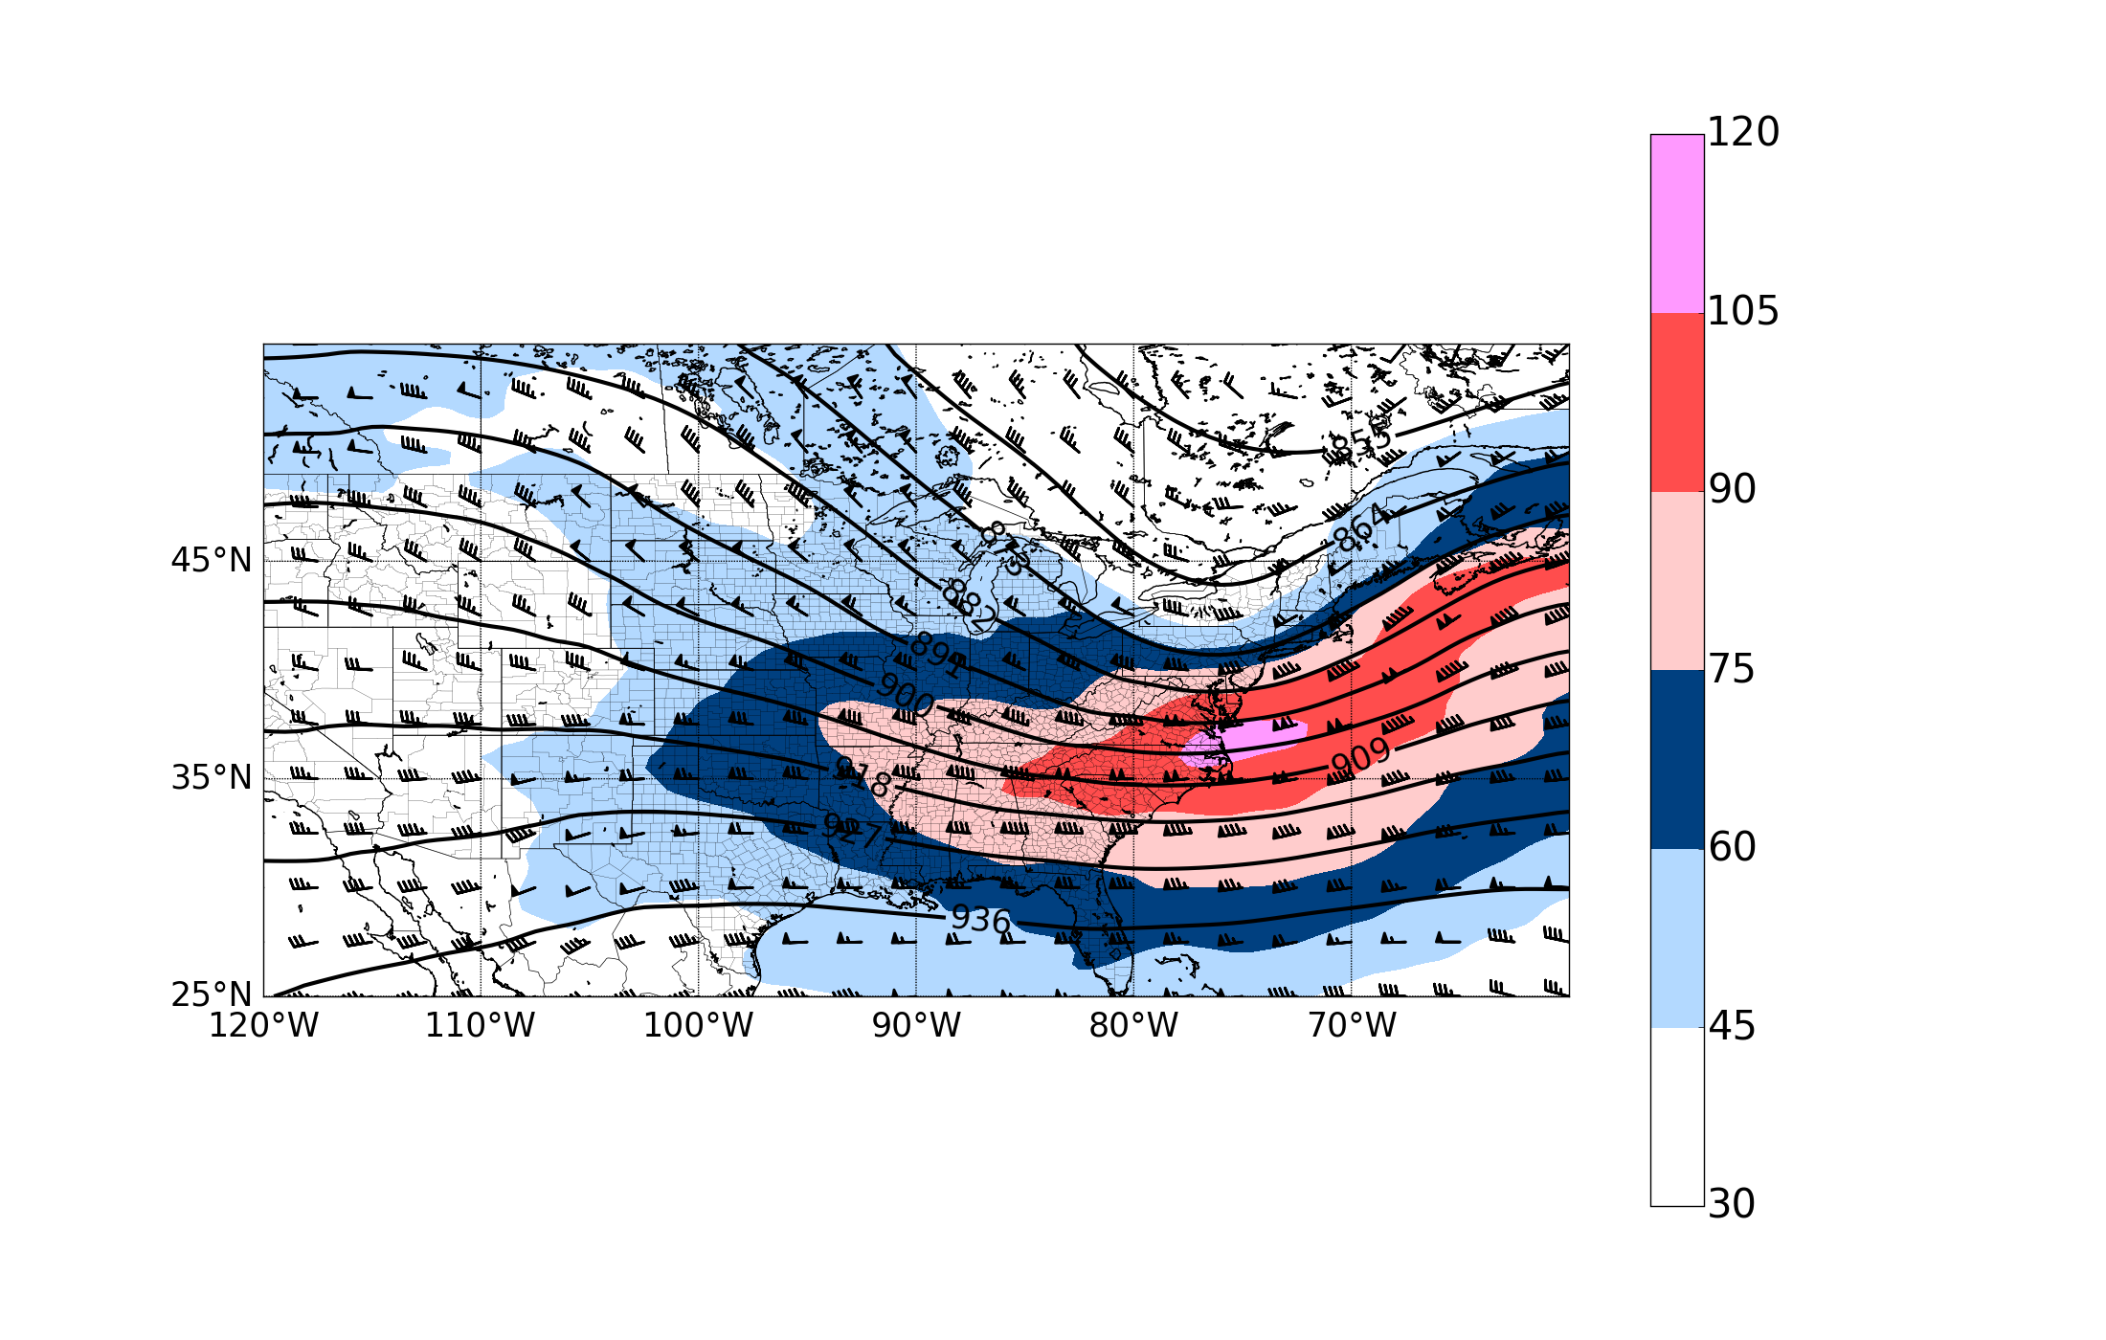
Motivation
Introduction
Methodology
Results
Conclusion
300-hPa jet
Jet and trough configuration is not favorable for upper-level divergence over the Capital District

Slide 21
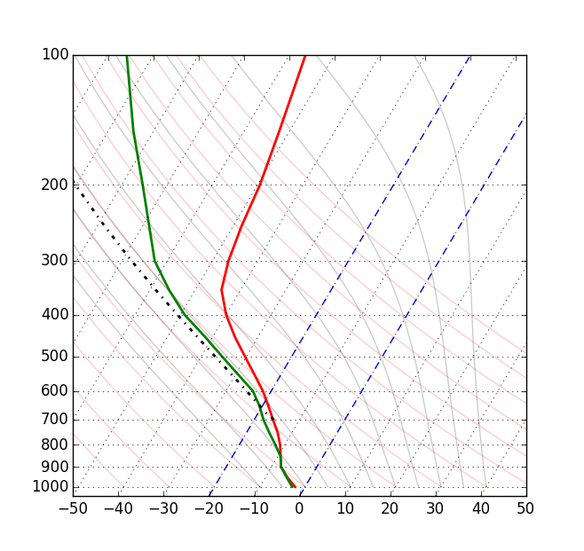
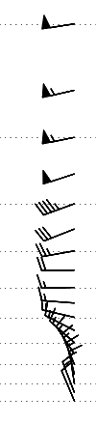
Motivation
Introduction
Methodology
Results
Conclusion
Composite sounding

Slide 22
Motivation
Introduction
Methodology
Results
Conclusion
Composite sounding
Moist

Slide 23
Motivation
Introduction
Methodology
Results
Conclusion
Composite sounding
Warm air
advection
Moist

Slide 24
Motivation
Introduction
Methodology
Results
Conclusion
Composite sounding
Cold air
advection
Warm air
advection
Moist

Slide 25

Motivation
Introduction
Methodology
Results
Conclusion
Key points from MHC composite:
Low positioned off the coast of New England

Slide 26
Motivation
Introduction
Methodology
Results
Conclusion
Key points from MHC composite:
Low positioned off the coast of New England
North/northwesterly geostrophic flow at low-levels

Slide 27
Motivation
Introduction
Methodology
Results
Conclusion
Key points from MHC composite:
Low positioned off the coast of New England
North/northwesterly geostrophic flow at low-levels
Cold air advection aloft with weak warm air advection at the surface

Slide 28
Motivation
Introduction
Methodology
Results
Conclusion
Key points from MHC composite:
Low positioned off the coast of New England
North/northwesterly geostrophic flow at low-levels
Cold air advection aloft with weak warm air advection at the surface
Anticyclonic vorticity advection at 500-hPa

Slide 29
Motivation
Introduction
Methodology
Results
Conclusion
Key points from MHC composite:
Low positioned off the coast of New England
North/northwesterly geostrophic flow at low-levels
Cold air advection aloft with weak warm air advection at the surface
Anticyclonic vorticity advection at 500-hPa
Capital District not located in a region of upper-level divergence

Slide 30
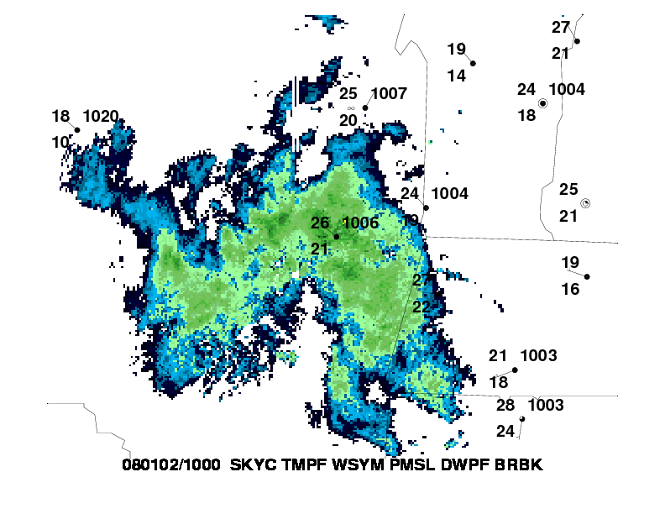
Motivation
Introduction
Methodology
Results
Conclusion
Case study:
On 2 January 2008, a departing low off the New England coast had dropped more than 15 cm of snow around the Capital District
Upwards of an additional 12.7 cm was reported in Cohoes, NY due to MHC

Slide 31
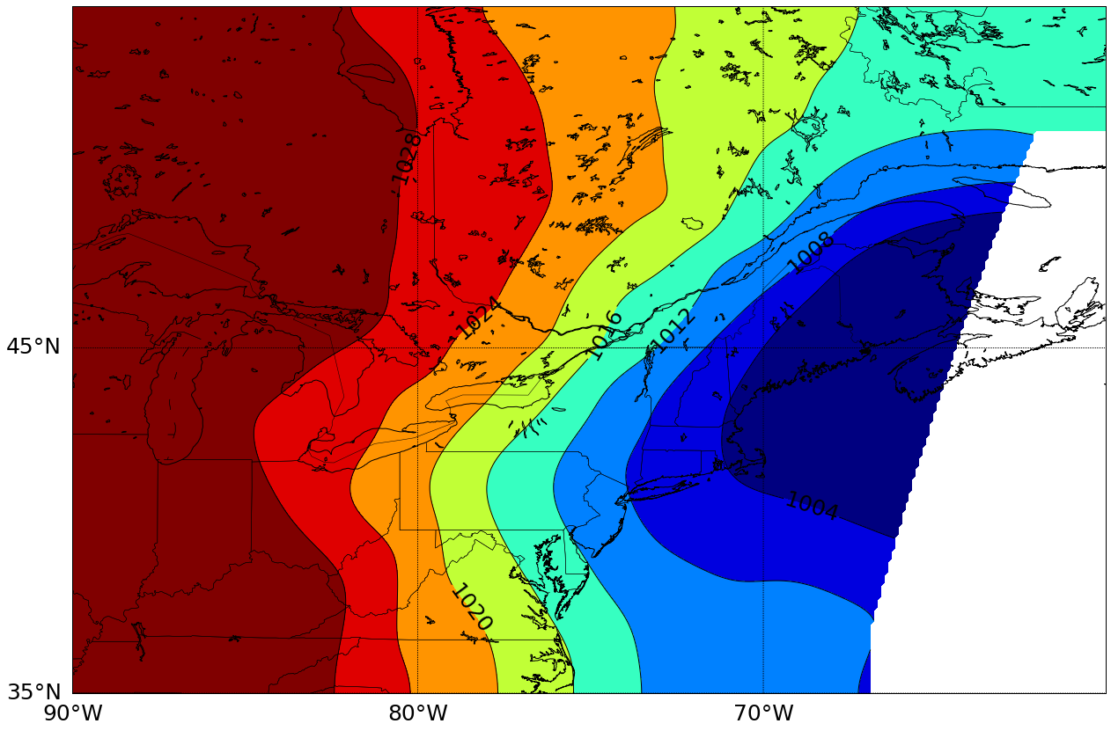
Motivation
Introduction
Methodology
Results
Conclusion
1200 UTC mean sea level pressure
L

Slide 32
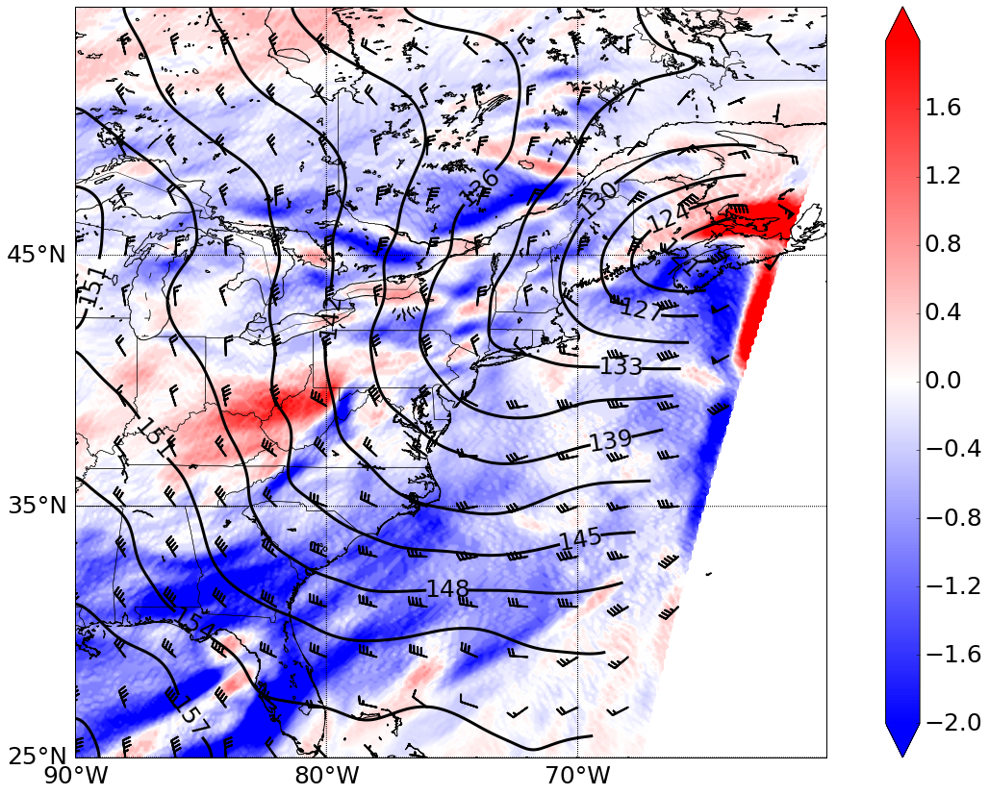
Motivation
Introduction
Methodology
Results
Conclusion
1200 UTC 850-hPa temperature advection
Warm air advection at 850-hPa

Slide 33
Motivation
Introduction
Methodology
Results
Conclusion
1200 UTC 850-hPa temperature advection
Warm air advection at 850-hPa
Matches the composite, just with a stronger signal

Slide 34
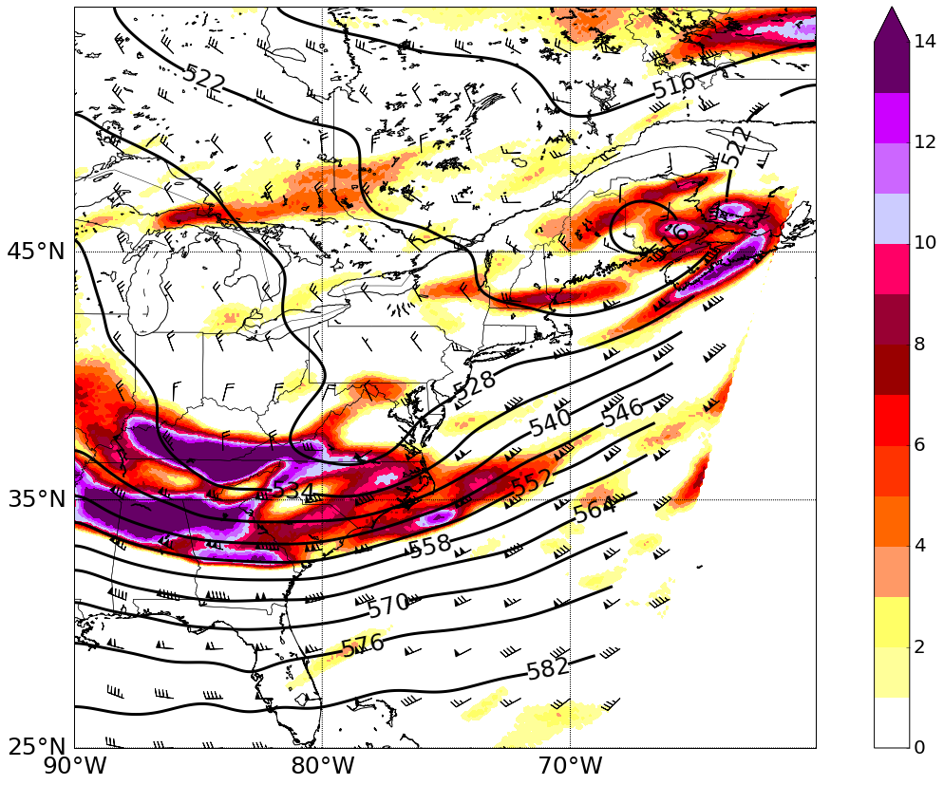
Motivation
Introduction
Methodology
Results
Conclusion
1200 UTC 500-hPa relative vorticity
Cyclonic relative vorticity advection at 500-hPa

Slide 35
Motivation
Introduction
Methodology
Results
Conclusion
1200 UTC 500-hPa relative vorticity
Cyclonic relative vorticity advection at 500-hPa
After the vorticity maximum moves through, the Capital District is in a region of anticyclonic relative vorticity advection forcing descent

Slide 36
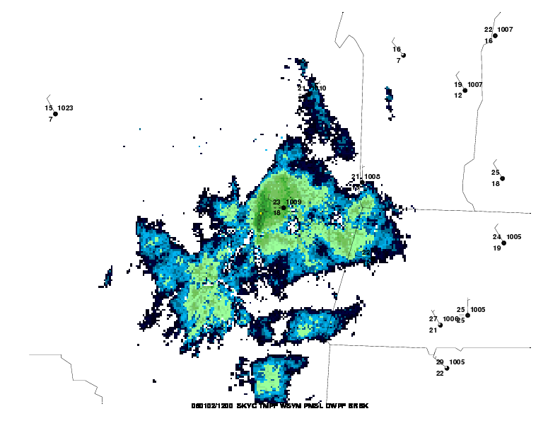
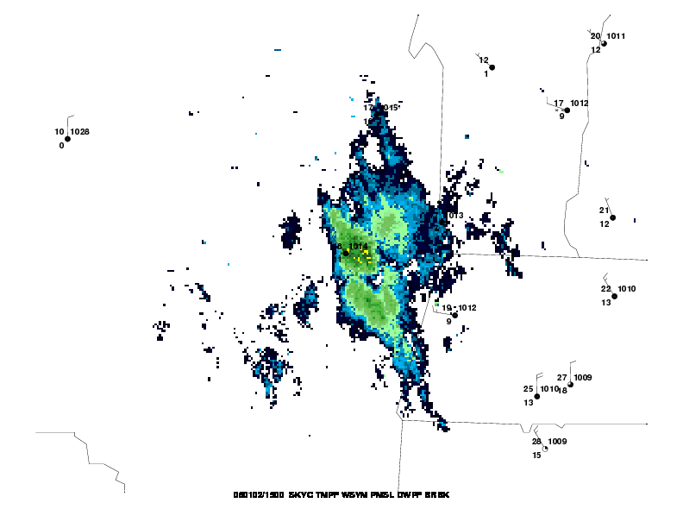
Motivation
Introduction
Methodology
Results
Conclusion
1200 UTC 500-hPa relative vorticity
1200 UTC
1500 UTC

Slide 37
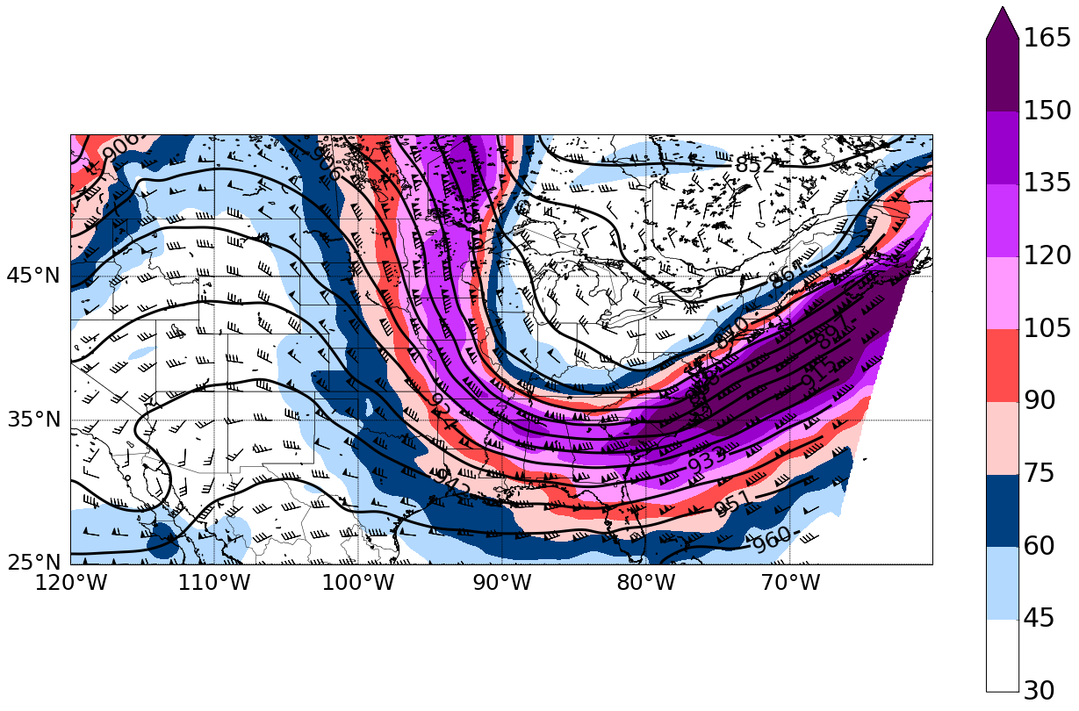
Motivation
Introduction
Methodology
Results
Conclusion
1200 UTC 300-hPa jet
Jet pattern is not favorable for upper-level divergence over the Capital District

Slide 38
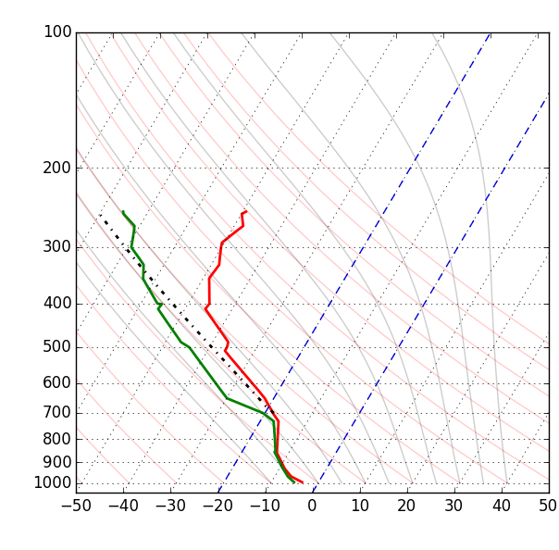

Motivation
Introduction
Methodology
Results
Conclusion
Observed sounding at 1200 UTC
MHC composite sounding
a)

Slide 39
Motivation
Introduction
Methodology
Results
Conclusion
Forecasting tips:
MHC is most likely when….
Surface cyclone located just east of Cape Cod inducing geostrophic north/northwesterly flow over NY

Slide 40
Motivation
Introduction
Methodology
Results
Conclusion
Forecasting tips:
MHC is most likely when….
Surface cyclone located just east of Cape Cod inducing geostrophic north/northwesterly flow over NY
Low-level warm air advection leads to low-level upward vertical motion in a saturated boundary layer

Slide 41
Motivation
Introduction
Methodology
Results
Conclusion
Forecasting tips:
MHC is most likely when….
Surface cyclone located just east of Cape Cod inducing geostrophic north/northwesterly flow over NY
Low-level warm air advection leads to low-level upward vertical motion in a saturated boundary layer
Mid-level anticyclonic vorticity advection associated with a 500-hPa trough forces mid-level descent, capping the phenomenon

Slide 42
Motivation
Introduction
Methodology
Results
Conclusion
Conclusions:
Composites and case studies should help forecasters predict MHC events with more lead-time

Slide 43
Motivation
Introduction
Methodology
Results
Conclusion
Conclusions:
Composites and case studies should help forecasters predict MHC events with more lead-time
NYS Mesonet will provide high-resolution analysis and better forecasting for future events

Slide 44
Motivation
Introduction
Methodology
Results
Conclusion
Conclusions:
Composites and case studies should help forecasters predict MHC events with more lead-time
NYS Mesonet will provide high-resolution analysis and better forecasting for future events
Need to examine null cases to as subtle differences in features can lead to forecast busts

Slide 45
Motivation
Introduction
Methodology
Results
Conclusion
Conclusions:
Composites and case studies should help forecasters predict MHC events with more lead-time
NYS Mesonet will provide high-resolution analysis and better forecasting for future events
Need to examine null cases to as subtle differences in features can lead to forecast busts
MHC also occurs in the warm season and can lead to unexpected severe weather events

Slide 46
Motivation
Introduction
Methodology
Results
Conclusion
Conclusions:
Composites and case studies should help forecasters predict MHC events with more lead-time
NYS Mesonet will provide high-resolution analysis and better forecasting for future events
Need to examine null cases to as subtle differences in features can lead to forecast busts
MHC also occurs in the warm season and can lead to unexpected severe weather events
Questions?
dcard@albany.edu

Slide 47
Next in my academic journey…

