Slide 1
NWP Final Project
ATM 562
Dylan Card

Slide 2
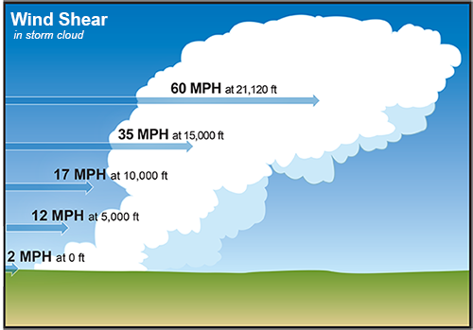
Goal:
Examine the effects of vertical wind shear on the development of a cloud in a warm bubble in a neutral environment.
Variables to look at-
Perturbation Pressure
Perturbation Theta (temperature)
Clouds and updrafts
Vorticity

Slide 3
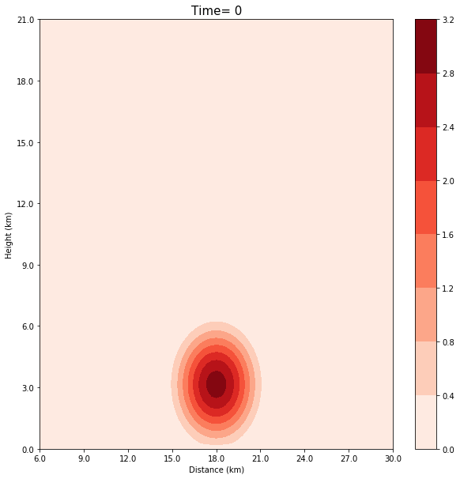
About the model:
Using the neutral environment from model task 5
Warm Bubble (4000mx4000m)
3K amplitude at the center
nx=121, nz=80
dx=dz=300m
dt=1 second (Run for 1000 seconds)
cs=50 m/s
X-dir and Z-dir second order diffusion (0.5)
Warm Rain Microphysics, Allows for the formation of clouds. Latent Heat and Latent Cooling allowed by phase transition
*However rain is only allowed to evaporate to become vapor. Beyond this the rain is just removed. (ie it does not fall)
Shaded is perturbation theta

Slide 4
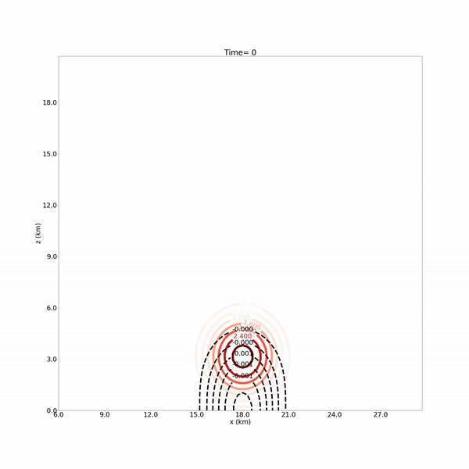
About the model:
Using the neutral environment from model task 5
Warm Bubble (4000mx4000m)
3K amplitude at the center
nx=121, nz=80
dx=dz=300m
dt=1 second (Run for 1000 seconds)
cs=50 m/s
X-dir and Z-dir second order diffusion (0.5)
Warm Rain Microphysics, Allows for the formation of clouds. Latent Heat and Latent Cooling allowed by phase transition
*However rain is only allowed to evaporate to become vapor. Beyond this the rain is just removed. (ie it does not fall)
Shaded is cloud water, contoured (black) perturbation pressure, and contoured (colored) perturbation theta. Wind is shown in quivers

Slide 5
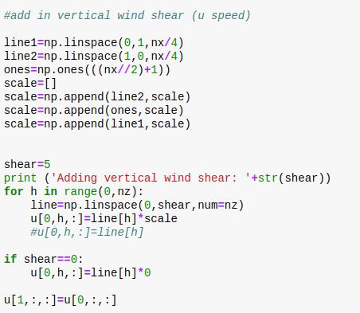
Adding Windshear:
Wind shear initialized through function that linearly increases the wind from the model surface to the model top to the max value.
Horizontally the function also increases the wind speed linearly towards the center of the domain.
This helps reduce strong wind gradients at the boundaries.

Slide 6
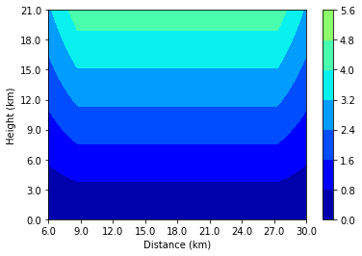
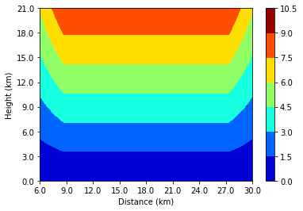
Shaded is u-direction wind
Adding Windshear:
Wind shear initialized through function that linearly increases the wind from the model surface to the model top to the max value.
Horizontally the function also increases the wind speed linearly towards the center of the domain.
5m/s
Shear
10m/s
Shear

Slide 7
Shaded is u-direction wind
Adding Windshear:
Wind shear initialized through function that linearly increases the wind from the model surface to the model top to the max value.
Horizontally the function also increases the wind speed linearly towards the center of the domain.
From 9-27 km on the x-axis a parcel will feel the full effect of the linear vertical shear
5m/s
Shear
10m/s
Shear

Slide 8
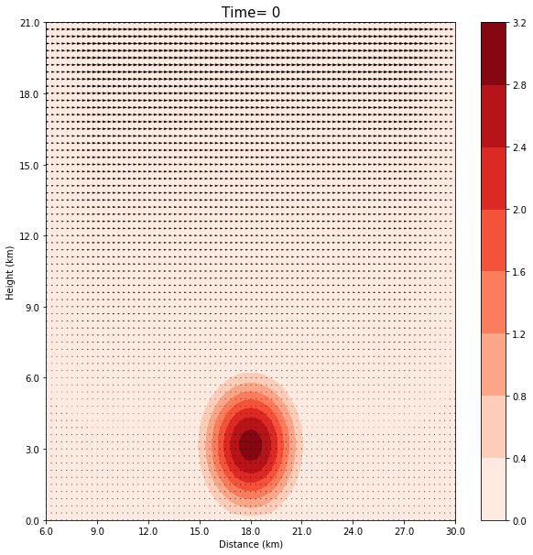
Adding Windshear:
5m/s Shear
10m/s Shear
Shaded is perturbation theta and wind in quivers

Slide 9
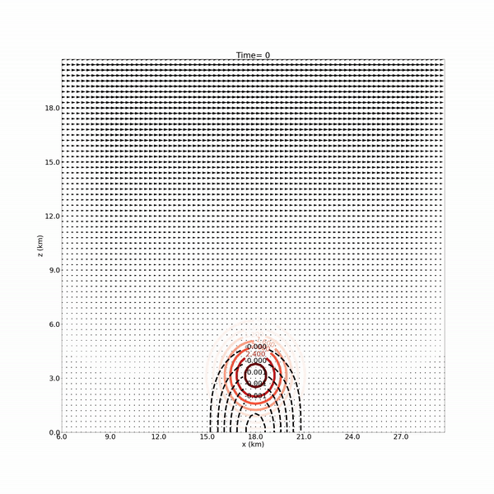
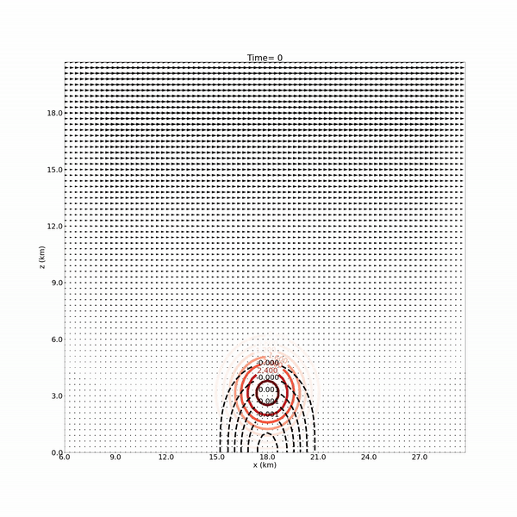
Model Results:
5m/s Shear
10m/s Shear
Shaded is cloud water, contoured (black) perturbation pressure, and contoured (colored) perturbation theta. Wind is shown in quivers
Shaded is cloud water, contoured (black) perturbation pressure, and contoured (colored) perturbation theta. Wind is shown in quivers

Slide 10
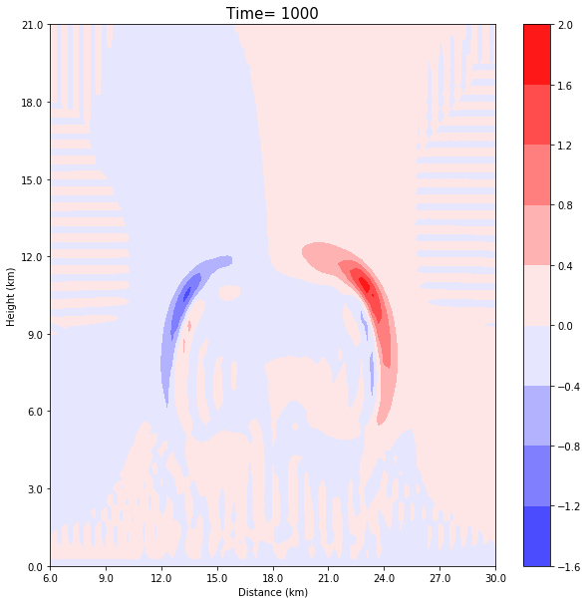
Perturbation Temperature Difference Evolution
Model Results:
5m/s Shear - 0m/s Shear
Shear induces ventilation and causes mixing upshear and displaces heat downshear.
2K warmer downshear but just over 1K colder upshear
Shaded is perturbation theta differences between 5m/s and 0m/s shear cases

Slide 11
Perturbation Temperature Difference Evolution
Model Results:
5m/s Shear - 0m/s Shear
Latent Cooling upshear caused by cloud mixing with the environment. More cooling in the 5m/s model run.
Latent Heating downshear caused by additional displaced cloud downshear. More heating in the 5m/s model run.
Latent Cooling
Latent Heating
Shaded is perturbation theta differences between 5m/s and 0m/s shear cases

Slide 12
Perturbation Temperature Difference Evolution
Model Results:
10m/s Shear - 0m/s Shear
Shear induces ventilation and causes mixing upshear and displaces heat downshear. (much like the 5m/s model)
3K warmer downshear but just over 2K colder upshear
Shaded is perturbation theta differences between 10m/s and 0m/s shear cases

Slide 13
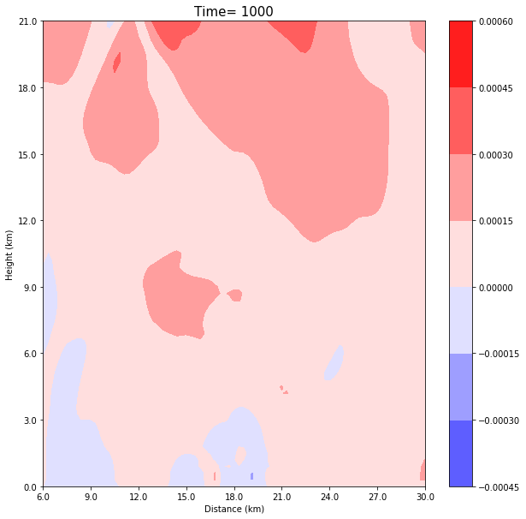
Perturbation Pressure Difference Evolution
Model Results:
5m/s Shear - 0m/s Shear
Most perturbation pressure differences here occur at the top boundary.
Shaded is perturbation pressure differences between 5m/s and 0m/s shear cases

Slide 14
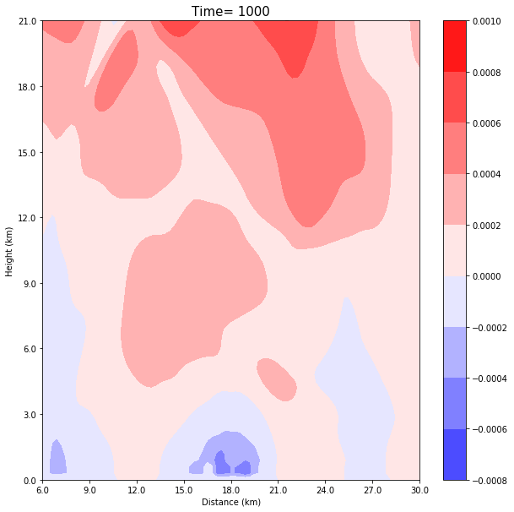
Perturbation Pressure Difference Evolution
Model Results:
10m/s Shear - 0m/s Shear
Most perturbation pressure differences here occur at the top boundary. However in the 10m/s model there is a weak perturbation pressure deficit near the surface.
Shaded is perturbation pressure differences between 10m/s and 0m/s shear cases

Slide 15
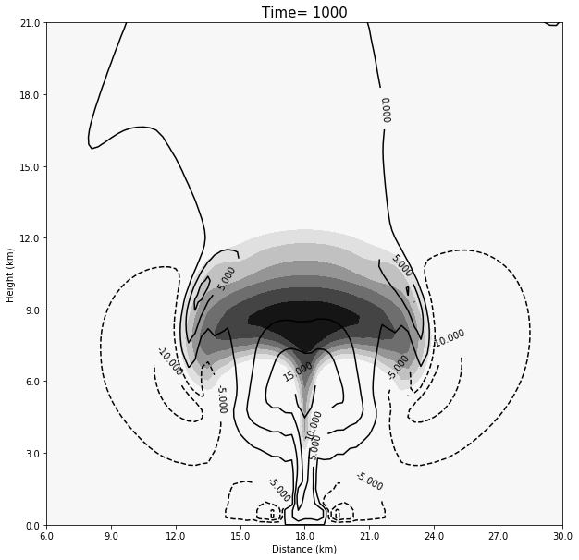
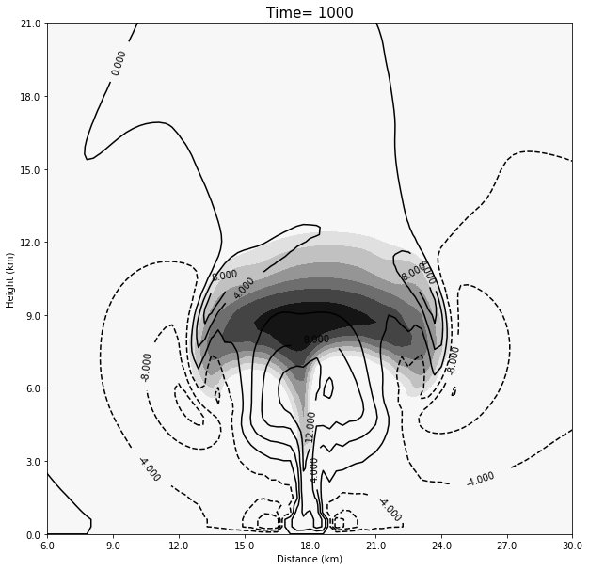
Clouds and Vertical Motion Difference Evolution
Model Results:
5m/s Shear - 0m/s Shear
0 m/s
5 m/s
Shaded is cloud water and contoured is vertical motion

Slide 16
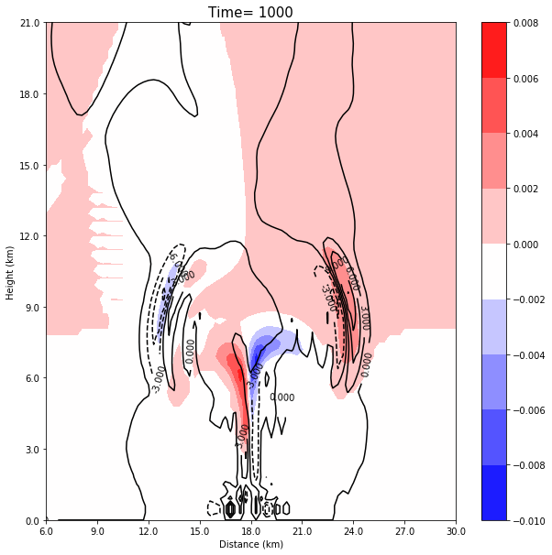
Clouds and Vertical Motion Difference Evolution
Model Results:
5m/s Shear - 0m/s Shear
Shear increases the cloud cover downshear and enhances the vertical motion on the downshear cloud edge
Also notice the displacement in the updraft. It tilts upshear
Shaded is cloud water and contoured is vertical motion differences between 5m/s and 0m/s shear cases

Slide 17
Clouds and Vertical Motion Difference Evolution
Model Results:
5m/s Shear - 0m/s Shear
Shear increases the cloud cover downshear and enhances the vertical motion on the downshear cloud edge
Also notice the displacement in the updraft. It tilts upshear
Shaded is cloud water and contoured is vertical motion differences between 5m/s and 0m/s shear cases

Slide 18
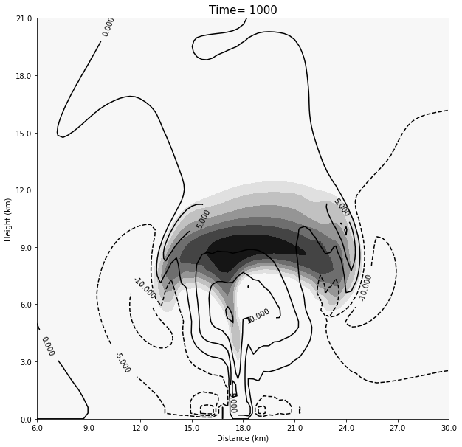
Clouds and Vertical Motion Difference Evolution
Model Results:
10m/s Shear - 0m/s Shear
0 m/s
10 m/s
Shaded is cloud water and contoured is vertical motion

Slide 19
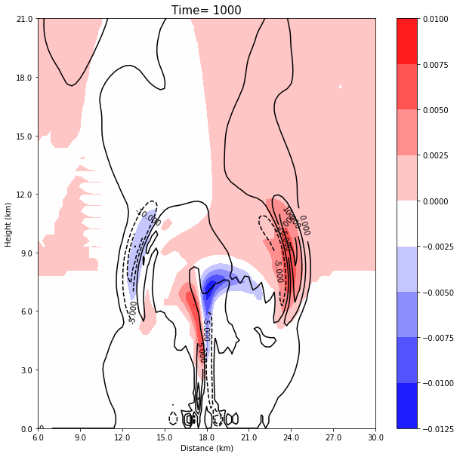
Clouds and Vertical Motion Difference Evolution
Model Results:
10m/s Shear - 0m/s Shear
Shear increases the cloud cover downshear and enhances the vertical motion on the downshear cloud edge
Also notice the displacement in the updraft. It tilts upshear
These results are even stronger in this 10m/s shear model run!
Shaded is cloud water and contoured is vertical motion differences between 10m/s and 0m/s shear cases

Slide 20
Clouds and Vertical Motion Difference Evolution
Model Results:
10m/s Shear - 0m/s Shear
Shear increases the cloud cover downshear and enhances the vertical motion on the downshear cloud edge
Also notice the displacement in the updraft. It tilts upshear
These results are even stronger in this 10m/s shear model run!
Shaded is cloud water and contoured is vertical motion differences between 10m/s and 0m/s shear cases

Slide 21
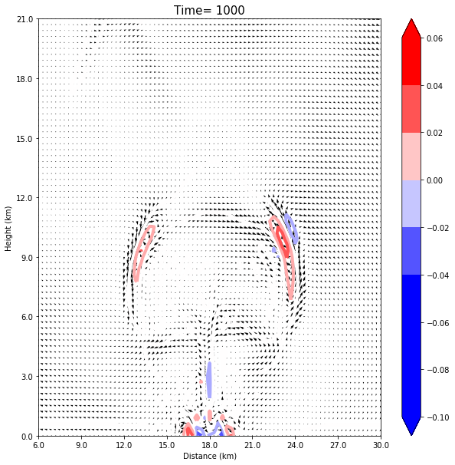
Horizontal Vorticity Difference Evolution
Model Results:
5m/s Shear - 0m/s Shear
Shear increases the vorticity downshear
This is because the environment provides additional vorticity downshear
Colored contours are vorticity and quiver wind differences between 5m/s and 0m/s shear cases

Slide 22
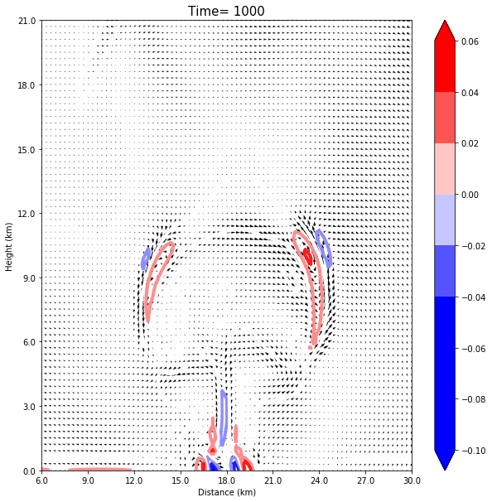
Horizontal Vorticity Difference Evolution
Model Results:
10m/s Shear - 0m/s Shear
Shear increases the vorticity downshear
This is because the environment provides additional vorticity downshear
The resulting vorticity is even stronger in the 10m/s model run
Colored contours are vorticity and quiver wind differences between 10m/s and 0m/s shear cases

Slide 23
Horizontal Vorticity Difference Evolution
Model Results:
10m/s Shear - 0m/s Shear
I want to point out the interesting things going on at the surface of the model
Though I have neglected rainfall, latent cooling still results in the development of what looks like a cold pool (you can see the vorticity couplet at the surface)
There is also a signal of this in the perturbation pressure analysis
Though this looks like a cold pool it is quite possibly not as this signal does not show up in the perturbation theta analysis
Colored contours are vorticity and quiver wind differences between 5m/s and 0m/s shear cases

Slide 24
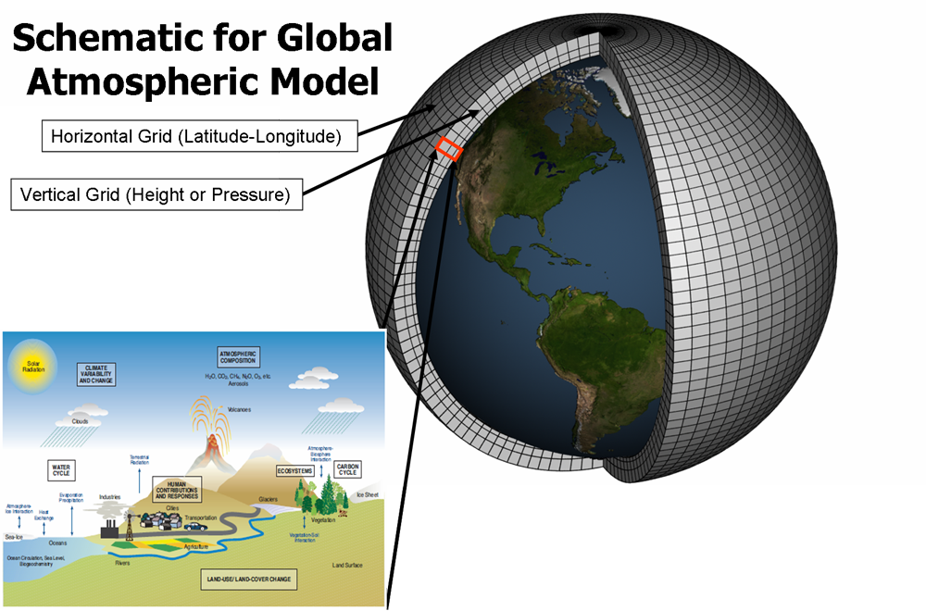
Model Final Project
Conclusion:
Implementing shear and moisture in the cloud model developed in class presented a few additional complexities.
The 10m/s shear model run developed large asymmetries in the cloud structure.
Causing more latent heat release downshear and extra latent cooling upshear due to ventilation
Clouds carried downshear as a result of the increased shear
Additional horizontal vorticity downshear
Tilting of the updraft upshear
In both sheared model runs an interesting feature develops along the surface that looks like a cold pool but does not have a perturbation theta associated with it
Though rainfall was neglected in this model it could be added to better resolve how rain may slow and change the updraft
More complex microphysics with ice could possibly be added

